Slide 3
Project and Experiment Safety Support (PESS)
Yves Loertscher, Simon Marsh, Owain Williams
2019 DOE Accelerator Safety Workshop
Oak Ridge National Laboratory, September 10th-12th

Slide 4
CERN in a short way
CERN is an international research organization for fundamental particle physics
established 1954, located at and on the French/Swiss border
Budget ~1.15 BCHF per year
provided by 23 Member States + 8 Associated Members
Mission of CERN
push forward frontiers of knowledge,
develop new technologies,
train scientists and engineers,
unite people from (many) different countries and cultures
CERN’s guest scientists are rather diverse
12,200 Users from 78 countries and with 111 nationalities

Slide 5
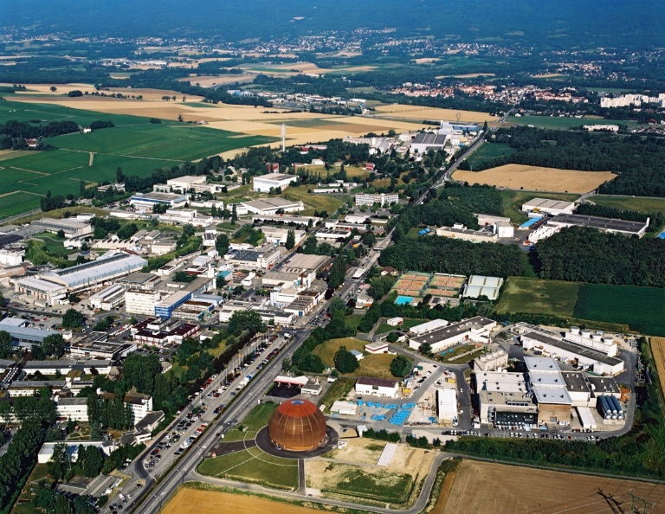
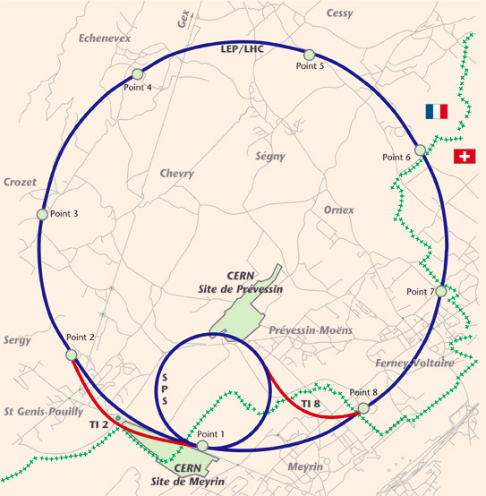
CERN in a short way
2 large sites
Meyrin (Switzerland, extension into France end of 1960ies)
Prevessin (France, since 1970ies)
8 small sites along LHC tunnel (Switzerland and France)
+ further small sites (for access and assembly)

Slide 6
HSE Unit
Radiation
Protection
Occupational Health & Safety
Director General
Safety Policy Committee
(SAPOCO)
Fire & Rescue Service
Controls and
Environmental Protection
Training and coordination
Directors Complex Manager
Complex Safety Advisory Panels (CSAPs)
Safety Officers (DSOs, TSOs, SSOs ..)
Department Heads
Safety Officers Committee
(DSOC)
Safety Support Officers (Safety Linkperson, etc.)
Group Leaders
Specialised Safety Officers Committees
Section Leaders/ Supervisors
Roles and responsibilities
Safety responsibilities at CERN
Individuals

Slide 7
Roles and responsibilities
Safety responsibilities for Large Experiments
Safety officers and advisers with delegated authority
Safety Committees and their reporting lines
HSE Unit
Director General
Safety Policy
Committee (SAPOCO)
Directors
Responsible for large Experiments
Complex manager
Complex Safety
Advisory Panels (CSAPs)
Safety Officers
(LEXGLIMOs, SLIMOs…)
Technical Coordinator
Safety Officers Committee (DSOC)
Collaborating Institutions
Specialised Safety Officers Committees

Slide 8
Mandate of the HSE Unit
Establishes and updates Safety Rules as required for the proper functioning of the Organization
Expert advice and services in matters Occupational Health and Safety
Grant authorizations (clearance) for installations, equipment, activities and projects with major Safety implications
Support
Authorizations
Safety rules
Monitors the environmental impact of the Organization’s activities
Responsible for
Radiation Protection
Environmental monitoring
RP
HSE
Mission
Responsible for fire and rescue and emergency response
Responsible for Occupational Medicine
Occupational Medicine
Fire & rescue service
The HSE Unit REPORTS directly to the DG

Slide 9
Projects at CERN
Full spectrum of activities and capex
Range of durations (a couple of months to several years)
From simple infrastructure renovations, all the way through to future accelerator and experimental facilities

Slide 10
Role of CERN HSE in Projects
Interpretation and application of the CERN Safety rules or applicable regulation
Advising on hazard identification and safety aspects (expert opinion)
Assisting in solution definition and defining compensatory measures
Providing Safety clearance, where applicable
Is the authority for Radiation Protection
All safety domains, except RP, managed through the Project and Experiment Safety Support (PESS) activity

Slide 11
PESS - Context
Aim: to support the full variety of projects being conducted at CERN from an occupational, environmental and process safety perspective
PESS (Project and Experiment Safety Support) offered as a service to project leaders
Initially offered as a voluntary service. Increasingly all new projects are handled through PESS
The PESS service is currently supporting 100 projects, across the full range of CERN’s activities

Slide 12
Approach
A single point of contact between the project and the specialists
Focus on early involvement
Projects divided into different Types, so as to provide the appropriate level of support
A standard checklist for identifying relevant safety domains
“Cradle to Grave” support for the project
CERN Conventional Safety Disciplines
Acoustics
Asbestos / lead
Chemical
Civil / structural
Confined spaces
Cryogenics
Electrical
Emergency / evacuation
Ergonomics
Environmental protection
Events
Fire prevention
HVAC
Laser
Legionella
ODH
Mechanical

Slide 13
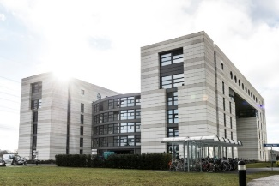
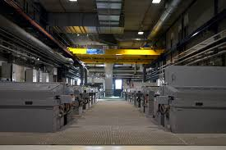
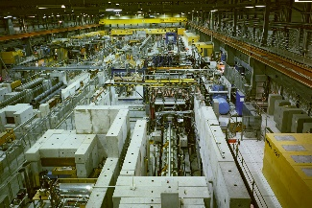
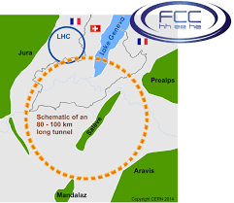
Project Types
Due to the wide variety of projects at CERN, the following categorisation is used within the PESS activity, to define the support process:
Type 1 – e.g. Offices and Tertiary Buildings
Type 2 – e.g. Industrial Installations
Type 3 – e.g. Experiments, Beam, and Underground Facilities
Type 4 – Studies (e.g. CLIC, FCC, etc.)

Slide 14
Project Initiation
PESS Coordination team informed of a project
“Coffee chat” between PESS coordination and the Project Leader
Project Type decided, and a Correspondent appointed
Formal Launch Safety Discussion (involving the HSE Correspondent, back-up, Project Leader, Project Safety Officer (PSO), Departmental Safety Office (DSO) representative)
Major Safety Implications (MSI) can be declared for projects with significant hazards to people, the environment, or the reputation of the Organization.

Slide 15
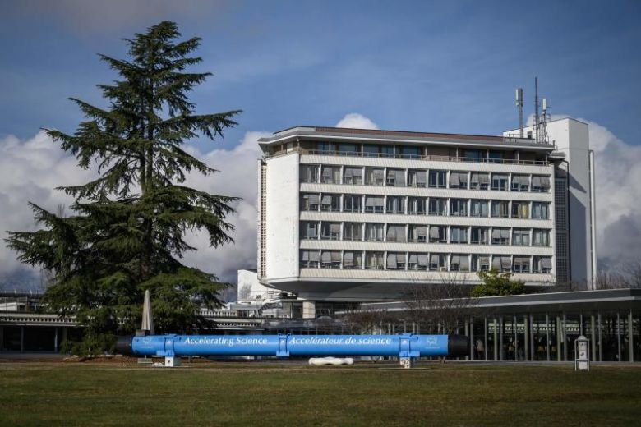
Type 1 Team – Offices and Tertiary Buildings
Largely based on standard rules and regulations
A core team has ownership over the activity, with specialisms relevant to Type 1 projects:
Emergency and evacuation
Ergonomics
Building inspection
Each project is assigned to a particular correspondent within the team
Projects are regularly reviewed by the team, allowing progress reports, and mutual support
Q&A approach with the project leader (and PSO/DSO).

Slide 16
Type 1 Team – Offices and Tertiary Buildings
Consultation with the relevant specialists on points raised in the Launch Safety Discussion
Continued dialogue between the correspondent and project leader (and PSO/DSO) throughout the project, as required
A final project “reception” to verify that the correct procedures have been followed, and identify any outstanding issues.

Slide 17
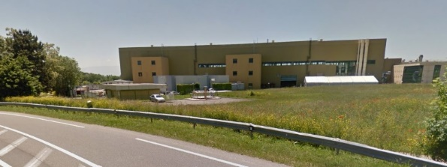
Type 2 Projects – Industrial Installations
Largely based on standard rules and regulations, but often with more complexities and higher profile
Dedicated team per 1st October 2019 with a variety of correspondents, with specialisms relevant to Type 2 projects (electrical, mechanical, civil, noise, worksite, etc.)
One correspondent appointed to each project
Where the project has Major Safety Implications (MSI), HSE clearance is required at commissioning.

Slide 18
Type 2 Projects – Industrial Installations
A detailed document produced for project leaders, giving safety requirements and solutions for each safety domain
Continued dialogue between the correspondent and project leader (and PSO/DSO) throughout the project
A final project “reception” to verify that the correct procedures have been followed, and identify any outstanding issues.
Safety clearance issued for MSI projects, subject to HSE requirements being met

Slide 19
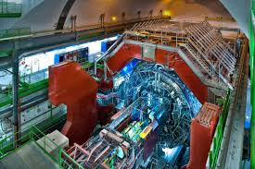
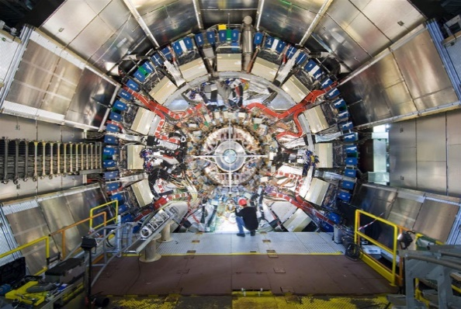
Type 3 Projects – Experiments, Beam, and Underground Facilities
Usually more bespoke, and sometimes difficult to fully ‘shoehorn’ into standard rules and regulations
No dedicated team, but a variety of correspondents, with specialisms relevant to Type 3 projects.
One correspondent appointed to each project.
A detailed approach is taken, to support the Project Leader and the PSO/DSO.
Where the project has Major Safety Implications (MSI), HSE clearance is required at commissioning.

Slide 20
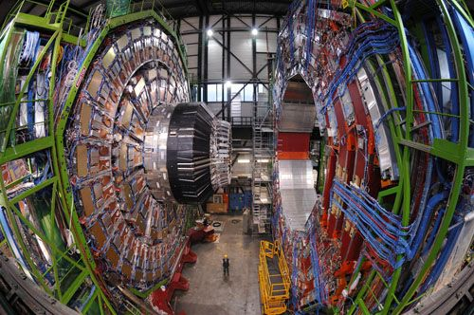
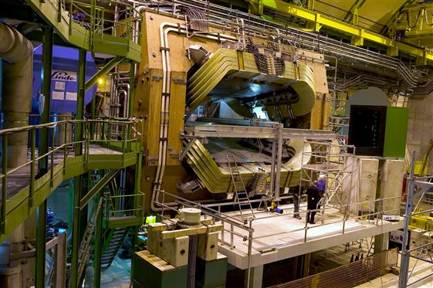
Type 3 Projects – Experiments, Beam, and Underground Facilities
A detailed document produced for project leaders, giving safety requirements and solutions for each safety domain
Continued dialogue between the correspondent and project leader (and PSO/DSO) throughout the project
A final project “reception” to verify that the correct procedures have been followed, and identify any outstanding issues.
Safety clearance issued for MSI projects, subject to HSE requirements being met

Slide 21
Type 4 Projects – Studies
Generally very complex projects, involving new (or not yet existing) technology
Completely bespoke approach
A single correspondent assigned to the project, but any number of specialists could be involved directly over a long period of time

