Slide 1
The MAX IV synchrotron radiation (SR) facility
Pia Eriksson
Swedish Radiation Safety Authority (SSM)

Slide 2
Presentation Outline
History
Decommissioning of MAX I-III
Licensing process for MAX IV
Inspection program for MAX IV
New beamlines
Notes:
- I will give you some history about synchrotron radiation facilities at MAX Lab
-
-
- The procedure we use when adding new beamlines to the license

Slide 3
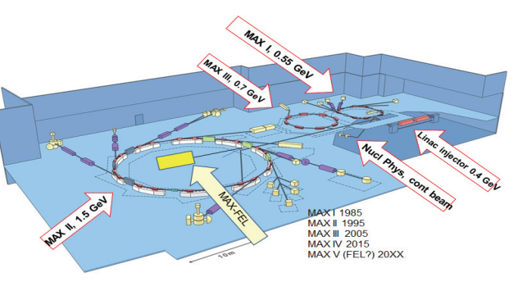
The SR facility history at Lund University
MAX I (0,55 GeV), 1986
MAX II (1,5 GeV), 1996
MAX III (0,7 GeV), 2007
Decommissioning completed in 2016
Notes:
- The MAX Lab, which is a part of Lund University, situated in the south of Sweden, has operated synchrotrons since more than 30 years.
The first synchrotron radiation facility had 3 storage rings, in operation since -86, -96 and -07.
They had plans for a MAX-FEL, but it was never constructed.
- Last operation for this facility was in the beginning of 2015
Decommissioning was completed in december 2016 - slightly less than 2 years from last beam till when the buildning was handed over for other projects.
Still used by LU, but not for activities involving ionizing radiation.

Slide 4
Decommissioning of MAX I-III
Performed by an approved radioactive waste management handler
About 2 years from last beam to decision from SSM on facility clearance
Clearance criteria: 10 µSv/year
Material sent to the waste management handler for clearance measurements and waste handling included 4800 objectives (280 tons)
Facility measurements resulted in that 40 m² of ceiling/floor had to be replaced
Notes:
This company is used to work with decommissioning and has experiences from waste handling and decommissioning of mainly nuclear power plants. The company took care of everything - the application to SSM (control program, metholodgy), emptying the rooms, shipping of material, measurements and the final report to SSM. Contact person (group) at MAX Lab with knowledge about the histyory and equipment at facility.
- SSM:s criteria for decommissioning was maximum 10 microSv/year for 1800 hours of exposure (40h/week, 45 weeks of work), which was fulfilled.
When the facility was emptied, the facility measurements resulted in, that in order to meet the clearance criteria, 40 m² of the ceiling in the Linac-room/floor of MAX I had to be replaced.
The decommissioning included 1500 m²

Slide 5
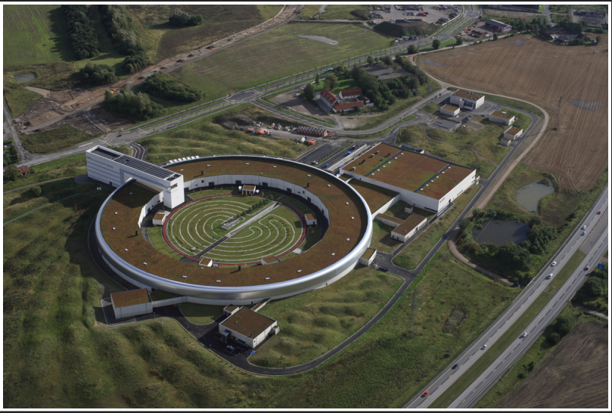
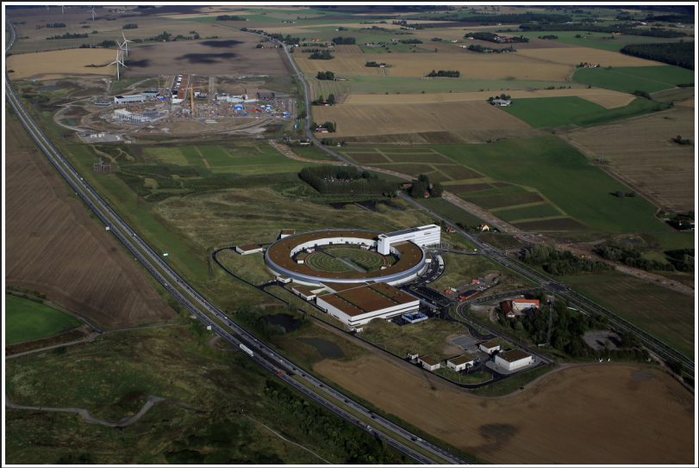
MAX IV
Notes:
Meanwhile, a brand new synchrotron radiation facility was constructed. MAX IV. Located only a few hundred meters from the European Spallation Source (ESS).
Here you can see MAX IV, and ESS which is under construction.
The 2 facilities are located close to each other, but they are run under completely different organizations. ESS is a European consortium with it’s own organization and economy, wheras MAX IV belongs to Lund University. So from us they need one linense each for activities with ionizing radiation.

Slide 6
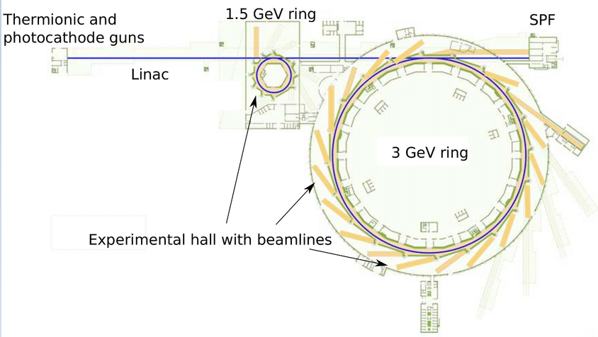
MAX IV
Linear accelerator, 300 m
2 storage rings (1,5 GeV, 3 GeV) and SPF
Possibility for 26 beamlines (financial plan covers 16)
Notes:
Max IV has a 300 m long linear accelerator, working as a full energy injector to the storage rings, using TopUp technique
The Linac is also a driver for the Short Pulse Facility.
Two electron guns
thermionic gun for the storage rings
photo gun for the SPF
3 GeV ring has a circumference of 528 m and is geared towards hard x-ray users
1,5 GeV ring has a circumferense of 96 m and is geared towards soft x-ray and UV users
The Linac operates at up to 100 Hz as driver for the SPF and injects into both storage rings at up to 10 Hz (only on 2 Hz today)
6 beam lines in normal operation today
- 4 connected to the 3 GeV ring
- 2 to the 1,5 GeV ring
Optical hutches are same as at ESRF.

Slide 7
Licensing process
SSM recieved first license application 2011
Stepwise licensing process
Installation
Trial operation
Routine operation
For each license application following areas were assessed
Protection against ionizing radiation during operation
Activation
Technical systems
Organization and qualifications for safe operation
Notes:
SSM recieved the first license application in 2011.
For a facility like this we have a stepwise licensing process, so first they get a license for installation, then a license for trial operation and finally a license for routine operation.
For each licence they apply for they need to send us an application. The application needs to describe how requirments under the follwing areas are fulfilled.
In the application for installation the description can be quite brief, for trial operation the descrition has to be more developed and they need to have more routines etc in place. For routine operation they need to show that they have everything in place.
Under this area we have requirements like that they need to have radiation shielding, PSS etc in order to ensure safe operation for workers and general public in relation to dose limits and internal set dose constraints.
Under this area we have requirements concerning control of activation of construction parts, air etc – of course also to ensure safe operation for workers and general public in relation to dose limits and internal set constraints
…requirements that they need to have certain technical systems, for example automatic shut down, PSS, dose rate monitoring etc, that they are functional and have a safe operation, IT-security
…requirements on management system, competence and education, report systems etc

Slide 8
Licenses
2013-05-07 License for installation
2013-07-04 License for trial operation, step 1 to 3
2013-12-05 License for trial operation, step 1 to 4
2014-03-25 License for trial operation, step 1 to 5
2015-06-09 License for trial operation, step 1 to 7
2016-04-12 License for trial operation, step 1 to 8
2016-12-13 License for normal operation
2017 – Inspection program
Assess applications for new beamlines
Notes:
Example: Step 1-3 trial operation of klystrons, modulators
4 system test of linac and electron gun
5 trial operation of linac and SPF
6-7 trial operation of 1,5 and 3 GeV storage rings
8 trial operation of first beam lines (NanoMAX and BioMAX)

Slide 9
Inspection program
2 inspections per year
2017
Overview of whole regulatory framework
PSS (function)
2018
Organization and management system
Competence and education
2019
To be decided

Slide 10
New beamlines
Application
Risk analysis
Commissioning plan
After commissioning
Report on radiological experiences
Notes:
Application needs to include…

Slide 11
Thank You!

