Slide 1
Development & Validation of BNL’s TBD for Release of M&E from Accelerator Facilities Chuck Schaefer, CHP Accelerator Safety Workshop September 2019

Slide 2
National Synchrotron Light Source II Facility
NSLS2 has ~ 15 Credited Controls

Slide 3
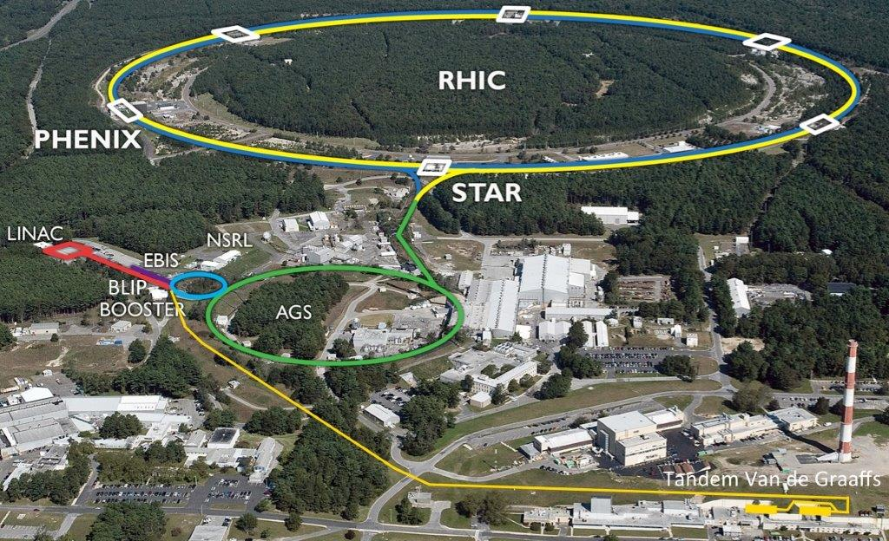
Collider – Accelerator Complex
CAD has ~ 40 Credited Controls

Slide 4
In early 2017 RCD Management decided to pursue TBD
Focus only on volume activity
Tier 1 (IFB only) to be used for routine operational releases
RCD’s existing survey process for M&E was to use Micro-R Meters
99% of BNL’s volume-activated material comes from C-AD

Slide 5
Survey Process
On-Contact scan surveys using Micro-R Meters in low-background areas < 13 µR/h
Scan at ≤ 2 inches/sec
Cover all accessible surfaces
No formal direction provided for surveying “small” items

Slide 6
PROBLEM #1: Where did 13 µR/h come from?
Had been limiting BKG value for performing activation surveys since 1990s
NO documentation existed for its basis:
→ Lessons Learned #1
Recent analysis showed can’t reliably detect volume activity of Group one R-Nucs (3 pCi/g) in a BKG of 13 µR/h

Slide 7
PROBLEM #2: What is an Acceptable Value of BKG?
Analyzed MDCR corrected for surveyor efficiency & converted to µR/h
6 µR/h is limiting BKG for reliably detecting 3 pCi/g of proxy R-Nucs (⁶⁰Co, ²²Na, etc.)
MDCs calculated using Microshield for objects from 0.01 Kg - 100 Kg

Slide 9
PROBLEM #3: Micro-R Meter a Good Release Instrument?
Spent 2 months performing a site-wide BKG survey & instrument comparison
Used 3 Scintillators: Micro-R Meter, Bicron Micro-Rem, & Radeye
Micro-R Meter exhibited best response behavior; lowest CV: Selected for use
Many areas ≤ 6 µR/h; Operations not restricted

Slide 10
Back to the TBD
Asked 3 authors of DOE-STD-6004 to peer review the TBD
Great comments!...but painful also
Had to develop a basis for maximum 8-inch distance between survey paths for large items → Instrument Sensitivity Study
Had to develop facility-specific Bounding Conditions (e.g., how long is ⁶⁰Co an adequate proxy for HTDs?)

Slide 11
Approval Process
Addressed all reviewer comments and internally approved in November 2017
DOE-BHSO forwarded to HQ for their review (J. Blaikie and M. Epps)
Only a couple questions, but no revision necessary
DOE-BHSO Formally approved in January 2018

Slide 12
Post-Approval Validation
Six RCTs individually surveyed 8 low-activity, small metallic items (0.3 – 3 kg)
Observations recorded as either “Rad” or “Non-Rad”
Samples subsequently characterized by gamma spectroscopy and offsite analysis for HTDs
Probability of detection plotted using dose response model

Slide 14
Summary
Instrument and site BKG studies proved very helpful
Establish Max. BKG for performing release surveys early in TBD development
Consider grouping small-mass items for survey whenever “practicable” to counter the mass effect
Peer review is a must!!!
Involve RCTs in the process

Slide 15
Thank you
Questions or Comments?

