Slide 1
JLAB Recent Electrical Safety Issue
Electrical Safety Session
2019 ASW
Harry Fanning – Jefferson Lab
Accelerator Division Safety Officer
Iran Thomas Auditorium
“SAFETY OVER SCHEDULE”

Slide 2
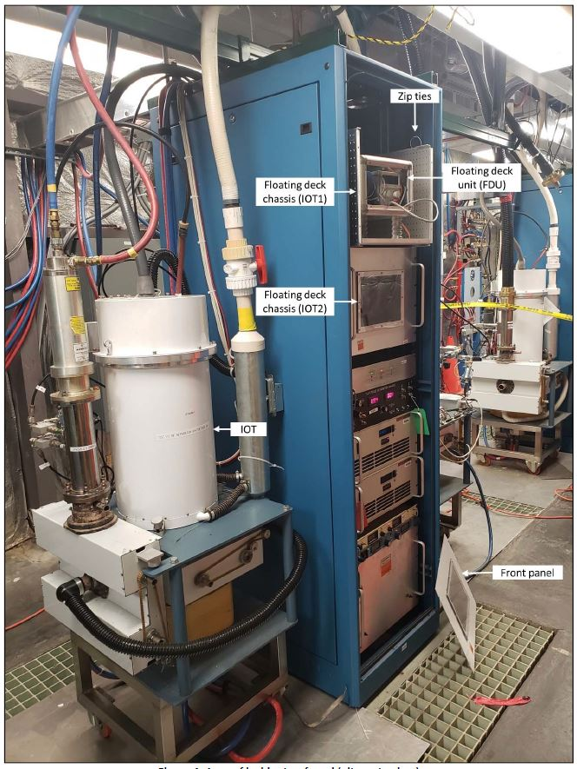
Agenda
What Happened?
Overview
Injury description
Incident Pictures
Lessons Learned
Questions

Slide 3
What Happened?
On April 26, 2019, an engineer while troubleshooting a Continuous Electron Beam Accelerator Facility (CEBAF) Radio Frequency (RF) Separator System received an electrical shock from a 27kV DC Floating Deck Unit (FDU) power supply.
The shock was sufficient to cause temporary impairment (could not move arms which “felt like logs”.)
The engineer was able to exit the building pushing through a propped open door and “flagged down” a passing coworker.
The engineer was transported by the coworker to an on-site Occupational Medicine (OccMed) before being taken to a local hospital for overnight observation.
The engineer regained the use of their arms, was released from the local hospital with no treatment rendered and was returned to work without restrictions.

Slide 4
What Happened?
The engineer sustained the following injuries:
1st degree burn to left palm along with small laceration.
2nd degree burn on the right wrist.
Apparent loss of consciousness immediately following the shock event, and falling backwards.
Small abrasion on the left middle finger and upper right arm. (The engineer was wearing a wedding ring on his left ring finger.)
Inability to raise the arms above waist height immediately following the shock event.
The engineer had to self‐rescue due to being alone in the building.
The engineer was able to exit the building due to the door being propped open with a rock.
They attempted to run towards the Machine Control Center (~150 yards) to get help when they encountered the coworker.

Slide 5
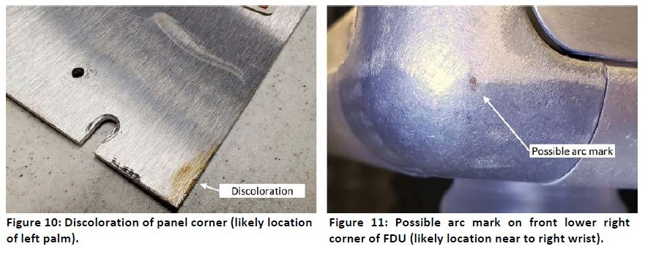
What Happened?

Slide 6
Lessons Learned from Electrical Shock Event
Familiarity of a system can blind us to potential hazards; especially when we perform tasks by memory instead of reviewing the procedure
The use of temporary measures (such as working alone and the use of temporary fasteners) can easily become the norm without effective monitoring and coaching from peers and supervisors
A formal turnover and walk-down of the work allows those involved to understand the current condition and help maintain a positive control of situation
The use of HPI tools such as pre-task review, procedural use & adherence, and having a questioning attitude provide opportunity to understand the potential hazards and required controls needed to perform the task successfully

Slide 7
Questions?
Harry Fanning – Jefferson Lab, Accelerator Division
fanning@jlab.org

Slide 8
Extra Slides: What Happened? – A Closer look
The engineer (E1) had been performing troubleshooting on the IOT system because it had not been regulating RF.
They initially recreated a test by using a local computer interface to see if IOT 1 was producing RF, and found that it was not.
The IOT can only produce RF whilst the HVPS is “ON” and FDU is in a high voltage state.
E1 found the breaker for the Low Conductivity Water (LCW) heater, located at the east end of the building, was in the “OFF” state and switched it “ON.”
E1 then returned to the IOT and attempted to produce RF, to no avail.
E1 looked at the front panel driver amplifier, and saw high‐reflected power; he checked the fault screen and saw no cathode current.
E1 looked at the filament power supply (through the front panel on FDU) and saw no current on the display.
E1 looked at a schematic on the bench and then returned to the rack.
E1 stated he was intently focused on why the IOT was not working.
E1 reached out with both hands and swung the front cover of the chassis that contained the FDU, that was attached with cable ties, up.
E1 moved his right hand towards the FDU, perhaps to check the fiber connections, and the next thing he knew he “came‐to” on the floor.
E1 reported both his arms “felt like logs” and were not working (he could not raise his arms above waist height).
Whilst in a sitting position, he “scooted” towards the exit door and found the door was wedged open (the exit doors in Building 82 have knobs, not handles or crash bars).
E1 shoved the door open, discovered he could walk, and then proceeded to run towards the Machine Control Center (MCC). He saw a golf cart approaching, and tried to wave the driver down, but could not raise his arms.
E1 instead ran towards the cart. The driver, a coworker, helped him into the vehicle and drove towards OccMed via the Guard Station. The guard on duty called 911 and notified OccMed that an injured person was inbound.
E1 was evaluated at OccMed and subsequently taken to a local hospital for observation (overnight by E1’s request).

Slide 9
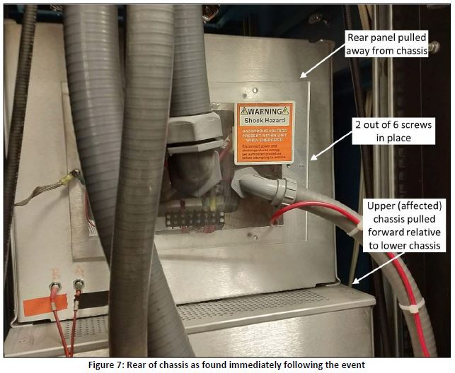
Extra Slides – Images

Slide 10
Extra Slides – Work Control Information
Restricted approach boundary is 2 feet 9 inches from exposed circuits (qualified persons).
Limited approach boundary is 8 feet (unqualified persons).
A front panel cover was placed temporarily for testing with cable ties at the time of the event.
The top cover of the chassis was not installed at the time of the event.
Technician (T1) left the area and did not provide proper pass-down to the engineer who came in afterward to check the system.
The nominal voltage of the system is –27kV DC. The CEBAF signal archiver shows system was in high voltage, and that it tripped off at precisely 15:01.
The front panel was found resting against the rack immediately following the event.
The FDU was found pulled out of the normal position.
The front of the IOT rack and FDU do not have a voltage readout or visual indication that high voltage is present.

