Slide 1

Qualified Electrical Worker Program at ANL
Electrical Safety
John Woodford, ANL

Slide 2
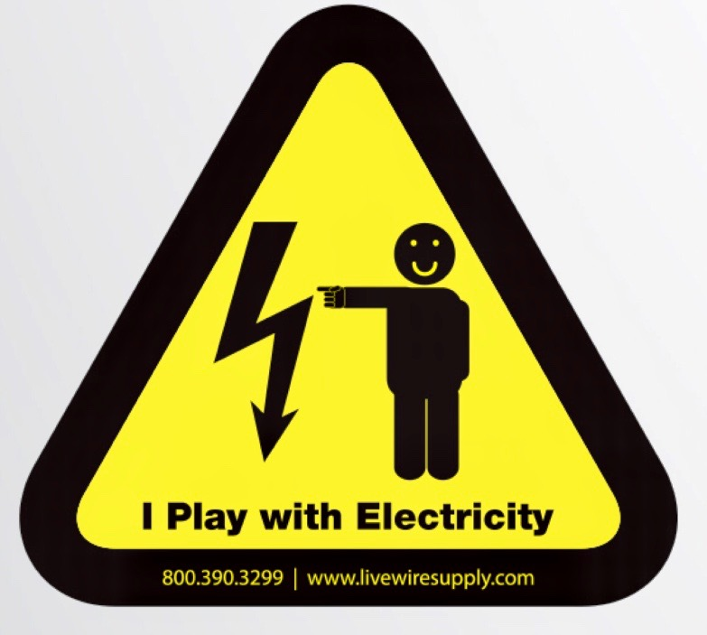
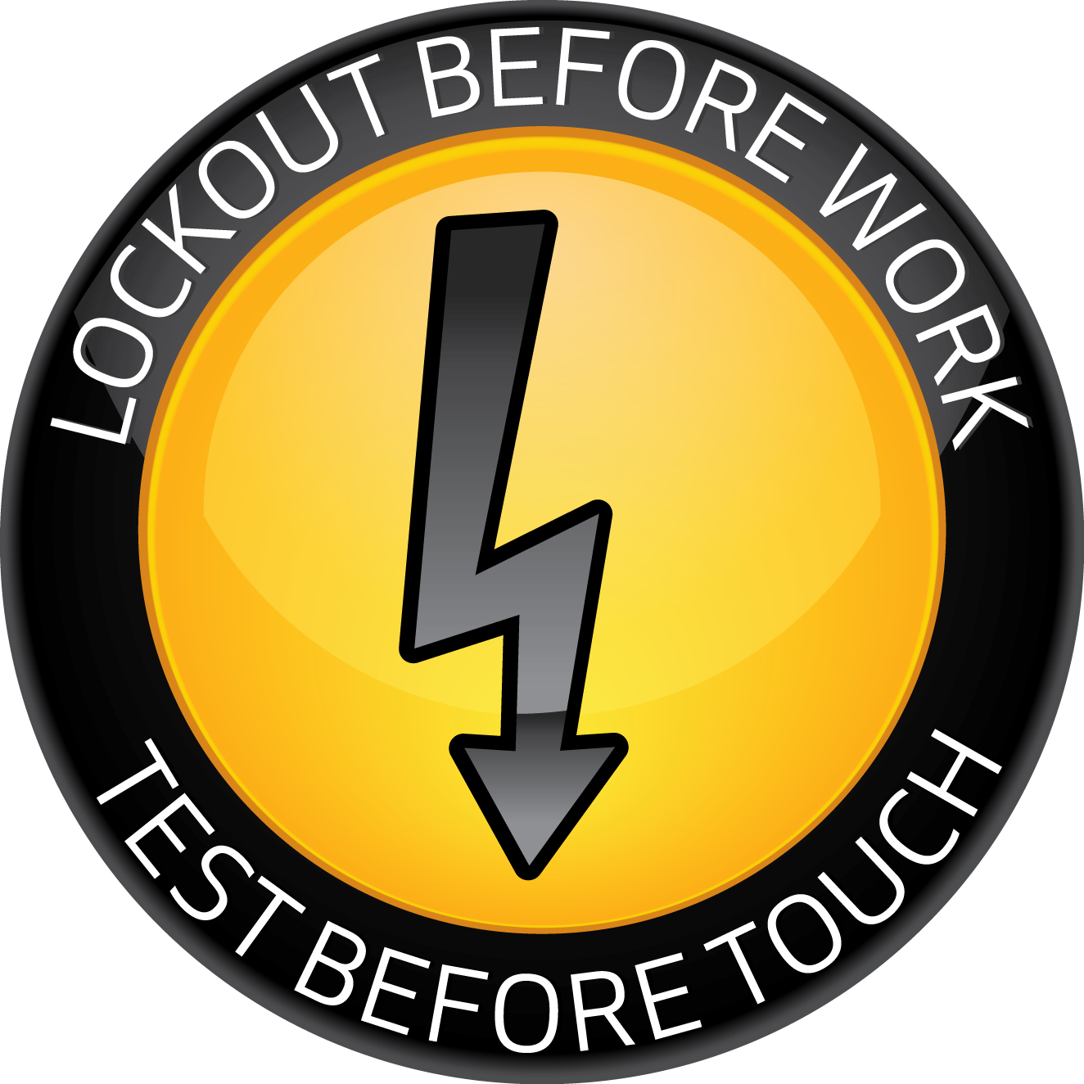
Outline
Where we were
What we did
What we learned

Slide 3
Argonne Electrical Incidents 2014 to March 2017
Notes:
5 incidents involved LOTO violations
5 incidents involved an electrical shock or burn.
2 incidents involved electrical fires.
2 incidents involved equipment coming in contact with partially inserted plug prongs.
2 incidents involved the unexpected discovery of electrical energy.
2 incidents involved overhead line contact.
1 incident involved a shock and LOTO violation.

Slide 4
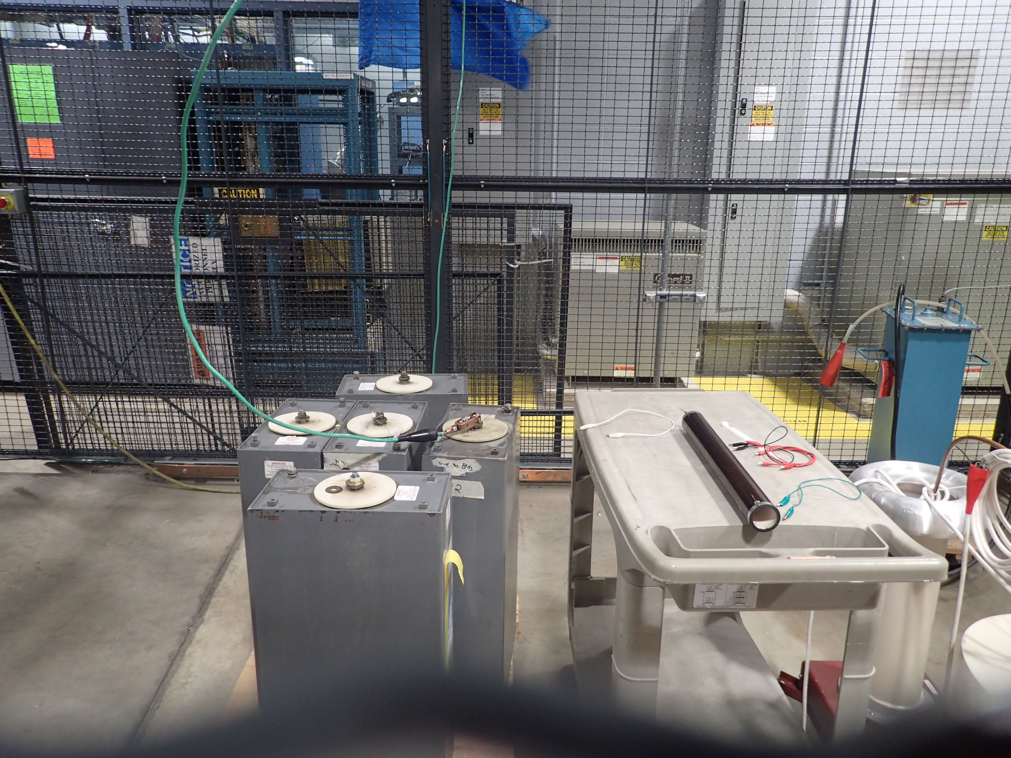
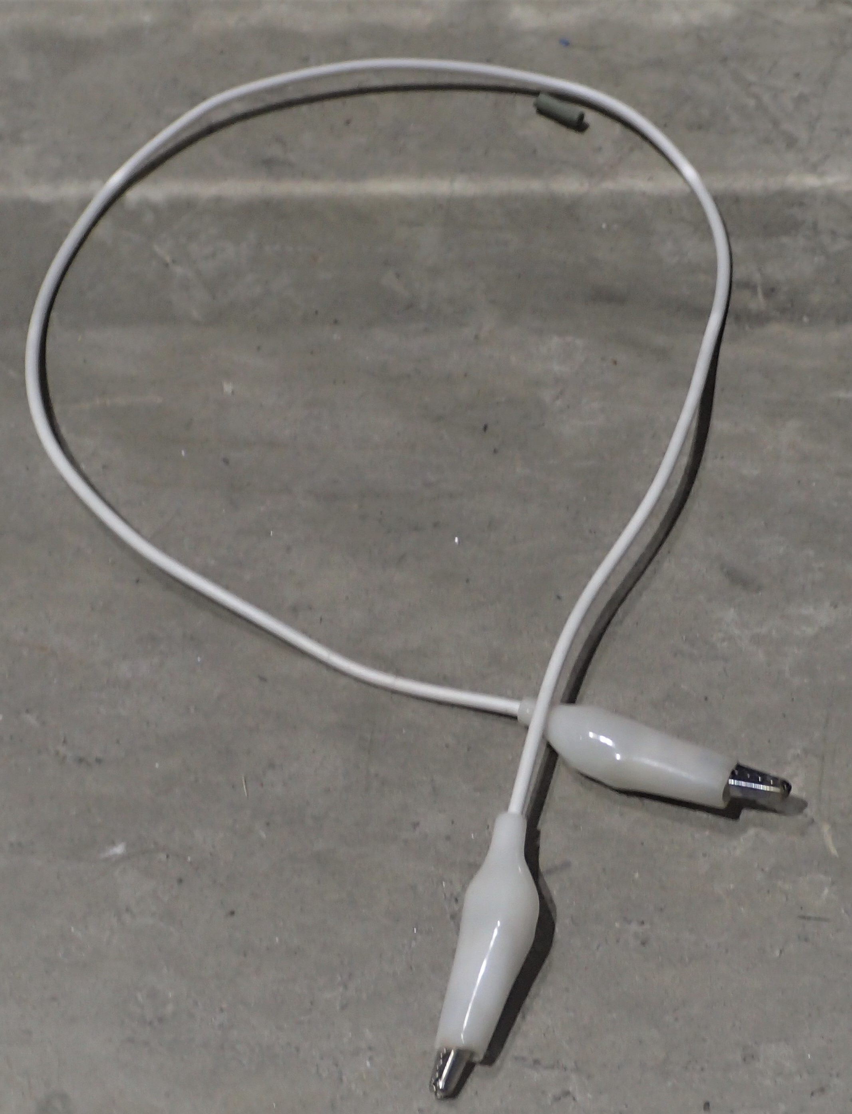
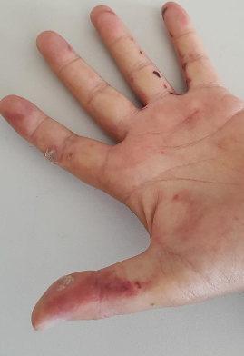
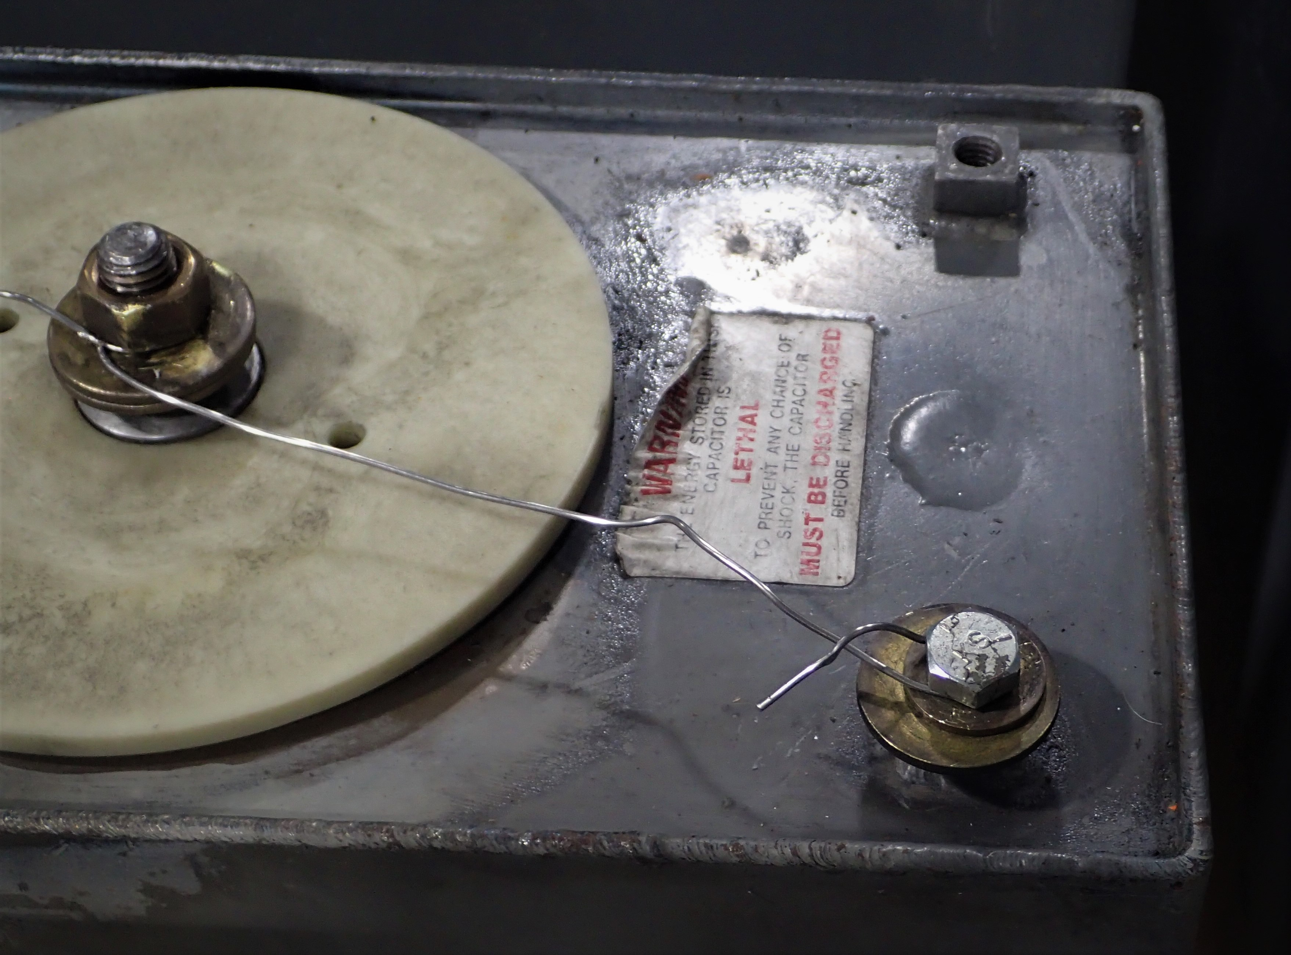
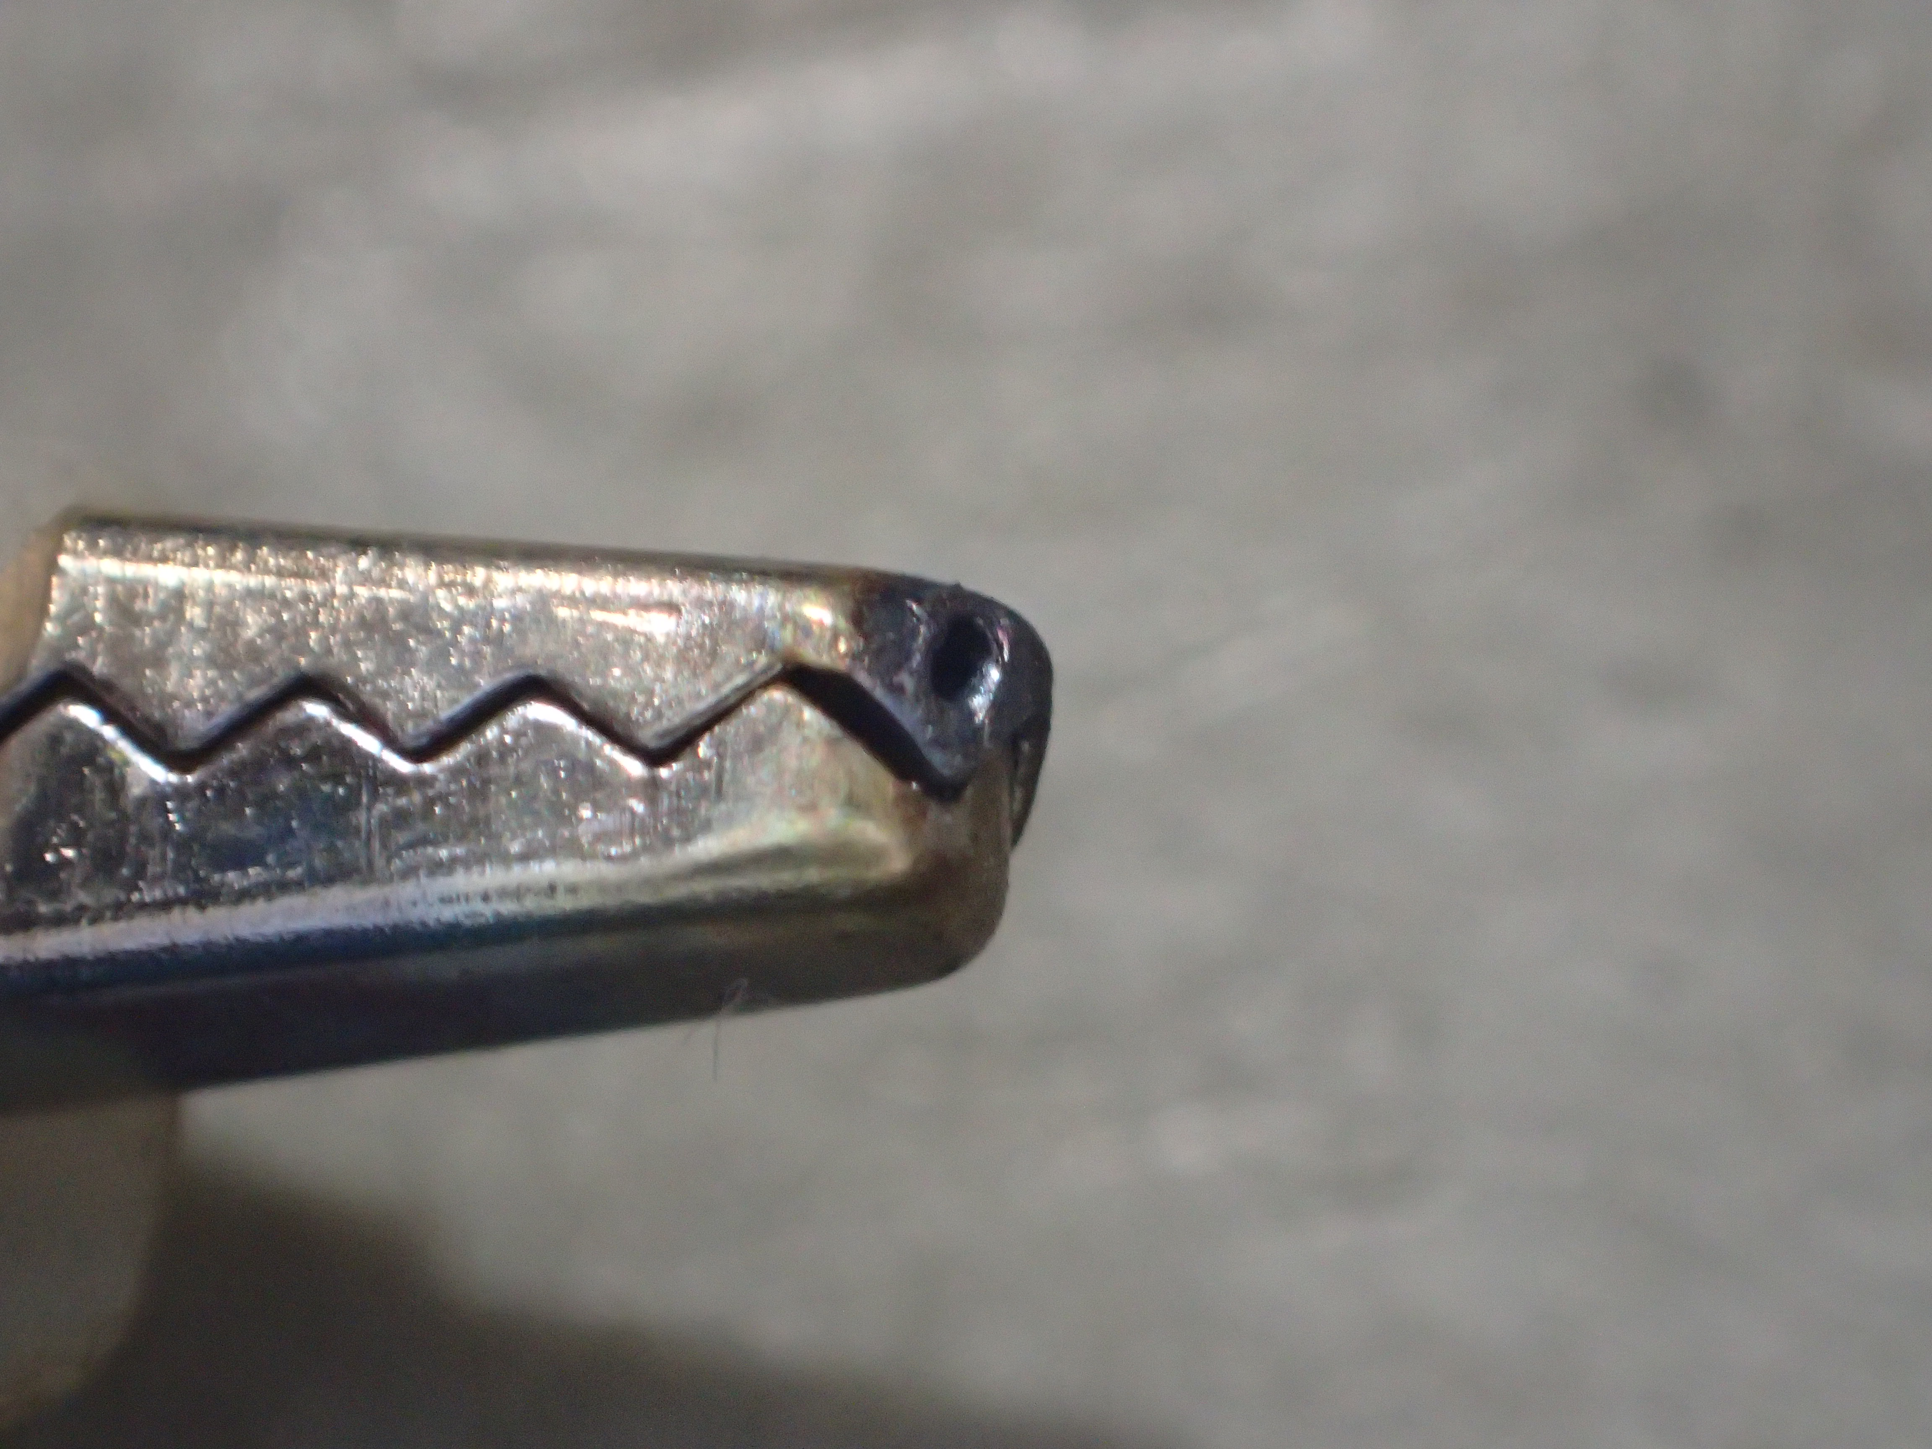
Argonne Electrical Incident July 2017

Slide 5
Common Elements amongst electrical incidents
No clear understanding of requirements
Training less than adequate for the complexity
Perception of already being over-compliant
Institutional Contributors
Electrical safety requirements organization, content, training and guidance significantly less than adequate.
Electrical Safety Program management lacking or ineffective at driving changes.
Limited incident investigations failed to uncover deeper root causes or latent conditions.
Notes:
There no way to identify or track the QEWs, no communications with the QEWs as a result.
No supervisor training.
Electrical Safety Program LTA
Management of Program LTA
QEW Program/Training LTA
Electrical Safety Procedures LTA
Supervision of QEWs LTA
Incident Investigations LTA

Slide 6
Developing and Implementing a
New Approach to Electrical Safety

Slide 7
New Habits to Change the Electrical Safety Culture
6
What MUST be done in order to stop the shocks?
Non-QEWs:
  Do not perform electrical work
  Report unsafe equipment
QEWs:
  Lockout & Test Before Touch
  Establish and Control Work Space
Management:
  Plan and control the work
  Correct unsafe behavior and conditions (accountability)
Notes:
Can discuss the recent recall on disconnects that don’t actually disconnect all of the way.

Slide 8
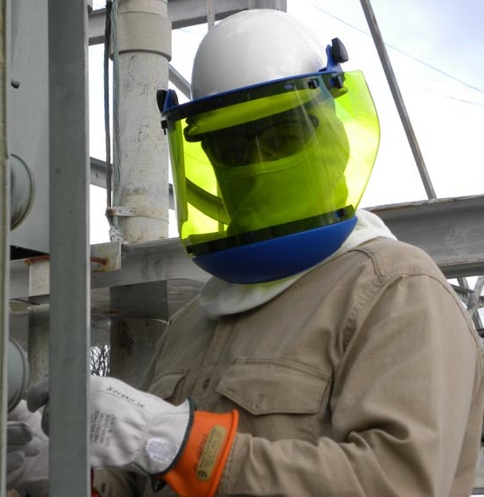
What is a Qualified Electrical Worker (QEW)?
One who has:
demonstrated skills and knowledge related to the construction and operation of electrical equipment and installations,
has received safety training to identify and avoid the hazards involved,
and who has been approved or accepted by the Electrical AHJ
NFPA 70E and OSHA
Lab Policy for assurance
Notes:
Derived from NFPA 70E.
This is what you might think of when you think of QEW, but does the assumption hold true at a science lab?

Slide 9
QEW 1 Training
QEW 1 Classroom Training
QEW1
Day 1,
4 Hours
QEW1
Day 2,
4 Hours
3 Year Repeat
Certification
QEW 1
Practical Prep
4 Hours
CPR/First Aid
4 Hours
QEW 1
Practical
2 Hours
2 Year Repeat
1 Year Repeat

Slide 10
QEW 2/3 Training
QEW 2/3 Classroom Training
QEW 2/3
Day 1,
4 Hours
QEW 2/3
Day 2,
4 Hours
QEW 2/3
Day 3,
4 Hours
3 Year Repeat
Certification
QEW 2/3
Practical Prep
4 Hours
CPR/First Aid
4 Hours
QEW 2/3
Practical
2 Hours
2 Year Repeat
1 Year Repeat
Notes:
QEW 3 has additional training and background requirements that did not change, NESC training etc.

Slide 11
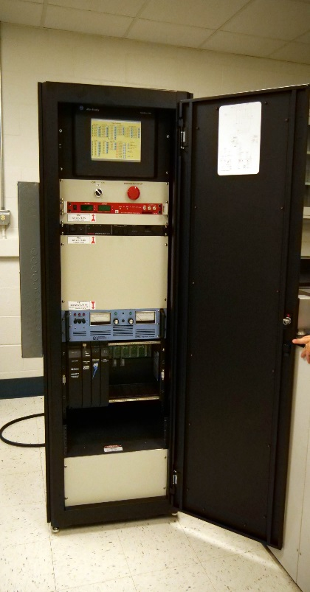
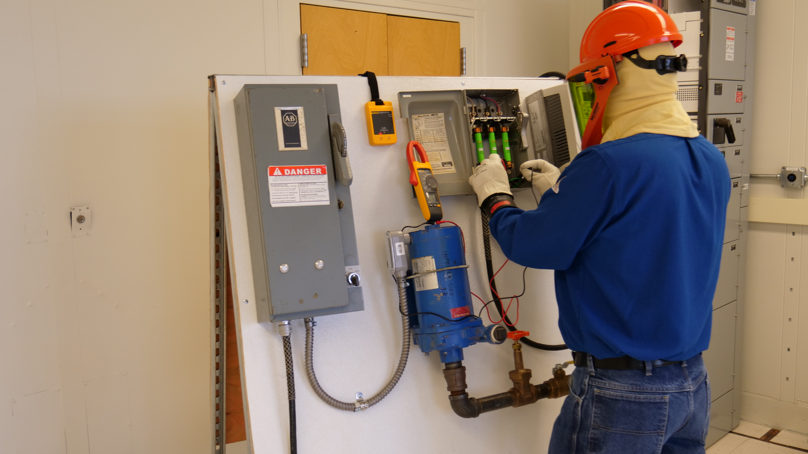
Hands-On, 1:1 Practical Certifications
Graded, one-on-one with an instructor
Critical failure points include PPE, LOTO and ZVV.

Slide 12
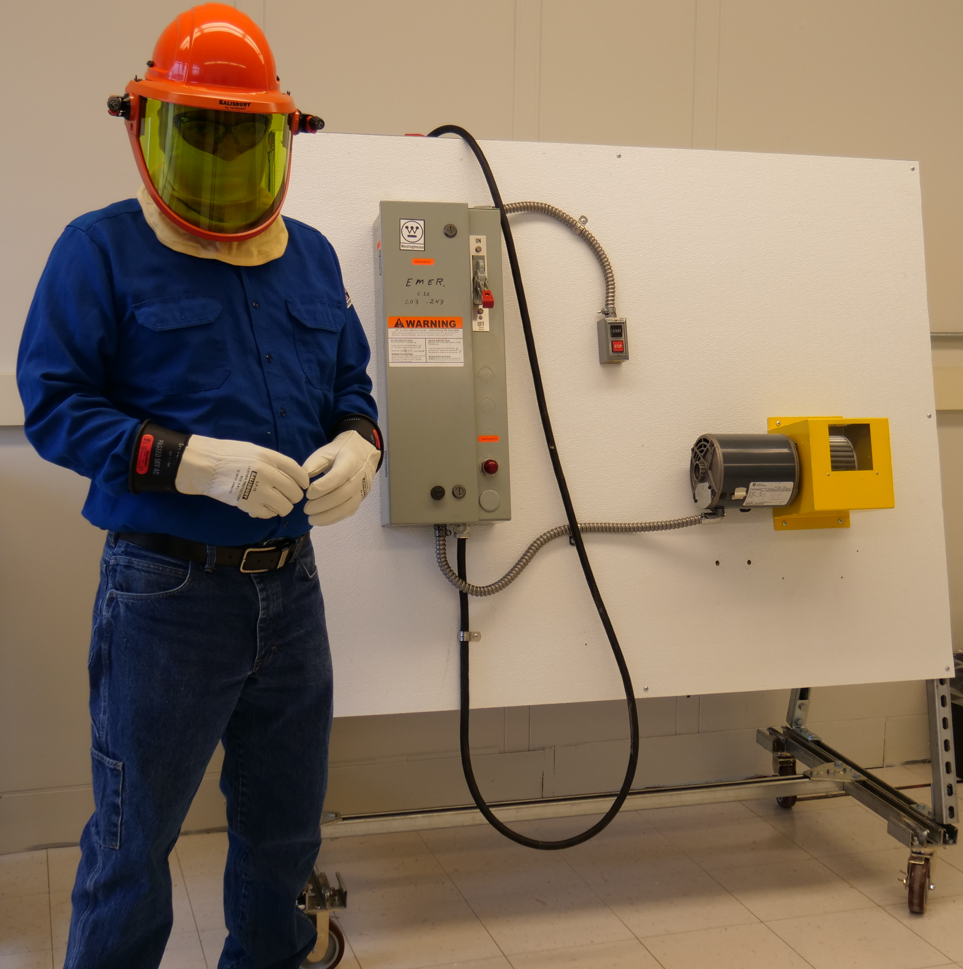
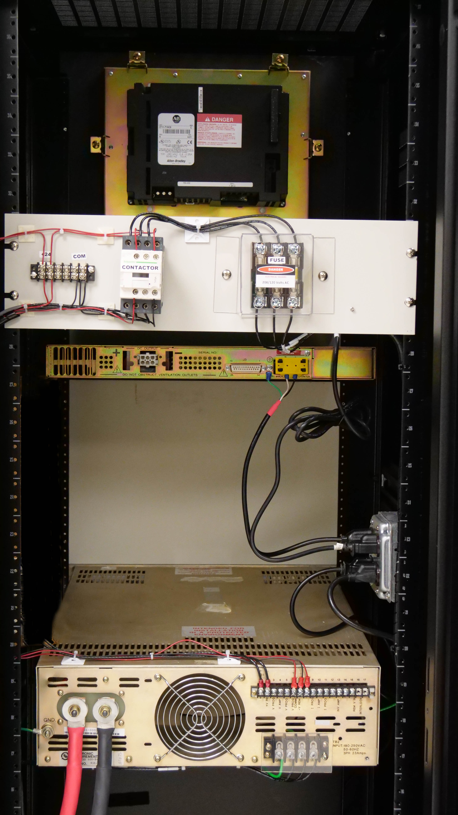
Hands-On, 1:1 Practical Certifications
Various equipment to tailor different QEW training needs
Immediate feedback
Assess skills and abilities

Slide 13
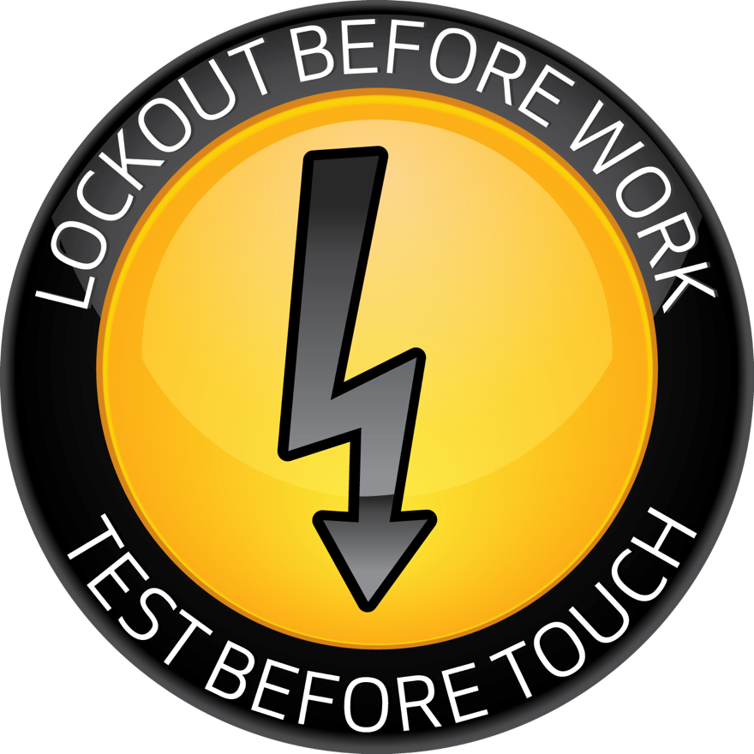
Fundamental Principle of Electrical Safety for ALL QEWs
Every QEW has one final line of defense:
  Lockout Before Work, AND
  Test Before Touch
This should be a HABIT that you perform every time!
YOUR LIFE IS IN YOUR HANDS

Slide 14
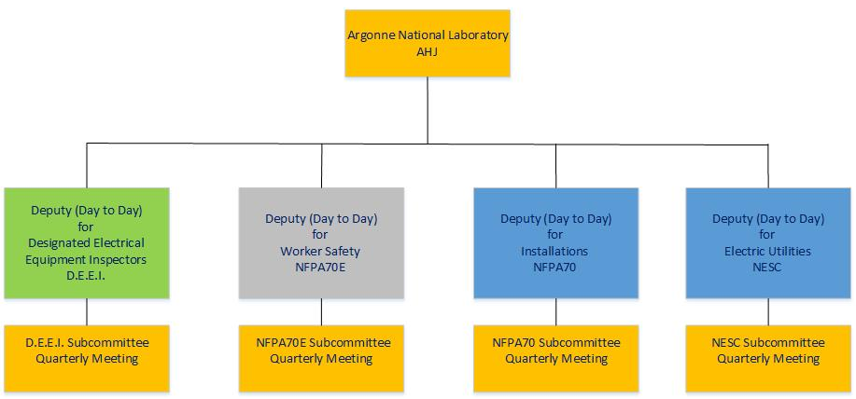
Authority Having Jurisdiction and Electrical Safety Committee
Electrical Safety Committee

Slide 15
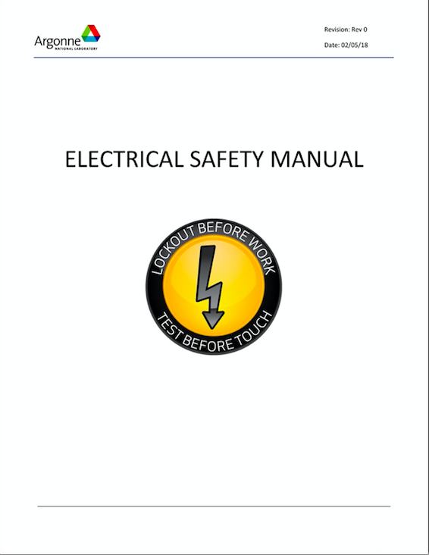
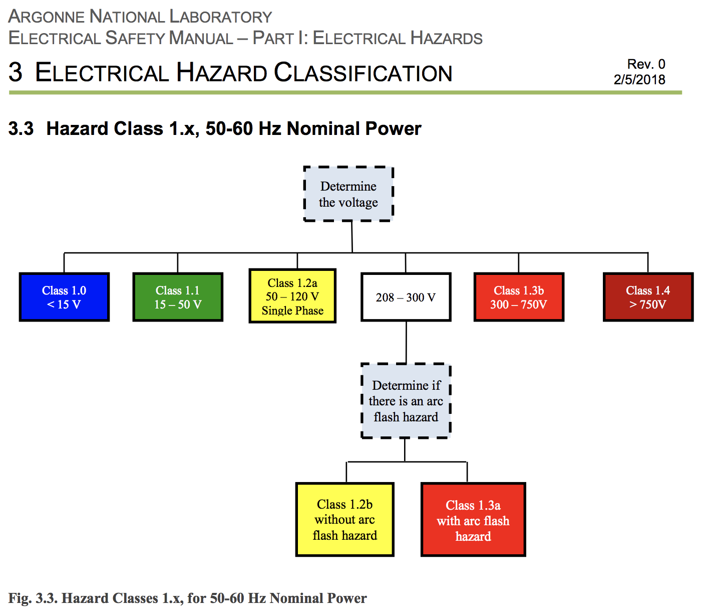
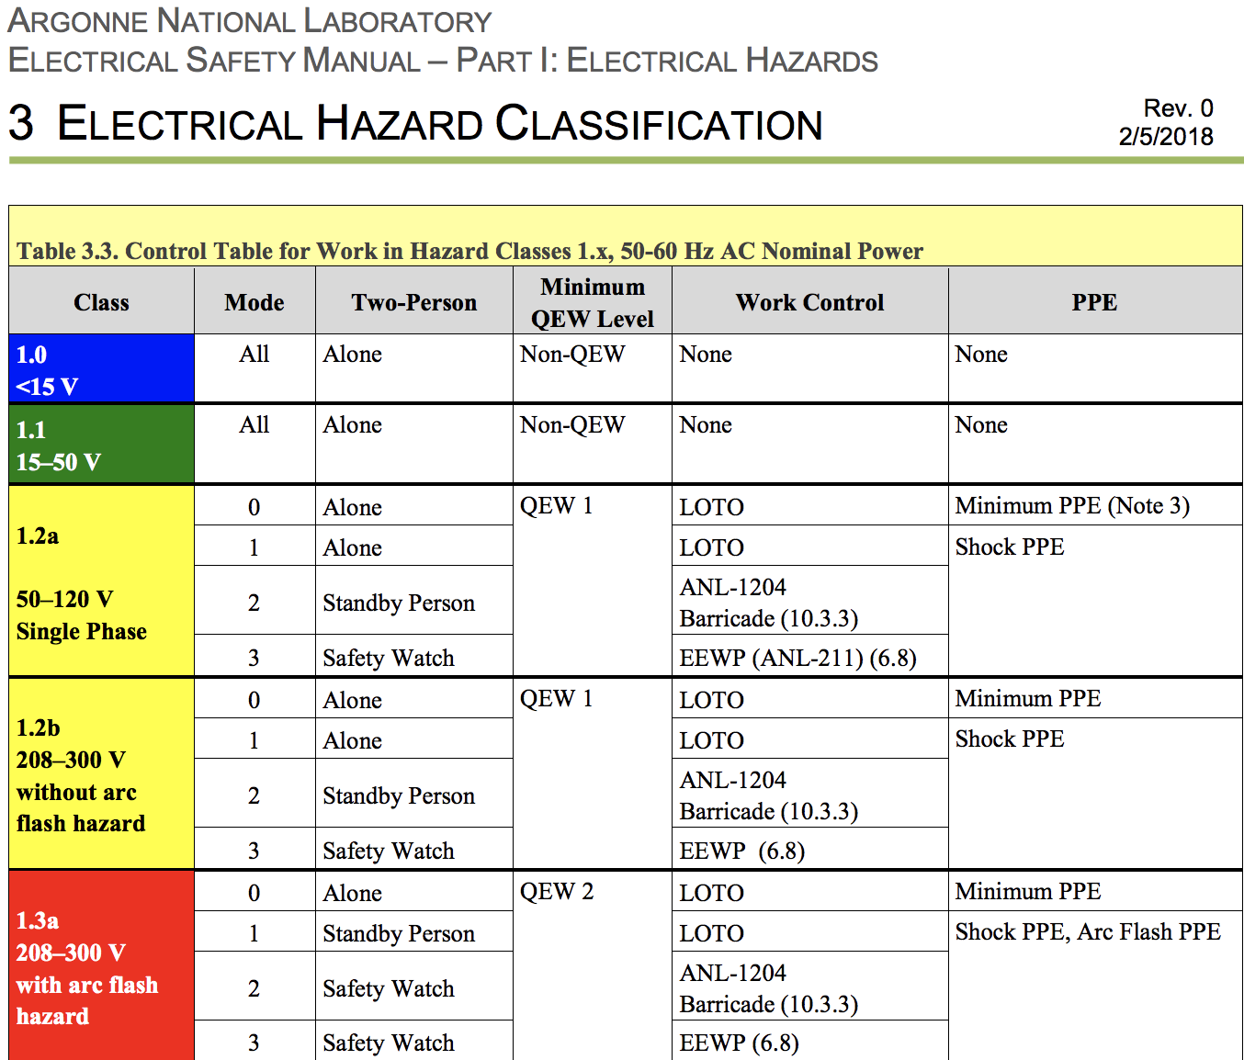
Electrical Safety Manual
Gathers requirements from over 20 codes and standards into one document.
Incorporates best practices and explanations.
Allows people to review wording and semantics before approval.

Slide 16
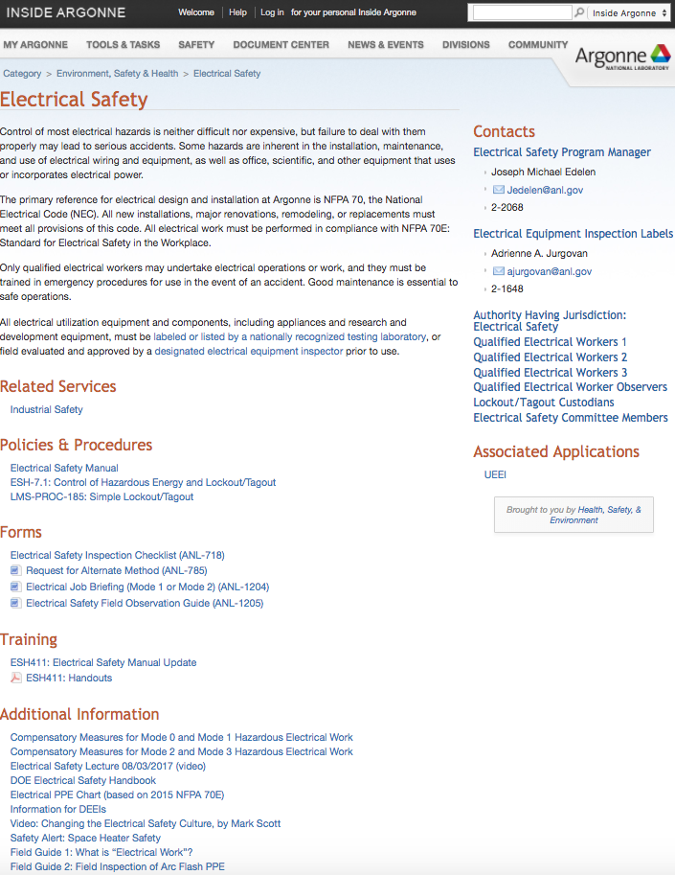
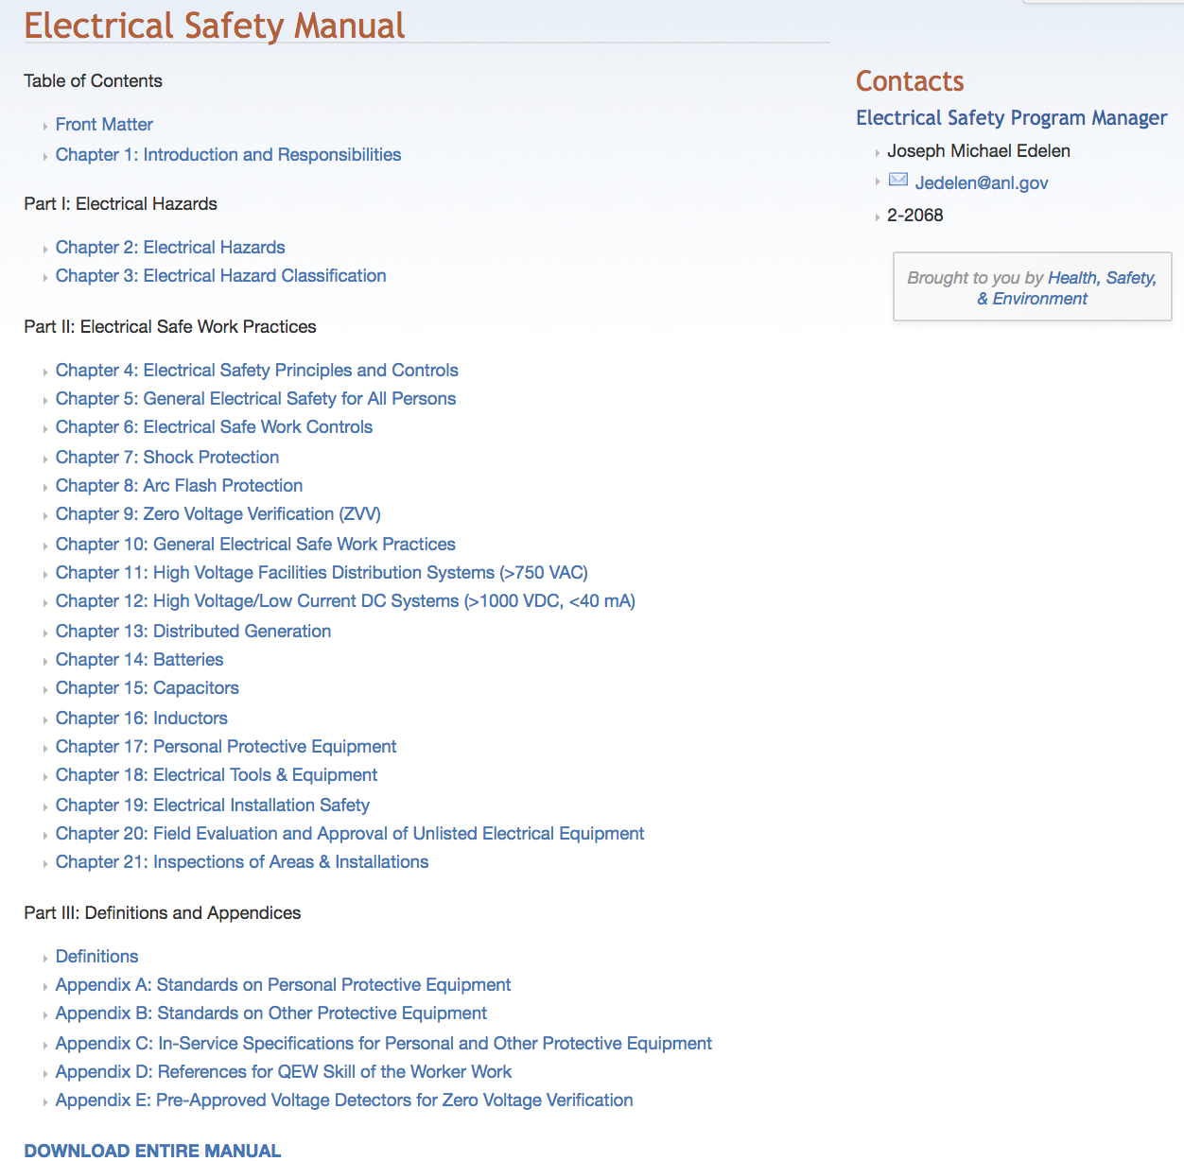
Electrical Safety Website
Make all documents easily accessible.
Communicate changes
Provide support

Slide 17
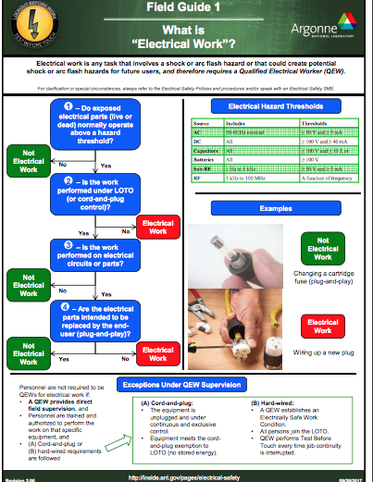
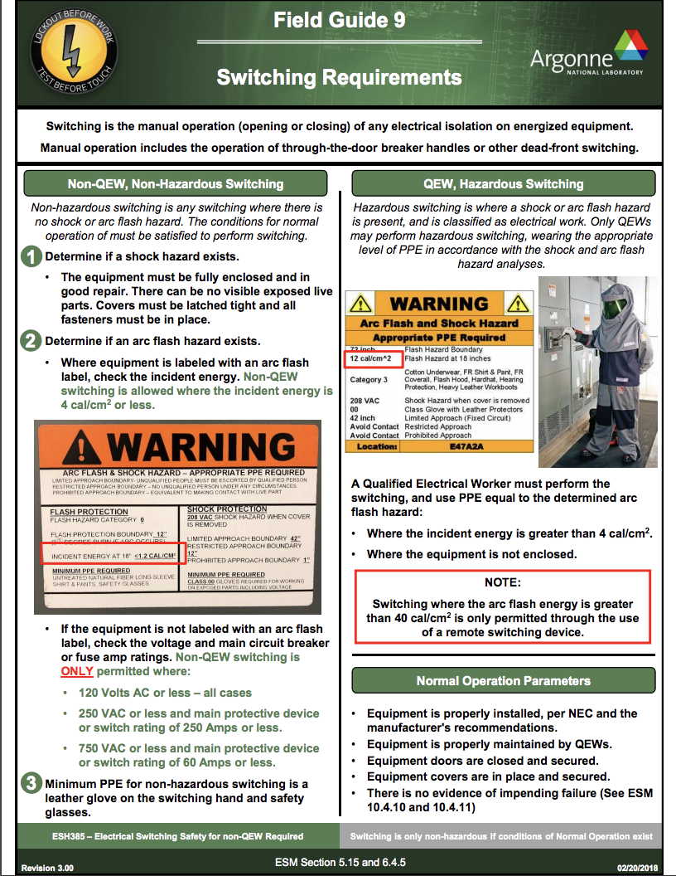
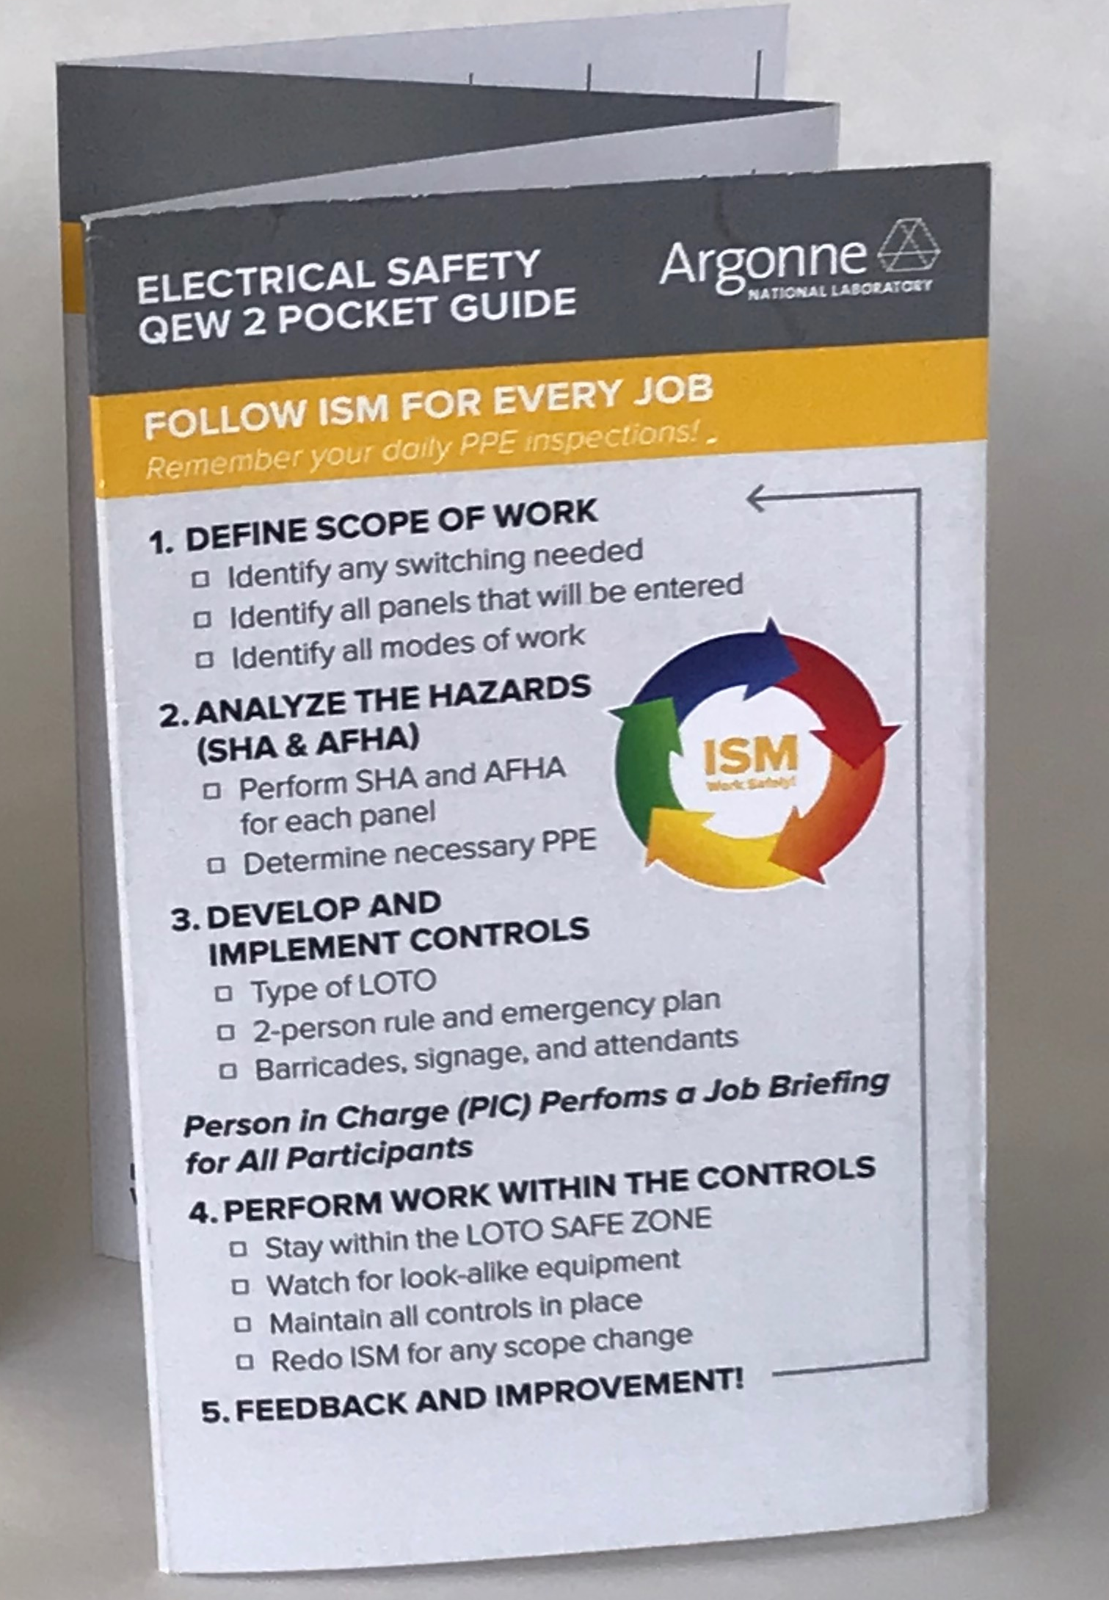
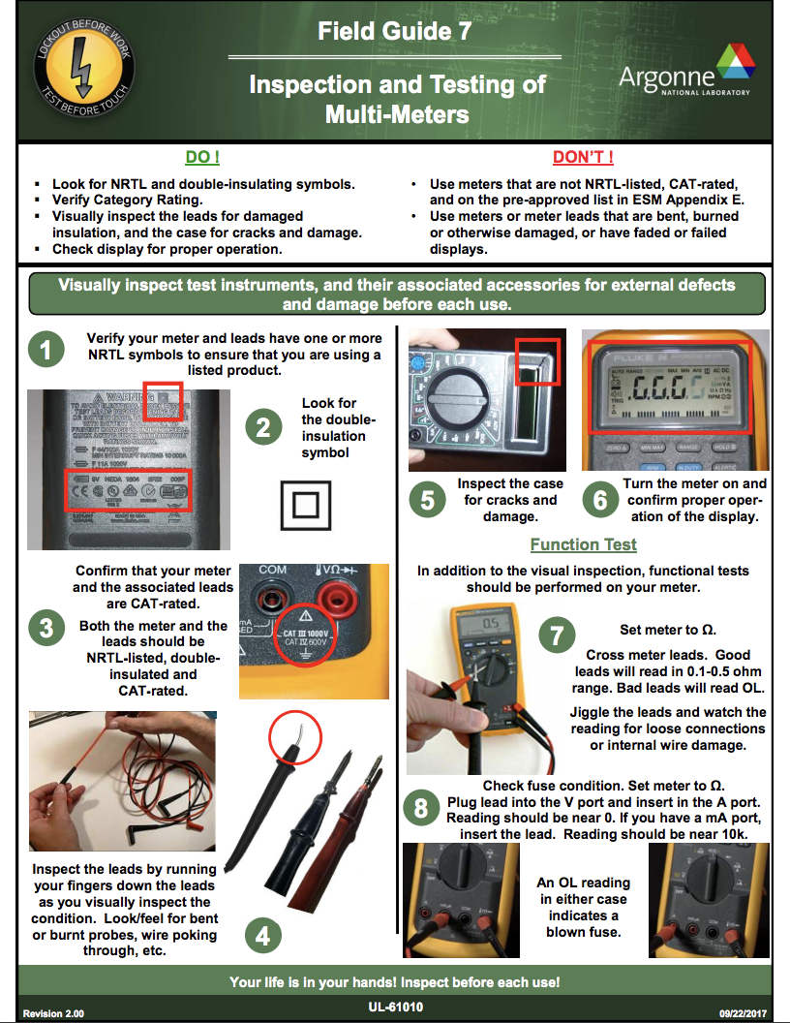
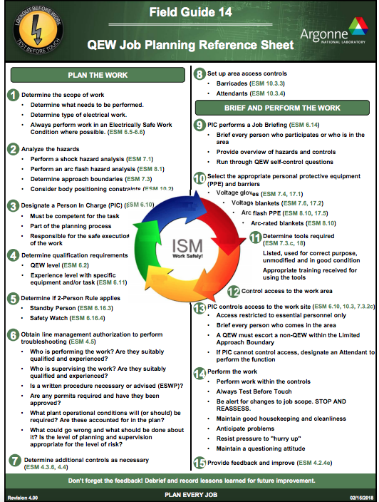
Field and Pocket Guides
Your life is in your hands! Lockout Before Work. Test Before Touch.
Your life is in your hands! Lockout Before Work. Test Before Touch.
Your life is in your hands! Lockout Before Work. Test Before Touch.
Your life is in your hands! Lockout Before Work. Test Before Touch.

Slide 18
What is Electrical Work?
Possibly the best field guide to start with at a science lab.
Communicates clear boundaries on electrical work.
Gets everyone on the same page.

Slide 19
Impact
~800 people doing electrical work down to ~300 QEWs.
>556 days since the last electrical shock incident, average for last three years was 58 days.
No shock incidents during LOTO or electrical work since July 2017.
Workers identifying hazards following training.
Quotes from QEW Trainees
“Most of the training here at Argonne tells us what NOT to do but not what TO do or HOW to do it safely. This is the first training here at Argonne that I have attended with a formal process in place for qualification training.” (17 yr ANL employee)
“This new electrical safety program is effectively bringing to light the true danger of working with electricity”
“This is the only training I’ve had at Argonne where I’ve actually learned something. It also helped me understand the 'Work Control’ document that I am writing as well.” (Researcher-Physics)
“This is the best course I’ve had in my nearly 44 years of working here at Argonne because it actually teaches you WHAT NOT to do, WHAT to do and HOW to do it., followed by a demonstration of understanding.”
Notes:
Good Feedback Comments from various Argonne Employees:
(The information here was gathered from QEW’s following their practical certifications. I asked for feedback on the new Electrical Safety Program implementation and the QEW process they just completed….Jeff Grovom)
“I never considered the hazard of a bleeder resistor failing on capacitors”
“This is the best training I’ve ever had here at Argonne”
“Its good to see that Argonne is serious about electrical safety now and it shows with this new process. In the past it seemed they were just going through the motions to meet a requirement”
“This new electrical safety program is effectively bringing to light the true danger of working with electricity”
“Very good class”
“In the past Argonne just told you to do something with no instructions, enforcement, accountability or follow-up so no one took it seriously.”
“Its refreshing to see structure being implemented for electrical safety here at Argonne.”
“I’m NOT really an electrician but they expect me to do electrical work (minor electrical tasks) as part of my job. After the training I am now more knowledgeable on what I am exposed to and know how to protect myself. I am very thankful for this training!”
“I have done things out here in the past while not really knowing what I was doing or what the real hazards were. I now know how LUCKY I’ve been that I wasn’t hurt or worse!”
“Most of the training here at Argonne tells us what NOT to do but not what TO do or HOW to do it safely. This is the first training here at Argonne that I have attended with a formal process in place for qualification training.” (17years employed at Argonne)
“It lifts our role as electrical workers to a level of professionalism (we are professionals). The detailed level of safety training does make me feel like I’m professionally trained in the hazards and expected safe work practices. As a manager, I’m especially thankful that this information is being presented to our new employees who may have not had this level of training elsewhere.” (28 years employed at Argonne).
“I really like the new electrical safety manual and the way it is laid out. The PROC’s were confusing and one could lose sight of the overall process and hazards. (11 years employed at Argonne)
This is the only training I’ve had at Argonne where I’ve actually learned something. It also helped me understand the “Work Control” document that I am writing as well. (Graduate School for PHD-Physics)
This is the best course I’ve had in my nearly 44 years of working here at Argonne because it actually teaches you WHAT NOT to do, WHAT to do and HOW to do it., followed by a demonstration of understanding. (44 years employed at Argonne)

Slide 20
Lessons Learned and Future Development

Slide 21
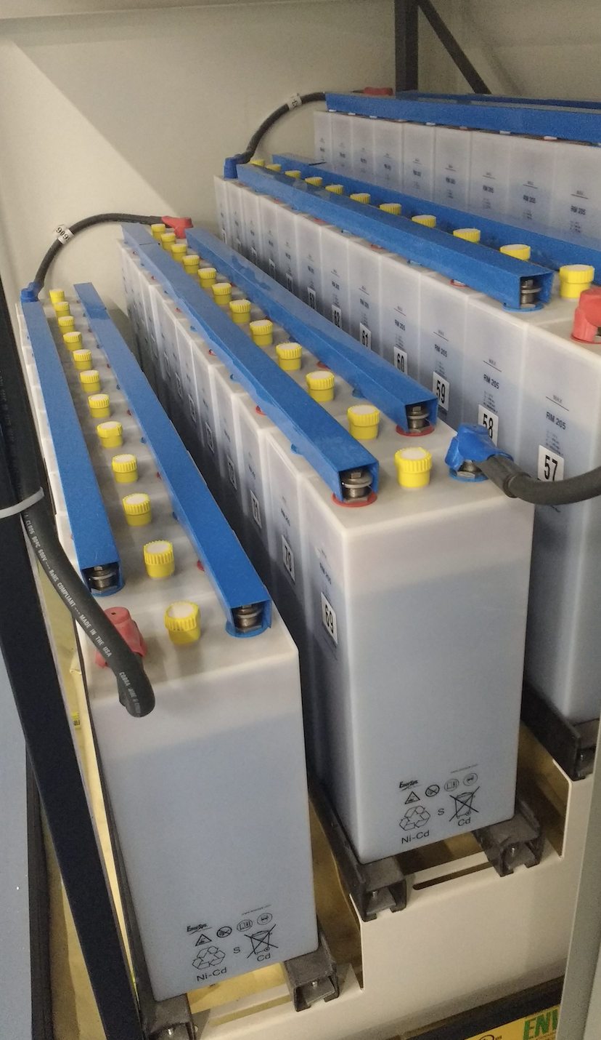
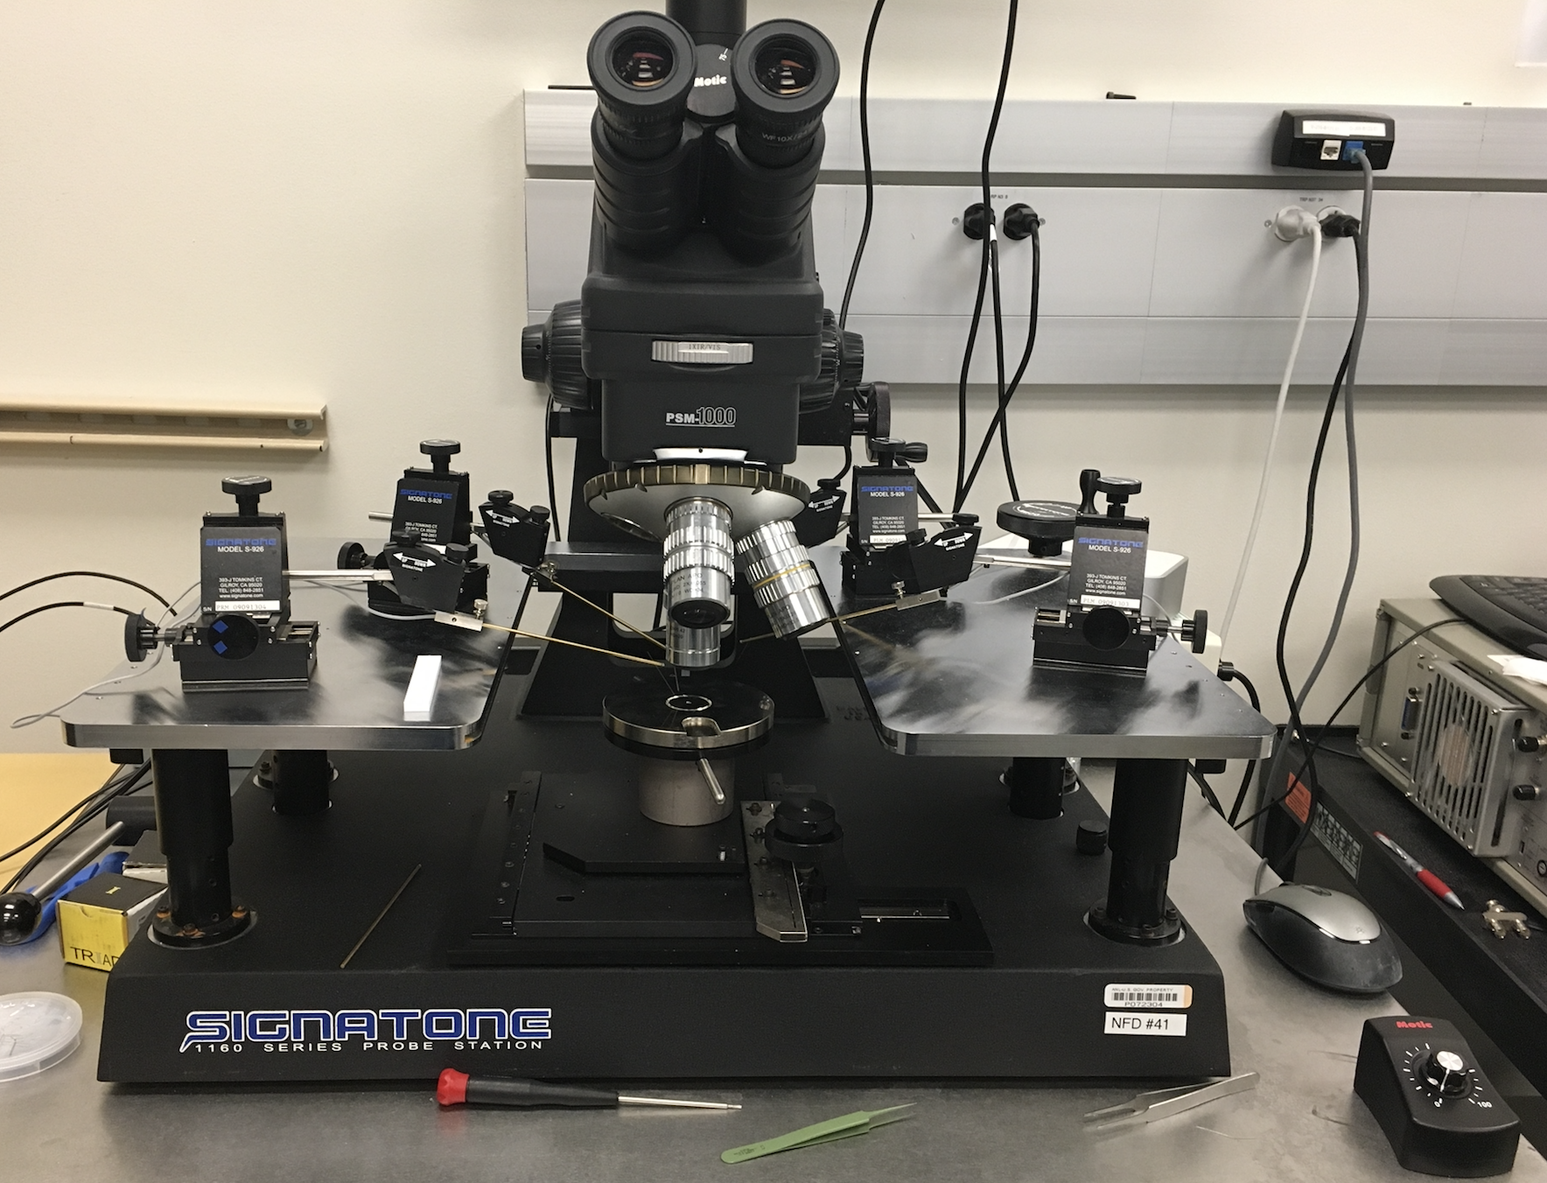
Implementation to R&D
If you cannot apply all the rules, you can still apply the core principles:
How will you LOTO?
How will you Test Before Touch?

Slide 22

Manage the Complexity
How do you maintain clarity while also ensuring technical accuracy?
Keep it simple
Train on the basics
Develop wide access to answers
Ensure documents adequately cover complex cases
The Worker’s Perspective:
“Just tell me what I need to do.
And don’t confuse me.”

Slide 23
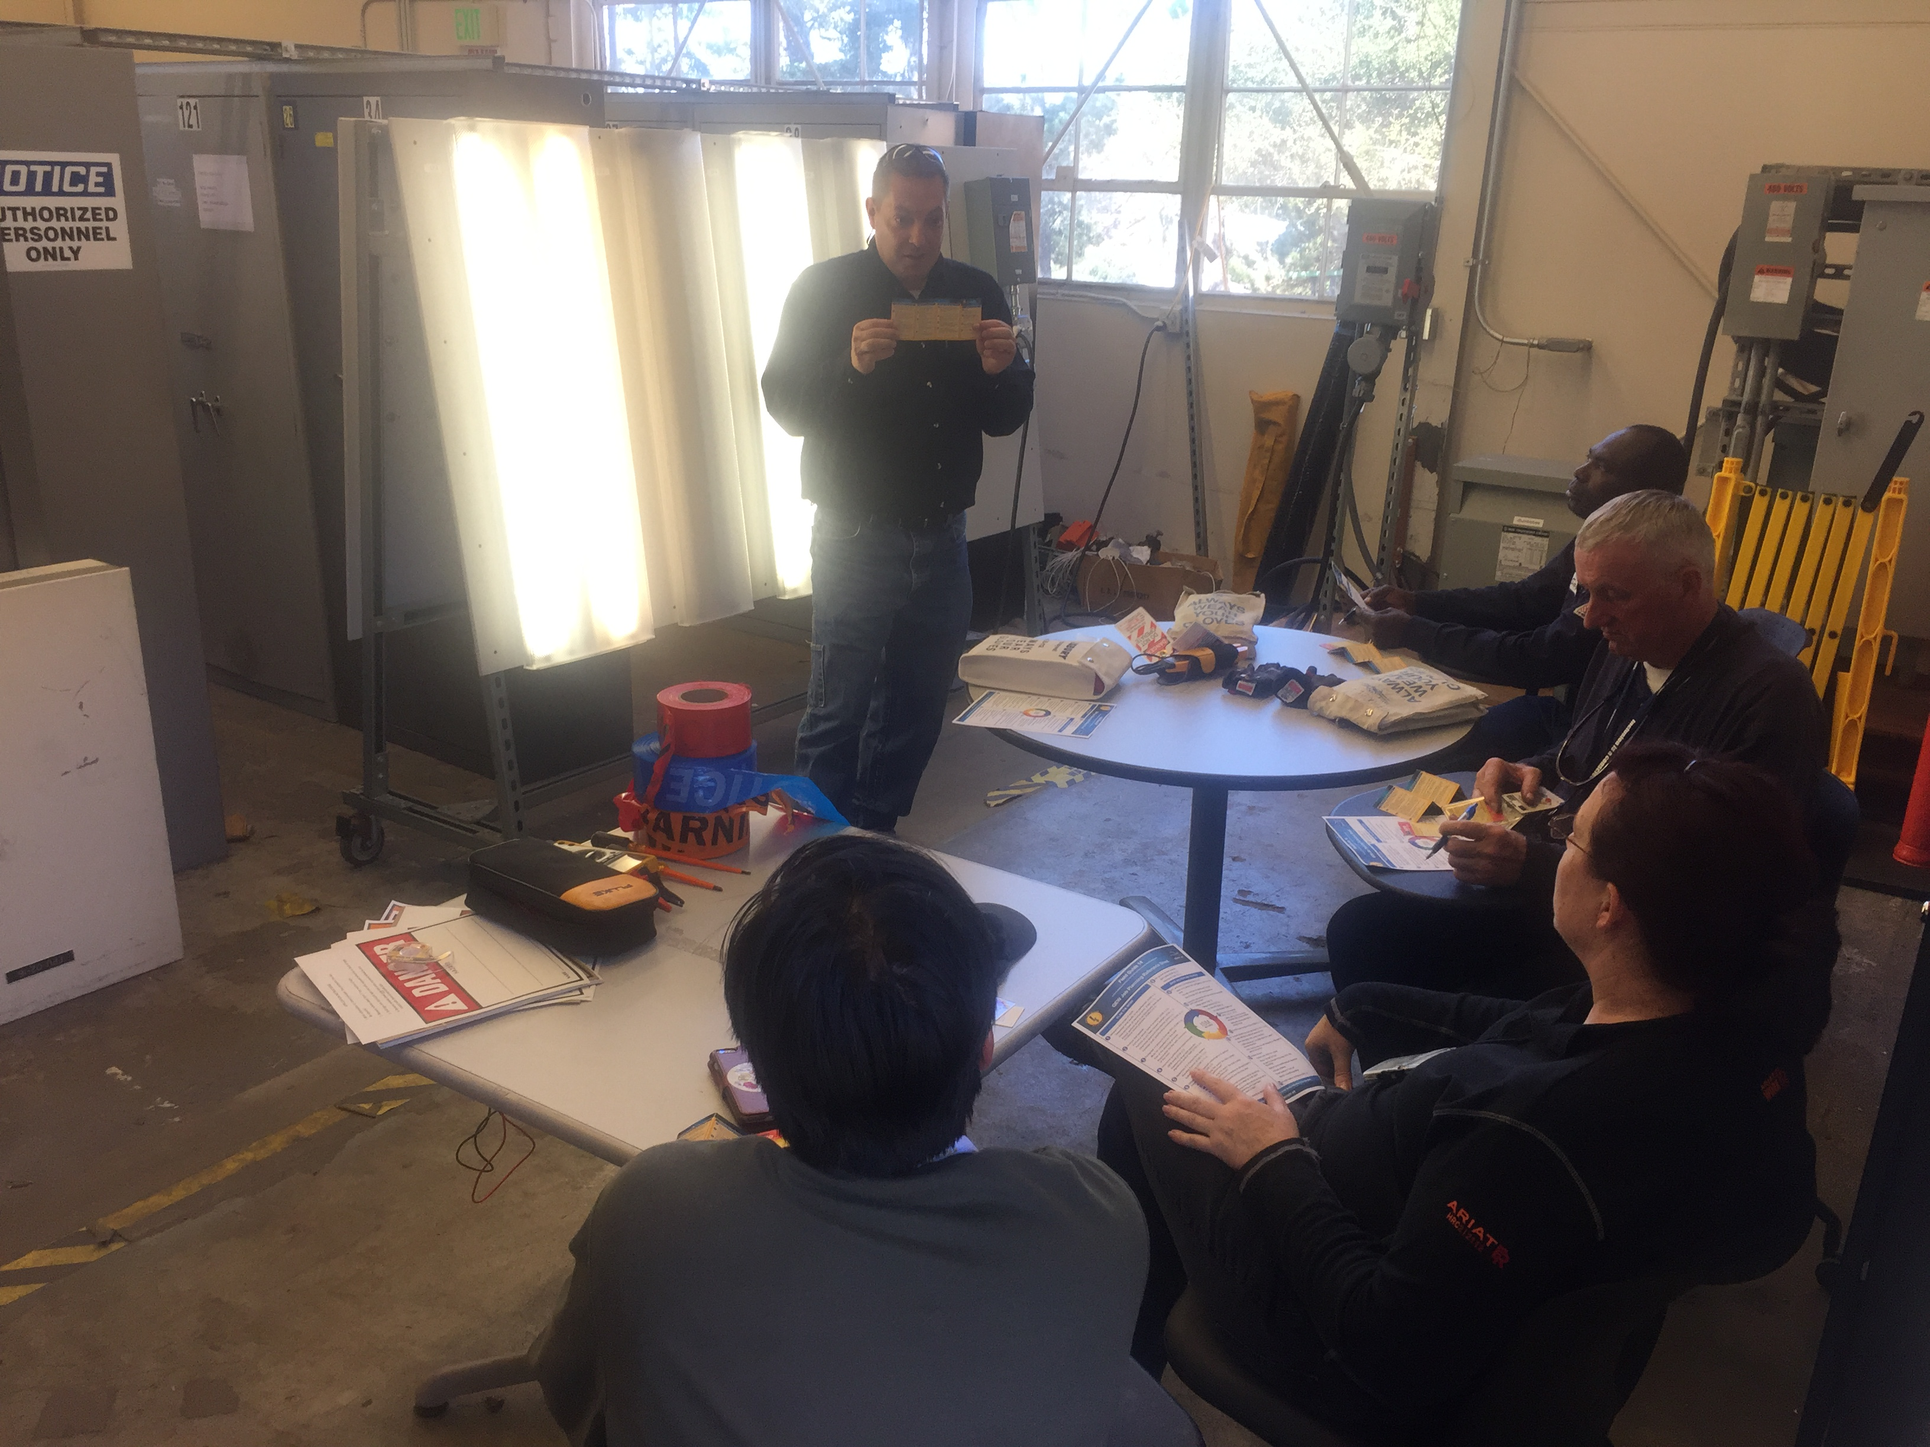
Access to Real Subject Matter Experts
Access to answers is vital in changing beliefs.
Smart people want to know WHY?
A solid program relies on good answers with case studies and examples.
Do NOT rely alone on enforced compliance.

Slide 24
Maintain the Core Basics: Preventing Shock
Non-QEWs:
  Do not perform electrical work
  Report unsafe equipment
QEWs:
  Lockout & Test Before Touch
  Establish and Control Work Space
Management:
  Plan and control the work
  Correct unsafe behavior and conditions (accountability)
Notes:
Do the basics, don’t chase

Slide 25
Moving Beyond Just Qualification & Training
Qualification & Training will help address 80-90% of the risk associated with daily tasks.
Work Planning & Control must address higher complexity.
Supervision must be engaged with workers in the field and with work planning.
SUPERVISION
WPC
QUALIFICATIONS
Notes:
Discuss Directorate Electrical Safety Officers

Slide 26
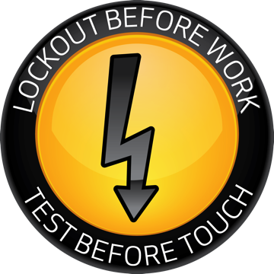
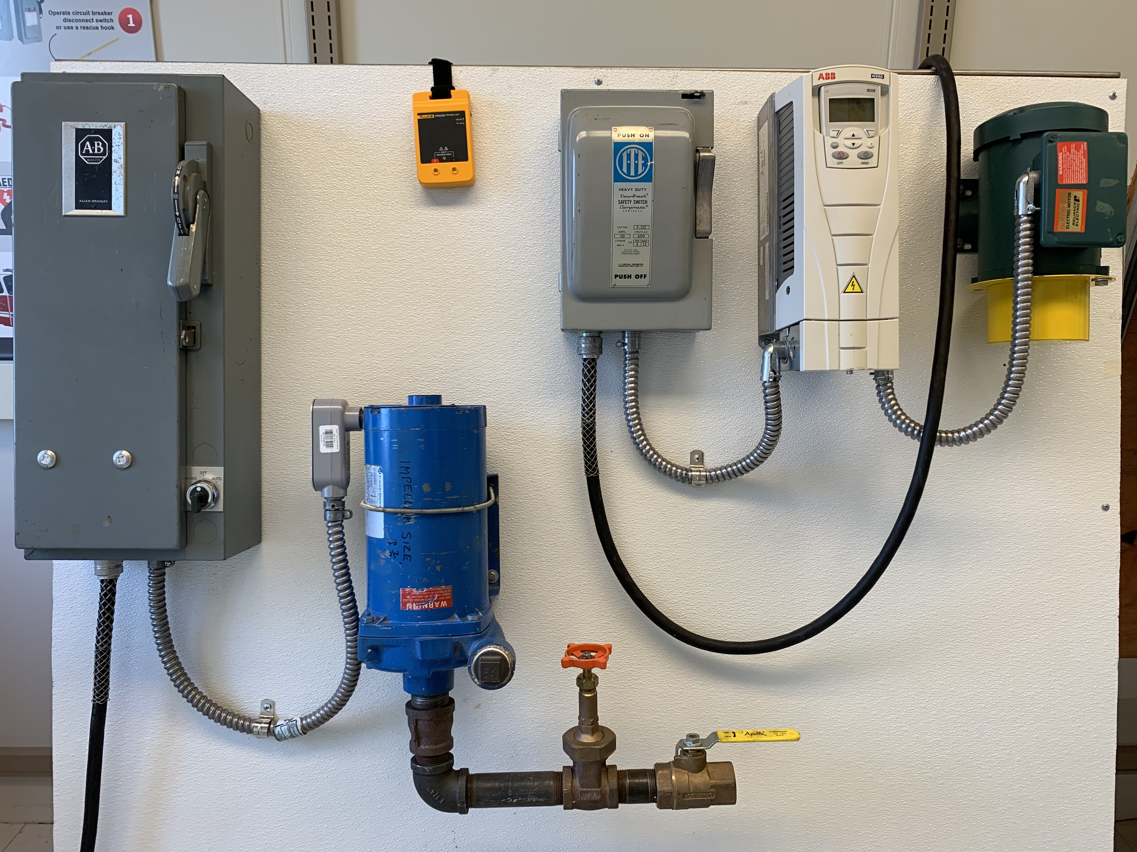
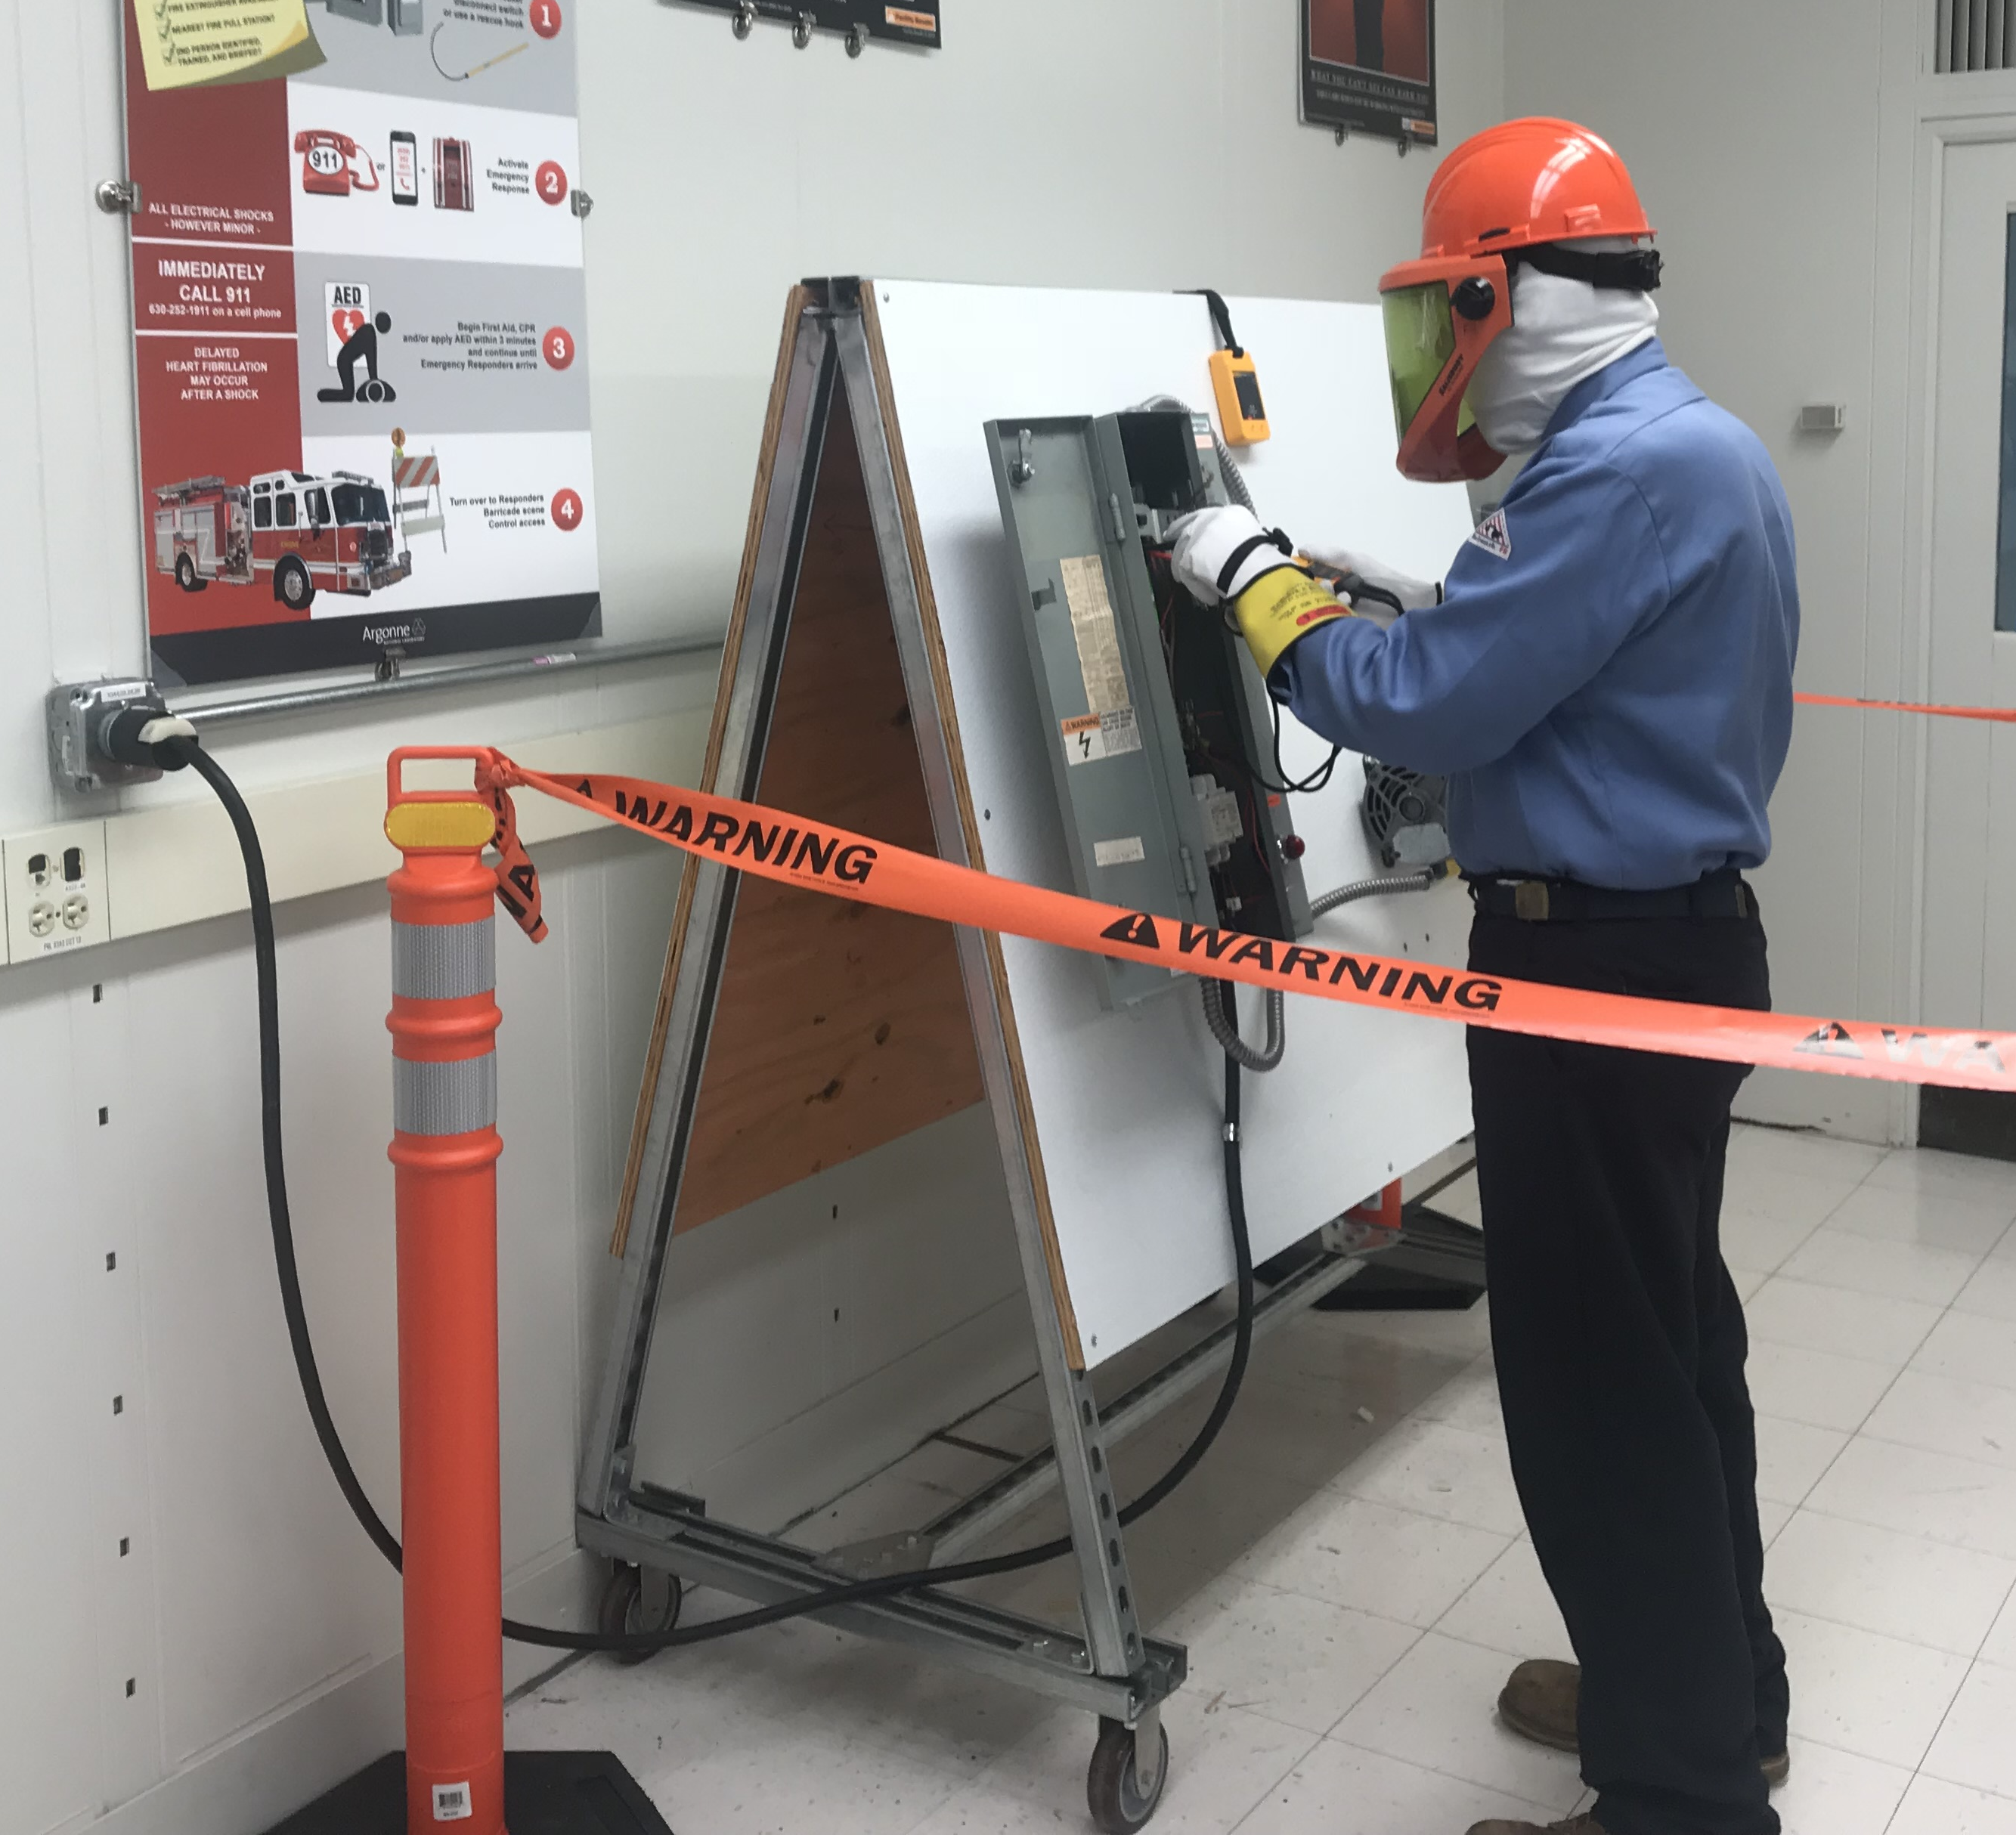
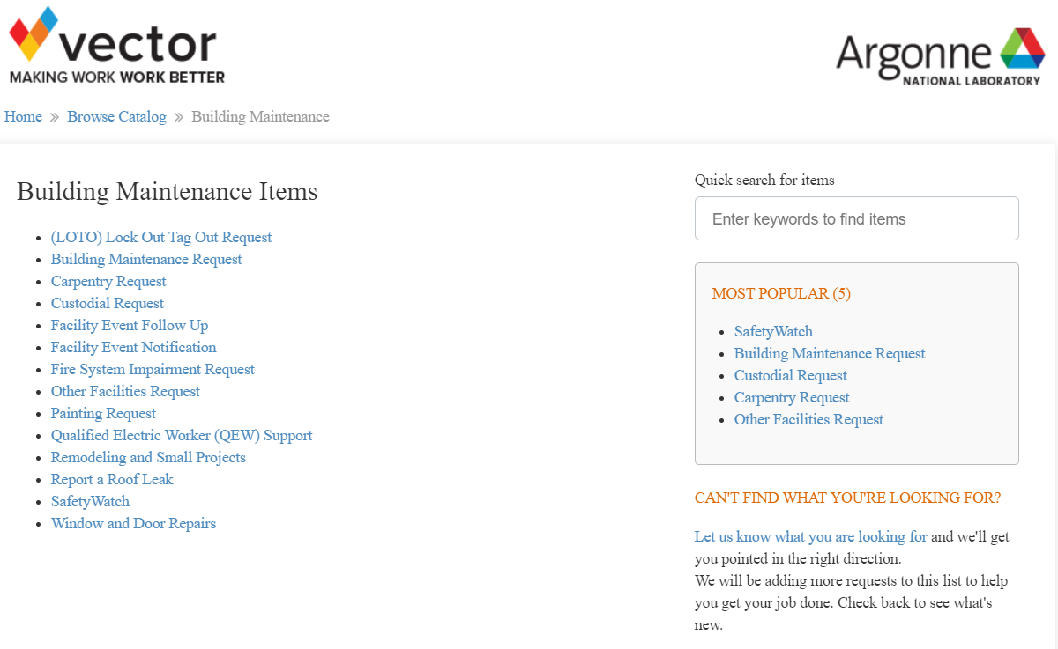
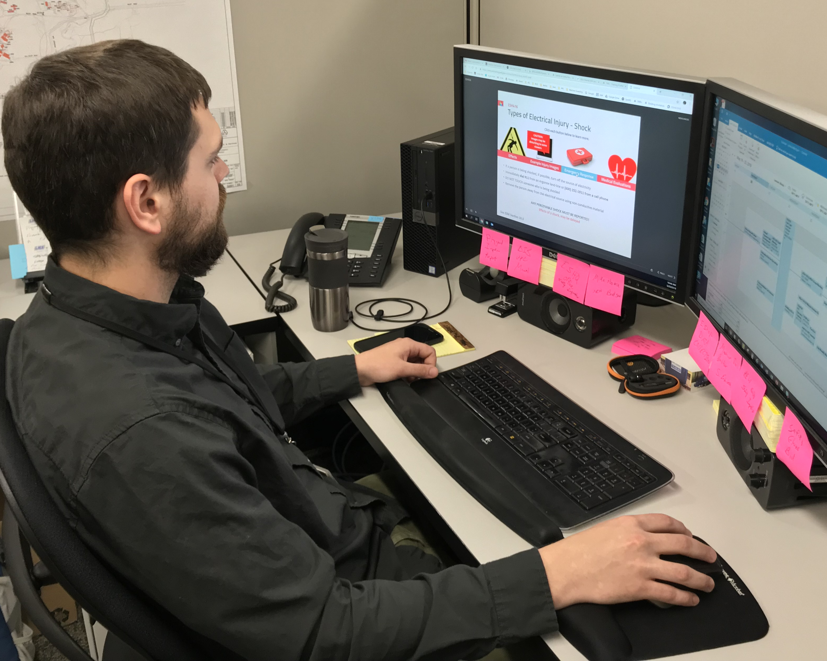
Changing the Electrical Safety Culture
QEWs:
  Lockout & Test Before Touch
    556 days since our last shock
  Establish and Control Work Space
    800 to 300 QEWs
Management:
  Plan and control the work
    WPC Revamp
    QEW Sup Training for 148 personnel
  Correct unsafe behavior & conditions
    Management commitment
Non-QEWs:
  Do not perform electrical work
    QEW & LOTO Support Program
  Report unsafe equipment
    Hired Electrical Inspector
Notes:
QEWs:
Lockout & Test Before Touch
800 to 300 QEWs
Assigned 4 Deputy AHJs for Electrical Safety (Safe Work Practices, Installations, Safe Equipment, High Voltage and Utilities
Improved Training with classroom, instructor led demonstrations, and hands on practical
90% approval rating of QEW courses as assessed during rollout in FY19 (independent assessment)
92% retest passing rate in CY19
Establish and Control Work Space
459 days since last shock
116 Battery Trained, 232 Capacitor Trained
13 Electrical SMEs to provide guidance (more help!)
Management:
Plan and control the work
WPC, QEW Sup Training for 148 personnel
Purchase of Remote Racking
Supervisor Approval for electrical work and troubleshooting
Correct unsafe behavior & conditions (accountability)
E-CARB
ANL-1205, Field Observations Guide
Electrical Safety Assessment Management is engaged and driving the culture
Lessons Learned and Safety Shares
9 Spot Awards or Pace Setters for Electrical
Completed 70 Corrective Action Plan Items
Non-QEWs:
Do not perform electrical work
Electrical SMEs to help determine
Clear definition of electrical work
Improved training for Electrical Safety Awareness Training, Basic and Advance delivered on May 31, 2019
Report unsafe equipment
Hired a full time electrical inspector
Building Operations Team as a resource.
Completion of 72 corrective action plan items
All but 2 are considered effective through Electrical Safety Assessment

Slide 27

Questions?

