Slide 1
ASW 2019 Electrical Incidents
Keith Jobe-Ian Evans

Slide 2
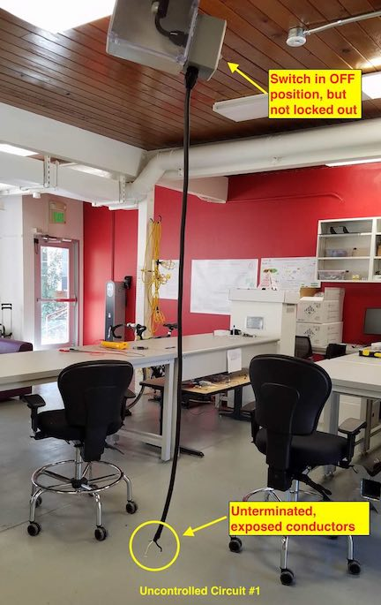
Electrical Incidents

Slide 3
Electrical Incidents
Electricians noticed two electrical cords with unterminated and exposed conductors hanging from junction boxes. One of the cords was connected to a switch mounted to the side of the junction box, while the other cord had a switch installed in-line with the cord.
The electricians observed that both of the switches were in the off (open) position, and they used a non-contact voltage detector to determine that no voltage was present on the load side of the switches and the exposed conductors at the end of the cords.
The electricians were concerned that this was an unsafe condition, as the unterminated and exposed conductors could be energized simply by turning on the switches.

Slide 4
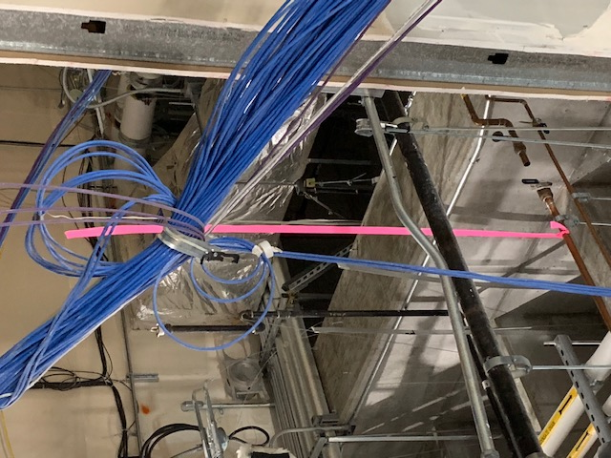
Electrical Incidents
?

Slide 5
Electrical Incidents
A demolition subcontractor working on the LCLS-II NEH reconfiguration project cut through a conduit containing an energized 480V circuit. The worker saw a spark and immediately stopped cutting. The worker was using a double insulated saw and did not experience an electrical shock or injury.
The demolition subcontractor saw that Conduit A was marked with orange paint to indicate that it was ready for demolition.
Here’s where it gets interesting…...

Slide 6
Electrical Incidents
At SLAC subcontractors are not allowed to isolate electrical systems. That task is performed by SLAC Electricians.
What failed:
The conduit in question was one of many that were ceiling mounted and went behind a large HVAC duct. The electrician went to the other side of the obstruction and mis-identified the continuation of said conduit, marking a different conduit with orange paint. During demolition activities, the demo worker proceeded as instructed, saw cutting conduit with orange markings, assuming the circuit had been de-energized by SLAC personnel.

Slide 7
New Installation – Crossed Conduit

Slide 8
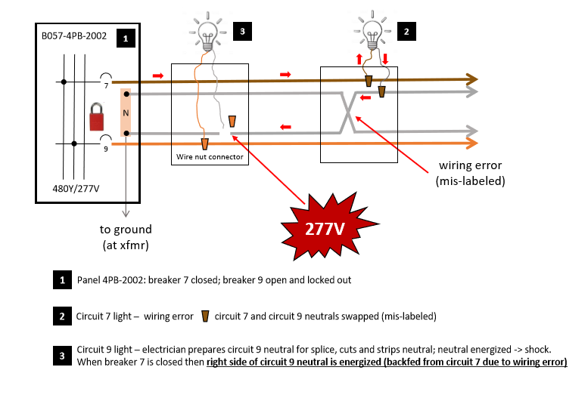
New Installation –Crossed Neutral

Slide 9
Summary & Questions
There are other instances of cut wires, crossed lines, failure to execute LOTO correctly.
Electrical work and installations remain a high visibility risk to SLAC.
Ongoing efforts are being looked at to improve the QA for new installations.
Questions?

