Slide 1
Implementation of DOE-STD-6004 on Clearance and Release of Personal Property from Accelerator Facilities at SLAC
Sayed Rokni, Jim Allan, Ryan Ford, Olga Ligeti James Liu, and Henry Tran
DOE Accelerator Safety Workshop, September 10-12, 2019
Oak Ridge National Laboratory, Oak Ridge, Tennessee

Slide 2
Topics to Discuss
  DOE-STD-6004-2016
  Clearance program at SLAC
        Tier 1:IFB Releases
        Progress
    Plans for Tier 2 &3 releases
  Summary

Slide 3
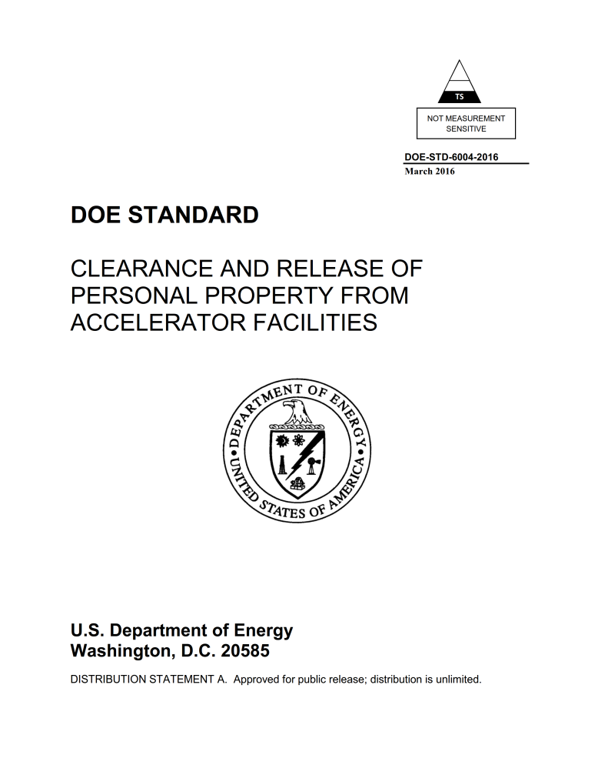
DOE-STD-6004 (2016): 7 Chapters
Purpose and Scope
Introduction
Material Clearance Protocols
Documentation and Reporting Requirements
DOE Independent Verification, Stakeholder Communication
References
Common Acronyms and Definitions
DOE Order 458.1 “Radiation Protection of the Public and the Environment”, Feb. 2011 (chg 3, January 2013)
ANSI N13.12 “Surface and Volume Radioactivity Standards for Clearance”, May 2013
Notes:
RevCom in May 2015
70 pages coveer to cover ; 64 pages

Slide 4
DOE-STD-6004 (2016): 5 Appendices
4
Rationale for Endorsement of ANSI N13.12-2013 SLs as DOE Pre-Approved Authorized Limits
Process Knowledge for Volumetric Activation in Accelerator Facilities
Technical Basis for Volumetric Activation at Electron Accelerator Facilities
Technical Basis for Volumetric Activation at Proton Accelerator Facilities
Technical Basis for Measurement Methods of Volumetric Radioactivity and Determination of Detection Capabilities
Appendices C and D: “proxy” radionuclides in materials are identified for effective measurements in the field

Slide 5
Tier 1 Clearance Criterion (IFB) for Volumetric Radioactivity
Basis, Requirements, Usage | DOE Approval
DTs < SLs Measurements are IFB (material has no detectable radioactivity other than background) IFB releases satisfy paragraph 4.k(3)(a) of O458.1 IFB is the preferred clearance criterion No radiological control is warranted and is already ALARA | Approval for releases is not needed, if the releases are covered by the scope of the site’s material clearance program
DT: Detection Threshold

Slide 6
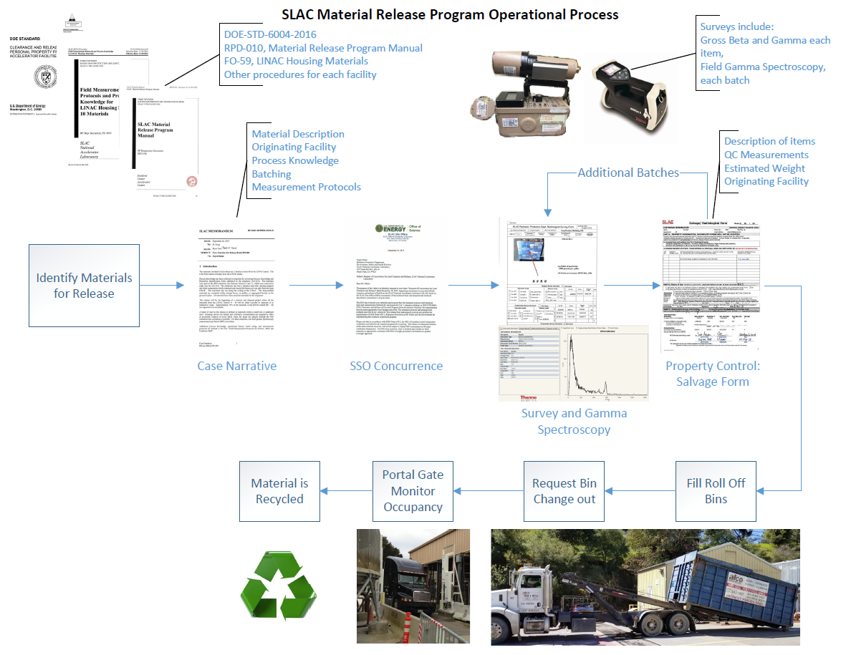
SLAC Material Clearance Program and Process
Notes:
Clearance: Removal of personal property that contains or may contain residual radioactive material from DOE radiological control.
Release: Process that material has gone through the clearance process and is released off-site or on-site from radiological control
Detection Limit (DL): The smallest amount of radioactivity (in pCi/g for volumetric radioactivity measurements, or dpm / 100 cm² for surface contamination) that can be detected and quantified by a measurement method.
Detection Threshold (DT): The instrument signal level (in cpm, μR/h, etc.) associated with a determination that a measurement is different than background
Indistinguishable from Background (IFB): The absence of detectable radioactivity, as determined by measurement methods.
Process Knowledge: A collective, objective description of the physical, operational, administrative, and radiological conditions associated with material being considered for clearance such that a reasonable and defendable decision can be made regarding whether the material could or could not have become activated or contaminated.

Slide 7
Lessons Learned
An activated steel threaded rod was found by Radiation Protection (RP) staff during survey of a metal recycle bin
Two pieces of activated concrete were found in the construction debris bin next to the recycle bin
Radiological survey of bins by RP, and screening through Portal Gate Monitor are part of the requirements under SLAC Clearance program
Defense-in-depth approach is necessary
Need to manage containers in a manner to prevent the addition of radioactive materials
Portal gate monitor as a barrier of defense provides additional assurance

Slide 8
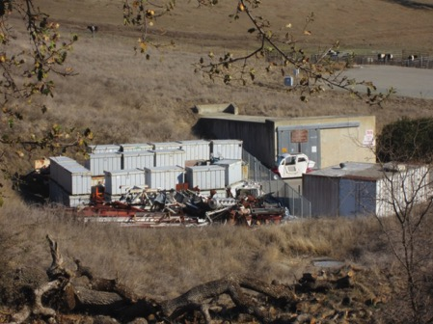
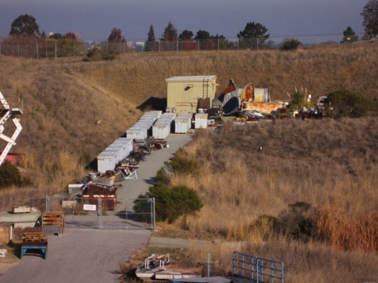
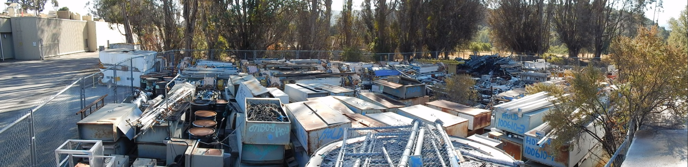
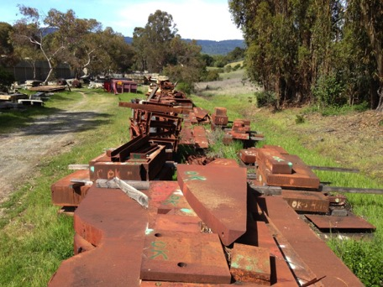
Excess Metal Accumulated at SLAC (before release)
Notes:
Steel/iron , concrete (with attached metal), aluminum, copper , wire, electronics
Covered-storage capacity for larger objects is exhausted. The excess items are being stored outdoors

Slide 9
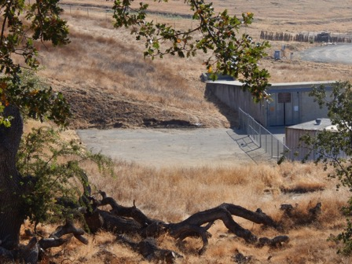
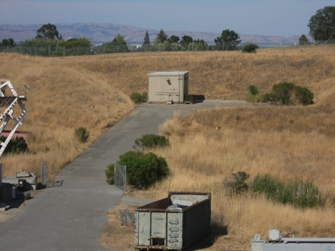
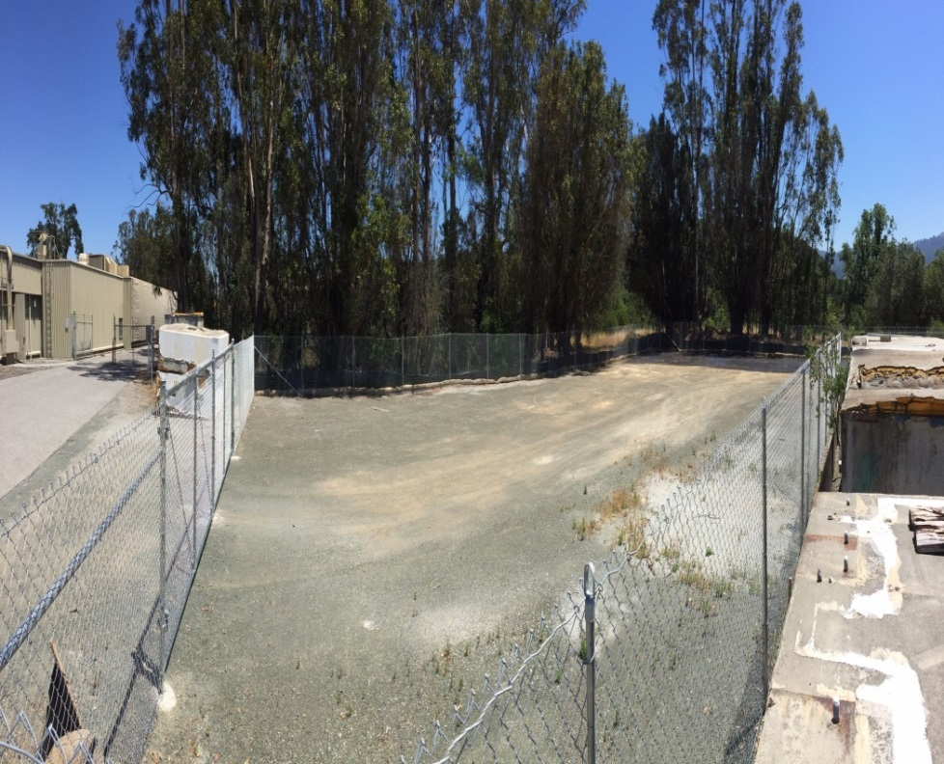
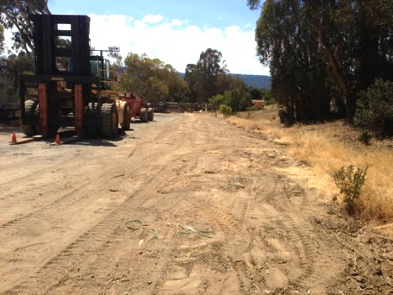
Excess Metal at SLAC (after release)
Notes:
Steel/iron , concrete (with attached metal), aluminum, copper , wire, electronics
Covered-storage capacity for larger objects is exhausted. The excess items are being stored outdoors
3528 tons , $1,479,318 loads

Slide 10
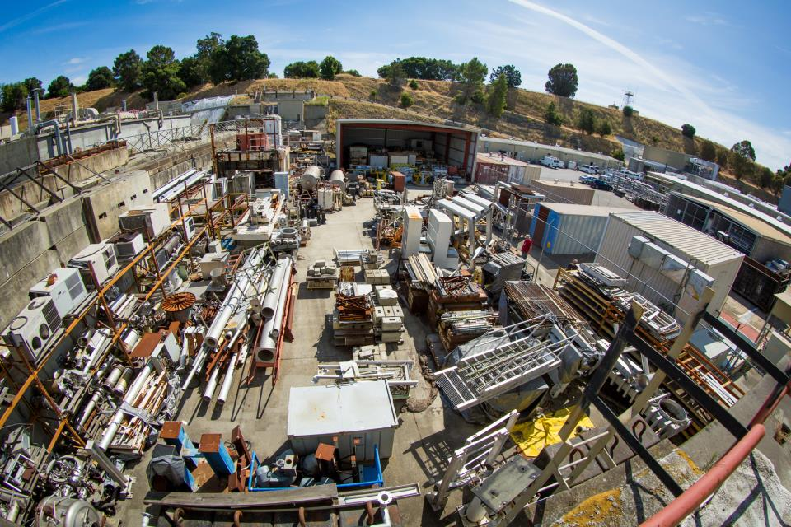
Beam Dump East Yard (Legacy Materials)

Slide 11
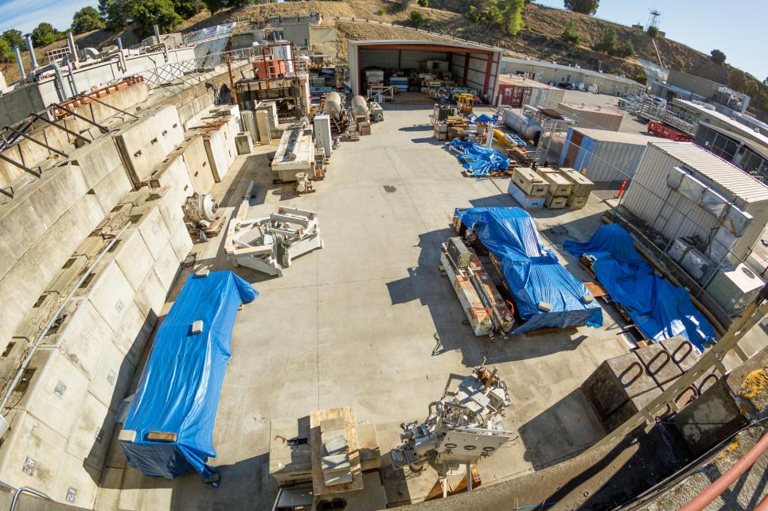
Beam Dump East Yard (Work in Progress)

Slide 12
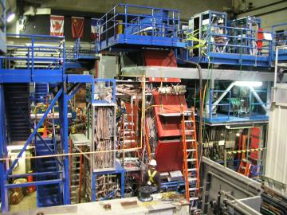
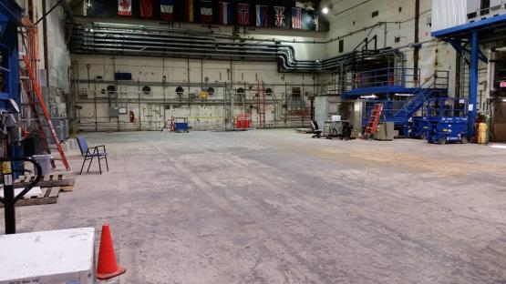
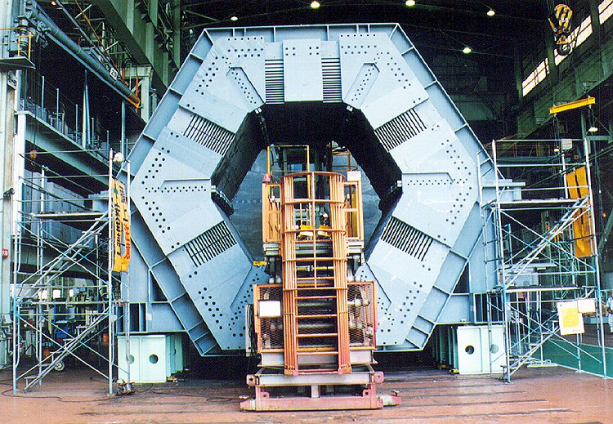
IR-02 – 1249 Tons from BaBar

Slide 13
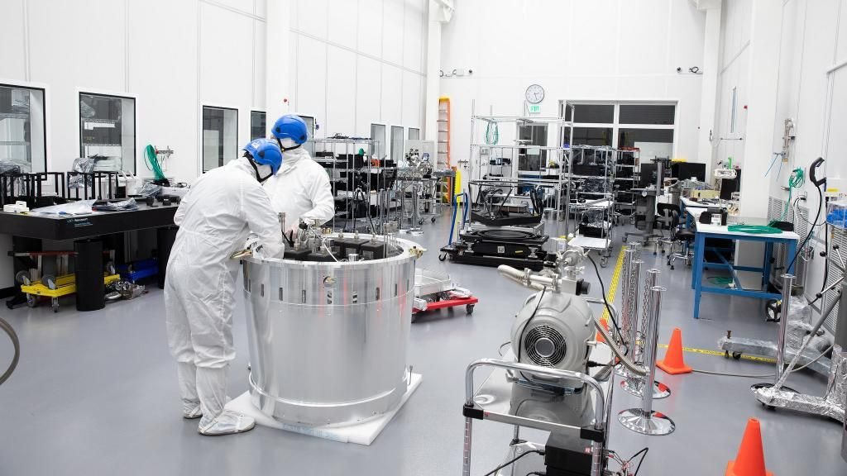
Reuse of IR-02 Hall as Cleanroom

Slide 14
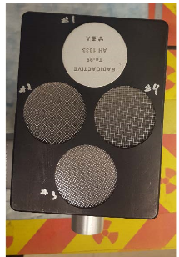
RP Note (RP 17-11) for Clearance of Lead
“Technical Basis and Measurement Methods for Radiological Clearance and Release of Lead at SLAC”
Describes use of Ludlum 44-94 for IFB measurements
Describes sensitivity of 44-94 to key radionuclides, with respect to ANSI screening level
Key radionuclides, Tl-204
Scanning includes 44-2, NaI survey

Slide 15
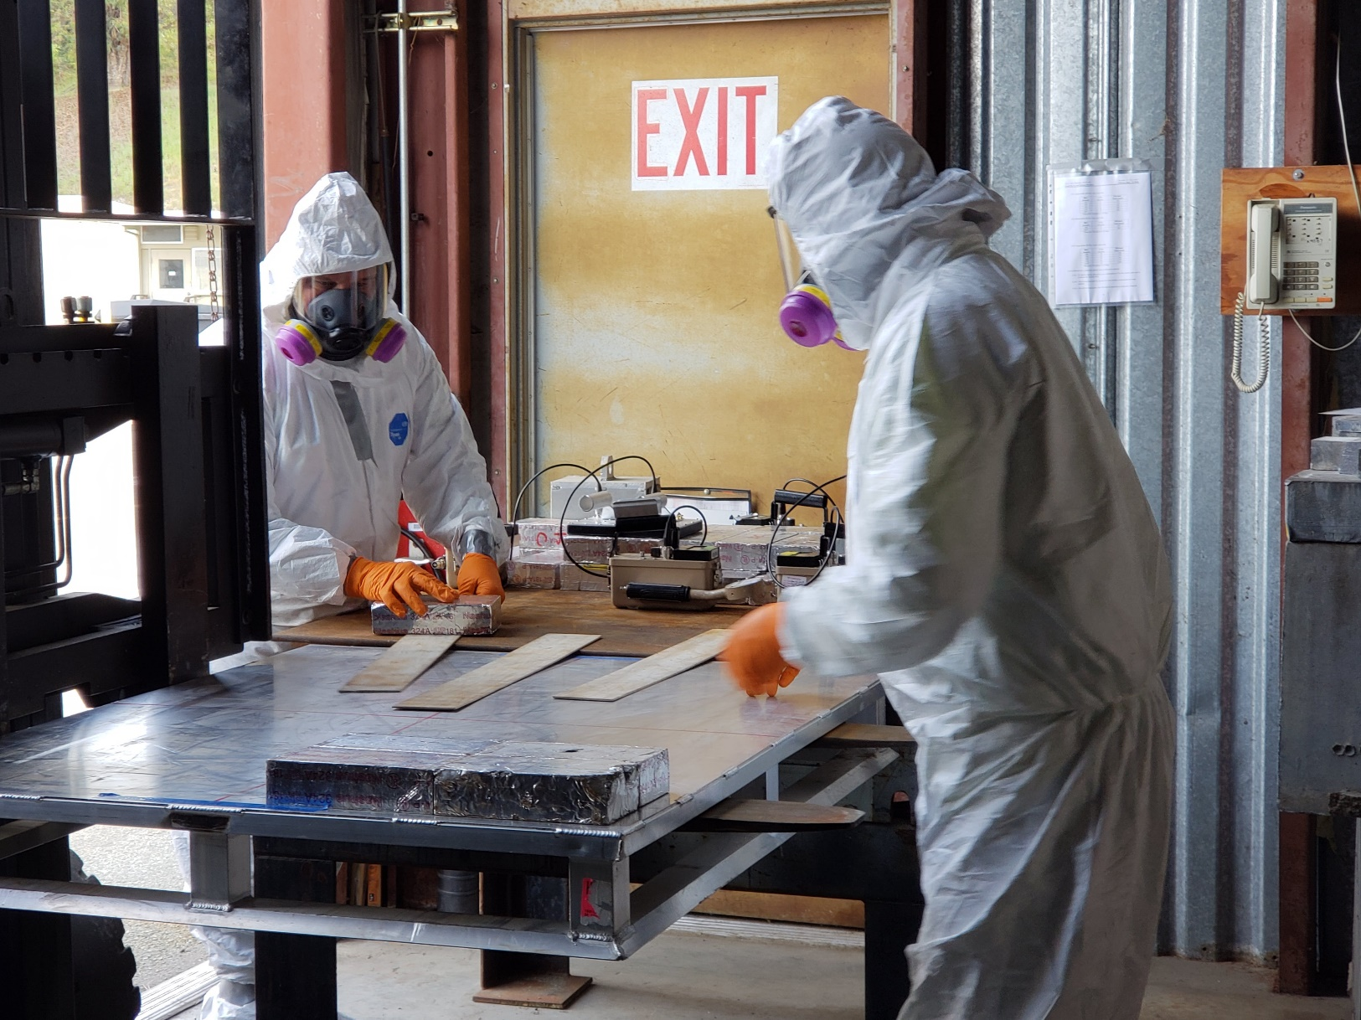
Radiological Survey of Lead
15

Slide 16
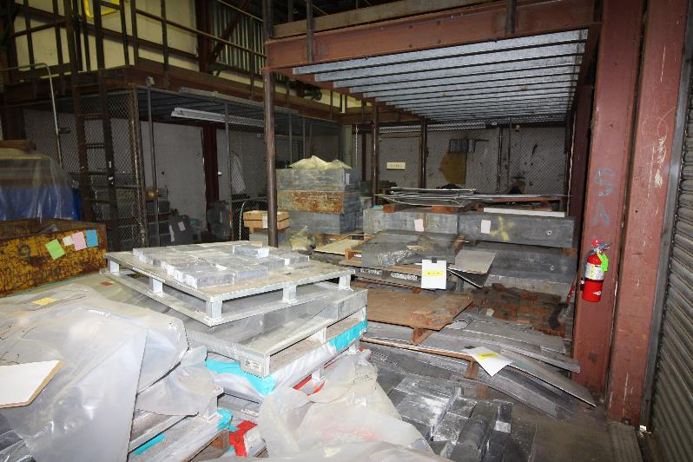
Lead Storage Area Before Cleanup

Slide 17
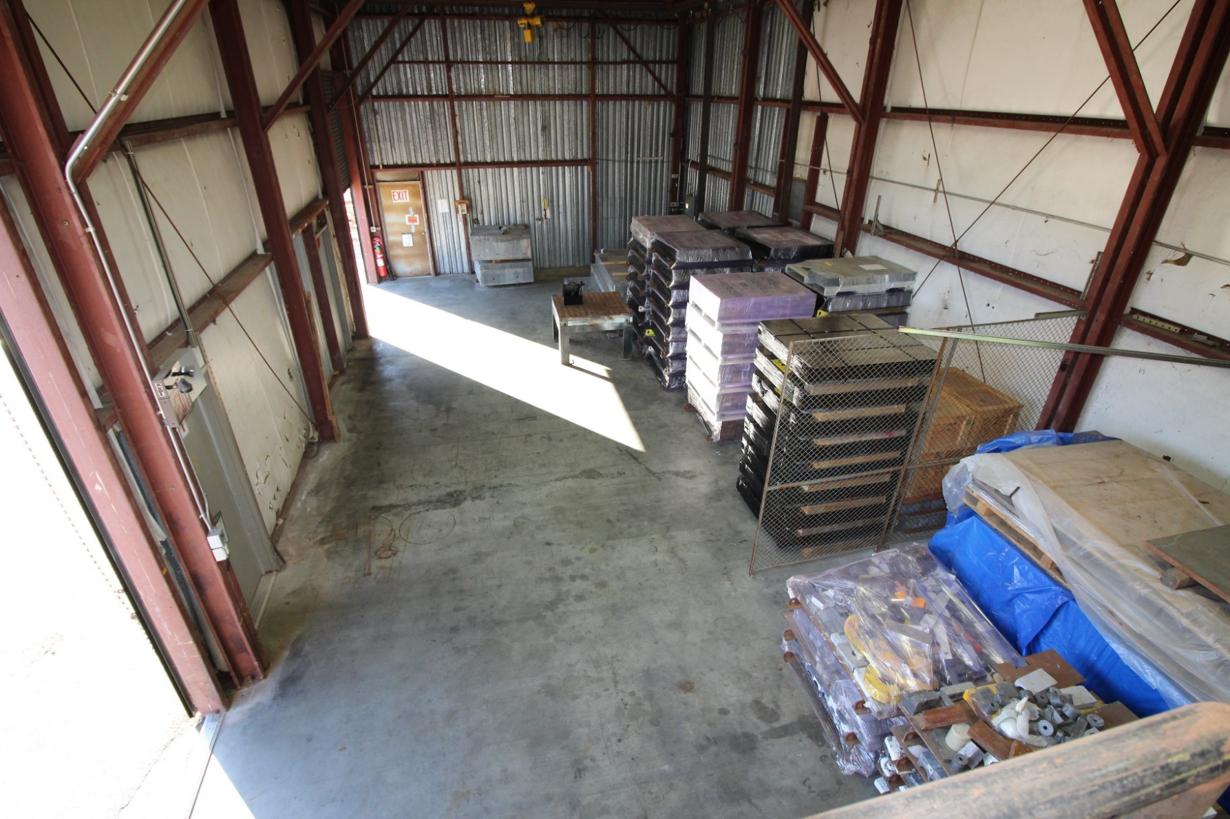
Lead Storage Area (55 tons recycled)

Slide 18
Recycling Weight and Revenue

Slide 19
Tier 2 Clearance Criterion (ANSI N13.12-2013 SLs)
12
Basis, Requirements, Usage | DOE Approval
DLs < SLs Measurements meet SLs (derived based on ANSI dose criterion of 1 mrem/y) Non-IFB release can satisfy paragraph 4.k(3)(b) of O458.1 under certain conditions ALARA analysis is required because materials with detectable radioactivity may be released | SLs are subject to DOE pre-approved AL process DOE Field Element approval of each release plan, which includes a qualitative ALARA analysis
DL: Detection Limit

Slide 20
Tier 2 Release Criterion
13
Tier 2 criterion is releasing materials with detectable radioactivity
More challenging characterization for proxy radionuclides is required:
      Spectrometry needed to quantify radionuclide types
      Estimates of radioactivity concentration (Bq/g)
Process to estimate the hard-to-measure radionuclides needs to be established
Reporting requirements: ∑_{i} (Ai / SLi) ≤ 1
May need to recycler site’s PGM alarms
Stakeholder communication (ASER, state, recycler, etc.)
Even more critical that community takes a consistent approach

Slide 21
Tier 3 Clearance Criterion: > ANSI 13.12 SLs
Basis, Requirements, Usage | DOE Approval
Follow DOE AL process to obtain approval for release under a site-specific Authorized Limits. Mainly for restricted release. | DOE approval of the clearance criterion as AL. DOE Field Element approval of each release plan, which includes a quantitative ALARA analysis and notification of DOE program elements and EHSS consistent with O458.1

Slide 22
Summary
DOE Technical Standard DOE-STD-6004 provides accelerator facilities an acceptable approach for release of personal property
The standard is designed to address DOE direction on improving monitoring and release programs and DOE metal hold policies
It includes processes and requirements that support implementing DOE O 458.1 clearance requirements
Implementation of the Tier 1 of has been important in clearing the site from excess materials, making space available for SLAC mission
Authorized Limit (AL) via DOE Order 458.1 is being pursued as a safe, secure and more economical alternative to dispose Tier 2 and Tier 3 low activity materials

Slide 23
Thank You

Slide 24
ANSI N13.12-2013 Screening Levels (SLs)
24
Radionuclide Group | Surface SL (dpm / 100 cm²) | Volume SL (pCi/g)
Group 1: High-energy gamma, radium, thorium, transuranics, and mobile beta-gamma emitters (e.g., ²²Na, ⁴⁶Sc, ⁵⁴Mn, ⁵⁶Co, ⁶⁰Co, ⁶⁵Zn, ¹²⁵Sb, ¹³⁴Cs, ¹⁵²Eu, ¹⁵⁴Eu) | 600 | 3
Group 2: uranium and selected beta-gamma emitters (e.g., ⁵⁷Co, ⁵⁸Co, ⁵⁹Fe, ¹¹³Sn, ¹²⁴Sb) | 6,000 | 30
Group 3: General beta-gamma emitters (e.g., ⁷Be) | 60,000 | 300
Group 4: Low-energy beta-gamma Emitters (e.g., ³H, ⁴⁵Ca, ⁶³Ni) | 600,000 | 3,000
Group 5: Low-energy beta emitters (e.g., ⁵⁵Fe) | 600,000 | 30,000

Slide 25
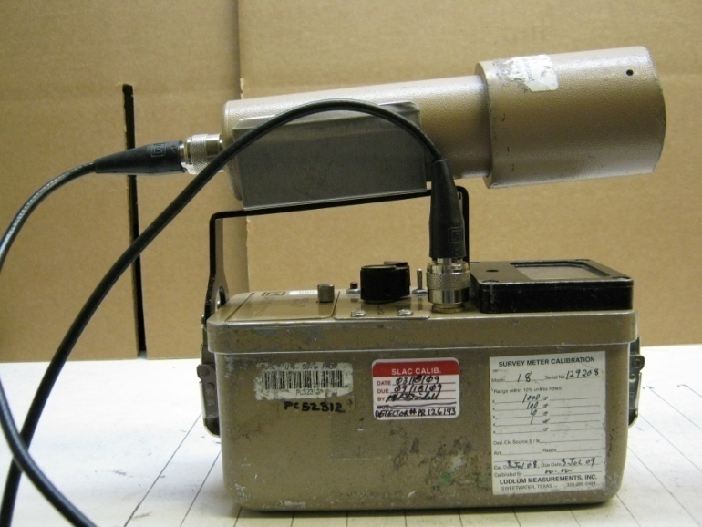
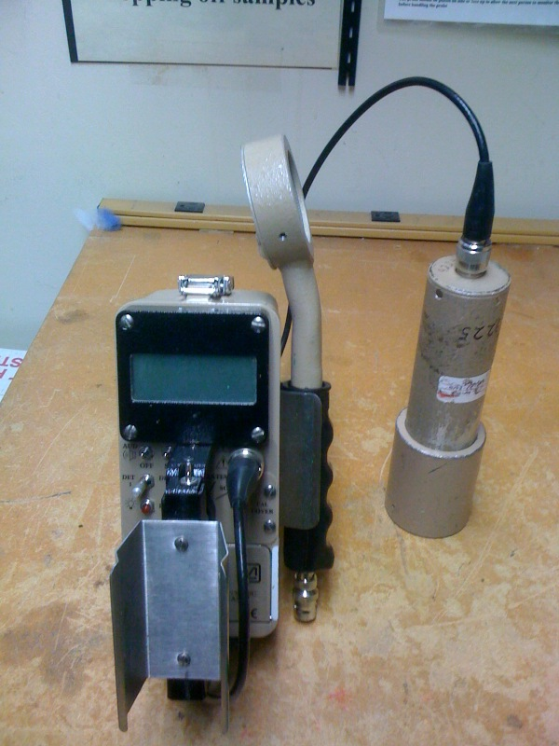
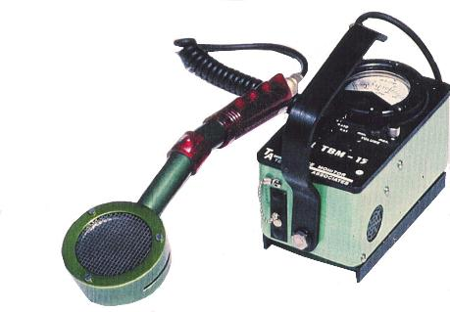
Field Surface Survey Instruments
Ludlum Model 2241 with both a 44-2 detector (1”x 1” NaI) and a GM pancake
Ludlum Model 18 with 44-2 detector
TBM P15

Slide 26
Record Management and Reporting
24
Release Records
    Release decisions (e.g., no potential reuse), authorization, and process knowledge, if any (conditions of accelerator, facility and/or materials)
    Survey results
      Large items are individually identified, surveyed, and recorded.
      Small items are individually surveyed, and collectively identified and recorded.
    Instruments, background signals, surveyor, date/time of survey
    Photos may be used.
    Survey and measurement procedures
    Training records for survey technicians
Reporting
    ASER
    Amounts and types of materials released

Slide 27
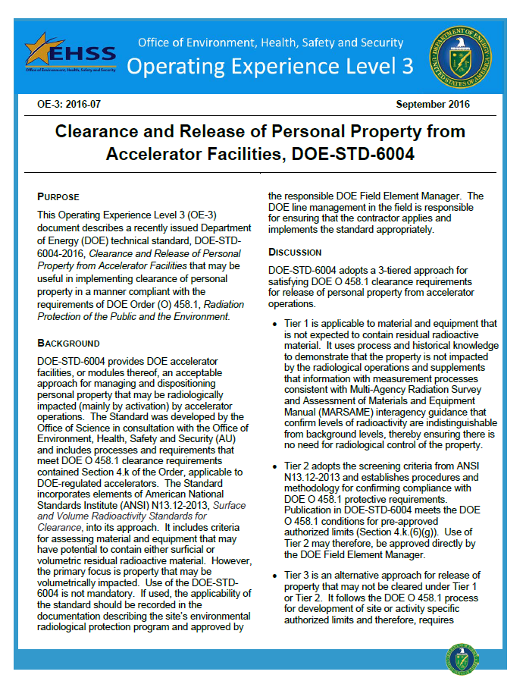
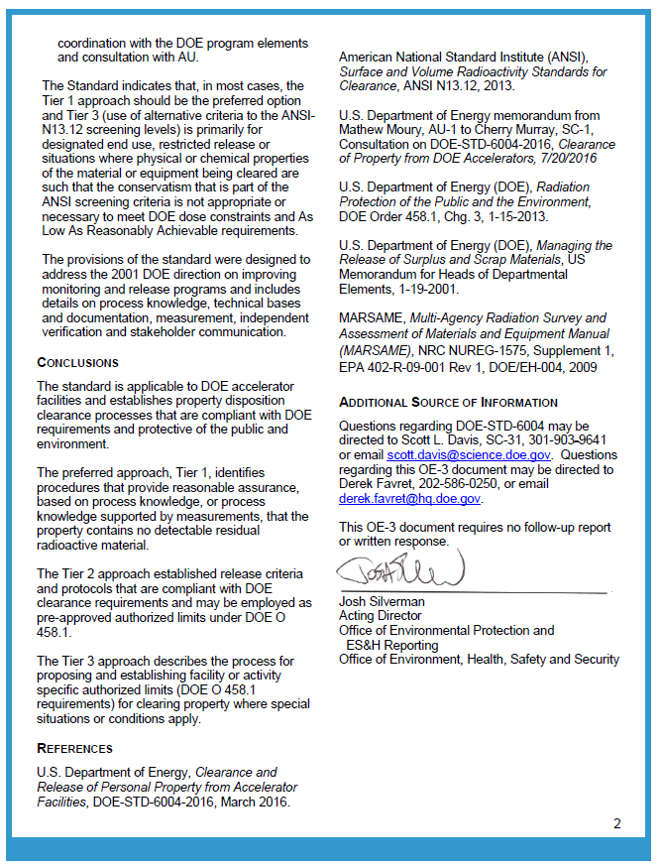
DOE EHSS Operating Experience Level 3 (OE-3: 2016-07)
6
Notes:
Clearance: Removal of personal property that contains or may contain residual radioactive material from DOE radiological control.
Release: Process that material has gone through the clearance process and is released off-site or on-site from radiological control
Detection Limit (DL): The smallest amount of radioactivity (in pCi/g for volumetric radioactivity measurements, or dpm / 100 cm² for surface contamination) that can be detected and quantified by a measurement method.
Detection Threshold (DT): The instrument signal level (in cpm, μR/h, etc.) associated with a determination that a measurement is different than background
Indistinguishable from Background (IFB): The absence of detectable radioactivity, as determined by measurement methods.
Process Knowledge: A collective, objective description of the physical, operational, administrative, and radiological conditions associated with material being considered for clearance such that a reasonable and defendable decision can be made regarding whether the material could or could not have become activated or contaminated.

Slide 28
DOE Order 458.1 4.k Release and Clearance of Personal Property
11
4.k.(3) Residual Radioactive Material. Property potentially containing residual radioactive material must not be cleared from DOE control unless either:
(a) The property is demonstrated not to contain residual radioactive
material based on process and historical knowledge, radiological
monitoring or surveys, or a combination of these; or
(b) The property is evaluated and appropriately monitored or surveyed
to determine:
    1. The types and quantities of residual radioactive material within the property;
    2. The quantities of removable and total residual radioactive material on property surfaces (including residual radioactive material present on and under any coating);
    4. That any residual radioactive material within or on the property is in compliance with applicable specific or pre-approved DOE Authorized Limits.
DOE-STD-6004 Tier 1: IFB
DOE-STD-6004 Tier 2: ANSI N13.12 SLs
Notes:
Clearance: Removal of personal property that contains or may contain residual radioactive material from DOE radiological control.
Release: Process that material has gone through the clearance process and is released off-site or on-site from radiological control
Detection Limit (DL): The smallest amount of radioactivity (in pCi/g for volumetric radioactivity measurements, or dpm / 100 cm² for surface contamination) that can be detected and quantified by a measurement method.
Detection Threshold (DT): The instrument signal level (in cpm, μR/h, etc.) associated with a determination that a measurement is different than background
Indistinguishable from Background (IFB): The absence of detectable radioactivity, as determined by measurement methods.
Process Knowledge: A collective, objective description of the physical, operational, administrative, and radiological conditions associated with material being considered for clearance such that a reasonable and defendable decision can be made regarding whether the material could or could not have become activated or contaminated.

Slide 29
Clearance Criteria in DOE-STD-6004 (2016)
5
  Volumetric radioactivity: 3-tiered clearance criteria related to ANSI N13.12-2013 Volume Screening Levels (SLs in Bq/g):
    Indistinguishable from Background (IFB)
      Material has no detectable radioactivity other than ambient background
      A level lower than the SLs
      Meet DOE O 458.1 4.k(3)(a) and is preferred clearance criterion
      Measurement methods shall have sufficient detection capability to provide reasonable assurance that M&E released on the basis of this criterion satisfy the 1 mrem/y dose constraint in O458.1.
    ANSI N13.12-2013 SL as Clearance Criterion
      Can satisfy paragraph 4.k(3)(b) of O458.1
    Higher than ANSI N13.12-2013 SLs
        Follows DOE AL process; mainly for restricted release
  Surface contamination: criterion approved in O458.1 (e.g., 10 CFR 835 surface contamination guideline until ANSI N13.12 surface SLs (in dpm /100 cm²) are approved

