Slide 1
System Engineer Training at SNS
Jacob Platfoot
Accelerator Safety Workshop 2019

Slide 2
Background and Overview
Internal audit of configuration management program identified system engineer training as “Notable Practice”
Purpose of System Engineer program
Training approach
Benefits to the Accelerator Safety Program

Slide 3
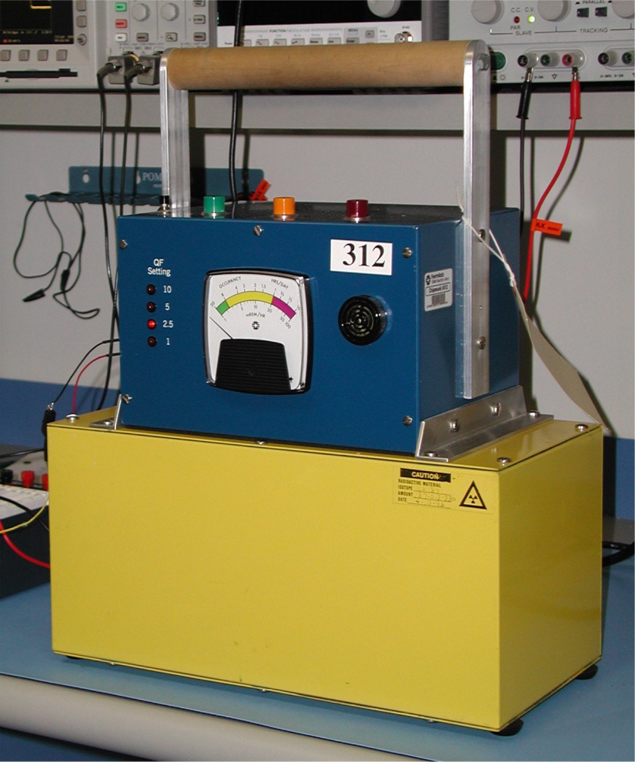
Need for the System Engineer Program
The SNS ASE relies primarily on Engineered Controls (CECs)
  9 active systems
  12 passive systems
These systems utilize a wide variety of designs
  Active – PLC-based, relay-based, fire suppression systems
  Passive – concrete and steel structures, piping and pressure vessels, ventilation, fire barriers, pressure relief devices
Two accelerator safety engineers
  Not practical to become system experts on all CECs

Slide 4
System Engineer Program
Each CEC has a designated System Engineer
  Qualified through a training course
System Engineer Responsibilities:
  Ensures CEC is maintained compliant with ASE and SAD
  Maintains Configuration Control of CEC
  Subject Matter Expert for USI Evaluations involving the CEC
  Provides technical support for operations and maintenance of CEC
  Cognizant of operational status, planned maintenance and changes
  Cognizant of system history

Slide 5
Training Approach
Formal course tracked in our training system (LRN)
Course has three parts:
  Safety Document Overview
  Required Reading for Specific CECs
  Review of Specific CECs (Knowledge Assessment)
Training is tailored to the specific CEC(s) assigned to the System Engineer

Slide 6
Safety Document Overview
General overview of accelerator safety program
  DOE O 420.2C
  ASE and SAD structure and contents
  USI Process
  Identify all the CECs
  Introduce terminology (active v. passive, engineered v. admin, etc.)
  System Engineer roles and responsibilities
  Initial opportunity for Q&A
  Provide individualized required reading

Slide 7
Required Reading for Specific CECs
Provides a detailed list of all sections in SAD and ASE that refer to the assigned and related CECs
Familiarizes the System Engineer with the credited functions described in the SAD/ASE and the level of detail in descriptions
Prompts the System Engineer to interrogate their system documentation and compare to safety documentation
  Often leads to updates and improvements to SAD
Typically leads to more detailed Q&A to clarify and understand exactly what the safety documentation is saying

Slide 8
Review of Specific CECs (Knowledge Assessment)
Focused interview between System Engineer and Accelerator Safety Engineer(s).
Provides a forum for further Q&A about safety documents
Provides a knowledge assessment to ensure the System Engineer understands the CEC’s safety role
  Typically the selected individuals are already the SMEs on the system itself
Final sign off by both System Engineer and Accelerator Safety

Slide 9
Benefits of System Engineer Training
Significantly improves institutional awareness and understanding of Accelerator Safety Program requirements
Installs a key lookout to implement the USI Process
Improves the accuracy and completeness of safety documents (SAD and USI Evaluations)
Grows the System Engineer’s understanding of the system requirements to streamline the design change process
Provides an opportunity for early contact with new hires
Great starting point to become a Qualified USI Preparer
  All (10) current System Engineers are Qualified

Slide 10
Challenges and Obstacles
Need buy-in from line management
  Takes up-front time investment from a key resource
  Pay-off isn’t always obvious or forthcoming
Engineers often push back on level of conservatism
It’s one more thing to do and manage
Worth it!

Slide 11

Questions?

