Slide 1
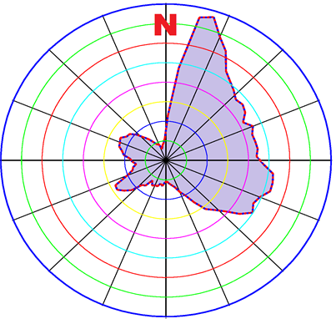
Use of fine-grained meteorological data for environmental hazard assessments DOE Accelerator Safety Workshop 2019 September 10-12, 2019
Joe Mildenberger
Head, Radiation Protection Group, TRIUMF

Slide 2
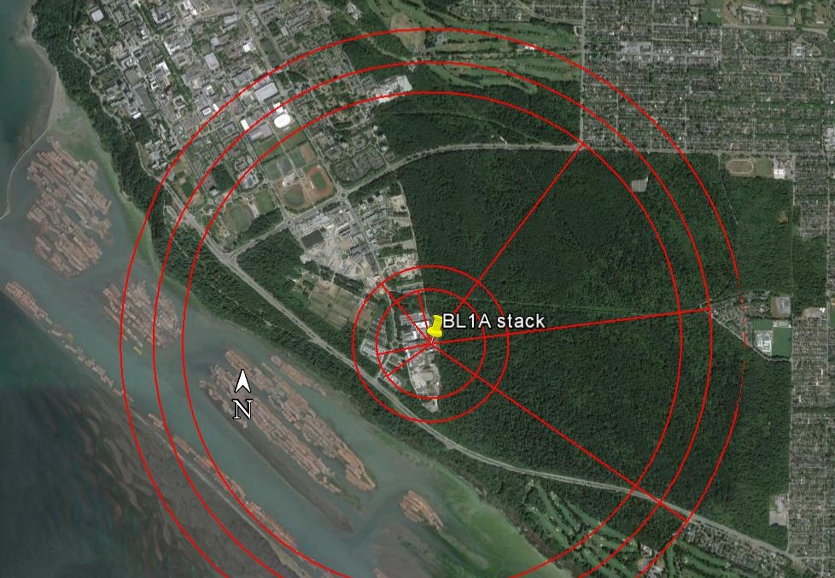
TRIUMF basics
South end, UBC campus
520 MeV sector-focused cyclotron
Materials studies (μ;π)
Medical isotope production
p, n irradiation facilities
Ultra Cold Neutron facility
Driver for ISAC ISOL facility
Four small medical isotope cyclotrons
Life Sciences research: 13 MeV
Commercial (BWXT): 42 MeV; 30 MeV (x2)
35 MeV superconducting e-linac: driver for ARIEL-II ISOL facility (under construction)
Soon: 24 MeV cyclotron (medical Isotopes); addition 520 MeV proton beam as second driver for ARIEL-II.
Nearest residents: 500m from most active stack; non-TRIUMF workers: 350m

Slide 3
CNSC Operating license requirements for Environmental Protection
CNSC = “Canadian Nuclear Safety Commission”
“TRIUMF shall establish and maintain Derived Release Limits (DRL) in accordance with CSA standard N288.1-14, Guidelines for calculating derived release limits for radioactive material in airborne and liquid effluents for normal operation of nuclear facilities, and shall monitor and control radiological emissions to ensure they remain ALARA with respect to these DRLs.”
N.b. CSA = “Canadian Standards Assn.”, non-profit developer of standards in 57 areas, including the nuclear power industry and related organizations, e.g. TRIUMF (cf. UL, ANSI, ISO, etc.)

Slide 4
Background
Principal improvements: 5y (2010-2014) of on-site weather data Previous data from YVR, ~6 km SW. Very different terrain: sea level, on island in Fraser River delta
Hourly rainfall data from UBC EOS department
More detailed stack data (height; diameter; flow; air temp.), used to construct “effective stack height”
Result: ~44000 independent “DRL atoms”, each one a complete “snapshot” with all necessary ingredients to calculate a multi-component, hourly “downstream dose”

Slide 5
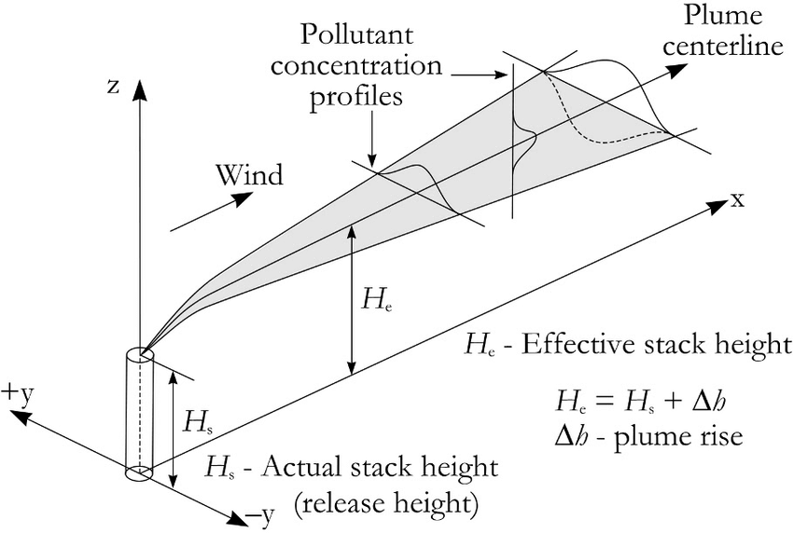
Conceptual model

Slide 6
Standard N288.1-14 formulation for “Gaussian Plume Model”
N288.1-14 formulation for $P_{01}$: Atmospheric dispersion
$${\left(P_{01}\right)}_{j}= \frac{\sqrt{2}}{\sqrt{π} x_{d}∆θ}\sum_{i,k}{\left[\frac{F_{ijk}D_{k} }{u_{k}Σ_{zi}}exp\left(\frac{−H_{ik}^{2}}{2Σ_{zi}^{2}}\right)\right]}$$
$(i,j,k)$ : (stability class, wind direction, wind speed); #Bins (6,16,6)
$H_{ik}$ : Effective stack height ; $Σ_{zi}$ : vertical dispersion
$x_{d}$ : receptor dist. ; $Δθ$ : horiz. spread ; $u_{k}$ : wind speed
$D_{k}$ : exponential for radioactive decay
$F_{ijk}$ : “triple joint frequency” (normalization factors) $\sum_{i,j,k}{F_{ijk}=1}$

Slide 7
Motivation for different averaging formalism
No intrinsic reason or motivation for “pre-averaging” $H_{ik}$ , $F_{ijk}$
Correlated variables non-commutative: $<xy> ≠ <x><y>$
➔Pre-averaging “washes out” potentially important correlations between quantities dependent on several meteorological variables
Experimenters’ ethos: Never throw away data!
If correlations are important➔TRIUMF method clearly better; otherwise equivalent to N288.1 formulation: “No lose” proposition
Leaving meteorological data un-binned also facilitates more detailed studies of dose v. meteorological variables for edification and (possibly) insight.

Slide 8
Alternative summing / normalization paradigm
TRIUMF formulation:
$${\left(P_{01}\right)}_{j}= \frac{\sqrt{2}}{\sqrt{π} x_{d}∆θ}\frac{\sum_{l=1}^{N_{w}}{\left[\frac{D_{l}\left(u_{l}\right)δ_{l}(j)}{u_{l}Σ_{Z}{\left(i\right)}_{l}}exp\left(\frac{−H_{l}^{2}\left(i\right)}{2Σ_{z}{{\left(i\right)}_{l}}^{2}}\right)\right]}}{N_{w}}$$
$N_{w}$: Number of hourly meteorological data sets (~44k)
$δ_{l}(j)$:1 if wind from sector j ; 0 otherwise ($\sum_{j,l}{δ_{jl}/N_{w})=1}$
Also :
$${\left(\frac{dose}{Bq}\right)}_{j}\sim \frac{\sqrt{2}}{\sqrt{π} x_{d}∆θ}\frac{\sum_{l=1}^{N_{w}}{\left[\frac{D_{l}\left(u_{l}\right)δ_{jl}}{u_{l}Σ_{Z}{\left(i\right)}_{l}}exp\left(\frac{−H_{l}^{2}\left(i\right)}{2Σ_{z}{{\left(i\right)}_{l}}^{2}}\right)×Ω_{l}\right]}}{N_{w}}$$
$Ω_{l}$ : “Downstream transport”; Not constant; depends on e.g. rain rate; abs. humidity
Four dose components: external immersion; ground deposit; ingestion; inhalation
Different components depend on meteorological data in different ways

Slide 9
Examples of correlations: Stability class variable v. time of day v. season

Slide 10
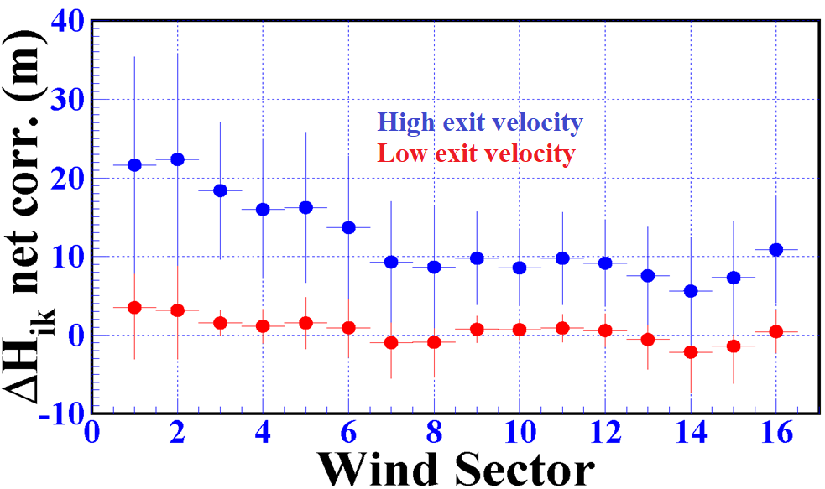
Examples of correlations: $ΔH(i)$ v. wind direction

Slide 11
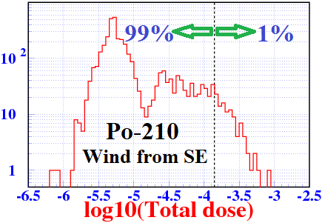
Insight and consistency: “Worst case releases”
“DRL atoms” provide a method to estimate “worst case” single-release effects (“SDRL”) using a method consistent with DRL modelling
One-hour data sets are appropriate for “TRIUMF-style” accidental release scenarios: failed medical isotope production targets; “short and sharp”
Tabulate individual “Dose/Bq” distributions for all receptors and nuclides
The far tail provides “Five year worst case dose” (c.f. “50 year flood”)
New TRIUMF convention is to use “1% worst case”: consequences would be less than this, 99% of the time.
By definition, the combination of meteorological factors is “plausible”, because it has been recorded as actually occurring in that particular wind sector.

Slide 12
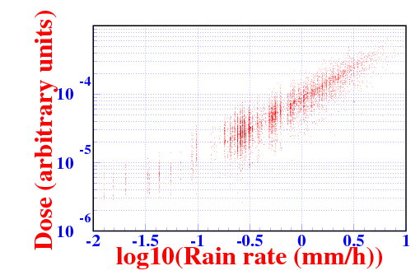
Case study: Po-210
Dominated by “food dose” from (assumed) locally grown fruits & vegetables
Deposition rate scales with rainfall rate.

Slide 13
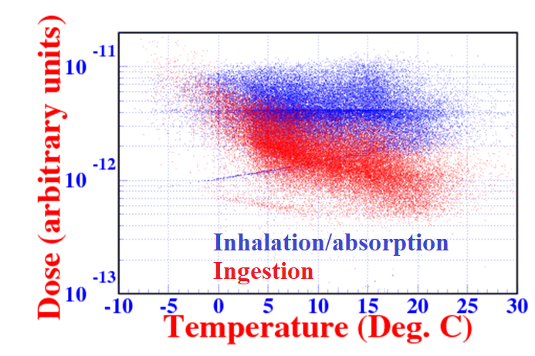
Case study: H-3
Major components from inhalation/skin absorption and ingestion
Uptake by plants scales inversely with absolute humidity➔temperature

Slide 14
Thank you / merci!
Questions?

