Slide 1
Configuration Management Initiatives at Argonne National LAboratory
drhgfdjhngngfmhgmghmghjmghfmf
John Quintana
Manager – Beamline and Accelerator Engineering

Slide 2
Contents
Motivation
Historical Observations
A Comment on Safety Envelopes
An Approach to Begin to Meld Decentralized Programs to a Labwide approach
Facility Configuration Management Program

Slide 3
Motivation
For many years, Argonne’s Accelerator Programs were fairly static. In addition the Safety Envelopes were analyzed to be beyond the physical limits of the machines at the time (e.g. APS).
Argonne’s Accelerator Facilities range from ”single room” experiments to the Advanced Photon Source. Program implementation can’t be “one size fits all”
Today, Argonne’s Accelerator Programs are evolving and becoming more complex.
LEAF (Low Energy Accelerator Facility) – Fission based Mo-99 program
A more rigorous restart for the AMORE Mo-99 program including a rigorous ARR.
Increased interest in phototransmutation for isotope production (e.g. Cu-67)
ATLAS/Physics
The 10 year strategic plan will require high intensity stable beam operations.
APS Upgrade
The DOE complex’s expectations around the accelerator safety program have continued to evolve since the APS was first constructed.

Slide 4
Historical Perspective
Historically, Argonne’s Accelerator Safety Management has been heavily decentralized with requirements from DOE O 420.2 passed to organizational (division and ALD) units for interpretation and implementation.
While DOE O 420.2C was revised in 2011, personnel changes and priorities resulted in a decision to wait for a new Guide to be issued before making changes to the Program.
Accelerator Safety Program Guide DOE G 420-2-1A issued in August 2014.
The Guide is a consensus guide primarily written by DOE Laboratory accelerator management and operations personnel that reflects the best thinking of accelerator management in the complex.
Continuing staffing changes and retirements at Argonne hindered progress.

Slide 5
Historical Perspective …
Argonne’s Independent Assessment organization performed a surveillance in 2015 highlighting differences between the Lab program and the Guide.
Focused on USI process and how they were not being really integrated into Argonne’s Program with some exceptions.
Was really more of a compliance surveillance.
Coming out of this surveillance, some people developed the perception that we aren’t doing “enough” USI determinations, whereas the real issue is that we had not incorporated the 2014 guidance.
In February 2018, Argonne commissioned an independent review conducted by various accelerator safety SME’s from around the complex (BNL, Jlab, LBNL ORNL).
“While you can capitalize on your excellent staff by making some changes, key parts of your program will benefit from transition to process/procedure based systems; this takes time buts it’s a method that has continuous improvement built in”
“These systems will have to be applied reasonably uniformly across accelerators and will have to be based on a common understanding of key requirements (like the content of the ASE and the USI process) but will have to [be] applied using a graded approach.

Slide 6
MeldinG to a Common Laboratory Approach
DOE O 420.2C indirectly requires through the ARR a “Facility Configuration Management Program that is related to accelerator safety” ensuring that facility and supporting safety documentation are current and complete.
The USI process is an important part of configuration management.
The USI process is NOT just about finding or preventing ”as found” positive USIs.
Without defining the ”Facility Configuration Management Program” and how the USI process fits, it is unclear how to apply it outside of evaluating as found conditions.
Note: Performing Determinations can be an important way to communicate with the DOE site office as part of Contractor Assurance.
Argonne’s challenge is that we haven’t adequately expressed our Facility Configuration Management Programs in a coherent way that includes a USI process at a Lab level.
Once we do that, then we can have common thinking about how we manage the program while still allowing graded local implementation practices.

Slide 7
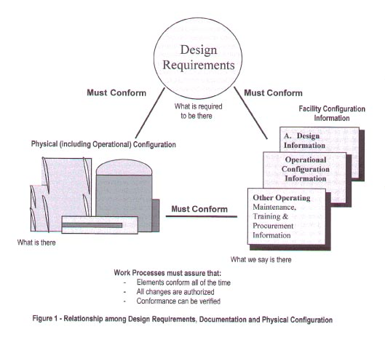
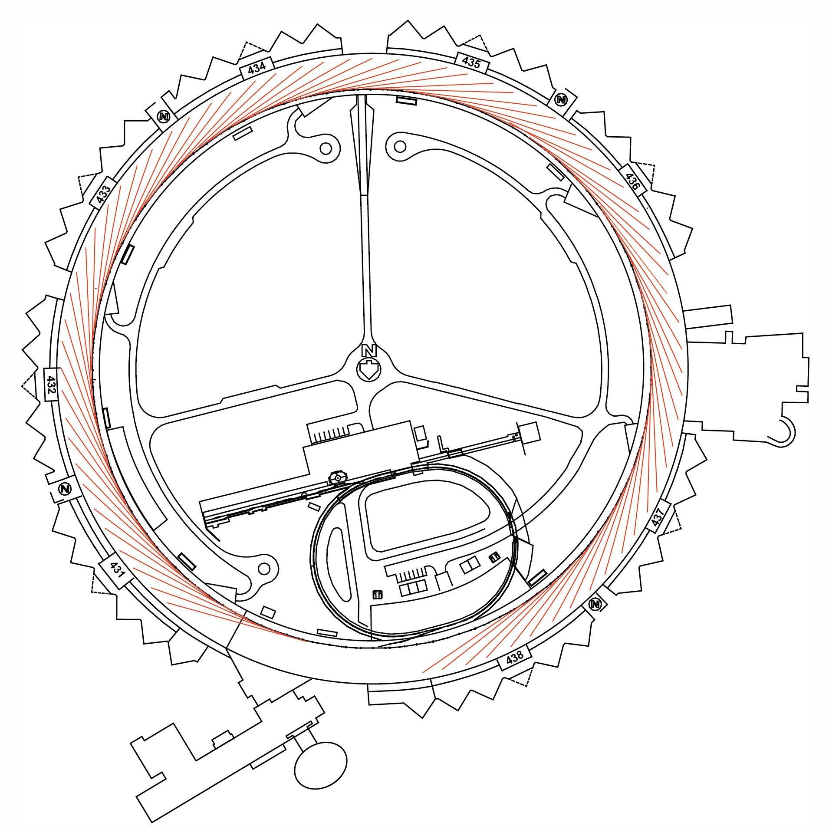
Configuration Management Related to Accelerator Safety
Accelerator Safety Envelope Supported by the Safety Assessment Document.

Slide 8
Facility Configuration Management Program
DOE G 420.2-1A has ~50 statements in it related to Configuration Management
Acknowledges that an effective CM program includes three effective elements.
Safety Documentation Program
Records Management and Training Program
Maintenance Program for credited controls
Includes making changes to those credited controls.
Guide is not real clear about how USI “plugs in” to this overall framework
DOE-STD-1073-2016 “Configuration Management” is being used by some sites as inspiration for their programs.
Requires appropriate down grading from nuclear language.
Specifies 5 major elements – High level framework may be useful if properly applied to accelerators
Design Control
Work Control
Change Control
USI Process entry point neatly fits here for activity screening
Document Control
Assessments

Slide 9
Facility Configuration ManagEmenT Program related to Accelerator Safety
Loose mapping of statements between DOE G 420.2-1A statements and DOE-STD-1073-2016
 | Design Control | Work Control | Change Control | Document Control | Assessments
Safety Documentation Program | 0 | 0 | 0 | 3 | 0
Records Management and Training Program | 1 | 0 | 0 | 5 | 1
Maintenance Program | 1 | 4 | 3 | 3 | 2
Distribution for All Identified Statements in Guide: | 7 | 17 | 20 | 40 | 9
Path Forward:
Added an 8 page Exhibit to Argonne Level Requirements around the five 1073 program elements (+ Training) but only start with expectations from the Accelerator Safety Guide. Augment with 1073 recommendations that makes sense at Argonne.
Require individual Facility Configuration Program Descriptions that mesh with the Labwide framework (Currently in progress with the LEAF facility completed). Program to be reviewed by Lab Level Accelerator Safety Review Committee.

Slide 10
Facility Configuration Program Requirements at Argonne
Element 1 of 4
A controlled Program Description Document, Policy Document, or other such document that describes how the particular facility’s procedures and processes are used to maintain appropriate configuration management over the SAD, ASE, credited controls their documentation and implementation. This is a high level document that addresses the five 1073 areas + training and describes how the Guide’s expectations are being implemented within the facility. One potential structure for such a document would be:
Introduction
Design Control
Work Control
Change Control
Document Control
Assessments

Slide 11
Facility Configuration Program Requirements at Argonne
Element 1 of 4
A controlled Program Description Document, Policy Document, or other such document that describes how the particular facility’s procedures and processes are used to maintain appropriate configuration management over the SAD, ASE, credited controls their documentation and implementation. This is a high level document that addresses the five 1073 areas + training and describes how the Guide’s expectations are being implemented within the facility. One potential structure for such a document would be:
Introduction
Design Control
Work Control
Change Control
Document Control
Assessments
Training

Slide 12
Facility Configuration Program Requirements at Argonne
Element 2 through 4 of 4
Physical Inventory List(s): Single or multiple lists/databases that maintain a record of the systems and components that make up the credited engineered controls that are under formal configuration management.
Administrative Inventory List(s): Single or multiple lists/databases that maintain the list of administrative controls, procedures, and documents that maintain the credited controls, their documentation and implement the Configuration Management Program. These procedures and maintenance of the list are also under CM.
The actual facility documentation (e.g., procedures, operating manuals, technical notes, etc.) that are used to maintain and change the credited controls over time. As part of the Accelerator Facility CM Program, these documents should be listed in the Administrative Inventory as noted above.

Slide 13
Key Elements of Configuration Management FOR ACCELERATOR SAFETY
Configuration Management for Argonne’s Accelerator Safety Program has Six Main Components (see LMS-PROC-188 and EGS-PP-100).
Design Control
Ensures that credited control designs have appropriate calculations, reviews etc…
Work Control
Makes sure that all work done on components under CM is properly performed and adheres to design and facility documents.
Ensures that equivalent protection is in place when a control is disabled.
Change Control
Ensures that design and safety requirements, facility documentation and physical controls are properly managed and are consistent.
Document Control
Maintains documents as controlled documents under an appropriate document control system.
Assessments
Provides an evaluation of the effectiveness of the program
Training
Ensures all people who interact with items under Configuration Management understand their roles and have competencies that are commensurate with their responsibilities.

Slide 14
Key Elements of Configuration Management FOR ACCELERATOR SAFETY
Mov
Credited Control
LEAF Configuration Management
Configuration Management for Argonne’s Accelerator Safety Program has Six Main Components (see LMS-PROC-188 and EGS-PP-100).
Design Control
Ensures that credited control designs have appropriate calculations, reviews etc…
Work Control
Makes sure that all work done on components under CM is properly performed and adheres to design and facility documents.
Ensures that equivalent protection is in place when a control is disabled.
Change Control
Ensures that design and safety requirements, facility documentation and physical controls are properly managed and are consistent.
Document Control
Maintains documents as controlled documents under an appropriate document control system.
Assessments
Provides an evaluation of the effectiveness of the program
Training
Ensures all people who interact with items under Configuration Management understand their roles and have competencies that are commensurate with their responsibilities.
Movable shielding
LEAF-SH-01
Do not remove or change this component without an approved work permit
Contact LEAF Manager: Sergey Chemerisov, 2-3477

Slide 15
Anticipated Benefits of the Approach at Argonne
Configuration Management Program expectations are based on criteria set in. the Guide to the Accelerator Safety Order
Clearer lines of inquiry for the Configuration Management portion of ARR.
Creation of the Description effectively becomes a management assessment and gap analysis between Laboratory level interpretations of the Guide and the local implementation.
Review by the the Laboratory ASRC (including the triennial assessment) provides a route for continuous improvement and gives focus to Argonne’s ASRC reviews.

Slide 16
A few comments on USI from the Accelerator Safety Guide
USI is not a Safety Analysis. That is done separately.
Purpose is to:
“(1) to inform the DOE field element of discoveries or proposed changes in activities judged to significantly affect the previously accepted risks and “
“(2) to ensure that the DOE field element is aware of proposed changes or discoveries that significantly increase risk. “
“USI process provides a structured approach for decision making and helps to determine who should approve the proposed change or continued operation after a discovery; that is, determine whether accelerator management or the DOE field element is the approver. “
The USI process should allow accelerator management flexibility to make changes to accelerator facilities and experiments and to operate the accelerators and experiments without prior DOE field element approval as long as these changes or discoveries do not significantly affect the risk conclusions in the safety analysis or result in a change to the ASE.

Slide 17
Thoughts?

