Slide 1
Extending Radiological Safety Configuration Control to Other Work
John Seabury, ESH&Q Manager, Accelerator Directorate
Keith Jobe, Safety Coordinator, AD Superconducting Linac Division
11 September 2019

Slide 2
Background
Established in the mid-1960’s, SLAC is a National Accelerator Laboratory that, when its latest series of upgrades are completed, will simultaneously operate six electron accelerators serving experimental areas
SLAC has a well-established process for performing work on configuration controlled radiological safety devices
Developed over 50+ years of accelerator operation
Used as a work planning tool within the WPC environment to evaluate the effects of this work on safety integrity
Called “Radiation Safety Work Control Form” process
Required of all accelerators across SLAC

Slide 3
Background
The LCLS-II project (superconducting Linac) currently under construction introduces new hazards at a level that also require safety configuration control
Non-ionizing radiation from Solid State HPRF amplifiers
Oxygen deficiency from cryogenically cooled accelerating structures, helium production plant
AD ESH&Q and SLAC Superconducting Linac Division determined that harmonizing safety configuration control processes across accelerators and across hazards would enhance successful operation
Similar safety configuration control system in place for laser safety configuration control, but that process is not managed by Accelerator Directorate

Slide 4
What is “safety configuration control”?
“Configuration control” is a component of “configuration management”, which begins at design and ends at removal
“Configuration control” focuses on maintaining specific existing, identified devices
“Safety configuration control” assures that devices identified as required to assure safety are in place and operational at any time the hazard exists
Analyzes the effect of modifying (including bypassing) these devices for any reason
If devices must be modified, determines what compensatory protective measures must be implemented
Assures adequate review of proposed work
Verifies restoration to baseline conditions after work is complete

Slide 5
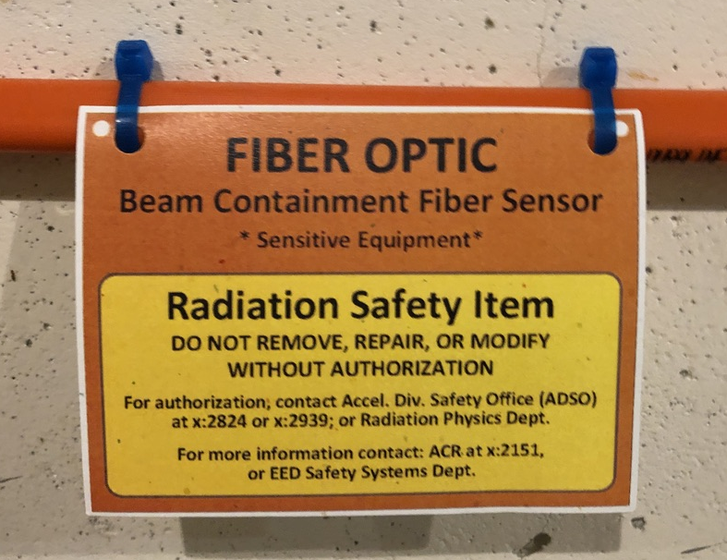
Elements of safety configuration control
Operations authorization documents identify specific safety configuration controlled devices, both Credited and Defense-in-depth
Identify in a list and in the field (signs)
Worker describes work and proposes mitigations
Independent system safety experts review description of work and mitigations for adequacy
Independent system safety experts verify that mitigations are in place before work can begin
Worker and system safety experts verify that work is complete and that safety systems have been restored
Independent authorization of restart

Slide 6
The safety configuration control process
Element | Radiological | Nonionizing Rad | Oxygen Deficiency
Identify configuration controlled devices | Beamline Authorization Sheet | System-specific RF Safety Plan | ODH Safety Review
Propose work including mitigations | Worker Accelerator Safety Officer (ASO) | Worker SC Linac Safety Coordinator | Worker SC Linac Safety Coordinator
Review work and approve proposed mitigations | ASO Radiation Physicist | SC Linac Safety Coordinator RF System Manager | SC Linac Safety Coordinator
Verify mitigations in place, authorize start of work | As assigned, usually Chief Operator ASO Radiation Physicist Person responsible for work | SC Linac Safety Coordinator OR RF System Manager | SC Linac Safety Coordinator
Verify work is complete and original conditions restored | As assigned, usually ASO Radiation Physicist | Worker OR SC Linac Safety Coordinator | Worker OR SC Linac Safety Coordinator
Approve restart of operations | ASO Chief Operator | SC Linac Safety Coordinator RF System Manager | SC Linac Safety Coordinator

Slide 7
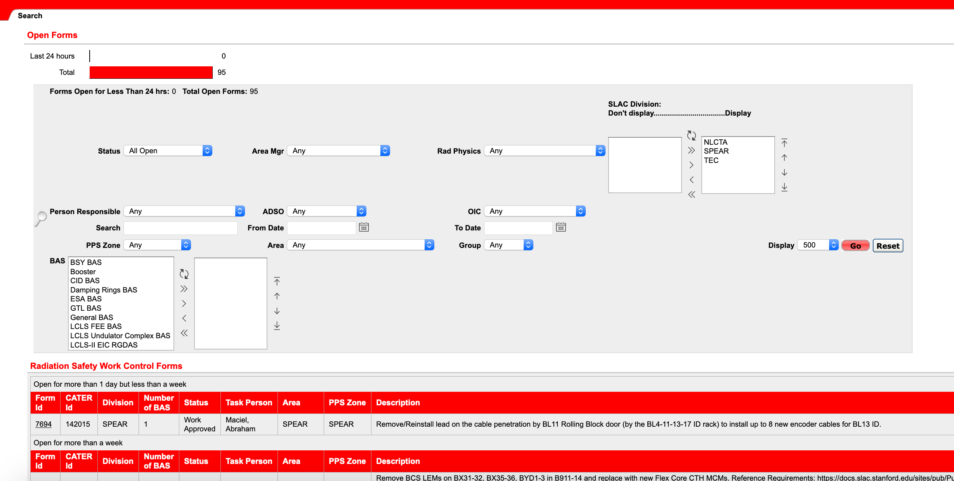
Computerized Radiation Safety Work Control Form

Slide 8
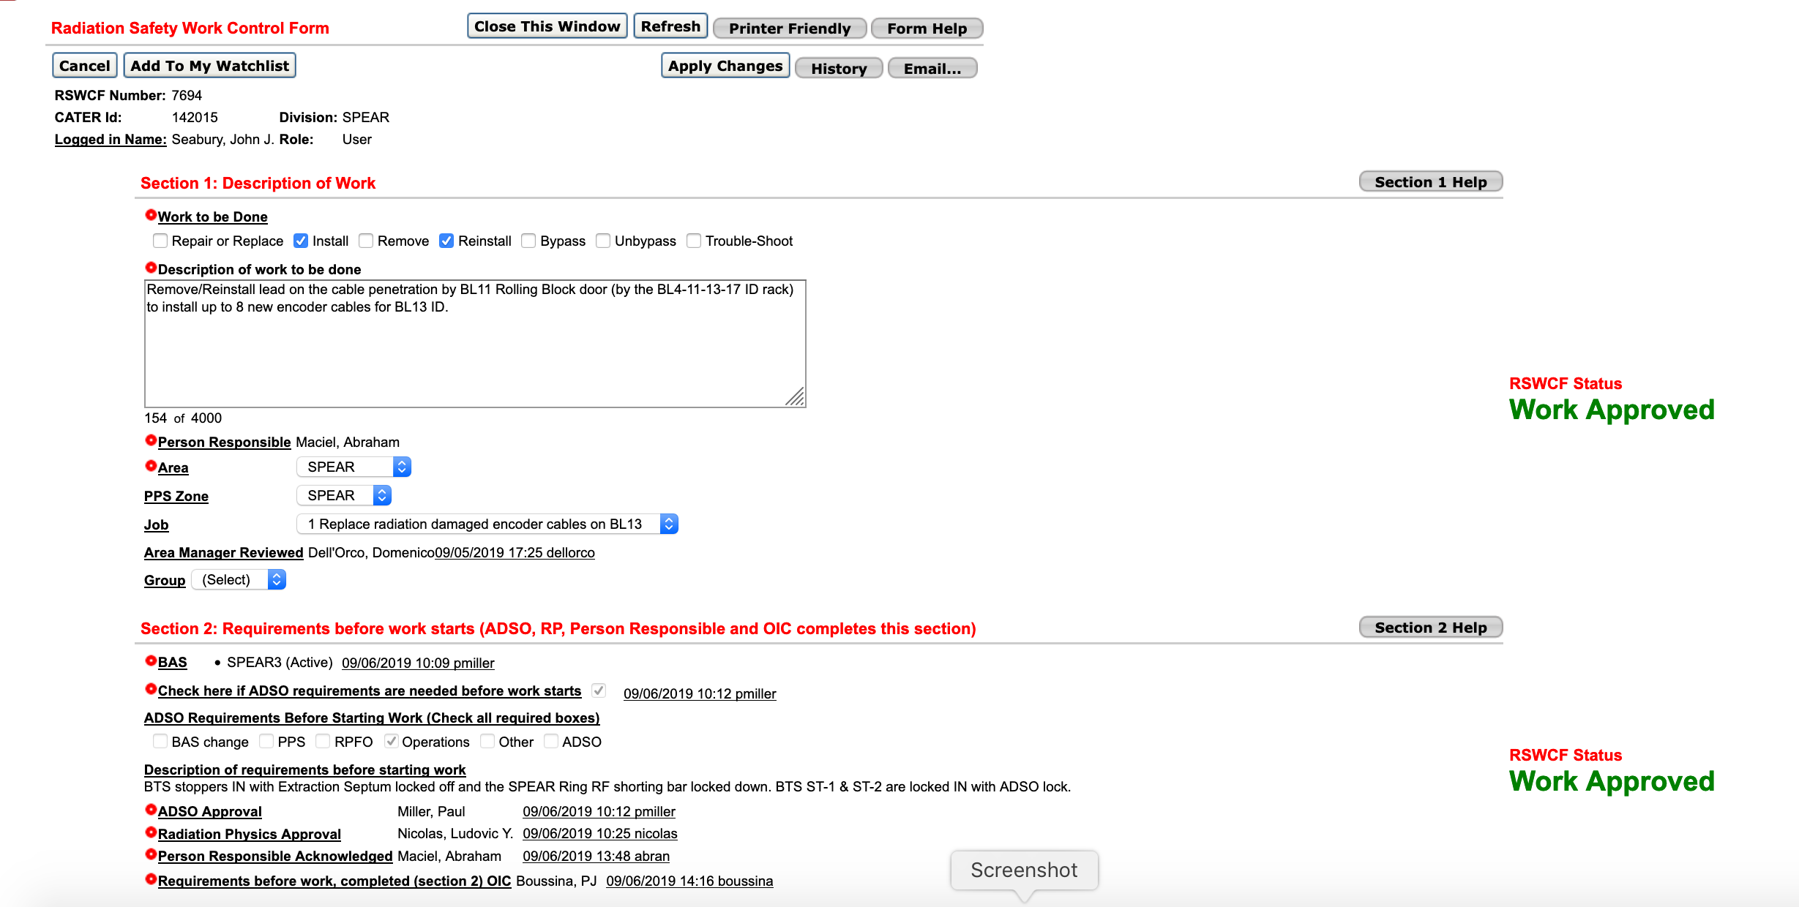
Computerized Radiation Safety Work Control Form

Slide 9
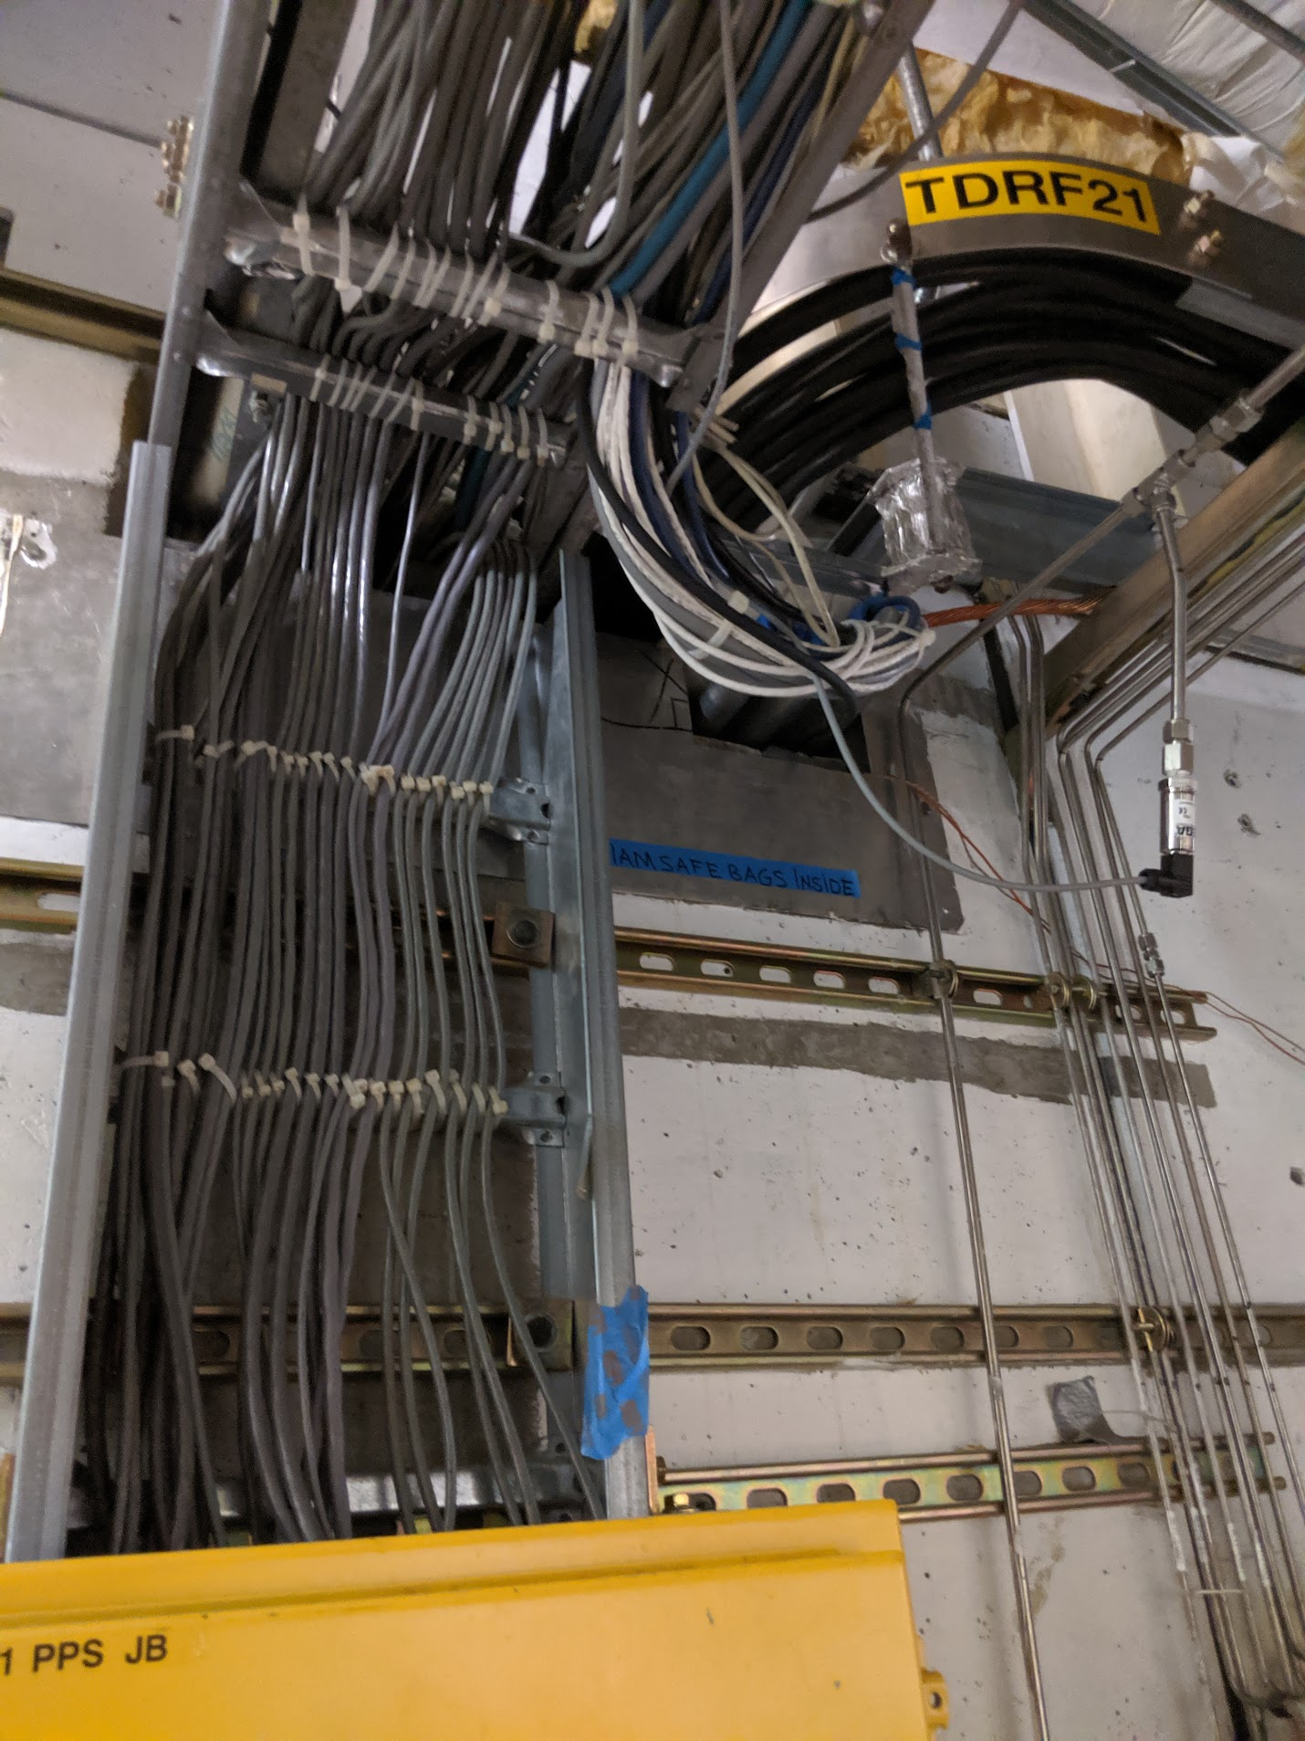
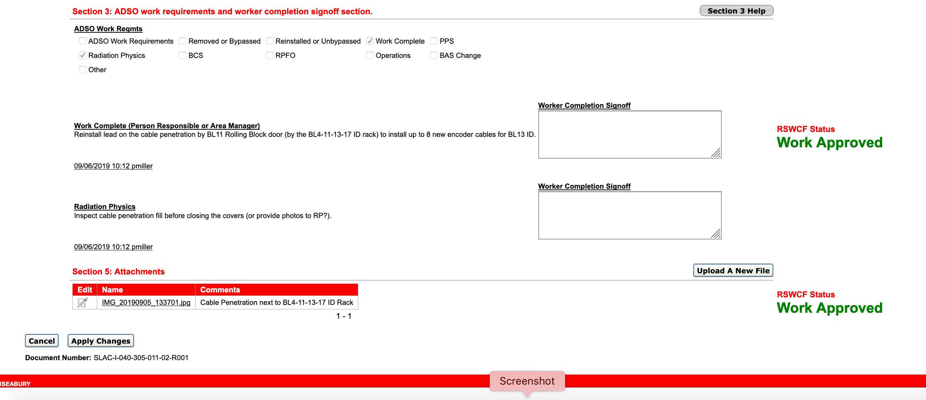
Computerized Radiation Safety Work Control Form

Slide 10
Status as of Summer 2016
Radiation Safety Work Control Form (RSWCF)
Very mature implementation
Main SLAC accelerator facility (NC LCLS, FACET-II, SC LCLS-II) uses a computerized RSWCF process, which is integrated with the computerized accelerator maintenance management system (others use paper process) for electronic review and approval
RF Safety Work Control Form (RFWCF)
Adolescent implementation based upon initial installation
Paper process at this point while bugs are worked out during system commissioning (we have some upgrading of ID labels to do)
ODH Work Control Form (ODHWCF)
Infant implementation - conceptual at this point, will follow the RFWCF process
Won’t need until we start introducing cryogens in spring 2020
Objective is to have a single Safety Work Control Form portal that is integrated with the maintenance management system – similar to existing RSWCF

Slide 11
Questions?

