Slide 1
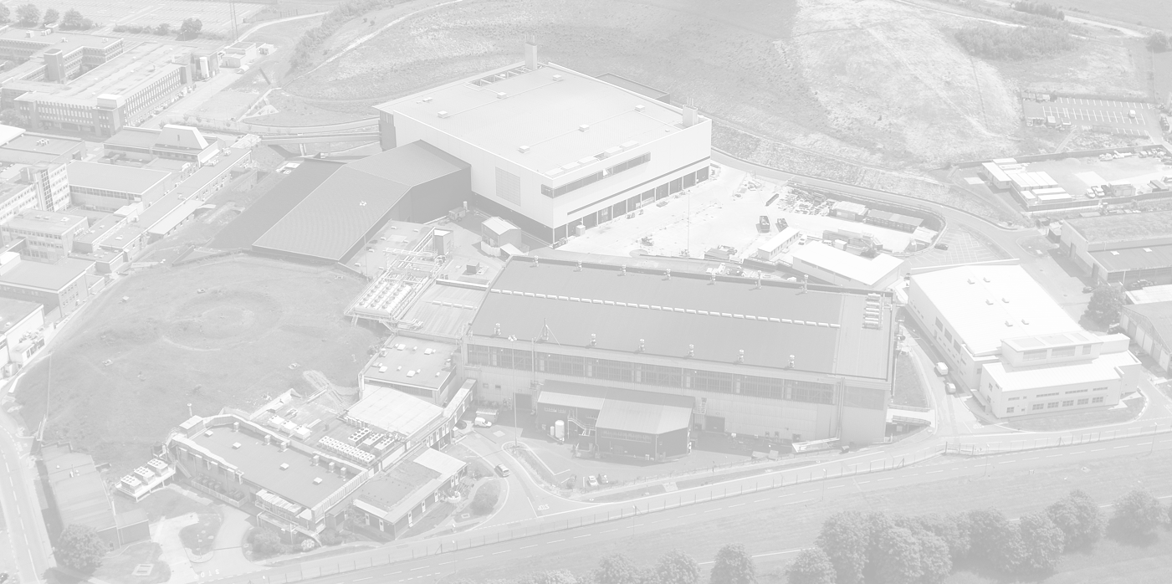
ISIS – from TS1 to TS2 to ISIS-II

Slide 2
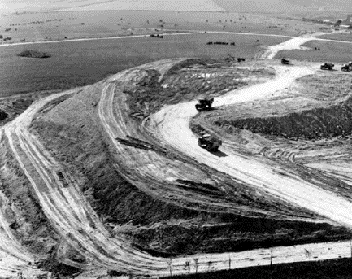
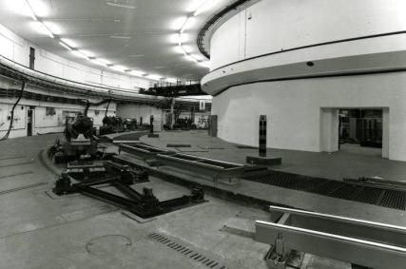
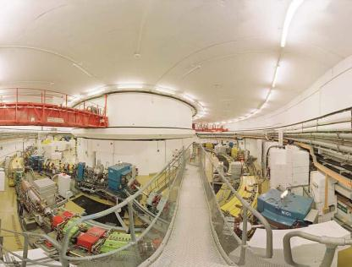
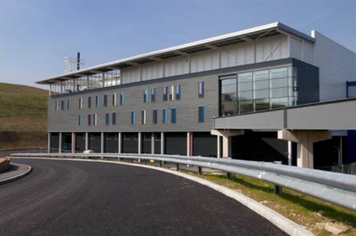
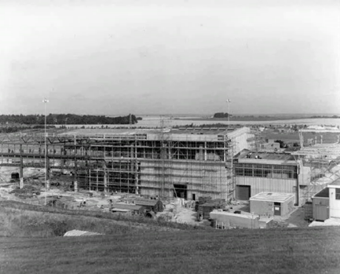
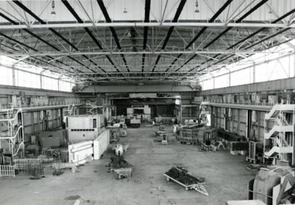
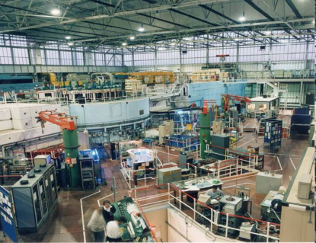
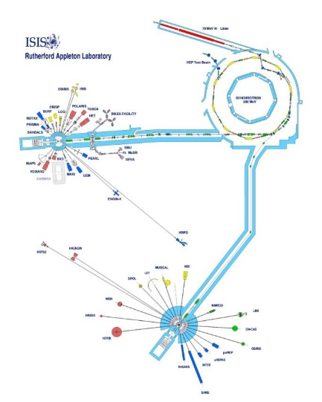
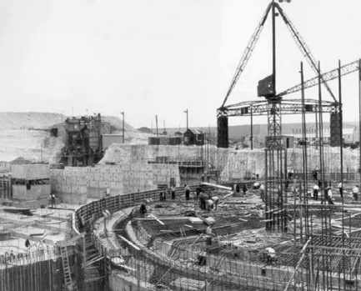
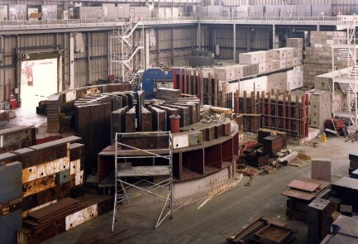
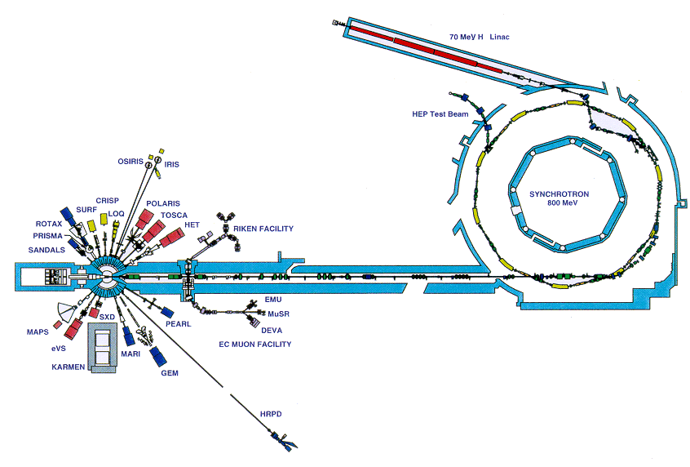
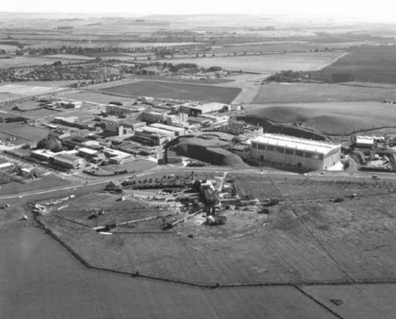
1964
1978
1984
2008

Slide 3
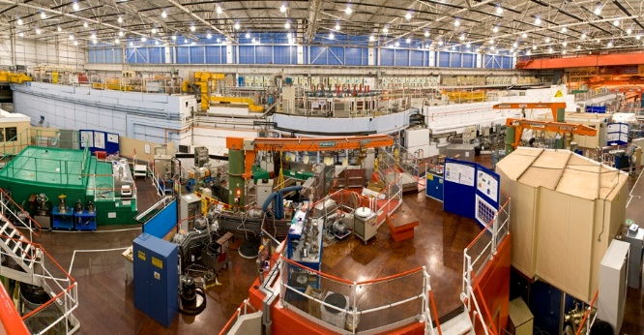
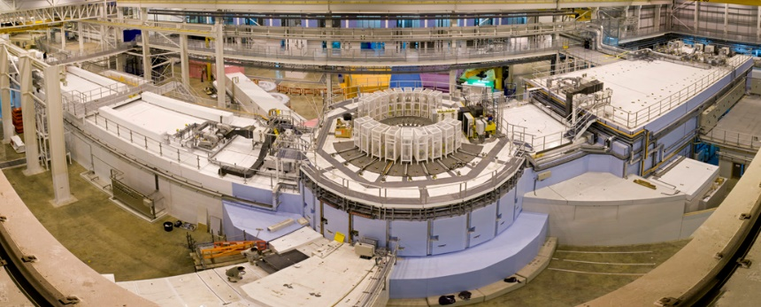
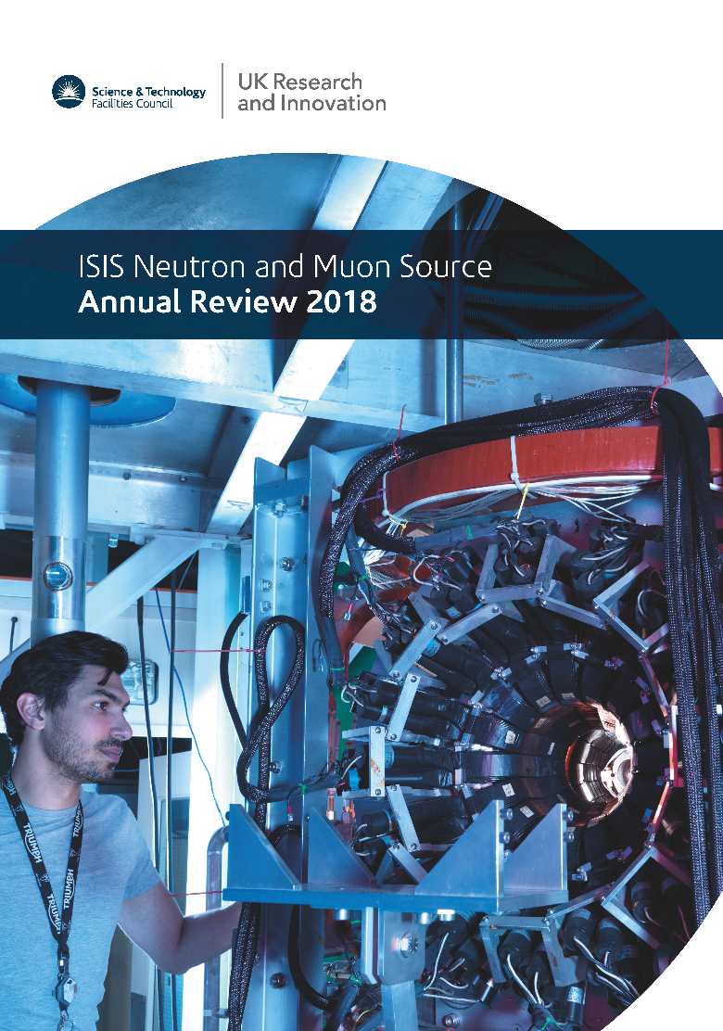
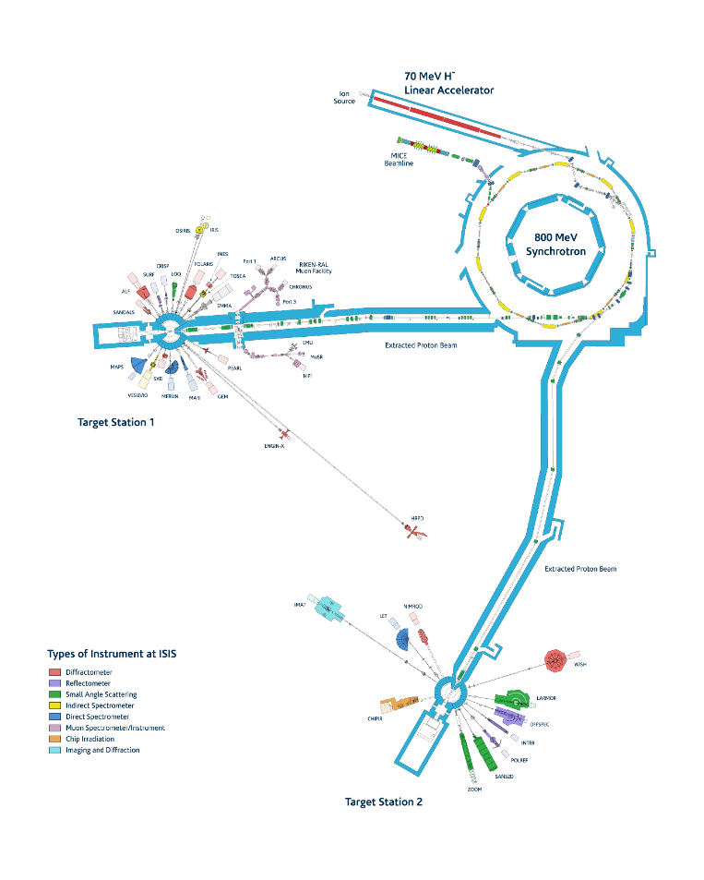
ISIS 2018
2 target stations
33 operational instruments
1505 proposals
1316 experiments
4370 instrument days
1771 unique users
3478 user visits
609 publications

Slide 4
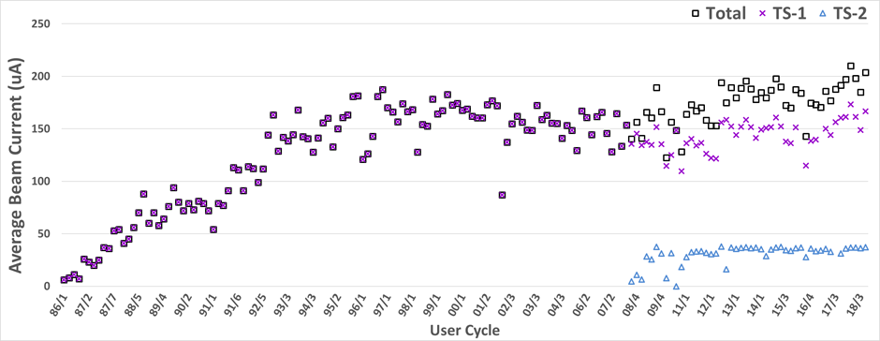
ISIS operations status

Slide 5
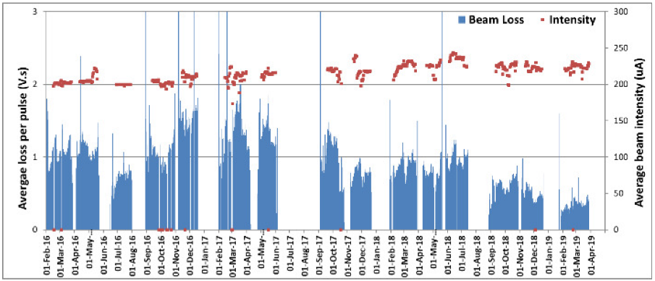
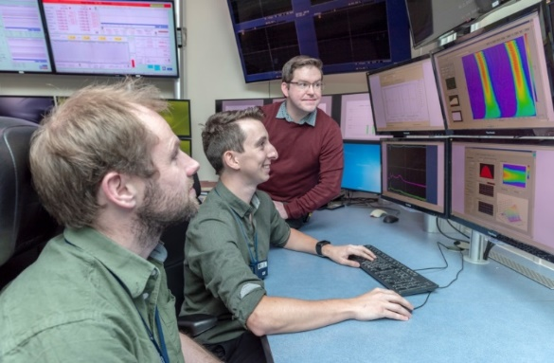
ISIS operations status
19th June 2019: 24 hour average beam current of 236 µA
5.64 mAh delivered with 99.4 % availability.

Slide 6
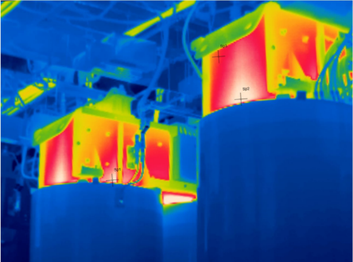
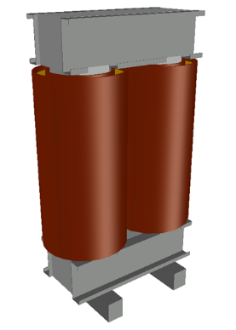
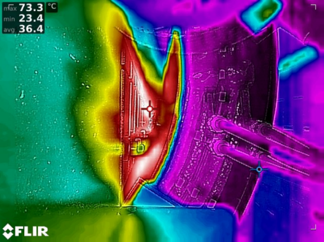
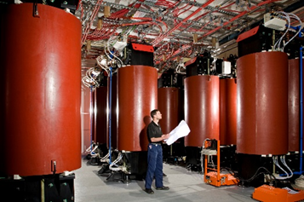
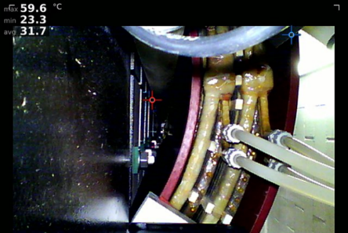
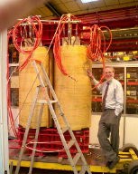
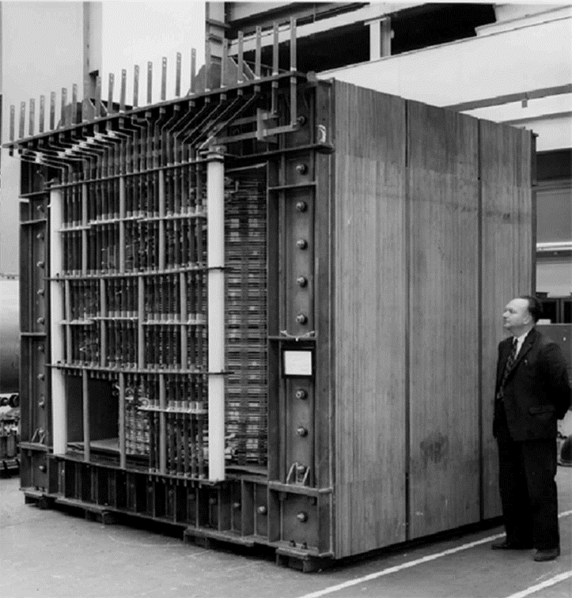
ISIS main magnet power supply
2018
2018
2009
2005
1964
2018

Slide 7
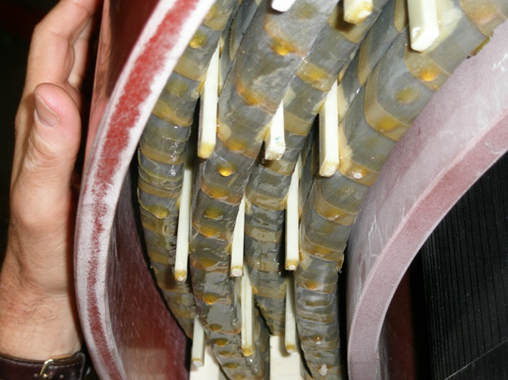
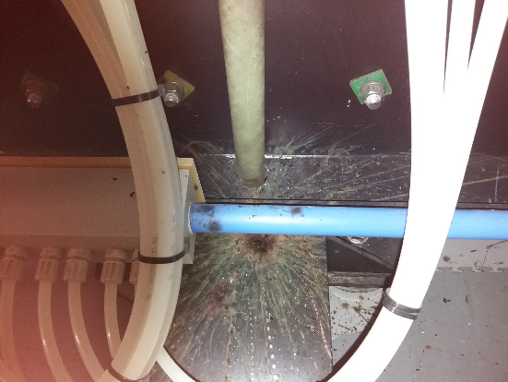
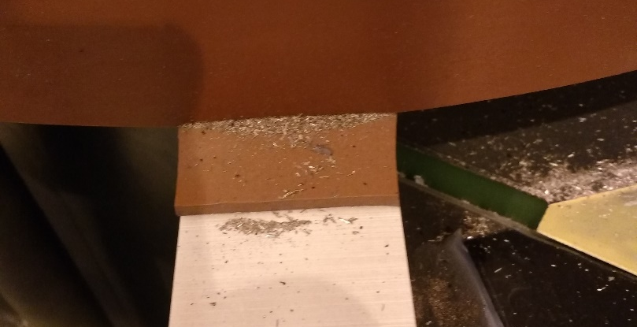
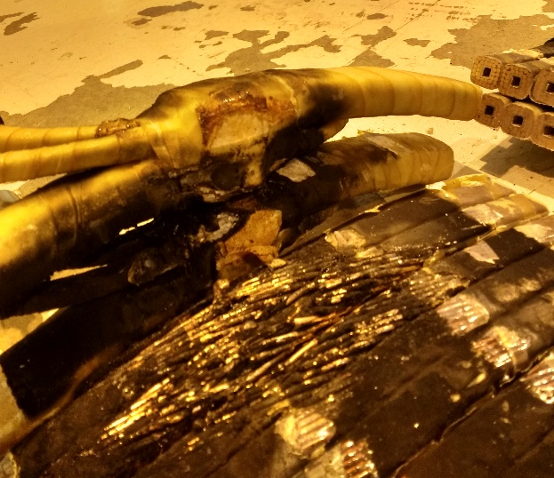
March 2019
First ISIS cycle in operation

Slide 8
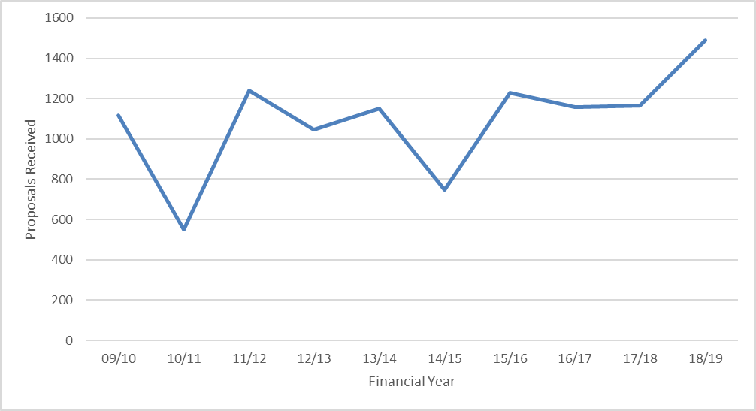
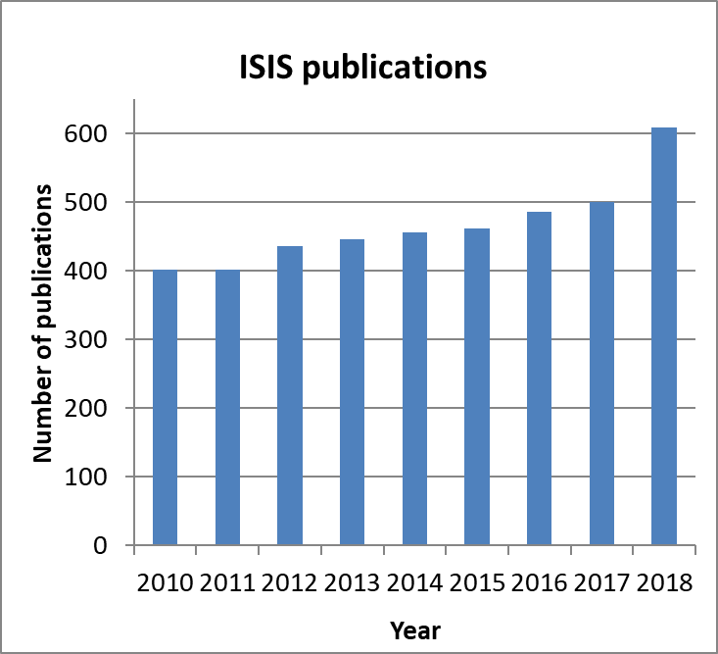
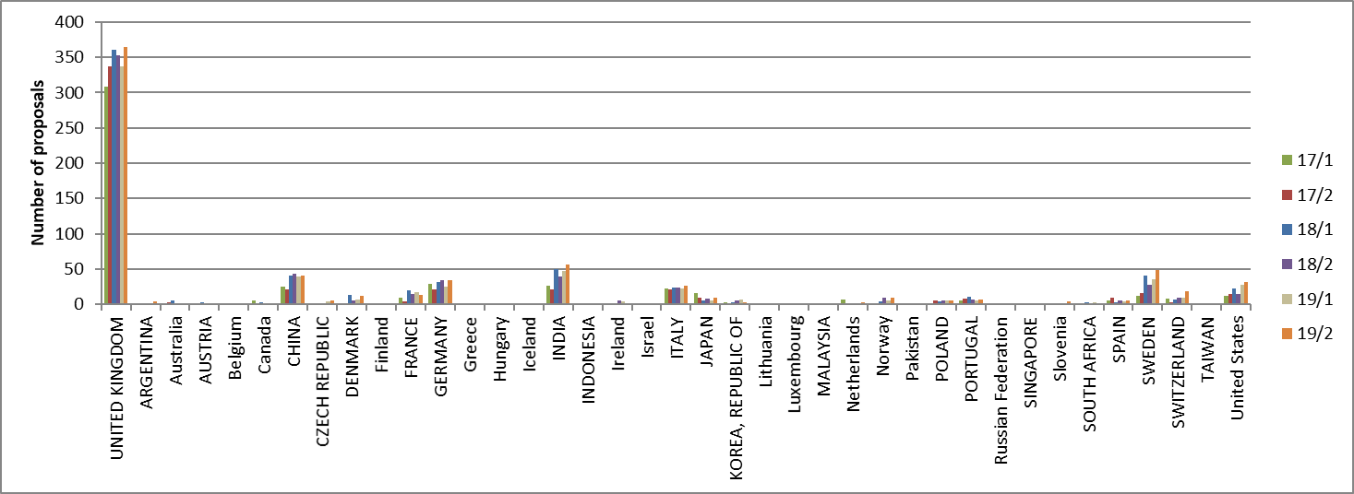
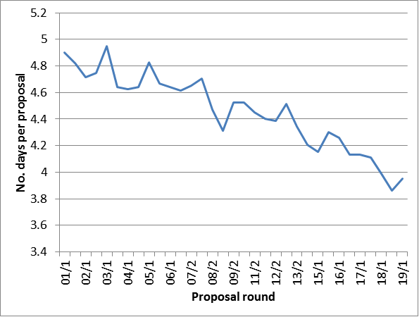
ISIS User programme

Slide 9
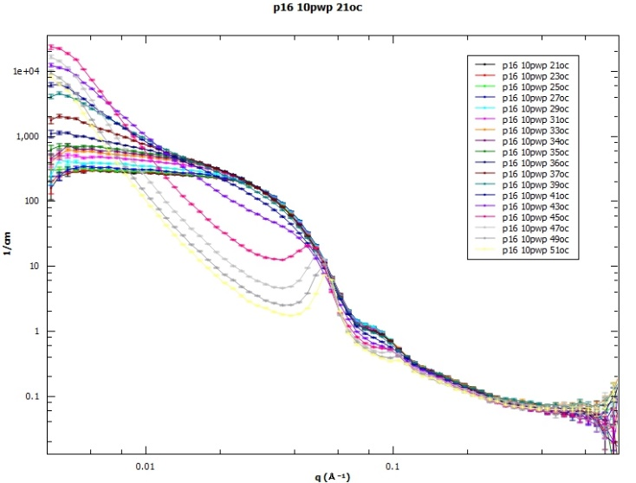
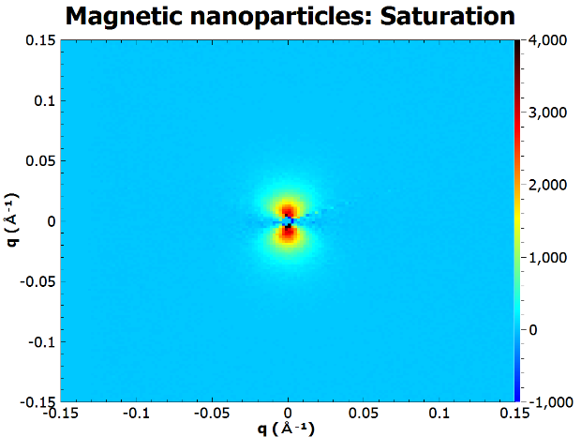
Instrument development - ZOOM

Slide 10
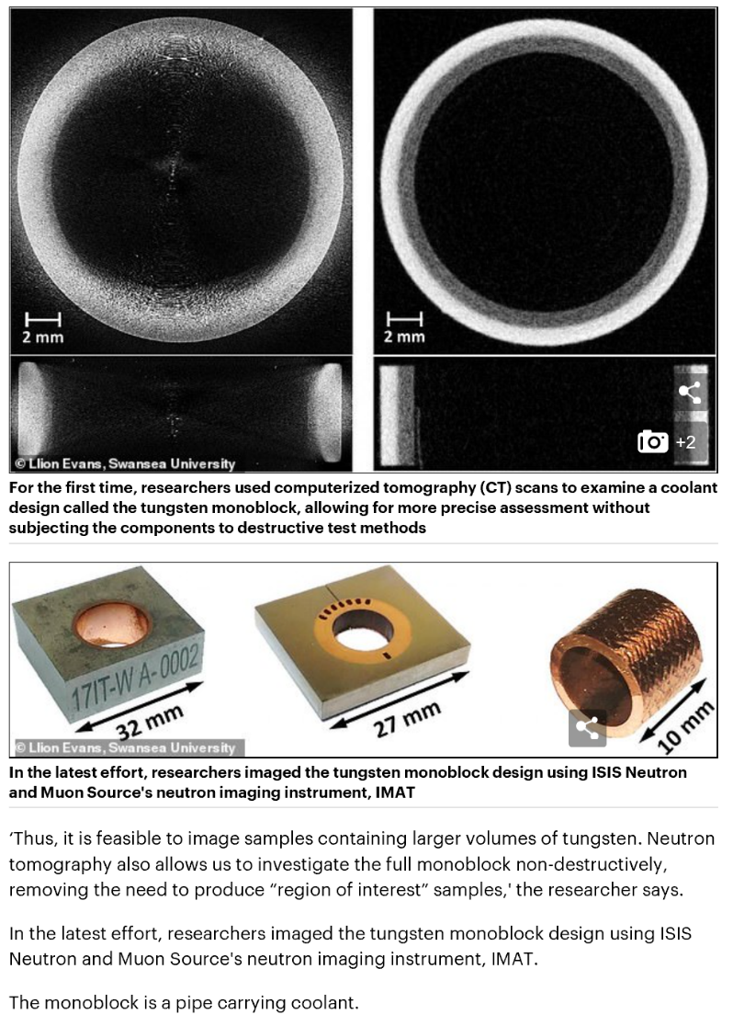
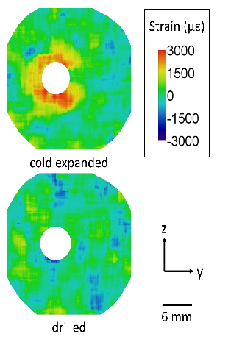
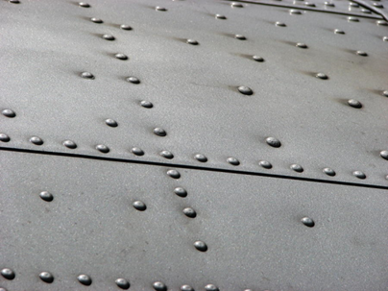
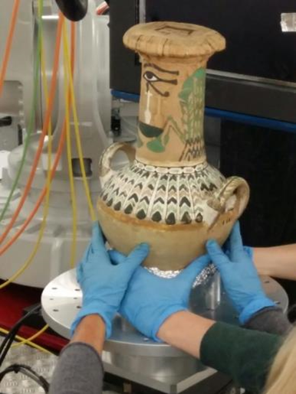
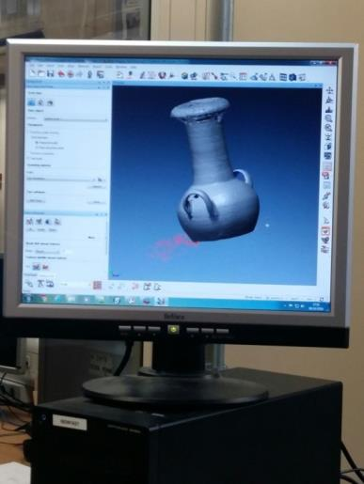
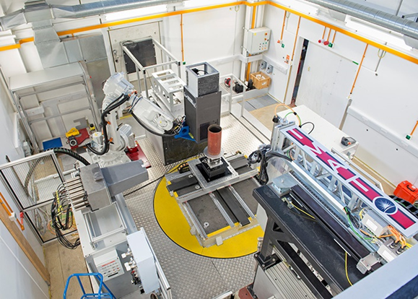
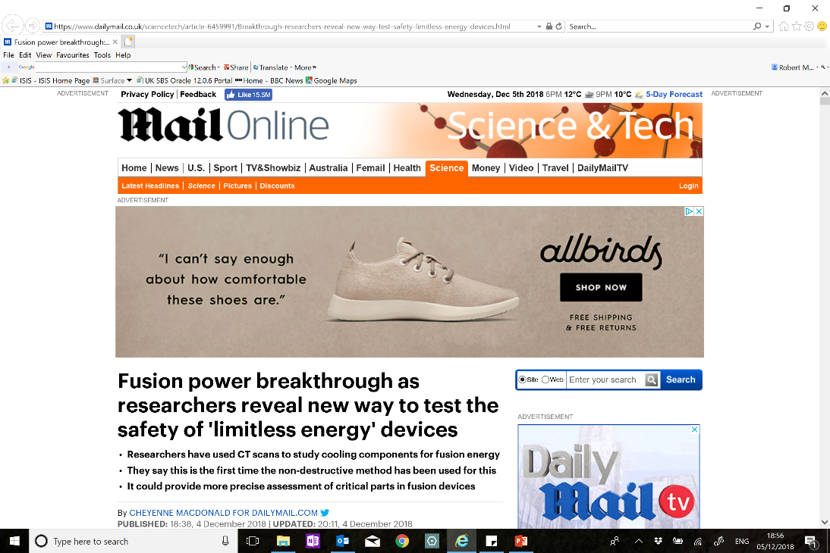
IMAT in the Mail Online

Slide 11

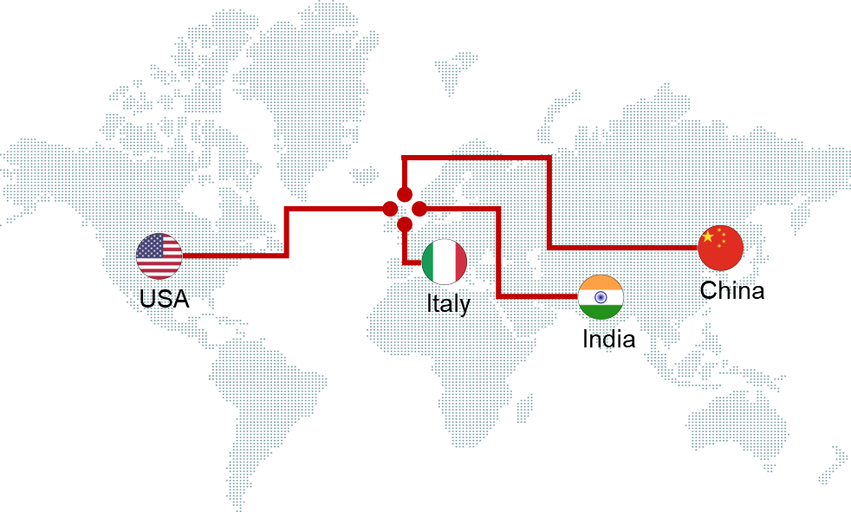

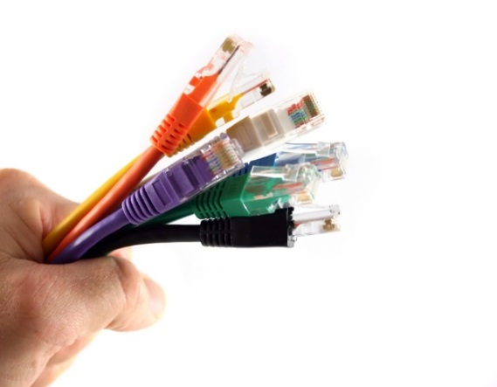

Instrument development - ChipIr
CISCO uses ChipIr right across its global business…
Cosmic rays are a significant problem for internet routers
Huge growth expected - global traffic to reach 40 Zb in 2020…
8.6 zettabytes
40 zettabytes
1.3 zettabytes
14 zettabytes in cloud
130 exabytes
2005
2005
2015
2020
Traffic
1 Zettabyte =
1,000,000,000,000,000,000,000 bytes

Slide 12
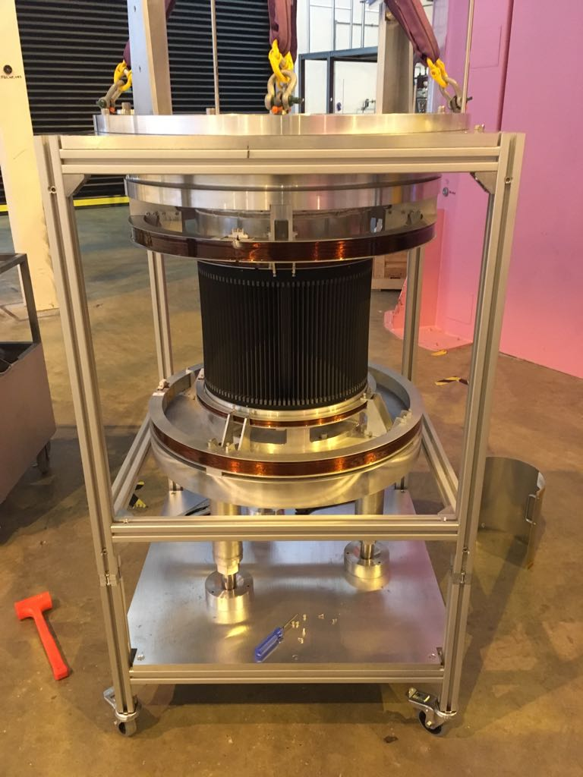
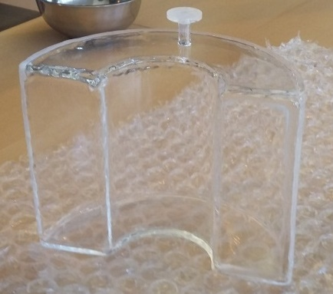
Instrument development – polarisation analysis on LET
Polarization analyzer based on ³He spin filter built and tested
First external user experiment

Slide 13
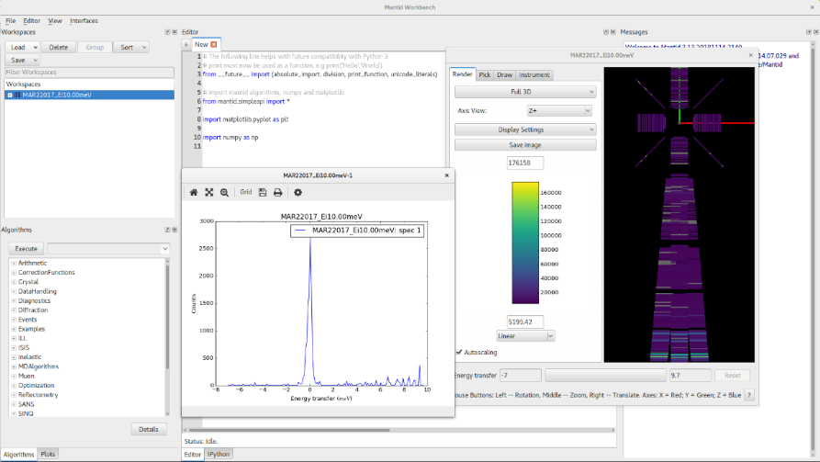
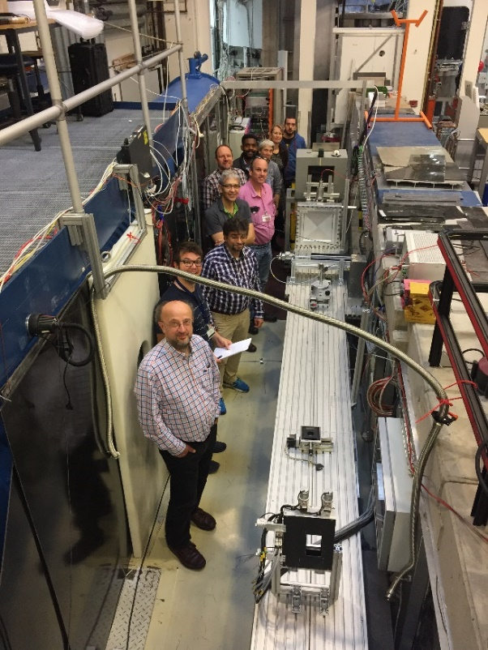
Scientific software
Continued development of Mantid in collaboration with ESS, ILL, SNS …
SCD-ISIS collaboration:
iDAaaS (ISIS data analysis as a service. Being trialled by LET and WISH.
Machine learning/AI
ESS data acquisition and reduction. Testing at HZB in December 2018.

Slide 14




PACE: Proper Analysis of Coherent Excitations
Data analysis as an integral part of the instrument
Integrated visualisation, simulation and fitting environment on massively parallel computing
Seamless integration with 3rd party modelling codes + full resolution convolution
Highlight: S(Q,ω) calculations from CASTEP output
Refactored various utilities in CASTEP into a unified Python library
Single command in Horace to perform calculation (cf trail of homebrew operations)
Factor 15-20 speed improvement – and no parallelisation yet!
La₂Zr₂O₇ data
Simulation

Slide 15










Detector development
0.2 mm resln. detector for SEMSANS
New NitroGEM monitor excellent n/ﻻ disc
INTER Detector development
1.5 m long straw tube pack in preparation - LoKI
Mari low angle
detector refurbished

Slide 16



Sample environment
Longest ever ISIS dilution fridge experiment: more than 1.5 month below 650 mK!
Lowest temperature: 50 mK
Neutron diffraction on WISH simultaneously with in situ magnetic susceptibility measurements.
E-18 Cryogen-free Dilution Refrigerator 275μW@100mK

Slide 17




Sample environment
Fast Cooling Furnace (SINE2020)
  Utilising flowing exchange gas to cool furnaces faster.
  Cooling times from 1000⁰C to 80⁰C reduced from 4.5 hours to 45 minutes – equivalent to 39 days of beam time per year.
  Modification possible for all vacuum furnaces.
  Fully automated system.
  No detrimental affect to element and heatshields.

Slide 18
Long shutdown
Long shutdown
Long shutdown
ISIS-II decision
2012
2013
2014
2015
2016
2017
2018
2019
2020
2021
2022
2023
2024
2025
2026
2027
2028
2029
2030
2031
2032
2033
2034
Larmor, IMAT, ChipIr, ZOOM
TOSCA, MAPS, MARI, OSIRIS
Instrument projects/Endeavour
ESS Instruments
RIKEN-RAL refurbishment
Harwell Fac Building
TS1 target feasibility
TS1 target implementation
Linac Tank IV
Linac Tank I
ISIS-II feasibility
ISIS-II studies
ISIS-II design
ISIS-II construction

Slide 19

Harwell Facilities Building
Radioactive waste handling
Large construction projects (TS1 target/moderator, ESS instruments, MEBT …)

Slide 20


TS1 target/moderator replacement
(2020 long shutdown)

Slide 21



TS1 target/moderator replacement
(2020 long shutdown)

Slide 22






TS1 target/moderator replacement
(2020 long shutdown)

Slide 23




Linac Tank IV replacement
(2020 long shutdown)

Slide 24



Endeavour – Instrument Development programme

Slide 25


ISEC - ISIS Stress Engineering Centre
IKON 8

Slide 26

ISIS-II
“For Europe to equate to the American and Japanese short pulse neutron sources (SNS and JPARC) by far the most cost effective solution would therefore be to build a MW-class short pulse facility at ISIS, reusing existing infrastructure and facilities as well as drawing upon on-site competences.“

Slide 27

Business model
2003
Output and Impact

Slide 28
Business model
Instruments
Instruments
Target
Moderator
Instruments
Instruments
Instruments
Source
Instruments
Target
Moderator
Instruments
Instruments
Instruments

Slide 29
Business model
Instruments
SE
SE
SE
SE
SE
SE
SE
SE
SE
Instruments
SE
SE
SE
SE
SE
SE
Target
Moderator
SE
SE
SE
Instruments
Instruments
Software
Instruments
Software
Source
Software
Software
Software
Instruments
Software
Target
Moderator
Instruments
Instruments
Instruments

Slide 30
Business model
Instruments
SE
SE
SE
SE
SE
SE
SE
SE
SE
Instruments
SE
SE
SE
SE
SE
SE
Target
Moderator
SE
SE
SE
Instruments
Instruments
Data
Software
Instruments
Software
Energy
Source
Software
Software
Data
Software
Instruments
Software
Data
Target
Moderator
Instruments
Instruments
Instruments

Slide 31





ISIS-II feasibility
ISIS-II Working Group has been set up, and consists of experts from accelerator, target, neutronics, instrument science, detector and engineering. Important to stress that this must be envisaged as a facility upgrade, not simply an accelerator upgrade
Multiple day-one target stations, variety of repetition rates, FFA options and muons all considered
Looking at:
  1) Stand alone facility
  2) Reuse of ISIS infrastructure
  3) Compact neutron sources
0.8 – 3.2 GeV RCS
0.4 – 3.2 GeV FFAG
0.5 – 1.2 GeV FFAG
⇒ Business case

Slide 32


Front End Test Stand

Slide 33


ICANS 2039?

