Slide 1


Status of China Spallation Neutron Source
Hesheng Chen
Institute of High Energy Physics, CAS

Slide 2
Outline
CSNS project overview
CSNS design
Commissioning & operation
Users and future plan
Summary

Slide 3
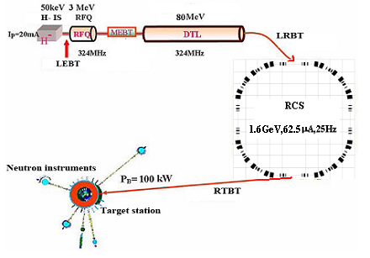
CSNS Facility Layout
The phase-I CSNS facility consists of 80-MeV H⁻ linac, 1.6-GeV RCS, beam transport lines, target station, and 3 instruments.
Upgradable to 500kW at 25Hz and 20 instruments
Conducted jointly by IHEP & IOP, CAS
 | CSNS-I | CSNS-II
Beam power (kW) | 100 | 500
Repetition Rate (Hz) | 25 | 25
# of Target | 1 | 1
Average cur. (μA) | 62.5 | 312
Proton energy(GeV) | 1.6 | 1.6
Linac energy (MeV) | 80 | 250

Slide 4
Key Milestones
July 1999 CSNS proposed
June 2005 proposal approved in principle (CD-0)
Jan. 2006-Dec. 2013 Prototyping R&D
Sept. 2008 proposal approved
February 2011 Feasibility study approved (CD-1)
May 2011 preliminary design approved (CD-2)
Sept. 2011 construction start (CD-3)
May 2012 – Jan 2016 civil construction
Sept. 2011–Mar. 2016 component fabrication
Oct. 2014- June 2017 installation & tests
Dec. 2016 RCS commissioning start
Nov. 2017 First beam on target
March 2018 project complete/operation start (6.5Y)
April 2018 First user exp. result paper published

Slide 5
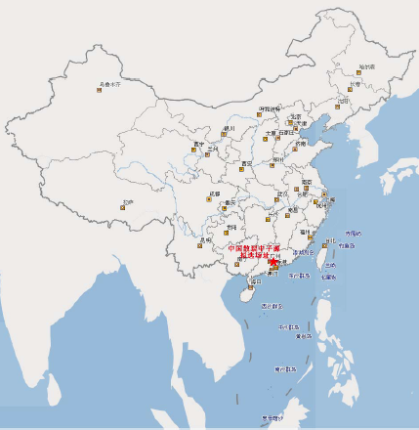

CSNS Site
The site of CSNS locates at Dongguan, Guangdong Province.
The Dongguan local government provided a land of about 0.67km² for CSNS campus. 0.27-km² is used for the phase-I construction.
50 min. by car from the Shenzhen Airport; 2 hours by train & car from Hongkong

Slide 6
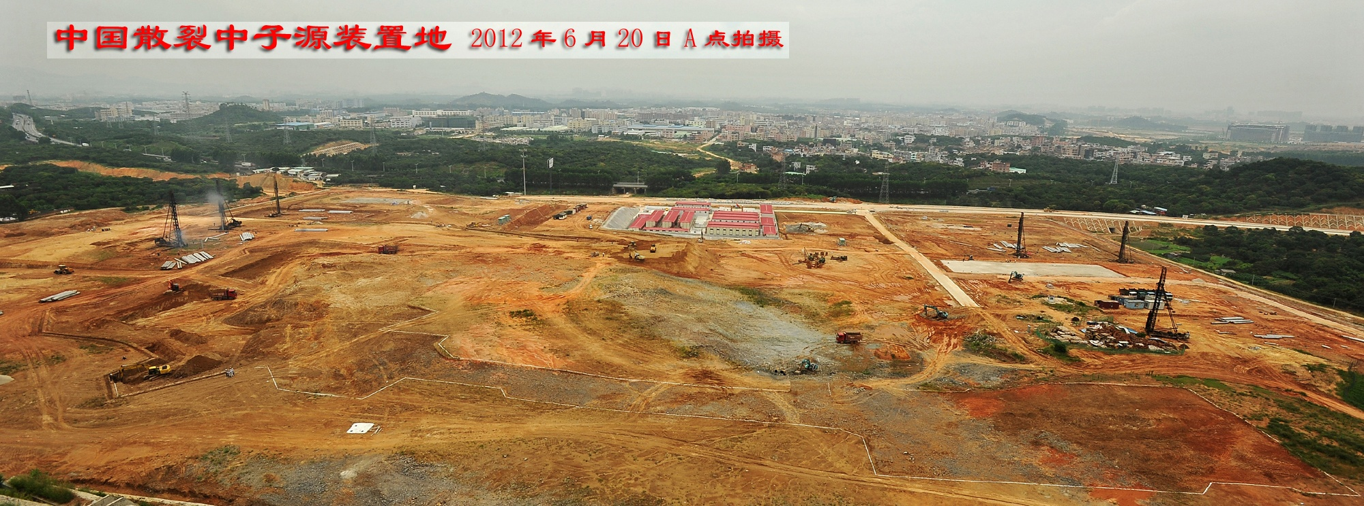
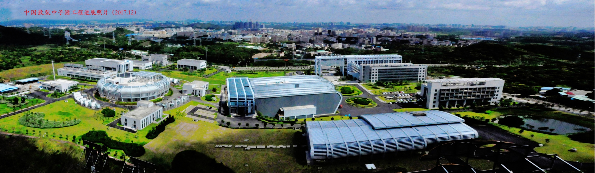

Slide 7
Outline
CSNS project overview
CSNS design
Commissioning & operation
Users and future plan
Summary

Slide 8
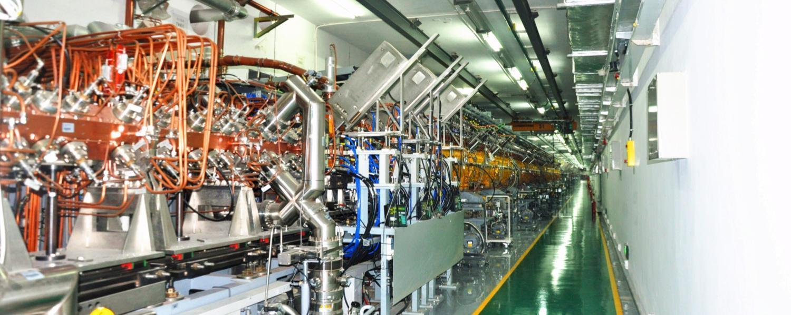
Linac Design

Slide 9
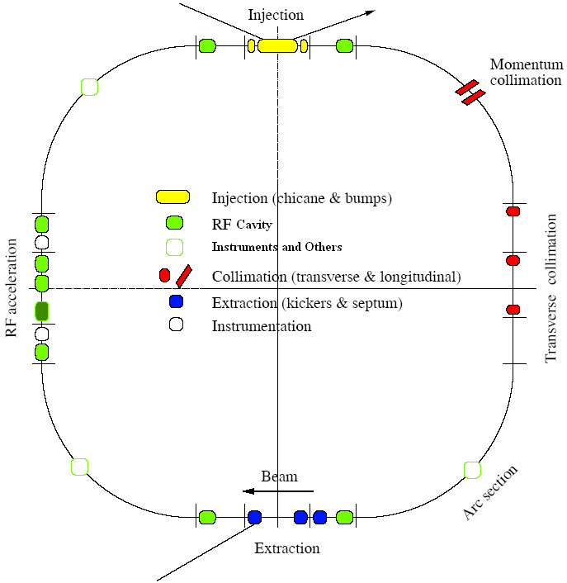
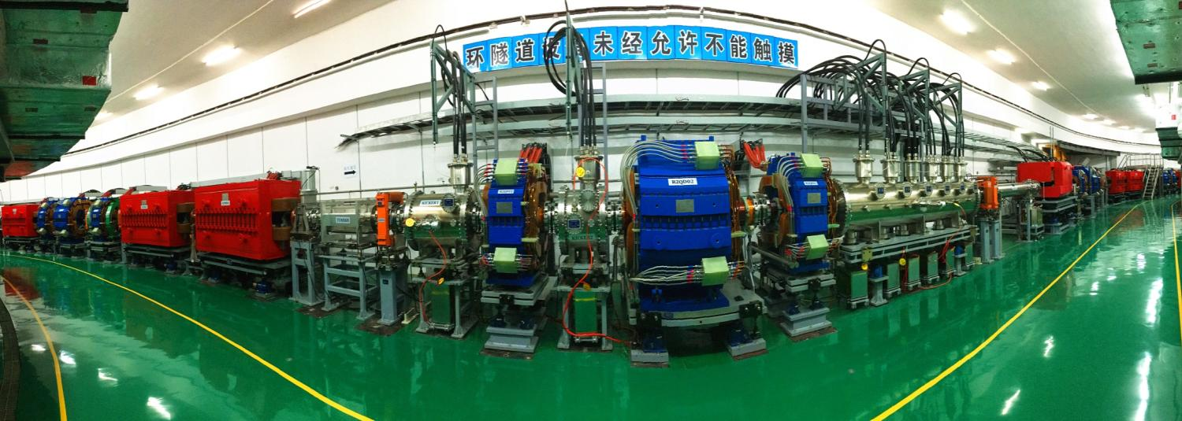
RCS Design
Lattice of 4-fold symmetry, triplet.
227.92m circumference.
Four long straight sections for injection, acceleration, collimation and extraction.
25Hz, 80~1600MeV

Slide 10
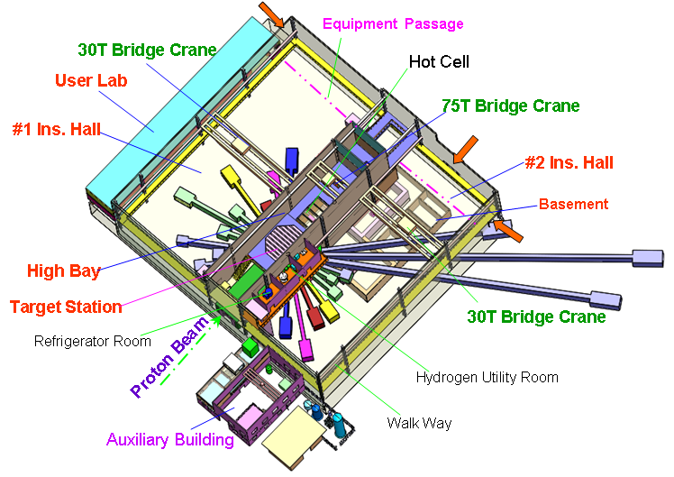
Neutron scattering hall

Slide 11
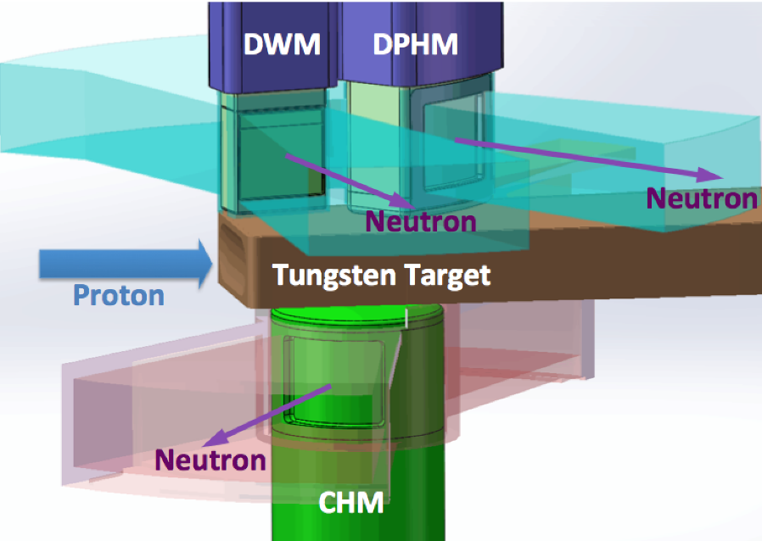
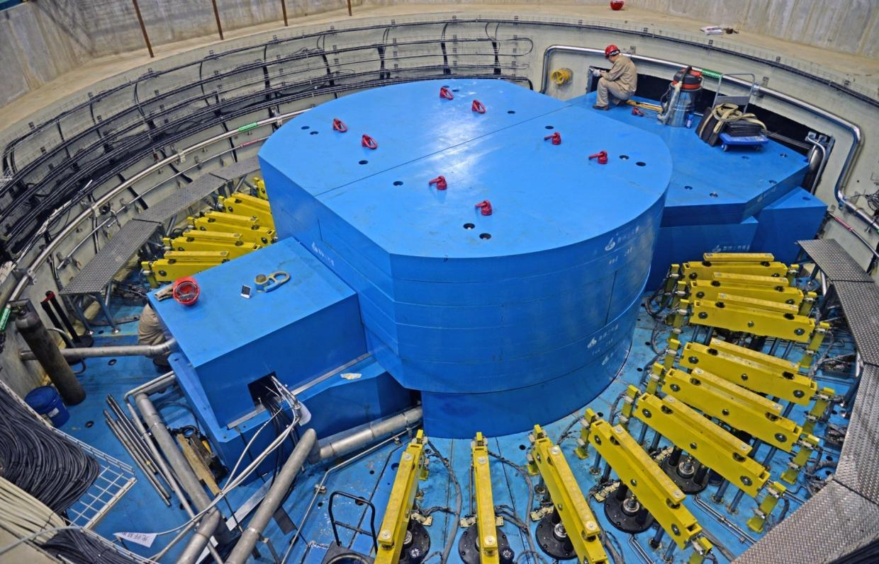
Target station

Slide 12
Neutron instruments layout
Back scattering
10B, reserved
High resolution PND
High energy neutron SEE
Engineering PND
Neutron physics
Cold neutron image
8A, reserved
VSANS
7, reserved
Quasi-elastic spectrometer
Molecular Vibration
High energy chopper spectrometer
MPI total scattering
High pressure PND
Low-energy chopper spectrometer
GPPD
Liquid reflectometer
Single crystal
MR
SANS
Polarized chopper spectrometer
Proton Beam
D+P, LH2 (20K）
C,LH2 (20K)
D, Water (300K)
D, LH2 20K)

Slide 13
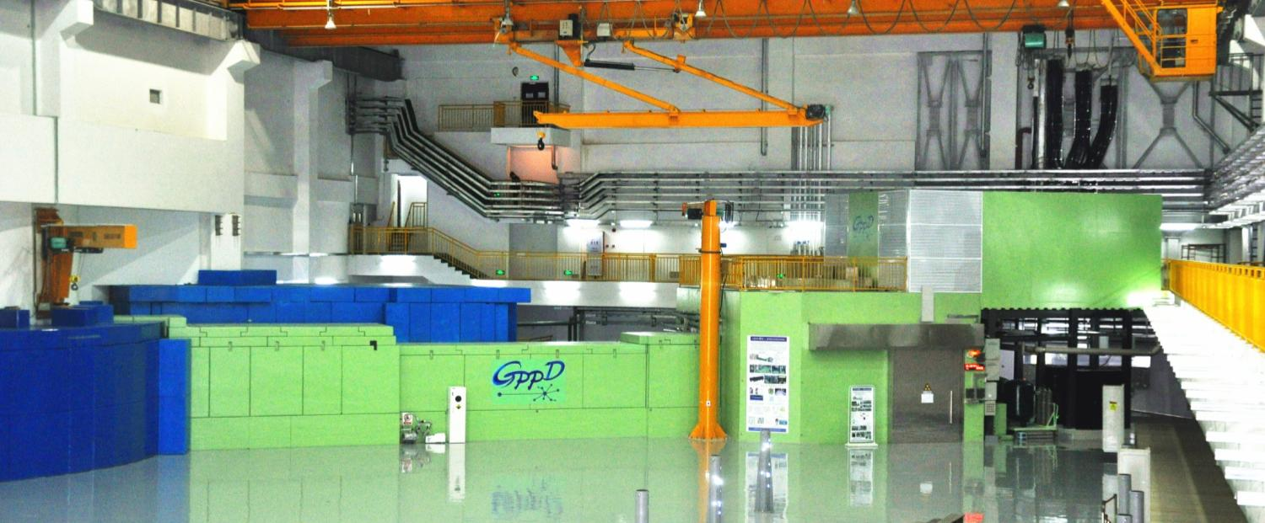
Neutron instrument: GPPD design
Moderator |  | DPHM（20 K）
Bandwidth(Δλ) |  | 4.5 Å
Max. Beam Size |  | 40(h)×20(w) mm
Flux at sample position |  | ~10⁷ n/cm²/s
Best Resolution(Δd/d) |  | 0.2 % at 2θ =150°
Guide |  | Taper focus, m=3
Source to sample distance L1 |  | 30 m
Sample-detector distance L₂ | 2θ =150° | 1.5 m
 | 2θ =90° | 2.0 m
 | 2θ =15° | 3.8 m
Performance:
  Determine crystallographic and magnetic structures in general purposes
  Best resolution Δd/d ~ 0.2 %.
  ~ mimutes for a diffraction histogram used by Rietveld refinement on ~ 1-g-weight sample
  Easily loading the ancillary equipment such as cryostat, furnace and pressure cell

Slide 14
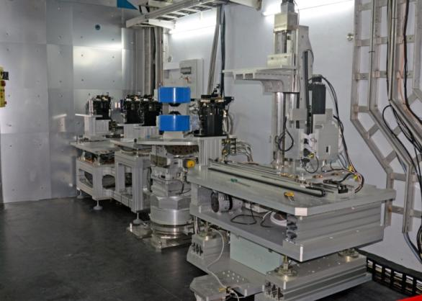
Neutorn instruments: MR design
Moderator | CHM (20 K)
Bandwidth（Δλ） | 6 Å
Guide | Bender+Sraight+Taper 40 × 60 → 20 × 30 mm²
SS distance L1 | 19.5 m
SD distance L2 | 2 m
Sample table | 6-axis movements
Polarizer/analyzer | Supermirror type
Detector | 2D position-sensitive resolution: 2 mm
Performance:
  Vertical sample geometry: solid film
  Reflectivity/diffraction
  Best resolution ΔQ/Q < 1%
  Polarizing analysis for spinoelectronics.
  In-suit study on growing films
  In-suit MOKE magnetic analysis
  Off-specular scattering
  Grazing-incidence small-angle scattering

Slide 15
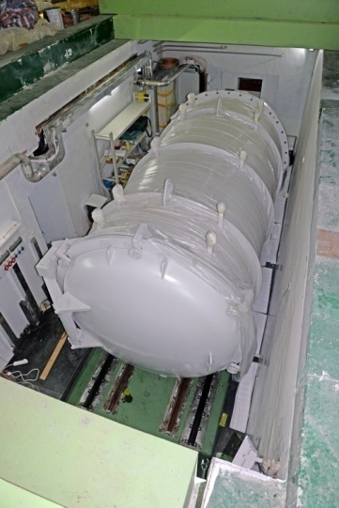
Neutron instruments: SANS design
Performance:
  Reliable SANS data between 0.01 ~ 0.5 Å⁻¹ to characterize 1-100 nm particles.
  Instrument resolution better than ~30% around Q_{min}
  Good dynamic range, sample space
  Variable sample size
Moderator | CHM（20K）
MS distance | 14 m
SD distance | 1~5 m
Detector
Effective area | 50×50 cm²
Resolution | 1 cm (FWHM)
Δλ | 0.4-8 Å
q range | 0.004-3.4 Å⁻¹

Slide 16
Outline
CSNS project overview
CSNS design
Commissioning & operation
Users and future plan
Summary

Slide 17
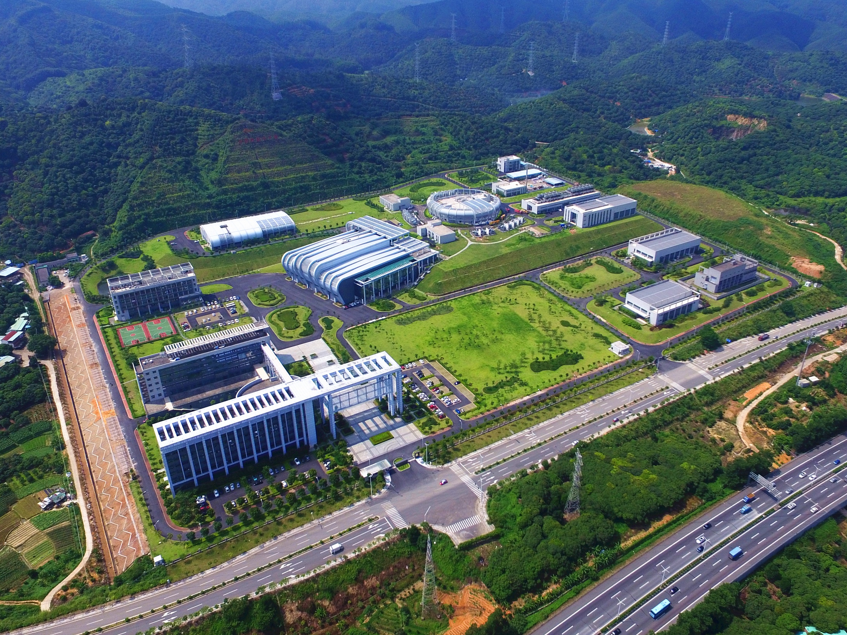
CSNS Site
Birds View of CSNS
August, 2017

Slide 18
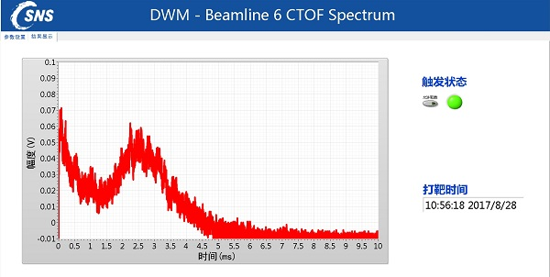
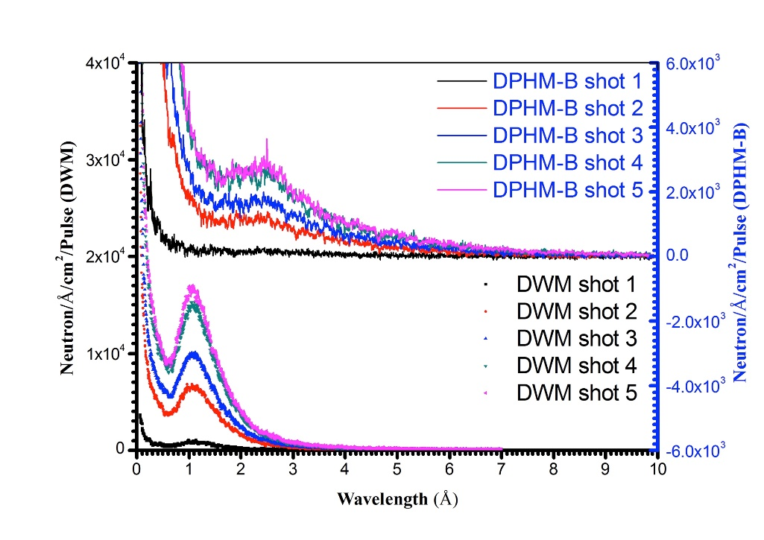
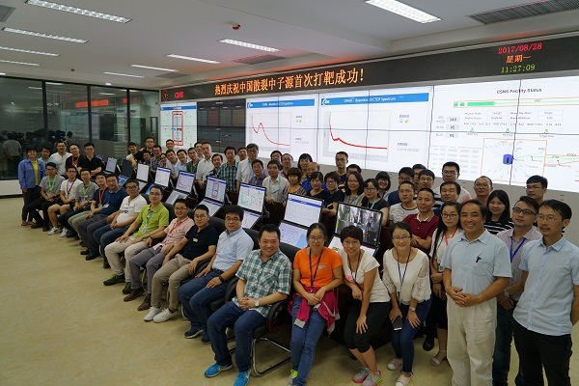
First Neutron @ Aug. 28, 2017

Slide 19
Design and Acceptance Goal
Design goal
Beam power | Rep. rate | Ave. Curr. | Beam Energy | Neutron Efficiency | Neutron Flux
100 kW | 25Hz | 63μA | 1.6GeV | 0.1(n/p/sr) | 2*10⁷
Acceptance goal
Beam power | Rep. rate | Ave. Curr. | Beam Energy | Neutron Efficiency | Neutron Flux
10 kW | 25Hz | 6.3μA | 1.6GeV | 0.005(n/p/sr) | 10⁵
23 kW | 25Hz | 14.5μA | 1.6GeV | 0.125 | 2.5*10⁶
In the technical test for official acceptance, all the acceptance goals have been reached, and most of them were exceeded.
On construction schedule!
19

Slide 20
Historical curve of beam power
80kW
30kW
50kW
10kW
20kW
Nov. 2017, First 10kW beam strike on target for a short while;
Mar. 2018, beam power over 20 kW in the test operation;
Jan. 2019, after 4 weeks beam commissioning , beam power was gradually increased to 50kW+ with well controlled beam loss.
Sep. 2019, based on the 6 weeks beam commissioning, the beam power in user operation was increased to 80 kW step by step.
We plan to increase the beam power to 100kW by the first half of 2020.
20

Slide 21
24 hours beam operation (Oct.8,2018)
21

Slide 22
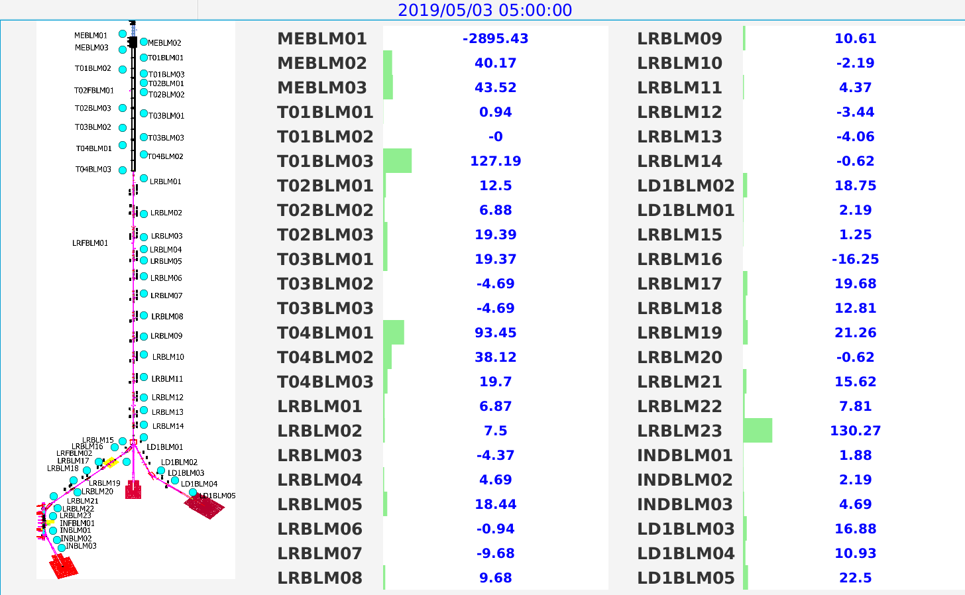
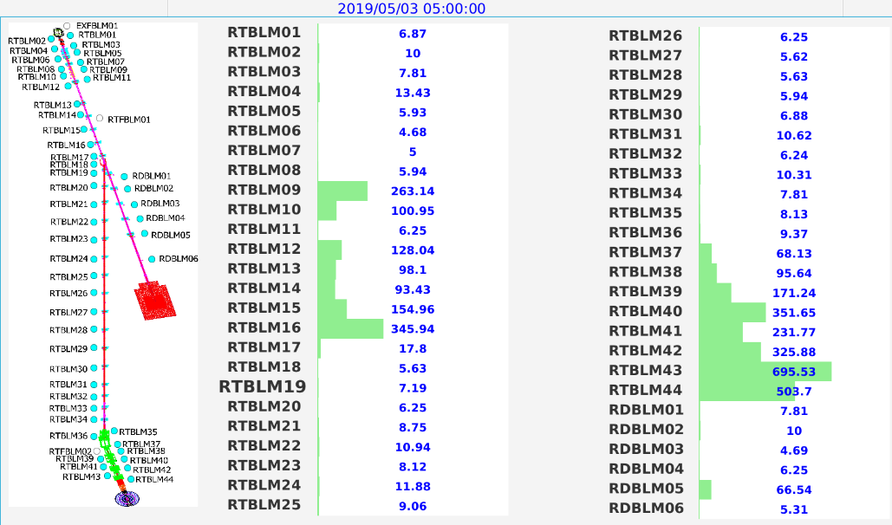
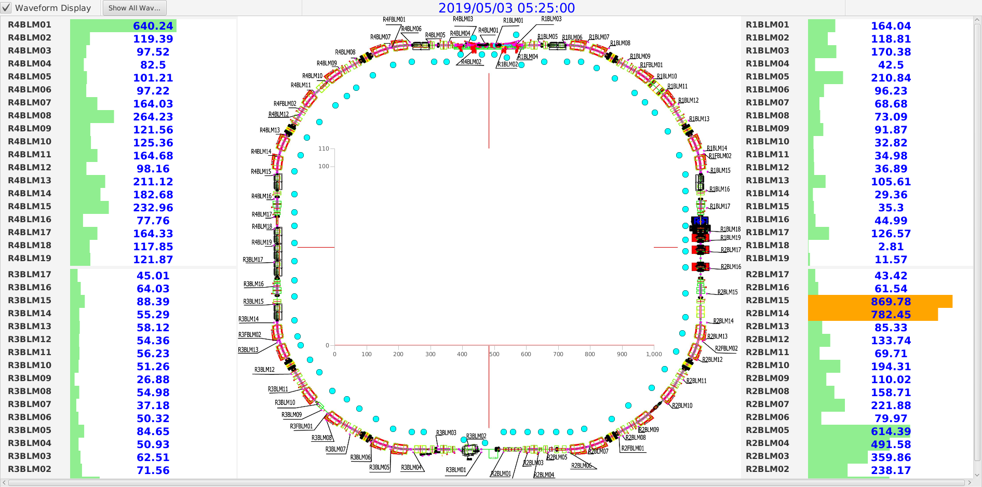
Beam loss and control
RTBT
Linac&LRBT
RCS
22

Slide 23
Machine hours Statistics (18.10-19.6)
4055 hours was provided to users in the first user operation
The availability is over 92% during the user operation
23

Slide 24
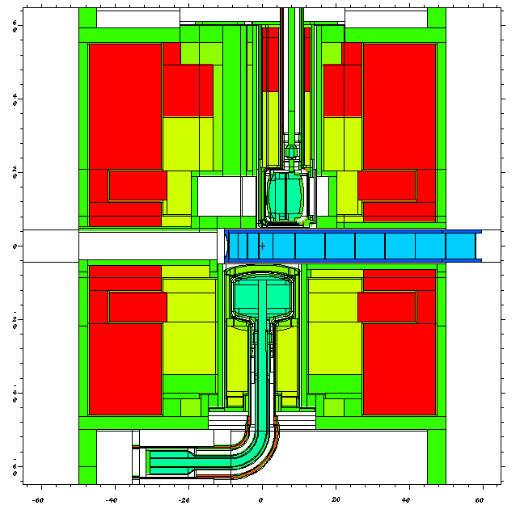
Neutronics Performance of Target Station
  Measured spectra & pulse shape agreed well with simulation.

Slide 25
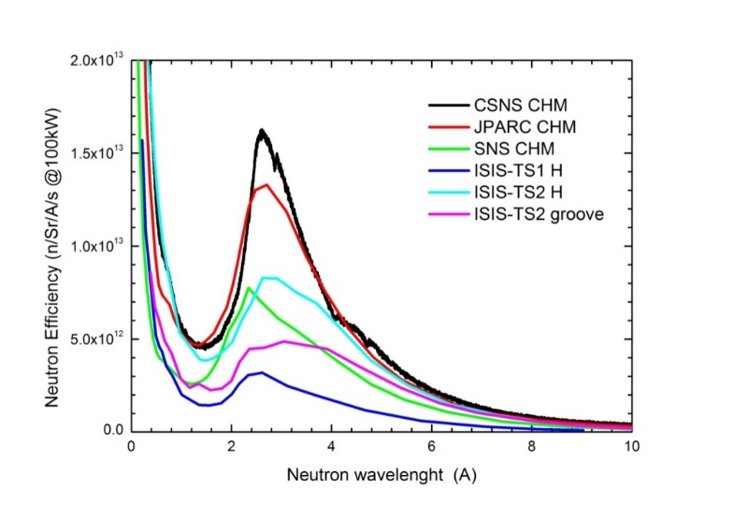
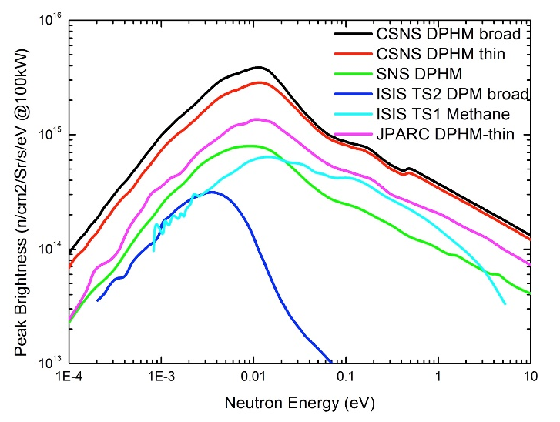
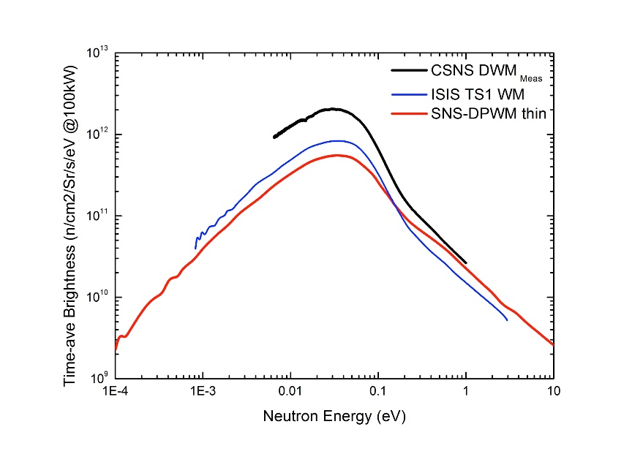
Neutronics Performance of Target Station
Wavelength spectra (CHM) Peak brightness (DPHM)
The neutronic performance of the source (and moderators) is excellent, and provides evidence of strong coupling between the target and the moderators.
NTAC10 report, Dec，2018
TAV brightness (DWM)

Slide 26
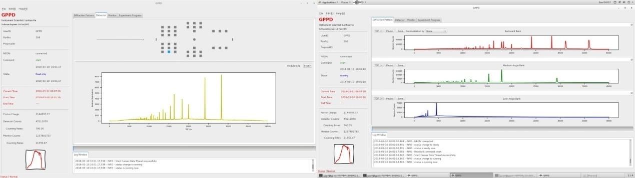
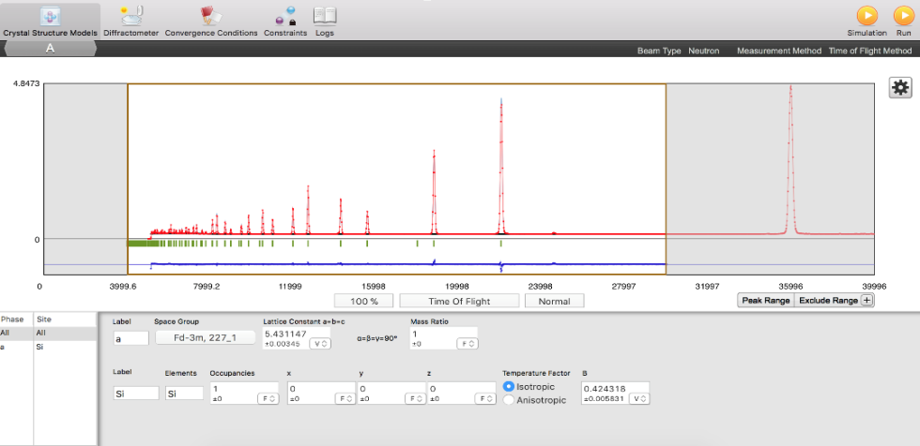
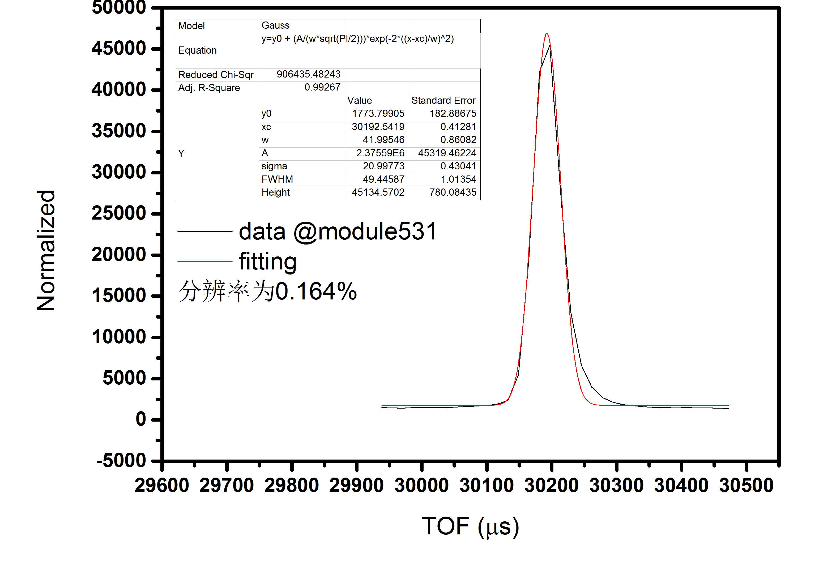
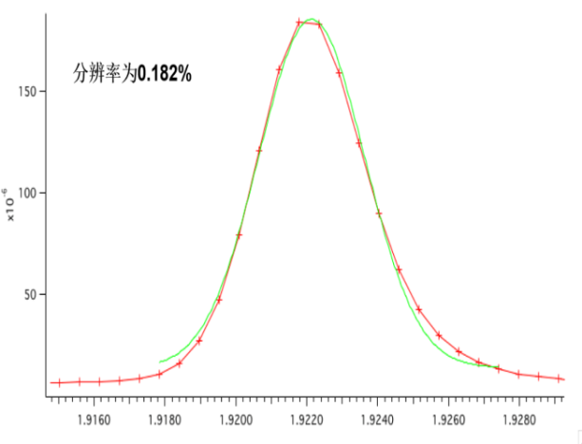
Commissioning of GPPD
NIST-640e standard sample Si, refinement Rp = 1.88%、Rwp= 2.89%
GPPD can obtain accurate and reliable information on the determination of crystal structure and magnetic ordered structure, the discrimination of light elements and adjacent transition elements and so on.
GPPD review committee, April, 2018
0.164% for one module
@ back scattering
0.182% for back scattering bank
Better than the design goal

Slide 27
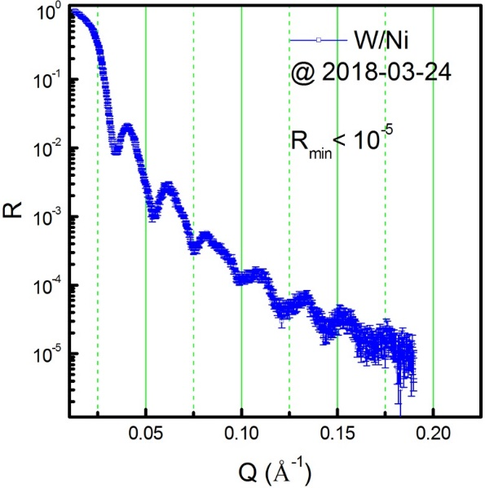
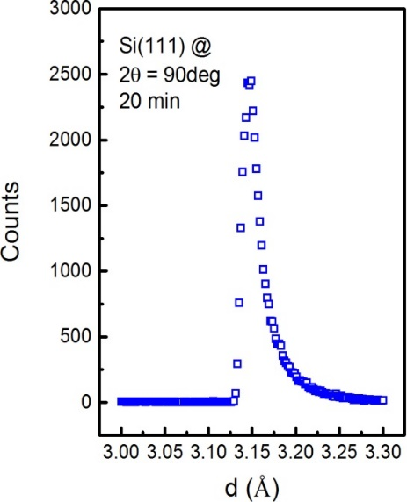
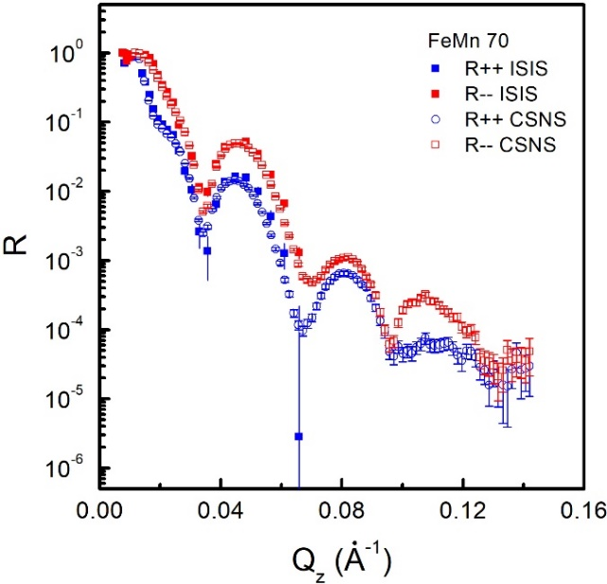
Commissioning of MR
∼20 hrs
Function NR：R_{min}<10⁻⁵ Diffraction: Δd/d = 0.6% PNR: done

Slide 28
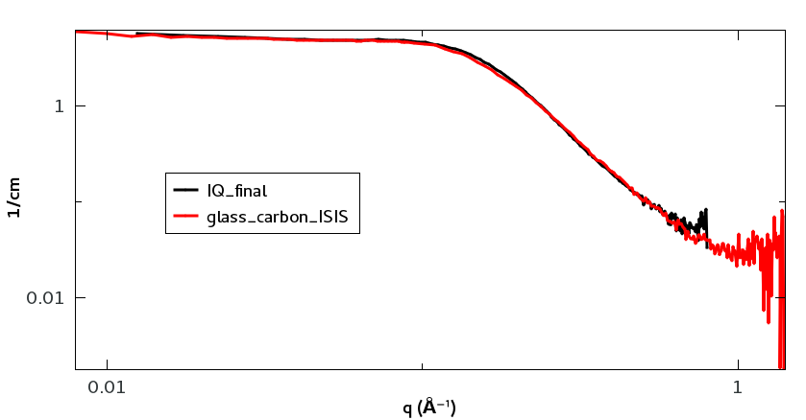
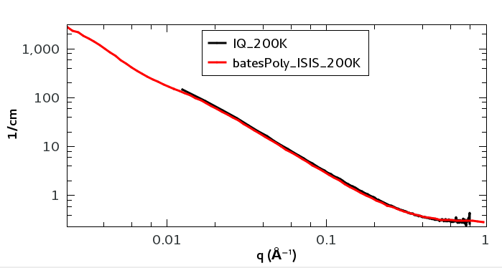
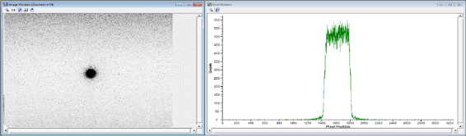
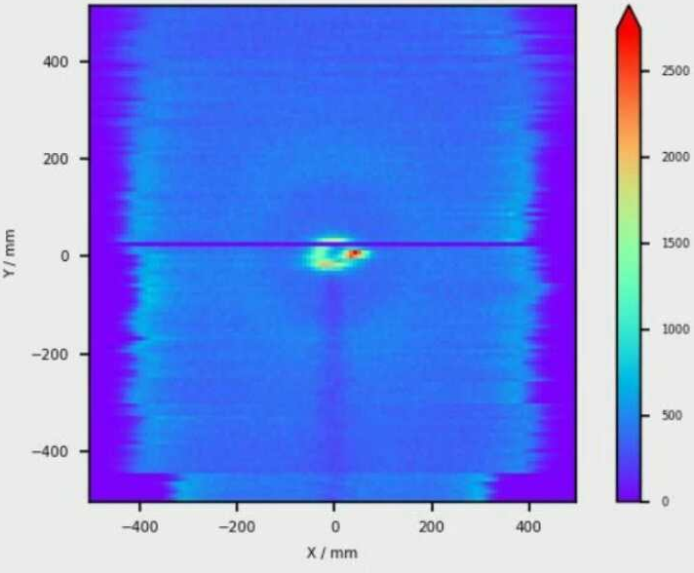
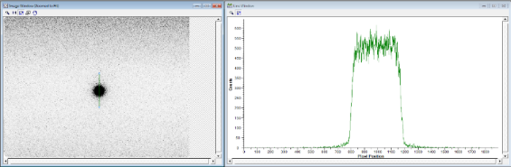
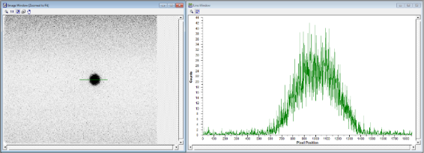
Glass carbon & Bates-poly，molecular weight: 200 k
Commissioning of SANS
Scattering from steel flange
Beam size diagnostic Background analysis

Slide 29
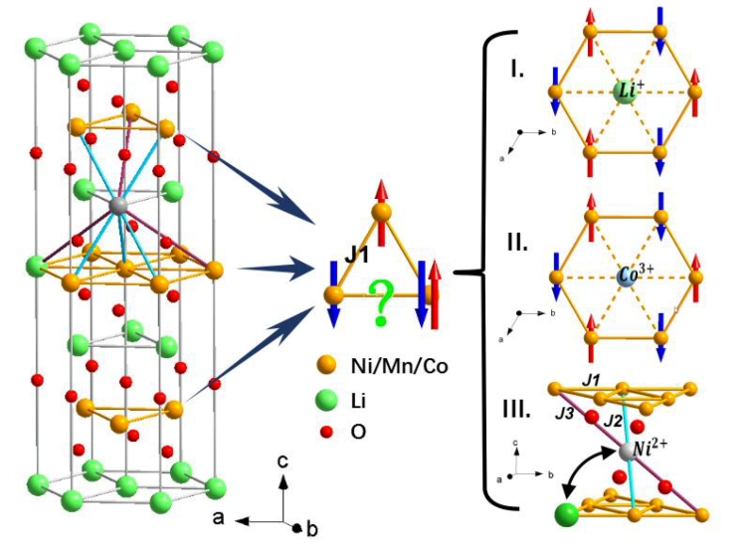
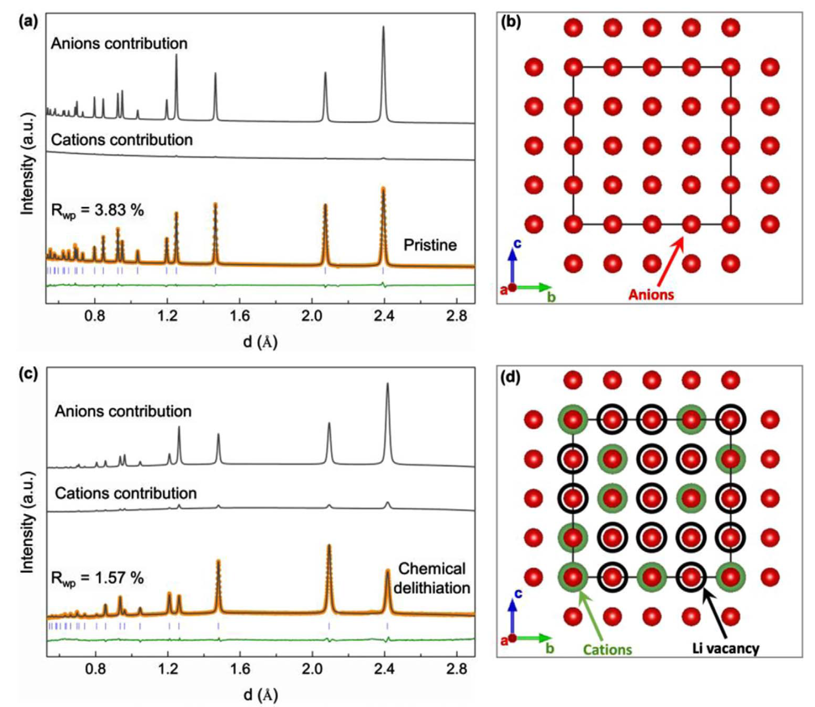
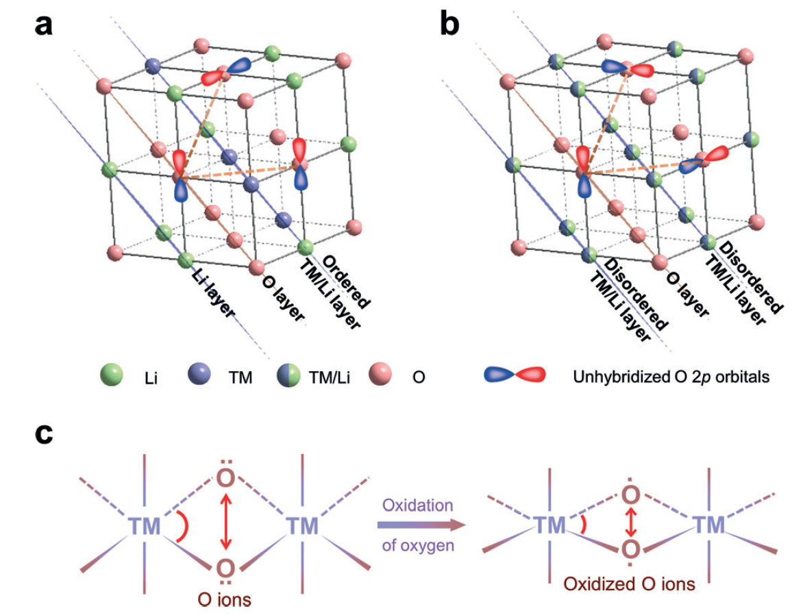
GPPD: Li-ion batteries research
Li/Ni exchange ratios in series of LiNi_{x}Mn_{y}Co_{z}O2 materials are precisely determined for the first time
The superior structure stability and robust anions framework of LTNNbOF (280 mAh/g) upon (de)lithiation process were experimentally demonstrated.
The structural-dimensionality effect on the l-OR and associated oxygen lattice stability in Li-rich cathodes have been characterized and clarified.
Illustration of a pair of Li/Ni exchange and arrangement of magnetic moments in the TM layer of triangular lattice
Rietveld refinement of the NPD patterns and calculated cations/anions diffraction patterns for the pristine and the corresponding schematic crystal structure.
a) 2D-ordered cation layer; b) 3D-disordered cation framework; c) Schematic representation of the shrinking distance between a pair of O–O ions and the corresponding structure distortion.
Y.G. Xiao et al. Nano Energy 2018, 49, 77–85
E.Y. Zhao et al. Energy Storage Materials 2019, 16, 354–363
E.Y. Zhao et al. Angew. Chem. Int. Ed. 2019, 58, 1–6

Slide 30
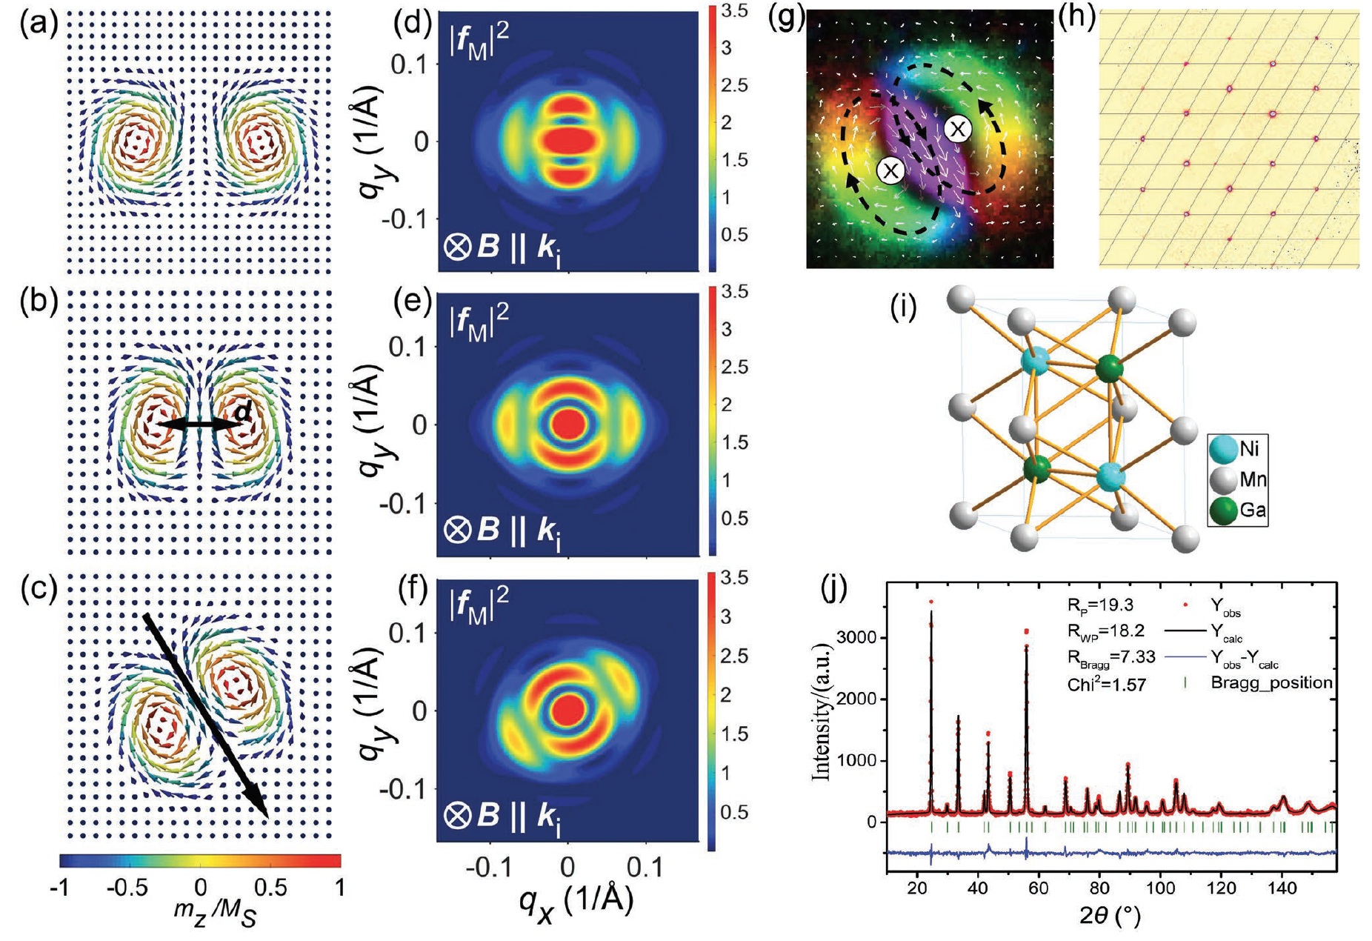
GPPD: Magnetic skyrmions research
The structural parameters of the biskyrmion state in MnNiGa bulk crystals was determined
a–c) Structural parameters describing a C2v biskyrmion; d–f) The simulated magnetic form factors corresponding to (a–c), respectively; g) An in-plane magnetization of the biskyrmion configuration. h) The MnNiGa single-crystalline sample is checked using a single-crystal X-ray diffractometer; i,j) The refinement result of high-resolution neutron powder diffraction data.
X.Y. Li, et al. Adv. Mater. 2019, 1900264
Notes:
1. Biskyrmions do not assemble into a long-range-ordered lattice. Instead, their correlation length always remains comparable to the periodicity of the stripe domains, and increases with increasing magnetic field.
2. Although biskyrmions do not order into periodic lattices on a large length scale, they are in-plane rotationally ordered, with the rotation direction being locked to certain crystallographic directions.
These polar molecular properties of the biskyrmion system suggest an intricate energy balance in MnNiGa, which is fundamentally different from chiral skyrmion systems. Such anisotropic nature, representing an extra degree of freedom for this type of skyrmions, may be exploited as information carrier. In this case, the two binary states are encoded within the same topological state, which reduces the energy consumption that is required for the state switching, demonstrating advanced device scheme for skyrmion-based memories.

Slide 31
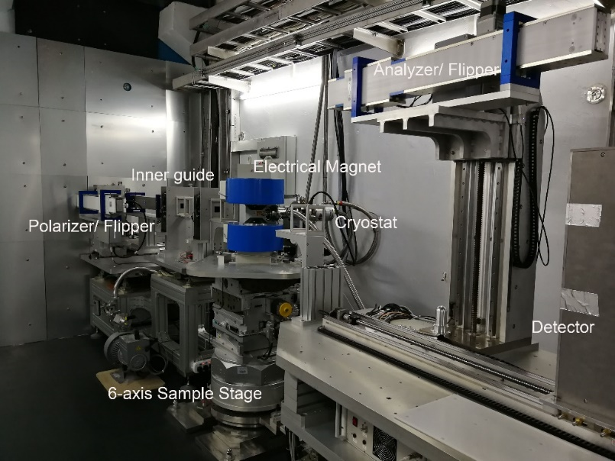
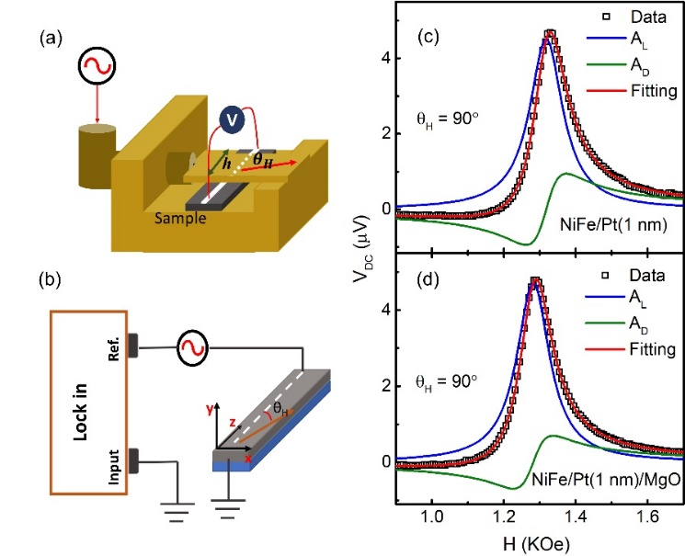
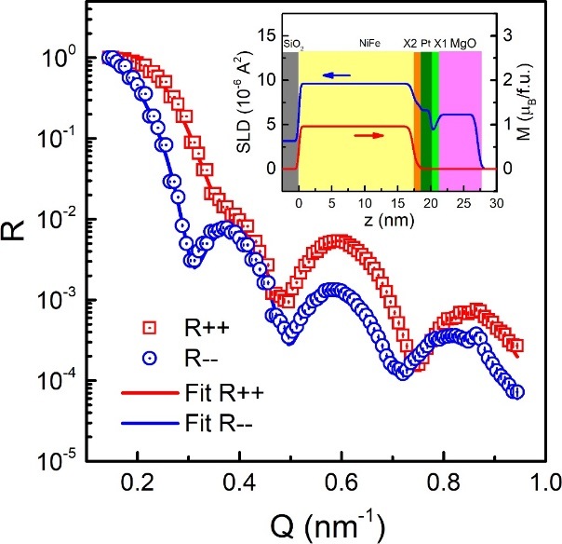
MR: Multipurpose Reflectometer
Interface Induced Enhancement of Inverse Spin Hall Voltage in NiFe/Pt Bilayers Capped by MgO layer
Probe the deep inside a film
First PNR data
@ CSNS
Zhu et al 2018 Neutron News, 29(2), 11
The SLD profile shows an interface between pure Pt and MgO layers with their nominal SLDs, which supporting an interfacial induced ISHE enhancement.
Zhu et al 2019 J. Phys.: Condens. Matter https://doi.org/10.1088/1361-648X/ab172a

Slide 32
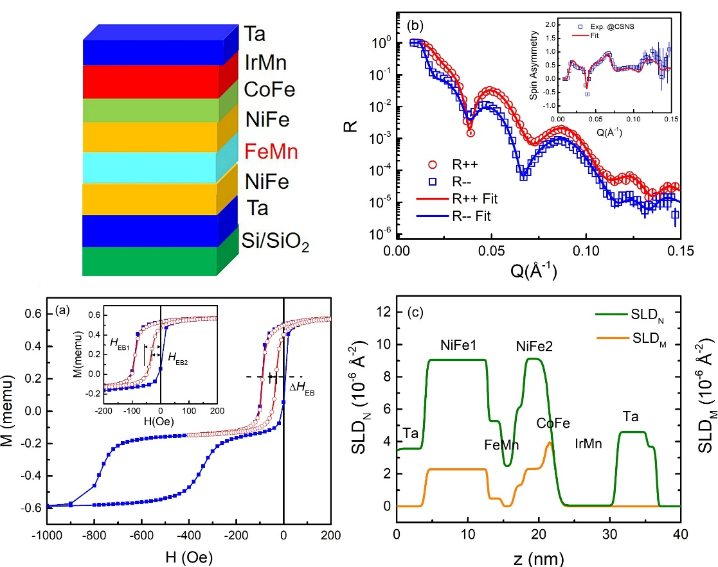
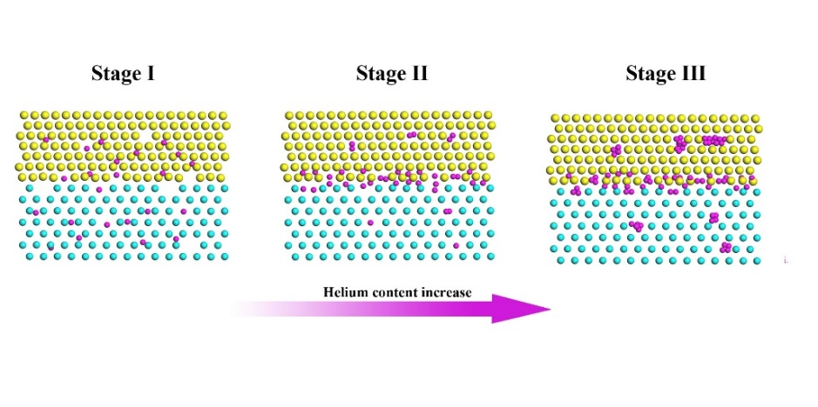
MR: Multipurpose Reflectometer
Probing the Transfer of the Exchange Bias Effect by Polarized Neutron Reflectometry
The behavior of helium atoms in He+ ion implanted W/Ni bilayer nanocomposite
Sensitivity to reveal the complicated
magnetic structure in the film.
X.Z. Zhan et al. 2019 Sci. Rep. 9, 6708
H.C. Chen et al. Appl. Phys. Surf. (in press)

Slide 33
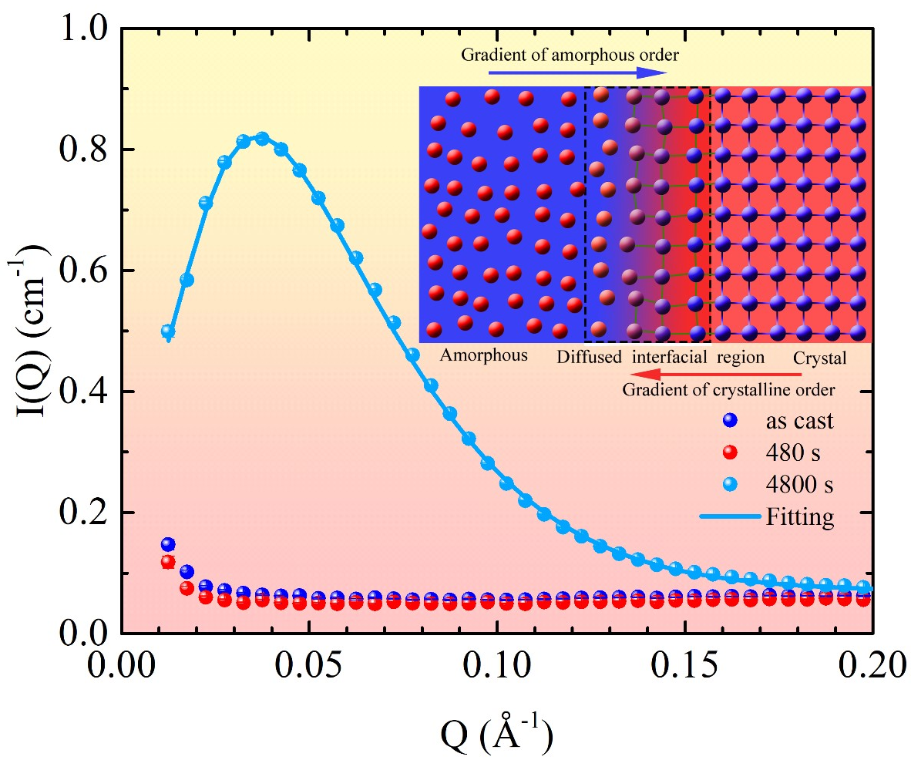
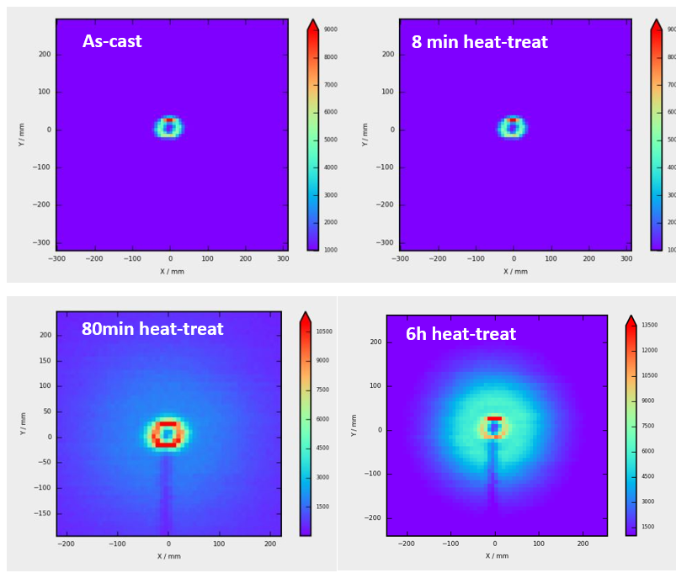
SANS: Metal glass
The pathway of amorphous-to-crystalline phase transformation in Zr-, Fe- and Pd-based bulk metallic glasses
In-situ observation of an unusual phase transformation pathway with Guinier-Preston zone-like precipitates in Zr-based bulk metallic glasses
W.X. Dong, et al. Acta Materials (Under Review) CityU & NUST team lead by X.L. Wang
Notes:
采用中子小角散射技术研究了Zr-基BMG由非晶到结晶的动力学问题，提出了一种基于短程原子输运的相分离机理。

Slide 34
Running Scheme in 2019
System /Instrument | Planed Hour | Included Hour |  |  |  | Running Data of Similar International Advanced Facilities
 |  | Preparation | Beam Time(for User Experiments) | Instrument Development | Downtime
Accelerator | 6000 | 1000 | 3600 | 1000 | 400 | 5900
Target | 5600 | 1000 | 3600 | 800 | 200 | 3980
Instruments
GPPD | 3600 | 50 | 2800 | 600 | 150
MR | 3600 | 50 | 2600 | 800 | 150
SANS | 3600 | 50 | 2600 | 800 | 150

Slide 35
Outline
CSNS project overview
CSNS design
Commissioning & operation
Users and future plan
Summary

Slide 36
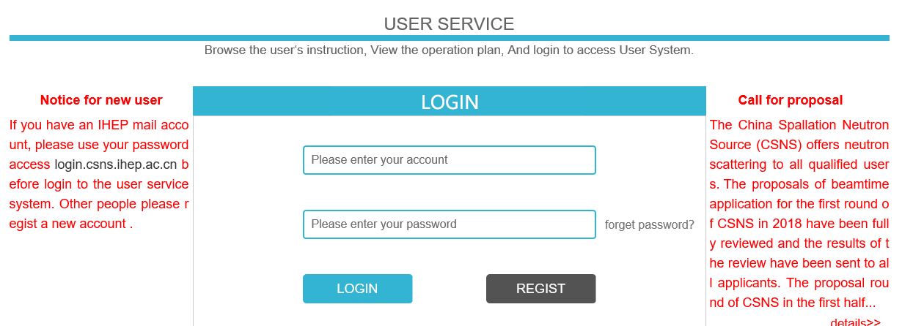
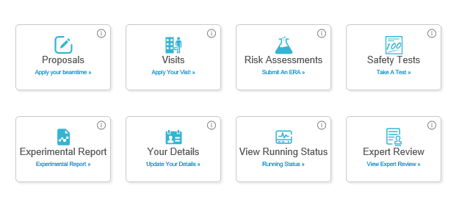
User service
https://user.csns.ihep.ac.cn (in both Chinese and English）
International users are welcomed
Register an account
Third call for proposal:
2019.06
For third round operation
2019.09-2020. 01
Submit a proposal
Proposal type：
1.Direct access
2.Rapid access

Slide 37

User Proposals
First operation year（Sept. 2018-June. 2019）:
    performed 101 (included 11 from oversea and HK) (acceptance 50%)
    Research fields: energy material, structural material， magnetic, film, alloy, polymer, nano, biology material, hydrogen storage, drug et. al.
Next operation period（Sept. 2019 - Jan. 2020）:
  regular application 164, 35% accepted
  approved 57 proposals (included 7 from oversea, HK and Macao)
Chinese publications in neutron scattering
37

Slide 38
User Instruments
Multiple Physics Instrument by Dongguan Institute of Technology, and CityU (HK) under construction
Engineering Diffractometer by Center for Excellent Advanced Materials (Dongguan) under construction
High Pressure Diffractometer by South China Univ. of Sciences and Technology (Shenzhen),
Atmosphere Neutron Irradiation by China Electronic Product Reliability and Testing Inst. under construction
High energy chopper spectrometer by SUN YAT-SEN Univ.
Guangdong Province Government Donation:
Very small angle neutron scattering
Energy resolved neutron imaging

Slide 39
Neutron instruments layout
Back scattering
10B, reserved
High resolution PND
High energy neutron SEE
Engineering PND
Neutron physics
Cold neutron image
8A, reserved
VSANS
7, reserved
Quasi-elastic spectrometer
Molecular Vibration
High energy chopper spectrometer
MPI total scattering
High pressure PND
Low-energy chopper spectrometer
GPPD
Liquid reflectometer
Single crystal
MR
SANS
Polarized chopper spectrometer
Proton Beam
D+P, LH2 (20K）
C,LH2 (20K)
D, Water (300K)
D, LH2 20K)

Slide 40
Future Plan
  CSNS Phase II (14th 5 year plan from 2021 ) :
  More neutron Instruments (10 instruments)
  More sample environment and user lab.
  Beam power upgrade to 500kW ：
    LINAC beam energy upgrading to 300MeV by superconducting cavities. The tunnel is available.
    RCS works for 500kW with minor upgrade
    Target upgrading to 500kW: new target and modulators. (shielding and utility fulfill 500kW)
    Long term
    Second target stations
    Muon beams
  ……

Slide 41
Summary
CSNS finished construction and reached the specifications on schedule, and passed the national acceptance on Aug. 2018 and was opened to users.
CSNS is the operation: stable running with high efficiency, improving performance.
The design and construction of user instruments are underway.
The phase-II instrument construction and the power upgrade will be started rather soon.
Thanks advices and helps from Foreign Lab.’s and scientists during the design, construction and commissioning of CSNS
CSNS welcomes intl. users and looks forwarded for cooperation in the neutron scattering and applications..

Slide 42

Thank you ！

