Slide 1
Challenges for Grazing Incidence Neutron Scattering at Pulsed Sources: Beyond basic experiments and data analysis
V. Lauter
Neutron Scattering Division
Oak Ridge National Laboratory, USA

Slide 2
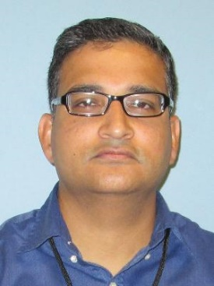


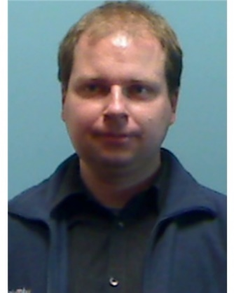
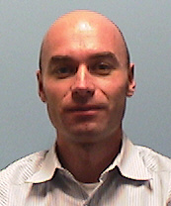

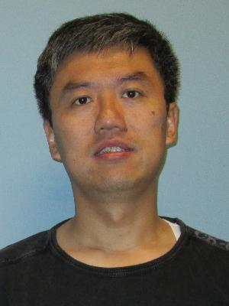


Collaborators & Acknowledgments
Center for Nanophase Materials Science, ORNL
Rajeev Kumar,
Wei Li
Bobby Sumpter
Neutron Scattering Division, ORNL
Andrei Savici, Steven Hahn, Mathieu Doucet
Computational Sciences&Engineering
Division, ORNL
Eric Lingerfelt
Yawei Hui
University of Tennessee, Knoxville
J. P. Mahalik
Scientific User Facilities Division, Office of Basic Energy Sciences, U.S. Department of Energy, Laboratory Directed Research&Development

Slide 3
Outline
Grazing Incidence Neutron Scattering (GINS):
GINS= Specular reflection + off-specular scattering+ GISANS
Scattering in Time of Flight : advantages, difficulties & specifics
Structure
How can we obtain a precise correlation between the local interfacial characteristics and global physical properties?
Computational workflow
SCFT modeling as benchmark
Outlook
Development of workflow that can be extended and applied to other codes running on HPC

Slide 4
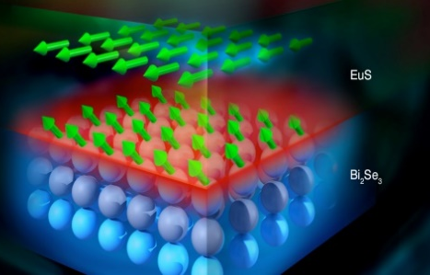
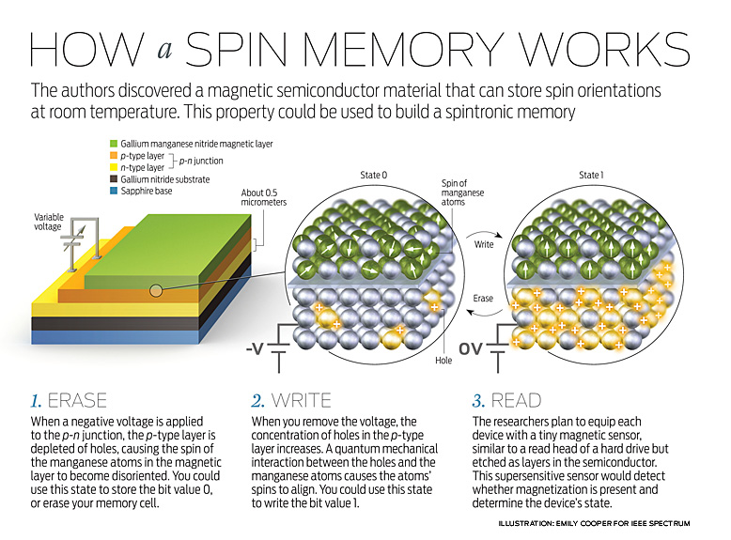
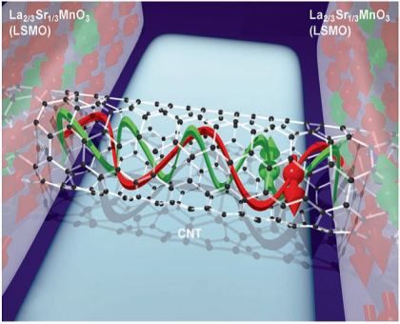
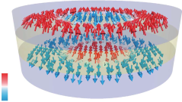
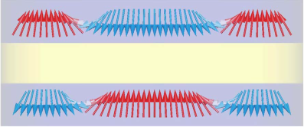
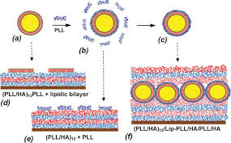
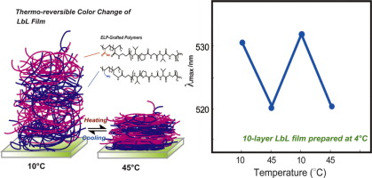
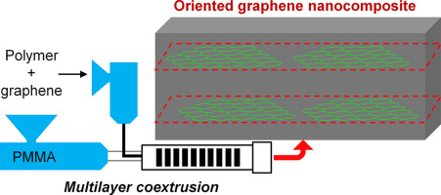
Mesoscale control of thin film heterostructure materials - Why is it important?
“Functionality often arises at the mesoscale, where defects, interfaces, and non-equilibrium structures are formed “,
From Quanta to the Continuum: Opportunities for Mesoscale Science, a report from the Basic Energy Sciences Advisory Committee (2012)
Topological insulators
Spintronic devices
Bi-layer skyrmion
Multifunctional oxide
heterostructures
Liposome in electrolyte multilayers
Thermo-responsive multilayer films of ionic polymers&peptide
Oriented graphene nanocomposites
These novel materials are in need of characterizing their surfaces, boundary conditions and interfaces in the microscopic and mesoscopic length scales.
Structural characterization of multiple length scale with depth sensitivity

Slide 5
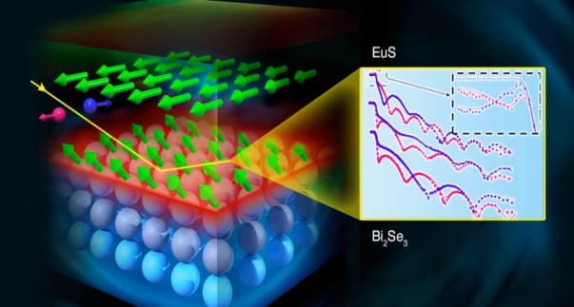
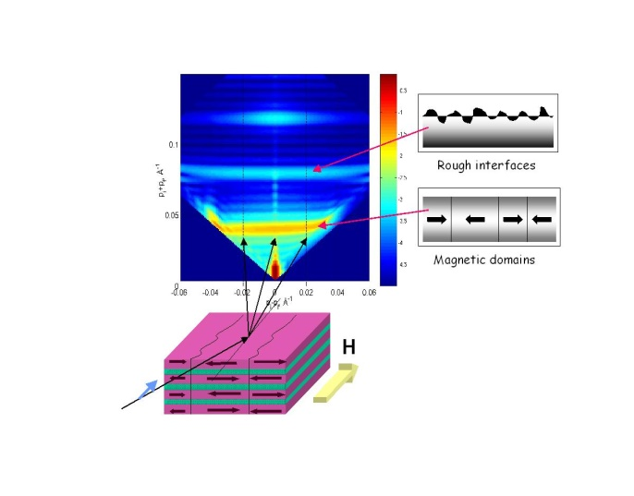
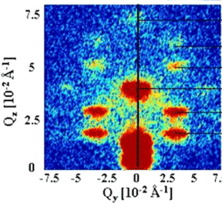
Solving the problem: using effective tools for characterization
Neutron Reflectometry – neutron grazing incidence method for thin films and heterostructures
Structure and magnetization
Depth-sensitive with high resolution
Neutron Reflectometry: 3 scattering channels:
Specular reflection
Off-specular scattering
GISANS
depth profile
lateral structure
lateral structure
0.5 nm resolution Qz
0.1-100μm length scale, Qx
1 - 100 nm length scale, Qy
Q_{z}
Q_{x}
Q_{y}
Lauter et al. Nature 2016
M. Wolf
At present the majority of published data on reflectometry concerns only specular reflection
Rich information contained in off-specular data is not being exploited
Analysis of all three channels: specular reflection, off-specular scattering and GISANS allows to explore the systems quantitatively in three dimensions on enormous length scales

Slide 6
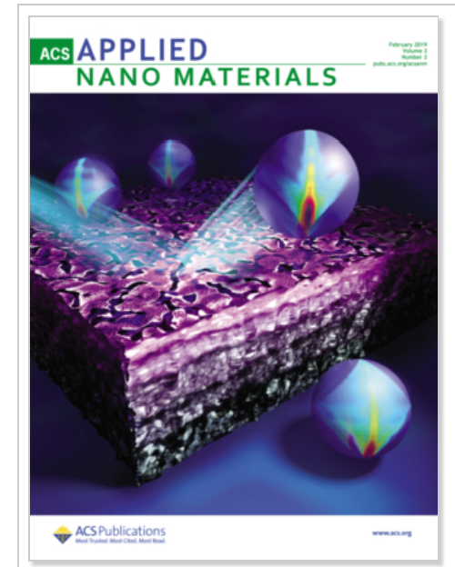
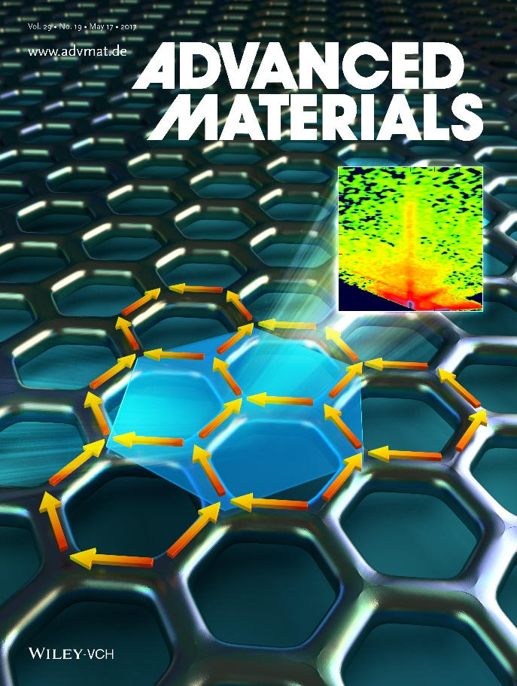

Recent publications from Magnetism Reflectometer at SNS
ITO Multilayer Thin Films for Patternable Transparent Electrodes
Artificial two-dimensional honeycomb lattice
Voltage pulses synchronized with the pulsed neutron source were applied to a phospholipid bilayer membrane
Published February 2019
Published March 2019
Published July 2019
Field and current control of the electrical conductivity of an artificial two-dimensional honeycomb lattice
Deepak Singh et al, Missouri University, Columbia
Voltage-Dependent Profile Structures of a Kv- Channel via Time-Resolved Neutron Interferometry
J. Kent Blasie et al, University of Pennsylvania
3D Nanoscale Mapping of Porosity in Solution-Processed ITO Multilayer Thin Films for Patternable Transparent Electrodes
Rosario Gerhardt et al, Georgia Tech, Atlanta

Slide 7
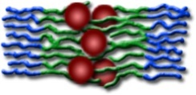
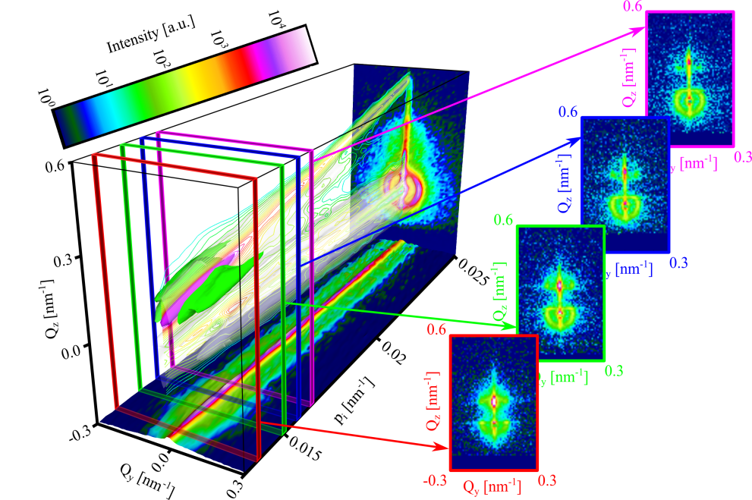
Beyond basic experiment: Unique capability at Spallation Source:
Grazing Incidence Neutron Scattering (GINS) for complete characterization and mesoscale control of thin film heterostructure materials
Specular reflection
+
Off-specular scattering
+
GISANS
=
GINS
depth profile
lateral structure
lateral structure
3D structure
GINS experiments are being performed now at SNS
Time-of-flight
Despite the exceptional experimental capabilities, robust, dedicated and publicly available software for data analysis and modeling is not available to users
Theoretical formalism of the Distorted wave Born approximation (DWBA) for calculation of GINS is reported in the literature but is no relevant code exists
The rich information contained in these data is not being exploited without advanced software
GINS pilot experiment performed at the Magnetism Reflectometer at SNS on a multilayer heterostructure of magnetic Fe₃O₄ nanoparticles self-assembled in a block-copolymer matrix
V. Lauter et al, Reference Module Material Science and Materials
Engineering, Elsevier, 2016; ISBN: 978-0-12-803581-8
Advanced software tools for the analysis and modeling of Grazing Incidence Neutron Scattering (GINS) of complex heterostructures at the Spallation Neutron Source -> access to the interface driven properties

Slide 8
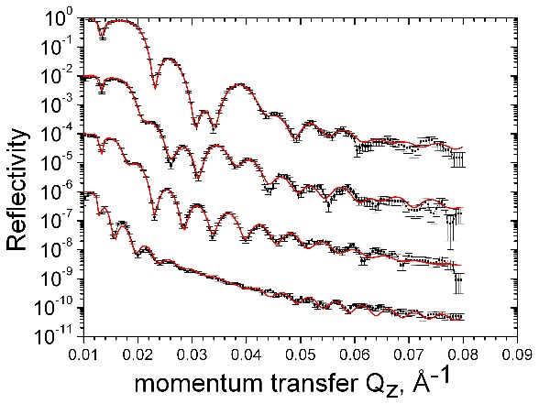
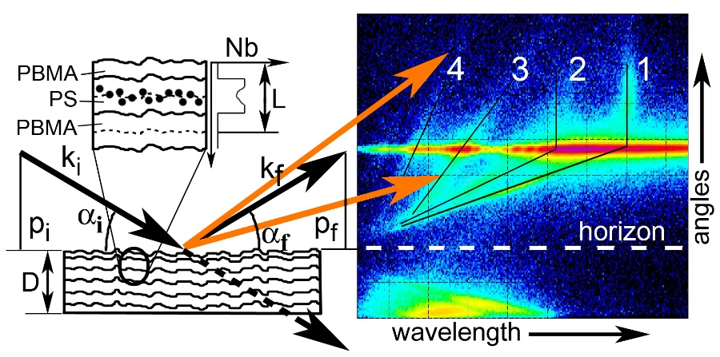
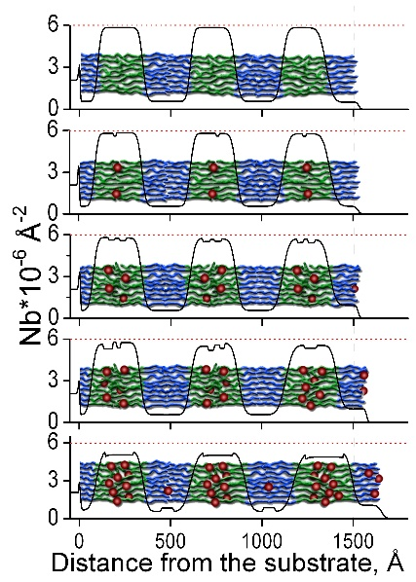
Novel approach towards exploration of mesoscale materials ?
Neutron Reflectometry Experiment
NSLD depth profile
V. Lauter et al. , 2016
Conventional reflectometry experiments provide only structural parameters via fitting model to the data
Can we obtain access to the interaction parameters causing this structure?
To realize this one needs a different approach to the data analysis
Development of next generation data handling modus operandi for data analysis and modeling

Slide 9
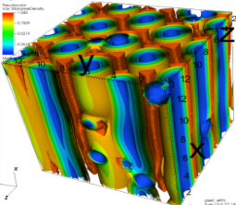

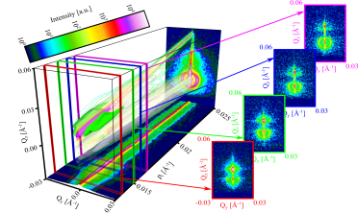
Development of computational workflow capable of generating theoretical models in quantitative agreement with Grazing Incidence Neutron Scattering data (GINS)
Beyond conventional data analysis
The implementation of a computational workflow integrating high performance computing (HPC) with experiment via an intuitive, cross-platform user interface
User-friendly Interface
Computational Workflow
4
TITAN
SCFT
simulations
3
Model
5
cost-function
Minimizer
1
2
Experiment
Theoretical
DWBA calculations
of GINS

Slide 10

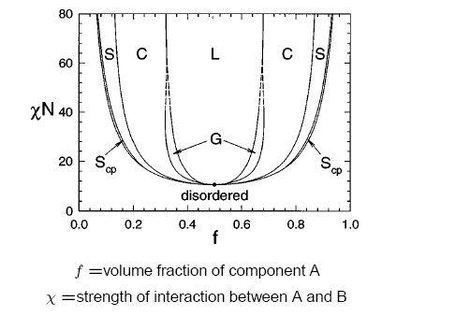
Development of computational workflow capable of generating theoretical models in quantitative agreement with Grazing Incidence Neutron Scattering data (GINS)
Beyond conventional data analysis
The implementation of a computational workflow integrating high performance computing (HPC) with experiment via an intuitive, cross-platform user interface
User-friendly Interface
Self-Consistent Field Theory (SCFT)
Computational Workflow
4
A
B
TITAN
SCFT
simulations
3
Model
5
cost-function
Minimizer
Phase diagram
1
2
Experiment
Theoretical
DWBA calculations
of GINS
χ - strength of interaction between A and B
f - volume fraction of component A

Slide 11
Development of computational workflow capable of generating theoretical models in quantitative agreement with Grazing Incidence Neutron Scattering data (GINS)
Beyond conventional data analysis
The implementation of a computational workflow integrating high performance computing (HPC) with experiment via an intuitive, cross-platform user interface
User-friendly Interface
Self-Consistent Field Theory (SCFT)
Computational Workflow
4
A
B
TITAN
SCFT
simulations
3
Model
5
cost-function
Minimizer
Phase diagram
1
2
Experiment
Theoretical
DWBA calculations
of GINS
χ - strength of interaction between A and B
f - volume fraction of component A

Slide 12
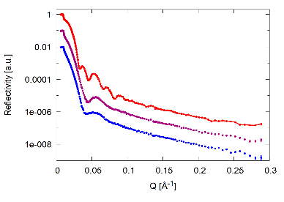
Development of computational workflow capable of generating theoretical models in quantitative agreement with Grazing Incidence Neutron Scattering data (GINS)
Beyond conventional data analysis
The implementation of a computational workflow integrating high performance computing (HPC) with experiment via an intuitive, cross-platform user interface
User-friendly Interface
Self-Consistent Field Theory (SCFT)
Computational Workflow
4
A
B
TITAN
SCFT
simulations
3
Model
5
cost-function
Minimizer
Phase diagram
1
2
Experiment
Theoretical
DWBA calculations
of GINS
χ - strength of interaction between A and B
f - volume fraction of component A

Slide 13
Modeling Scheme: Self-Consistent Field Theory
Polymer-air
Polymer-substrate
Polymer-Polymer
Hybrid SCFT scheme used for diblock copolymer nanocomposite thin films & Brownian dynamics of NPs
System: dPS-PBMA block copolymer thin film with or without hairy nanopartiles (Fe₂O₃ core and PS Corona), Lauter-Pasyuk et al, Langmuir, 19, 7783, 2003
Short range interaction parameter between different pairs fitted to match the scattering length density and neutron reflectivity profile of the experimental results.
χ_{S-Air}
χ_{BMA-substrate}
χ_{BMA-Air}
χ_{S-BMA}
χ_{S-Substrate}
dPS
PBMA
χ_{S-NP}
χ_{BMA-NP}
PS corona
Fe₂O₃ core
Polymer-nanoparticle
melt of n A-B diblock copolymer chains confined between two parallel substrates
Local incompressibility constraint: sum of volume fractions of all the components (substrates, polymers, and nanoparticles) add up to 1
Numerical solution of the SCFT equations &Brownian dynamics of NPs
simulated using Polyswift++ (https://www.txcorp.com)

Slide 14
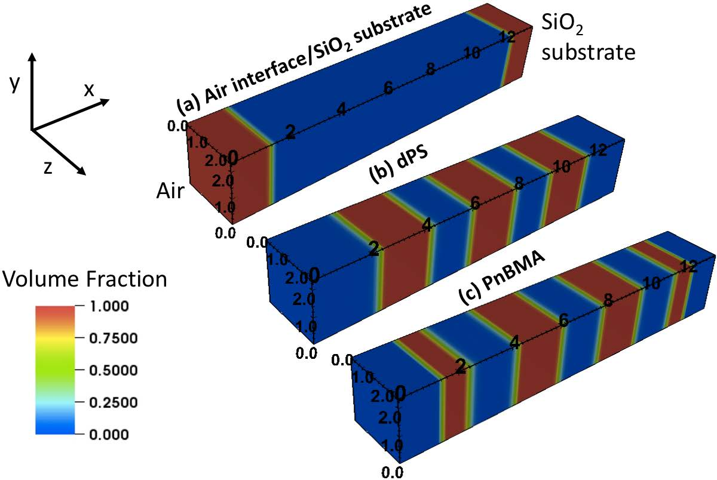
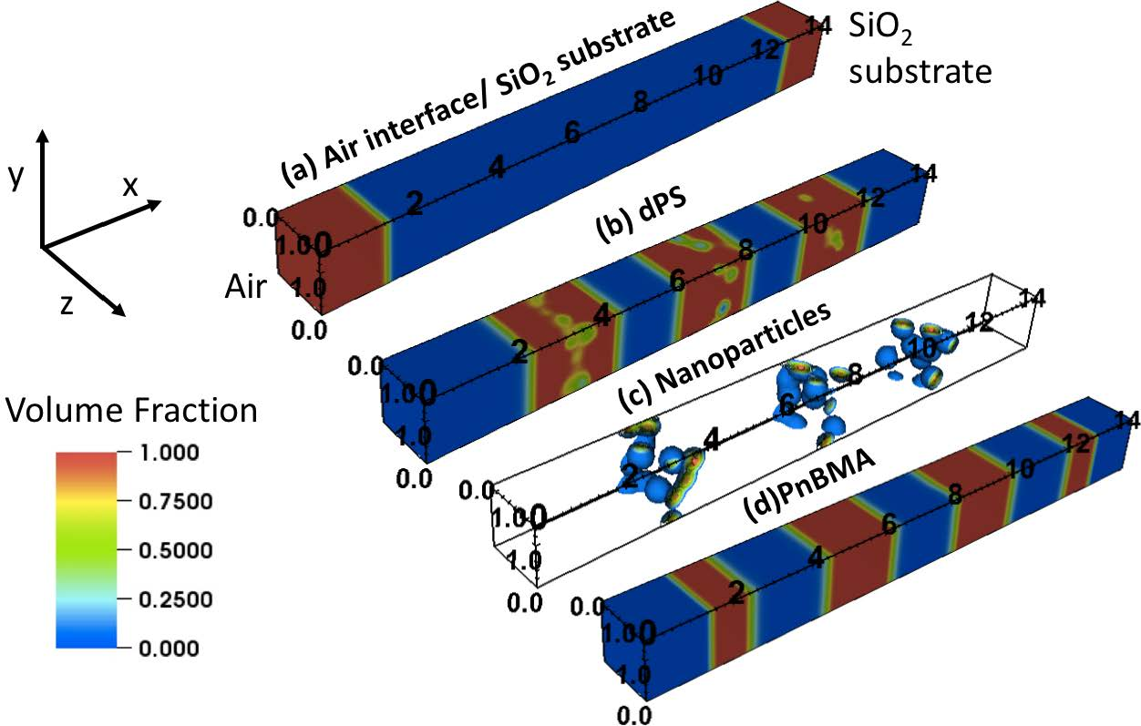
3D Volume fraction profile of different components in thin film obtained with SCFT
Without NP’s
With 7% NP’s
Parameters fixing length scales in the model:
Kuhn segment length (l),
average radius of the nanoparticle cores (Rp),
thickness of the nanoparticle corona (ξp),
polymer film thickness,
position (xa) and roughness of air interface (ξa), position (xs) and roughness (ξs) of the silica substrate
The nanoparticles preferentially accumulate at the center of the PS domains to avoid chain stretching penalty.

Slide 15

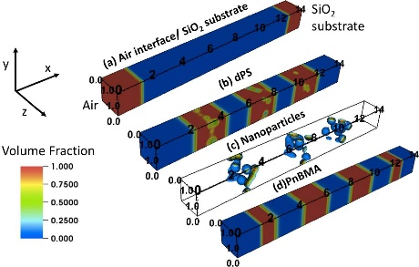
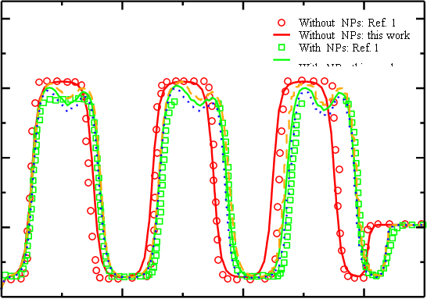
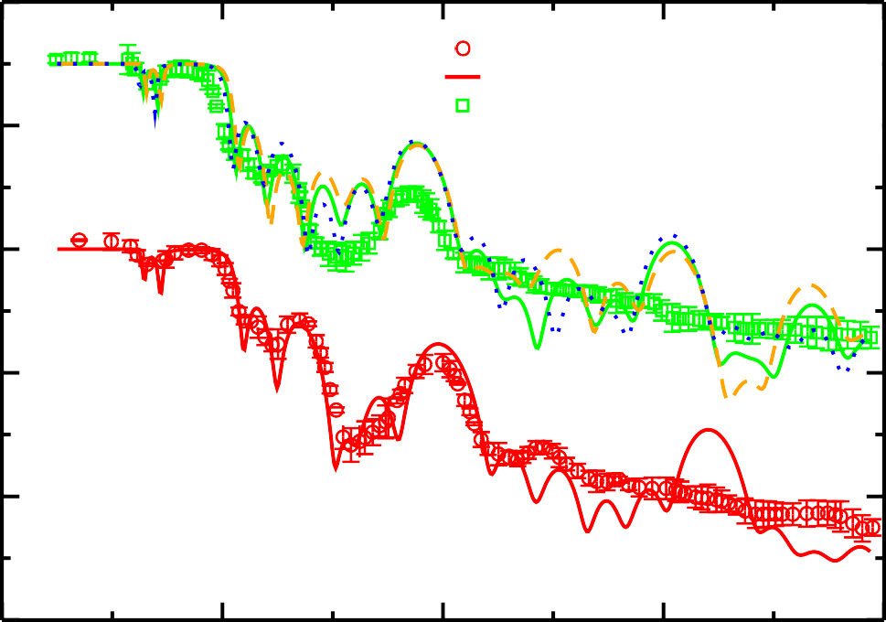
Scattering Length Density
Laterally averaged volume fraction profiles of components:
Air interface,
SiO₂ substrate,
dPS,
PnBMA,
NP
Lauter-Pasyuk et al, Langmuir, 19, 7783, 2003
Mahalik KP et al, Macromolecules, 2018

Slide 16
Published on-line April 2018 [1]:
Macromolecules, 2018, 51 (8), pp 3116–3125

Slide 17

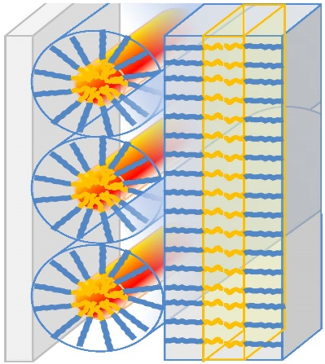
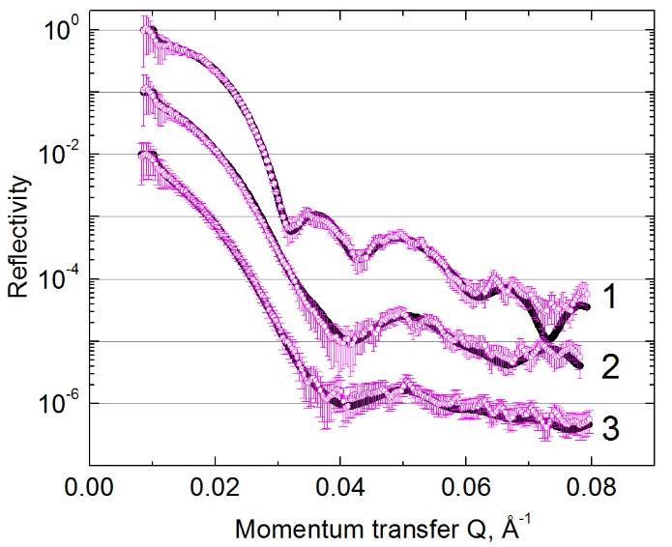
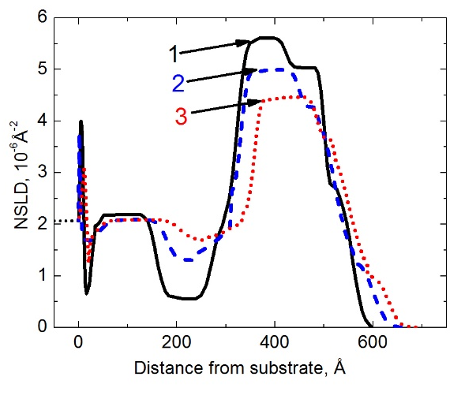
Asymmetric block copolymer nanocomposite thin film – SCFT model for NR analysis
substrate
0%
5%
10%

Slide 18
Development of hybrid particle-field based model for asymmetric co-polymer/nanoparticles systems
A=dPS
Fraction of A block, f_{A}=N_{A}/(N_{A}+N_{B})=0.34
Air Interface
dPS
PBMA
If l (Avg Kuhn length)=0.77 nm is used R_{go}=13 nm
Film thickness D/R_{go} ~ 4.2-4.4 R_{go}
But l is a fitted parameter, must depend on the f_{A}
𝛘N ~ 29-31 at 160 C
dPS-b-PBMA
Silica Substrate
Species | Polymer MW (Da) | Monomer MW (Da) | N’ | 𝛒_{o}⁻¹ (g/mol) | N
dPS | 59400 | 112 | 530 | 114.5 | 578
PBMA | 107000 | 142 | 754 | 159 | 1142
Total | 166400 |  | 1284 | 140.6 | 1719
N_{i}’=Polymer_Mw_{i}/Monomer_MW_{i}
N’=𝚺N_{i}’
𝝆_{o}⁻¹N’=𝜮𝝆_{oi}⁻¹N_{i}’
N_{i}=𝝆_{R}/𝝆_{oi}
𝛒_{R}⁻¹=105 g/mol (corresponding to protonated PS)
R is the reference component

Slide 19
Competing Structures in thin film
Structure 1: Cylinder
Structure 2: Mixed
Air Interface
PBMA
PBMA
Silica Substrate
dPS
dPS
Free energy difference between the mixed state and cylinder
𝞓F=F_{mixed} – F_{cylinder} > 0

Slide 20
Effect of film thickness
Parameters
𝞆_{AB}N=17
𝞆_{A-Air}N=0.0
𝞆_{A-Si}N=8
𝞆_{B-Air}=-80
𝞆_{B-Si}=0.0
With increase of film thickness ∆F decreases initially
Saturation of ∆F at certain thickness
Simulation box dimension in the horizontal direction was varied
to determine the free energy minima for different morphologies

Slide 21
Effect of 𝞆N and thickness
Higher D/Rgo (5.5) and lower 𝛘N: Cylinder
Lower D/Rgo (5): Cylinder
PBMA
PBMA
𝛘N=17
dPS
dPS
Thin Film results consistent with bulk results reported in literature
Higher D/Rgo (5.5) and higher 𝛘N: Lamellar
PBMA
Lamellar
𝛘N=30
dPS
Cylinder
Matsen, Eur. Phys. J. E., 30 361, 2009
0.34

Slide 22
Effect of polydispersity (polydisperse B block -PBMA)
𝛘N=17 ; D/R_{go}=5.0
10 quadratures
PDI=1.0, N_{B}=66
PDI=1.2, <N_{B}>=13.2
PDI=1.667, <N_{B}>=44
10 quadratures:
15.4, 33.0, 56.4,86.0,122.7
167.4,221.7,288.1,371.8,485.4
Parameters
𝞆_{AB}N=17
𝞆_{A-Air}N=0.0
𝞆_{A-Si}N=0.0
𝞆_{B-Air}=-80
𝞆_{B-Si}=0.0
𝛘N=25
10.1, 40.7, 92.4, 166.4, 264.9, 390.7
548.9, 747.6, 1002.8, 1355.5
Higher polydispersity prefers the mixed domain at low 𝛘N but increasing 𝛘N leads to lamellar structure

Slide 23
SLD comparison: Preliminary data
Modeled: Coexistence of cylinder and lamellar
Our SCFT based investigations revealed that a coexistence is thermodynamically stable in the presence of disperse majority block.
SCFT study clearly shows that vertical segregation based on chain lengths can lead to stabilization of cylinders near one substrate and lamellae near the other substrate.

Slide 24

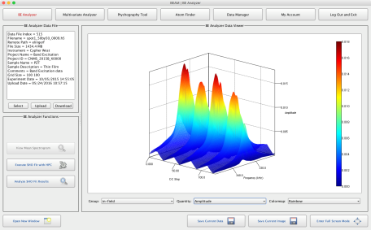
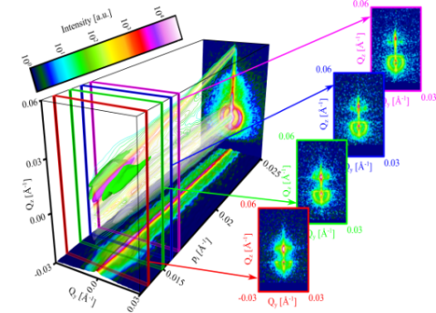


Development of a user-interface and computational workflow capable of generating SCFT models in quantitative agreement with GINS data
Architecture and Workflow
UI
From anywhere on www via XCAMS
(HTTPS)
Web & Data Server
CADES Cluster Computing
SCFT Simulations
&
Theoretical
DWBA
Calculations
of GINS
CADES Storage
MySQL
Database
Data
& Artifacts
LOCAL
High Speed Data Transfer with Globus
GINS at SNS
High Speed Data Transfer with Globus
SCFT Simulations/ HPC
Our target is demonstration of running software suite for processing, modeling and fitting of GINS data
Notes:
The Compute and Data Environment for Science (CADES) at ORNL is providing a compute and data infrastructure coupled with experts in data science to create a new environment for scientific discovery.

Slide 25
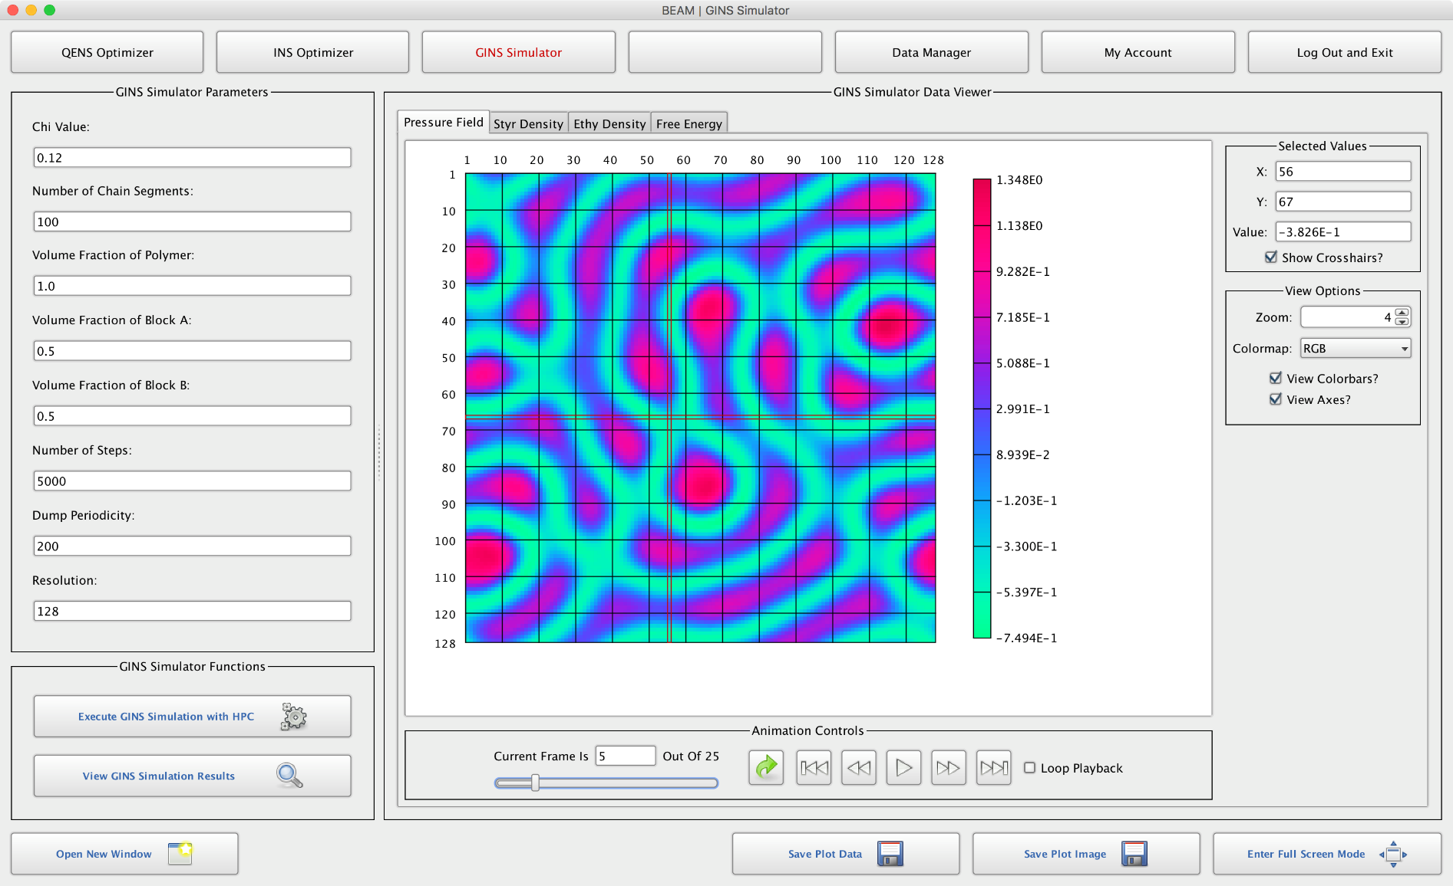
Developed User interface of GINS Simulator as part of the
Data Analysis workflow
Select data view from tabbed interface
Interactive 2D colormap visualization
View currently selected values and modify data view dynamically
Animation movie controls
Save current data file as HDF5 and image as PNG

Slide 26
Conclusions and outlook
Spallation neutron source delivers outstanding experimental conditions to perform simultaneously a combined measurement of specular reflection, OSS and GISANS using time-of-flight (TOF)
The first results on the implementation of a computational workflow integrating high performance computing (HPC) with GINS experiment via an intuitive, cross-platform user interface being developed at SNS/ORNL
We show that combination of GINS experiments with theoretical model in the computational workflow data provides a direct access to the physical properties.
The simulation approach developed for block copolymers is general to predict microphase separation in thin films of any block copolymer nanocomposite with the specific details encoded in the interaction parameters.

Slide 27
Development of computational workflow capable of generating theoretical models in quantitative agreement with Grazing Incidence Neutron Scattering data (GINS)
Beyond conventional data analysis
The implementation of a computational workflow integrating high performance computing (HPC) with experiment via an intuitive, cross-platform user interface
User-friendly Interface
Computational Workflow
4
TITAN
SCFT
simulations
3
Model
Self-Consistent Field Theory (SCFT)
(block copolymers)
Soft Matter
5
cost-function
Minimizer
Density-functional theory (DFT)
Quantum Materials
Oxide heterostructures
1
2
Experiment
Theoretical
DWBA calculations
of GINS

Slide 30
N_BMA
N_PS=34
Segregation of smaller PBMA chains near lamellar domain and larger PBMA chains near the substrate preferring curved structure
10.1
40.7
92.4
166.4
264.9
390.7
548.9
747.6
1355.5
1002.8

