Slide 1
Data acquisition at SNS and HFIR
Steven Hartman
Group Leader
NTD Instrument Data Acquisition and Controls
Presented to
International Collaboration on Advanced Neutron Sources
October 15, 2019

Slide 2
IDAC Group responsibilities are to…
Design, build and maintain electronics for acquiring neutron scattering data from detector and instrument systems
Develop and support software for acquiring, processing and managing data
Develop and support software and user interfaces for beam line control, experiment automation and data collection
Build and maintain the computing, data storage and network infrastructure for data acquisition and for Users
…in support of instrument operation, experiment data collection and instrument improvements at both SNS and HFIR

Slide 3
Our 2013 Plan: 18 instruments upgraded by 2018
Today, have deployed our improvements to
22 instruments:17 at SNS and 5 at HFIR
Software, firmware and electronics components for a complete upgrade to the data acquisition system have been deployed
These upgrades improve reliability and performance
Plans are in place to deploy this EPICS-based system to additional HFIR instruments

Slide 4

Our upgrade and improvement projects over the past six years have provided a comprehensive framework for increasing the reliability, operability and performance of the instruments
Channel Access
pvAccess
nED for DAQ
ADnED
  areaDetector
DisplayBuilder
ScanServer
Archiver
Alarms

Slide 5
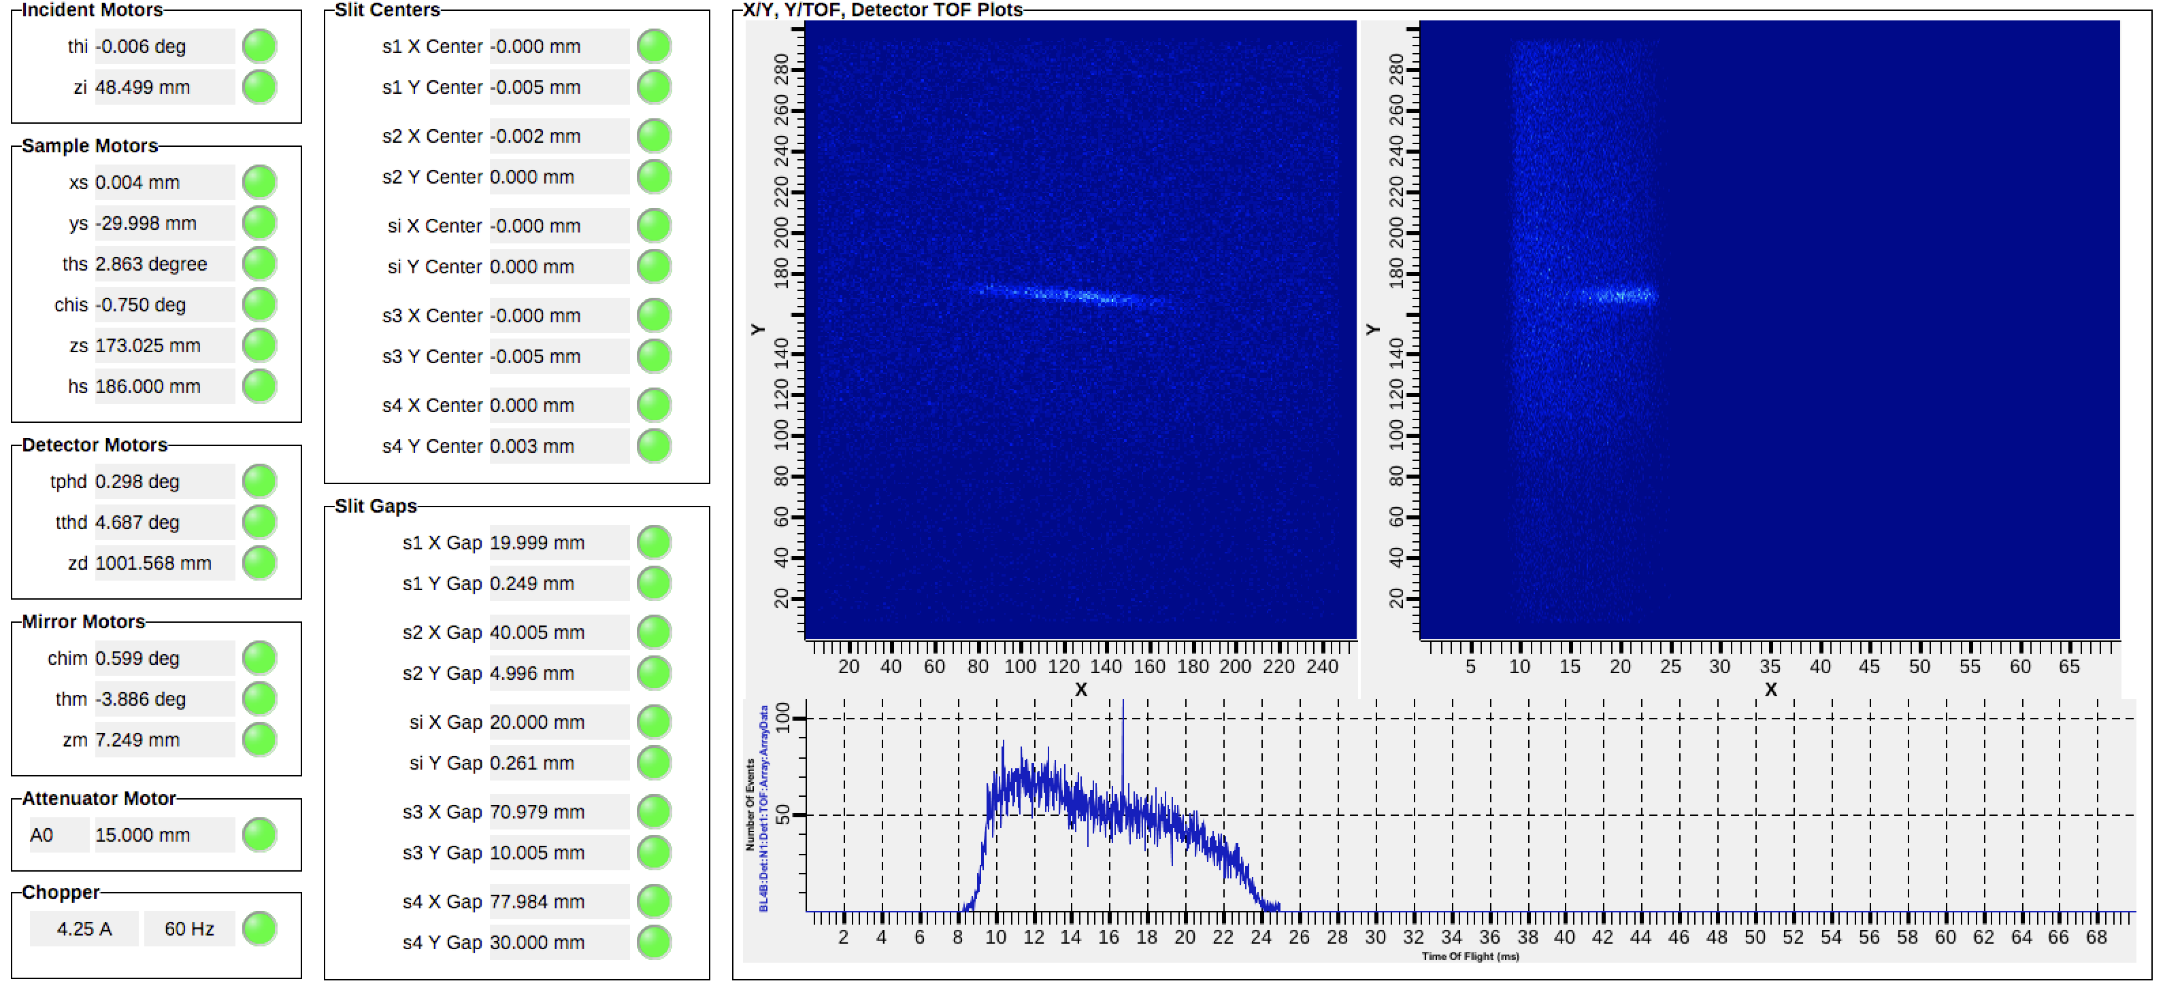
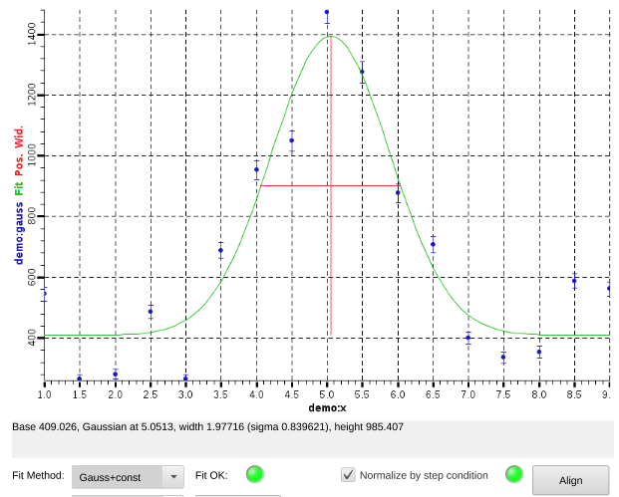
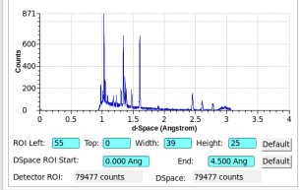
DAQ and Controls Software: We are implementing reliable tools for conducting experiments and collecting data
The EPICS-based software system provides a robust interface to sample environments, motors, detectors and other beam line equipment, plus tools for monitoring and automating experiments
Online data views provide counting criteria with regions of interest in detector-view, TOF, Q, d-space . . .
Data are saved to HDF5/NeXus files for post-processing

Slide 6
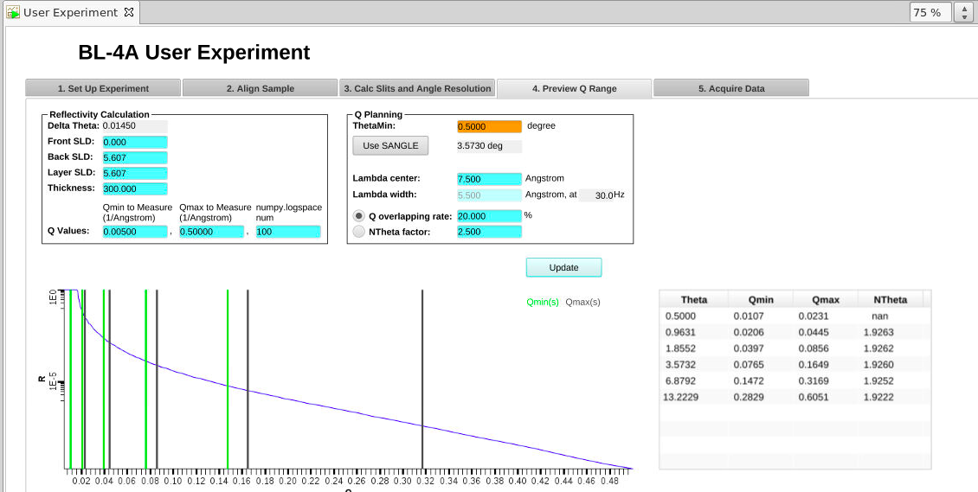
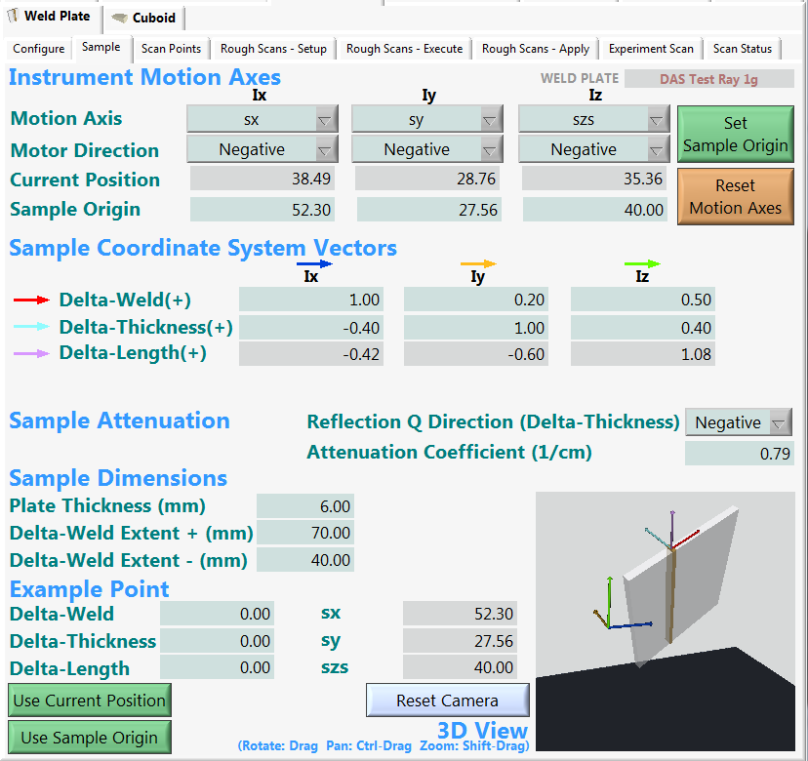
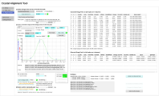
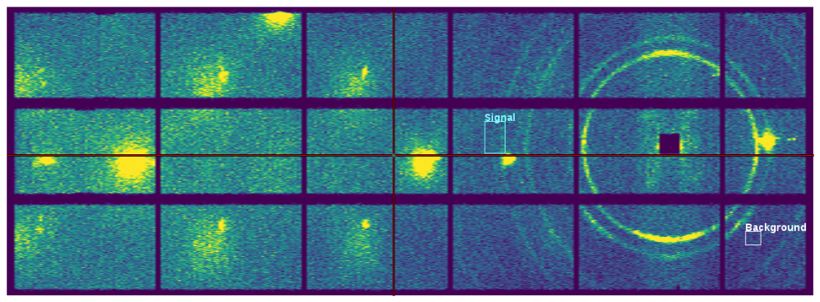

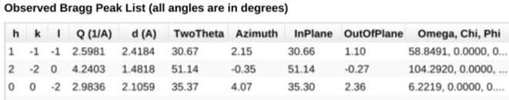
User Interfaces: We are enhancing instrument operability and increasing efficiency through guided experiment-workflows, planning tools and automation
Tools for sample alignment, sample mapping, crystal orientation and experiment setup are in use

Slide 7
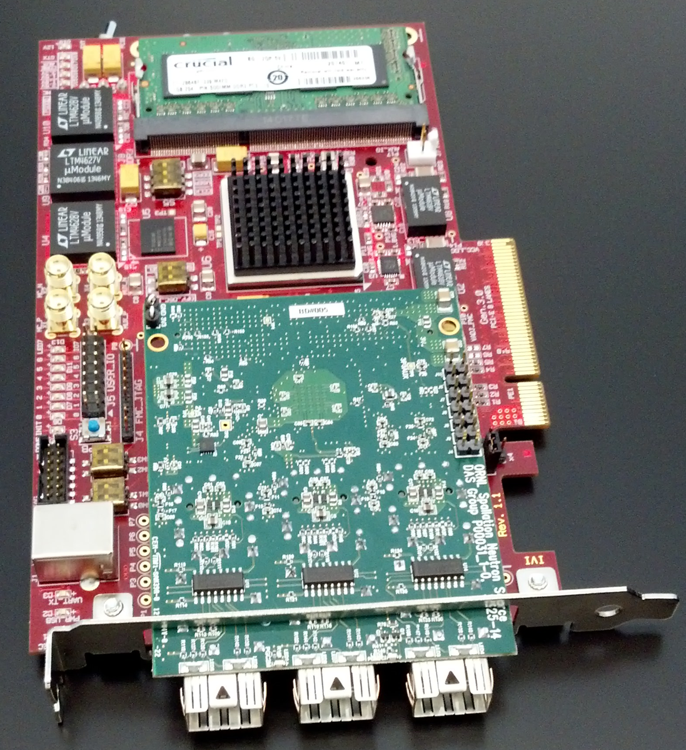
DAQ Electronics and Firmware: We are addressing obsolescence, improving performance and enabling new experiment techniques with hardware developments
Improvements to detector electronics firmware have directly addressed reliability. With these upgrades, our DAQ system is now capable of recording >5M counts per second per link
Time-resolved measurement for fast processes are simplified with tools for collecting signals as a part of the event data stream. This is used to record fast polarization state switching, and pulsed sample environments, such as electric or magnetic fields

Slide 8
Our upgrade process was organized around facility operation and maintenance period cycle of ~6 months
During run cycle: planning, requirements, offline development
During maintenance period: installation, subsystem testing
Start of next run cycle: integration testing, commissioning
Repeat

Slide 9
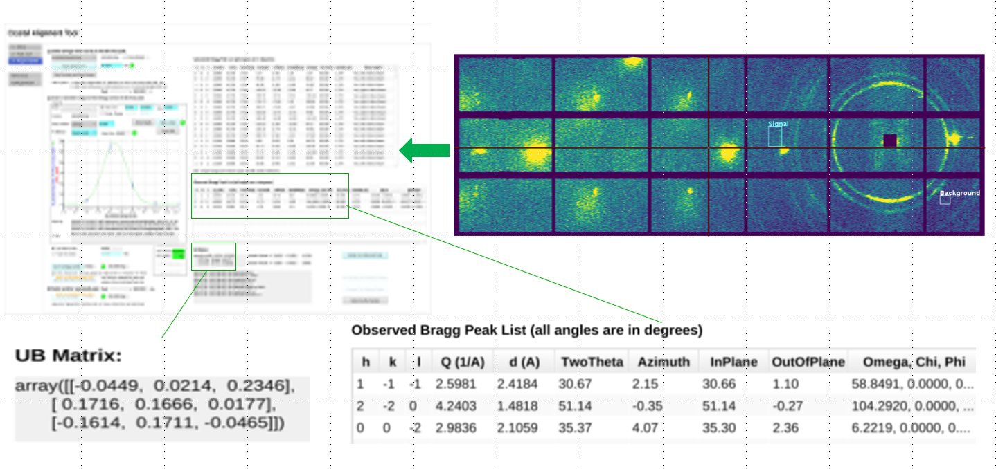
This focused development cycle allowed for continuous improvement in functionality and features
Each instrument project provided opportunity for developing new capabilities or upgrading core components
Newest features released to instrument under upgrade
Features deployed to other beam lines following cycle (typ.)
With new instrument projects we’ll continue with this project-based timeline, adapted to meet ongoing instrument needs

Slide 10
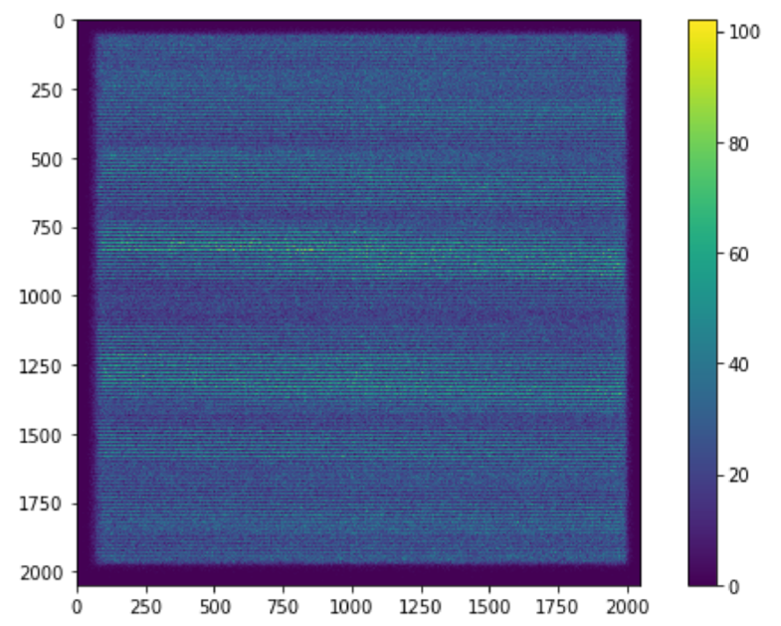
HFIR Residual Stress Mapping instrument: new cuboid scan mapping planning tool and new 2D detector

Slide 11
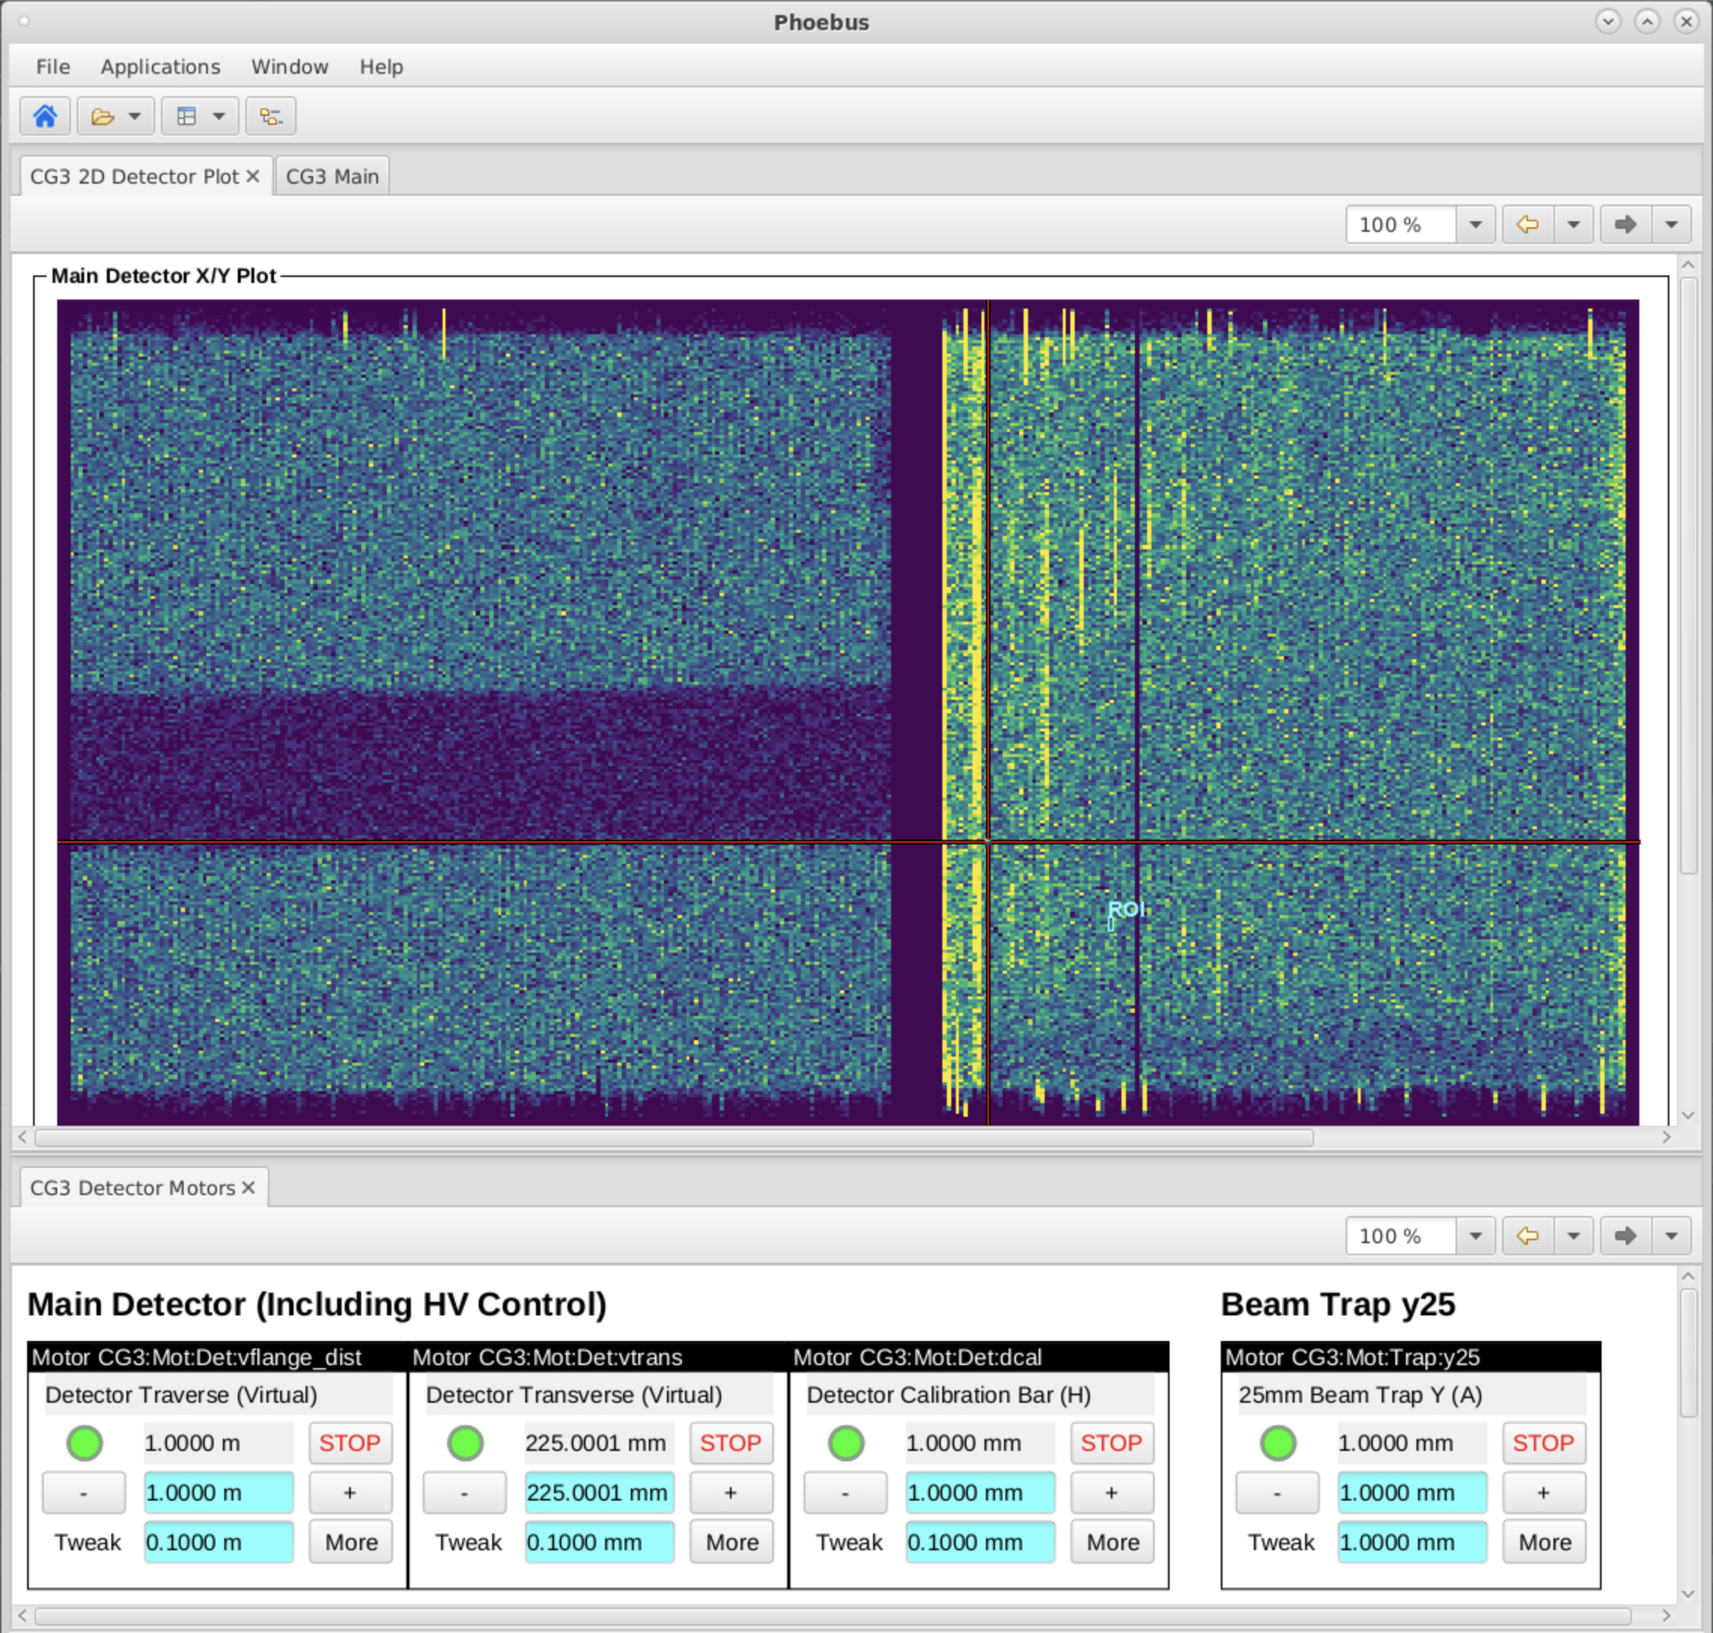
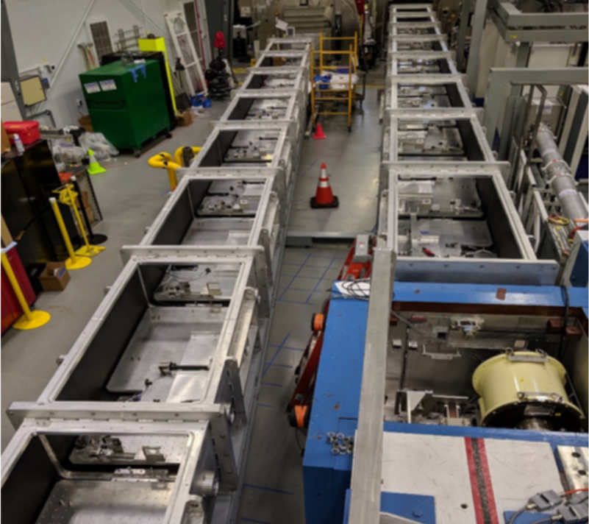
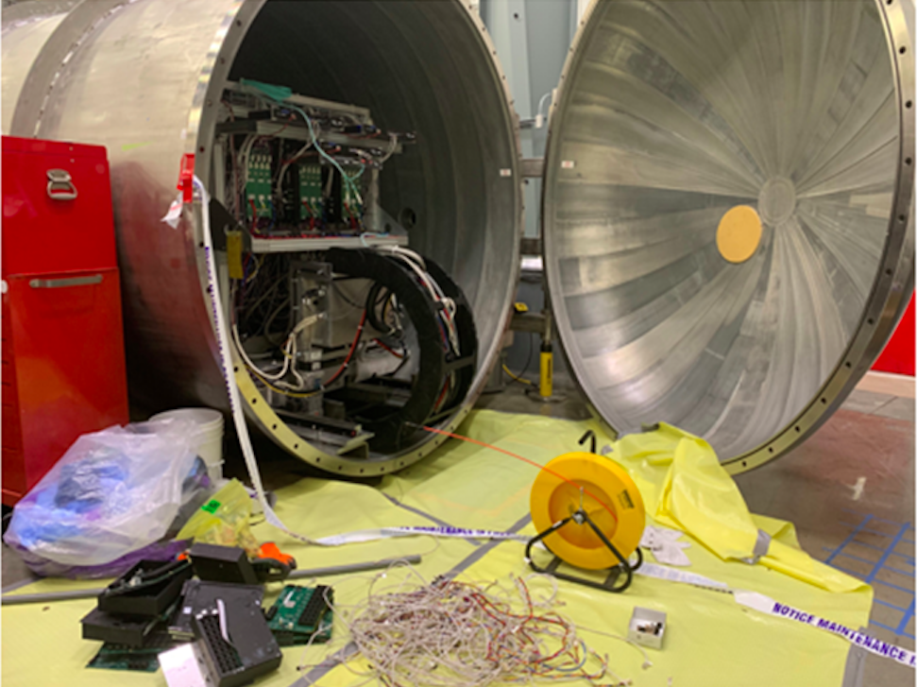
Project for the two SANS instruments at HFIR are underway now
New collimators and beam optics motion control
New shutter controls
Updated detector interface
All new instrument control and DAQ software
All new user interfaces

Slide 12
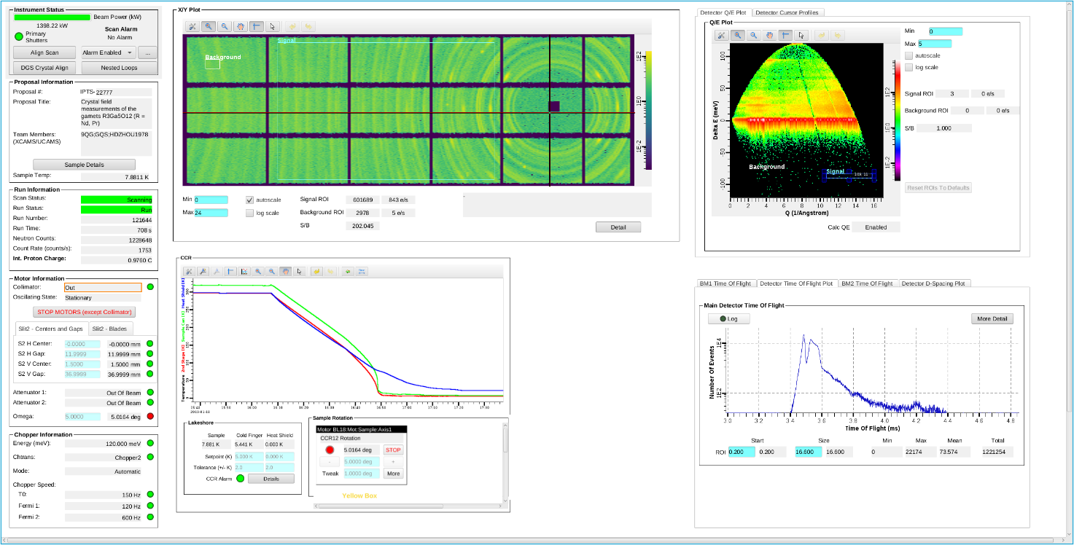
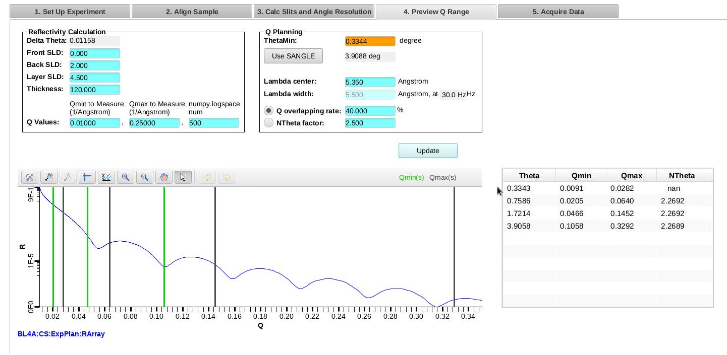
Future plans include focus on user interfaces and planning tools to increase instrument productivity

Slide 13
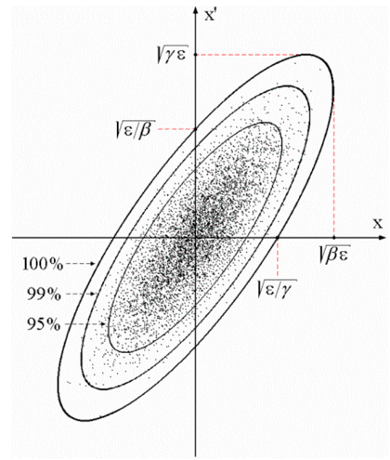
EPICS 7 offers new capabilities with high performance transport of structured data
First release in December 2017
Combines proven functionality and reliability of EPICS 3 with new capabilities and enhanced performance for transporting structured data from EPICS v4
3 + 4 = 7
0011 | 0100 = 0111
0011 ^ 0100 = 0111
$ pvget XCOR:LI24:900:TWISS
energy 5.00512
psix 37.7625
alphax 13.6562
betax -2.78671
etax -0.00698294
etaxp 0.00107115
psiy 31.9488
alphay 116.762
betay 5.2592
etay 0
etayp 0
z 2438.72

Slide 14

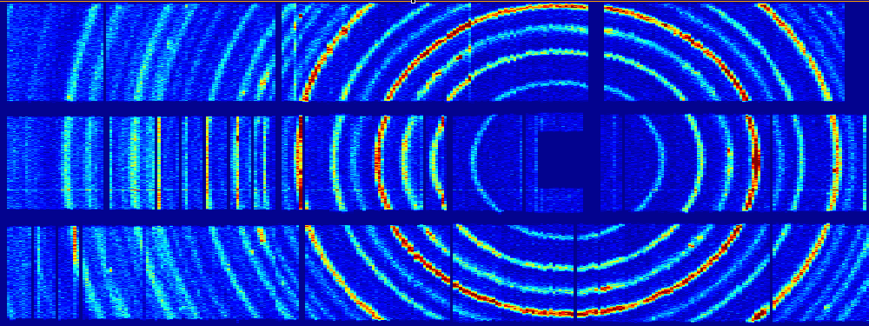
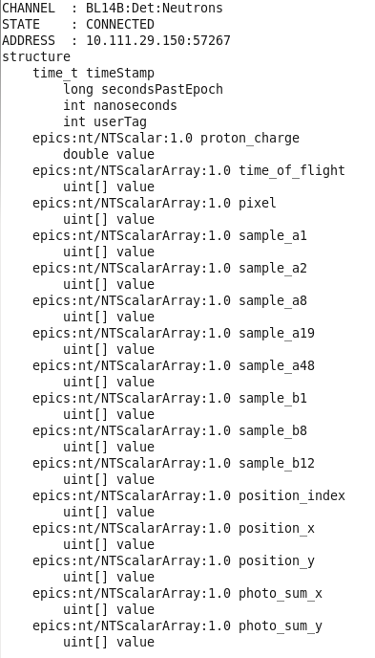
We have been using pvAccess for structured neutron event data transport since 2015
Neutron Detector
CS-Studio
nED
ADnED
pvAccess Server
CA Server
pvDatabase
areaDetector data processing
EPICS IOC
pvAccess Client

Slide 15
Ongoing development with EPICS 7 opens up more use cases for pvAccess
pvAccess Gateway
pvaPy Python client and server
Updated Java client and server
Updated C++ client and server
Integrated areaDetector support
Live data histograms
Structured tabular data
Python data processing services

Slide 16
Detector electronics upgrade is our current priority for DAQ upgrades
Obsolescence and performance drive need for update
Original design constrains the
form-factor, I/O interconnects and power dissipation requirements
New modular design offers backward compatibility and a future upgrade path

Slide 17
Our new modular read-out card offers a path forward for DAQ hardware
COTS carrier board or Vacuum compatible low-power carrier board
FMCs for interface to detectors
FMCs for digital communication
  LVDS for backwards compatibility
  Aurora for new installations
Provides platform for new board designs for detector DAQ electronics

Slide 18
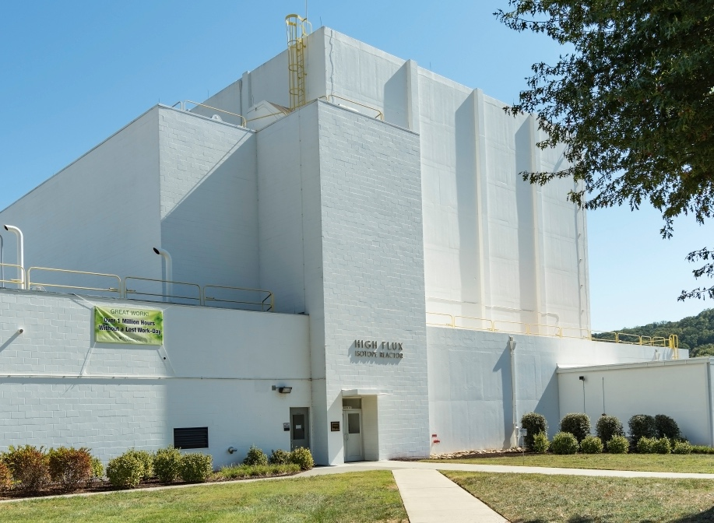
Questions

