Slide 1
Dissolve Next generation software for the analysis of total scattering data
Dr Tristan Youngs
Disordered Materials Group, ISIS Pulsed Neutron and Muon Source
STFC Rutherford Appleton Laboratory
Harwell Oxford, Didcot, Oxon, OX11 0QX

Slide 2
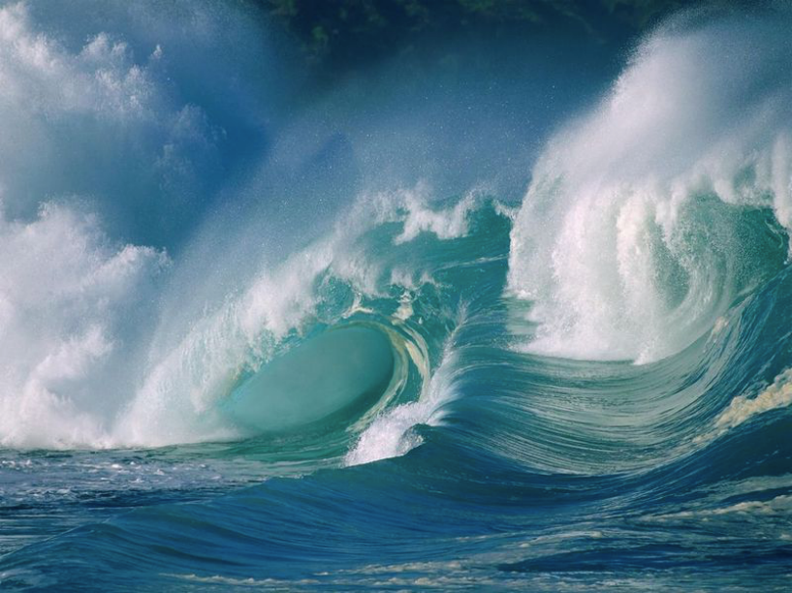
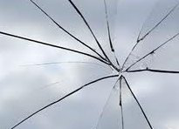
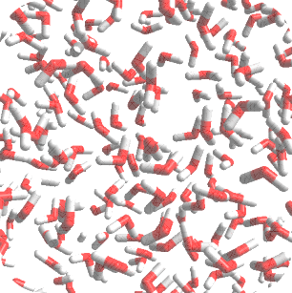
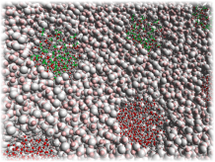
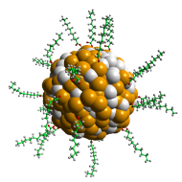
Disordered Materials
Characteristic Properties
Show predominantly local ordering (i.e. on the scale of atoms or molecules)
Show primarily diffuse scattering
Are typically dynamic (e.g. liquids) – average structural picture is obtained
May show long-range order (i.e. Bragg scattering)
May contain large length-scale correlations (e.g. micelles, lamellae)
Liquids
Glasses
Solutions
Condensed phases
under confinement

Slide 3
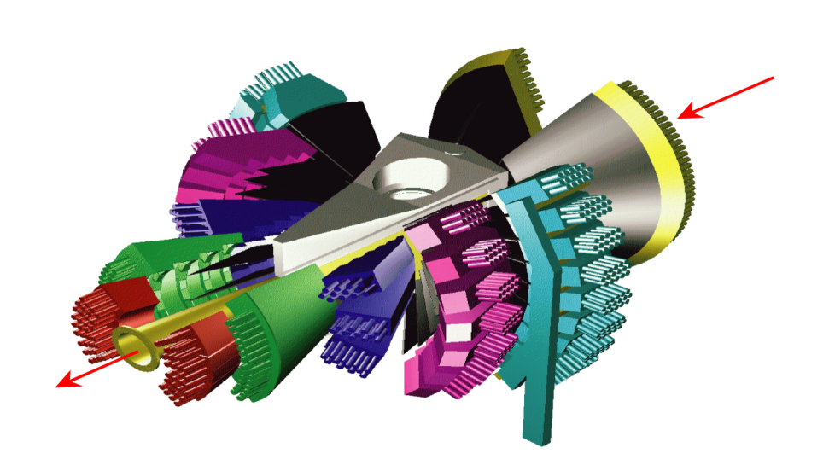
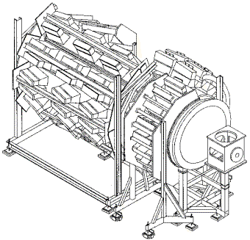
Disordered Materials Instrumentation
The Group’s Instruments
SANDALS
Small Angle Neutron Diffractometer
for Amorphous and Liquid Samples
GEM
General Materials Diffractometer
NIMROD
Near and InterMediate Range
Order Diffractometer

Slide 4
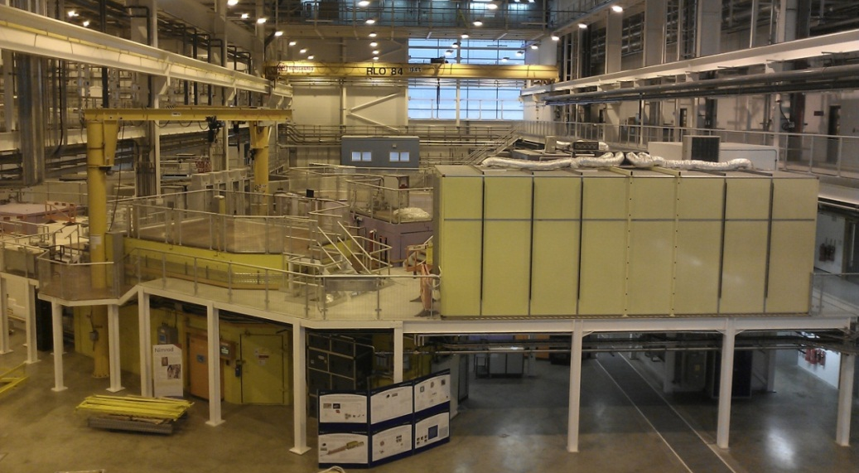
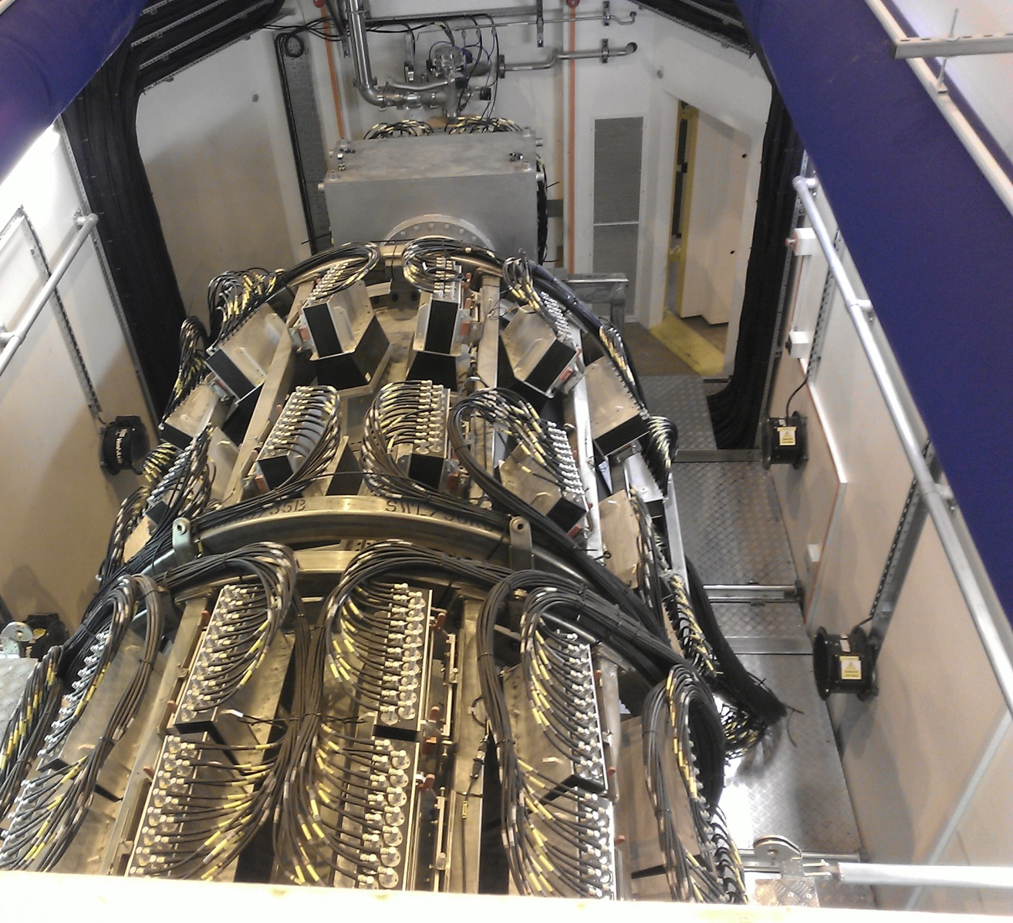

Slide 5
The Total Structure Factor
All Disordered Materials instruments give access to the total structure factor
Accessible Q range and target systems vary
Result of constructive interference between coherently scattered neutrons
Promoted by correlations between atoms / molecules
Arises from:
Chemical bonds within molecules
Attractive forces between molecules
Larger assemblies of molecules (e.g. micelles)
Lattice planes etc.

Slide 6
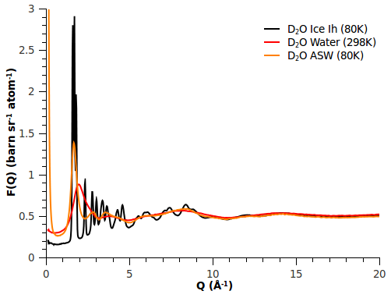
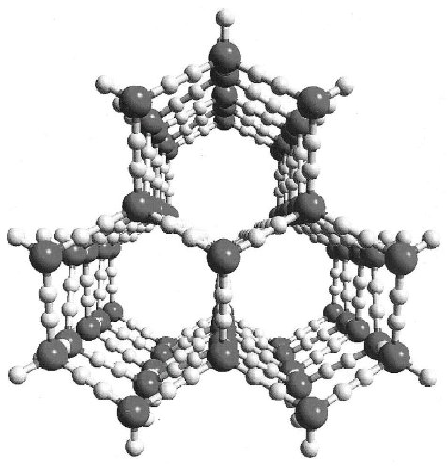
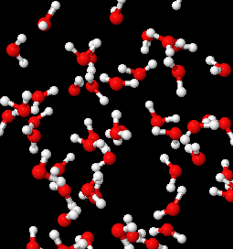
The Total Structure Factor
Water as an ice, a liquid, and a glass
Crystalline Solid
Liquid
Glass

Slide 7
Linking Experiment and Theory
Instruments give total structure factor, and which is generally too complex and “fluffy” to interpret by inspection
Contains information on all of the structural correlations occurring within a given sample
Only dependent on spatial arrangement of atoms
Classical simulation techniques have existed for many years, allowing real systems to be approximated on the atomic level by using empirical potential functions to describe the underlying interactions
Simulates the spatial arrangement of atoms
BUT – instrument measures in Q-space, and simulations work in real-space…

Slide 8
Linking Experiment and Theory
Instrument
Computer
Real System
Total Structure Factor F(Q)
Simulated System
Total Radial Distribution Function G(r)
Reciprocal Space
⇦ FT ⇨
Real Space
F(Q) and G(r) related by Fourier transform. Lucky!

Slide 9
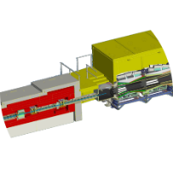
Basic Simulation
Published forcefield parameters describing many systems, so…
$$F\left(Q\right)$$
Compare
$$F\left(Q\right)$$
$$G\left(r\right)$$
Forcefield
Yes
No
Great, write the paper…
Agreement?
Tough!

Slide 10
Improving on a Basic Simulation
Need to have a forcefield-based simulation to interpret data in vast majority of cases – literature parameters exist for a variety of systems
How are these forcefield parameters obtained?
Reproduction of thermodynamic properties
Extrapolated / inferred from other systems
Chosen to reproduce experimental structural data? NO!
Change these somehow to improve the agreement between simulation experiment?
Tweaking by hand almost impossible
Fitting algorithm could work, but parameter space is large

Slide 11
Composition of the Total Structure Factor
Atom types and Partials
$$F\left(Q\right)=\sum_{i,j}{\left(2−δ_{ij}\right)c_{i}c_{j}b_{i}b_{j}S_{ij}\left(Q\right)}$$
Total Structure Factor
(Experimental Observable)
$$c_{i}=\frac{n_{i}}{N}$$
$$b_{i}=scattering length$$
$$S_{ij}\left(Q\right)=ρ\int_{0}^{∞}{4πr^{2}g_{ij}\left(r\right)}\frac{\sin{Qr}}{Qr}dr$$
Partial Structure Factor
(Accessed via Simulation)

Slide 12
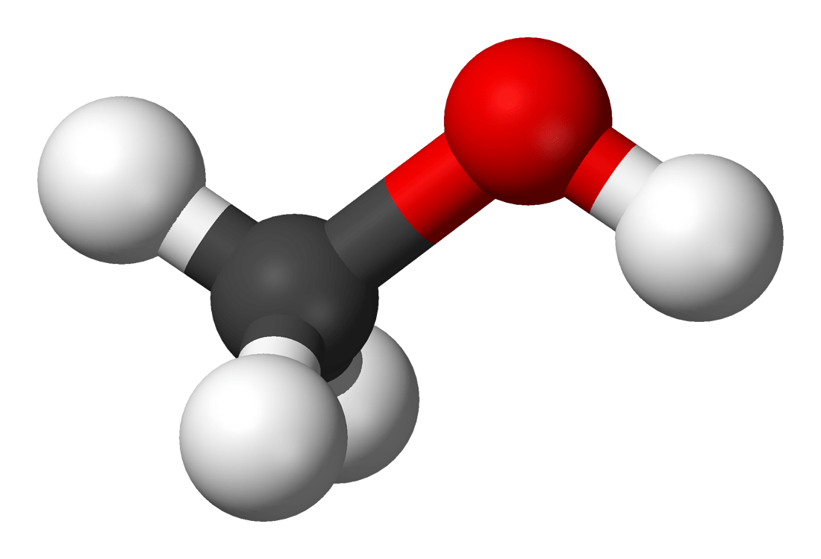
Partial Pair Correlations
An “atom type” is a specific kind of atom in the system
Depends at least on the element. Can be split by chemical environment.
Does not depend on isotope.
For example, water has two atom types – ‘O’ and ‘H’ – so there are three distinct partials: $S_{OO}\left(Q\right)$, $S_{OH}\left(Q\right)$, and $S_{HH}\left(Q\right)$
Argon
Water
Formaldehyde
Methanol
i
i
i
i
O
H
O
H
C
O
H
C
O
H1
H2
j
j
j
j
C
C
O
O
O
O
H1
H
H
H
H2
N = 1
Also N₂, O₂…
N = 3
Also benzene, silica…
N = 6
N = 10

Slide 13
The Goal – Experimental S(Q)
Total structure factor $F\left(Q\right)$ is a useful quantity, but the real value is in the individual partial $S\left(Q\right)$ that constitute it
If we can obtain the partial $S\left(Q\right)$ then we have direct information on the pair correlation functions, and can manipulate this to infer pair potentials
But, can’t do this directly from a single measured dataset:
$$w_{ij}=\left(2−δ_{ij}\right)c_{i}c_{j}b_{i}b_{j}$$
$$S_{OO}\left(Q\right)$$
$$S_{OH}\left(Q\right)$$
$$S_{HH}\left(Q\right)$$
$F_{H_{2}O}\left(Q\right)$
=
0.0374 | –0.0964 | 0.0622

Slide 14
Isotopic Substitution
The Power of Neutrons
$$F\left(Q\right)=\sum_{i,j}{\left(2−δ_{ij}\right)c_{i}c_{j}b_{i}b_{j}S_{ij}\left(Q\right)}$$
x-ray
 |  |  | C | Al | Fe
n (b_{c}) (fm) | –3.74 | 6.67 | 6.65 | 3.45 | 9.45
 | H | D (²H)
Scattering Lengths
Change weightings of partials in the measured $F\left(Q\right)$ by changing isotope
e.g. ²H for H, ¹⁵N for N, ⁶Li for Li
Key assumption: structure is independent of isotopes used
Perform multiple measurements on the same system, with different isotopic substitutions

Slide 15
Inversion of the Scattering Matrix
$$w_{ij}=\left(2−δ_{ij}\right)c_{i}c_{j}b_{i}b_{j}$$
$F_{H_{2}O}\left(Q\right)$
$F_{D_{2}O}\left(Q\right)$
$F_{HDO}\left(Q\right)$
0.0374 | –0.0964 | 0.0622
0.0374 | 0.1722 | 0.1980
0.0374 | 0.0378 | –0.0277
$$S_{OO}\left(Q\right)$$
$$S_{OH}\left(Q\right)$$
$$S_{HH}\left(Q\right)$$
=
$$w_{ij}^{−1}$$
$$S_{OO}\left(Q\right)$$
$$S_{OH}\left(Q\right)$$
$$S_{HH}\left(Q\right)$$
4.8238 | –2.7037 | 24.6061
–5.8227 | 1.6265 | 4.1962
4.1525 | 4.1525 | –8.3050
$F_{H_{2}O}\left(Q\right)$
$F_{D_{2}O}\left(Q\right)$
$F_{HDO}\left(Q\right)$
=
Direct extraction of individual $S\left(Q\right)$ is possible for ‘simple’ systems

Slide 16
Potential Refinement
Generating an improved interaction potential
Take differences between experimental and simulated $F\left(Q\right)$ to get $∆F\left(Q\right)$
Fit the $∆F\left(Q\right)$ using a suitable approximation (Poisson expansion)
Enter these $∆F\left(Q\right)$ into the inverse scattering matrix to generate $∆S\left(Q\right)$
Fourier transform the $∆S\left(Q\right)$ into $∆g\left(r\right)$ and use these to form an additional, empirical potential for each atom type pair
Repeatedly run the simulation and generate additional potentials until the experimental and simulated $F\left(Q\right)$ ‘match’
$${∆S}_{OO}\left(Q\right)$$
$${∆S}_{OH}\left(Q\right)$$
$${∆S}_{HH}\left(Q\right)$$
4.8238 | –2.7037 | 24.6061
–5.8227 | 1.6265 | 4.1962
4.1525 | 4.1525 | –8.3050
${∆F}_{H_{2}O}\left(Q\right)$
${∆F}_{D_{2}O}\left(Q\right)$
${∆F}_{HDO}\left(Q\right)$
=

Slide 17
“Enhanced” Simulation
$$w_{ij}$$
FT
$$F_{A}\left(Q\right)$$
$$F_{B}\left(Q\right)$$
$$F_{C}\left(Q\right)$$
Compare
$$F_{A}^{sim}\left(Q\right)$$
$$F_{B}^{sim}\left(Q\right)$$
$$F_{C}^{sim}\left(Q\right)$$
$$S_{aa}^{sim}\left(Q\right)$$
$$S_{ab}^{sim}\left(Q\right)$$
$$S_{bb}^{sim}\left(Q\right)$$
$$g_{aa}^{sim}\left(r\right)$$
$$g_{ab}^{sim}\left(r\right)$$
$$g_{bb}^{sim}\left(r\right)$$
FT^{–1}
Yes
No
Take
Difference
$${∆F}_{A}\left(Q\right)$$
$${∆F}_{B}\left(Q\right)$$
$$∆F_{C}\left(Q\right)$$
$${∆S}_{aa}\left(Q\right)$$
$${∆S}_{ab}\left(Q\right)$$
$$∆S_{bb}\left(Q\right)$$
Great, write the paper…
Agreement?
$$w_{ij}^{−1}$$
Experimental datasets actively used to derive new pair potentials

Slide 18
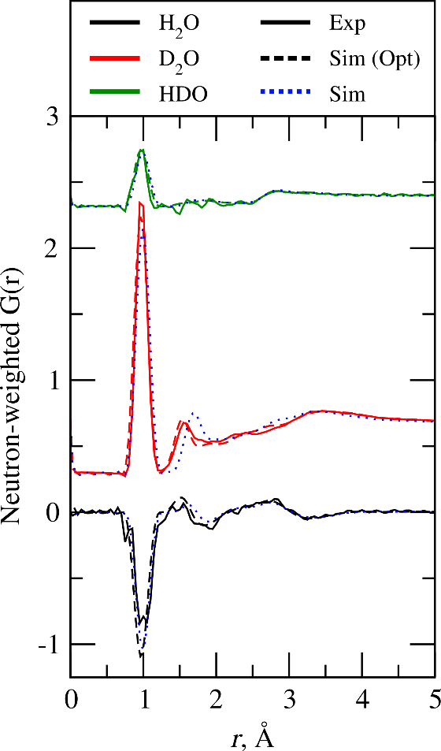
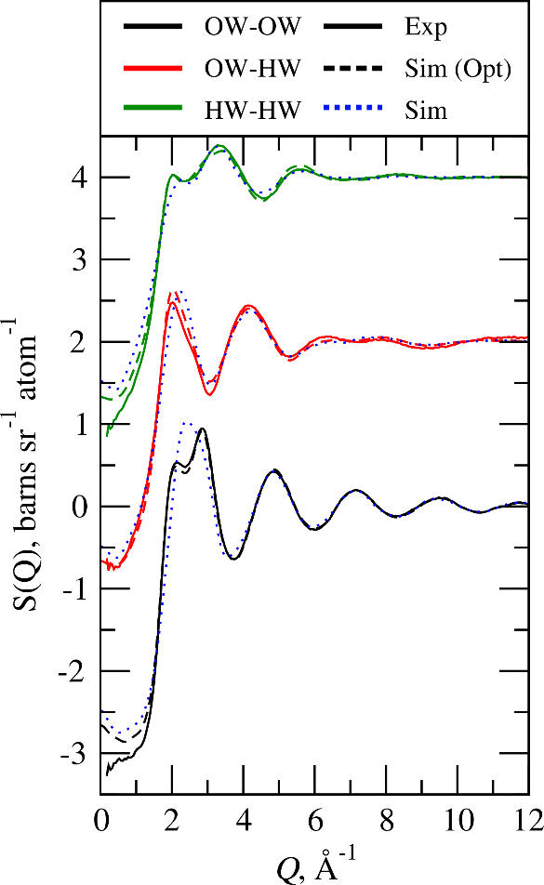
Liquid Water
Structure Factors / Total G(r)

Slide 19
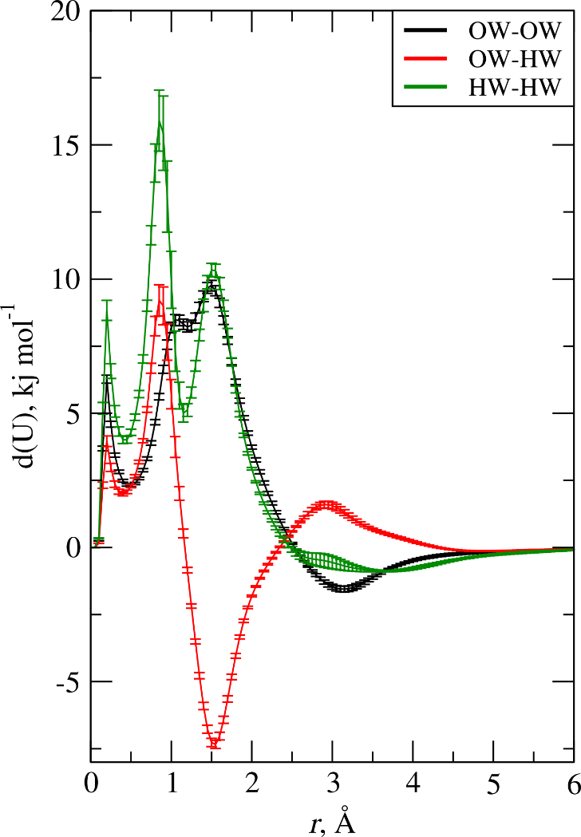
Liquid Water
Optimised Forcefield / Augmented Potentials
Parameter | SPC-Fw | Optimised
q(O) | –0.82 e | (empirical)
q(H) | 0.41 e | (empirical)
σ(O) | 3.165 Å | (empirical)
ε(O) | 0.6503 kJ mol^{–1} | (empirical)
σ(H) | -- | (empirical)
ε(H) | -- | (empirical)
r(O–H) | 1.0 Å | 0.975 Å
k(O–H) | 4431.53 kJ mol^{–1} Å^{–2}
θ(H–O–H) | 113.24° | 104.0°
k(H–O–H) | 317.57 kJ mol^{–1} rad^{–2}

Slide 20
Isotope Availability & Access
For many systems, there are too few isotopic sample possibilities available
Elements for which there are no suitable isotope pairs
Isotopic exchange prohibited by difficulty in synthesising target compounds
System complexity means there may be too many measurements to make in the timescale of a reasonable experiment
For instance, silica:
No inversion possible, so no access to partial $S\left(Q\right)$
$$S_{SiSi}\left(Q\right)$$
$$S_{SiO}\left(Q\right)$$
$$S_{OO}\left(Q\right)$$
$F_{SiO_{2}}\left(Q\right)$
=
0.0191 | 0.1070 | 0.1497

Slide 21
Generalisation
The Augmented Scattering Matrix
What is a general method to allow inversion of the underdetermined case?
Use the simulation? It has all the partials we need, which are hopefully a good “guess” for the experimental ones
Define a feedback factor, $0<f<1$, and write new weights factors…
$$S_{SiSi}\left(Q\right)$$
$$S_{SiO}\left(Q\right)$$
$$S_{OO}\left(Q\right)$$
$F_{SiO_{2}}\left(Q\right)$
=
0.0191 | 0.1070 | 0.1497
$$w_{ij}=f\left(2−δ_{ij}\right)c_{i}c_{j}b_{i}b_{j}$$
$$x_{ij}=\left(1−f\right)$$

Slide 22
The Augmented Scattering Matrix
Generalised Access to S(Q)
For each partial in the simulation, add a row to the scattering matrix weighted by $x_{ij}$
Typically, $f\sim 0.9$
Now have an overdetermined matrix for which we can find a (pseudo) inverse
$F_{SiO_{2}}\left(Q\right)$
$$S_{SiSi}^{sim}\left(Q\right)$$
$$S_{SiO}^{sim}\left(Q\right)$$
$$S_{OO}^{sim}\left(Q\right)$$
0.0172 | 0.0963 | 0.1347
0.1 | 0.0 | 0.0
0.0 | 0.1 | 0.0
0.0 | 0.0 | 0.1
$$S_{SiSi}\left(Q\right)$$
$$S_{SiO}\left(Q\right)$$
$$S_{OO}\left(Q\right)$$
=

Slide 23
Empirical Potential Structure Refinement
The Disordered Materials Workhorse
Developed and maintained by Prof. Alan Soper
Creation driven by scientific interest, and which went on to fulfil the needs of other users who became the Disordered Materials community
Proven on a variety of systems – pure liquids, liquid mixtures, polymers, confined liquids in porous media etc.
80% of SANDALS publications use EPSR
Chem. Phys. 202, 295 (1996); Mol. Phys. 99, 1503 (2001);
Phys Rev. B 72, 104204 (2005)

Slide 24
Five Caveats with EPSR
Limited to ~ 140 k atoms in a simulation
At water liquid density ⇒ ~110 Å box length ⇒ 55 Å correlation length max
Single configuration / single simulation
One atomic configuration at a time, subject to the same algorithms
Custom forcefield – not so good at handling large / floppy molecules
Not a “standard” classical forcefield
Parallel via OpenMP – limited to running on a single enclosure
Author retired!

Slide 25
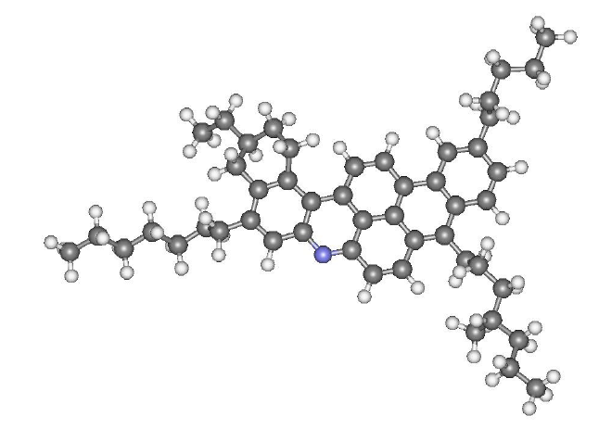
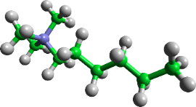
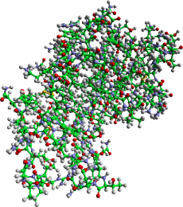
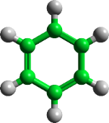
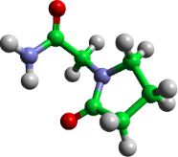
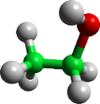
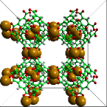
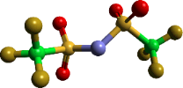
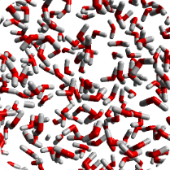
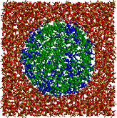
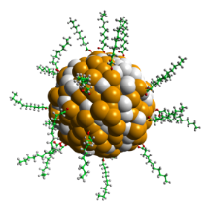
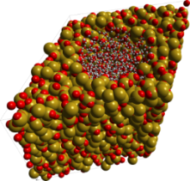
Evolving Science
Not Getting Any Easier…
Component
Size
Small / “Simple”
Moderate
Large / Flexible
Crystals
Biological
Single Phase
Multiple Phase
Dynamic / Ill-defined Phase
Pure Liquids
Mixtures / Solutes
Confined Liquids / Mixtures
Reacting Mixtures / Amorphous Solids / Disordered Crystals
System
Complexity
System
Size

Slide 26
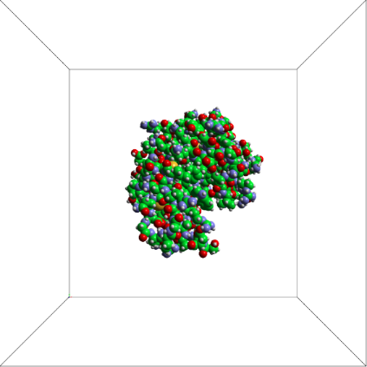
Current / Future Applications
Solvated macromolecules
Dilute systems, mostly solvent
Solvent-solute structuring often primary concern
Interaction between solutes is also of interest
Flexibility and conformation of molecules
⇒ Requires million atom simulations
⇒ Require proper intramolecular description of the protein
⇒ Molecular dynamics required to usefully relax the protein (in addition to Monte Carlo)

Slide 27
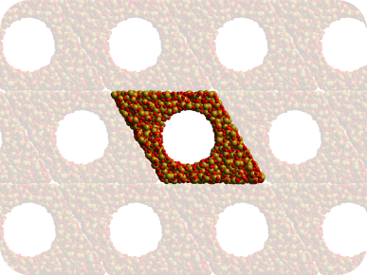
Current / New Applications
Pore filling of porous silicates
Liquids confined in imperfect lattices
Variance of substrate
Pore size, surface roughness, surface hydroxylation
Variance of deposited liquid
Degree of pore filling
Composition fo pore filling in mixed systems
⇒ Procedural, parameterised generation of configurations
⇒ Multiple configurations required to account for structural diversity

Slide 28
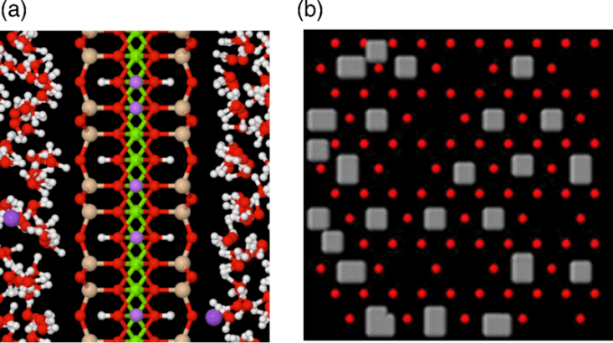
Current / New Applications
Interfaces
Laponite suspensions
Periodic “platelet” in original study
Simulate free platelet(s) in solution
⇒ Large system sizes
⇒ Specific forcefield terms for platelets required
Nanotubes
Low concentrations of solute / surface
Account for polydispersity (realism)
⇒ Multiple configurations / procedural generation
⇒ Need for “exotic” analysis of the structure

Slide 29
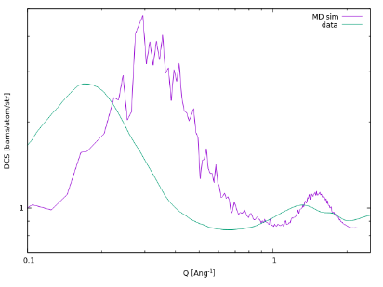
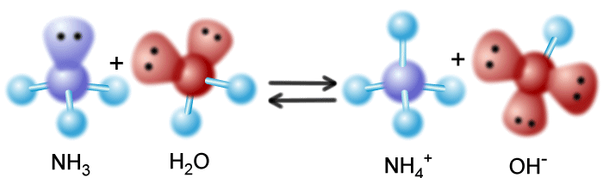
Current / New Applications
Macromolecular aggregates
Asphaltenes in solution
Aggregation of large molecules with variable size and structure
Micelle formation
Account for multiple micelle formation
⇒ Million atom simulations
Variable or ill-defined bonding
Metal organic framework melts
Ability to study melting – need to “sit” between crystal and liquid
Proton-transfer in acid-base systems
⇒ Explore macroscopic parameters as part of refinement

Slide 30
Dissolve
Find Dissolve on GitHub (trisyoungs/dissolve)
Preliminary paper at: https://doi.org/10.1080/00268976.2019.1651918
Current State:
Full classical forcefield engine
Monte Carlo and molecular dynamics evolution
Million atom capable / parallelised with OpenMPI
Fully customisable simulation – “do what the system needs”
Basic procedural generation of configurations
Analysis framework – built-in quantity calculation / also user-definable
Full GUI for setting up / monitoring / analysing simulations

Slide 31
