Slide 1
ESS Accelerator Update and
Experience from Ion Source and LEBT Beam Commissioning
Ryoichi Miyamoto (ESS-AD)
On behalf of ESS AD Members and Collaborators
2019-10-17, ICANS XXIII

Slide 2
Outline
Introduction to ESS linac
Recent highlights at the ESS site
Source and LEBT beam commissioning
(Disclaimer: Materials are heavily biased by a point of view of beam physicist, working on beam commissioning.)

Slide 3
Introduction to ESS linac

Slide 4
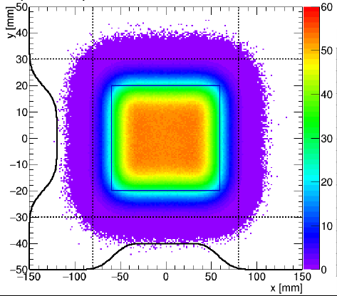
ESS proton linac at a glance
Parameter | Value
Ave power (design) [MW] | 5
Max energy (design) [MeV] | 2000
Ave power (initial) [MW] | 2
Max energy (design) [MeV] | 800
Peak current [mA] | 62.5
Pulse length [ms] | 2.86
Rep rate [Hz] | 14
Duty cycle [4] | 4
RF freq [MHz] | 352.21/704.42
Beam footprint on target
(Courtesy of H. Thomsen)

Slide 5
Time structure of beam
ISrc
< 100 mA
~3000 µs
2860 µs
~100 µs
LEBT
(chopper)
Mode | Current [mA] | Length [µs] | Rep [Hz]
Probe | ≤ 6 | ≤ 5 | ≤ 1
Fast tuning | ≤ 62.5 | ≤ 5 | ≤ 14
Slow tuning | ≤ 62.5 | ≤ 50 | ≤ 1
Long pulse verification | ≤ 62.5 | ≤ 2860 | ≤ 1/30
Production | ≤ 62.5 | 2860 | 14
6-70 mA
~0.1+20 µs
5-2860 µs
~0.1 µs
RFQ
6-63 mA
MEBT
(chopper)
6-62.5 mA
~0.01 µs
5-2860 µs
~0.01 µs
Notes:
.

Slide 6
Beam stops
Location | Type | Availability | Tuning | Long-pulse | Production
LEBT (inside tank) | FC | Permanent* | Yes | Yes | Yes
LEBT (outside tank) | FC | Temporary* | Yes | Yes | Yes
MEBT (inside tank) | FC | Permanent | Yes | -- | --
DTL2 (intertank) | FC | Permanent | Yes | -- | --
DTL4 (intertank) | FC | Permanent* | Yes | -- | --
Spokes (doublet #1) | Stop | Permanent | Yes | -- | --
Medium-β (doublet #6) | Stop | Permanent | Yes | -- | --
Dump line | Dump | Permanent | Yes | Yes | --
Target | Target | Permanent | Yes | Yes | Yes

Slide 7
Diagnostics
 | ISrc | LEBT | RFQ | MEBT | DTL | SPK | MBL | HBL | HEBT | A2T | DmpL | Total
FC |  | 1 |  | 1 | 2 |  |  |  |  |  |  | 4
IBS |  |  |  |  |  | 1 | 1 |  |  |  |  | 2
BCM | 1 | 1 | 1 | 2 | 5 |  | 1 | 1 | 2 | 3 | 2 | 19
FBCM |  |  |  | 1 |  |  |  |  |  |  |  | 1
FBPM |  |  |  | 1 |  |  |  |  |  |  |  | 1
Dpl |  | 1 |  |  |  |  |  |  |  |  |  | 1
BPM |  |  |  | 7 | 15 | 14 | 9 | 21 | 16 | 12 | 4 | 98
BIF |  | 2 |  | 2 |  |  |  |  |  | 1 |  | 5
IPM |  |  |  |  |  | 1 | 3 | 1 |  |  |  | 5
EMU |  | 1 |  | 1 |  |  |  |  |  |  |  | 2
LBM |  |  |  | 1 |  | 1 | 1 |  |  |  |  | 3
WS |  |  |  | 3 |  | 3 | 3 | 1 | 3 | 1 |  | 14
AptM |  |  |  |  |  |  |  |  |  | 3 | 1 | 4
Img |  |  |  |  |  |  |  |  |  | 2 | 1 | 3
nBLM |  |  |  | 4 | 42 | 26 | 2 | 2 | 2 | 4 |  | 82
icBLM |  |  |  |  | 5 | 52 | 36 | 84 | 49 | 34 | 6 | 266

Slide 8
Diagnostics
 | ISrc | LEBT | RFQ | MEBT | DTL | SPK | MBL | HBL | HEBT | A2T | DmpL | Total
FC |  | 1 |  | 1 | 2 |  |  |  |  |  |  | 4
IBS |  |  |  |  |  | 1 | 1 |  |  |  |  | 2
BCM | 1 | 1 | 1 | 2 | 5 |  | 1 | 1 | 2 | 3 | 2 | 19
FBCM |  |  |  | 1 |  |  |  |  |  |  |  | 1
FBPM |  |  |  | 1 |  |  |  |  |  |  |  | 1
Dpl |  | 1 |  |  |  |  |  |  |  |  |  | 1
BPM |  |  |  | 7 | 15 | 14 | 9 | 21 | 16 | 12 | 4 | 98
BIF |  | 2 |  | 2 |  |  |  |  |  | 1 |  | 5
IPM |  |  |  |  |  | 1 | 3 | 1 |  |  |  | 5
EMU |  | 1 |  | 1 |  |  |  |  |  |  |  | 2
LBM |  |  |  | 1 |  | 1 | 1 |  |  |  |  | 3
WS |  |  |  | 3 |  | 3 | 3 | 1 | 3 | 1 |  | 14
AptM |  |  |  |  |  |  |  |  |  | 3 | 1 | 4
Img |  |  |  |  |  |  |  |  |  | 2 | 1 | 3
nBLM |  |  |  | 4 | 42 | 26 | 2 | 2 | 2 | 4 |  | 82
icBLM |  |  |  |  | 5 | 52 | 36 | 84 | 49 | 34 | 6 | 266
Comprehensive set of permanent diagnostics.
Temporary diagnostics line is used only for IS+LEBT commissioning.
Pro: Allows to come back to the "same" machine condition later.
Con: Makes harder to identify an issue near an interface.

Slide 9
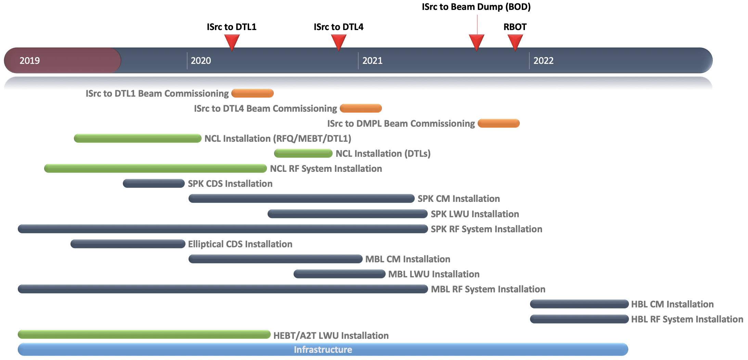
High-level plan

Slide 10
Recent highlights on the ESS site

Slide 11
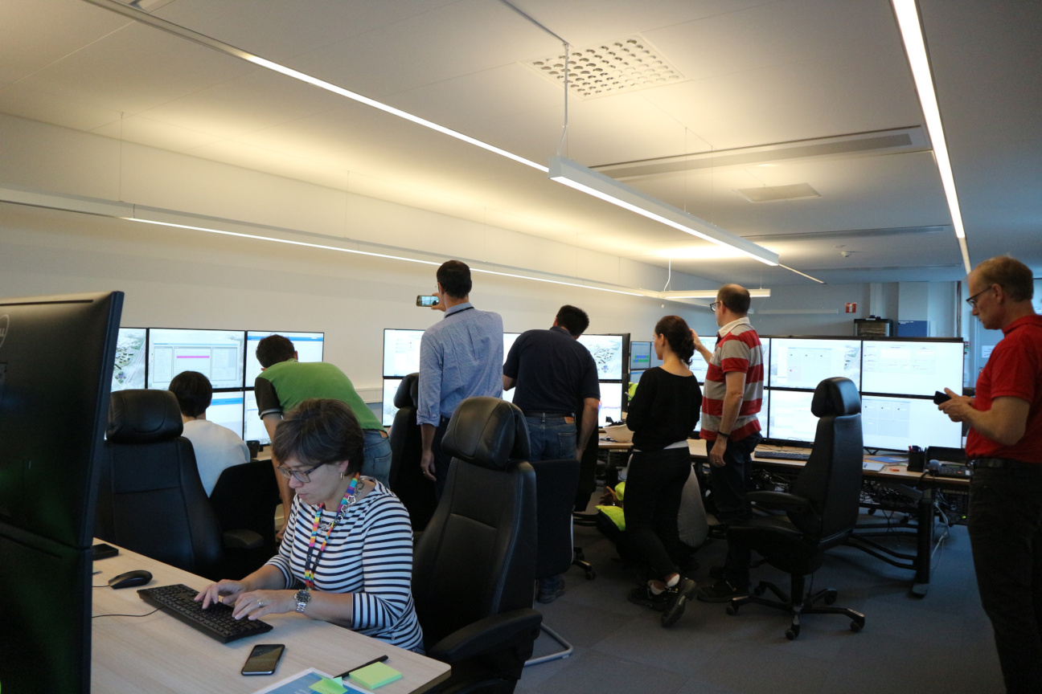
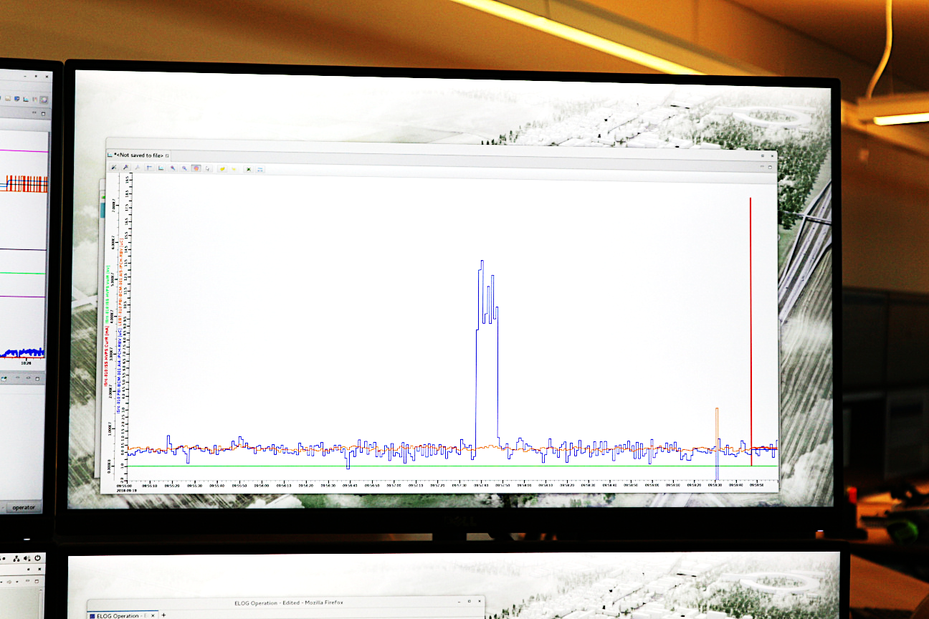
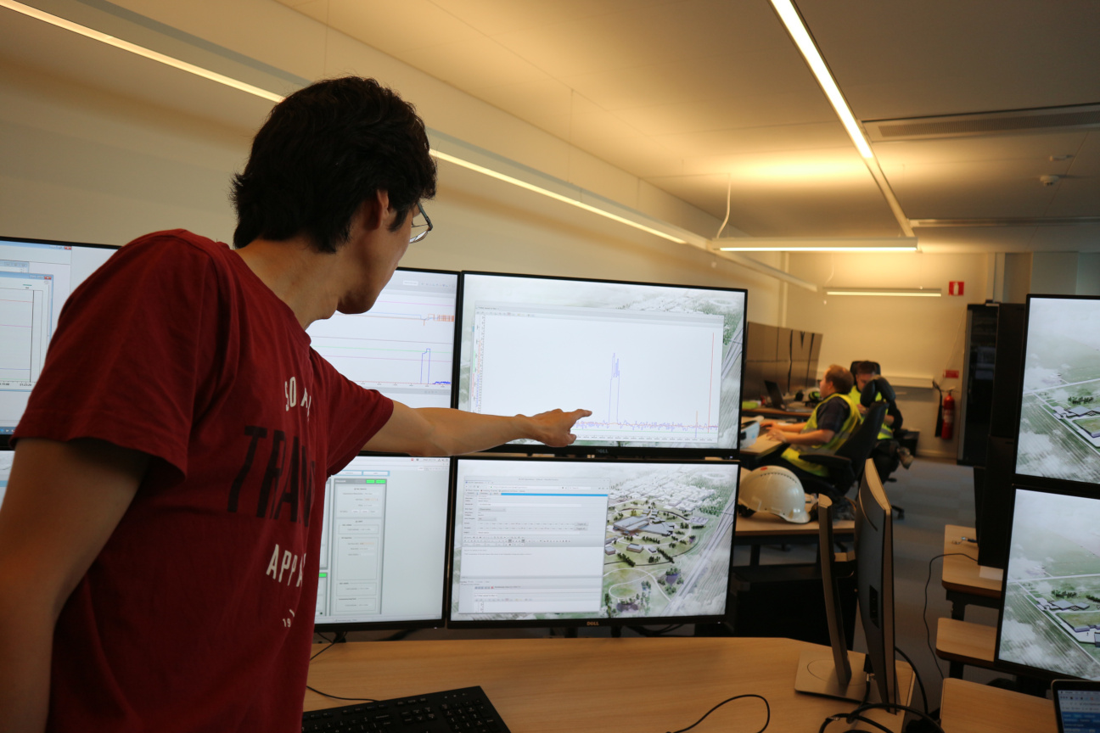
First beam on the ESS site, 2018-09-19
Logbook message ID 69, 2018-09-19 10:31
Ryoichi on behalf of ISrc team.
"THE" screenshot of the first beam! Blue trace is the integrated charge per pulse in micro-C. 12 micro-C and 2 ms gives 6 mA. We had the beam for about 10 s.

Slide 12
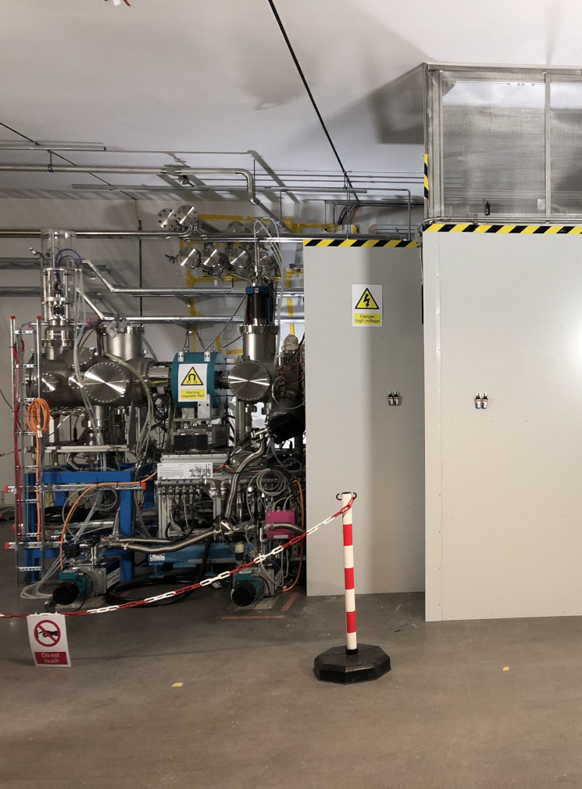
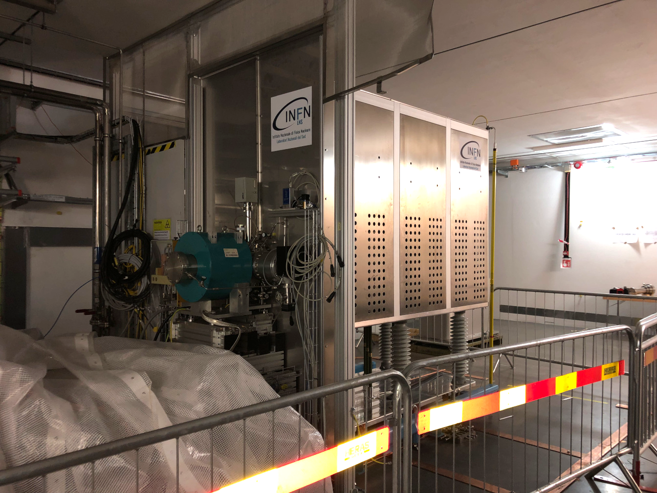
IS+LEBT beam commissioning
2018-09-19 ~ 2019-07-03
Most of LEBT is now disassembled for
  RFQ bead-pull
  Repairs and updates: Repeller (RFQ interface), iris, chopper, diagnostics...

Slide 13
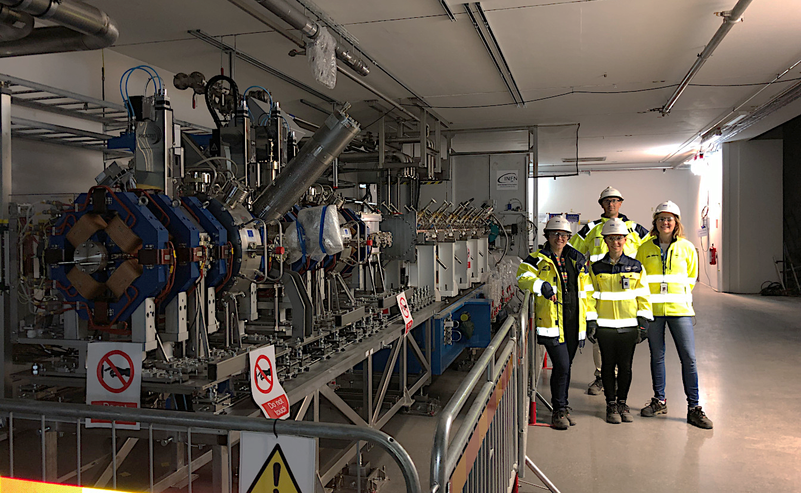
IS+(LEBT)+RFQ+MEBT in the tunnel

Slide 14
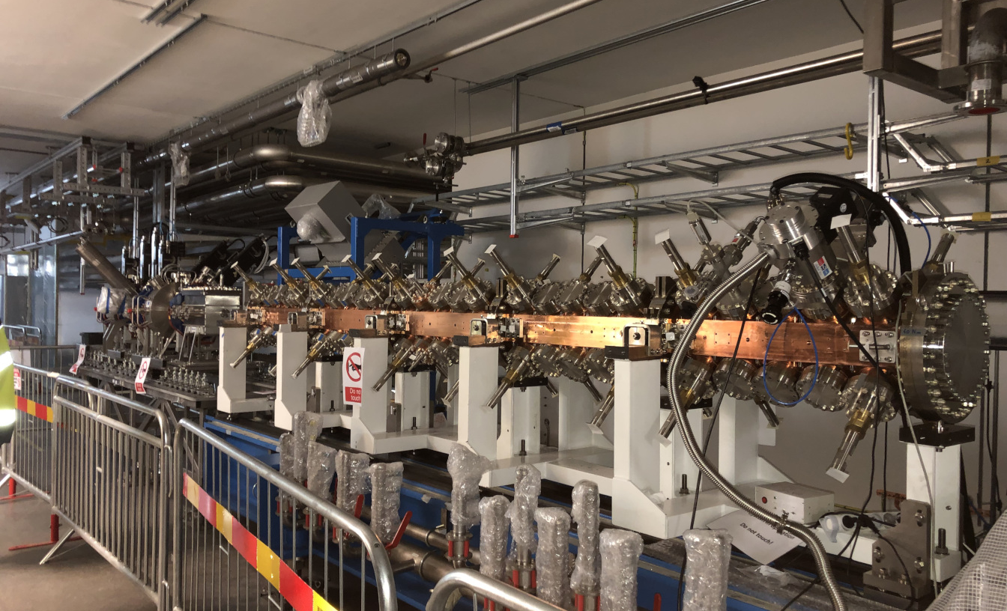
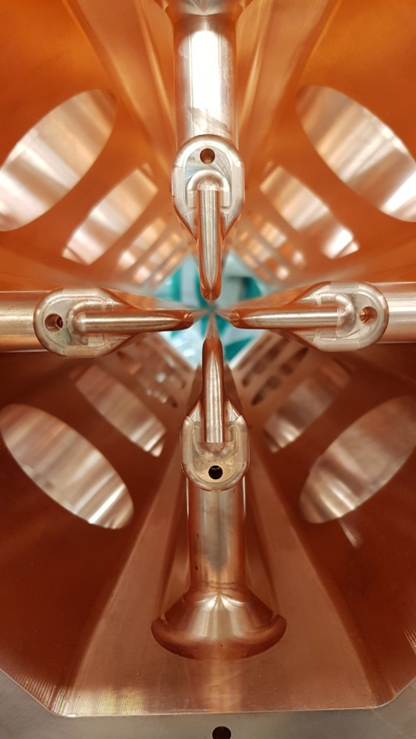
RFQ is the next priority
RFQ RF measurement has started. (CEA)
RFQ conditioning planned in next April.
Still a lot of ancillary items to install.

Slide 15
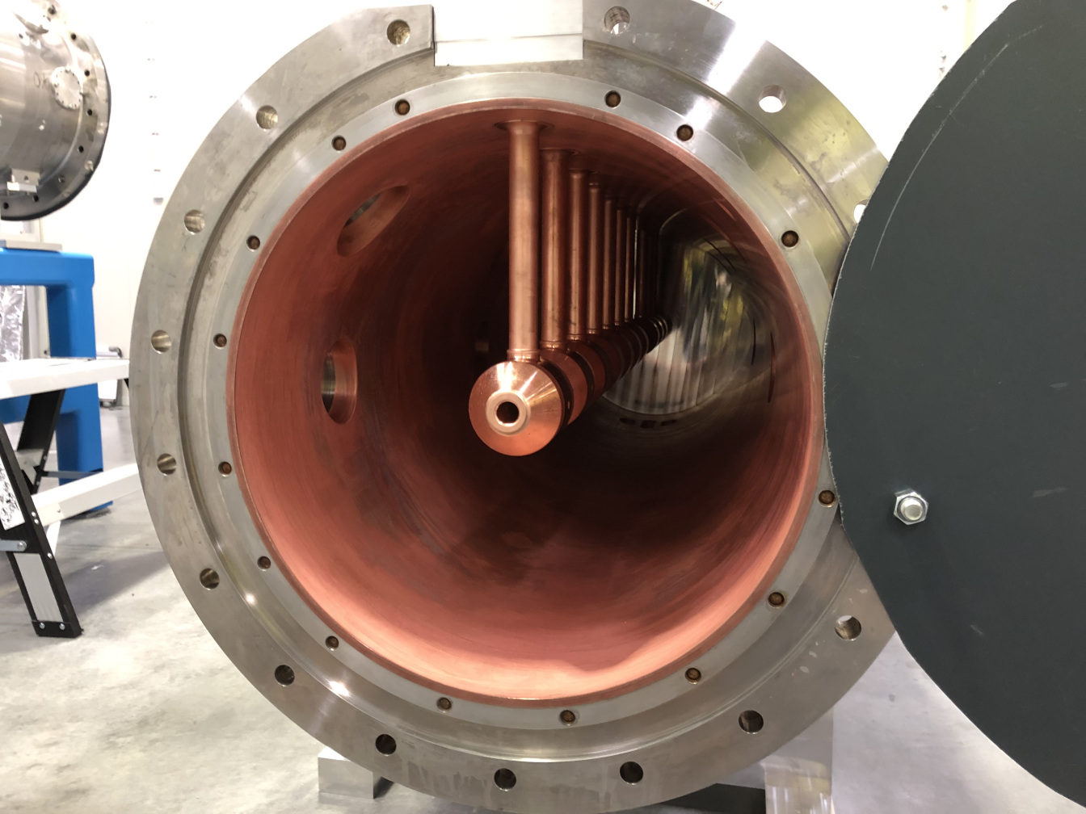
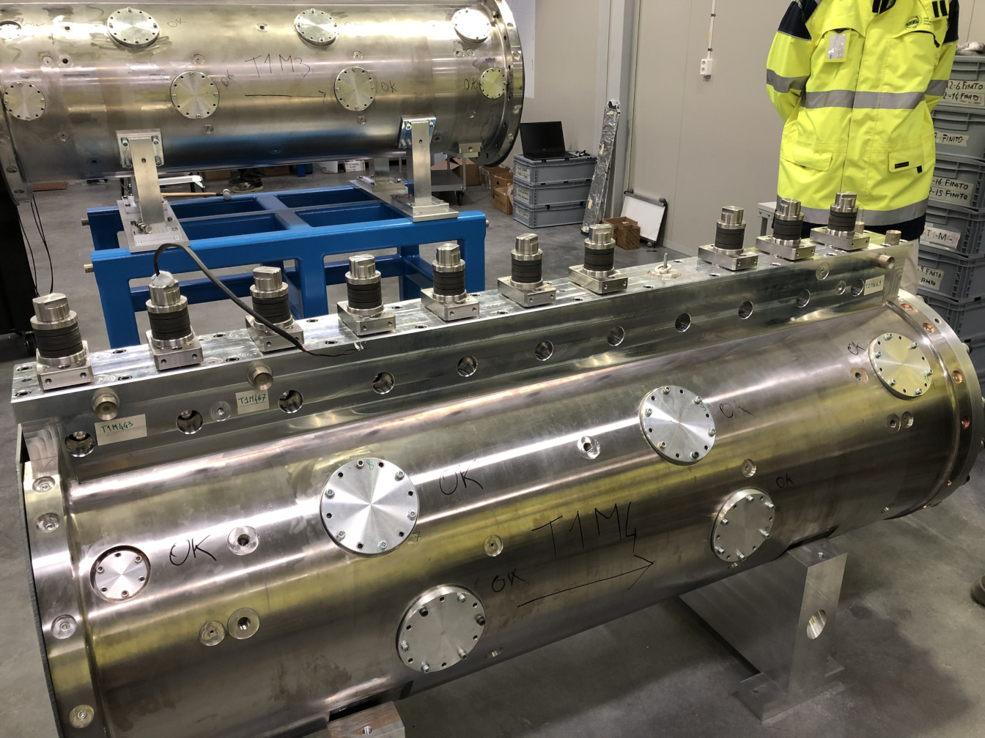
DTL1 assembly ongoing
DTL1 is most challenging:
  60 tubes
  12 dipole correctors
  6 BPMs
  ...

Slide 16
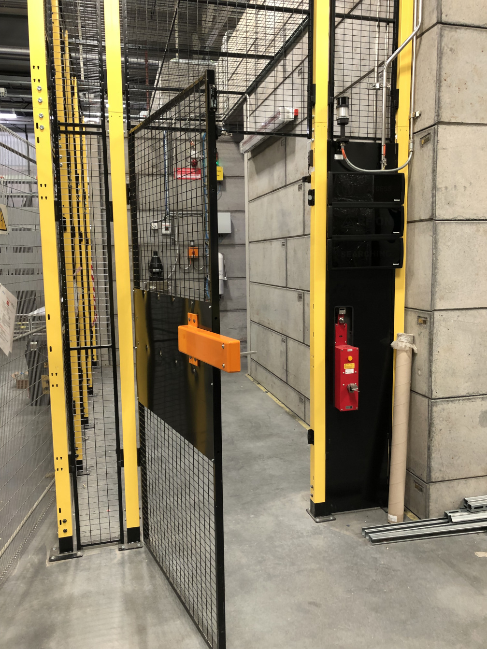
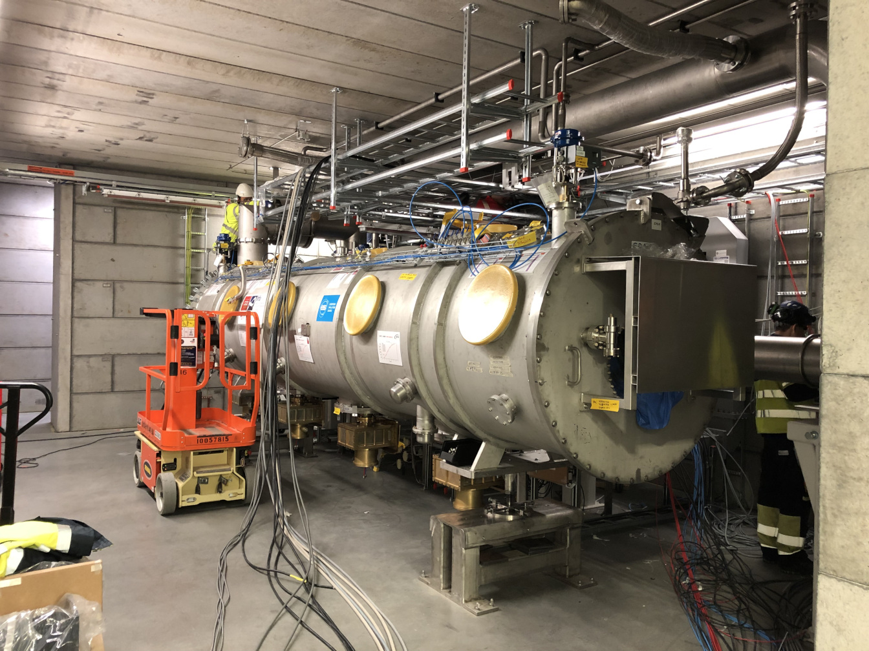
Medium-beta CM prototype test about to start
(Test Stand 2)
sss
TS2-PSS
Passed the Safety Readiness Review.
Still some issues to solve
  Water quality
  Cryo connection (female-female)
  Helium leak
  ...

Slide 17
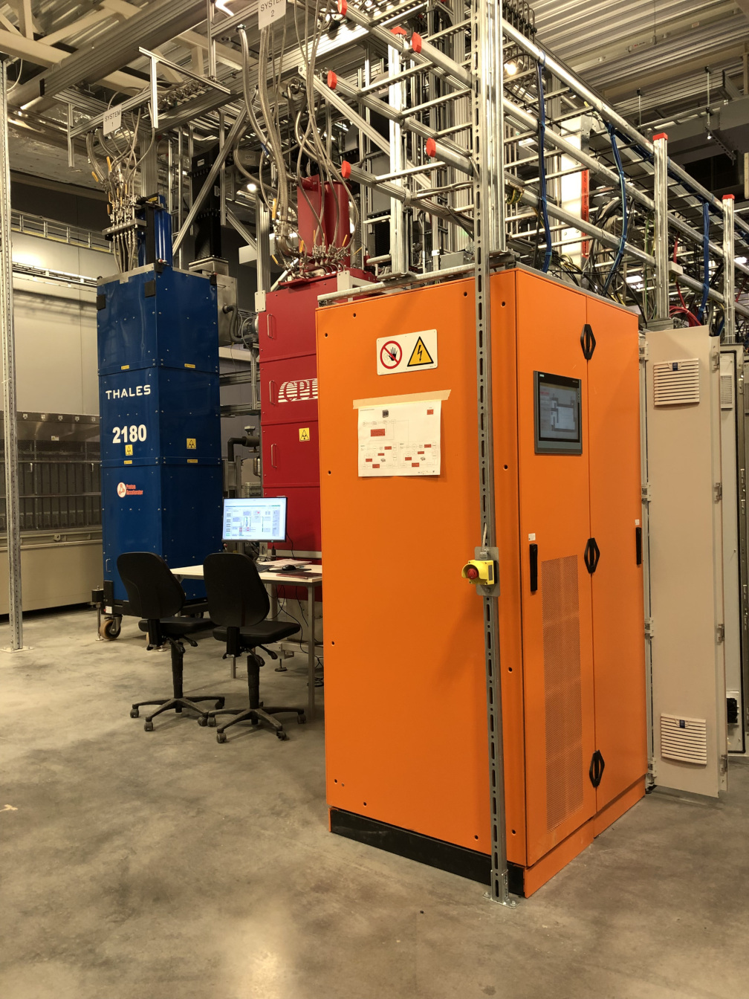
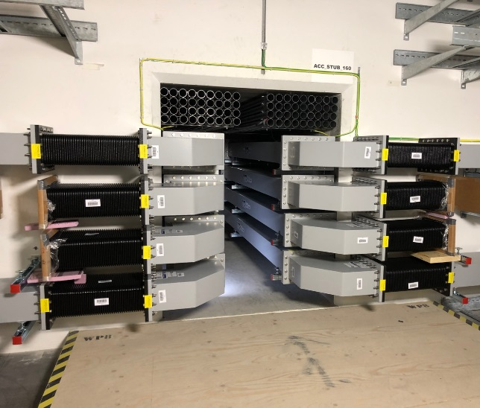
RF
sss
Klystron testing has been ongoing.
24 (out of 36) MB klystron received.
First 5 series modulator received.
All waveguides now in the stubs.
Phase reference line commissioning (first part) starts in Oct.

Slide 18
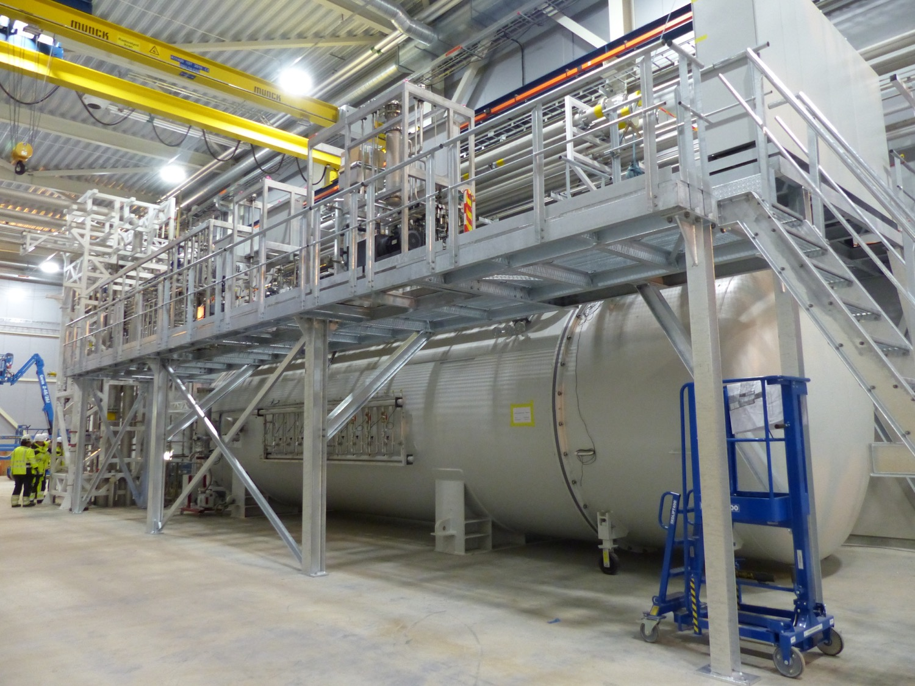
Cryo system
Cryo-plant commissioning has been ongoing.
Distribution system install is progressing, planned to be finished this year.

Slide 19
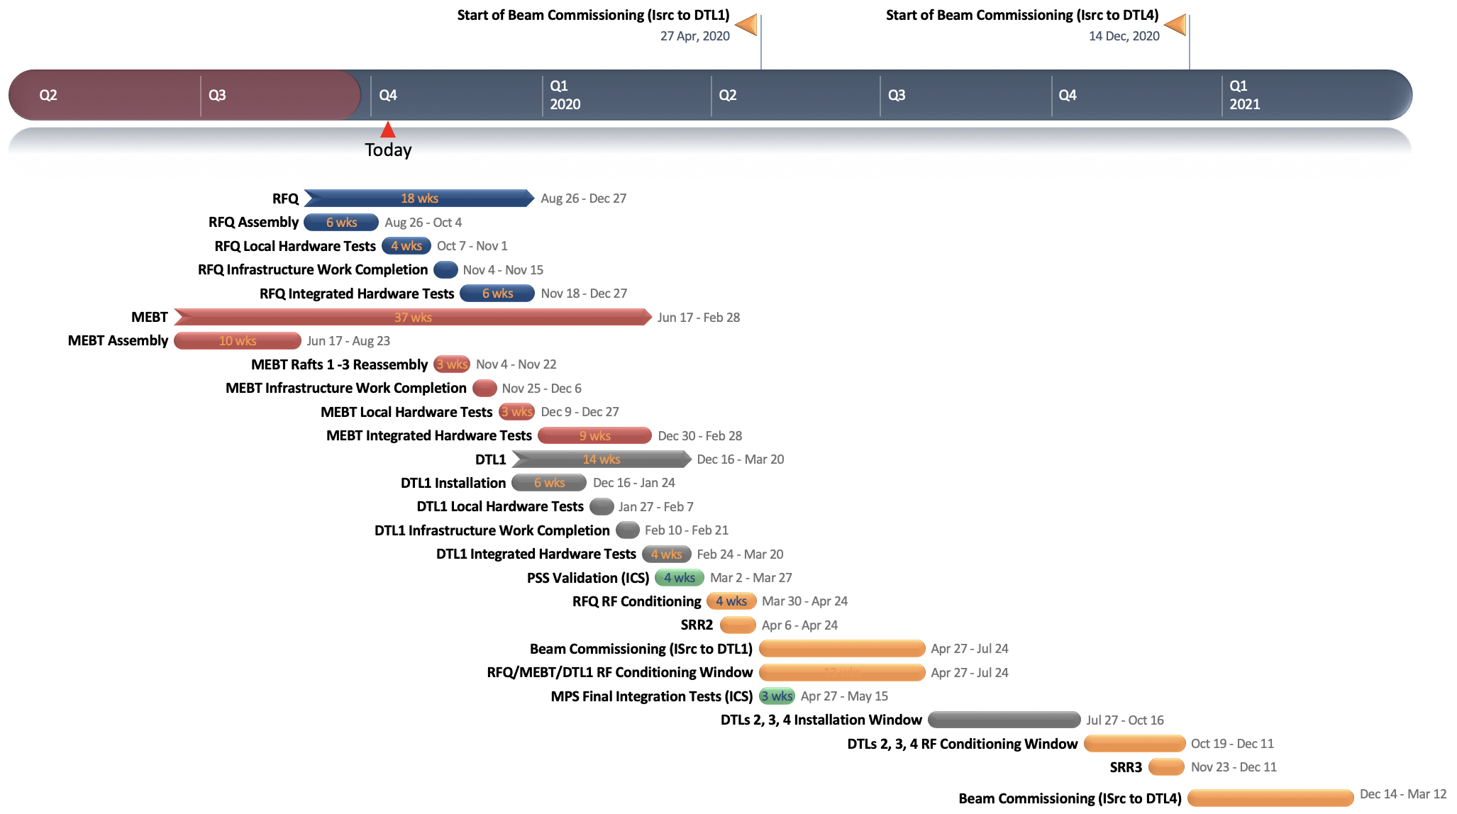
Near-term plan and focus
Prioritizing to start RFQ conditioning in April next year. This requires
  Low power tuning
  Integration to control
  RF ready
  PSS
  Temporary shielding
Aiming to make RF for MEBT bunchers and DTL1 ready in June.

Slide 20
Configuration during NC linac commissioning
2020-April
MEBT FC
DTL2 FC
RFQ
MEBT
DTL1
DTL2
DTL3
DTL4
DTL5
Temp shield wall
2020-Nov
MEBT FC
DTL2 FC
DTL4 FC
RFQ
MEBT
DTL1
DTL2
DTL3
DTL4
DTL5
Limited pulse parameters:
  FC limit => (50 µs, 1 Hz) or (5 µs, 14 Hz).
  Dose (1.5 µSv/h) behind the wall => ~15 min/h beam for 74 MeV, 5 µs, 14 Hz
Temp shield wall

Slide 21
Source and LEBT beam commissioning

Slide 22
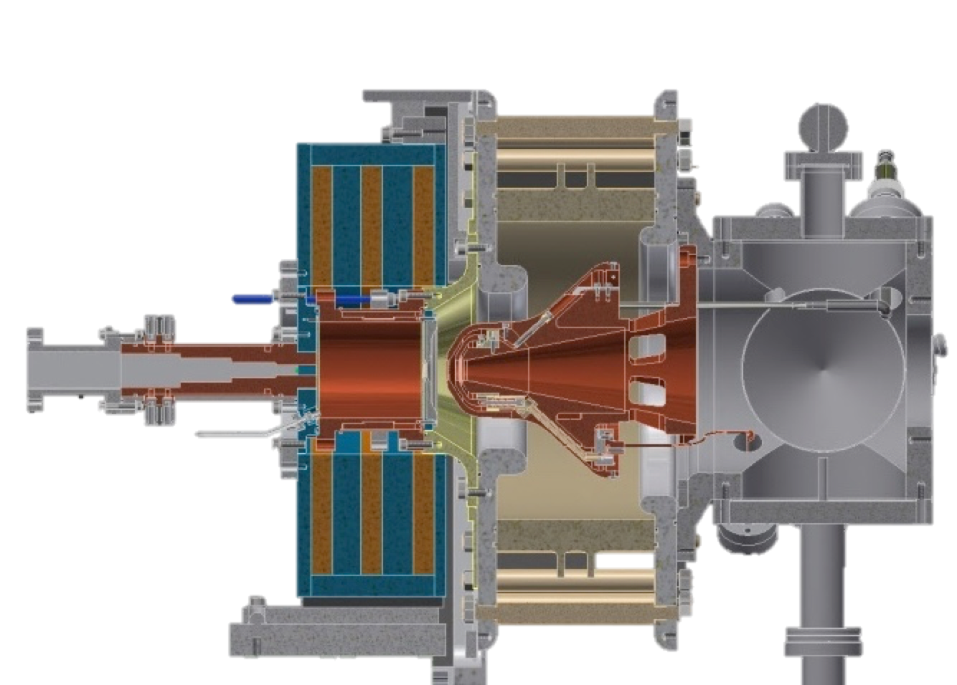
Microwave discharge ion source
Requirements | Value
Beam energy [keV] | 75±5
Proton current [mA] | 74
Proton fraction [%] | >75
Pulse length [ms] | 6
Pulse flattop length [ms] | 3
Rep rate [Hz] | 14
Pulse to pulse stability [%] | ±3.5%
Pulse flattop stability [%] | ±2
Emittance (99%) [π mm mrad] | 1.8
Divergence (99%) [mrad] | 80
High voltage insulator
Plasma chamber
Waveguide
Gas injection
5 Primary knobs:
  RF power
  H2 flux
  3 solenoids (coils) => great flexibility
3 Solenoids
Pumping ports
Extraction electrodes

Slide 23
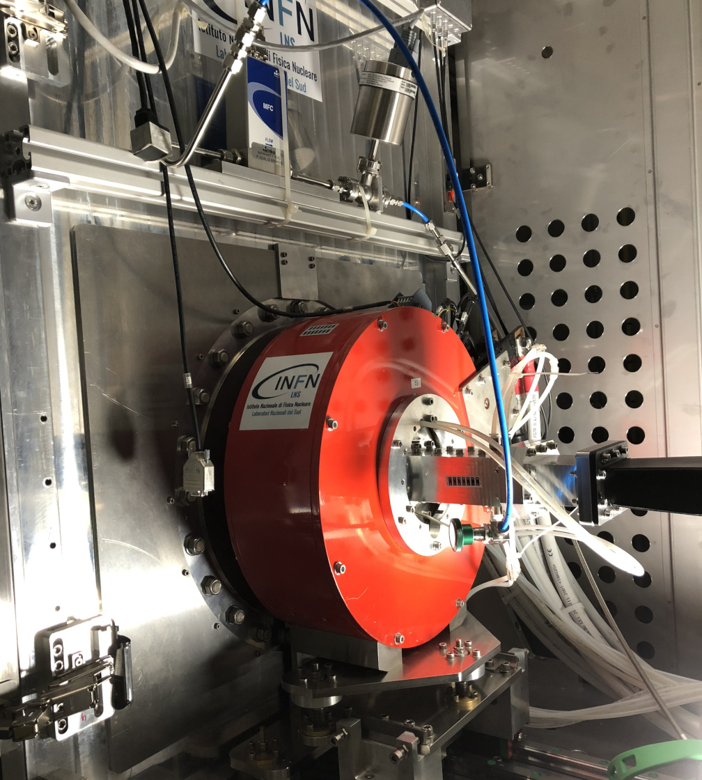
Ion Source in real life

Slide 24
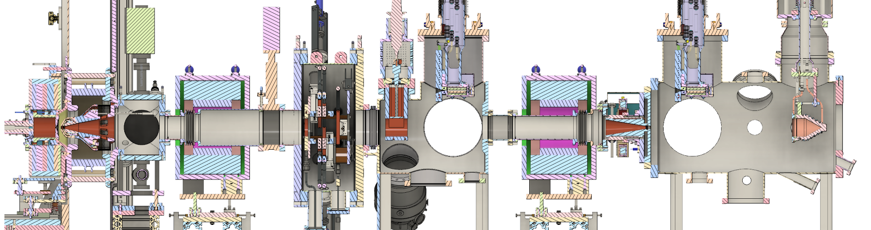
LEBT during commissioning
(Plan)
Permanent Tank
Commissioning Tank
ACCT
FC
EMU (H)
EMU (V)
NPM (H)
NPM (V)
Dpl
BCM
EMU (V)
NPM (H)
NPM (V)
FC
HV
Repeller
Chamber
Repeller
N₂ injection
Iris
Chopper
Collimator
Beam stop
Solenoid 1
(Steerer 1H)
(Steerer 1V)
Solenoid 2
(Steerer 2H)
(Steerer 2V)

Slide 25
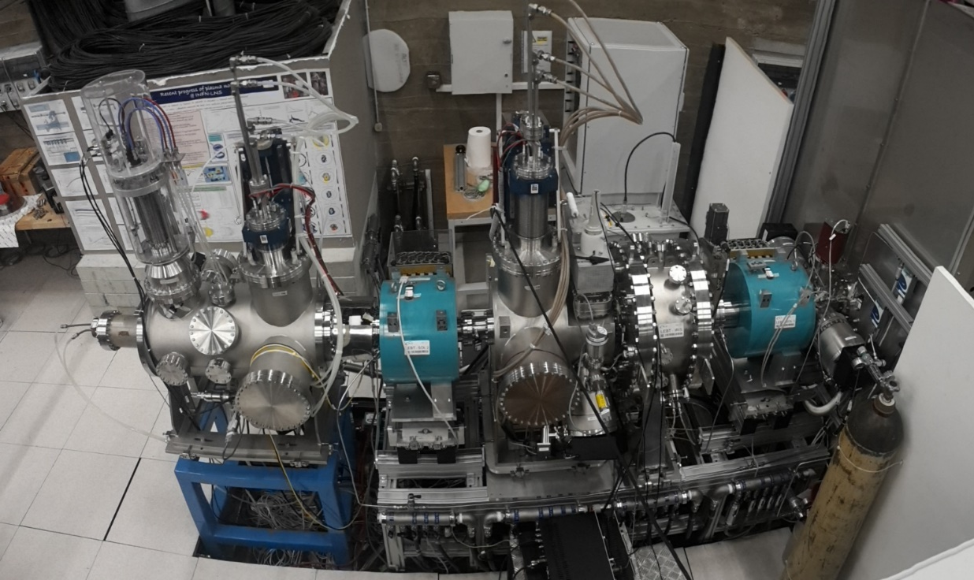
LEBT in real life
Catania installation

Slide 26

How the beam should look like in a (IBSimu) simulation
70 mm
Parameter at IS exit | Value
Proton current [mA] | 70.8
Emitt (RMS) [π mm mrad] | 0.14
β [m] | 0.44
α | −4.24
Plasma surface
75 kV
0 V
–3.5 kV
Space charge compensation start?
H₂⁺
H⁺

Slide 27
ISrc and LEBT commissioning activities
(In Lund)
Commission systems with beam.
  Establish stable operation of source.
  ... (diagnostics, control, ...)
Study source behavior (against 5 knobs).
Correct beam trajectory.
Study matching to RFQ.
  Matching to the RFQ is ultimately optimized by scanning the 2 solenoids and maximizing the transmission through the RFQ.
Prepare "candidates" for the nominal setting.
  We don't know beam loss and matching condition of the RFQ.
Establish adjustment capabilities of pulse length and current with the chopper and iris.
(Check stabilities.)
(Transfer expertise to the operation team.)

Slide 28
Saving the history...
Date | Event
2017-12-14 | Source and LEBT delivered to ESS.
2018-07-18 | Safety readiness review completed.
2018-09-19 | Started beam commissioning and had 1st beam.
2018-10-02 | Started the source repeller repair and 1st round of EMC grounding work.
2018-11-28 | Solenoid 1 power supply damaged (one for Solenoid 2 switched to 1).
2018-12-11 | Extracted beam for ~2 min and damaged power supplies of 3 coils.
2018-12-12 | Started 2nd round of EMC grounding work.
2019-02-08 | Effectively started beam commissioning (with only solenoid 1).
2019-03-08 | Both solenoids became available.
2019-03-19 | Started to cover longer hours.
2019-04-05 | Chopper became available.
2019-04-25 | EMU became available.
2019-04-26 | Planned last day of source and LEBT commissioning.
2019-04-29 | Started the scheduled water pipe works for NC linac installation.
2019-06-11 | Started the extended period (back to normal hours).
2019-07-03 | Source and LEBT commissioning ended.

Slide 29
LEBT when we started
ACCT
FC
EMU (H)
EMU (V)
NPM (H)
NPM (V)
Dpl
BCM
EMU (V)
NPM (H)
NPM (V)
FC
HV
Repeller
Chamber
Repeller
N₂ injection
Iris
Chopper
Collimator
Beam stop
Solenoid 1
(Steerer 1H)
(Steerer 1V)
Solenoid 2
(Steerer 2H)
(Steerer 2V)

Slide 30
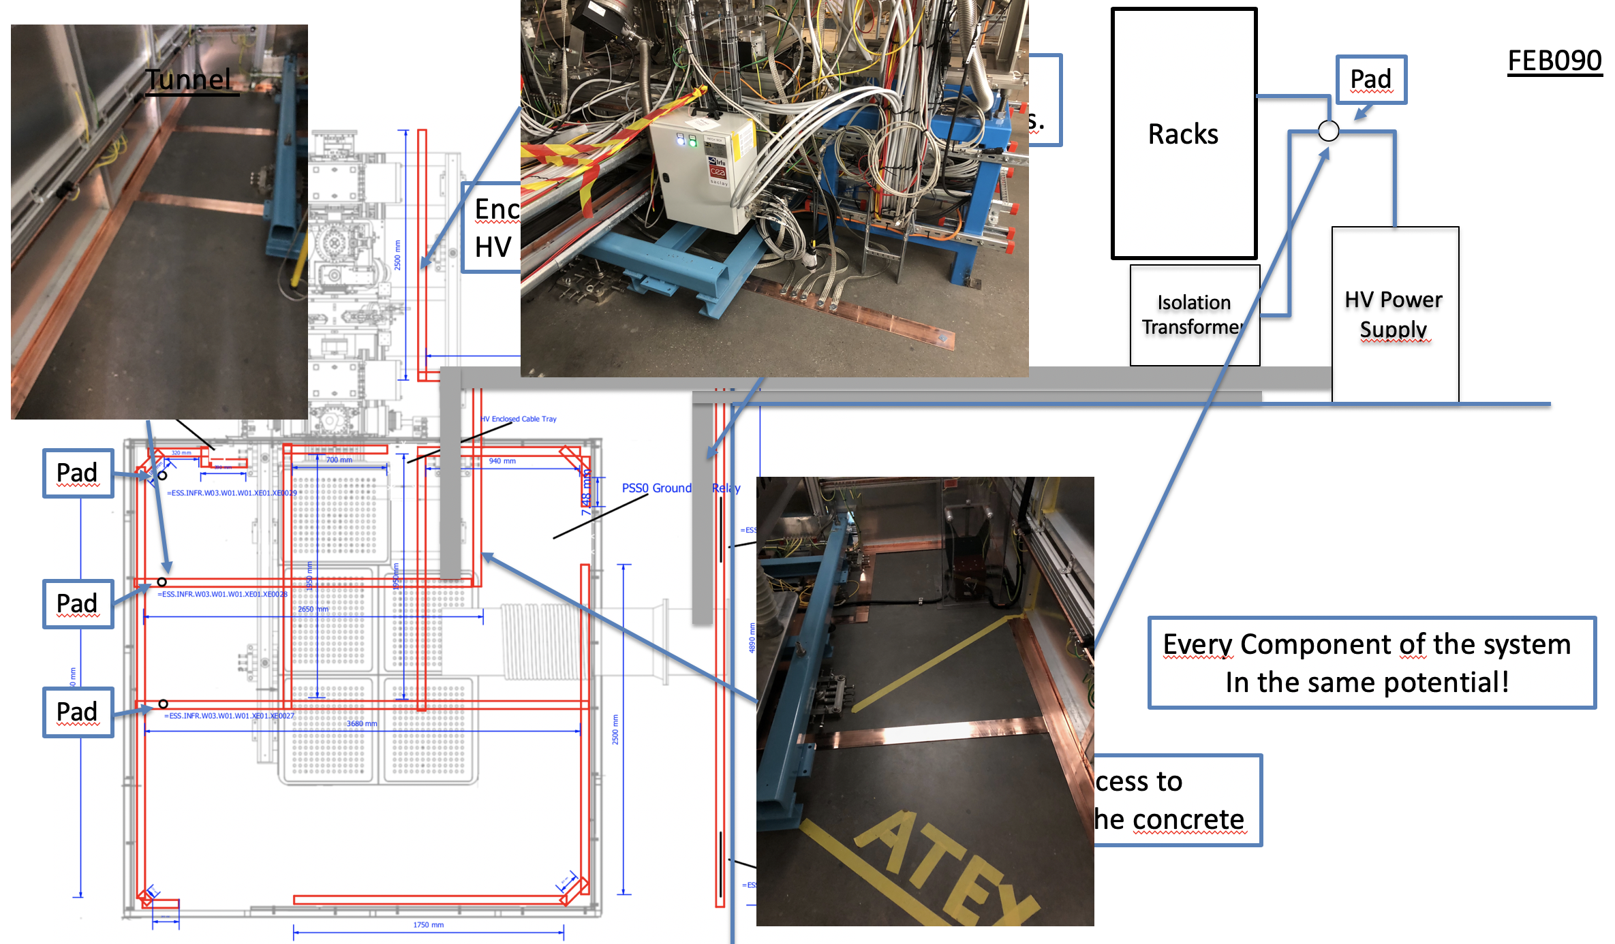
Fighting with EMI for ~5 months

Slide 31
Stable source operation achieved after EMI issue was fixed
~174 hours of beam time in April.
  "Shifted working hours" to cover 9 to ~24.

Slide 32
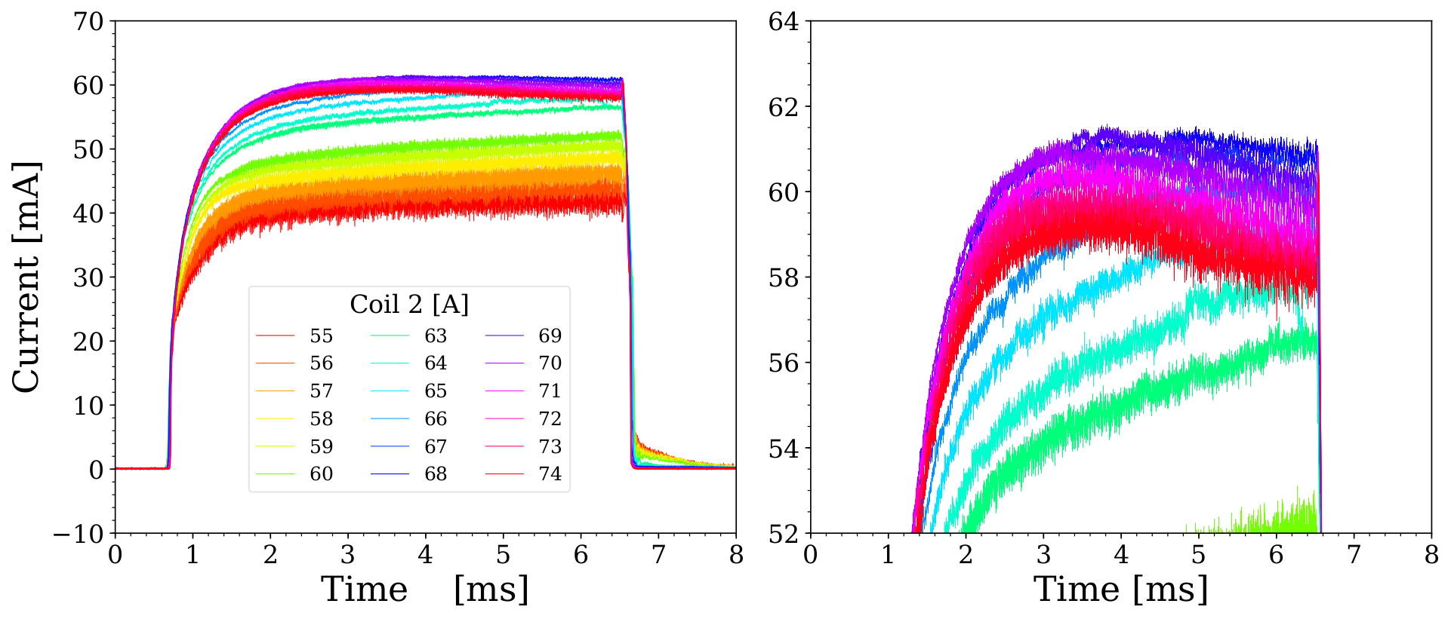
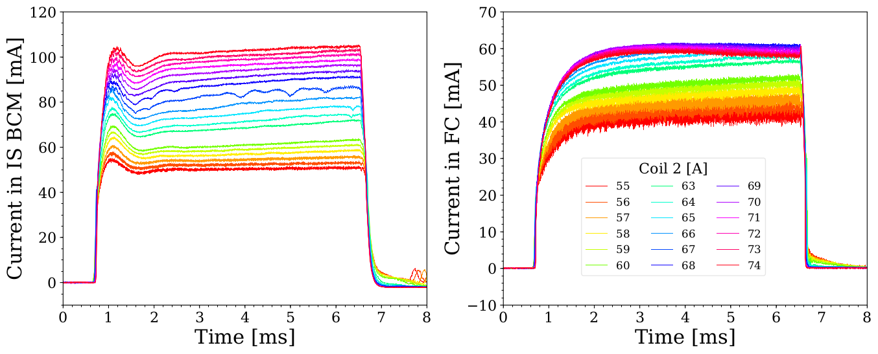
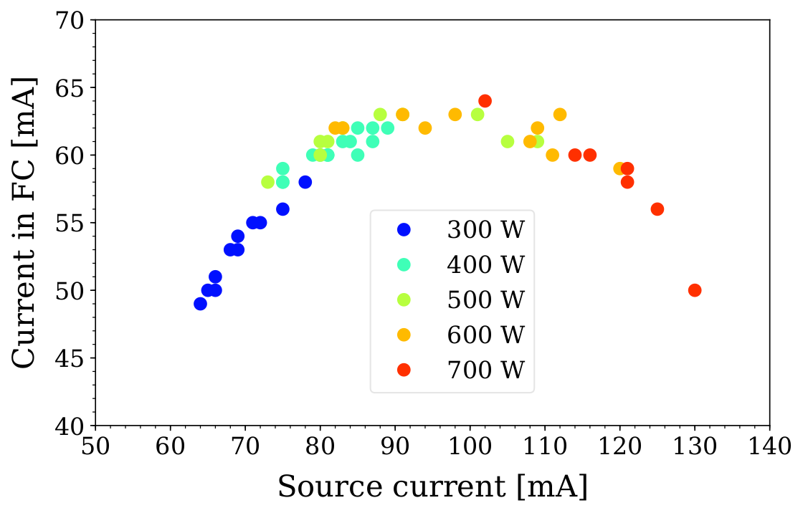
Source characterization
The source proved to be very flexible and provide a wide operation range.
We can easily establish a new set point in a systematic manner (coil2 scan).
The source beam characteristic is dictated by the extracted current.
  Seems no special source configuration with a high brightness.

Slide 33
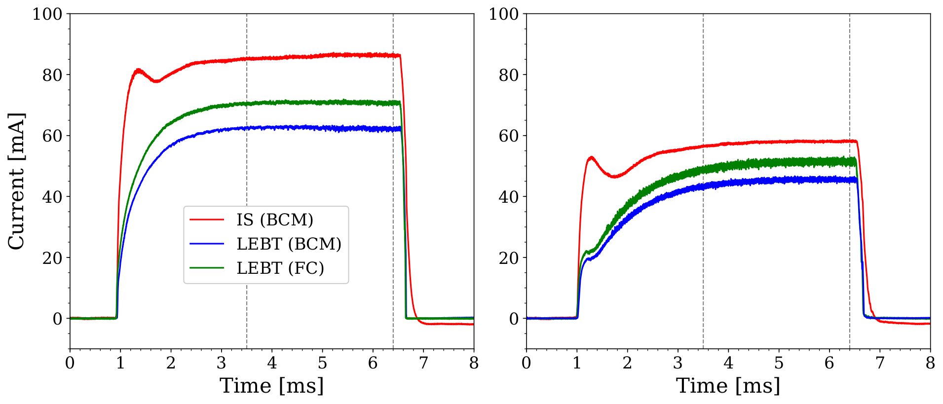
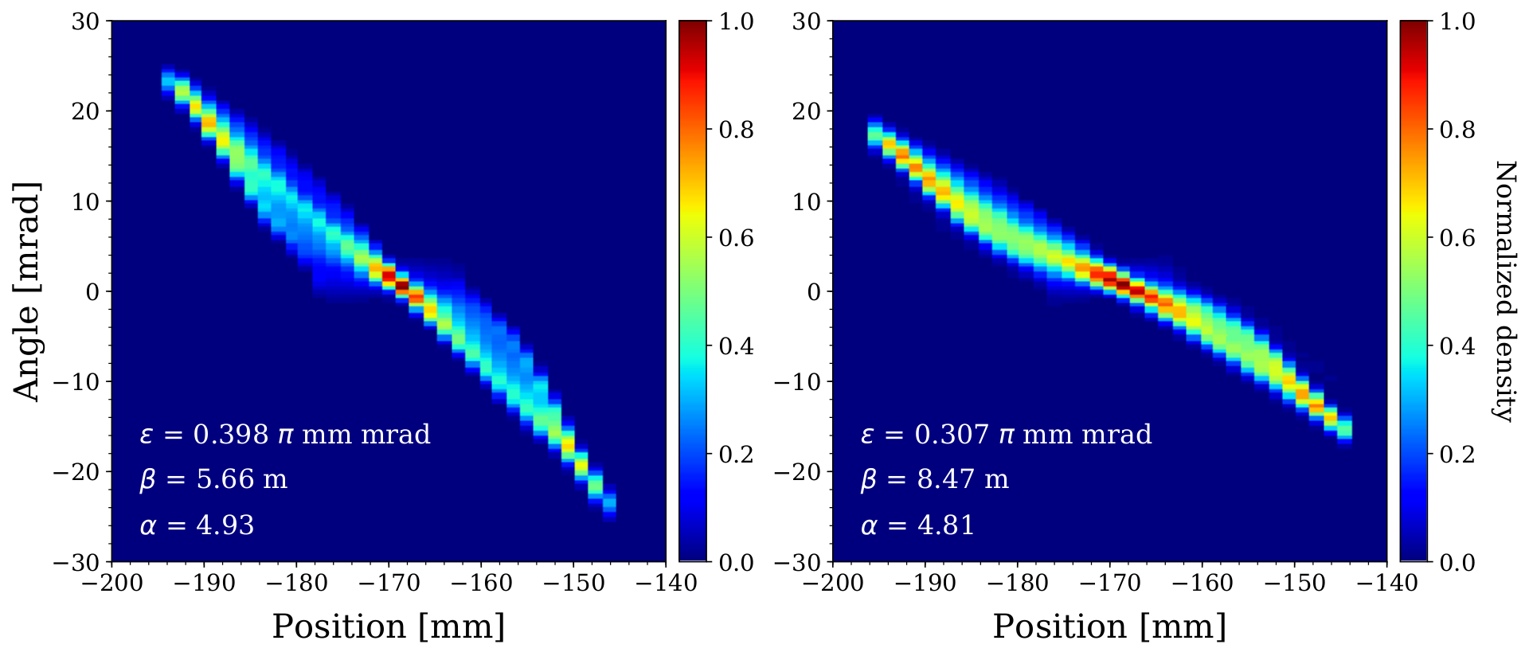
(Practical) ranges of current and emittance
~85 mA extracted
~60 mA extracted
Off site commissioning had 0.2-0.3 π mm mrad for ~85 mA extraction ???
No positive impact seen by N₂ injection.
Large initial divergence?
Large discrepancy between the FC and BCM (even cases with good transmissions).
Emitt after sol1

Slide 34
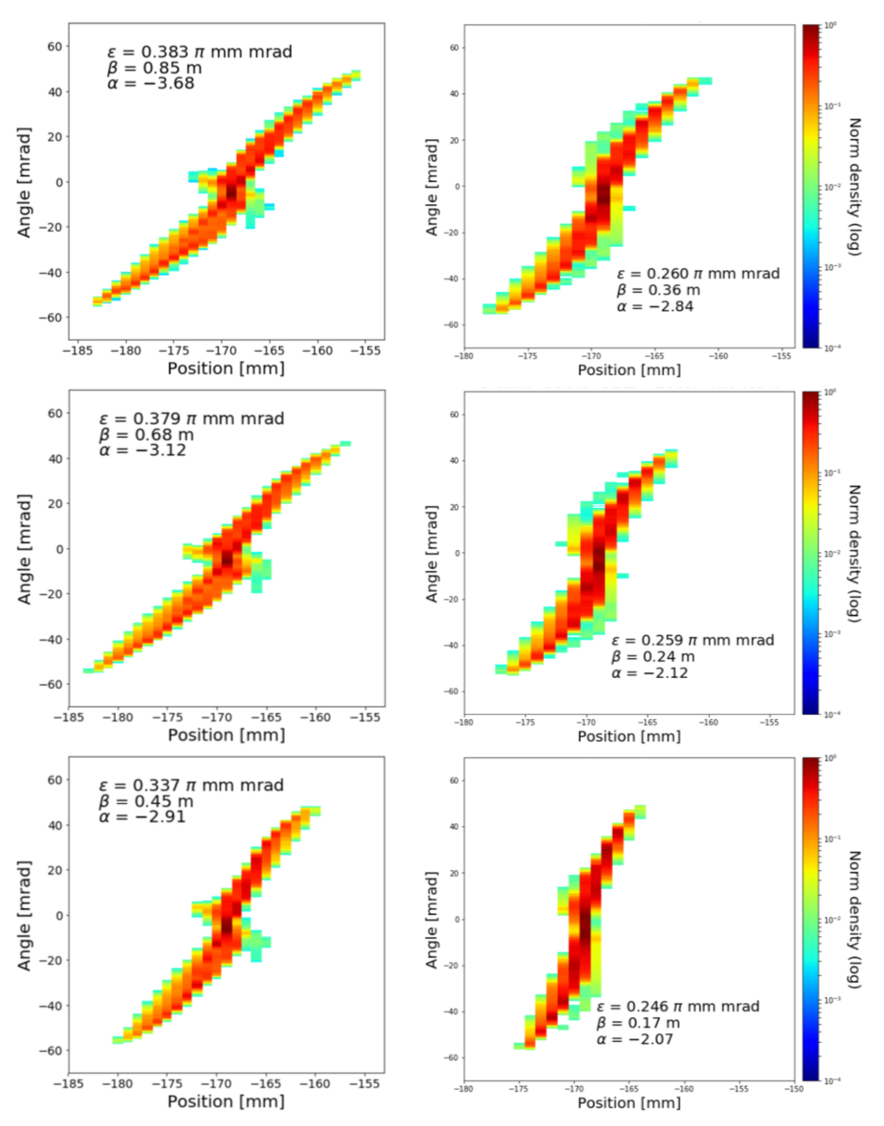
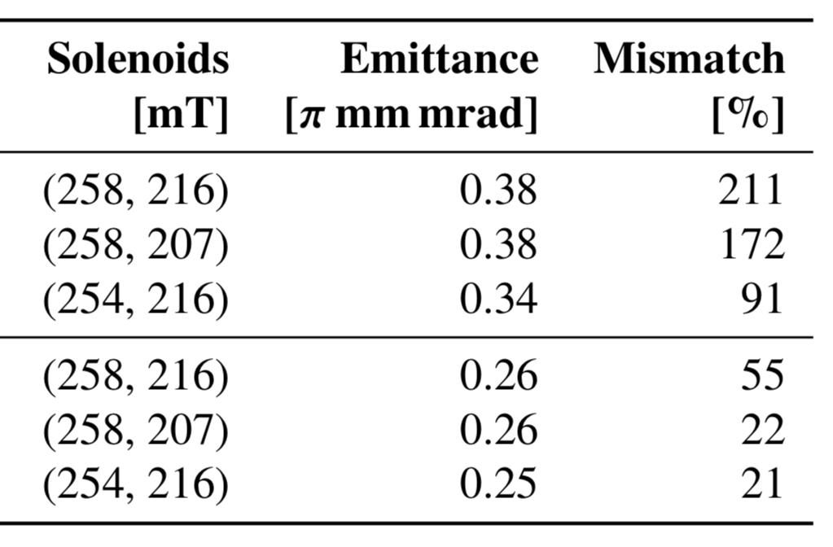
Matching study with EMU in commissioning tank
~85 mA extraction
~60 mA extraction
~85 mA
~60 mA

Slide 35
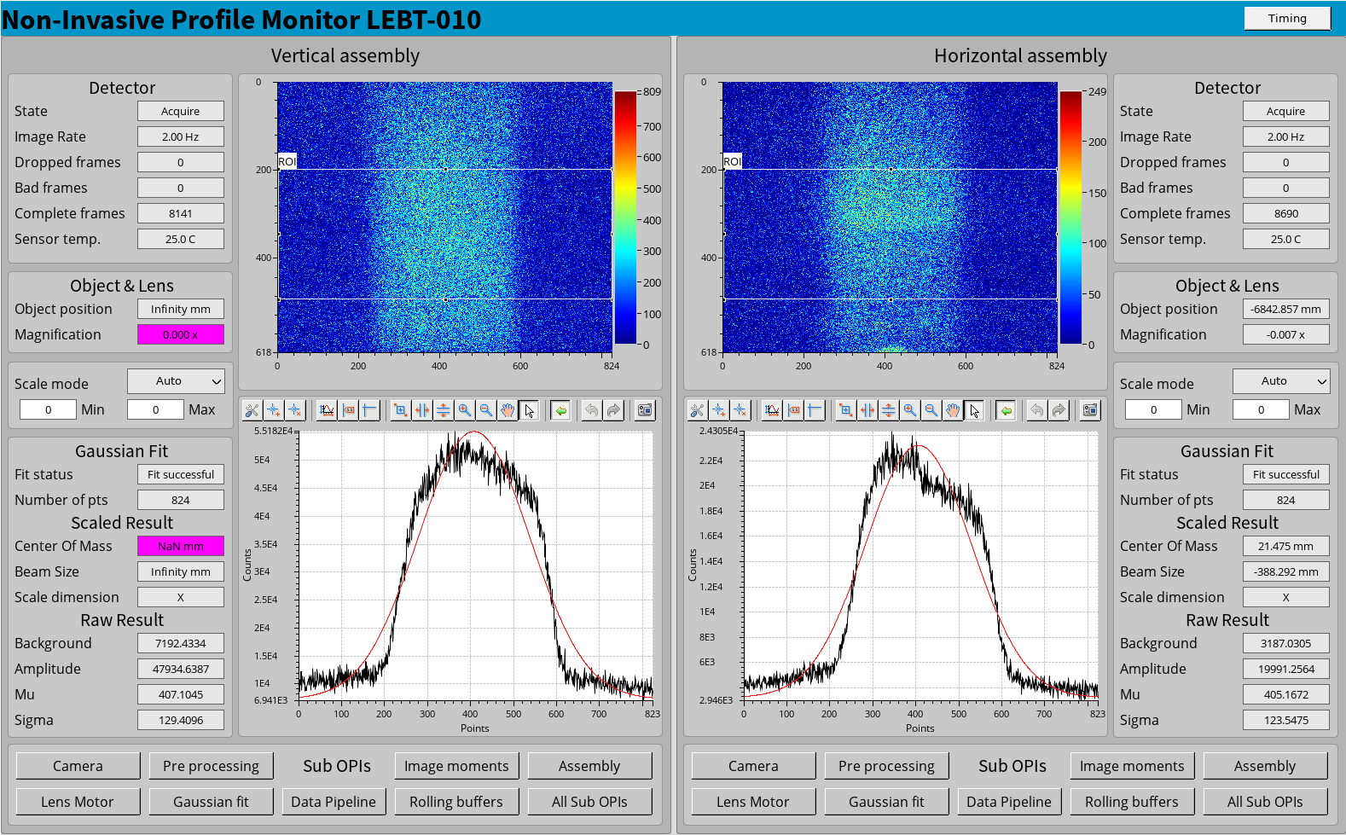
NPM (non-invasive profile monitor)
Viewport is large enough to measure angle and divergence.

Slide 36
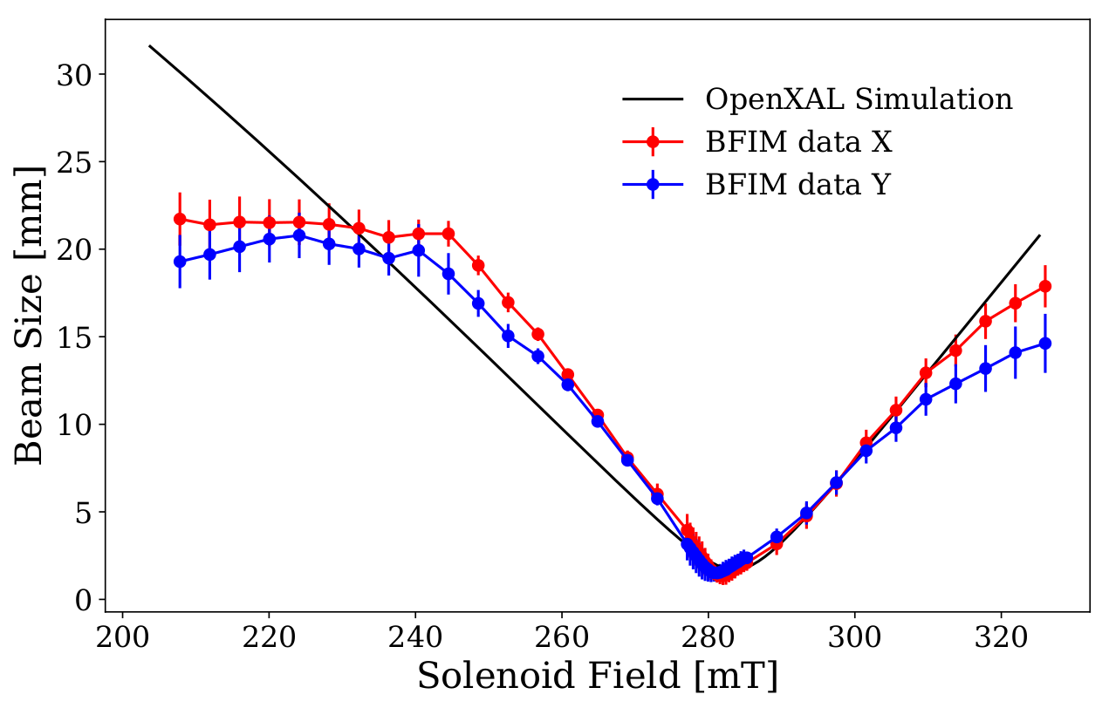
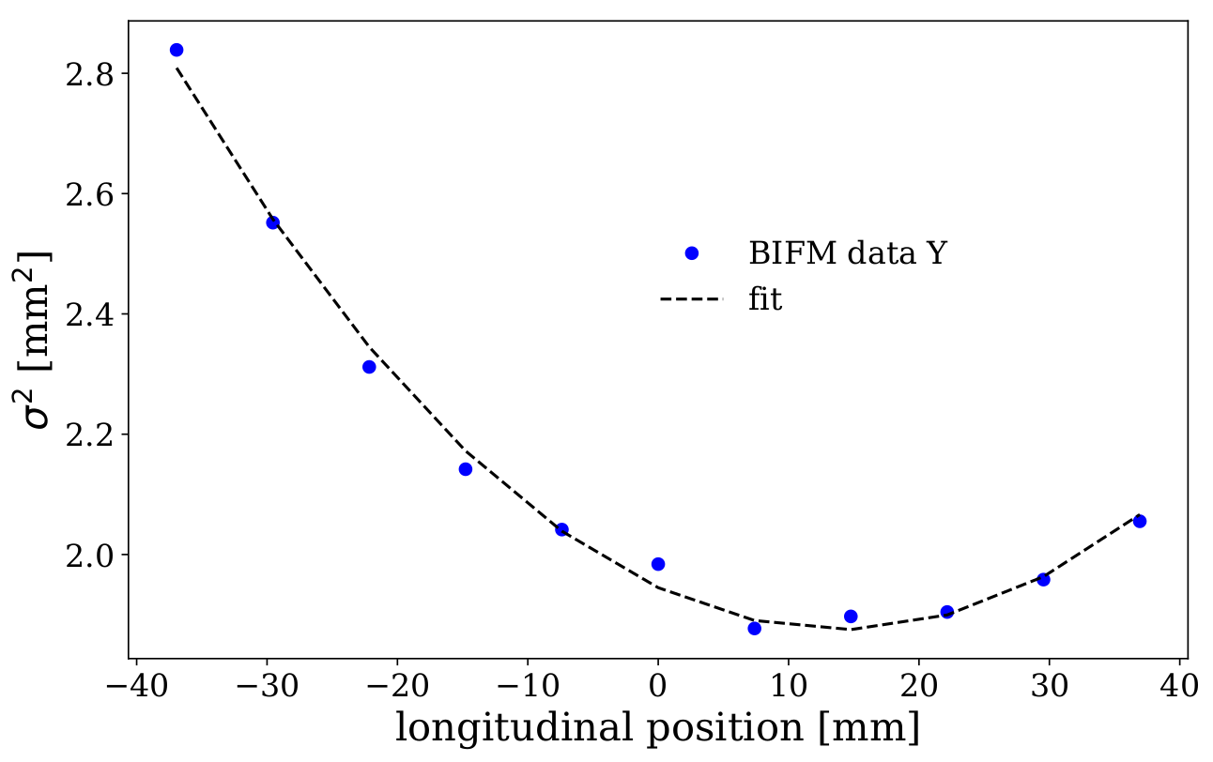
Emittance measurement with NPMs
NPM monitor provides two more independent ways to measure emittance:
  "Quad" scan
  Parabolic fit near the beam waist (assuming zero space charge)
All 3 methods were consistent within a ~10% level.

Slide 37
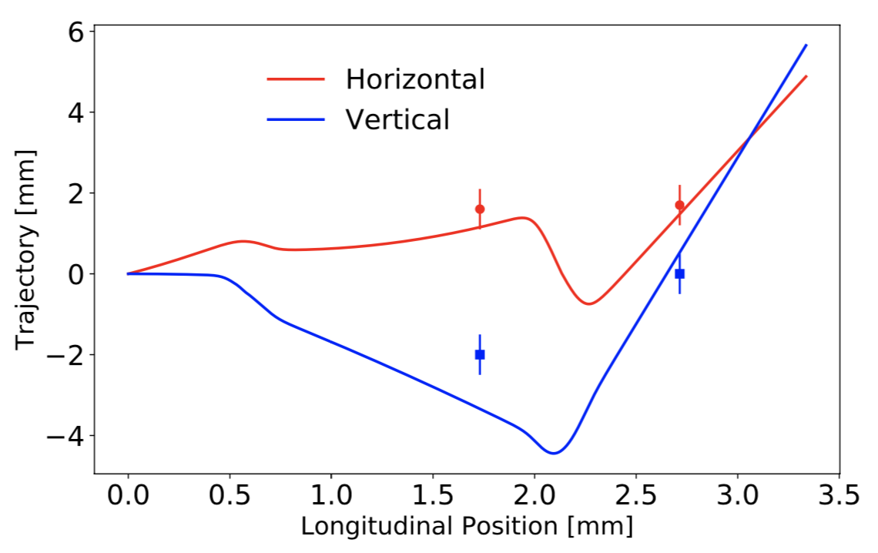
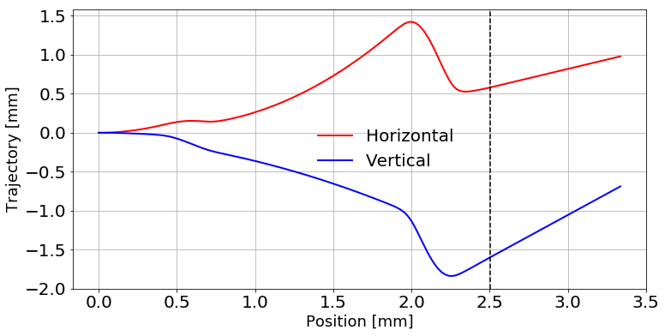
Trajectory in LEBT
Large initial angular offsets and solenoid tilts.
  Using the condition of having an image point (waist) at NPMs.
  Reasonably good model reconstruction.
  Solenoid measurement at CEA predicted 10-20 mrad??
Earth magnetic field (47 µT downward) was not considered but has a significant effect.
Famous polarity problem:
  Solenoid polarity was not specified.
  Steerer planes swapped: H1<>V1 and H2 <> V2.
  1st NPM sign is swapped.
Reconstruction
Traj. w/ Earth field
Source |  | Solenoid 1 |  | Solenoid 2
x' [mrad] | y' [mrad] | Pitch [mrad] | Yaw [mrad] | Pitch [mrad] | Yaw [mrad]
1.3±0.3 | 0.0±0.4 | −1.0±0.5 | −4.0±0.1 | 2.0±0.7 | 7.0±2.0

Slide 38
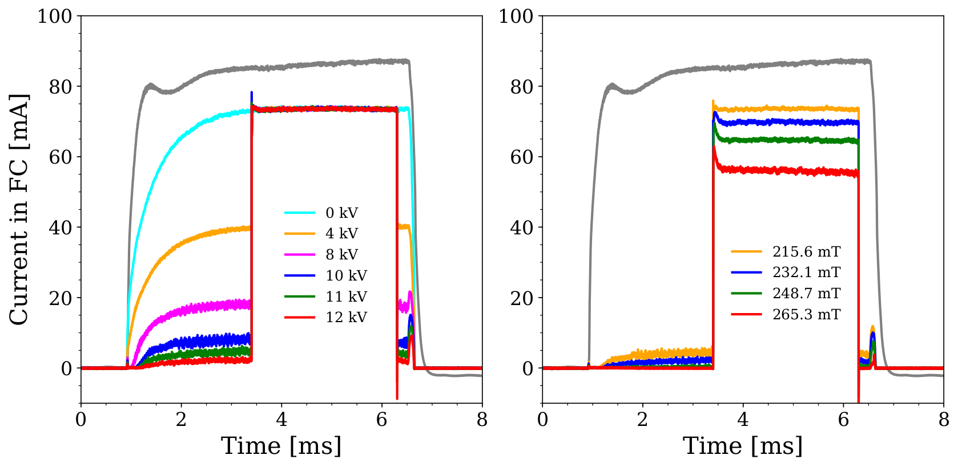
Chopper and iris issues
11 kV, vs sol2
We couldn't move the iris blades before the commissioning was over.
Chopper electrode was originally designed for positive bias, but the bias was swapped.
  To avoid to draw electrons.
  For consideration of space charge neutralization.
  Because the field is nonlinear, the swap degraded the efficiency. (The large emittance also has a negative impact.)
Chopper and iris have to be tested from scratch in the beginning of the next phase.
  Less straightforward with the RFQ connected.

Slide 39
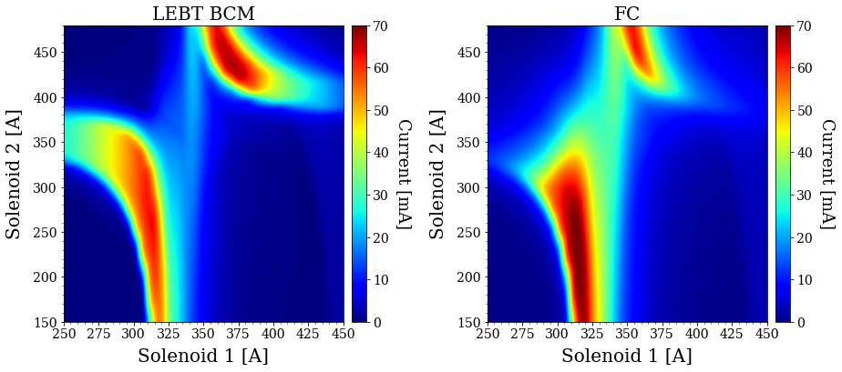
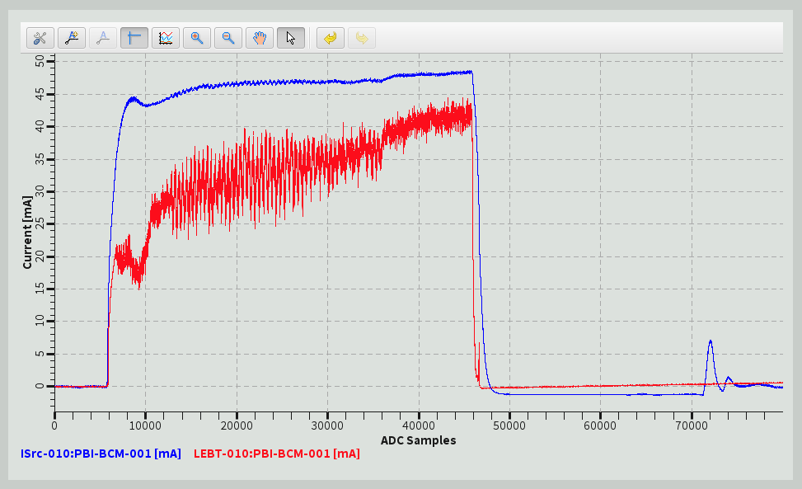
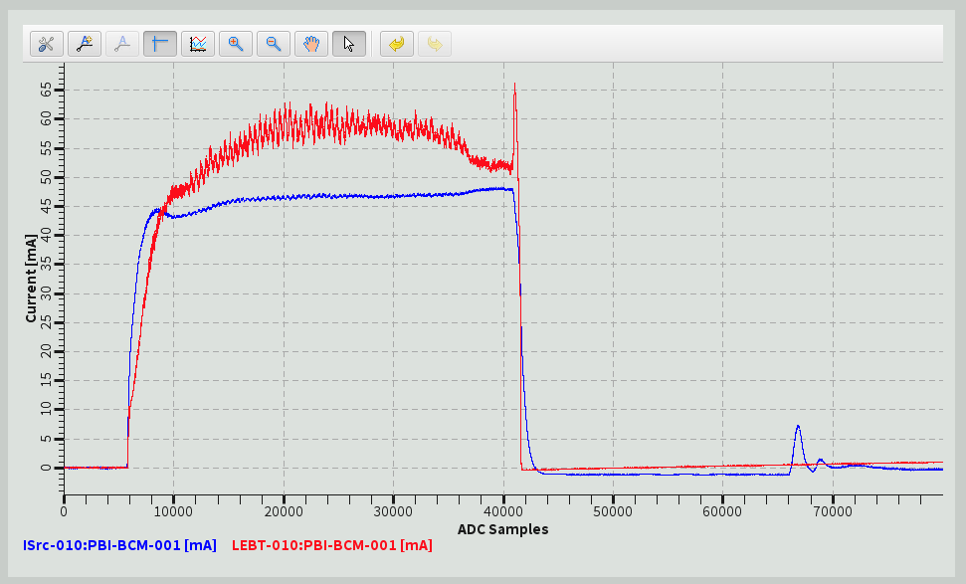
Beam current measurement issues
No PV for the average current on the flattop.
Discrepancy between FC and BCM.
Missing LEBT repeller causing some doubt in current measurement.

Slide 40
Conclusions
Overall
  A lot of progresses in all area of the accelerator project.
  NC linac commissioning is planned next year.
Ion source and LEBT
  Spent nearly 5 months to overcome the EMI issue. Afterwards, stable operation was achieved for the source.
  Understanding of the source behavior was much improved.
  Issues present with beam quality and trajectory.
  Couldn't establish adjustments of the pulse width and current with the chopper and iris.
  Resource limitation of the controls team was and will be a major issue. Already talking about the bare minimal configuration for the next phase.

Slide 41
Thank you for your attention!

Slide 42
Backup

Slide 43
Abstract
On the site of the European Spallation Source (ESS) in Lund, Sweden, great progresses have been made in all areas of its linac construction. Highlights include that installations of the radio frequency quadrupole and the following medium energy beam transport are being completed, assembly of the first drift tube linac tank is also being completing, the cryomodule test-stand is about to start its operations, and steady progresses have made in installations and testing of the RF system. One of the recent biggest highlights was the first beam extraction on the ESS site, followed by an establishment of stable operations of the ion source (IS) and various types of characterizations and optimizations performed for the IS and the following low energy beam transport (LEBT). This contribution presents these recent highlights on the ESS site, with a focus on results from the first beam commissioning activities on the ESS site for the IS and LEBT.

Slide 44
Note on LEBT subsystems
Chopper
  The beam pulse out of ISrc is ~6 ms and the LEBT chopper trims it to ~3 ms.
  Beam stops beyond LEBT can take only up to 50 µs (for 62.5 mA). The LEBT chopper also makes short pulses needed during beam commissioning.
  Primary device for machine protection.
Iris
  For a linac itself, 2 options for current are (almost) good enough:
    Lowest (safe) current: 6 mA
    Nominal or operational current: 62.5 mA
  Better and prompt adjustability (iris) is required for the power ramp, because our users demand to keep 2.86 ms and 14 Hz.
NPM
  Non-invasive profile monitor (NPM), aka beam induced fluorescence (BIF) monitor, detects light induced by the beam and allows to measure centroid position and profile.
  It seems new to be used in LEBT.
Dpl
  Doppler detector measures Doppler shift of light "emitted by the beam" and thus measure fractions and energies (speeds) of the ion species.

Slide 45
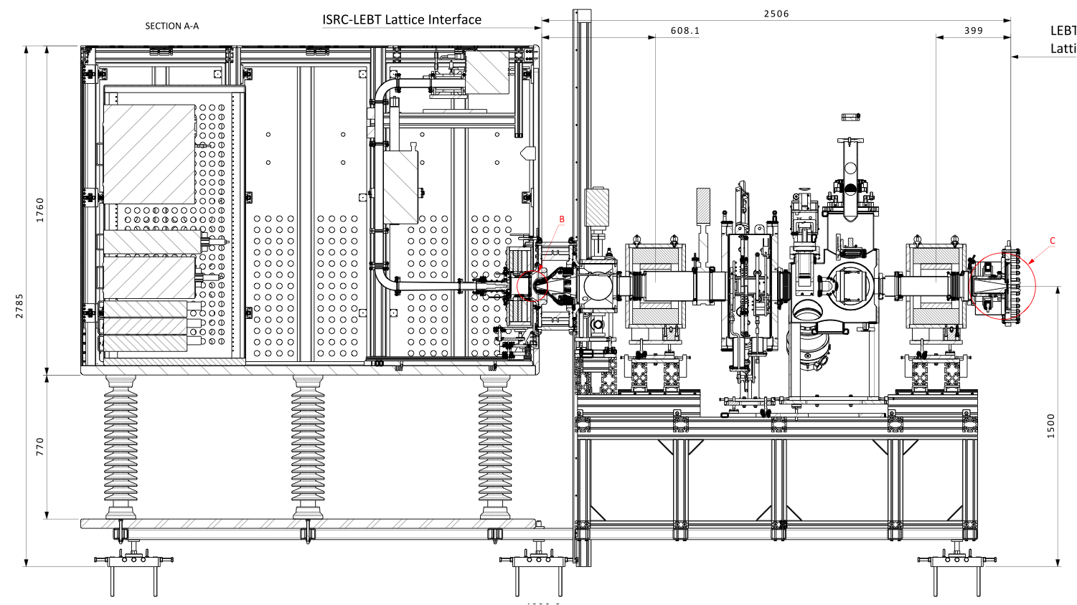
Trip of the electrical panel on Dec 11th damaged power supplies of 3 coils
Electrical Panel

Slide 46
EMI consolidation in detail
Scope: Optimize installation and protect the system operation from surges.
Actions:
Design and installation of an EMC grounding system for Ion source and LEBT
Focus on electronics and Racks by redesign and adding copper foil.
Optimisation and Verification of existing protective grounding (additional connections- correcting actions).
Redesign the power distribution panel inside HV platform (EMC filter and replace Surge arrestor).
Installation of enclosed cable trays to protect against EMI interference.
- Design and installation of EMC Grounding system for all components and electronics on rack and Tunnel area
In addition to the protective grounding system- In progress- Creation of EMC Task force
Scope:
-Ensure Equipotentiality between rack area and tunnel area.
-Protect system from High frequency currents.
-Provide low impedance path towards ESS EMC grounding mesh beneath the concrete.
-Flat copper conductor mesh inside protective cage extended to LEBT and wall area connected to main ESS EMC grounding mesh.
-Use of flat Aluminum foil and EMC braids to ground rack electronics, PDU, Isolation Transformer , HV power supply and “strangle” possible ground loops.

Slide 47
What changed from Catania??
Catania, no N2
Lund, no N2
Identical source setting produces a very similar pulse but a much larger beam.
  Good solenoids in Catania: (270, 320) A
  Good solenoids in Lund: (309, 230) A
Saw no improvement with N2 injection.
Data from EMU screen doesn't take into account the region of interest.
Something to do with the extraction region? (Earth magnetic field??)
Catania, 1 sccm N2

Slide 48
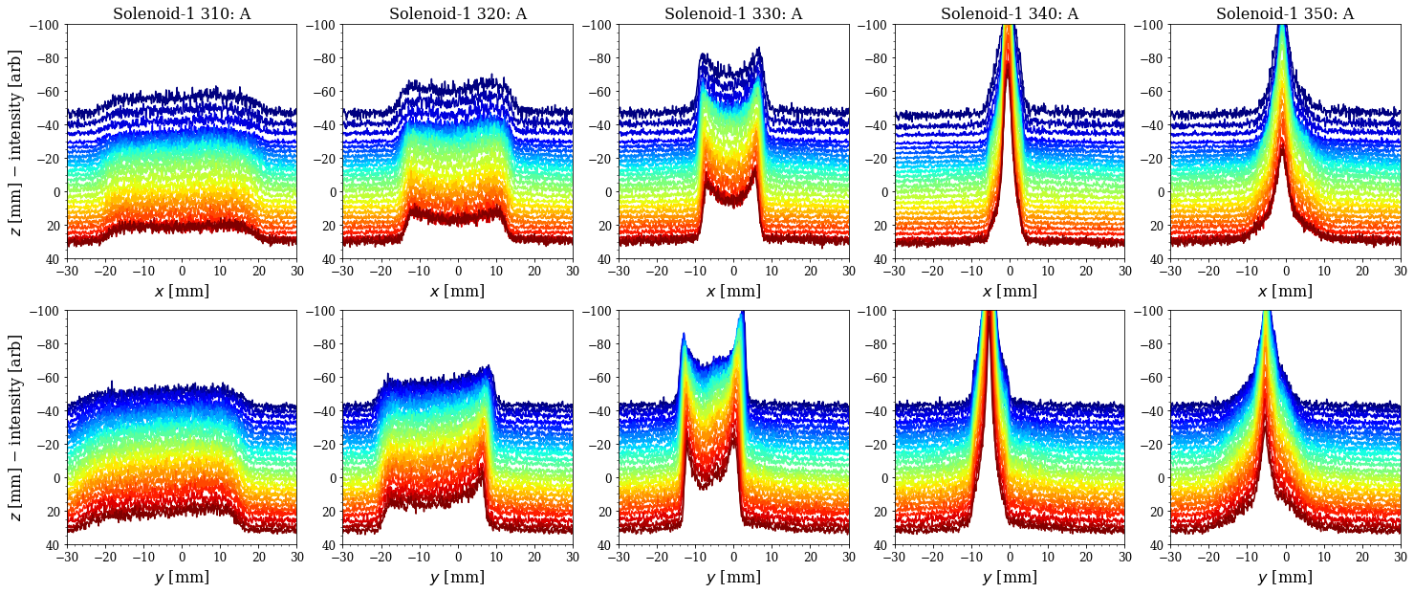
NPM data in a waterfall plot

