Slide 1
Conventional Ring Designs for ISIS II
D J Adams,
&
C M Warsop, H V Cavanagh, P T Hicks, B Jones, B G Pine,
R E Williamson
ICANS - October 2019
Notes:
This is a talk on accelerator physics work
The physics design of the AR and RCS
The people listed here are those who are and will be doing the study.

Slide 2
Objectives of AR/RCS Study
  Determine the ‘best’ conventional ring designs for ISIS II. Part of the Feasibility, design studies and R&D [2017-2027] in the ISIS II Roadmap
  Accelerator options under study: RCS or Accumulator Ring, within the existing ISIS Hall or a Stand Alone ie green field site.
  Use conventional hardware with ISIS design and operational experience.
  Physics designs complete by 2025 for comparisons with FFA.
  Currently focus on 400–1200 MeV RCS within the existing hall. Considered most challenging due to high space charge levels and injection requirements.
Power | TS1 | TS2
Power (MW) | 1.0 | 0.25
Frequency (Hz) | 40 | 10
Energy (GeV) | 1.2 | 1.2
Notes:
So what are we aiming to do in the AR/RCS work?
Find the best conventional design for ISIS II
This fits into the feasibility part of JWGT’s road map over 2017-2027
We need to look at a number of options
Probably the most important is the option re-using ISIS infra structure, which is reusing the ISIS hall, and makes use of the existing TS2 and a new Ts3, with overlapping use of the old ts1.
The spec from the road map is … 1.25 MW as outlined by JWGT.
We also need to look at relative merits of AR and RCS … see which is best (cost, reliability, flexibility)
The other main option is the stand alone or green field option, where we assume reuse of no existing infrastructure.
As in the roadmap this is nominally similar to the upgraded SNS with 2.5 MW, but the final target power will depend on experience from SNS et al
The work will be covered by synch group, aim is for a physics design, i.e. beam dynamics, with consultation with engineers as required to ensure practical, but full technical design later …
Important to emphasise work and collaboration with FFA work: swap ideas, expertise, share personnel as projects evolve

Slide 3
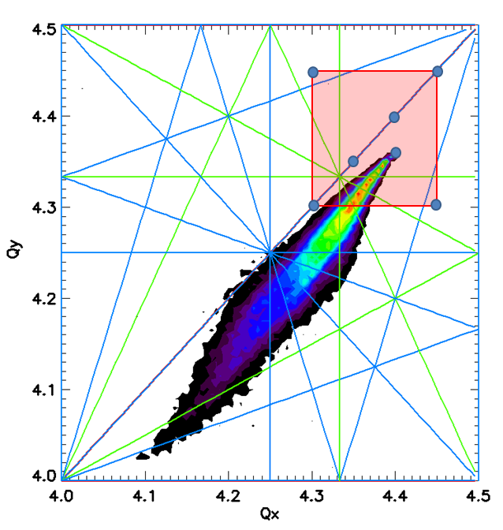
Working Point
High ring operating intensity requires large incoherent tune shifts: ~ -0.2 to -0.4
SNS, JPARC ~ -0.2
ISIS ~ -0.3 to -0.4
~400 MeV injection energy for 1.3x10¹⁴ injected particles
Lattice working points under study
Qx 4.3 – 4.45
Qy 4.3 – 4.45
Requires transverse and longitudinal distributions control( emittance, bunching factors), good 3D space charge tracking (ORBIT code)and careful resonance studies (tracking and error analyisis)

Slide 4
Injection Options
Injection control dominates beam dynamics requirements.
H- Charge Exchange Injection
  Foil hits (foil temp < 2000 degC), scattering, activation.
Proton Injection through tilted septum injection
  Recirculating hits = 0 , septum damage and activation
Highly non linear problem that is only solvable with simulations.
Hill Climb optimiser built around ‘One turn code’ with smooth space charge (2D, pic code, 50 space charge kicks per turn) used to probe parameter space ( paint amplitudes, Ring beta, Q, foil/septum hits)

Slide 5
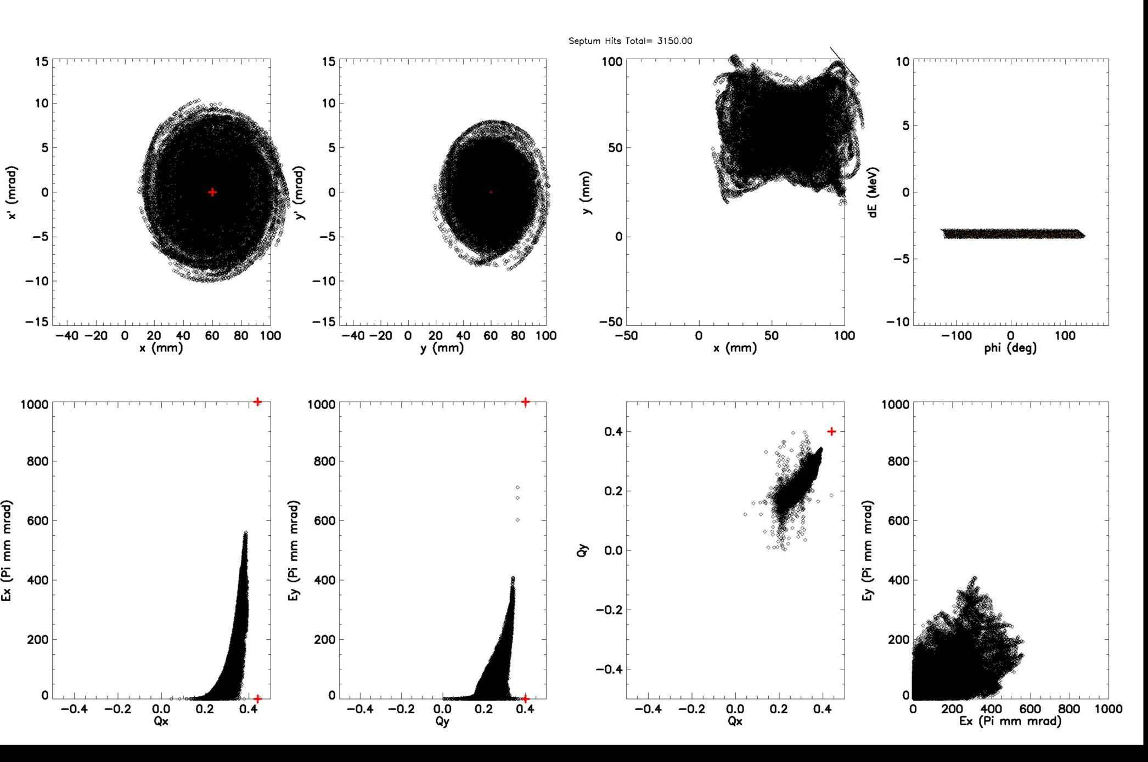
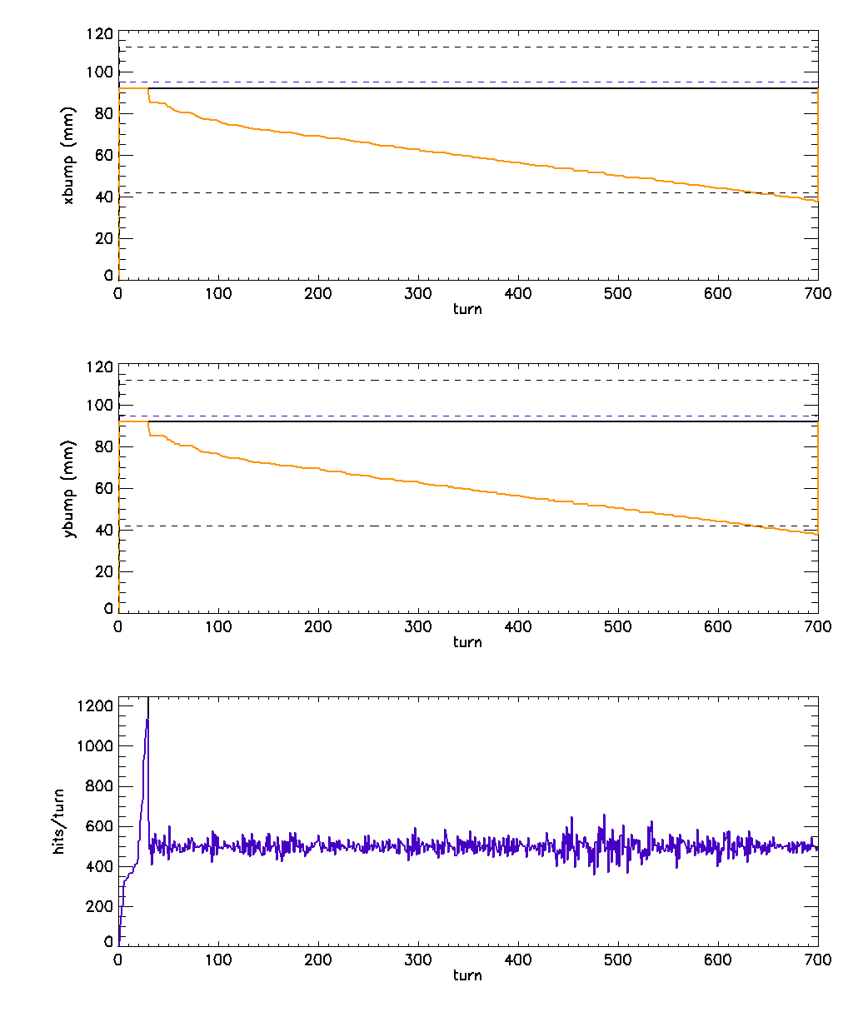
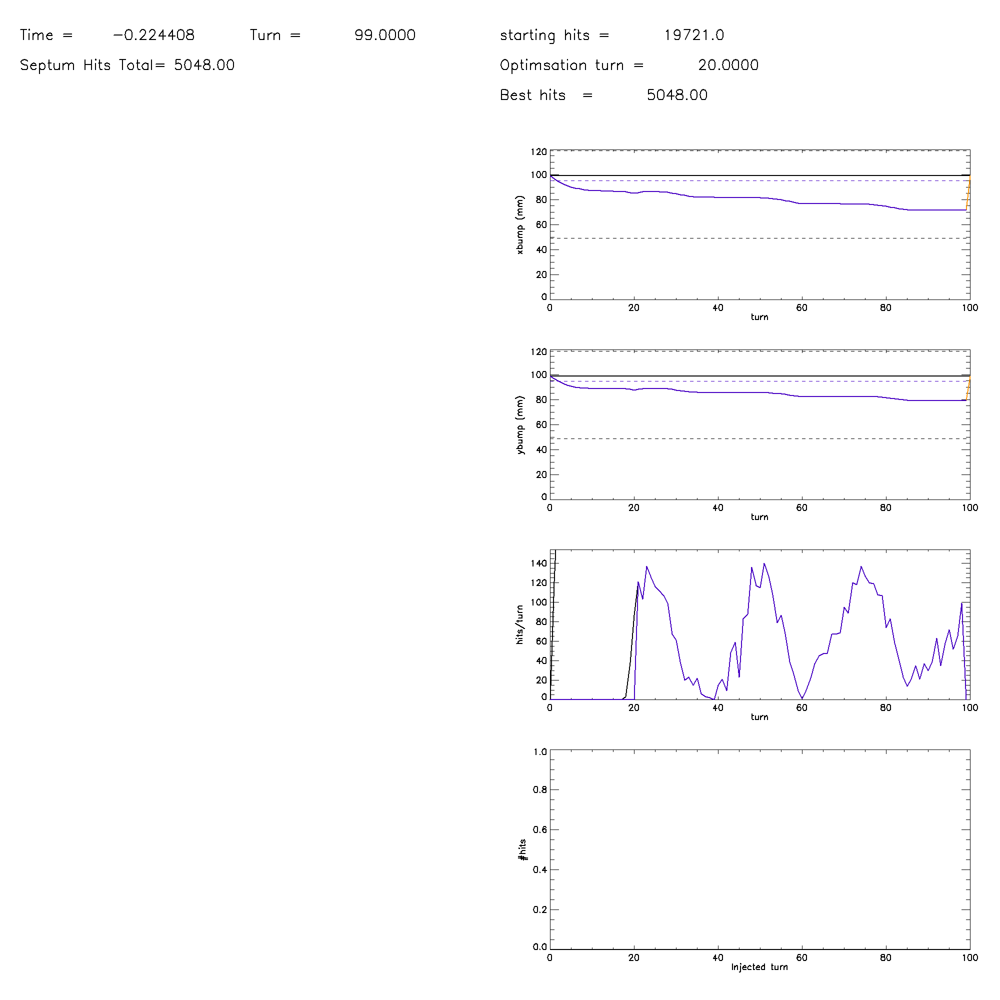
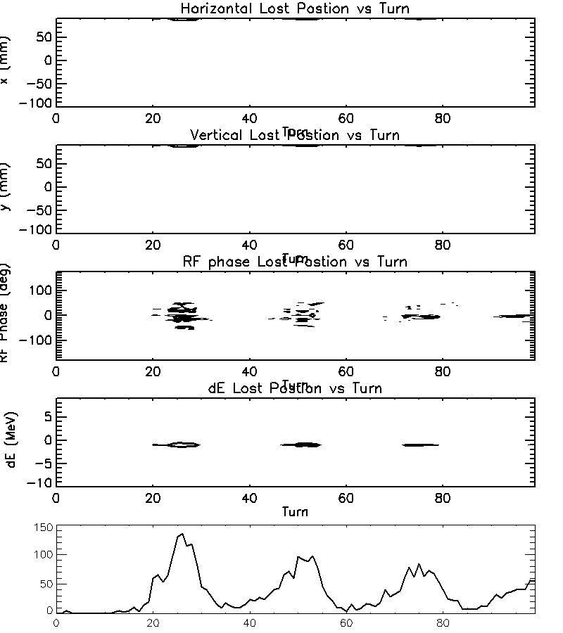
One Turn Hill Climb Code
Injection End One turn output
OptimisedHorizontal and vertical painting
2.5 foil hits
Proton inj hits with smooth focusing
Macros hits
One turn code
25 % loss
ORBIT
17.6 % loss
Turn
ORBIT : 1.96 hits
Proton inj hits with ORBIT 3D space charge
Macros hits
Turn

Slide 6
H- Painting Schemes
ANSYS foil temperature
calculation
H- injection through carbon foils
ANSYS studies suggest re-circulations < 3
required to keep foil temps < 2000 K
Anti-correlated and Correlated paint studies suggest centroid paint amplitudes up to
500 pi mm mrad required
y (mm)
x (mm)
Novel oscillating amplitudes reduce painted emittance whilst reducing foil hits
Ring circumference helps…
££ Costs: circumference vs aperture

Slide 7
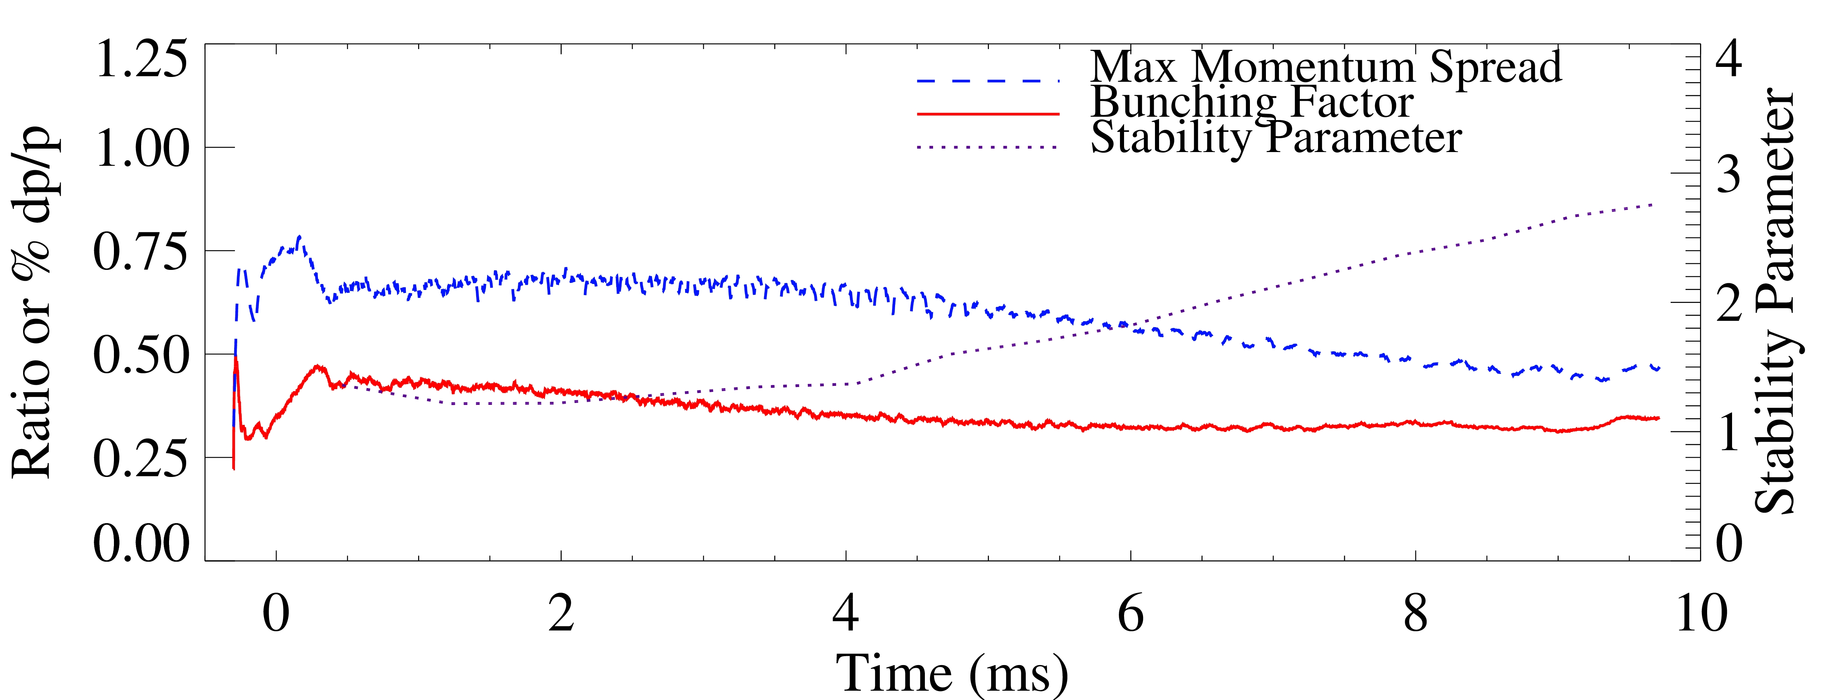
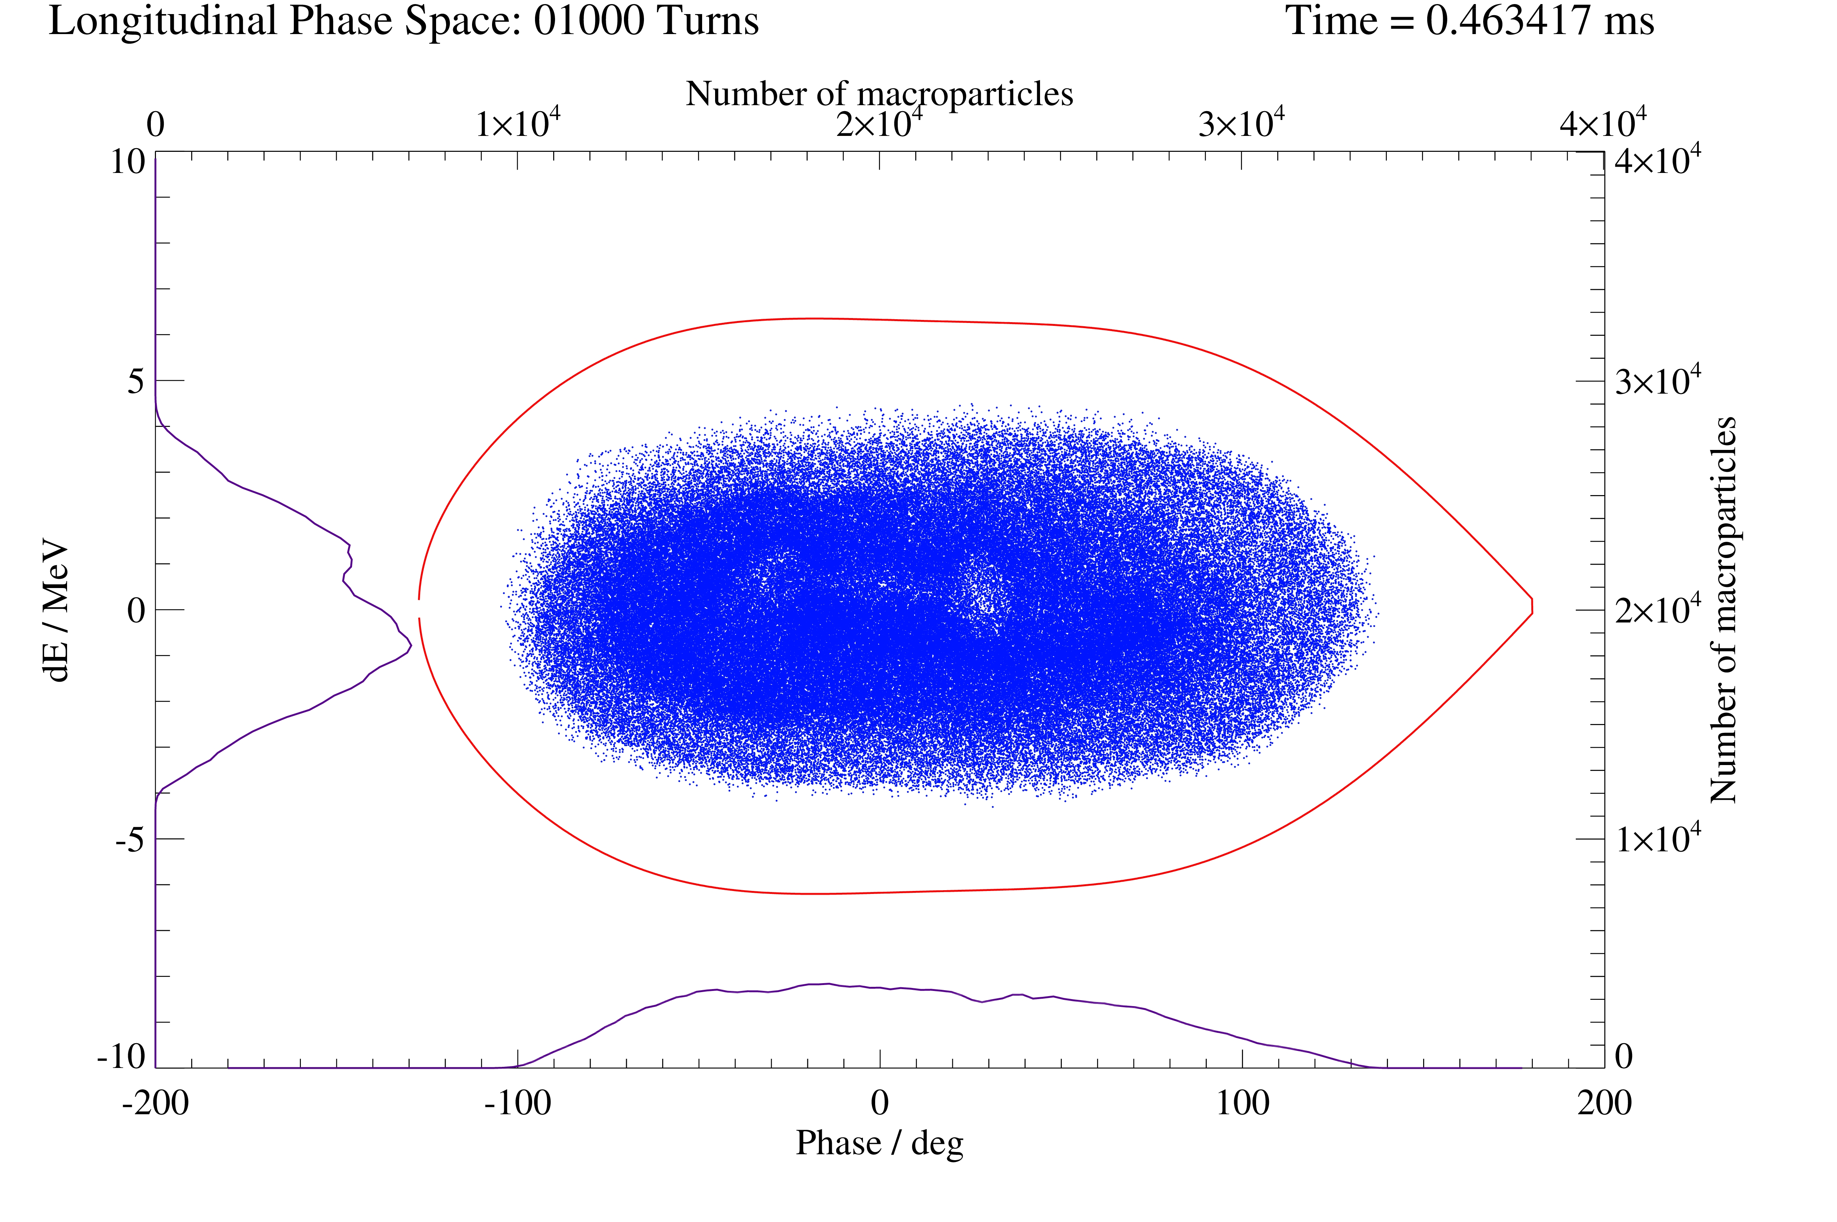
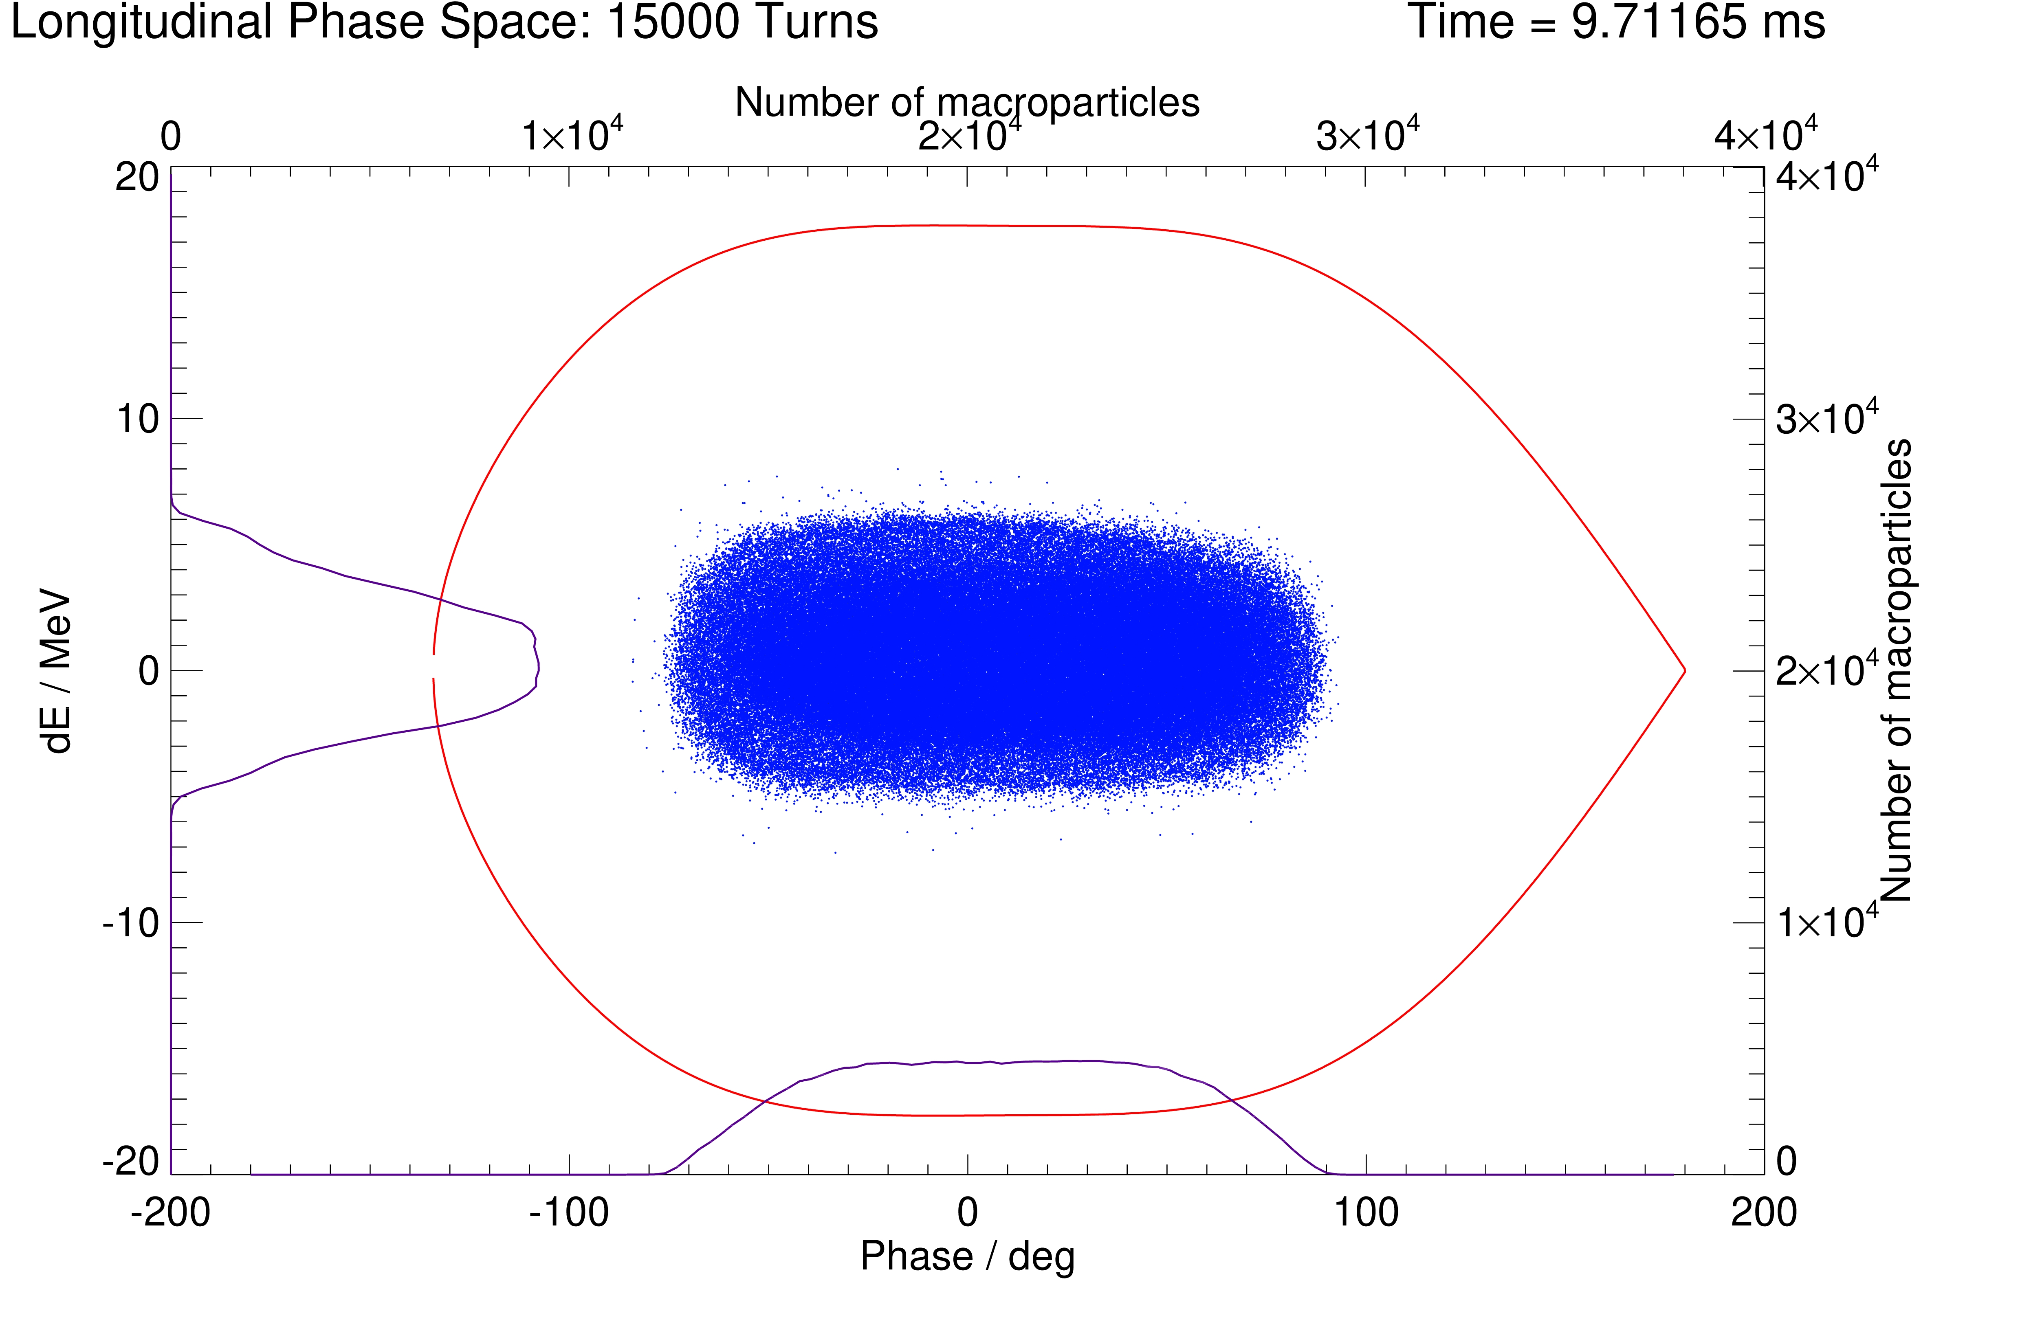
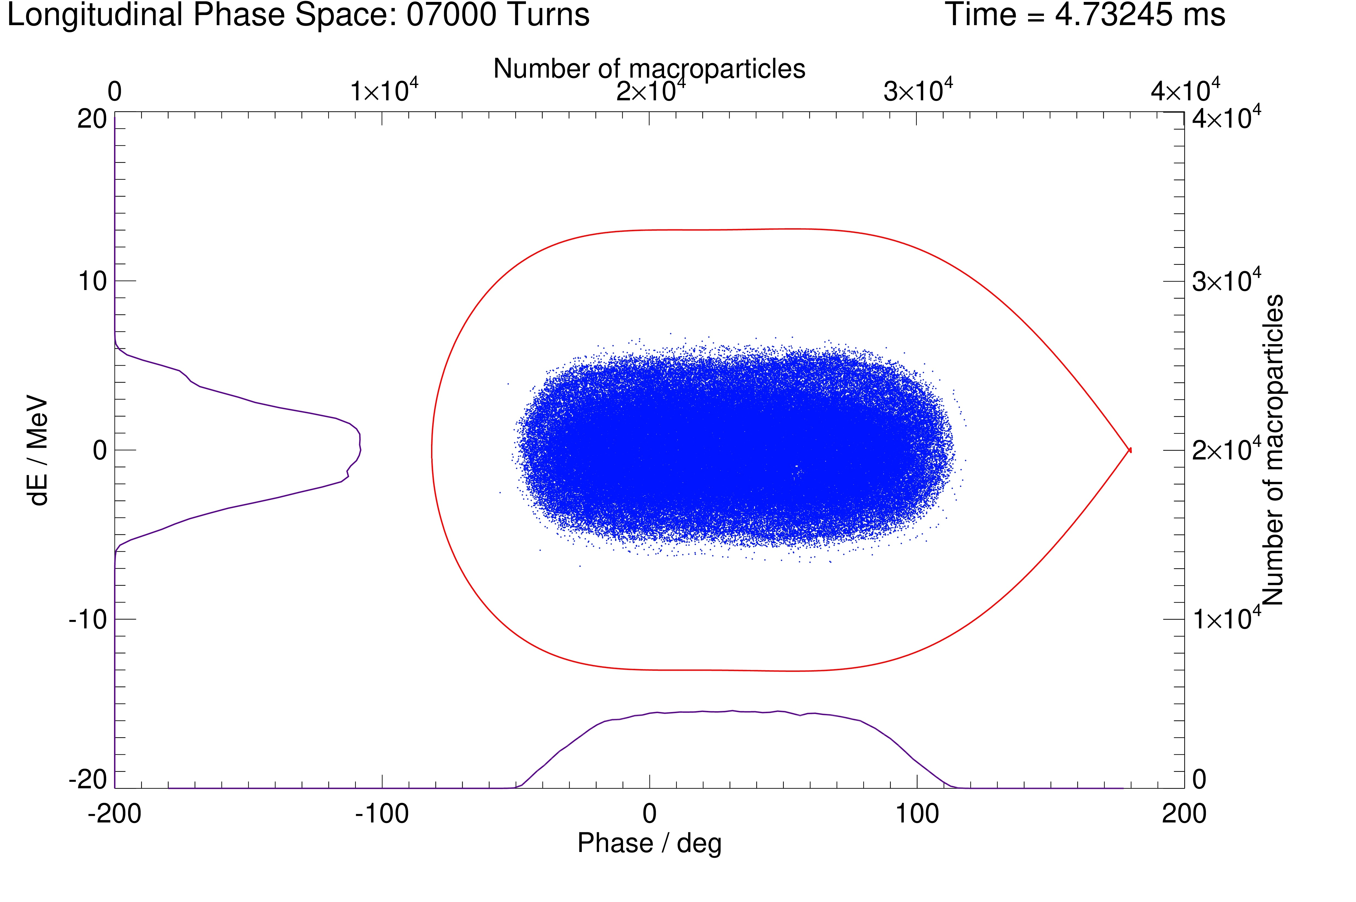
Longitudinal Dynamics
Dynamics for 1.2 GeV RCS 1.25 MW
  Longitudinal dynamics design (1D)
    Dual harmonic h=2,4
    60 % duty factor injected beam, 750 turns
    Painting gives reasonable distributions
    Bunching factor~0.4, KSB~1-3
    Controlled halo at extraction
Longitudinal Distributions
Injection, mid cycle, extraction
Injection end Mid Cycle Extraction
Notes:
An important aspect of both RCS and AR is the longitudinal dynamics, which determines the spec of the RF system.
This design starts with 1D calculations and 1D space charge codes, developed in-house and bench marked on ISIS.
This has been used for a number of ISIS ug designs as well as bunch shortening manipulations for muon users on ISIS.
So the study optimizes RF parameters for painting and accumulating a distribution over ~600 turns, then accelerating whilst minimising halo that would be lost at extraction. We also derive a stability number that ensures the ratio of space charge to RF volts is sufficient for a stable beam.
These designs produce zero loss in 1D, and optimise BF to reduce transverse space charge.
These are later combined in a 3D simulation …
We have good parameters for the RCS, but some potential for optimisation.

Slide 8
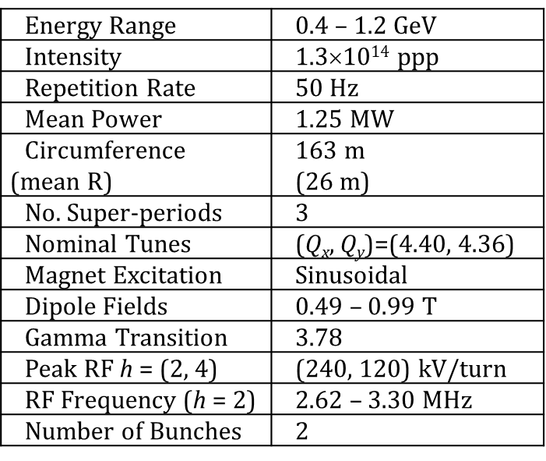
RCS Ring Parameters and Lattice Requirements
ISIS Hall Rings
  Mean radius 26 m to fit in ISIS Hall
    RCS: Max pole tip fields ~ 1T,
    40 m for dual harmonic RF Cavities.
~ 10 m for injection,
~ 10 m for extraction
Collimation region.
ISIS like pulsed dipoles for inj/ext
Total loss < 0.2 %

Slide 9
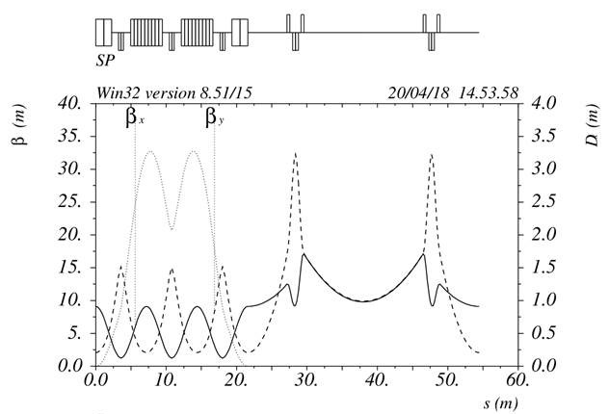
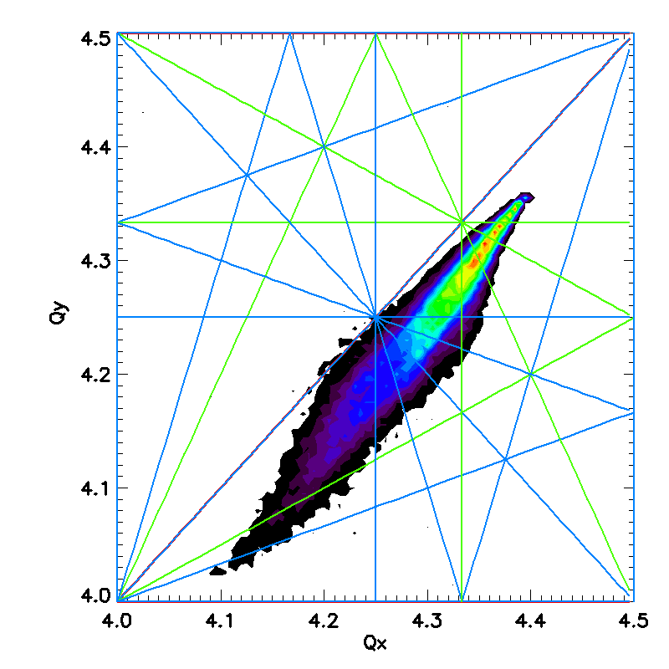
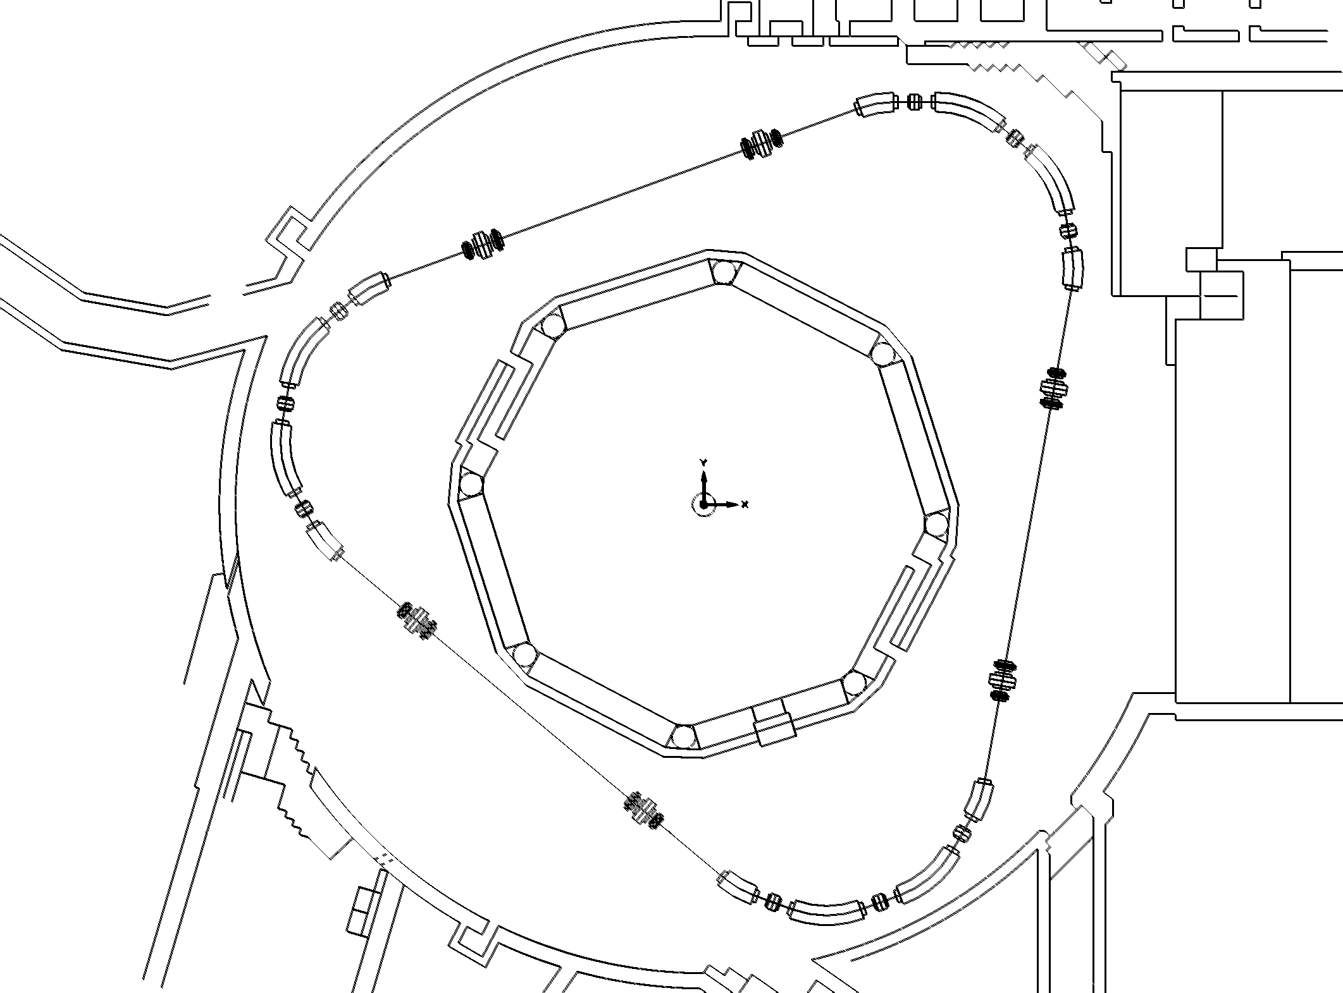
Lattice 1 – CF Dipoles-Triplet Straight
RCS Optics
Injection End
1.35 foil hits , foil temp 1635 K
RCS in ISIS Hall
Collimation at 500 pi loss = 0.098 %
  Lattice and optics must satisfy requirements
    Circumference, apertures, long straights
    Optics, space for injection, extraction, collimation
    Beam dynamics, stability, loss, …
  Promising design: 0.4-1.2 GeV RCS lattice
    Achromatic BF-D and triplet optic
    Satisfies criteria (so far …)
    Studies of beam dynamics underway
  Next steps
    Explore options; check errors, tune-ability
    Revisit for AR and Stand Alone
Notes:
A new ring usually starts with an optics and lattice design, and we have started by looking at designs for AR and RCS’s that fit in the ISIS Hall
The key constraints and challenges are … see slide
We have a working design for a 0.4-1.2 GeV RCS, that satisfies most requirements, params … see slide, nice because ….
Is promising but further work on detailed beam dynamics, errors etc

Slide 10
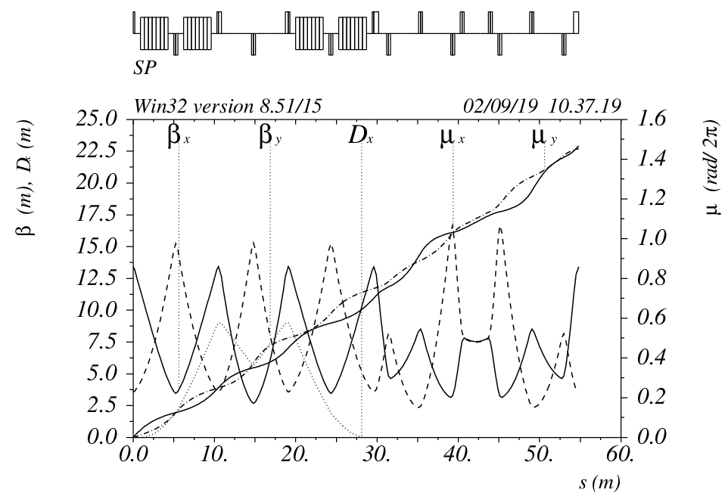
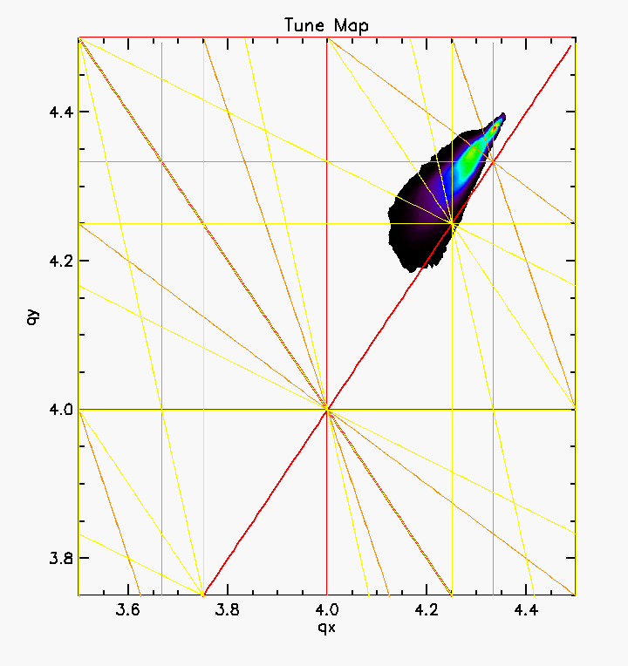
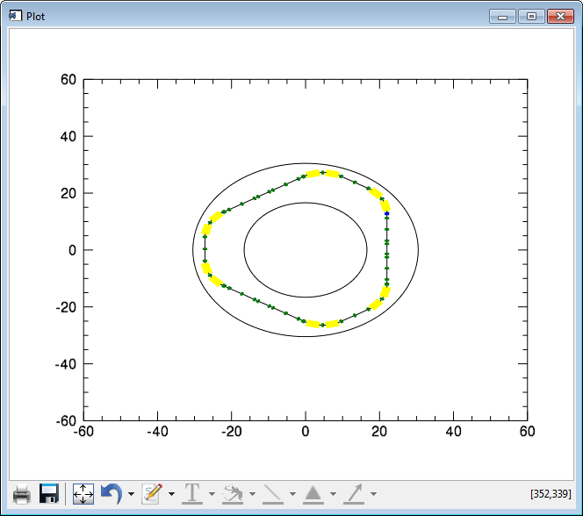
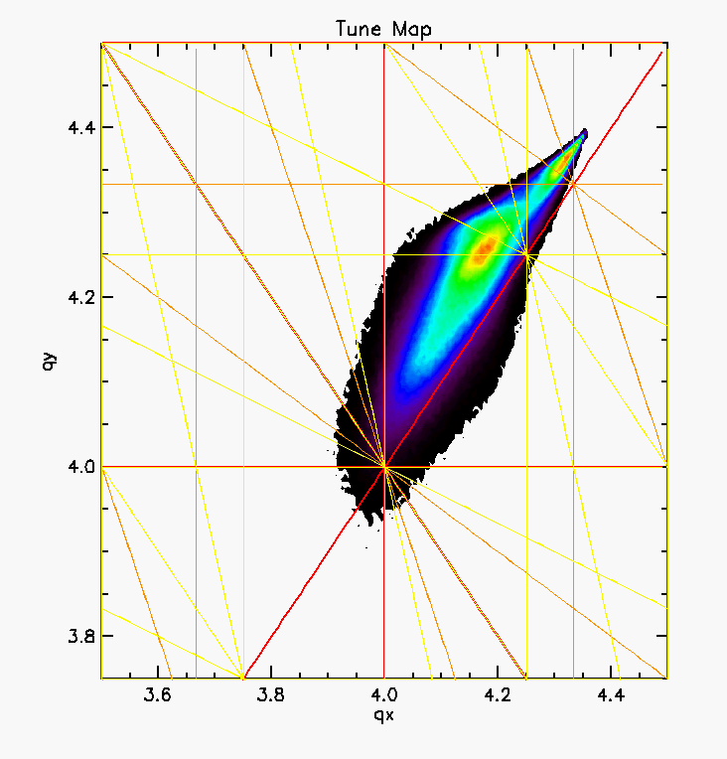
Lattice 2 : FODO arc, FODO/Doublet straight
RCS Optics
Tune plane at injection end
Un-normalised emittance
(pi mm mrad)Time (ms)
7.47 foil hits
Ex99%= 596
Ey99%=1058
Un-normalised emittance
(pi mm mrad)Time (ms)
1.6 foil hits
Ex99%= 324
Ey99%=467
Inner/out hall walls

Slide 11
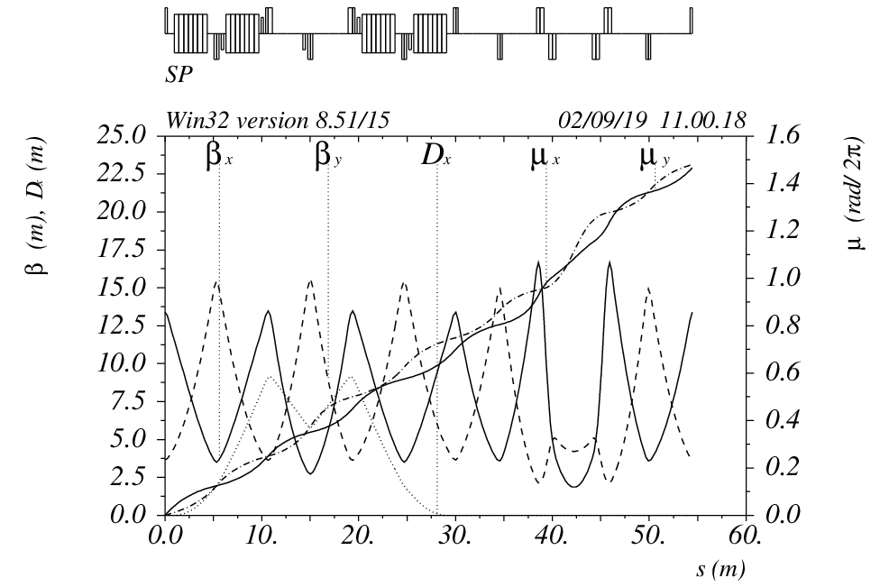
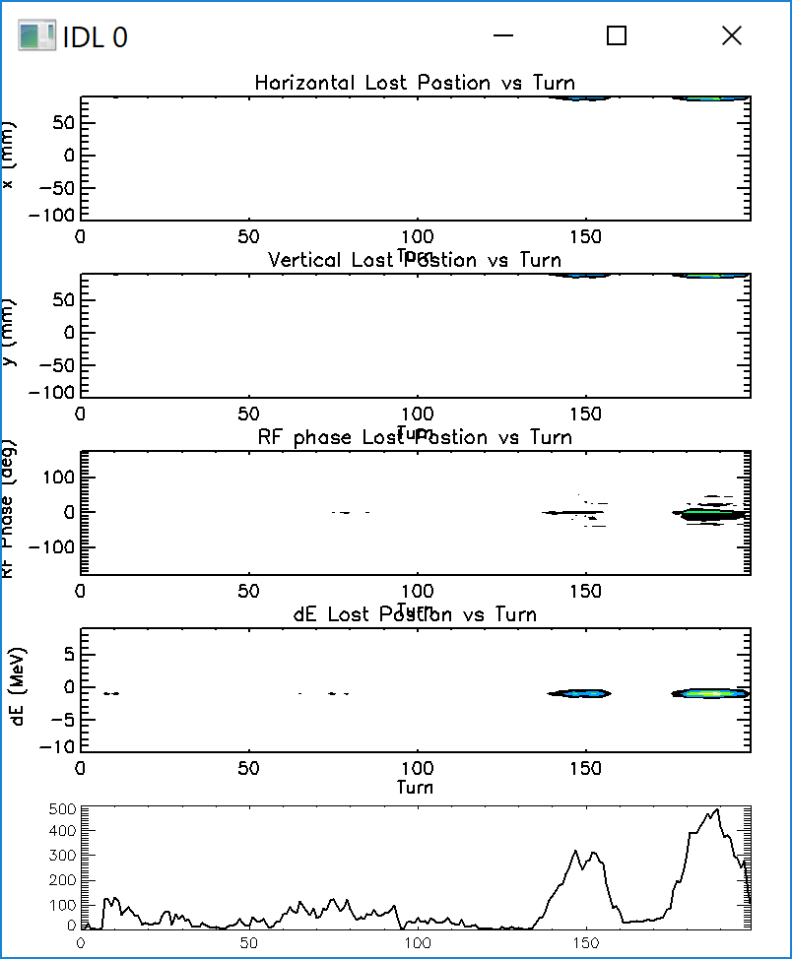
Proton Injection
Smooth focusing optimised painting for zero loss
Un-normalised emittance
(pi mm mrad)Time (ms)
Time (ms)
ORBIT with 3D space charge : 4.74 % loss
goal = zero Loss
Macro particle Loss
Injected Turn

Slide 12
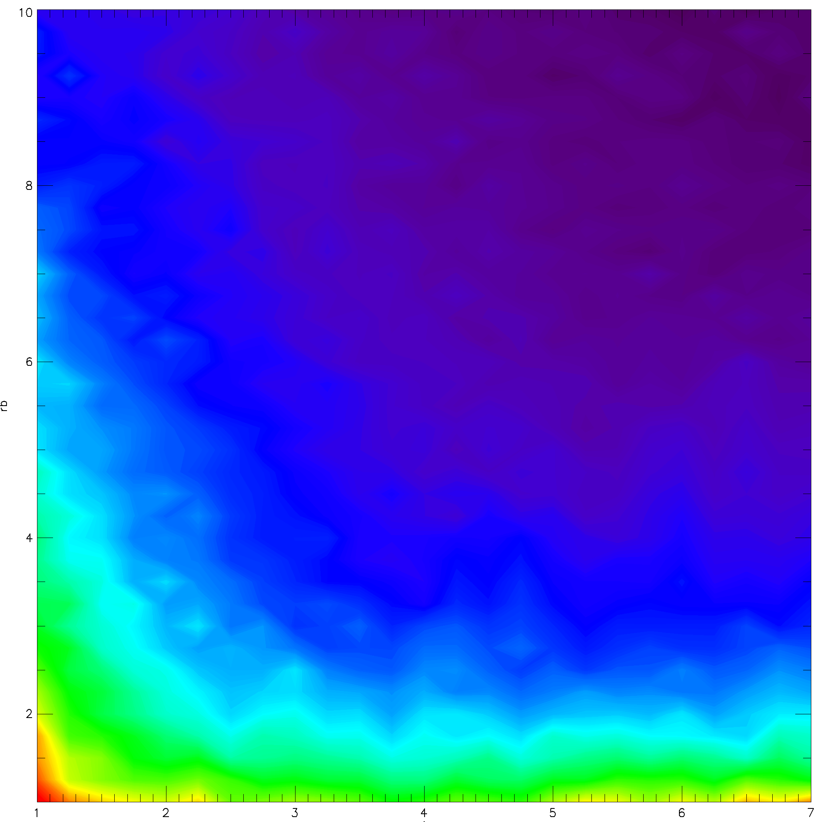
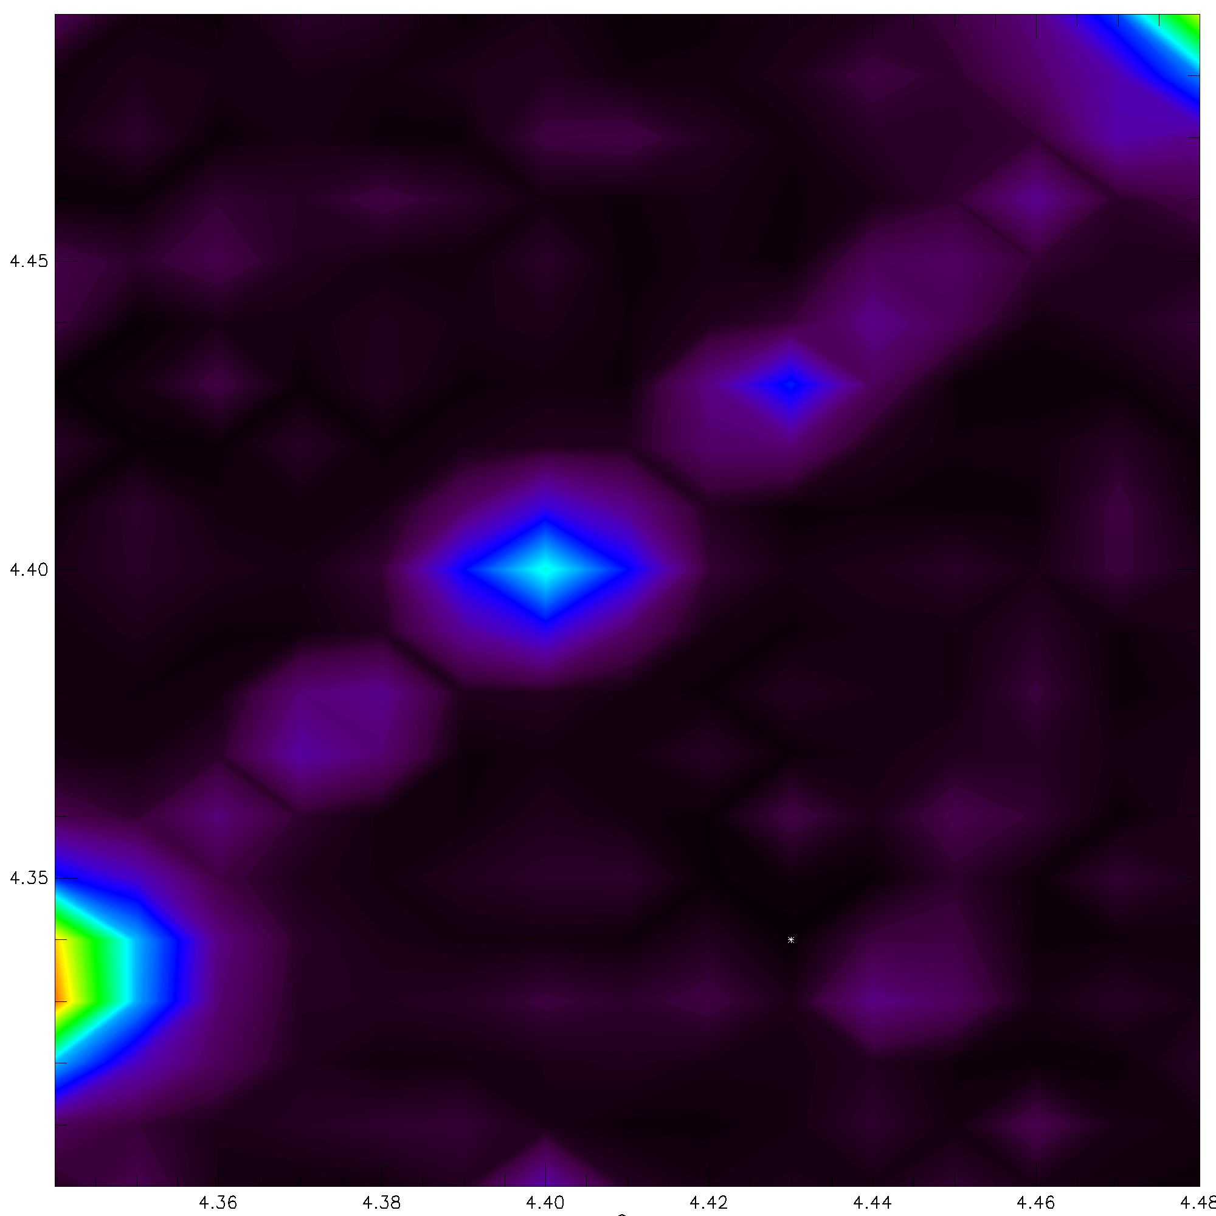
Septum Injection: Parameter Probing vs Painting Amplitude on turn 100, No space charge
Z=Painted Ex+Ey
Ring Bety
Qy
Painted emittance
(pi mm mrad)
Ring Betx
Qx
Smooth space charge code : Painting amplitudes, bxy=7.5m,qx=4.36,qy=4.4,
exinj rms = 0.15 (0.92 max) normalized pi mm mrad, full intensity, zero loss
Painted emittance
(pi mm mrad)
Time (ms)

Slide 13
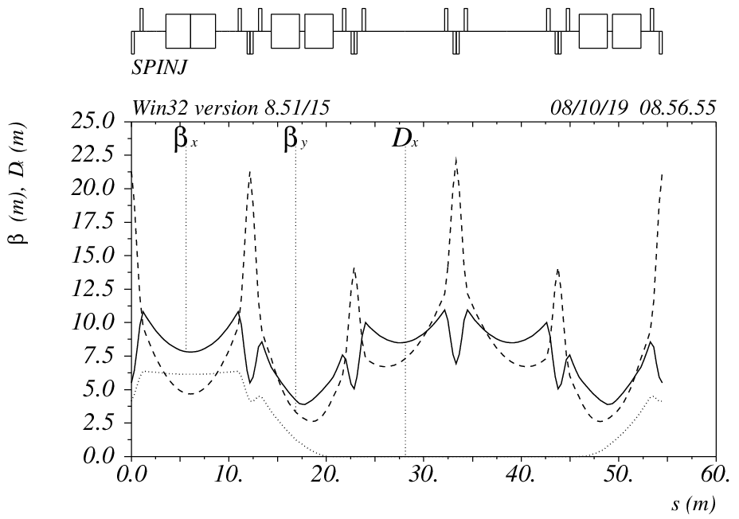
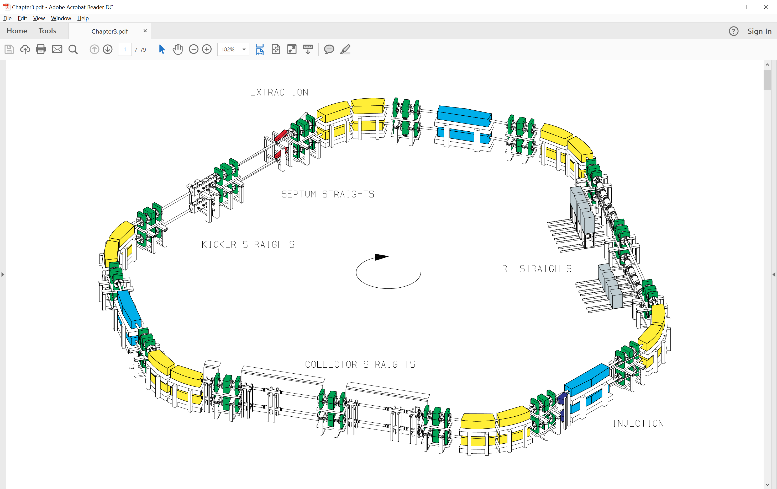
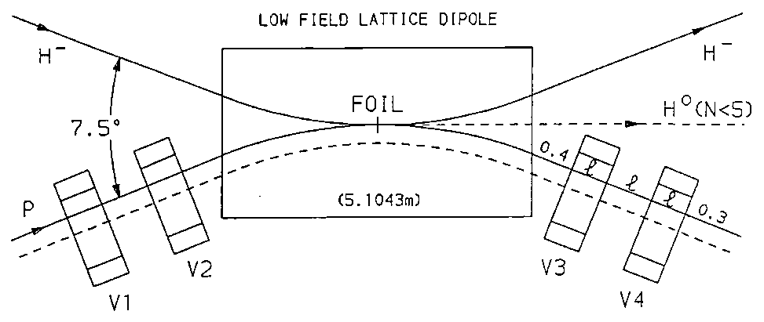
ESS Accumulator Design
ESS Ring design from 1996 to fit in ISIS Hall
108 mA h- linac 1.334 GeV,
50 Hz Accumulator ring , 2.5 MW short pulse option
Injection through a dipole with dispersive H paint
Revisit design using ORBIT with 3D space charge:
Beam Loss ~ 2.4 %, Foil hits = 8, Foil ~ 3200 K
1.25 MW options studied using ORBIT
1000 turn Correlated Paint, 108/2 mA linac, Beam Loss ~ 0.06 % Foil hits ~ 6 , Foil
500 turn Correlated Paint, 108 mA linac, Beam Loss ~ 0.01 % Foil hits ~ 3
ESS Injection
Notes:
For both the AR and RCS injection is the key challenge, keeping foil re-circulations low enough to control foil temperatures and related losses, plus optimising beam distributions to minimise effects of space charge.
We have looked at two interesting options so far, with detailed 3D beam dynamics simulations, plus appropriate simulations of foil scattering and heating.
The first was looking again at an old, but carefully studied design from the original ESS from1996, which fitted in the ISIS hall. This has the distinctive dispersive injection, which makes good use of a bend region and allows for easy removal of stripping products. Our reworking of beam dynamics showed this is a plausible option for 1.25 MW, but also indicated it would be useful to look at more conventional injection.
Present machines inject in dispersive regions with fixed spot on the foil and independently controllable painting in 3 dimensions. SO this is what we have designed for the RCS lattice – and numerical optimisations show very promising results with this pating function. Foil hits and losses look promising.
This is a very flexible solution, now more detailed studies to understand beam evolution with space charge and possible loss mechanisms

Slide 14
Further Studies
Beam Losses vs Acceptance
Machine Error (alignment and field)
Resonance and Loss Mechanisms
Extraction
Injection straight Field maps/stripping
Mechanical and practical constraints.

Slide 15
Thankyou for you time.
Questions ?

