Slide 1
Multi-Grid Boron-10 detector: from proof-of-principle to applications in time-of-flight spectrometers
Anton Khaplanov
European Spallation Source ERIC
15/10-2019

Slide 2
Outline
Multi-Grid technology
  Proof-of-principle
  Characterization
Prototypes and technology demonstrators
  IN6
  CNCS
  SEQUOIA
Results
  Results from chopper spectrometer tests
  Recent measurement on V20

Slide 3





Acknowledgements
Multi-Grid proposed by the ILL. Developed collaboratively with ESS and Linköping University
Tests at ILL, SNS, HZB, IFE, LLB
The bulk of development under

Slide 4
Development Requirements
Alternative to the existing ³He technology
Original driver – cost
Further driver – rate capability
Detector performance needs:
  Efficiency
  Background
  Gamma rejection
  Fast neutron sensitivity
  ToF/energy resolution
  Uniformity
Design needs:
  Cost
  High active area
  Vacuum compatibility

Slide 5

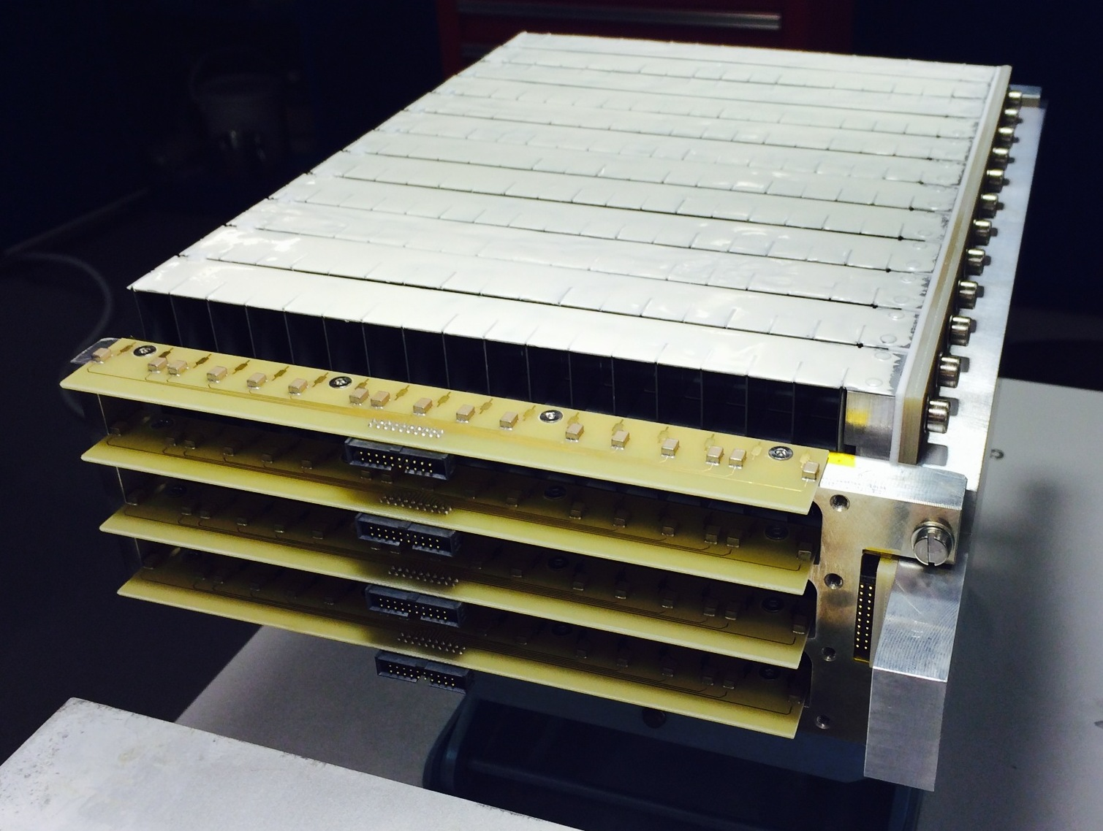
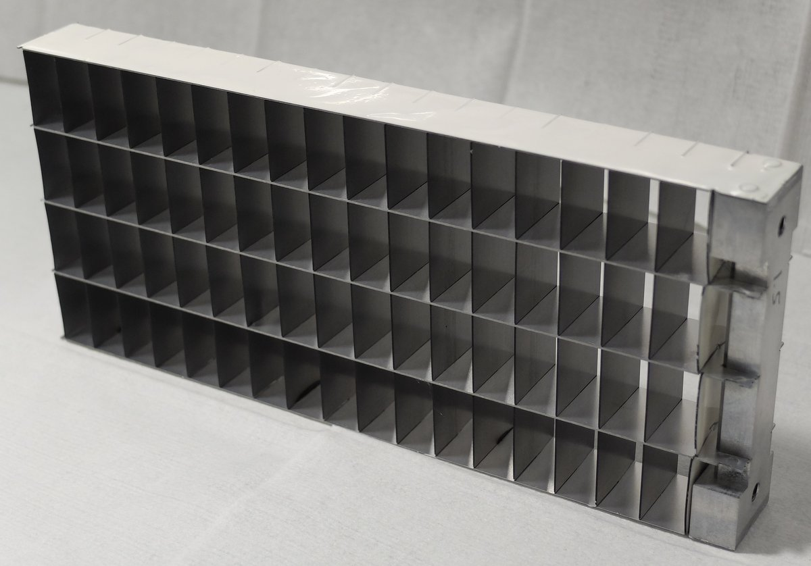
Multi-Grid Technology
Detection in multiple thin layers of ¹⁰B₄C
gas
n
conversion
fragment 2
n
fragment 1
gas
B-10 film
Al substrate
Low cost for large area
High total efficiency
Readout split over many layers – lower local rate
No need for resistive readout – low gain
n

Slide 6
Efficiency Optimization
Many B-10 layers that don’t have to be the same
Efficiency depth profile,
efficiency per blade
→ Constant vs. optimized B4C thickness
Efficiency optimized depending on wavelength prioritization
Grid with varied B₄C layer thickness
n
0.5μm
1.0μm
1.5μm

Slide 7
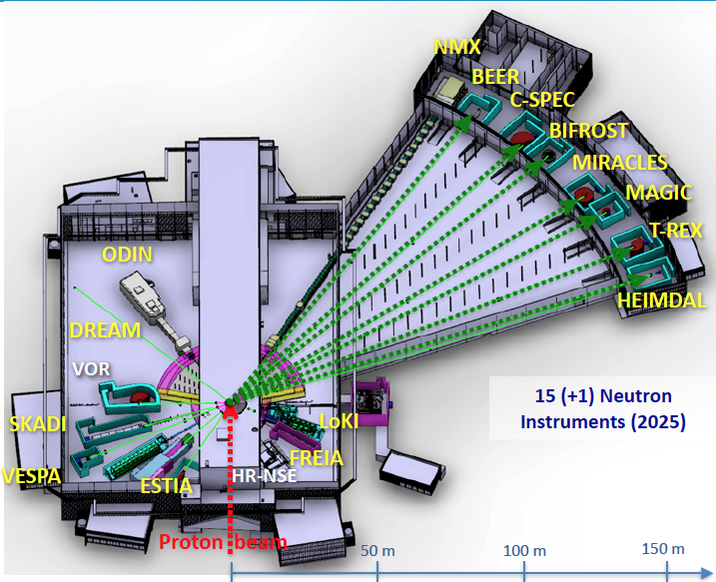
B4C Layer Thickness
Choices for cold and thermal instruments
CSPEC-optimized grid
Efficiency as a function of wavelength for MG optimized for cold vs. thermal spectrum
n
CSPEC optimization
MG.CNCS
T-REX optimization
MG.SEQ
0.5μm
1.0μm
1.5μm
Layer thickness in MG.CNCS (16 blades)
7 blades 0.5μm,
7 blades 1.0μm,
3 blades 1.5μm
4 blades 1.0μm,
10 blades 1.25μm,
6 blades 2.0μm.
Layer thickness in MG.SEQ (20 blades)
 | CSPEC | T-REX
Typical initial λ, Å (meV) | 2 to 15 Å (20 to 0.36 meV) | 0.7 to 6.4 Å (160 to 2 meV)

Slide 8
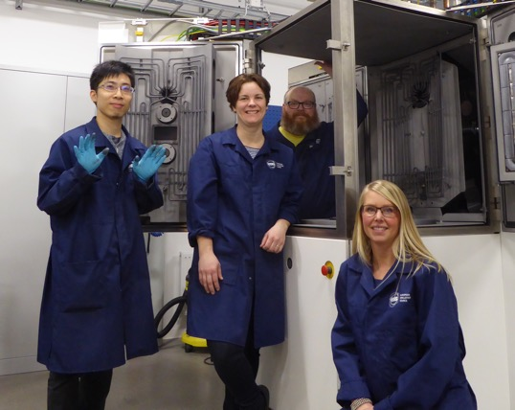
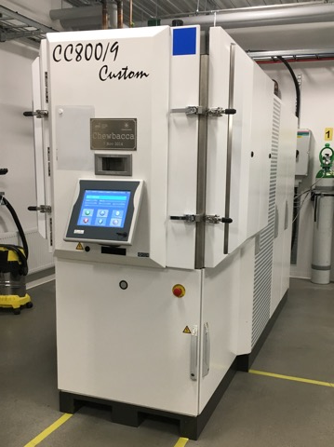
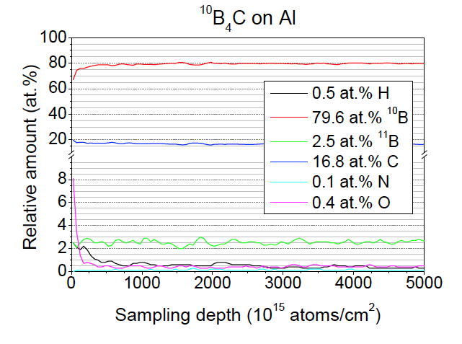
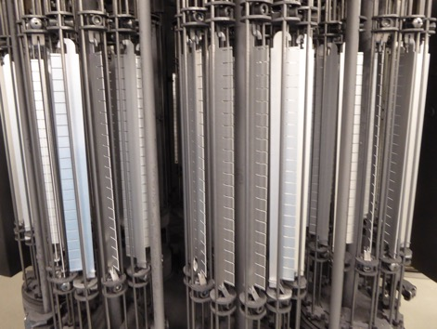
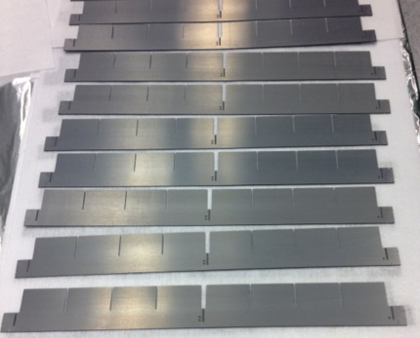
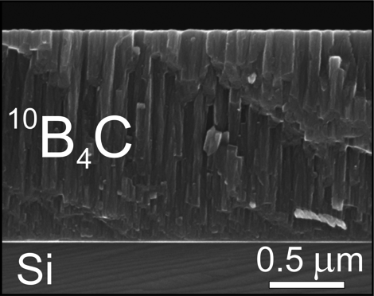
¹⁰B₄C Layer Production
Magnetron sputtering in ESS workshop in Linköping
DC magnetron sputtering used to create coatings on Al and other substrates
97% enriched ¹⁰B₄C
Layer thickness 0 to about 10um
Composition, impurities:
Deposition on blades
Produced blades for MG
Thickness uniformity

Slide 9
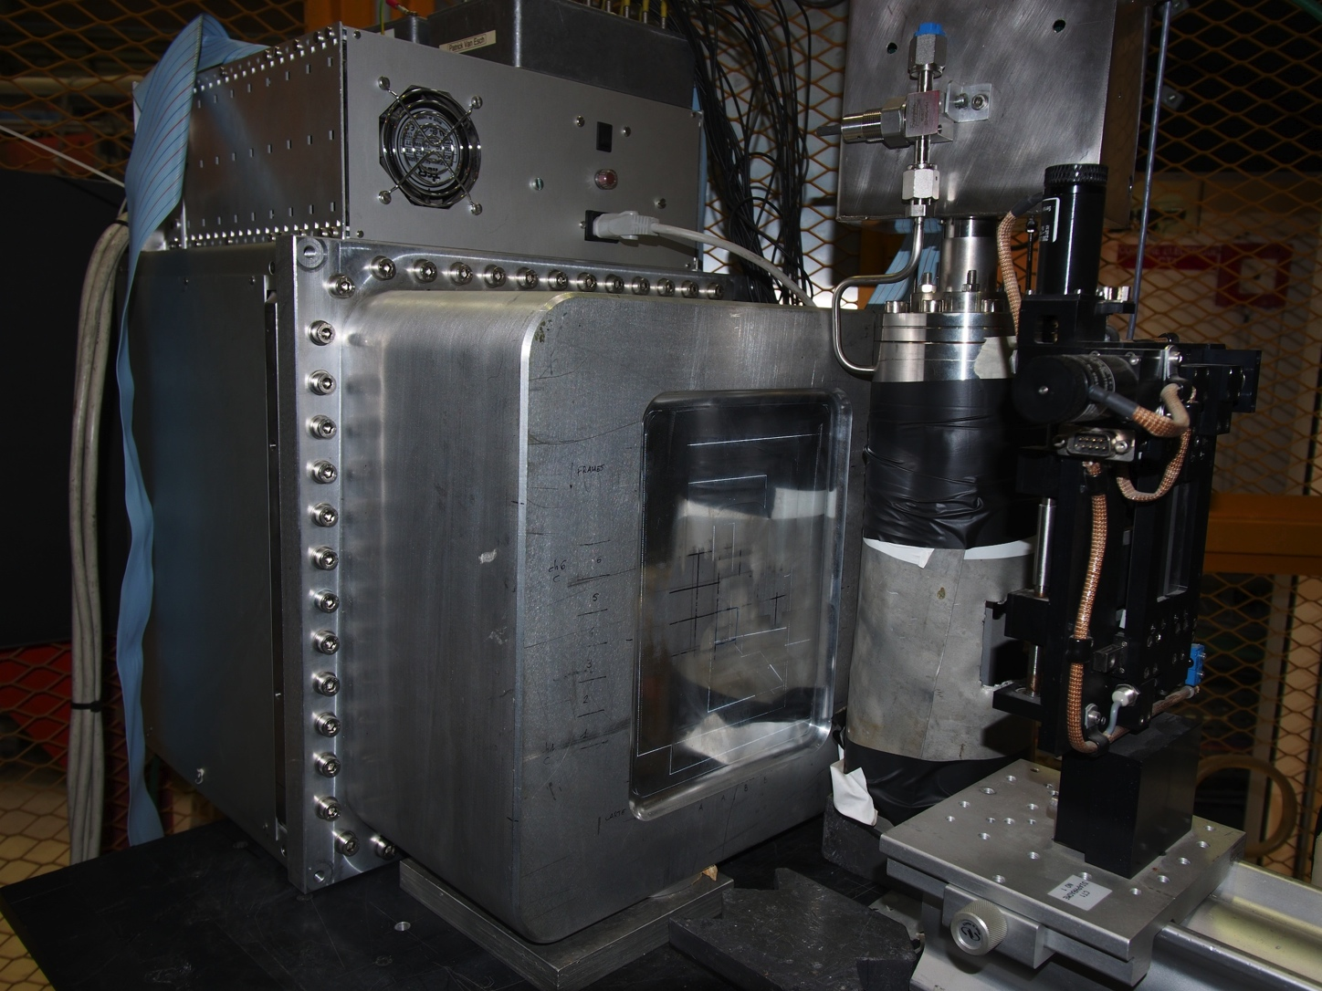
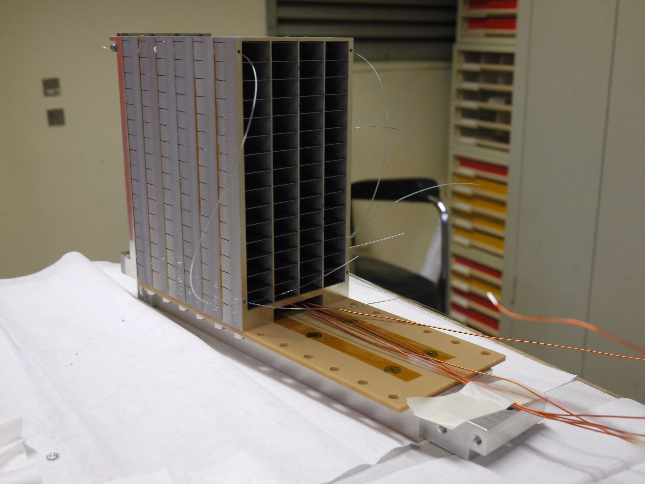
Prototype 1
Built and tested at ILL – demonstration of detection and efficiency
Pulse height spectra due to conversion process with 2 particles
Measured confirmation of efficiency
function of:
Number of layers (here = 15),
Thickness of layers,
Threshold,
Neutron wavelength (here = 2.5Å)

Slide 10
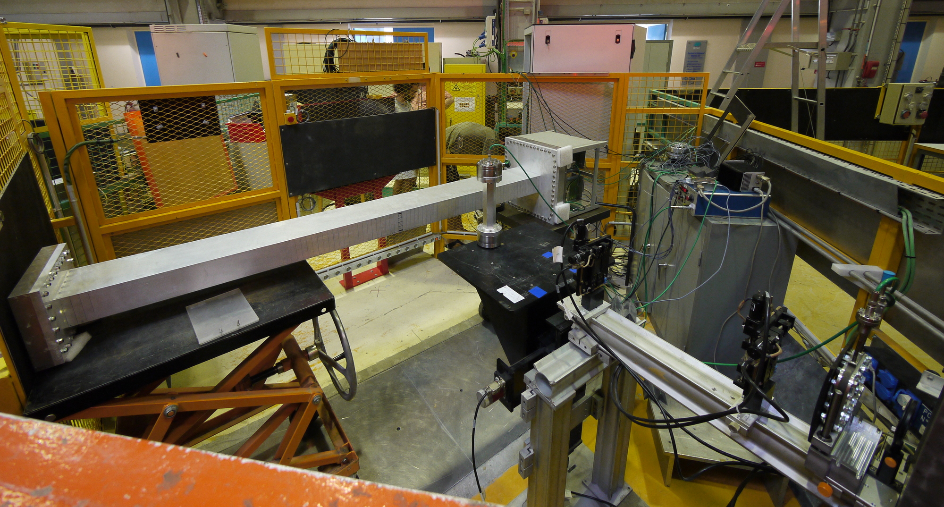
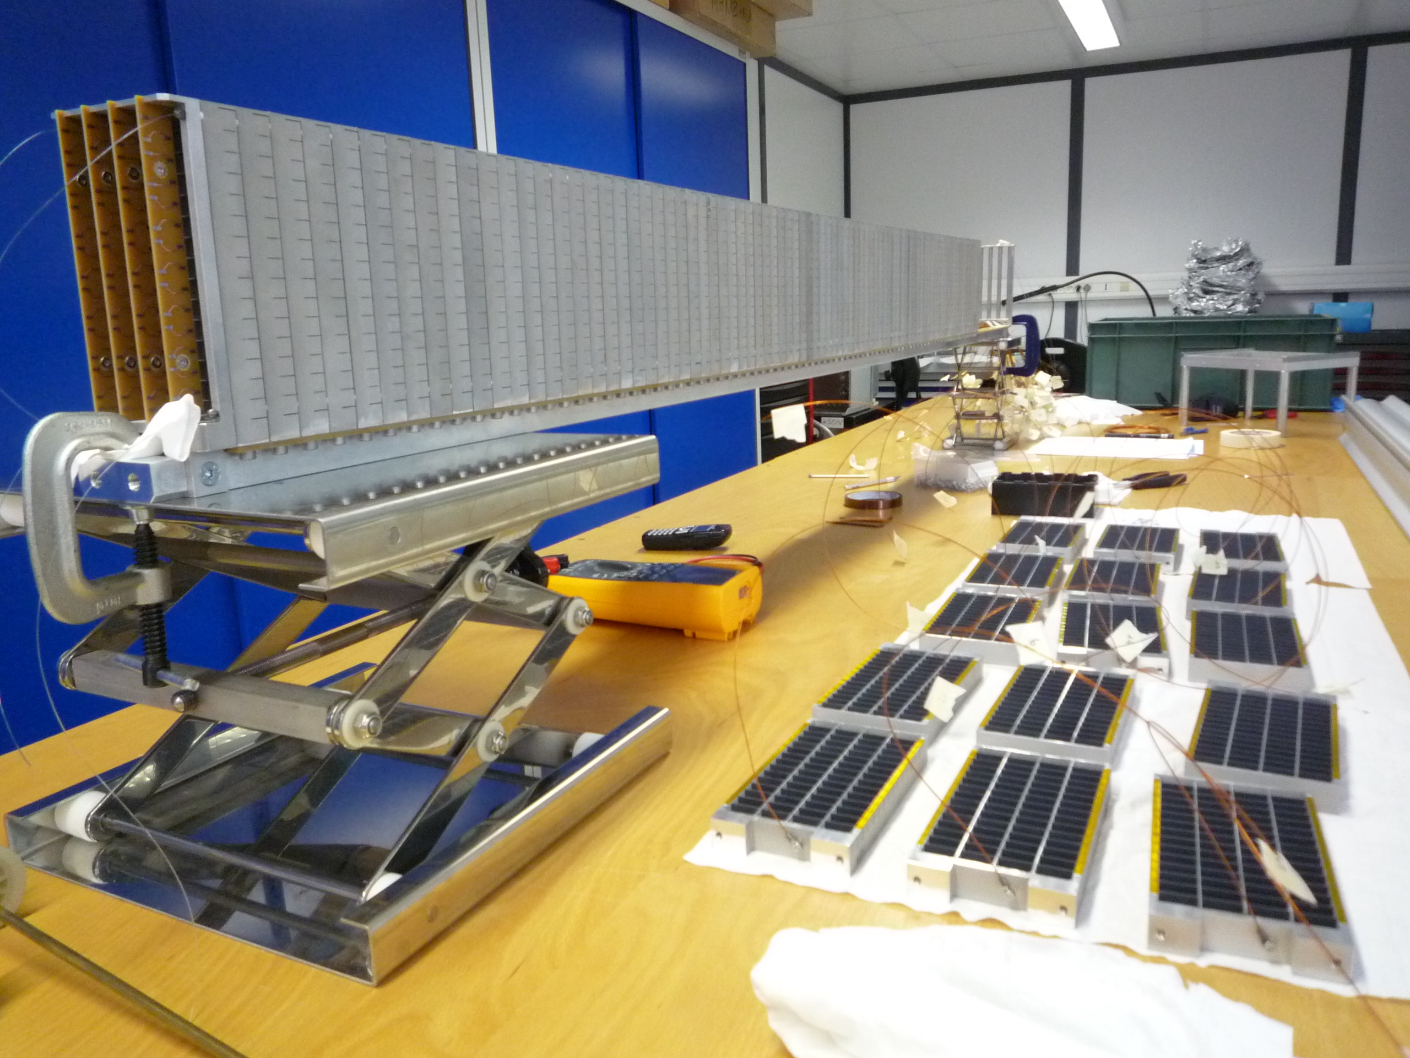
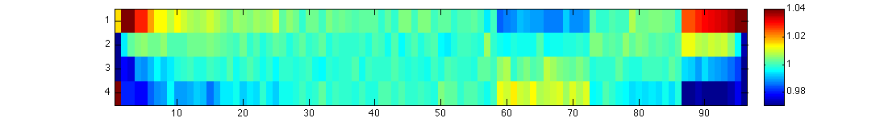
Prototype 2
Built in ILL, demonstrated operation of long detector
2-m stack of 96 grids with 64 wires
Technological feasibility
Deformation effects
Beam test at CT2 in ILL
Uniformity study
A
B
C
D

Slide 11
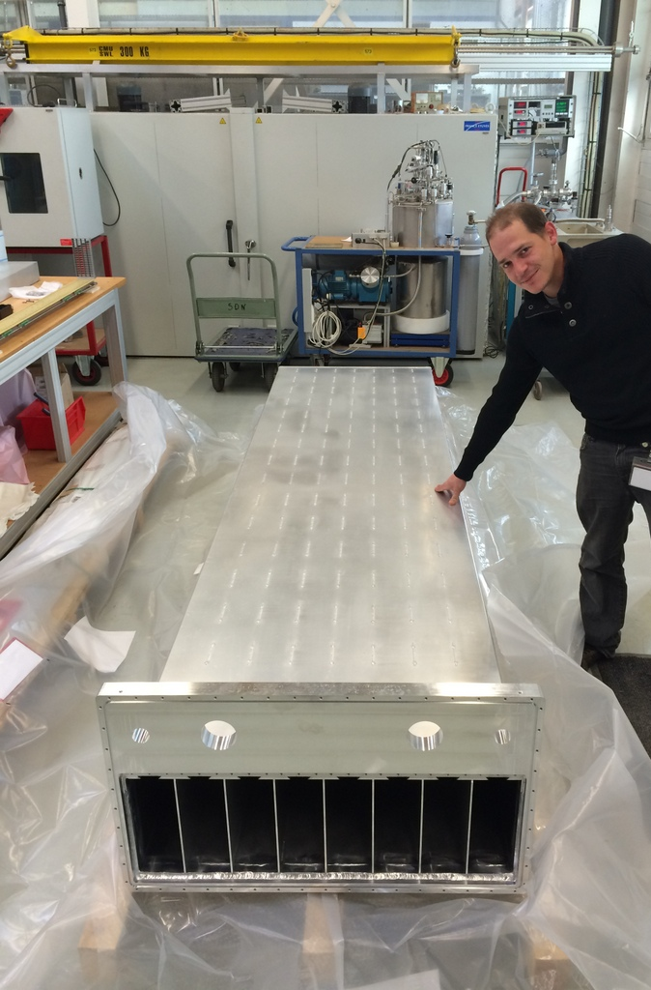
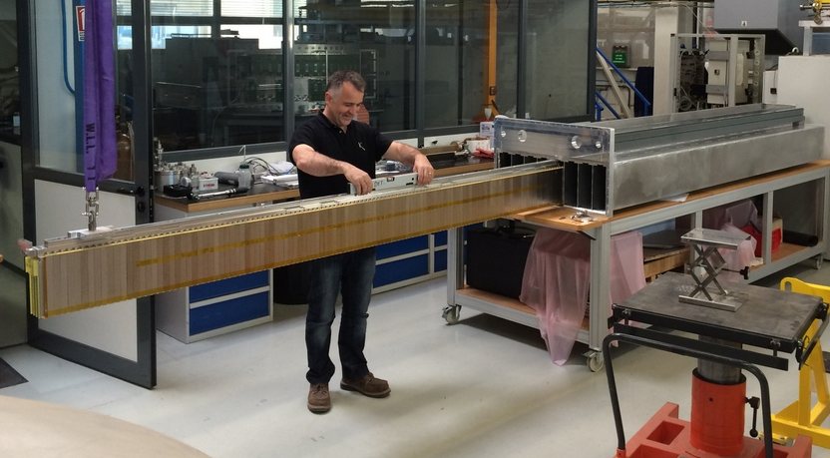
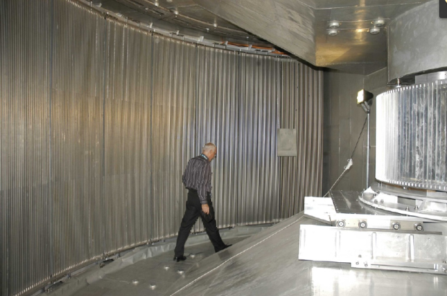
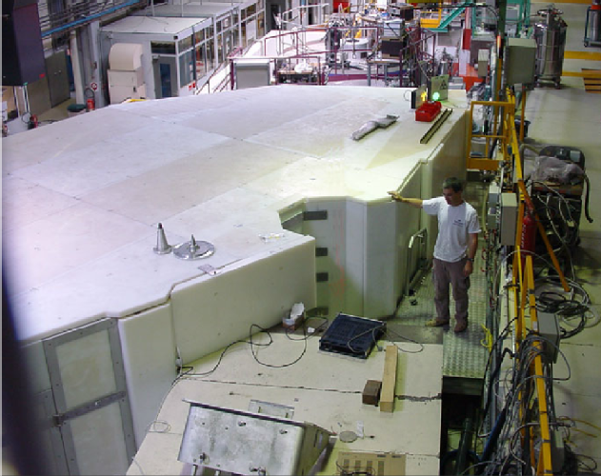
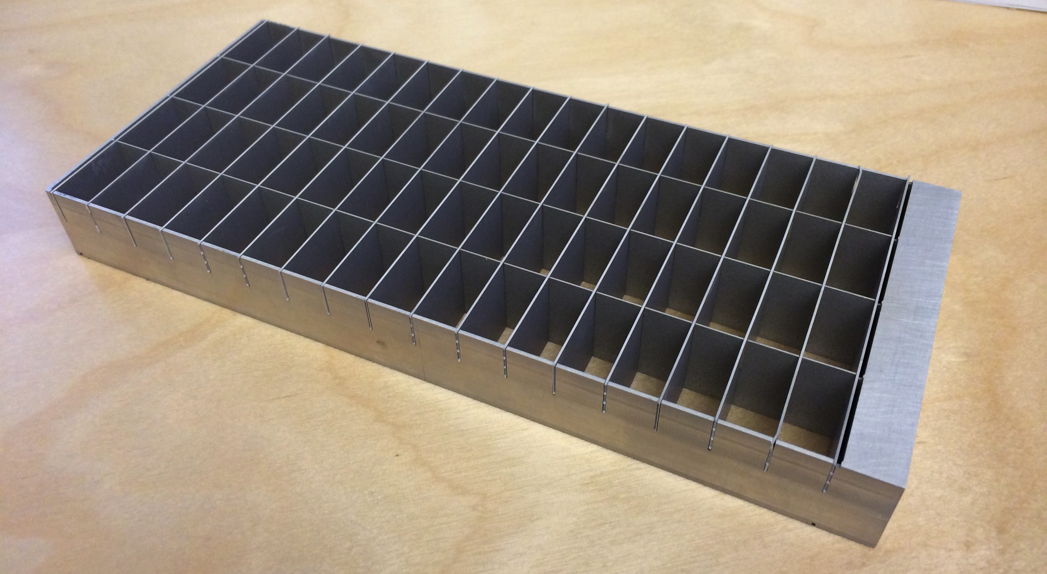
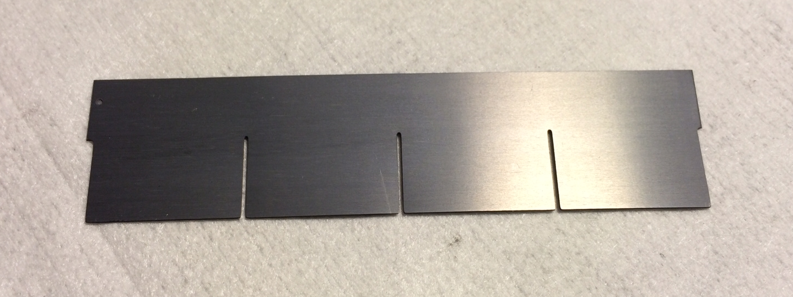
IN5 Demonstrator
Demonstration of full-scale detector production
Column x8:
wire-frame coincident readout
IN5 Spectrometer at ILL
3 m
Grid x1024:
low background,
minimal dead material
Blade x18432:
enriched B4C coating
good adhesion, uniformity,
80cm
Detector:
2.4 m² active area

Slide 12
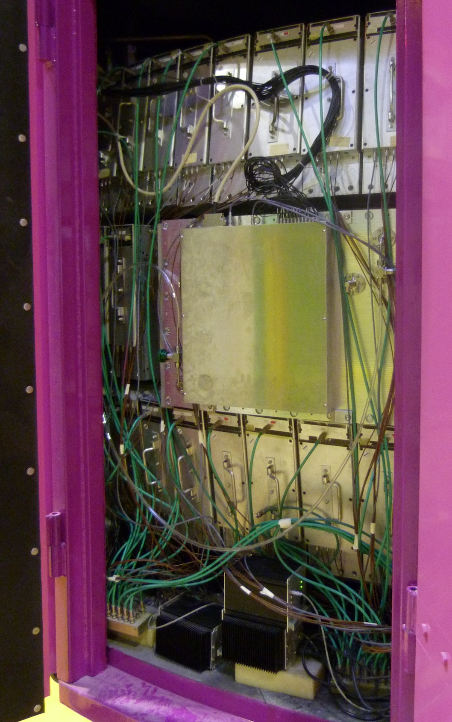
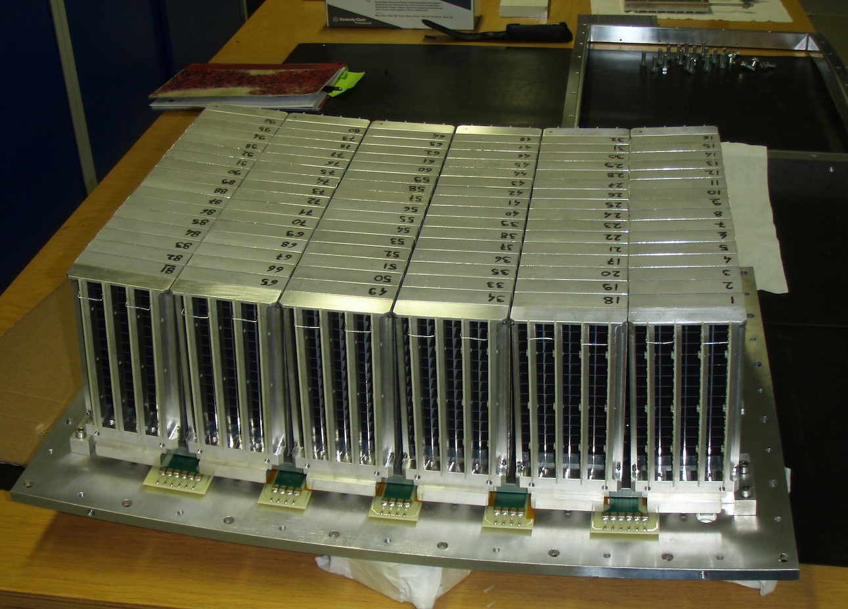
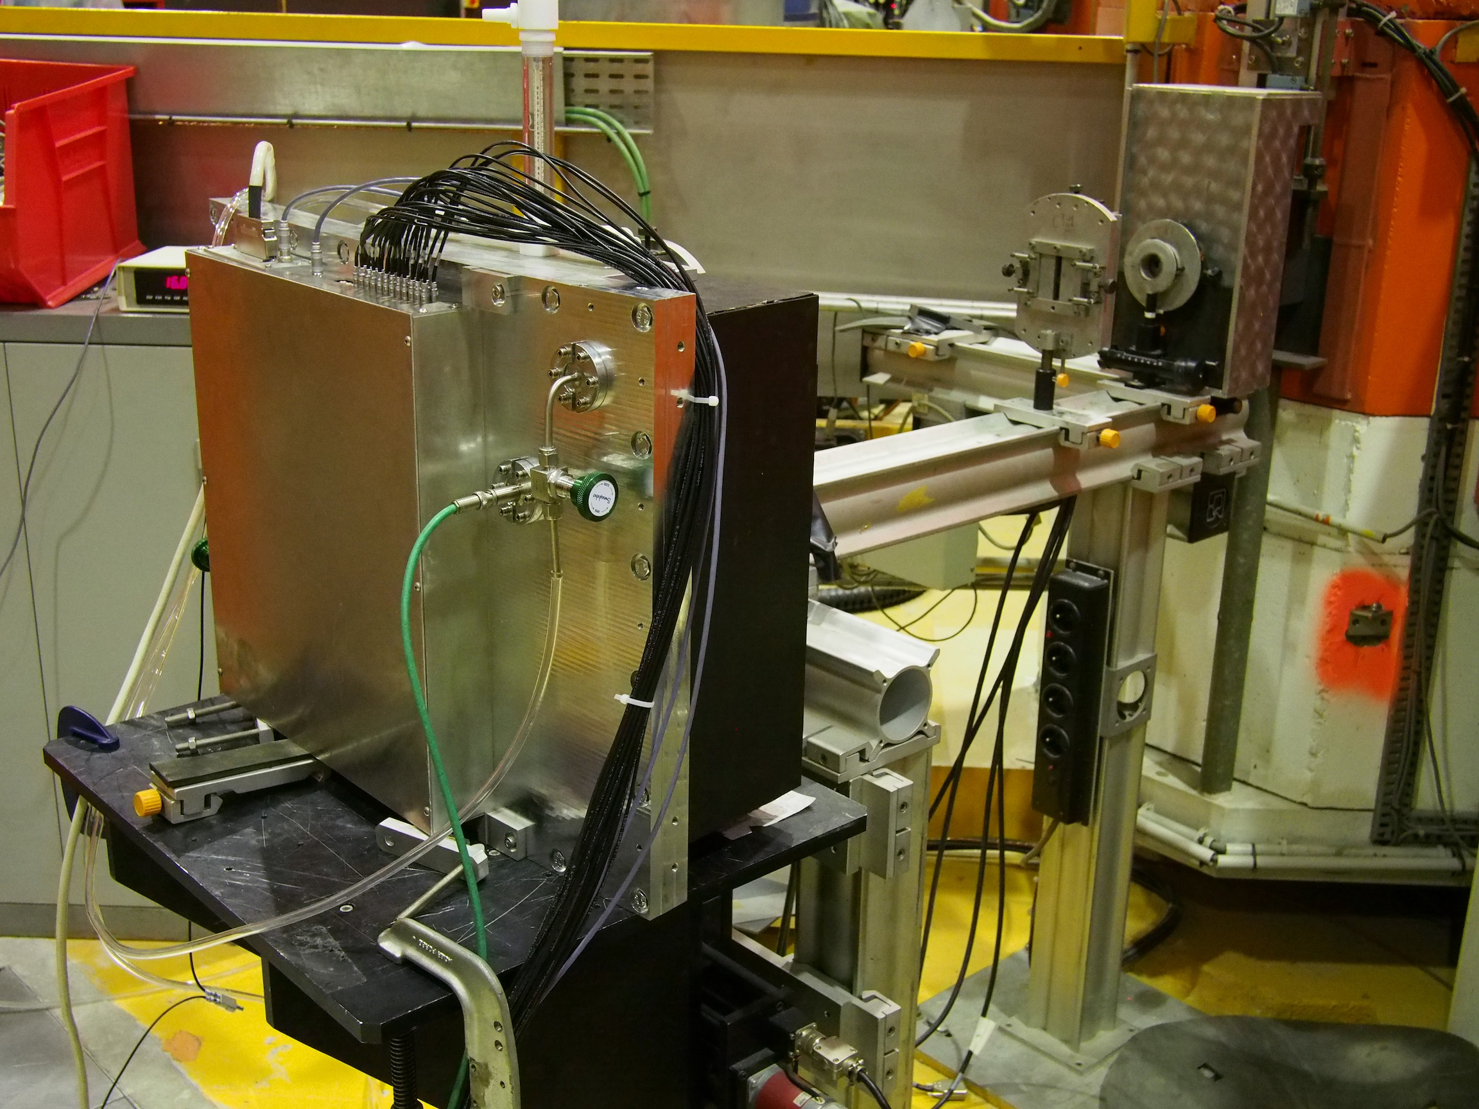
IN6 Demonstrator
First demonstration on ToF spectrometer
96 grids in 6 modules of 16
30x45 cm² active area
Installed and operated at IN6 at ILL for 2 weeks
Data compared to ³He detectors at the same angle

Slide 13
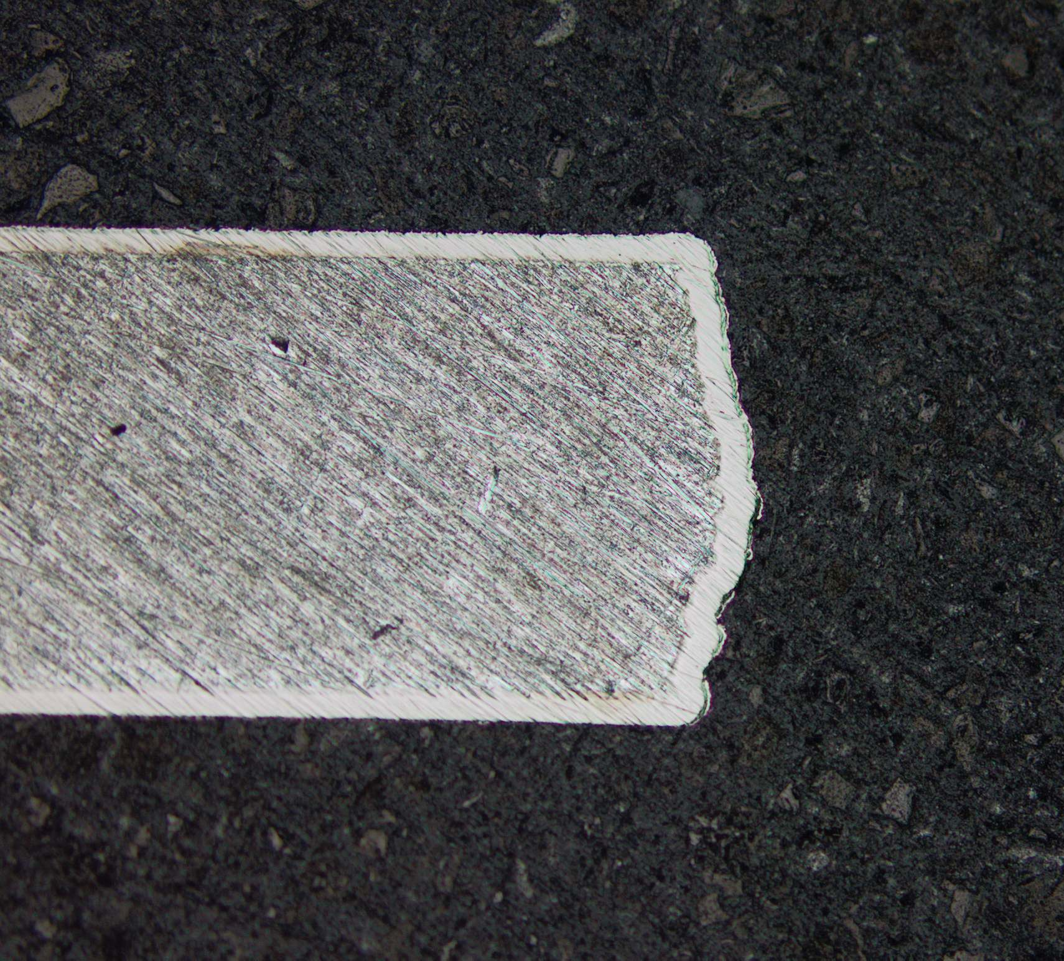
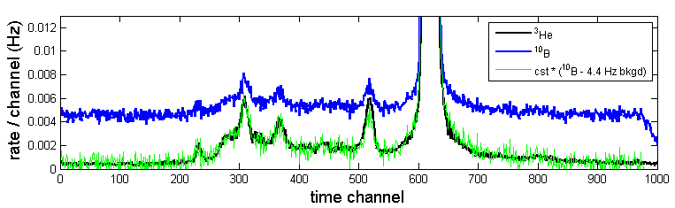
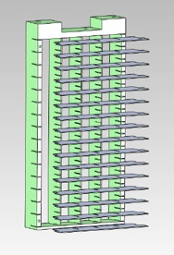
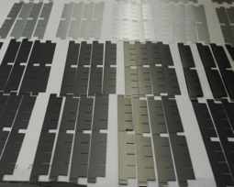
IN6 Demonstrator
An unexpected issue – intrinsic background
25 um Ni plating
pure Al (5N5+ purity):
U/Th concentration < 1ppbw
25 um Ni plating or pure Al
→ x100 improvement

Slide 14
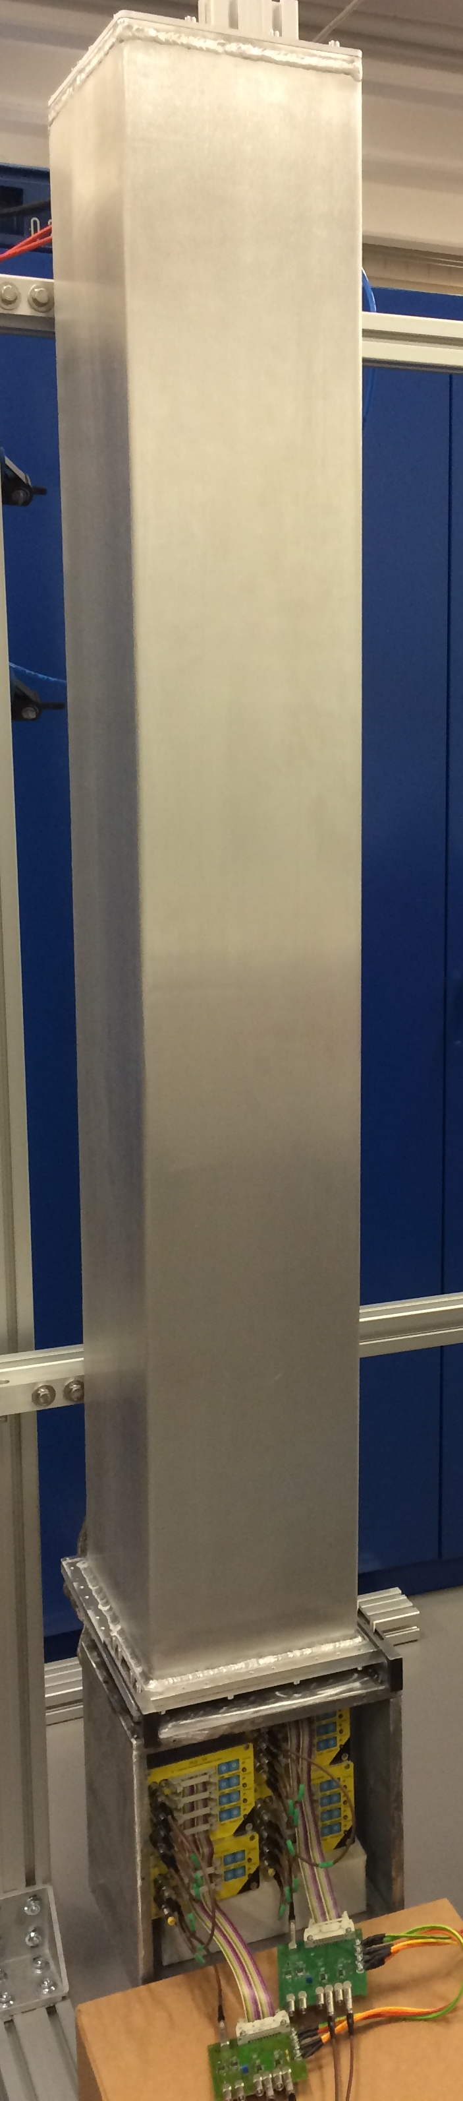
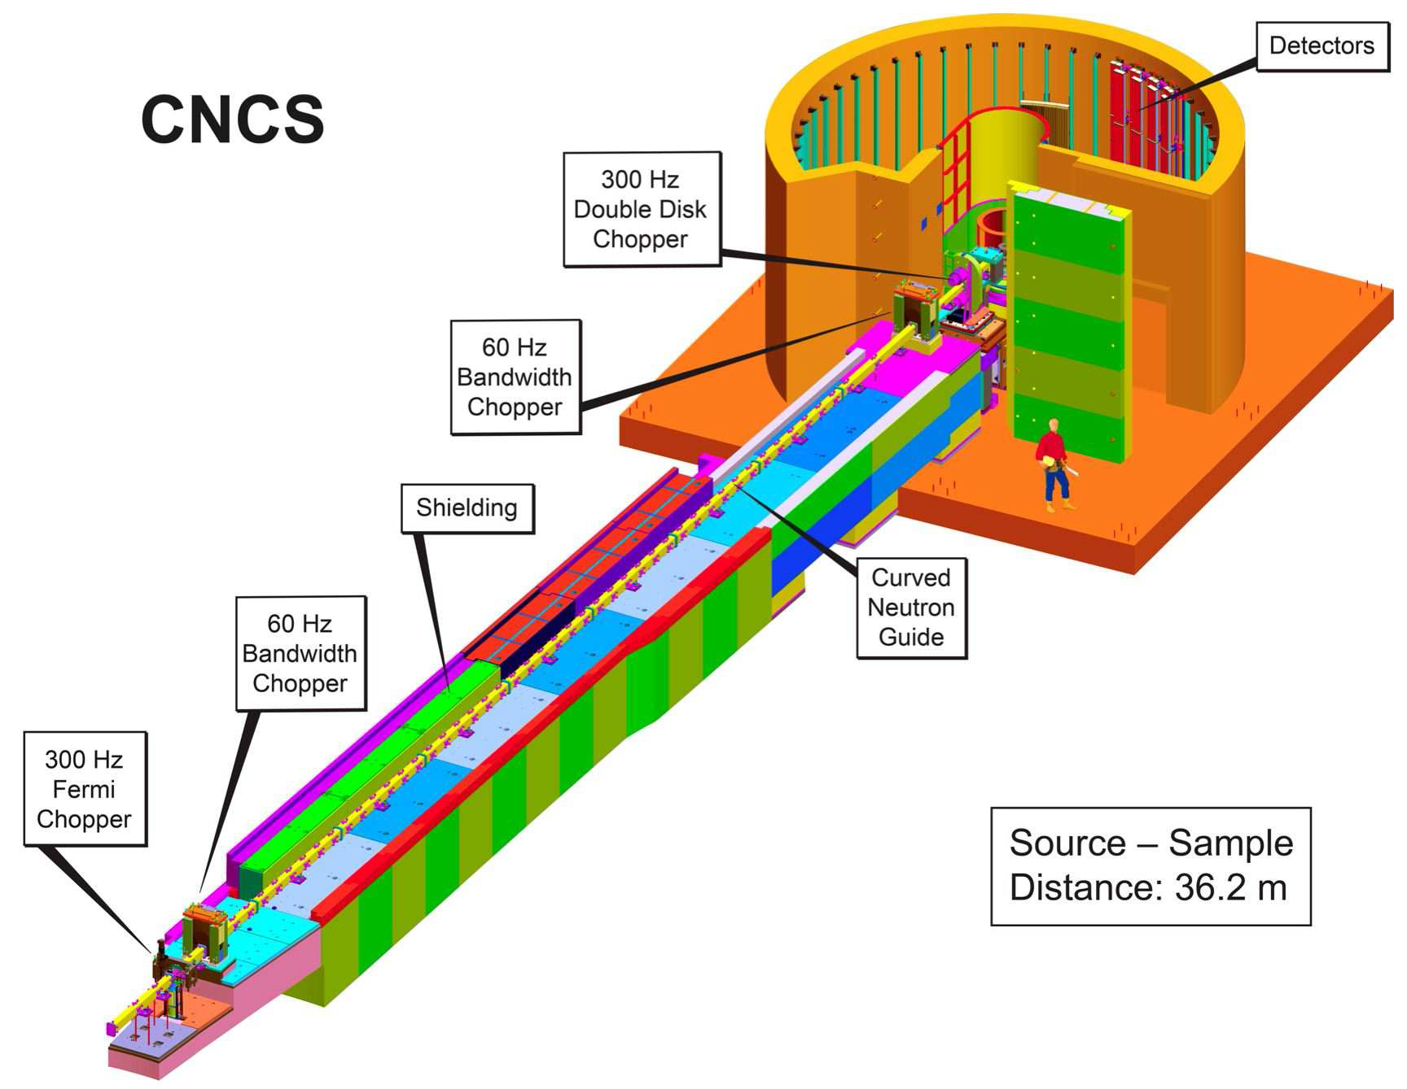
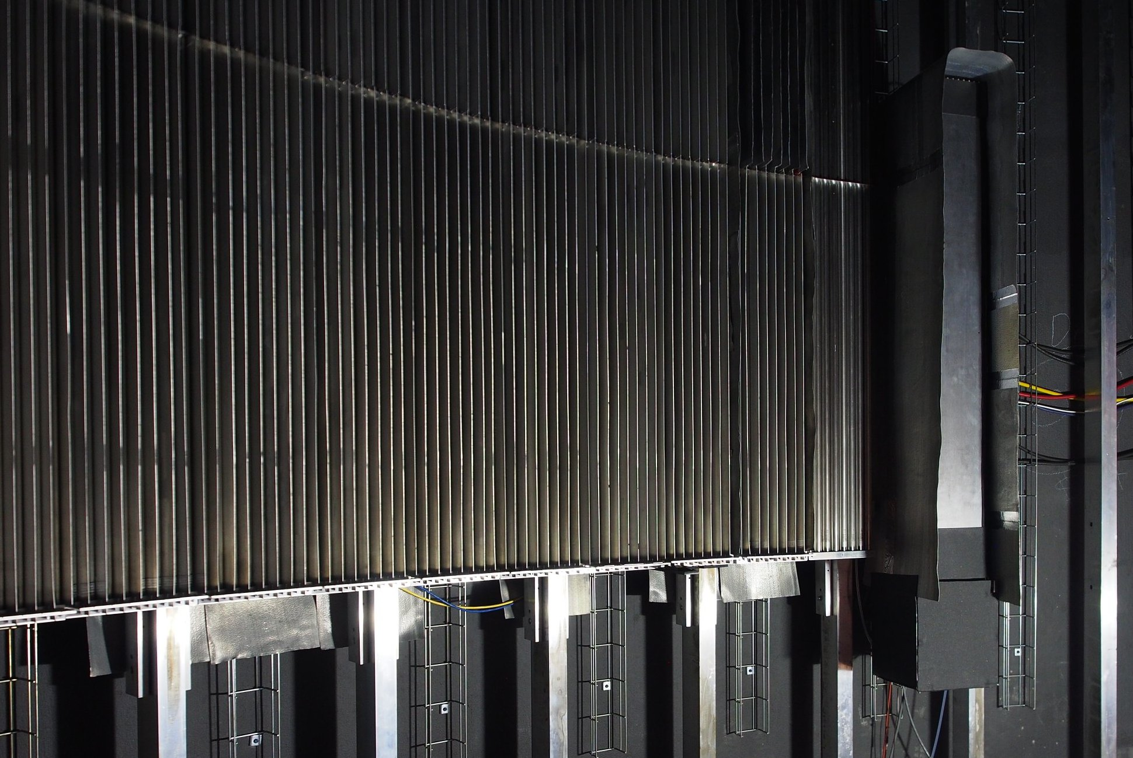
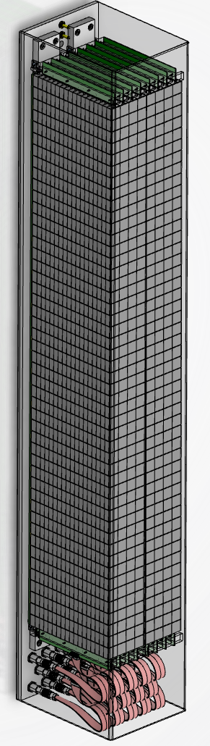
MG.CNCS Installed at CNCS, SNS
Long-term functionality of MG on a cold spectrometer
1.1m
He-tubes
MG
A.Khaplanov et al. “Multi-Grid Detector for Neutron Spectroscopy: Results Obtained on Time-of-Flight Spectrometer CNCS" https://arxiv.org/abs/1703.03626 2017 JINST 12 P04030

Slide 15
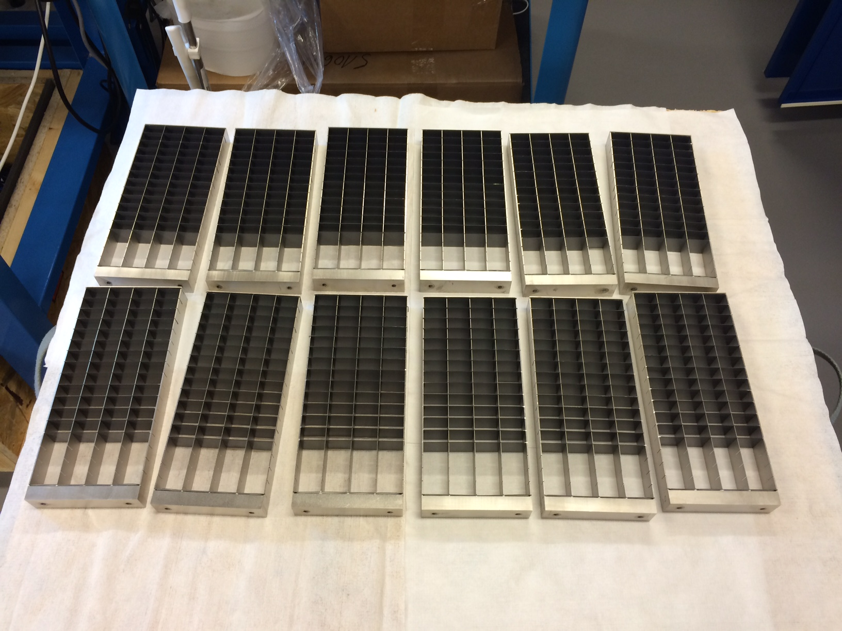
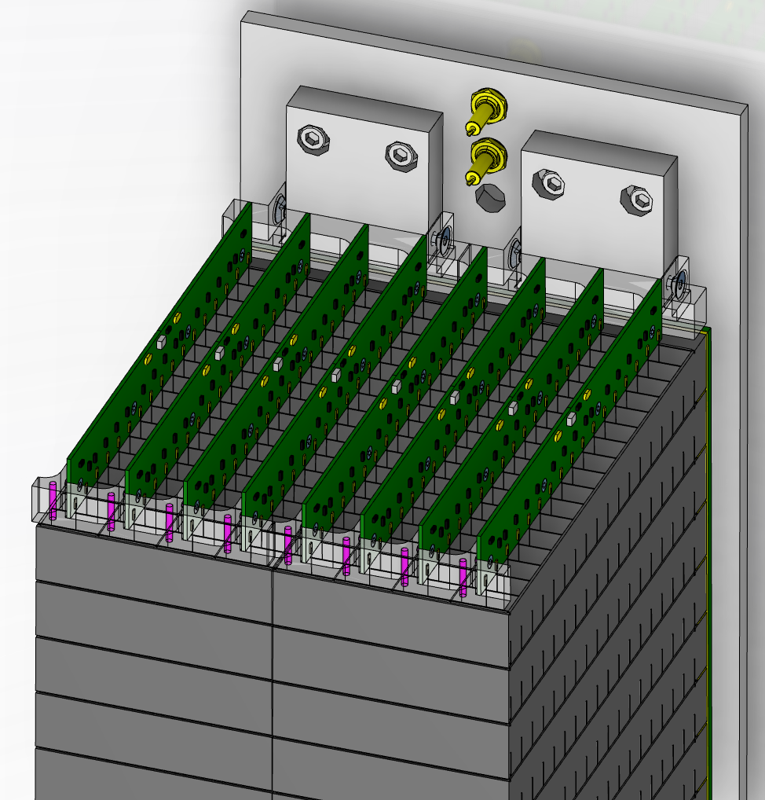
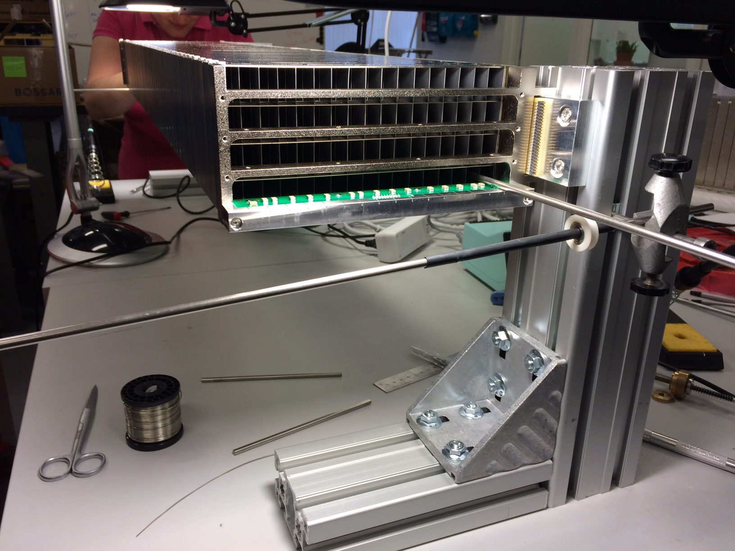
MG.CNCS Demonstrator
Design and assembly
96 grids in 2 modules of 48
110x19 cm² active area
3-thickness optimized grids in construction
1.1m
Installation of anode wires
64 wires per module
20-um tungsten Au-plated wire
15

Slide 16
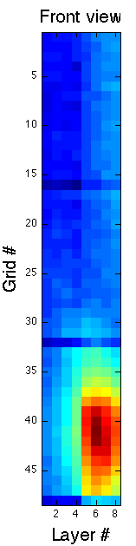
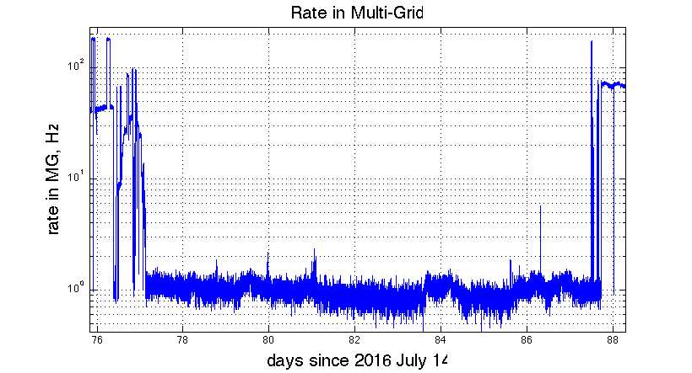
MG.CNCS Results Summary
Snapshot from 1 year of operation
Fast neutrons (fission, prompt)
Vanadium
Single crystal
Water, Ice
Gamma background
(NaI detector installed near MG)
Background
Allowing to measure:
Energy resolution, efficiency, scattering, background sensitivity, saturation

Slide 17
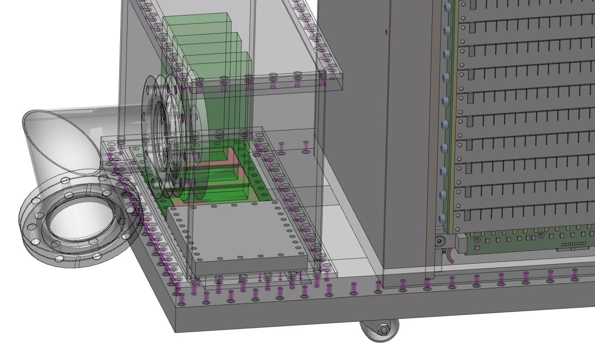
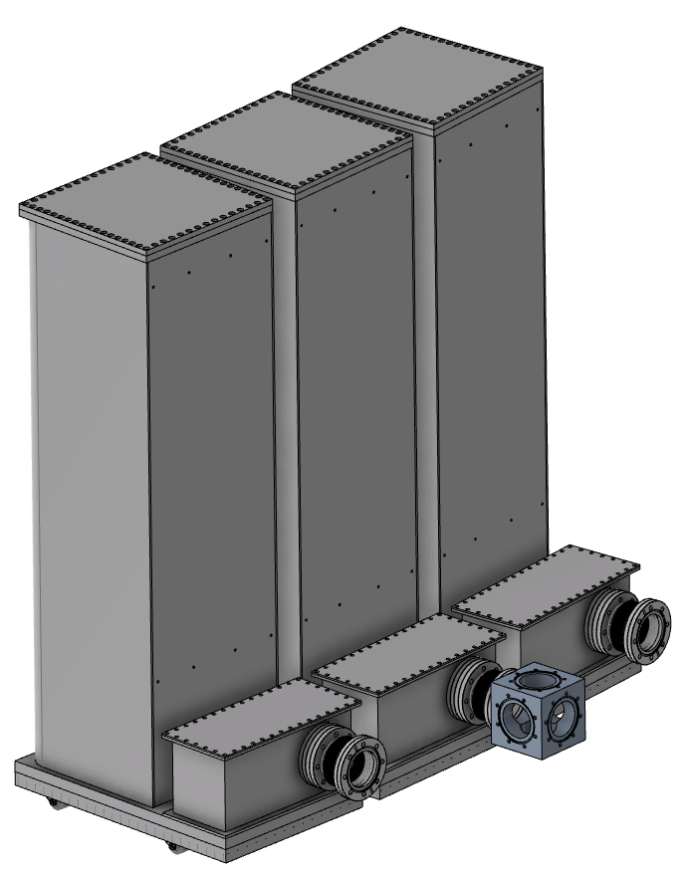
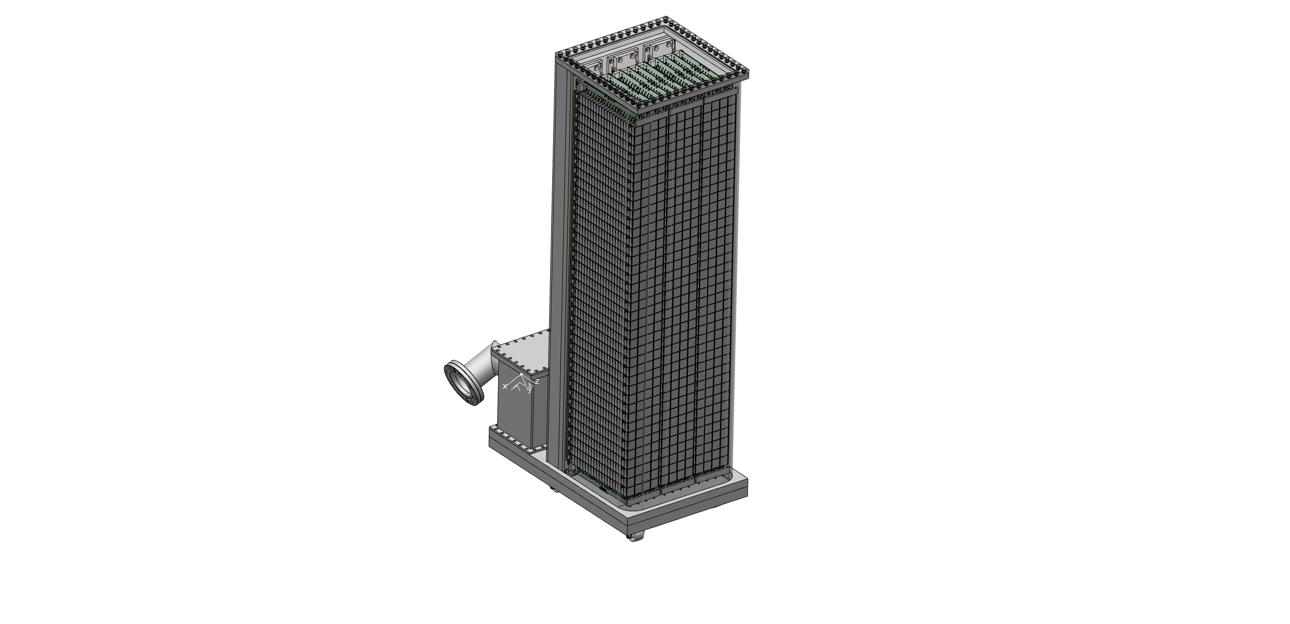
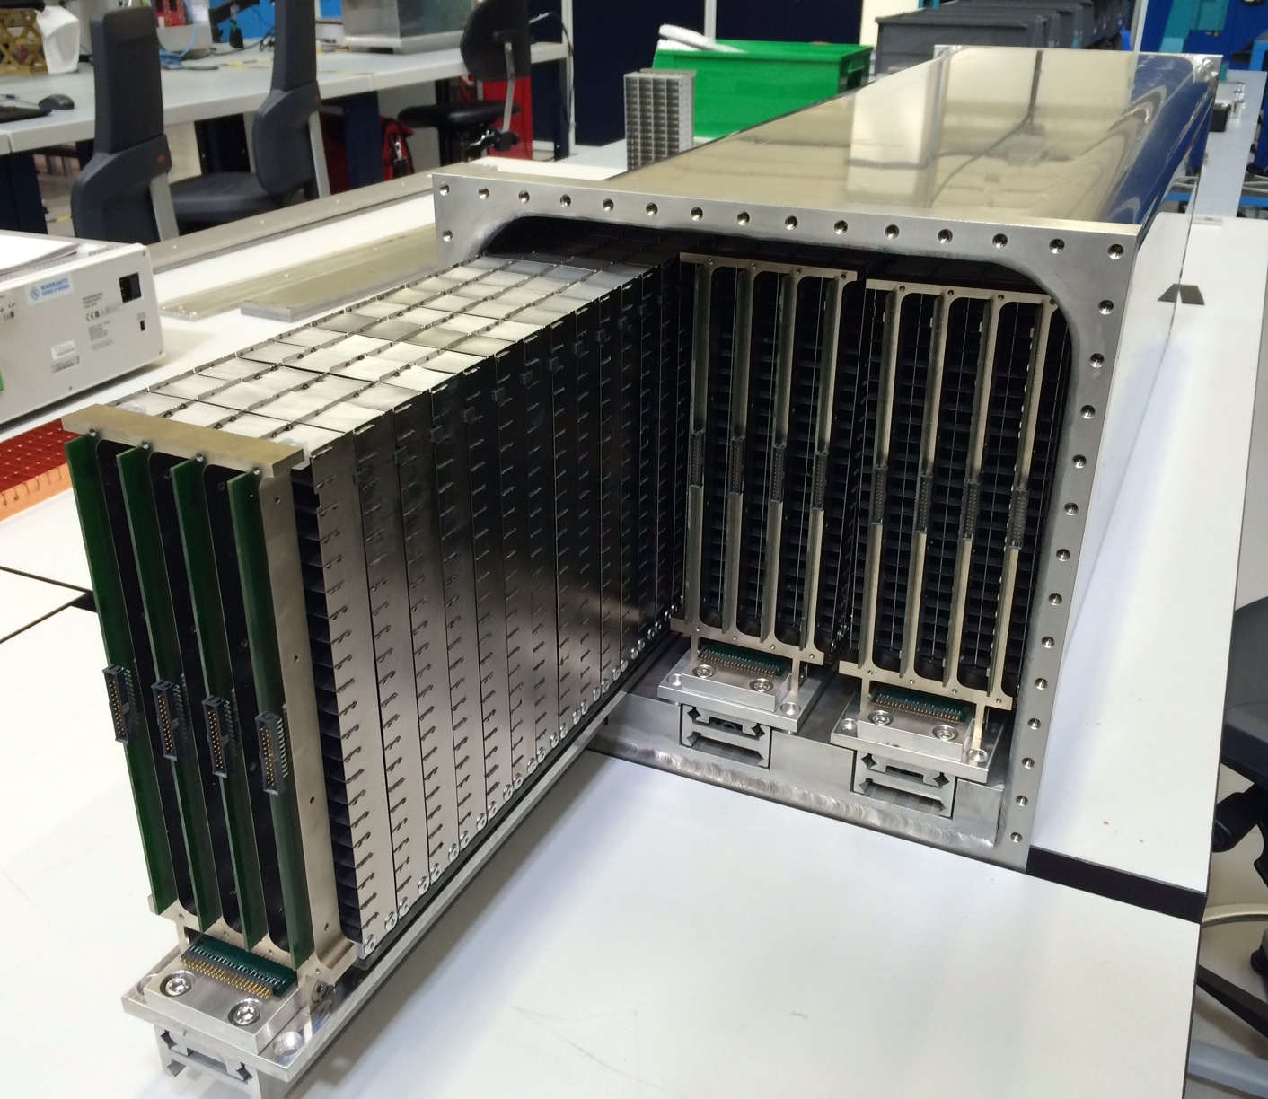
MG.SEQ Detector Tested at SNS
Test with thermal n; first test in vacuum
Electronics compartment
Characteristic | Values
Detector area | 0.8 m²
# of grids | 360*
# of wires | 720
# readout channels | 1080*
# voxels | 28800
# of ¹⁰B₄C layers | 40
¹⁰B₄C on radial blades | Yes + No
# of detectors | 3 (+1 spare)
Detector weight | 110kg x3
Sample-detector | ~5.5m
Detector angle | 25-35 deg
Simplified module access

Slide 18
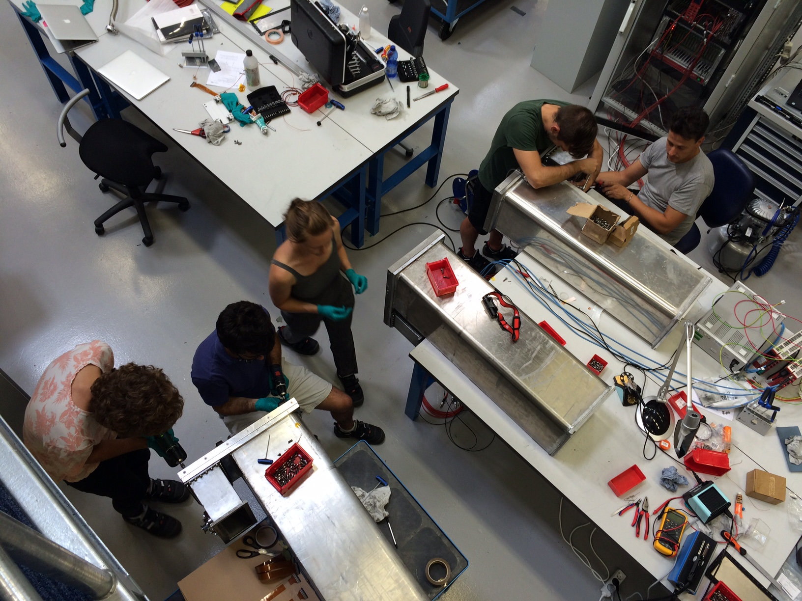
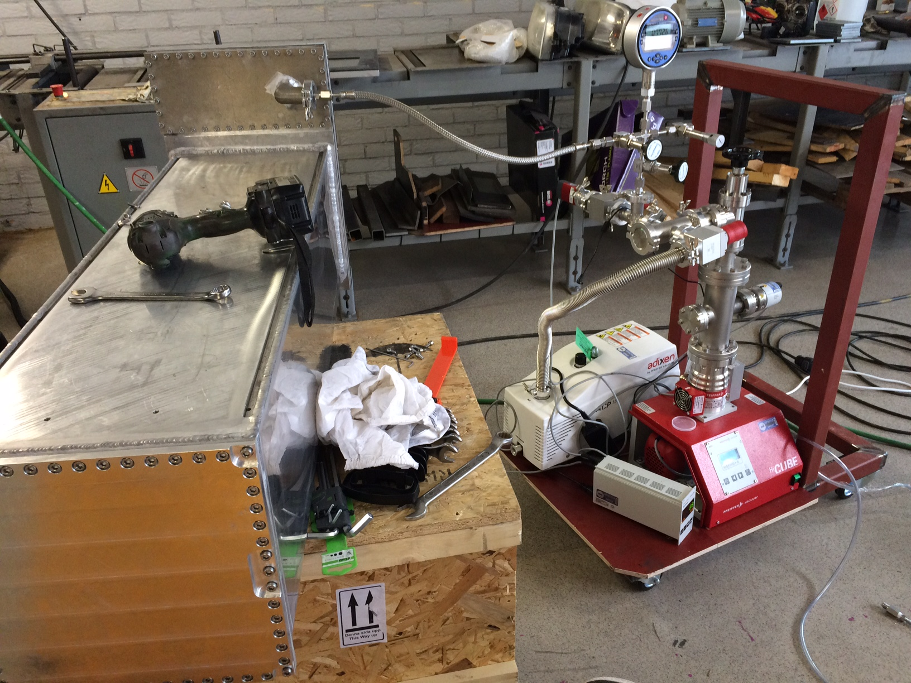
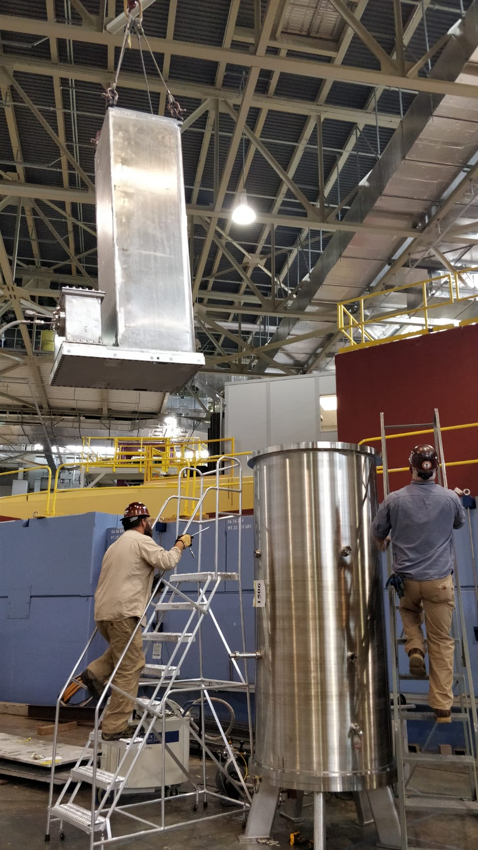
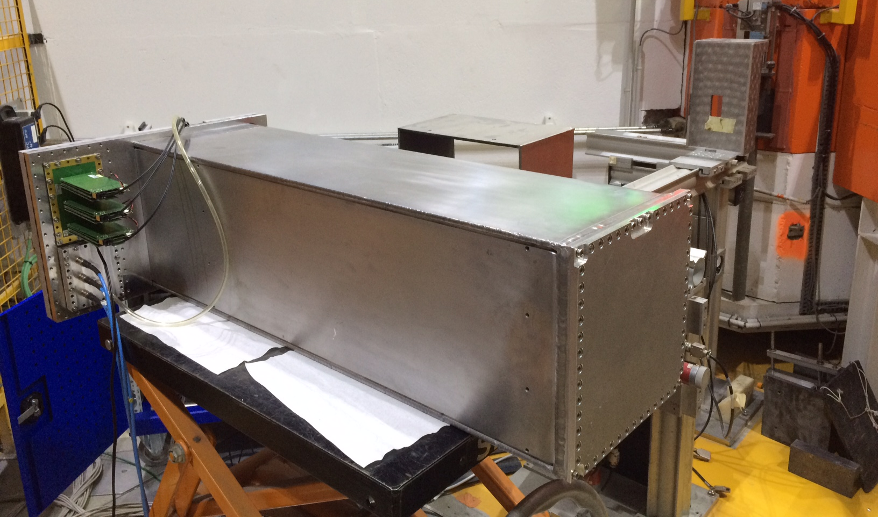
MG.SEQ Testing
In workshop, in beam, vacuum/pressure
Vacuum tank test at SNS
Vacuum / pressure tested at EWCON
Beam test at ILL, CT2
Neutron Beam/ source tests for detection
Tested to 1.1 bar overpressure,
10+ cycles
Leak rate measurements at 1 bar overpressure

Slide 19
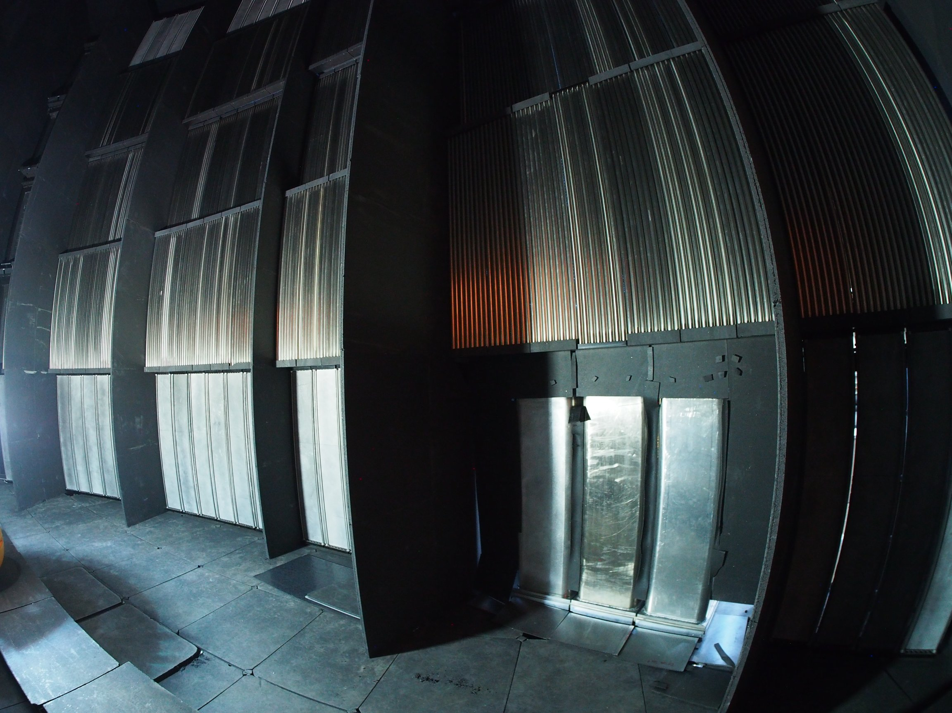
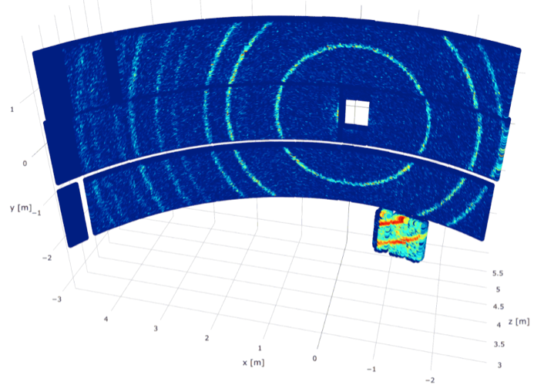
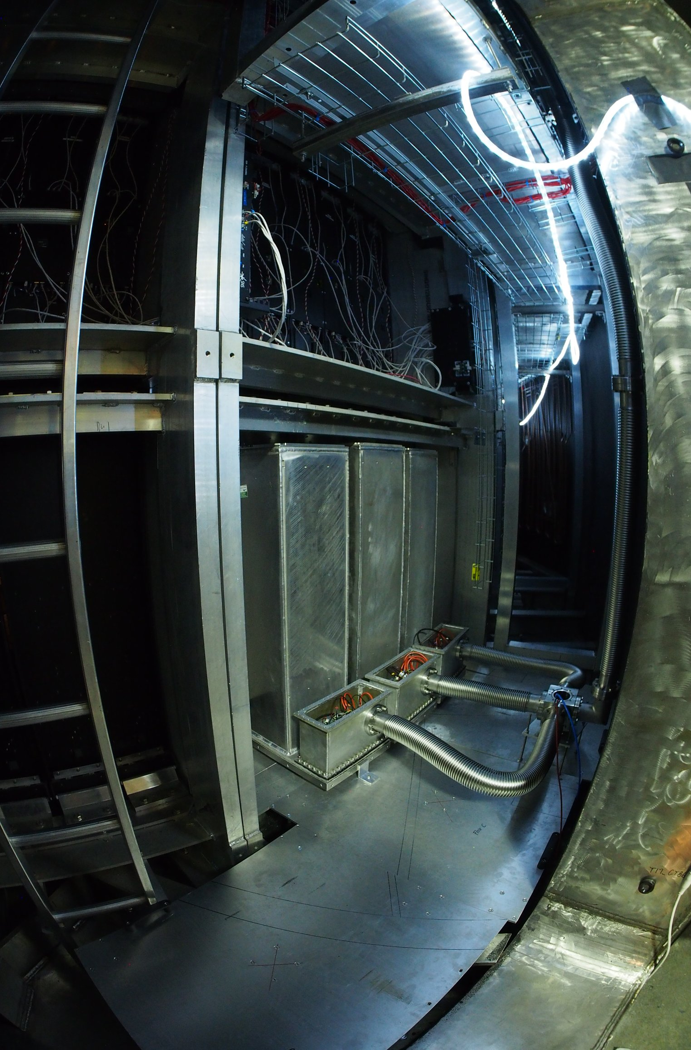
MG.SEQ at SEQUOIA
MG test in vacuum and at high energies
The three detectors installed in the lower detector bank
Sample
MG.SEQ
Monitor
Vacuum connections to the outside
Fermi
White beam on Si-powder
T0
Primary spectrometer provides beams with Ei from 2 to 5000 meV

Slide 20
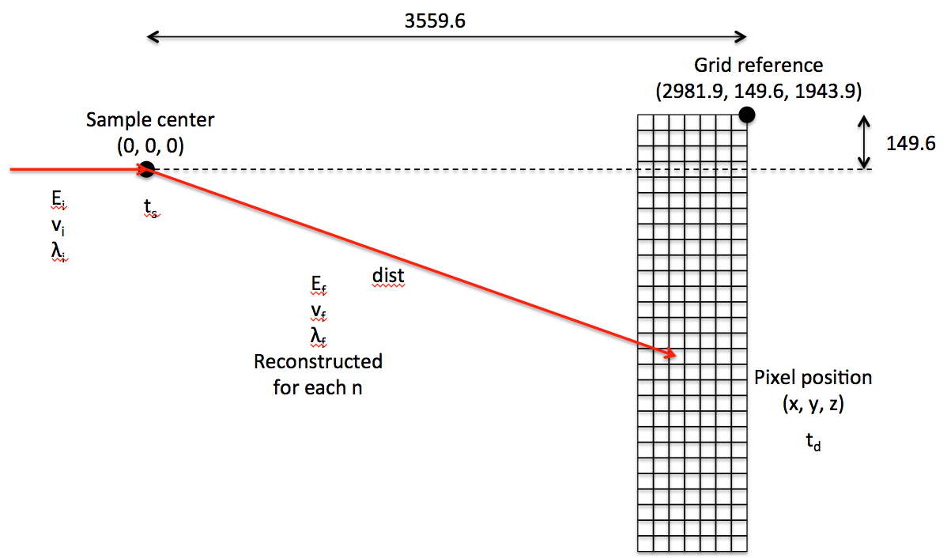
Data Acquisition and Analysis
Spectra and their features
Time-of-Flight
Energy Transfer

Slide 21
MG.SEQ Measurements: Vanadium
Comparison to He-3 at a range of energies
50 meV
8 meV
25 meV
80 meV
160 meV

Slide 22
MG.SEQ Measurements: C₄H₂I₂S
Sample with vibrational and rotational levels over a range of E
MG vs. ³He
Spectra at several E_{i}
Agreement in peak position and width over the range of Ei and Ef
50 meV
70 meV
100 meV
200 meV

Slide 23
MG.CNCS/SEQ Elastic Enerrgy Resolution
FWHM of the elastic line
Good agreement in FWHM for all energies in HR and HF modes
MG slightly higher resolution – likely due to thinner detector cells
MG.CNCS
MG.SEQ

Slide 24
MG Efficiency as a Function of Energy
Measured relative the ³He detectors at CNCS and SEQUOIA
MG.CNCS
MG.SEQ
Counts from integral of the elastic peak in dE.
Efficiency measured relative to He3 tubes at the same scattering angle.
He3 efficiency according to the calibration curve used in the SNS instrument used for normalization.

Slide 25
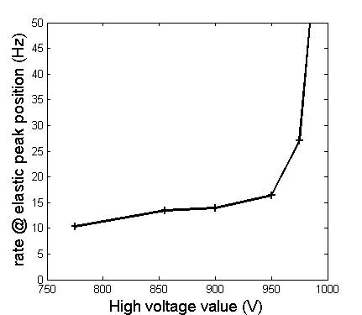
Multi-Grid Gamma Sensitivity
… is very low, similar to He-3 detectors
Measured with 164 MBq ¹³⁷Cs source, γ (662 keV)
Multi-Grid He-3
Gamma sensitivity in the IN6 measurement
Effect of the threshold on neutron efficiency
* A. Khaplanov et al., JINST 8, P10025 (2013), arXiv:1306.6247

Slide 26
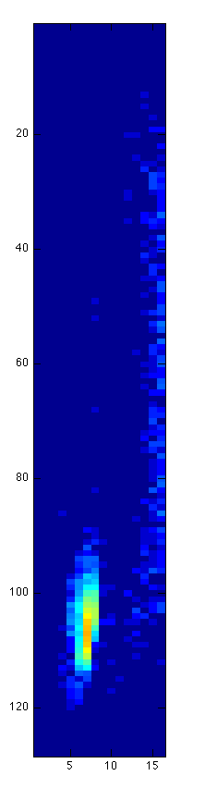




Rate Study in MG.CNCS
Using a Bragg Reflection to create an intense localized spot
Low intensity
High intensity
Loss of position resolution
He3
He3
Position:
Charge division in He3 PSD – saturation causes loss of position resolution
Coincidence between grids and wires in Multi-Grid
Local count rate limit:
space charge in gas (*)
  x10 lower in MG due to multiple layers
  x10 lower in MG due to lower gain
Dead time of electronics
depends on electronics, similar
MG
MG
Reflected beam at E_{i} = 17.20meV
Crystal sample
Reflected beam at E_{i} = 13.74meV
Incident beam

Slide 27


MG Background
Shielding for low-level investigations in Utgård
Background measurements available in many configurations.
Large differences due to location and shielding
Some regions had background issues
Detector | Conditions | Background rate, Hz/m²
³He CNCS | Source off, shutter closed | 0.4
³He SEQUOIA | Source on, shutter closed | 0.15
MG.CNCS | At CNCS, source off shutter closed | 0.55 (no cuts) 0.25 (with cuts)
MG.SEQ (pure Al) | At CNCS, source on shutter closed | 1.40 (no cuts) 0.63 (with cuts)
MG.SEQ (pure Al) | In Utgård | 0.3 (no shielding) 0.07 (with shielding) 0.04 (with shielding and cuts)
Shielding cave:
Mirrobor, 5mm, (80% B₄C)
HDPE, 70mm

Slide 28

Scattering in Grids
Why a ToF measurement is necessary
Looking for a <10⁻² effect
Continuous beam measurements are not sufficient. Problems arise from:
Beam halo
Scattering along the direction of the beam
Incomplete shielding
Background
IN6 Data
Detector depth
ToF

Slide 29
Complications with Scattering Measurements
Only accessible in ToF, but many effects complicate results
The shoulder is not always easy to quantify consistently.
Many energy-dependent effects influence the shape simultaneously. Many of them – not detector-dependent.
Scattering effects from SE and detector
Sample
Sample environment
Detector
Incident n
When scattering “switches on” in MG, it also switches on in other beam-line components.

Slide 30
MG.SEQ Results: Scattering Effect on Line Shape
Line shape comparison to He3
→ Scattered neutrons appear slower than they should.
Effect of scattering is energy dependent.
Appears on energy-loss side in dE spectra.
Define as relative intensity of the shoulder between 3𝜎 and 5𝜎.
Effect of scattering as a function of energy for the 3 MG.SEQ modules and the SEQUOIA He3 array.
Trend – coating the radial blades reduces the effect.

Slide 31


HZB V20 Beam Line Measurement
Direct beam monochromated with a Fermi chopper
Direct pulsed beam measurement
Fermi chopper to generate a train of monochromatic pulses
Pulse resolution ~10us
Interval 1 ms
Study after-pulse effects, broadening due to scattering in grid
Collimators
Detector
Monitor
Fermi chopper

Slide 32

Further In-Beam Tests
V20 direct beam with Fermi chopper
Direct pulsed beam measurement
Fermi chopper to generate a train of monochromatic pulses
Pulse resolution ~10us
Interval 1 ms
Study after-pulse effects, broadening due to scattering in grid
*note: shielding around detector was added after this photo

Slide 33
Conclusion
Development Requirements addressed
Alternative to existing ³He technology → Detector validated for ESS ToF Spectrometers
Original driver – cost → Cheaper than ³He
Further driver – rate capability → Exceeds ³He
Detector performance needs:
  Efficiency
  Background
  Gamma rejection
  Fast neutron sensitivity
  ToF/energy resolution → Matching, or close to ³He
  Uniformity
Design needs:
  Cost
  High active area
  Vacuum compatibility
Studies of the detailed line shape are ongoing

