Slide 1


Report from the First ARIES Workshop on Efficient Neutron Sources
Yoann Charles | ICANSXXIII | 18.X.2019
This project has received funding from the European Union's Horizon 2020 research and innovation programme under grant agreement No 730871.

Slide 2
Contents
The ENS2019 ARIES Workshop
What Is Energy Efficiency of Neutron Sources?
Outputs
  Neutron Production
  Moderators & Reflectors
  Neutron Guides
  Compact Sources
  Modeling Capabilities
  Network & Collaboration
Closing remarks

Slide 3
The ENS2019 ARIES Workshop
This project has received funding from the European Union's Horizon 2020 research and innovation programme under grant agreement No 730871.

Slide 4
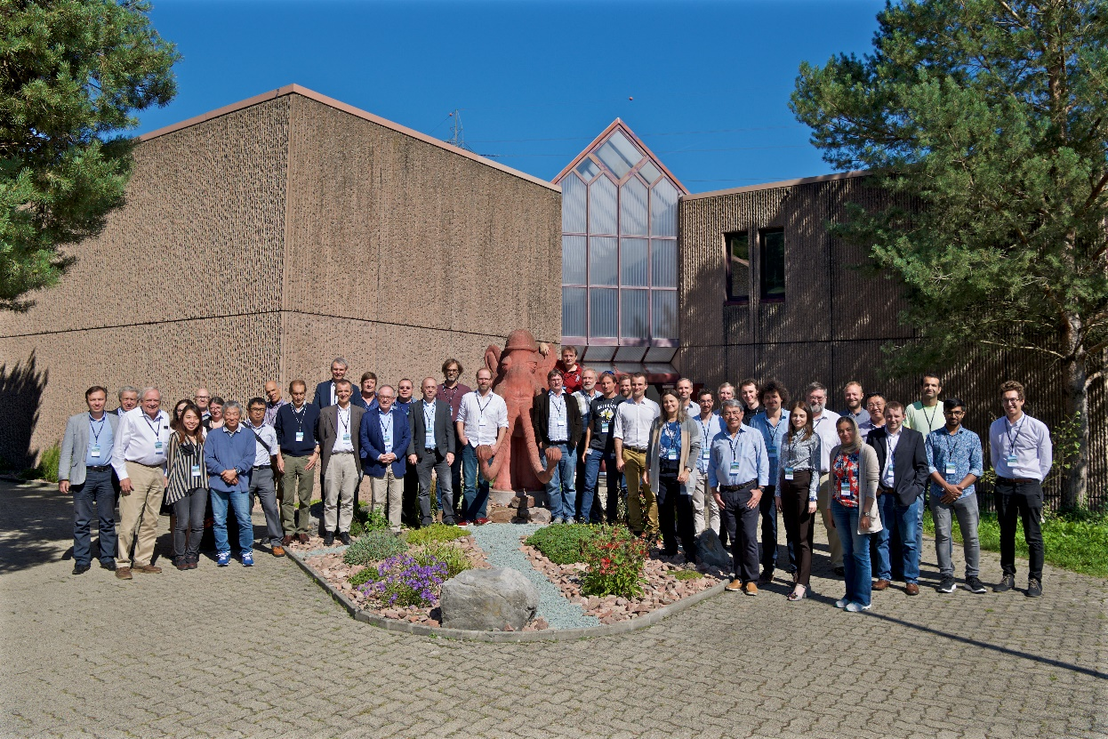
ENS2019 Workshop
63 participants from 17 countries
33 talks and 3 discussion rounds over 3.5 days, no parallel sessions
3 keynote lectures
  J.M. Carpenter, Neutron Production, &C.
  F. Mezei, Combined Efficiency of Moderation and Beam Delivery
  R. Granada, Cold Neutron Moderators and Reflectors: Some Recent Problems and Results
Proceedings:
  Booklet
  Neutron News article
https://indico.psi.ch/event/7274/

Slide 5
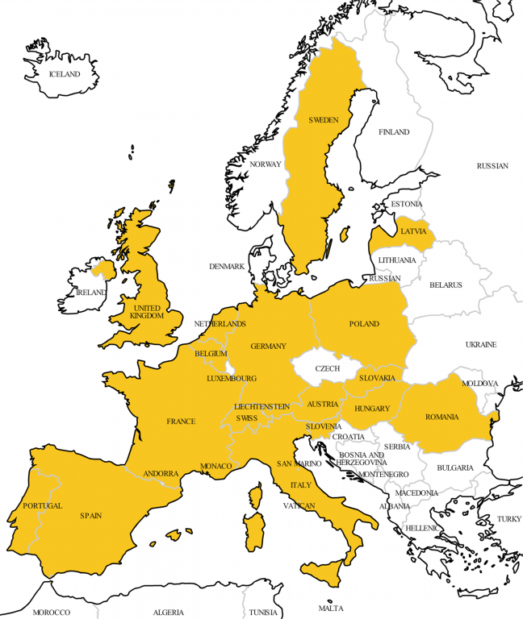


Organization
Organized by PSI and ESS
Held in Villigen (CH) on September 2-5, 2019
Funded by ARIES (EU - Horizon 2020), coordinator M. Vretenar
Explore ideas on improvement of existing and future sources.

Slide 6
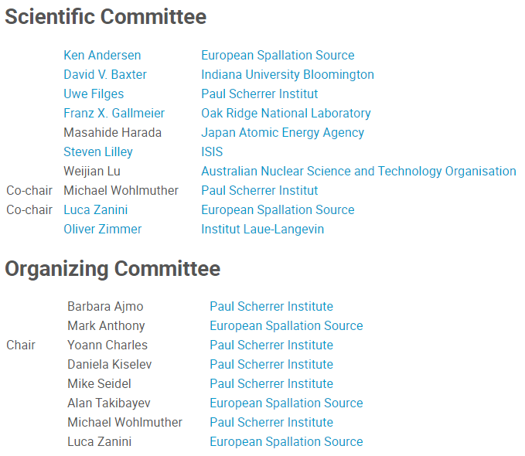
Organization
Session chairs
E. Iverson
M. Janoschek
F.X. Gallmeier
M. Harada
S. Lilley
C. Niedermayer
A. Takibayev

Slide 7
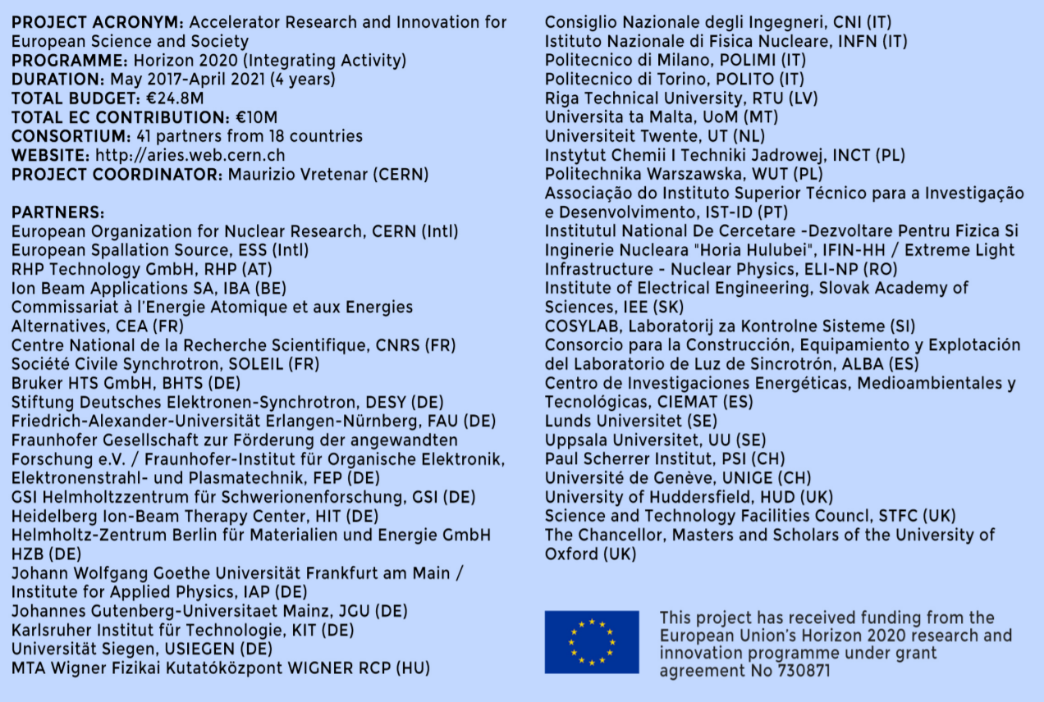
Funding

Slide 8
What is energy efficiency of neutron sources?
This project has received funding from the European Union's Horizon 2020 research and innovation programme under grant agreement No 730871.

Slide 9
There are several efficiency definitions
Efficient Neutron Source
Comparing Sources
Neutron/Joule
Neutron/Proton
User
SNR
Reliability
Funding Agency
Science/$
Neutron/Heat
Life cost
Moderated Neutron/Fast Neutron
Efficient Beam Delivery
Energy drawn from power grid
Heat load on target
Dissipated (lost) heat
Background noise
Disposal must be included!

Slide 10
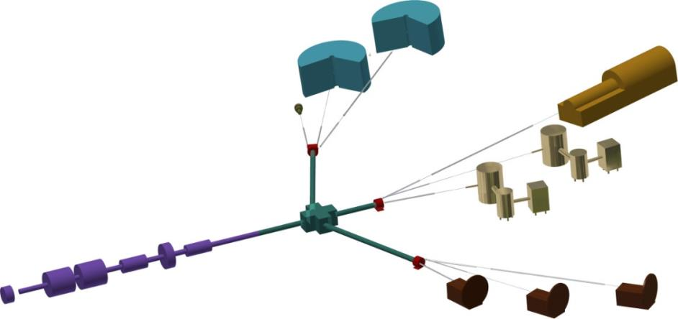
Efficiency must consider
The entire chain:
Source
Neutron Extraction
Moderator Systems
Beam Delivery
Instruments & Detectors
Analysis, Modelling & Interpretation
Source: T. Gutberlet
Instruments
Targets
Accelerator
Beam multiplexing

Slide 11
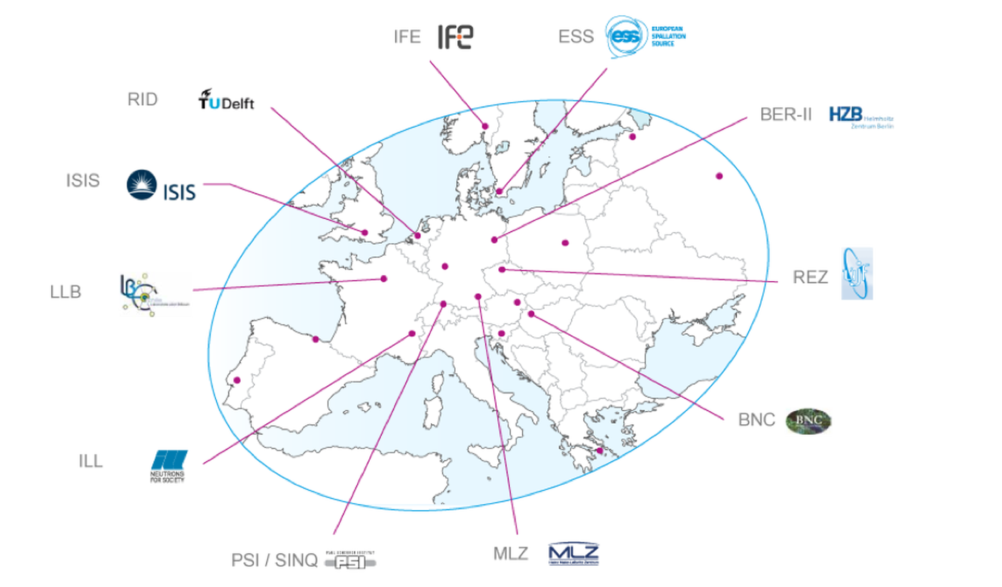
Efficiency must consider
The entire chain
The entire ecosystem
  Capacity
  Capability
  Education
Source: LENS

Slide 12
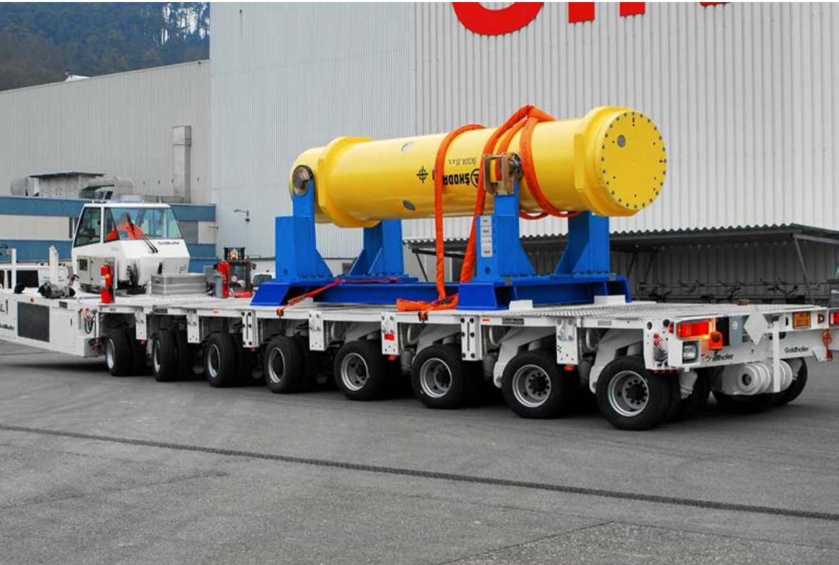
Efficiency must consider
The entire chain
The entire ecosystem
Entire life cost
  Initial investment
  Operation
  Disposal
  Etc.
Disposal of MEGAPIE at SINQ

Slide 13
Outputs
This project has received funding from the European Union's Horizon 2020 research and innovation programme under grant agreement No 730871.

Slide 14
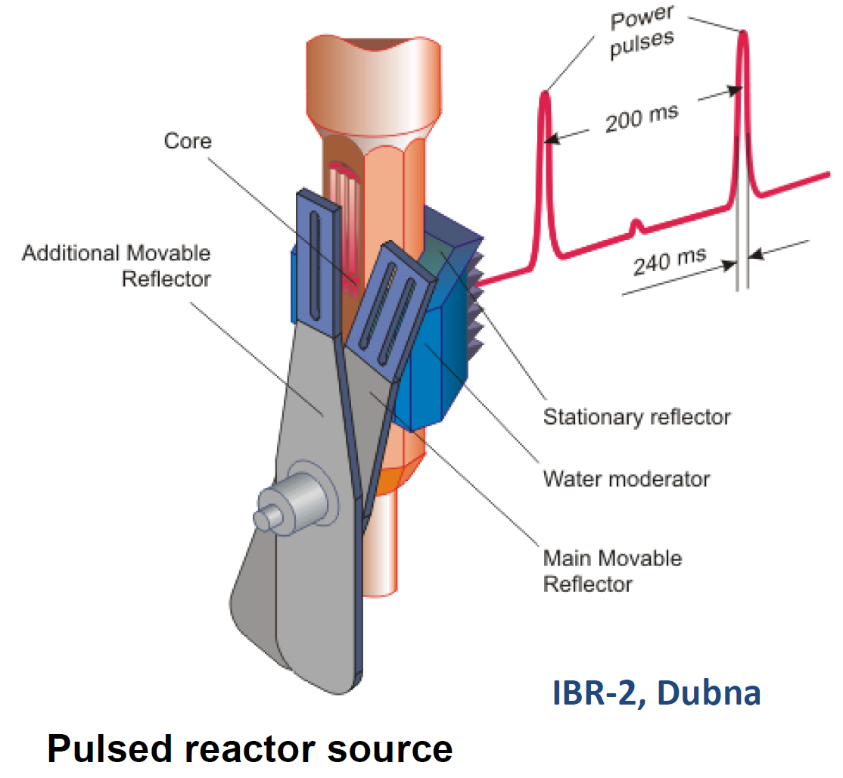
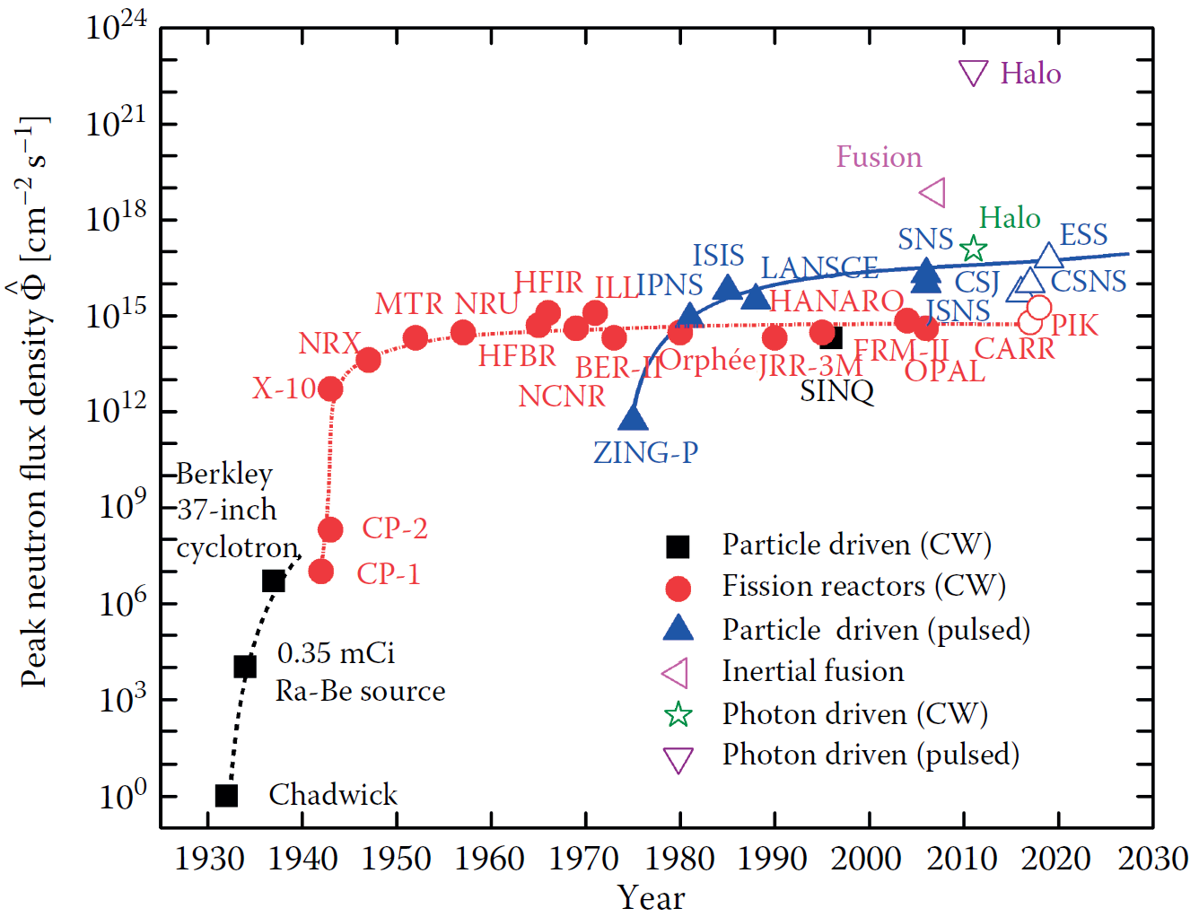
Neutron Production
Low pulse repetition rate gives more time to use all the spectrum, increasing efficiency
Long pulses in spallation is cheapest way to obtain intense short pulses
  Mechanical choppers for pulse shaping
  Tunable pulse length
  Pulse can be used multiple times with different choppers
  High integrated intensity per pulse
Long pulses with choppers is cheap and flexible way to obtain short pulses
Superimpose fast modulation to a pulse for higher resolution
Importance of signal-to-noise ratio
  Focus on background reduction, use Monte Carlo to study origin of noise
Future opportunities, e.g. Inverse Compton Scattering, Laser Fusion, Plasma or Halo Nuclei
Source: P. Böni & W. Petry

Slide 15
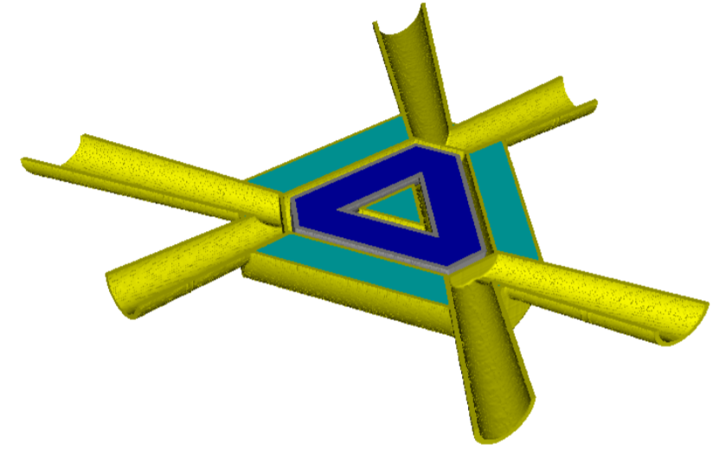
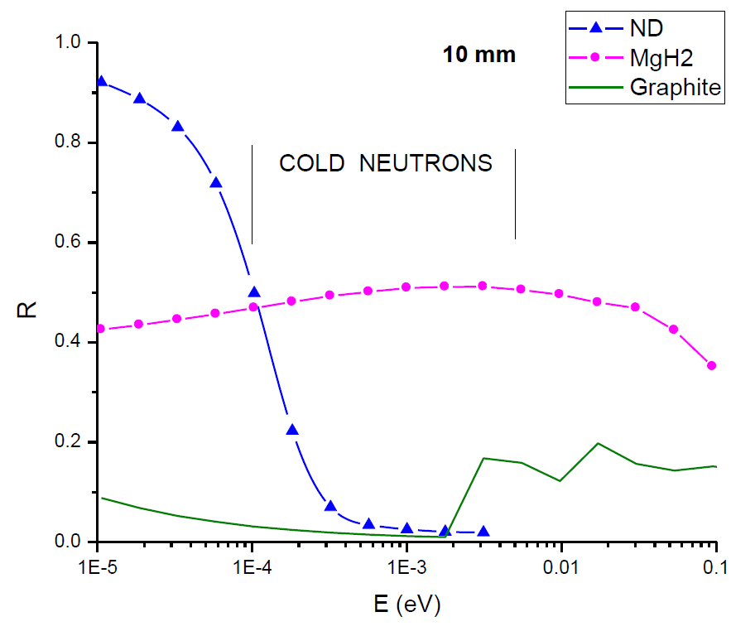
Moderators & Reflectors
We need the ORNL moderator test facility
  Provide space for neutron extraction
General trend towards low-D moderators, better brightness and efficiency
  Applicable to both high power and compact sources, considered at continuous sources
  Engineering puts constrains on design
MgH₂ as reflector and nanodiamond layers as albedo material in beam extraction
  Experiments on reflective properties needed
  Engineering solution to manufacture a reflective layer may be sandwiched and rolled between cladding, same with nanodiamonds?
Moderator material:
  High power sources: para-H₂ and water, and beryllium reflector
  Continuous sources: D₂O and D₂
  Other materials: clathrates, ethane, methane, mesitylene (e.g. IBR-2, NETPUN); challenges to be overcome
Need for collecting benchmark material for TMRA simulation work
  Often already existing, need to be processed and made available e.g. Github-style repository
Source: E. Iverson
Source: R. Granada

Slide 16
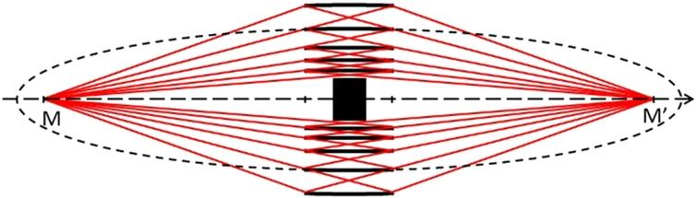
Neutron Guides
Opportunities for significant improvements at large sources
  e.g. U. Filges SINQ upgrade
Supermirrors, Montel optics, elliptic guides
  Challenge in reducing absorption
Nested mirrors assemblies
  Wolter optics for versatility
Source: P. Böni
Source: O. Zimmer

Slide 17
Opportunities at CANS
Flexible design
  Lower power deposition
  Good for testing new concepts and materials
  Useful for education
  Multiple targets from single accelerator allows to specialize each target
  Use commercial products
  Drive innovation
Potential to replace research reactors at lower cost
Significant gain margins
  Less understood target nuclear data
  Material effects
  Cooling
Solid moderators at colder temperatures may give unique opportunities
Industrial interest (BNCT, imaging, etc.), soon economically viable
Source: P. Zakalek

Slide 18
Scattering data
Need experts in thermal and cold scattering data/library production
  Working group
  Education of newcomers in dedicated workshops
Evaluation of cross-sections differ strongly, suggesting that cross sections are not well-known
Provide feedback to TENDL developers
Very few groups develop cross-sections for cold moderator systems and our exotic needs. Various groups have some expertise but not the time
  Working group
  Scattering kernel school?

Slide 19
Simulation capabilities
We need to enhance the capabilities of our simulation tools, including aspects such as snr, background, etc.
Background simulation
Identified need of learning to process experimental data to a format usable in Monte Carlo
Feedbacks between particle transport codes and fluid/mechanical models
  Density varies with power deposition, impacting moderator efficiency
  Change of dynamical regimes in fluid targets and moderators
  Transport of delayed neutrons by coolant/moderator fluid
  Etc.

Slide 20
A Diverse Community
Target
LENS
UCANS
Instrument
ICANS
ARIES
Accelerator
CRP (IAEA)
…
…
Spallation
Flagship
Low Flux
Reactor based
Medium Flux
CANS
…
…

Slide 21
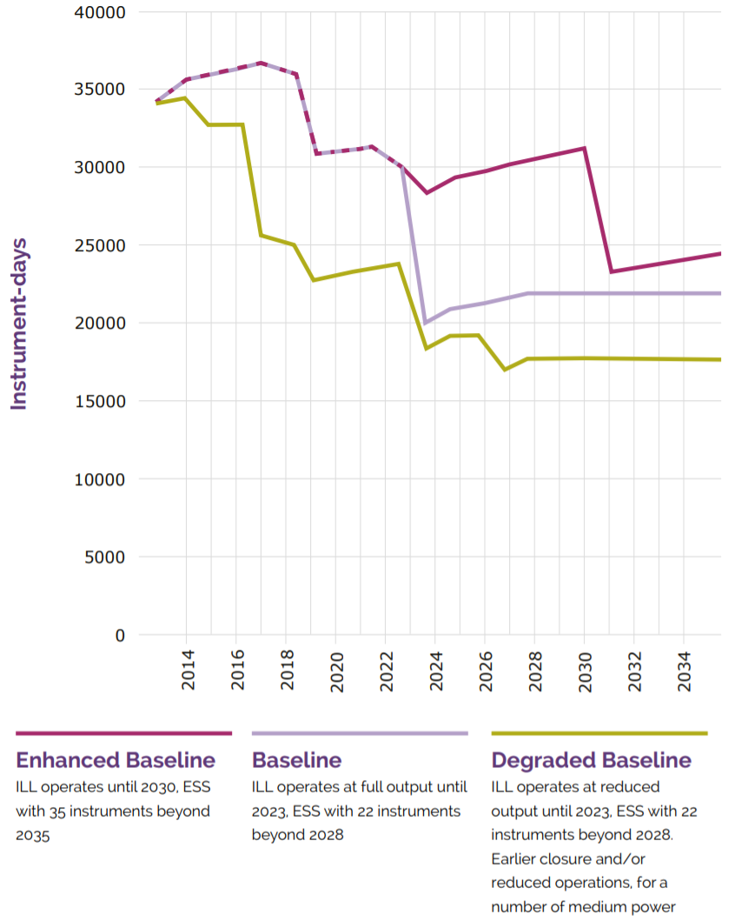
Enhanced Collaborations and Visibility
Consortium for Neutron Sources:
  Facilitate the development of a collective strategy across facilities worldwide
  Engage with stakeholders and funding bodies to shape future policies
  Identify key areas and technologies to develop
  Promote the scientific, industrial and societal applications of neutron science
  Enhance the interactions between communities, fields of expertise, facilities, etc.
  See LENS (League of advanced European Neutron Sources), LEAPS (synchrotrons)
Working groups on key topics
  Cross sections for cold moderator systems
  Thermal and cold scattering data/library production
Connect source and instrument/detector people
Instrument-days in Europe
Source: ESFRI 2016

Slide 22
Closing Remarks
This project has received funding from the European Union's Horizon 2020 research and innovation programme under grant agreement No 730871.

Slide 23
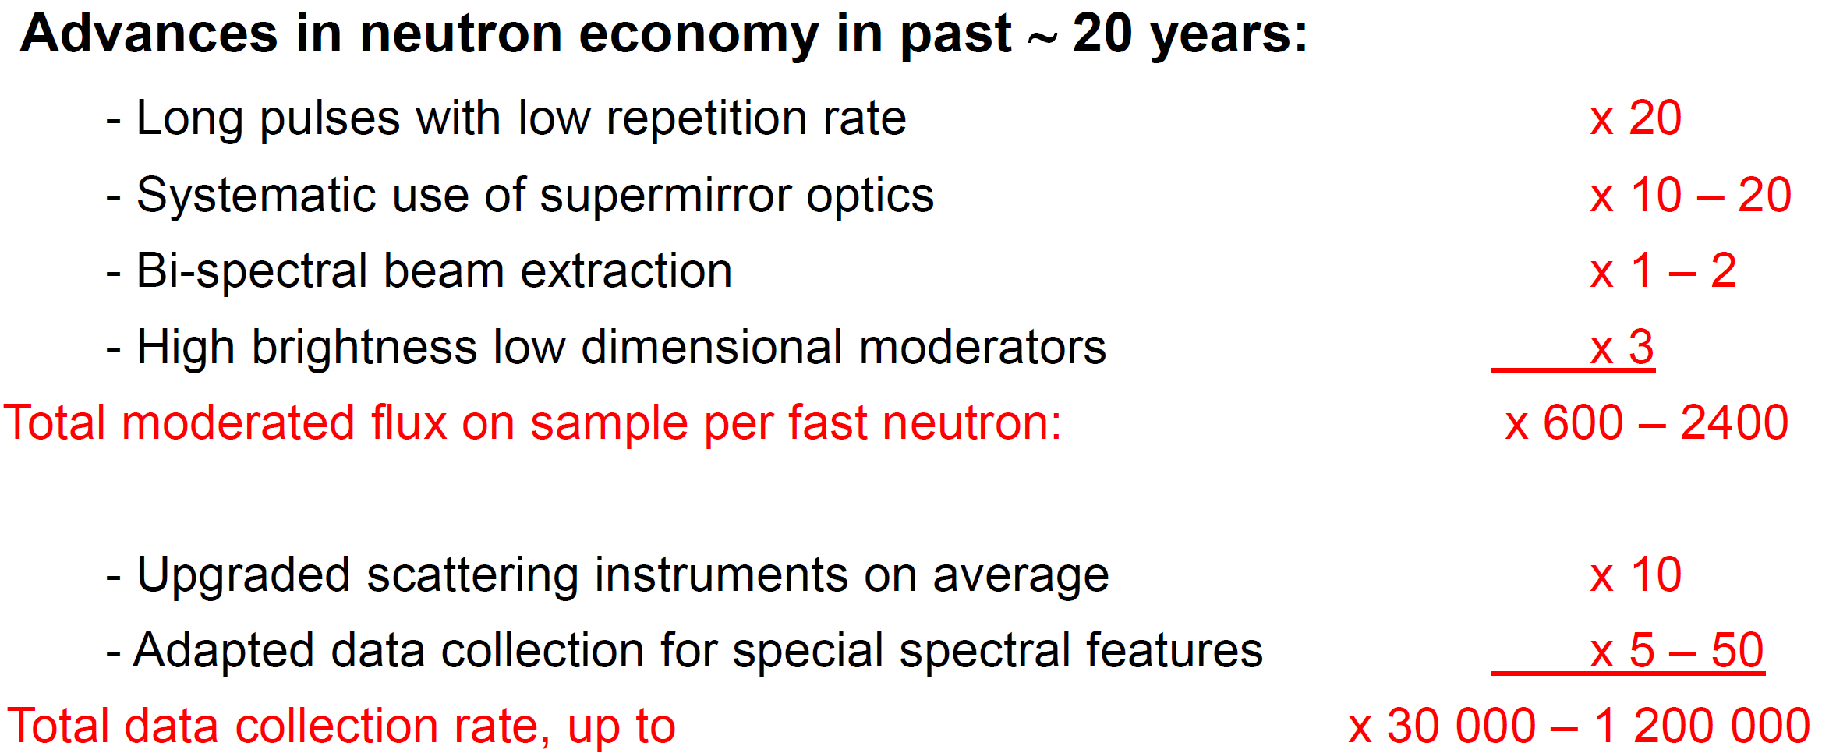
Closing Remarks
Heat dissipation on load and on decay is the major engineering limitation
It is important to report failures as well as successes
Holistic optimization of the neutron source
  From accelerator/fuel element to instrument
  Consider modelling capabilities and data analysis
  Place in ecosystem
  Life cycle
Source: F. Mezei

Slide 24

This project has received funding from the European Union's Horizon 2020 research and innovation programme under grant agreement No 730871.

