Slide 1
Scope and Status of Materials Research for Source Technologies at ESS
Yong Joong Lee
ICANS XXIII, Chattanooga
October 14, 2019

Slide 2
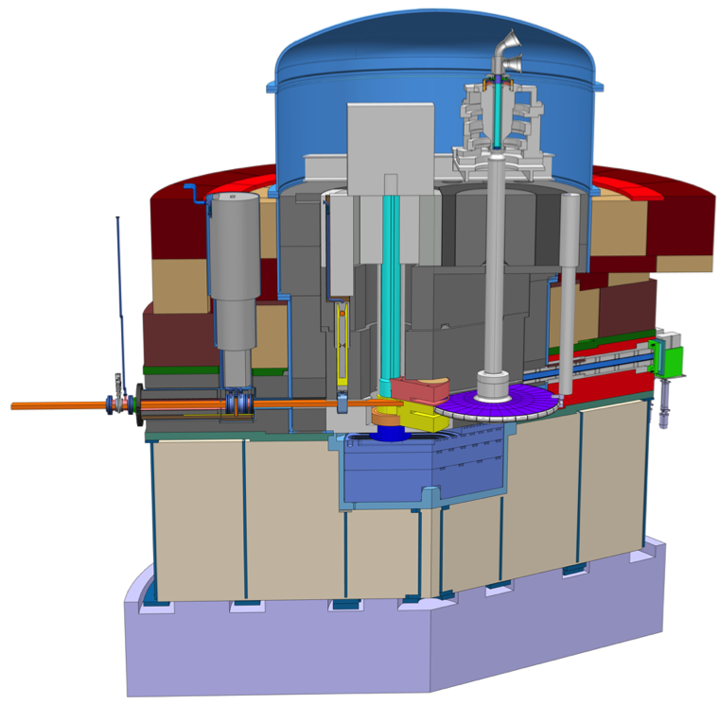
ESS Target Environment
Proton Beam Instrumentation
Target Wheel Drive Unit
Proton Beam Window (PBW)
Proton beam (2 GeV/5 MW)
Beam Extraction Unit
Moderator Reflector
Target Wheel

Slide 3
Materials Research in Target Environment
Motivation and Mission
Degradation of functional and structural materials in target environment poses challenges to operational reliability and costs.
The materials research at ESS is dedicated to
  Selection of materials which endures intense radiation field in target environment
  Determination of component lifetime, which are subject to radiation damage
  Realization of the visions of materials R&D at ESS
  Contributions to the high power target community with the knowledge acquired

Slide 4
Status Overview of Materials Activities
Spallation Materials
Mechanical Properties
Oxidation Properties
Proton Beam Window Materials
BLIP Irradiation Campaign
PIE of STIP Specimens: Al6061-T6, Alloy 718, Ti-6Al-4V
PIE of STIP-V Specimens
RI Beam Irrad. Campaign & PIE
Moderator Materials
Measurement Tech for Ortho-Para H₂
Conversion Kinetics of Ortho-Para H₂
Beryllium XS Characterization
Beam-Material Interaction
Dynamic Response of W to Raster
Beam Intercepting Diagnostic Devices
LINAC Beam Dump
Beam Conditions on Target
Polymeric Materials
Irradi. Campaign & PIE of Elastomers
Irrad. Campaign & PIE of Grease
Materials Lab
SEM
Optical Microscope
EDX
Project Support
Materials Handbook
Materials Selection & Lifetime Criteria
Multiphysics Analyses
Tritium Release, Water Radiolysis, Corrosion Issues
Future Projects
Irradiation Module
Proposals for External Grants
Muography for TG Monitoring
Elemental Analyses
Structural Behavior of Coated Al6061
LFA
Water-cooled Back-up Target
Colour | Status Description
 | Completed
 | Ongoing
 | Failed and Activity Closed
 | In Plan (External Funding)

Slide 5
Project Support
ESS Materials Handbook
Define selection criteria and lifetimes of materials that are subject to hadron and gamma radiation doses.
Record decisions regarding materials, which are made in consensus between the Materials Group and the relevant sub-project unit, and the reasoning behind such decisions.
Compile material properties data to serve for the engineering of the ESS systems in target and accelerator environments.
Period |  | Main Activities and Milestones
Start | Finish
Jan 1, 2015 | Dec 31, 2019 | Real-time compilation of project materials data in place
Dec 31, 2019 |  | Completion of CDR of all sub-projects and design freeze
Jan 1, 2020 | Dec 31, 2020 | Compilation of all required project materials data in place
Jun 30, 2021 |  | Preliminary version release and start of review process
Jun 30, 2021 | Dec 31, 2021 | Final editing and review of each completed section
Dec 31, 2021 |  | Release of the final version

Slide 6
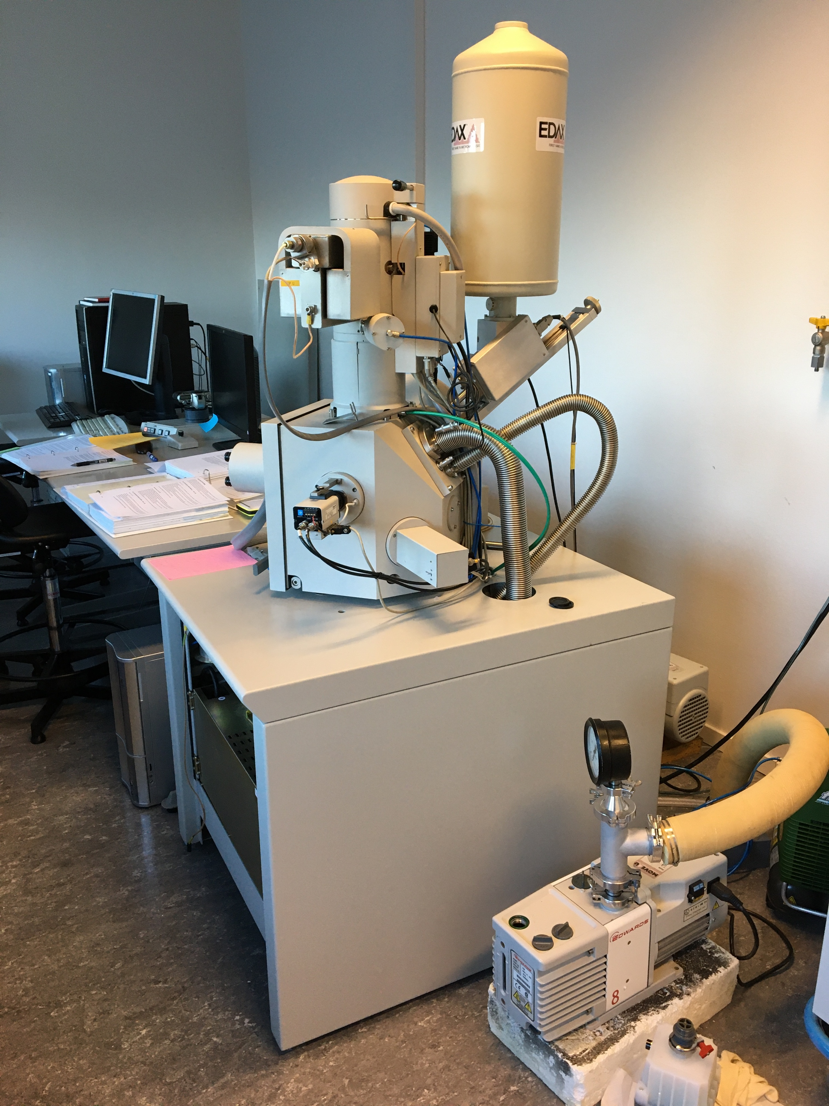
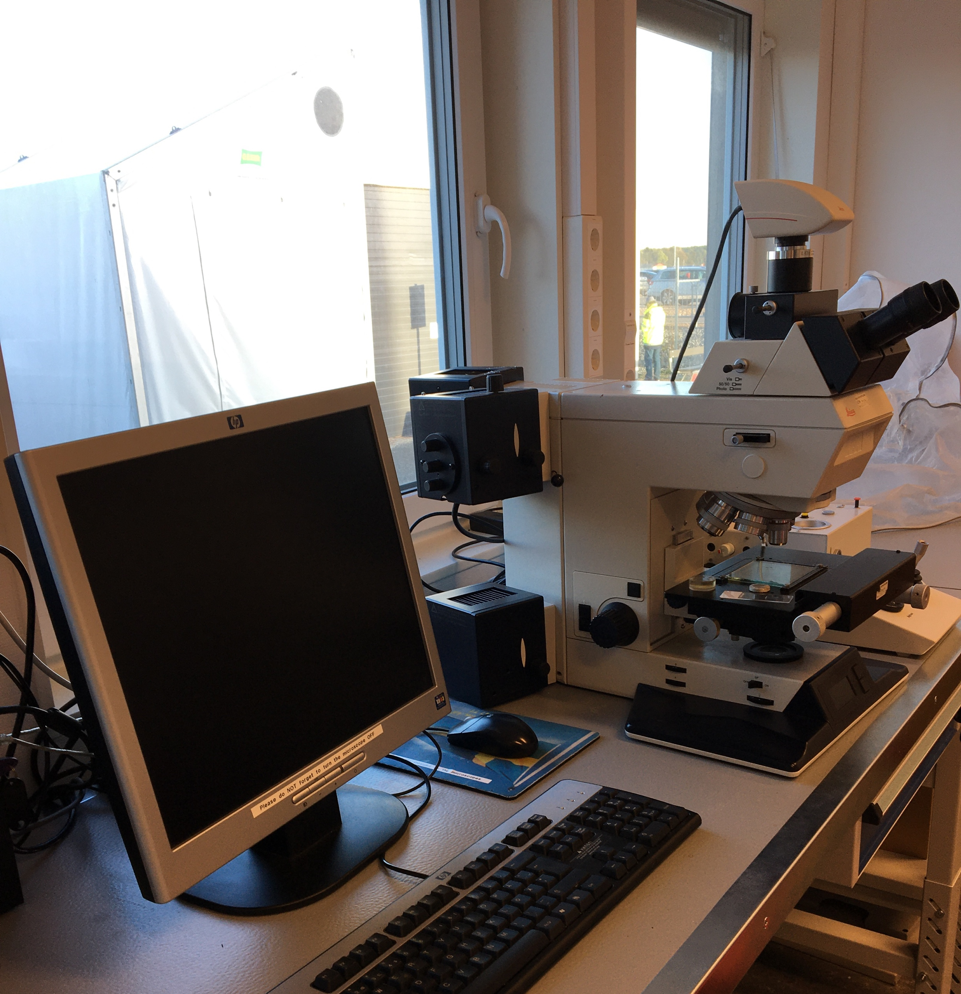
Materials Lab (Hossein Sina)
Provide Services for Materials Characterisation
Currently Equipped with SEM/EDS, LFA and Optical Microscope

Slide 7
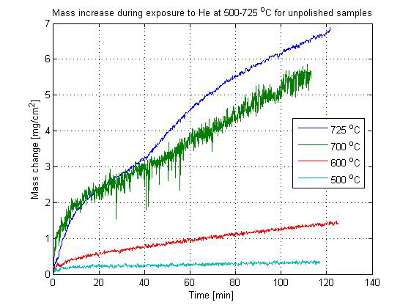
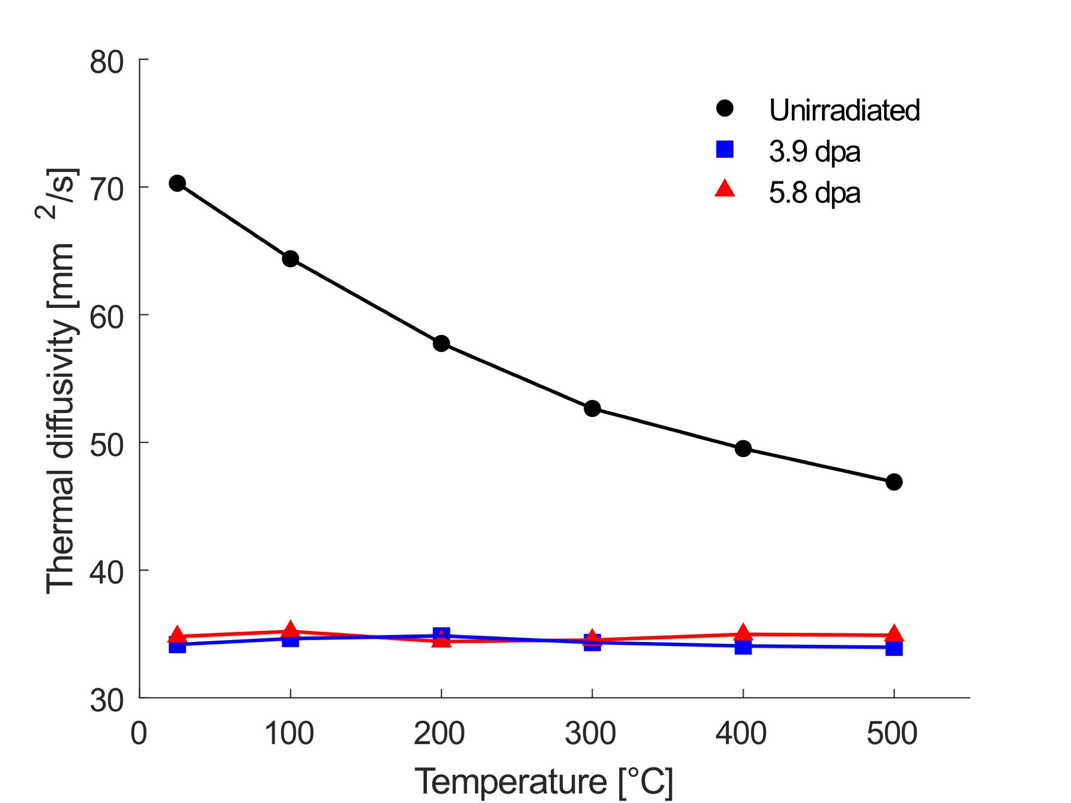
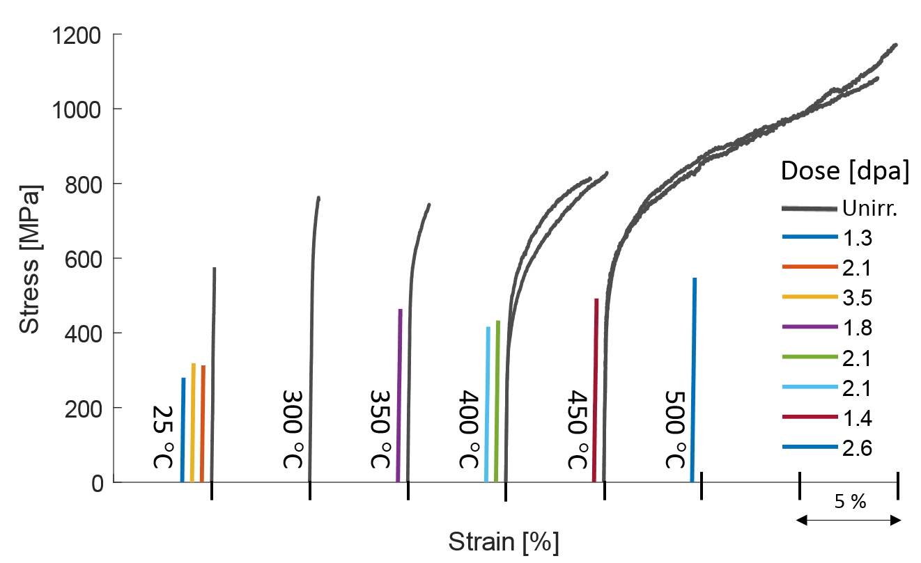
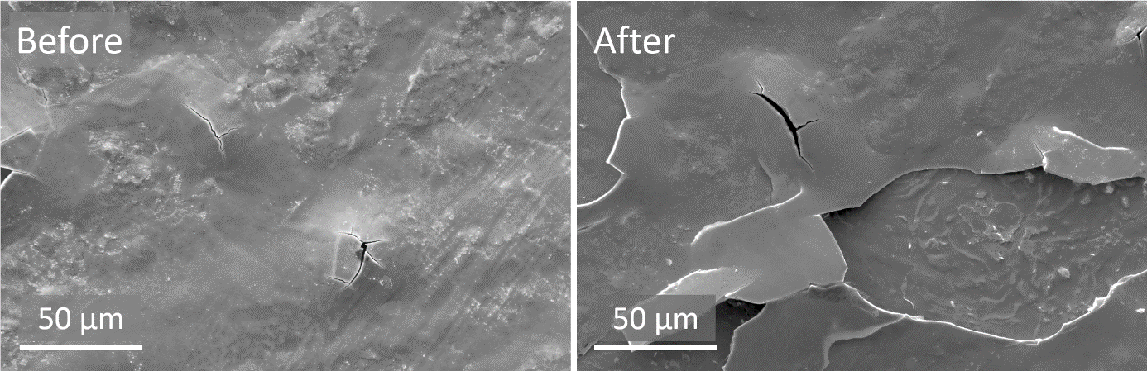
Spallation Materials: Tungsten (J. Habainy)
Work Scope
Tensile and Fatigue Tests (Lund U)
  Define the operational stress range
  Define the quality criteria in choosing tungsten grade
  Vendor evaluation
Oxidation Tests (Lund U)
  Define the operational temperature range
  Provide inputs for hazard analysis
PIE of STIP-V specimens (PSI)
  Proton induced degradation of mechanical properties
  Proton induced degradation of thermal properties
  Proton induced change in microstructure
PIE of RI beam irradiated W (GSI, PSI, Darlana U)
  Displacement damage induced degradation of mechanical and thermal properties
  Dynamic response of oxide layer to the pulsed beam
Release fraction (DTU)
Erosion and oxide aerosol release (Lund U)

Slide 8
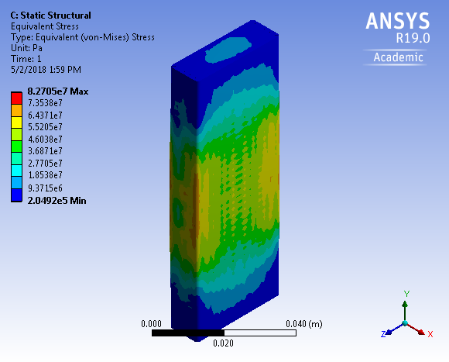
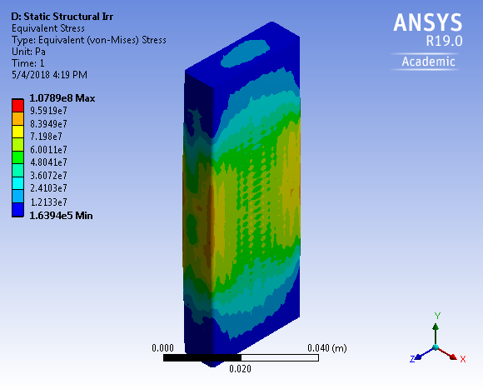
Spallation Materials: Tungsten
Project status: Competed except
  LFA and mechanical tests of high dose STIP-V samples
Design requirements:
  The surface temperature of tungsten shall be lower than 500 C during normal operation.
  The surface temperature of tungsten shall be lower than 700 C in loss of coolant accidents.
  The steady state equivalent stress in tungsten shall be lower than 100 MPa.
  The beam pulse induced stress amplitude in tungsten shall be lower than 50 MPa.
Radiation Impacts:
  Reduced strength and ductility
  Reduced thermal conductivity
  Potential stiffening
Equivalent stress
Post pulse
-20% therm. cond.
+ 20% stiffness
+ 25 MPa

Slide 9
Proton Beam Window Materials
PBW is exposed to the highest flux of protons
  Short lifetime
  Challenge in operation and maintenance
BLIP Irradiation Program (RaDIATE Collaboration)
  Al5754-O
  Al6061-T6
STIP Program (PSI)
  Materials:
    Al6061-T6 (STIP-VII)
    Alloy 718 (STIP-II)
    Ti-6Al-4V (STIP-VII)
  Status: Project Launched
    PIE of alloy 718 planned in 2019

Slide 10
Moderator Materials
Liquid Hydrogen
Challenges:
  The brightness of the ESS neutron beam is dependent on a high para fraction of liquid hydrogen
  Neutrons and gamma back convert para-H₂ into the ortho state
  Required to keep converting ortho-H₂ back to para
Investigated Areas:
  In situ Raman spectroscopy technologies
  In situ vibrational spectroscopy technologies (SNS)
  Conversion kinetics of catalysers
  In beam measurement of ortho-para fraction (J-PARC)
  Safety measure and licensing of sapphire window
More details:
Monika Hartl, 12:10 PM, Oct 15
Moderators and Reflectors Session
Emil Karlsson, MSc Thesis, Lund U

Slide 11
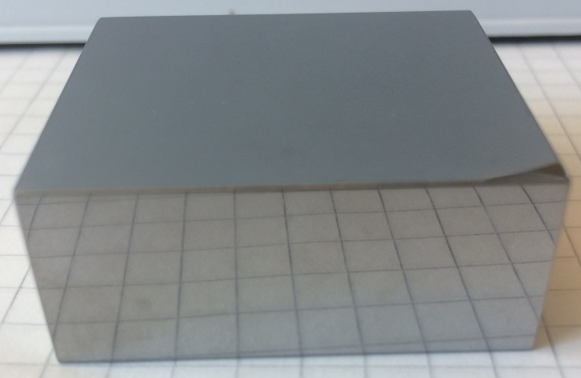
Moderators and Reflectors
Beryllium
Beryllium Selection Criteria
  Isotropic texture
  Small grain size
  High purity
Research on the correlation between neutron scattering cross-section and different beryllium grades is launched
  S-65: Vacuum Hot Pressed
  S-65-H: Hot Isostatic Pressed
  S-200-F: Vacuum Hot Pressed
  Sintered/Forged Be from Ulba
Investigated areas:
  Grain structure and elemental characteristics (Slava Kuksenko, UKAEA)
  Neutron scattering experiments (LANSCE)
More details:
Douglas Di Julio, 10:30 AM, Oct 15
Moderators and Reflectors Session

Slide 12
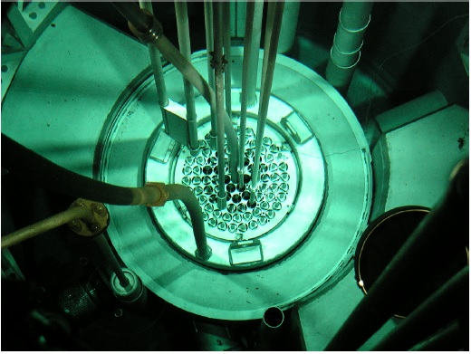
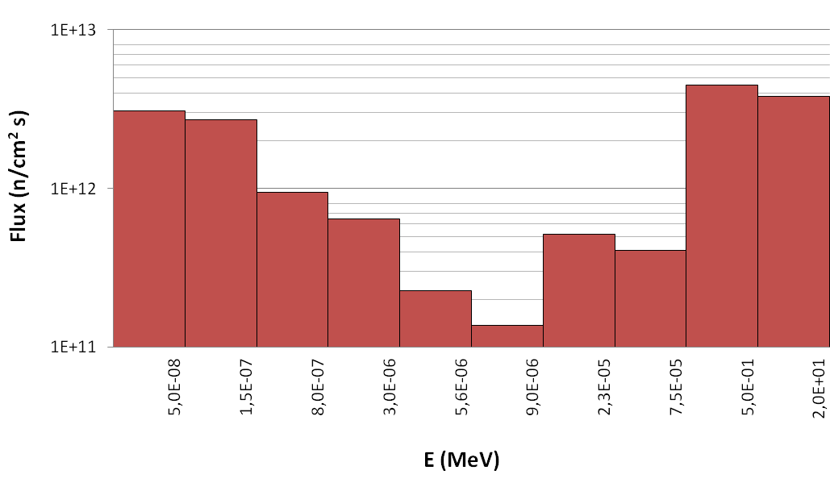
Polymeric Materials: LENA Irradiation Campaign
Matteo Ferrari
TRIGA MARK-II Nuclear Research Reactor in Pavia
  250 kW maximum power
  Central thimble with a diameter of 3.8 cm houses the test specimens
  Total maximum neutron flux: 1.72e13 neutron/cm²/s
    Thermal (E < 0.8 eV): 6.75e12 neutron/cm²/s
    Fast (E > 0.5 MeV): 3.80e12 neutron/cm²/s
  Maximum irradiation temperature: 60 C

Slide 13
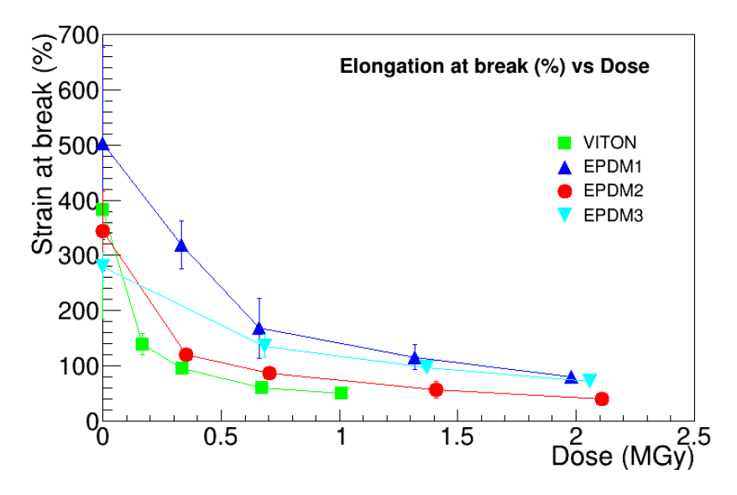
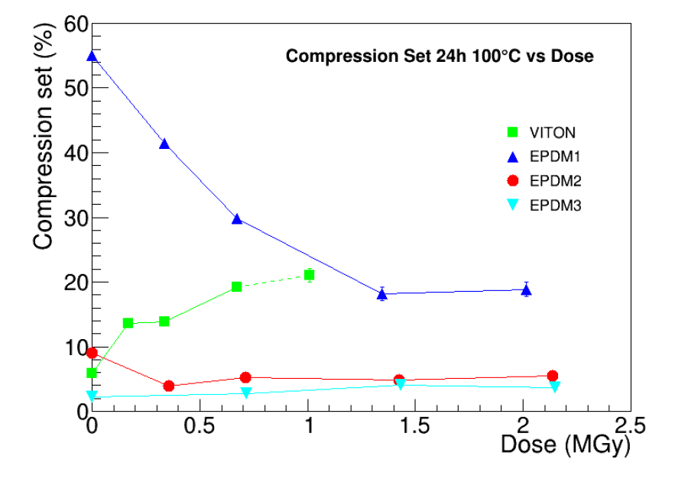
Polymeric Materials : PIE of Elastomers
Matteo Ferrari

Slide 14
Polymeric Materials : PIE of Lubricants
Matteo Ferrari
Project Status: Completed
  Grease types in neutron heavy environment is recommended
  Elastomer types in neutron heavy environment is recommended
Significant difference in damage rates between the gamma irradiated and neutron irradiated grease base oil has been identified.

Slide 15
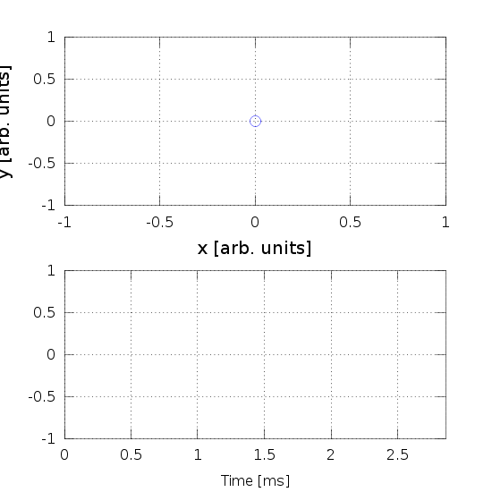
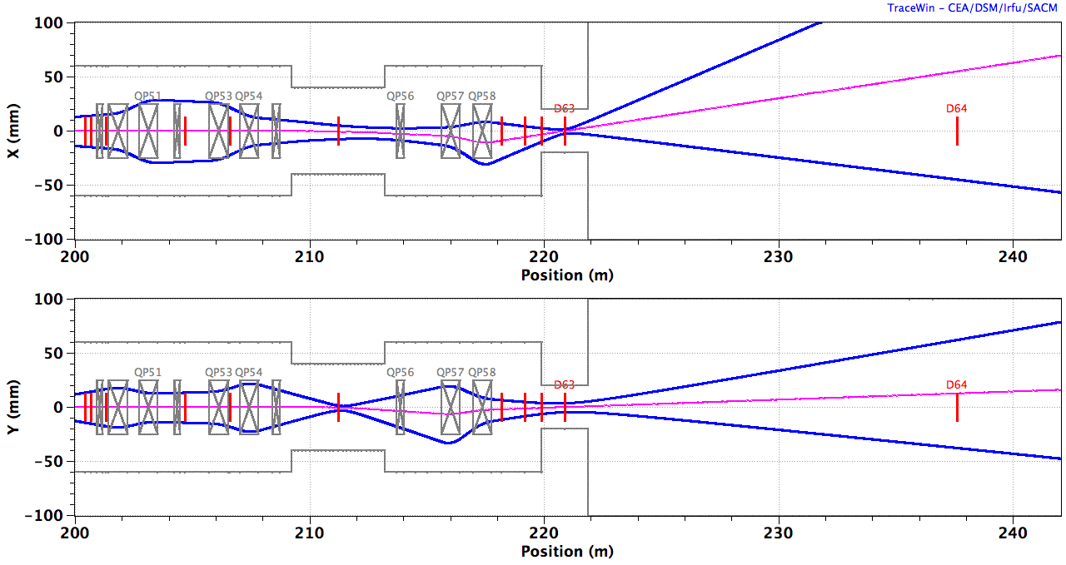
Raster Beam and Tungsten Interaction
H. D. Thomsen

Slide 16
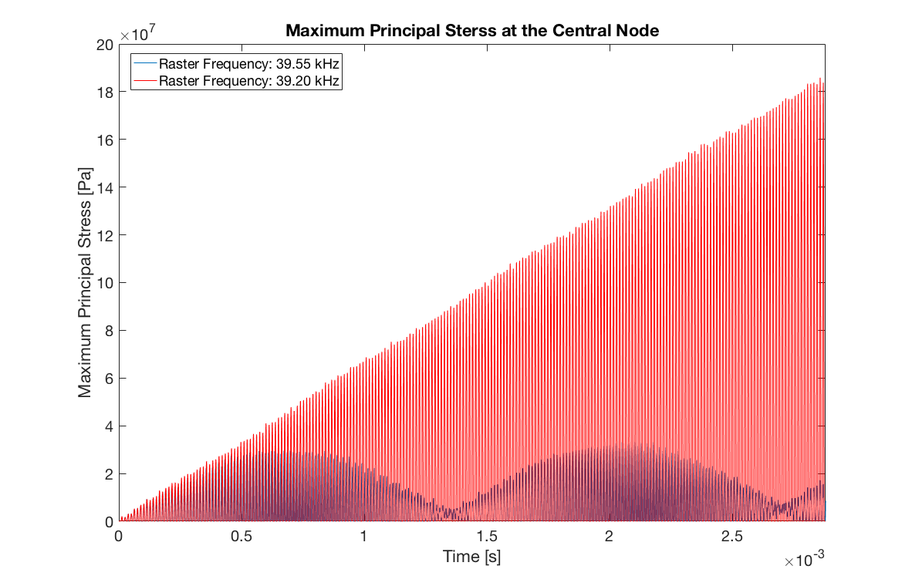
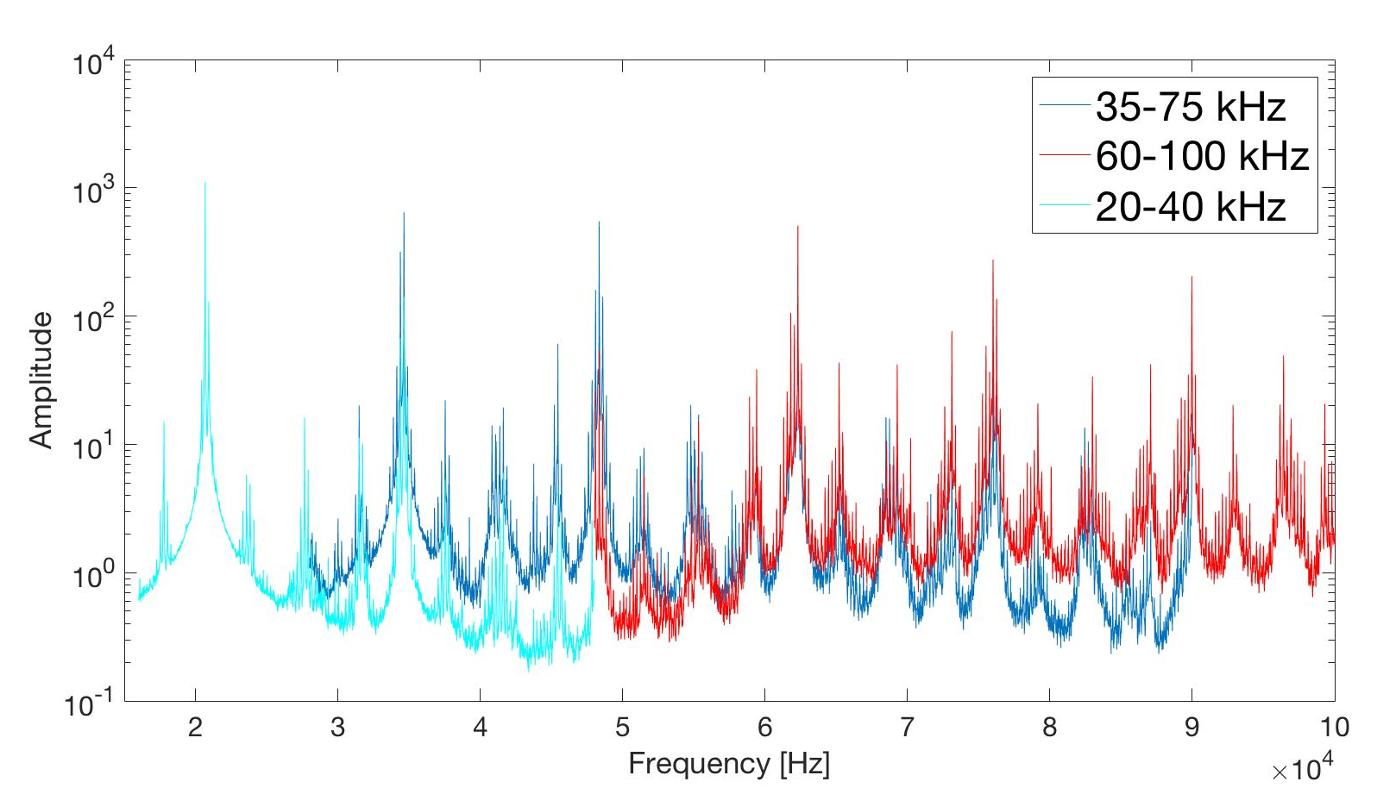
Raster Beam and Tungsten Interaction
Prospect for 2019
Risk of coherency between the raster frequency and resonance mode of tungsten brick is identified.
Mechanical resonance test are performed for different temperatures and data analysis is in progress.
Decisions on MPS parameters for beam on target condition are in progress.
Measurement performed by Henk Nolles, UKAEA

Slide 17
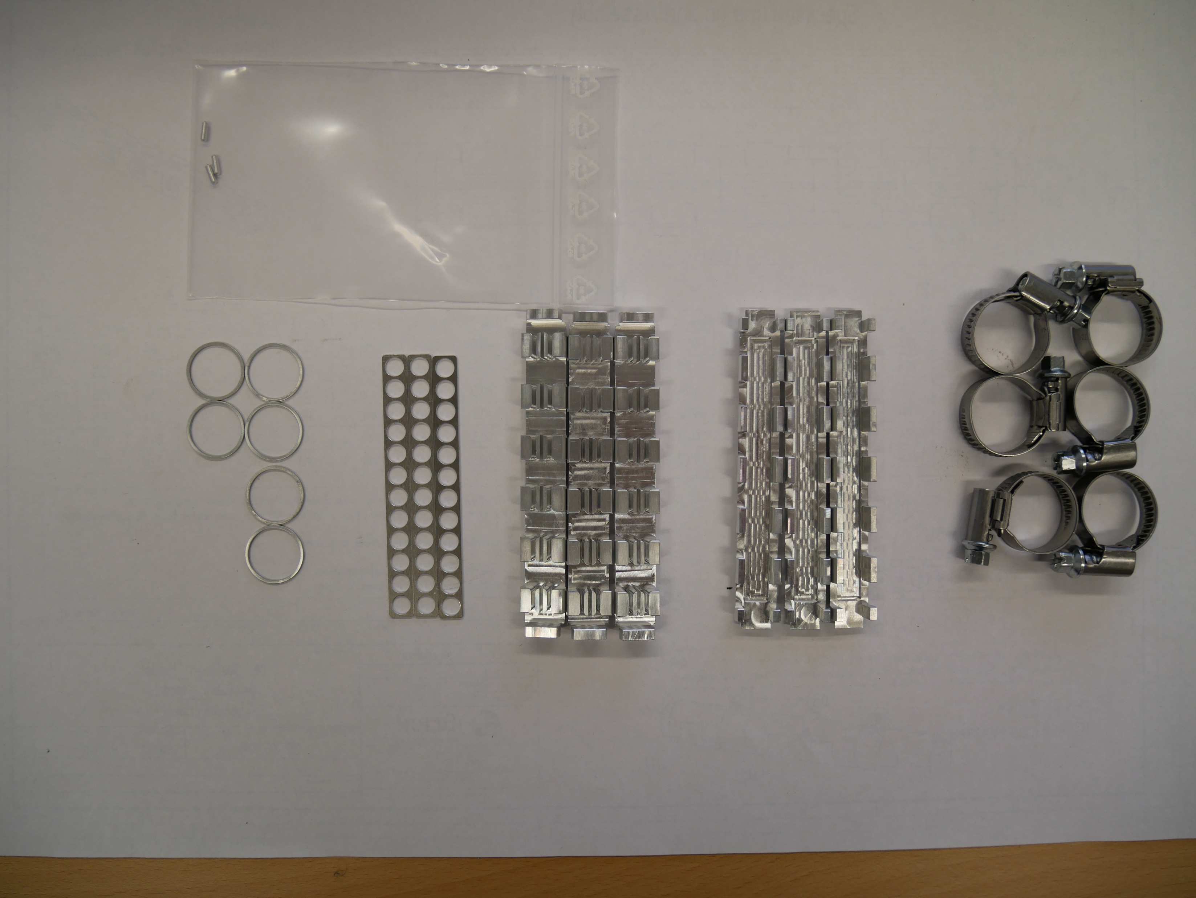
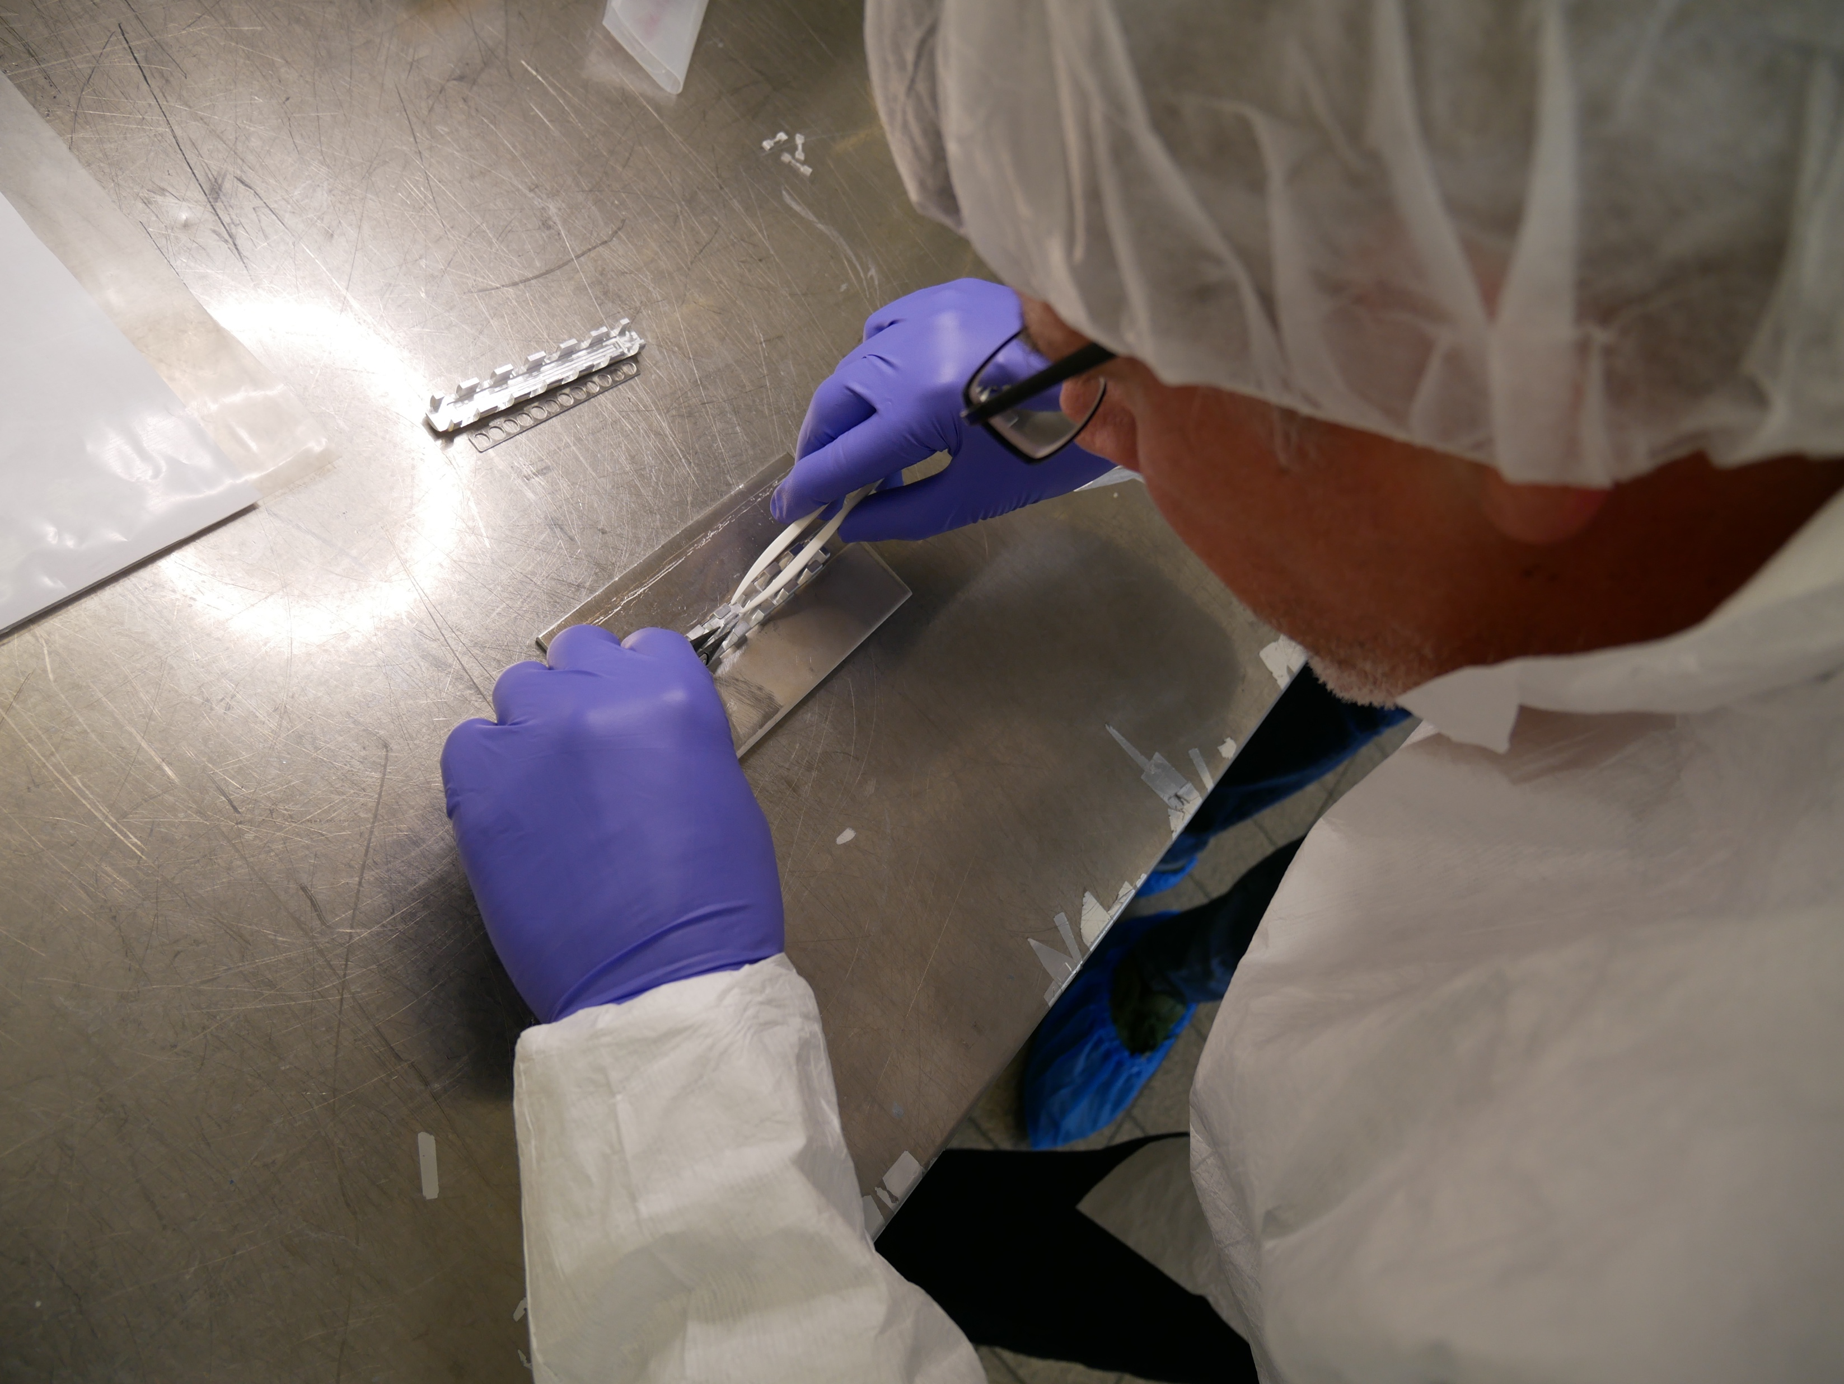
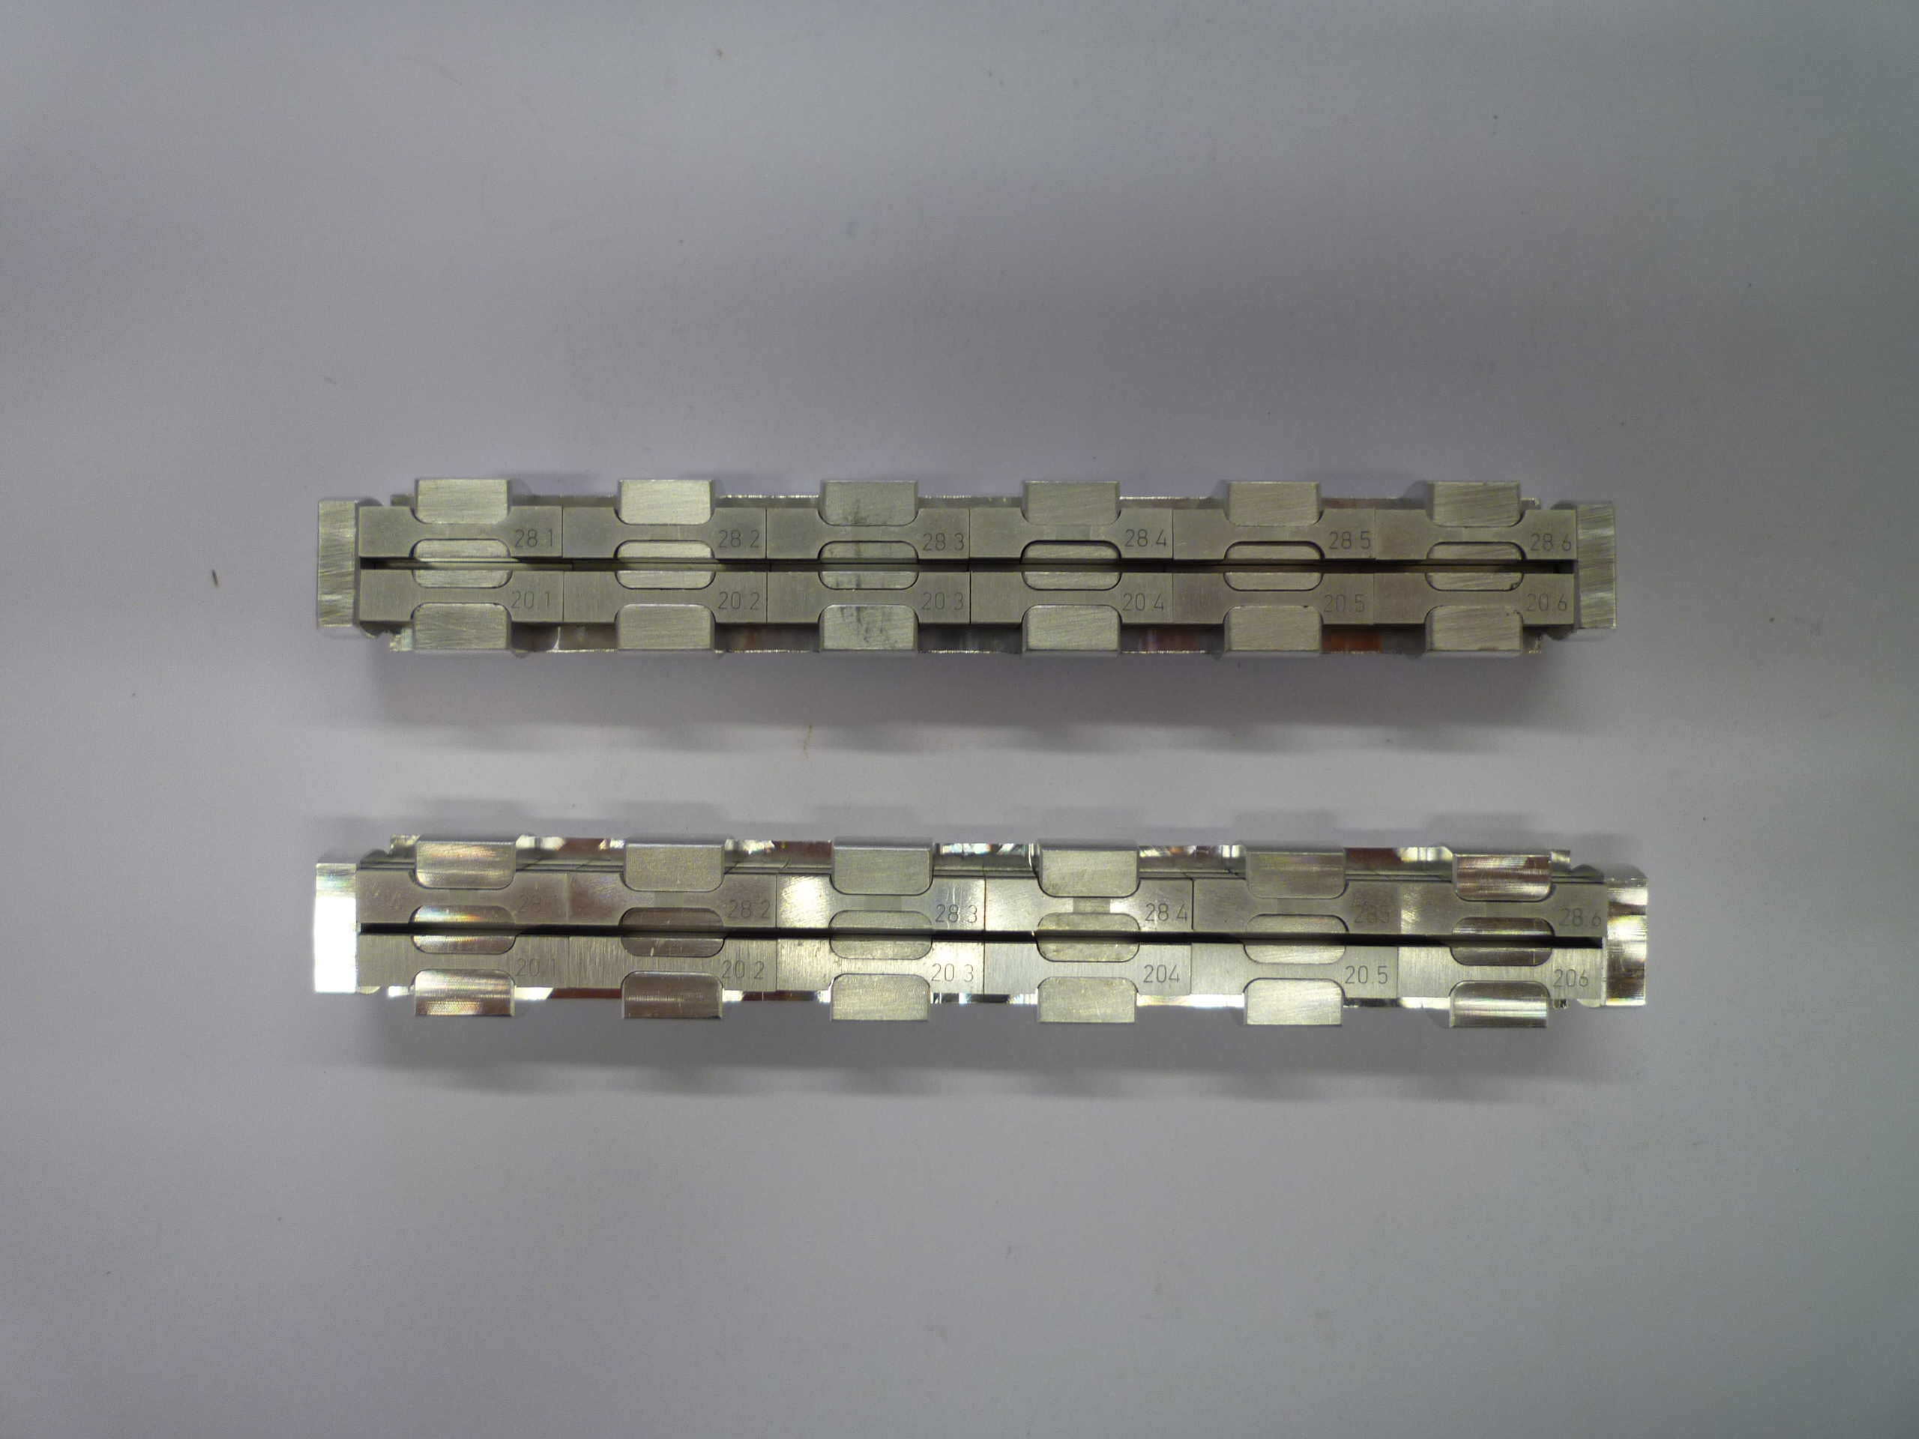
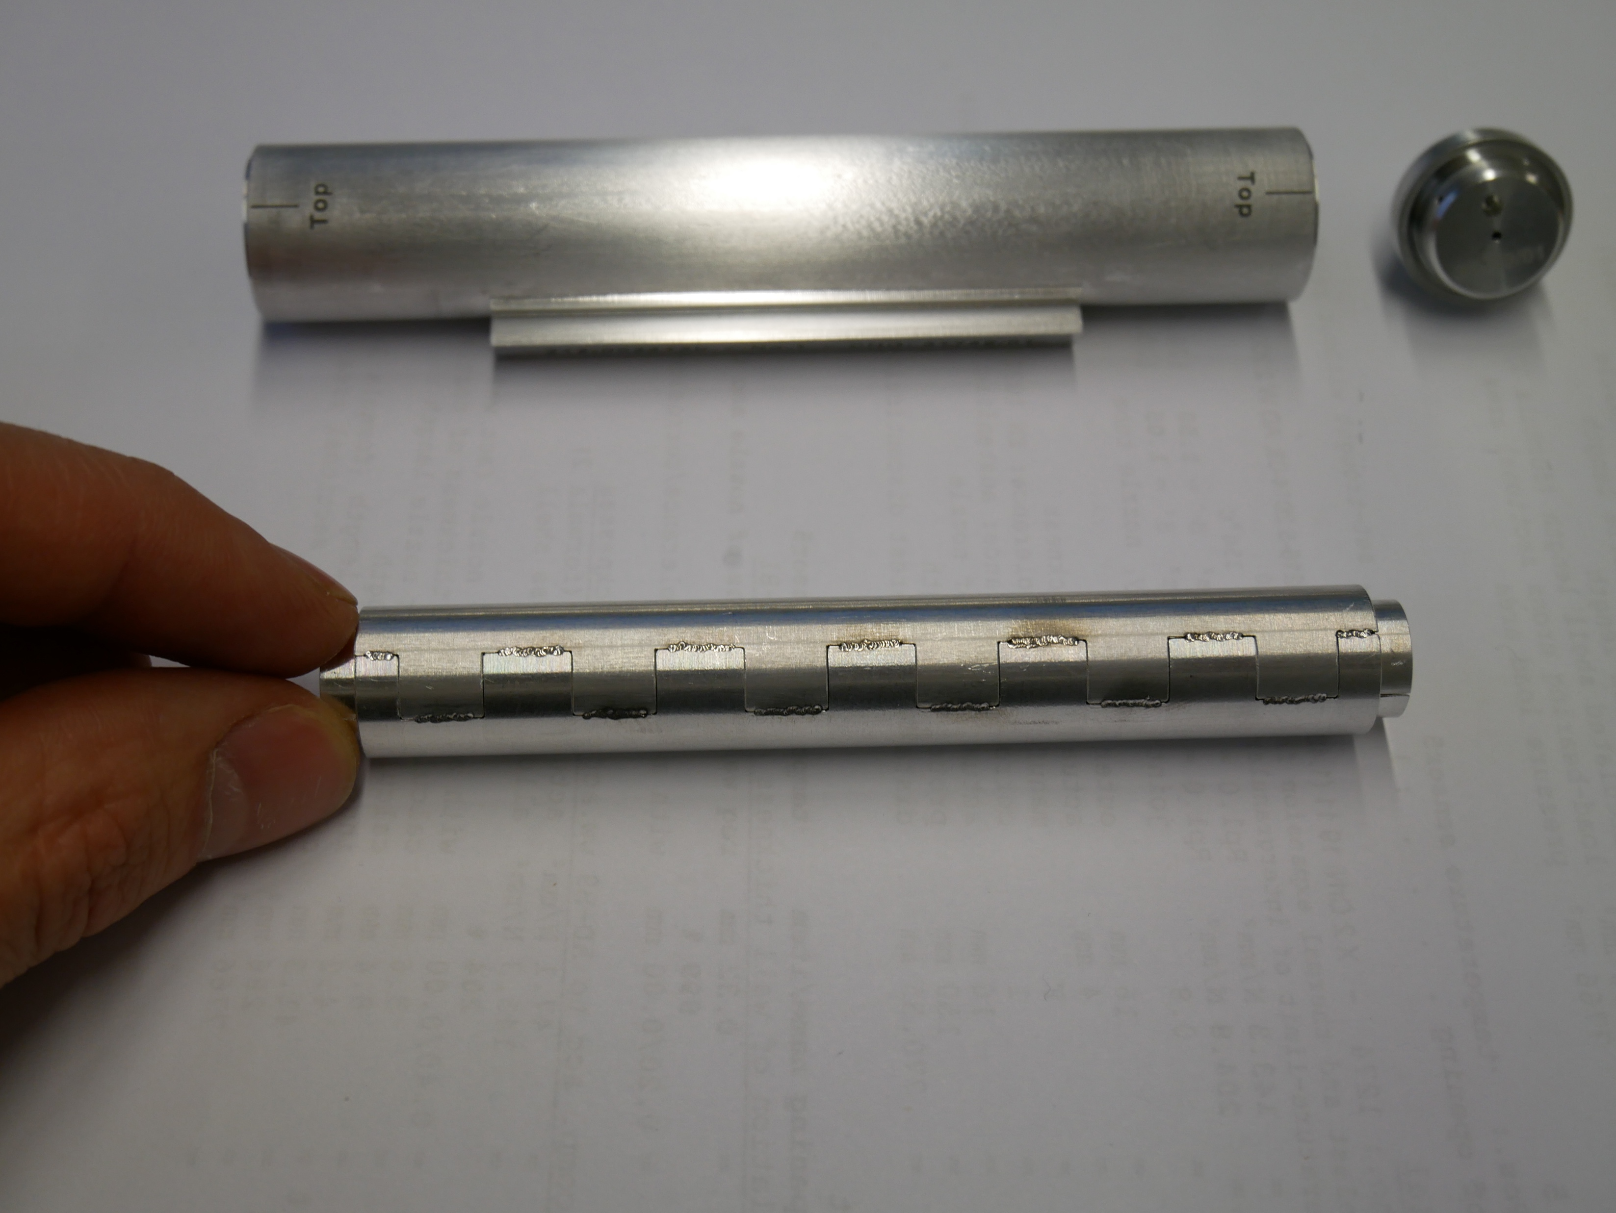
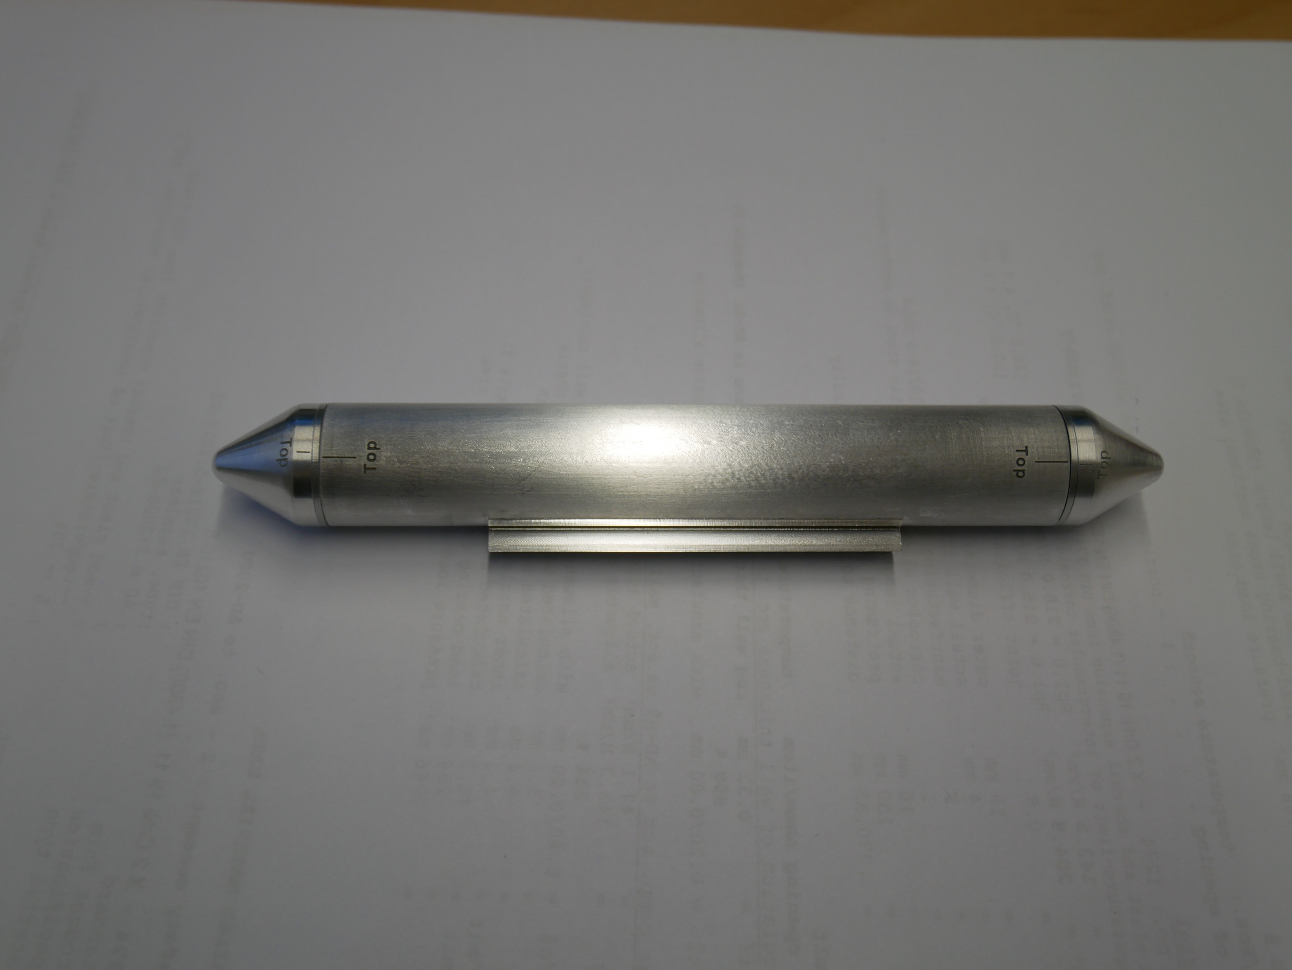
Future Project
Irradiation Module

Slide 18
Future Projects
Feasibility Studies for Exploring Opportunities for Research Grant
Parasitic production of medical isotopes
  Conceptual Design Study
  Operational Model Study
  Identification and Teaming-Up of Potential Stakeholders
Muon radiography of target internal structure
  Cosmic-ray muons for 3D imaging of target internal structure in beam-off condition
  Spallation muons for 2D imaging of target internal structure in beam-on condition
G. Yang et al. / Philosophical Transactions of the
Royal Society A, 377(2137), Dec 2018

Slide 19
Summary
ESS Project is actively progressing with focus on installation, integration and commissioning
While actively serving for various subproject work packages, materials research at ESS begins to prepare its role for initial operation
Currently, main focus is to manage Materials Handbook towards its release planned in end 2021

Slide 20
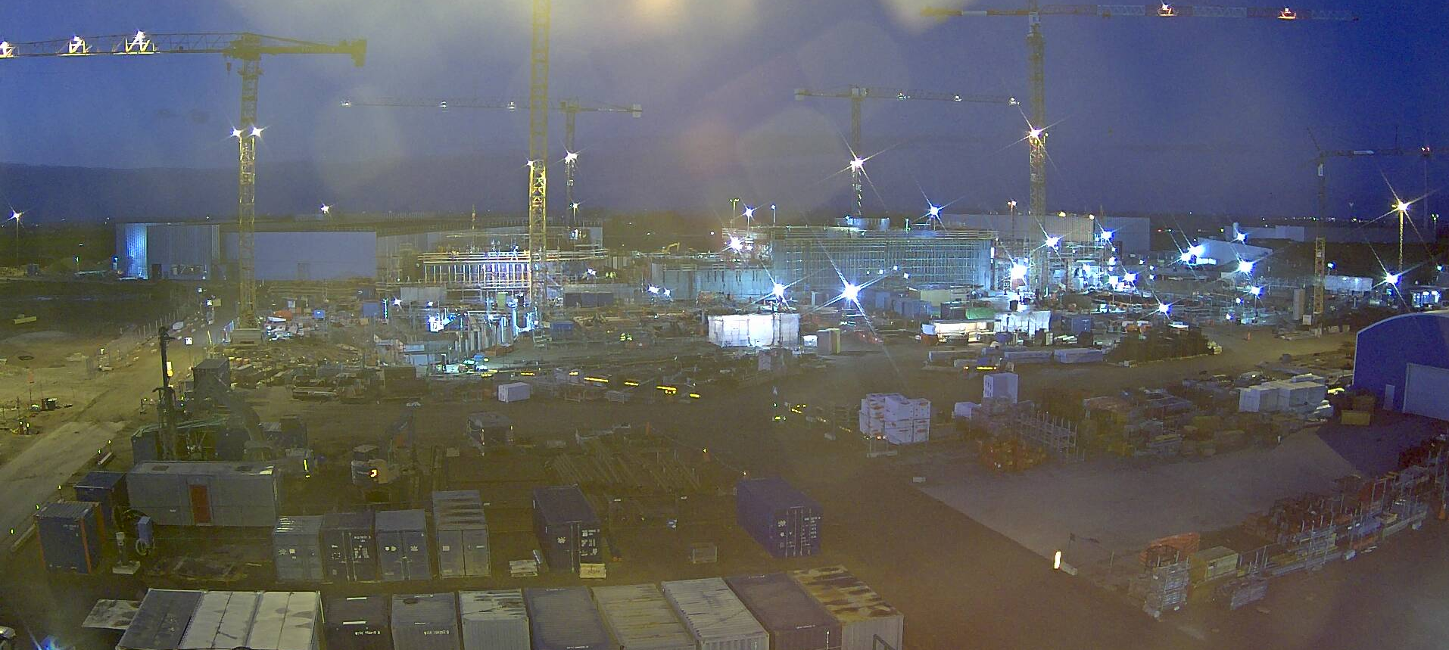
Thank You for Your Attention!

