Slide 1
Bubble Generation using a Micro-Orifice Nozzle in Liquid Cross-Flow
Charlotte Barbier
Volkan Yildirim
Elvis Dominguez-Ontiveros
10/16/2019
ICANS 2019

Slide 2
Introduction
The Spallation Neutron Source (SNS) at ORNL uses a liquid mercury target
Due to the short proton beam pulse, heat is deposited rapidly in the liquid mercury, resulting in strong pressure wave due to rapid thermal expansion.
These pressure waves cause high stresses and cavitation damage. To mitigate them, SNS has been injecting small Helium bubbles in the target.
Although satisfying results were observed, more mitigation is desired to increase target reliability.

Slide 3
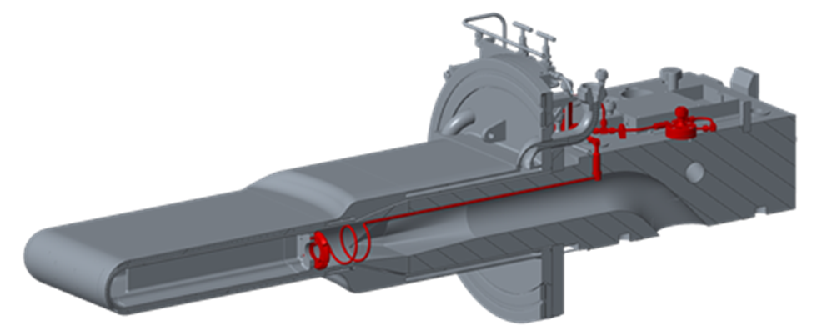
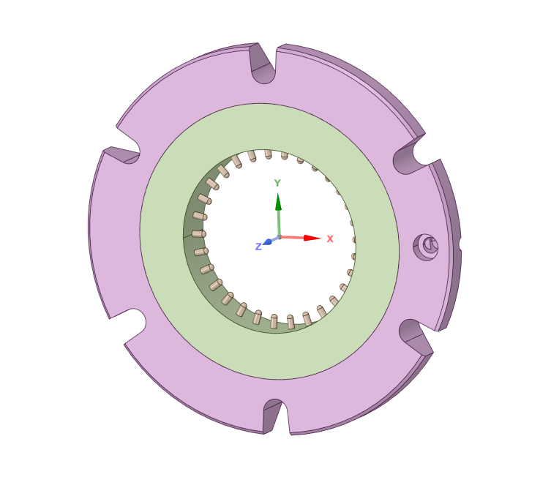
Gas Injection at SNS: Inlet Orifice Bubbler (IOB)
Proton beam
1/16” diameter nozzle
mercury flowing at ~100GPM
1.8” diameter
IOB
The orifices work under “choked flow” conditions. Gas flow rate is constant when gas reaches sonic velocity going through the outlet orifice.
operating at 100 psig
1/8” length

Slide 4
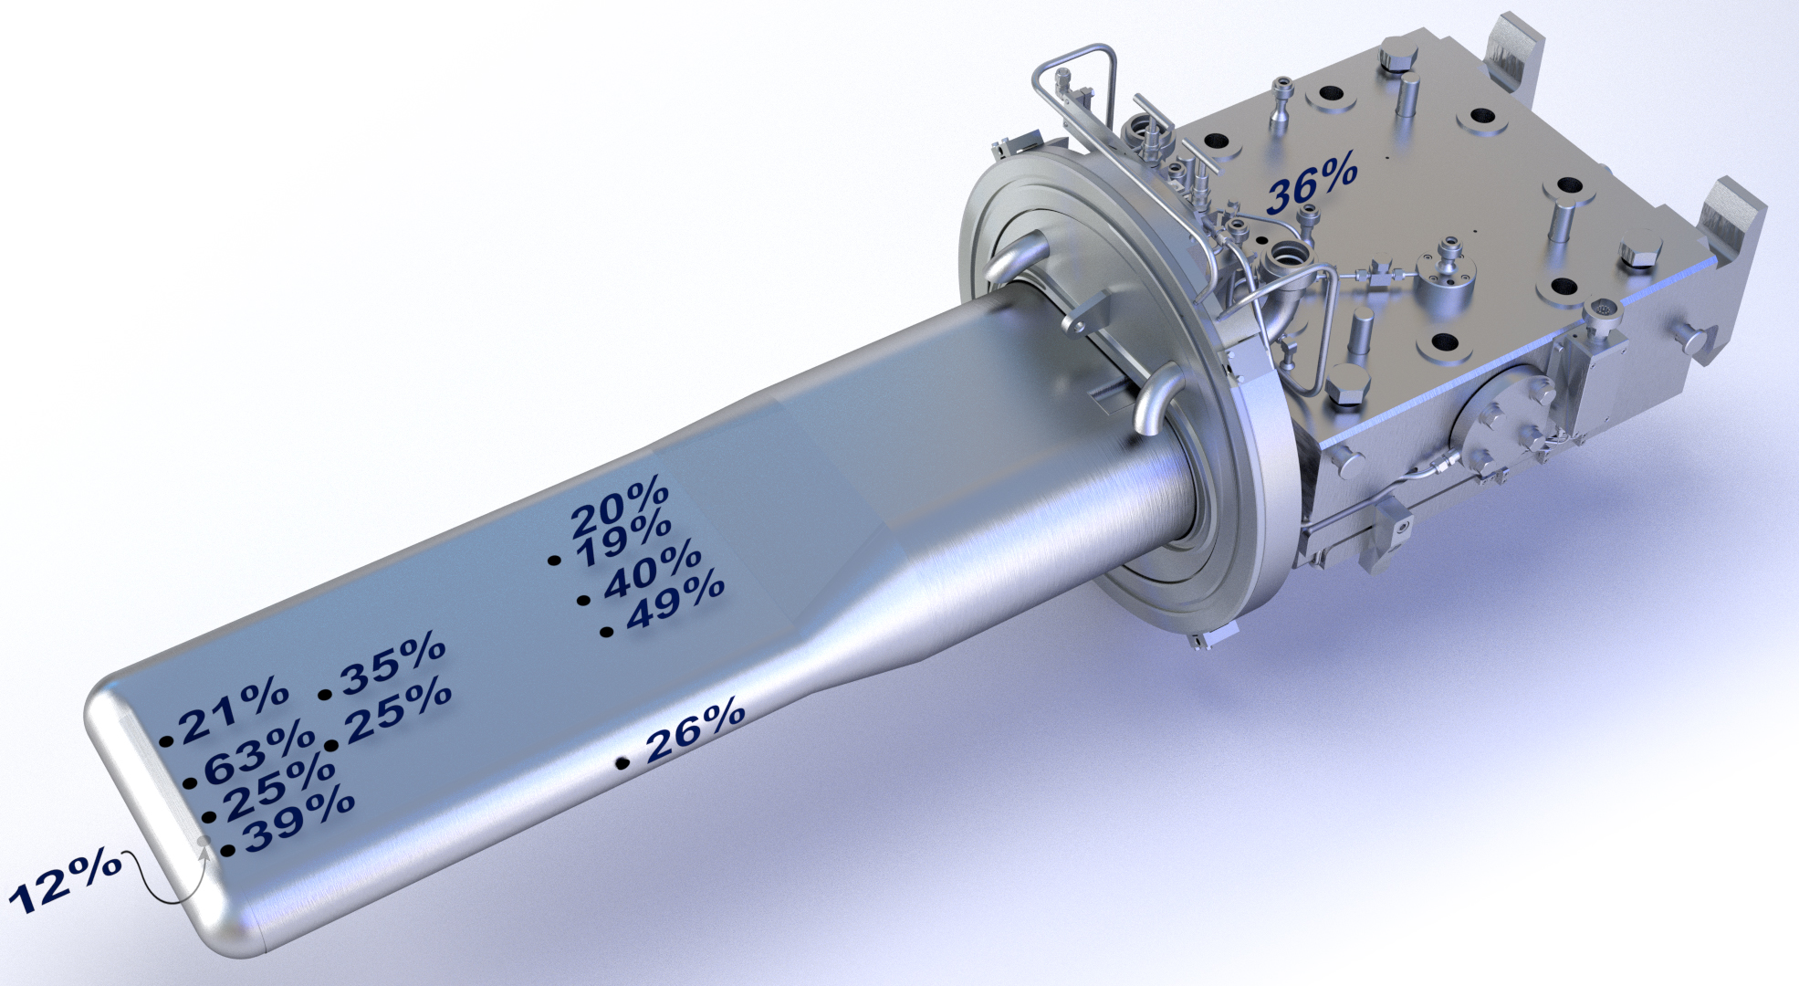
Strain Reduction
Strain reduction across the target vessel was observed even at low gas flow rate injection (~0.5 SLPM)
% strain reduction caused by gas injection
Courtesy of W. Blockland/Y. Liu/D.Winder

Slide 5
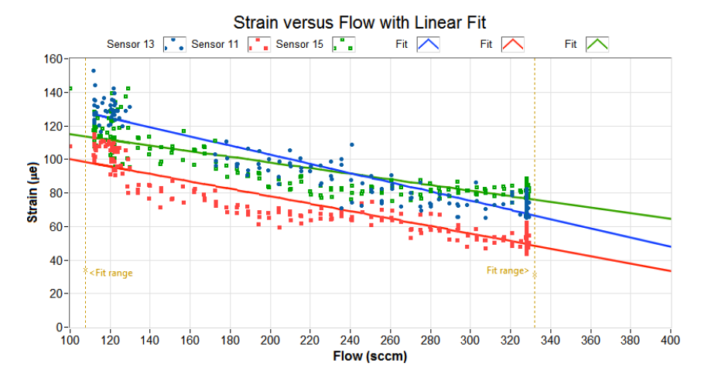
More gas seems to lead to less strain!
Courtesy of W. Blockland/Y. Liu/D.Winder

Slide 6
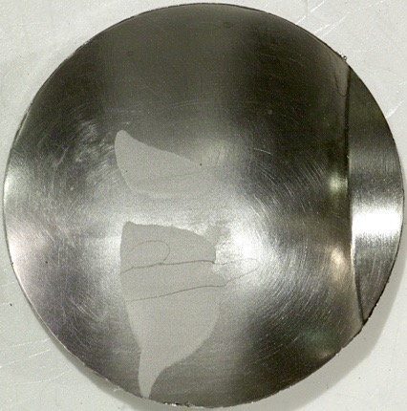
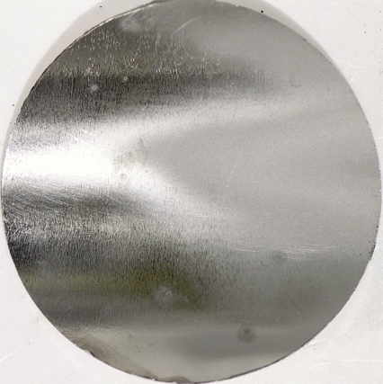
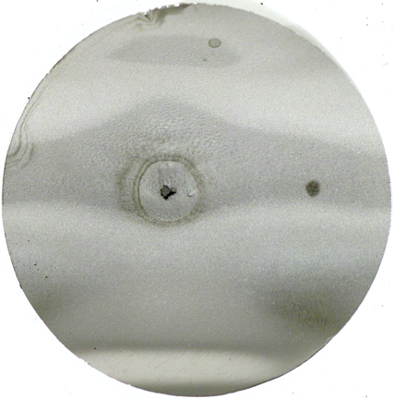
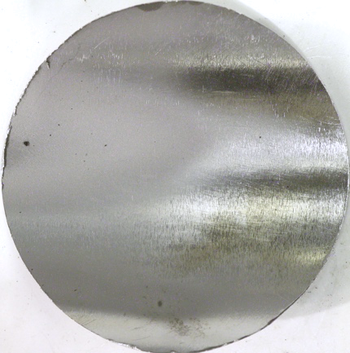
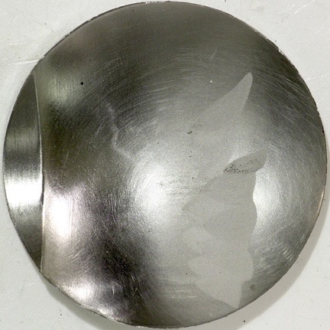
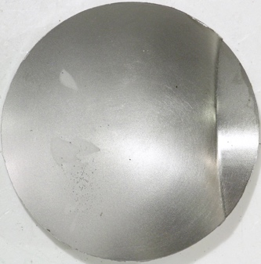
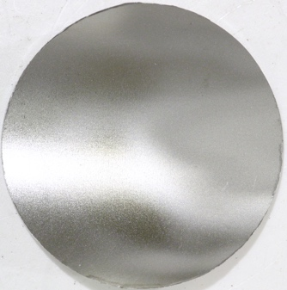
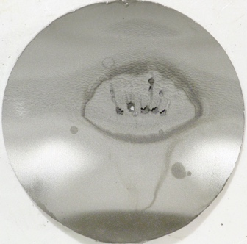
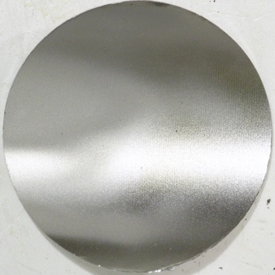
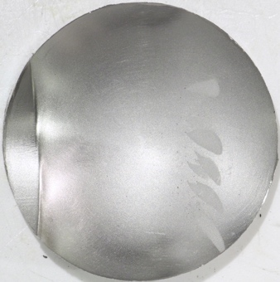
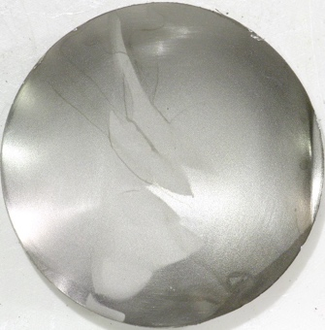
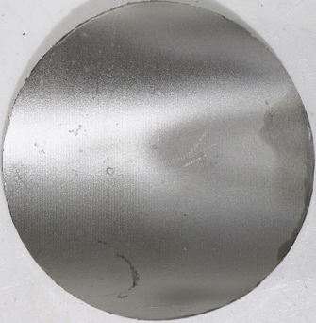
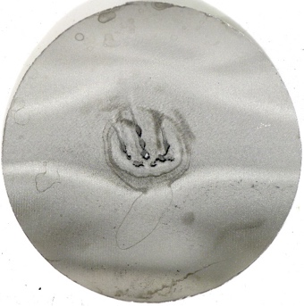
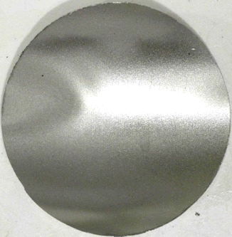
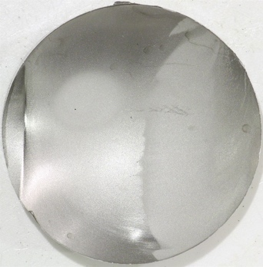
More gas less cavitation damage!
Target 20 – Inner Wall
(Jet-flow design)
Q_{avg} = 0.57 SLPM
P_{avg} = 1287 kW
E_{total} = 2231 MW-hr
Target 19 – Inner Wall
(Jet-flow design)
Q_{avg} = 0.45 SLPM
P_{avg} = 1187 kW
E_{total} = 1987 MW-hr
Target 18 – Inner Wall
(Jet-flow design)
Q_{avg} = 0.31 SLPM
P_{avg} = 1121 kW
E_{total} = 1260MW-hr
Courtesy of D. McClintock

Slide 7
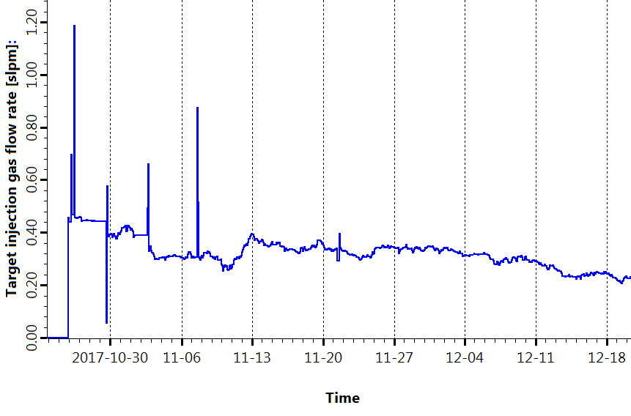
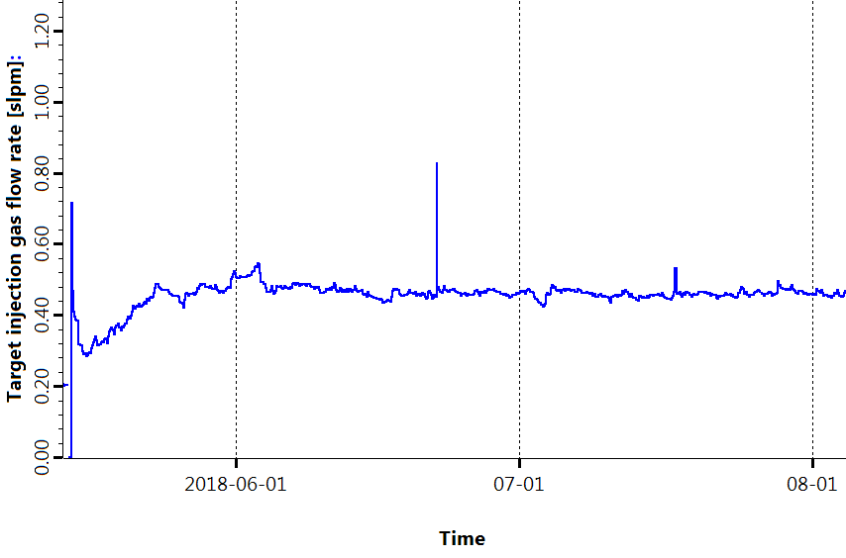
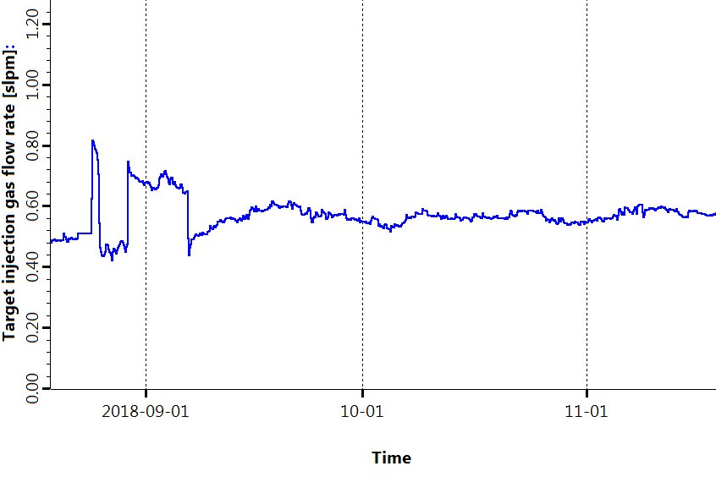
IOB headaches: Fabrication and Operation Issues
Fabrication challenges
nozzles get clogged during welding process
labor intensive (60 small nozzles to weld)
Unable to achieve design flow rates
Performance degradation
Flow rate decreases during operation
OE limit
T18
0.45 SLPM
0.25 SLPM
OE limit
OE limit
0.71 SLPM
0.8 SLPM
0.45 SLPM
0.6 SLPM

Slide 8
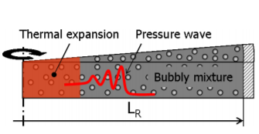
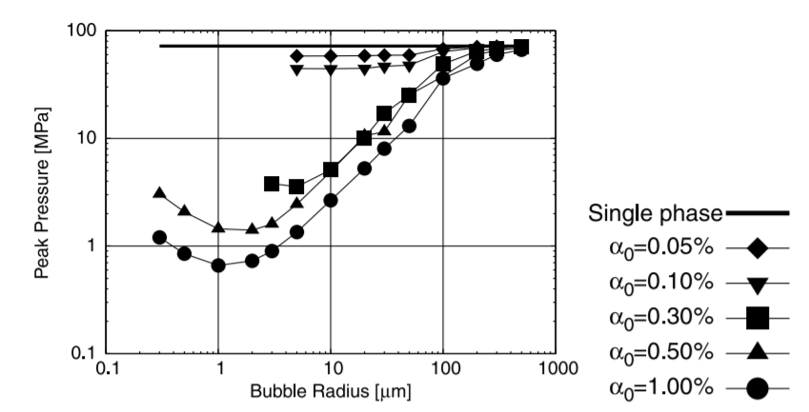
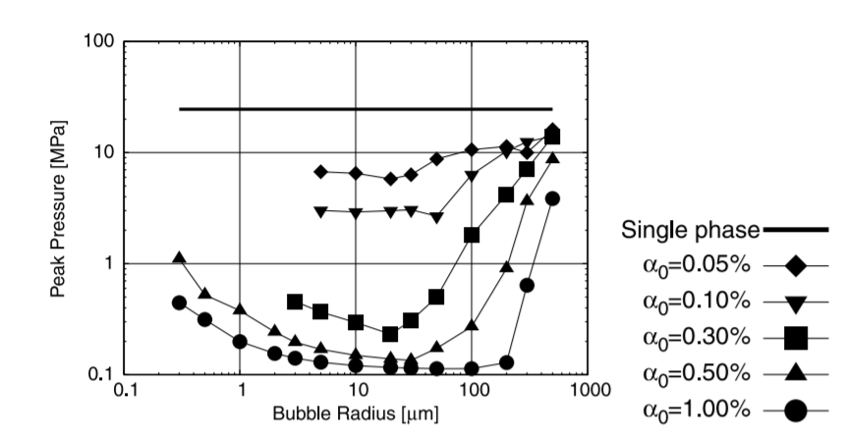
Pressure Wave Mitigation Theory
SNS: VF<0.05%
At the center
=30mm
1D simulation in a cylinder, monodisperse population, no bubble-bubble interaction
Peak pressure decrease is a function of:
bubble size
void fraction (total number of bubbles)
At the wall ➔ VF matters the most
1% VF with 300 μm diam bubble: 25 MPa ➔ 0.6 Mpa
0.05% with 40 μm diam bubbles: 25 Mpa➔ 6 Mpa
Higher pressure wave mitigation when the wave propagates through a liquid-bubble mixture.
At the wall
Okita, K., Takagi, S. and Matsumoto, Y., 2008. Propagation of pressure waves, caused by a thermal shock, in liquid metals containing gas bubbles. Journal of Fluid Science and Technology, 3(1), pp.116-128.

Slide 9
Next IOB Generation at SNS
Use larger orifices and operate them at lower pressure:
flow is still under choked conditions
if orifices get clogged, pressure can be increased to maintain constant mass flow rate
How increasing the orifice size impact the bubble size?

Slide 10
Experimental Setup
0.5 μm filter
Helium
mass flowmeter
water
10-30 GPM
Acrylic section with flat outside surface to avoid optical distortion
Inner diameter of test section = 2”
Nozzle: 1/16” tubing with orifice diameter of 8 to 18 micron diameter.
Water flow rate: 10 to 30 GPM
High Speed Movies (4k fps) with telecentric lens:
18.0 μm/px
GPM | V_{ave} (m/s) | Re
10 | 0.31 | 1.6E+04
20 | 0.62 | 3.2E+04
30 | 0.93 | 4.7E+04

Slide 11
Example of Videos
10 micron
P_{He} = 100 psig
Q_{H2O} = 30 GPM
18 micron
P_{He} = 100 psig
Q_{H2O} = 30 GPM

Slide 12
8 micron clogging
10 GPM, 40 psi
<d>=428 micron
Est. flow rate = 0.75 ccm
10 GPM, 40 psi (43 min later)
<d>=209 micron
Est. flow rate = 0.04 ccm
Expected flow rate = 6.4 sccm
The measured gas flow rate corresponds to the one expected from a 2. 8 micron diameter orifice

Slide 13
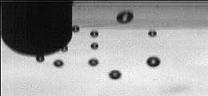
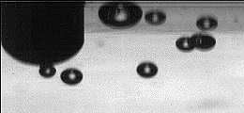
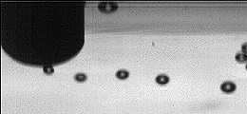
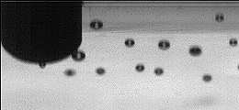
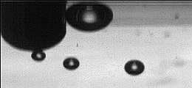
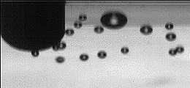
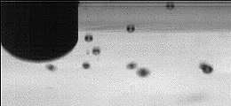
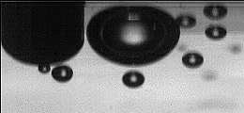
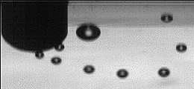
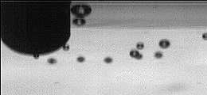
He pressure (psi)
40
60
80
100
“8 µm” [1.9 µm]
Water (GPM) | 10 | 20 | 30

Slide 14
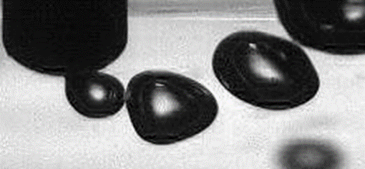
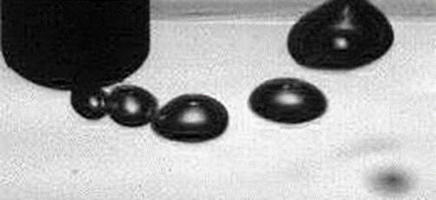
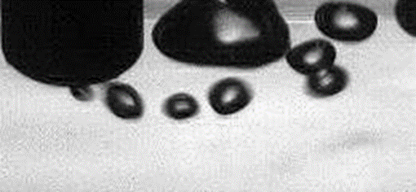
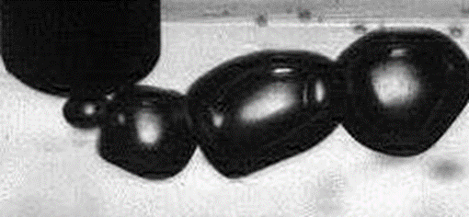
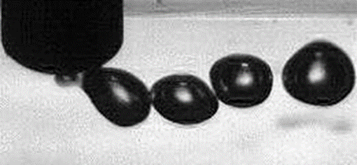
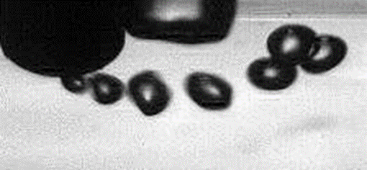
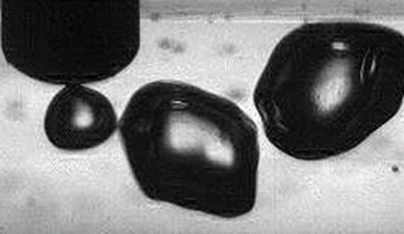
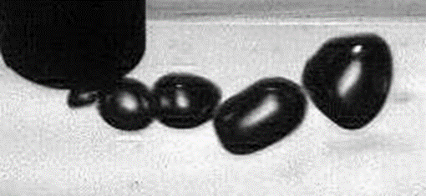
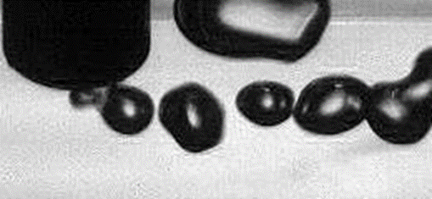
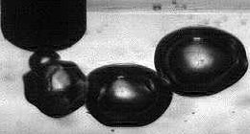
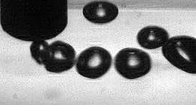
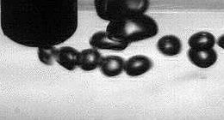
He pressure (psi)
40
60
80
100
“10 µm” [9.6 µm]
Water (GPM) | 10 | 20 | 30

Slide 15
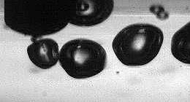
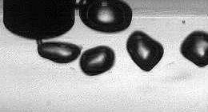
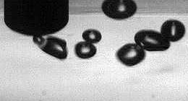
He pressure (psi)
40
60
80
100
“12 µm” [8.9 µm]
Water (GPM) | 10 | 20 | 30

Slide 16
He pressure (psi)
40
60
80
100
“16 µm” [10.7 µm]
Water (GPM) | 10 | 20 | 30

Slide 17
He pressure (psi)
40
60
80
100
“18 µm” [16.3 µm]
Water (GPM) | 10 | 20 | 30

Slide 18
Modes of Bubble Formation
Single bubbling:
very low gas injection rate
spherical bubble
Pulse bubbling:
Bubble are less spherical
Bubble formed from necking
Jetting:
bubble size independent of orifice size
Single bubbling
Pulse bubbling
Increasing gas injection
Jetting
Cavity formation
orifice flow rate
Forrester, S. E., and C. D. Rielly. "Bubble formation from cylindrical, flat and concave sections exposed to a strong liquid cross-flow." Chemical Engineering Science 53.8 (1998): 1517-1527.
liquid velocity

Slide 19
Higher gas injection flow rate generally lead to slightly larger bubbles
Increasing water velocity strongly reduced bubble size

Slide 20
Bubble Generation Frequency

Slide 21
Gathering all the data together:
100 GPM? Orifice diameter impact relatively low

Slide 22
CFD: All Experiments in Same Flow Regime
Power law velocity profile
Smooth surface no-slip walls
P=0
Perfect similarity: all the experiments are in the same flow regime.

Slide 23
Bubbles are mainly following streamlines+gravity

Slide 24
Scaling From Water to Mercury
 | Ratio Mercury/Water
Density | 13.6 (!)
Surface tension | 6.7
Dynamic viscosity | 1.7
Shear strain rate > 750 s⁻¹

Slide 25
Scaling From Water to Mercury
 | Ratio Mercury/Water
Density | 13.6 (!)
Surface tension | 6.7
Dynamic viscosity | 1.7
smaller diameter
Shear strain rate > 750 s⁻¹
Mirsandi, H., et al. "Bubble formation from an orifice in liquid cross-flow." Chemical Engineering Journal (2019).

Slide 26
Scaling From Water to Mercury
 | Ratio Mercury/Water
Density | 13.6 (!)
Surface tension | 6.7
Dynamic viscosity | 1.7
larger diameter but not too bad since high shear rate
Shear strain rate > 750 s⁻¹
Mirsandi, H., et al. "Bubble formation from an orifice in liquid cross-flow." Chemical Engineering Journal (2019).

Slide 27
Scaling From Water to Mercury
 | Ratio Mercury/Water
Density | 13.6 (!)
Surface tension | 6.7
Dynamic viscosity | 1.7
Small impact
Shear strain rate > 750 s⁻¹
Mirsandi, H., et al. "Bubble formation from an orifice in liquid cross-flow." Chemical Engineering Journal (2019).

Slide 28
Conclusions from the single orifice experiments in water
At high liquid flow rates (higher shear rate), the impact of the nozzle diameter is expected to be negligible.
Bubbles in mercury are expected to have smaller average diameters
higher density
higher turbulence

Slide 29
Experiments using Liquid Mercury
8 micron orifices
0.85 SLPM
18 micron orifices
2.8 SLPM
Comparison between 8 and 18 micron IOB: qualitative

Slide 30
Comparison between 8 and 18 micron IOB: quantitative
* the BSD was normalized such that the total number of bubble was 1000 for both measurement
8 micron IOB-Bubble Size Distribution (BSD) slightly more skewed towards smaller bubble diameter, but BSD are otherwise very similar.

Slide 31
Conclusions
Experiments demonstrate the same difficulties than experiments: small orifices clog easily!
At 100 GPM, the expected shear rate at the nozzle is large enough that the orifice size has a relatively mild impact on the bubble size.
Both 8 and 18 micron IOB demonstrated at TTF (mercury loop) their abilities to generate bubbles with diameters less than 300 μm.
As the orifices are clogging during operation, the bubble size distribution is also affected. Keeping the same bubble size distribution during the target lifetime is challenging with the IOB. ➔ SNS will switch to swirl bubbler for the PPU project.

