Slide 1
Target Segment Design Analysis for the STS Conceptual Design
T. McManamy, Min-Tsung Kao, I. Remec, M. Rennich, P. Rosenblad
Oak Ridge National Laboratory, Oak Ridge, TN, USA
ICANS XXIII
Chattanooga, Tn
Oct 14- 18, 2019

Slide 2
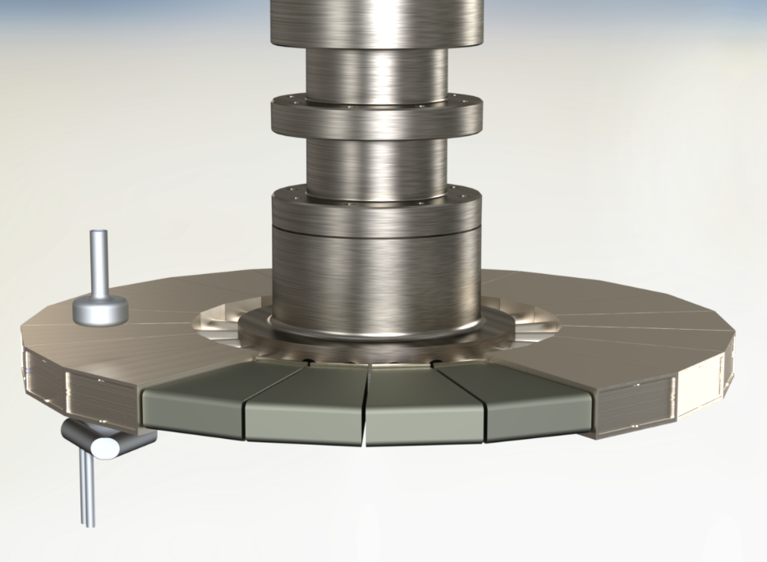
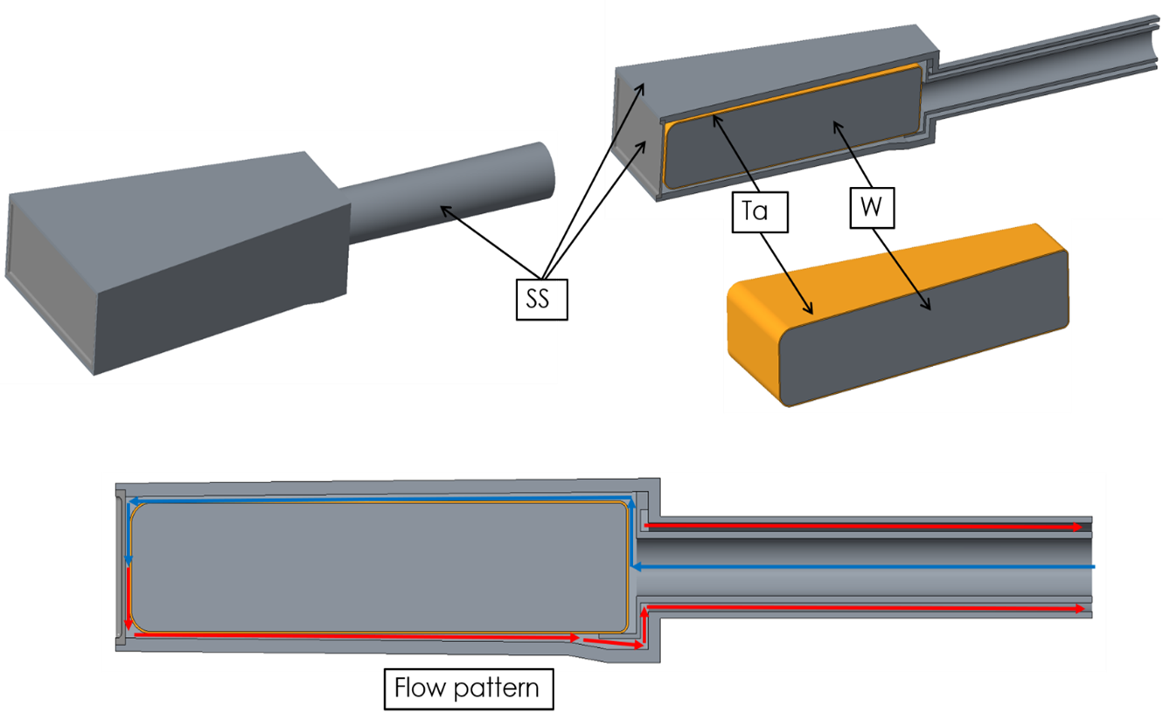

STS rotating target disk 2019
1 segment
Upper moderator
Lower moderator
21 separate segments
1.16m diameter
316L SS Outer Shroud
Tungsten block target
1mm Tantalum Clad all tungsten surfaces
700 kW – 15 Hz Proton beam
Synchronous operation @ 42.9 RPM
Water cooled
Tungsten (W) height – 58 mm
Height with clad – 60 mm
Tungsten width at OD – 164 mm
Tungsten radial depth – 250 mm
H₂O flow per segment – 0.47 kg/s

Slide 3
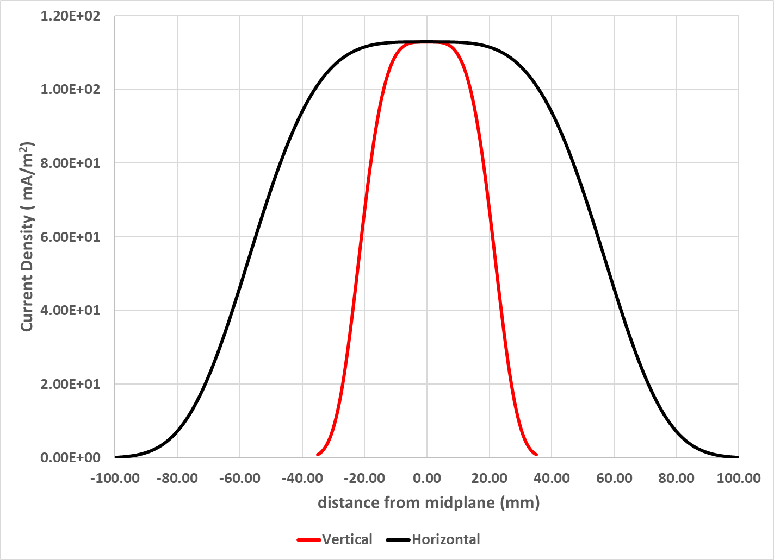
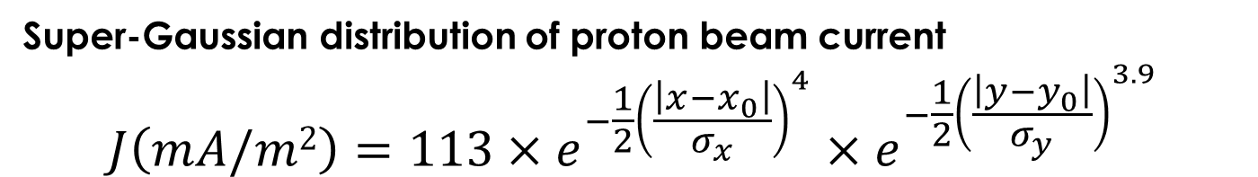
Nominal Proton Beam Profile for Initial Studies
Super-Gaussian distribution of proton beam current
$$J{\left(mA/m2\right)=113×e}^{−\frac{1}{2}{\left(\frac{\left|x−x_{0}\right|}{σ_{x}}\right)}^{4}}×e^{−\frac{1}{2}{\left(\frac{\left|y−y_{0}\right|}{σ_{y}}\right)}^{3.9}}$$
σ_{x} | σ_{y} | Vert. Extent 95 % Beam | Horiz. Extent 95 % Beam | ~Area of 90 % Beam | Max. Heating
(mm) | (mm) | (mm) | (mm) | (cm²) | (J/cc/ pulse)
19.8 | 51.7 | 48 | 130 | 62.4 | 39.0

Slide 4
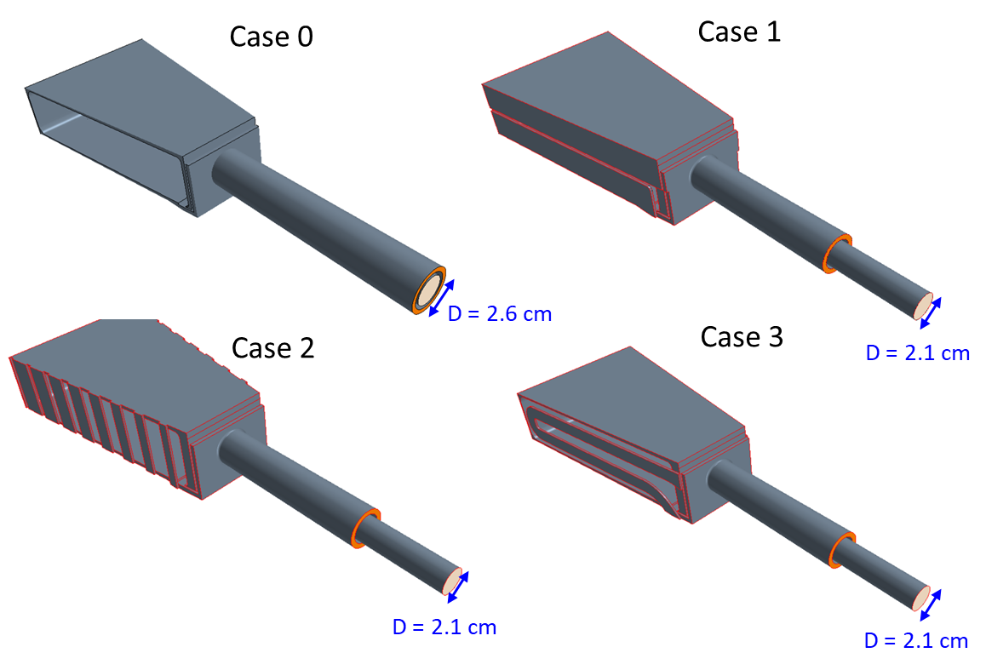
Initial CFD Evaluations with nominal beam
First CFD calculations looked at the basic flow scheme for cooling the tungsten block and 3 options for adding cooling for the Shroud side walls using STARCCM+ or COMSOL
Top and Bottom flow channels tapered from 4 mm at the rear to 2 mm at the front to give approximately constant 1 m/s flow over the surfaces
Case 0 – no side cooling
Case 1 - midplane flow separator
Case 2- Top to bottom side channels
Case 3 – Side curved flow channel 2mm x 15 mm

Slide 5
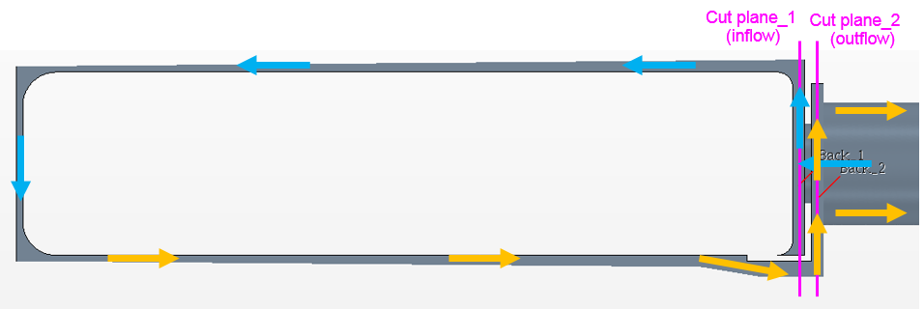
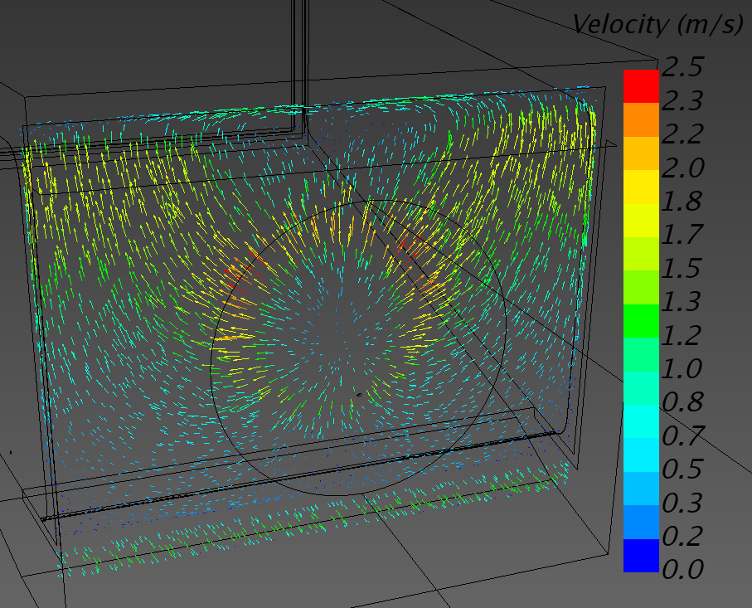
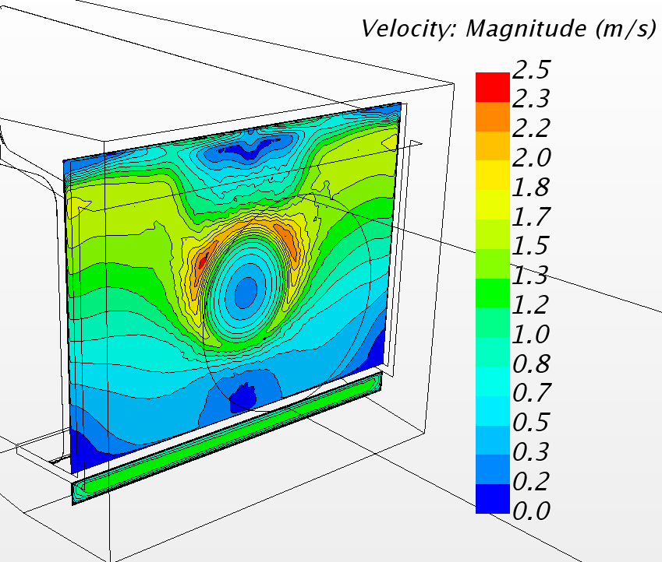
CFD Analysis example Case 0 - Velocity vectors
STARCCM+: Realizable k-epsilon
Velocity at inflow plane
outflow

Slide 6
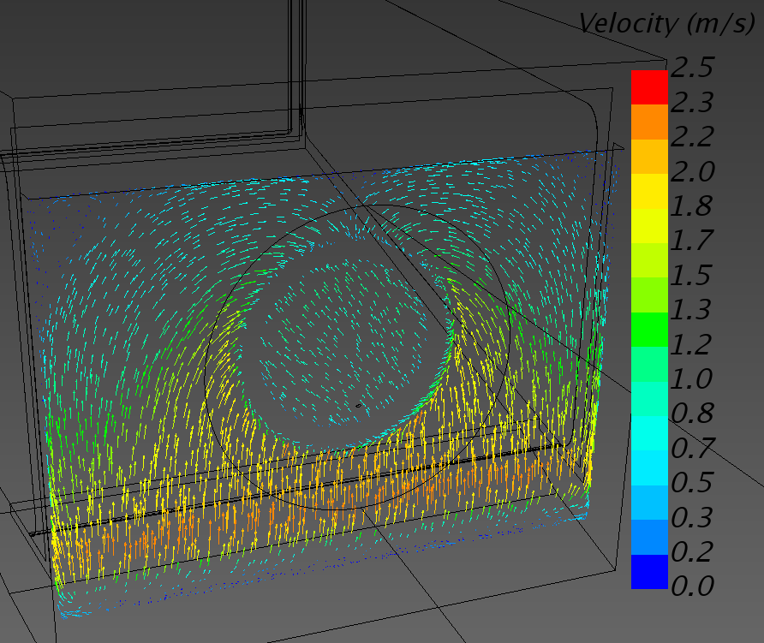
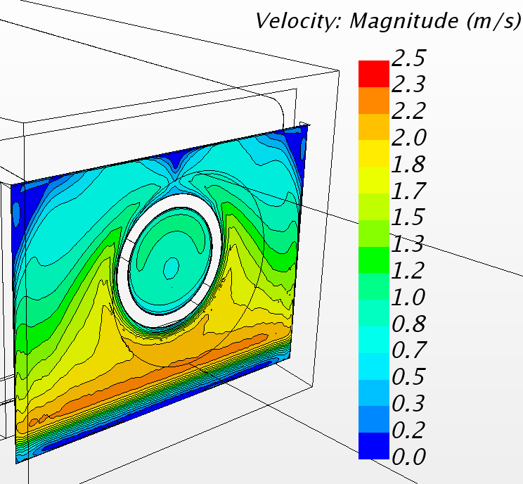
Case 0 – Velocity Vectors
STARCCM+: Realizable k-epsilon
Velocity at outflow plane

Slide 7
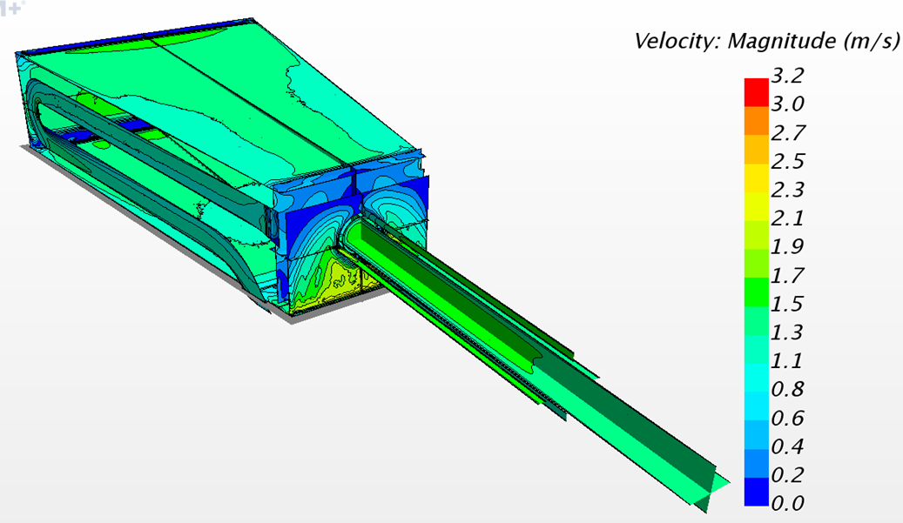
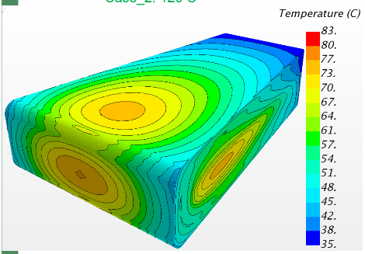
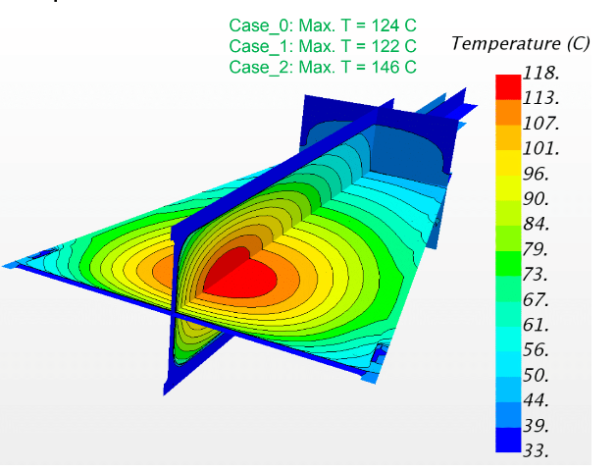
Initial results
Basic tungsten cooling with tapered top and bottom flow channels scheme looks viable
  Average velocities ~ 1.2 m/s top/front/bottom
  Pressure drop ~ 7kPa
Option 3 with a side cooling channel gave the best overall results with max SS temperature of 75 ºC
Ta surface 83 ºC max
W Max 118 ºC

Slide 8
Analysis Progression using Case 3 model
Accelerator Physics developed beam optics to produce a profile at the proton beam window which was a close match to the SuperGaussion function
This new profile was used to obtain energy deposition which included heating from the two nearest segments which added approximately 10% to the heating from a single pulse
Cases were analyzed which included offset beams, over focused and diffuse conditions
Cases with tungsten unirradiated and irradiated material properties were included

Slide 9
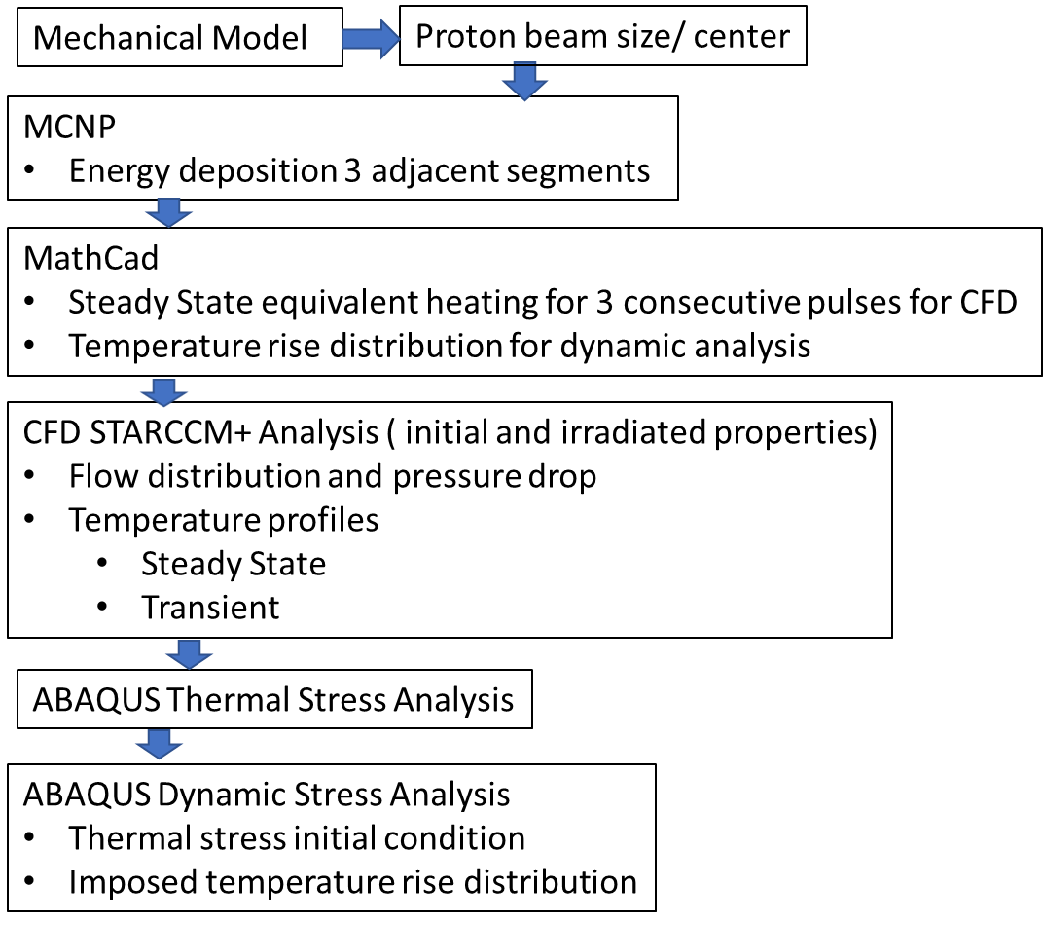
Analysis Sequence
Case 3 was evaluated for a variety of beam parameters, offsets and some by-pass flow conditions

Slide 10
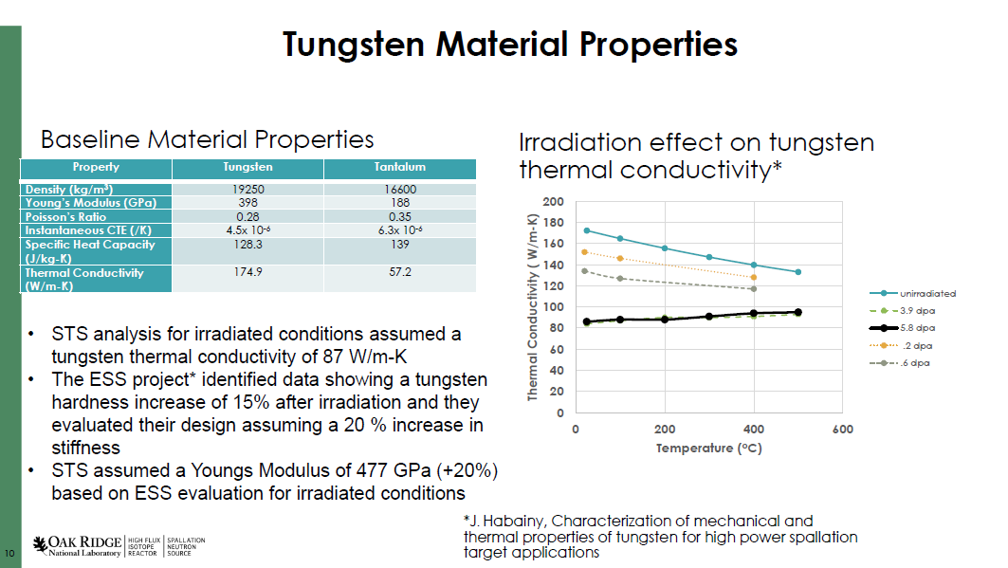

Slide 11
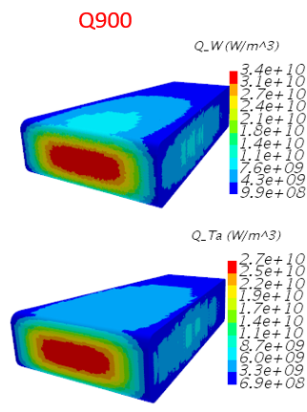
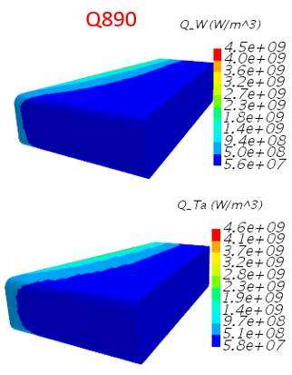
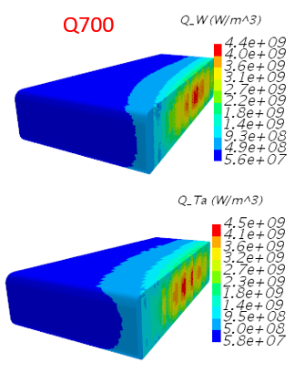
Energy deposition on “center” block from 3 consecutive pulses
Tungsten :
Tantalum:
Pulse hits the right block
then hits the center block
then hits the left block
t = 0 s
t = 1/15 s
= 0.066667 s
t = 2/15 s
= 0.1333 s
This sequence then repeats in 1.4 seconds

Slide 12
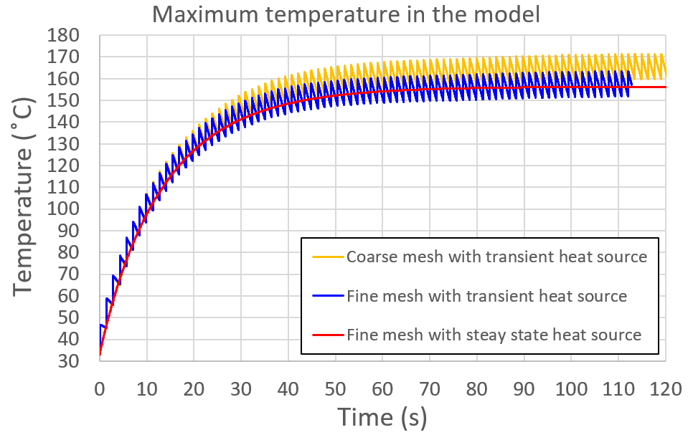
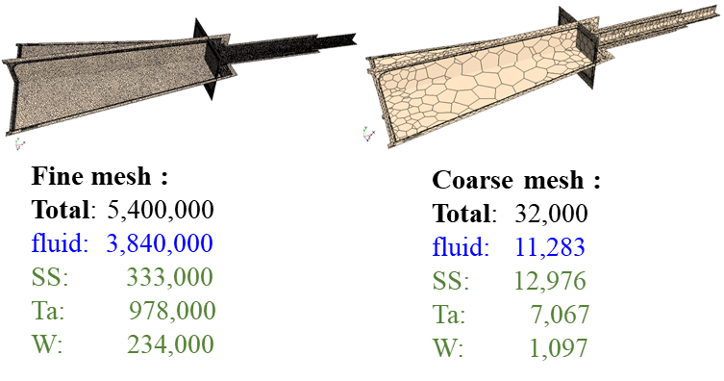
Peak Temperature vs Time ( irradiated properties)
Transient heat source models all pulses
Steady State heat source sums energy depositions from 3 pulses and averages over 1.4 s

Slide 13
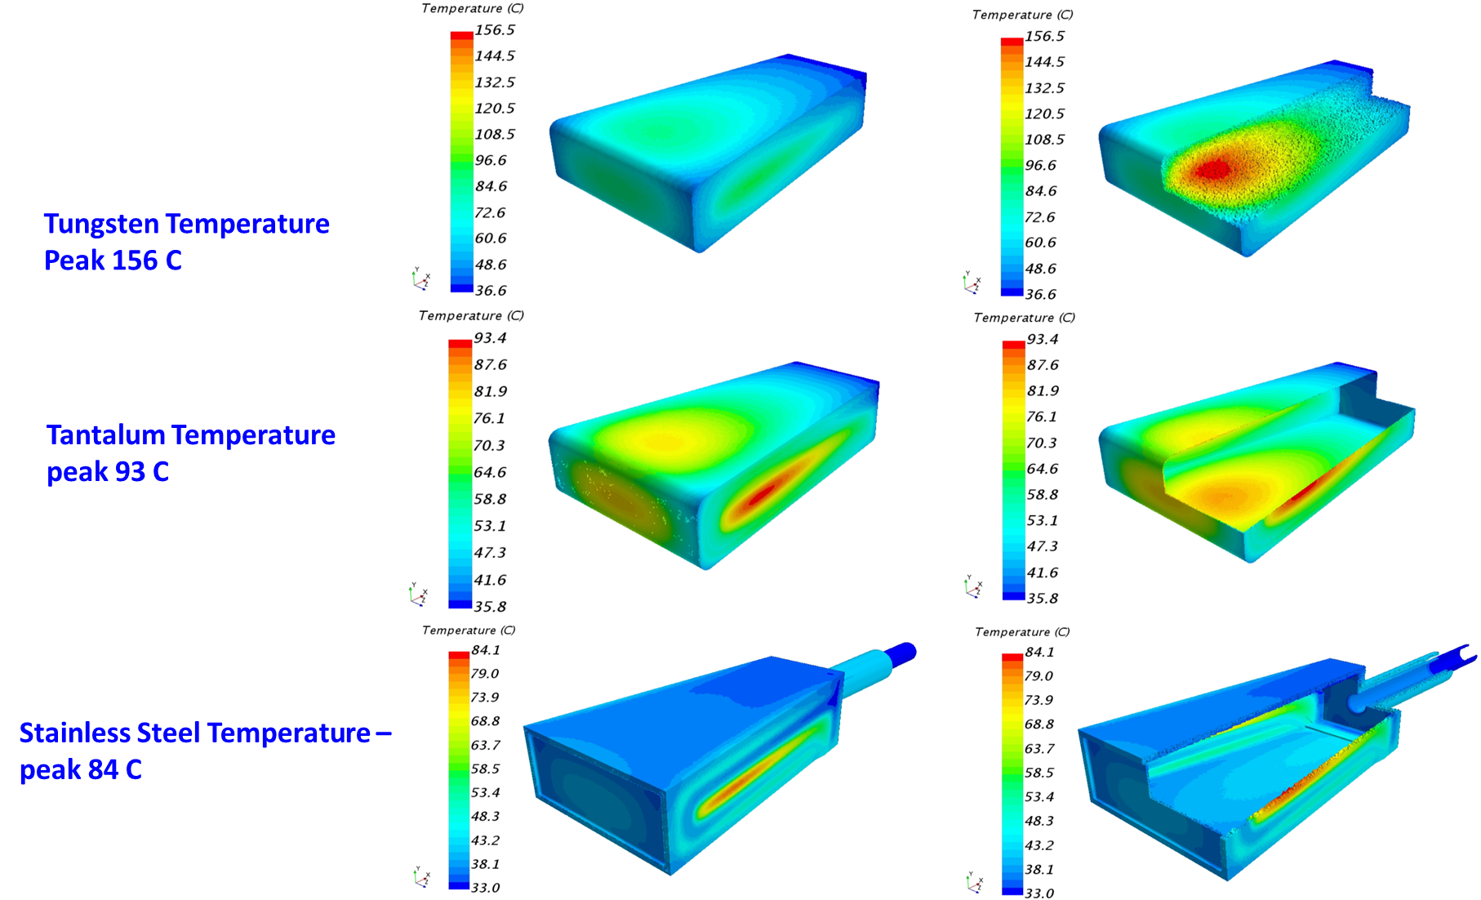
Centered Beam – Steady State Heating, Irradiated
.

Slide 14
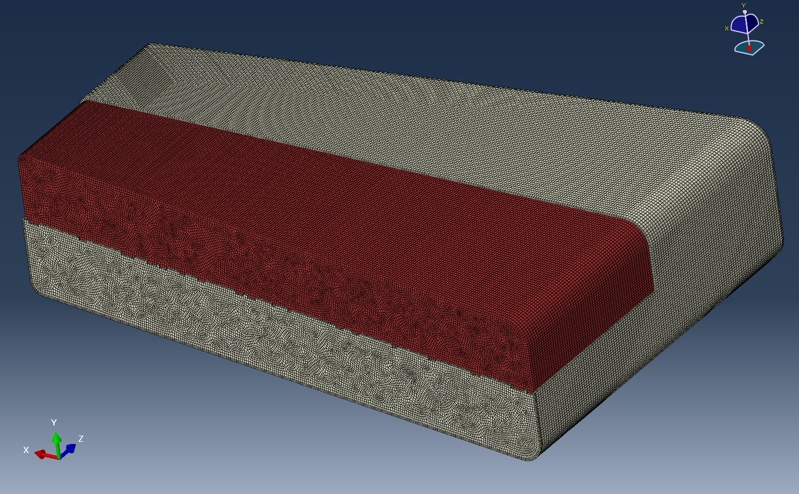
Abaqus Model
Parameters
Tantalum clad and tungsten mesh
2,234,115 C3D8R linear elements
Nominal global mesh size 1 mm
Full target model to allow for offset beams and water bulk temperature rise
Abaqus standard thermal stress analysis
  CFD temperature distributions mapped to mesh
Abaqus explicit dynamic analysis with same mesh as thermal stress model
  Thermal stress results imported from odb (output data base) file as initial condition

Slide 15
Centered beam case – Irradiated Material condition- Thermal Stress
Mapped Temperatures – peak 156.4 C
Initial Von Mises Stress – 135.1 MPa peak

Slide 16
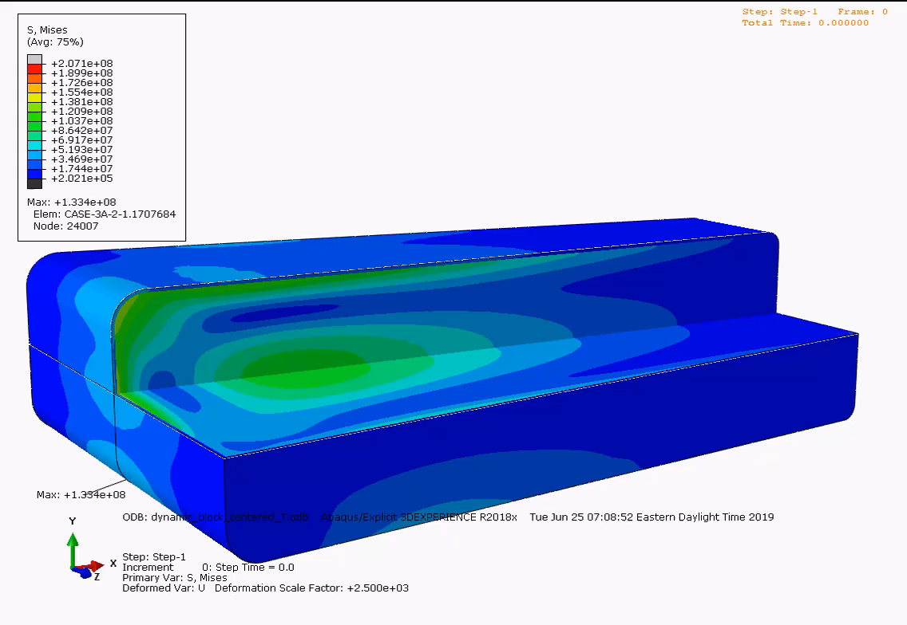
Centered Beam Case – Dynamic Response
Temperature distribution ramped over 10⁻⁶ seconds – 14.3 ºC max
Von Mises Stress and displacements over 10⁻⁴ s

Slide 17
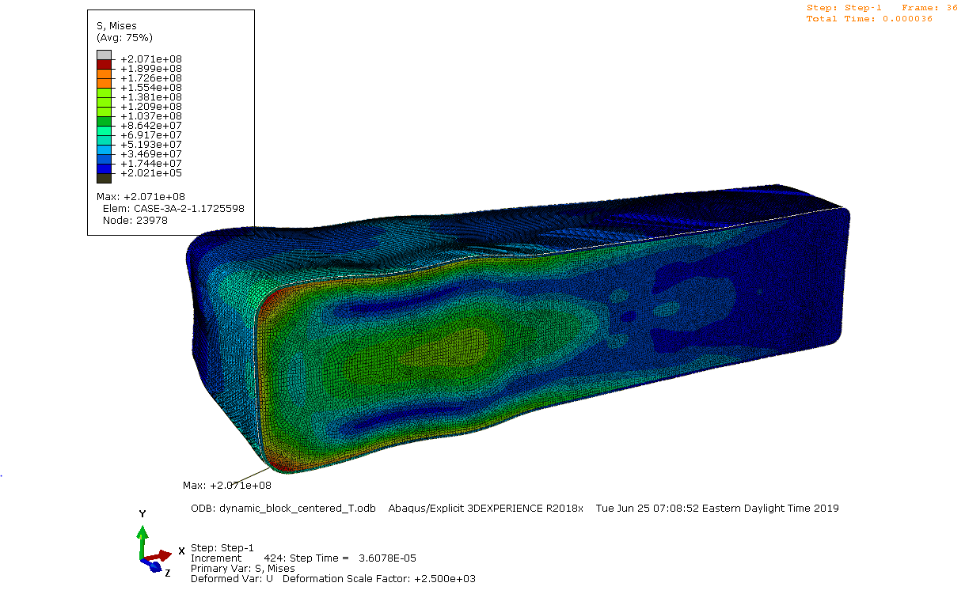
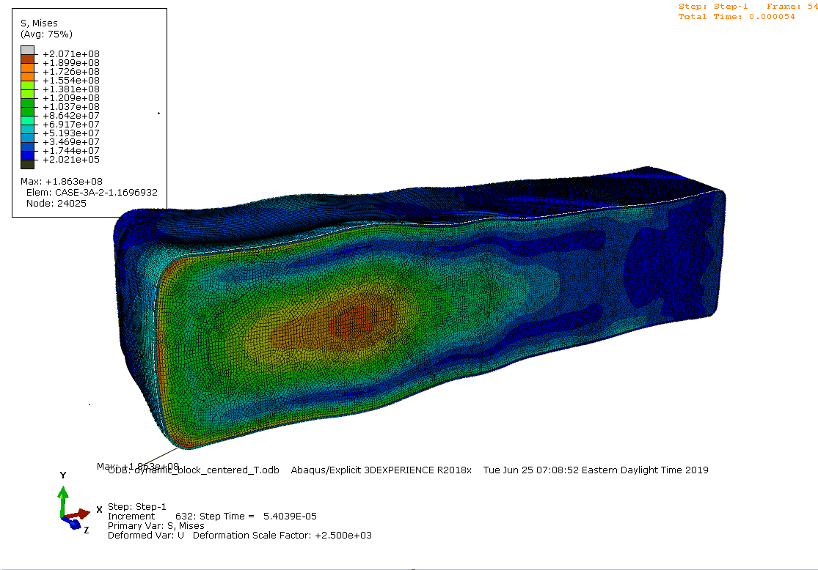
Centered Beam case -irradiated material –Dynamic Von Mises Stress
Peak Stress 207 MPa (corner) 36μs
Peak Alternating Stress 72.2 MPa 54 μs
Peak Alternating stress location

Slide 18
Centered Beam Irradiated material Peak Stress vs. time
Von Mises Stress peak alternating stress element with and without pre-pulse thermal stress
Von Mises Stress at peak stress element and element with peak alternating stress (on axis)

Slide 19
Centered Beam Irradiated conditions Ta and SS Von Mises Stress
Tantalum Peak Stress 72 MPa @ 36 μs
Shroud Peak Stress 117 MPa

Slide 20
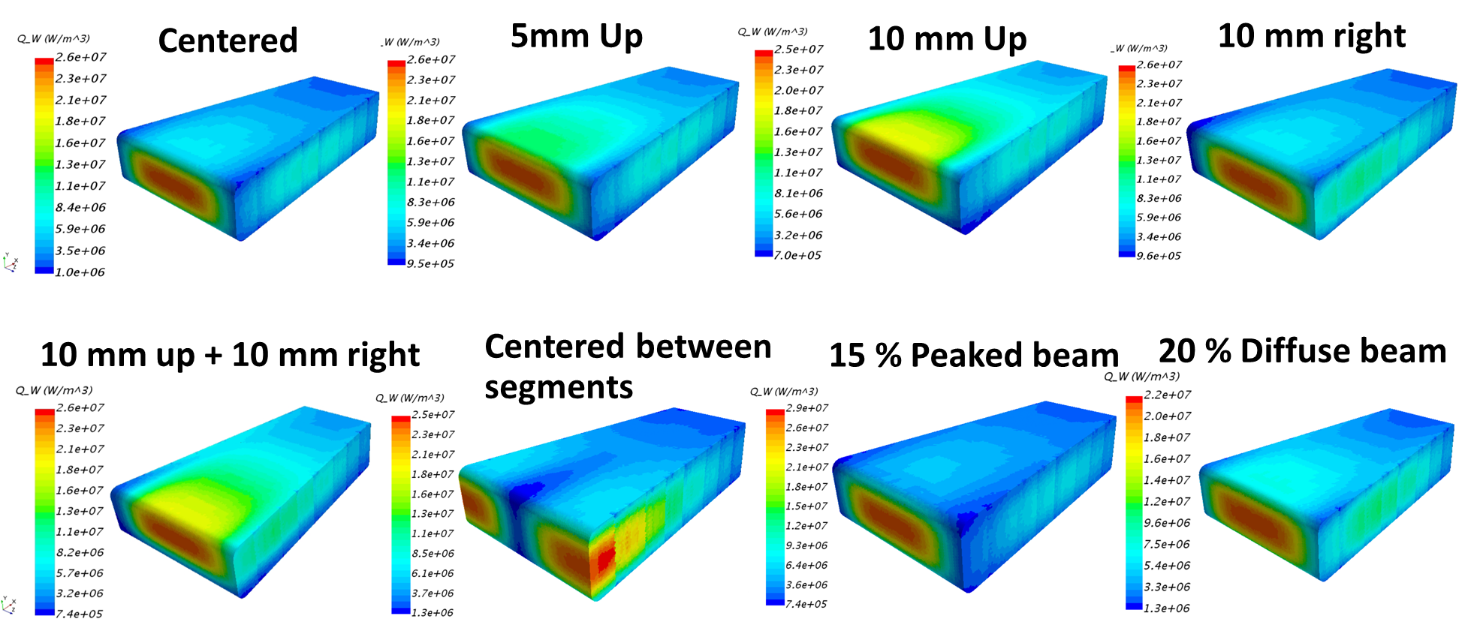
Simulation Beam Cases with Steady State Heat Sources

Slide 21
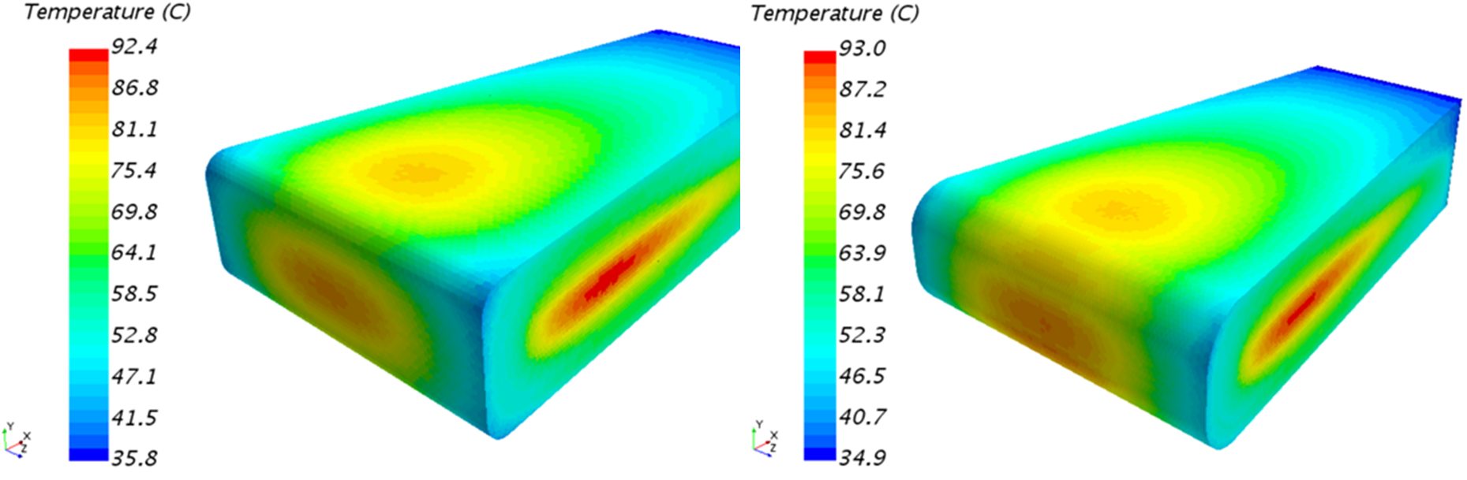
Modified Target Design Case with Peaked Beam
Radius of curvature increased on front edges to reduce heat transfer and bring edge temperature closer to average
Radii at rear eliminated to make fabrication easier
Tantalum and Tungsten peak stress reduced
More uniform temperature around edge
Original
Modified – Larger Radii

Slide 22
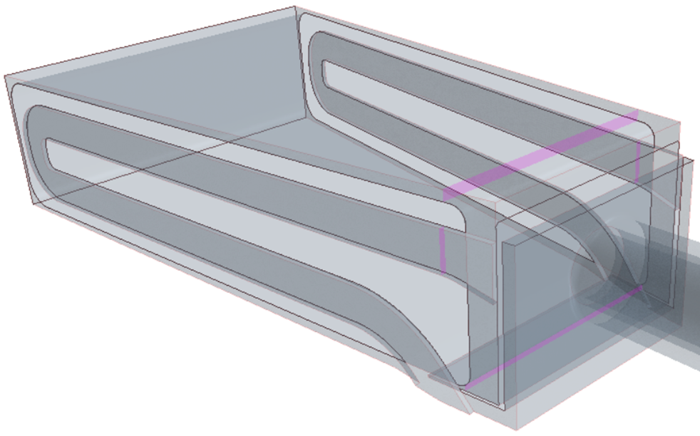
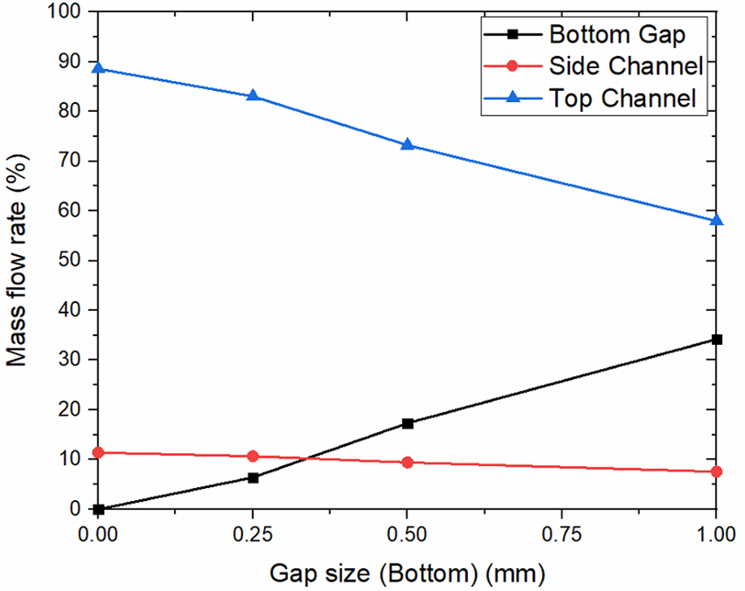
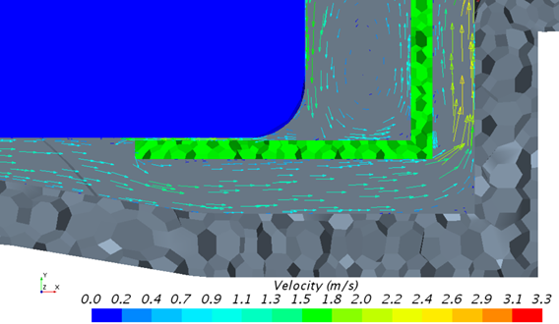

Evaluation of By-pass flow from gaps at target bottom
Potential gap between supply and return flows
Gap size (Bottom) (mm) |  | Bottom Gap (%) |  | Side Channel (%) |  | Top Channel (%)
0.00 |  | 0 |  | 11 |  | 89
0.25 |  | 6 |  | 11 |  | 83
0.50 |  | 17 |  | 9 |  | 73
1.00 |  | 34 |  | 8 |  | 58

Slide 23
STS Cases Evaluated
Case | Tungsten Peak von Mises stress (MPa) | Tungsten peak Dynamic Alternating stress intensity (Sa - MPa) | Peak Thermal Stress before pulse | Peak stress after pulse averaged over 1e-4 or 5e-4 s | Stainless Steel Shroud Peak Thermal Stress (MPa)
Centered | 140 | 44.3 | 79 | 91.4 | 117.4
Centered irradiated | 207 | 72.2 | 135 |  | 117.4
Centered irradiated/transient | 203 | 72 | 127.1 | 145 | 117.4
5mm up irradiated | 210 | 72.0 | 133.9 |  | 114
10mm up irradiated | 202.6 | 67 | 128.4 |  | 104.5
10mm right irradiated | 205.7 | 72.1 | 132.4 |  | 134.5
10mm right & 10 mm up irradiated | 201 | 65.6 | 127.5 |  | 119.3
Between irradiated segments | 158.6 | 45 | 106.1 |  | 176.2
Peaked 15% irradiated | 233.5 | 79.1 | 149.2 |  | 102.2
Peaked 15% modified nose irradiated | 228 | 71.4 | 144.1 |  | 102.9
Peaked 15% irradiated 1 mm flow gap | 245.3 | 79.1 | 149.2
Diffuse irradiated | 185.7 | 66.1 | 118.1 |  | 176

Slide 24
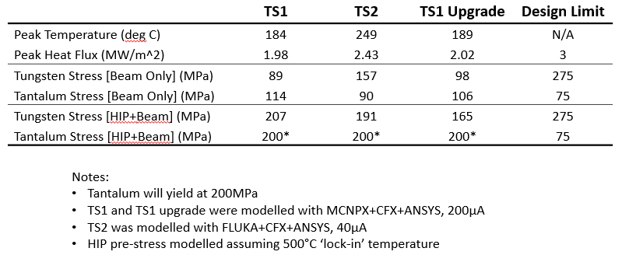
Design Limits
Considerations
Tungsten has been shown to become brittle after irradiation ( DBTT shift)
Little mechanical fatigue data after irradiation is available
ESS testing of unirradiated fatigue life typically had minimum S_{a} for 10⁵- 10⁶ cycles of about 200 MPa¹
3-point bend tests on irradiated samples at 25 C had an average failure strength of 304 MPa²
Ultimate strength is typically ~ 500 MPa, but varies with fabrication methods and at least one test on irradiated material failed at 60 MPa
ISIS has operated target successfully with estimated stresses on the order of 200 MPa
ISIS Design Limits³
ESS Design Limits²
Tungsten mean stress 100 MPa
Tungsten Alternating Stress (S_{a}) 50 MPa
J. Habainy, Characterisation of mechanical and thermal properties of tungsten for high power spallation target applications
2. J. Habainy, et.al., Journal of Nuclear Materials
506 (2018) 83-91
3. Dan Wilcox
High Power Targets Group, RAL
6th High Power Targetry Workshop, 12/04/2016

Slide 25
Next steps for conceptual design with tantalum clad
Prestress from HIPing Tantalum to Tungsten will be included
Will evaluate using internal seals to limit by-pass flow on sides and rear surface
Mechanical support will be added for gravity and centrifugal force ( ~1g for both)
Coriolis forces on flow will be added
Stainless steel shell will be optimized to make fabrication easier
Removal of any trapped air after filling will be evaluated

Slide 26
Summary
Water cooling flow velocities, pressure drops and component temperatures all seem to be acceptable
The peak Von Mises stresses in tungsten are generally below the ISIS target experience peak of approximately 200 MPa, especially without including irradiation damage material property changes
Design limits for the dynamic alternating stress at ~10⁵ Hz are not known and target experience is probably the best guidance at present
Tantalum stress level without including HIPPING are well below the yield strength
Design optimization will continue

Slide 27
Backup

Slide 28
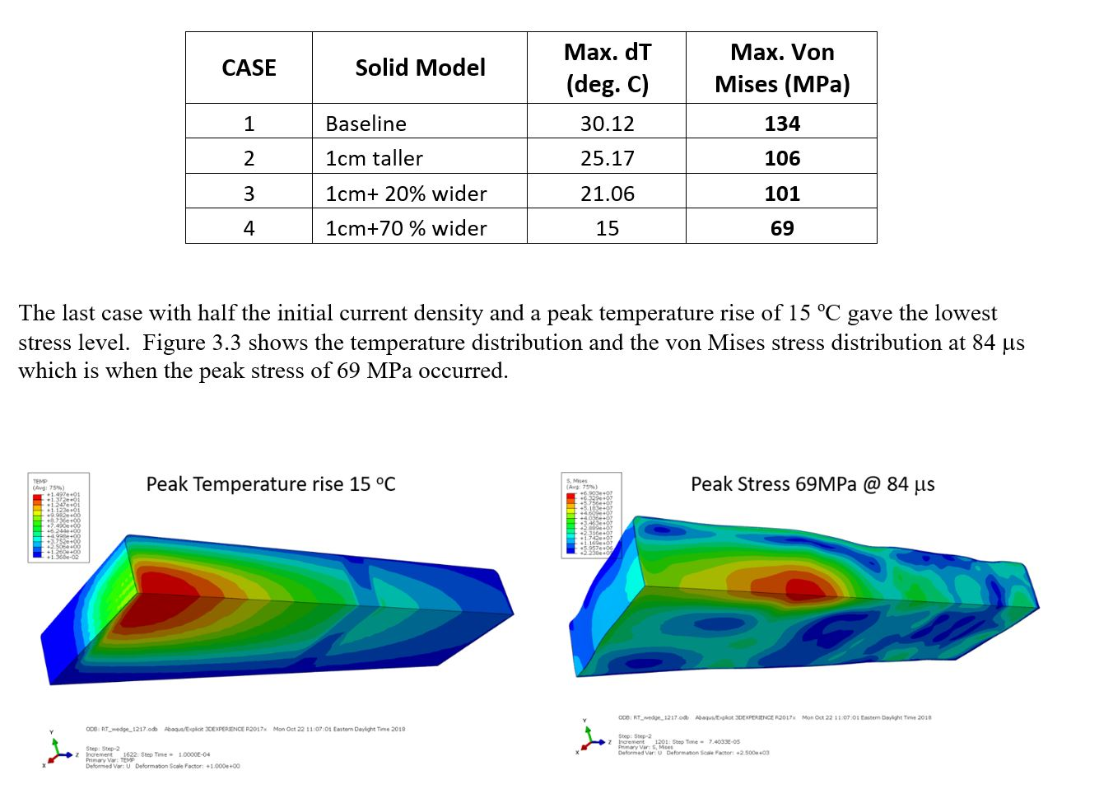
Summary of Profile Study Stress results

Slide 29
Centered Beam Irradiated Material Peak stress element transient 128 s calculation of pre-pulse stress
Average stress agrees with transient thermal stress after pulse

