Slide 1
Neutronics Analyses for the Conceptual Design of the SNS Second Target Station
Igor Remec and Franz Gallmeier
Oak Ridge National Laboratory, Oak Ridge, TN, USA
ICANS XXIII
Chattanooga, Tn
Oct 14- 18, 2019
Neutronics Analyses Team
Neutron Technologies Division
ICANS XXIII 13-18 October 2019

Slide 2
Outline
Introduction
SNS STS history
STS parameters / requirements
Neutronics analyses tools and models
STS target evolution
Decay heat, activation
Proton beam profile
Moderator characteristics and performance
Current moderator configuration
Moderator optimization
Summary

Slide 3
SNS STS history
Since 2006: SNS FTS in operation, designed to allow two major upgrades:
PPU: proton power upgrade, doubling the SNS beam power
STS: adding second target station
Jan. 2009: DOE approved STS scientific mission need (CD-0)
2010-2012: long (1 ms) and short (< 1µs) pulse options explored
2013-2014: pre-conceptual design effort
Jan. 2015: published Technical Design Report
Sept. 2015: rotating target recommended for the baseline configuration
Oct. 2015: STS workshop conducted to seek the community’s input on all aspects of the project with the emphasis on the instruments
Jan. 2016: Funded to start the conceptual design work on rotating target
April 2017: STS updated, rotating target, short pulse ( < 1µs)
June 2017 –Sept. 2018: STS work largely on hold, priority given to PPU
Sept. 2018: STS work resumed
Feb. 2019: performed STS Target Systems Conceptual Design Review
August 2019: STS project office established at ORNL
June 2020: potential for DOE CD-1 review of STS

Slide 4
FTS/STS parameters
FTS (upgraded)
Short (<1 μs) proton pulses
1.3 GeV protons
45 pulses/second
2 MW beam power
44.4 kJ per proton pulse
Large beam footprint:
~ 140 cm²
Hg target
STS
Short (<1 μs) proton pulses
1.3 GeV protons
15 pulses/second
700 kW beam power
46.7 kJ per proton pulse
Smaller beam footprint:
~ 60 cm² (90% of the beam)
W target (Ta clad, water cooled, segmented, sync.)
STS requirements
Provide high peak brightness at long neutron wavelengths
Accommodate 22 instruments
Notes:
Both FTS and STS will operate with short < 1 µs proton pulses of 1.3 GeV protons.
FTS will receive 45 pulses/s and STS will receive 15 pulses/s. Beam power delivered to FTS will be 2 MW, for STS 0.7 MW. Power per pulse will be just ~ 5% higher for STS.
FTS has large beam footprint of 140 cm2, while planned beam footprint for the STS is only ~ 60 cm2.
FTS target material is mercury. STS uses tungsten. It is interesting to note that
both FTS and STS neutron-producing target material is moving. FTS circulates mercury through the target.

Slide 5
Neutronics analyses tools
Traditional tools:
MCNPX 2.6, 2.7 (most work to date)
CINDER 90 with enhancements
Activation scripts
Recently added:
MCNP 6.1
DAGMC: Direct Accelerated Geometry Monte Carlo toolkit implemented in MCNP 6.1
CINDER 2008
ADVANTG (for weight window generation)
Space Claim, Cubit (for DAGMC model preparation)

Slide 6
DAGMC toolkit: provides automatic CAD-to-MCNP model conversion resulting in high fidelity “engineering” models
Conversion workflow
Cad
Detailed MCNP models that closely match the engineering models can be produced
Iterations may be necessary to produce viable MCNP model
Notes:
The DAGMC toolkit gives as a way to “automatically” convert CAD models into MCNP models for neutronics analyses. The process starts with the engineering CAD model in CREO. This model is processed through SpaceClaim and Cubit to produce the MCNP model. In principle the conversion could be automatic, with little human intervention. However, our experience is that complex target models always require iterations to produce functional MCNP models. The conversion produces “high fidelity” MCNP models which closely match the engineering design. DAGMC is developed at the University of Wisconsin-Madison by the group of prof. Paul Wilson.

Slide 7
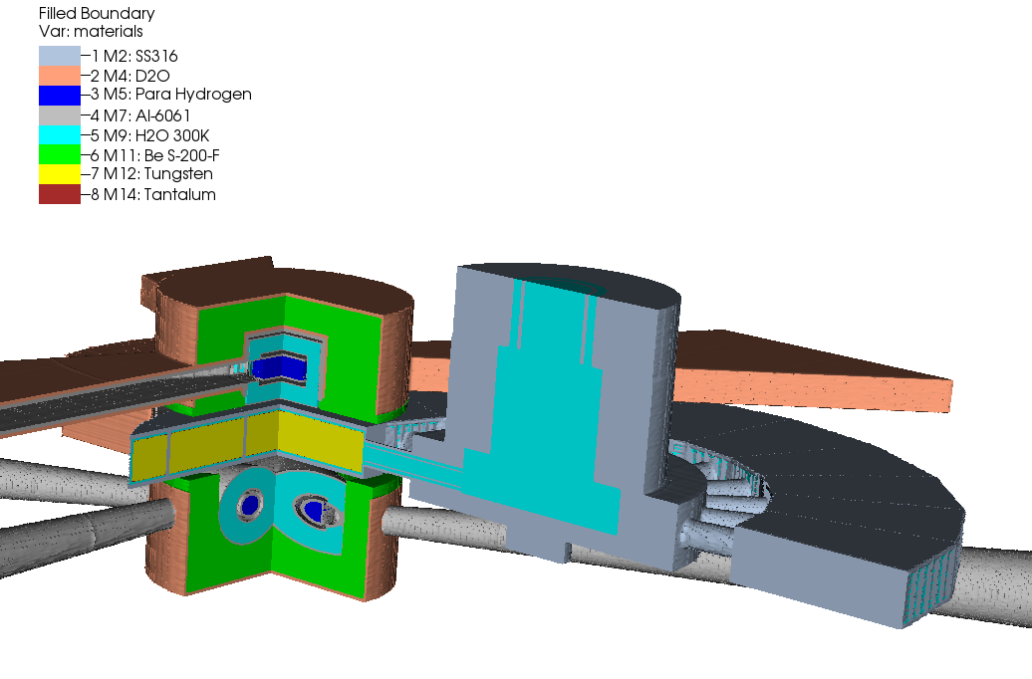
Simple “physics” MCNPX model used for most of the simulations
Models
Coupled para-H₂ “cylindrical” mod.
Target shaft
Target disc
Proton Beam
Coupled para-H₂
“tube” mod.
Be reflector, D₂O cooled
Notes:
Current STS neutronics analyses are performed with “physics” models, such as the one shown here. These models realistically describe important characteristics of the main components such as the target, moderators and reflector, while simplify or omit complex engineering details. The model here shows the target disc, target shaft, cylindrical moderator located above the target, and tube moderator below the target. Both moderators are surrounded with beryllium reflector.

Slide 8
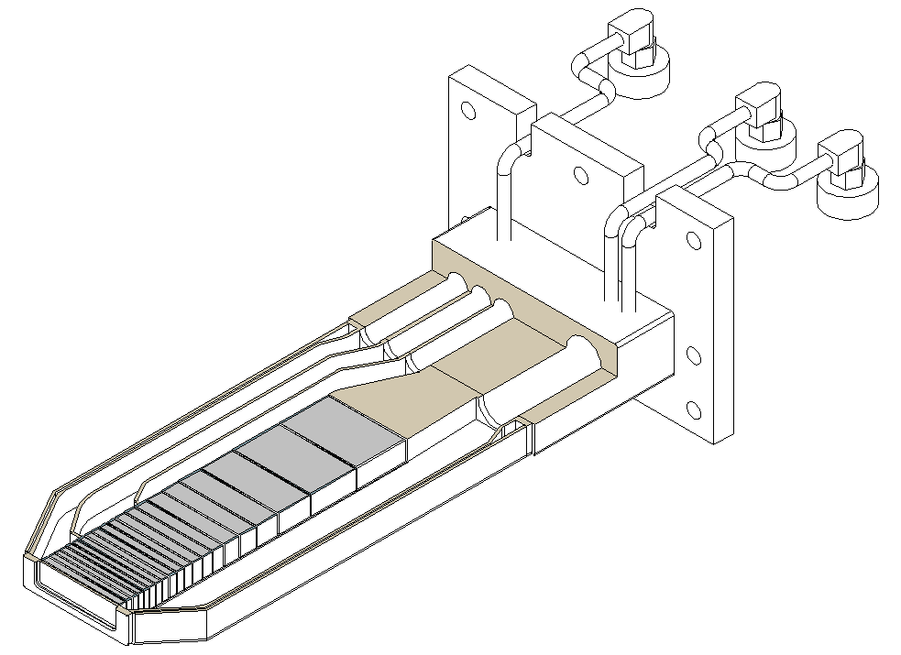
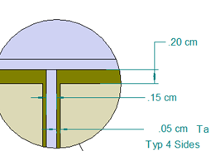
STS target evolution: stationary target layout (2015)
FTS
beam footprint
140 cm²
17 W plates clad with Ta
30 cm total length
Cooled with D₂O
p beam
STS
beam footprint
30 cm²
p beam
Plate thicknesses vary to limit peak temperature in plate < 250°C, peak surface temperature < 110°C
1.5 mm cooling channels between plates
Notes:
Peak surface temperature 110 C was determined for flat beam profile. With the 1.2 peaking of the SuperGaussian profile the surface temperatures were about 125 C; further design was not done. It would likely be possible to increase the exit pressure slightly or to develop a new slightly thinner set of plate thicknesses to maintain the 110 C.

Slide 9
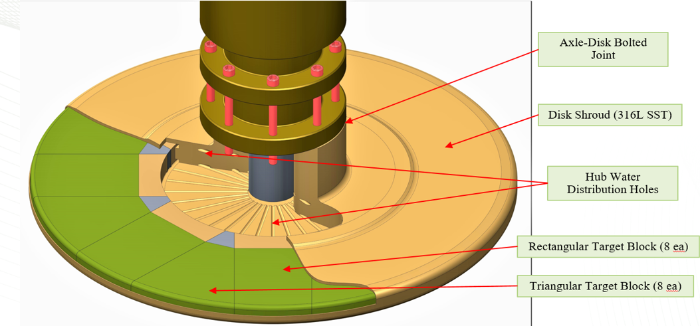
STS target evolution: rotating target, previous design (2017)
tungsten disk, continuous
Ta clad,
asynchronous operation
D₂O cooled
Cooling: D₂0, 30ºC, 3 m/s nominal
Notes:
Changes since: synchronous, 1 rotation in 1.4 s (~ 43 RPM) , disk has 21 segments,
Beam footprint increases from 7.5 cm x 4 cm (30 cm2) to 13 cm x 4.8 cm ( 62 cm2; 90 % of the beam)

Slide 10
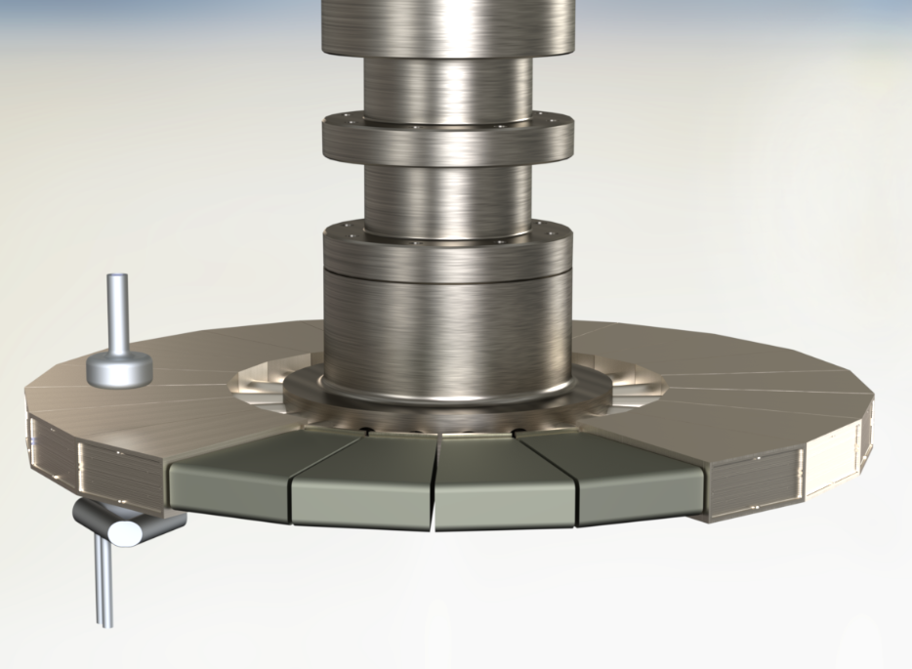
STS target evolution: rotating target, current design (2019)
21 tungsten segments,
Ta clad,
Synchronous operation
H₂O cooled
Rotating target | Synchronous
Rotational speed | 1 turn in1.4 s
Number of segments | 21
Target Material | W
W width | 163.7 mm
W height | 58 mm
W length | 250 mm
Clad material | Ta
Clad thickness | 1 mm
Disk diameter | 1156 mm
Shroud material | 316L SS
Cooling | H₂0

Slide 11
STS target evolution
Changed in the target design driven mainly by:
High decay heat density in stationary target and unacceptable consequences on loss of cooling accident
Solved by transition from stationary to rotating target
Need to reduce stresses induced by pulsed operation
Solved by increasing proton beam footprint on the target

Slide 12
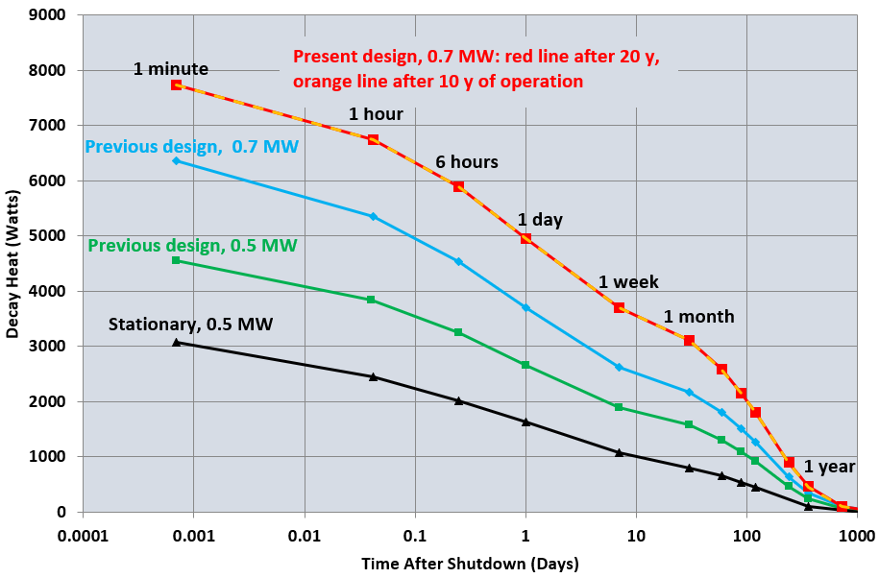
Target decay heat
Rotating target,
present design:
after 20 y and
10 y of operation (5000 h/y), at 0.7 MW
Rotating target,
previous design:
after 20 years of operation (5000 h/y),
at 0.5 MW and 0.7 MW
Stationary target:
after 1 year of operation (5000 h/y),
at 0.5 MW
Total decay heat for the rotating target is much higher than for the stationary target.
But in the rotating target the decay heat is distributed over large volume and does not cause prohibitively high temperatures in the case of the loss of active cooling.
Average decay heat density in W and Ta at shutdown is 2.1 W/cc for stationary target and 0.18 W/cc for rotating target.

Slide 13
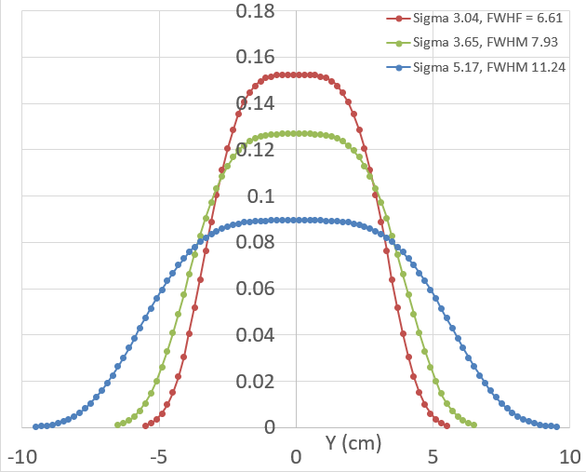
Proton beam size/ profile
Footprint 30 cm² 62 cm²
Von Mises Stress 134 MPa 69 MPa
Proton Beam Profile | σ_{x} | σ_{y} | Vert. Extent 95 % Beam | Horiz. Extent 95 % Beam | ~Area of 90 % Beam | Max. Heating | Max. dT
 | (cm) | (cm) | (cm) | (cm) | (cm²) | (J/cc/ pulse) | (deg. C)
1.0-1.0 | 1.65 | 3.04 | 4.0 | 7.6 | 30.4 | 77.9 | 30.12
1.2-1.0 | 1.98 | 3.04 | 4.8 | 7.6 | 36.5 | 65.1 | 25.17
1.2-1.2 | 1.98 | 3.65 | 4.8 | 9.2 | 44.2 | 54.8 | 21.06
1.2-1.7 | 1.98 | 5.17 | 4.8 | 13.0 | 62.4 | 39.0 | 15.00
Distribution in
Horizontal
Direction (Y)
Super-Gaussian distribution of proton beam current
$$p\left(x,y\right){=NF×e}^{−\frac{1}{2}{\left(\frac{\left|x−x_{0}\right|}{σ_{x}}\right)}^{4}}×e^{−\frac{1}{2}{\left(\frac{\left|y−y_{0}\right|}{σ_{y}}\right)}^{3.9}}$$
FWHM = 2.18 * σ
Doubling the proton beam footprint (from ~ 30 cm² to ~ 60 cm²),
causes only modest decrease in moderator performance:
~ 2 – 5 % reduction in peak and tint brightness.
Notes:
First I will discuss the effect of the size of the proton beam footprint on the target.
Out initial plan was to keep the beam footprint as small as possible to create a geometrically small zone in the target with high density of neutron production.
We started out with 30 cm2 beam footprint, and double super-gaussian proton current profile. This beam profile resulted In peak energy deposition of ~ 78 J/cc/pulse and, with the pulse length of less than 1 µs, an almost instantaneous temperature rise of 30 deg. K. Resulting stresses in tungsten were too high. So we had to explore larger profiles.
In order to reduce the stresses to acceptable limits it was necessary to increase the beam height by about 20% and the width by 70%. We ended up with a beam footprint of ~ 62 cm2. This profile gives the peak energy deposition of 39 J/cc/pulse and temperature rise of ~ 15 deg. K.
We were concerned how much will this reduce the performance of the moderators.

Slide 14
Moderators characteristics and performance

Slide 15
Moderator and reflector requirements
Samples are getting smaller
allows smaller beams, requires higher brightness
The size of the moderator viewed area determines the brightness but also the beam intensity – conflicting quantities
Selected moderator viewed areas 3 cm × 3cm, or diameter 3 cm
Neutron beam dimensions of ~ 3 cm provide good illumination of sample sizes up to ~1 cm (Zhao et al, Rev Sci. Inst. 84 (2013)
Smaller viewed areas allow smaller moderators, tighter coupling to the neutron production area in the target
Significant increase in brightness can be achieved
High heating rates require use of liquid hydrogen for moderator
max. ~ 1.2 W/cc in H₂, ~8 W/cc in H₂O and Al
Beryllium reflector (a standard at spallation neutron sources)
Notes:
Samples trend to smaller sizes 1 cm and smaller
increasing difficulty to synthesize complex materials,
required higher resolution
limited sample environments sizes

Slide 16
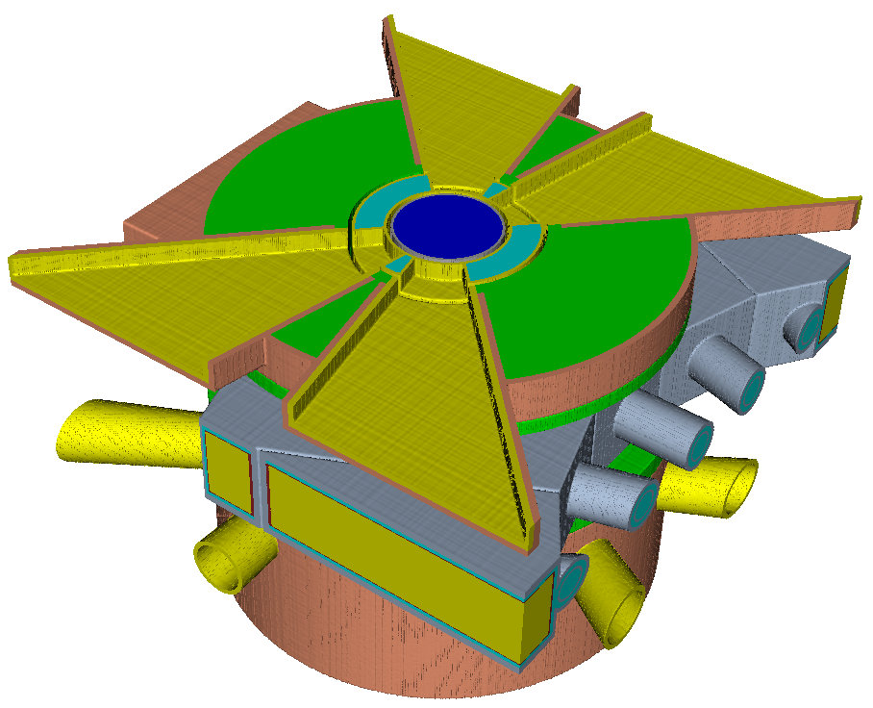
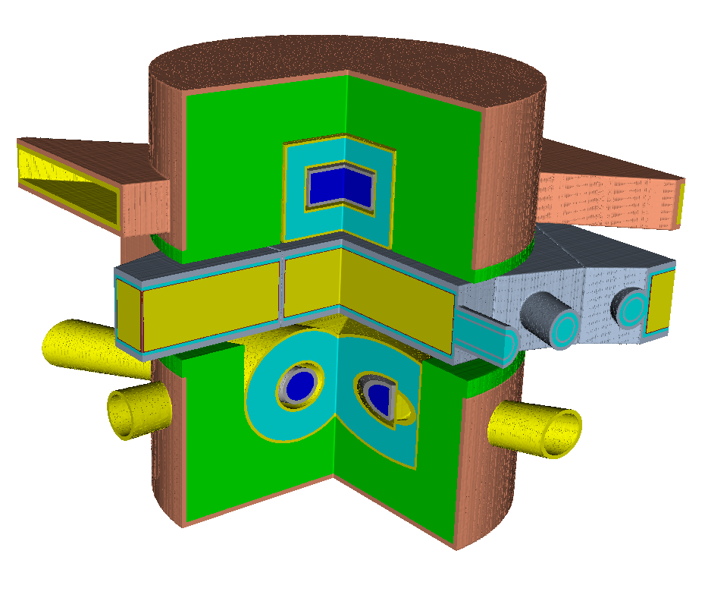
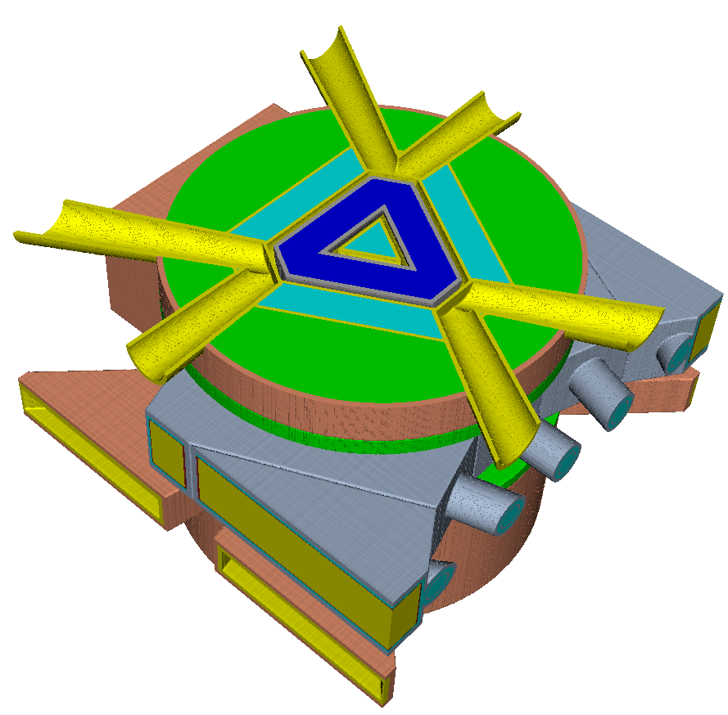
STS moderators: current configuration
Top moderator:
16 beamlines
Two moderators:
Both coupled, para-H at 20ºK,
H₂O pre-moderator
Bottom moderator:
6 beamlines
Notes:
Current STS configuration has two moderators. Both are coupled, para-hydrogen moderators, with H2O premoderators. Cylindrical moderator is located above the target and serves 16 beamlines; tube moderator is below the target and serves 6 beamlines.

Slide 17
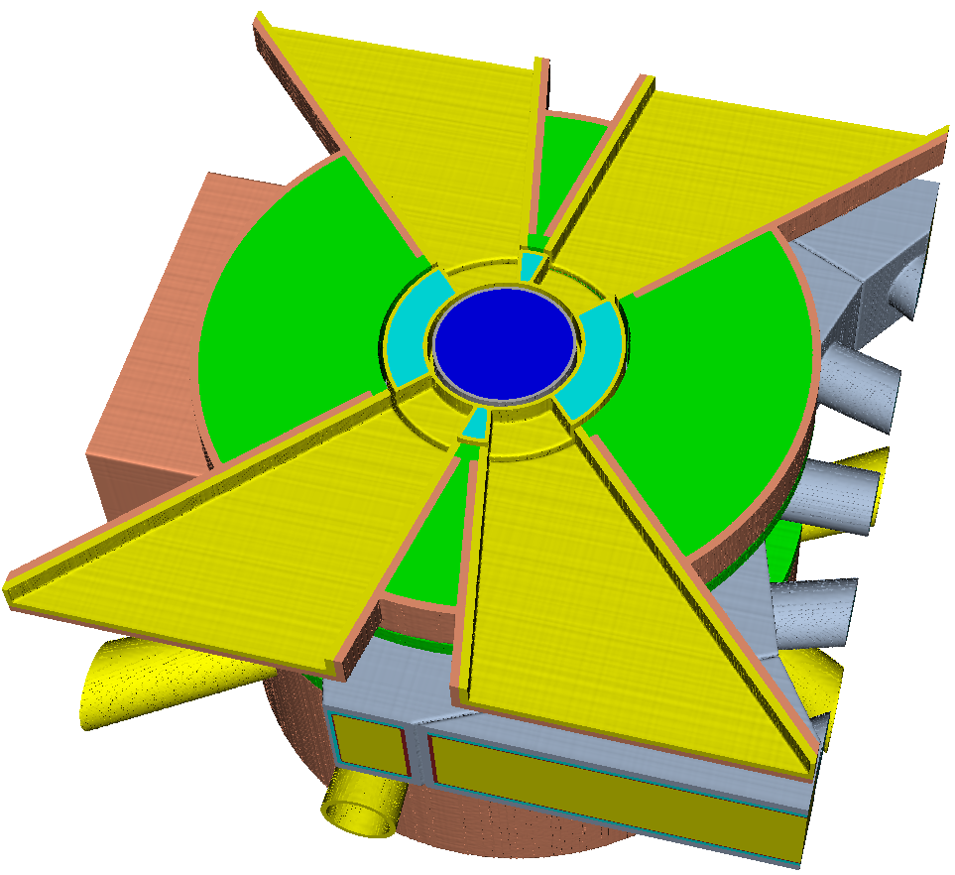
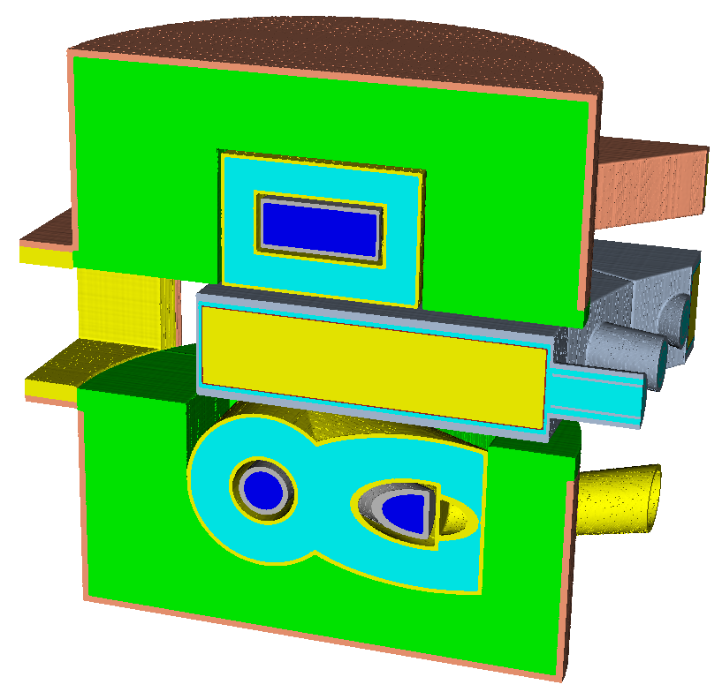
Cylindrical moderator: coupled para-H at 20ºK, with H₂O pre-moderator
Four 3 cm x 3 cm moderator faces
TZO
PMLT
PMLR
2 MBR
PMLB
Cylindrical moderator was optimized for peak brightness.
Notes:
The parameters optimized were the diameter of the hydrogen cylinder, thicknesses of the water pre-moderator at the top, bottom, and at the side, the position of the moderator relative to the front of the target, and the height of the proton beam.
We will repeat the optimization as the design evolves.

Slide 18
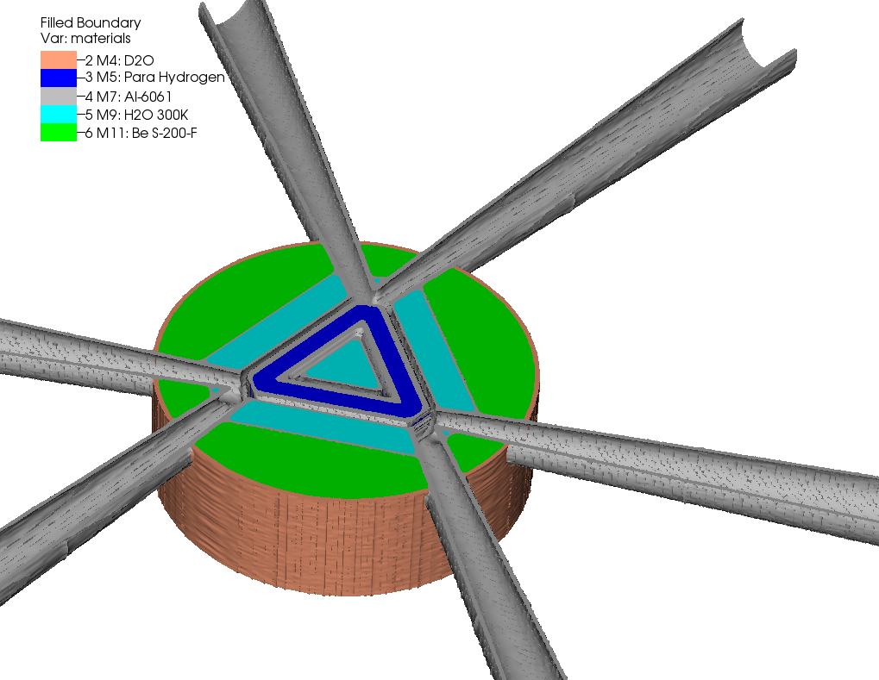
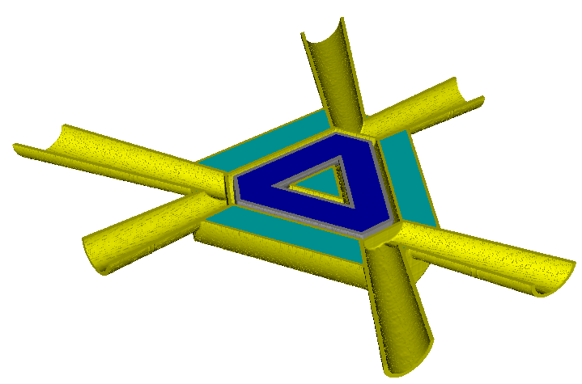
Tube moderator: coupled para-H at 20ºK, with H₂O pre-moderator
Hydrogen tubes: diameter 30 mm, para-H
Premoderator: thickness ~30 mm, H₂O
Premoderator
thickness
Hydrogen tube length
Tube moderator was optimized for maximum time-integrated cold neutron brightness (E <10 meV).
Optimized: tube length,
premoderator thickness,
moderator position
Tube moderator concept proposed by Franz Gallmeier; see report:
“A Liquid Hydrogen Tube Moderator Arrangement for STS,” January 2018
Notes:
The tube moderator concept was developed by Franz Gallmeier. It consists of three tubes filled with para-hydrogen. It has three viewports and serves six beamlines. Hydrogen tubes are surrounded by water pre-moderator.
Tube moderator was optimized to achieve maximum time-integrated cold neutron brightness (E<10 meV).
Optimized: tube length,
premoderator thickness,
moderator position

Slide 19
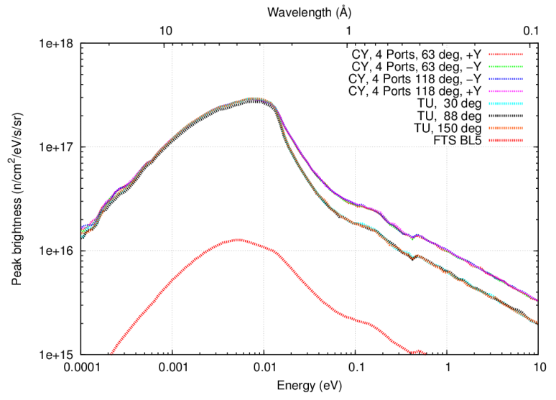
Peak moderator brightness
STS:
0.7 MW, 15 Hz, 1.3 GeV
FTS:
“as is, Oct. 2019”:
1.4 MW, 60 Hz, 1.0 GeV,
Al proton beam window,
IRP2 with D₂O cooling,
30% ortho hydrogen
20% loss due to power-induced degradation
STS ~25 x
higher
at 3 Å
STS Cy Mod.
FTS BL5
STS Tube Mod.
Notes:
Now we will look at the performance of the moderators. peak brightness. The STS cylindrical and tube moderators have about the same peak brightness for wavelengths 2.5 angstroms and longer. For shorter wavelengths the cylindrical moderator has higher brightness.
We can see that a very significant improvement of the peak moderator brightness at STS was obtained relative to the FTS.
The peak brightness of both the cylindrical and the tube moderator are ~25 times higher (at 3 angstroms) than the peak brightness of FTS coupled moderator
(FTS BL-5 looks at top downstream coupled H2 moderator.)
The FTS performance is calculated for the “as is” FTS, not the FTS after the completion of the PPU.

Slide 20
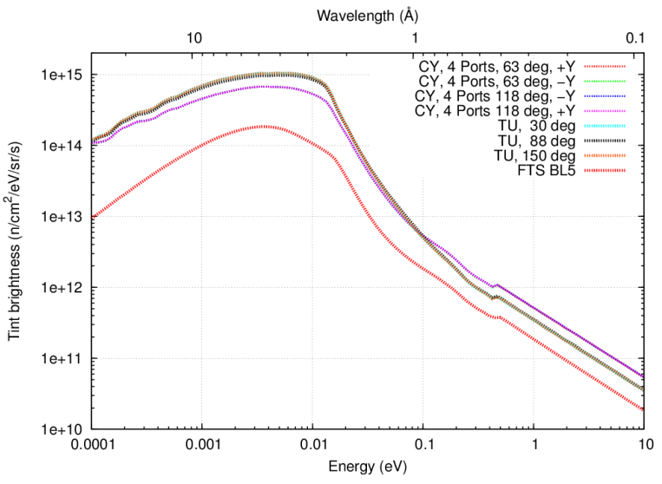
Time integrated brightness
STS:
0.7 MW, 15 Hz, 1.3 GeV
FTS:
“as is, Oct. 2019”:
1.4 MW, 60 Hz, 1.0 GeV,
Al proton beam window,
IRP2 with D₂O cooling,
30% ortho hydrogen
20% loss due to power-induced degradation
FTS BL5
STS Tint brightness ~4 to 5 × higher than FTS
Notes:
Time-integrated brightness:
the STS tube moderator shows higher time-integrated brightness than cylindrical moderator, mostly due to wider pulses.
Again we see a significant 4 to 5 times improvement over the FTS moderator time-integrated brightness.
The FTS performance is calculated for the “as is” FTS, not the FTS after the completion of the PPU.

Slide 21
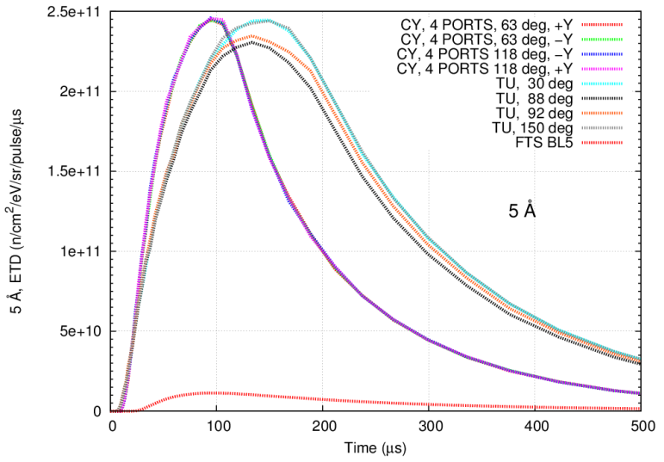
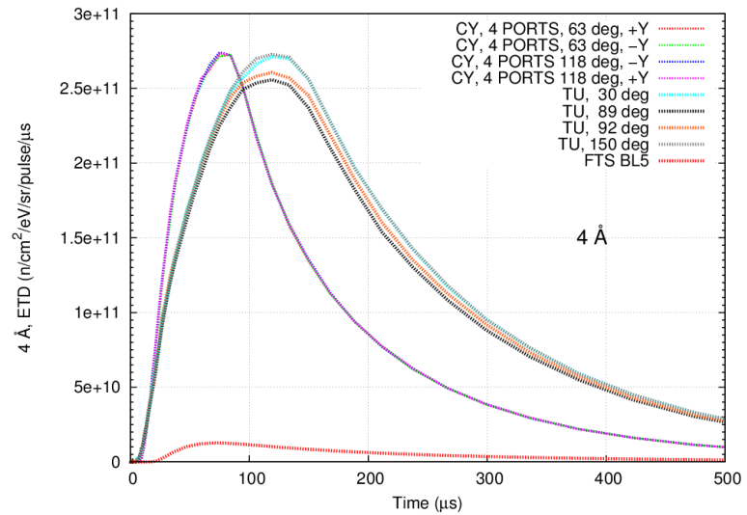
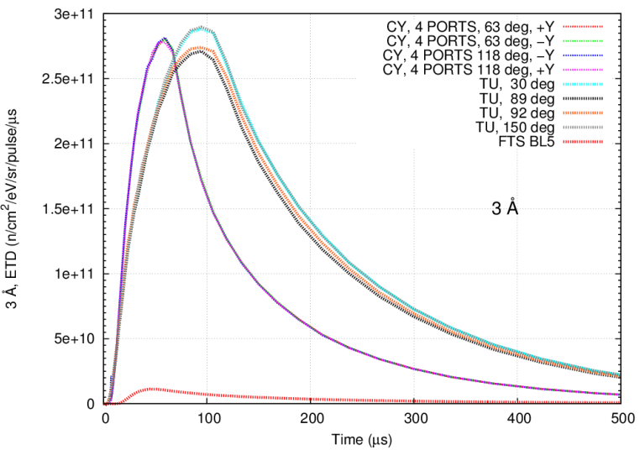
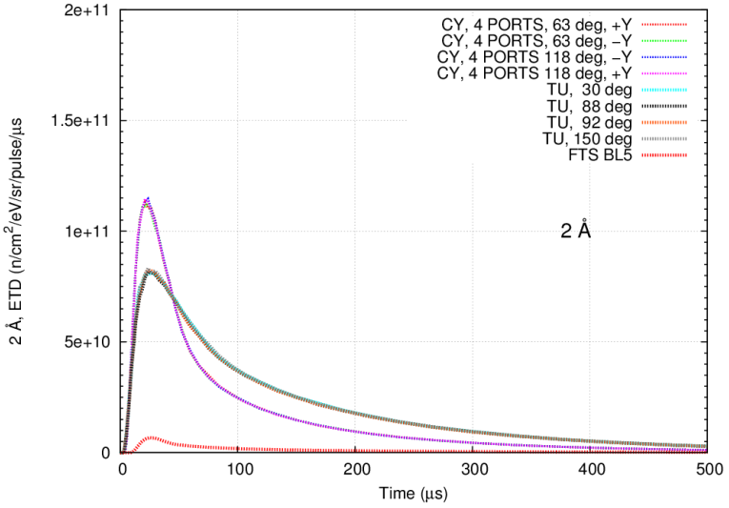
Tube mod.
Tube mod.
5 Å
4 Å
Cylindrical
mod.
Cylindrical
mod.
FTS BL5
FTS BL5
STS pulse shapes
Cylindrical
mod.
Tube mod.
3 Å
2 Å
Cylindrical
mod.
Tube mod.
FTS BL5
Notes:
Shapes of the pulses at different wavelengths:
we can observe again that the tube and cylindrical moderator have very similar peak brightness and the cylindrical moderator has higher peak brightness at shorter wavelengths.
The tube moderator has wider pulsed and therefore higher time integrated brightness.
Again we see a large improvement over FTS.

Slide 22
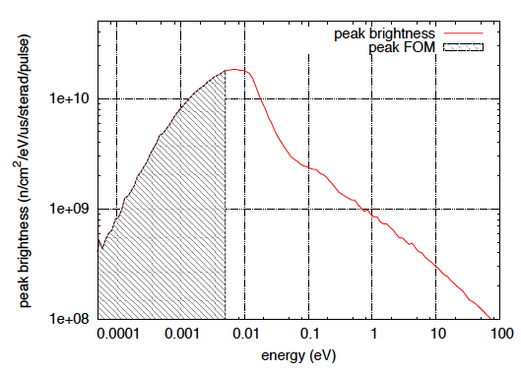
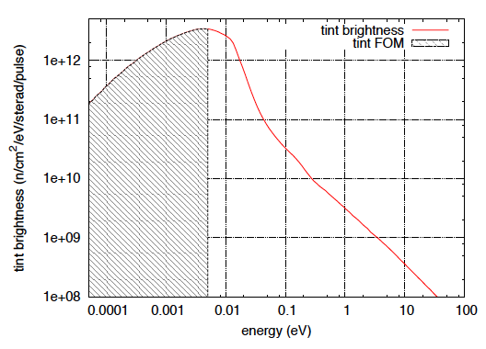
Moderator optimization: figures-of-merit
Peak-brightness integral E< 5meV or 10 meV (used for cylindrical moderator)
Time-integral brightness E< 5meV or 10 meV (used for tube moderator)

Slide 23
Optimal moderator parameters
CYLINDRICAL MODERATOR
 | H₂ Radius | Premod. Rad. Thick. | Premod. Bottom | Premod. Bottom | Z offset
 | (cm) | (cm) | (cm) | (cm) | (cm)
Tint brightness | 8.500 | 2.000 | 2.992 | 2.000 | 0.000
Peak brightness | 4.341 | 2.000 | 2.607 | 2.000 | 0.000
Tint-Peak | 6.100 | 2.000 | 2.700 | 2.000 | 0.000
TUBE MODERATOR
 | Tube length | Premod. Thickness | Z offset
 | (cm) | (cm) | (cm)
Tint brightness | 19.820 | 2.727 | 0.000
Peak brightness | 10.330 | 2.727 | 0.000
Tint-Peak | 15.000 | 2.727 | 0.000
Notes:
Tint FOM is ~ 18 % higher for the tube moderator than for the cylindrical moderator (both optimized for Tint brightness < 10 meV)

Slide 24
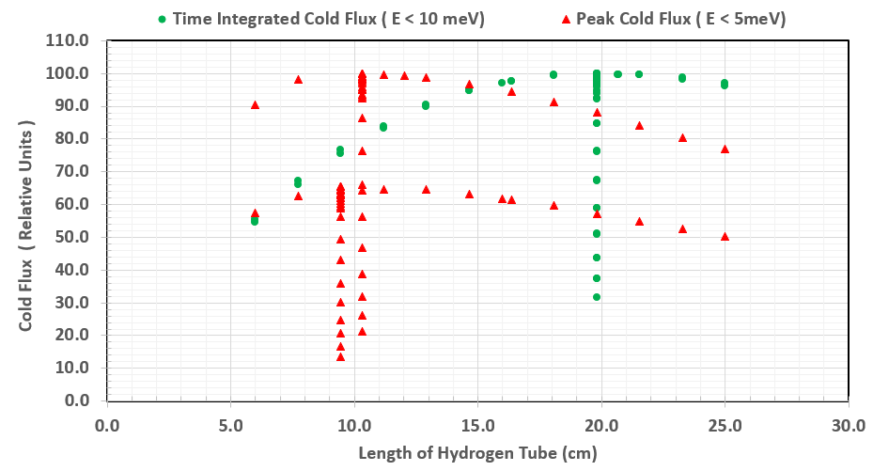
Tube moderator optimization
Peak: 63 MCNPX runs, Tint: 63 MCNPX runs

Slide 25
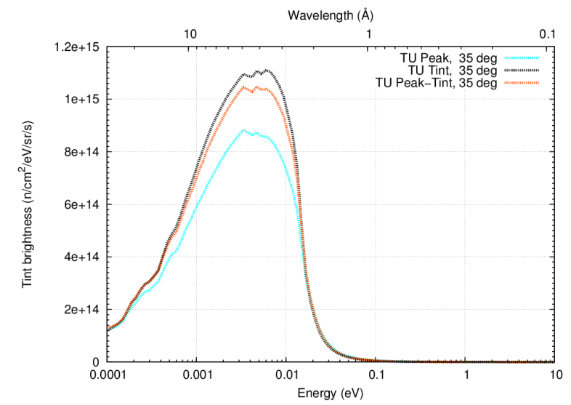
Tube moderator Tint brightness
20 cm
15 cm
10 cm

Slide 26
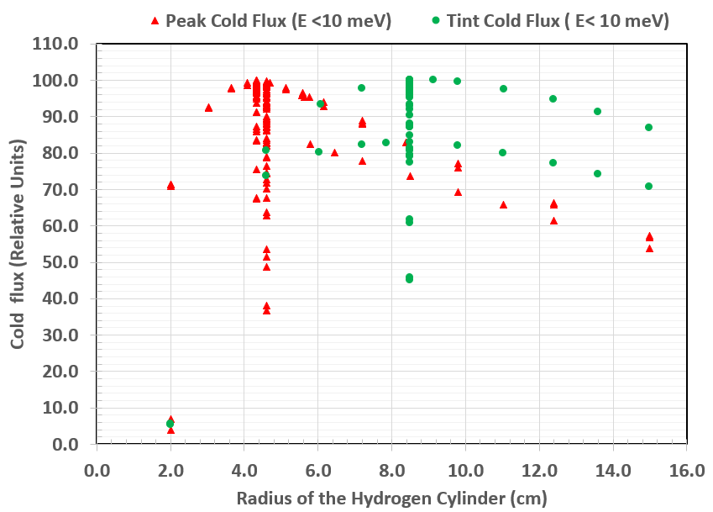
Cylindrical moderator optimization
Peak: 171 MCNPX runs,
Tint: 77 MCNPX runs

Slide 27
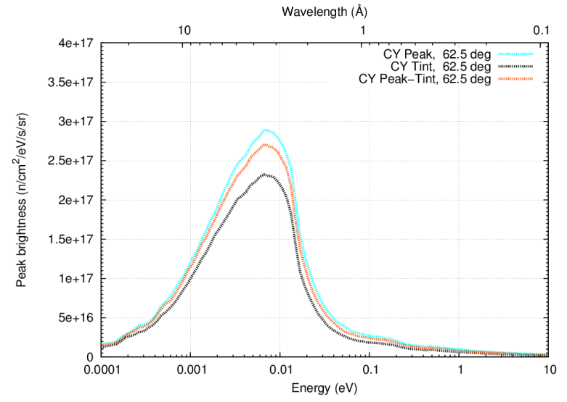
Cylindrical moderator peak brightness
4 cm
6 cm
8 cm

Slide 28
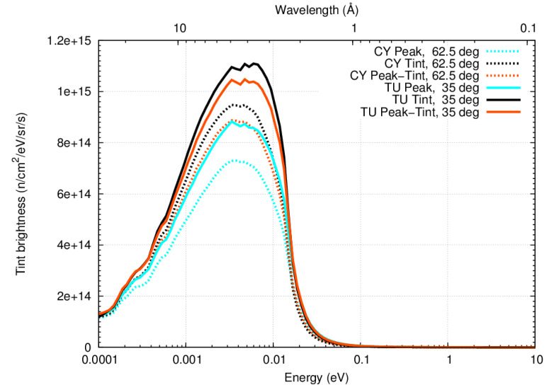
Cylindrical and tube moderator Tint brightness

Slide 29
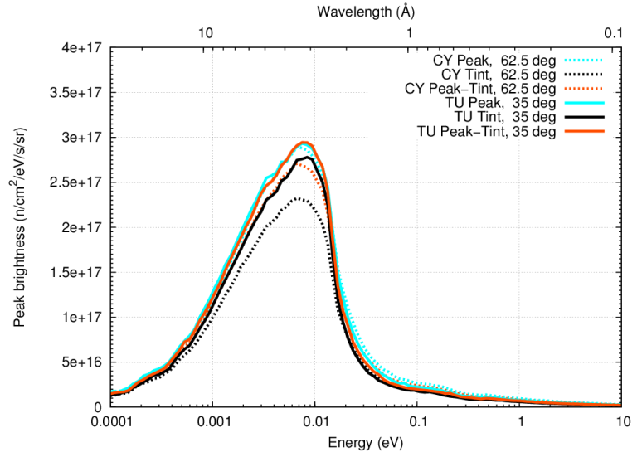
Cylindrical and
tube
moderator
peak
brightness

Slide 30
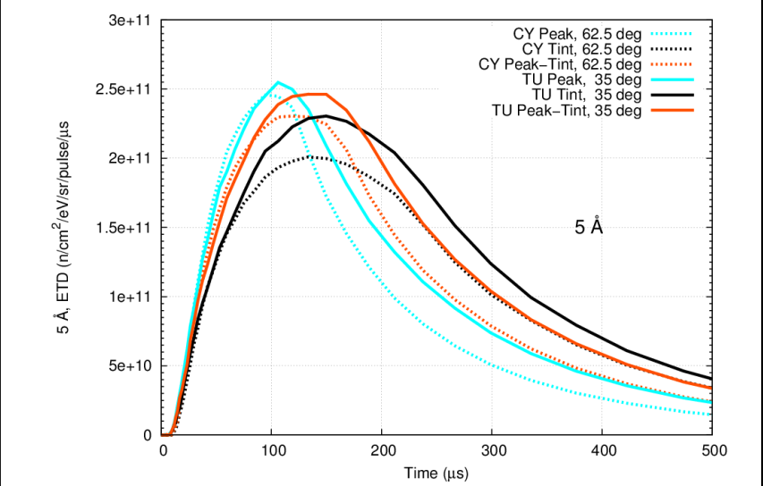
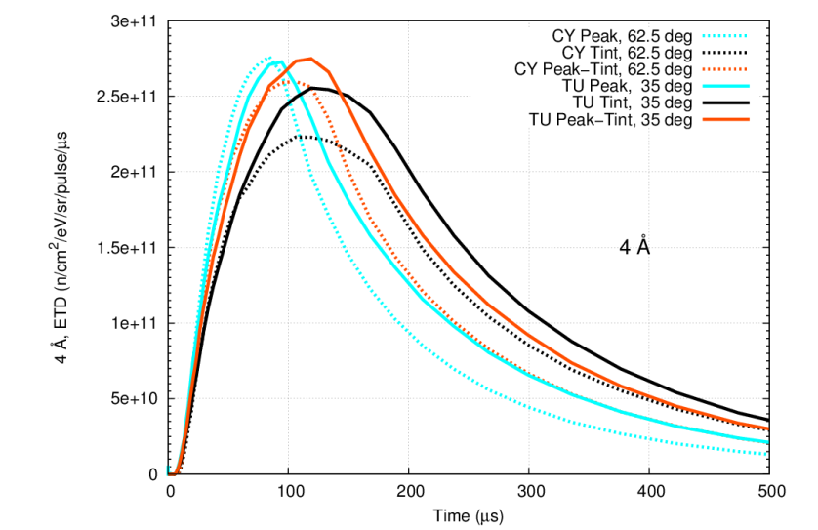
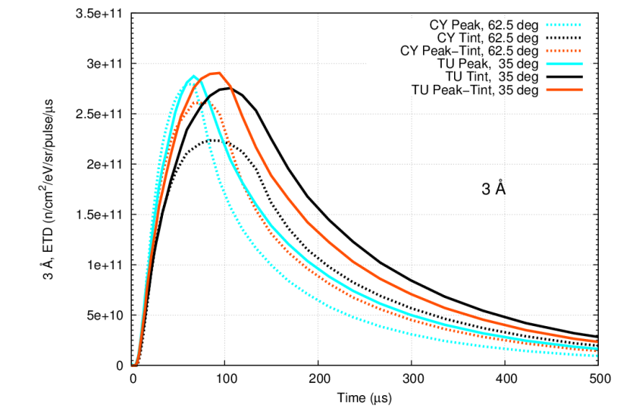
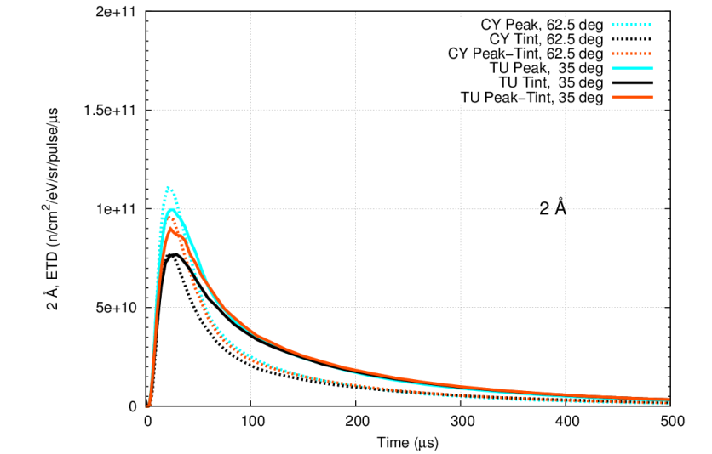
Pulse shapes for different configurations of cylindrical and tube moderators

Slide 31
Summary
Some aspects of neutronics analyses in support of STS design were presented
Rotating synchronous W target looks promising
provides compact, high intensity neutron source
shows acceptable stresses
can withstand loss-of cooling accident without major damage
Small moderators with tight coupling to the target provide exceptional brightness
~ 24 times in peak brightness
gains over FTS are ~4-5 times in the time-averaged brightness, and
Further moderator / reflector optimization may be based on instrument specific metrics

Slide 32
Additional Slides

Slide 33
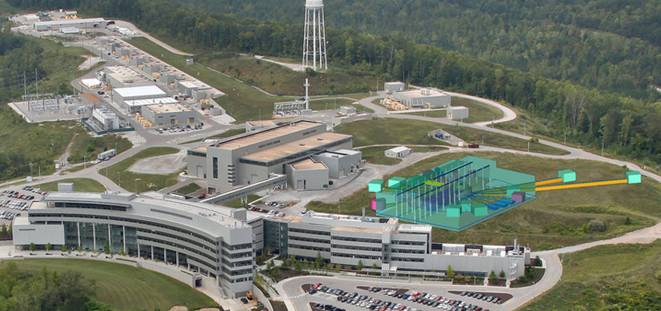
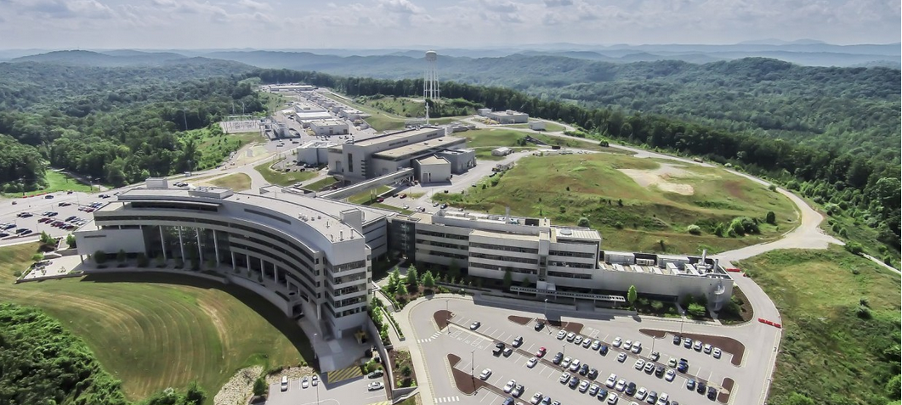
ORNL Three Source Strategy
1. HFIR reactor:
high-intensity continuous source of cold and thermal neutrons
3. STS: optimized for
cold neutron beams
with highest peak
brightness for small
sample sizes
2. FTS: optimized for
high-resolution
thermal and cold
neutron beams

Slide 34
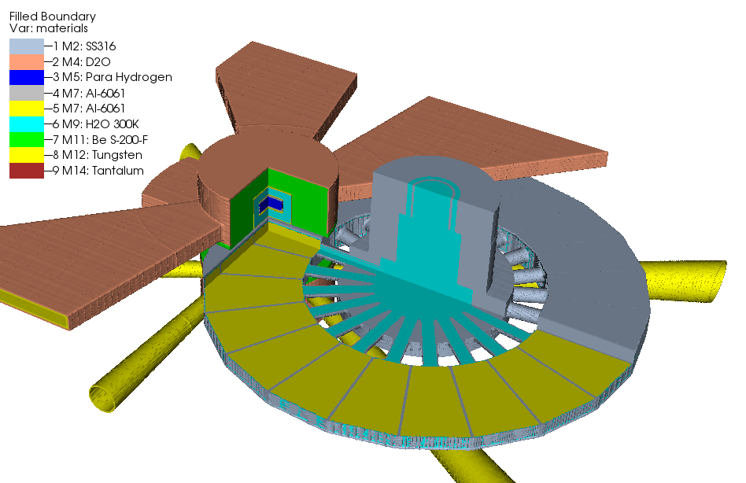
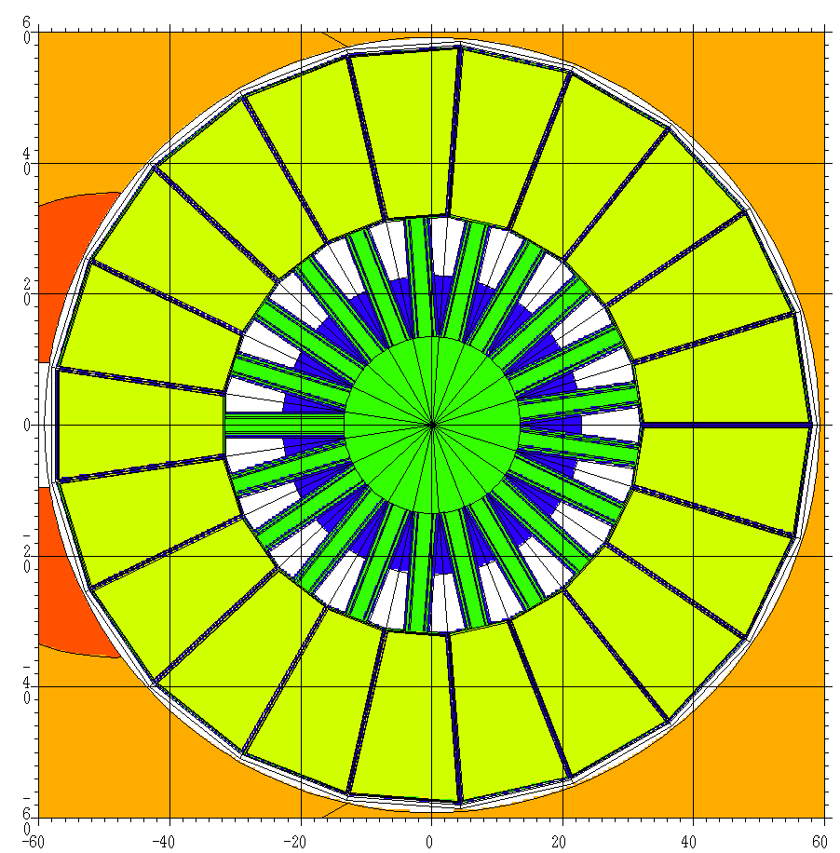
MCNPX model
Horizontal section through target centerline
Rotating target | Synchronous
Rotational speed | 1 turn in1.4 s
Number of segments | 21
Target Material | W
W width | 163.7 mm
W height | 58 mm
W length | 250 mm
Clad material | Ta
Clad thickness | 1 mm
Disk diameter | 1156 mm
Shroud material | 316L SS
Cooling | H₂0
Notes:
More details of the MCNPX model are shown here.
STS uses rotating disk with 21 tungsten segments. Each tungsten segment is clad with tantalum, covered with stainless-steel shroud and cooled with water. Target rotation will be synchronized with proton beam pulses. The target will complete 1 rotation in 1.4 seconds so that the consecutive pulses will hit adjacent target segments.
Tungsten segment dimensions are: height 58 mm , length 250 mm, ~ 164 mm width at the disk perimeter ( point to the table … and figures)

Slide 35
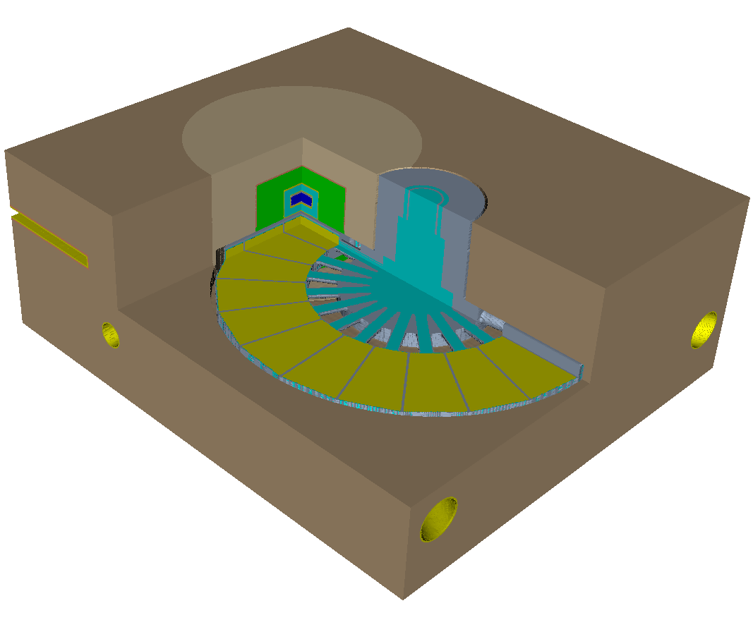
MCNPX physics model with steel shielding
Steel with 5% D₂O
Be
Steel with 5% H₂O
Notes:
THE target, moderator and reflector assemblies are surrounded with steel shield.

Slide 36
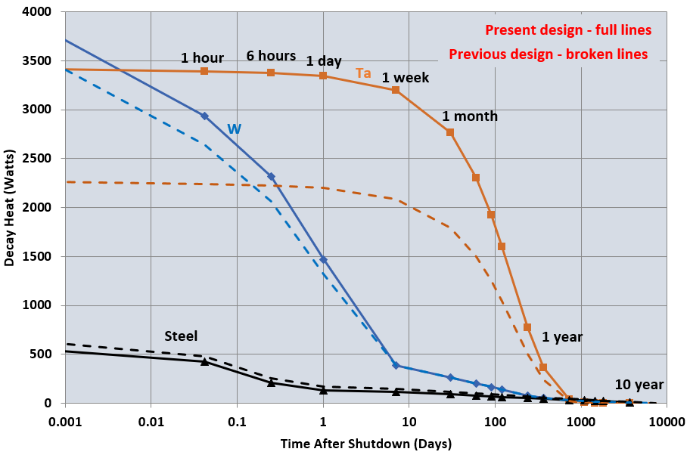
Rotating target decay heat, by material
20 years of beam-on operation (5000 h/y); 0.7 MW, 15 Hz
Ta contribution is dominant over long period of time.
 | Current |  | Previous
 | Mass (kg) | Mass Ratio | Mass (kg)
W | 743.60 | 0.98 | 757.80
Ta | 38.03 | 1.18 | 32.20
Steel | 562.40 | 1.22 | 462.47
Target decay heat and radionuclide inventory are high.
Improvement is desirable…

Slide 37
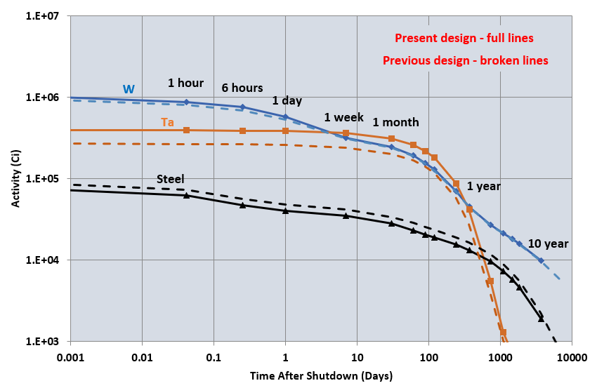
Rotating target activity, by material
Activity after 20 years of operation (5000 h/y), at 0.7 MW,
Ta clad

Slide 38
Target radionuclide inventory (with Ta clad)
At Shutdown
Top 20 nuclides sorted by activity
Activities by isotopes
after 20 years of operation (5000 h/y) at 0.7 MW, Ta clad
Detailed isotopic inventories were produced for accident analyses and waste management planning.
Isotope | Half-life (s) | Activity (Ci)
W -187 | 8.54E+04 | 3.86E+05
TA-182 | 9.89E+06 | 3.75E+05
W -183* | 5.20E+00 | 3.08E+05
W -185 | 6.49E+06 | 1.78E+05
TA-182* | 2.83E-01 | 1.70E+05
W -181 | 1.05E+07 | 4.44E+04
MN- 56 | 9.28E+03 | 2.35E+04
TA-183 | 4.41E+05 | 1.87E+04
W -179 | 2.25E+03 | 1.69E+04
H - 3 | 3.89E+08 | 1.60E+04
TA-178 | 5.59E+02 | 1.60E+04
TA-179 | 5.74E+07 | 1.51E+04
TA-177 | 2.04E+05 | 1.29E+04
W -178 | 1.87E+06 | 1.24E+04
CR- 51 | 2.39E+06 | 1.21E+04
W -185* | 1.00E+02 | 1.07E+04
TA-176 | 2.91E+04 | 9.56E+03
FE- 55 | 8.62E+07 | 9.47E+03
HF-175 | 6.05E+06 | 8.03E+03
TA-175 | 3.78E+04 | 7.51E+03
Target total |  | 1.97E+06
Target decay heat and radionuclide inventory are high.
Improvement is desirable…

Slide 39
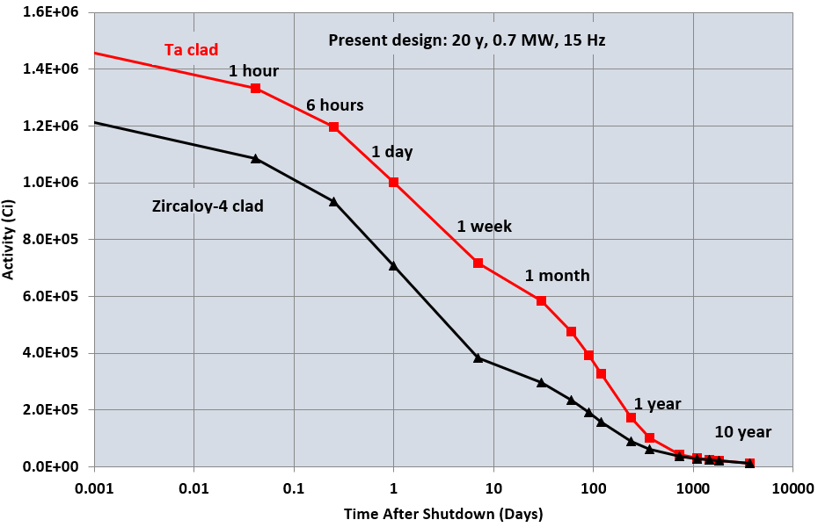
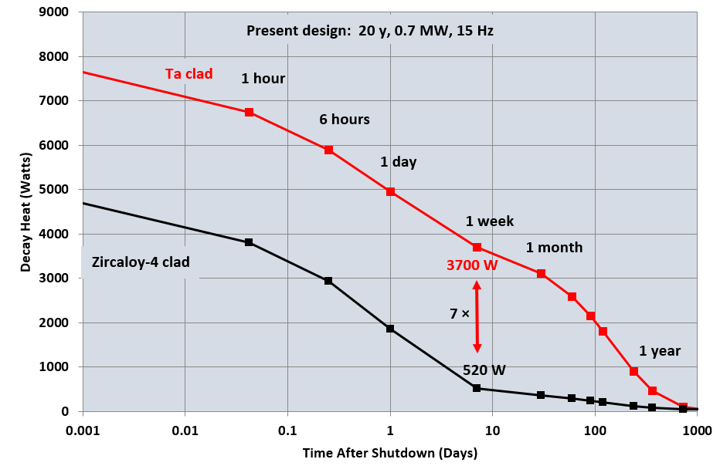
Reducing target decay heat and activity: Ta clad replaced with Zircalloy
2 x
By replacing Ta with Zircaloy significant reduction in decay heat and
activity can be obtained.

Slide 40
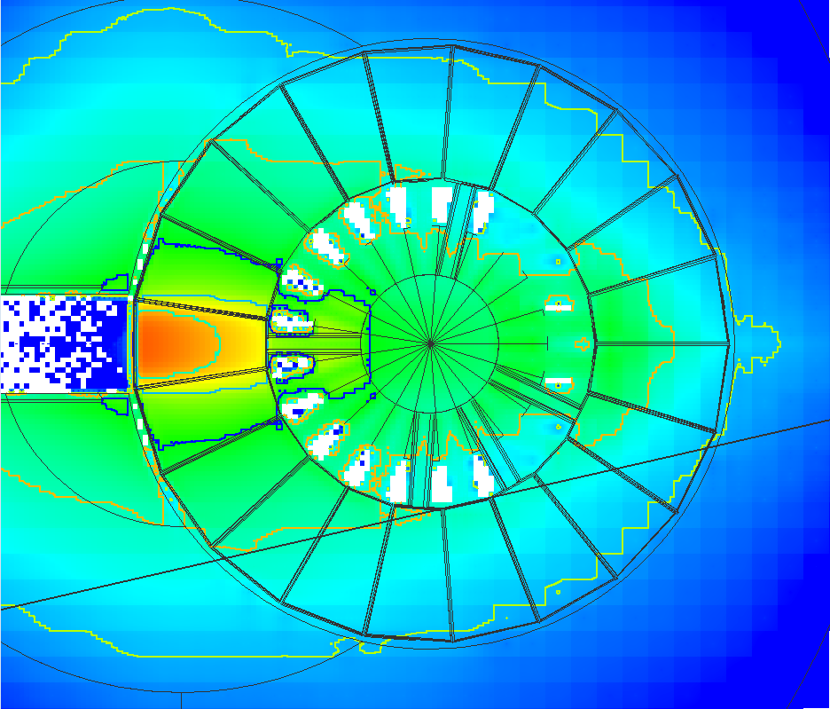
Energy deposition
per pulse
Horizontal cut through
target midplane
Energy deposition:
max. 39.0 J/cm³/pulse;
at 46.7 kJ proton energy per pulse.
Consecutive pulses hit different segments of the target; deposited energy is spread over large volume.
Notes:
The figure here shows the map of the energy per unit volume deposited in the target, per pulse, with larger beam profile. The map shows the horizontal cut through the target midplane.

Slide 41
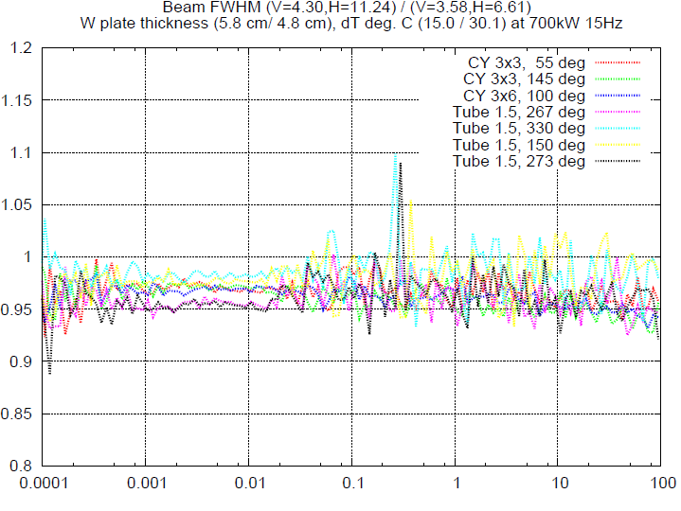
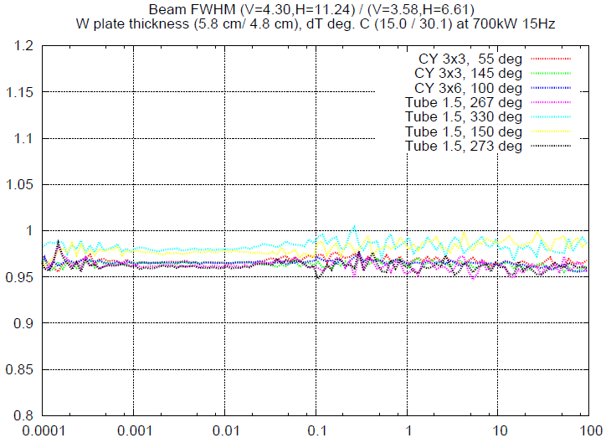
Larger beam profile has small effect on moderator performance
1.00
1.00
0.95
Ratio of peak brightness:
Large Beam / Small Beam
Ratio of time-integrated brightness:
Large Beam / Small Beam
Doubling the proton beam footprint (from ~ 30 cm² to ~ 60 cm²), causes only modest decrease
in moderator performance: ~ 2 – 5 % reduction in peak and tint brightness.
Notes:
It turn out that the effect is relatively small. The peak and time-integrated moderator brightness decreased by 2 to 5 %. So the larger beam footprint was accepted.

Slide 42
Component life expectancies: summary
Component | Target type/ beam profile | Material | Dpa Limit | Rate Rate | He Limit | He rate | Lifetime (dpa limit) | Lifetime (He limit)
 |  |  | (dpa) | (dpa/y) | (appm) | (appm/ y) | (year) | (years)
Target Window |  | SS | 12
 | Stationary /small |  |  | 16.7 |  |  | 0.7
 | Asynchronous Rot. / small |  |  | 0.35 |  |  | 51
 | Synchronous Rot. / large |  |  | 0.444 |  |  | 27
Proton Beam Window |  | Al | 40 |  | 2000
 | Stat. or Async./ small |  |  | 2.3 |  | 1335 | 17 | 1.5
 | Synchronous Rot. / large |  |  | 1.07 |  | 616.3 | 37 | 3.2
Moderator Vessels |  | Al | 40 |  | 2000 |  | 5.1
 | Stat. or Async./ small |  |  | 7.8 |  | 116 | 5.1 | 17
 | Synchronous Rot. / large |  |  | 5.24 |  | 68.2 | 7.6 | 29
Notes:
So in summary the shortest lifetime is predicted for the proton beam window: just over 3 years.
Predicted target lifetime based on target window dpa is long, 27 years. So it may turn out that it will actually be limited by other factors, such as tantalum clad durability.

Slide 43
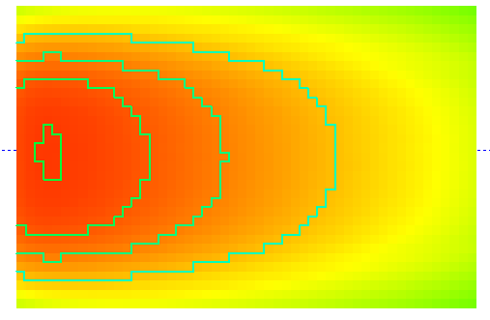
Dpa in tungsten
Highest dpa rate is ~ 0.750 dpa/ year
After 27 years of operation: maximum in W is 20.2 dpa.
Horizontal cut through tungsten plate
Vertical cut through tungsten plate at centerline
10
5
15
20
Isolines are shown for 5, 10, 15 and 20 dpa after 27 years of operation
Notes:
The highest dpa in tungsten is just over 20 dpa after 27 years of operation. Significant amounts of tungsten see dpa levels above 15 dpa, 10 dpa and 5 dpa.

Slide 44
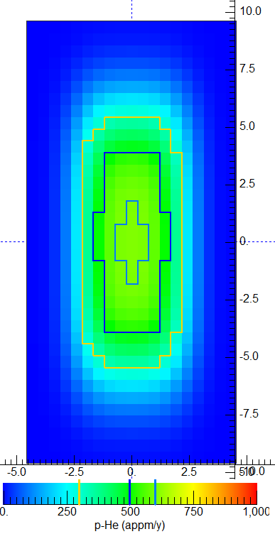
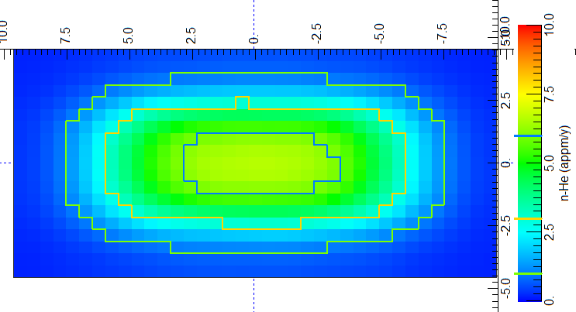
Aluminum proton beam window: He production rate
Window is 5.1 mm thick aluminum, water cooled
p-induced He production rate (appm/y)
n-induced He production (appm/y)
600 appm/y
Previous design
Max. He production rate: 1335 appm/y @ 15 Hz
~890 appm/y @ 10Hz
Estimated lifetime: 1.5 years @ 15 Hz
2.2 years @ 10 Hz
Neutron contribution is negligible.
Current design:
Estimated lifetime 3.2 years, limited by He production (limit 2000 appm)
Max. He production rate (n + p) ~616 appm/y @ 15 Hz
n-induced 6.75 appm/y
p-induced 609.5 appm/y
Dpa based lifetime estimate: 37 years
Notes:
The proton beam window lifetime is limited by helium production and is 3.2 years (38 months). Lifetime limit based on dpa is much longer: 37 years.

Slide 45
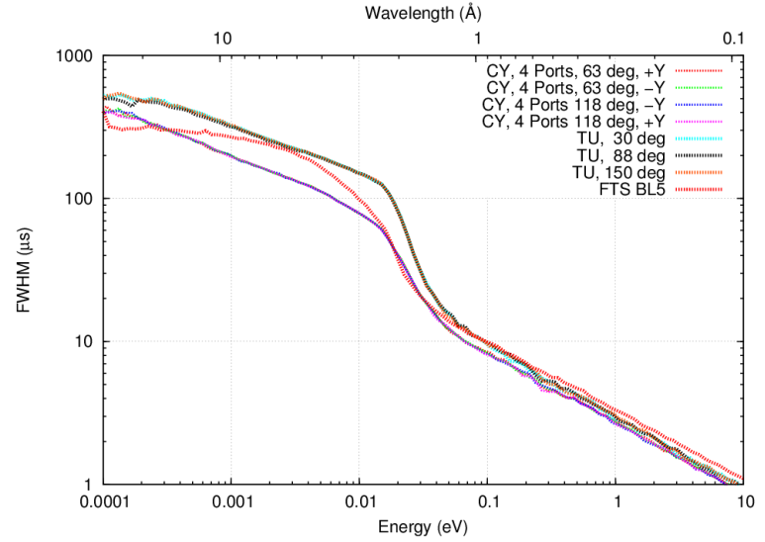
Pulse widths STS cylindrical moderator narrower than FTS Tube moderator pulses ~ 50 % wider
STS Tube Mod.
STS Cy Mod.
FTS BL5
Notes:
Pulse widths:
STS tube moderator has ~ 50% wider pulses than the STS cylindrical moderator; FTS is mostly sort-of in between.

