Slide 1
Shielding development for VENUS instrument
ICANS XXIII
Chattanooga, TN, October 17, 2019
I. I. Popova and F.X. Gallmeier

Slide 2
Outline
Introduction
Geometry description
Source definition
Methods
Results
Conclusion

Slide 3
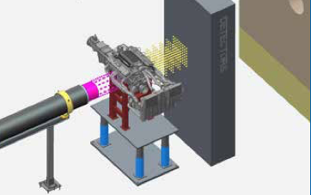
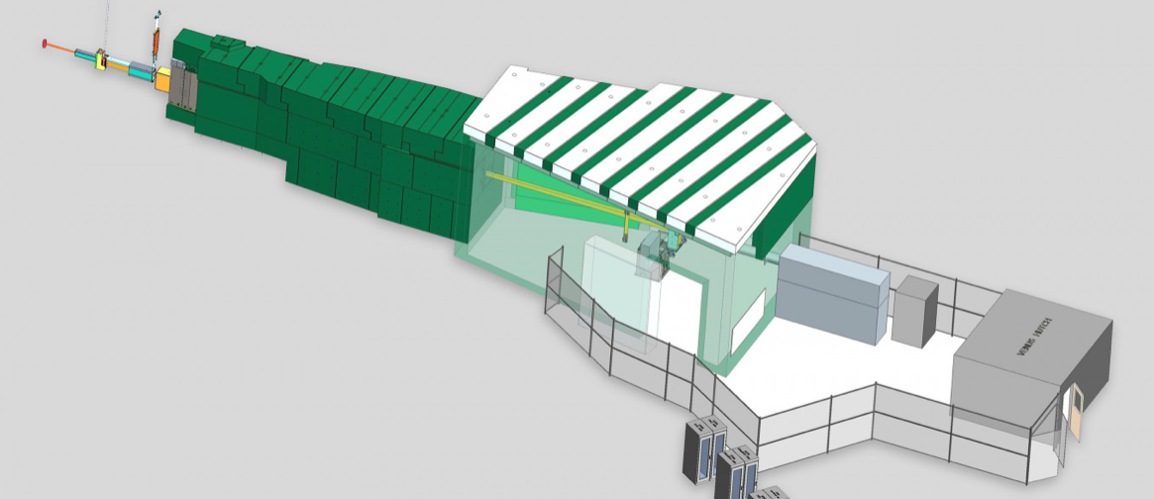
Introduction
VENUS - Versatile Neutron Imaging Instrument – in process to be built and is expected to be completed in 2022 and ready for scientific use by 2023
Instrument is based on time-of-flight technique across a range of energies from cold/thermal to epithermal
Beam footprint at the sample position is as high as 28 by 28 cm²
High-energy beam in combination with large beam footprint on the sample position are challenges for shielding and budget

Slide 4
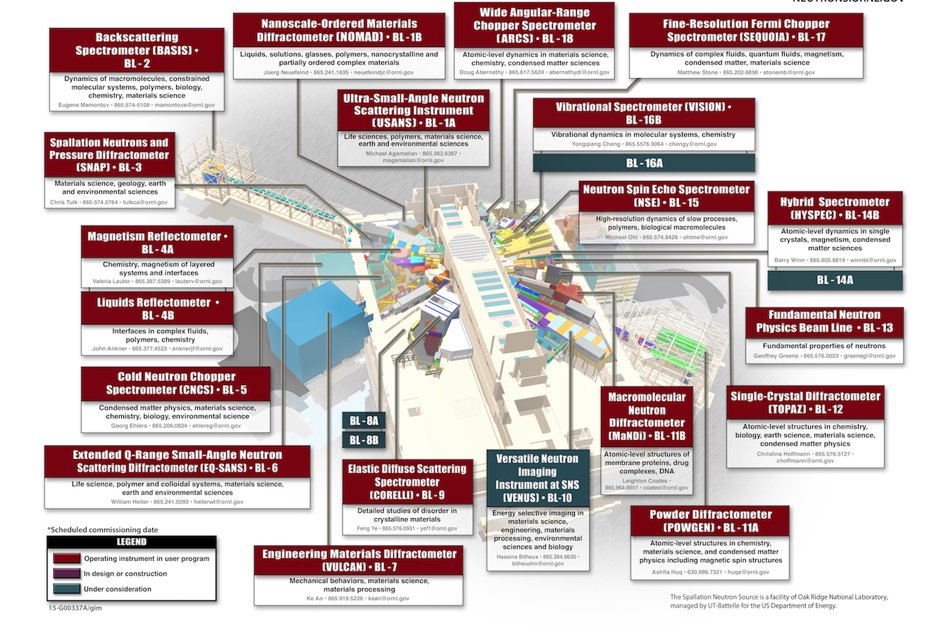
Introduction
Instrument to be built on beam line 10 and will face decoupled poisoned H2 moderator
For cost reasons VENUS will be built in a downsized enclosure version at beam restrictions to 20x20 cm² with T0-chopper and 4x4 cm² with white beam
Shielding is upgradable (about doubling shielding side walls) at later time to allow 28x28 cm² white beam originally envisioned
Beamline shielding is designed for on full white beam.

Slide 5
Geometry description
Shielding analyses are performed for:
Beam line shielding
Enclosure and beamstop shielding
Beam line shielding starts from the target monolith
Enclosure follows the beam line shielding

Slide 6
Requirements
Dose rates in generally accessible areas of 0.25 mrem/hr
Shielding height off floor of 4.45 m (2.4 m off centerline) to 7.4 m radius from monolith center
Shielding height off floor of 3.96 m (1.9 m off centerline) to 11.4 meter radius

Slide 7
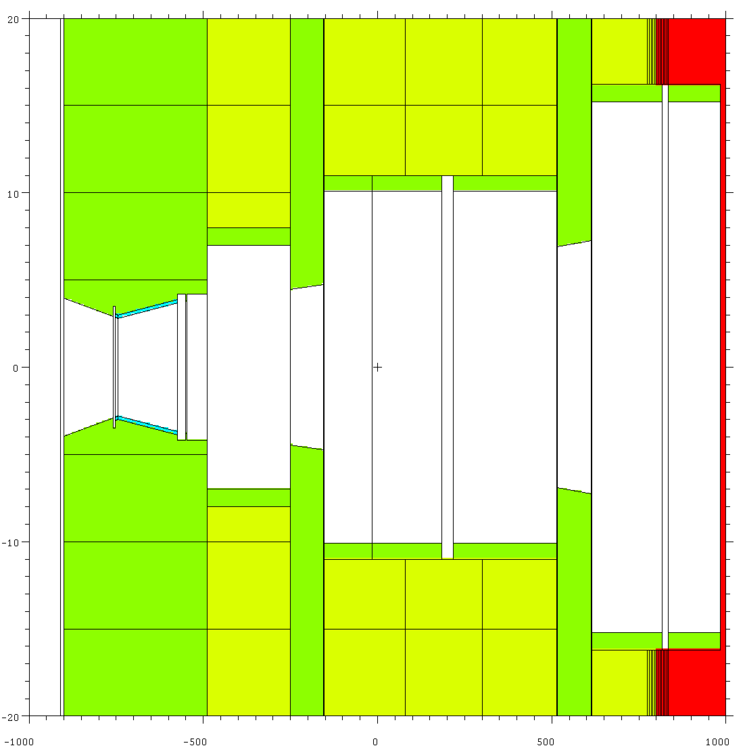
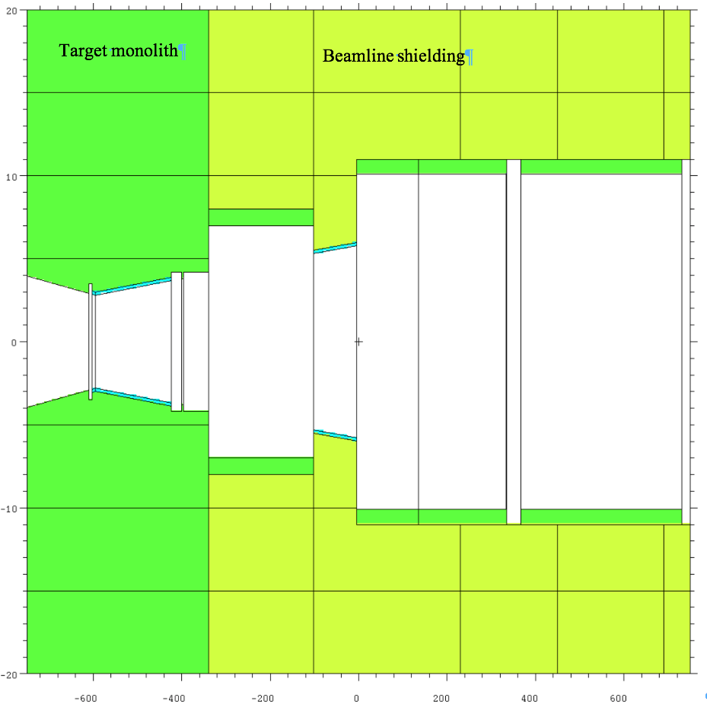
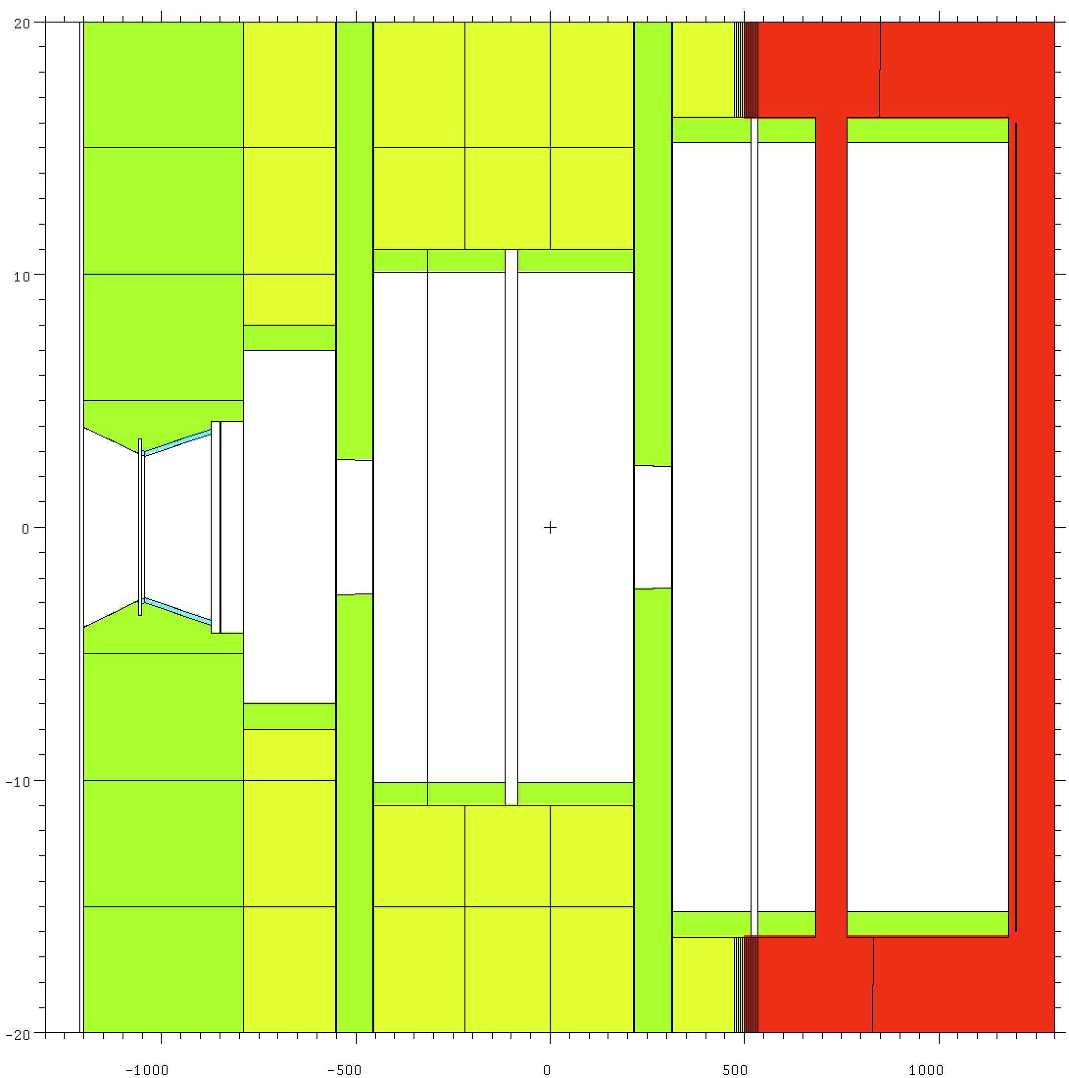
Geometry description – beam line
Beam optics starts 1 meter downstream of moderator
Optical components are comprised of a series of selected apertures, T0 and bandwidth choppers, beam scrapers and a fast shutter
+20cm
+10cm
Moderator
Full 28x28 cm² beam
20x20 cm² beam
4x4 cm² beam
Pinhole
-10cm
Flexible aperture
T0 chopper
BW chopper
BW chopper
-20cm
1m 4.5m 7m 14.5m

Slide 8
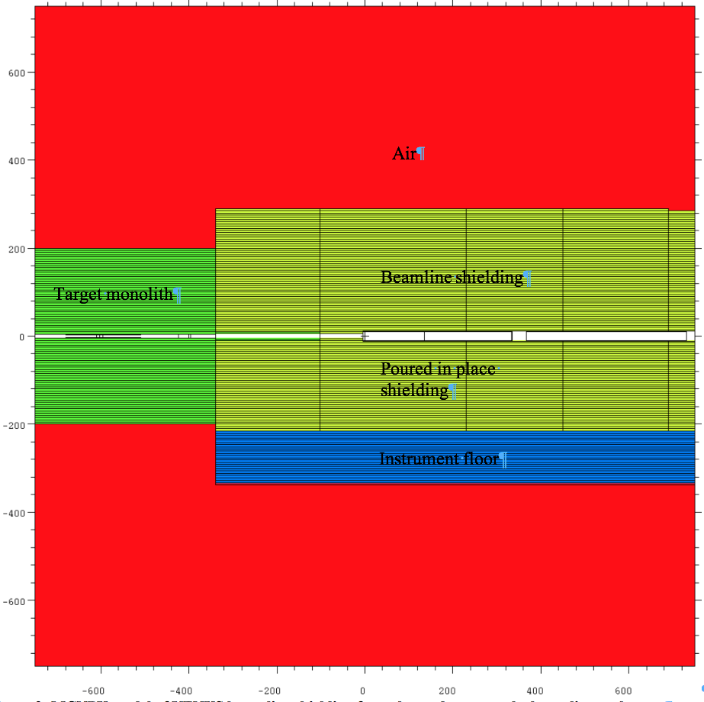
Geometry description – beam line
Beam path is shielded by:
high-density concrete, which extends to 2.90 m from the beam centerline to the top and to the side
high-density concrete, which extend to 2.14 m on the bottom followed by instrument floor from regular density concrete
+6m
+4m
+2m
+0m
-2m
-4m
-6m
1m 4.5m 7m 14.5m

Slide 9
Geometry description – enclosure
Beam line enclosure is made from HD concrete
Enclosure thickness on the side is 40-cm and on the top is 75-cm
Enclosure thickness on the downstream wall is 55 cm
Sample in the analyses is 2.45cm thick steel and 32cm by 32cm.
Additional analyses are performed for case, when sample is slanted 45 degrees towards hot cell.

Slide 10
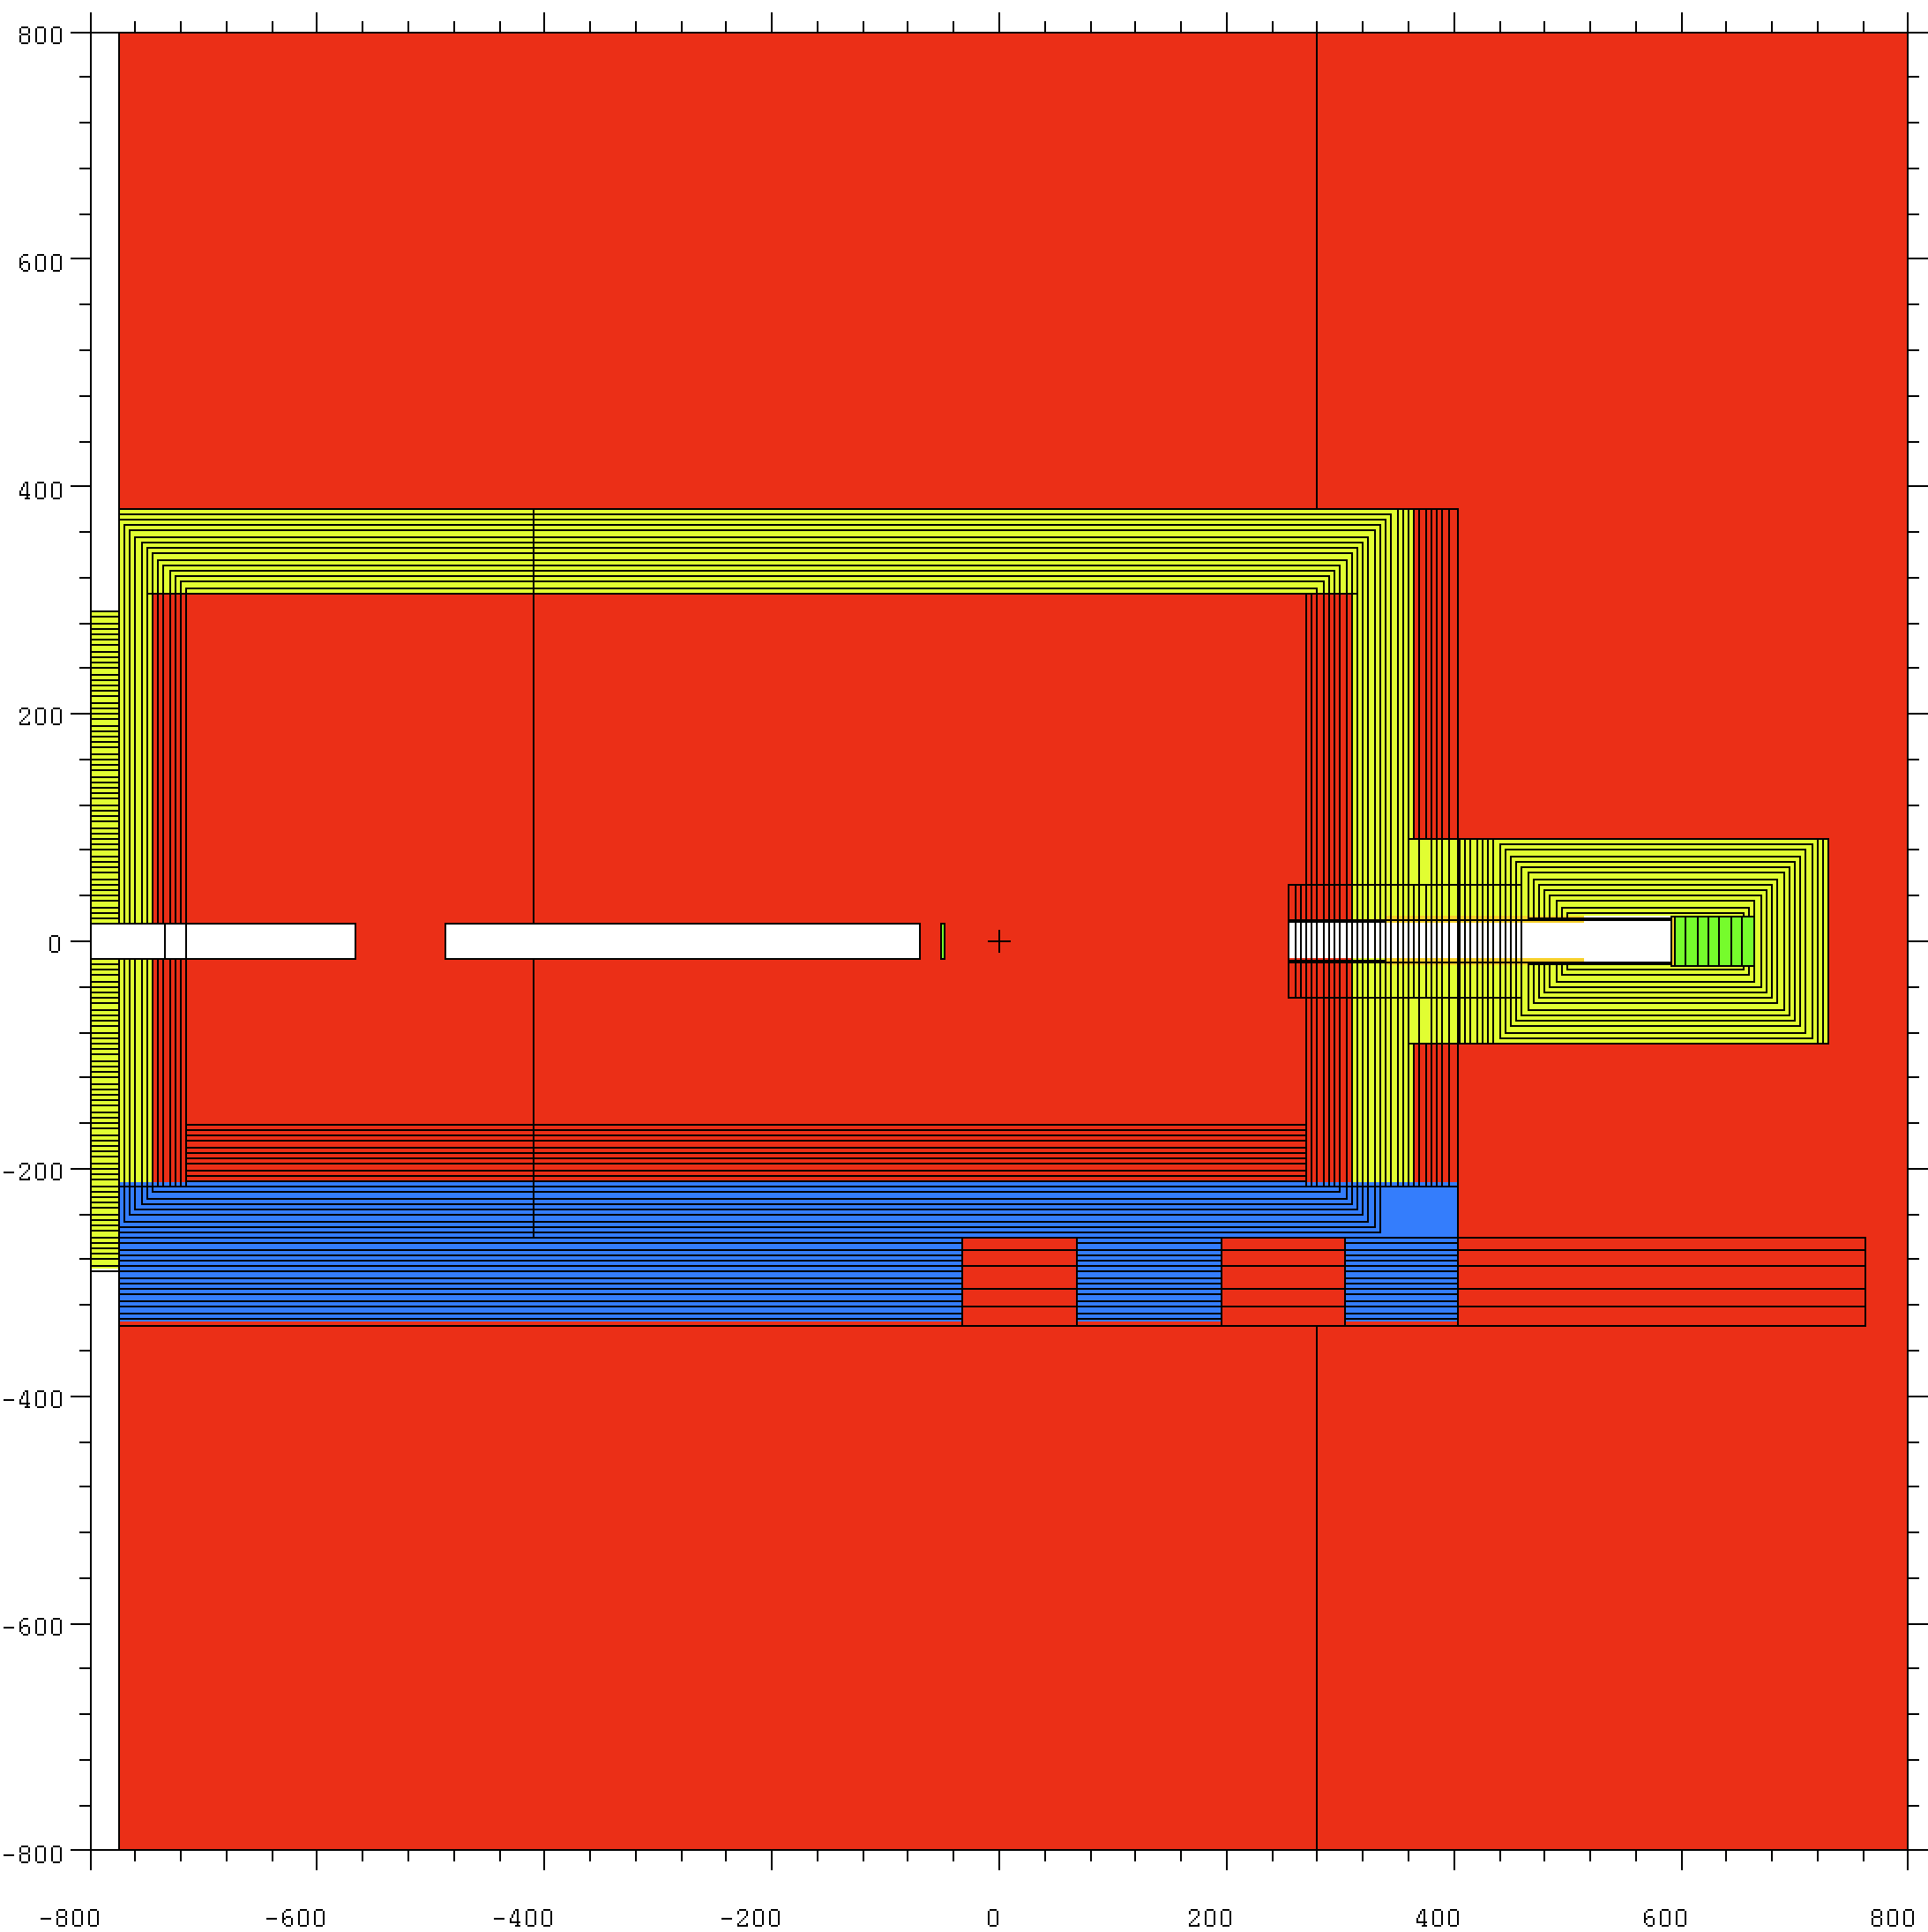
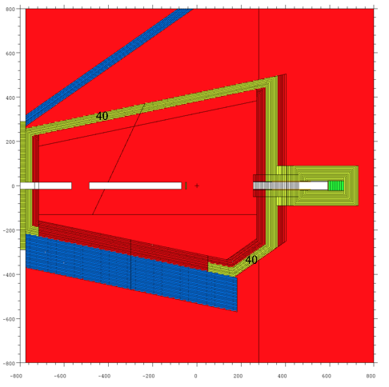
Geometry description – enclosure
75
55
90
68

Slide 11
Source definition
Beam line shielding
Source terms based on 1.0 GeV, 2MW operation
as a neutron beam with intensity of 4.47 10¹² n/s, starting at core vessel insert nose
0-0.5 degree, 0.5-1 degree and 1-2 degree angular segments
Enclosure shielding
The source for PPU assuming a 1.3 GeV proton beam at 2 MW power
0-0.5 degree, 0.5-1 degree and 1-2 degree angular segments
The new 0.5-0 deg bin has a softer spectrum than the original most forward bin.
The acting T0 chopper was figured into a modified source description accounting for:
Timing of chopper causing a energy-dependent opening
Attenuation of beam by 30 cm of Inconel

Slide 12
Source term description
The effect of the T0 chopper is:
Suppressing epithermal spectral components (E=1-500eV)
Eliminating fast component (1keV-10MeV)
Suppressing high-energy component (>10MeV)
solid -original
dashed-
modified

Slide 13
Methods
Analyses are performed with the Monte Carlo code MCNPX version 2.7.0
Shielding is modeled in 5 cm increments to use geometry splitting
2D mesh-tallies are defined in Cartesian coordinate
Thickness of the slice is 20 cm and mesh size is 5 cm x 5cm
Dose rate are obtained by folding fluxes with flux to dose conversion coefficients

Slide 14
Beam line shielding analyses
Five sets of analyses are performed:
White beam, beam line shielding is from high-density concrete ;
White beam, beam line shielding is from high-density concrete, with steel in first 55 cm from the beam center line;
T0 chopper intercepting the beam, beam line shielding is from high-density concrete;
White beam, regular-density concrete;
White beam, regular-density concrete with steel in first 55 cm from the beam center line.

Slide 15
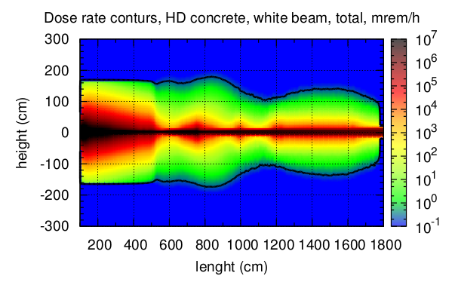
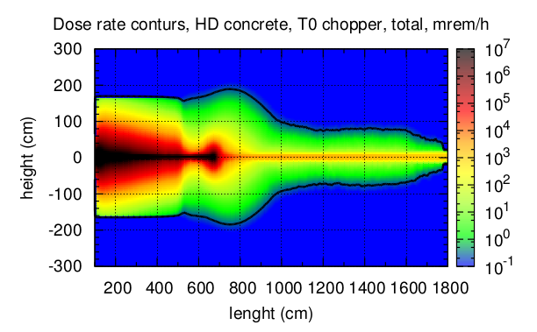
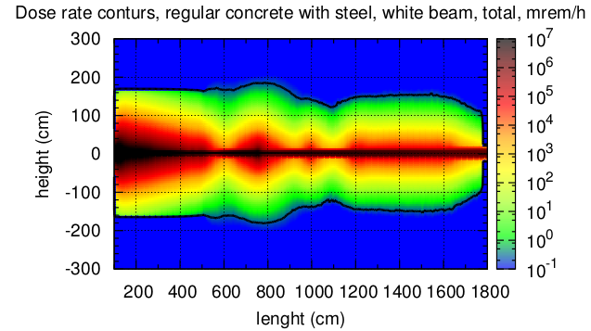
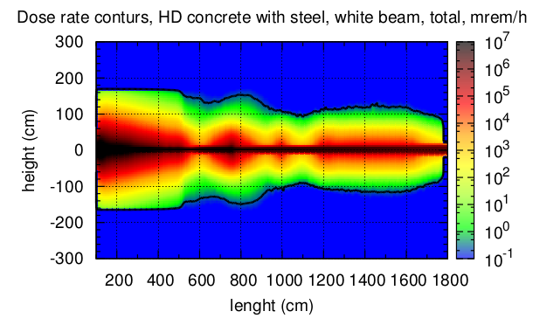
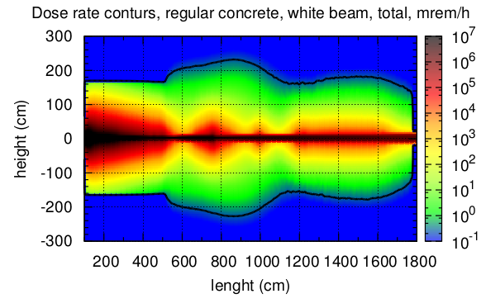
Beam line shielding results

Slide 16
Enclosure shielding results
Three sets of analyses are performed:
Beam areas at sample position defined by collimator/scrapers to be 20x20 cm with T0 chopper acting;
Beam areas at sample position defined by collimator/scrapers to be 4x4 cm with white beam;
Beam area at sample position is 28x28cm, there is no collimator scrapers

Slide 17
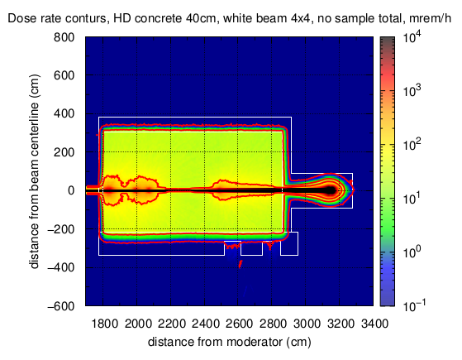
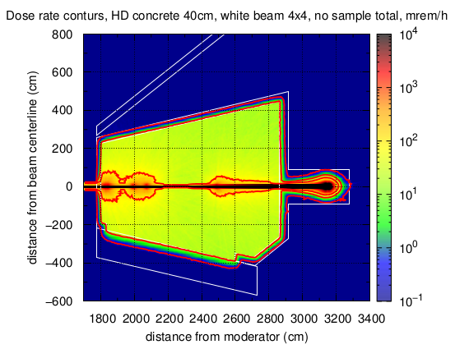
4x4cm white beam with 40-cm HD enclosure, no sample
White beam
Analyses for beam stop
Dose rate contours at 0.25, 10, 100mrem/h, red color
Enclosure contours are in white color

Slide 18
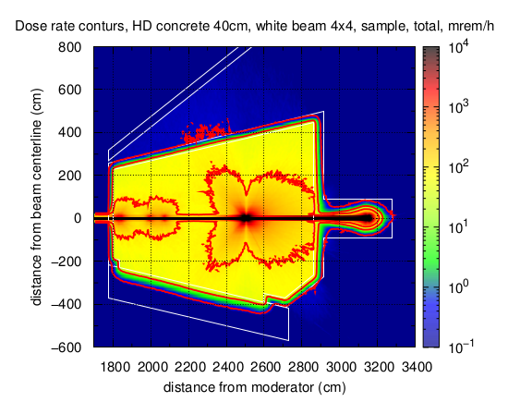
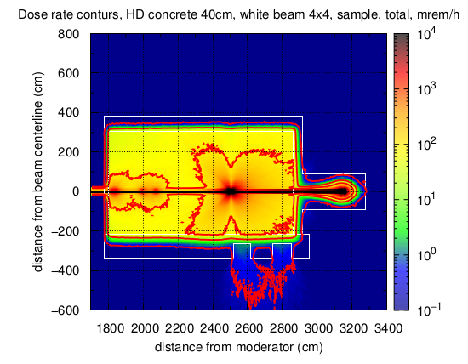
4x4cm white beam with 40-cm HD enclosure, sample
White beam
Dose rate contours at 0.25, 10, 100mrem/h, red color
Enclosure contours are in white color

Slide 19
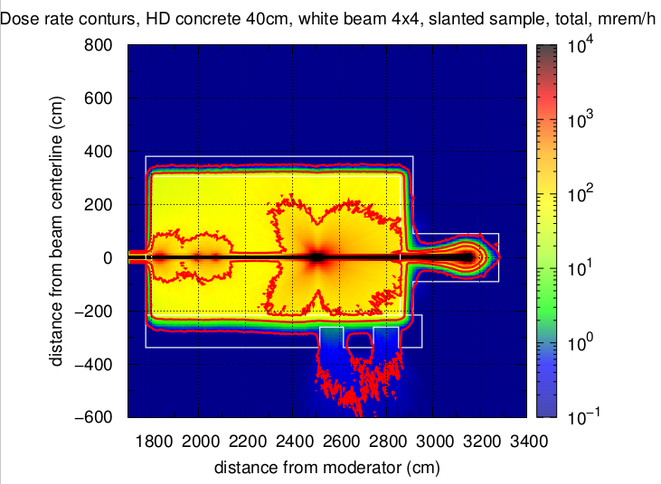
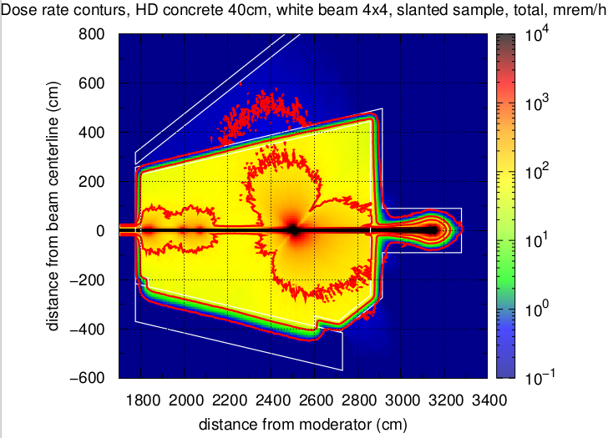
4x4cm white beam with 40-cm HD enclosure, slanted sample
White beam
Dose rate contours at 0.25, 10, 100mrem/h, red color
Sample is slanted 45 deg towards hot cell, beam passing path is 2.54cm
Dose rates elevated outside the enclosure upto 0.5 mrem/r

Slide 20
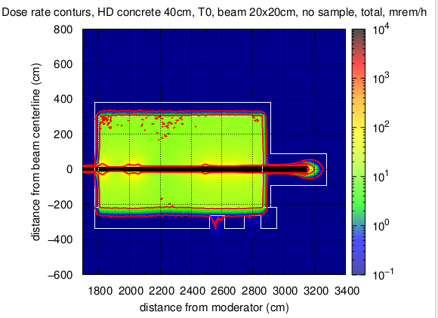
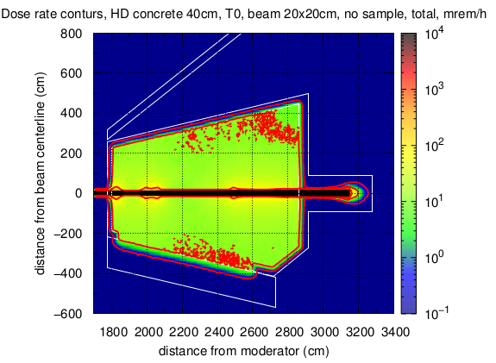
20x20 cm beam, acting T0 chopper in 40cm HD enclosure
Analyses for beam stop
Dose rate contours at 0.25, 10, 100mrem/h, red color
Enclosure contours are in white color

Slide 21
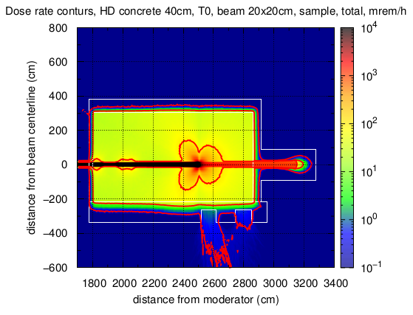
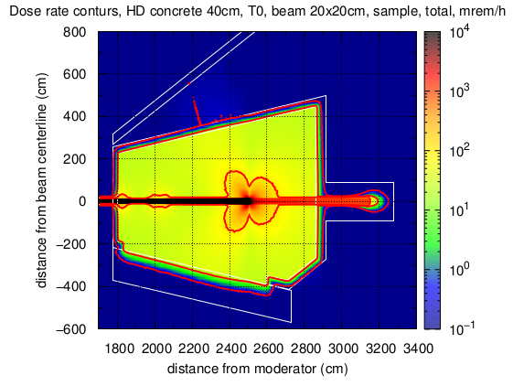
20x20 cm beam, acting T0 chopper in 40cm HD enclosure
Dose rate contours at 0.25, 10, 100mrem/h, red color
Enclosure contours are in white color

Slide 22
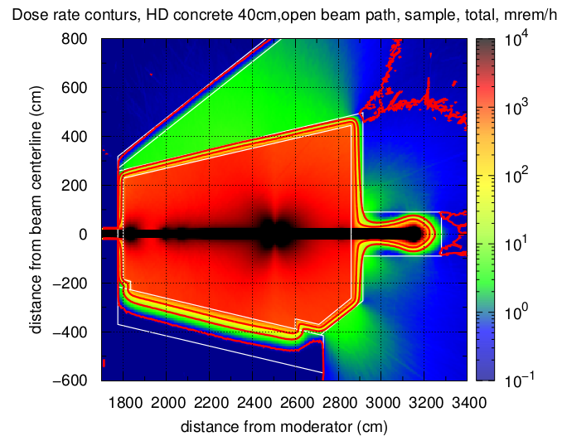
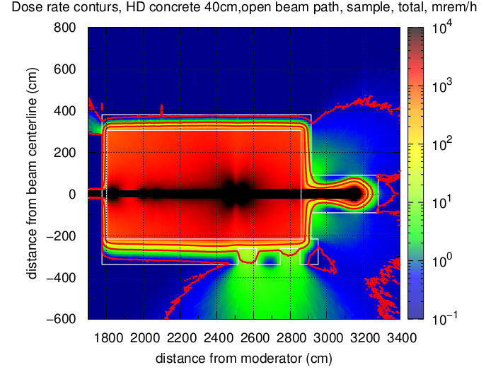
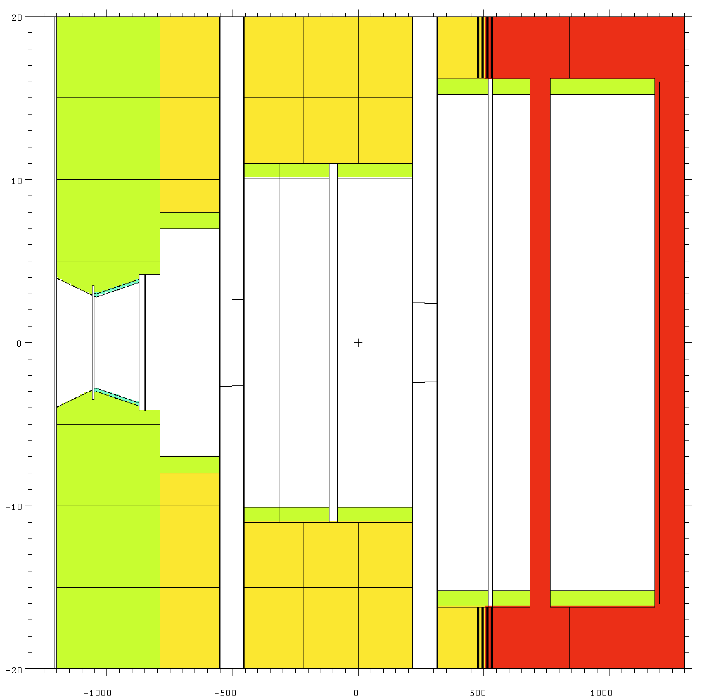
White beam, no collimator/scrapers, sample
White beam
Dose rate contours at 0.25, 10, 100mrem/h, red color
Enclosure contours are in white color

Slide 23
Conclusions
Five sets of analyses are performed to help define beamline shielding:
Dimensions
Materials
Three sets of analyses for the enclosure are performed to define:
Enclosure thickness
Enclosure material – high-density concrete
Beam stop shielding thickness

