Slide 1
Proposal for a Fusion Prototypic Neutron Source at LANSCE
ICANS-XXIII
Chattanooga, USA
Eric Pitcher and Yuri Batygin
14 October 2019
LA-UR-19-30377

Slide 2
The U.S. Department of Energy’s Office of Fusion Energy Sciences seeks an irradiation capability to test fusion materials
Workshop held in August 2018 concluded:
A near term, moderate cost Fusion Power Neutron Source (FPNS) would advance our scientific understanding of materials degradation in the intense fusion neutron environment
FPNS is a potential intermediate step to next generation sources such as IFMIF/DONES/A-FNS, if it becomes available near-term
Requires start of construction within about three years from a decision
Parameter | Guideline
Damage rate | ~8–11 dpa/calendar year (Fe)
Spectrum | ~10 appm He/dpa (Fe)
Sample volume in high flux zone | ≥ 50 cm³
Temperature range | ~300–1000°C
Temperature control | 3 independently monitored and controlled regions
Flux gradient | ≤ 20%/cm in the plane of the sample

Slide 3
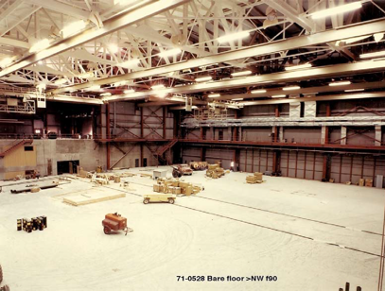
LANSCE can deliver 1 MW of 800-MeV protons to drive a Fusion Power Neutron Source (FPNS)
LANSCE accelerator delivered 800-kW proton beam for more than a quarter century (1972 – 1999)
Large experimental hall is available to accommodate FPNS
Large quantity of steel and cast iron available on site for beamline and target station shielding
Two hot cells adjacent to the
experimental hall can be
dedicated to post-irradiation
examination of irradiated
samples
Substantial expertise exists
at LANSCE to support the
safety basis and permitting,
and target operations

Slide 4
Concept: Annular tungsten target cooled by helium gas, fusion materials samples placed inside target annulus
annular
tungsten
target
helium coolant
SS housing
helium flow
out
sample
can
~2 cm
in
~6 cm
proton beam axis
annular proton
beam spot
in
out

Slide 5
MCNP model showing details of the sample can
VERTICAL CUT ALONG PROTON BEAM AXIS
VERTICAL CUT TRANSVERSE TO PROTON BEAM AXIS
Tungsten target
Helium cools the tungsten target
Target wall contains helium
Vacuum gap between
target and sample can
Sample can outer wall
Heavy water channels
cool can walls and samples
Insulating gas gap (1 of 3) filled
with He+Ar mixture that controls
thermal conduction from samples
120° wedge (1 of 3) filled
with materials test specimens
annular beam
spot on target

Slide 6
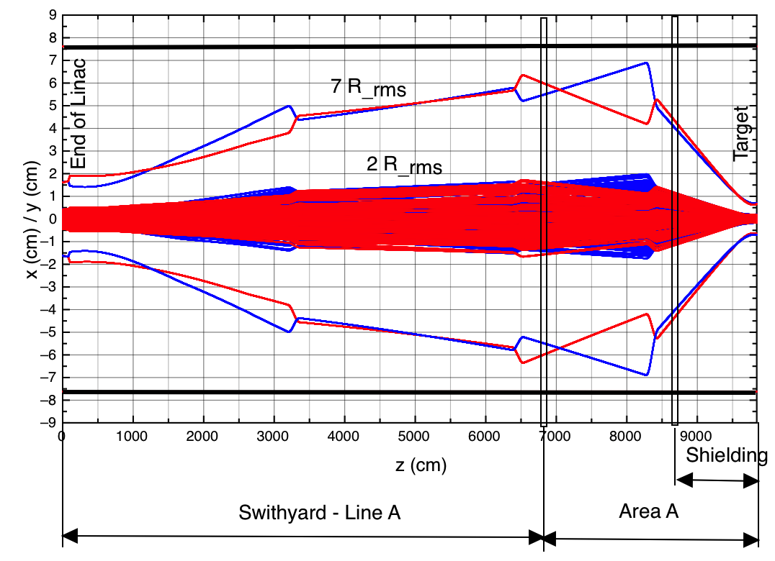
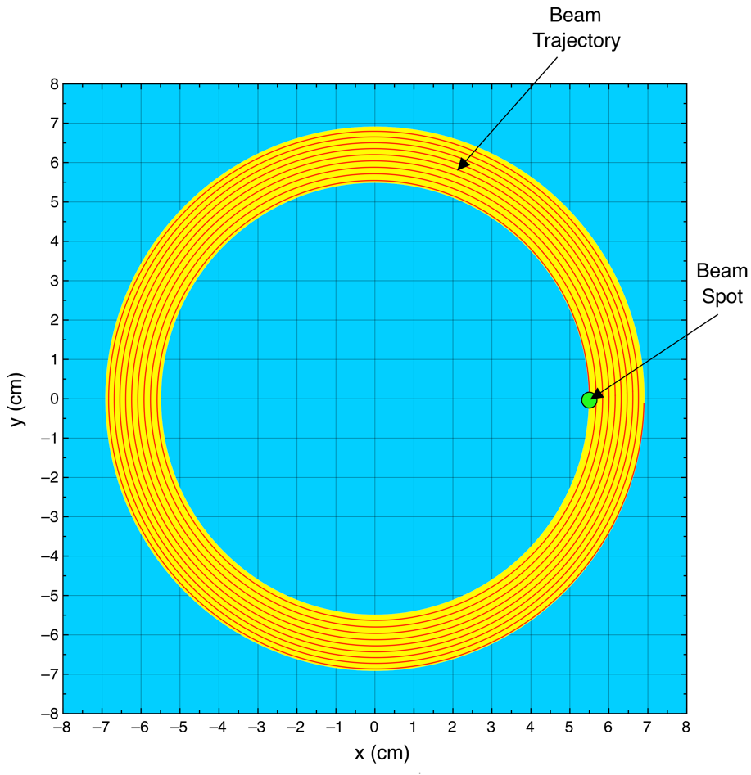
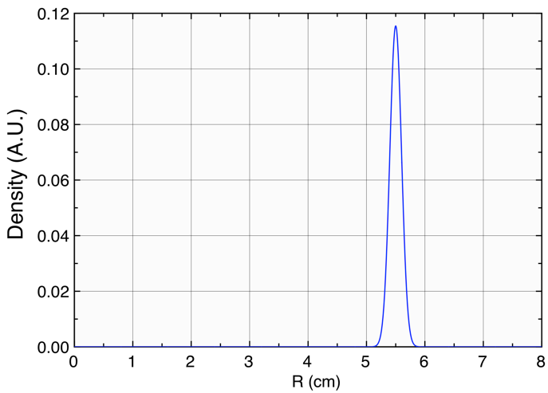
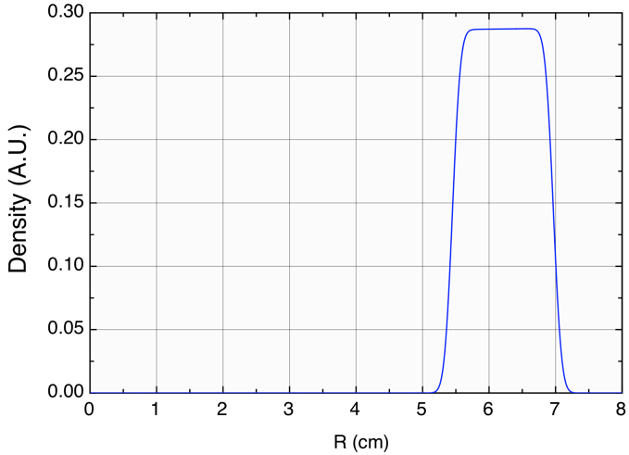
Proton beam is rastered to form an annular beam spot
Beam transport is designed to provide transverse focus in both planes (1 mm rms) at the target
Sinusoidal raster magnets sweep an incrementally larger circular pattern on target (17 times)
SINGLE SWEEP
17 SWEEPS

Slide 7
Protons are reasonably well confined to the target, with some penetration into the sample can downstream
MCNP GEOMETRY
PROTON FLUX
r
Peak current density on target is 54 µA/cm²
Target window (SS316L) damage rate is 17 dpa/calendar year
SINQ cannelloni tubes (SS316L) have gone to 22 dpa, so target should last one year

Slide 8
Neutrons leak radially inward into the sample can, creating a region of peak flux with low spatial gradient
NEUTRON FLUX
Fe DISPLACEMENT RATE
Average neutron flux in the 53-cc tally volume is 1.2×10¹⁵ n/cm²/s
Average Fe displacement rate is 20.6 dpa/fpy with <10%/cm gradient, with neutrons responsible for 97% of the displacements
Substantial irradiation volume in the reflector with up to 18 dpa/fpy

Slide 9
Helium production in the peak neutron flux region is well matched to fusion reactor first wall conditions
Fe HELIUM PRODUCTION RATE
Fe HELIUM-TO-DPA RATIO
He-to-dpa ratio in the 53-cc tally volume has an 11–18 appm/dpa range, with an average value of 14.6 appm/dpa
The broad range of He-to-dpa ratio allows researchers to study the sensitivity of mechanical properties to this important quantity

Slide 10
Design satisfies volume and displacement rate goals
Calendar year (CY) assumes 3400 hours at
full power, which equals 0.39 fpy (full-power year)
Within the fusion-relevant range of 6 to 16 appm/dpa, 50 cm³ of sample volume exceeds 17 dpa/fpy
Sample Can Volume vs. Displacement Rate
Summary of parameters for the 53-cc tally volume:
= 8 dpa/calendar year
Additional irradiation volume
available in the reflector.

Slide 11
Beam trips cause samples to be irradiated at temps below the target temp for a small fraction of time
Radiation (mostly by gammas and scattered protons) deposit
8.4 W/g of heat in the materials test specimens
This heat causes a temperature rise of ~20°C/s in the samples
When the beam trips, samples cool at this rate until their temperatures approach the coolant inlet temperature
Historical data indicates the LANSCE beam trips 40 times per day
At this beam trip rate,
the maximum fraction
of time that a sample
is >20°C below its
desired irradiation
temperature is 6%

Slide 12
Solid transmutants may enhance embrittlement in iron-based alloys
Ti, Sc, Ca, and K are produced in amounts that are at least a factor of 5 greater than in a fusion reactor first wall
Solid transmutants have been observed to migrate to grain boundaries, which may cause embrittlement
The degree to which solid spallation product segregation enhances embrittlement and hardening relative to that induced by the much higher levels of helium (~100 appm He/appm Ca), is an open question
Elemental composition of EUROFER97 irradiated to 200 dpa in DEMO and MTS [E.J. Pitcher, C.T. Kelsey IV, and S.A. Maloy, Fus. Sci. & Tech. 62 (2012) 289].

Slide 13
Target cooling with helium appears viable from a thermal-hydraulics standpoint
helium flow
out
in
Deposited power = 530 kW Operating pressure = 20 bar
Helium mass flow rate = 2.5 kg/s Target pressure drop = 0.4 bar
Coolant channel width = 1 mm Helium inlet temperature = 400 K
Helium flow velocity = 5 to 3 m/s Helium temperature rise = 40 K
in
out

Slide 14
Cost range and schedule are based on the previously proposed Materials Test Station project
Costs accounted for differences in scope between the two projects and escalation since 2012 when MTS cost estimate was performed
  Hot cells refurbishment
  Helium circulator vs. electromagnetic pump
  Accelerator rf systems, beam diagnsotics, magnet power supplies
  PIE equipment
FPNS cost range is –25% to +50% of $101M point estimate, or
$76M to $152M
Schedule is five to six years from approval of mission need (CD-0)
  Conceptual design: 12 months
  Preliminary design: 18 months
  Final design: 12 months
  Construction: 24 months
  Commissioning: 3 months

Slide 15
FPNS at LANSCE satisfies all requested guidelines
Capitalizes on substantial existing infrastructure, reducing construction cost and schedule
Cost range is $76M to $152M
Project estimated to take five to six years

