Slide 1
Solving Process Instrumentation Challenges for the ESS Target Safety System
Ola Ingemansson
Electrical & Instrumentation Engineer
European Spallation Source ERIC
2019-10-15

Slide 2
Outline
Introduction
ESS overview
Target Safety System
Process Instrumentation Selection for TSS
Sourcing equipment
Compatibility
Resistance to environment
Obsolescence
Solving challenges
Documentation requirements
Summary

Slide 3
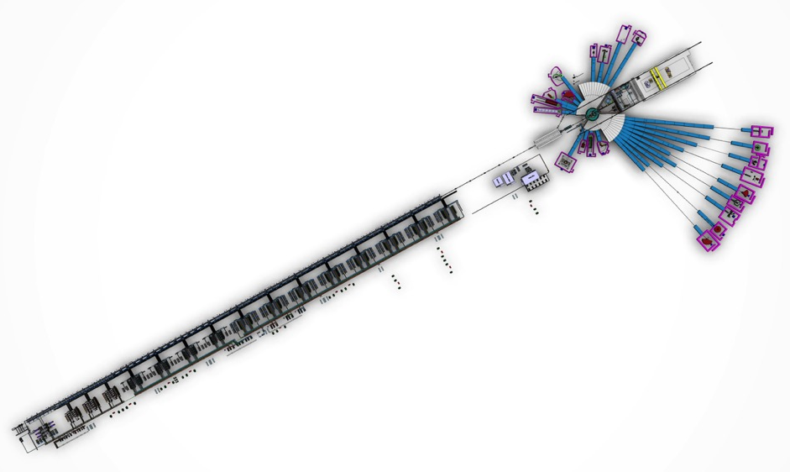
The ESS facility layout Main parts
The European Spallation Source (ESS) is a multi-disciplinary research center based on the world’s most powerful neutron source
Neutron Science Systems
22 planned and budgeted neutron scattering instruments
Neutron beam line lengths ranging from 10 m to 150 m from source
Proton Linear Accelerator
Pulse frequency 14 Hz
Proton energy 2 GeV
Beam power, time averaged 5 MW, within pulse 125 MW
Beam current 62,5 mA
Target

Slide 4
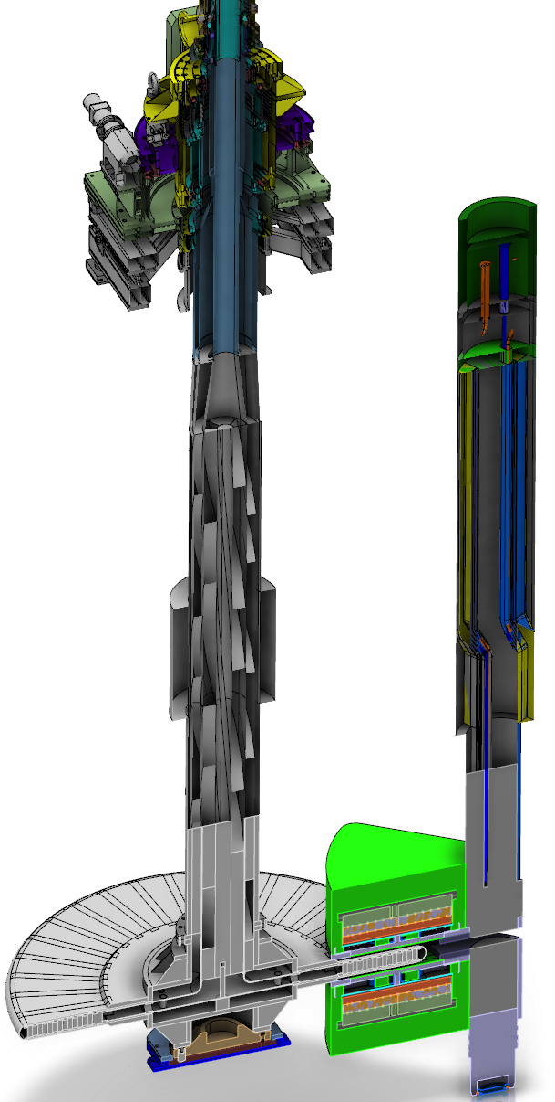
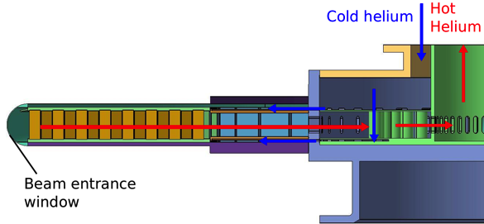
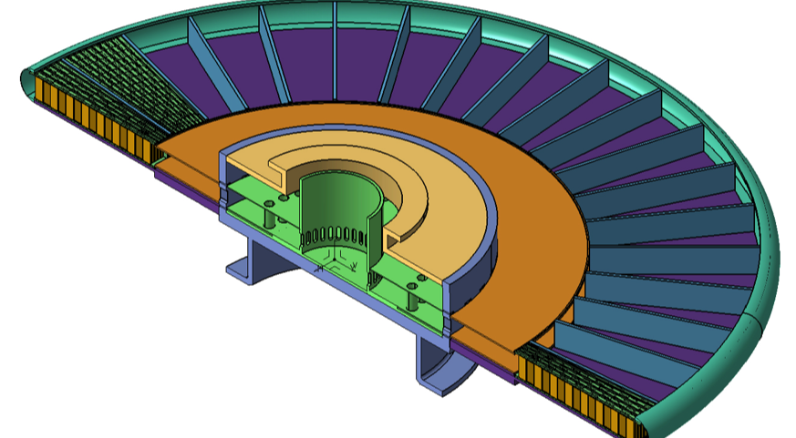
ESS Target Station
5 MW long pulse spallation source
2.86 ms proton bunch at 14 Hz rep rate
Raster pattern where protons incident upon Target wheel
Rotating tungsten target
5.4 tons (4900 kg) wheel only, (11 tons wheel + shaft)
rotating at 23.3 rpm (sector receives beam pulse every 2.4 seconds)
5 year lifetime, He gas cooled
Cold Moderators
Liquid hydrogen with 2-5 year lifetime
Inventories
High power beam impacting the tungsten target will create an inventory of nuclides
Primary inventory is in wheel (monolith and storage in active cells)

Slide 5
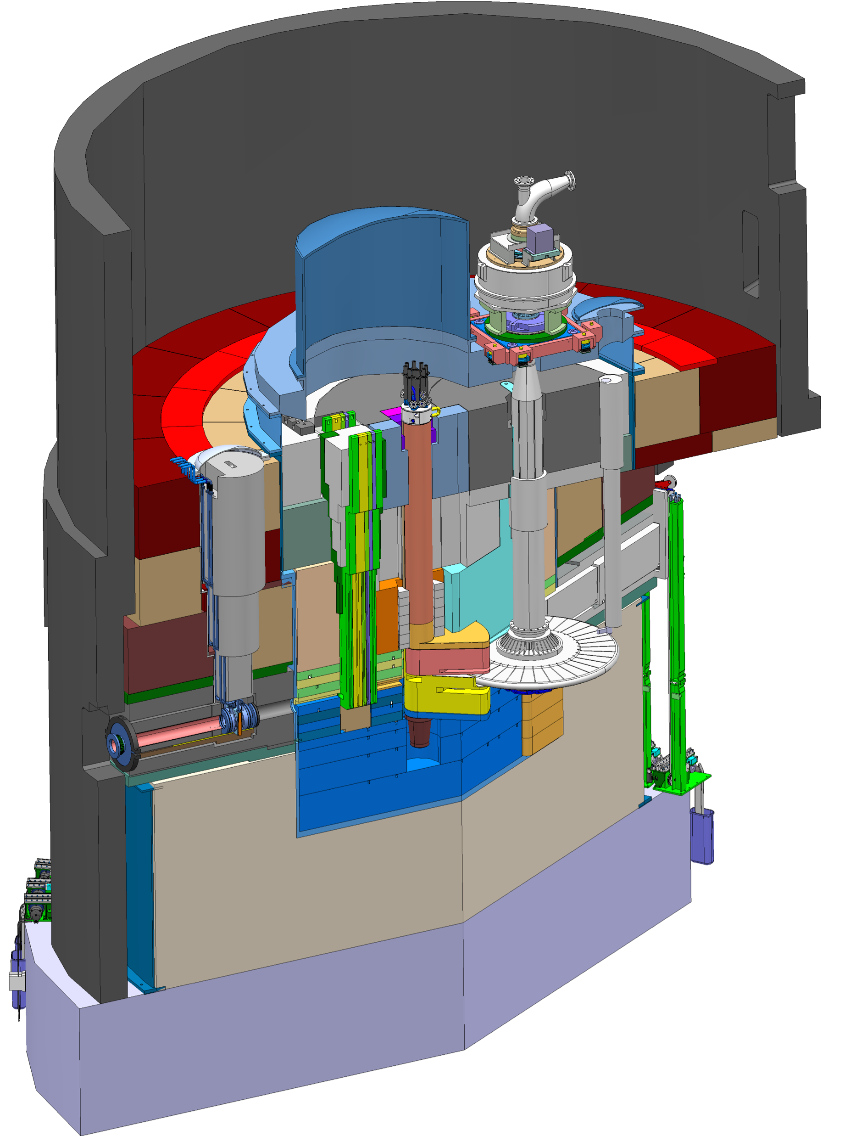
Key features of the ESS Target Station
Moderator and reflector
Target Safety System
Monitors target coolant flow, pressure and temperature, monolith pressure, & target wheel rotation
Prohibit beam on target if parameters are outside specified limits
proton beam instrumentation plug
Helium cooling of target material
Mass flow 3 kg/s
Pressure 11 bar
Temperature inlet/outlet 40 °C/240 °C
monolith vessel
neutron beam extraction port
Rotating solid tungsten target
36 sectors
Mass, total 11 tonnes, with 3 tonnes of W
Rotates 23.3 rpm, synchronized with pulsed proton beam 14 Hz
proton beam
target wheel
target monitoring plug
proton beam window
Diagnostics and instrumentation
Controlled and integrated commissioning and operation of the accelerator and target
Fluorescent coating of PBW and target front face
Optical paths, grid profile monitor, aperture monitor
Wheel monitoring including position, temperature, vibration, as well as internal structure
Moderators
Provisional locations of moderators above and beneath the target wheel, i.e. monolith centre
1st MR plug exploits the upper space, offering:
Cold, 30 mm high, liquid H₂ moderators, 17 K
Thermal, 30 mm high, H₂O moderator, 300 K

Slide 6
Target Safety System, TSS Role
Deep defense (C.5 & C.6)
What is the role of the TSS?
The TSS is an independent monitoring interlock system, it is a safety SSC in the Safety Group that acts on DiD Level 3 to:
Protect the public from exposure to unsafe levels of radiation and prevent the release of radioactive material beyond permissible limits
Bring the target into a safe state in case of an abnormal event from the radiation safety point of view
The safe state, from the TSS point of view, is defined as no beam on the target
The TSS handles only radiation safety, not ODH, electrical hazards, fire, etc.

Slide 7
TSS Context: ESS Radiation Safety
Where does TSS fit within overall Target Radiation Safety Strategy?
TSS is part of our set of tools
Outcome of Radiation Safety Hazard Analysis for Target Station systems includes:
Identification of safety functions
Identification of safety SSCs (structures, systems, and components) and safety-related SSCs
Contributors to Radiation Safety
Administrative
Controls
Zoning
Security
System
design
PSS
TSS
Safety
Culture
Operational
Group
Controls
Site
Monitoring
BPCS
MPS

Slide 8
Target Safety System (TSS) general overview
3 channel, 2 train safety system
2 sub relay based trains, performs 2oo3 voting
1 PLC based train, performs 2oo3 voting
Affects 2x2 actuators
By breaking up the power supply to the RFQ and Ion-Source
Accident analysis points out 5 conditions to supervise
Helium mass Flow, He ṁ
Helium Temperature, He T
Helium Pressure, He P
Monolith Pressure (Vacuum), Mo P
Wheel Rotation Supervision, Wh ω

Slide 9
General Overview
This presentation focuses on the input side, conditions
TSS Instrumentation
Monitors
Helium pressure (He P)
Helium temperature (He T)
Helium mass flow (He F)
Wheel rotation (Wh ω)
Monolith pressure (He P)

Slide 10
TSS General Overview
Location

Slide 11
TSS General Overview
Location

Slide 12
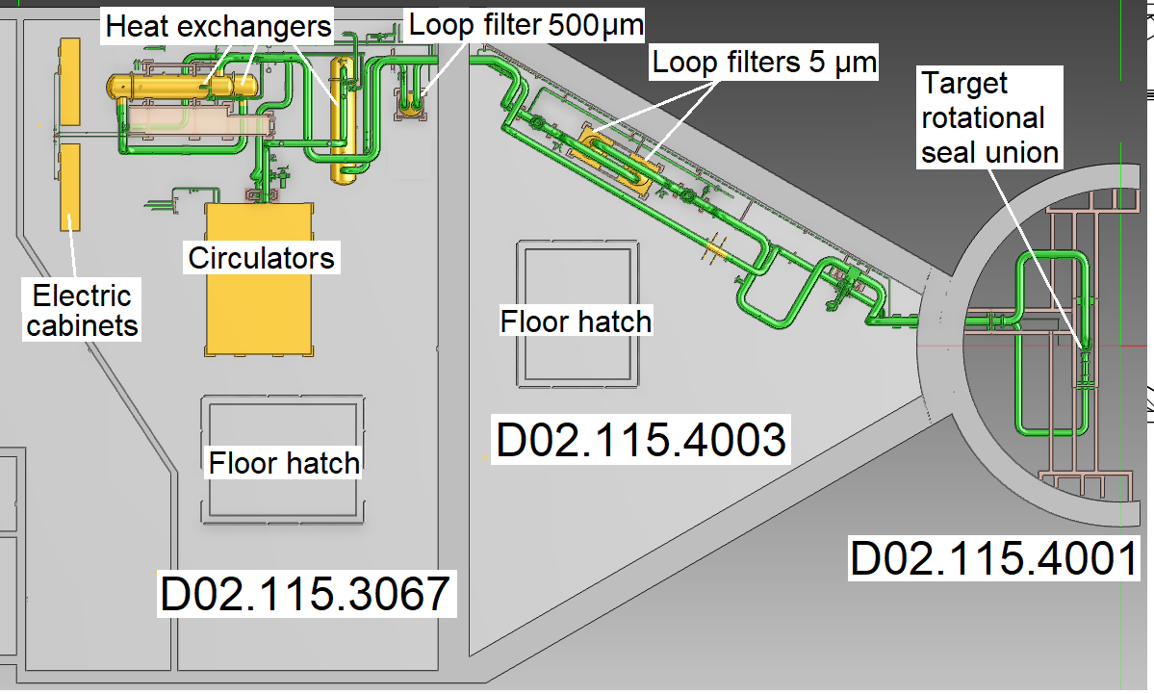
TSS General Overview
Location
Monolith cell about 10 meters in diameter
Triangular room about 15 meters / side
Utility room about 15 meters deep & 20 meters wide
We move in to the TSS

Slide 13
Challenges for instrumentation selection
Must be able to meet regulatory requirements
Must be able to meet environmental conditions
involves qualification of instruments
Must be able to monitor necessary parameters on the processes

Slide 14
1: Sourcing equipment
Apply the KISS-rule, Keep It Simple Stupid
Set up a technical specification for each field object to be used in the safety solution
Avoid brand-specific specifications in the document
Ask plants that are operating within a similar regulatory context for their choice of suitable equipment
What do “you” use?
What is your experience of brand X &Y
Fault tracing
User-friendly
Availability
Supplier’s ability
How did you perform the environmental qualification?
Try to find a number of suppliers for each condition in order to create a competition situation

Slide 15
2: Compatibility
Will chosen component fit into the design rules?
SSM design rules
Structures, systems and components of importance to radiation safety shall be based on proven technologies and proven methods, and be tested before application.
The time during which the facility’s structures, systems and components of importance to radiation safety can be used in a safe manner shall be determined in the design
Facility structures, systems and components of importance to radiation safety shall be designed so that sufficiently high quality can be maintained throughout the intended lifetime
SSM design rules with respect to Common Cause Failure (CCF)
a. Functions are performed in physically different ways.
b. Functions are performed by different Technologies/design solutions.
c. Structures, systems or Components are from different manufakturers.
d. Structures, systems or Components are installed on different occasions.
e. Structures, systems or Components are verified, validated, maintained and tested at different times and by different personnel.
Conclusion
This will not allow us to use the same brand for diverse functions, i.e. Monolith Pressure & Helium Pressure

Slide 16
2: Compatibility
Will chosen component fit into the design rules?
We have to be observant with respect to which internal components are in use
Honeywell micro switches are very commonly used
AD-converters are very commonly used
Try, if possible, to pick different types of measurement i.e. Pressure switches: Bourdon type vs Diaphragm type
We have to make sure that chosen equipment can work together with other ESS equipment
What power source do we need for transmitter power supply, 24VDC?
Will the microswitches be able to handle the electrical currents possible in the solution?
Proven technology
Aim to use Commercial-off-the-shelf components, COTS
Proven design, Components with a good record, Robust components
Base our choice on experience
Brand, supplier, establish a contact with the supplier, meet them, visit them, invite them

Slide 17
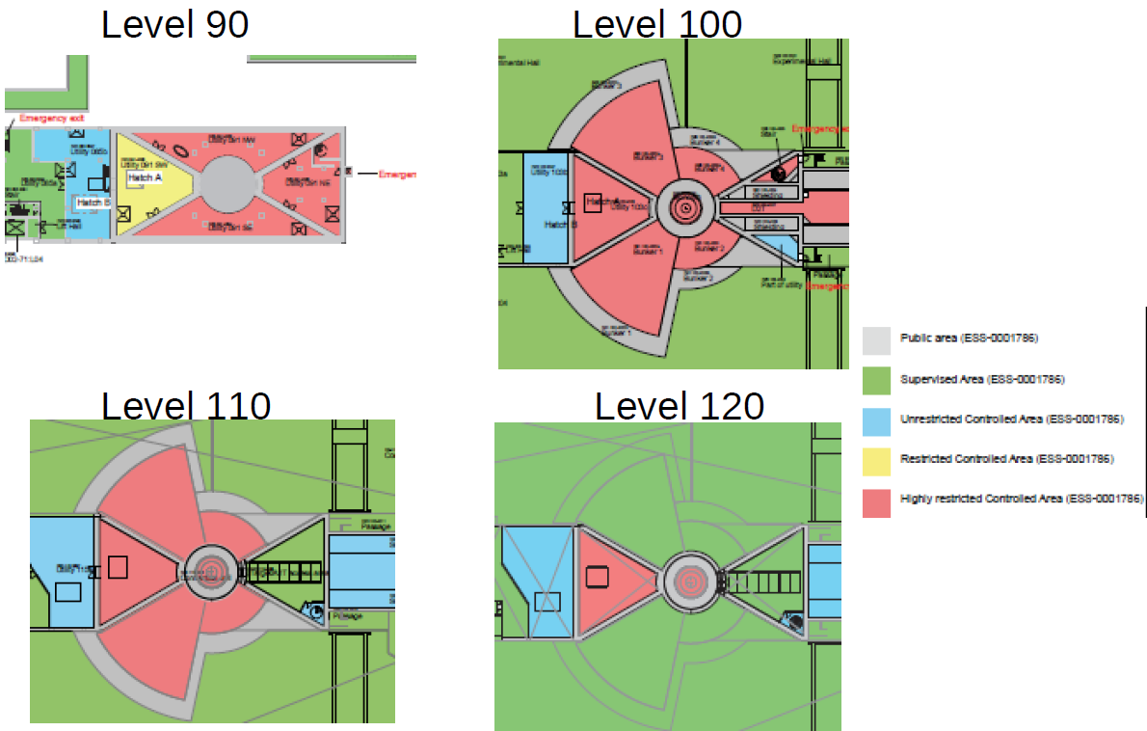
3: Resistance to environment
Will the chosen equipment withstand the environment?
Dose mapping (normal operation) results in a zoning
Area of interest is level 110
Conclusion
No active electronics in red areas

Slide 18
3: Resistance to environment
Will the chosen equipment withstand the environment?
Environmental qualification – Performed in two steps
Pre-qualification performed on test objects
Select institute (RISE in Sweden) to perform the tests
Perform Moisture pre-test
Perform Heat/cold pre-tests, cycling the temperature
Perform vibration pre-test
And any other tests necessary according to the technical specification
Evaluate the results
Make a pre-selection as input into procurement process
This may result in going back a step and finding other solutions/suppliers

Slide 19
3: Resistance to environment
This is our present state!
Environmental qualification – Left to do!
Purchase the components intended to use
Include an estimation of the number of spares for 10-15 years of use, and include one test object
Qualify the batch purchased by
Repeat environment tests on one unit of each type on one randomly selected test object
Evaluate results
Document all tests and results
Output of the process is a qualified batch of process instruments according to the chosen standard – IEC 61226 (nuclear standard)

Slide 20
4: Obsolescence
Will we be able to supply ESS with components at least the first 10 years?
One tricky part is to handle Obsolescence
How do we ensure a stable supply of replacement parts? We can’t!
We intend to use this strategy!
Choose a well known brand
Choose a well known supplier, establish a good relationship
Ensure that we have spares for a long time, estimate the need for 10-15 years
If a component breaks down “too” often, find a new one and perform the environmental qualification again

Slide 21
Solving challenges
Solutions
Helium Mass Flow Measurement, Challenges
Radiation environment
Solved by moving transmitters away from direct process related areas
Mass flow
Solved by one unit measuring both static and dynamic pressure, add a temperature measurement, calculate mass flow locally
Pressure drop
Solved by using venturi tube type of measurement

Slide 22
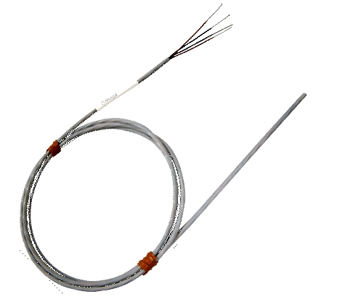
Solving challenges
Solutions
Helium Temperature Measurement, Challenges
Radiation environment
Solved by using Pt-100 sensors, a Platinum wire
Response time issues
Solved by not having a thermo well and by taking down outer diameter of sensor as far as possible, 2.5 to 3mm thick sensors, to give response time of about 10 seconds

Slide 23
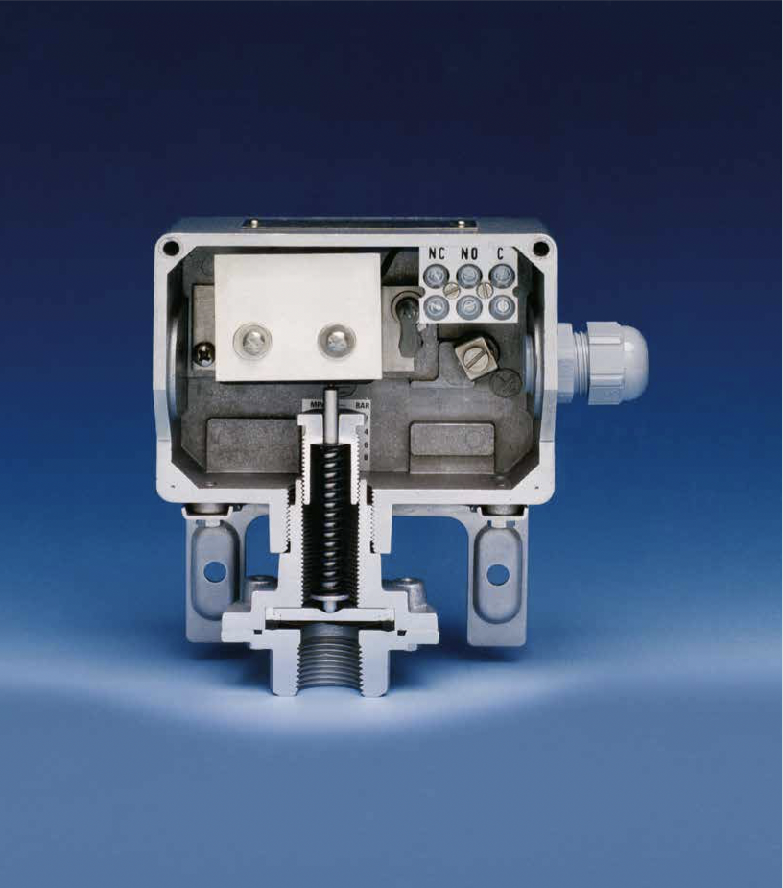
Solving challenges
Enclosure
Switching element on stainless steel bracket
Terminal block standard
Electrical conduit connection:
-Pg 13,5 -M20 x 1,5 -3/4 NPT (F) -1/2 NPT (F)
Cable gland (Option “C”)
Earth terminal (Standard)
Spring
Pressure sensor body
Process connection (Wetted)
Solutions
Pressure & Vacuum Measurements in Helium & Monolith areas, Challenges
Radiation environment
Solved by moving pressure switches away from direct process-related areas
CCF issues
Solved by choosing different brands and suppliers of the two conditions

Slide 24
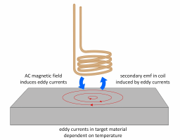
Solving challenges
Solutions
Wheel Rotation Measurement, Challenges
Hard neutron and gamma radiation environment
Solved by using radiation resistance cabling
Solved by planned maintenance to change out equipment every 24 months
Or more often if needed
Trouble finding more than one supplier
Not solved

Slide 25
5: Documentation Requirements
Often forgotten in purchasing safety equipment!
Buy the test documentation packages from the supplier
Be sure to require information on how often the component should be replaced
Ideally not during the lifetime of ESS!
Require traceability from the manufacturing process
One reason for us to use a supplier from the nuclear industry is that they are used to this and have ready-made documentation packages tailored to nuclear requirements
Document FAT, SAT, make the supplier a part of this
Document every decision taken
Key document to keep in perfect order is the technical specification
Make sure that components are inserted into the Enterprise Asset Management system (EAM)
Will help us to keep the traceability throughout the life cycle of the components

Slide 26
Summary
Chosen strategy
We buy “Commercial-off-the-Shelf” components & rely on proven design
This will secure a stable supply of spares if needed – at least the first years of running the ESS
We aim to have at least two alternatives on every measurement type
We go on a public procurement when buying the equipment
In order to create a competition situation
We perform the environmental qualification ourselves, using an independent test institute
We shall attend when tests are performed
And we have to be sure to document every step taken and the decisions that were made
The test institute will provide us with a test report
We will rely on the test institute quality system with respect to test setup, interpretation of the test standards and how to perform the tests
We will take part in reviewing the test report

Slide 27
Example of qualification test
A small movie to give you an idea of environmental qualification!
Vertical shaking
The whole sequence is 3-200Hz and then 200-3Hz
This is repeated 10 times
Shown here is 20-45Hz
Then shaking in X-direction is done
Then shaking in Y-direction is done
Thank you for your attention!

