Slide 1

Good neutron absorbers make good beamline neighbors
Presented to ICANS XXIII
Matthew Stone
ORNL
Neutron Scattering Directorate
Chattanooga, TN
October 14, 2019
Victor Fanelli
Lowell Crow
Jennifer Niedziela

Slide 2

Outline
Scope & Introduction
Materials characterized
Measurements
Conclusions
“He only says, ‘Good fences make good neighbors.’”
R. Frost Mending Wall (1914)

Slide 3
Scope
Not biological shielding
Shielding in the vicinity of the neutron beam
  Apertures
  Masks
  Shielding sample environments and samples
  Shielding inside of instruments
Hippocratic oath of neutron shielding
  “First, do no harm”
  Some shielding adds to the background

Slide 4
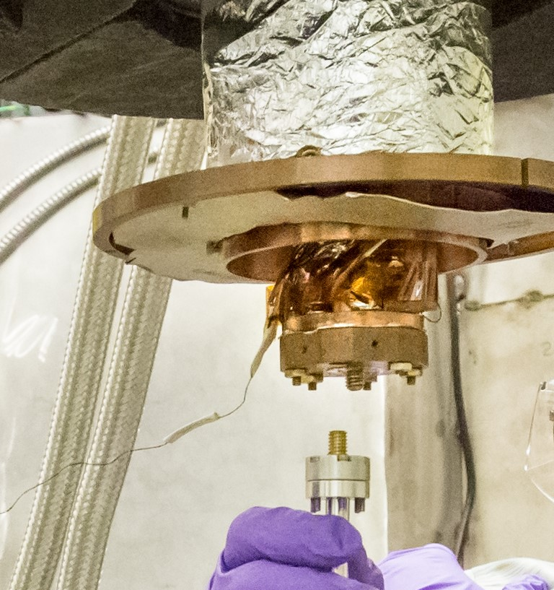

Boron Carbide (ZHIP)
Cadmium
Sample

Slide 5
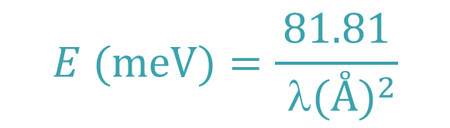

Total cross section is sum of two parts
  Scattering cross section PLUS Absorption cross section
$Σ_{T}$= $Σ_{s}+Σ_{a}=Σ_{c}+Σ_{i}+Σ_{a}$
Absorption varies with energy
  Faster neutrons (higher energy, shorter wave-lengths) are more difficult to absorb
$$E (meV)=\frac{81.81}{{ λ(Å)}^{2}}$$

Slide 6
How much material do you need to stop a neutron?
z
E=3.5 meV
λ=4.8 Å
E=14.7 meV
λ=2.4 Å
E=81.81 meV
λ=1 Å
Compound
Z (mm)
Z (mm)
Z (mm)
Melting Point (K)
Al
1600
3300
7800
933
Cu
70
140
340
1358
V
60
120
290
2183
Gd
0.02
0.03
N/A
1586
Cd
0.19
0.39
N/A
594
99.75 % absorption
BN
0.53
1.08
2.55
1663
B
C
0.27
0.55
1.29
2763
4
10
B
C
(90%
10
B)
0.06
0.12
0.29
2763
4
Li
CO
9.3
19
45
996
2
3
Beer-Lambert law
6
Li
CO
6
0.78
1.6
3.7
996
2
3
(90%
Li)
(Set A=0.9975, look up δ_{p}, solve for Z)

Slide 7
Many different materials examined in experiments
(some thickness dependence examined)
Boron Nitride (BN) (3.3 mm)
Borated Aluminum (4.5%) (1.2 mm)
Aluminum (1.74, 5.2 mm)
Borated Polyethelene (5%) (25 mm)
Polyethelene (10.6 mm)
B₄C – different types (2.2-12.8 mm)
Gadolinium (0.1 mm)
Cadmium (0.4 mm)
High density concrete (25.4 mm)
Concrete (25.4 mm)
Borated coraflon (epoxy) (0.1-0.4 mm)
BN paint (0.05 mm)
Lithiated coraflon (0.2 mm)
Boroflex (3.2 mm)
B₄C in epoxy (6.4 mm)
Li₂CO₃ in epoxy (6.4 mm)

Slide 8
Beamlines used for measurements
CG-1B at HFIR
E=14.7 meV
λ=2.42 Å
SEQUOIA at SNS
E=10 to 10000 meV
λ=2.5 to 0.1 Å
Scattering in Reflection
Transmission
Scattering in Transmission
Scattering in Transmission

Slide 9
Angle dependent scattering (CG-1B)
Scattering in Reflection (r)
D
Incident Beam
2θ
Scattering in Transmission (t)
D
Incident Beam
2θ

Slide 10
Bragg peaks from absorbers (CG1B)
E=14.7 meV
λ=2.42 Å

Slide 11
Highly borated materials look very similar (CG1B).
E=14.7 meV
λ=2.42 Å
Boron carbide in different forms behaves very similarly.
Surface texture may be important for reflectometers and SANS.
Borated Aluminum is a reasonable substitute at high scattering angles.

Slide 12
Borated Polyethelene (CG1B)
E=14.7 meV
λ=2.42 Å
(Rocking Curves)
Detector fixed at 90 degrees, rotating sample
Incident Beam
Scattered Beam
D
Borated Poly (5%) absorbs the transmission neutrons
BUT Borated Poly glows from the neutrons scattering from the surface.

Slide 13
Absorbers in epoxy (CG1B)
E=14.7 meV
λ=2.42 Å
Just like the borated polyethelene, the absorbers in epoxy will have enhance scattering in reflection.
B₄C in epoxy works well, but still has extra scattering in reflection geometry

Slide 14
Concrete (CG1B)
E=14.7 meV
λ=2.42 Å
High density concrete scatters less than traditional concrete
Both scatter nearly the same as polyethelene.

Slide 15
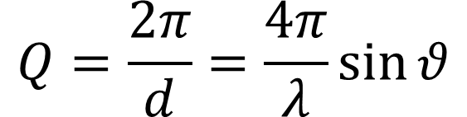
Time-of-flight Bragg peaks from absorbers (SEQUOIA)
Cadmium has very little Bragg scattering
Boron carbide has very little Bragg scattering.
$$Q=\frac{2π}{d}=\frac{4π}{λ}\sin{θ}$$

Slide 16
What about painted coatings? (SEQUOIA - TRANSMISSION)
Borated Coraflon coatings work with multiple layers of application.
NOTE wavelength cutoffs for Gadolinium and Cadmium

Slide 17
Time-of-flight Bragg peaks from absorbers (SEQUOIA)
Borated Poly (5%) looks fantastic for transmission geometry
BUT Borated Poly glows from the neutrons scattering from the surface.

Slide 18
Photoneutrons
Cadmium+n = prompt gamma
Prompt gamma + Be = n
High energy Photoneutrons were found to be produced in Be filters at the time-of-flight pelican instrument.

Slide 19
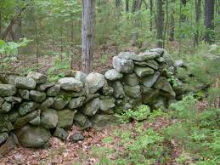
Conclusions
Good neutron absorbers make good neighbors
Watch out for Bragg peaks
Poly has its place – not near the direct beam
Cadmium is great.
  Unless you heat up sample
  Unless you have E>100 meV
  Unless you have gamma sensitive detectors (or people)
  Unless Beryllium is nearby
  Otherwise choose Boron Carbide
“Before I built a wall I'd ask to know
What I was walling in or walling out,
And to whom I was like to give offense.”
R. Frost Mending Wall (1914)
Published in NIMA

