Slide 1

Technique Development Beamlines at the High Flux Isotope Reactor
Lowell Crow
Neutron Optics and Polarization Team
Neutron Technologies Division
ICANS XXIII October 2019 – Chattanooga, Tennessee

Slide 2
Why do we need development beams?
We need moderators, guides, filters, shutters, choppers, monochromators, analyzers, focusing devices, sample environments, detectors, shielding , etc. All need testing
Prototyping of new techniques using neutrons may require configuration changes, novel apparatus, or long preparation times
This is difficult to schedule on busy, oversubscribed user instruments
We maintain development beamlines at HFIR, which support our efforts at both HFIR and SNS – these were constructed on existing locations with operating funds (ORNL-NScD Instrument Improvement for CG4B)

Slide 3
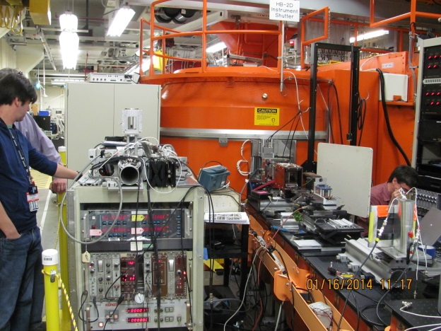
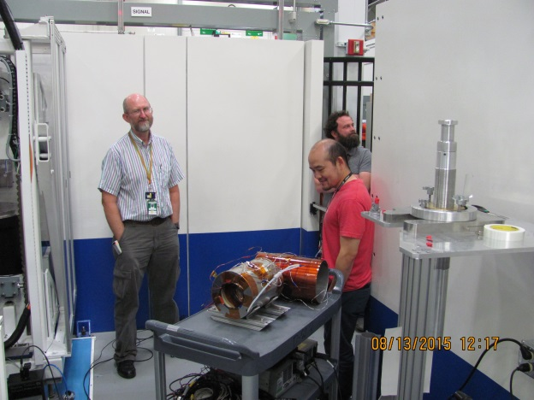
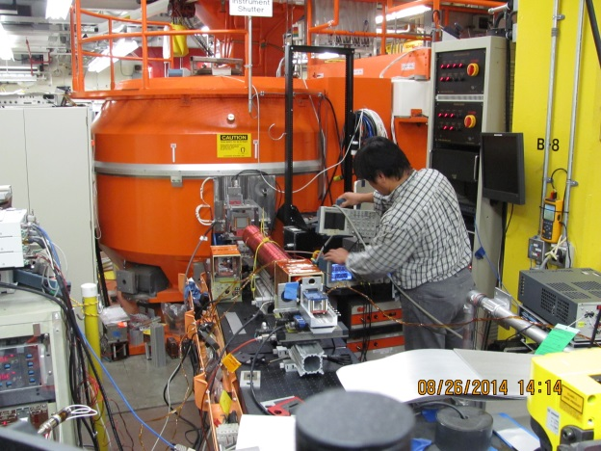
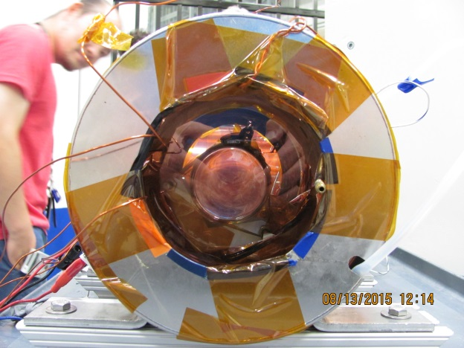
Work with Indiana University Group
Roger Pynn, Steven Parnell (now at TU Delft), Steve Kuhn
Neutron Optics and Polarization Team
Lee Robertson (lead)
Lowell Crow
Peter Jiang (³He polarizers)
Josh Pierce (Dynamical Nuclear Polarization)
Fankang Li
Ryan Dadisman
Dante Quirinale
Nicolas Silva
Ann Jennings
Landen Mcdonald
David Wasilko
Jillian Ruff
Past members: Bill Hamilton, Jinkui Zhao, Xin Tony Tong, Tianhao Wang
CG1A (Detectors): Rick Riedel, Jason Hodges, Kevin Berry, Loren Funk
CG1B (NSD): Jaime Fernandez-Baca, Mike Cox, Spectroscopy Group, Diffraction Group
HB-2D Polarized Development Beamline at HFIR

Slide 4
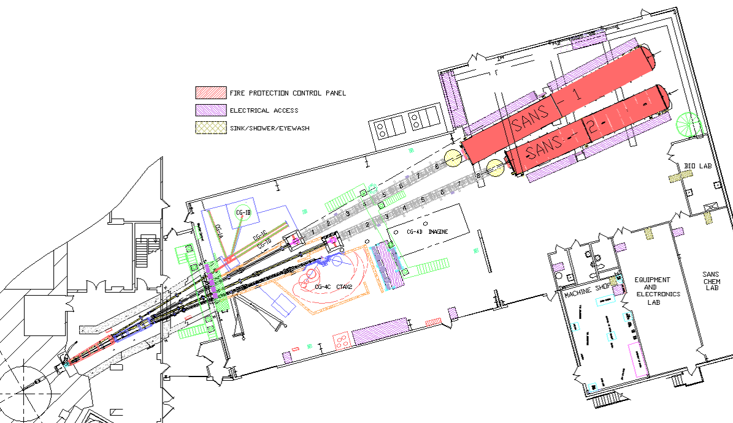
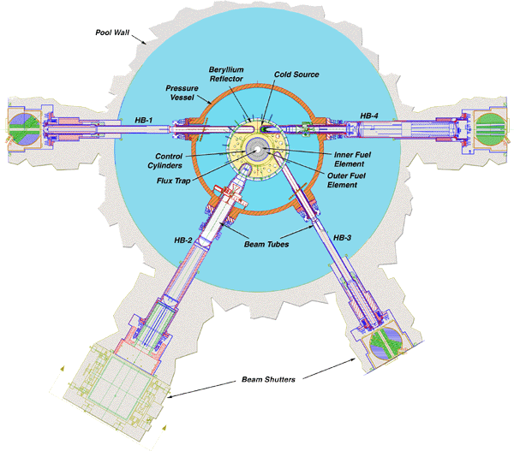
A short overview of HFIR
High Flux Isotope Reactor – since 1965
Flux trap flux : 2.5 x 10¹⁵ thermal
Beam tube flux : 1.2 x 10¹⁵ thermal
Cold Source and Guide Hall – Commissioned 2007
CG1B
HB-2 – radial beam tube in a Beryllium reflected reactor
+ very high thermal flux
- very high fast flux
Use a cooled Sapphire filter
Supports 4 beamlines, including
HB-2D Polarization Development
CG1A
CG4B area

Slide 5
We currently have four development beamlines at HFIR
Detector Test Station CG1A
Alignment Diffractometer CG1B
Polarized Neutron Development Beamline HB-2D
Cold Neutron Polarization Development Beamline CG4B

Slide 6
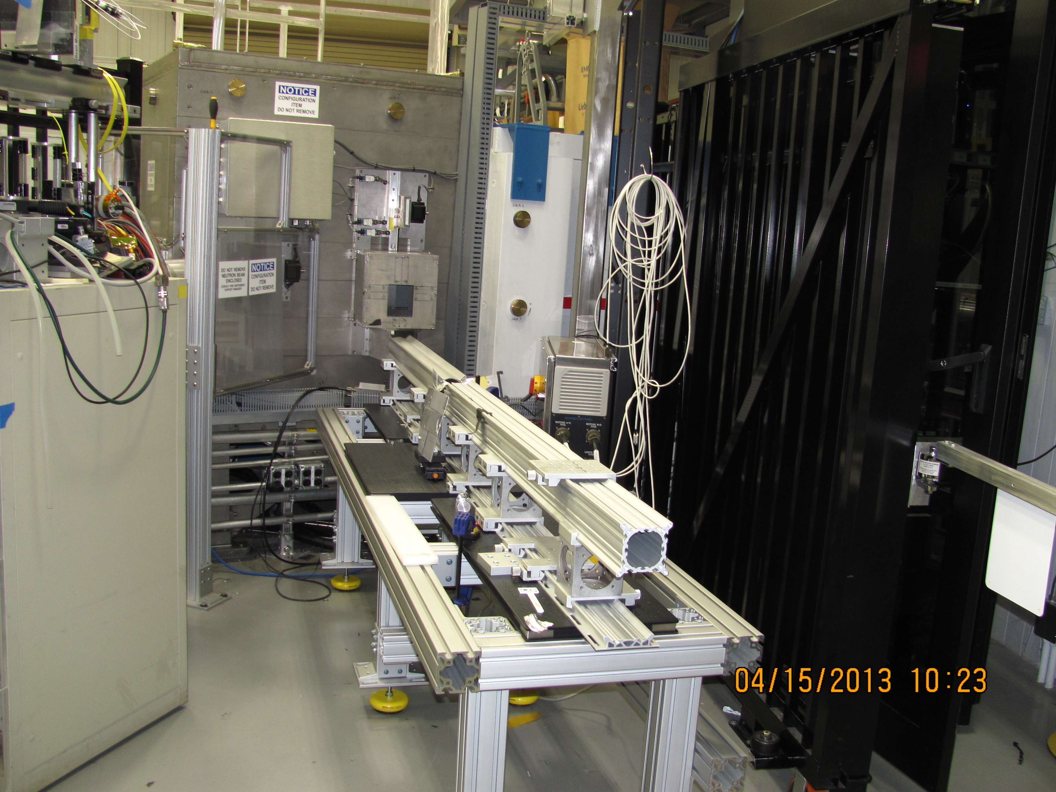
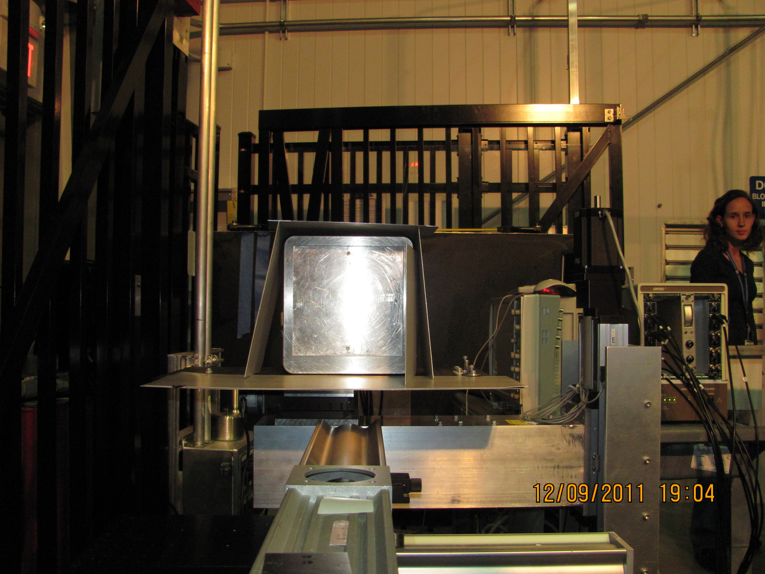
CG1A Detector Test Station Wavelength 4.22 Å
Flexible rail mount with about 3 m of operational space
Flux is > 10⁶ n/cm² s
Detector Calibration (e. g. Anger Cameras)
Detector Prototype Tests
Contact: Rick Riedel
Parallel plate monitor test 2011

Slide 7
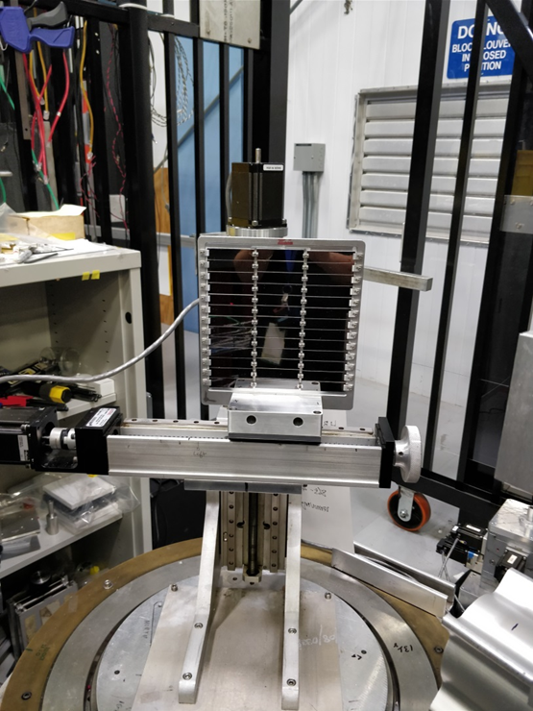
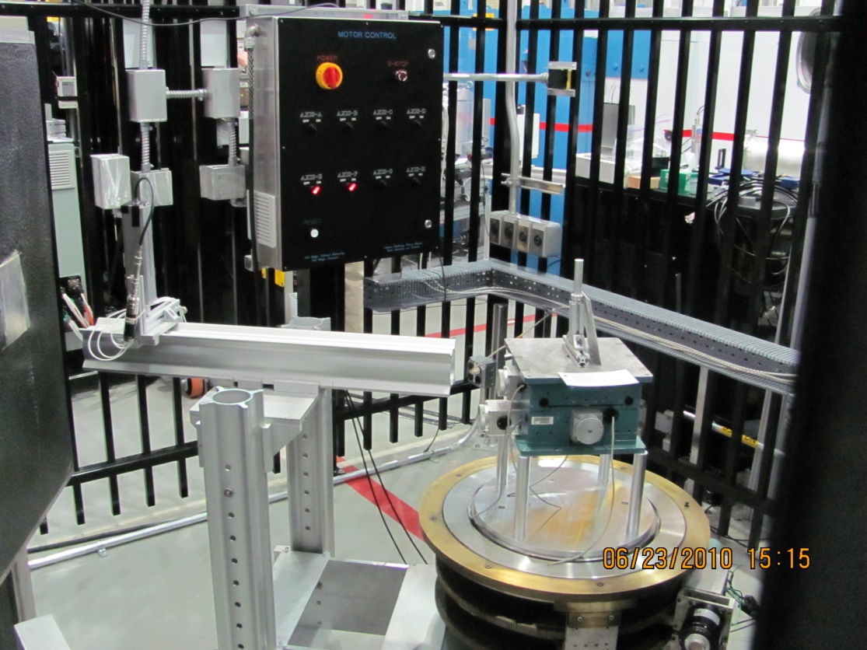
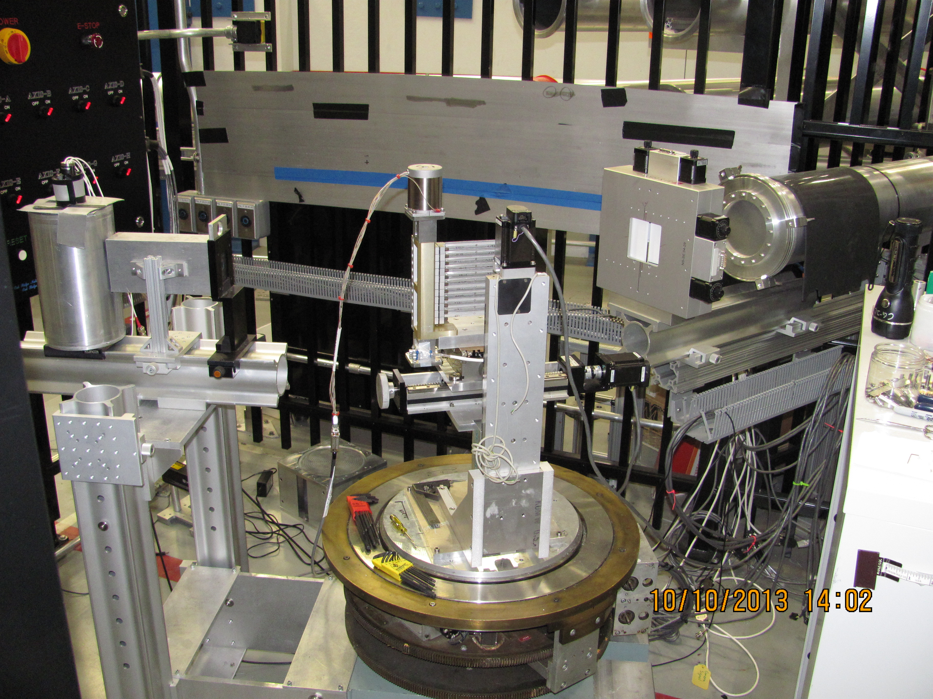
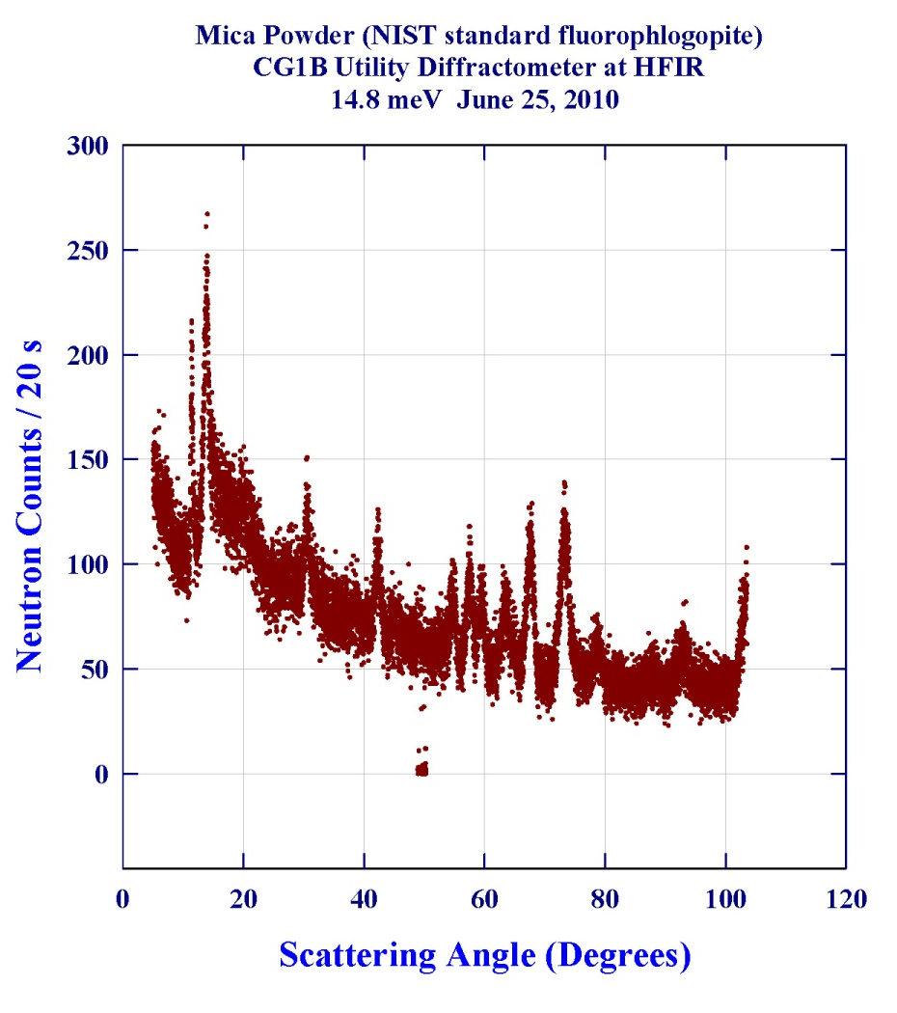
CG1B Alignment and Utility Diffractometer 2.417 Å, 14.0 meV
Monochromator/analyzer tests
Sample alignment (saves time on user instruments)
Optics and components tests (e.g. sample cans)
Flux is about 1.4 x 10⁶ n/cm² s
Beam is up to 8 × 8 cm² at about 4 m from the flat graphite monochromator
Alignment of
CTAX Monochromator
Alignment of new HB-1A M1 monochromator before 2018 installation
Contact: Jaime Fernandez-Baca, Mike Cox (NSD)

Slide 8
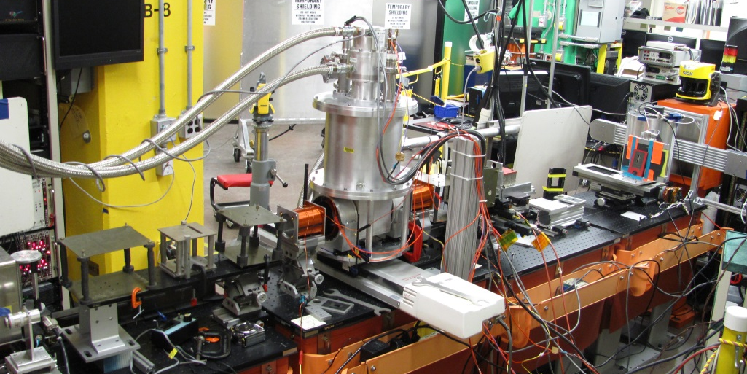
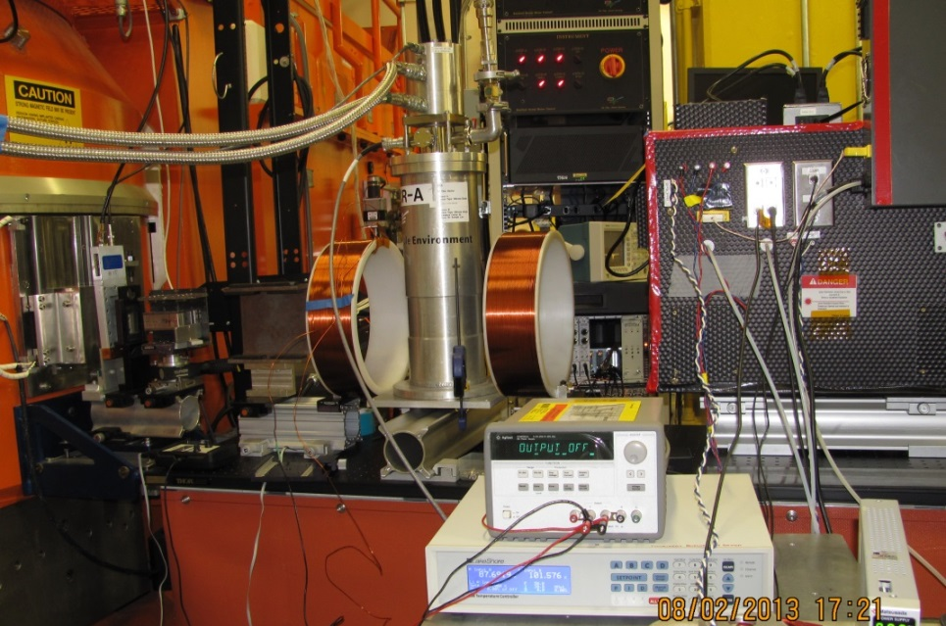
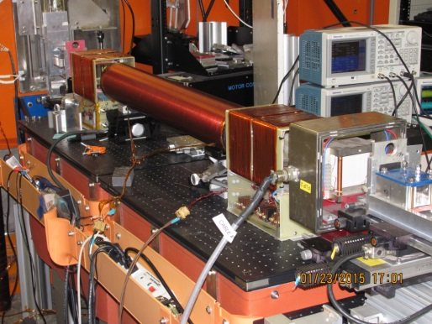
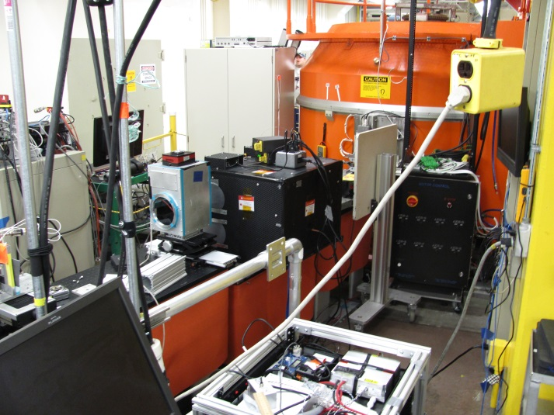
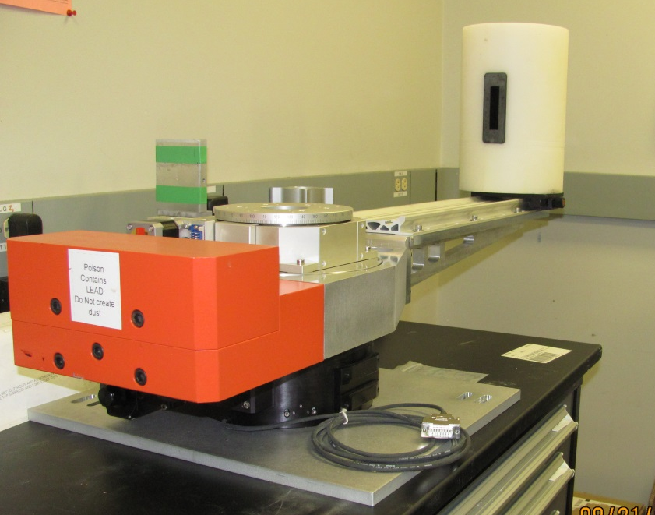
HB-2D Polarization Development Beamline – in HFIR Beamroom
The beamline is configured for each measurement; the only fixed components are the monochromator drum, shutter, and beamstop. Variable-height lift tables allow us to position components. We have a variety of polarizers, flippers, stages, and detectors available
3D Polarimetry with Indiana University
Cryoflipper with ³He analyzer
Double cell ³He measurement
Diffractometer Arm
MICE Demonstration
HB-2D Polarized Development Beamline at HFIR
With Graphite: 4.25 Å (use Be filter or accept harmonics)

Slide 9
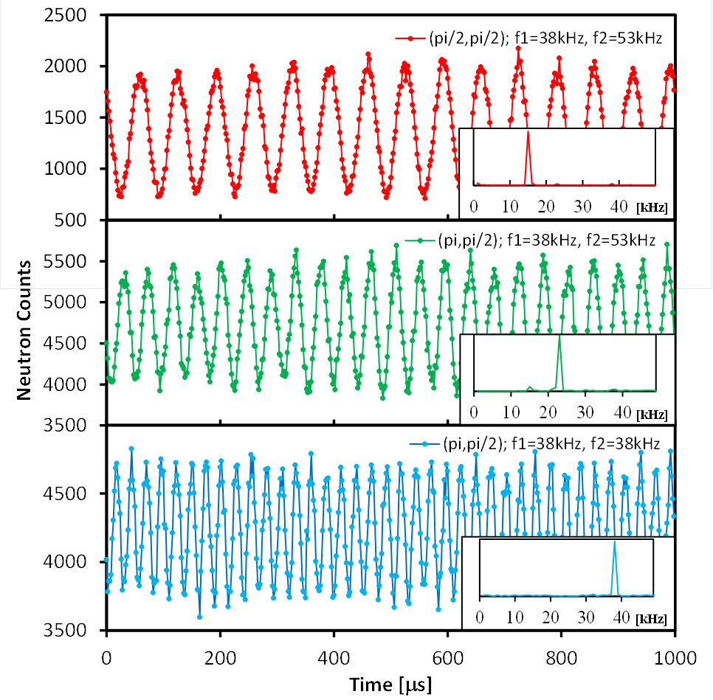
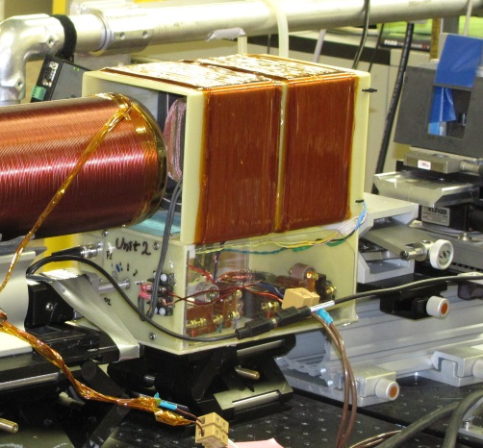
Modulated Intensity by Combined Effort (MICE)
Larmor rf encoding (like NRSE or MIEZE)
Modulation is before any sample (like MIEZE)
Neutrons travel through an adjustable-current solenoid between the RF flippers; since it does not rely on a zero-field region, the performance should be robust in moderate magnetic field environments
First measurements demonstrate frequency time-focusing
Demonstration experiment on HB-2D
Neutron Intensity Modulation and Time-Focusing with Integrated Larmor and rf Techniques
J. Zhao, W. A. Hamilton, S.-W. Lee, L. Robertson, L. Crow, Y. W. Kang Applied Physics Letters
HB-2D Polarized Development Beamline at HFIR

Slide 10
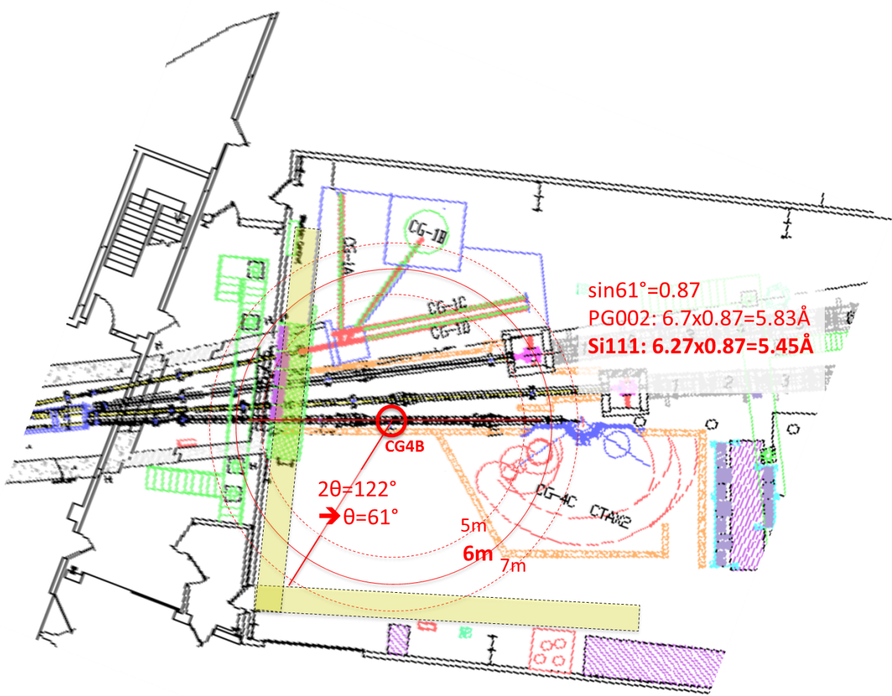
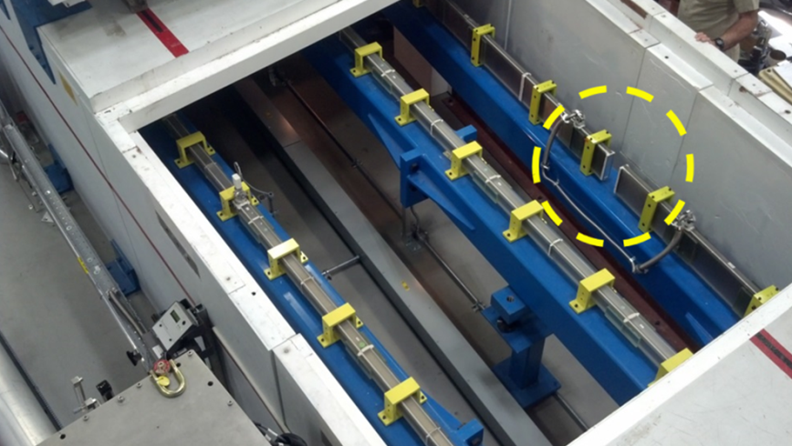
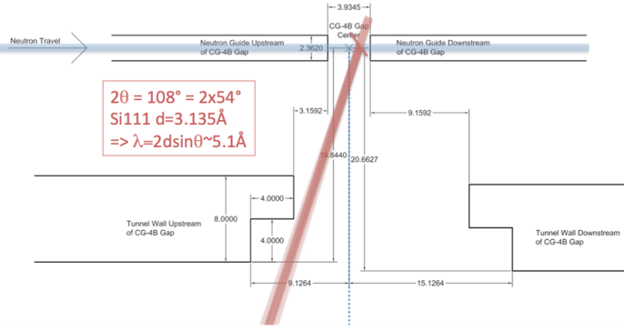
New Last Year: CG-4B Cold Neutron Polarization Development Beamline
This new beamline allows a longer wavelength, 5.48 Å, and a longer flight path length (about 6.5 m ) than in our previous development positions at HB-2D or CG1A.
This yields enough space for Larmor spin encoding techniques which require significant flight path distance, such as SERGIS, SESANS, MIEZE, or MICE. It also provides space for the power supplies, refrigerators, electronics, and cooling required for these methods.
Polarized Development Beamlines at HFIR

Slide 11
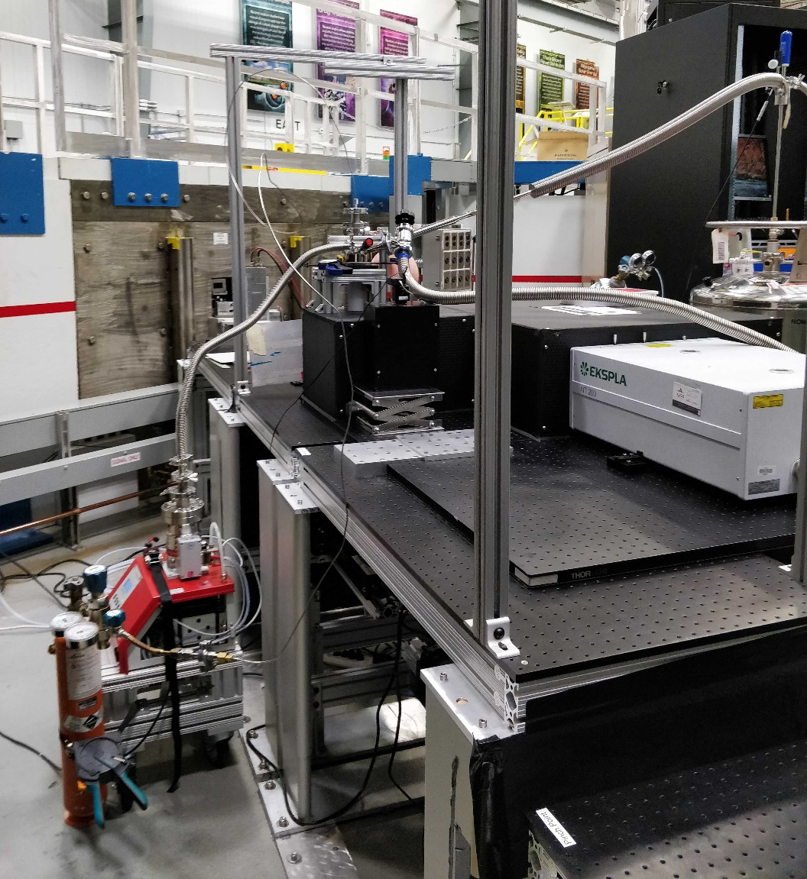
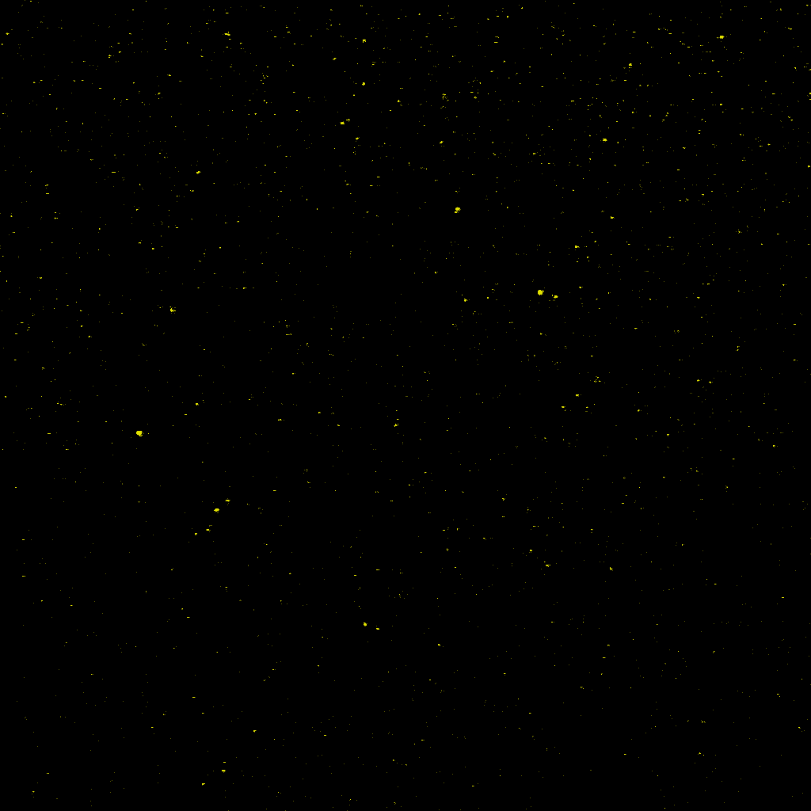

First Experiment on CG4B: Helium Turbulence
To be submitted:
Imaging fluorescence of ${He}_{2}^{∗}$ excimers created by neutron capture in liquid He II—an alternative for turbulent flow research
X. Wen, Shiran Bao, L. McDonald, J. Pierce, G.L. Greene, Lowell Crow, Xin (Tony) Tong, A. Mezzacappa, R. Glasby, W. Guo, and M.R. Fitzsimmons

Slide 12
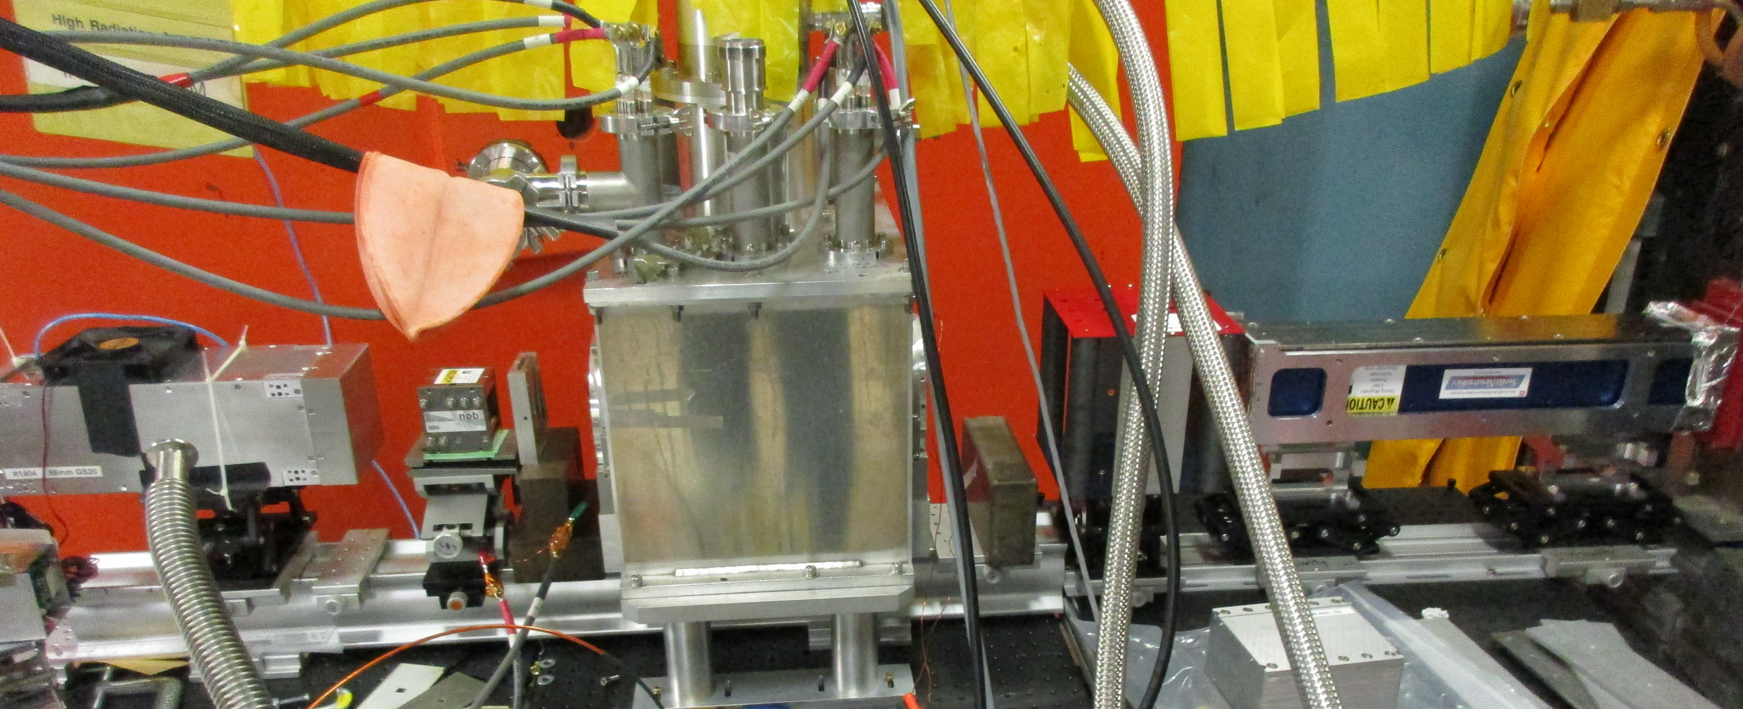
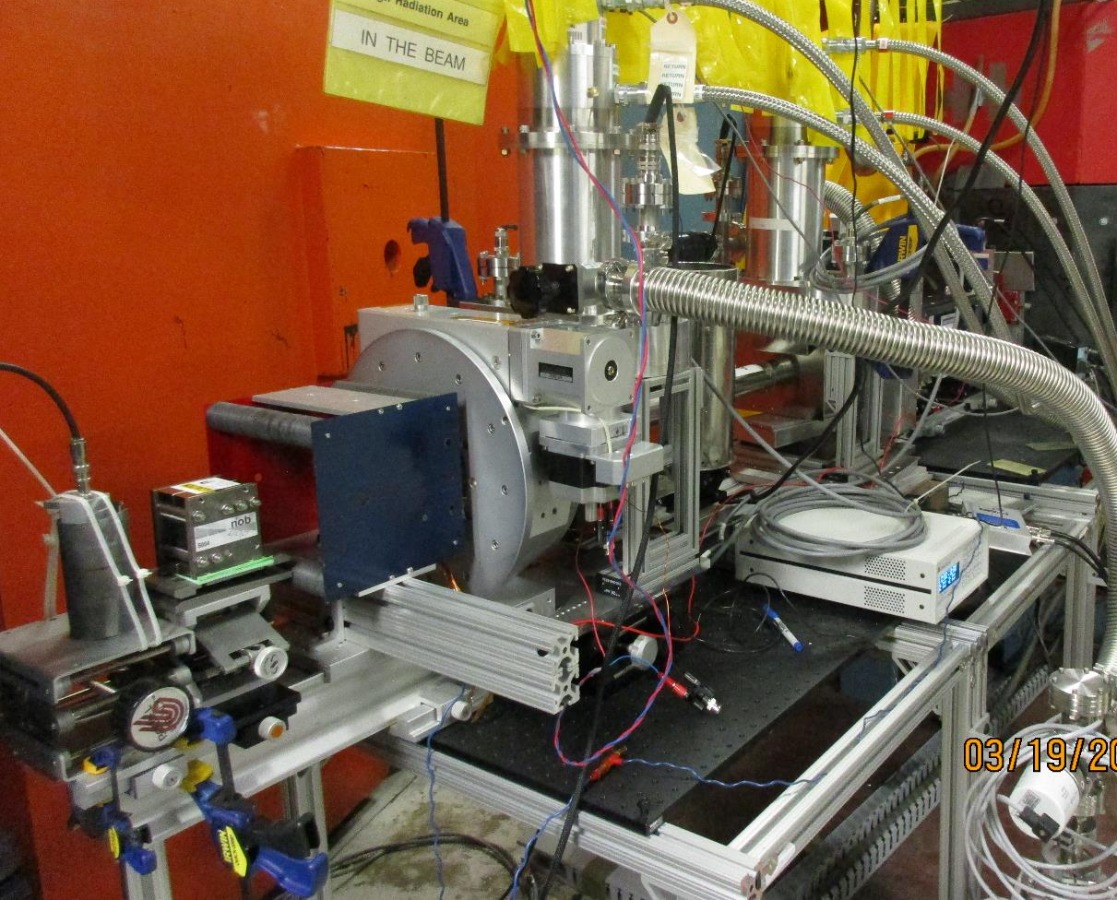
Transverse Resonant Spin Echo
– Fankang Li, Ryan Dadisman, David Wasilko, Steve Kuhn
Note: since HFIR was down this year, we borrowed 2XC at MURR (Columbia, Missouri)
Other projects – Lowell Crow, Lee Robertson, Jodi Camino
Detector tests – Rick Riedel, Su Ann Chong
Spherical Polarimetry
– Peter Jiang, Tianhao Wang, Nicolas Silva, Jillian Ruff
Next Experiments at CG4B
Transverse Resonant Spin Echo (Fankang Li)
Quantum Entanglement with Wollaston Prisms (with Jaime Fernandez-Baca)
Revisit Turbulence ( with Mike Fitzsimmons)
SANS with Dynamical Nuclear Polarization (Josh Pierce)
and HB-2D
Spherical Polarimetry (Peter Jiang)

Slide 13
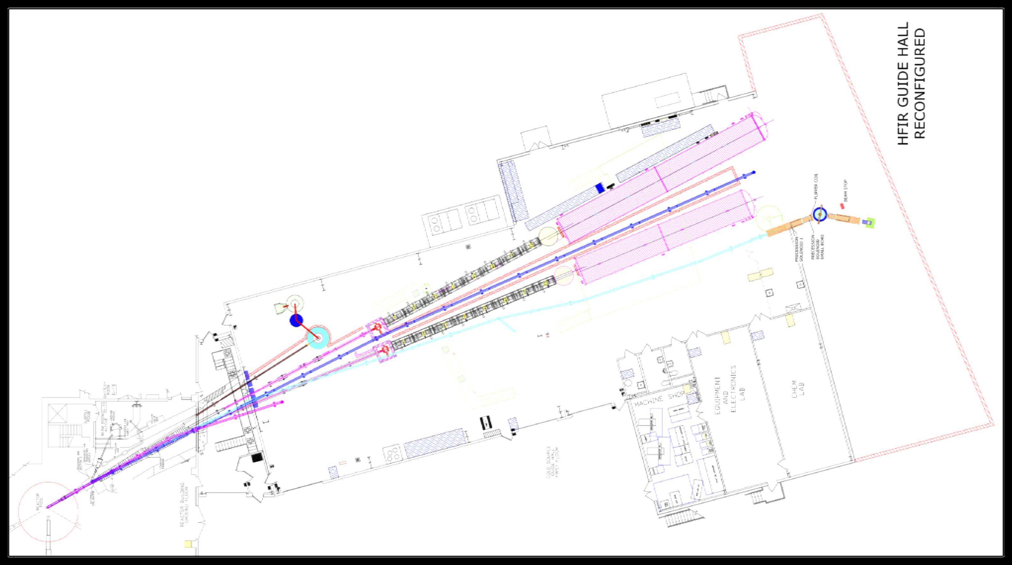
In about 2023, all HFIR instruments come out, and we have to reinstall all of them!
Planning is already in progress
Where are development locations?
New Guide Hall Layout
Extend the building
Move both SANS downstream
New locations for IMAGINE and Imaging
New guide supports Larmor, Spin Echo
Alignment is satellite of Spin Echo
Imaging
“MANTA” new Cold 3-Axis
Spin Echo
HB-2 tunnel in beam room will be modified
Do we keep HB-2D, and if so in what form?
Alignment
IMAGINE

