Slide 1
Microscopic samples and high precisions: challenges and solutions at the ESS
Malcolm Guthrie
European Spallation Source ERIC

Slide 2
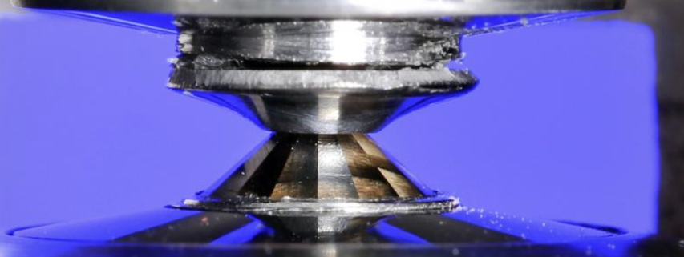
The Challenge
Key design feature of recent neutron sources is beam brightness
Allows significant reduction in sample sizes.
Requires step change in precision and repeatability of sample positioning
Sample diameter ~ 500μm

Slide 3
Kinematic mounting
ESS has defined a standard mounting system based on kinematic positioning
Geometric constraints systematically constrain 6 degrees of freedom
Reproducibility < 1 μm (theoretical)

Slide 4
Universal Coordinate System
Absolute repeatability enables concept of “universal coordinate system”:
define origin as sample position
define cartesian axes with standard convention, aligned to beam
map this system onto all beamlines
Can also map onto offline stations (alignment, Raman...)

Slide 5
Alignment protocol* (*assumes known sample position “+”)
Before alignment:
Beam
Calib’Standard
Inst. 1
Inst. 2
Inst. “n”

Slide 6
Alignment protocol* (*assumes known sample position!)
Install standard
Beam
Calib’Standard
Inst. 1
Inst. 2
Inst. “n”

Slide 7
Alignment protocol* (*assumes known sample position!)
Install standard
Adjust mount to align
Beam
Calib’Standard
Inst. 1
Inst. 2
Inst. “n”

Slide 8
Alignment protocol* (*assumes known sample position!)
Install standard
Adjust mount to align
Repeat on Inst 2
Beam
Calib’Standard
Inst. 1
Inst. 2
Inst. “n”

Slide 9
Alignment protocol* (*assumes known sample position!)
Install standard
Adjust mount to align
Repeat on Inst 2
Beam
Calib’Standard
Inst. 1
Inst. 2
Inst. “n”

Slide 10
Alignment protocol* (*assumes known sample position!)
Install standard
Adjust mount to align
Repeat on Inst 2
Etc…
Beam
Calib’Standard
Inst. 1
Inst. 2
Inst. “n”

Slide 11
Alignment protocol* (*assumes known sample position!)
Install standard
Adjust mount to align
Repeat on Inst 2
Etc…
Beam
Calib’Standard
Inst. 1
Inst. 2
Inst. “n”

Slide 12
Alignment protocol* (*assumes known sample position!)
Install standard
Adjust mount to align
Repeat on Inst 2
Etc…
Beam
Calib’Standard
Inst. 1
Inst. 2
Inst. “n”
Expect periodic recalibration (beam drift, concrete subsidence etc.)
Note: Samples must be calibrated relative to “equipment” mount
This can be done offline by calibrating an “alignment station” in exactly the same way as the instruments

Slide 13
Universal Coordinate System
Beam
Calib’Standard
Calib’Standard
Calib’Standard
Inst. 1
Inst. 2
Inst. “n”
Allows rapid exchange of different equipment on one beamline
Allows rapid exchange of same equipment on many beamlines
Allows offline definition of ROI’s that can be transferred to beamline

Slide 14
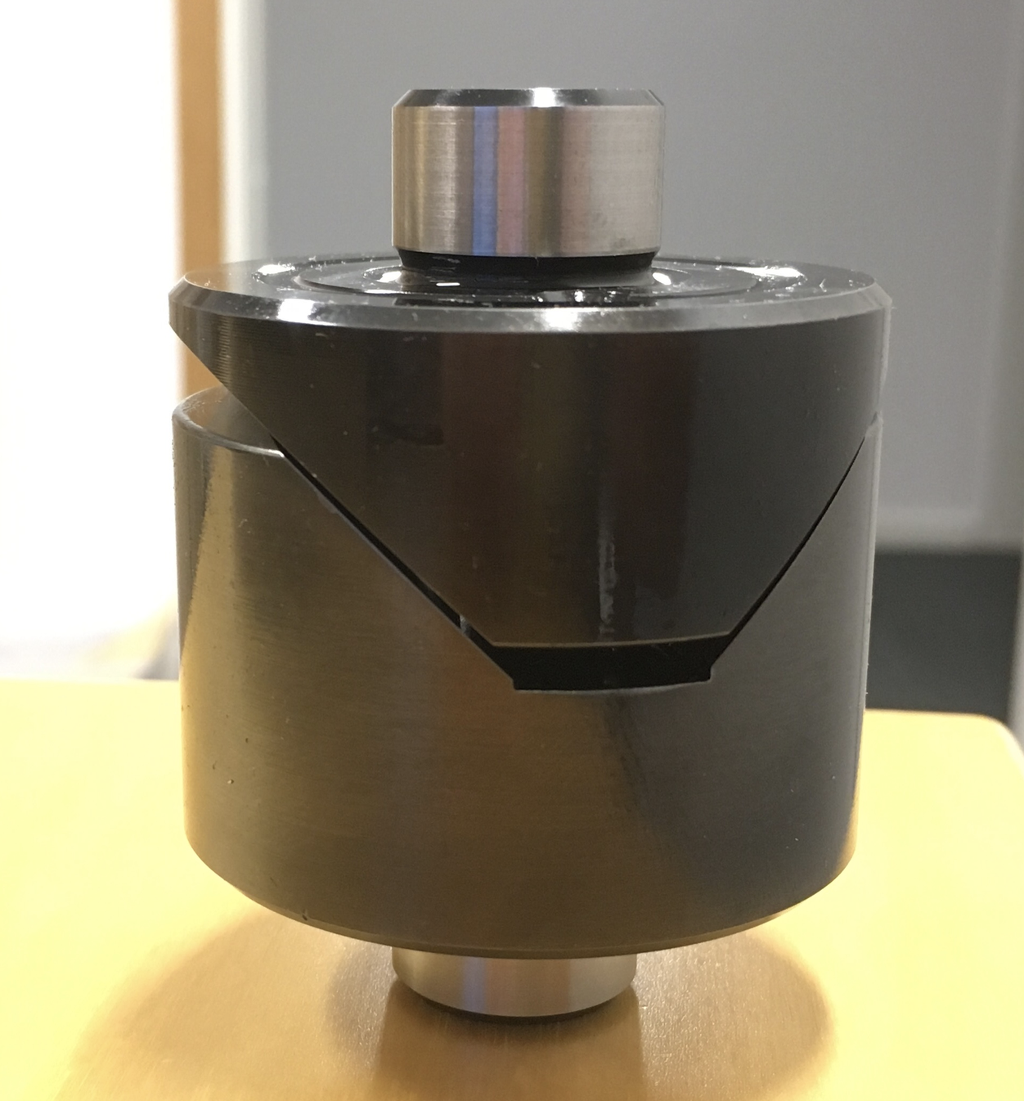
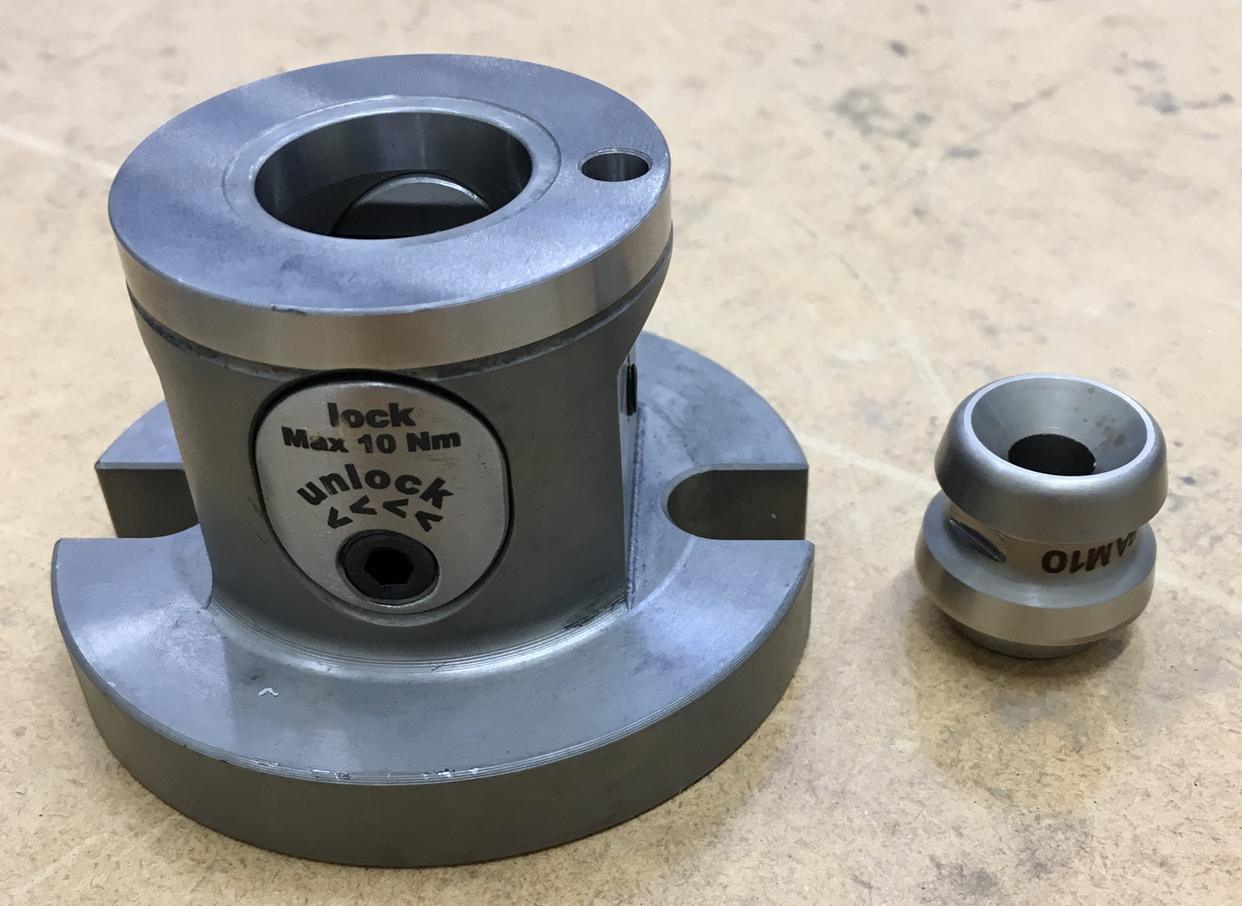
Kinematic component
Tested two alternative kinematic components:
Kipp “Zero point” system
Baltec Canoe Spheres/Vee blocks

Slide 15
Kinematic component
Tested two alternative kinematic components:
Comparison
Mechanism | Pros | Cons
Baltec | Available with multiple material choices all interface components are identical relatively low cost for one-off instrument part of interface (€450) | Relatively high ongoing cost (will cost €450 for each item of SEE) Small scale "family business" manufacturer based in CA, USA, medium risk to long term supply of standard. Only provides alignment, requires separate clamping mechanism standard material is magnetic, non-magnetic is available but at additional cost
Kipp | Well-established supplier, low risk of long-term supply of standard. built-in clamping mechanism Relatively low ongoing cost (will cost €90 for each item of SEE) | magnetic component and mfg hasn't yet confirmed if non-magnetic version is possible (although we're in discussion) Relatively high cost for one-off instrument part of interface (€1200).

Slide 16
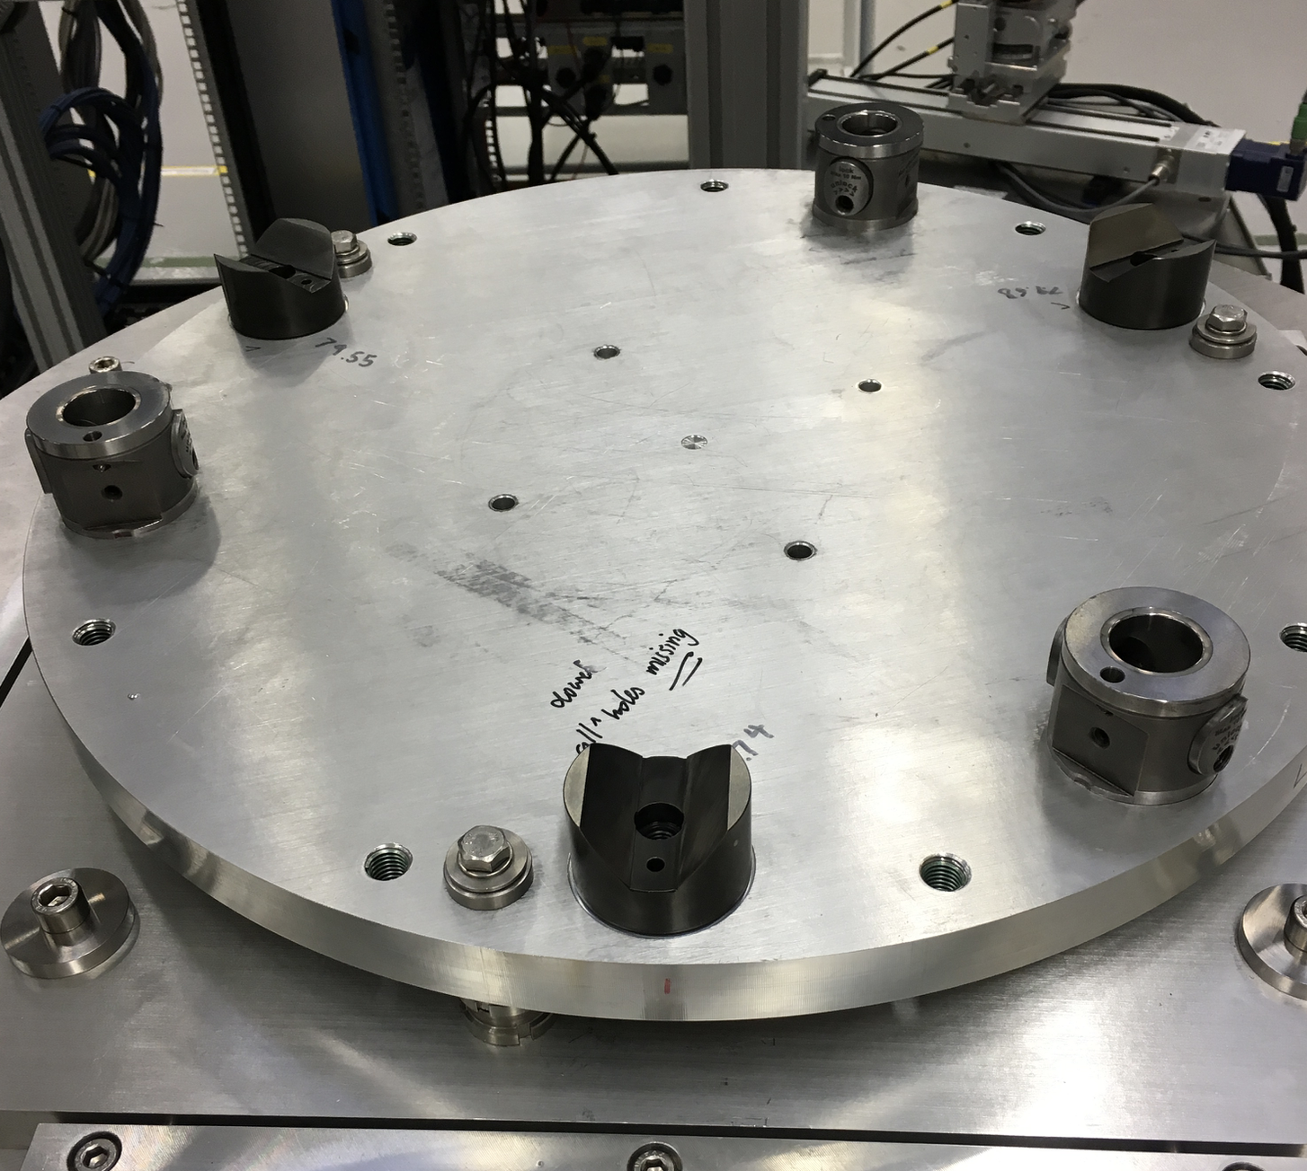
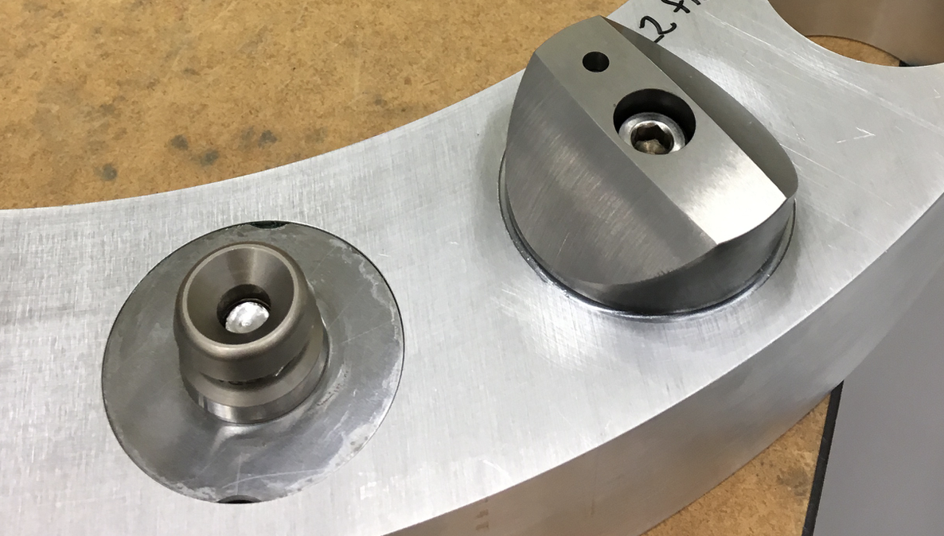
Test setup
Mounted both “instrument” interfaces, rotated by 30°
Mounted matching “equipment” interfaces onto flange

Slide 17
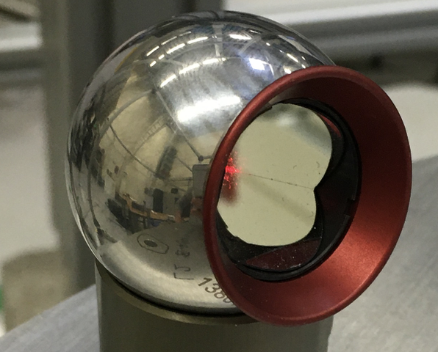
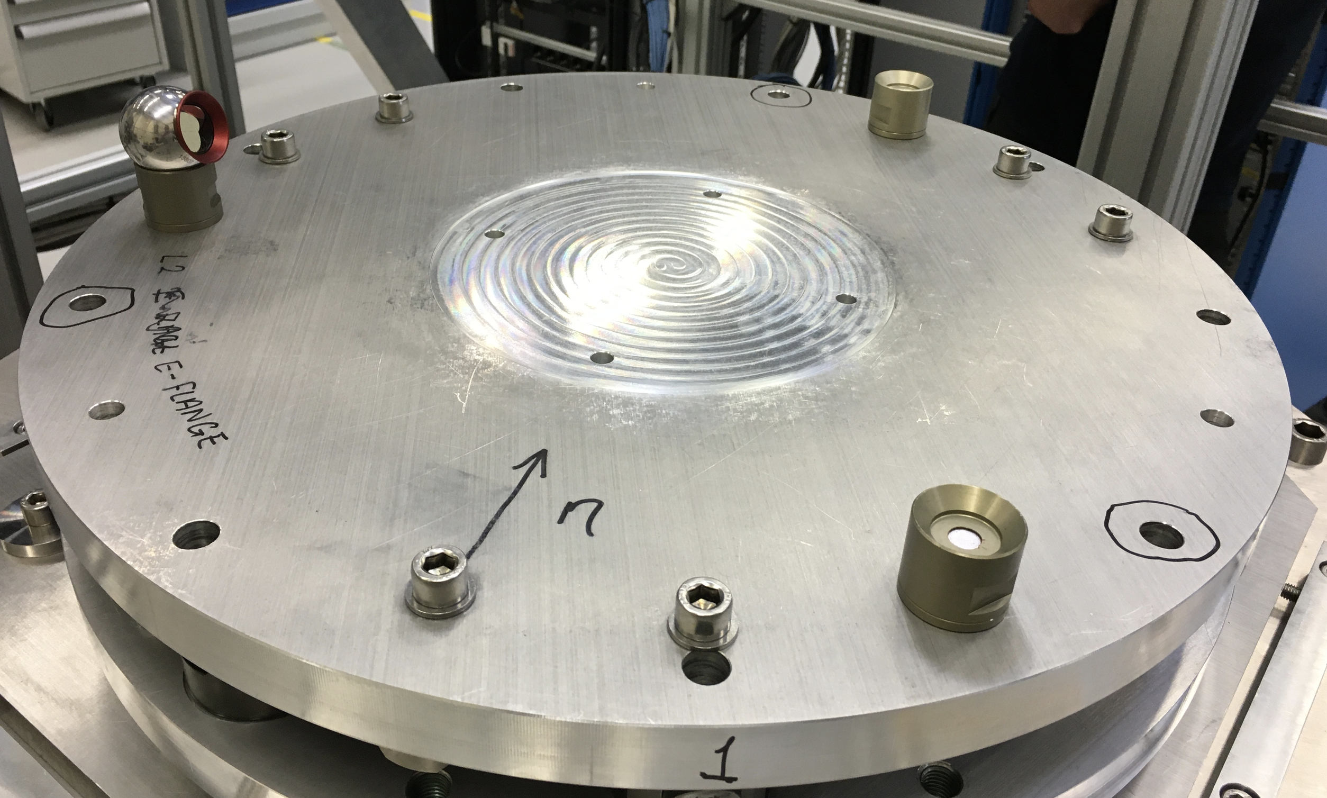
Test setup
Installed 3 laser fiducials on top of flange

Slide 18
Test setup
Both systems showed repeatability within tolerance of measurement
Will test effect of loading
axial and offset
Effect of locking mechanism
Long term repeatability/wear

Slide 19
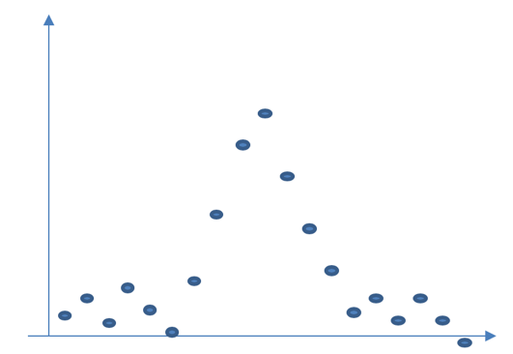
Mapping the UCS onto sample position
Need to rapidly identify beam centre...
Use beam scanning methodology
Setup:
counts
z-axis
Beam
Detector
y-axis
Position (mm)

Slide 20
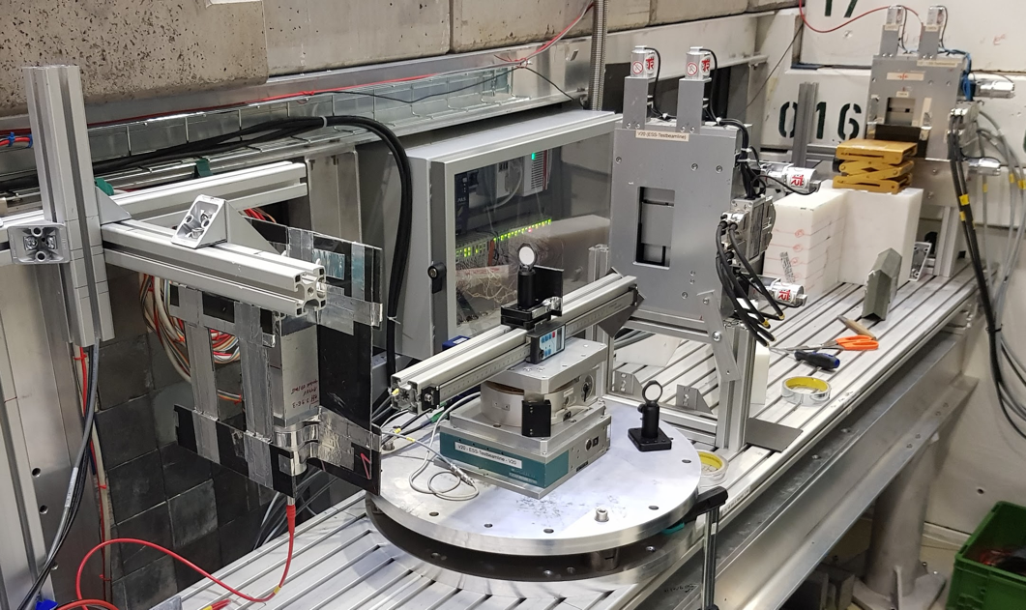
HZB alignment, scanning tests
Set up
ø25mm hBN disc (several pinhole sizes)
Upstream slits (10x10mm)
Downstream slits (6x6mm)
HZB beam monitor
X-Y-Z stage on SAD standard kinematic mount

Slide 21
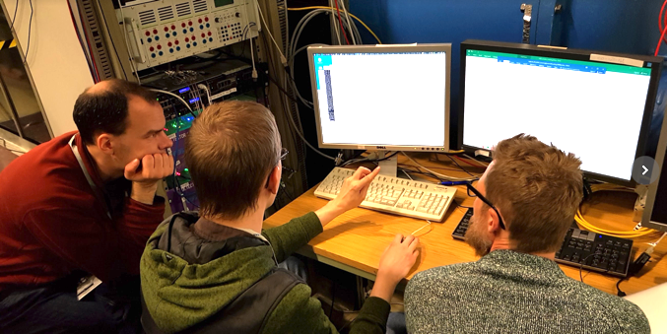
HZB alignment, scanning tests
Interfaces
stages+
pinhole
HZB monitor
V20 team
SAD
ECDC
Beckhoff driver
Monitor readout
DMSC /
Det. Group
Timing system
Motion
Control +ICS
EPICS control layer
counts
NICOS control layer
DMSC
Position (mm)
Notes:
MESI had critical role.
Encountered sharply defined and well-defended scope (e.g. motor control). similar to instrument experience.

Slide 22
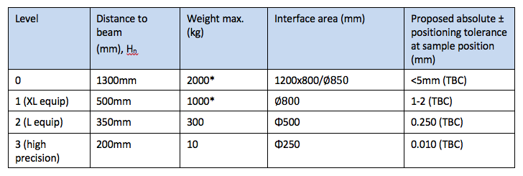
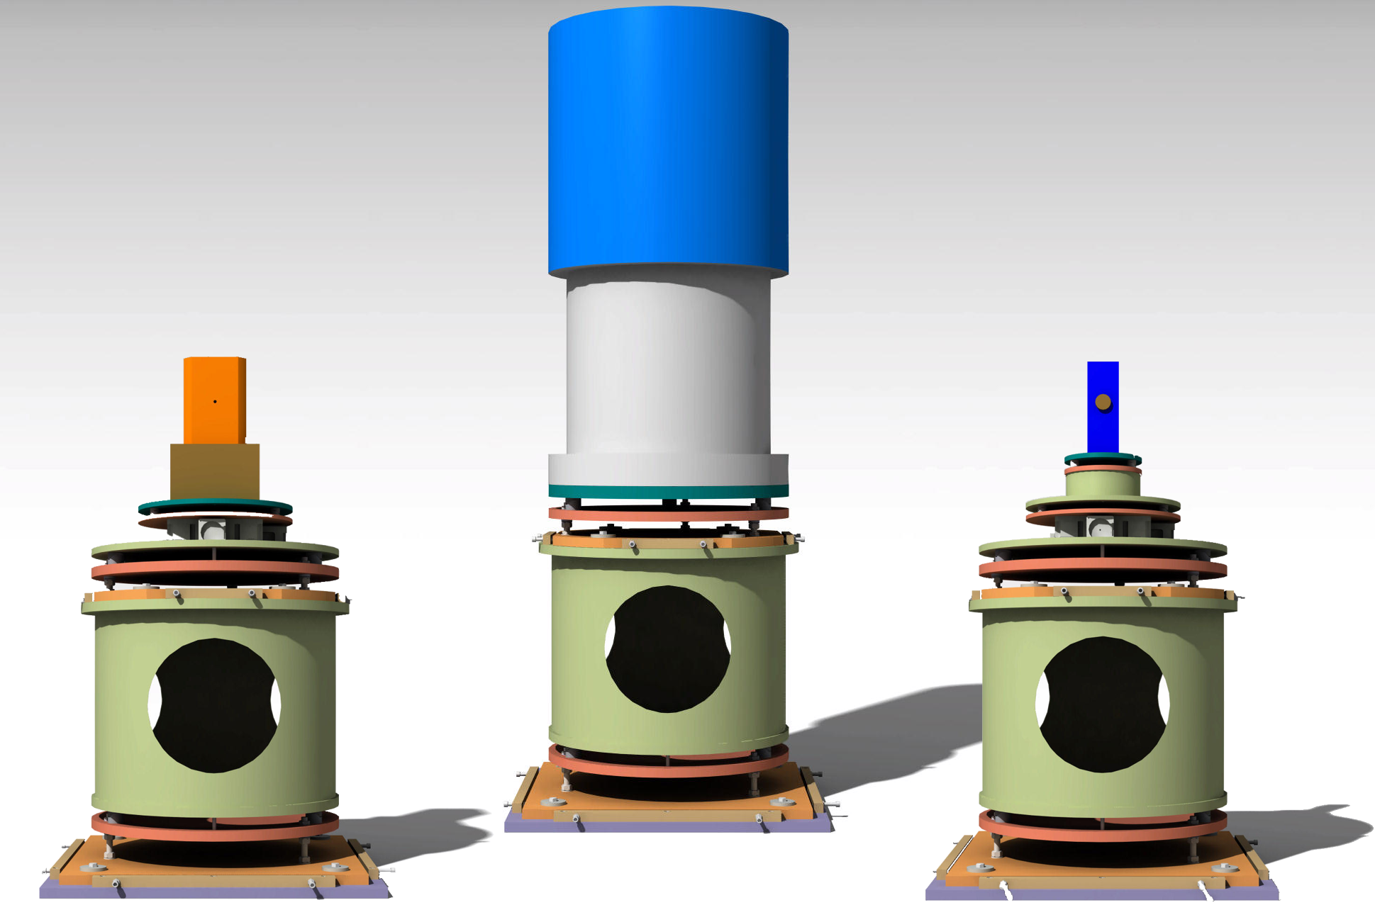
Multiple installation levels

Slide 23
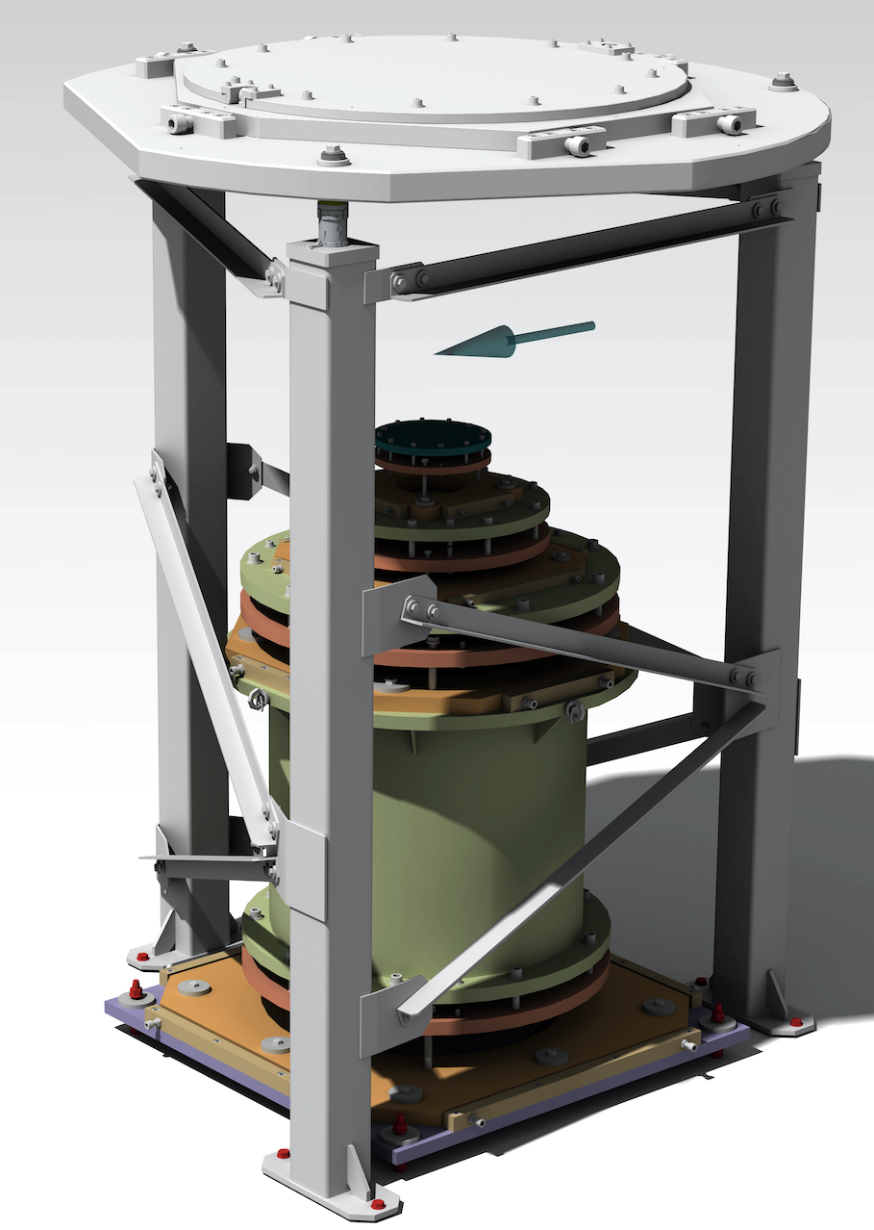
Sister system: “Flange mount”
Design for Level 1 interface finished
Prototype support frame ready for procurement
Detailed design for Levels 2-3 ongoing
Level | Distance to beam (mm),H_{n} | Flange-to-beam (“bucket” design) (mm), H_{n} | Weight max. (kg) | Opening diameter (mm) | Proposed absolute ± positioning tolerance at sample position (mm)
1 (XL) | 600 | 600 | 1000* | $∅805$, | 1-2 TBC
2 standard (L) | 600 | 350 (TBC) | 300 | Φ505 | 0.25 TBC
3 high-precision | 600 | 200 (TBC) | 5 | Φ255 | 0.01 TBC

Slide 24
Acknowledgements
Lauritz Saxtrup
Anders Pettersson

