Slide 1


Detector rate estimate for the BIFROST instrument at ESS
Milán Klausz^{1,2,3}
Kalliopi Kanaki², Thomas Kittelmann², Rasmus Toft-Petersen^{2,4},
Péter Zagyvai^{1,3}, Jonas Okkels Birk, Martin Olsen⁴, Richard Hall-Wilton^{2,5}
Milan.Klausz@esss.se
HAS Centre for Energy Research
European Spallation Source ESS ERIC
BUTE Institute of Nuclear Techniques
Technical University of Denmark
Università degli Studi di Milano-Bicocca
ICANS XXIII
Chattanooga, 17 October 2019

Slide 2
Outline
BIFROST Instrument
Simulation Tools
Simulation Model
Results
Outlook

Slide 3

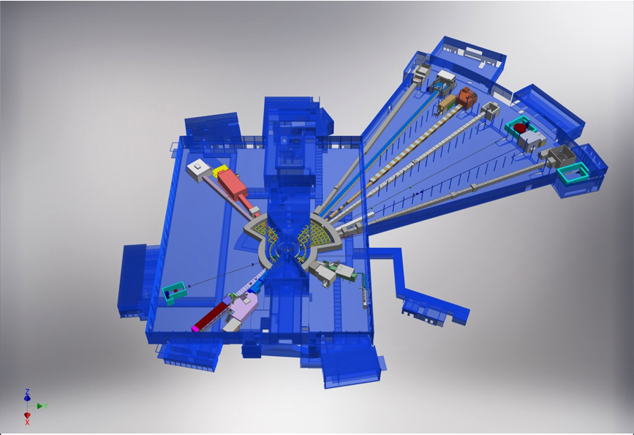











ESS - Instruments
+
Nuclear Physics Institute
NMX
BEER
+
C-SPEC
BIFROST
MIRACLES
MAGIC
ODIN
T-REX
DREAM
HEIMDAL
LoKI
VESPA
FREIA
SKADI
ESTIA
+

Slide 4
Location of BIFROST
BIFROST

Slide 5
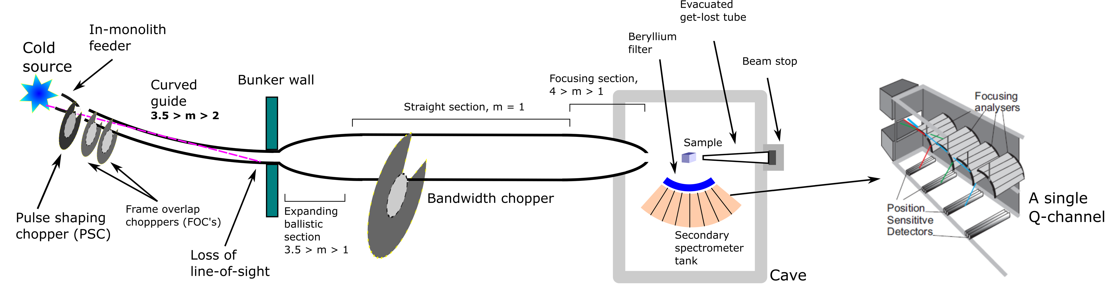
Bifrost instrument
High flux indirect geometry cold spectrometer
Small sample (1 mm³) in extreme environment
Relatively simple beam transport and conditioning system
Option to use full ESS pulse in low resolution mode

Slide 6
Scattering Characterization System

Slide 7
Scattering Characterization System
10¹⁰ n/s/cm² flux on sample
Detect weak inelastic signal
Survive intense Bragg peak
Important to define the incident detector rate

Slide 8
Outline
BIFROST Instrument
Simulation Tools
Simulation Model
Results
Outlook

Slide 9
Simulation Tools - Options
Guide
Sample + analyzers
Detectors

Slide 10

Simulation Tools - Options
Guide
Sample + analyzers
Detectors

Slide 11
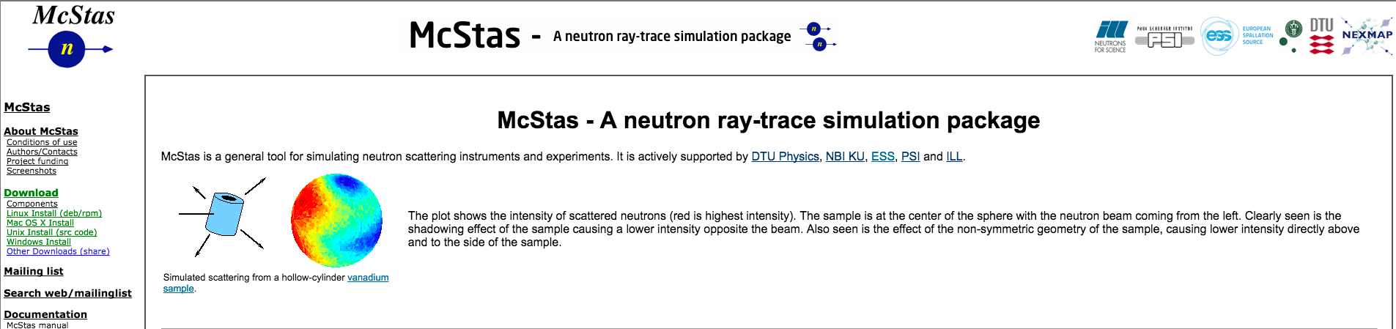
Simulation Tools - McStas
  Simulation of neutron scattering instruments and experiments
  Monte Carlo ray-trace algorithm
  Cross-platform, open source
  Version 2.5 (December, 2018)
  Collaboration:
    DTU Physics
    University of Copenhagen
    Paul Scherrer Institute
    Institut Laue-Langevin
Source: http://mcstas.org/

Slide 12
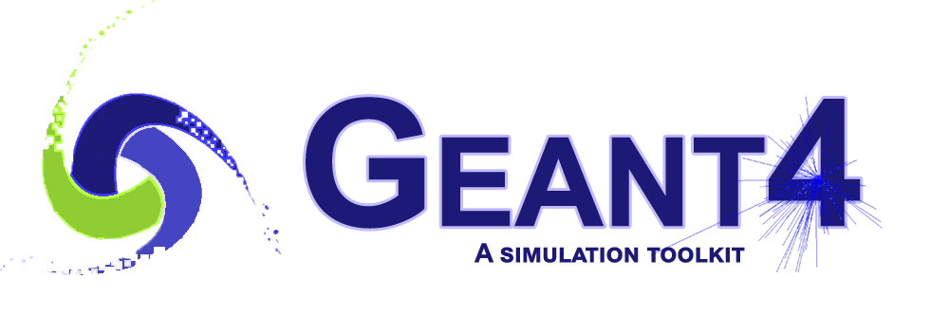
Simulation Tools - Options
Guide
Sample + analyzers
Detectors

Slide 13
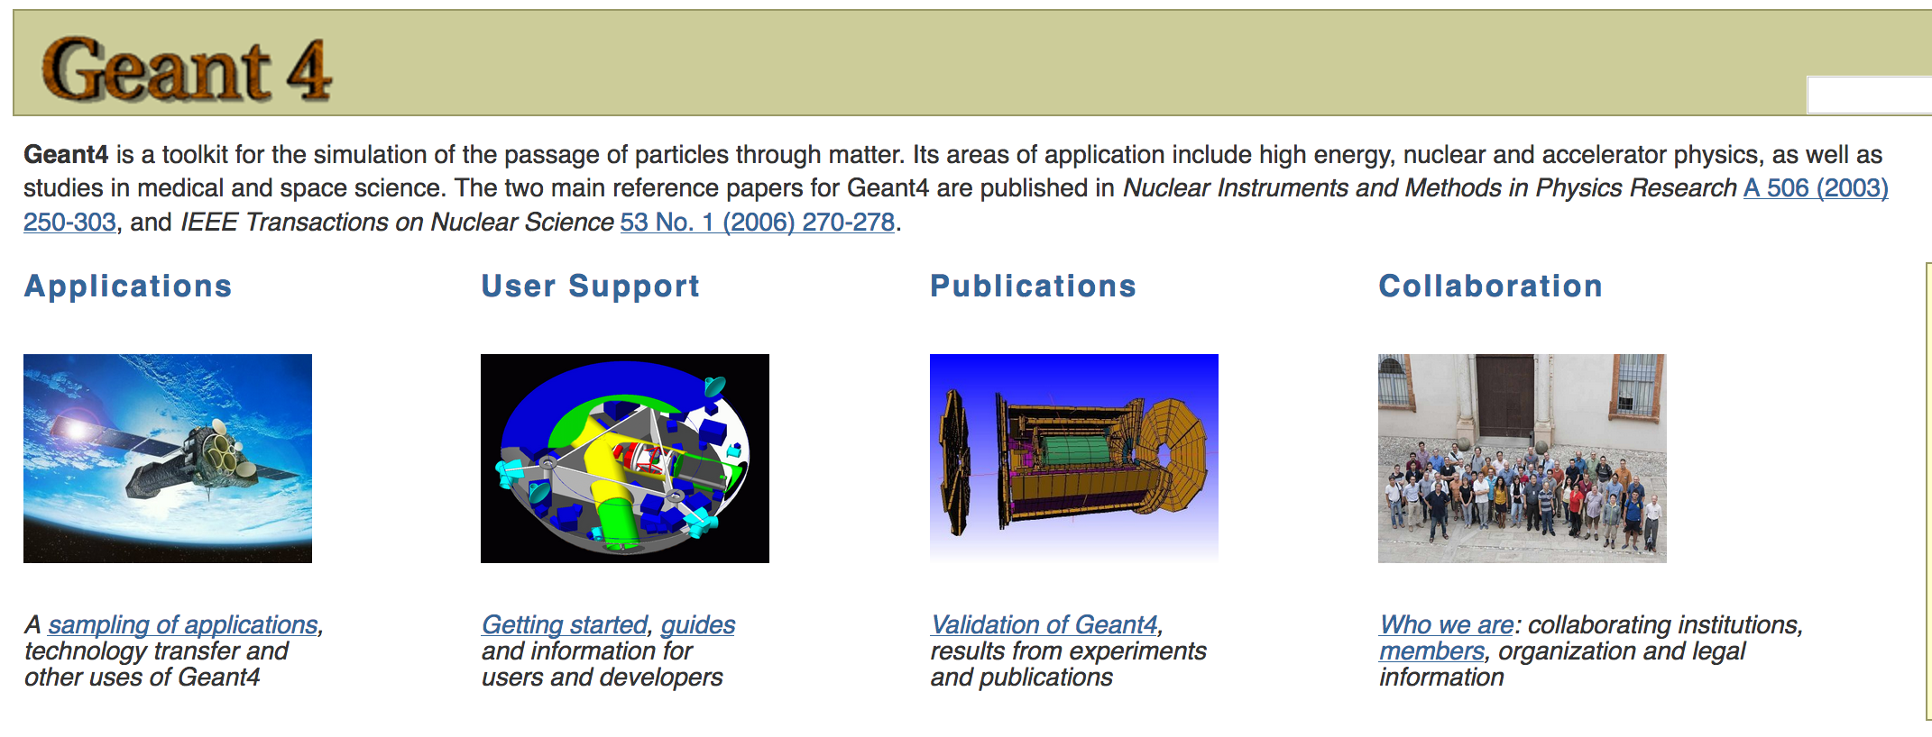
Simulation Tools: Geant4 + DG Framework
  General purpose
  Developed in CERN
  Application in various fields
  Detector Group Framework
    Code repository + build system
    Tools, issue tracker, wiki
    Geant4, C++, Python
T. Kittelmann, et al., Geant4 based simulations for novel neutron detector development,
J. Phys. Conf. Ser. 513 (2014) 022017
Source: http://geant4.cern.ch/

Slide 14
Simulation Tools - Options
Guide
Sample + analyzers
Detectors

Slide 15
Simulation Tools - Options
Guide
Sample + analyzers
Detectors

Slide 16

Simulation Tools - Options
Guide
Sample + analyzers
Detectors

Slide 17
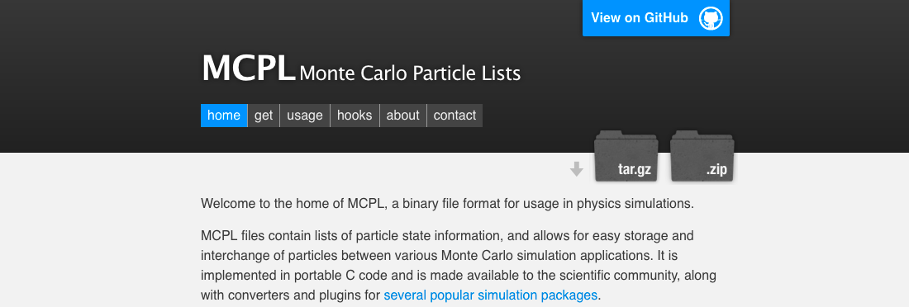
Monte Carlo Simulation: MCPL
  Monte Carlo Particle List
  Binary format
  Open source
  Compatible MC tools
    McStas
    McXtrace
    Geant4
    MCNP6, MCNPX
T. Kittelmann et al., Monte Carlo Particle Lists: MCPL,
Computer Physics Communications 218 (2017) 17-42.
Source: https://mctools.github.io/mcpl/

Slide 18
Simulation Tools - Options
Guide
Sample + analyzers
Detectors

Slide 19
Simulation Tools - Options
Guide
Sample + analyzers
Detectors
+
NCrystal
+

Slide 20
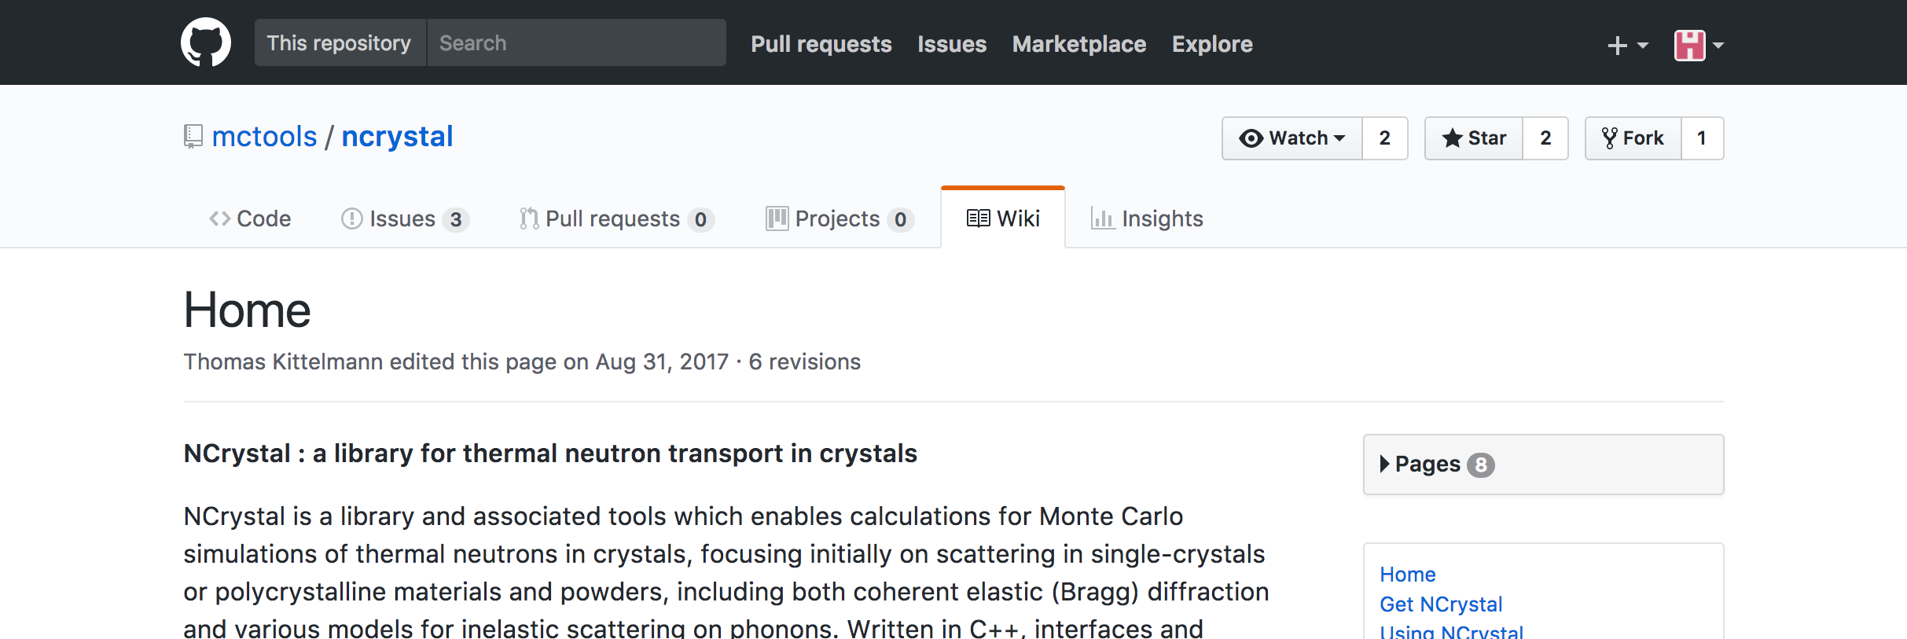
Simulation Tools: NCrystal
  Library + tools for thermal neutron transport in crystals
  Cross-platform, open source, v1.0.0
  Multiple interfaces (Geant4, McStas, …), validated results
  Collaboration:
    Xiao Xiao Cai (CNCS)
    Thomas Kittelmann (ESS)
  Supported by:
    BrightnESS (No 676548)
X. X. Cai, T. Kittelmann, NCrystal: a library for thermal neutron transport,
Computer Physics Communications (2019)
Source: https://mctools.github.io/ncrystal/

Slide 21
Simulation Tools: NCrystal
  Enables Monte Carlo simulation of neutrons in crystals
  Single-crystals
  Polycrystalline/powder materials
  Anisotropic layered crystals: pyrolytic graphite
  Coherent elastic (Bragg) diffraction
  Includes ”background” (inelastic/incoherent)
    Harmonic approximation
    Incoherent approximation
    Debye approximation
Source: https://mctools.github.io/ncrystal/

Slide 22
Simulation Tools - Options
Guide
Sample + analyzers
Detectors
+
NCrystal
+

Slide 23
Simulation Tools - Options
Guide
Sample + analyzers
Detectors
+
NCrystal
+

Slide 24
Simulation Tools - Options
Guide
Sample + analyzers
Detectors
+
NCrystal
+

Slide 25
Simulation Tools - Options
Guide
Sample + analyzers
Detectors
+
NCrystal
+

Slide 26
Outline
BIFROST Instrument
Simulation Tools
Simulation Model
Results
Outlook

Slide 27
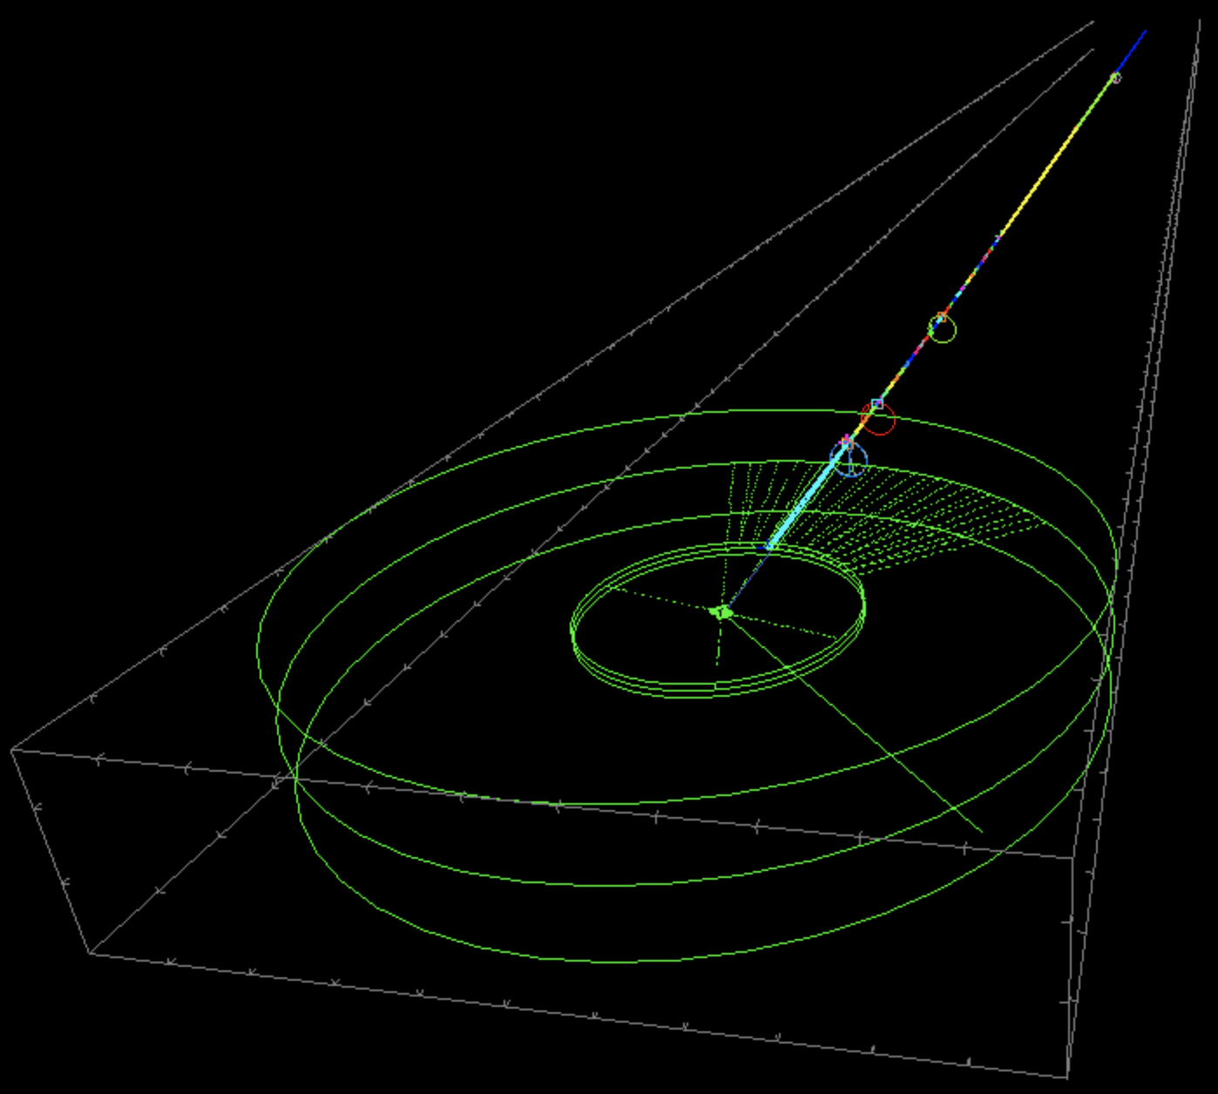
McStas Model – Full Instrument
ESS Butterfly source
4 choppers, all guide sections
Authors:
Rasmus Toft-Petersen
Jonas Okkels Birk
Martin Olsen

Slide 28
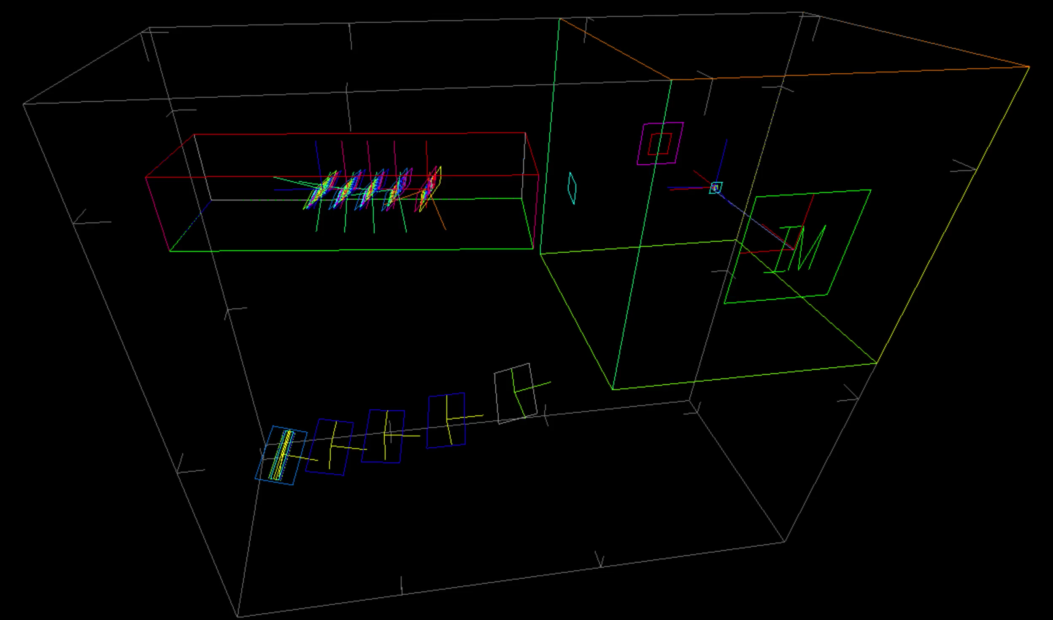
McStas Model – Analyzer-Detector system
Transmission monitor
Transmission monitor
Analysers and monitors
Sample
MCPL Source (end of guide)
5.0 meV
Detectors
Detectors (monitors)

Slide 29
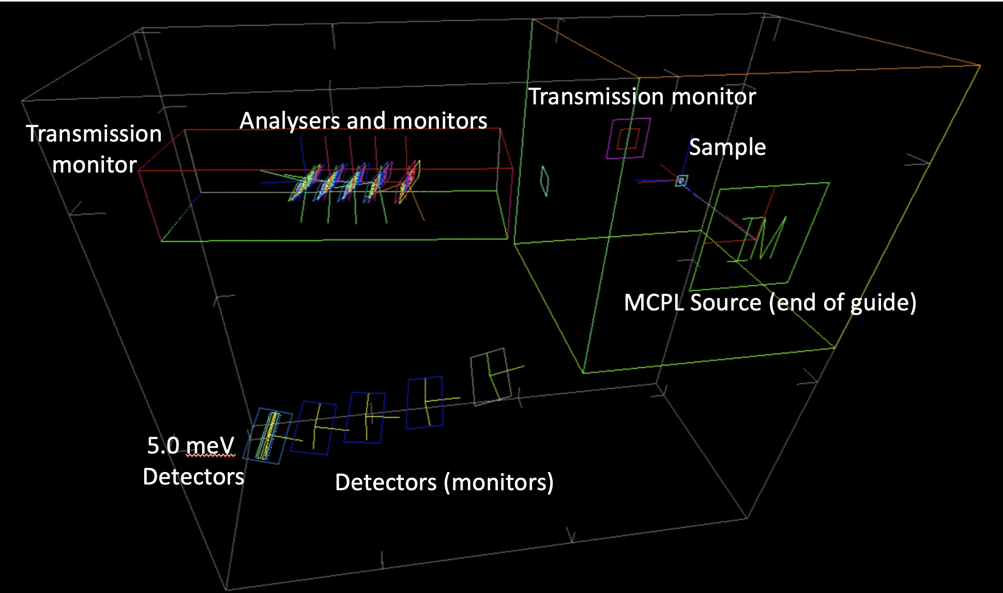
McStas Model – Analyzer-Detector system

Slide 30
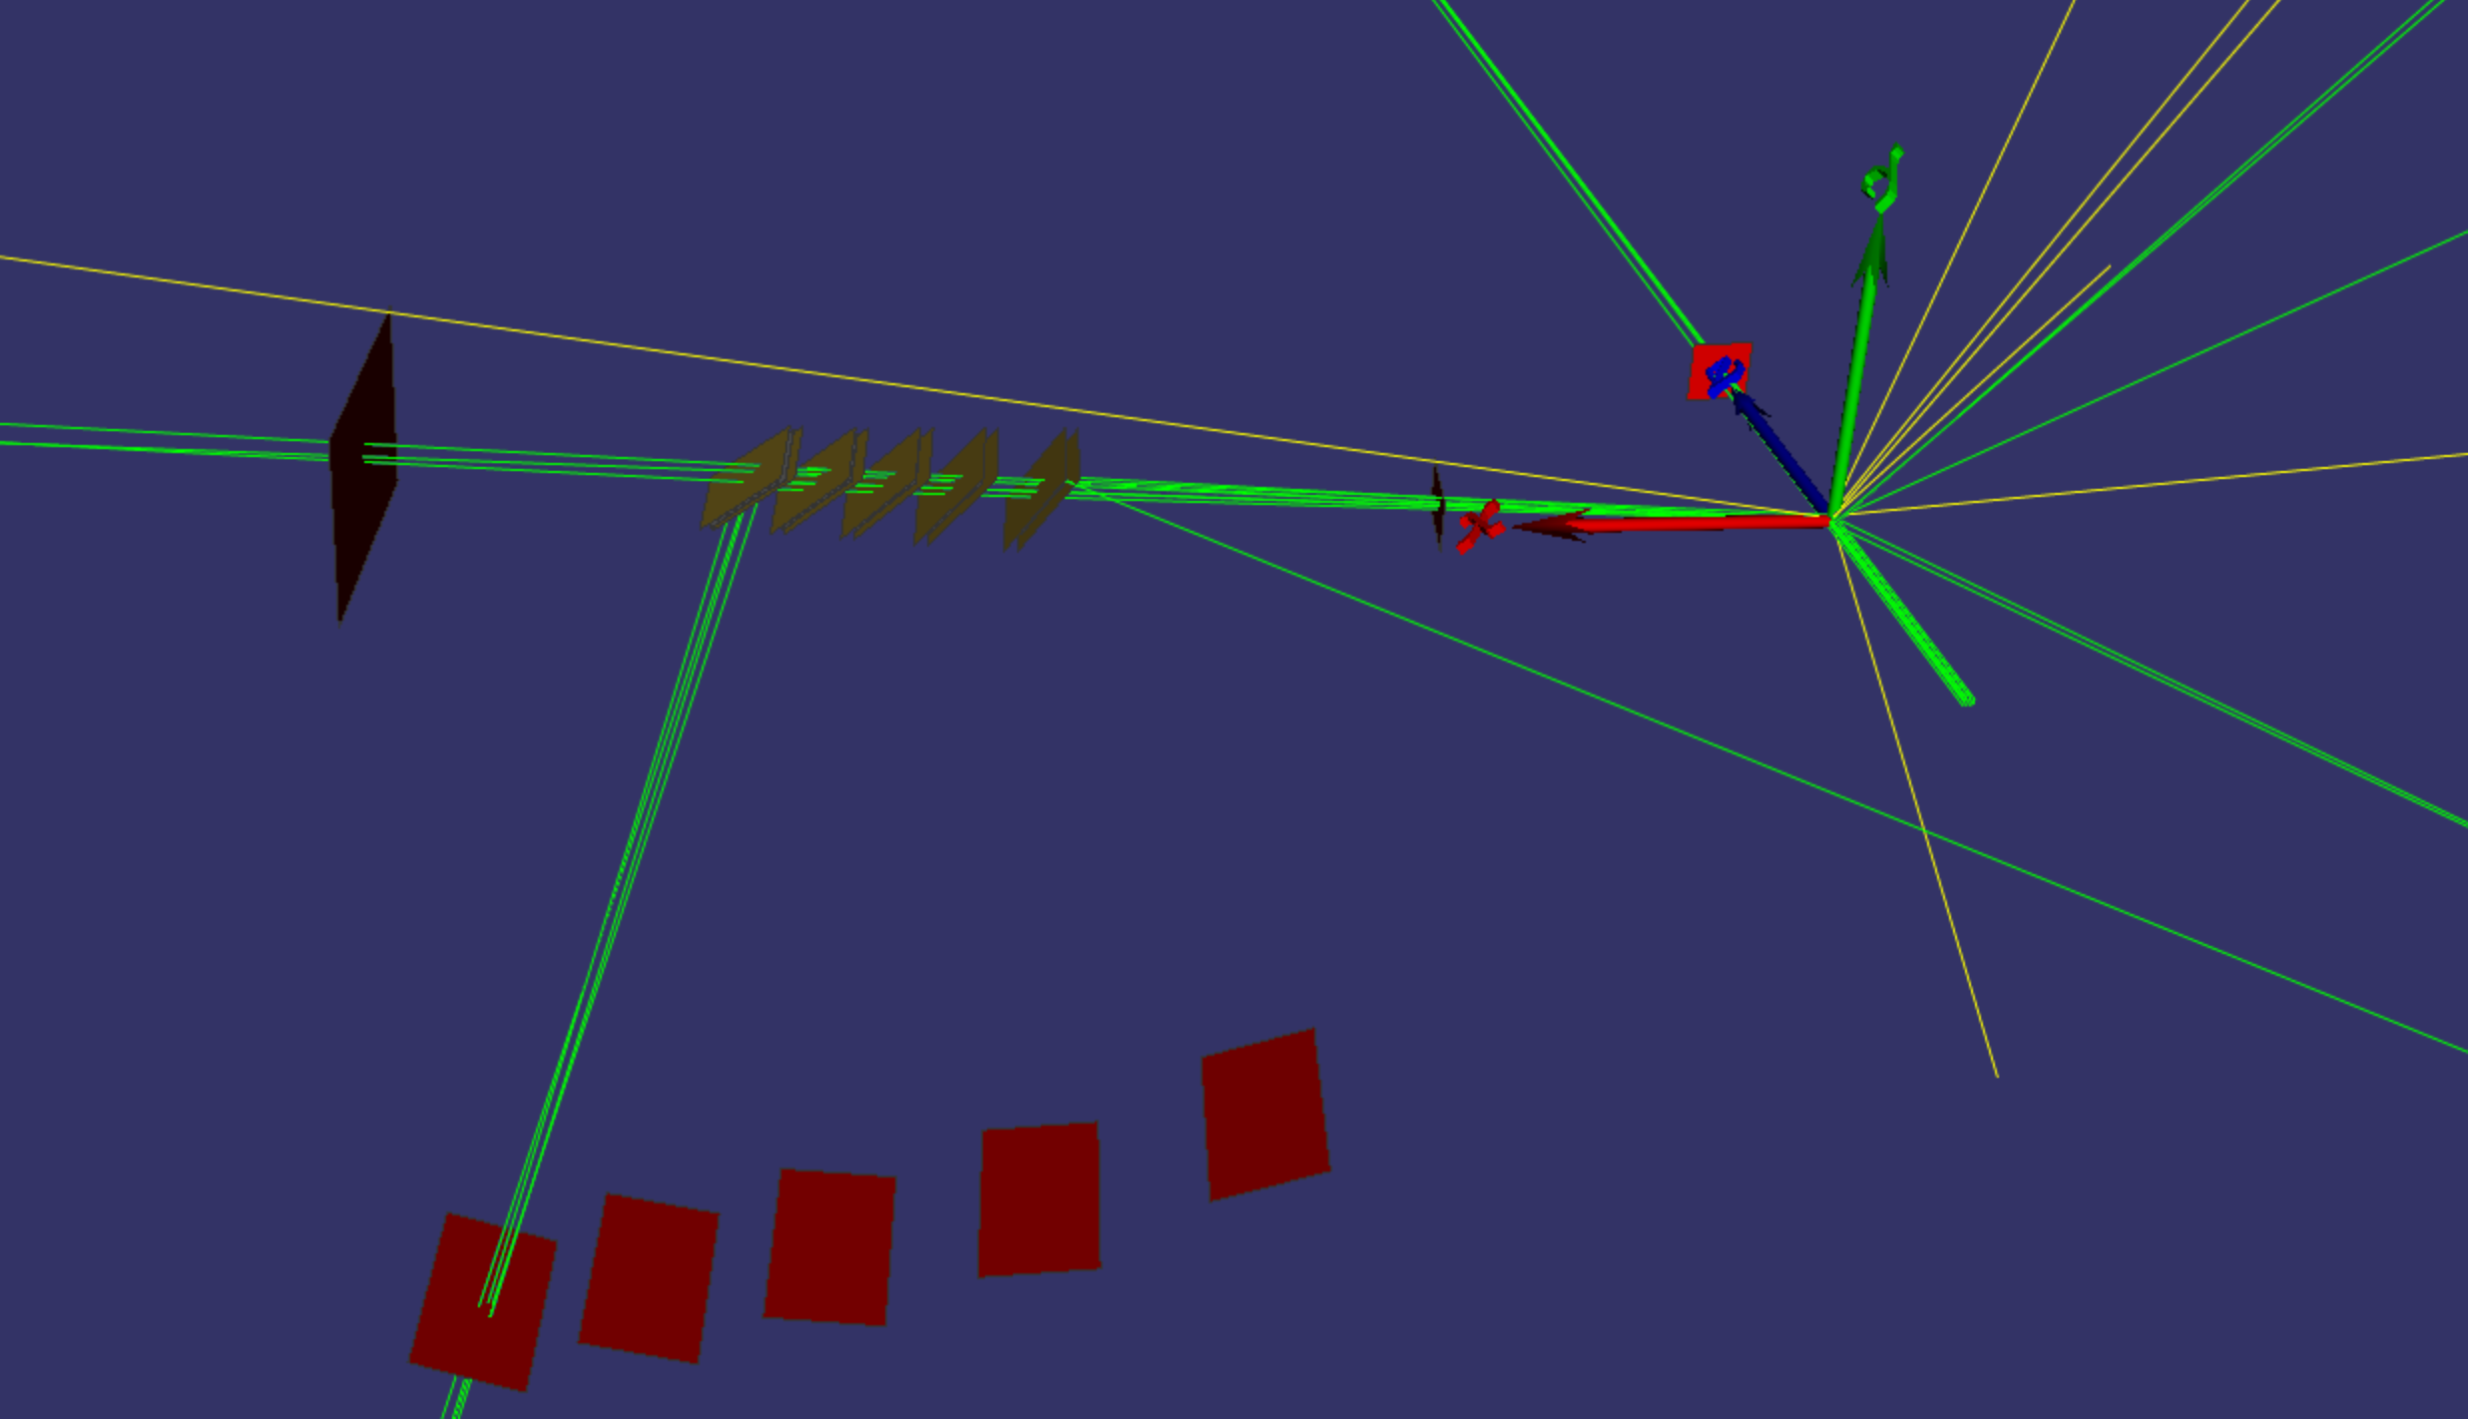
Geant4 Model – Analyzer-Detector system
Transmission monitor
Transmission monitor
Analysers and monitors
Sample
MCPL Source (end of guide)
5.0 meV
Detectors
Detectors (monitors)

Slide 31
Outline
BIFROST Instrument
Simulation Tools
Simulation Model
Results
Outlook

Slide 32
Change of energy spectrum after sample
McStas
Geant4

Slide 33
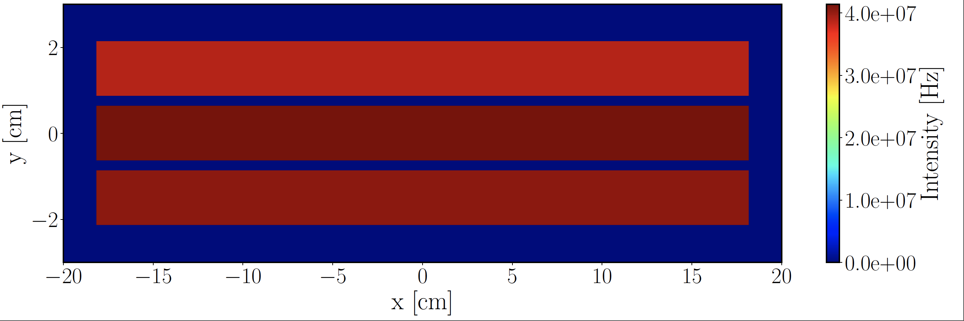
Intensity on detector
McStas
Geant4

Slide 34
Time averaged incident rate
McStas
Geant4

Slide 35
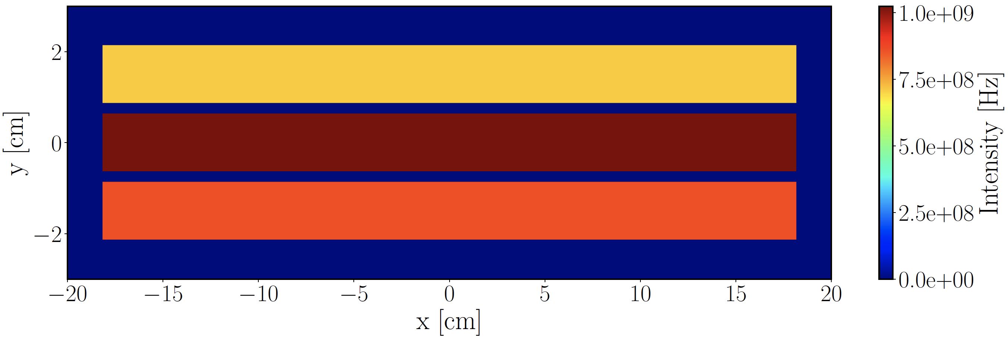
Peak instantaneous incident rate
McStas
Geant4

Slide 36
Conclusion
Parameters:
  Sample: Y₂O₃ single-crystal, hkl=2,-2,-2 (d_{hkl} = 3.0724 Å)
  cylindrical h=d=15 mm, mosaicity = 60 arcmin
  Analyzer: thickness = 1 mm, mosaicity = 60 arcmin
  Source power = 5 MW
  PSC opening time = 5 ms (full ESS pulse)
Time averaged incident rate on one He-3 tube: 4e7 Hz
Peak instantaneous incident rate on one tube: 1e9 Hz

Slide 37
Effect of sample mosaicity
Sample mosaicity matching the analyser mosaicity (60 arcmin) gives the highest incident rates

Slide 38
Effect of sample size
Detector rates drop significantly with smaller sample size:
15 mm -> 12 mm (h=d) a factor of 1.4 rate drop
15 mm -> 3 mm (h=d) a factor of 40 rate drop

Slide 39
Outline
BIFROST Instrument
Simulation Tools
Simulation Model
Results
Outlook

Slide 40
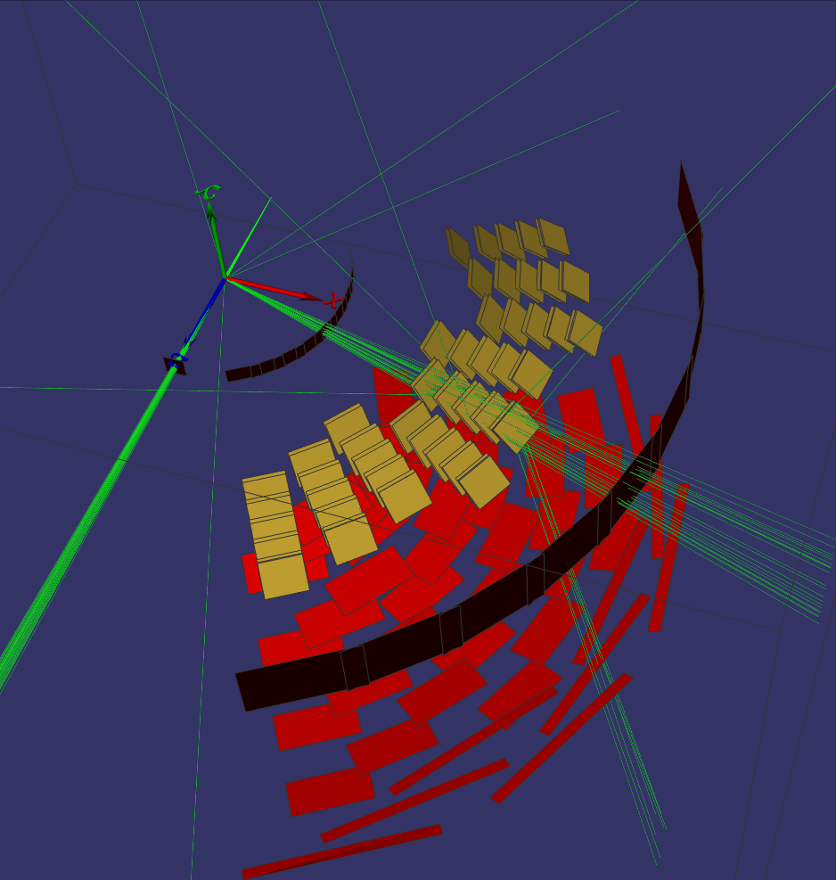
Geant4 model with all Q channels

Slide 41
Ongoing and possible studies
Simulation of calibration sample (vanadium) with full model
Study the effect of PSC opening time on energy resolution and rates
Beryllium filter + radial collimator
Detectors
Cross-talk shielding
Backscattering
Connect to Mantid

Slide 42
Acknowledgments
Xiao Xiao Cai, Peter Willendrup
Data Management&Software Centre (DMSC)
Thank you for your attention!

