Slide 1



Spin-Dependent Sub-Millimeter Fifth Force Search Using Ferrimagnetic Test Masses
Josh Long
Indiana University, Bloomington
Classification, parameterization
Motivation and existing limits (mass-coupled)
Experiment overview
Polarized test masses; spin density
Cooling system
Projected sensitivity
Notes:
I am going to present another tabletop experiment (another IU experiment…) designed to be sensitive to sub-mm range 5th forces.
Does not have the sensitivity of ARIADNE but has greater versatility: sensitive to broader range of interactions
Overview, talk about polarized test masses, and discuss sensitivity

Slide 2















Axion-mediated interactions
J. E. Moody and F. Wilczek, Phys. Rev. D 30, 130 (1984)
Yukawa (“Monopole²”)
$$m_{a}$$
$$g_{s}$$
$$g_{s}$$
$$m_{A}$$
$$m_{B}$$
r
$$m_{a}$$
Spin-spin (“dipole-dipole”)
$${iγ_{5}g}_{p}$$
$${iγ_{5}g}_{p}$$
$$m_{A}$$
$$m_{B}$$
Spin-mass (“Monopole-dipole”)
$$m_{a}$$
$$g_{s}$$
$${iγ_{5}g}_{p}$$
Violates P,T
$$m_{A}$$
$$m_{B}$$
Notes:
In fact it was originally optimized for mass-coupled Yukawa-type interaction
2 test masses A and B
Alpha is strength relative to gravity and lambda is the range
Lambda also the Compton wavelength of the force mediator of mass m_(little a)
Nice generalization of 1/r potentials for the case of massive mediator
Here it is again in terms of this scalar coupling constant which measures the strength relative to the strong interaction.
This is the notation commonly used for spin-dependent interactions. You can have a massive spin-spin interaction or massive spin-mass interaction. The latter of which would violate both parity and time reversal symmetries.
These potentials are of special interest since they could be mediated by the axion, a promising light dark matter candidate.
In the absence of a signal most experiments report their results in terms of limits on the couplings as function of the range.

Slide 3
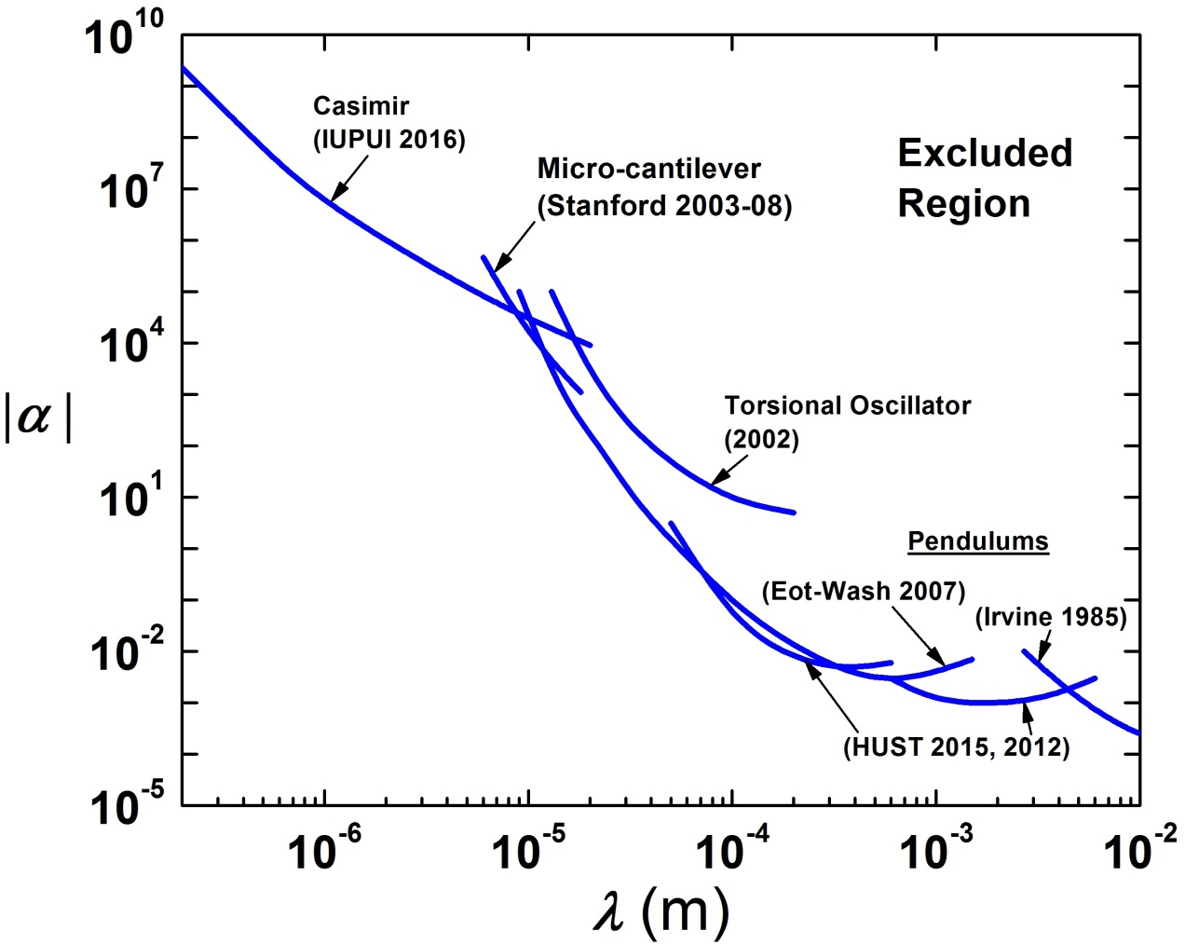
Short Range limits – mass coupled
Experimental limits:
Irvine, HUST, Eot-Wash =
torsion pendulum experiments
Stanford, IUPUI = MEMS/AFM-type experiments
Torsion Osc: JCL et al., Nature 421 922 (2003)
Irvine: J. Hoskins et al., PRD 32 3084 (1985)
HUST: W.-H. Tan et al., PRL 116 131101 (2016)
Eot-Wash: D. Kapner et al., PRL 98 021101 (2007)
Stanford: A. Geraci et al., PRD 78 022002 (2008)
Casimir: Y.-J. Chen et al., PRL 116 221102 (2016)
Notes:
Here are the experimental limits on spin-independent forces in the sub-mm range.
Lambda ranges from 1cm down to below 1um. Alpha runs from 1E-7 times gravity to 1E10
Experimentally exclude region is above and to the right of the blue curve.
Above 10um the best limits come from torsion pendulum experiments, Below they are set by AFM type experiments. The IU experiment is a hybrid.

Slide 4
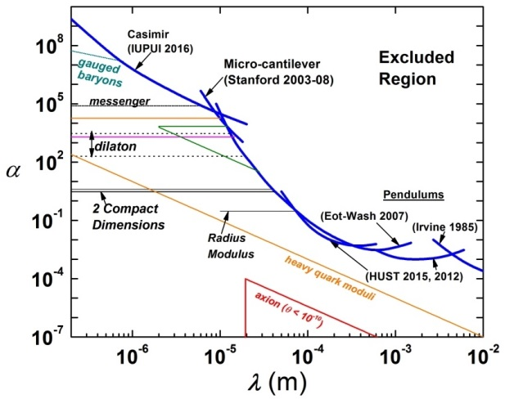
Short Range limits and predictions
Experimental limits:
Irvine, HUST, Eot-Wash =
torsion pendulum experiments
Stanford, IUPUI = MEMS/AFM-type experiments
Limits still allow forces 1 million times stronger than gravity at 5 microns
Theoretical predictions:
“Large” extra dimensions
Irvine: J. Hoskins et al., PRD 32 3084 (1985)
Vacuum energy: prediction from new field which also keeps cosmological constant small
HUST: W.-H. Tan et al., PRL 116 131101 (2016)
Eot-Wash: D. Kapner et al., PRL 98 021101 (2007)
Stanford: A. Geraci et al., PRD 78 022002 (2008)
Moduli, dilatons: new particles motivated by string models
Casimir: Y.-J. Chen et al., PRL 116 221102 (2016)
Theory: S. Dimopoulos, A. Geraci, PRD 68 124021 (2003)
Notes:
The fine and dashed lines are theoretical predictions. I will not discuss them except to point out that there is a prediction for the axion for unpolarized test masses, indirect limit from constraints on theta QCD from neutron EDM experiments. 1E4 below current direct limits.

Slide 5
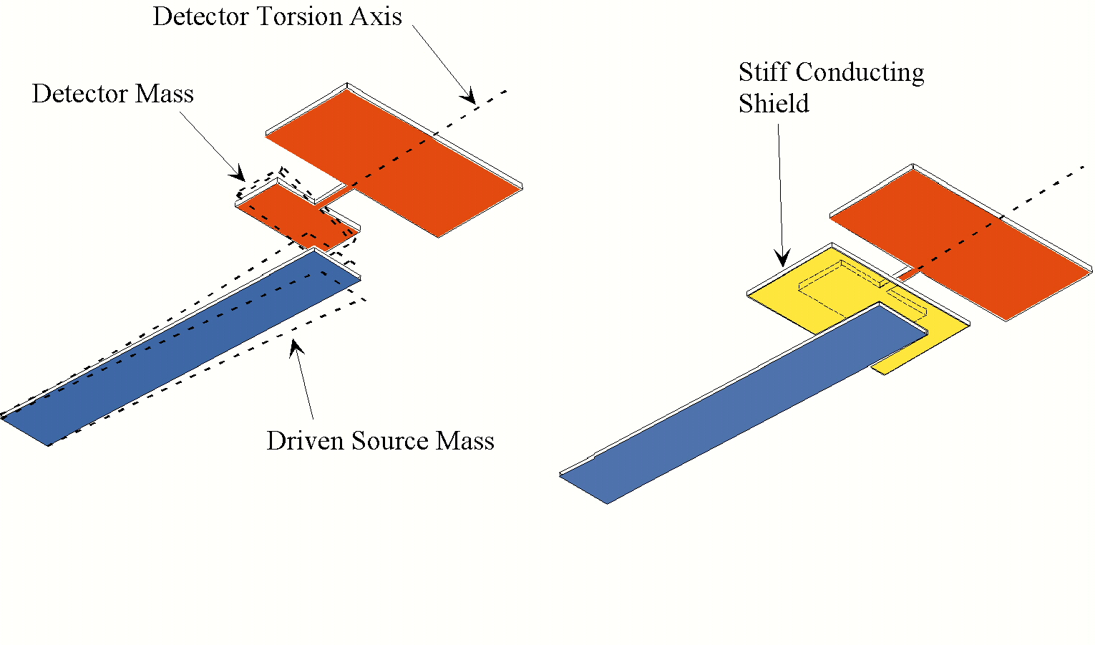
Indiana short-range experiment
Planar Geometry - null for 1/r²
Resonant detector with source mass driven on resonance
1 kHz operational frequency - simple, stiff vibration isolation
Double-rectangular torsional detector: high Q, low thermal noise
Stiff conducting shield for background suppression: limits gap to 80 μm
~ 5 cm
Source and Detector Oscillators
Shield for Background Suppression
Notes:
When we started the Indiana short-range experiment we did not think torsion balance would be the instrument of choice: seismic and room vibrations, mechanical drifts that we though would be exacerbated at short-range.
This is a cartoon
It uses planar geometry to concentrate as much mass as possible at the range of interest
We have a resonant detector with a source mass driven on resonance to maximize the signal
Resonant operation puts heavy burden on vibration isolation
Why we choose a 1 kHz operational frequency since at 1 kHz it is possible to use a stiff, passive vibration isolation system
In the absence of resonant backgrounds the limiting background is thermal noise, which is why the detector has this double rectangle shape since it has a high Q
There is also a stiff conducting shield between the test masses which limited the gap to 80 um

Slide 6
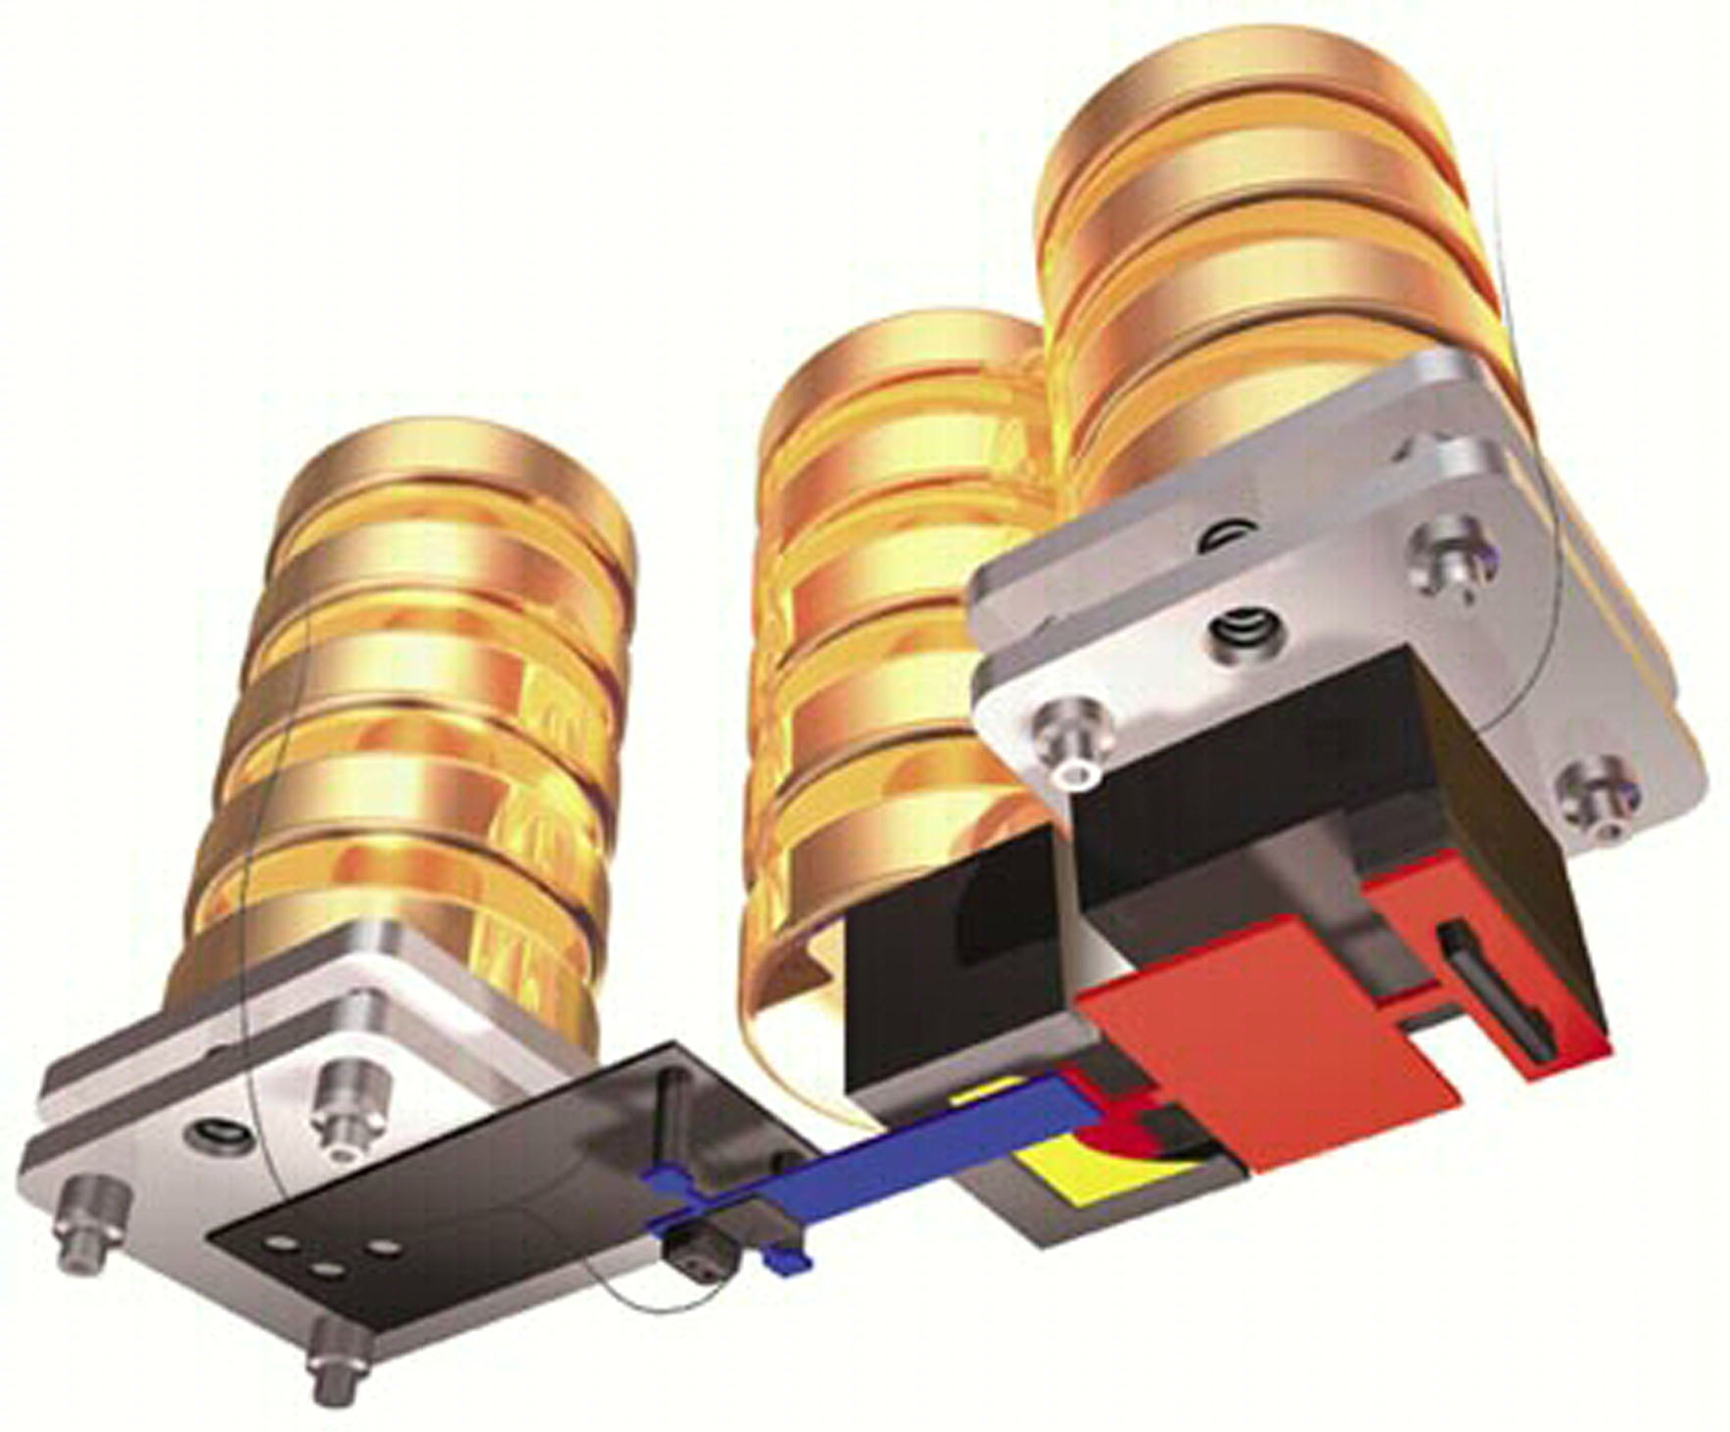
Central Apparatus
Scale:
1 cm³
Vibration isolation stacks: Brass disks connected by fine wires; soft springs which attenuate at ~10¹⁰ at 1 kHz (reason for using 1 kHz)
vibration
isolation
stacks
tilt stage
Readout: capacitive transducer and lock-in amplifier referenced by source drive frequency
transducer
amp box
detector mass
shield
PZT bimorph
source mass
Vacuum system: 10⁻⁷ torr
Figure: Bryan Christie (www.bryanchristie.com) for Scientific American (August 2000)
Notes:
Cartoon of whole central apparatus, with test masses in same orientation and color scheme
Each element suspended from one of our vibration isolation stacks, which acts as a series of soft springs relative to the 1 kHz operation frequency: kHz vibrations of the source are attenuated by 1E10.
Readout not shown: capacitive probe just above the detector, and a front-end JFET amplifier which ouputs the signal to a lock-in.
Further reduce acoustic background, placed in 75L bell jar and pumped to 1E-7 torr.

Slide 7
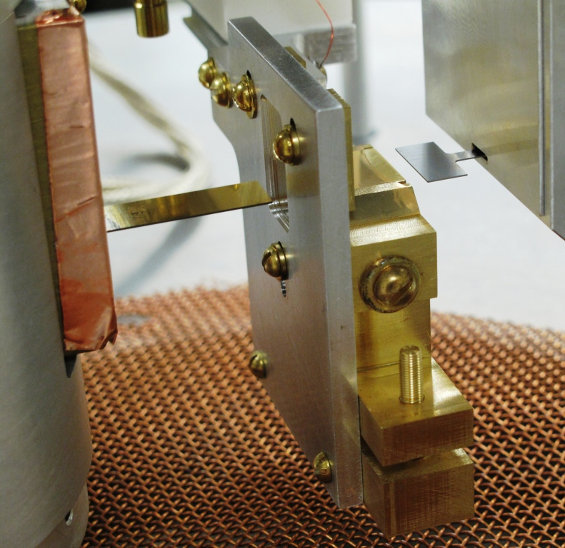
Interaction Region
10 μm stretched Cu membrane shield (shorter ranges possible)
source mass (retracted)
~1 cm
detector mass front rectangle (retracted)
Thinner shield
60 μm thick sapphire plate replaced by 10 μm stretched copper membrane
Compliance ~5x better than needed to suppress estimated electrostatic force
Minimum gap reduced from 105 μm (2003) to 40 μm.

Slide 8
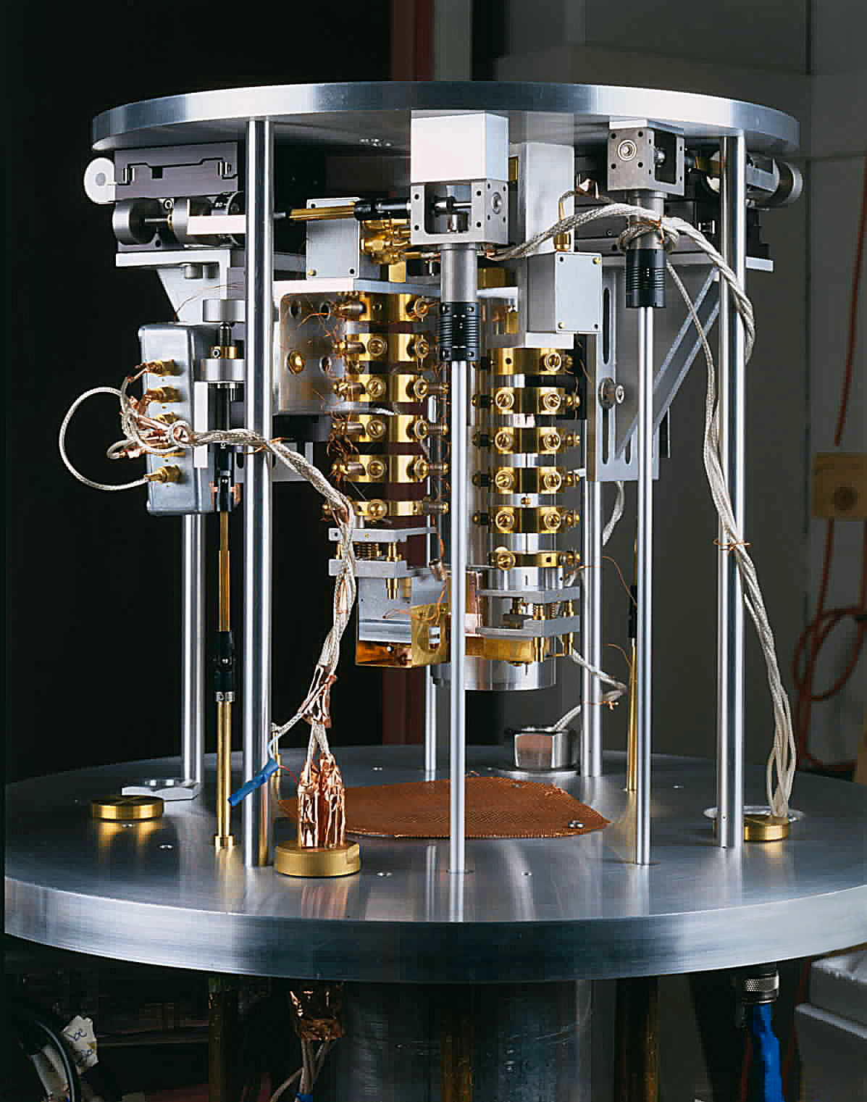
Central Apparatus
Inverted micrometer stages for full XYZ positioning
~50 cm
Vacuum system base plate
Torque rods for micrometer stage control

Slide 9
Sensitivity: increase Q and statistics, decrease T
Signal
Force on detector due to Yukawa interaction with source:
~ 3 x 10⁻¹⁵ N (for α = 1, λ = 50 μm)
Thermal Noise
sensitivity
~ 3 x 10⁻¹⁵ N (300 K, Q = 5 x10⁴, 1 day average)
10⁻¹³ g
~ 7 x 10⁻¹⁷ N (4 K, Q = 5 x10⁵, 1 day average)
Notes:
This is our sensitivity to yukawa forces
Model the signal as the yukawa force between flat plates: for our geometry this works out to a few fN for a gravitational-strength Yukawa interaction at 50 um.
Estimate the thermal noise from the mechanical Nyquist formula. This is the mechanical analog of Johnson noise in a resistor where the resistance is replaced by the mechanical damping factor, inversely proportional to the quality factor.
For our test masses this works out to a few fN at room T assuming Qs of about 50k, and 1 day integration time.
A cryo experiment might do better by 2 OOM, not just from the T but the expected improvement in Q.

Slide 10
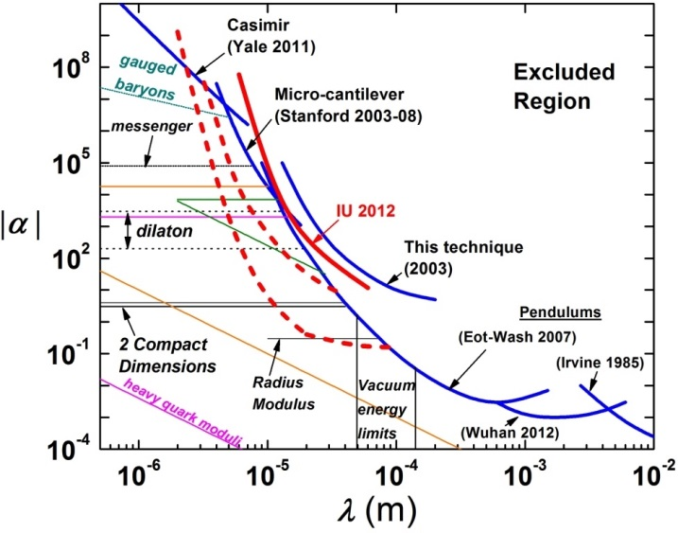
Current Limits (2σ) and Projected Sensitivity
Upper: 1 day integration time, 50 micron gap, 300 K
Lower: 1 day integration time, 50 micron gap, 4.2 K, factor 50 Q improvement
Present gap ~ 80 microns; need flatter, more level elements

Slide 11
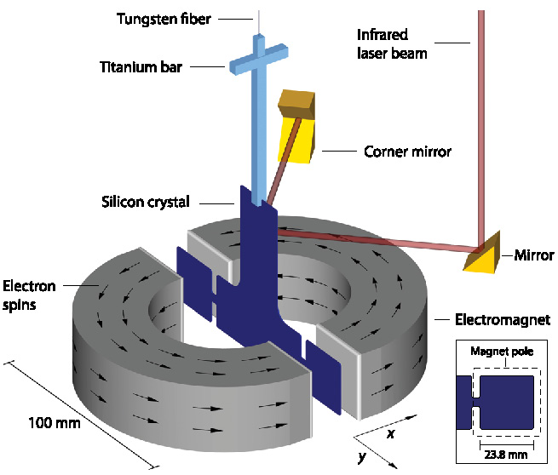
Spin – Dependent experiments (electron)
Eot-Wash ALP torsion pendulum
“Compensated” test mass
e.g., Dy₆Fe₂₃
(W.-T. Ni, C. Speake, R. Ritter)
S. Hoedl et al., PRL 106 (2011) 041801

Slide 12
Spin-Polarized Test Mass: Ferrimagnet
μ₁
μ_{Total}
μ₂
R.C. Ritter, C.E. Goldblum, W.-T. Ni, G.T. Gillies, C.C. Speake, PRD 42 977 (1990)
Notes:
To search for spin-dependent 5th forces, need spin-polarized test masses. Polarized sources are magnetic; how control backgrounds?
Trick from Wei-Tou Ni: compensated ferrimagnets
Ferrimagnet has at least 2 magnetic sublattices, anti-aligned, labeled mu1 and mu2 here
Total magnetic moment is upward

Slide 13
Compensated Ferrimagnet
μ₁
T₀
μ_{Total}
μ₂
μ₁
T₁ < T₀
μ_{Total}
μ₂
μ₁
T_{C} < T₁
μ_{Total} = 0
μ₂
R.C. Ritter, C.E. Goldblum, W.-T. Ni, G.T. Gillies, C.C. Speake, PRD 42 977 (1990)
Notes:
The temperature dependence of the magnetization of each sublattice is different
So that as I cool the sample, the magnetism of mu2 grows faster
At some magic temperature or compensation temperature the magnetizations are equal and opposite so the total moment vanishes

Slide 14
Compensated Ferrimagnet
μ₁
s_{Total}
T₀
μ_{Total}
μ₂
μ₁
T₁ < T₀
μ_{Total}
μ₂
μ₁
T_{C} < T₁
μ_{Total} = 0
μ₂
R.C. Ritter, C.E. Goldblum, W.-T. Ni, G.T. Gillies, C.C. Speake, PRD 42 977 (1990)
Notes:
Now I take advantage of the fact that in some materials, part of the magnetization is due to orbital motion rather than spin
For example if mu 2 is a rare earth
Which I have illustrated schematically by the black arrows

Slide 15
Compensated Ferrimagnet
μ₁
s_{Total}
T₀
μ_{Total}
μ₂
μ₁
T₁ < T₀
s_{Total}
μ_{Total}
μ₂
μ₁
T_{C} < T₁
s_{Total}
μ_{Total} = 0
Dy₆Fe₂₃, ErFe₃, HoFe₃, …
Rare Earth Iron Garnets
μ₂
R.C. Ritter, C.E. Goldblum, W.-T. Ni, G.T. Gillies, C.C. Speake, PRD 42 977 (1990)
Notes:
You can see what happens to the total spin when I reach the compensation temperature. I have a material with spin but no magnetism.

Slide 16
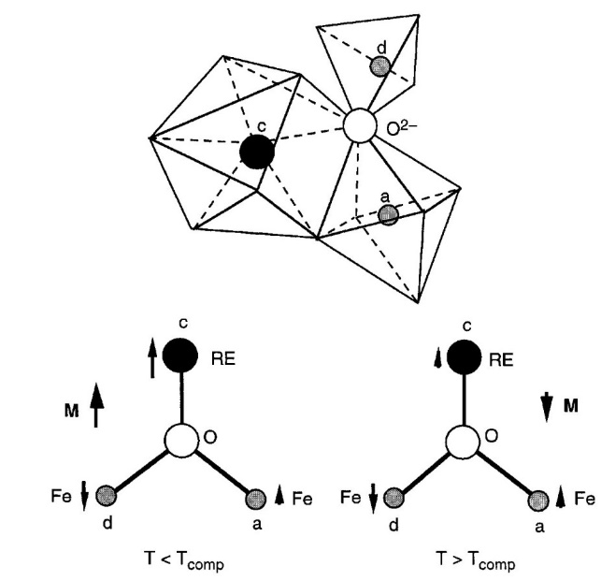
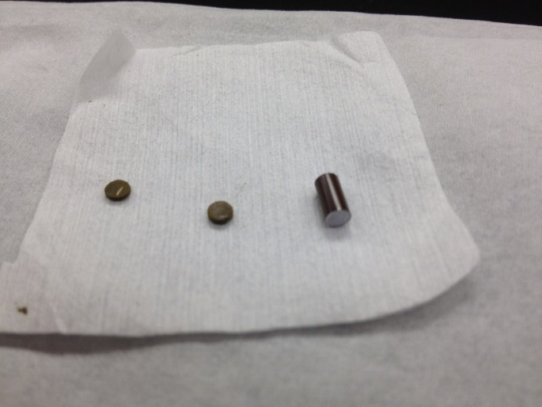
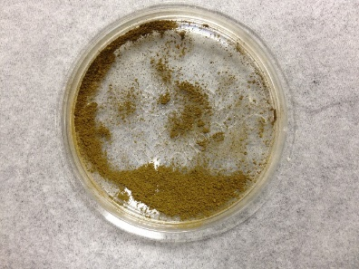
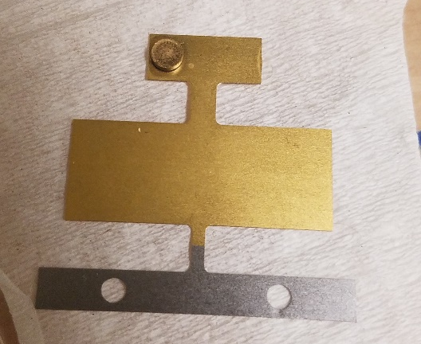
Dysprosium Iron Garnet
Dy₃Fe₅O₁₂
DyIG pressed pellets
DyIG powder
G. Dionne, Magnetic Oxides (N.Y., Springer, 2009)
Dy₃Fe₅O₁₂ recipe [1]
1. Add H₂O to Dy(NO₃)₃·H₂O powder for a 1M solution
2. Combine with 1M H₂O and FeCl₃·6H₂O solution
3. Add drops of base NaOH to precipitate rust colored solid
4. Dry and press into pellet
5. Fire at 900C - color changes to olive green
6. Grind and fire again to increase purity
3 mm x 1 mm
[1] M. Gesselbracht, et al., J. Chem. Educ 71 (1994) 696

Slide 17
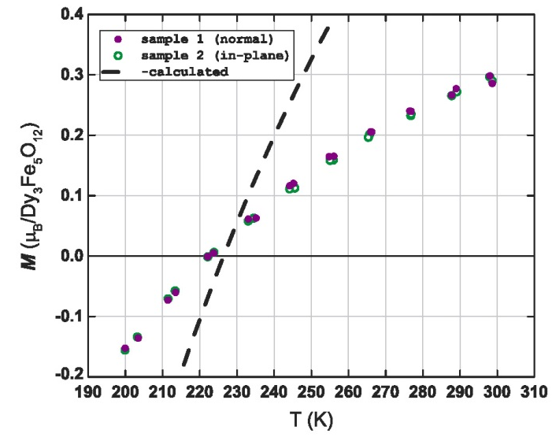
Spin density of existing samples
Magnetic behavior (Quantum MPMS magnetometer)
Magnetize to saturation (~ 0.5T)
Sample 1:
Sample 2:
Ramp field to zero
Measure remnant magnetization vs. T (300 K→200 K→300 K)
multiple passes, ~12 hr dwell at Tc: unchanged
Spin density
(units of ħ/cc)
Result [2]
n_{s} = 4.0 × 10²⁰/cc (normal)
Correction for incomplete magnetization [1]:
n_{s} = 4.1 × 10²⁰/cc (in-plane)
_Measured slope_
= 0.36
Calculated slope
T_{c}
[2] T. M. Leslie, E. Weisman, R. Khatiwada, JCL, PRD 89 (2014) 114022
[1] R. Ritter et al., PRD 42 (1990) 977
Notes:
The plot shows the remnant magnetization as a function of temperature.
We magnetize the sample to saturation and turn off the field.
As we lower the T, the magnetization drops to zero, reverses, then recovers to its initial value on warming
This process is repeatable and does not appear to degrade at least for several weeks.
Based on a molecular field calculation we estimate a spin density of about 1E20 per cc

Slide 18
Radiative Cooling System
Liquid nitrogen-cooled shield inside vacuum bell jar
Hold at 223 K compensation T with existing PID controller (± 0.1 K)
Finite element model: 223 K reached in ~ 2.5 hr with shield at 77 K
Notes:
To take full advantage of the low magnetization we need to operate at the compensation T
Plan to cool the experiment radiatively, by surrounding the central apparatus with a conducting shield cooled by liquid nitrogen
An existing PID temperature sensor and heater should be able to keep the mass to within 0.1 K of the compensation temperature.
Shield still in the shop; Plot of T (K) vs time (s) from a detailed finite element model. With a 77K shield the system should reach Tc in about 2 ½ hours.

Slide 19
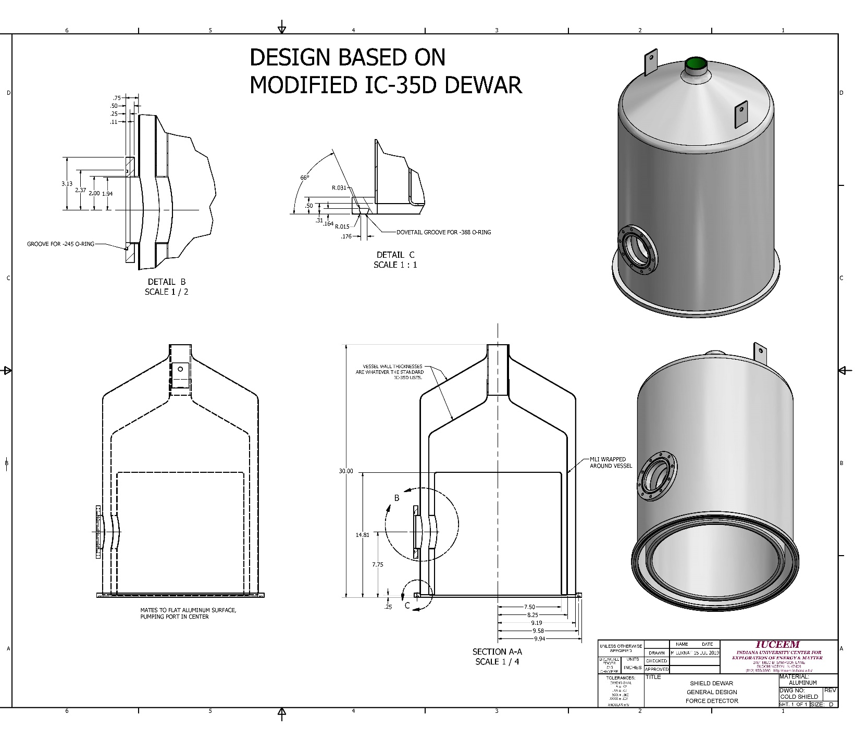
Radiative Cooling System
Notes:
Keeping the shield at 77K should not be a problem: The shield consists of a new outer vacuum volume, surrounds a liquid nitrogen dewar in which the liquid volume extends all the way down in this narrow space to the vacuum baseplate.
Hoping to show results from the cooldown, but capital purchase rules being what they are…

Slide 20
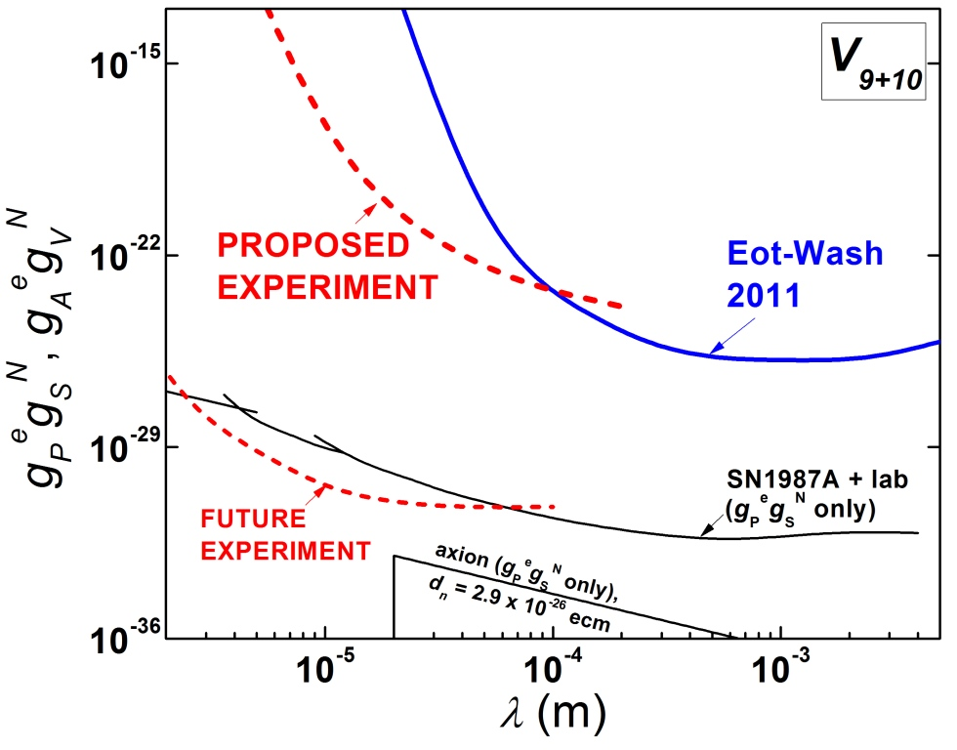
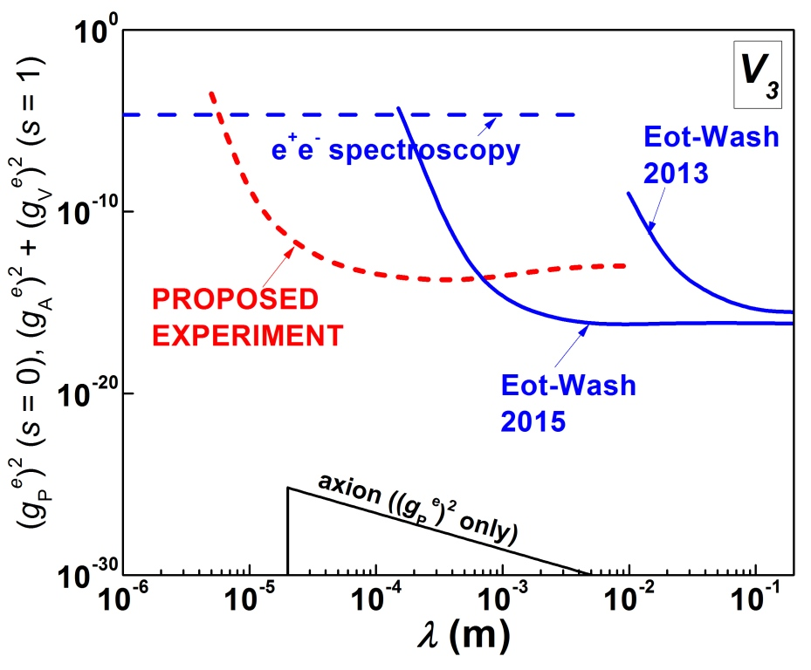
Projected sensitivity
Measured garnet spin density = 4×10²⁰ ħ/cc
T. M. Leslie, E. Weisman, R. Khatiwada, JCL, Phys. Rev. D 89 114022 (2014)

Slide 21
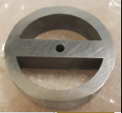
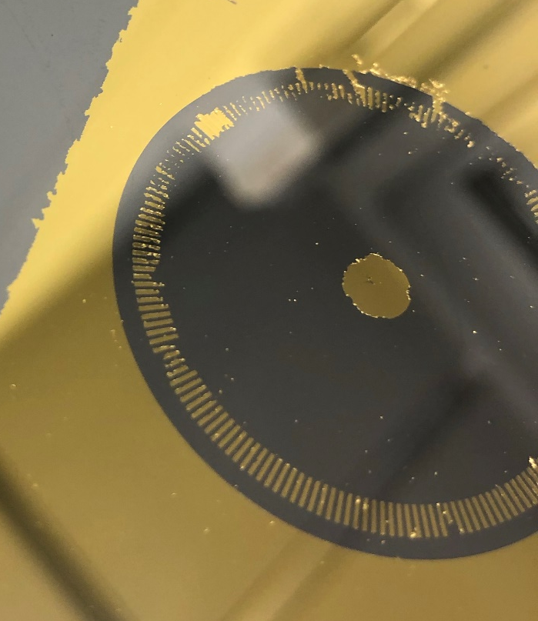
ARIADNE source mass
Tungsten prototype
Top plate with reflective velocity pattern
11 teeth (200 μm protrusions)
under development
wire EDM
Surface magnetic field < 30 pT (PTB lab, Berlin)
Notes:
For axion sensitivity, ARIADNE is one approach
Our group has experience with tungsten machining and has prototyped the source mass: we have fabricated a prototype from tungsten via wire EDM and showed it to have magnetic impurities of less than a ppm.
Currently working on a reflective pattern for the top, so a laser can probe the velocity.

Slide 22
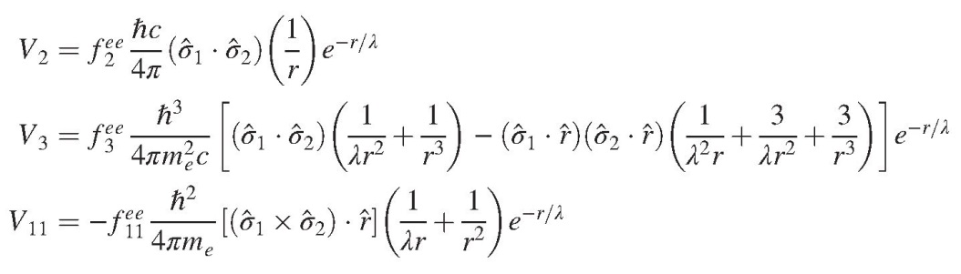
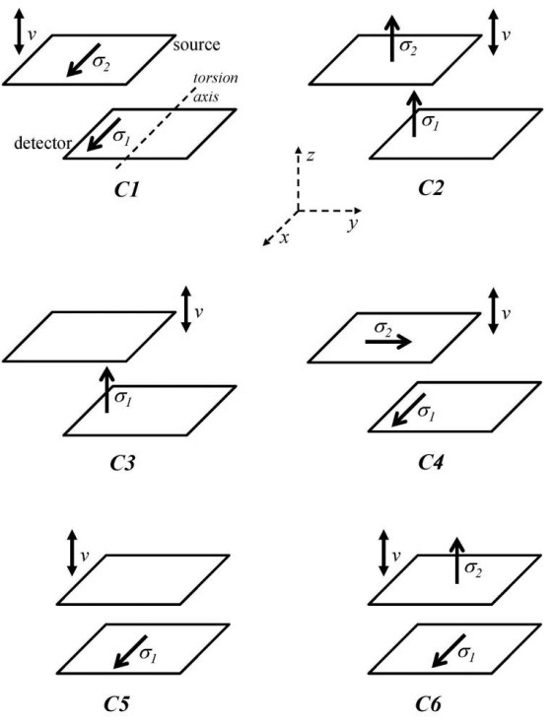
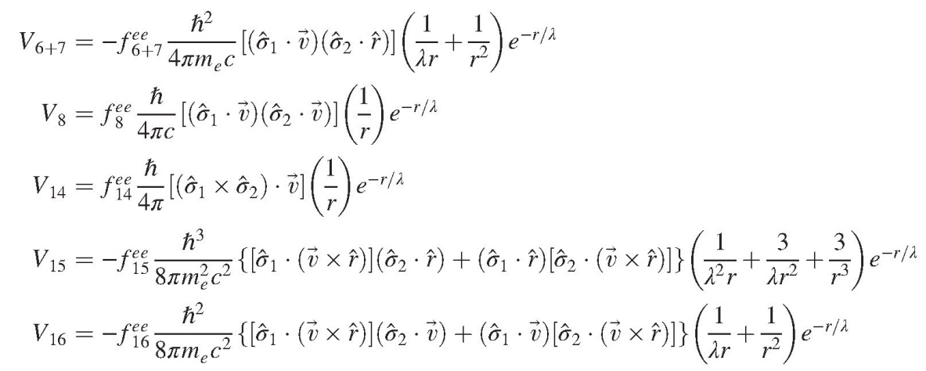
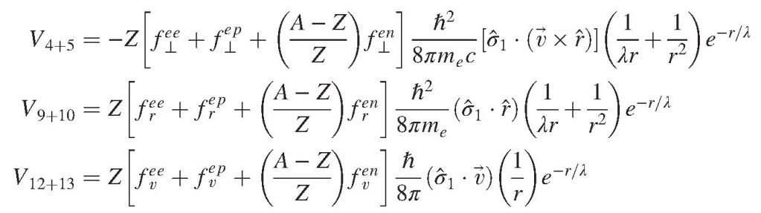
Rotationally invariant, non-relativistic, single exchange (s=0,1) [1]
To be updated…[2]
[1] B. Dobrescu and I. Mocioiu, J. High Energy Phys. 0611, 005 (2006)
T. M. Leslie, E. Weisman, R. Khatiwada, JCL, Phys. Rev. D 89 114022 (2014)
[2] P. Fadeev, et al., Phys. Rev. A 99 022113 (2019)
Notes:
In addition to the spin-dependent potentials described by Moody and Wilczek, there are at 13 additional potentials consistent with rotational invariance and single boson exchange.
This is just to show that with suitable arrangement of the spin-polarized samples on our test masses, we have access to all 15 potentials.
These potentials have been updated and we are re-evaluating them

Slide 23
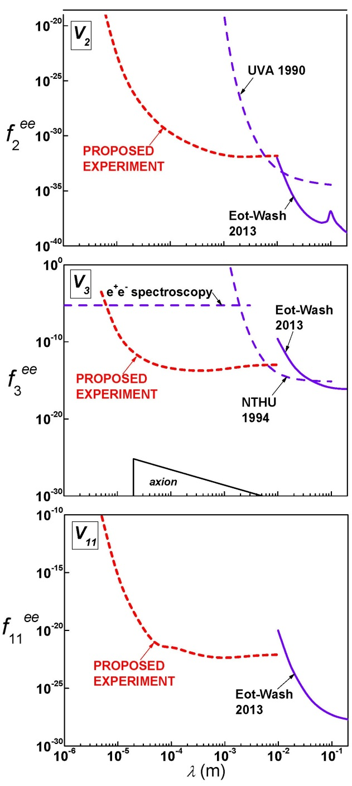
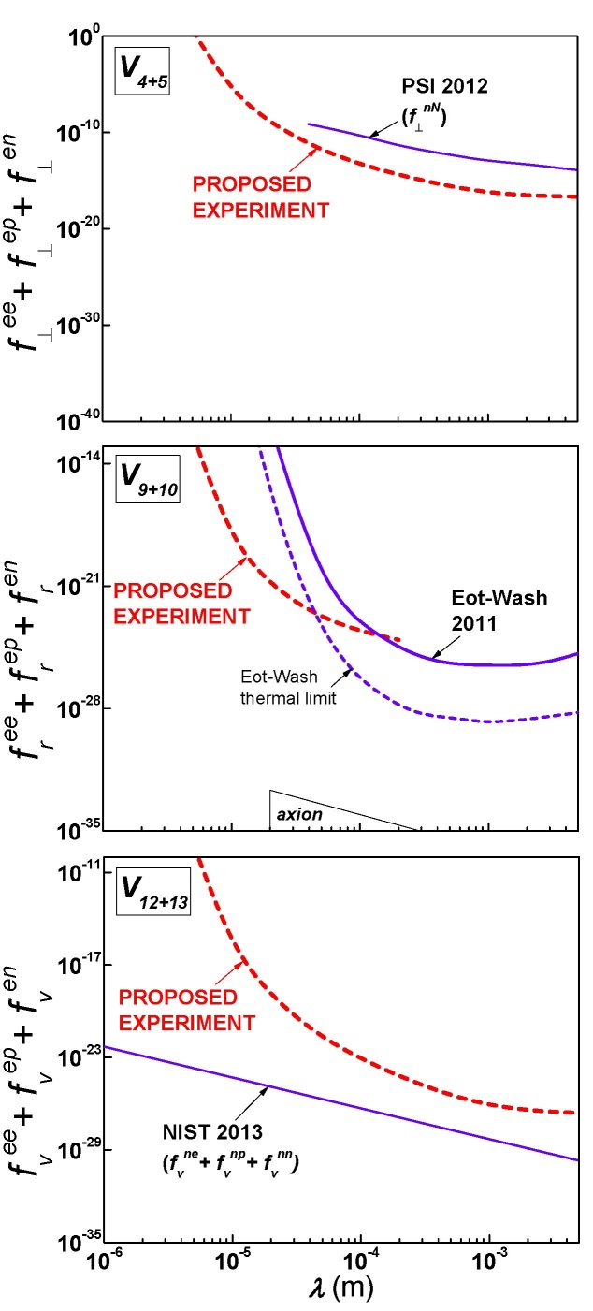
Projected sensitivity (10²⁰ ħ/cc)
Static spin-spin interactions (V₂, V₃, V₁₁):
Spin-mass interactions (V₄₊₅, V₉₊₁₀, V₁₂₊₁₃):
Notes:
advantage of our approach: versatility
And sensitivity at short range
Here are projected limits on 3 of the spin-spin interactions: essentially unconstrained below a few mm
Projected limits on spin-mass interactions: there are some new limits, but for nucleon couplings

Slide 24
Conclusions
Dark matter
Dark energy
Unification models with
  extra dimensions
  extended symmetries
  Local Lorentz Violation
Great interest in macroscopic forces with weak couplings to matter
Macroscopic mass experiments: ~ 10 square decades of parameter space below 1 cm in past 10 years
IU High-frequency experiment currently excludes spin-independent forces > 10⁵ times gravitational strength above 10 microns
Cryogenic experiment: gravitational sensitivity at 20 microns possible
Spin-dependent experiments: greater exclusion of parameter space below 1 cm in past 5 years, many new channels identified
Ferrimagnetic test masses operating at compensation T:
very low magnetic backgrounds and sub-mm test mass separations
sensitivity to 15 interactions with polarized electrons (new limits ~ 1 yr…)

Slide 25
(supplemental slides)

Slide 26
Parameterization
Yukawa Interaction
Power Law
m_{B}
r₀ = experimental scale
m₁
m₂
m=0
r
m=0
m₁
m₂
α = strength relative to gravity
set limits on β_{n} for n = 2 - 5

Slide 27
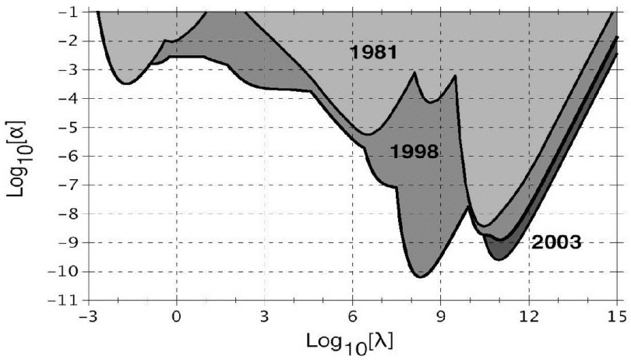
(old) Limits from 1 mm to 1 light year [1,2]
Lake
Laboratory
Tower
Earth-LAGEOS
LAGEOS-Lunar
Planetary
LLR
(λ in m)
[1] E. Fischbach and C. Talmadge, The Search for Non-Newtonian Gravity (Springer-Verlag, 1999)
[2] S. Reynaud and M.-T. Jaekel, Int. J. Mod. Phys. A 20 2294 (2005)

Slide 28
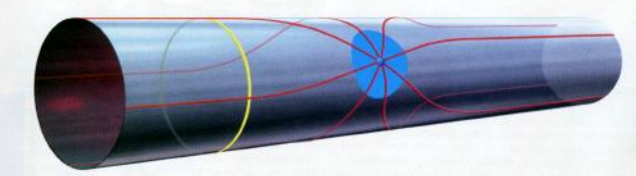
“Large” Extra Dimensions
compact
dimension
R
Infinite dimension
Strong, Weak, EM force confined to 3 dimensions
Gravity spreads out into n extra dimensions of size R, appears diluted
Gravity unifies with EW force (M* ~ 1 TeV) if n = 2, R ~ 1 mm
n = 3, R ~ 1 nm
N. Arkani-Hamed, S. Dimopoulos, G. Dvali, Phys. Lett. B 429 263 (1998)

Slide 29
Challenge: scaling and backgrounds
m₁, ρ₁
m₂, ρ₂
r
r
~ 2r
    ρ₁ = ρ₂ = 20 g/cm³, r = 10 cm ⇒ F ≈ 10⁻⁵ N
    r = 100 μm ⇒ F ≈ 10⁻¹⁷ N
ε₀V ²
Electrostatic:
F_{E} ~
r²
Magnetic (contaminant):
F_{M} ~
r ⁴
ħc
Casimir:
F_{C} ~
r ⁴
Notes:
Experimentalist needs to scale all dimensions of experiment to the range desired, otherwise swamped out by large Newtonian force at larger distances.
What happen? (Illustrate schematically)

Slide 30
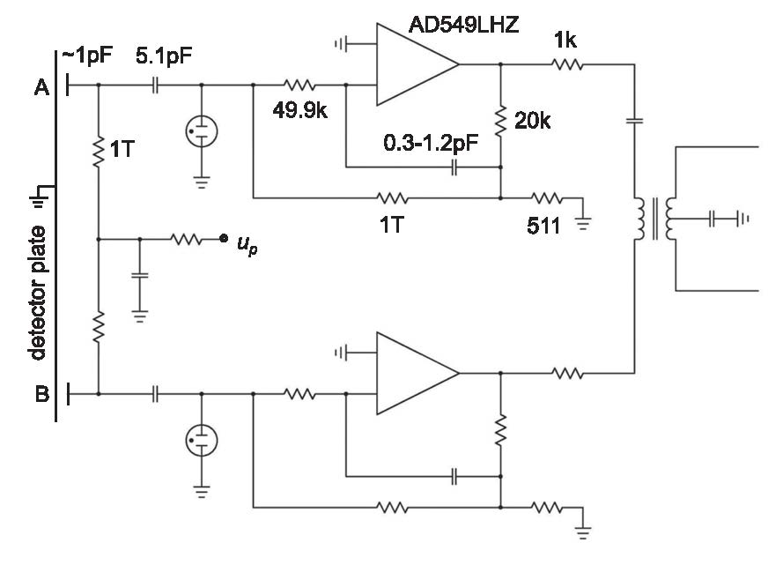
Readout: capacitive transducer, differential amplifier
Haiyang Yan, et al., Class. Quantum Grav. 31 205007 (2014)
~ 100 nV/√ Hz (includes preamp, lock-in)
Sensitive to ≈ 100 fm thermal oscillations
Interleave on resonance, off resonance runs
Typical session: 8hrs with 50% duty cycle
Notes:
A word about the readout.
We use a capacitive transducer coupled to a differential amplifier.
Described in this reference by Haiyang Yan, our postdoc who is now at the Academy of Engineering Physics, Mianyang
Based on this low-noise op-amp. The noise is 100 nV per root Hz. Not just the op-amp but the entire readout.
Not state-of-the-art but sufficient to resolve the thermal oscillations, which are about 100 femtometers.
Pretty sensitive physics with few $100 equipment (+ few months of postdoc time…)
There are offsets in the electronics but we resolve them by tuning slightly off resonance, so the duty cycle is about 50%.

Slide 31
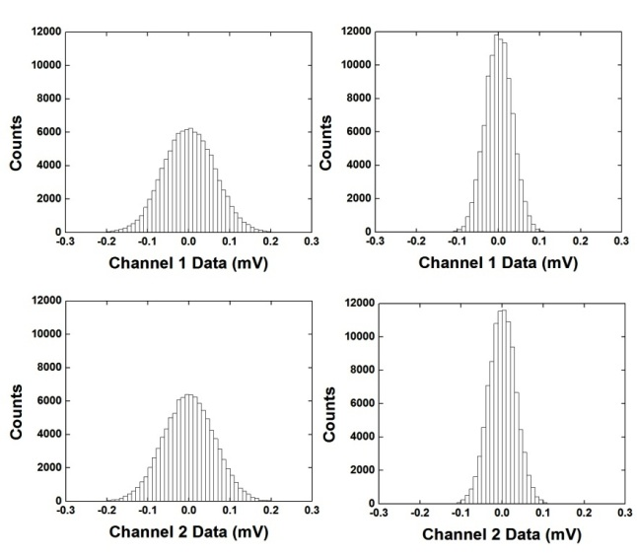
Force Measurement Data – March 2012
On Resonance
Off Resonance
19 hours on-resonance data collected over 3 days with interleaved diagnostic data
On-resonance: Detector thermal motion and amplifier noise
Off-resonance: amplifier noise

Slide 32
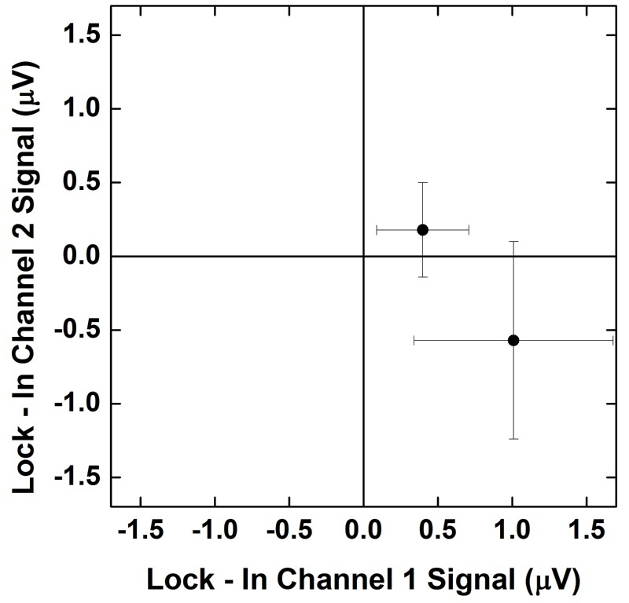
Force Measurement Data - Detail
Net Signal:
V_{on} – V_{off} = 0.93 ± 0.74 μV (1σ)
Force:
F = 4.0 ± 3.2 fN
off-resonance
on-resonance

Slide 33
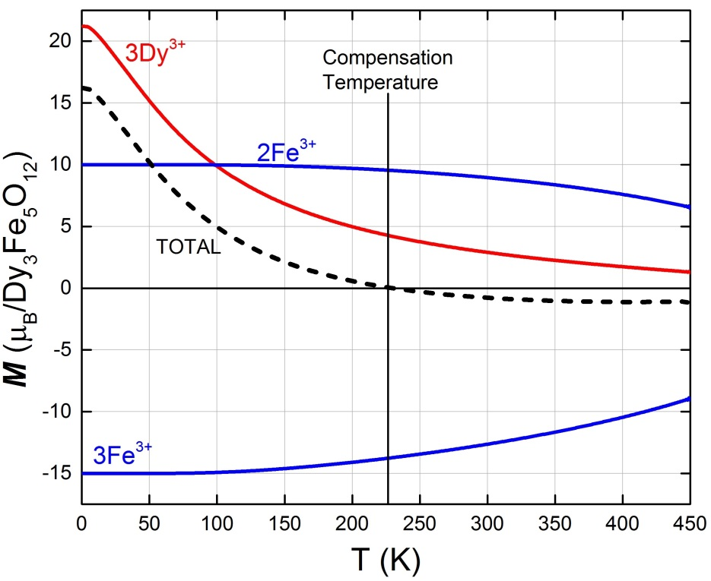
DyIG spin excess
3-sublattice molecular field model [1]:
M_{3Dy} = 4.2μ_{B}/molecule at T_{c}
M_{2Fe} = 9.6μ_{B}, M_{3Fe} = -13.8μ_{B}, all spin
(S_{Dy} = 5/2, L_{Dy} =1.9)
⇒ 73% (3.1μ_{B}) due to spin, 27% due to orbital L
[1] G. Dionne, J. Appl. Phys. 47 (1976) 4220

