Slide 1


Techniques and Systematic Effects of a Critically Dressed System
PSTP 2019
Christopher Swank
NSF-1506459
NSF-1812340

Slide 2
Signal in the SNS nEDM Experiment
Neutron interaction with ³He is spin dependent
Interaction is spin dependent, sensitivity to the angle between the neutron and ³He
keV
Stark µ_{E}·E
Zeeman µ_{B}·B
B, ±E

Slide 3
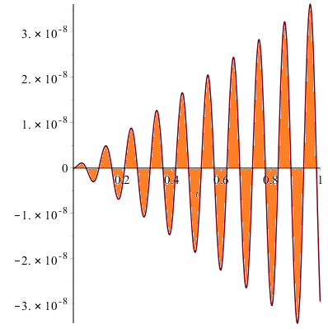
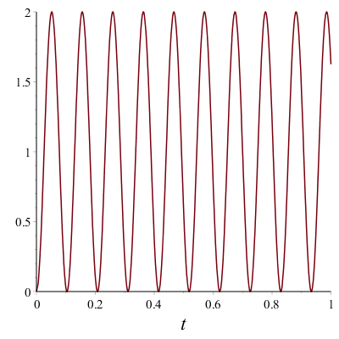
Two species free precession (FID)
Uniform B field
  Signal oscillates at beat frequency.
nEDM Signal E=±75kV/cm, d_{n}=10⁻²⁸

Slide 4
Spin dressing classical treatment
A technique to modify the effective gyromagnetic precession rate
  Application of an off resonance field B_{rf}
The angle from the x axis from the RF field is given as,
Therefore the time average expectation value is scaled by the Bessel Function

Slide 5
Spin Dressing quantum model
The Hamiltonian
With the expectation value
For ω_{rf} >> ω

Slide 6
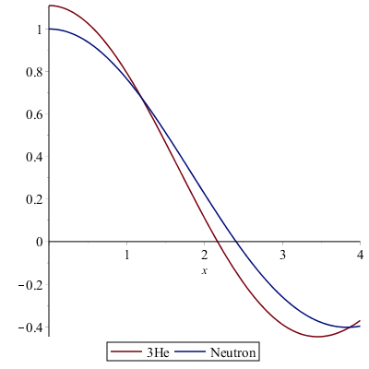
Critical Dressing
Critical Dressing
Spin dressing can be applied so that.
For neutrons and ³He α=1.11. And X_{c} is the critical dressing parameter,
Dressed with this parameter the two spin species will have the same effective precession.
With this technique we can set at the optimum and leave it
X

Slide 7
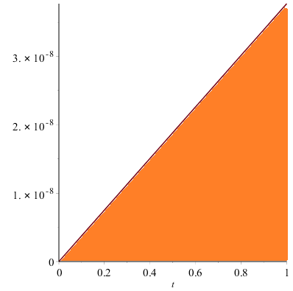
Sensitivity is a function of the phase difference
We can maximize sensitivity if we can take away Zeeman splitting
Notes:
REMEMBER TO MENTION THE FITTING INCREASES UNCERTAINTY

Slide 8
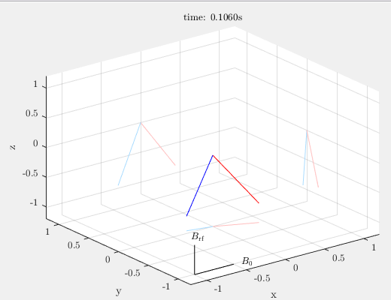

Critical Dressing in 5th order Runge-Kutta
ω_{RF}=1000 rad/s
ω_{RF}=10,000 rad/s

Slide 9
Modulated Critical Dressing.
Systematic effects can be mitigated by modulation
  Maintain maximum sensitivity by modulating to maximum sensitivity phase.
Simulated by Ezra Webb

Slide 10
Perturbation theory
Add small stochastically varying fields in time into the Hamiltonian

Slide 11
Perturbation theory
Add small stochastically varying fields in time into the Hamiltonian
Calculate with a state perturbed (time dependent) to 2nd order
  Ignore terms that don’t contribute
    Uncorrelated observables, non-stationary oscillating terms
Matrix elements that remain

Slide 12
Evaluation of matrix elements
the matrix elements needed to calculate
  Sorry for the mess, but…
Notes:
Several cross terms,

Slide 13
Evaluation of matrix elements
Elements oscillate with the dressed energy splitting
Notes:
Several cross terms,

Slide 14
Evaluation of matrix elements
Note the cosine factors, arising from the oscillating field.

Slide 15
In terms of the spectrum of correlation functions
Let observables in H be defined by particles position (trajectory)
  Deviations can be written as field gradients and positions. H(t) ∝ G*x(t)
  Our will be position correlation functions.
The rate of decay (Real Part) or frequency shift (Imaginary part) is the time derivative

Slide 16
Final Results. (in terms of correlation functions)

Slide 17

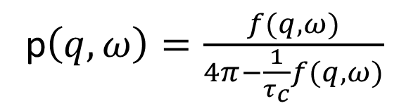
Calculate Correlation function.
Diffusion theory not adequate for the range of mean free path in the experiment
Use random walk with thermal scattering
  A convolution allows us to write the closed form solution in terms of the spectrum of an expanding sphere.
Expanding
r=vt
Convolution.
f$\left(r,t\right)=$
p$\left(q,ω\right)=\frac{f(q,ω)}{4π−\frac{1}{τ_{c}}f(q,ω)}$

Slide 18
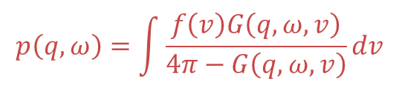
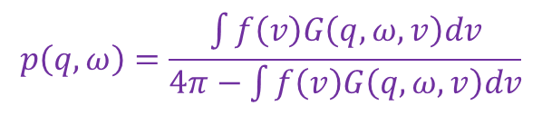
Random walk agreement with diffusion theory at low frequencies
  T2 can be predicted from random walk with velocity distribution.
Thermalization model
$$p\left(q,ω\right)=\frac{\int{f\left(v\right)G\left(q,ω,v\right)dv}}{4π−\int{f\left(v\right)G\left(q,ω,v\right)dv}}$$
Frozen model
$$p\left(q,ω\right)=\int{\frac{f\left(v\right)G\left(q,ω,v\right)}{4π−G\left(q,ω,v\right)}dv}$$
Notes:
First time ever! For a random walk with a spectrum of velocities.

Slide 19
Linear in E Frequency Shifts
Comparison Simulated in 5th Order Runge-Kutta
No linear in E terms
E=750 kV/cm, G= 1x10⁻⁵ ppB₀/cm
Modulated Dressing phase shift.
Un-modulated Dressing phase shift.
Notes:
Point out temperature!!!!

Slide 20
No coupling between DC and AC
Gradient in the spin dressing has negligible linear in E frequency shift.
  After algebra… We find these terms always contain a non-stationary oscillating factor

Slide 21
Relaxation
Cross-terms!
Vanishing relaxation…

Slide 22
Relaxation
Vanishing Relaxation effect confirmed!
Full Cancelation
Partial Cancelation (97%)

Slide 23
More advances in spin dressing.
Robust dressing...
Take note of dynamics of spin in regular critical dressing
ω_{RF}=1000 rad/s
ω_{RF}=6,000 rad/s

Slide 24
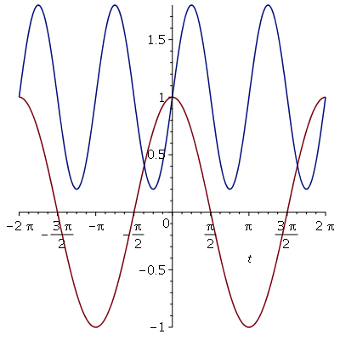
Robust Dressing
Why not lock all the spins to the same phase?
Modulate dressing frequency at 2 times the dressed precession.
Blue: F_{ω}(t)
Red: S_{z}
Dress the faster precessing spins more,
Dress the slower precessing spins less.
B(t) on the next page.
24

Slide 25
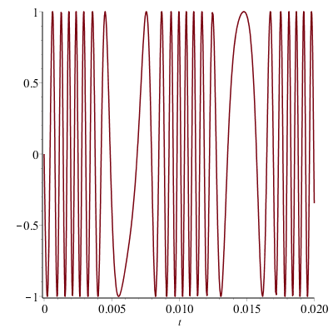
Robust Dressing
The function that goes into the power supply.
Not so crazy looking
B1 (arb)
Does it work?
(Why would I be showing this if not)
RESULT on the next page.
(s)
25

Slide 26
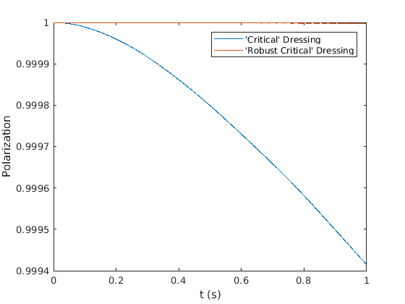
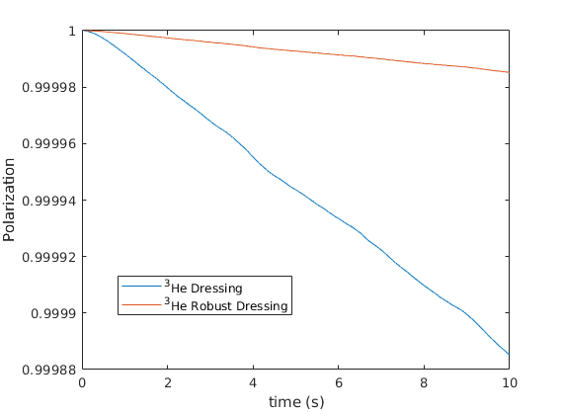
Result: Simulation in Gradient field of 1e-4 ppB/cm
helium-3
neutron
Utility:
Not good for measurement of frequency shift.
Good for keeping spins at a desired phase!!
Use for a B₁ 𝜋/2 pulse for a well determined starting phase with low noise. But HOW?!?
26

Slide 27
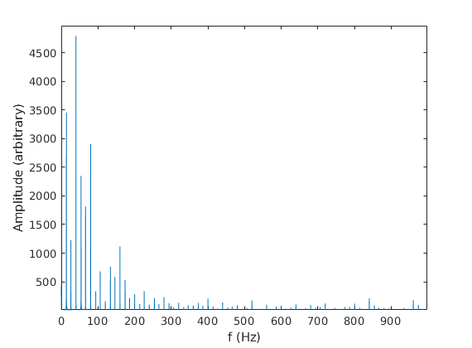
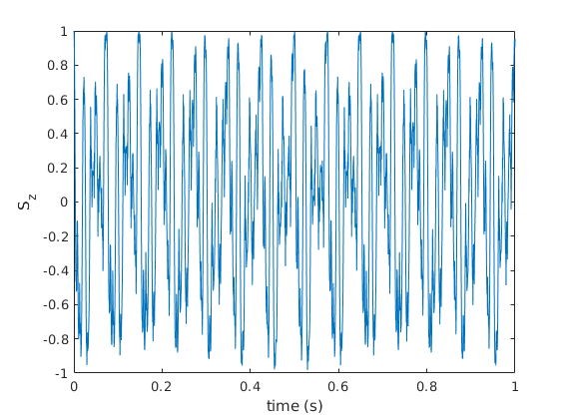
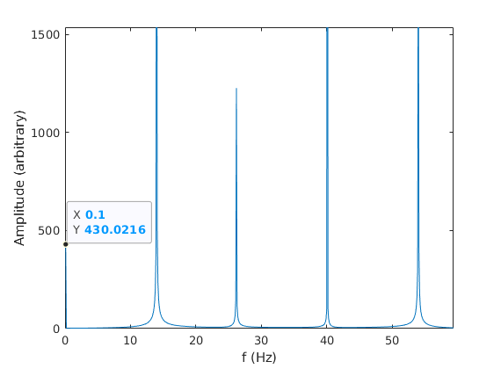
Robust Dressed Pi/2 pulse,
Keep spins in phase while we tip them?
What Frequency?
Spectrum of robust dressed spins
Precession of robust dressed spins
Try DC offset to tip.
This is available on the power supply.

Slide 28
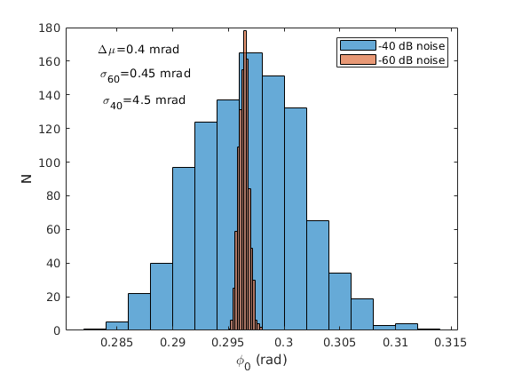
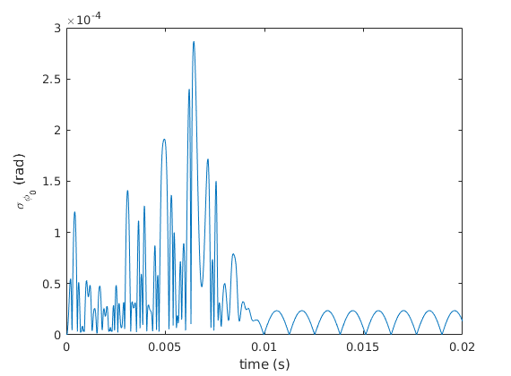
Robust Dressing pulse: Robust Dressing plus DC offset field.
Robust Dressing Tipping statistics
(B1 power supply noise)
Factor of ~10 better than sech pulses, if noise is the same.

Slide 29
Conclusions
Sensitivity of the experiment has an optimum phase between neutrons and ³HE
There is no coupling between the vxE and the RF field.
The spectrum is evaluated at the dressed frequency to determine relaxation, frequency shifts
DC Relaxation can be reduced by applying RF gradient
Modulation can be used to reduce relaxation.

Slide 30
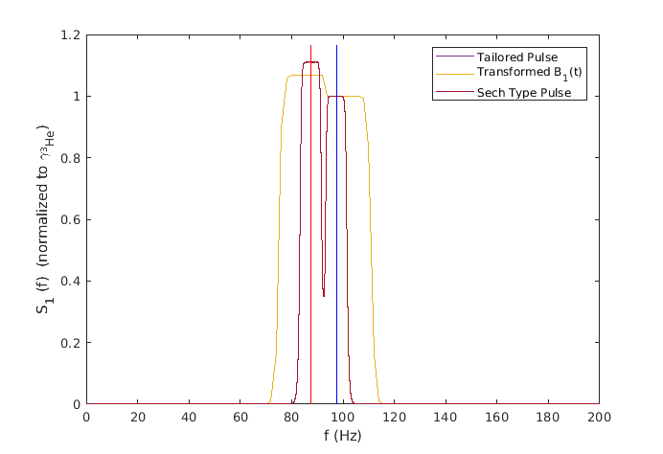
Comparison between optimized pulses

Slide 31
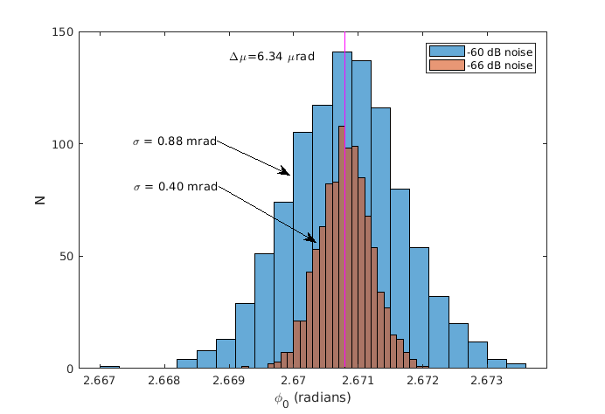
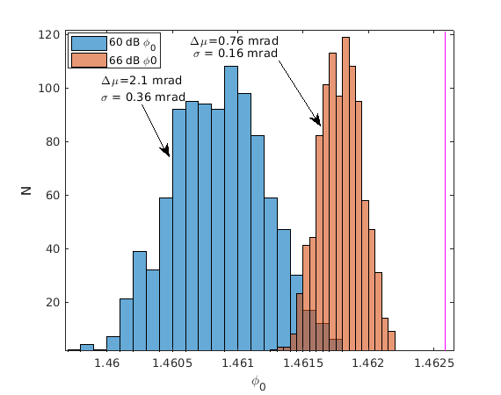
Phase noise
Phase noise is worse due to larger B1 magnitude.
  Standard deviation goes about with B1max*sqrt(T) (~3) as expected.
  IF B1 noise is determined from Maximum voltage this is about 10 times worse than robust dressing tip.
Tailored
Sech Type

Slide 32
Perturbation theory
Add small stochastically varying fields in time into the Hamiltonian
Together with the unperturbed Hamiltonian.
Calculate with a state perturbed to second order
  Left arbitrary for now,
,
,

Slide 33
Perturbation theory
Calculate matrix elements from perturbed state,
Ignore terms that don’t contribute significantly.

