Slide 1

Development of a Polarized
³He⁺⁺ Ion Source for the EIC
Matthew Musgrave
G. Atoian, E. Beebe, S. Ikeda, S. Kondrashev, J. Maxwell, R. Milner,
M. Okamura, A. Poblaguev, D. Raparia, J. Ritter, S. Trabocchi, A. Zelenski
PSTP 2019
September 26, 2019

Slide 2
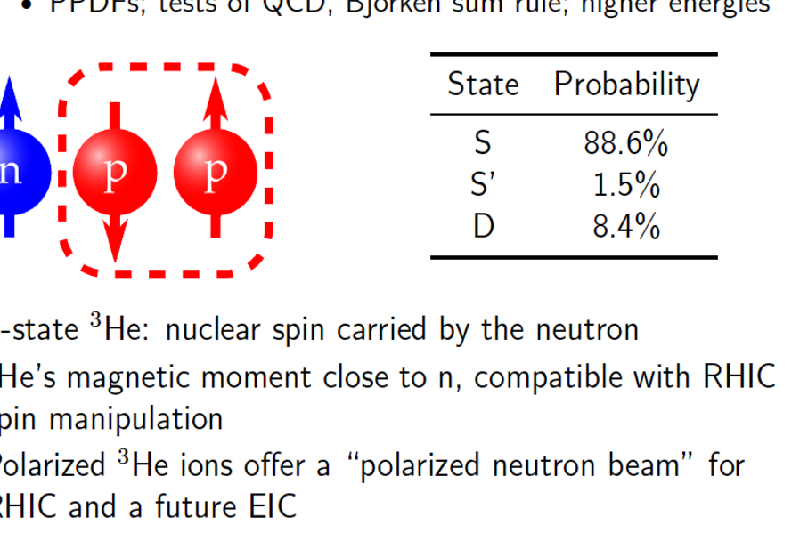
Why a Polarized ³He Ion Source?

Slide 3
Source Concept
Identified as high priority R&D for EIC by EICAC review in 2009, Office of Nuclear Physics Community Review in 2017, and the 2018 assessment of the US National Academy of Sciences.
Requirements
Polarized ³He using optical pumping and injection into EBIS at 5 T
Maximum polarization >70%
Intensity 2.5 × 10¹¹ ³He++ ions in 20 𝜇s pulse (~4 mA peak current)
Spin-flip in the beam transport line

Slide 4
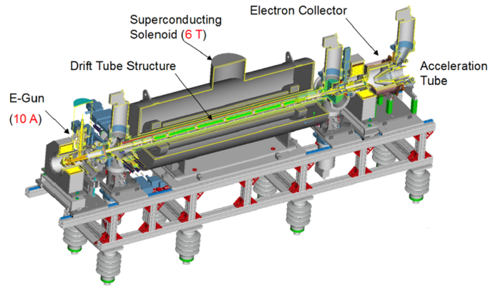
RHIC EBIS
Radial trapping of ions by the space charge of the electron beam
Axial trapping by applied electrostatic potentials at ends of trap
Ion output per pulse is proportional to the trap length and electron current
5 T
5T solenoid B Field; 1.5 m ion trap
20 keV electrons up to 10 A
5 Hz maximum repetition rate

Slide 5
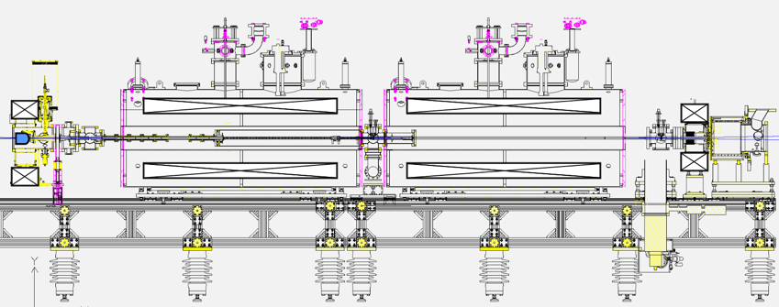
Extended EBIS Upgrade
Add a second 5 T superconducting solenoid for trap length extension: 40% increase in Au intensity
Install ³He polarization and injection system into the upstream solenoid
Opportunity for various vacuum and other minor improvements
³He polarization and injection systems
Electron Collector
Electron Gun

Slide 6
Extended EBIS Superconducting Solenoids
5.0 Tesla field, about 1.0 Tesla at field minimum in solenoid separation (~30 cm)
Electron beam successfully propagated through both solenoids in May 2019.

Slide 7
Polarized ³He Ion Source

Slide 8
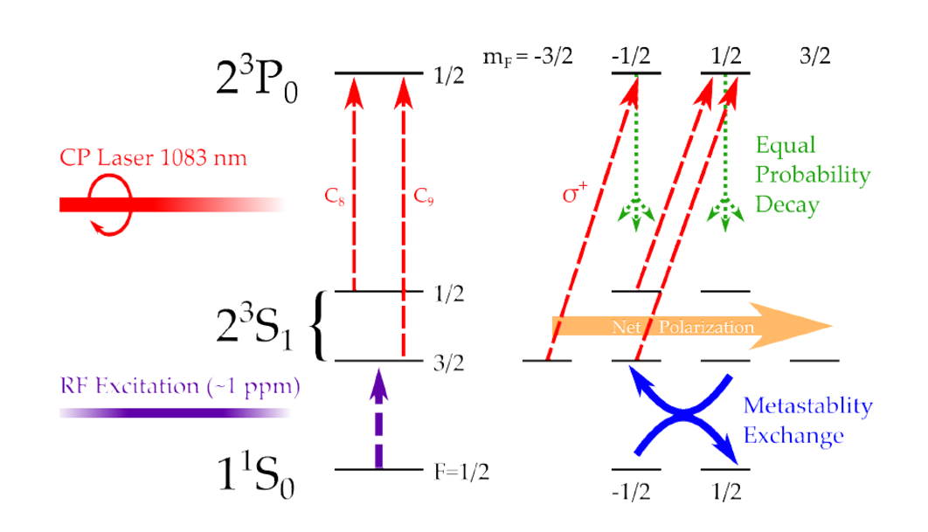
Metastability Exchange Optical Pumping

Slide 9
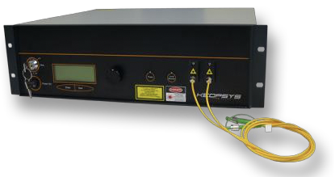
High-Field MEOP
Lumibird Pump Laser Specifications
276769.46 GHz central frequency
2 GHz linewidth
~300 GHz thermal tuning range
5 GHz remote fine tuning range
5 W Power
GHz Shift from ³He C1 Frequency at 0 T

Slide 10
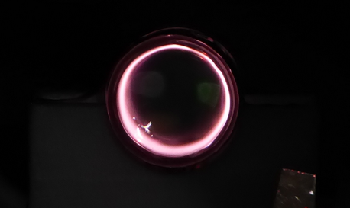
RF Discharge at Multi-Tesla Fields
RF discharge parameters strongly affect maximum polarization.
RF discharge power needs to be reduced as ³He polarization increases.
Optimization of the ³He cell geometry and placement of RF electrodes should improve polarization.

Slide 11
Optical Probe Polarimetry
Wavemeter
Probe laser, Toptica, diode laser
Pumping laser
GHz Shift from ³He C1 Frequency at 0 T
³He cell
Detector
Pumping laser-Keopsys 10 W 1083 nm- fiber laser

Slide 12
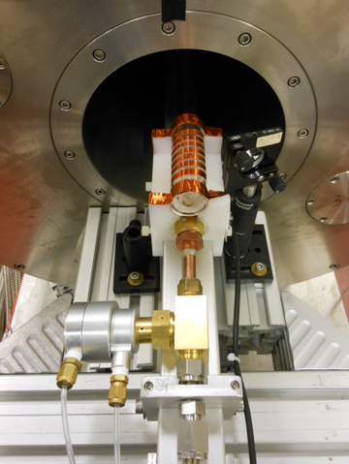
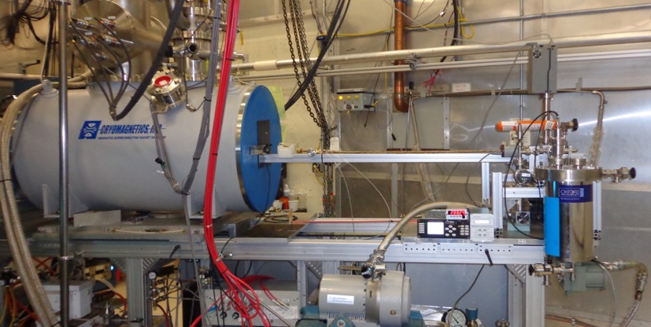
Open ³He Cell and Gas Purification System
OPPIS (RHIC’s polarized proton source) was converted into a high field MEOP system for polarizing ³He.
Non-magnetic brass pneumatic remotely controlled Isolation Valve

Slide 13
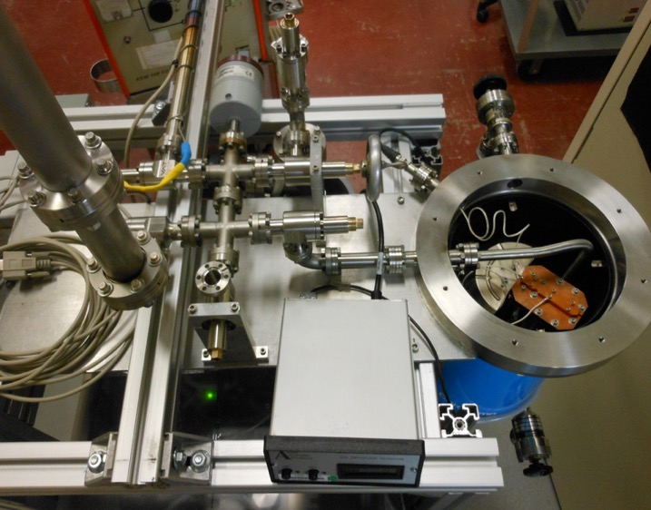
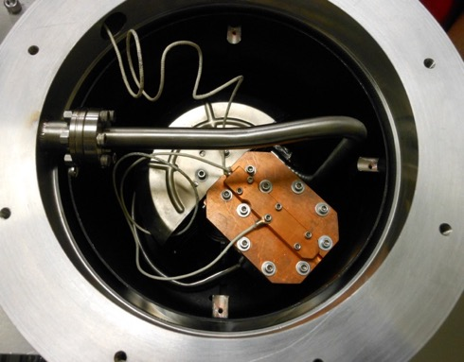
Open ³He Cell and Gas Purification System
³He cyro-purification and storage system was built from a modified cryo-pump. Pumps everything except helium!

Slide 14
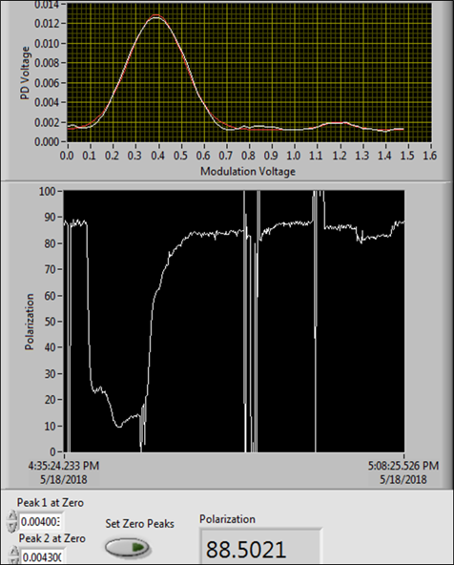
³He Open Cell Results
³He pressure can be controlled with the cryo-pump temperature.
Polarizations have been measured >80% at 2 torr and higher pressures have similar results.
Relaxation time of 30 s measured in open cell. Relaxation rate is limited by metal surfaces of the fill valve and gas contamination.
Valve construction and open cell design will be optimized to improve relaxation rate and maximum polarization.

Slide 15
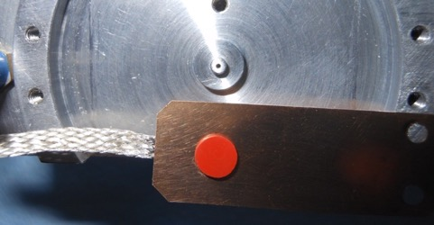
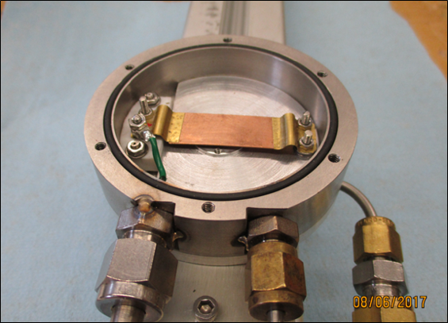
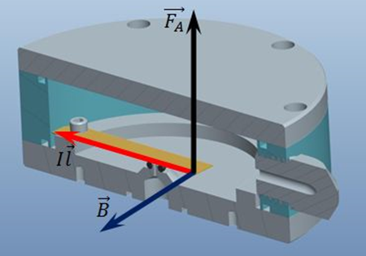
High Speed Pulsed ³He Valve
Pulsed current causes valve to open by Lorentz Force to the conducting plate in high magnetic field.
Valve design has successful long-term operation in OPPIS: B=3 T, I=100 A, L=5 cm, F=15 N, τ=100µs.

Slide 16
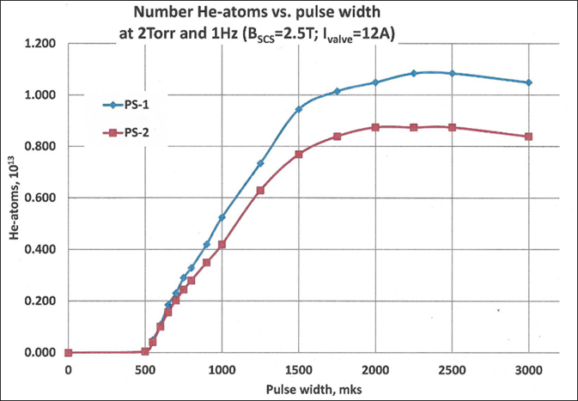
High Speed Pulsed ³He Valve
Test of high speed pulsed valve in a 2.5 T field in the OPPIS solenoid.
B = 2.5 T, I = 12 A, ³He reservoir pressure = 2 Torr
*Actual valve open time will differ from the electric current pulse width.
µs

Slide 17
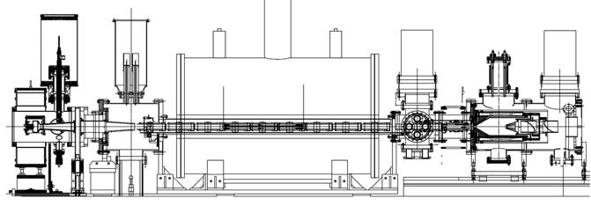
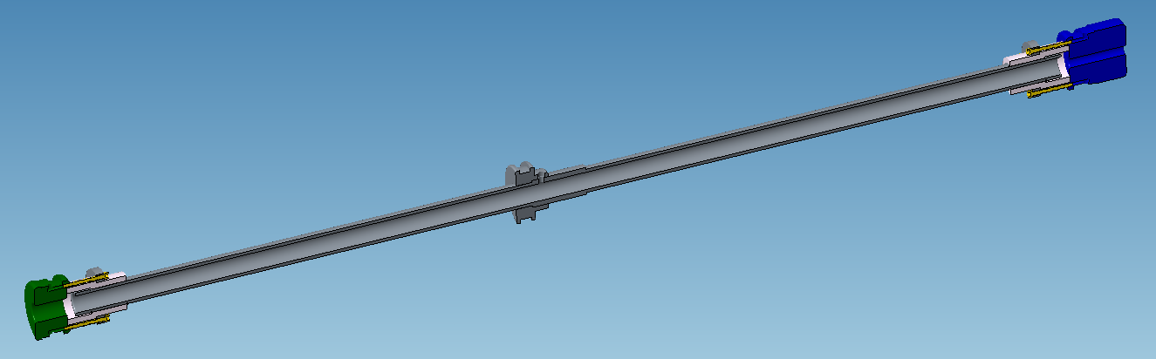
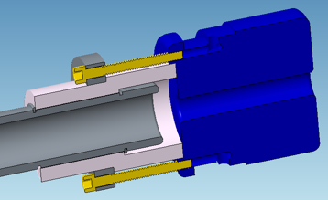
Gas Ionization Cell for Electron Beam Tests in the BNL TestEBIS
46 cm long, 1 cm diameter gas ionization cell
3 cm long, 0.5 cm diameter down stream barrier (blue)
Electron beams of 6 Amps were successfully propagated through the assembly.

Slide 18
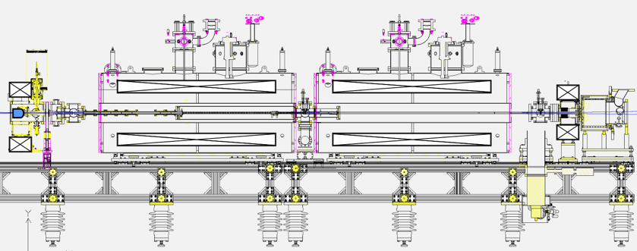
Vacuum Simulations of EBIS with MolFlow
Timing & Trap Capacity
Maximum EBIS pulse time = 200 ms
Charge Capacity = ~10¹² elementary charges
³He++ Capacity = ~ 2.5x10¹¹ ³He++
Electron Beam
1 mm diameter
10 Amp
25 keV
Pressure
1x10⁻⁶ mbar during gas injection
1x10⁻¹⁰ mbar standard operation

Slide 19
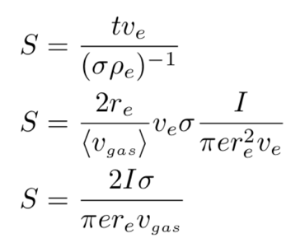
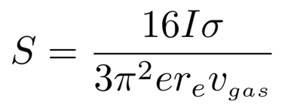
Electron Beam Ionization of ³He
The e-beam acts like an ion pump in the EBIS vacuum; therefore, treat the e-beam as an ideal pump with a transparency defined the pumping efficiency (S).
The pumping efficiency is the ratio of the ³He mean free path through the e-beam and the average distance the 3He travels through the e-beam (from the electrons reference frame).
The actual pumping rate of the e-beam is independent of the beam radium & gas velocity because these are canceled out by parameters in the simulation.
3π/8 correction to average velocity of gas that hits e-beam.

Slide 20
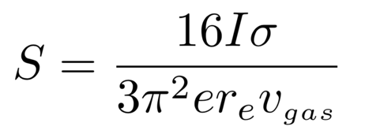
Electron Beam Ionization of ³He
For an e-beam of 25 keV there is a ≈0.5% probability that ³He is ionized during traverse of the e-beam.
Treat the e-beam as an ideal pump with 99.5% transparency.

Slide 21
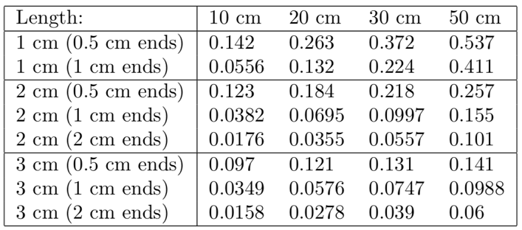
Electron Beam Ionization of ³He
Proportion of ³He ionized after 20 ms
For an e-beam of 25 keV there is a ≈0.5% probability that ³He is ionized during traverse of the e-beam.
Treat the e-beam as an ideal pump with 99.5% transparency.

Slide 22
Electron Beam Ionization of ³He

Slide 23
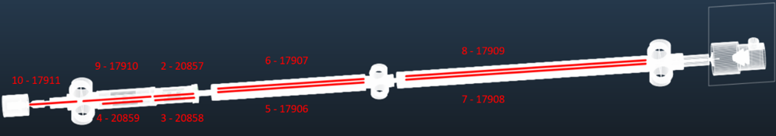
Gas Diffusion and EBIS Vacuum
2.65 x 10¹² ³He atoms injected
10 A, 25 keV e-beam
10⁻¹⁰ mbar EBIS vacuum

Slide 24
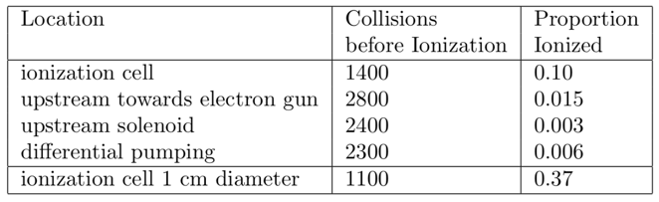
³He Wall Collisions Before Ionization

Slide 25
Simulation Results for ³He Injection into EBIS
All results are encouraging for the project!
Data for gas injection will be collected after installation of the Extended EBIS in the summer of 2020.

Slide 26
6 MeV ³He⁺⁺ Polarimeter
“Precision absolute polarimeter development for the 3He++ ion beam at 5.0-6.0 MeV energy”
Grigor Atoian
Friday at 13:40

Slide 27
Summary
Extended EBIS upgrade is ongoing and electrons were propagated through two 5 T solenoids.
³He was successfully polarized to >80% in a 3 T field.
An optical probe polarimeter to measure ³He polarization was developed.
A prototype high-speed pulsed valve has been tested.
Gas injection & ionization simulations show promising results.
The ³He spin-rotator is being designed and equipment purchased.
The 6 MeV ³He polarimeter has been designed and the concept was tested with an alpha source.
Now all the parts need to be put together. We plan for partial installation in the summer of 2020 and complete installation followed by polarization measurements in the summer of 2021.

Slide 28
Thank you for your attention
MIT-BNL Polarized ³He Ion Source Collaboration
G. Atoian, E. Beebe, S. Ikeda, S. Kondrashev, J. Maxwell,
R. Milner, M. Musgrave, M. Okamura, A. Poblaguev,
D. Raparia, J. Ritter, S. Trabocchi, A. Zelenski
This work was supported by DOE Office of Nuclear Physics, R&D for Next Generation Nuclear Physics Accelerator Facilities.

