Slide 1

Precision absolute polarimeter development for the ³He⁺⁺ ion beam at 5.0-6.0 MeV energy
Workshop on Polarized Sources, Targets, and Polarimetry
Grigor Atoian, A.Poblaguev, A.Zelenski
Brookhaven National Laboratory
Sep 26, 2018

Slide 2
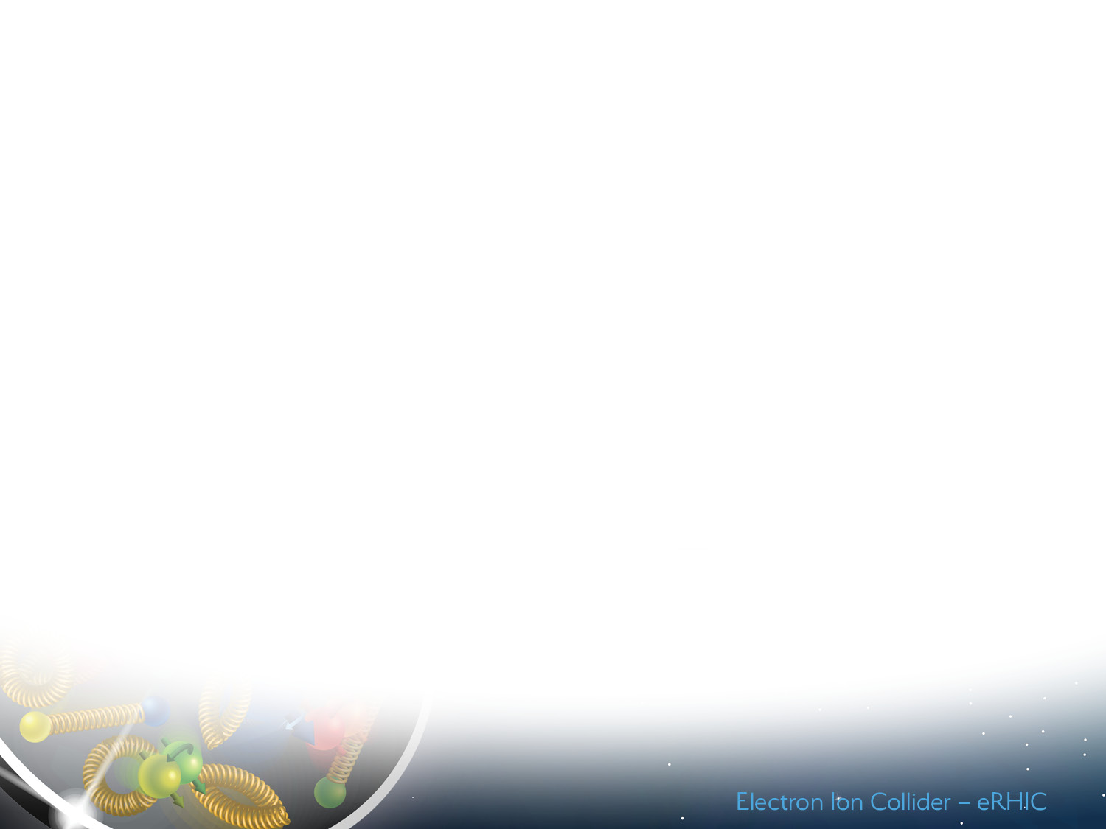
Polarized 3He++ ion source development in EBIS
BNL-MIT collaboration
Proposal of production of polarized ³He⁺⁺ beam in EBIS.
A.Zelenski, J.Alessi, ICFA Beam Dynamics Newsletter 30, p.39, (2003)
Polarized ³He++ production is important part of the ongoing extended EBIS “upgrade" project. Completion-2021
The 3He++ spin-rotator and polarimeter is funded by DOE grant Research and Development for Next Generation Nuclear Physics Accelerator Facilities. Completion-2020.
U. S. Department of Energy
Office of Science | Nuclear Physics FY 2018
Research and Development for Next Generation Nuclear Physics Accelerator Facilities
… A doubly polarized electron-ion collider (EIC) is the best way to examine the internal structure of the proton and neutron. The technology to accelerate polarized proton beams has been well established at RHIC. However, studying the structure of the neutron requires the acceleration of polarized 3He++, which carries ~90% of its polarization in the neutron, and to match the unprecedented statistical precision an EIC will provide, it is indispensable to have high precision measurements of the hadron beam polarization. For this reason, development of a polarized ³He ion beam has been identified as an R&D priority by the EIC Advisory Committee in 2009 and the Office of Nuclear Physics Community Review in 2017.
2

Slide 3
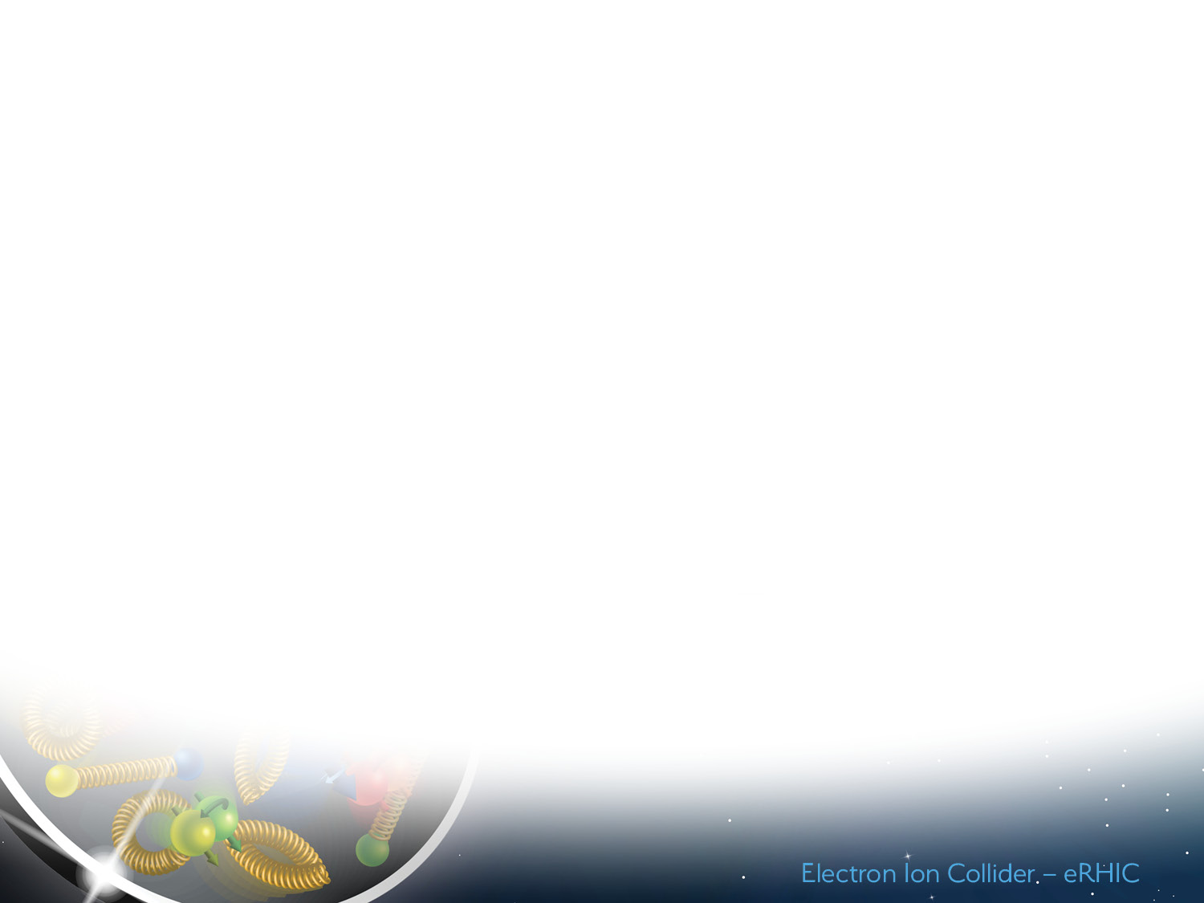
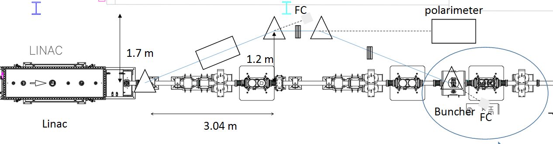
“Extended” EBIS upgrade with new “injector” solenoid spin rotator and polarimeter for polarized ³He⁺⁺ ion production
Holder ³He-cell
with filling and injection valves
Transition region
The development of the ³He polarizing apparatuses, the spin-rotator, and the nuclear polarimeter at the ³He++ ion beam energy 6.0 MeV is funded by the DOE Research and Development Funds for the Next Generation Nuclear Physics Accelerators Facilities.

Slide 4
Optically-pumped ³He in the high magnetic field
Holder 3He-cell with filling and injection valves inside the EBIS SC solenoid at 5.0T magnetic field
Purification system of ³He gas into cell by modified creo-pump and absorbed cartridge pump;
Polarization 1Torr ³He gas inside glass-cell by MEOP technique;
Measurement and control polarization by optical probe polarimeter;
Injection of polarized ³He into drift tube (beam line) by pulsed valve ( ~2-3*10¹² atoms/pulse);
10 Amp electron beam completely ionizes the polarized atoms;
Accelerate to 6 MeV by RFQ-LINAC system;
Rotate a spin from the longitudinal to the vertical direction by bunsher-1;
Measurement polarization of ³He beam by 6MeV polarimeter;
beam
3He-cell
D 175mm
D 216mm
beam
Drift tube -20-40 kV
Insulator
Pulsed valve

Slide 5
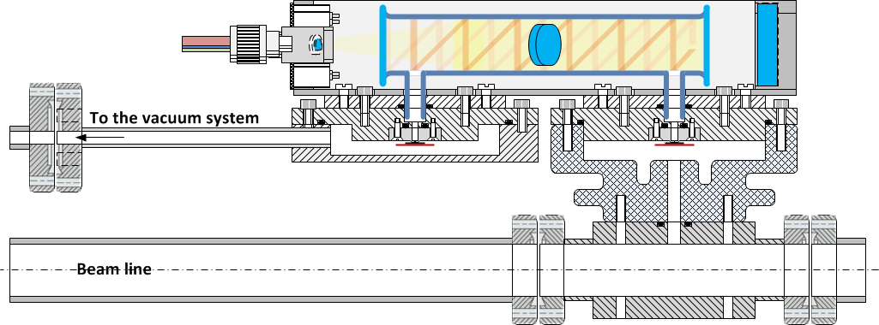
³He optically-pumped cell in the high magnetic field
Inputs& outputs:
RF- discharge cable;
pumping laser high power optic fiber;
probe laser optic fiber;
³He spectra control fiber;
filling valve pulse cable;
Injection valve pulse cable;
PD output cable;
3He gas filling line
³He filling valve
³He-cell
³He injection valve
HV isolator
Drift tube
A long drift tube with a small diameter (~10-15mm) acts like a ³He storage cell, which reduces gas load of the EBIS vacuum system.

Slide 6
“Extended” EBIS upgrade with new “injector” solenoid spin rotator and polarimeter for polarized 3He⁺⁺ ion production
After EBIS LINAC the polarized ³He beam will have an energy 6MeV and a longitudinal spin direction. Before it will transport to the Booster the spin will be rotated to the vertical direction by dipole. With additional enable spin-flip we can measure polarization of the beam by a standard configuration of left/right symmetric Si strip detectors like proton-carbon polarimeters in AGS and RHIC, and H-jet polarimeters in RHIC.
FC
dipole
polarimeter
solenoid
quad
dipole
quad
³H⁺⁺
Linac
Booster
dipole
Existing line
dipole
21.5 deg
buncher2
FC

Slide 7
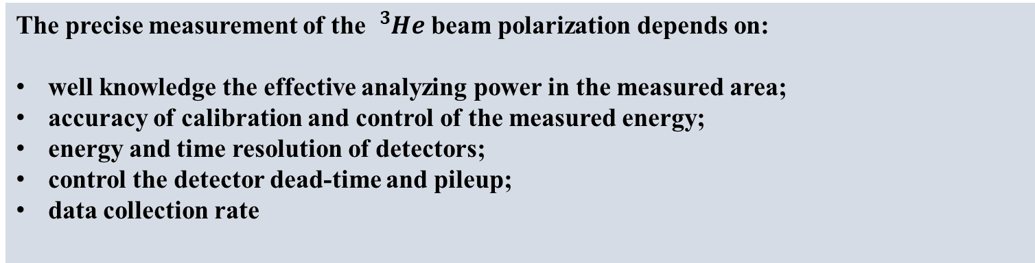
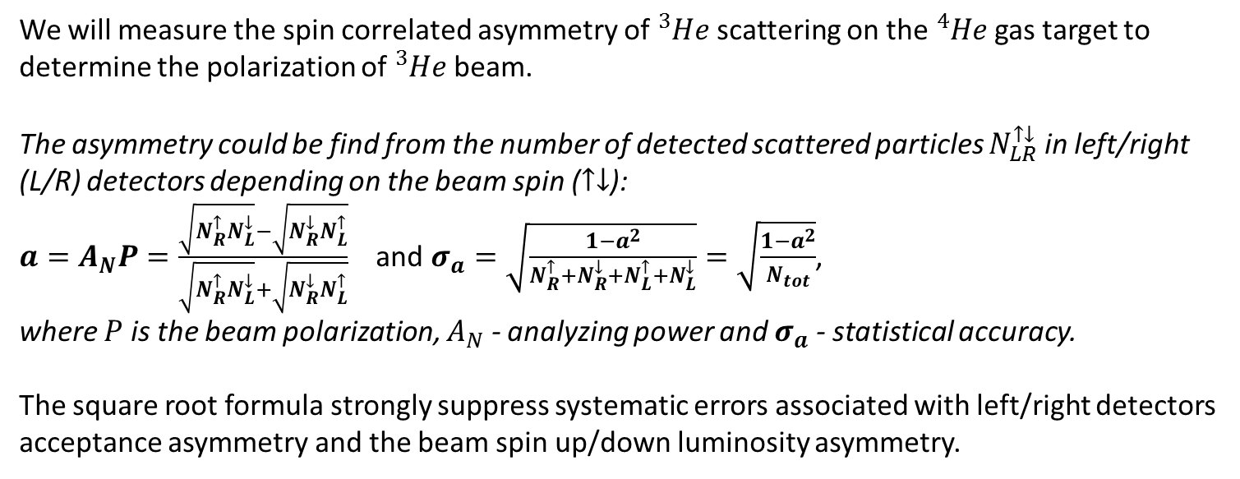
³He-⁴He scattering polarimeter at 6.0 MeV beam energy
We will measure the spin correlated asymmetry of ${}_{}^{3}{He}$ scattering on the ${}_{}^{4}{He}$gas target to determine the polarization of ${}_{}^{3}{He}$ beam.
The asymmetry could be find from the number of detected scattered particles $N_{LR}^{↑↓}$ in left/right (L/R) detectors depending on the beam spin ($↑↓$):
$a=A_{N}P=\frac{\sqrt{N_{R}^{↑}N_{L}^{↓}}−\sqrt{N_{R}^{↓}N_{L}^{↑}}}{\sqrt{N_{R}^{↑}N_{L}^{↓}}+\sqrt{N_{R}^{↓}N_{L}^{↑}}}$ and $σ_{a}=\sqrt{\frac{1−a^{2}}{N_{R}^{↑}{+N}_{R}^{↓}+N_{L}^{↑}{+N}_{L}^{↓}}}=\sqrt{\frac{1−a^{2}}{N_{tot}}}$,
where $P$ is the beam polarization, $A_{N}$ - analyzing power and $σ_{a}$ - statistical accuracy.
The square root formula strongly suppress systematic errors associated with left/right detectors acceptance asymmetry and the beam spin up/down luminosity asymmetry.
The precise measurement of the ${}_{}^{3}{He}$ beam polarization depends on:
well knowledge the effective analyzing power in the measured area;
accuracy of calibration and control of the measured energy;
energy and time resolution of detectors;
control the detector dead-time and pileup;
data collection rate

Slide 8
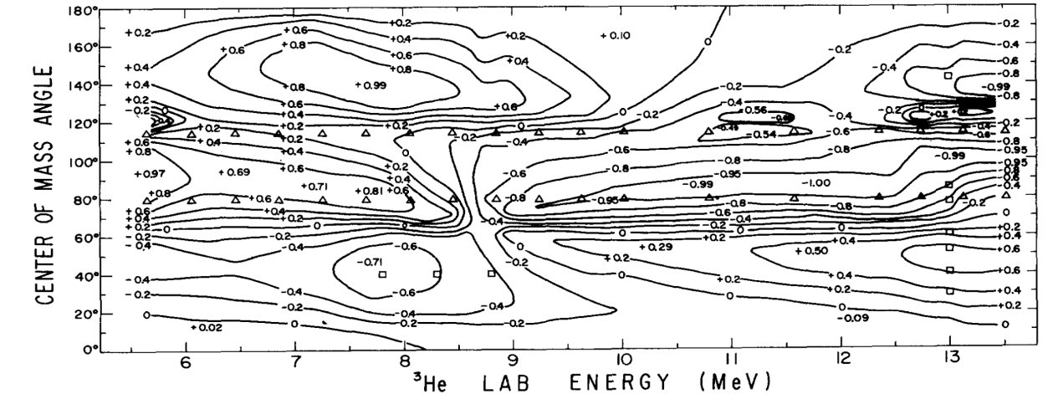
Analyzing power of ³He-⁴He scattering
The analyzing power for elastic ³He-⁴He scattering is a function of the beam kinetic energy and the CM scattering angle - 𝐴_{𝑁}(𝐸_{𝑏𝑒𝑎𝑚},𝜃_{𝐶𝑀}) and can reach 100% at several points (𝐸,𝜃) [1].
[1] D.M. HARDY et al. “POLARIZATION IN ³He + ⁴He ELASTIC SCATTERING”, Pys. Let. Vol.31B, #6, 16 March 1970, p. 355-357

Slide 9
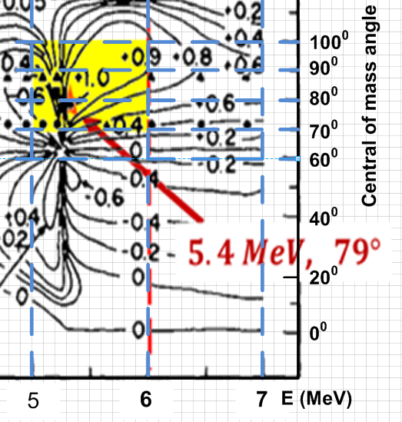
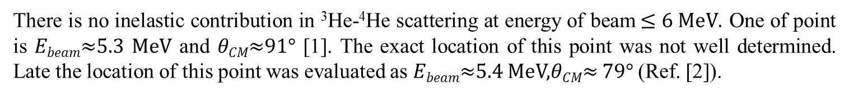
Analyzing power of ³He-⁴He scattering
There is no inelastic contribution in ³He-⁴He scattering at energy of beam$≤6 MeV$. One of point is 𝐸_{𝑏𝑒𝑎𝑚}≈5.3 MeV and 𝜃_{𝐶𝑀}≈91° [1]. The exact location of this point was not well determined. Late the location of this point was evaluated as 𝐸_{𝑏𝑒𝑎𝑚}≈5.4 MeV,𝜃_{𝐶𝑀}≈ 79° (Ref. [2]).
[1] G.R. PLATTNER et al. “ABSOLUTE CALIBRATION OF SPIN -1/2 POLARIZATION”, Pys. Let. Vol. 36B, #3, 6 Sep 1971, page 211-214 [2] W.R.Boykin, S.D.Baker, D.M.Hardy, “Scattering of ³He and ⁴He from polarized ³He between 4 and 10 MeV,” Nucl. Phys. A 195, 241 (1972).

Slide 10
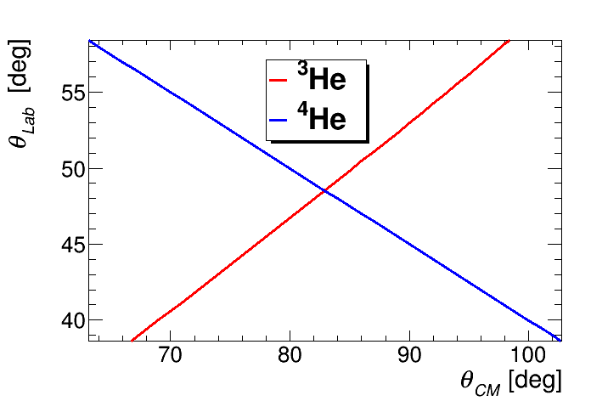
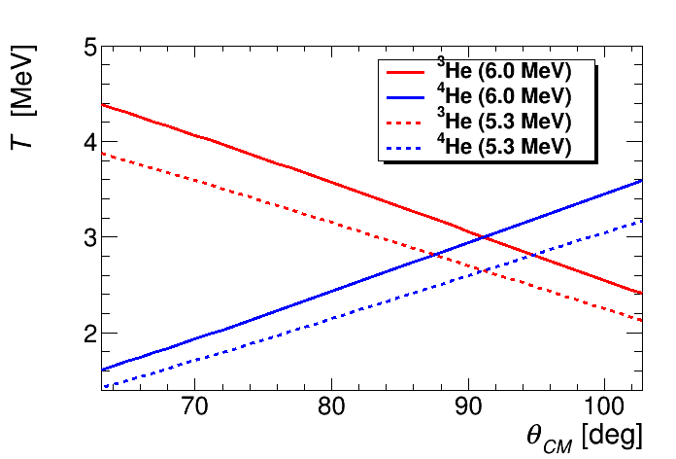

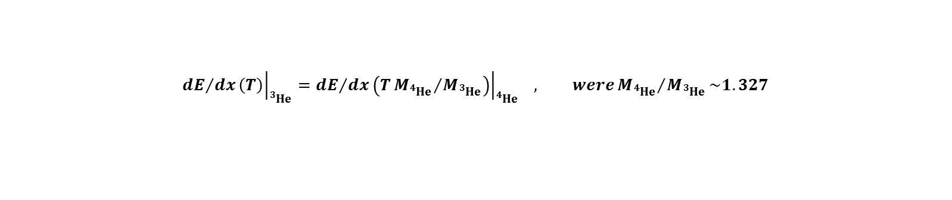
Analyzing power of ³He-⁴He scattering at 6MeV
$${\left.{dE}/{dx}\left(T\right)\right|}_{{}_{}^{3}{He}}={\left.{dE}/{dx}\left(T{M_{{}_{}^{4}{He}}}/{M_{{}_{}^{3}{He}}}\right)\right|}_{{}_{}^{4}{He}} , were{M_{{}_{}^{4}{He}}}/{M_{{}_{}^{3}{He}}}\sim 1.327$$

Slide 11
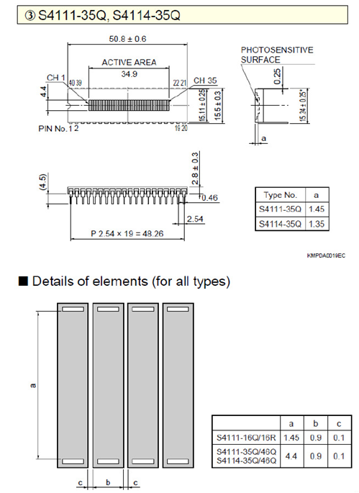
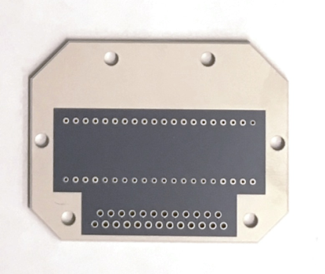
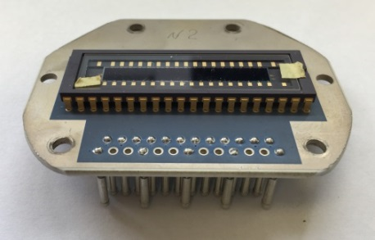
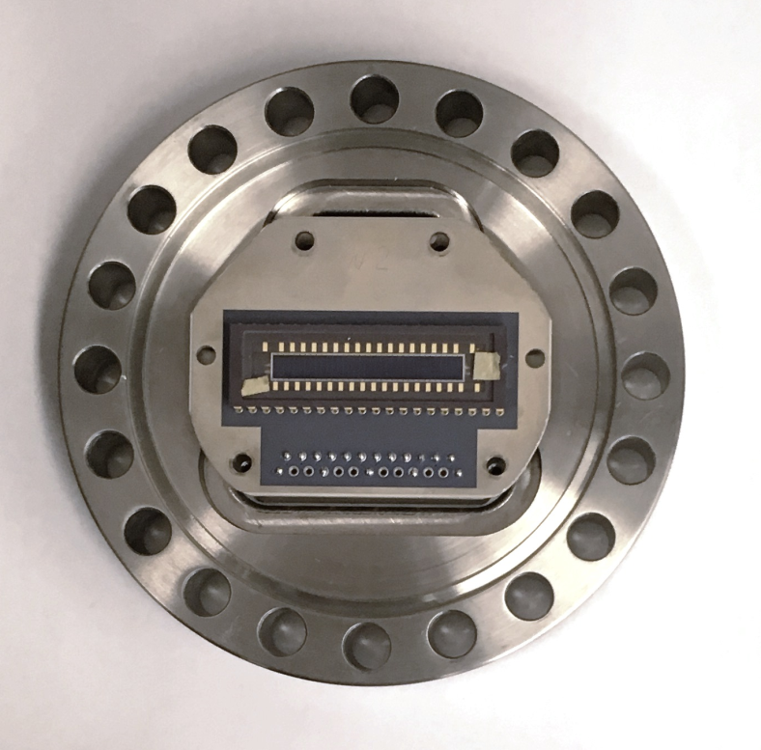
Detector
The requirement of the range and an accuracy of measured energy can be satisfied by Hamamatsu Si-photodiode array S4114-35Q.
Hamamatsu Si-photodiode array S4114-35Q:
Number of channels: 35
Channel size: 0.9mm x 4.4mm
Depletion region >30mkm
Hamamatsu photodiode array S4114-35Q mounted on the ceramic board and connect with D-sub vacuum thru connector on the flange.

Slide 12
³He-⁴He scattering polarimeter at 6.0 MeV beam energy
Top view
Valve-1
Valve-2
⁴He

Slide 13
³He-⁴He scattering polarimeter at 6.0 MeV beam energy
Top view
Side view
LED
Si-array
collimator

Slide 14
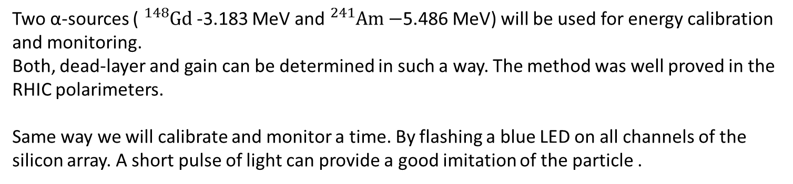
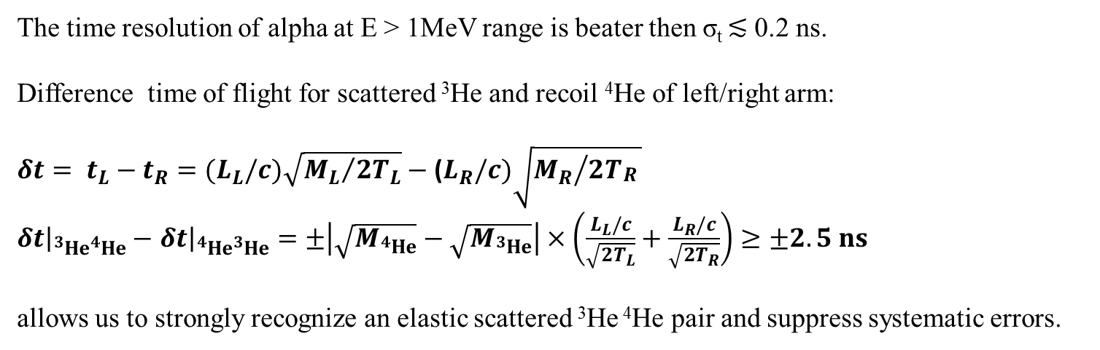
Calibration and monitoring of energy and time
Two α-sources ( ${}_{}^{148}{Gd}$ -3.183 MeV and ${}_{}^{241}{Am}−$5.486 MeV) will be used for energy calibration and monitoring.
Both, dead-layer and gain can be determined in such a way. The method was well proved in the RHIC polarimeters.
Same way we will calibrate and monitor a time. By flashing a blue LED on all channels of the silicon array. A short pulse of light can provide a good imitation of the particle .
The time resolution of alpha at E > 1MeV range is beater then σ_{t} ≲ 0.2 ns.
Difference time of flight for scattered ³He and recoil ⁴He of left/right arm:
$δt= t_{L}−t_{R}={(L}_{L}/c)\sqrt{{M_{L}}/{2T_{L}}}−$ ($L_{R}/c)\sqrt{{M_{R}}/{2T_{\begin{aligned}R \\ \end{aligned}}}}$
${\left.δt\right|}_{{}_{}^{3}{He{}_{}^{4}{He}}}−$ ${\left.δt\right|}_{{}_{}^{4}{He{}_{}^{3}{He}}}=±\left|\sqrt{M_{{}_{}^{4}{He}}}−\sqrt{M_{{}_{}^{3}{He}}}\right|×\left(\frac{L_{L}/c}{\sqrt{2T_{L}}}+\frac{L_{R}/c}{\sqrt{2T_{R}}}\right)≥±2.5 ns$
allows us to strongly recognize an elastic scattered ³He ⁴He pair and suppress systematic errors.

Slide 15
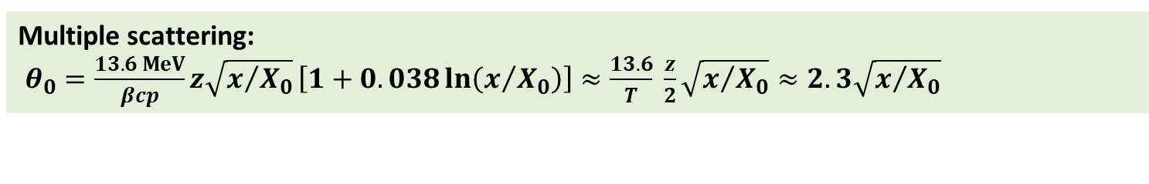
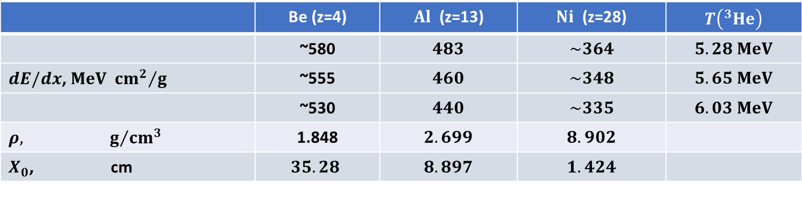
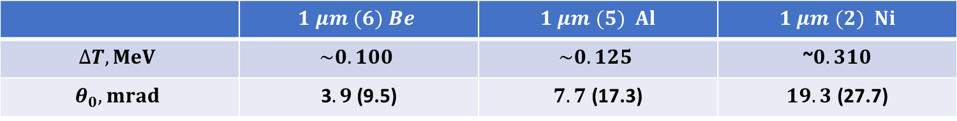
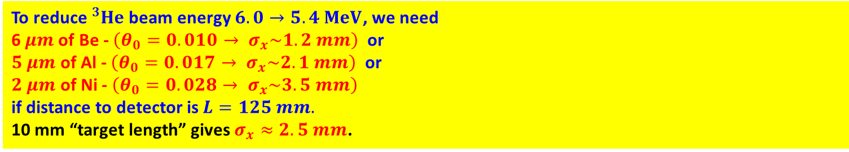
Vacuum window
 | Be (z=4) | $Al$ (z=13) | $Ni$ (z=28) | $T\left({}_{}^{3}{He}\right)$
 | ~580 | $$483$$ | $$\sim 364$$ | $$5.28 MeV$$
$dE/dx$, $MeV {{cm}^{2}}/g$ | ~555 | $$460$$ | $$\sim 348$$ | $$5.65 MeV$$
 | ~530 | $$440$$ | $$\sim 335$$ | $$6.03 MeV$$
$$ρ, g/{{cm}^{3}}$$ | 1.848 | $$2.699$$ | $$8.902$$
$X_{0}$, cm | $$35.28$$ | $$8.897$$ | $$1.424$$
Multiple scattering:
$θ_{0}=\frac{13.6 MeV}{βcp}z\sqrt{x/{X_{0}}}\left[1+0.038\ln\left(x/{X_{0}}\right)\right]≈\frac{13.6}{T} \frac{z}{2}\sqrt{x/{X_{0}}}≈2.3\sqrt{x/{X_{0}}}$
 | $$1 μm (6) Be$$ | $1 μm (5) Al$ | $1 μm (2) Ni$
$$∆T, MeV$$ | $$\sim 0.100$$ | $$\sim 0.125$$ | ~$0.310$
$$θ_{0}, mrad$$ | 3$.9$ (9.5) | $7.7$ (17.3) | $19.3$ (27.7)
To reduce ${}_{}^{3}{He}$ beam energy $6.0→5.4 MeV$, we need
6$μm$ of Be - $\left(θ_{0}=0.010→ σ_{x}\sim 1.2 mm\right)$ or
$5 μm$ of Al - $\left(θ_{0}=0.017→ σ_{x}\sim 2.1 mm\right)$ or
$2 μm$ of Ni - $\left(θ_{0}=0.028→ σ_{x}\sim 3.5 mm\right)$
if distance to detector is $L=125 mm.$
10 mm “target length” gives $σ_{x}≈2.5 mm$.

Slide 16
Vacuum window
Absorber | Vacuum window | Al foil-1 | Al foil-2 | Al foil-3 | Al foil-4 | Al foil-5
Thickness, um | 2 | +1 | +1 | +1 | +0.5 | +0.5
Beam energy, MeV | 5.75 | 5.625 | 5.50 | 5.375 | 5.25 | 5.125
The energy of the ³He beam can be increased or decreased by up to 140 keV in total by the buncher.

Slide 17
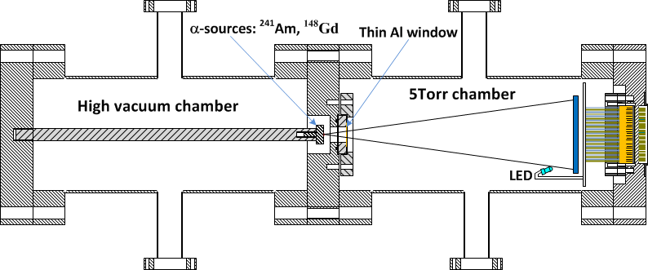
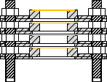
Test setup for 6 MeV polarimeter
Vacuum gauge1
Vacuum gauge2
⁴He filling system
We studied:
mechanical and vacuum properties of thin foil for window;
safe procedure of filling 5Toor ⁴He-gas in chamber;
electronics: amplifier , shaper and DAQ;
the time and energy resolution of the detector;
energy absorption in thin window vs. thickness and ⁴He gas;
…

Slide 18
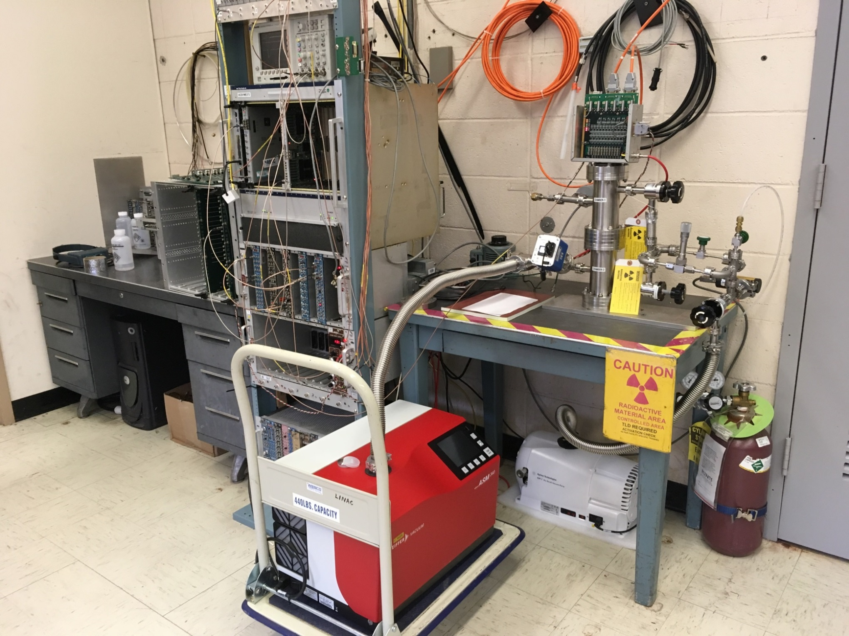
Test setup for 6 MeV polarimeter
Dry scroll pump
Pfeiffer Vacuum
Leak detector

Slide 19
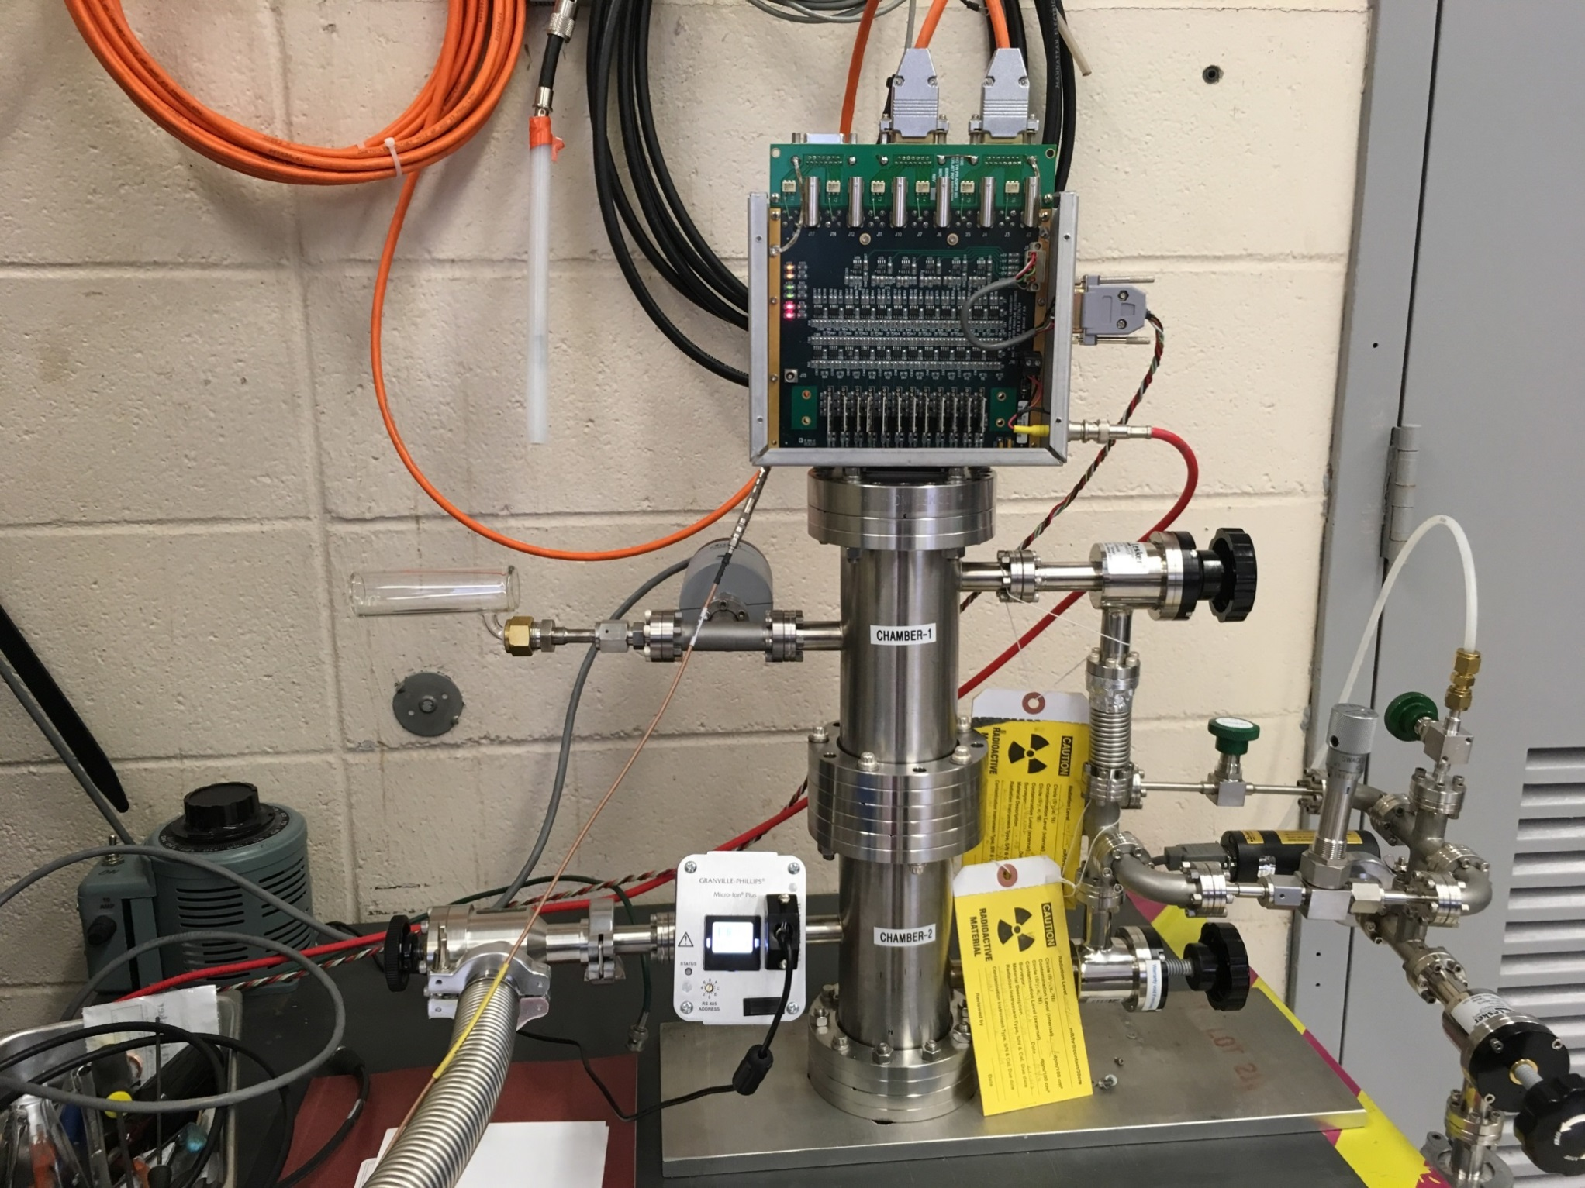

Test setup for 6 MeV polarimeter
12 ch. preamplifie
Vacuum gauge1
Chamber 1 (5Torr ⁴He)
⁴He filling system
Vacuum gauge1
Chamber 2
α-sources: ${}_{}^{148}{Gd}$ ,${}_{}^{241}{Am}$

Slide 20
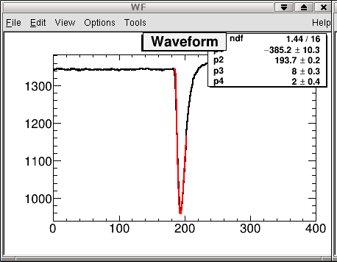
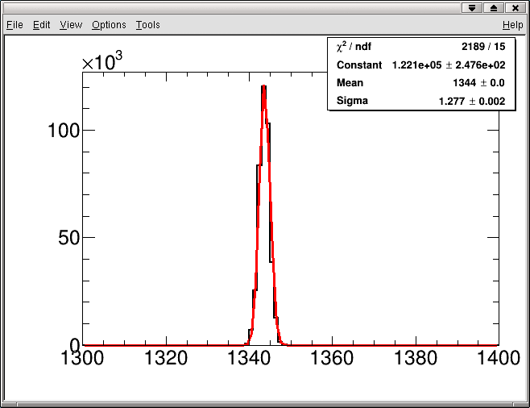
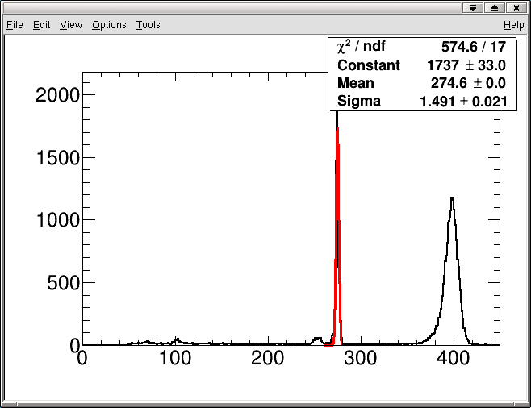
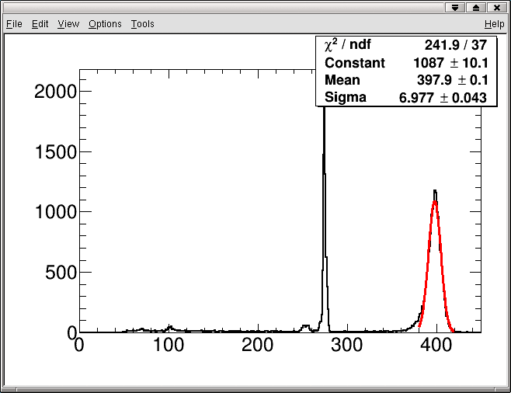
Spectra of ¹⁴⁸Gd after and ²⁴¹Am before ~7mkm Al-foil by Hamamatsu Si array detector (S4114-35N)+preamplifier(charge)+shaper(CNI).
Sigma noise ~15keV; energy resolution of ¹⁴⁸Gd (3.184MeV) ~18keV
and ²⁴¹Am (+7mkm of Al) ~80keV; full-width of the signal ~130nsec

Slide 21
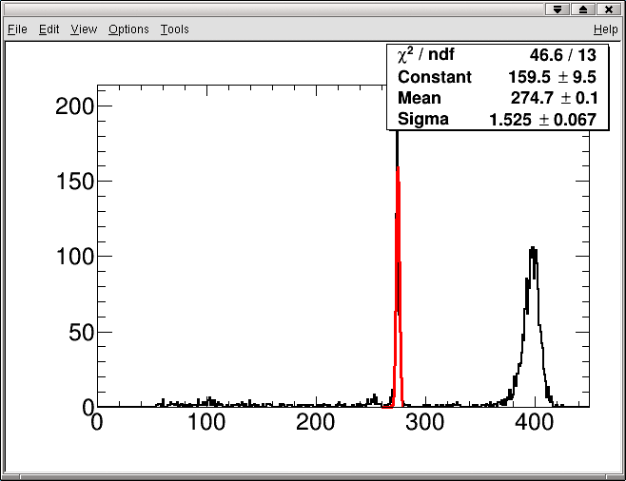
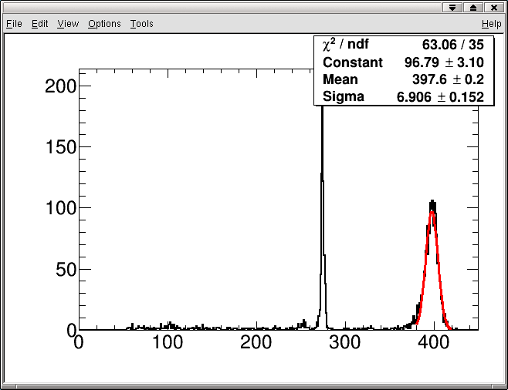
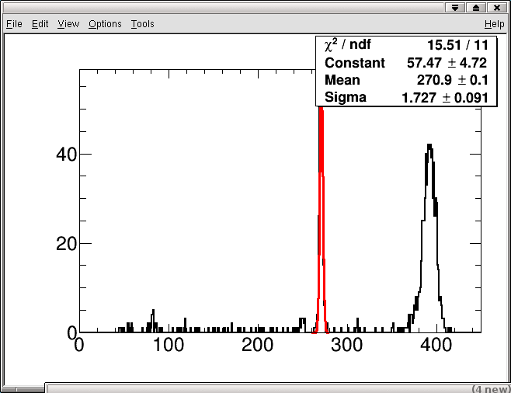
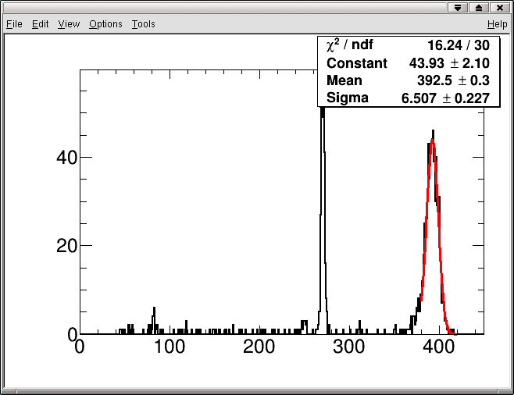
Absorption energy of alpha in ⁴He gas
 | ¹⁴⁸Gd | ²⁴¹Am | 5 Torr, 12.5cm | 5 Torr, 12.5cm
10⁻⁵ Torr, 20cm | 274.6 ch. | 397.6 ch.
10 Torr, 20cm | 270.9 ch. | 392.5 ch.
Delta | ~50keV | ~60keV | ~15keV | ~13keV

Slide 22
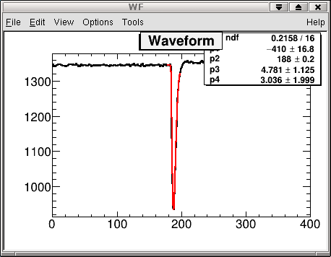
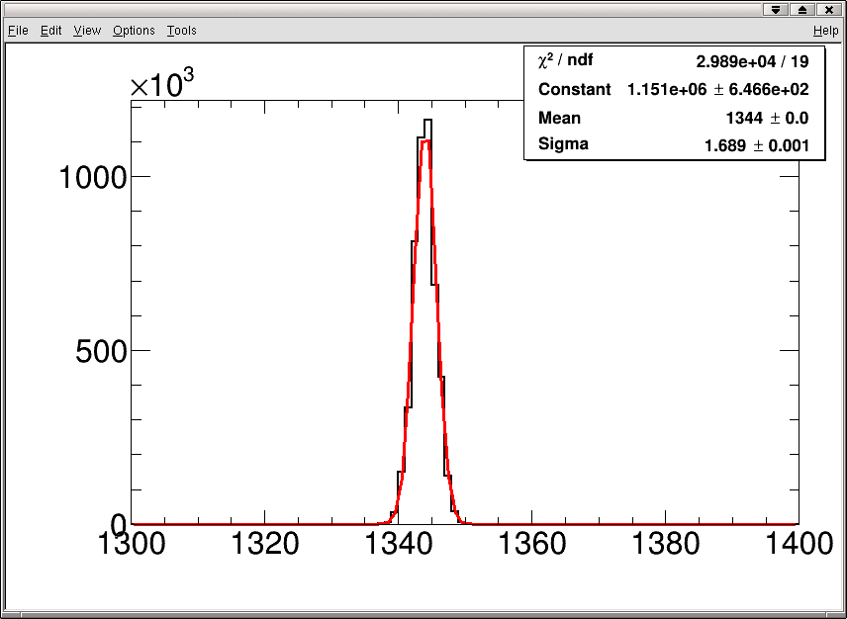
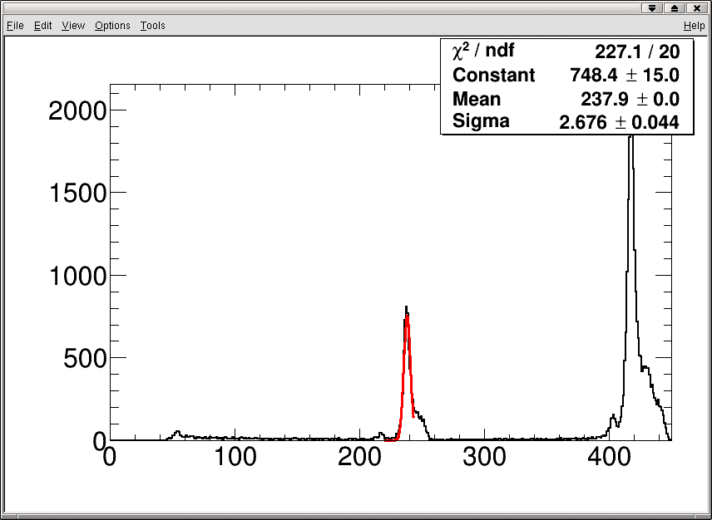
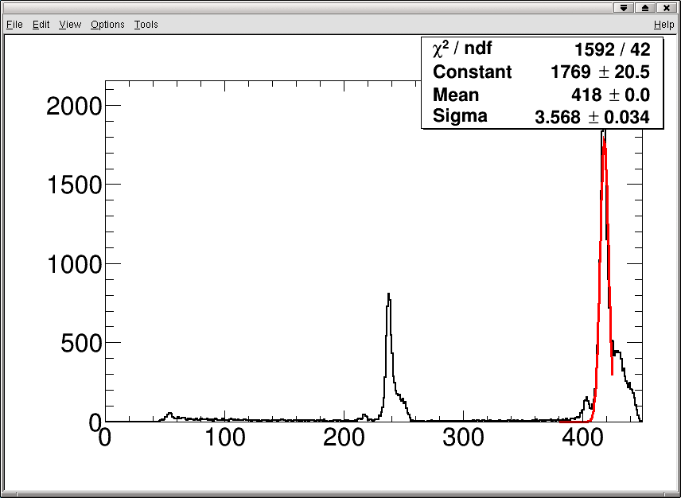
Spectra of ²⁴¹Am (5.388-1.6%, 5.443-13%, 5.486-84%, 5.511, 5.545MeV) and ¹⁴⁸Gd (3.184MeV) by Hamamatsu Si array detector (S4114-35N)+preamplifier(charge)+shaper.
sigma noise ~21keV;
energy resolution of alpha (¹⁴⁸Gd) ~35keV;
full-width of the signal ~60nsec.

Slide 23
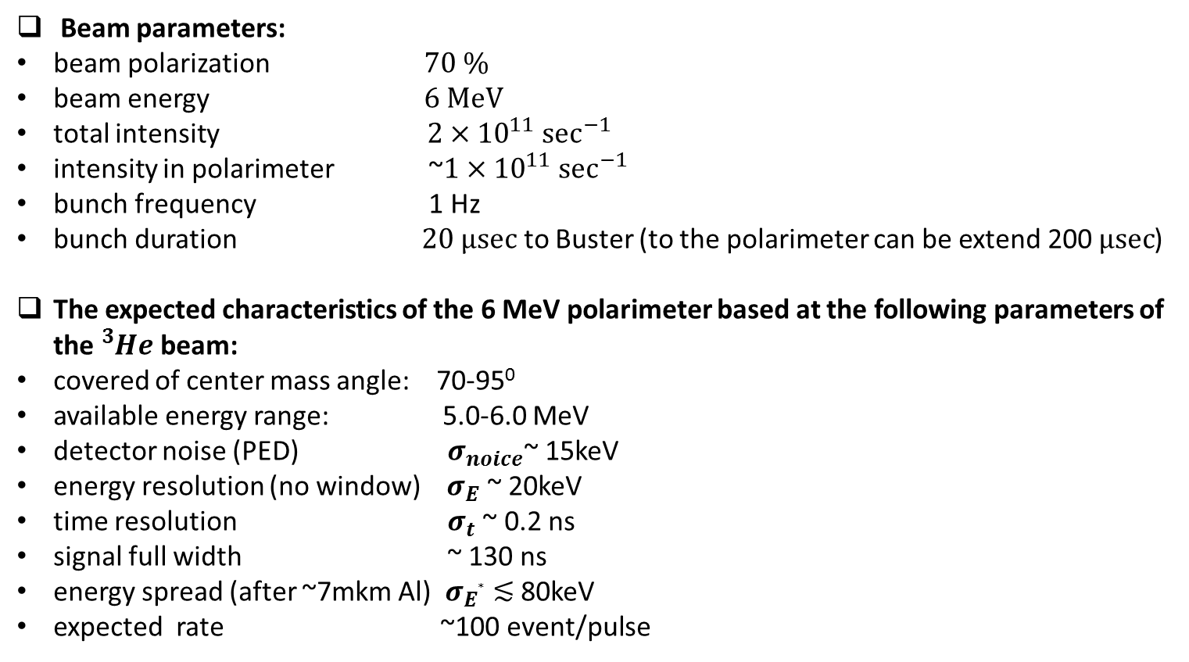
Expected Characteristics of the beam and Polarimeter
Beam parameters:
beam polarization $70 \%$
beam energy $6 MeV$
total intensity $2×{10}^{11} \sec^{−1}$
intensity in polarimeter ~$1×{10}^{11} \sec^{−1}$
bunch frequency 1 Hz
bunch duration $20 μsec$ to Buster (to the polarimeter can be extend 200 $μsec$)
The expected characteristics of the 6 MeV polarimeter based at the following parameters of the ${}_{}^{3}{He}$ beam:
covered of center mass angle: 70-95⁰
available energy range: 5.0-6.0 MeV
detector noise (PED) $σ_{noice}$~ 15keV
energy resolution (no window) ${ σ}_{E}$ ~ 20keV
time resolution $σ_{t}$ ~ 0.2 ns
signal full width ~ 130 ns
energy spread (after ~7mkm Al) ${ σ}_{E∗}$ ≲ 80keV
expected rate ~100 event/pulse

Slide 24
Summary
Development of a polarimeter at the end of October 2019
  Mechanical and vacuum tests of the polarimeter.
Complete test of polarimeter on the BNL Tandem non polarized ³He and ⁴He continuous beam in December 2019:
  study of the signal coincidence in two arms:
    background;
    ³He /⁴He separation;
    energy and time resolution of detector
  absorption energy in the vacuum window;
  absorption energy on the Al foil vs. thickness and deposited energy in ⁴He gas vs. pressure;
  …
Prepare the polarimeter for installation on the EBIS line in early 2020

Slide 25
Acknowledgements
E. Beebe, S. Ikeda, T.Lehn, S. Kondrashev, M. Musgrave, J. Maxwell,
R. Milner, M. Okamura, D. Raparia, J. Ritter, S. Trabocchi
Thank you

Slide 26
Backup

