Slide 1
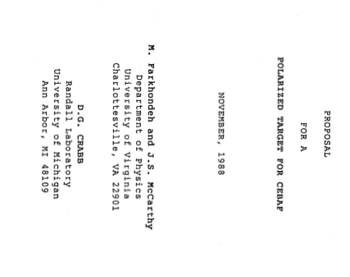
Donald Crabb and Me
*Donal Day*
I first met Donald Crabb in 1999
In 1988 UVa proposed a comprehensive polarized target program for CEBAF
First goal was a measurement of electric form factor of the neutron, submitted in 1989 to PAC , approved in 1993, ran in 1998
We had no experience with DNP targets and solicited the help of Don Crabb to convince the lab that it was possible and a substantial program of physics was possible
I recall meeting Don for the first time when I picked him up at the NN airport in 1989 so he might make a presentation to CEBAF.
In 1990 he joined UVa – and he began to train me in polarized targets
We have been inseparable since.

Slide 2
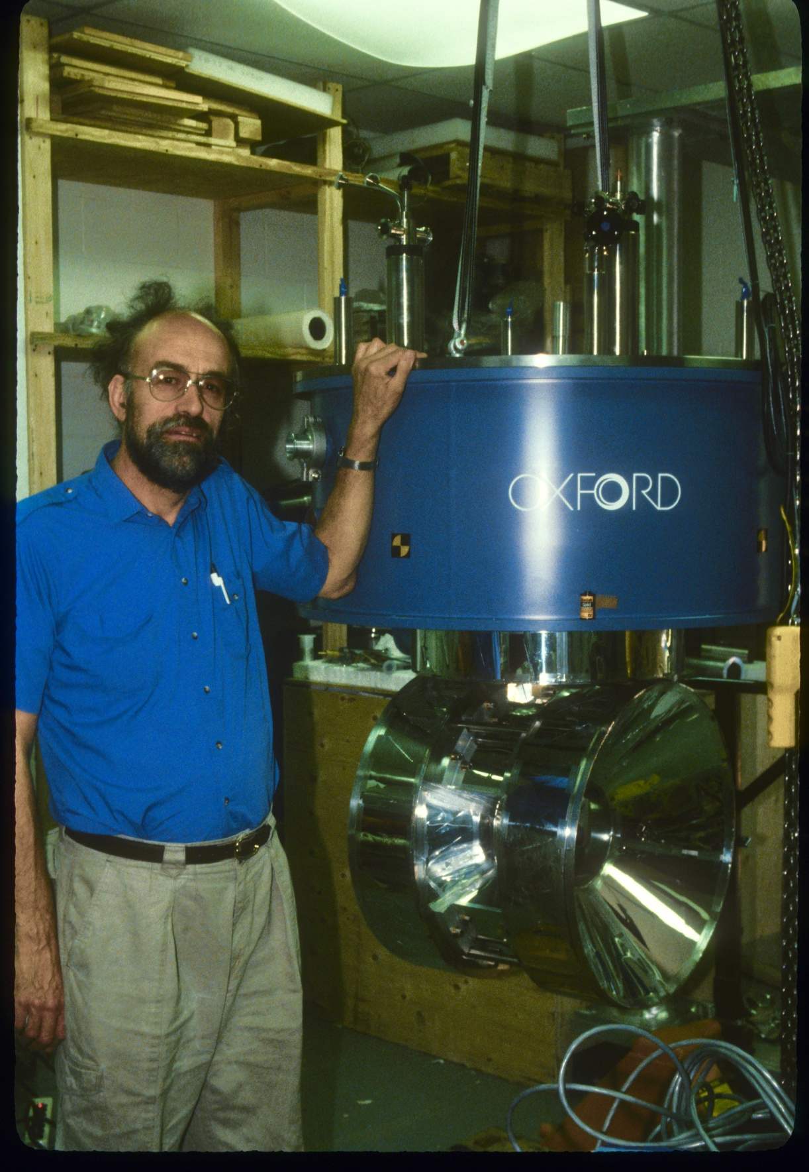
Donald Crabb and Me
Donal Day
In 1988 UVa proposed a comprehensive polarized target program for CEBAF
First effort was to be a measurement of electric form factor of the neutron
UVa had no experience with DNP targets and solicited the help of Don Crabb to convince the lab that a substantial program of polarized target physics was possible
I met Don for first time when I picked him up at the NN airport in 1989 so he might make a presentation to CEBAF.
In 1990 he joined UVa – and he began to train me in polarized targets
We have worked closely together since.
Magnet arrives 1992 @ UVa
Goes to SLAC in 1993 for spin structure experiments; then used first time at JLAB in 1998

Slide 3
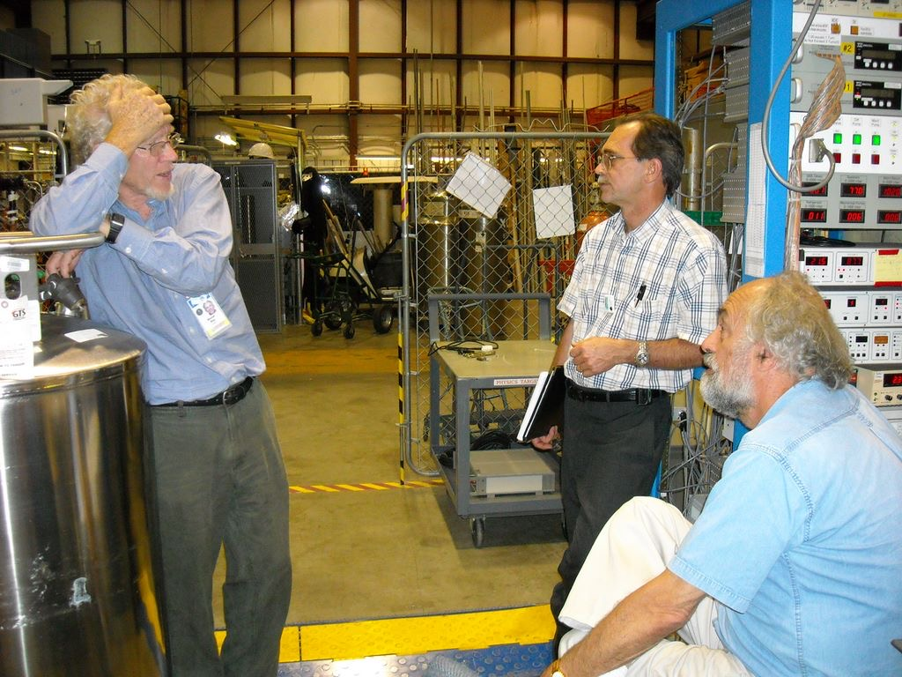
SLAC E143 1994 JLAB 2009

Slide 4
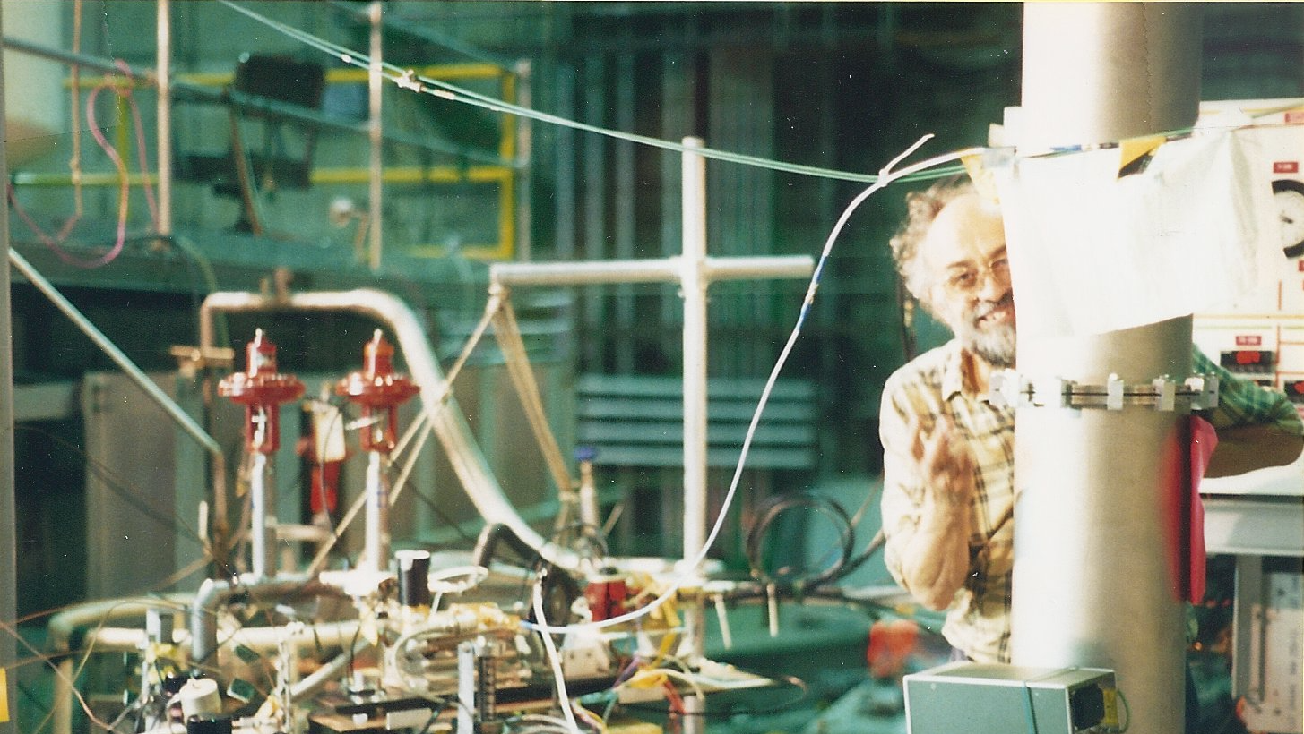
If he is working on a target, he is smiling!
Al Tobias and no fall protection!

Slide 5
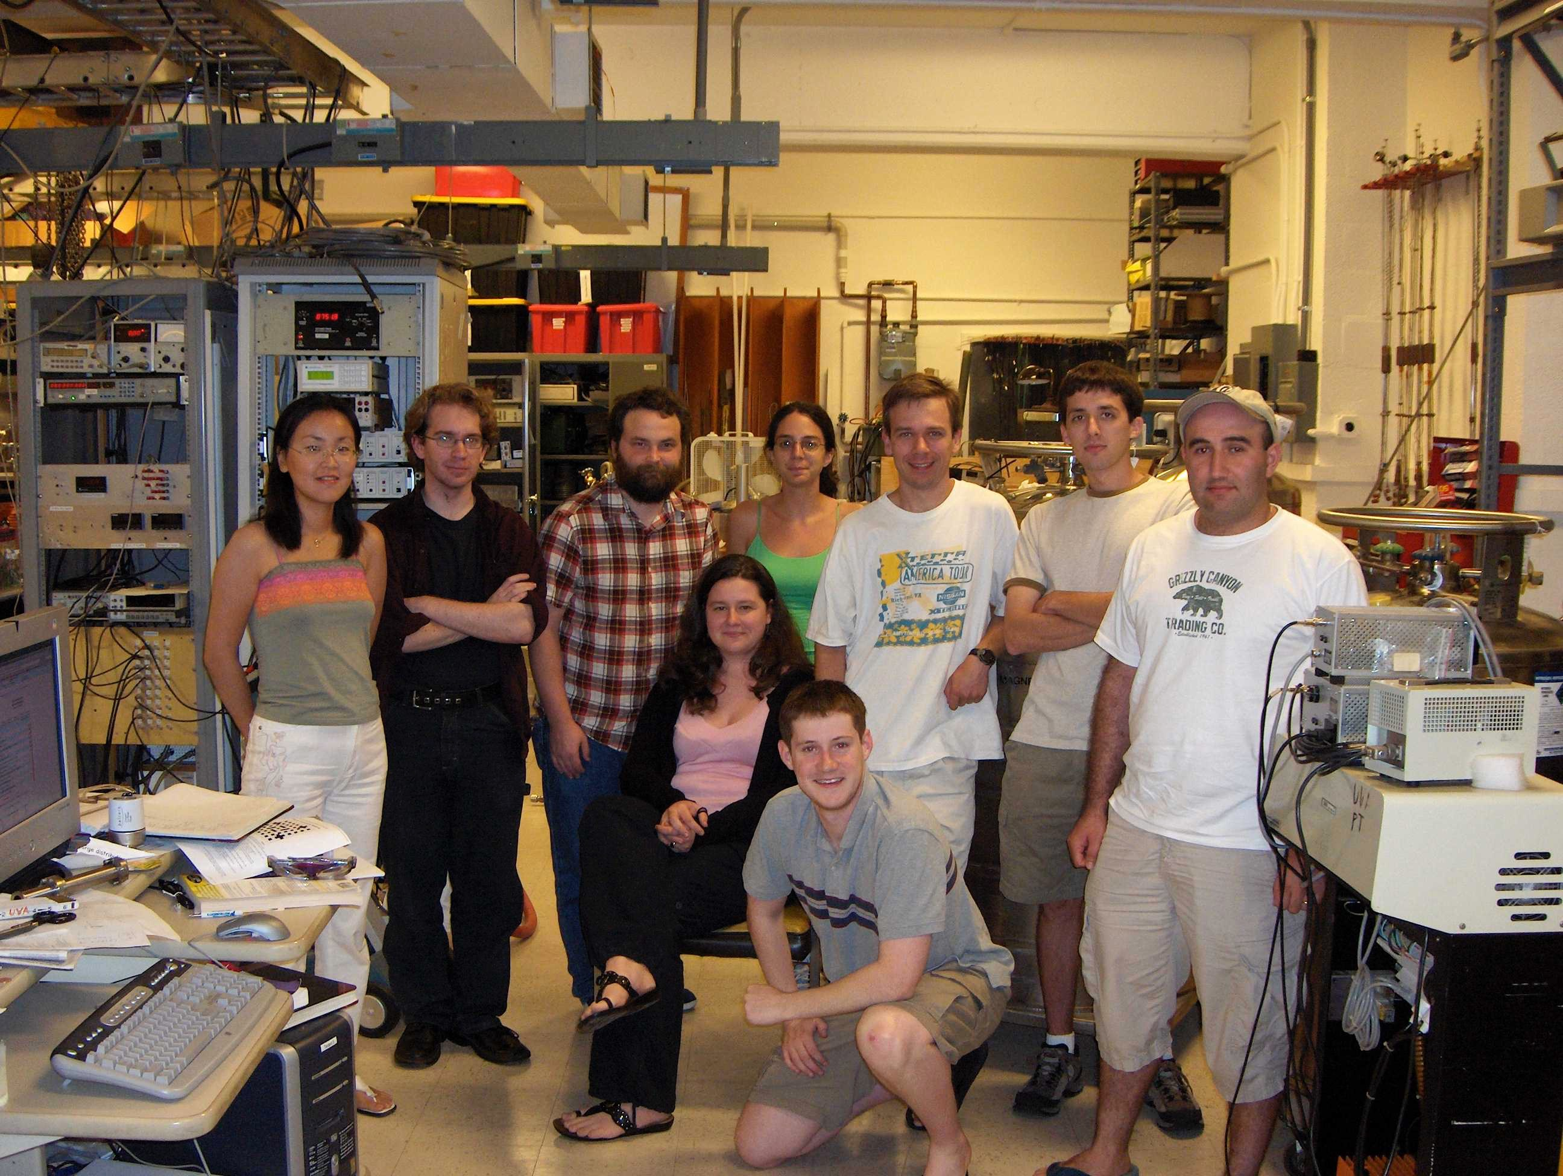
PostDocs
Glen Warren
Frank Wesslemann
Beni Zihlmann
Marko Zeier
Karl Slifer
Hovannes Baghdasaryan
Dustin Keller
Stephen Bueltmann
Joe Mitchell
Narbe Kalantarians
Josh Hoskins
Zulkaida Akbar
Jixie Zhang
Shige Tajima
Students
Josh Pierce
Renee Fatemi
Dustin McNulty
Yelena Prok
Al Tobias
Jonathan Mellor
Kang Kovacs
Nicholas Kvaltine
Svyatoslav Tkachenko
Don’s life has been spent teaching
Helped train many more
Todd Averett
TJ Liu
James Maxwell
Paul McKee
Nadia Fomin
Vahe Mamyan
Hongguo Zhu
Chris Harris
Justin Wright
Chris Cothran
Mikhail Yurov
Dien Nguyen

Slide 6
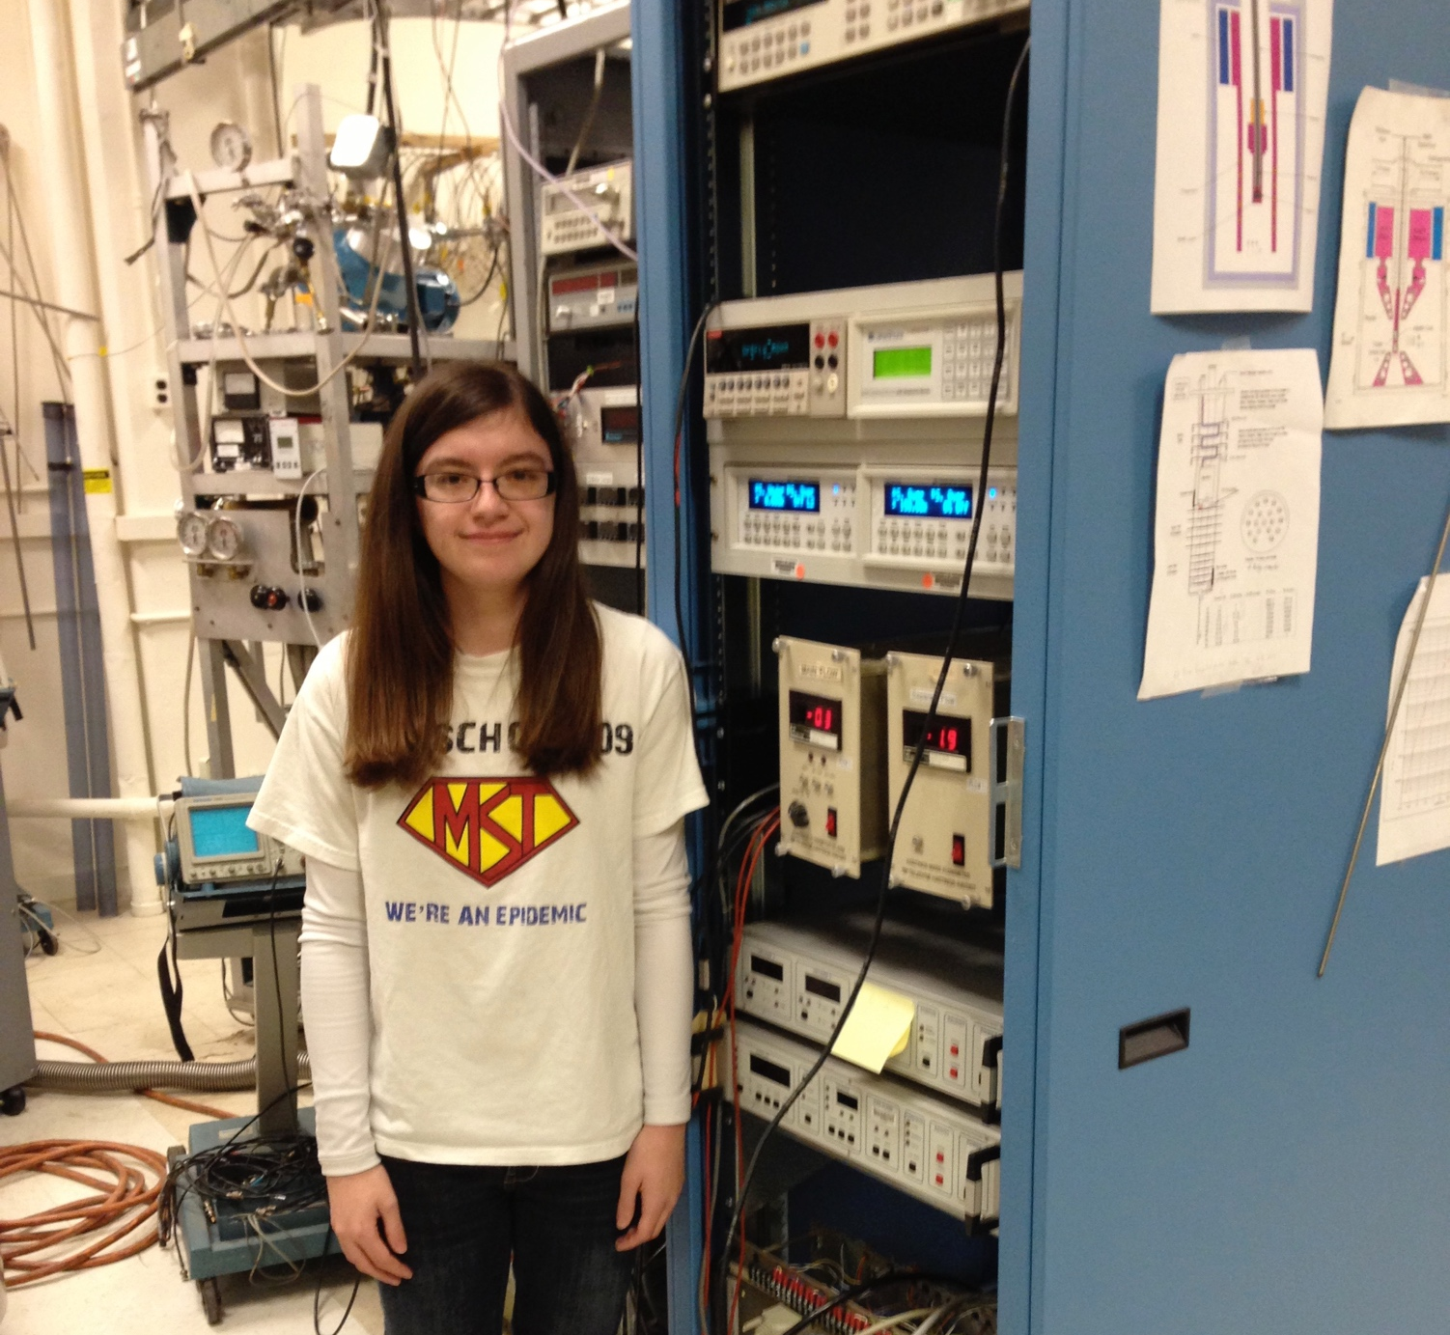
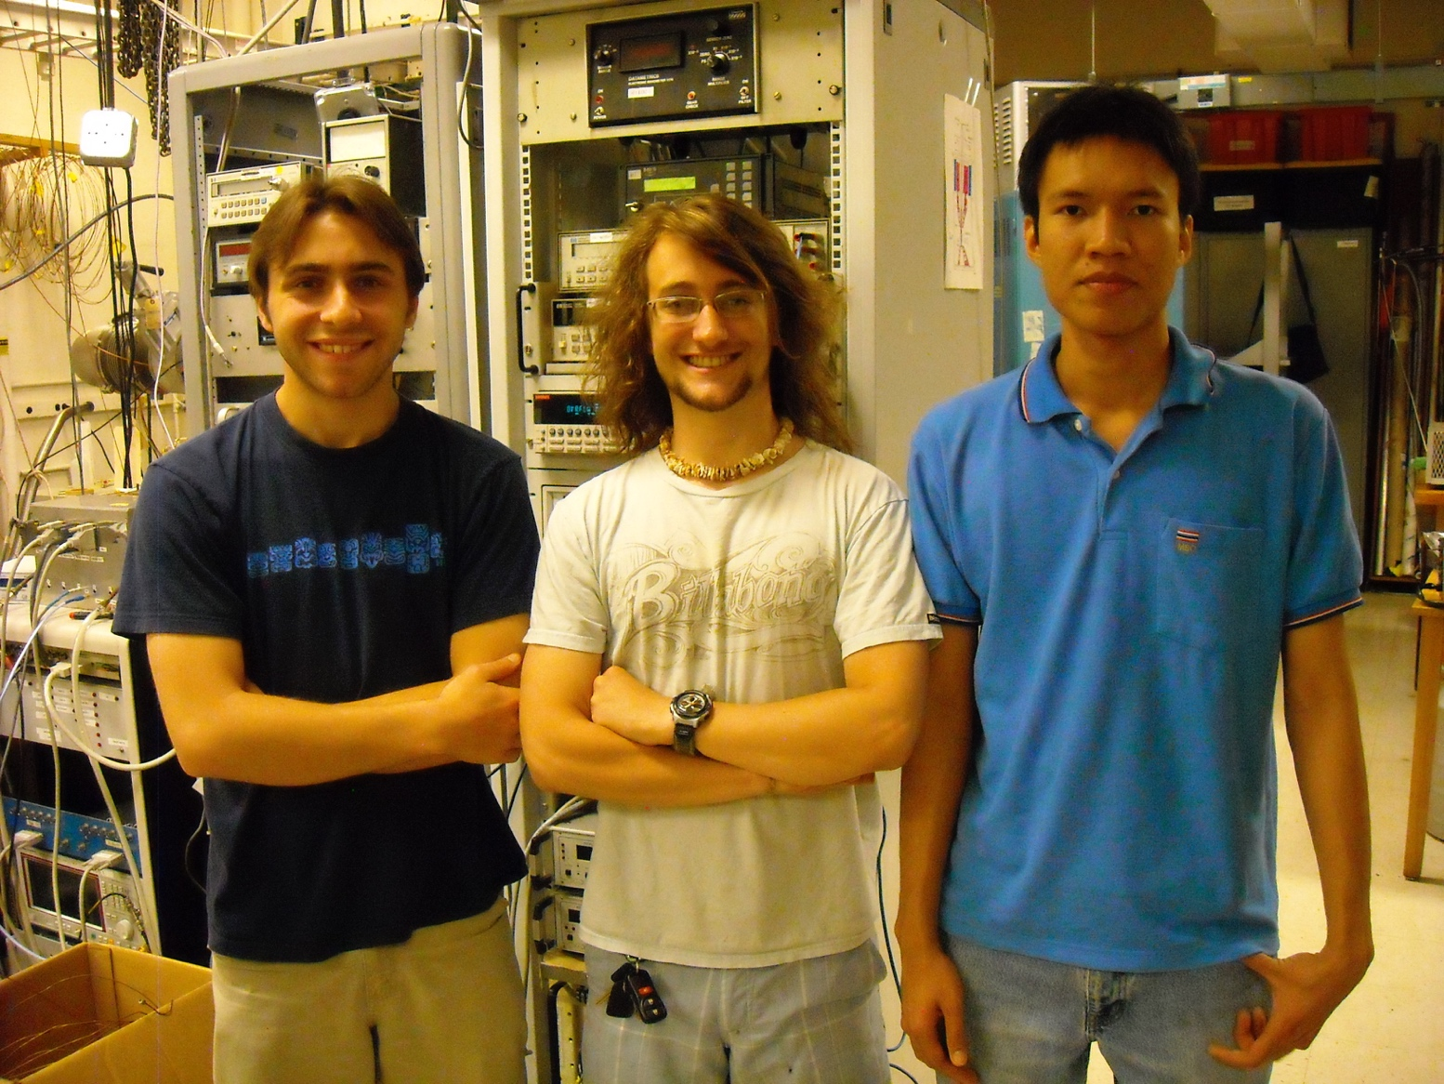
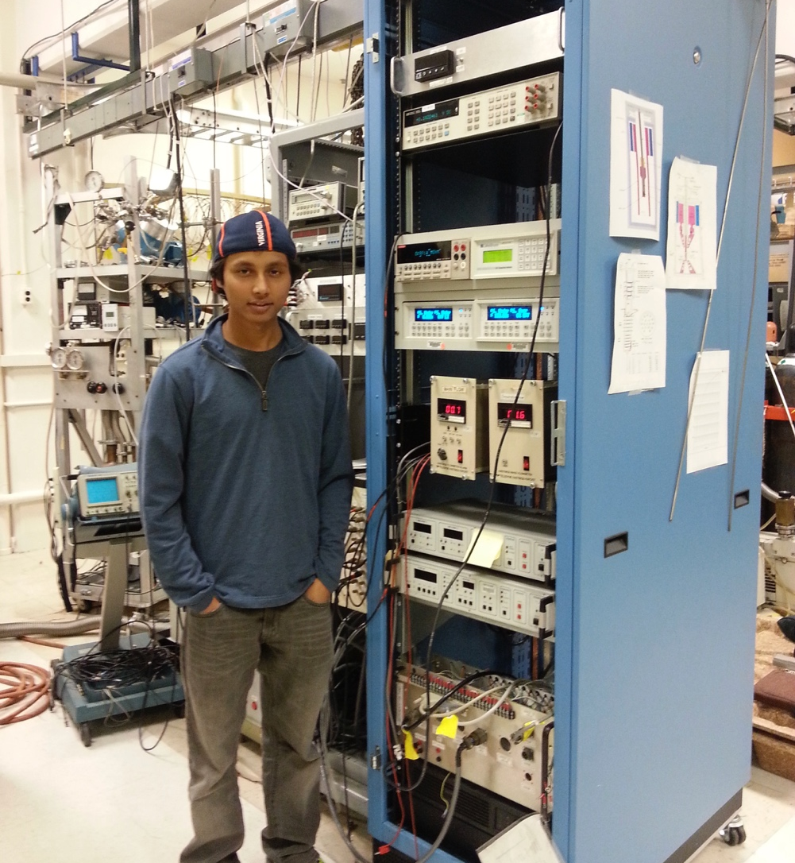
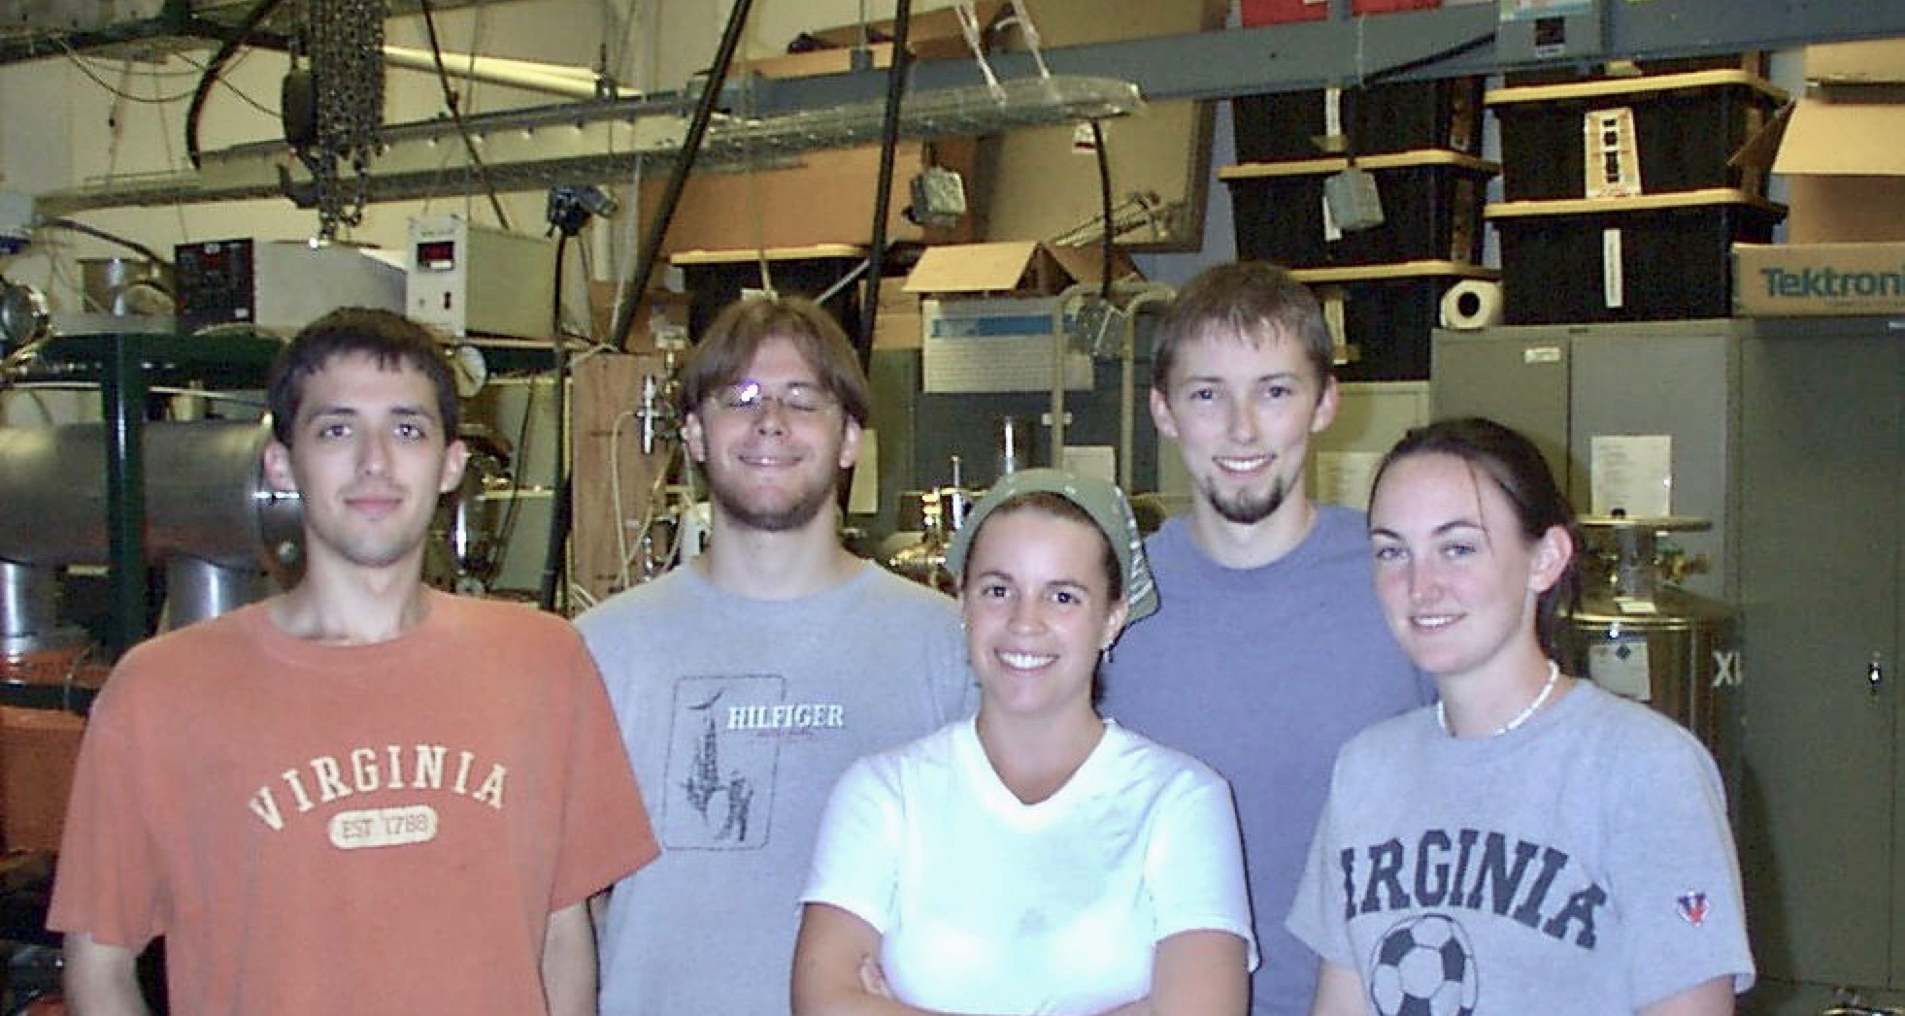
Dozens of undergraduates

Slide 7
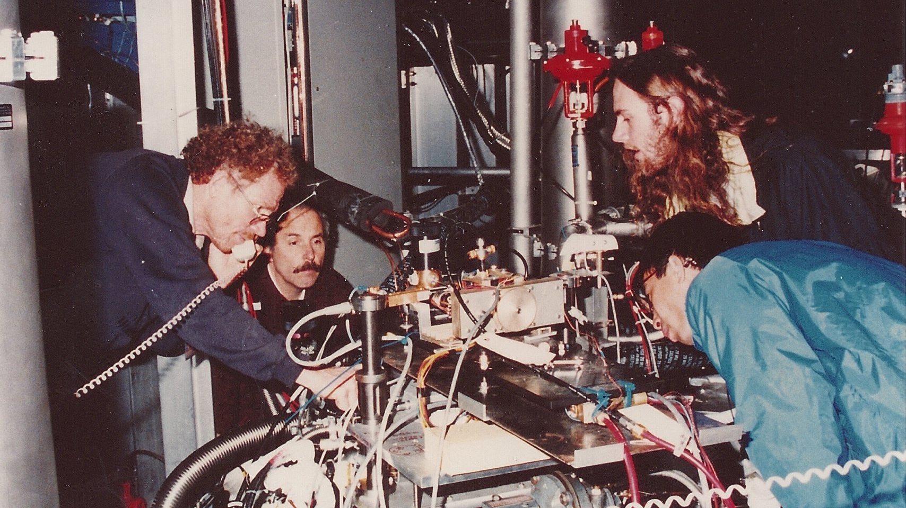
I am at SLAC and confused.
Don is on the line in Charlottesville sorting us out.
Not a rare occurrence.

Slide 8
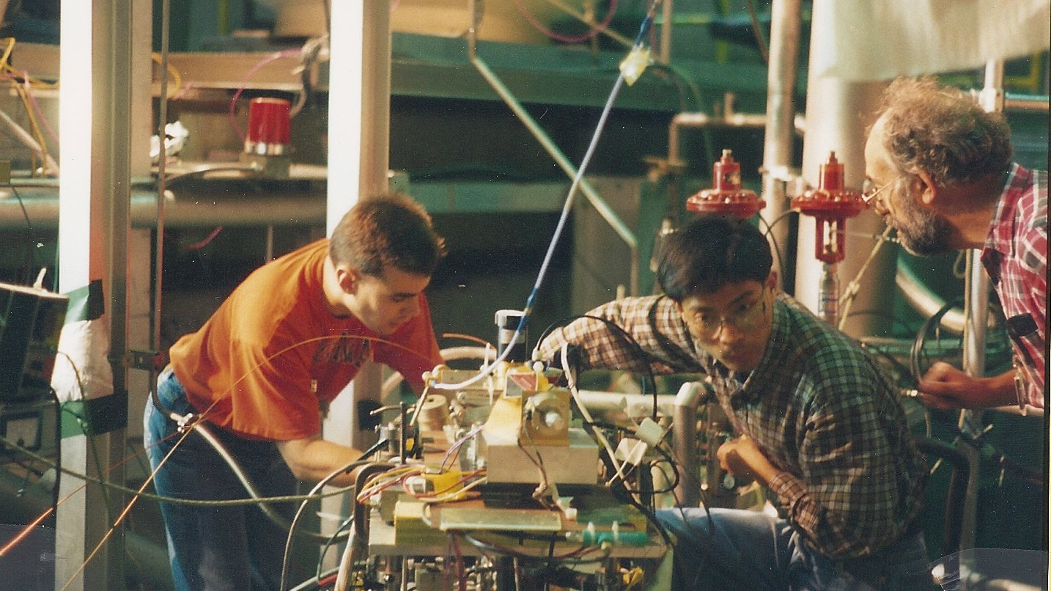
SLAC
Training, guiding, teaching

Slide 9
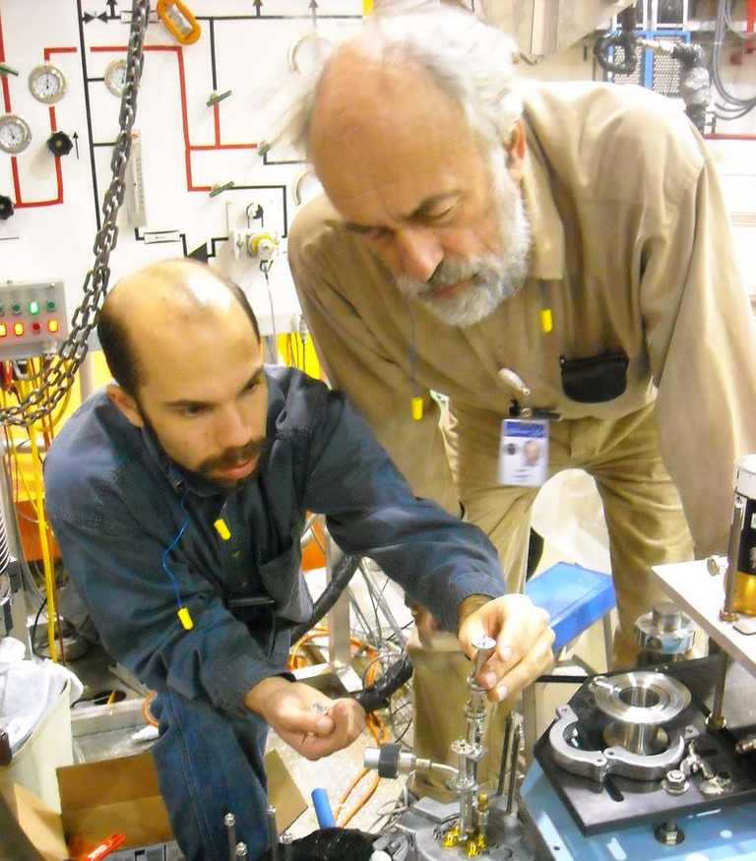
JLAB
Training, guiding, teaching

Slide 10
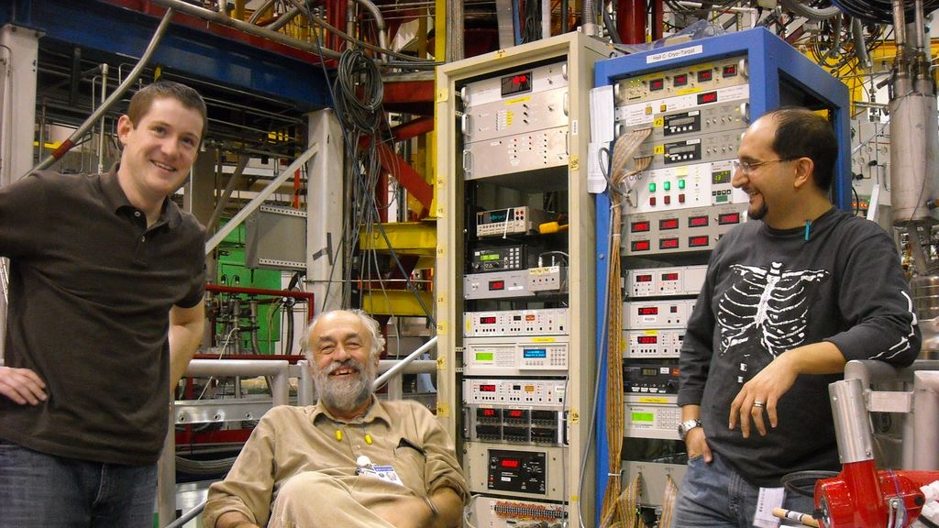
Training, guiding, teaching.
Smiling, always smiling

Slide 11
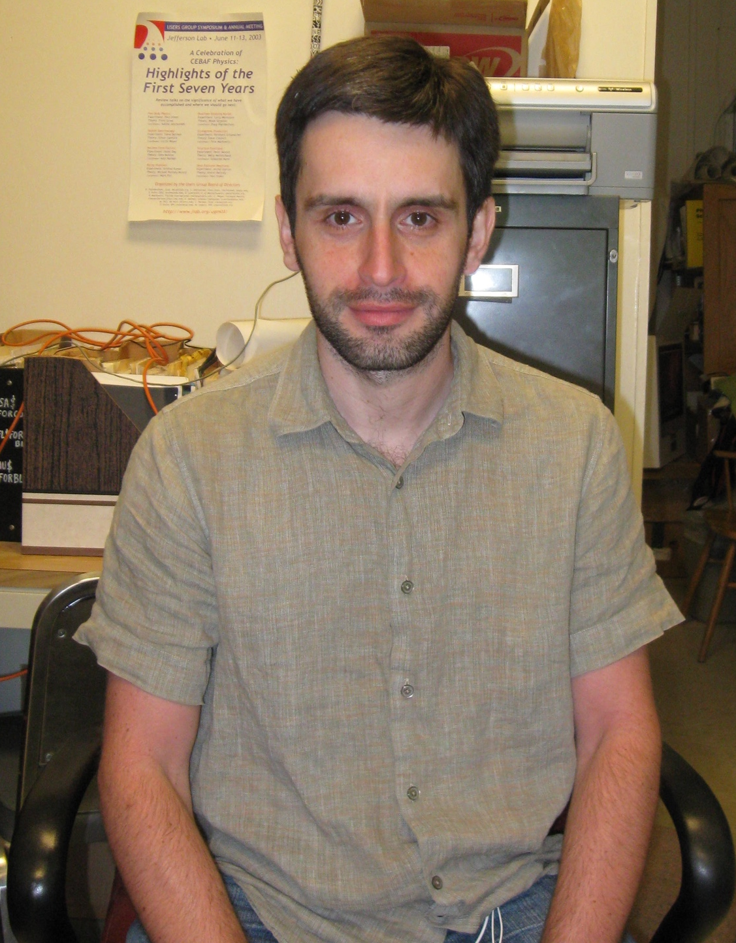
Building Polarized Targets

Slide 12
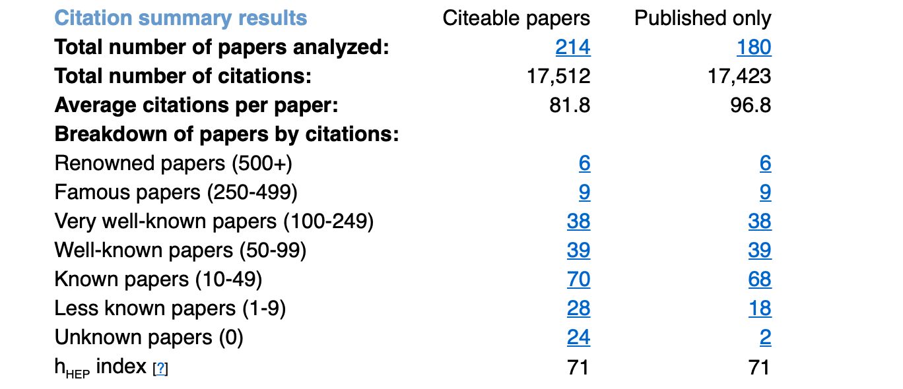
inSPIRE knows of him too “find a crabb,dg”

Slide 13
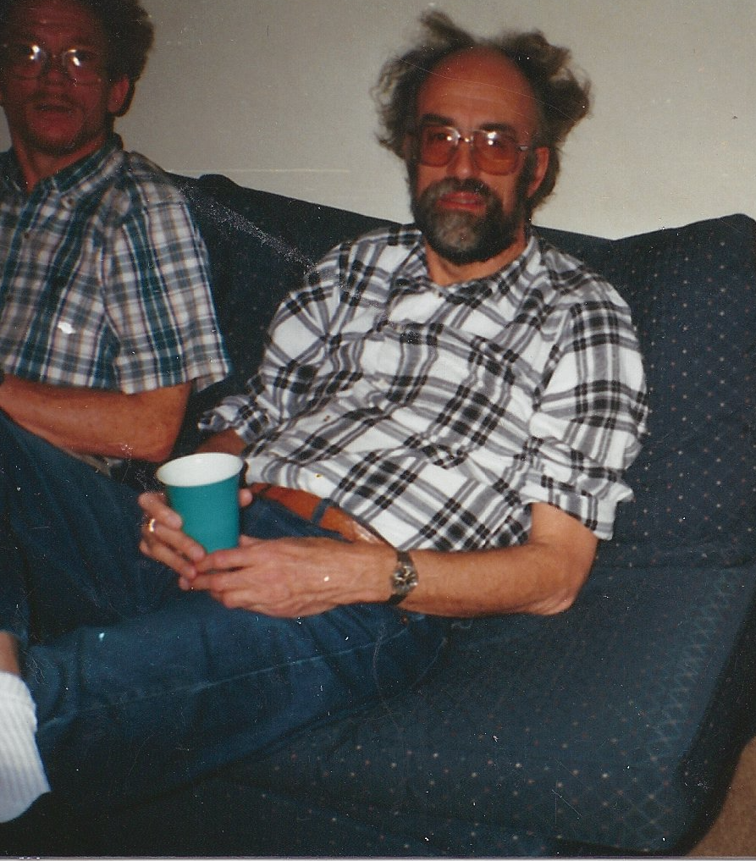
Don has always had great hair

