Slide 1
Spallation Neutron Source and High Flux Isotope Reactor
Crystal Schrof, Manager
Scientific and Program Services Office
June 11, 2019
Oak Ridge, Tennessee

Slide 2
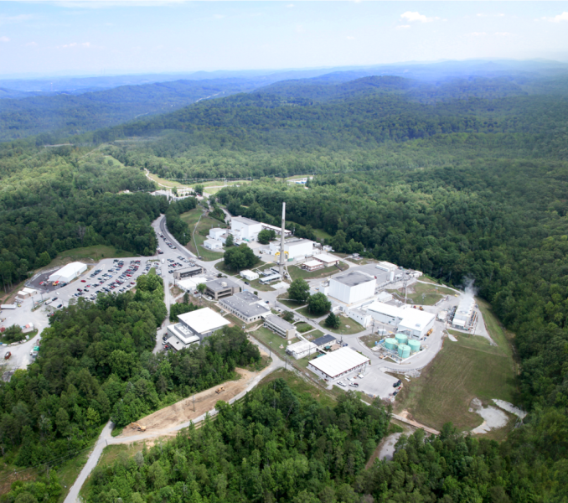
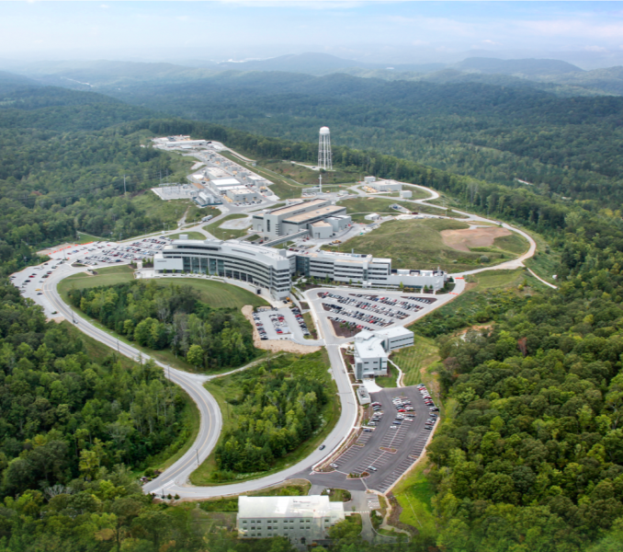
ORNL develops and operates advanced neutron scattering user facilities
High Flux Isotope Reactor (HFIR)
Intense steady-state neutron flux
and a high-brightness cold neutron source
Spallation Neutron Source (SNS)
World’s most powerful
accelerator-based neutron source
U.S. Department of Energy user facilities:
Unique capabilities available through peer review
Notes:
2
We operated two powerful advanced neutron scattering research facilities HFIR and the SNS on behalf of DOE.
The SNS began operations in 2006 and is the world’s most powerful source of pulsed neutrons,
The accelerator, which is situated here operates at about 1MW. This is the first target station. We have a well-developed upgrade path which includes a second target station which will be position here.
The STS will give researchers new opportunities in for mesoscale science
This building houses the SNS offices and labs, and this adjoining building houses the CNMS.
Here is the Joint Institute for Neutrons Sciences, constructed with funding from the State of Tennessee, a partnership facility with UT with a focus on industrial users, student and staff training, and visiting scientist programs.
And this is our guest house.
HFIR has been in operation since 1965. It operates at 85MW. We’ve just completed 50 cycles of operation with a cold neutron source of unsurpassed brightness which provide researchers the ability to determine nanoscale structures in a vast array of materials (polymers, biological macromolecules, solids).
Between the SNS and HFIR we currently operate 30 beam lines serving around 1200 unique users a year.

Slide 3
Thousands of researchers rely on ORNL’s neutron facilities annually for scientific discovery
More than 3000 total researchers
More than 1300 experiments
More than 102,000 hours of beam time for users
More than 700 scientific publications
30 neutron scattering instruments

Slide 4
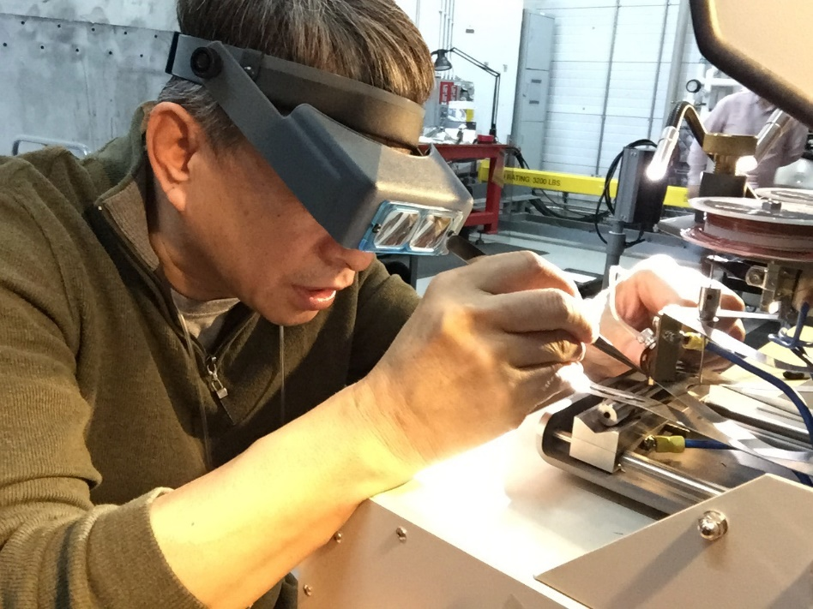
Industry is accessing ORNL’s neutron sources
Contractual mechanisms for users that need assistance with neutron scattering
  Full or “concierge” service
  Remote data collection

Slide 5

































Industry Partners
Neutron measurement techniques at ORNL support applied research and product development
Hill
Engineering
LLC
Notes:
>30 industrial companies utilized ORNL neutron measurement techniques in recent years but currently a limited number of “major” programs: e.g. Cummins, DuPont, GE, GM, & P&W, Honda, Corning, & US Steel.

Slide 6
Industry has three avenues to access ORNL’s neutron sources
General User Program
  Apply for beam time through competitive proposal process
    Submit proposal using on-line system
      Two-page statement of research, plus sample description
    Must be technically feasible and safe
Mail-in Program
  Submit proposal using on-line system
  Limited to beam lines with a Mail-in Program
Industrial Applications Program
  Apply for beam time through Industrial Liaison
  Proposal developed with user and submitted by instrument scientist
  Internally reviewed for technical feasibility, safety, and merit

Slide 7
Interacting with the private sector
Technology licensing
Sponsored research
Industrial partnerships
Economic development
Sub-
contracting
Moving intellectual property developed
at ORNL
to the commercial marketplace
Bringing ORNL expertise and facilities to bear
on problems
that can only
be solved
using these resources, with full cost recovery
Engaging
in collaborative R&D for shared benefit
Providing technical assistance to solve complex problems
Supporting
the creation
of new jobs,
new companies, and increased competitiveness for the region, the state,
and the nation
Purchasing
a wide variety
of goods
and services, with a special emphasis
on small businesses

Slide 8
We have experience partnering on beam line construction
Neutron Spin Echo, BL-15, at SNS
  Strategic Partnership Project (SPP) agreement
VULCAN, BL-7, at SNS
  Strategic Partnership Project (SPP) agreement

Slide 9
We are exploring a model used by other DOE User Facilities for beam line construction and operation
Collaborative Access Teams
  Construct beam line
  Operate beam line
  Percentage of the beam time is reserved for the General User Program, but majority goes to the Collaborative Access Team

Slide 10
Additional information on ORNL neutron sciences
neutrons.ornl.gov
Industrial Applications Program
  Dr. Ke An, Industrial Liaison
  kean@ornl.gov

