Slide 1
The User Facilities at the Oak Ridge National Laboratory
Clarina dela Cruz Quantum Materials Initiative Coordinator Neutron Sciences Directorate
Inaugural Meeting for Opportunities at the SEEMS Facility June 12, 2019

Slide 5
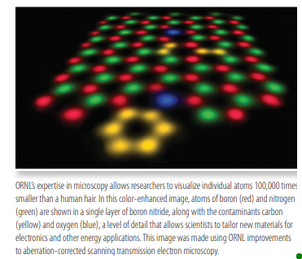

Slide 6
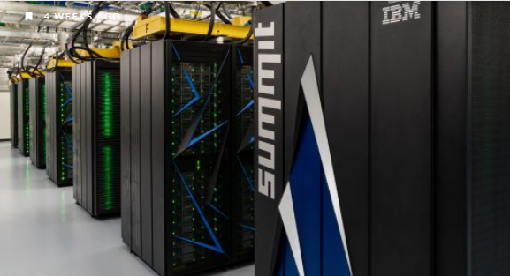
Summit, the world’s most powerful and smartest supercomputer, debuted in 2018.
SUMMIT
Oak Ridge National Laboratory's 200 petaflop supercomputer
Summit is the next leap in leadership-class computing systems for open science. With Summit we will be able to address, with greater complexity and higher fidelity, questions concerning who we are, our place on earth, and in our universe.

Slide 7
Oak Ridge National Laboratory Industry Partnership Program
helping start-up companies to Fortune 500 giants supercharge their competitiveness through access to world class computational resources and expertise not available elsewhere
firms gain hands-on experience applying advanced computational tools to their problems and realizing bottom line business benefits.

Slide 10
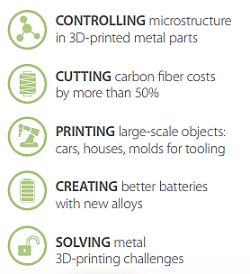
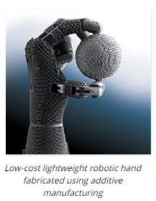
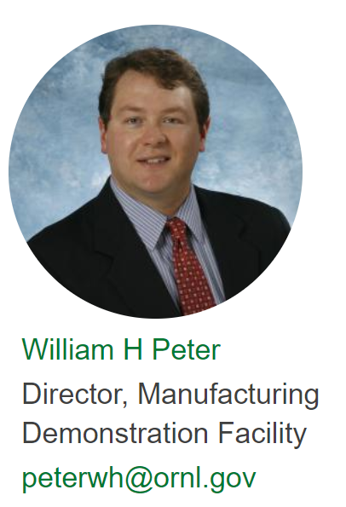

Slide 11
