Slide 1
SNS Accelerator Advisory Committee Meeting
STS Target Concepts
Mark Rennich
February 17, 2016

Slide 2
Committee Charge
‘Is the proposed approach for the STS target systems reasonable for an early design stage, and in particular is the choice of a rotating target with vertical access for maintenance appropriate?’
Design Status
The selection of a rotating target and the resulting remote maintenance approach led to a significant revision in the proposed STS design.
The updated concept was completed in January and is currently undergoing a comprehensive series of stakeholder design reviews.

Slide 3
Evolution of the Proposed STS Target
A 2013 neutronics optimization study established the baseline compact neutron production zone for the 2014 conceptual design (see Technical Design Report dated Jan 2015, ORNL/TM-2015/24)
Proton beam power (467 MW), cross section (30 cm²) and Pulse rate (10 Hz)
Moderator-reflector configurations
Neutron beam sizes (3 cm to 7 cm)
Stationary target configuration and material (Ta clad W)
Moderators and beam lines were matched to an ideal instrument suite
The baseline configuration was given a complete design and safety review in 2015
Target – proton beam interface refined
Target residual heat impacts on safety considered
Stationary vs rotating targets compared
Rotating target selected

Slide 4
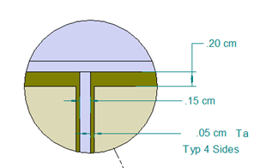
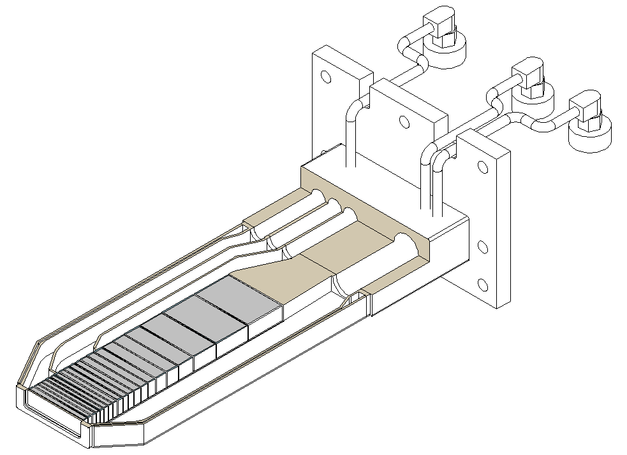
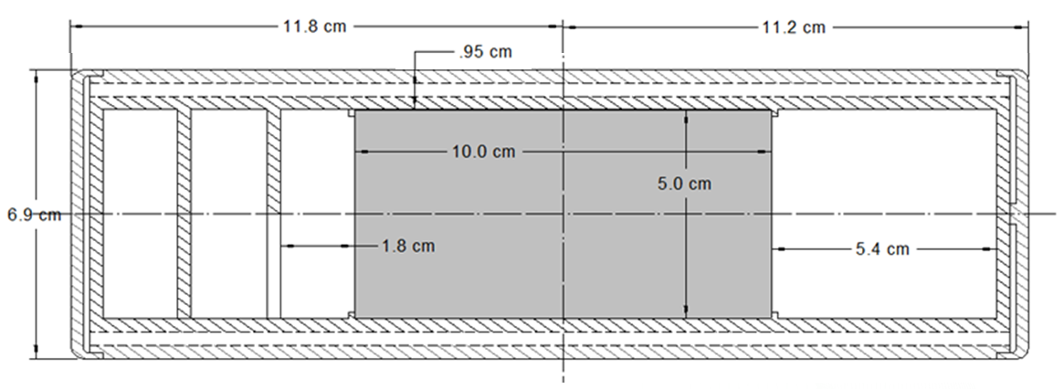
Stationary Target Configuration (TDR)
Stainless Steel Shroud
17 plates (Ta clad W)
36.3 cm total depth
1.5 mm D₂O Cooling Channels Between Plates
10 m/s Flow Velocity
Independent Shroud Cooling Channel
Similar To Proven ISIS Design
Shroud
Cooling
STS beam footprint ~ 7.5 cm x 4 cm

Slide 5
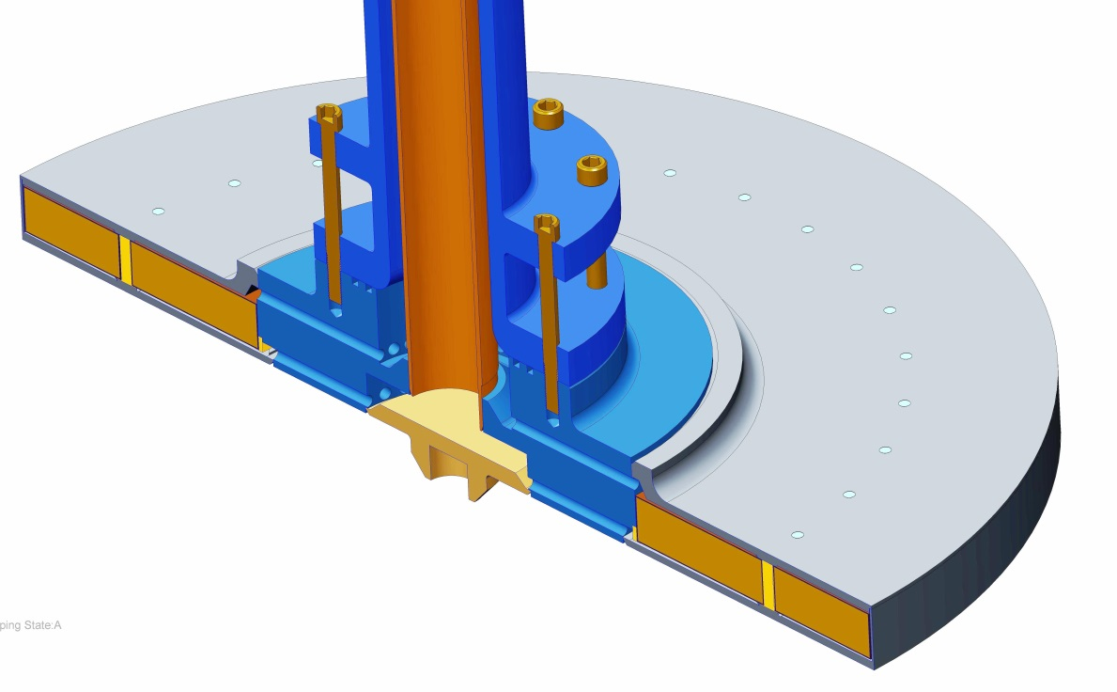
Rotating Target Configuration
Shaft w/Concentric
Water Pipes
SST Hub Distributes
Water to Plates and
SST Shroud
Target Diameter: 1.15 m
Asynchronous Timing
Rotation Speed ~19 RPM
31 Pulses/Revolution
Stainless Steel Shroud
32 Plates (Ta clad W)
30 cm Depth
3-4 m/s Water Flow Velocity
Theoretical Life >40 years
Tantalum clad
Tungsten Plates
(5 cm thick)

Slide 6
Target Comparison
Rotating Target has a tungsten/tantalum mass ~20.9 times larger than a stationary target
Rotating target is ~14 % denser than the stationary target in the high intensity zone (~12.8 cm deep)
Comparison of Target Cores

Slide 7
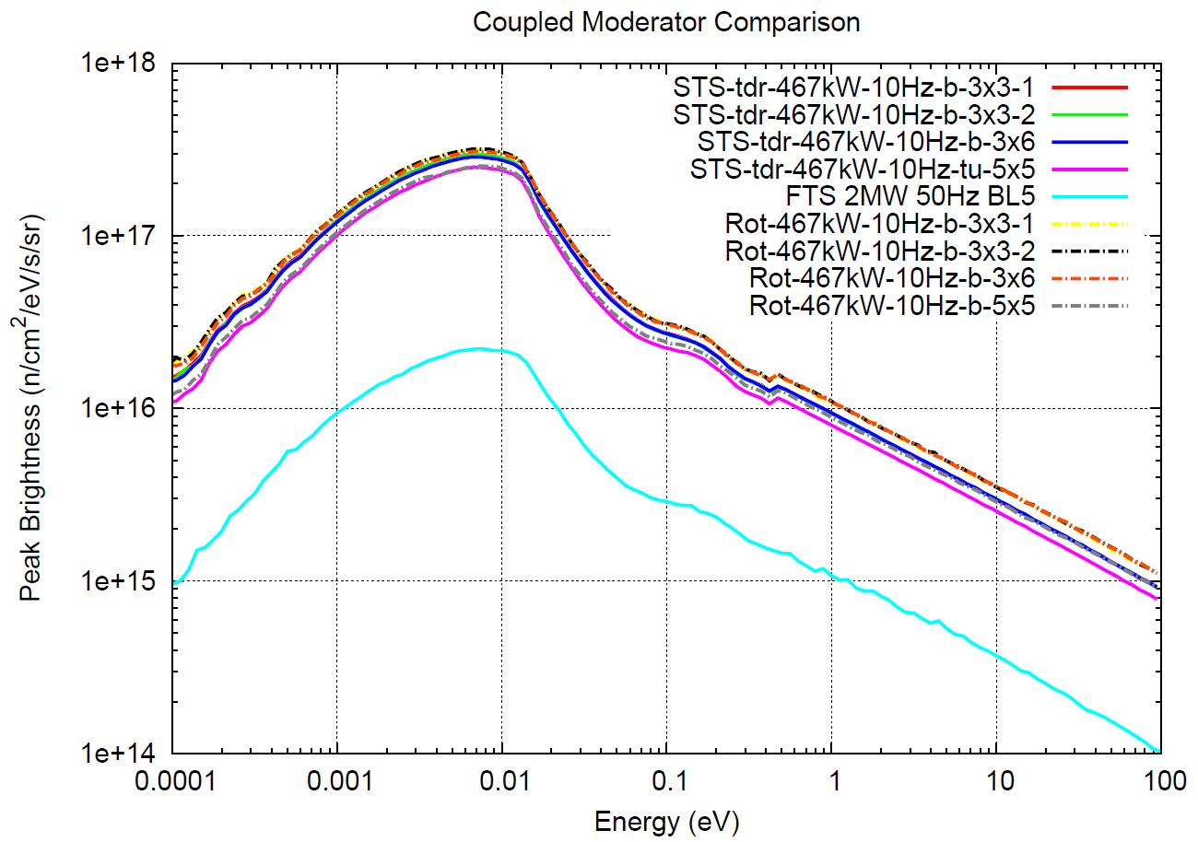
Physics Performance
The stationary and rotating targets have virtually identical neutronic performances
STS: 0.467 MW, 10 HZ
FTS: 2MW, 50 HZ
Peak brightness versus neutron energy for coupled para-H₂ moderators
Analysis by I. Remec

Slide 8
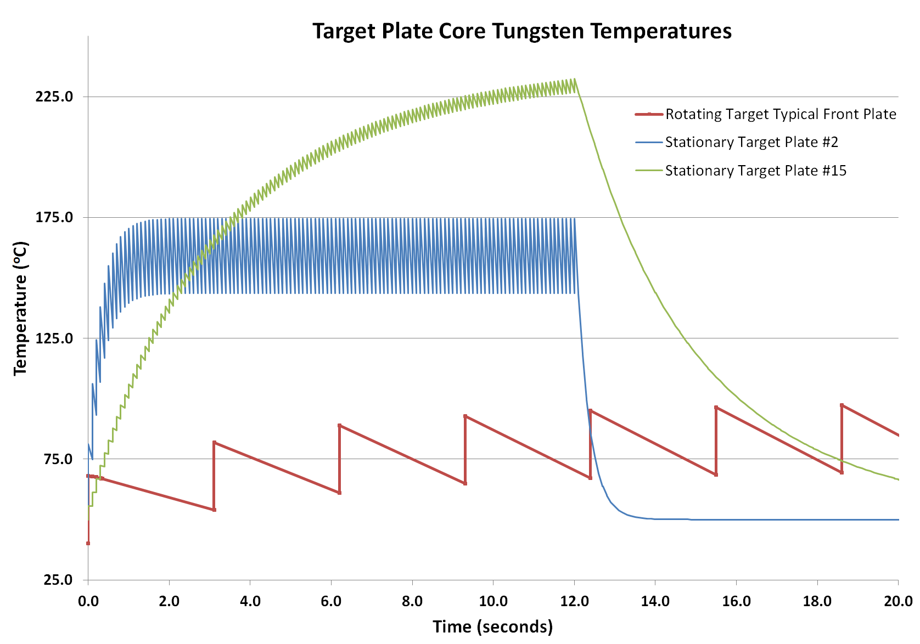
Comparison of Normal Operating Temperature Cycles
Stationary target normal operating thermal cycles are substantially higher than the rotating target
Rotating Target
T_{out}=40 ºC
H=1.7e4 W/m2-K (@ 3m/s)
31 wedge target
Synchronized beam
Stationary Target
T_{out} = 50 ºC
Plate #2 in peak heating location
Plate #15
H=4.5e4 W/m2 –K (@10m/s)
Note: higher bulk temperature rise than rotating target
Analysis by C. Barbier and T McManamy

Slide 9
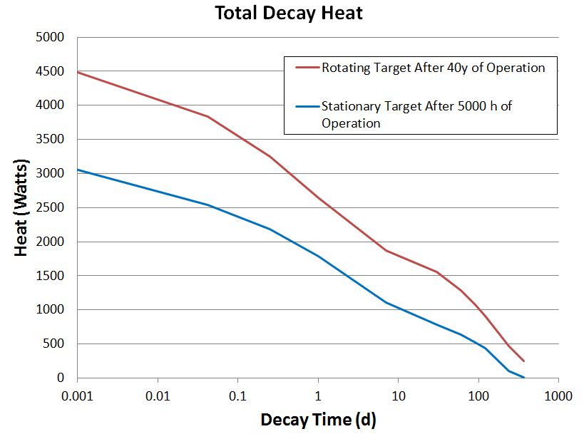
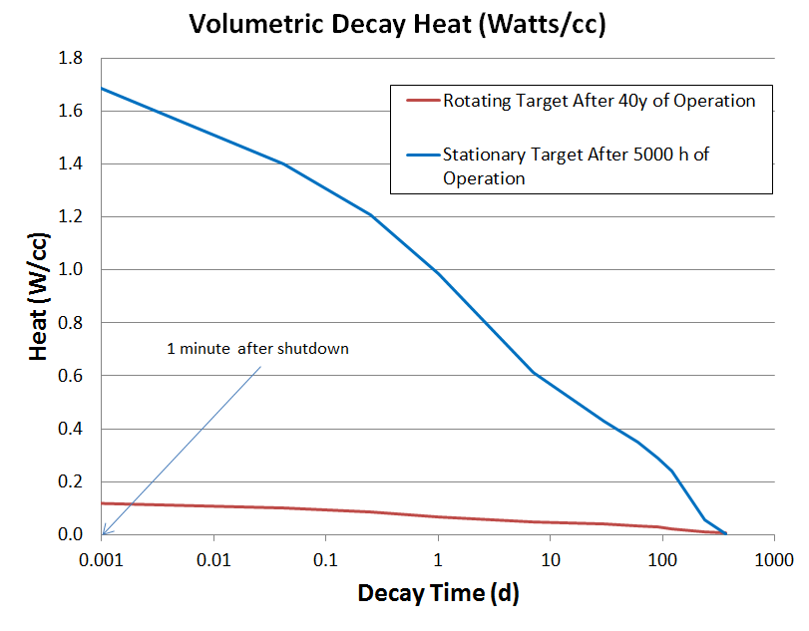
Residual Heat
The nominal peak volumetric residual heating in the stationary target is substantially higher than the rotating target
Residual Heating Is Not Proportional To Target Size
Analysis by I Remec

Slide 10
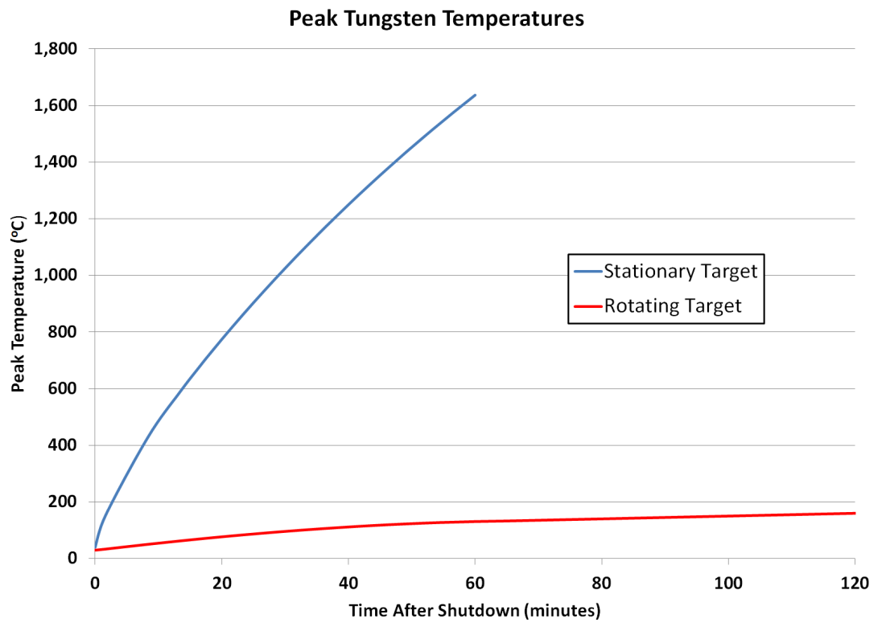
Loss of Coolant Failures
Stationary Target
Heat transfer from a compact target to surroundings is ineffective
A dry stationary target reaches tungsten oxidation temperatures in 20 min if the IRP has also lost coolant. SST shroud will begin to fail in ~ 1 hour.
Alternative stationary target cooling accidents all exceed 800 ºC within 1 hour.
Shroud cooling limits tungsten to 320 ºC and the shroud to ~200 ºC (not seismically qualified & restart will be difficult)
Rotating Target
slower rise and lower maximum temperature
conservative model shows peak temperature of only ~380 ºC after 41 days
Radiant heat transfer is effective
Primary Safety Consideration
Tungsten reacts with water at ~800 C generating hydrogen gas and tungstic acid powder
Tungsten Oxidation Temperature
‘
Stationary vs. Rotating Target Performance in a Loss-of-Coolant Accident
Analysis by T McManamy

Slide 11
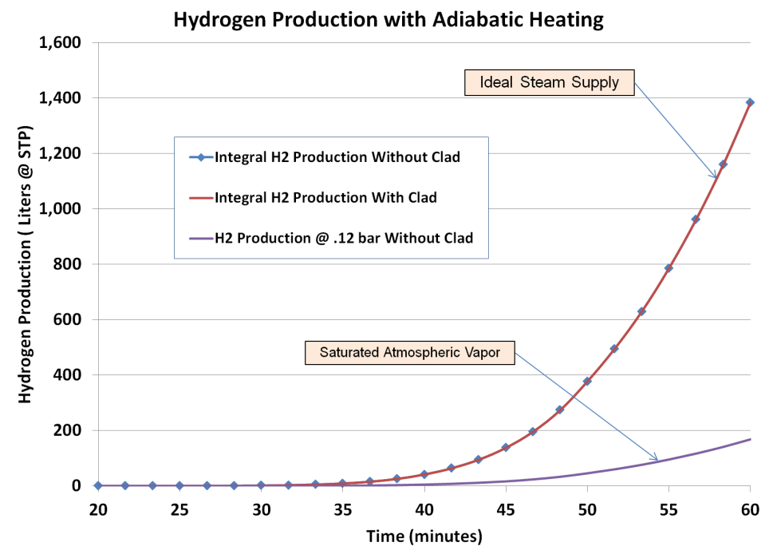
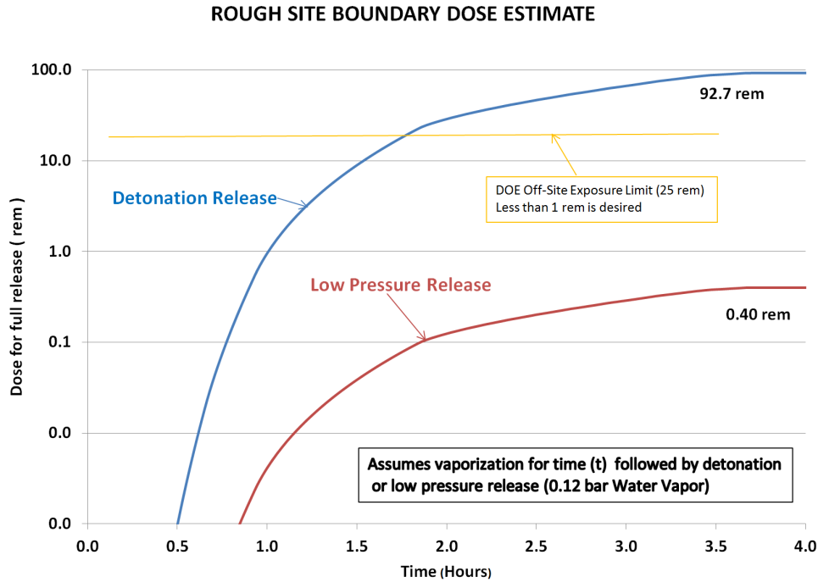
Preliminary Safety Analysis of Stationary Target
In all loss-of-coolant accident cases water vapor will be present
It is difficult to eliminate the worst case accident scenario in which a hydrogen detonation vents the activated powder to the site boundary
A preliminary analysis of this scenario indicated the stationary target could exceed DOE off-site safety limits
Additional analysis and testing could possibly address this issue-but this could be a risky assumption
Analysis by T McManamy

Slide 12
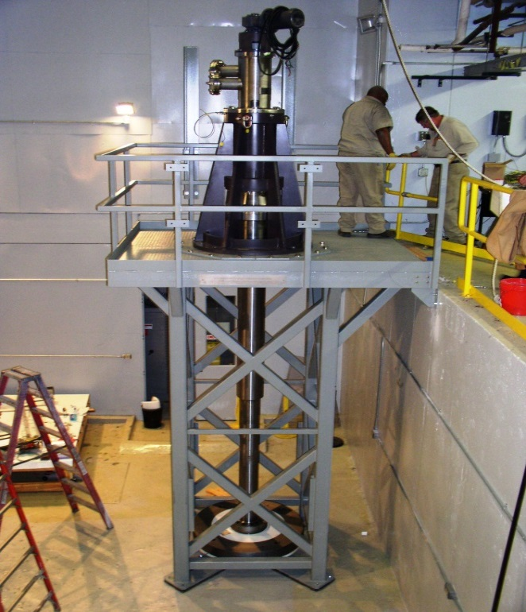
Rotating Target Design Based on 2010 Study
A successful, full scale prototype assembly was built in conjunction with ESS-Bilbao and IDOM
Extended shaft arrangement locates the drive and bearings >3 meters from target to enable maintenance and limit radiation damage control
No mechanically active components located in high radiation environment
Tested at speeds between 6 and 60 rpm
Less than 0.02 inches of run-out
Successful 5400 hr operational test completed (no water leaks, bearings experienced no temperature rise or wear related deterioration)
Full Scale Test Assembly

Slide 13
Mockup Target Operating @ 60 RPM

Slide 14
Decision to use a Rotating Target
Attribute | Stationary Target | Rotating Target
Total Loss-of-Coolant Accident | Potentially significant off-site release | No significant off-site release (mitigated)
Operational loss of coolant flow (no leak) | Rapid (<<1 sec),reliable beam trip required | Gradual temperature rise
Independent shell cooling | Required | Not required
Thermal stresses (Max) | ~120 MPa | ~58 MPa
Thermal Cycle Rate | 10 Hz | 0.32 Hz
Change-out Rate | Annual | >10 years (determined in operation)
Unit cost of targets | >$250K (SWAG) | > $1,000K (SWAG)
Change-out Difficulty | > One week | >One month
Residual Heat Control | Active heat removal; special handling during change-out | Passive heat removal; no special handling
Spent target storage | Active cooling required | Passive cooling (large wells)
Change-out Configuration | Service cell | Overhead shielded containers
An independent review of STS target options with an emphasis on safety recommended the rotating target (Sept 2015).

Slide 15
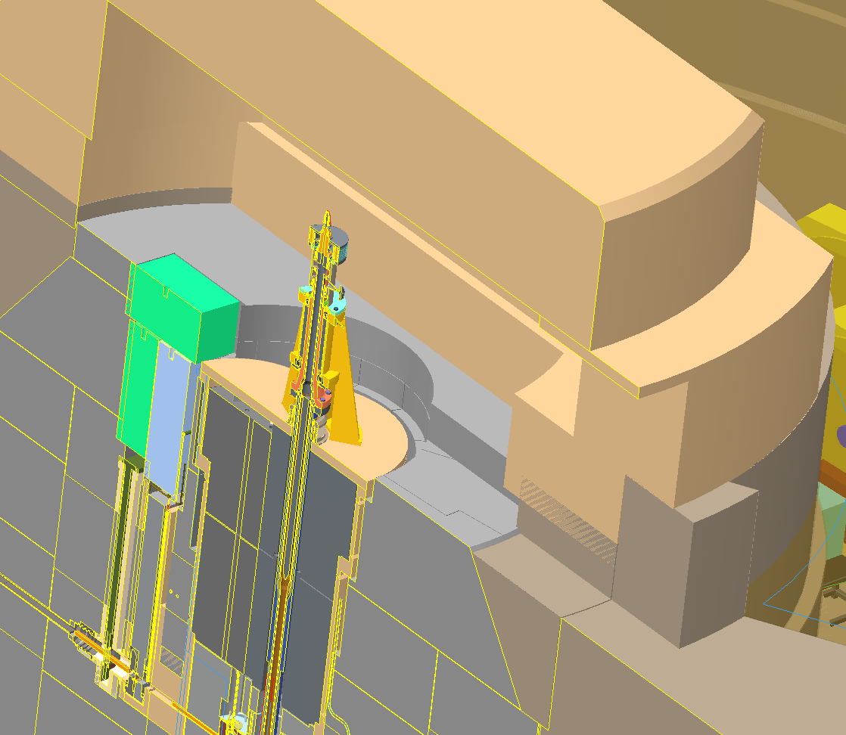
Vertical Access to Monolith Components
Drive bunker will be a ‘hands-on’ access to all pipe, instrument and power connections to core target components
Removal of over head shielding will provide vertical handling access into ‘bell jar’ containers
Removable Shielding (Required for Plug Removal)
Target Drive
Harp, PBW and Viewing Assembly Access
Personnel Access
(Shield Door Not Shown)
Drive Bunker

Slide 16
Change-out of Reflector Plug and Target
Stem Used To Handle and Rotate Plug
The core components have different change-out rates:
Reflector plug: 4-5 years
Target: >10 years
The reflector plug can be replaced with target in-place
Target change-out can be performed by pivoting the reflector plug to the side
Reflector Plug In Operating Position (Target Shielding Not Shown)

Slide 17
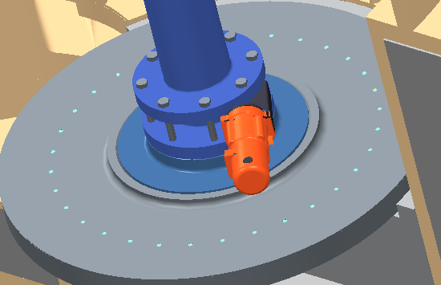
Removal and Shipping of Spent Rotating Target
Disk and Axle (4 m long) parted, in-situ during removal to reduce handling complexity and container size
Disk will require cool-down storage-in handling cask (>1 year) then loaded directly into a commercial cask (CNS-8-120B)
Axle can be loaded directly into a custom Type A container similar to or same as that used for the monolith inserts
There are no plans for post irradiation disassembly of the target
Bolts
Retained
Cutting Slot
in Axle
Rebar
Cutter
In-situ separation of disk and axle
Analysis by I Remec

Slide 18
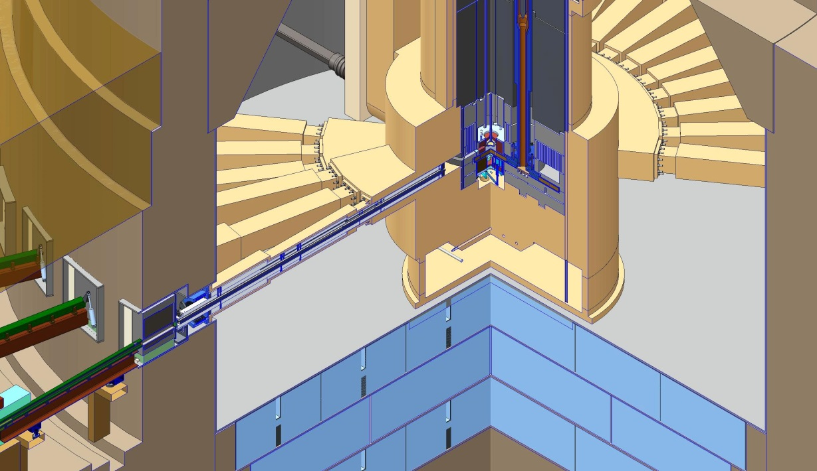
Shutter and Monolith Inserts
Monolith
Insert
Core
Vessel
Nozzles
(22 ea)
Shutters located at outside of monolith
the desire to place shutters as a logical beam line break
ease of installation and maintenance
Monolith inserts could be 4.5 meters long
Monolith designed for 22 inserts with an average gap of 11º.
Shutter
Quarter Section of Vessel along Beam Line

Slide 19
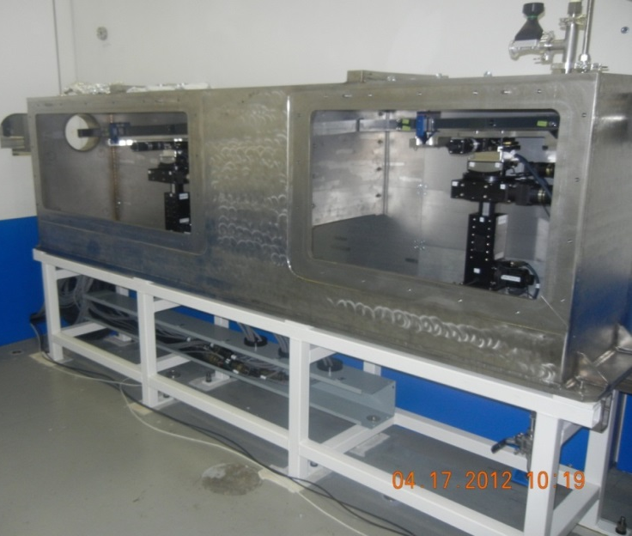
Elliptical Neutron Beam Steering
STS will include several neutron beam lines with active alignment or elliptical focusing mirror systems
Active alignment systems will be located near the monolith
Personnel will need to access the systems during short maintenance outages
IMAGINE Focusing Assembly

Slide 20
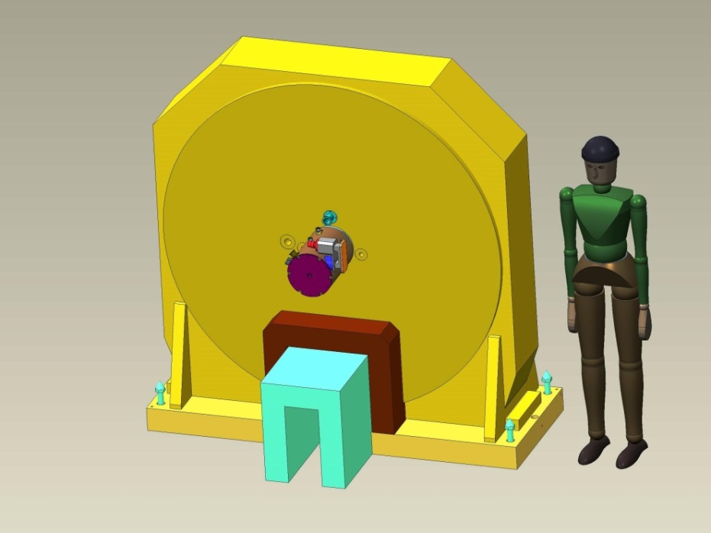
Large Choppers
Due to the 10 Hz operating rate of the STS it is possible that choppers (e.g., T_{o}) could be up to 1.7 meters diameter- most will be smaller
Large choppers may be located near monolith
Large choppers may weigh up to 8000 Kgs and require an installed area 2 meters wide
Alternatives to the large chopper are being considered.

Slide 21
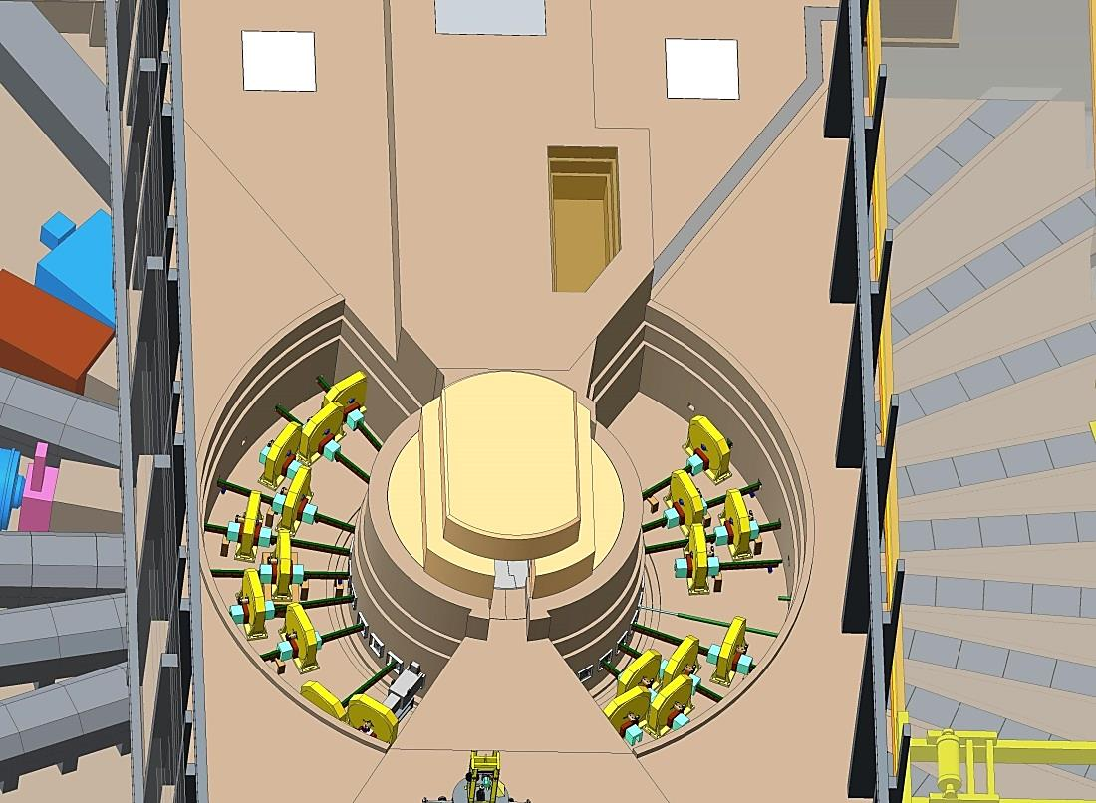
Bunkers Required to Accommodate Choppers and Active Alignment Systems
Bunker based on 2 meters of HD concrete shielding (estimated)
Bunker top blocks removable for crane handling of large components (e.g. choppers and shutters)
Outer inside diameter of bunker determined by space (~5.5 m) required to remove activated inserts
Currently Outer exterior radius is 13.5 m
Monolith Bunkers
[Upper Shield Blocks Not Shown]

Slide 22
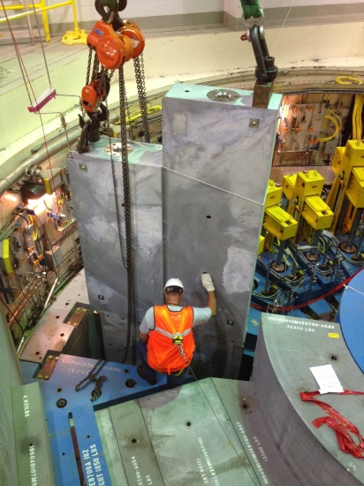
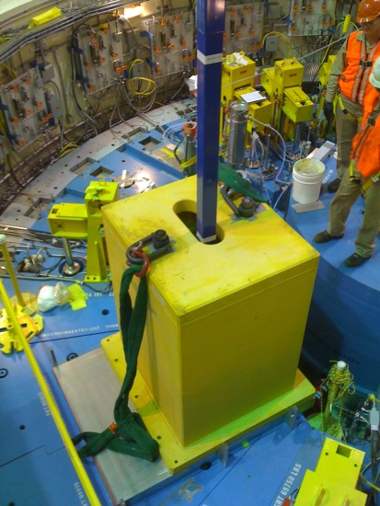
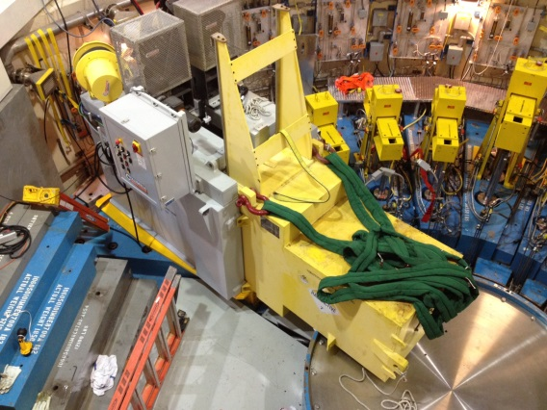
STS Remote Handling Operational Requirements
SNS has extensive experience with change-out of activated components similar to those in the STS:
Proton Beam Window
Shutters
Neutron Beam Inserts
Miscellaneous Drive and Process Piping Components
The rotating target and reflector plug are being designed to be handled using the same methods

Slide 23
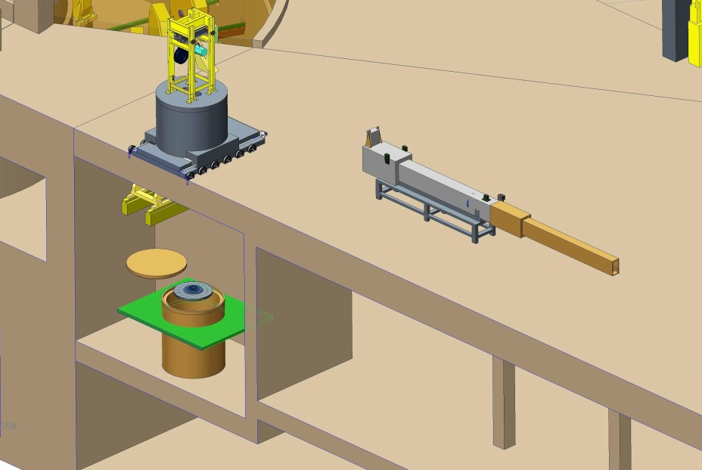
Waste Transfer Bay Can Replace Service Cell
STS Does Not Have Activities Requiring A Service Cell
All components handled with shielded containers positioned outside the monolith boundary
In-situ disassembly of activated components proven in FTS
There is not a horizontal target cart
Water cooling process system located in vaults
It may be possible to use the FTS cell for an unforeseen emergencies
Waste transfers require a relatively small shielded bay
Elimination of cell is a large cost, space and operating savings
‘Bell Jar’ Handling Cask
Shielded Transfer
Bay w/Lid Hoist
Insert Transfer
Assembly

Slide 24
Target Building Layout
Water Utilities
Instrument
Operator Area
Target Building is designed to be primarily occupied by operations support and maintenance personnel
The exception is the first floor which can be used to house instrument operations, sample environment etc.
High rad areas concentrated near proton beam to optimize use of shielding
First Floor Section

Slide 25
Looking Forward
Engineering is currently focused on developing the CD-1 design and documentation
Preliminary Hazard Analysis Report
Preliminary Safety Analysis Report
Conceptual Design Report
Neutronics analysis support
Instrument design support
Conventional facilities design support
Target fabrication
Utilities distribution
Remote handling procedures and tooling
Cost estimate and Schedule

