Slide 1
Update on Target Post Irradiation Examination
Bernie Riemer
David McClintock

Slide 2
Outline
Recent Target Power Histories
Modification of Administrative Dose Limits at the SNS
  Change in target dose calculation methodology
  Increase in administrative dose limit for target modules
  Increase in administrative dose limit for Inconel proton beam windows (PBW)
Current Post Irradiation Examination (PIE) Characterization of SNS Targets
  Target 10: sampling, cleaning and characterization
  Target 12: pressure decay, leak location, photography
Current BWXT target PIE Contract
  Target 6 inner window fracture characterization
  Targets 8 and 9 tensile property characterization and helium gas measurements
  Target 9 outer wall erosion characterization
PBW Sampling Effort and Characterization of Samples

Slide 3
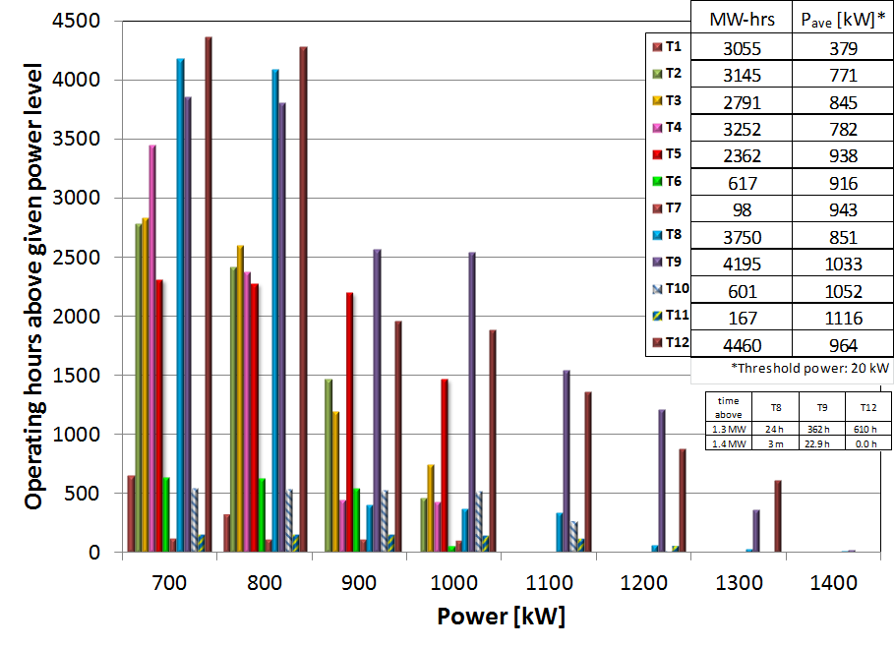
SNS Target Power Histories

Slide 4
The target dose calculation methodology was changed to better reflect neutron contribution to dpa
Target radiation damage is estimated online using beam profile data from the RTBT Wizard
The maximum displacements per atom (dpa) dose calculation methodology was based on empirical data
  This method over predicted the neutron contribution to dpa with more peaked beam profiles and under predicted with less peaked beams
New dpa dose calculation methodology is modeling based (MCNPX)
  New method better accounts for the neutron contribution when the peaking ratio deviates from the baseline beam profile (P/P_{o} = 1)
dpa (dose)
Total _{dpa}
Proton _{dpa}
Neutron _{dpa} (previous)
Neutron _{dpa} (new)
1
P/P_{o} (Peaking Ratio)

Slide 5
The dose limit for target modules was increased after reviewing results from PIE tensile tests
The administrative dose limit for the target was originally set at 5 dpa and was increased to 10 dpa after consultation with subject matter experts
Tensile testing results from SNS targets revealed appreciable ductility was retained after ~7 dpa, which provided confidence to change dose limit
Two changes were made to the target administrative dose limit:
  The administrative dose limit was increased to 12 dpa
  The region of consideration for the dose limit was changed from the mercury vessel inner wall to the shroud inner wall
    The shroud is the containment boundary when the mercury vessel leaks
These two changes increased the effective target radiation damage lifetime by approximately 50%
106010000-TR0130-R00
106010000-TR0131-R00

Slide 6
The dose limit for the Proton Beam Window was also increased
The administrative dose limit for the Inconel® 718 PBW at the SNS was initially 10 dpa
  Dose limit was implemented due to uncertainty in the radiation-induced changes in mechanical properties of solution annealed (SA) Inconel® 718
A review of contemporary operational history of Inconel® 718 in high-radiation environments was conducted
  Inconel® 718 PBW at the ISIS First Target Station (FTS) reached 30-90 dpa without failure
After review of accident scenarios and load cases for the SNS PBW the administrative dose limit for Inconel 718 PBWs was increased from 10 to 15 dpa
Samples have been removed from PBW #4 and tensile properties will be characterized in future PIE work to reevaluate the limit

Slide 7
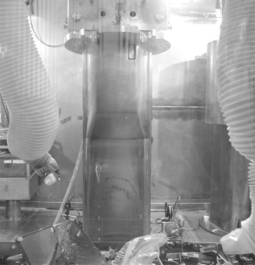
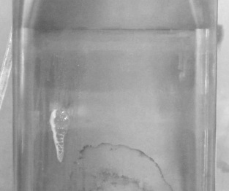
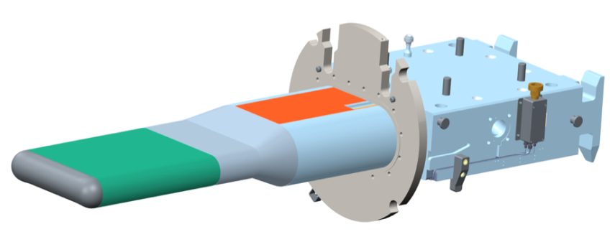
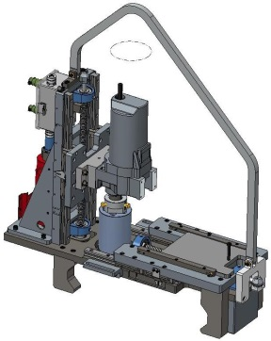
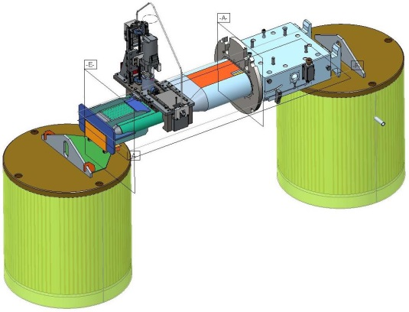
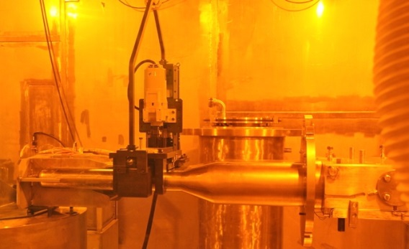
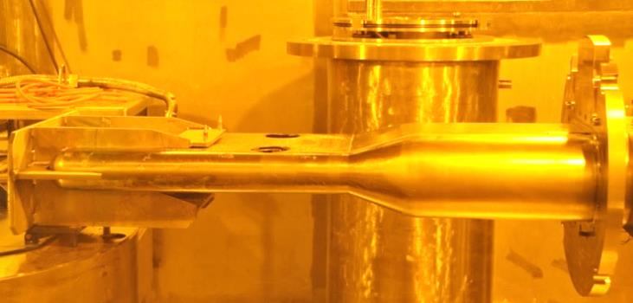
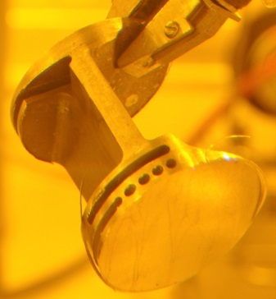
The leak location in SNS Target 10 was sampled
Target 10 (jet-flow) leaked during operation at/near an electron beam weld:
Approximate Leak Location
Bolt-on shroud enabled visual access to outside of mercury vessel!!
Bubbles Discharging from Leak Location
A device was designed and built to sample the leak location using a 4” diameter annular cutter
Drill Motor
Annular Cutter
Target-Gripping Clamps
“Core” Sample Containing Leak Location
The leak location was sampled last November

Slide 8
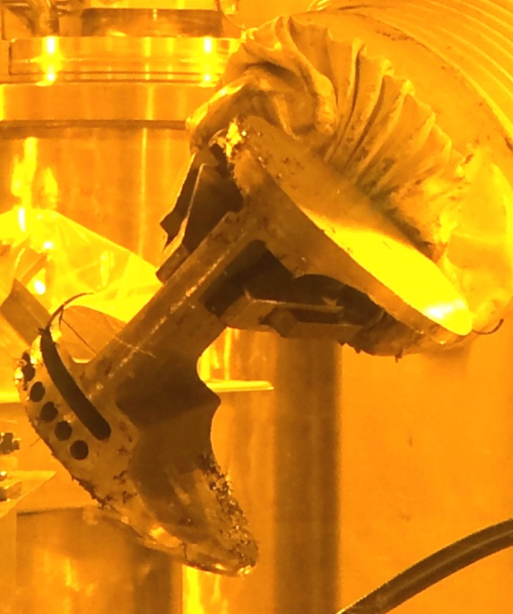
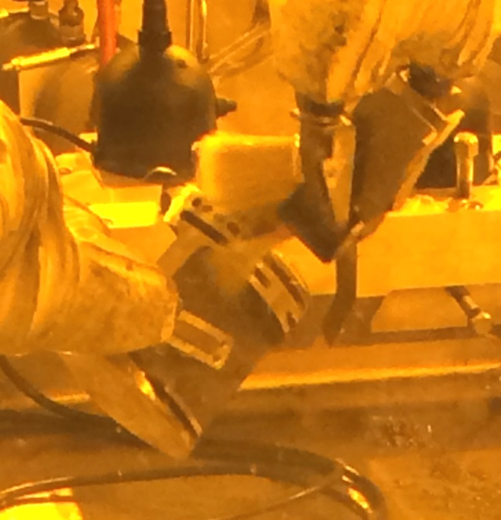
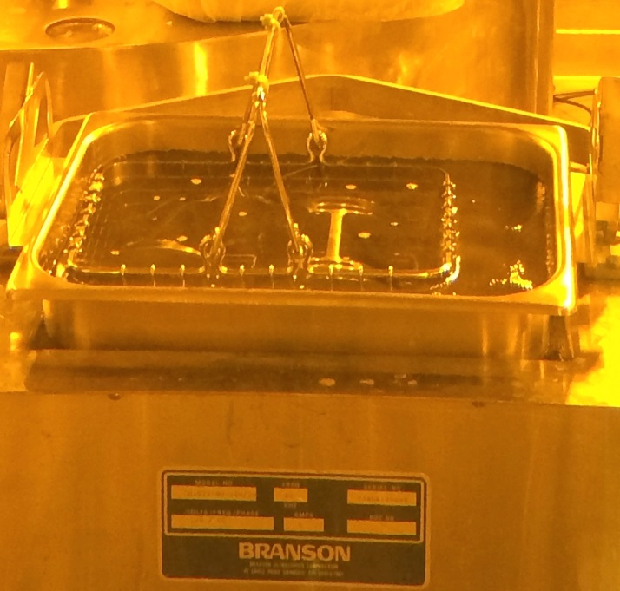
Target 10 “core” samples were recently cleaned using an ultrasonic cleaning procedure
A sequence of cleaning solutions and rinse are used
  Removes the majority of cutting swarf, mercury and spallation products
  Done remotely
Subcontract proposals for detailed examination and analysis are under currently evaluation
  Aim is to characterize mechanisms that led to leak and assess weld integrity
  Award is expected by end of February

Slide 9
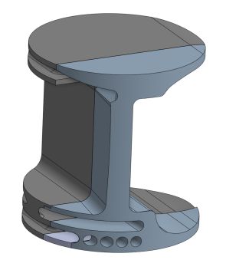
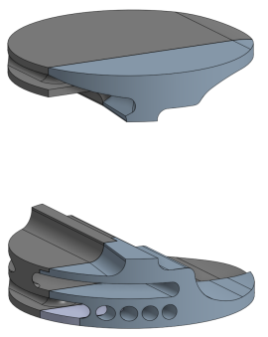
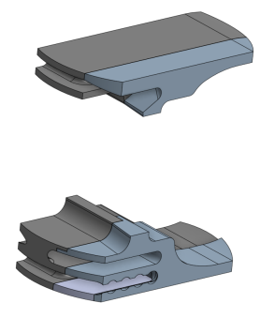
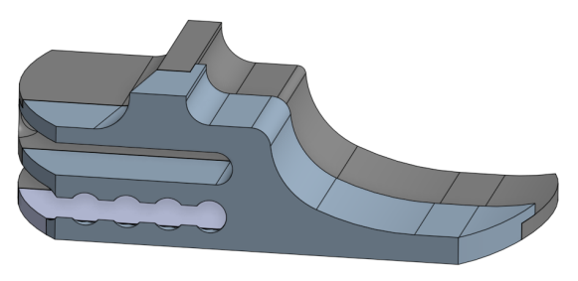
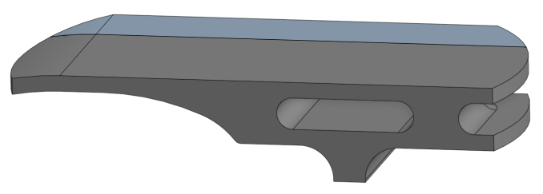
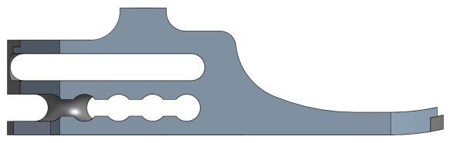
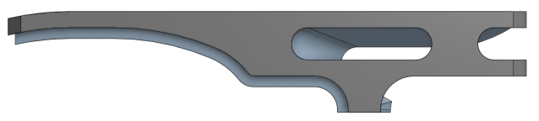
The Leak Location Sample will be Characterized to Understand the Target 10 Failure Mechanism
Target 10 “core” samples will be evaluated using nondestructive evaluation (NDE) prior to sectioning
After NDE characterization the samples will be sectioned to produce metallography and fractography specimens
Following sectioning, metallography of the electron beam weld and subsequent fractography of the fracture surfaces will being examined via scanning electron microscopy
Estimated Leak Location
LLTS
(Leak Location Transition Section)
Target Transition Section
Estimated Leak Location
Target Front Body
Target Front Body
LLB-1
LLB-2
LLB-3
LLB-4
Target Transition Section
LLFB
(Leak Location Front Body)
LLT-1
LLT-2
LLT-3
LLT-4

Slide 10
Pressure-decay testing of Target 12 suggested that the leak is located at the front of the target
Pressure-decay testing was performed on all SNS targets that have indications of a leak
  To perform the test: the target interstitial region is pressurized, the interstitial volume is isolated, and the drop (decay) in pressure is monitored
Initially, Target 12 was tested while hanging vertically and no pressure decay was observed
When tested in the horizontal position the pressure rapidly decayed after isolation (black curve on plot)
It is suspected that laying the target horizontally caused the residual mercury and debris to uncover/expose the leak location at the front of the target
T-12 leak hole diameter estimate is ~ 85 µm

Slide 11
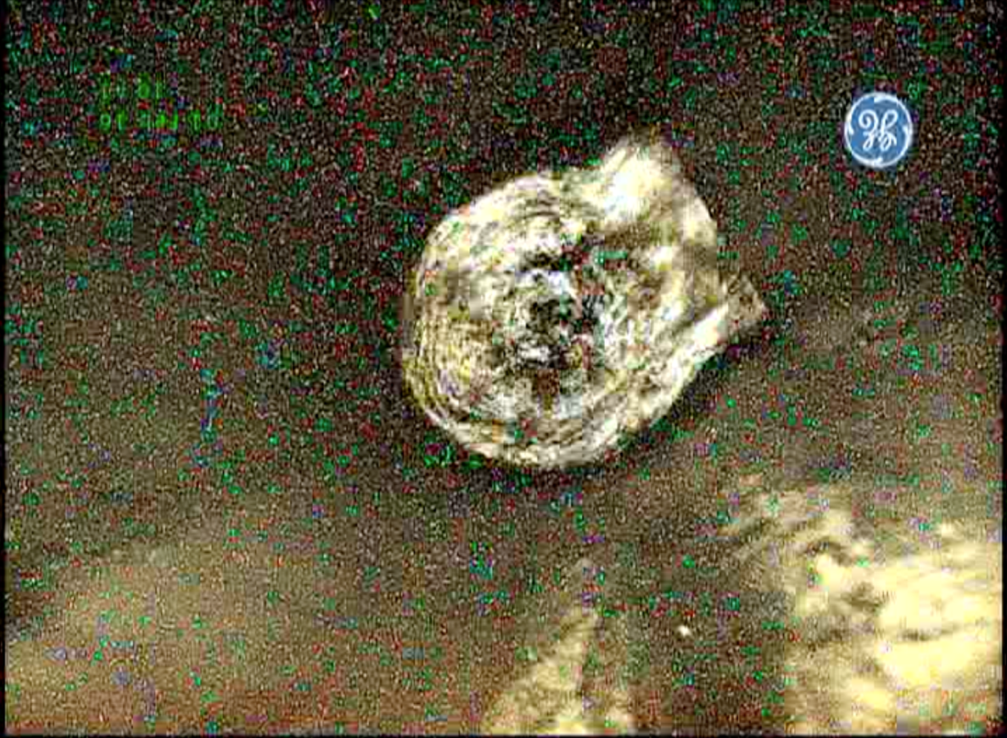
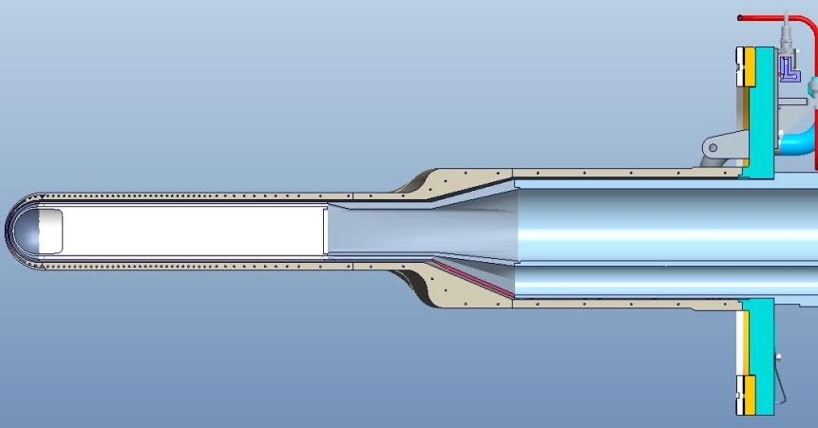
The Target 12 leak location was found during videoprobe inspection
The interstitial region was pressurized while the target was hanging vertically
  Residual mercury obscured viewing of the vessel surface
A videoprobe was inserted into the bulk supply passage and bubbling gas was observed percolating through the mercury
Top of Target
Left Side Flow Baffle
Bubble Emanating from Center of Supply Passage at Target Inner Wall
Bottom of Target

Slide 12
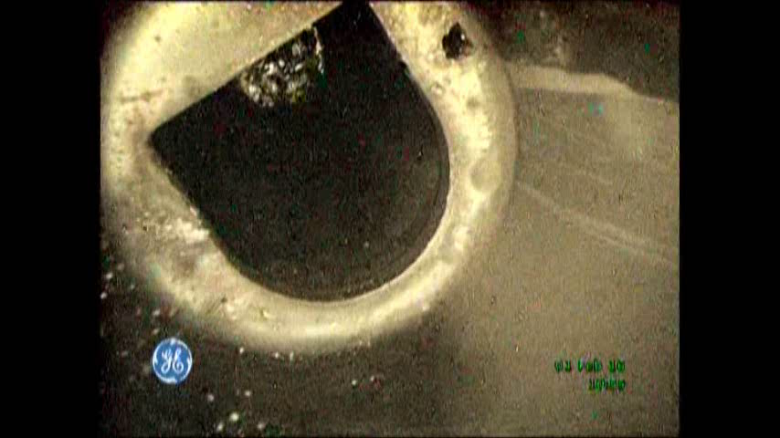
Video of finding Target 12 leak
View from left bulk inlet
“D” orifice in transition section
Small hole for draining on bottom

Slide 13
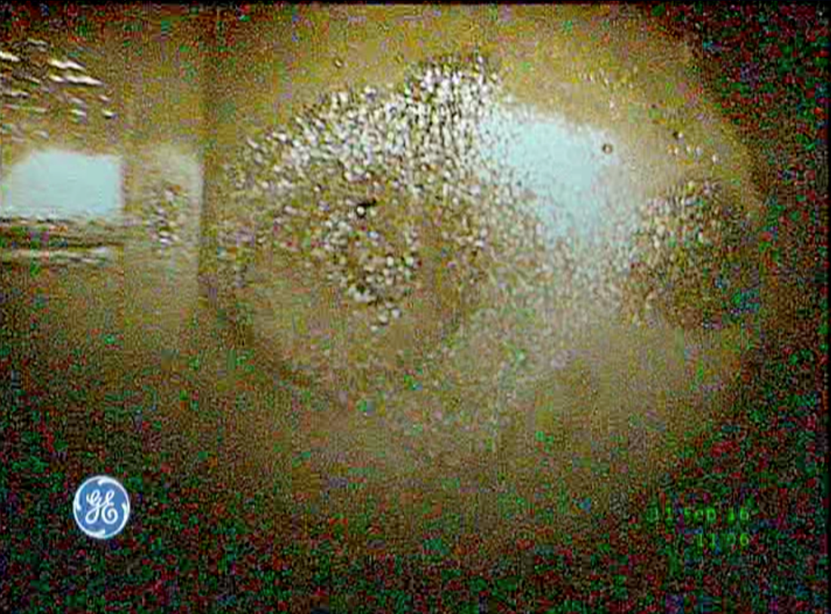
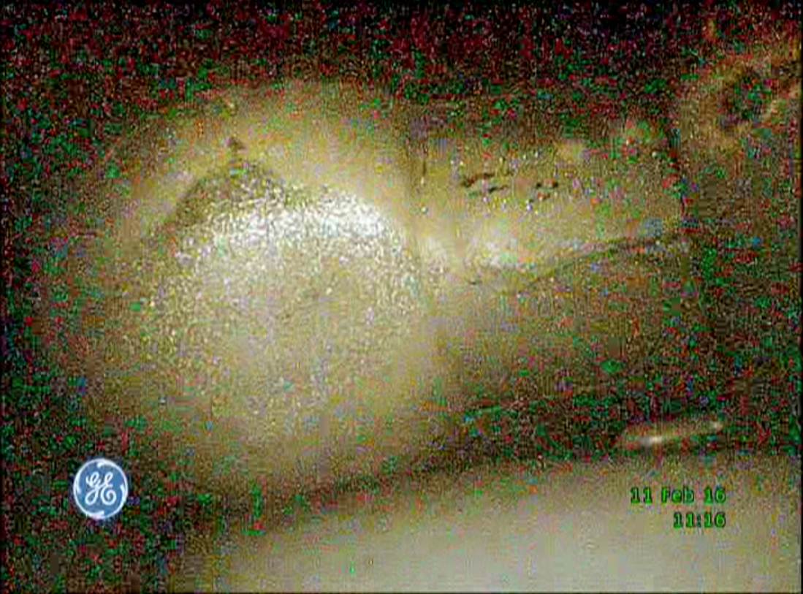
T-12 video probe inspection reveals leak location in left side of outer window
Left edge of inner window
Fractured & eroded
Right edge of inner window
Fractured & eroded
Probable leak location
View from left side bulk inlet to outer window
View from right side bulk inlet to outer window
Note: Images are upside down

Slide 14
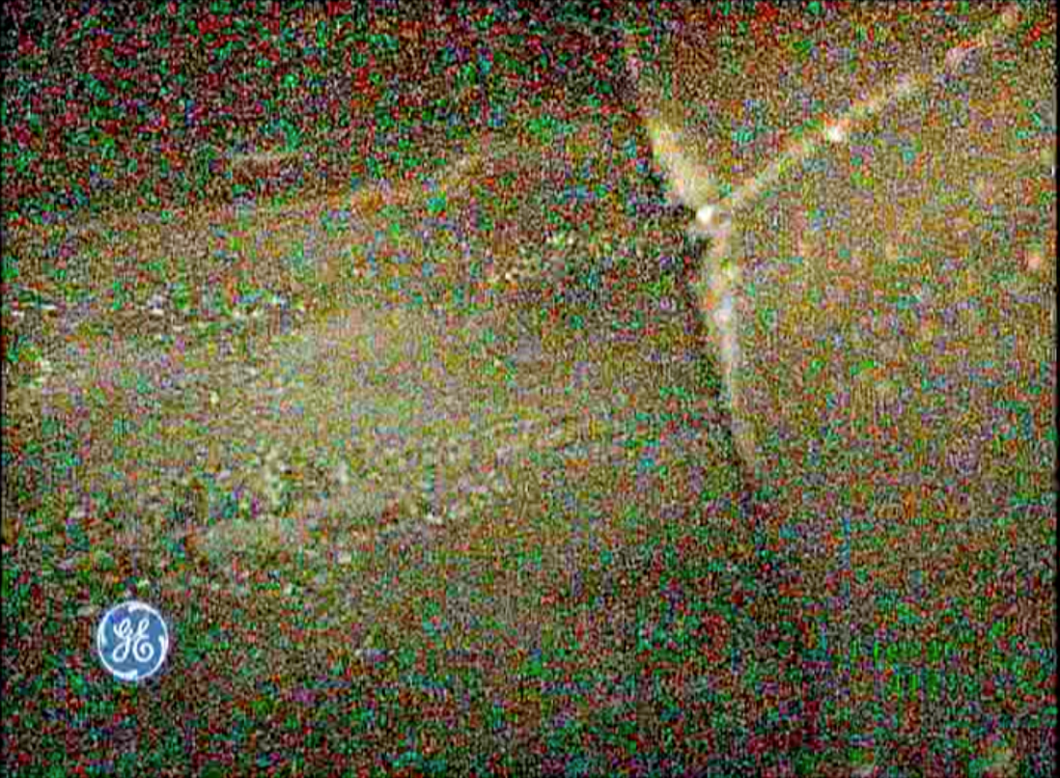
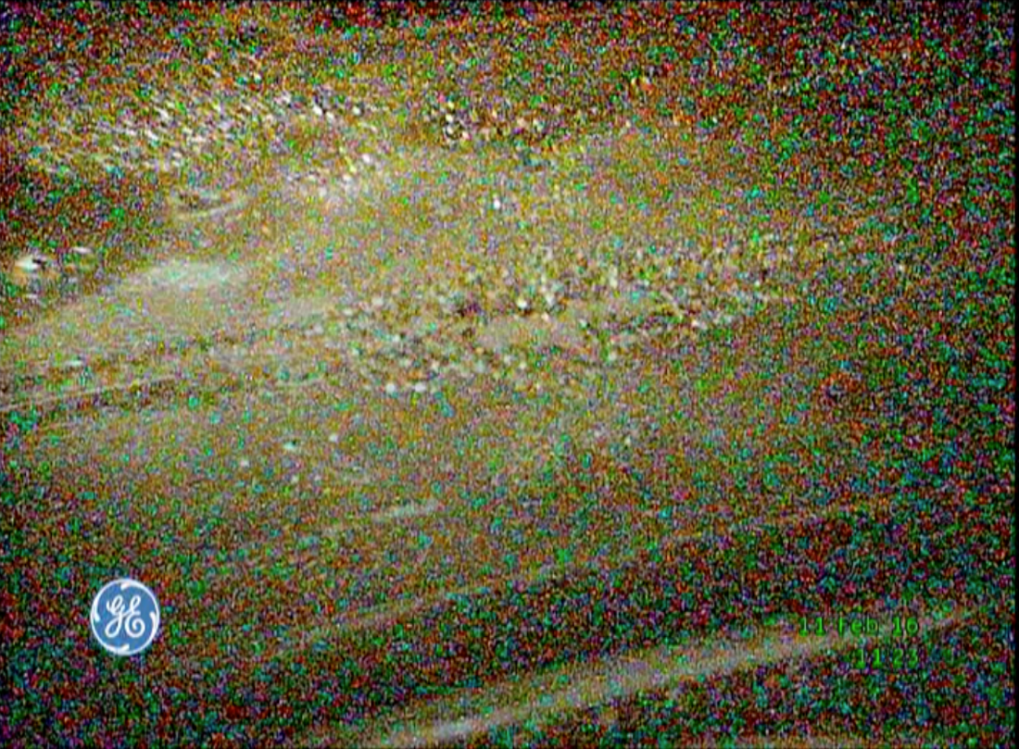
Views from bulk return of center baffle and inner window – both fractured and eroded
Front edge of center baffle
Inner window
Outer window can be seen through eroded hole
Note: Images are upside down

Slide 15
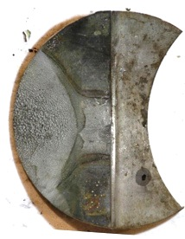
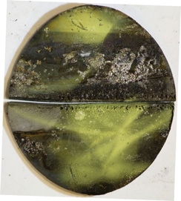
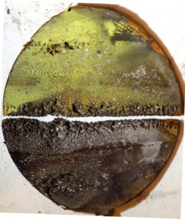
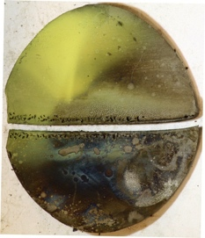
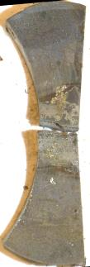

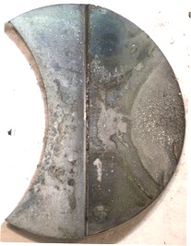
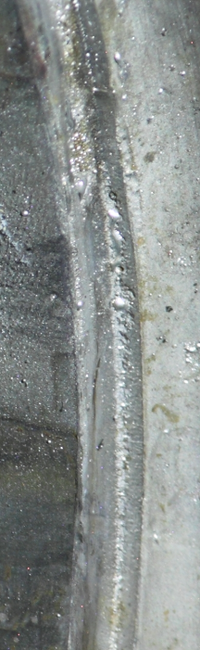
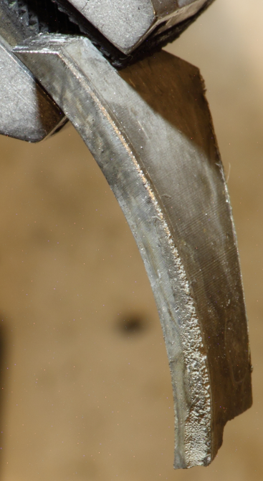
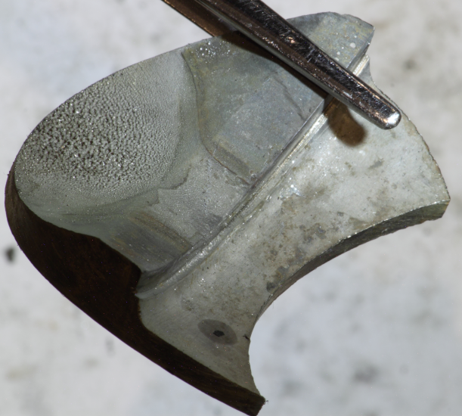
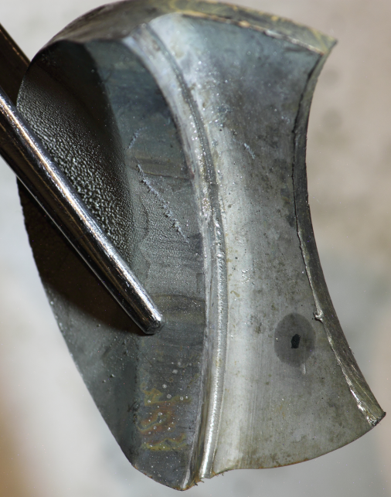
Target 12 leak location is not yet precisely known, but Target 3 photography showed damage in this area
“Suspect Areas”
“Suspect Areas”
Target 3 – Inner Window
T3
2791 MW·h
845 kW
Erosion at End of Supply Passage
Erosion in Corner of Press Fit Between Inner/Outer Hg Vessel

Slide 16
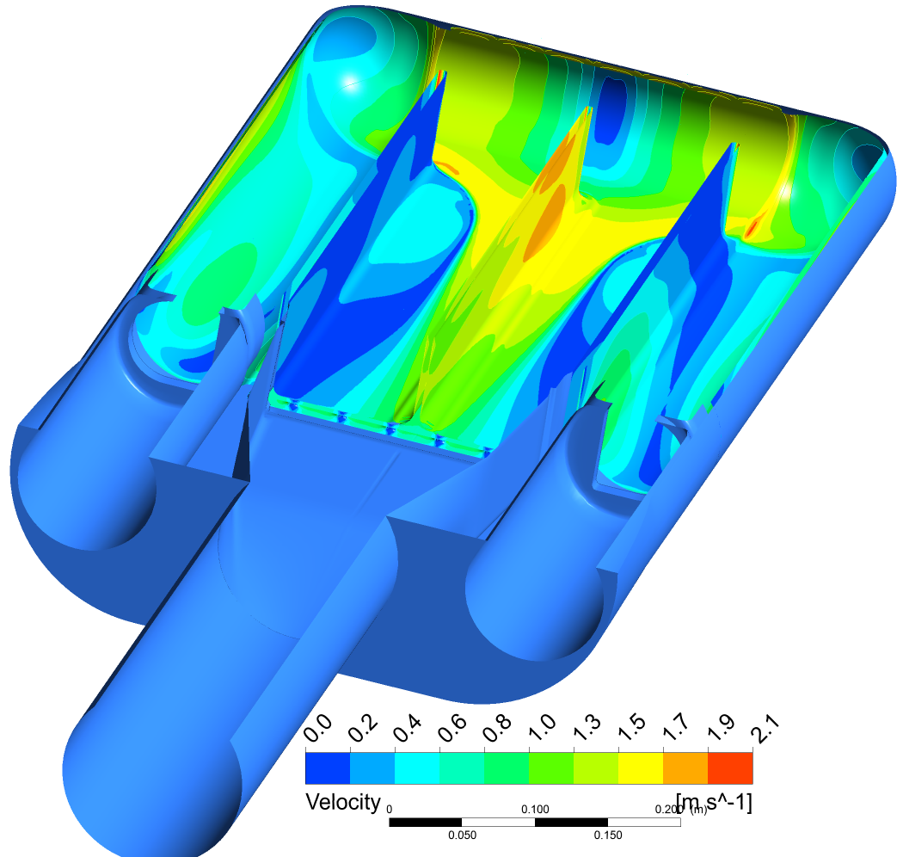
The T-12 leak is at vessel region of moderately high saturation time – a metric of cavitation damage potential
It is also a region of relatively low mercury velocity at the wall, a damage mitigating mechanism
µs
Saturation time around front portion of bulk mercury volume
Mercury shear flow velocity on inside target surface

Slide 17

Next steps for T-12 PIE
Drain residual mercury by rotating horizontal
Inspect beam entrance region with video probe
Turn vertical, use probe with “snoop” to precisely find leak
T3 sample
Cut samples from target nose using existing cutting machine
  Shift cut location as needed
Conduct through-wall photography of target carcass
Prepare T-12 for waste shipment in mid March
Clean samples & perform direct photography
Detailed PIE analysis plan to be determined

Slide 18
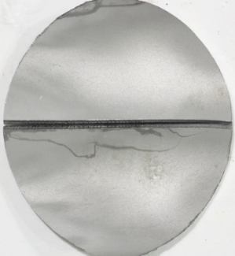
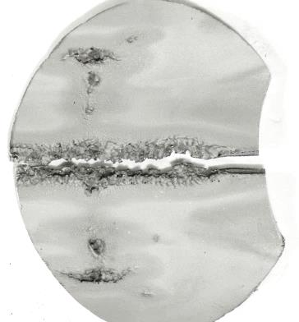
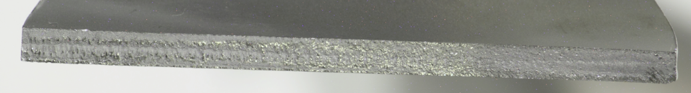
A PIE characterization contract is currently underway with BWXT (Lynchburg, VA)
By examination and comparison to T7, the inner wall of T6 appeared to have fractured not long before leak occurred
The fracture surface is relatively fresh and should reveal information on fracture mechanism
  Fatigue, liquid metal embrittlement, etc.
T6
617 MW·h
916 kW
Target 6 – Inner Wall
High-dose tensile and helium gas measurement specimens will be machined and tested from Target 8 and 9 disk specimens
Target 8 – Disk 6
Target 8 – Disk 7
Target 9 – Disk 6
Target 9 – Disk 7

Slide 19
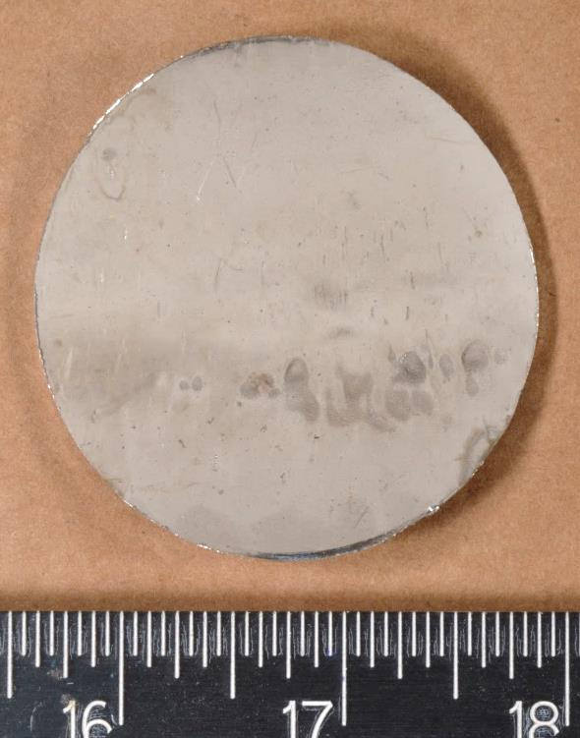
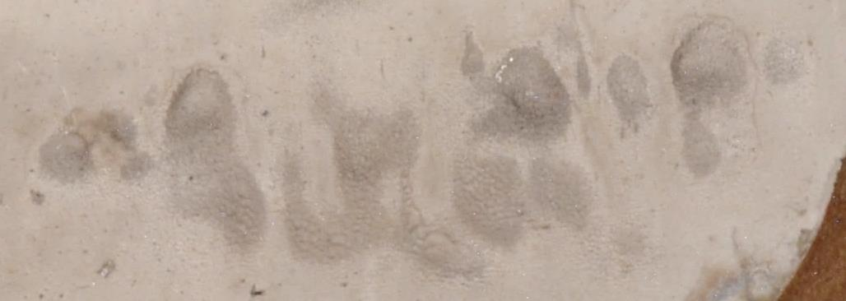
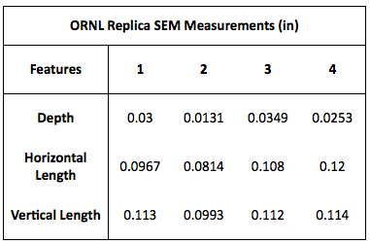
The erosion depth on the mercury window flow facing side of the Target 9 outer window has been measured
The depth of erosion to the window flow-facing surface of the Target 9 Hg vessel outer wall (leak boundary) was measured using a surface replica and SEM examination
Target 9 – Disk 6
Image of Erosion on Target 9/Disk 6
1
4
3
2
SEM Image of Target 9/Disk 6 Surface Replica
The nominal wall thickness on this target was 0.120”
Thickness in latest target design is 0.090”
  Reduces thermal stress
T9
4195 MW·h
1033 kW

Slide 20
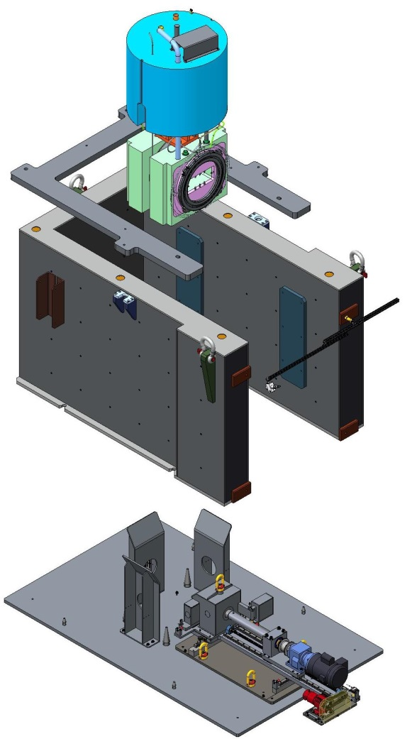
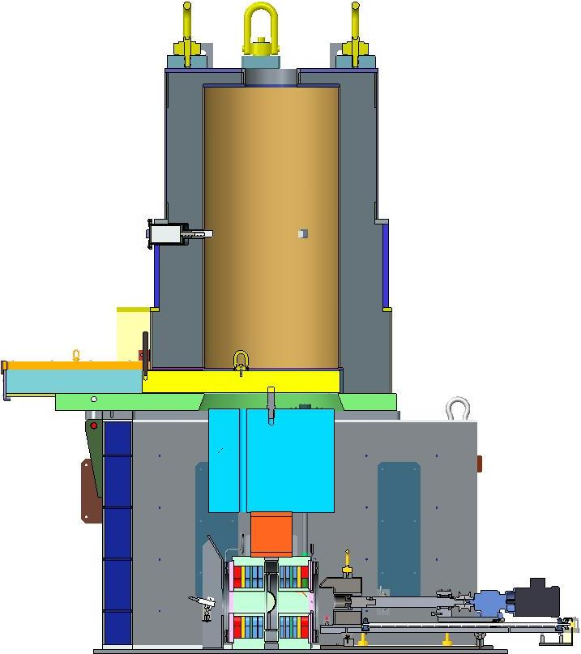
Samples were removed from SNS Inconel® 718 proton beam window #4 using a new annular cutter machine
Operation was conducted in target cart transfer room – underneath the service bay
PBW Sampler Configuration (exploded view)
PBW Sampler Configuration (cross section)
Proton Beam Window Assembly
PBW Sampling Device
Proton Beam Window Assembly
Sampling Device Cutter

Slide 21
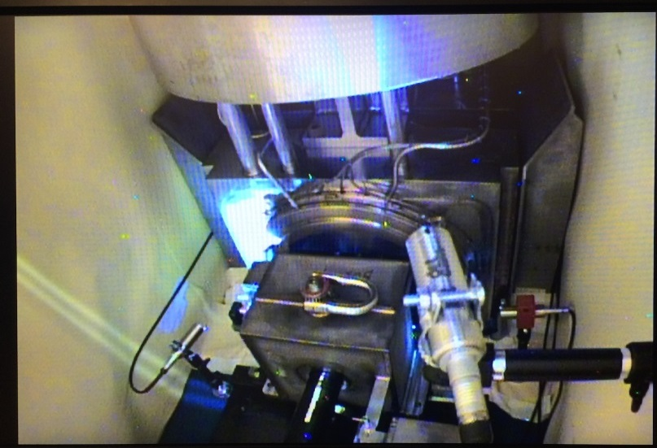
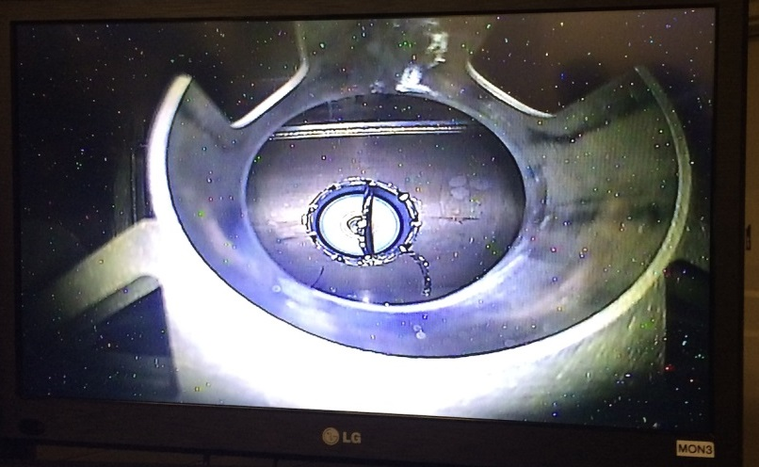
Plan is to have PBW samples characterized using tensile testing and electron microscopy
Specimens will be machined and tested from the four PBW #4 disk shaped specimens, similar to target characterizations:
  Tensile specimens to characterize irradiated tensile properties
  Specimens to measure helium content and data to benchmark neutronics codes
On hold -
PBW PIE contract not funded

Slide 22
Summary
Target 12 set the record for total beam energy received and hours operating above 1.3 MW
The target dose calculation methodology was changed to better account for neutron contribution
Administrative dose limits for the target module and PBW were increased
Target 10 leak location was sampled and the failure mechanism will be characterized by outside vendor
Target 12 leak location was found and characterization of the leak location and preparations for sampling are ongoing
The erosion depth to the outer Hg vessel wall was measured for Disk 6 from Target 9 – nearly 30% wall thickness lost
Four disk-shaped specimens were sampled from the Inconel 718 PBW #4 and are available for future testing

