Slide 1
Implementing Target Gas Injection:
Short and Long Term
Bernie Riemer
Charlotte Barbier
Joe Devore
Mike Dayton
Elvis Dominguez-Ontiveros
Dave Felde
Dave Freeman
Lorelei Jacobs
Steve Parson
Bob Sangrey
Greg Stephens
Mark Wendel
Drew Winder
Notes:
Contributors:
Charlotte Barbier, Joe Devore, Mike Dayton, Elvis Dominguez-Ontiveros, Dave Felde, Dave Freeman, Lorelei Jacobs, Steve Parson, Greg Stephens, Mark Wendel, Drew Winder

Slide 2
Short-pulse beam initiates pressure waves in the mercury target that lead to:
Giga-cycles of fatigue stress in the mercury vessel over desired target lifetime
Pitting & erosion damage to the vessel caused by mercury cavitation
Both phenomena have led to target leaks and interruption of neutron production
Pulse stresses and erosion rate increase with higher power

Slide 3
Example beam entrance wall damage from three targets
Inner wall pitting damage and pulse stress lead to wall fracture and disturbance of window channel flow
Inner wall bulk
Hg facing surface
Eroded depth: 0.9 mm
Wall thickness: 3 mm
Outer wall
containment boundary
Erosion and fracture of center baffle also occurs

Slide 4
Target gas injection is essential part of efforts for long target life at high power
Reducing pulse stress by small gas bubble injection can add fatigue life margin over substantial portion of the mercury vessel
Fatigue design curve for series 3XX stainless steels
Modest stress reduction in this regime can make difference
Small gas bubbles (SGB) can also reduce cavitation damage rate

Slide 5
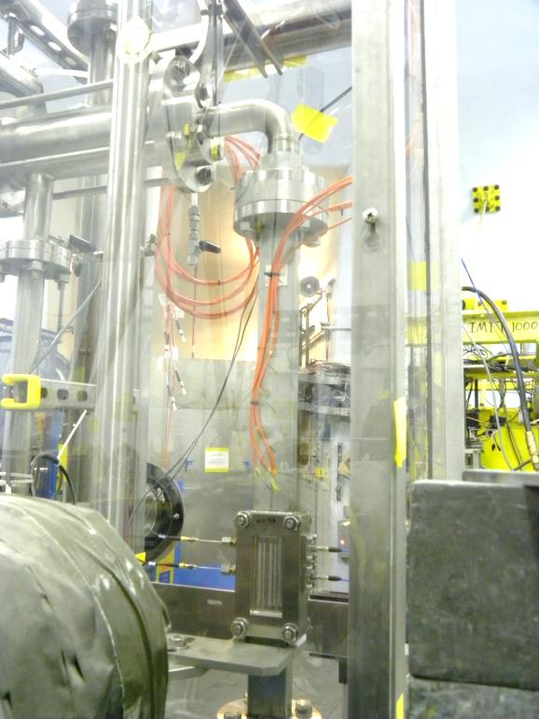
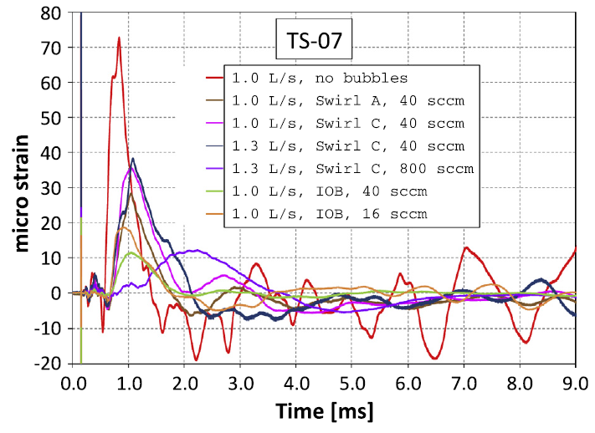
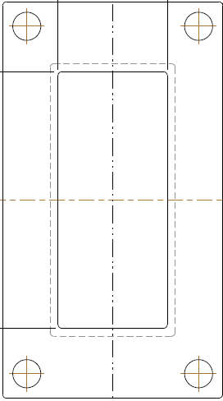
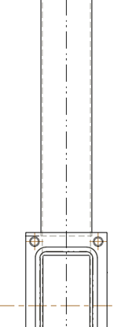
Evidence for fatigue reduction by SGB: SNS target development experiments
SNS experiments at the LANSCE – WNR showed significant stress reduction at locations some distance from incident beam spot
Gas bubbles reduced strain magnitude and cycles
50 mm
50 mm
92 mm
50 mm
TS-07
8 mm
81 mm
100 mm
  B.W. Riemer et al. / Journal of Nuclear Materials 450 (2014) 192–203
  Beam spot on target
  1 and 2 σ outlines
  Bubbler test loop at WNR
Stress reduction in the beam spot was not clear
Notes:
Note: injected gas fraction for 40 sccm helium / 1 L/s mercury is 6.7E-4

Slide 6
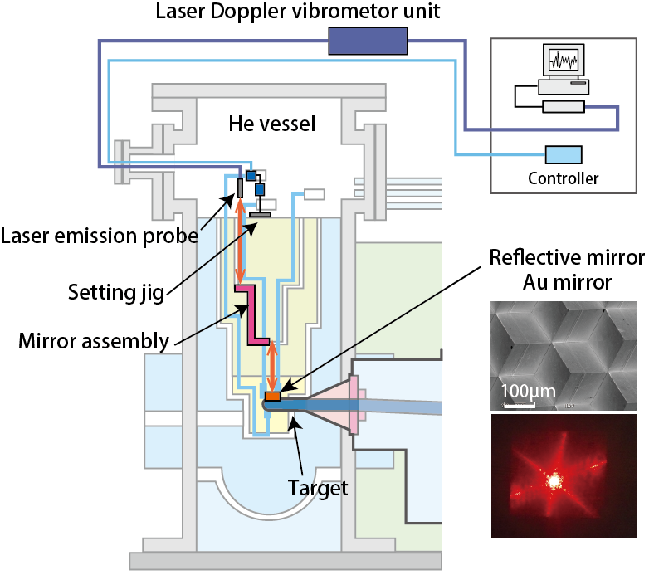
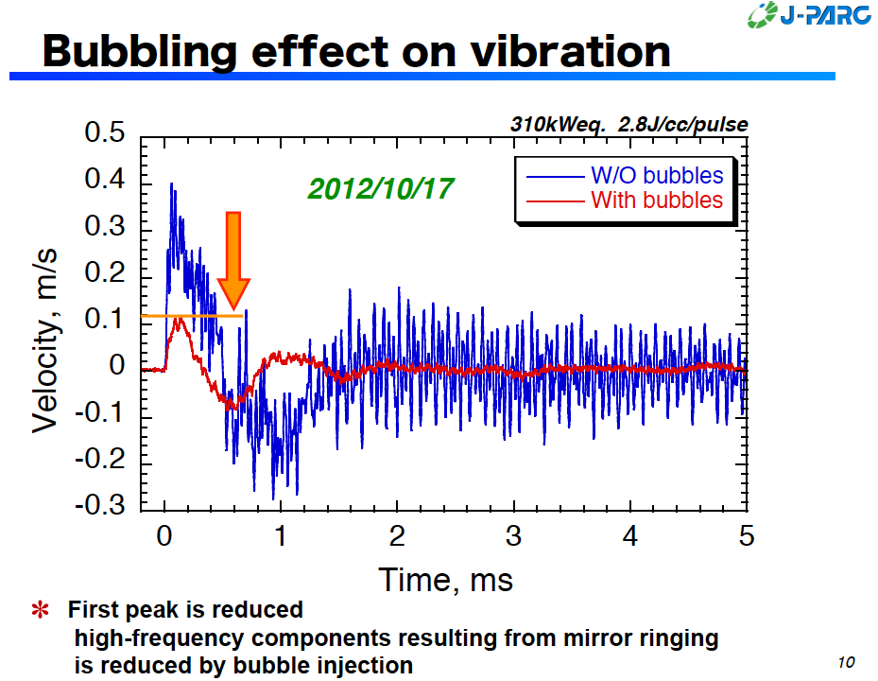
Evidence for fatigue reduction by SGB:
JPARC MLF mercury targets
JPARC mercury targets with gas injection have demonstrated significant vibration reduction at the one monitored spot
H. Takada, 2015 SNS-JSNS Collaboration meeting.
T. Naoe, 2012 SNS-JSNS Collaboration meeting.
Mirror is 15 cm from tip of target

Slide 7
Expectations for pitting damage reduction with SGB injection alone are less clear
SNS target experiment at the WNR in 2011
  Bubble injection reduced cavitation damage to about one-third that of stagnant mercury as measured by damaged area fraction
  Other result metrics such as maximum pit depth and cavitation damage potential showed less improvement
  Results were characterized by large scatter due to low number of test beam pulses
  Mercury flow at the wall was confirmed to have some benefit – jet-flow should help
JPARC mercury target PIE for pitting damage assessment has been limited
  Latest observations indicated SGB did not stop damage

Slide 8
Uncertainty in pitting damage mitigation with SGB means protective gas walls – and jet-flow – may also be needed
No damage observed with earlier WNR gas wall target tests
  Again, low number of test pulses
  B.W. Riemer, “Results from cavitation damage experiments with Mercury spallation targets at the LANSCE – WNR in 2008”, Proc. ICANS XIX, Grindelwald, Switzerland, 2010
First jet-flow target inner wall damage compared well to similarly used conventional target

Slide 9
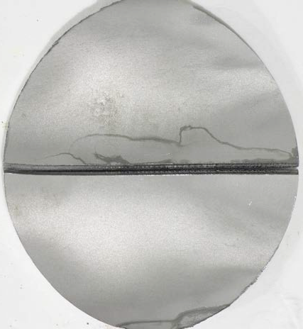
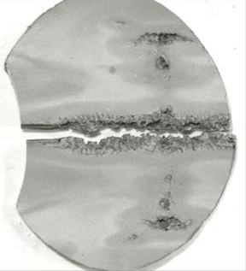
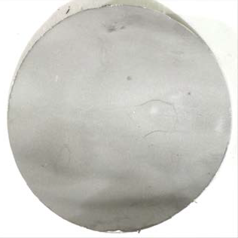
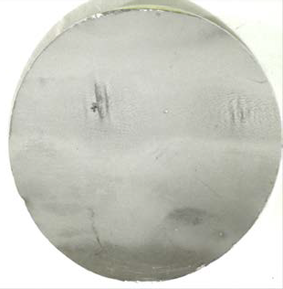
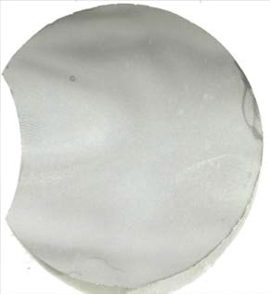
Jet-flow principle confirmed with Target 10
Fortunate comparison with Target 6 that had a similar operating life
Inner wall of T-10 had less erosion and was not fractured
T-6
617 MW·h
916 kW
T-10
jet-flow
601 MW·h
1052 kW
Notes:
Backup slide ?

Slide 10
Challenges for gas injection in SNS target
Efficient small bubble generation and distribution throughout target
Adverse effects of gas in process loop operation
  Increased loop pressure drop – more pump load
  Loss of heat exchanger efficiency
  Flow instruments may not read correctly, in particular bulk return venturi
    Credited mercury pump dP instruments should be OK
Postulated accidents must be mitigated
  Overflow of pump tank from displaced mercury caused by excessive gas hold-up
  Liquid mercury to Mercury Off-gas Treatment System (MOTS) must be prevented

Slide 11
The SNS mercury process loop was not designed for gas injection
All gas will not be removed at target vent
  As configured, most injected gas will pass through return pipe and heat exchanger before discharging into the pump tank
Gas buoyancy acts against mercury flow in return pipe
  Down turning pipe elbows, low down-slope pipes, flow venturi and heat exchanger bulkheads
Small bubbles will coalesce and can grow to large pockets that may become trapped at locations

Slide 12
Tests done on the Target Test Facility (TTF) confirmed significant gas hold-up is possible
Substantial gas hold-up can occur depending on the injected gas rate and mercury flow rate
  Unfortunately, gas rates believed ultimately needed are likely problematic
    Observed ca. 13 gallons (50 L) of mercury were displaced with 8 SLPM rate, raising Hg level to TTF tank overflow nozzle
      SNS pump tank does not have an overflow
  Test with low flow rate of 0.5 SLPM reached steady state below the overflow, only displacing ca. 2 gallons
  As a result, near term goal is for a cautious, low gas rate
Two-phase simulations of gas in process piping are not robust enough to predict SNS hold-up behavior

Slide 13
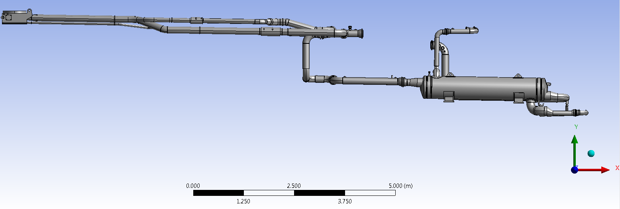
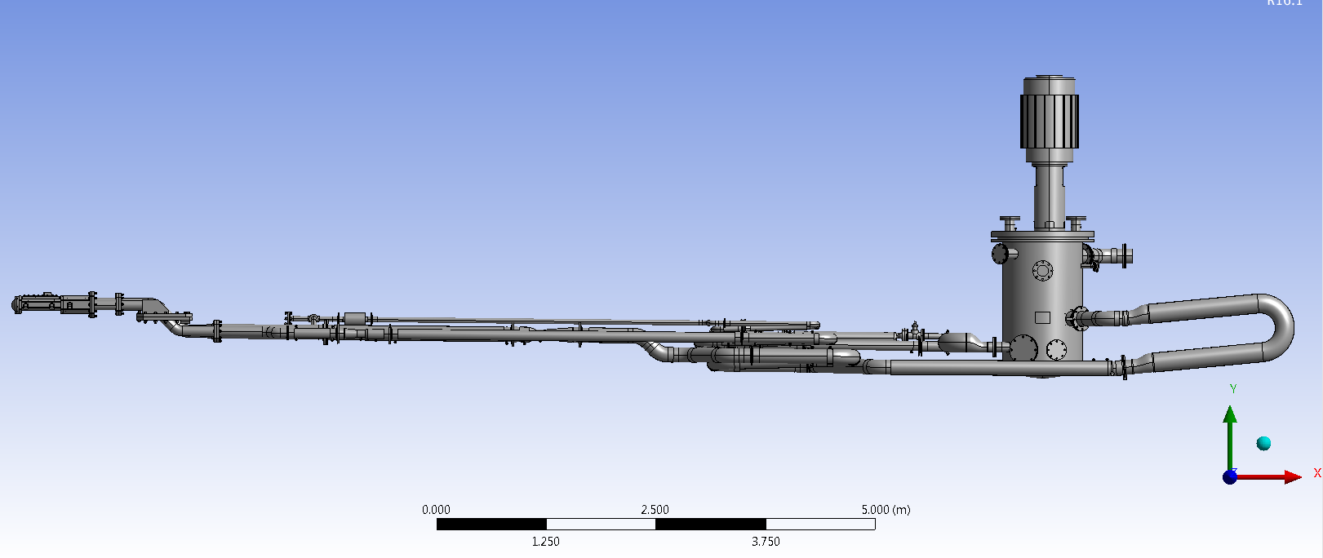
Differences between SNS and TTF mercury loops are such that SNS could be worse for gas hold-up
pump
SNS
(w/o pump and target)
Sheet & tube
heat exchanger
TTF
Spare HX has outlet on high side
C. Barbier, 106010101-TR0019
Notes:
Elevation view
Heat exchanger and large down elevation drop in SNS loop make gas hold-up worse

Slide 14
Short and long term gas injection goals
Near term plan is based upon orifice bubblers with a low gas flow rate and probably once-through gas supply
Intermediate term: swirl bubblers and recirculating gas
Protective gas wall later
Envisioned near- and long-term gas injection parameters
 | Initial attempt SGB | Long term SGB | Long term gas wall
Bubbler type | Orifice | Swirl | Nozzle
Supply pressure [ATM] | 6.8 | < 1 | tbd
Gas injection rate [SLPM] | 0.5 ~ 1.5 | 5.0 ~ 8.0 | 5.0 ~ 8.0
Gas injection method | Once-through or recirculating | Recirculating | Recirculating
Injected gas rate volume fraction (at STP) | 0.0004 ~ 0.0012 | 0.003 ~ 0.006 | 0.003 ~ 0.006
Add these if both SGB and GW deployed: ~1%

Slide 15
Question on MOTS adsorber bed stability with high gas flows has been addressed with tests
Tests confirmed no bed particle instability
  Carbon adsorber, CuO reactor and gold amalgamation bed did not become fluidized with helium gas flow between 1 and 20 SLPM
  G. Stephens, Gas Flow Limits of Mercury Off-Gas Treatment System (MOTS) Components, 108030700-TR0008-R00
High MOTS flow rate only needed for once-through gas injection
  Not in current plans; will have recirculator for high flow
An additional, room temperature carbon adsorber will be installed to reduce greater activation load expected with target gas injection at any gas rate
  Installation summer 2016

Slide 16
Preventing liquid mercury getting out of the service bay via MOTS has been the most difficult safety challenge to date
Overfilling of the process loop leading to liquid mercury escaping via the MOTS vent line already has a credited control for prevention
  A previously identified accident scenario
This particular control provides no protection for gas hold-up leading mercury displacement and overflow of the pump tank
  Another approach is needed

Slide 17
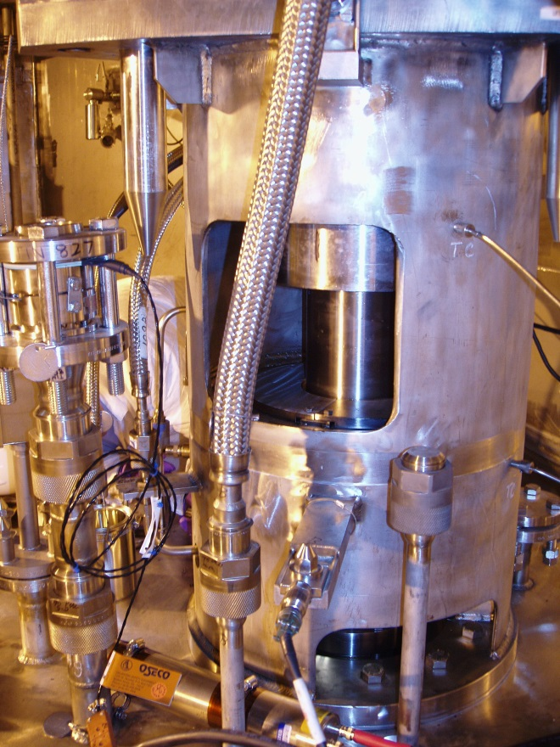
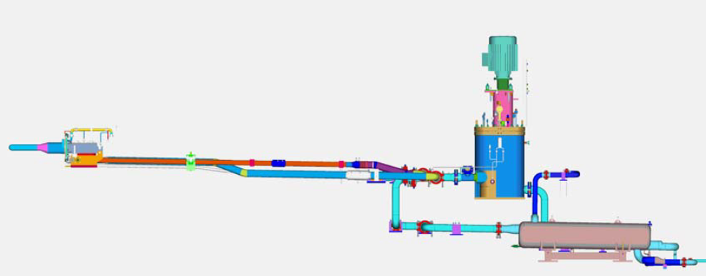
Mercury loop, pump tank and vent loop seal
Tank burst disk
Tank vent line
Tank vent line to MOTS
No room to move higher
(not to scale)
13 feet
Mercury fill level in tank must be high enough to fill target
Tank burst disk

Slide 18
We propose to credit the pressure relief burst disk on the pump tank and add layers of other non-credited controls as defense in depth
MOTS vent line loop seal goes to 156 inch (3.96m) above the pump discharge elevation
The pump tank burst disk is currently rated at 45 psig – 92 inch (2.34m) of Hg
  Burst disk is ~69 inch above pump discharge
  Burst disk will not rupture until mercury is 161 inch (4.08m) above the pump discharge
  Loop seal (@ 156 inch / 3.96m) is too low
We intend to reduce the burst disk pressure to 30 psig and make it a credited control
  Archive data for gas pressure in pump tank shows P_{max} < 20 psia

Slide 19
Other, non-credited controls under consideration for defense in depth
Tank level sensor (bubbler type) trip at ~95% fill level
Tank level sensor trip at full level (RTD type, level A)
Install pressure relief valve at same connection as burst disk, and set at lower pressure
  ~ 20 psig
Reconfigure vent line downstream of seal to create liquid trap at a low point before it enters mercury vapor condenser and gold bed
  Have liquid detection sensor and drain connection storage tank
Responses under consideration
  Stop beam
  Stop gas flow
  Stop mercury flow
  Drain mercury

Slide 20
Initial bubbler target deployment goal is 2017 winter outage
Orifice type bubblers retrofit into jet-flow target that is already well under fabrication
Probably will use once-through gas injection
  Recirculating gas compressor work also underway
30 orifices installed in target bulk inlet lines upstream of Hg flow orifices
Total gas rate estimated at 0.7 SLPM
  At 350 rpm pump speed, injected gas fraction will be ca. 0.0004
    WNR 20122 bubble injection tests gas fraction range was 0.0003 ~ 0.0103
  Small bubble population (R ≤ 0.15 mm )in spallation zone will be estimated with TTF tests
    10⁻⁵ volume fraction expected
Retrofit bubbler hardware will not introduce risks to target lifetime
Operation can continue with gas turned off
Strain and vibration instruments on mercury vessel essential to assessing pressure wave mitigation
Notes:
SNS (350 rpm)
0.7 SLPM / (310 gpm * 3.8 L/gpm) = 4.2E-4
WNR:
(16 sccm He) / { (1 L/sec Hg)*(60 sec/min) } = 2.7E-4
(40 sccm He) / { (1 L/sec Hg)*(60 sec/min) } = 6.7E-4
(800 sccm He) / { (1.3 L/sec Hg)*(60 sec/min) } = 0.0103

Slide 21
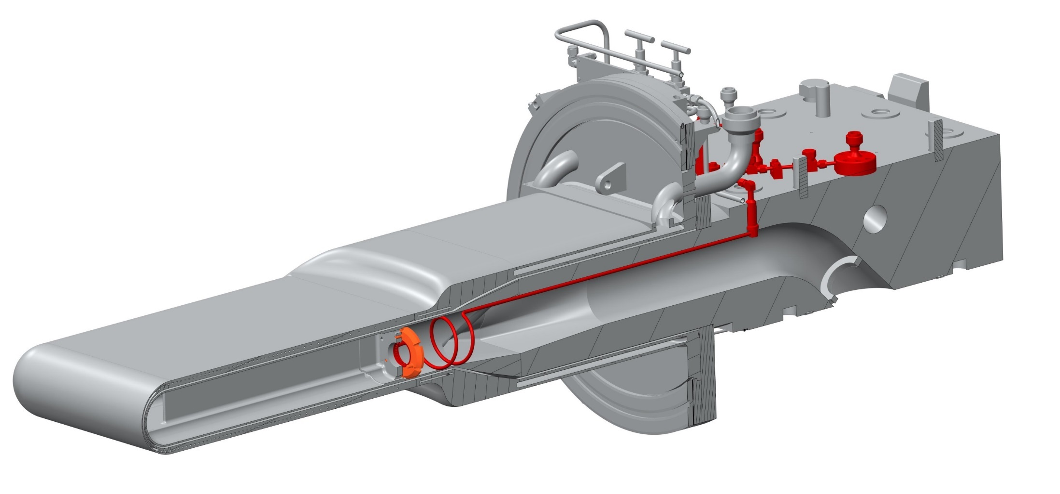
Retrofit orifice bubbler assembly installed in jet-flow target
New gas supply port
Modified vent
New hardware in mercury passages
(one on each side)

Slide 22
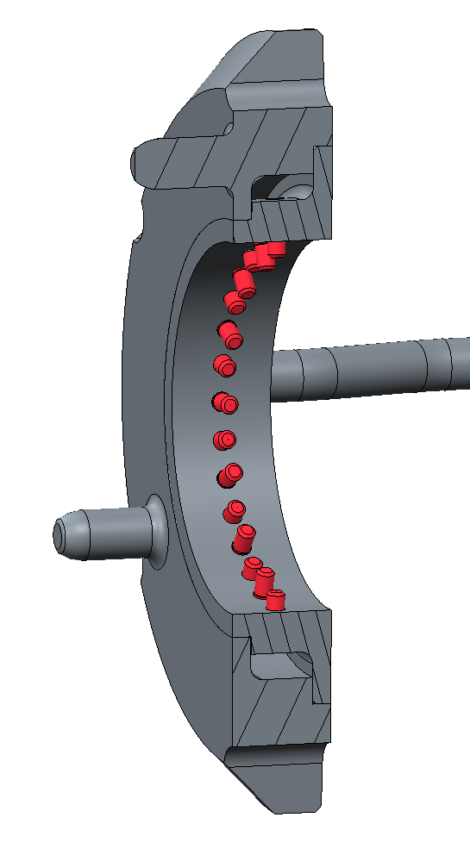
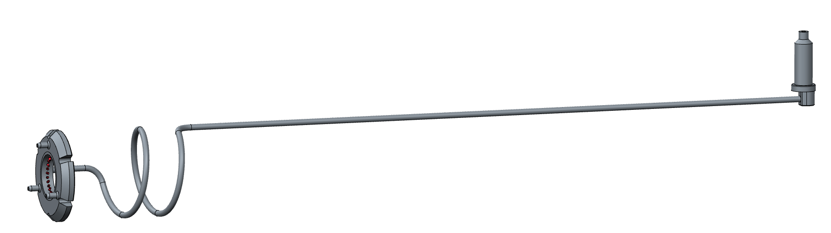
Orifice bubbler details
Penetration passes gas from the back of the target to inside the flow passages.
Single bent tube supplies gas. Will be in the mercury flow.
Bubbler weldment fits in new holes in transition piece.
30 orifices per side
Gas orifice φ = 0.0003” (7.6 µm)

Slide 23
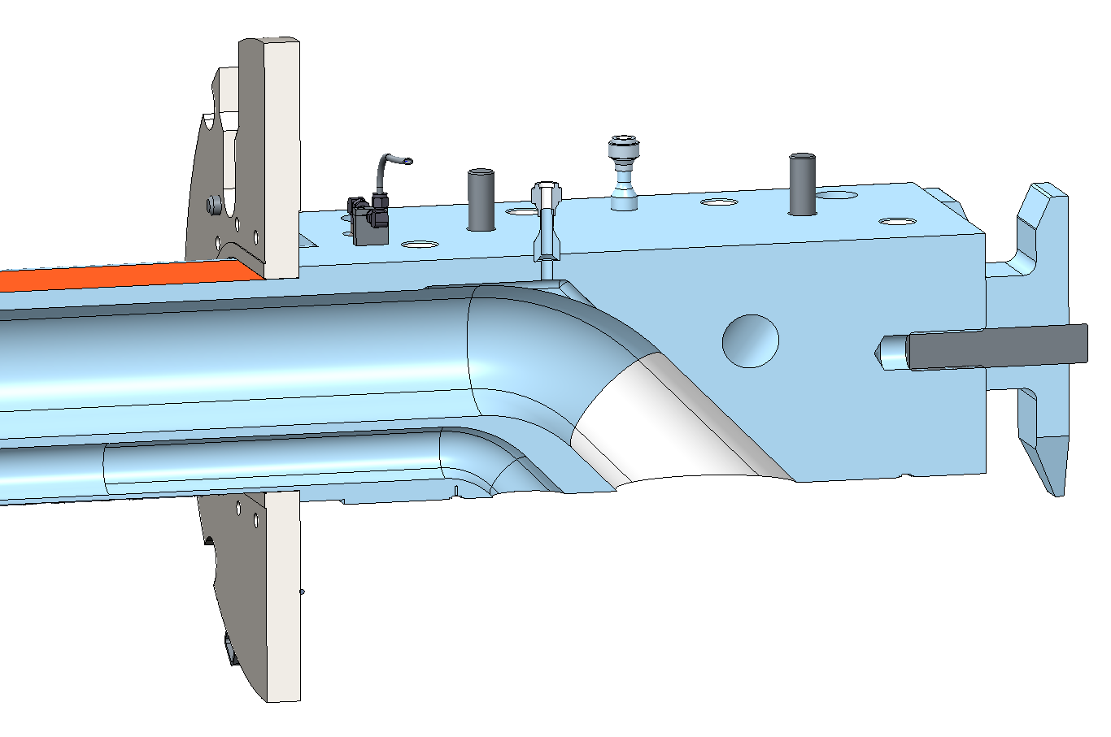
Modifications to jet-flow targets
Gas vent changed
  Moved towards elbow
  Collection pocket added
  New jumper to carriage needed
Old Vent Location
New Vent Location
Added gas collection pocket

Slide 24
External (of service bay) gas supply is preferred once-through approach
Either from building helium or bottle(s)
  Bottle inside service bay offers limited operation time, limits control options, adds remote handling and waste burdens
Safety: must assure liquid mercury or hot gases do not leave service bay, or that consequences are acceptable
Back flow from target must be stopped
Credited controls may be needed
  Loop seal in service bay with height greater than mercury pressure at injection point
  Series of check valves, tested and certified
Recirculating gas compressor advantage – fully contained in service bay

Slide 25
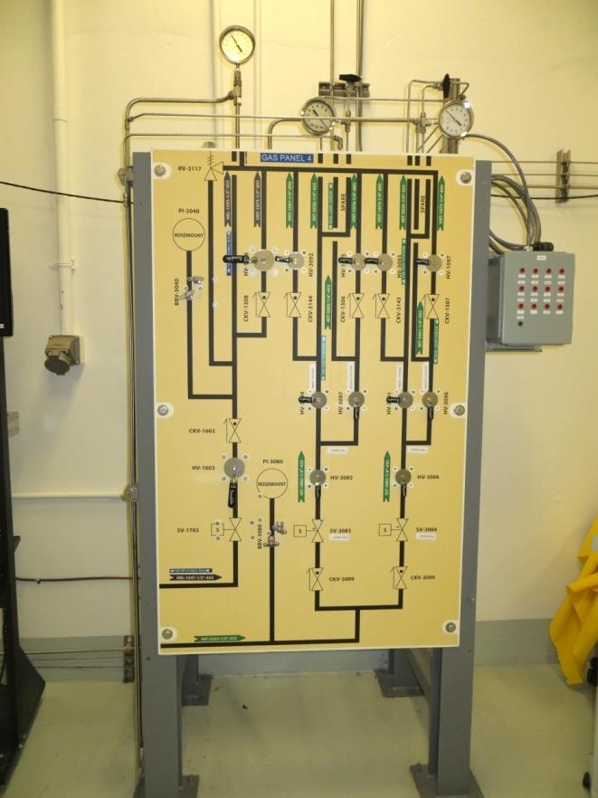
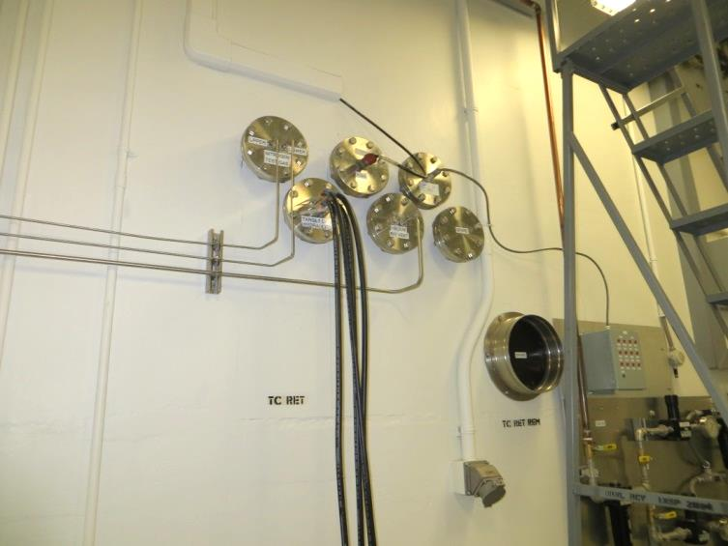
Manipulator gallery gas panel and wall penetration options for once-through
Reconfiguration would be needed here and at basement gas panel
People in these areas regularly
Alternative is gas bottle pack in manipulator or service galleries

Slide 26
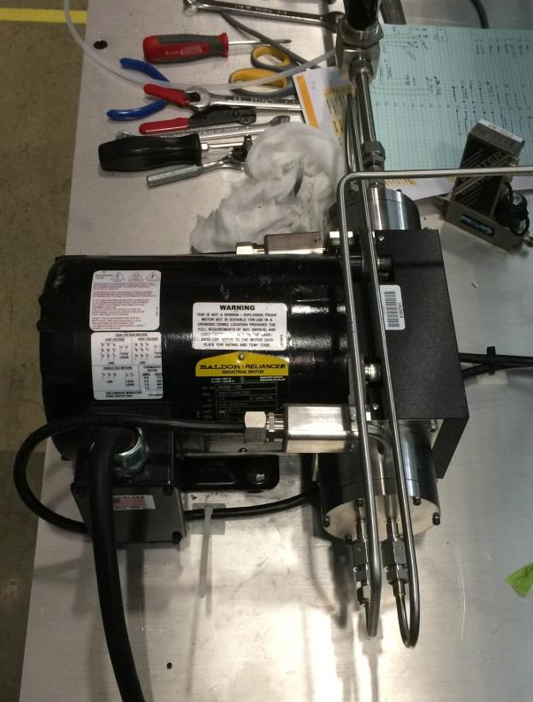
Recirculating gas compressor features
Fully contained in service bay
  No path out for liquid or gas
  Single bellows compressor pump adequate
Does not add to MOTS gas flow
  But specific activity still expected to increase
Compact – can be mounted on wall shelf and replaced remotely
Powered from service gallery
Gas flow controlled via back-pressure regulator
Fixed speed motor sufficient
Double bellows compressor for TTF testing

Slide 27
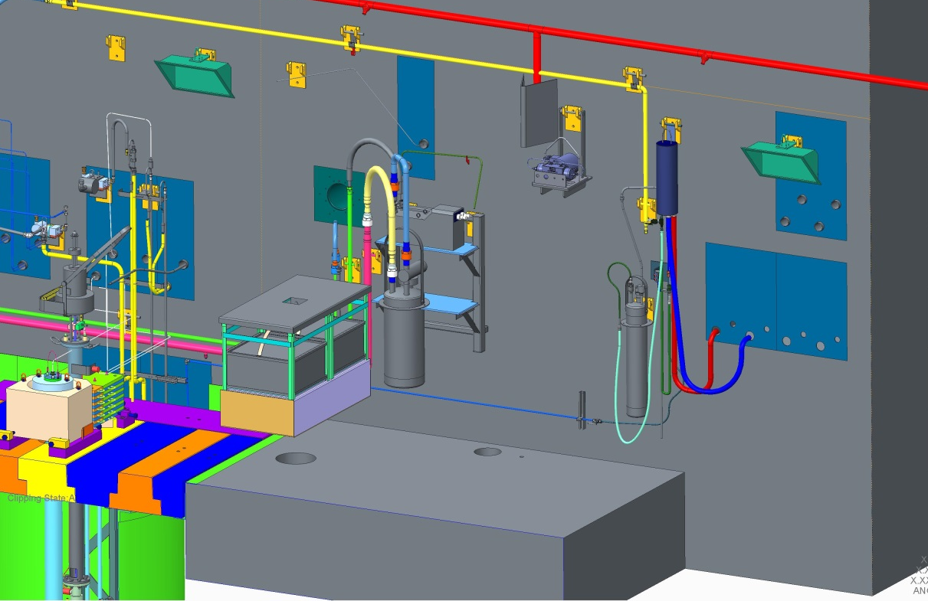
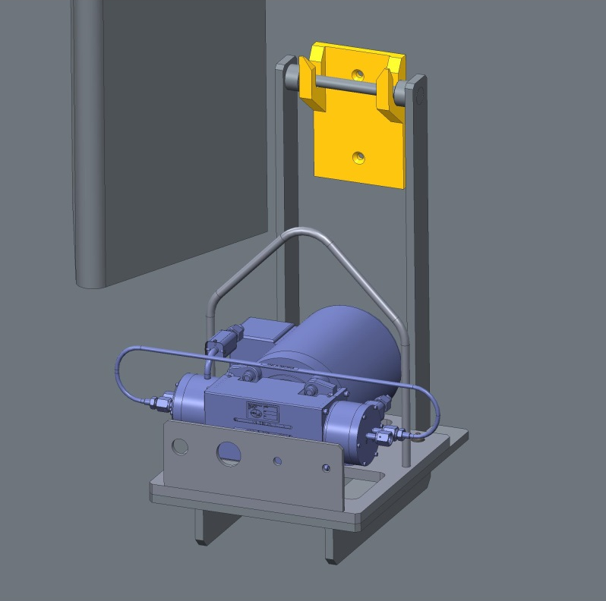
Wall hangar concept for mounting compressor on east wall
Platform likely to grow to add control valves, sensors and RH features, but will still be small

Slide 28
DRAFT - Once-through / recirculating helium injection system P&ID
Hg Vapor Condenser
Hot Cell
Gold Amalgamation Room
Sump Tank
Gold Bed 1
Gold Bed 2
Excess Flow from Compressor
To MOTS
FT
Gas Mass
Flow Meter
Equilibar Back Pressure Regulator
New Carbon
Adsorber
Target Carriage & Target
Helium Supply
(Once-Through System)
Gas compressor
Single bellows
Fixed speed
(208 VAC, 3 phase fed from Panel TA-3PP4B in Service Gallery )
PT
PI
S
FS
Excess Flow Switch
Pilot Pressure for
Controlling Back Pressure Setpoint
Precision Regulator for
Pilot Gas Supply
Carbon Adsorber Room
Notes:
Not shown: line from sump tank vent teed to line to storage tank.
Greg investigating physical location; could be useful as overflow trap with capability to detect and send Hg back to tank.

Slide 29
Process for approval
Conceptual Design Report (CDR) – under preparation
  Continuous interaction with safety staff
Internal design reviews
Internal safety reviews
USI initiated
ASE revision (for credited controls) initiated
SNS management approval
DOE approval of USI and ASE revision

Slide 30
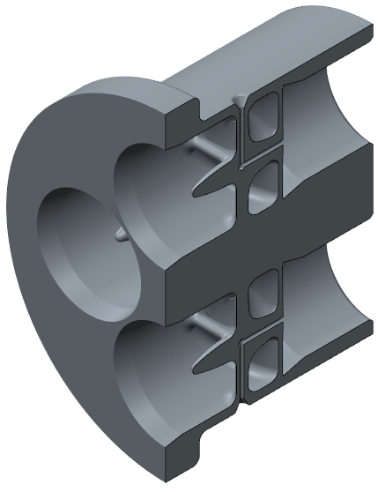
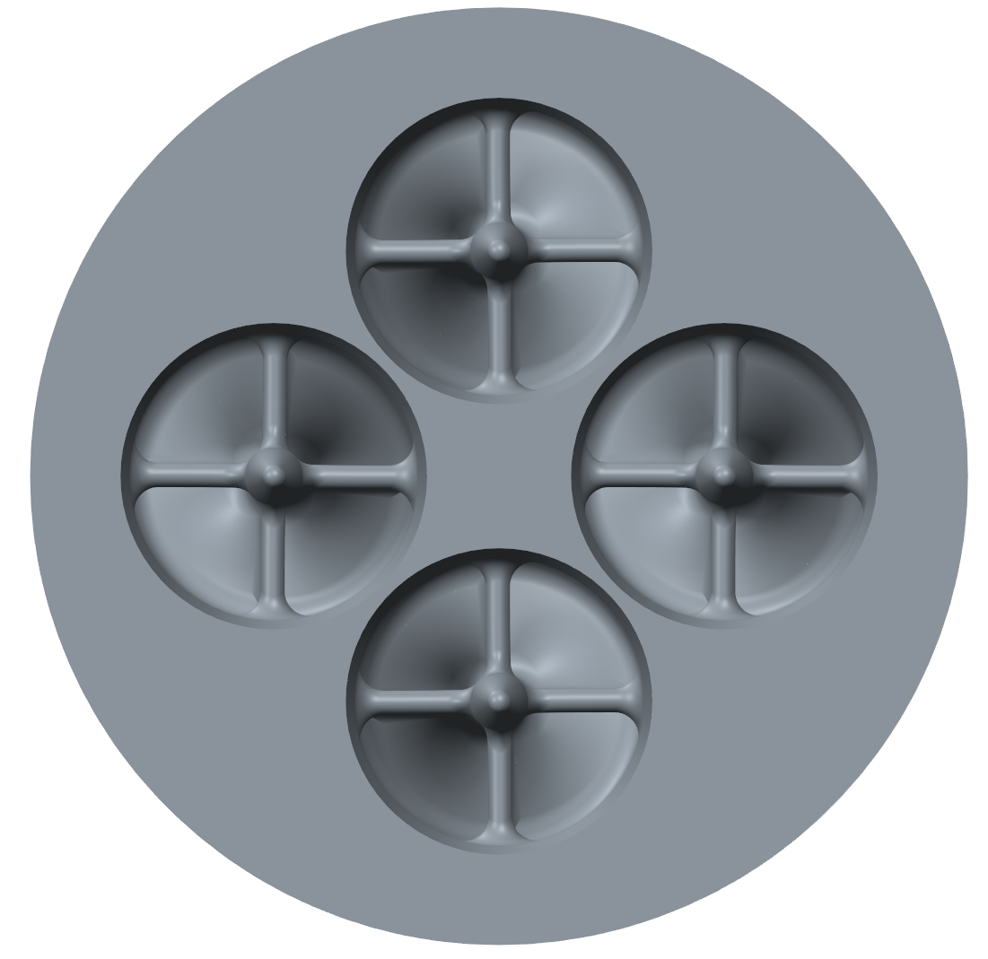
Swirl bubbler development
First generation units are now being 3D printed for water testing
  Design assistance from JPARC
  Will characterize generated bubble populations and flow behavior
When ready, will produce metal versions for mercury testing in TTF
  Considering 3D metal printing option
FLOW

Slide 31
Other near-term developments
Recirculating compressor test unit ready for installation in TTF
  Gain operational experience
  Along with new mercury vapor condenser, gain confidence for no condensate in compressor bellows
Improving bubble size distribution in target volume / spallation zone
  CFD and experimental studies needed

Slide 32
Longer term development outlook
If gas hold-up or heat exchanger efficiency look difficult, potential need for
  Gas-liquid separation
  HX replacement
    Both are remote handling challenges
Gas-wall development
  Concept to incorporate with jet-flow configuration
Hg pump replacement – higher flow

Slide 33
Accelerator upgrade PPU aims to have First Target Station target accept 2+ MW
FTS design basis was 2MW, except for target mercury vessel
Mercury vessel may need
  More aggressive design changes of target flow arrangement / vessel shape, vessel material
  Fully developed gas injection, SGB and GW
Review of all other target systems, find most limiting condition

Slide 34
Gas injection effort contributors are mostly part-time on this task
Altogether ca. 3.5 ~ 4.0 full time equivalents
Charlotte Barbier
Joe Devore
Mike Dayton
Elvis Dominguez-Ontiveros
Dave Felde
Dave Freeman
Lorelei Jacobs
Steve Parson
Bernie Riemer
Bob Sangrey
Greg Stephens
Mark Wendel
Drew Winder

Slide 35
Summary
Initial plan for deploying target gas injection has orifice bubblers retrofit into a jet-flow target that is already in production
SNS loop was not design for gas injection, and there are safety issues to address before deployment
Initial gas rate will be low to cautiously observe how mercury process and off gas systems behave
Instruments to measure target strain and vibration will give critical feedback on efficacy of gas for pressure wave mitigation
Longer term outlook is for higher gas rates, improved bubblers and a protective gas wall

Slide 36
Backup slides

Slide 37
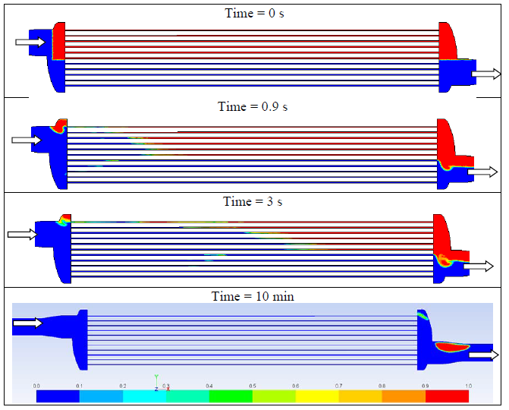
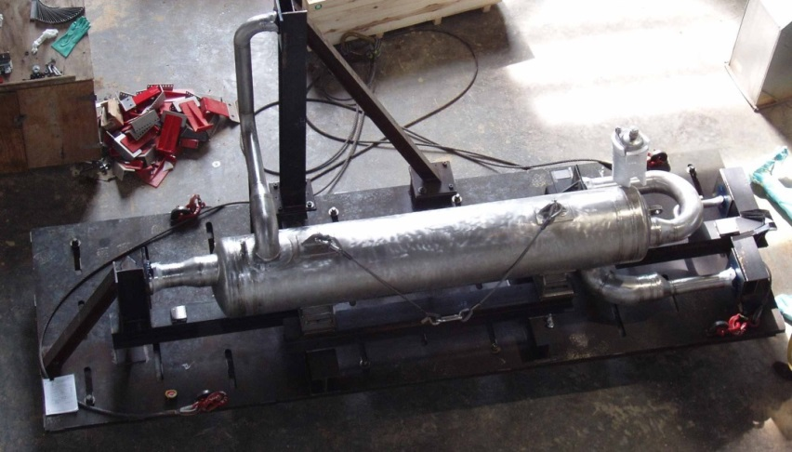
Heat exchanger gas fouling is not a major concern at this point
Up to 12% loss of efficiency based upon 2-phase CFD simulation if mercury flow above 300 gpm (1140 LPM)
  There is adequate margin in the HX up to 1.4 MW
However actual behavior will be monitored during initial deployment
Gas volume fraction through heat exchanger
  A. Abdou and M. Wendel,106010202-DA0022-R00

Slide 38
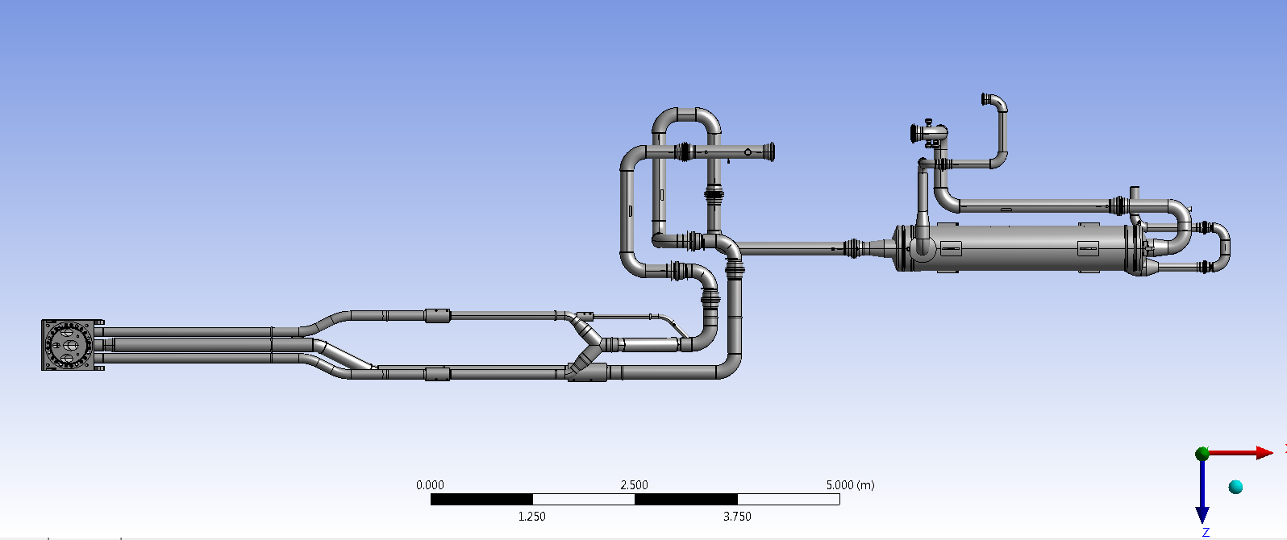
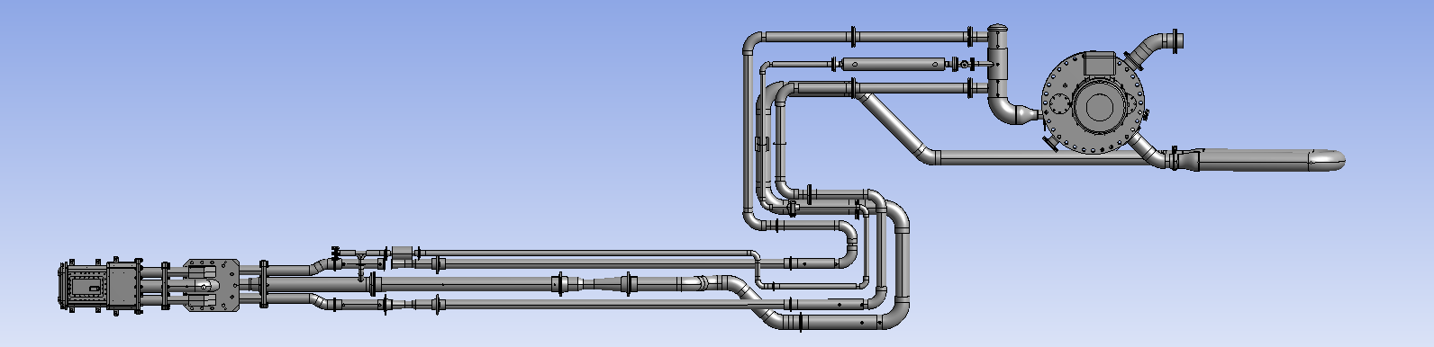
Plan view of SNS and TTF loops
pump
SNS
(w/o pump and target)
TTF
Notes:
backup

Slide 39
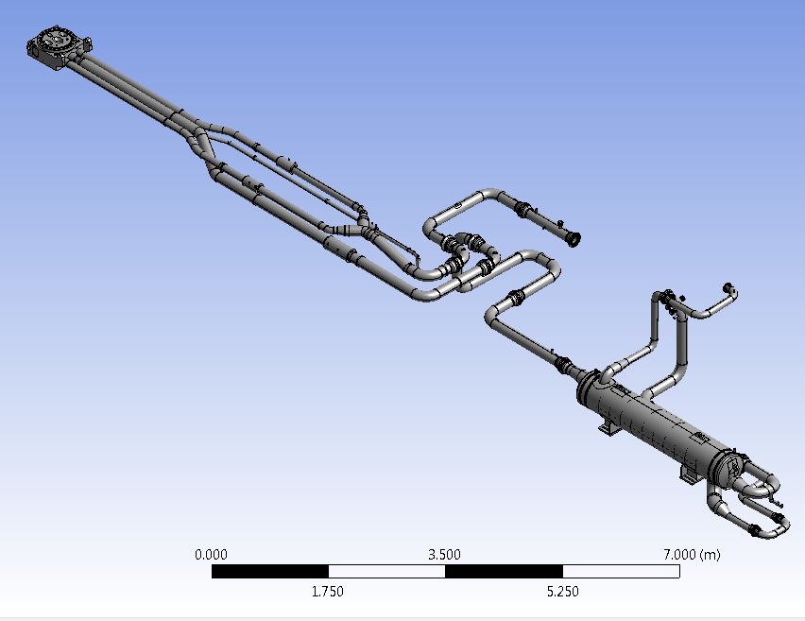
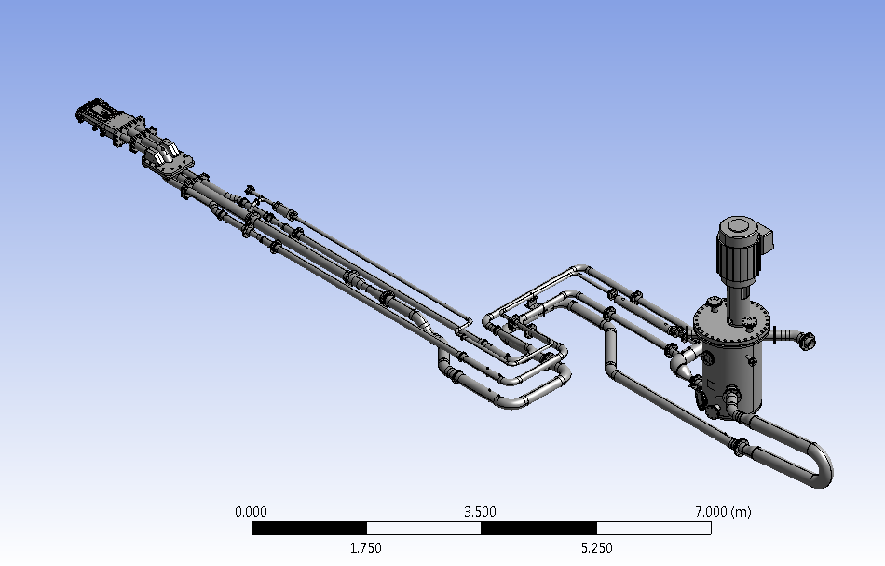
Iso views
SNS
(w/o pump and target)
TTF
Notes:
backup

Slide 40
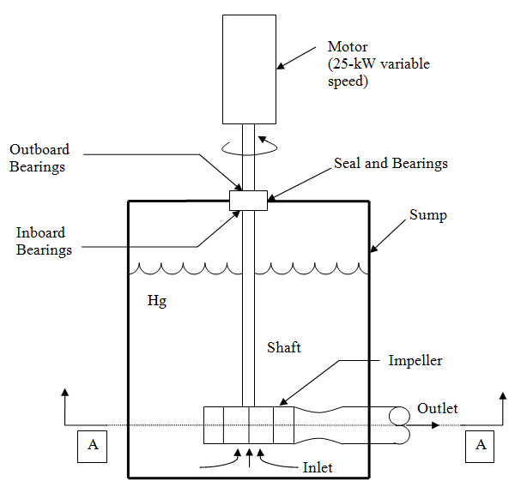
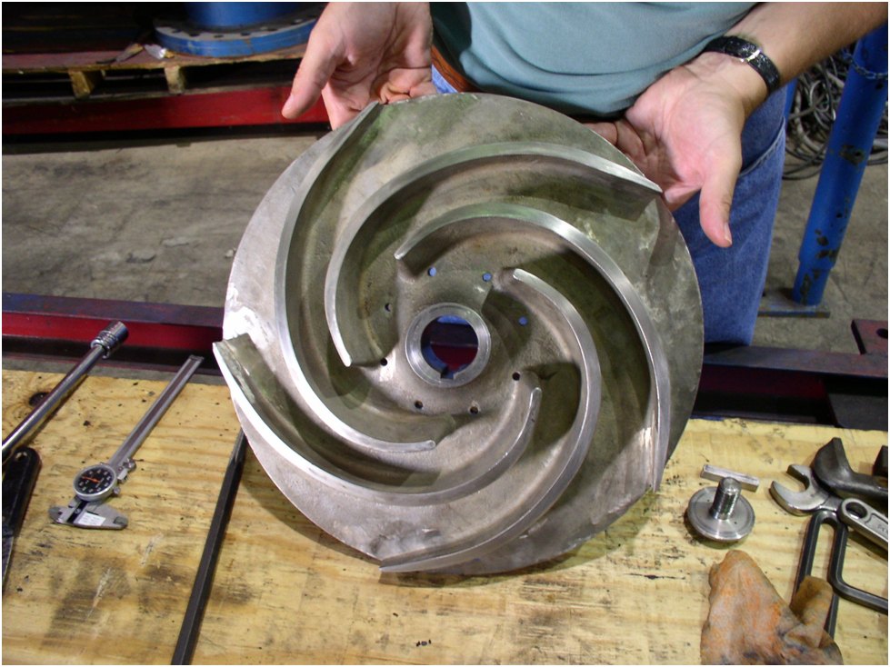
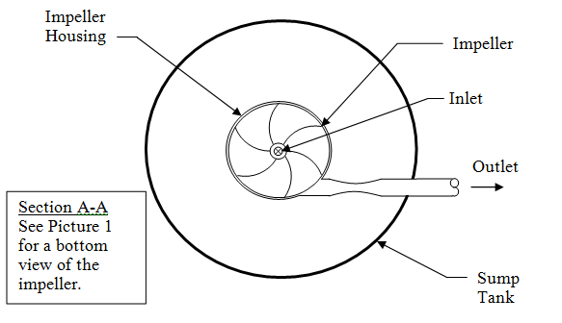
Pump details
Bottom view of the SNS impeller

Slide 41
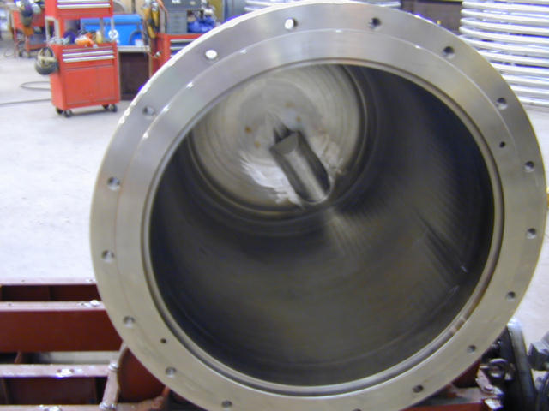
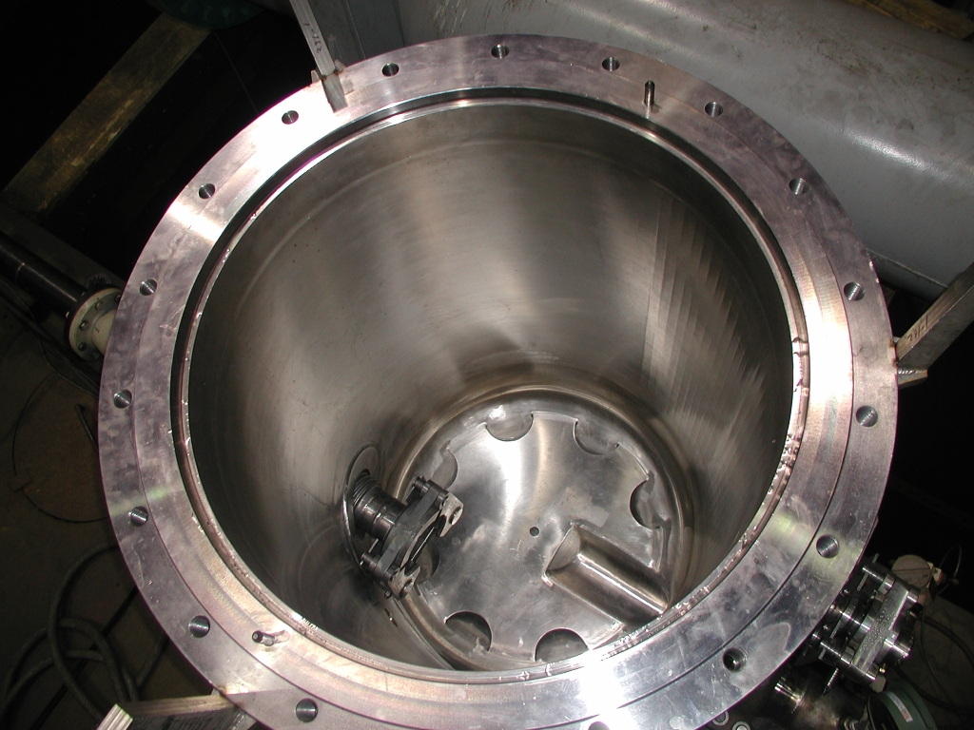
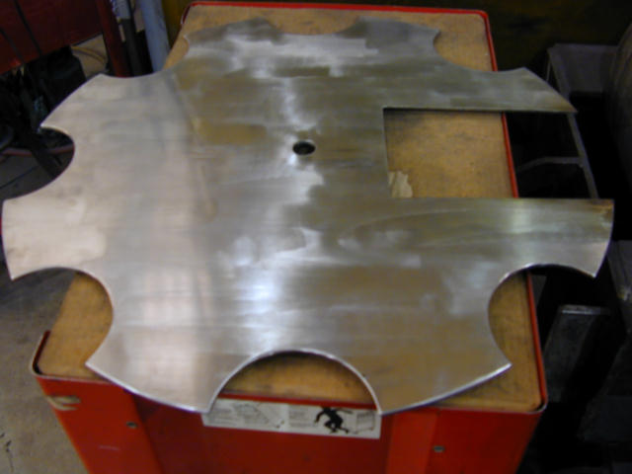
Pump details

