Slide 1
Target Module Fabrication Status
Drew Winder Target Systems
Don Abercrombie
Mike Atherton
Bernie Riemer
Mark Wendel

Slide 2
Outline
Spares status
Ongoing Fabrication Status
Upgraded original flow targets
Jet-flow targets
FY16 Planned Fabrication
Water shroud
Updated original flow mercury vessels
Future Fabrication

Slide 3
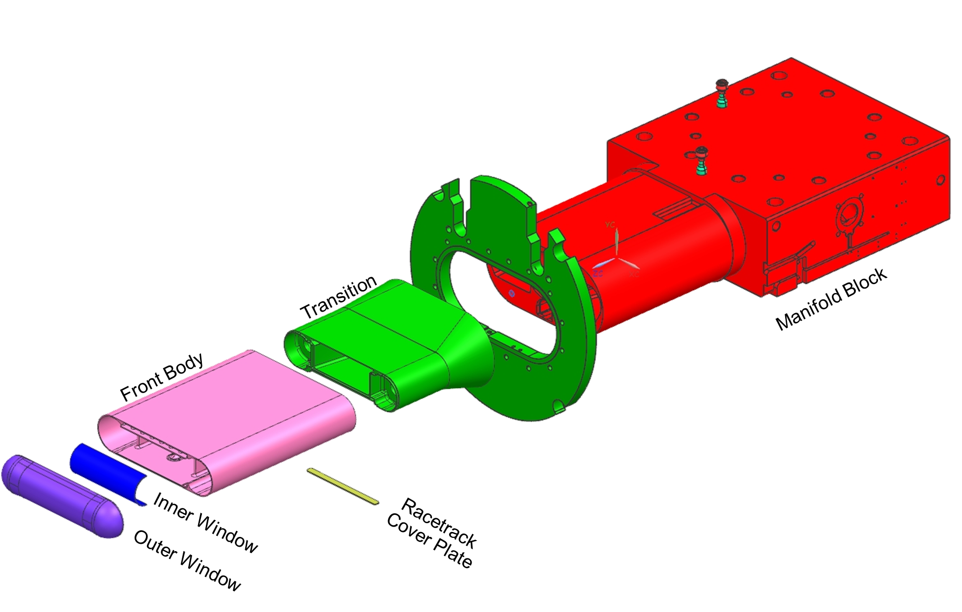
Terminology

Slide 4
Spares Status
2 ready spare targets
ORTE-003 – Original design
Sister unit to both ORTE-001 (>4100 MW∙hr) and ORTE-002 (166 MW∙hr)
Includes trapezoidal cover plate
Water shroud not removable
Does not include newer material and processing improvements to increase cavitation damage resistance

Slide 5
Spares Status
MTX-010 – Upgraded original design
Does not have trapezoidal cover plate
Removable water shroud
Includes improvements to materials and processing to increase cavitation damage resistance
Includes modifications to increase fatigue life at front body to transition weld
Includes strain and temperature sensors

Slide 6
Ongoing Fabrication Status
Target fabrication is ongoing at Metalex
3 targets of 7 target contract delivered
Reduce partial penetration welds
Original flow targets,
1 delivered without weld changes,
1 delivered with changes,
1 to be delivered with changes
Gas injection
Jet-flow targets,
1 delivered and developed leak
2 to be delivered with changes,
1 on hold (was welded before 2014 failures, has thin outer window)

Slide 7
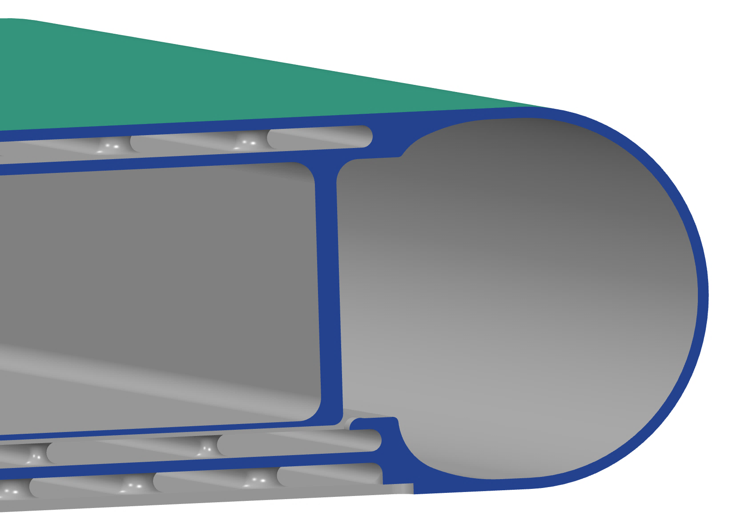
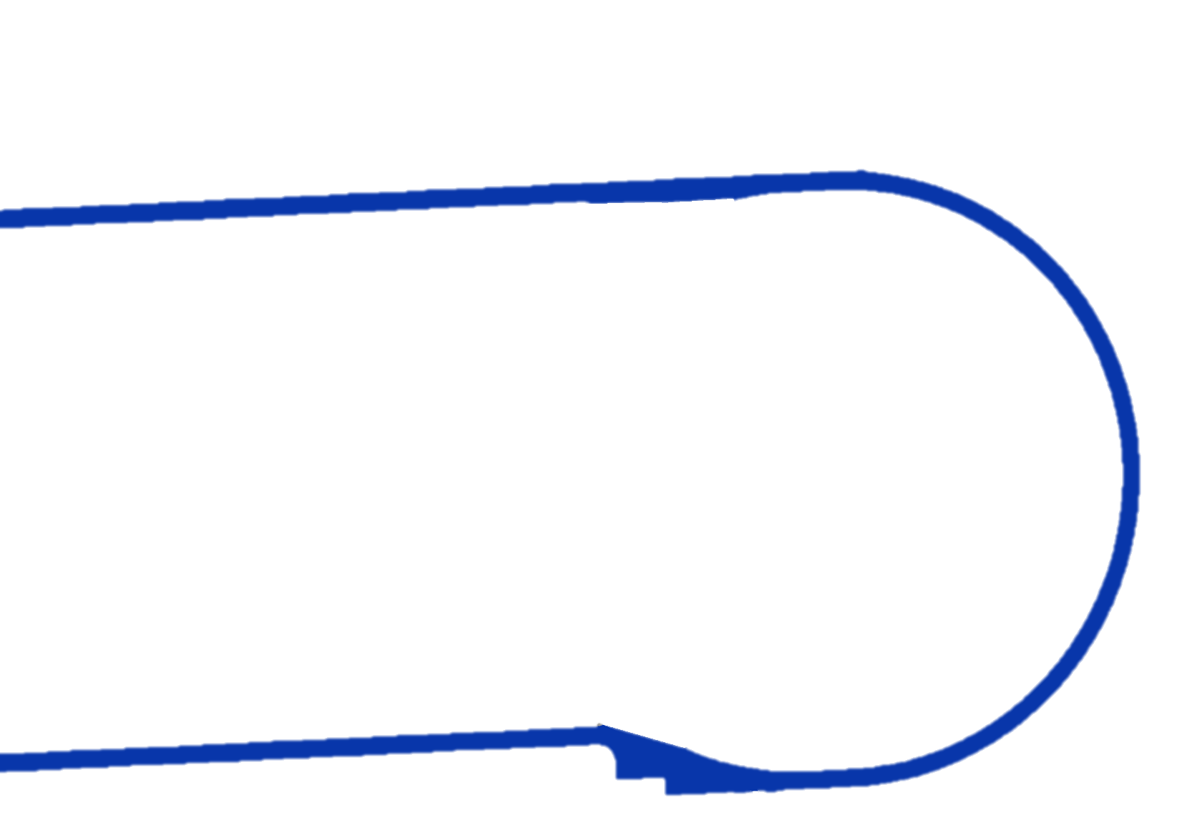
Reduce Partial Penetration Welds
Weaknesses
Partial penetration weld,
Lack of inspectability,
Stress concentration from change in geometry, and
Stress singularity at weld root is bad for fatigue and impossible to resolve with linear FE analysis
Designed Weld Penetration
Unwelded portions

Slide 8
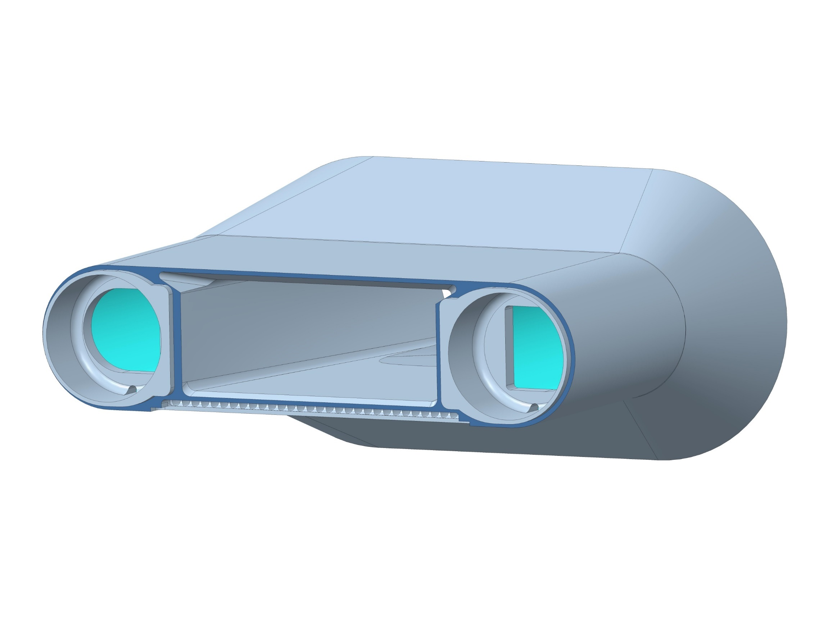
Reduce Partial Penetration Welds
Un-modified
Modified

Slide 9
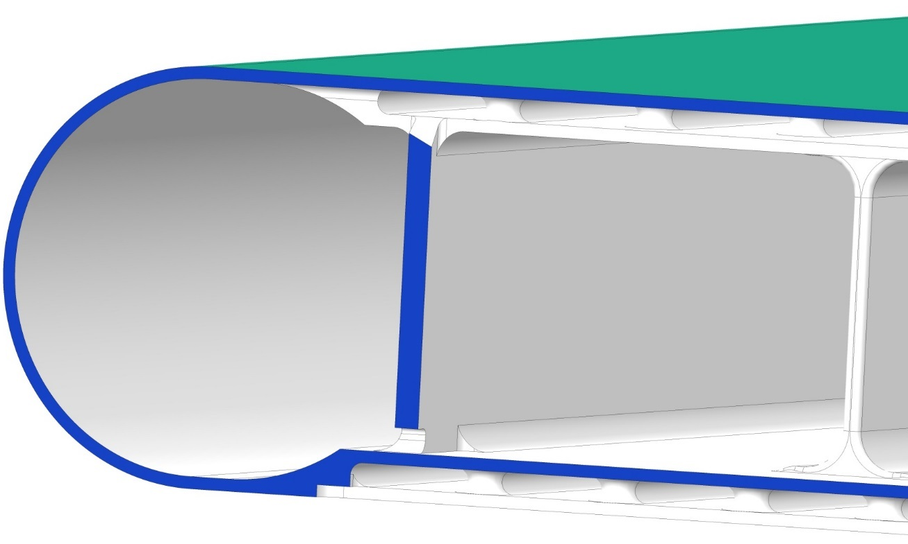
Reduce Partial Penetration Welds
Un-modified
Modified

Slide 10
Reduce Partial Penetration Welds
Machined features leave ½ inch by ¼ inch (12 mm x 6mm) passages between bulk inlets and return passage.
Size intended to allow radiograph film to be inserted.
Mercury flow through holes not significant.
Transition
Front Body

Slide 11
Ongoing Fabrication Status
MTX-013
Updated original type, identical to current MTX-010 spare
Sensors will be improved over MTX-010.
Projected delivery June 2016.

Slide 12
Gas Injection
New gas supply port
Modified vent
New hardware in mercury passages
(one on each side)

Slide 13
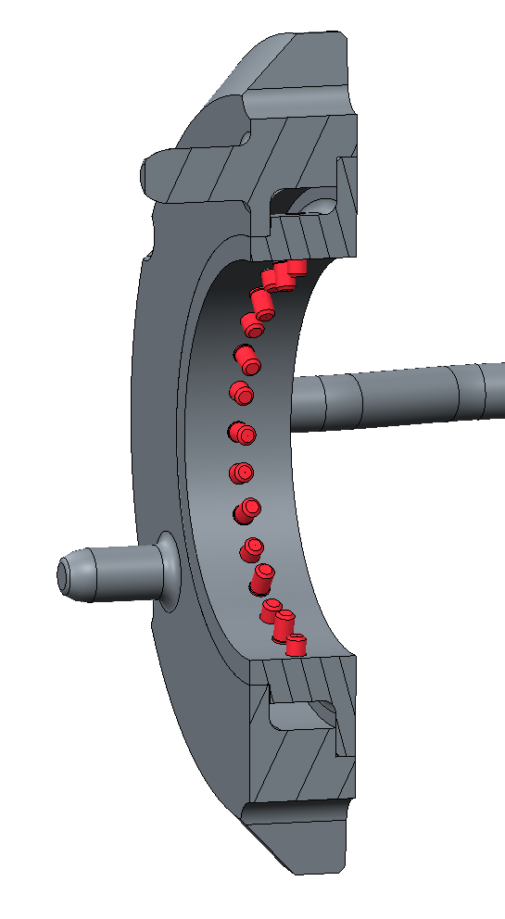
Gas Injection
Bubbler
Penetration passes gas from the back of the target to inside the flow passages.
Single bent tube supplies gas. Will be in the mercury flow.
Bubbler weldment fits in new holes in transition piece.

Slide 14
Gas Injection
Old Vent Location
(will be capped)
New Vent Location
Gas vent changed
Moved towards elbow.
Collection pocket added.
Added gas collection pocket

Slide 15
Ongoing Fabrication Status
MTX-011
Jet-flow type target
Includes modifications to increase fatigue life at front body and transition weld
Includes orifice bubbler gas injection hardware.
Will include strain sensors
Projected delivery August 2016
MTX-012
Jet-flow type
Same as MTX-011
Projected delivery September 2016

Slide 16
Ongoing Fabrication Status
MTX-008
Jet-flow type target
Construction on hold
At time of T10 leak, was already fabricated past the weld of the T10 leak location
Has 25% reduction in thickness at T12 leak location
Projected delivery not before January 2017

Slide 17
FY16 Fabrication
Fabrication plans are based on projected target consumption.
Consumption rates are based on planned target removals in the near term, followed by a 2 target a year pace in future years.
Goal is to maintain at least 3 ready spares

Slide 18
FY16 Target Fabrication
Projected target inventory
Winter 15/16 Shutdown | Early 16 | Summer 16 Shutdown | Late 16 | Winter 16/17 Shutdown (IRP) | Early 17 | Summer 17 Shutdown | Late 17 | Winter 17/18 Shutdown | Early 18 | Summer 18 Shutdown | Late 18 | Winter 18/19 Shutdown | Early 19
 | MTX-009 |  | MTX-010 |  | MTX-011 |  | MTX-011 |  | MTX-013 |  | MTX-012 |  | MTX-008
 | ORTE-003 |  | ORTE-003 |  | ORTE-003 |  | ORTE-003 |  | ORTE-003 |  | ORTE-003 |  | ORTE-003
 | MTX-010 |  | MTX-013 |  | MTX-013 |  | MTX-013 |  | MTX-012 |  | MTX-008
 |  |  | MTX-011 |  | MTX-012 |  | MTX-012 |  | MTX-008
 |  |  | MTX-012 |  | MTX-008 |  | MTX-008
Installed
Ready Spares
Arriving Spares

Slide 19
FY16 Target Fabrication
Goal was to develop an improved original flow type target design to begin fabrication in mid-2016
Analysis has shown proposed target designs have vulnerabilities
More details in next presentation
Continue to pursue improved target designs, but will fabricate more original flow type targets in the interim

Slide 20
FY16 Target Fabrication
Target fabrication requires ~66 weeks
Water shroud and mercury vessel components are independent until 41st week.
Water shroud fabrication requires ~16 week lead
66 weeks
Water Shroud Fabrication
Final Target Assembly
Mercury Vessel Fabrication
16 weeks

Slide 21
FY16 Target Fabrication
Will start fabrication of two water shrouds by summer 2016
Will incorporate lessons learned into drawings and fabrication specifications
Will follow with order of at least one original type mercury vessel within 16 weeks
Will incorporate lessons learned into drawings and fabrication specifications
No major changes past current original type targets under fabrication

Slide 22
Future Target Fabrication
Updated target mercury vessel designs will be procured when designs are complete
Will keep the target fabrication pipeline flowing
Winter 15/16 Shutdown | Early 16 | Summer 16 Shutdown | Late 16 | Winter 16/17 Shutdown (IRP) | Early 17 | Summer 17 Shutdown | Late 17 | Winter 17/18 Shutdown | Early 18 | Summer 18 Shutdown | Late 18 | Winter 18/19 Shutdown | Early 19
 | MTX-009 |  | MTX-010 |  | MTX-013 |  | MTX-013 |  | MTX-011 |  | MTX-012 |  | MTX-008
 | ORTE-003 |  | ORTE-003 |  | ORTE-003 |  | ORTE-003 |  | ORTE-003 |  | ORTE-003 |  | ORTE-003
 | MTX-010 |  | MTX-013 |  | MTX-011 |  | MTX-011 |  | MTX-012 |  | MTX-008
 |  |  | MTX-011 |  | MTX-012 |  | MTX-012 |  | MTX-008
 |  |  | MTX-012 |  | MTX-008 |  | MTX-008
Installed
Ready Spares
Arriving Spares

Slide 24
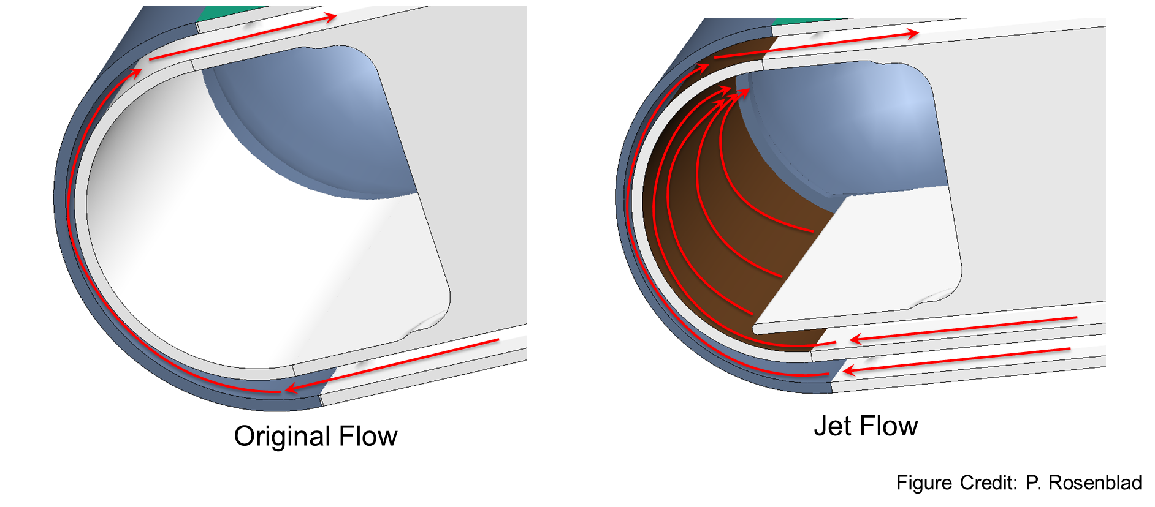
Backup

Slide 25
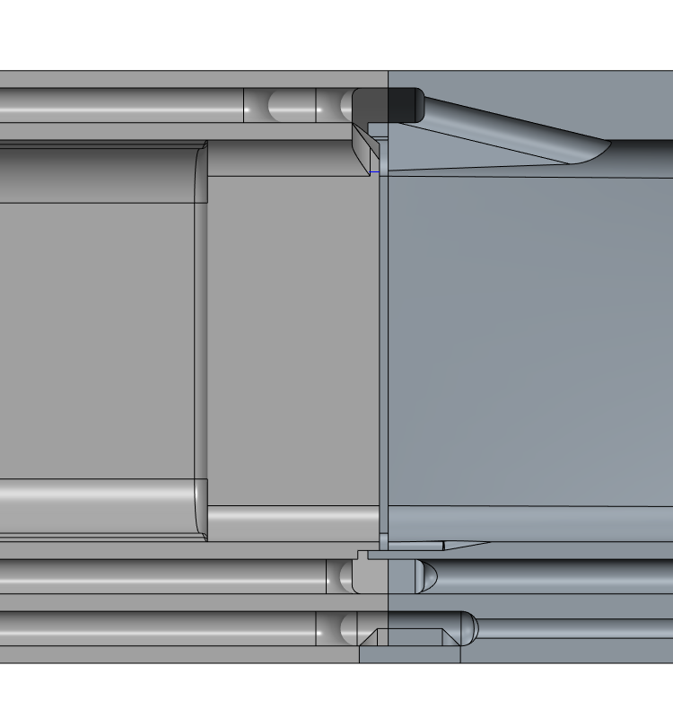
Backup
Benefits
Full penetration weld all around.
Area near racetrack will be machined before welding to allow full penetration, then filled back with GTAW.
Radiographs possible all around weld.
Compatible with analysis.
Removes contact ambiguity on abutting faces.
Transition
Front Body

Slide 26
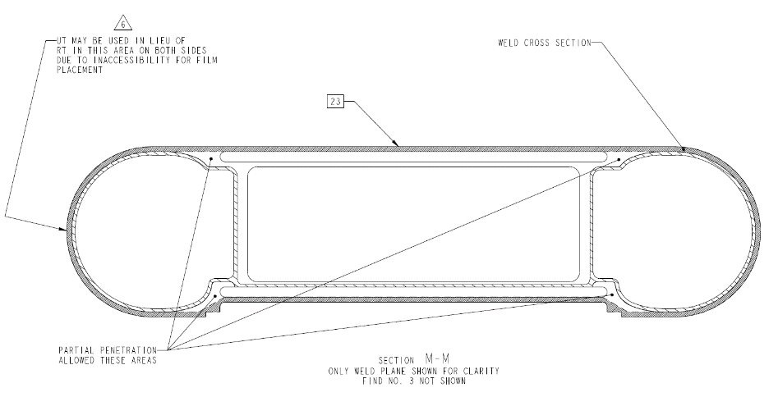
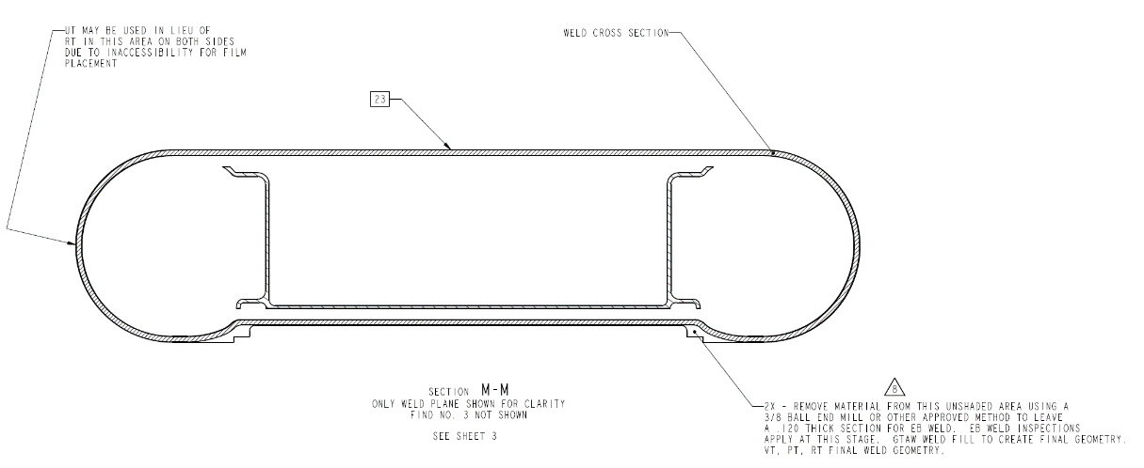
Proposed Changes – Elimination of Partial Penetration Weld Areas
Mercury Vessel Weldment before Modification, Drawing A222, Rev. 7
Mercury Vessel Weldment after Modification, Drawing A222, Proposed Rev. 8

