Slide 1
Instrumentation of SNS Target Module
M. W. Wendel
SNS Accelerator Advisory Committee Meeting
February 16–18, 2016
Key contributors:
Wim Blokland, Jeff Bryan, Yun Liu, Bob Sangrey, Bernie Riemer, Drew Winder

Slide 2
Contents
Purpose of instrumentation
Plan for instrumentation
Report on first data
Upcoming developments

Slide 3
Sensors are now routinely installed on the target mercury vessels
Motivation is to improve target reliability by understanding mercury vessel dynamic response
Improve structural analyses to extrapolate new designs
Discover unaccounted-for vulnerabilities (e.g., structural mode excitation)
Evaluate gas injection system
Intent is to improve and extend the instrumentation suite
Stainless steel vessel (strain, temperature, acceleration)
Mercury (temperature, pressure, flow)
Dosimetry and materials irradiation
Goal is to fully understand the response of the target to beam pulse

Slide 4
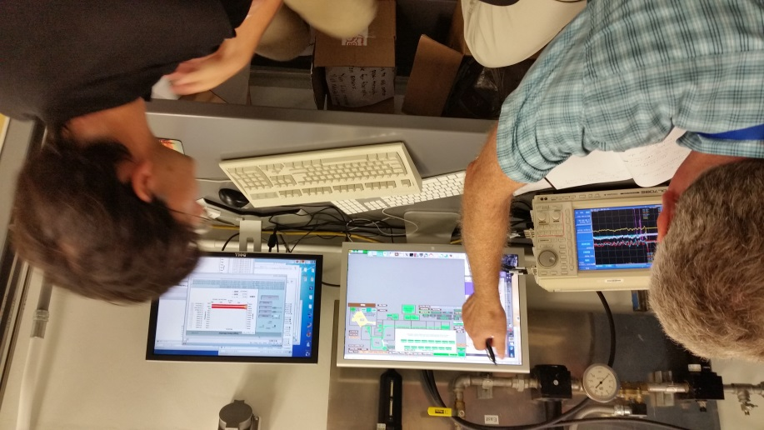
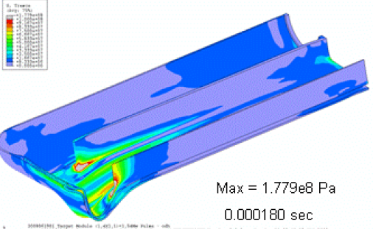
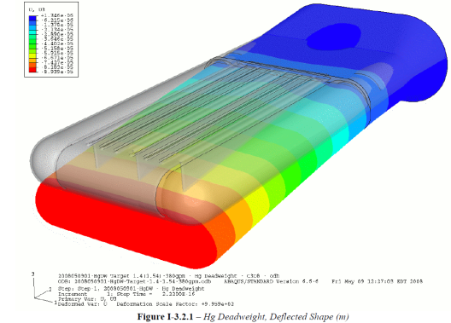
On-vessel instruments will provide understanding of actual target response
Analysis has uncertainties in the EOS
Liquid, vapor, non-condensable gas
Measurements can improve analytical predictions
Strain
Temperature, velocity and pressure
October 8, 2015
Successful measurements of target strain
FEM predictions

Slide 5
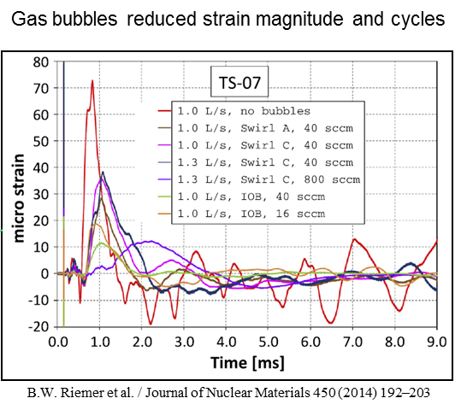
With gas injection, reduction in pressure pulse loads should be evident in reduced strain
Gas injection
Gas bubbler
A similar benefit: the success of some design changes can be confirmed by measurement

Slide 6
Strict requirements for addition of instrumentation are established
Zero impacts to beam operations due to functional failure of instrumentation hardware (including installation, removal, and disposal)
No impacts on leak detector function throughout the target lifetime
Seal on cable through target flange must be tight
Hardware must be connected by Remote Handling
Nominal target installation, removal, and disposal can not be precluded
In-beam testing plan must be coordinated with SNS operators

Slide 7
Strain sensor measurements from in-beam experiments at Los Alamos helped jump-start the effort
Six in-beam damage test campaigns were conducted since 2000 investigating cavitation damage on mercury targets:
2011 experiment

Slide 8
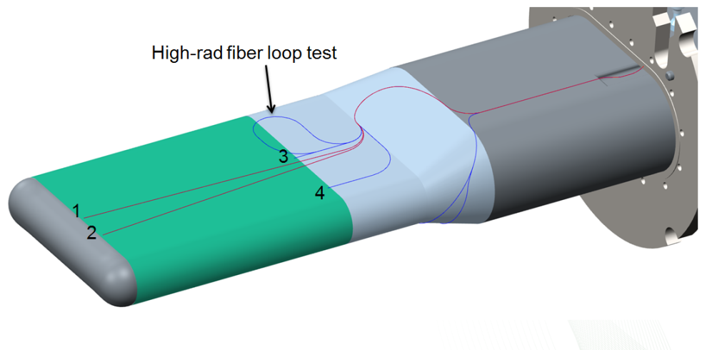
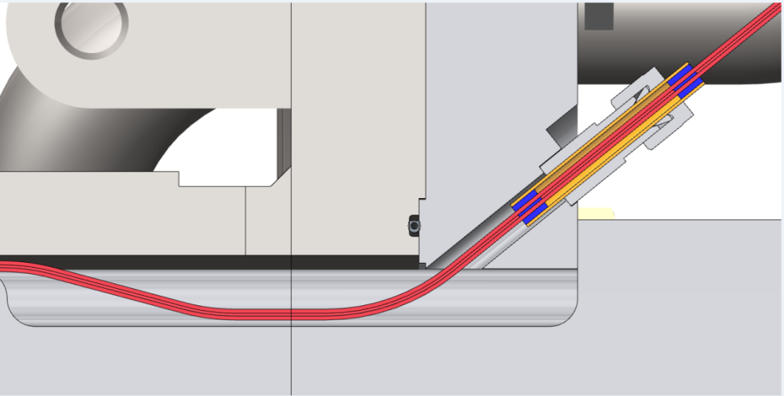
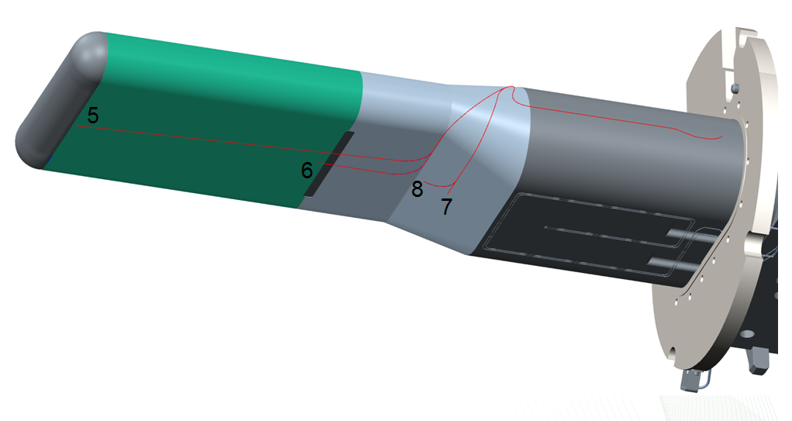
Strain sensors were installed at the target manufacturer by SNS staff
Eight strain sensors
Transmission test run of single-mode fiber
Two accelerometers

Slide 9
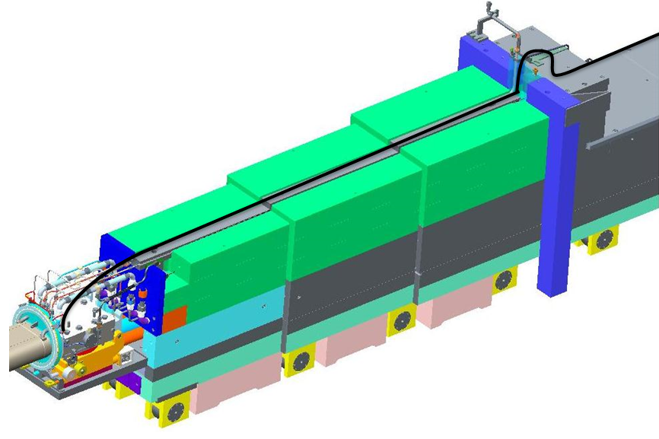
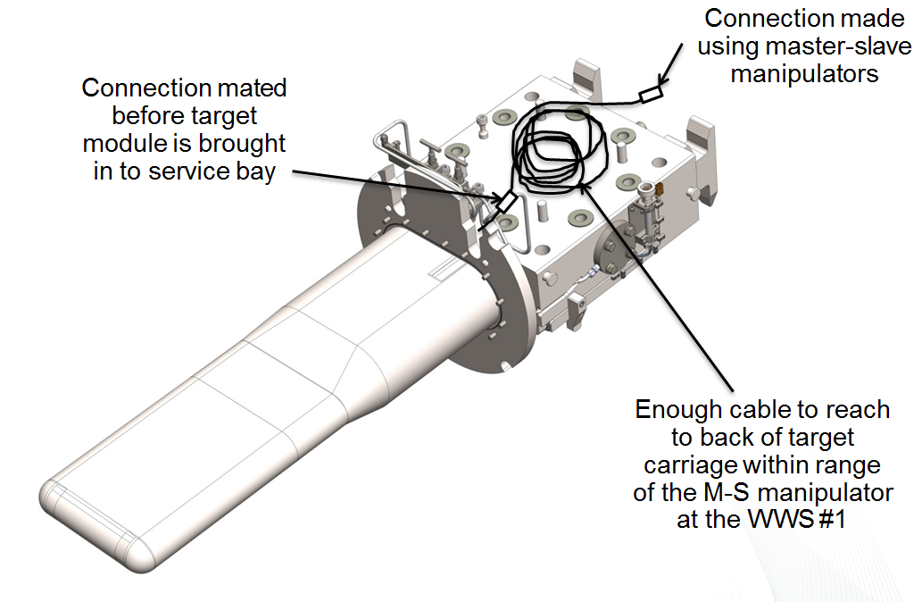
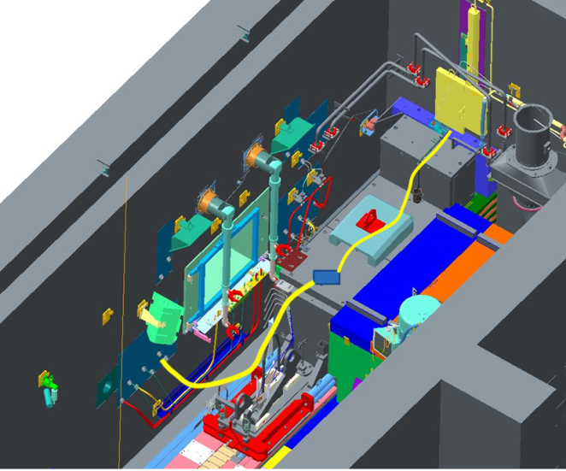
Leads are coiled up on back of target module for connection after install
Unfurling/handling the fiberoptic cable
Making the connection in the cell with MSM
Cutting the fiberoptic cable

Slide 10
Target T13 with cables ready for installation
Fiber bundle
Connector Box and spool

Slide 11
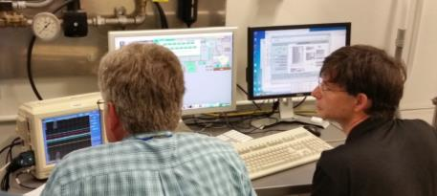
First instrumented target (T13) provided valuable data
Strain sensors on target front
Accelerometers on piping
Collaboration involving many SNS groups
Obtained data for single pulses and bursts of 10
Engineers monitor target data acquisition system during pulse-on-demand
Accelerometers
Strain Sensors
PROTONS
Instrumented Target Installed into Core Vessel

Slide 12
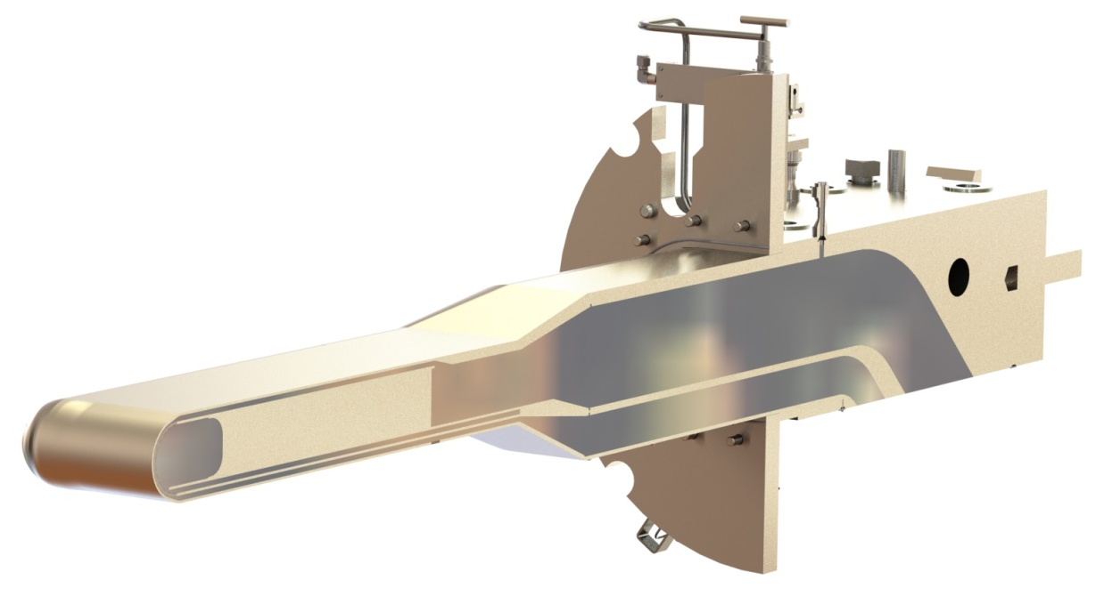
Data were collected for the following conditions before
Internal pressure (positive and negative)
Dead weight with and without mercury
Flowing mercury at various pump speeds (vibrations)
Single beam pulses
Cycled beam pulses

Slide 13
Generally, the target responded as predicted with FEA
1 MW equivalent pulse
PROTONS

Slide 14
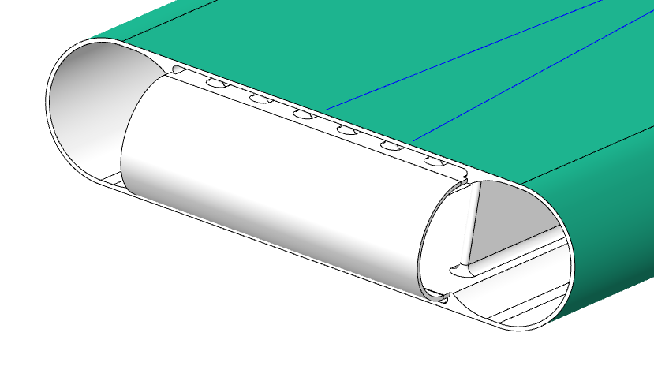
Best agreement between predicted and observed response in forward region
Calculated
Calculated
1
2
Positioned between ribs

Slide 15
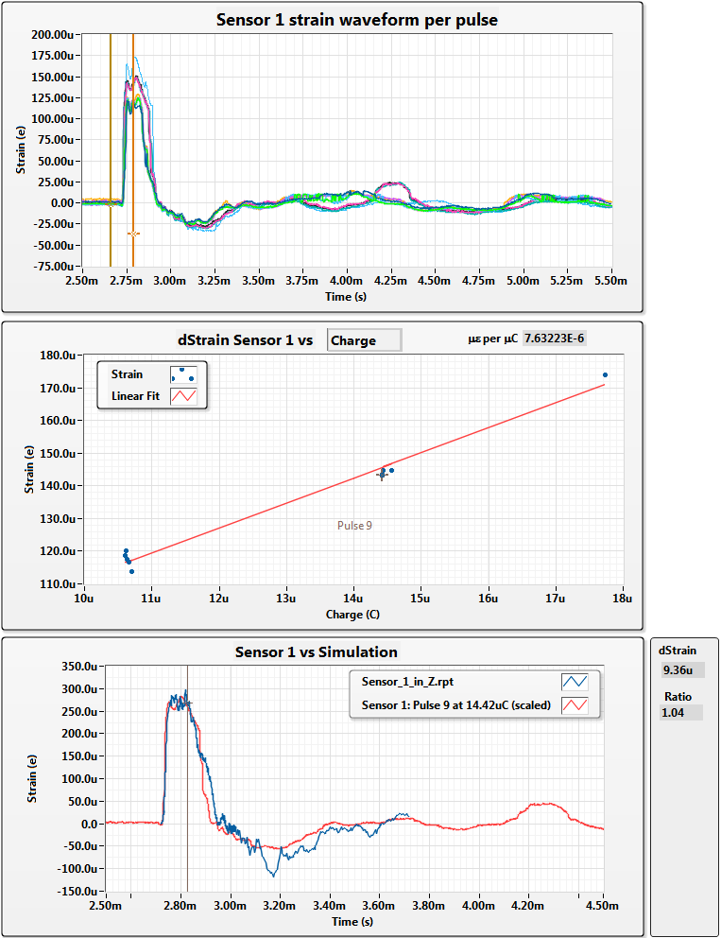
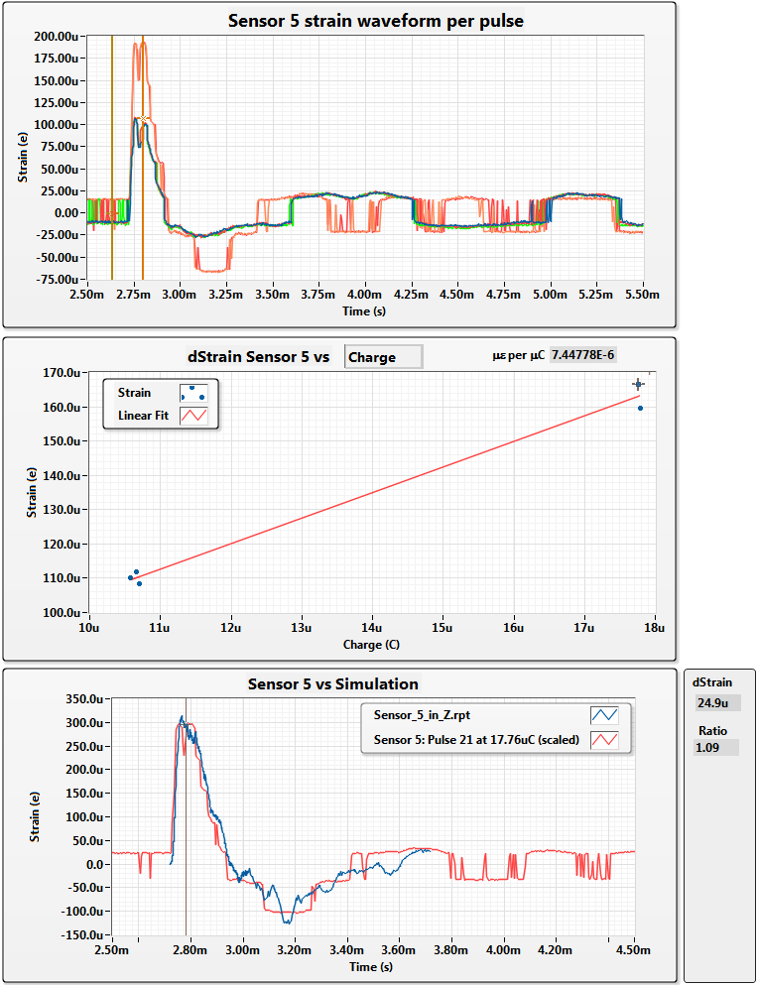
Sensors 1 & 5 should have similar responses – the data validate this
Calculated
Calculated
Vertical offset should be corrected

Slide 16
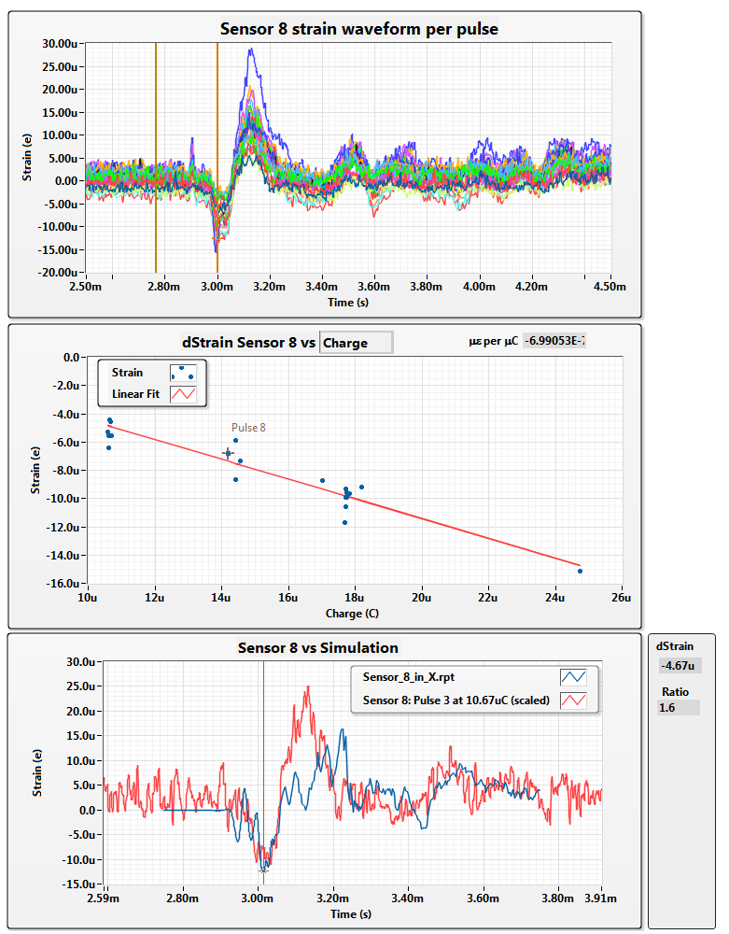
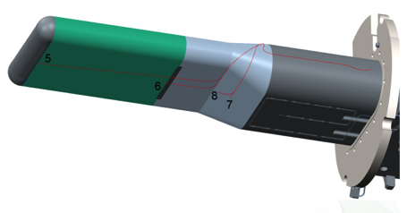
Sensor 8
Sensor 8
Pulse 1 at 10µC
Calculated
Pulse 19 at 25µC

Slide 17
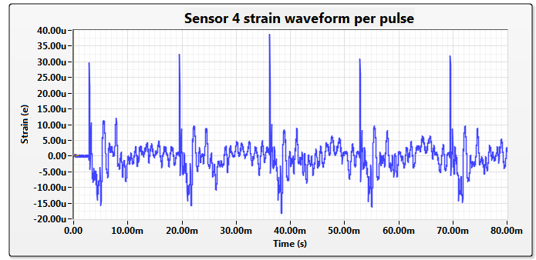
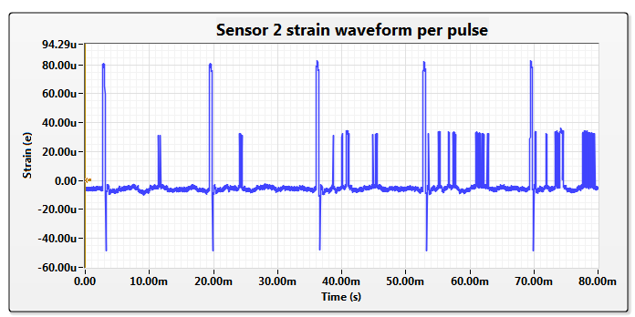
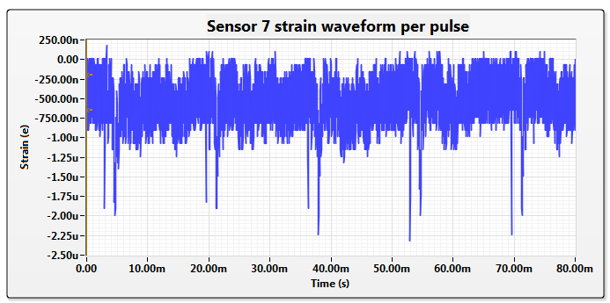
With burst of 10 pulses, no build-up is observed
Sensor 4
Sensor 7

Slide 18
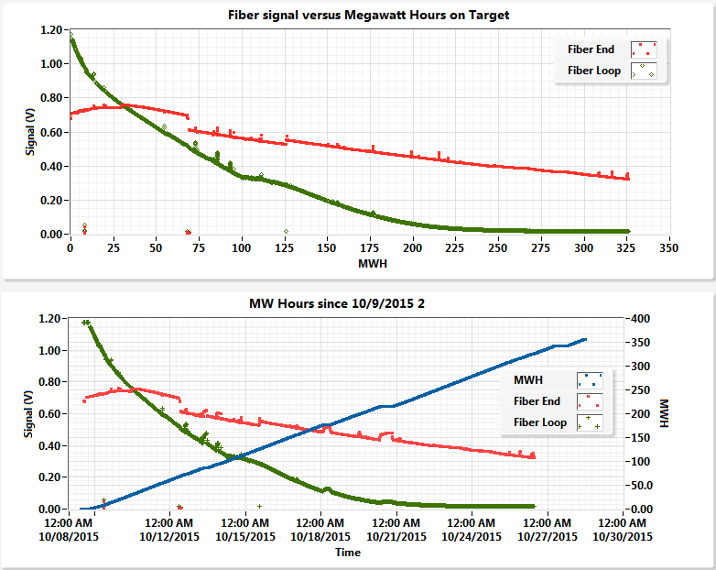
R&D of rad-hard optical strain sensors
Radiation up to 10¹⁰ Rem/hr neutron and 10⁸ Rem/hr gamma for 5000 hrs
No commercial solution for high radiation optical strain sensors
~850 kW beam

Slide 19
Instrumented target MTX-009 results
Data were obtained for 83 pulses
FEA evaluation showed agreement in timing and quality
Prompt response right at the beam was the best-predicted
Underestimated damping of the media (sensor 2 is interesting)
Overestimated strains in the transition section
Strains do not change with ten 60 Hz pulses
Single pulse assumption for FEA simulation is applicable
15 years of in-beam scaled experiments can be used more confidently
No under-damped resonance modes were observed
Responses are linear with pulse charge
Instrumentation on future targets will investigate the unexpected results

Slide 20
MTX-010 has been received with sensors installed
Same sensor locations
High-rad multimode option for the fiber strain sensors
Prototypes for single mode sensor (4)
Robust connector for remote-handling fiber-optic connection
Thermocouples near the back of the target

Slide 21
Future developments
Longer life strain sensors to track changes
High rad multi-mode
Single mode
Metal foil
Mercury flow and temperature
Vessel temperatures
Irradiation tests

Slide 22
Summary
MTX-009 (T13) strain sensor results are already useful
MTX-010 (T14) has been received with improved sensor array
Plan is to grow the extent of the diagnostics to fully understand the target response

