Slide 1
Summary of Development and Engineering Activities and Staffing
Summary of Target Development and Engineering Activities and Staffing
Mark Wendel
Target Systems Team Leader
SNS Accelerator Advisory Committee Meeting
February 16–18, 2016

Slide 2
Charge to the 2016 AAC/target committee
How might the target design & fabrication decisions that we are making now be improved for reaching the short-term 1.4 MW reliability goal?
Drew Winder presentation
How aggressively should SNS pursue implementation of gas injection for the short-term (1-year) and long-term plans? Are we using the right strategies?
Bernie Riemer presentation
What other areas of target development (besides gas injection) might have significant rewards for future target reliability?

Slide 3
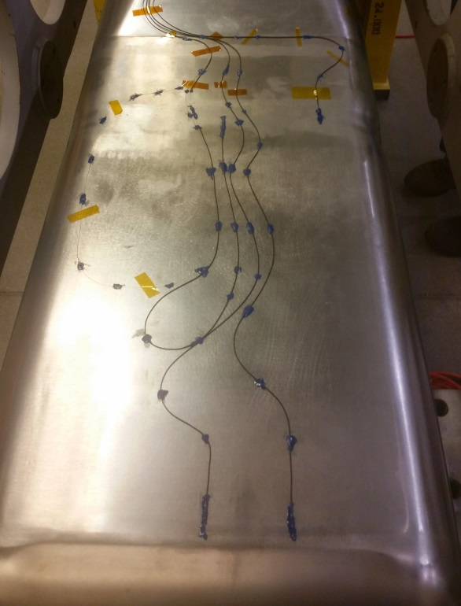
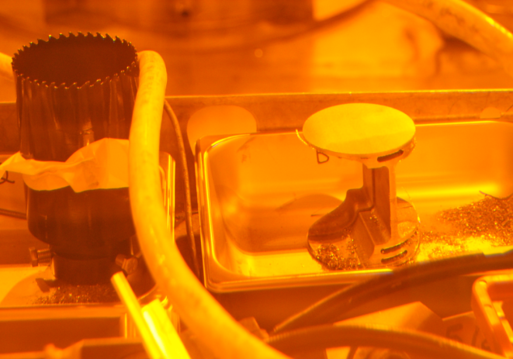
2015 Review → Target Reliability Improvement Program
Eight strain sensors on the target vessel
Target redesign for higher power
Strain measurements on a target
Fabrication improvements
Gas bubble injection
Increased pump speed
Improved PIE
Leak on E-beam weld
Beam Pulse Strain Measurement
Credit: David McClintock and Mike Dayton
Sample removed from the cutter bit

Slide 4
Also, since the Feb 2015 review…
Strategic goals have been set for SNS targets
1.4 MW operation
No more than 2 target changes per year
Predictable target change-outs
STS CD1 effort has been funded
FTS must handle 2 MW, requiring an even more robust target design
For power exceeding 2 MW, FTS systems will need an upgrade
Two more targets have been operated
Target T12 set longevity record at 4560 MW-hr
Target T13 is still operational at 1567 MW-hr
GOAL:
>104 cumulative days at 1.4 MW
based on a 5000 hour operational year

Slide 5
The targets that failed early came in pairs
Target | Exposure (MW-hrs) | Avg. Power (KW) | Failure
 | 3055 | 379 | None (Removed from Service)
 | 3145 | 771 | None (Removed from Service)
 | 2791 | 845 | Unknown
 | 3252 | 782 | None (Removed from Service)
 | 2362 | 938 | None (Removed from Service)
 | 617 | 916 | Transition cover plate weld
 | 98 | 943 | Transition cover plate weld
 | 3750 | 851 | None (Removed from Service)
 | 4195 | 1033 | None (Removed from Service)
 | 601 | 1052 | Front / transition weld
 | 167 | 1116 | Transition cover plate weld
 | 4560 | 964 | TBD – leaked on nose
 | 1565 | 1000 | In service
1
2
3
4
5
6
2012
Fabrication Improvements
7
Early weld failures
8
9
10
2014
Design Improvements
11
12
13
x
Original target
x
Jet-flow target
x
Original target plus

Slide 6
Two goals
Reliable 1.4-MW operation
No more than two predictable target change-outs per year
Higher power (2 MW+?)
In preparation for accelerator upgrade

Slide 7
What limits the target lifetime?
Administrative radiation damage limit of 12 dpa (applies to the shroud)
Early structural failures
Welds are the most susceptible
Fatigue due to high-cycle pressure-pulse and/or low-cycle thermal
Complicated by secondary corrosive factors
Cavitation damage erosion (CDE) of target vessel
Flow erosion/corrosion of the target vessel

Slide 8
Early fatigue failures (10⁷ < N < 10⁸) occurred at welds not located within the beam deposition region
Fatigue failure
Target | Exposure (MW-hrs) | Avg. Power (MW) | Thermal Cycles | Pulse Cycles
 | 617 | 916 | 640 | 160 × 10⁶
 | 98 | 943 | 178 | 27 × 10⁶
 | 601 | 1052 | 570 | 135 × 10⁶
 | 167 | 1116 | 194 | 31 × 10⁶
6
7
10
11
Design changes address this issue, but more margin is still desired
Weld vulnerabilities

Slide 9
Operational history shows status toward the >104-day, 1.4 MW goal
Days of longevity above certain power levels:
Range | T3 | T4 | T5 | T8 | T9 | T12 | T13
> 900 kW | 44.9 | 18.6 | 90.5 | 16.6 | 106.7 | 78.6 | 27.8
>1000 kW | 29.5 | 17.4 | 60.2 | 15.3 | 105.9 | 75.7 | 27.4
> 1100 kW | 0.0 | 0.0 | 0.0 | 14.1 | 64.1 | 57.2 | 26.8
> 1200 kW | 0.0 | 0.0 | 0.0 | 2.4 | 51.0 | 36.6 | 15.4
> 1300 kW | 0.0 | 0.0 | 0.0 | 1.0 | 15.1 | 24.9 | 14.1
Terminus > | Leaked | Removed from Service | Removed from Service | Removed from Service | Removed from Service | Leaked | In Service
T3 leak is unexplained
T9 demonstrated “full” life above 1 MW and ½ life above 1.2 MW
T12 demonstrated ¼ life above 1.3 MW – only lifetime data point for longer-life targets!
T12 leak appears to be due to cavitation damage

Slide 10
There are competing interests in deciding which targets to order
Time pressures:
Sufficient target inventory must be maintained
Analysis cycle is slow, but improving
Pressure to reach the 1.4 MW goal quickly
Desire for systematic changes, so that we learn something
Desire for stable target geometry
Center baffle cracking
Inner window cracking
Desire to push beyond 1.4 MW

Slide 11
What information do we have?
Target performance and PIE (Riemer presentation)
In-situ data (Wendel presentation)
EPICS sensors showing pressures, flows, temperature
New mercury vessel strain and temperature sensors
Target mock-ups
Water loop
Target test facility (TTF) mercury loop
Analytical models
FEM prediction for stress and strain

Slide 12
Current target module design and development staffing
Target design and analysis
Technical oversight and support of target fabrication for 4 targets yet to be delivered
Place new orders for target to keep inventory deep
Incremental design changes to build margins and respond to PIE
Radically new target concepts including one with swirl bubblers
Target development
Build and test swirl bubblers in our water and mercury test loops
Develop gas handling strategy for mercury system
Develop gas circulator in mercury test loop
Flow erosion testing
New and more extensive instrumentation on target module

Slide 13
Summary
Much work was accomplished this year in target design and development
Short-term 1.4 MW goal is challenging, but seems within reach
Long-term 2+ MW goal we think will require much more effort
We need the committee’s advice on our priorities and strategies to reach both goals

Slide 14
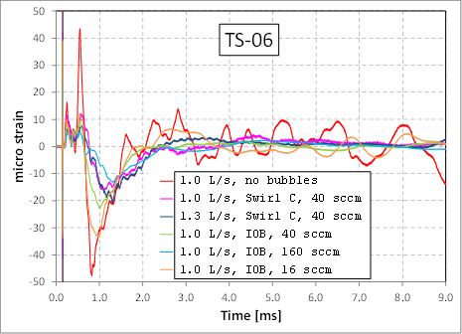
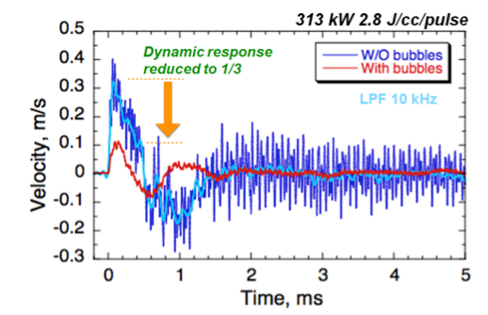
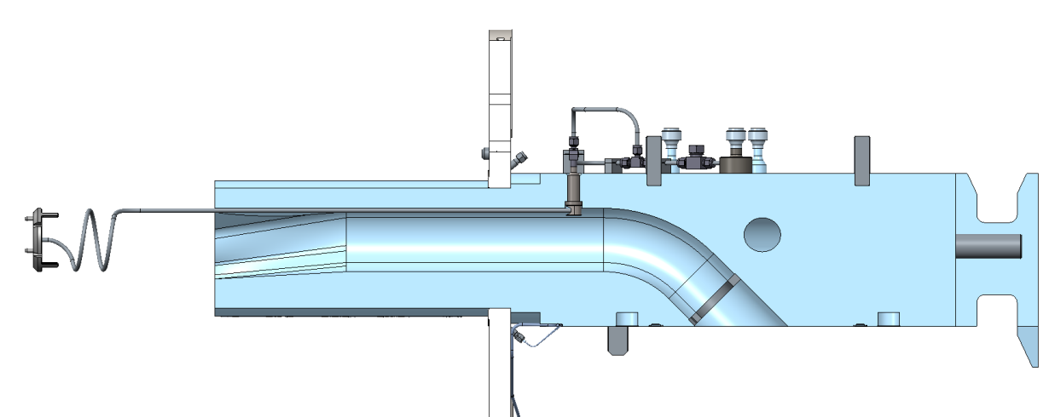
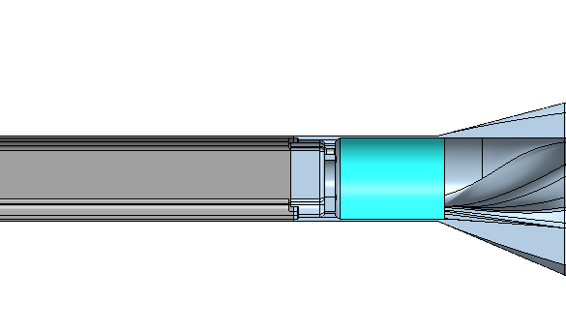
Work underway to expedite gas injection on a target within a year
Scaled Experiment at Los Alamos
Vibration measurements at J-PARC
Reduction in Hg vessel strain
by gas injection
Strain (10⁻⁶)
0.07%
SNS retrofit (0.06%)
0.3%
0.03%
B. Riemer et al.
T. Naoe, J-PARC
Jet-flow target retrofit to be delivered late Summer 2016

