Slide 1
Status of Linac High Voltage Converter Modulator Upgrades
Accelerator Advisory Committee Review
David E. Anderson, High Voltage & Pulsed Power Systems
Research Accelerator Division
February 2016

Slide 2
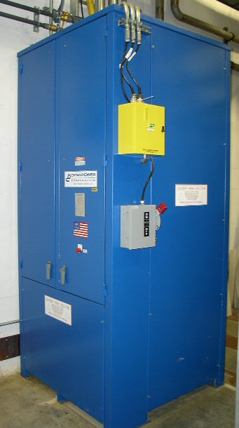
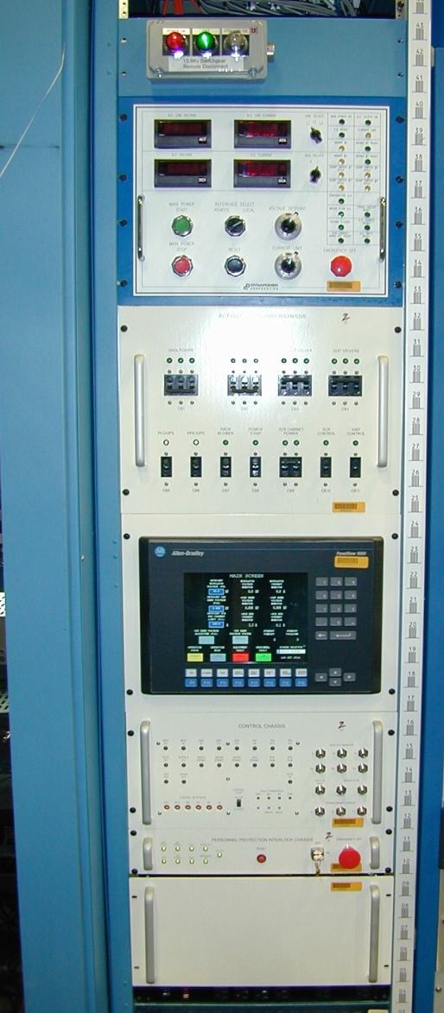
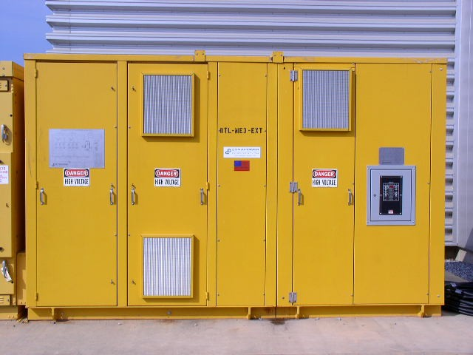
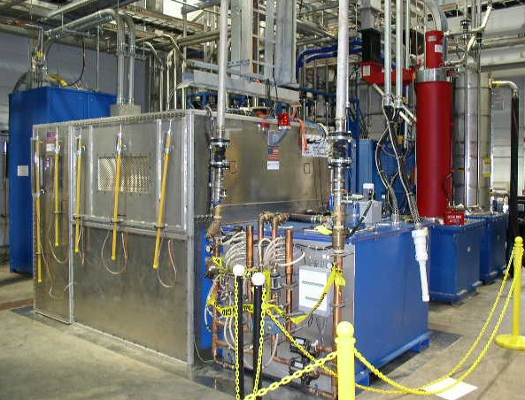
Modulators provide pulsed power to high power RF klystrons using 20 kHz switching with IGBTs
Provides up to 135 kV, 1.35 ms pulses at 60 Hz to amplify RF to 5 MW
3 phases employed to increase output ripple frequency
  Minimizes output filter requirements
  Minimizes fault energy available to klystron
Powers multiple klystrons up to 11 MW peak power
Currently there is ≤5% pulse droop operating in open-loop

Slide 3
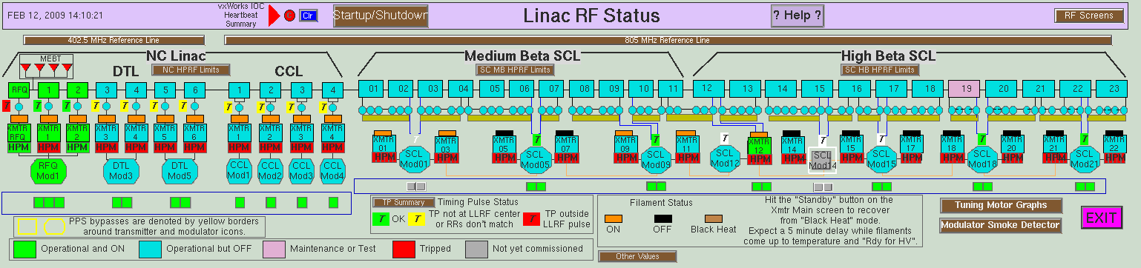
15 Modulators in 3 different configurations power 92 klystrons to support operation of the Linac
115 kV
125 kV
≤135 kV
71 kV
75 kV
DTL (8.5-10.6 MW peak)
SCL (8.0-8.8 MW peak)
CCL (8.4-9.1 MW peak)
15 modulators: 3 - DTL, 4 - CCL, 8 – SCL (1 added 2008)
Multiple HVCM/Klystron Configurations
Approx. 1×10⁶ combined operational hours on all modulators

Slide 4
Despite numerous short duration trips, the HVCM systems’ downtime is dominated by >4 hour events
HVCM Number of Events by Duration
Initiated 12-18 month boost capacitor replacement campaign
Notes:
Earlier run periods (not shown) had dominating HVCM down times
HVCM down times #4 or #5 during first part of CY12 operations

Slide 5
Analysis of failures by major component & subsystems is critical to improving overall system availability
Downtime Hours | Feb-Jun 2012 | Aug-Dec 2012 | Jan-May 2013 | Aug-Dec 2013 | Feb-Jun 2014 | Aug-Dec 2014 | Jan-Jun 2015 | Aug-Dec 2015 | Σ Hours
Scheduled Beam Hours | 3130 | 1868 | 3355 | 2789 | 3331 | 3105 | 3458 | 3037 | 24,073
Boost Capacitor | 36.9 | 11.4 | 27.7 | 10.4 | - | - | - |  | 86.4
IGBT/driver | 5.0 | - | - | - | 13.0 | - | 28.1 | 5.0 | 51.1
SCR Hardware | 22.8 | - | - | - | 17.9 | - | - |  | 40.7
Controller / PLC | - | 20.9 | - | 6.5 | - | 8.2 | - |  | 35.6
Mod. Tank | - | 20.0 | - | - | - | - | 5.7 |  | 25.7
SCR Controls | - | 3.0 | - | - | - | 7.3 | - |  | 10.3
Control Cables | - | 4.0 | 6.0 | - | - | - | 8.5 | 3.9 | 22.4
Water Panel | - | 8.0 | - | - | - | - | - |  | 8.0
Ctrl. Electronics | - | - | 4.5 | - | 9.0 | - | 2.4 |  | 15.9
Oil Pump | - | 7.1 | - | - | 7.7 | - | - | 10.1 | 24.9
Miscellaneous | 0.5 | - | 4.4 | 18.3 | 0.1 | 13.8 | 2.7 | 7.3 | 47.1
Σ | 65.2 | 74.4 | 42.6 | 35.2 | 47.7 | 29.3 | 47.4 | 26.3 | 368.1(1.5%)
Initiated 12-18 month boost capacitor replacement campaign
Notes:
IGBT timing change between CY09-1 and CY09-2
All switch plates caps replaced after CY09-2
Availability = total hours of operation (N times scheduled beam hours) – sum of downtime hours / total hours of operation

Slide 6
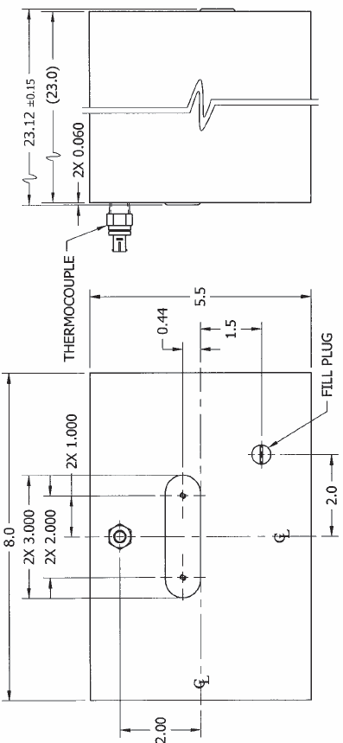
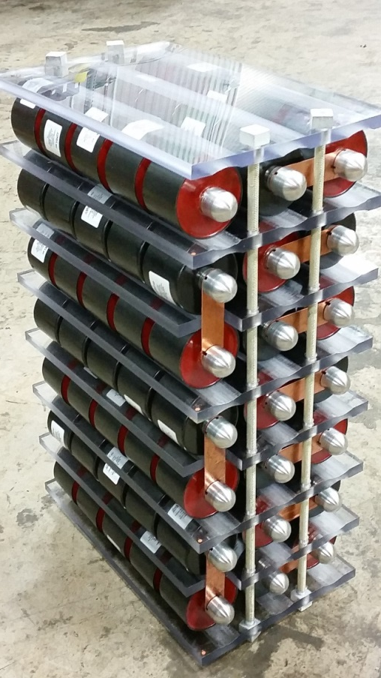
A key vulnerability to continuing reliable operation are the NCL HVCM boost capacitors
Condenser Products currently utilized in all systems but have exhibited some problems
  Case cracking and thermal fluid degradation
  Weld and material tested to 65°C
  Cargill says no chemical interaction w/ FR3 based on their analysis
Current strategy is to replace NCL every 12-18 months
  Hardware costs ~$50k (NCL only)
  Effort ~2 days each × 7 units (~$30k)
  Completed during winter 2015/2016 outage
NWL capacitors currently under evaluation in CCL-Mod1 (~4000 hrs. operation) and NWL will deliver a thermally-instrumented unit in March
Investigate alternate capacitor designs / technologies
  TPC solution shown is metallized poly, also permits tuning of resonant circuit
  Under test now in RFTF

Slide 7
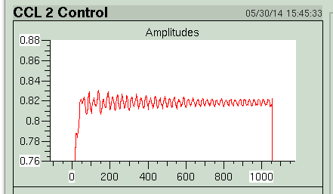
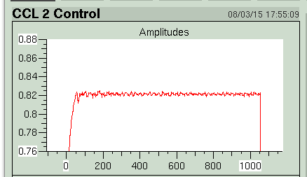
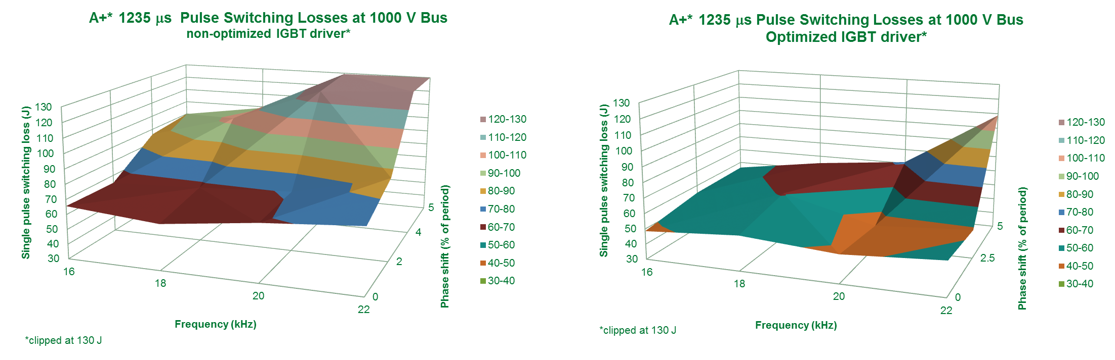
New IGBT gate driver circuits improve reliability, lower losses, enhance IGBT protection and reduce ripple
Currently installed on all systems
Demonstrated IGBT switching loss reduction of 30%
Provides protection for IGBT / driver issues
Modular and connectorized for ease-of-maintenance
~5X reduction in RF forward power ripple
BEFORE
AFTER
Forward Power
Forward Power

Slide 8
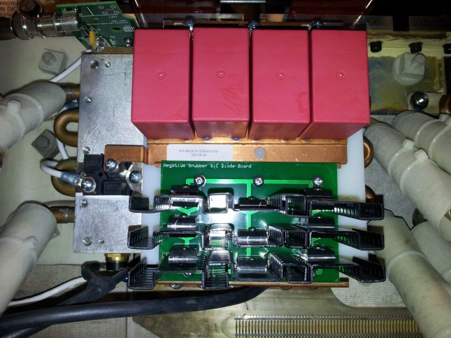
Adding IGBT snubbers permits higher voltage operation, reliable higher current IGBT operation & eliminates fault over-voltage problem
Installed on 12 of 15 operational modulators, 2 test stands
Combined >100,000 operational hours w/ no issues
Necessary for reliable pulse flattening and improved IGBT reliability
Notes:
Area above the red line primarily responsible for high IGBT failure rates in early operations

Slide 9
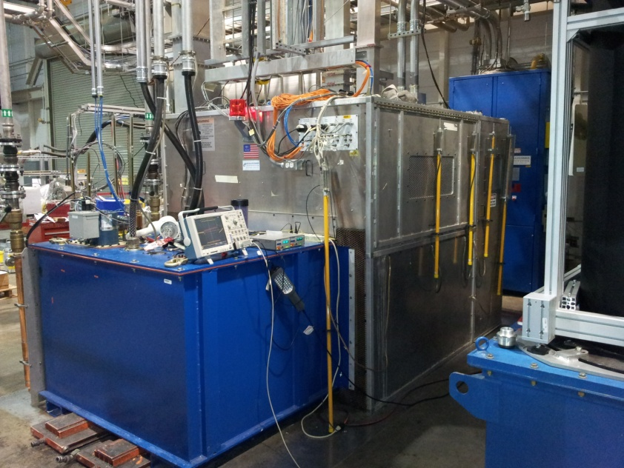
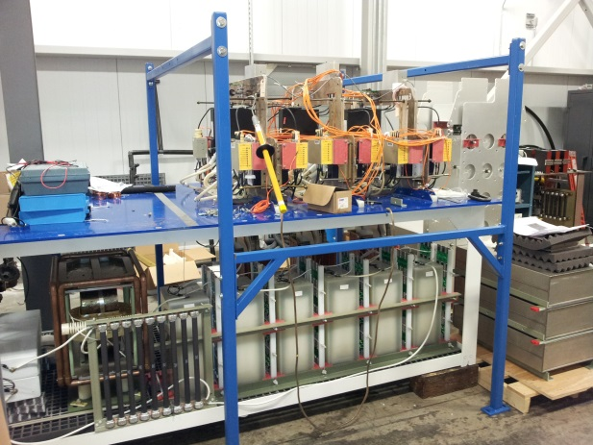
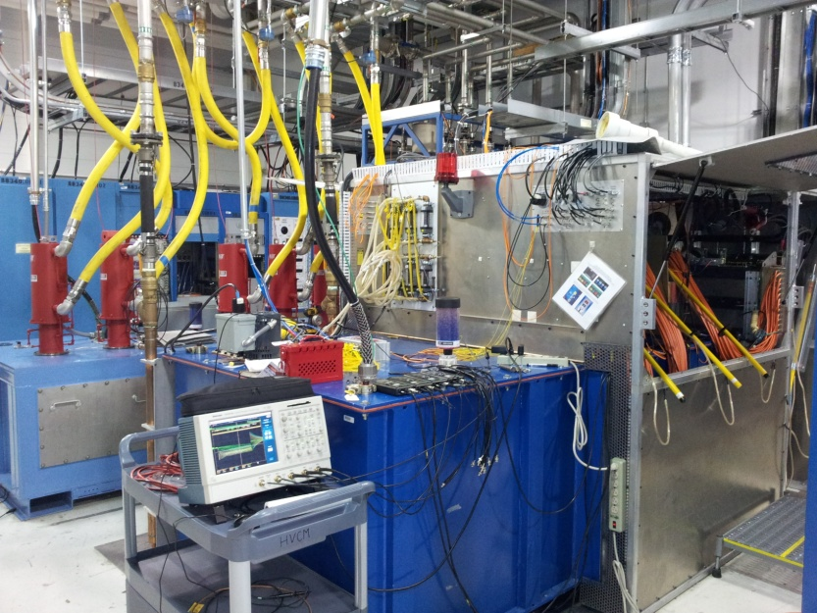
2 additional modulators plus a partial system are available to support modulator development and testing activities
RFTF HVCM
NCL variant of HVCM
Primarily to support RF- and cryo module testing, ISTF (new RFQ)
Secondary mission is NCL HVCM work
  Extended run testing
Open frame test stand
Prototype efforts
  Alternate topology
  Laminated bus
Affords flexibility and more extensive instrumentation @ limited power levels
HEBT HVCM
SCL variant of HVCM, STS-rated beam stick load
Dedicated mission is to support HVCM testing
Most development work is initiated here
Single Phase Test Stand (not shown)
Useful to test IGBT assemblies for matched timing on all 4 IGBTs and pre-qualification of spares

Slide 10
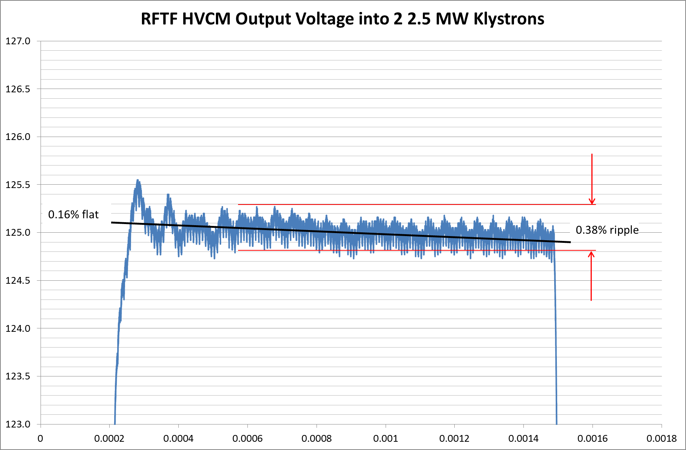
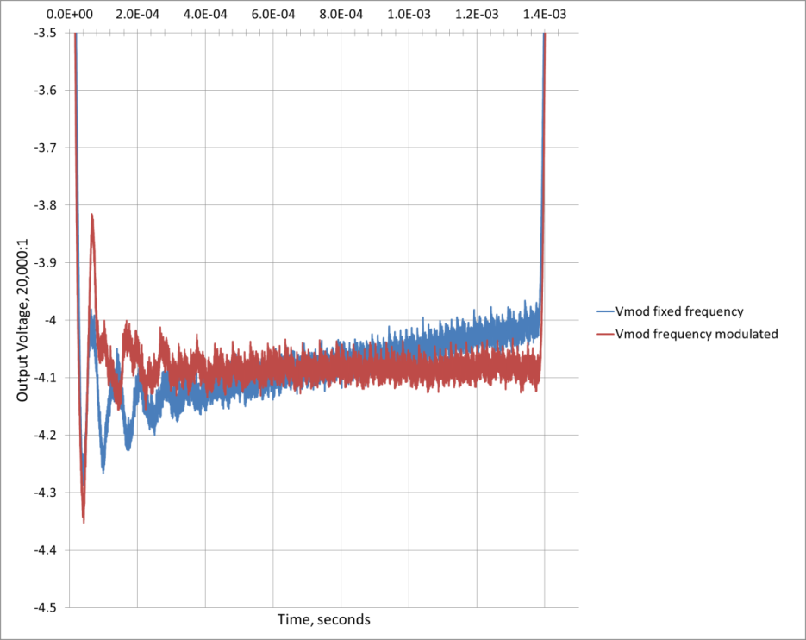
Pulse flattening to achieve reliable 1.4 MW operation, provide additional LLRF control margin and support PPU
Klystrons are at saturation at the end of the pulse with no remaining control margin
Pulse flattening for improved LLRF control margin demonstrated and currently running on DTL-Mod5, SCL-Mod18 and test modulators
  Utilizing frequency modulation
  Comparable LLRF regulation error
IGBT commutation currents increase by 40% but still acceptable
SCL-Mod18 Output Voltage with 17.8 to 23.0 kHz frequency modulation
18.5 – 23.0 kHz sweep with vernier

Slide 11
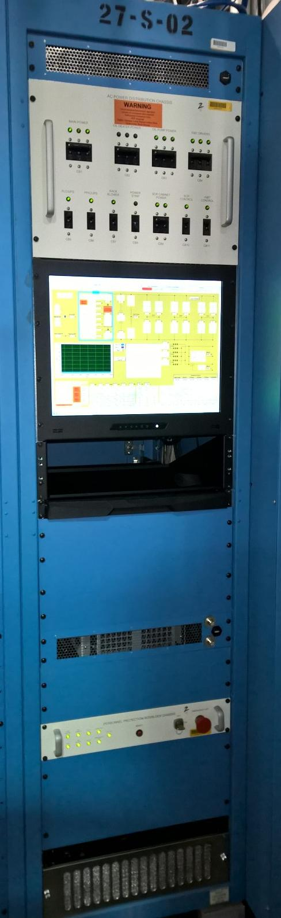
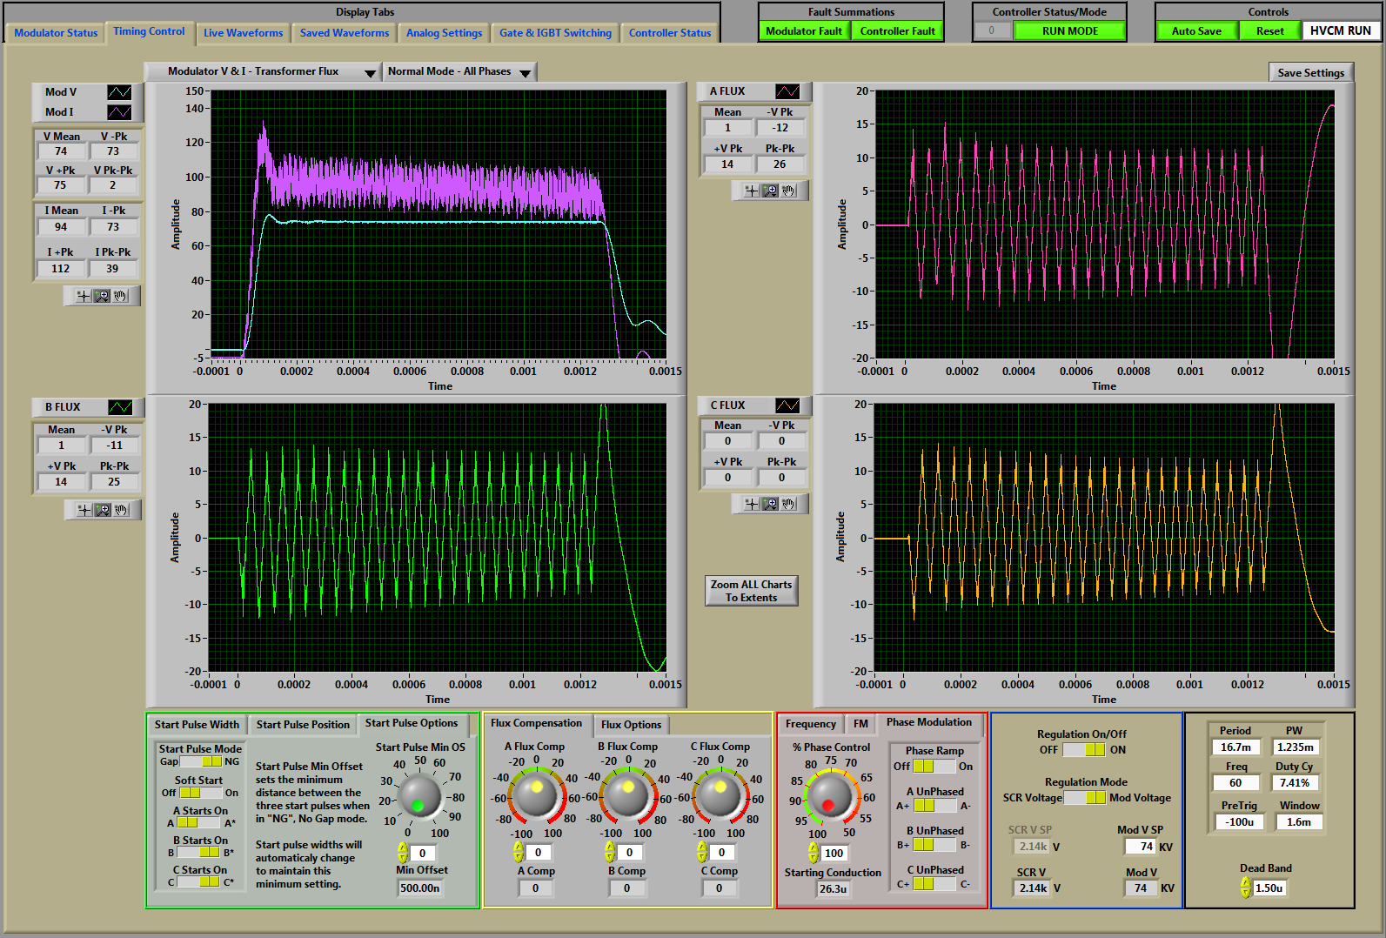
The new controller supports the proposed modulation scheme and can provide additional functionality (AIP-34)
Installed in test stands 2013
Installed in Summer 2014 in 1 SCL HVCM
Installed Winter 2015 in 1 DTL, 1 CCL, 1 SCL HVCMs
First Fault detection
Pulse Flattening
Full waveform capture
Commercial platform-based
Additional operational modes
Enhanced IGBT functionality integrated
Intellectual property ownership

Slide 12
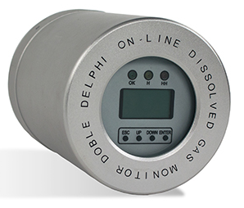
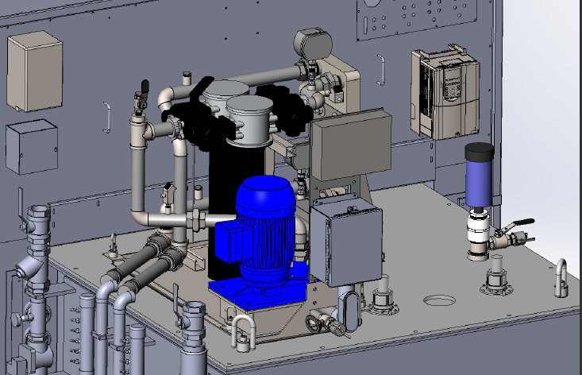
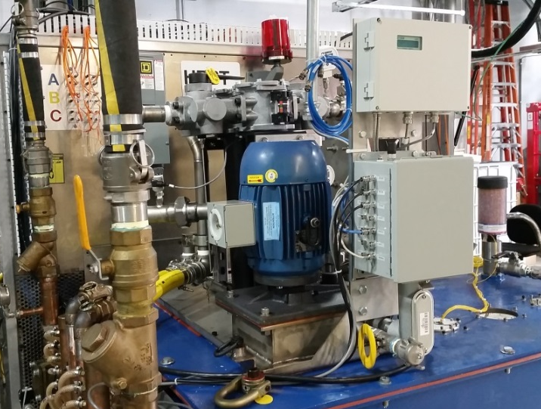
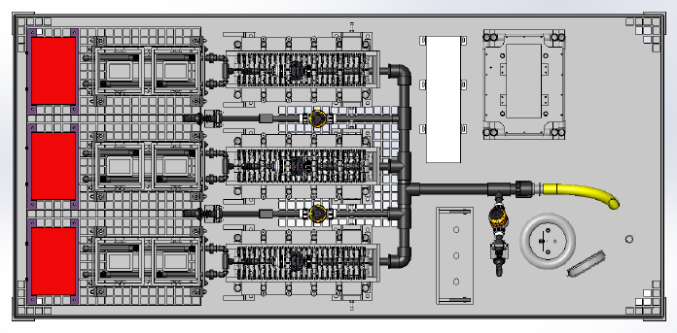
Enhanced reliability and reduced MTTR is improved by replacing the existing oil cooling system (AIP-36)
System/Operation Improvements:
Filter can be swapped during operation w/o interruption
Pump/motor assembly can be changed without removing the tank
Internal surface temperatures have dropped by at least 45 ° F
Oil turnover and filtering has improved more than 3X and flow does not decrease during operation
The Barron’s Oil system can be used during operation
Will be adding dissolved gas analyzer (H₂, CO, C₂H₂, & C₂H₄ (ethylene))
Design Model of Pump Ass’y.
Design Model of Internal Piping

Slide 13
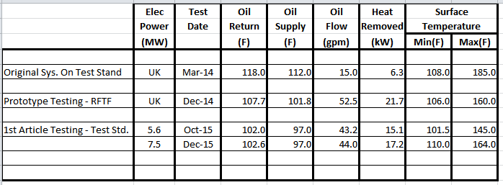
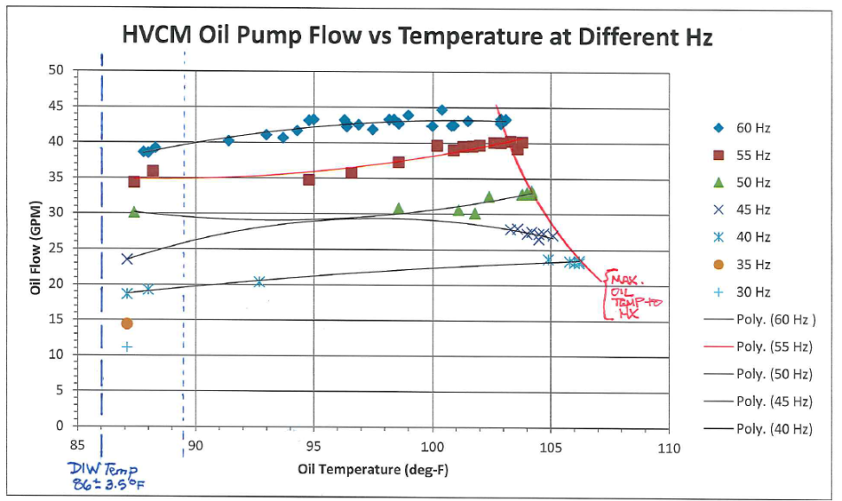
1st Article measurements indicate substantial improvements in component and oil temperature
Thermal/Hydraulic Improvements:
Overall the bulk oil temperature to the HX has dropped from greater than 118°F to 102°F
Overall heat removal to the cooling water has increase more than 300%
Internal surface temperatures have dropped from 108°/185°F to 101°/145°F
Oil turnover and filtering has improved more than 3X and flow does not decrease during operation

Slide 14
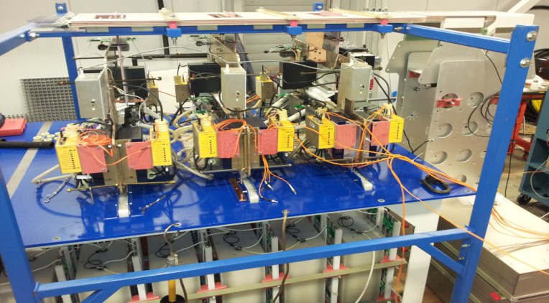
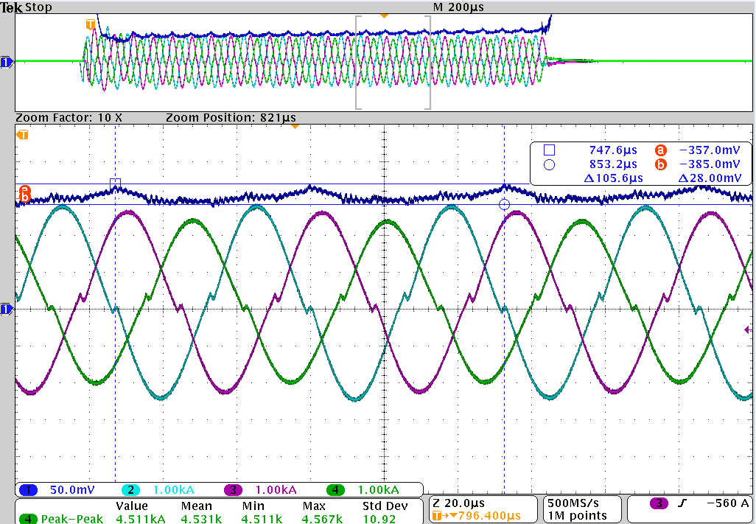
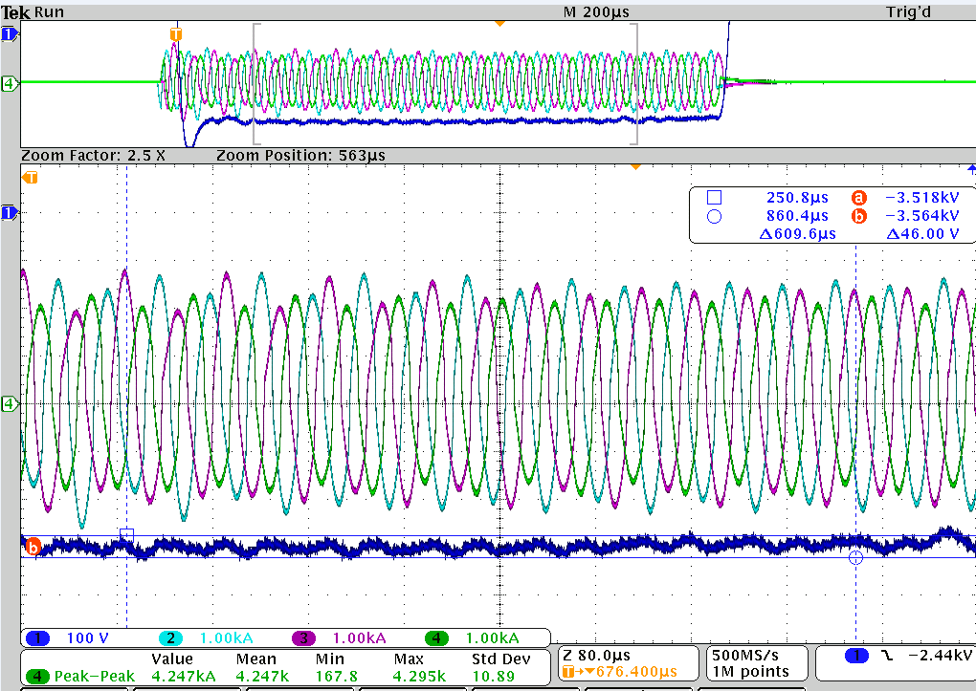
The Alternate Topology Modulator (ATM) shows promise for PPU and other applications
Presently installed in HEBT test stand.
Delivering 1.2ms 70kV 100A pulse at 60 Hz.
92% efficient ZVS/ZCS power conversion.
Thermal run completed. Maximum temperatures recorded transformer (76 °C), rectifier (72 °C) and resonant capacitor (39 °C) are well within safe operating margins.
Plan to operate at levels required for PPU after verifying safe for beam stick loads (shorted wire test)
Fixed frequency operation: output regulation 0.7% pp presently limited by phase to phase imbalance in resonant tank components.
Variable frequency operation: 24kHz-19kHz sweep illustrating pulse flattening capability
1.2ms pulse
1.2ms pulse
Mod Vout ripple detail
AØ,BØ,CØ XFMR Primary Currents
AØ,BØ,CØ XFMR Primary Currents
Mod Vout ripple (~1.3%)

Slide 15
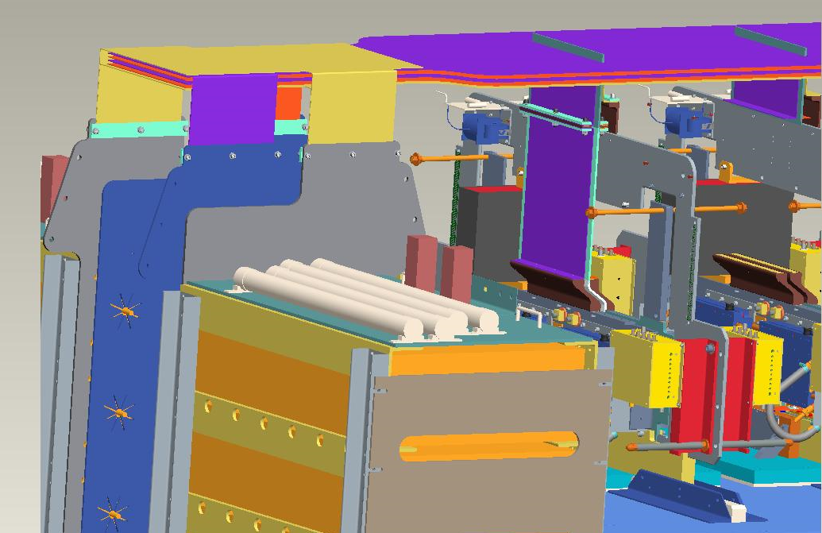
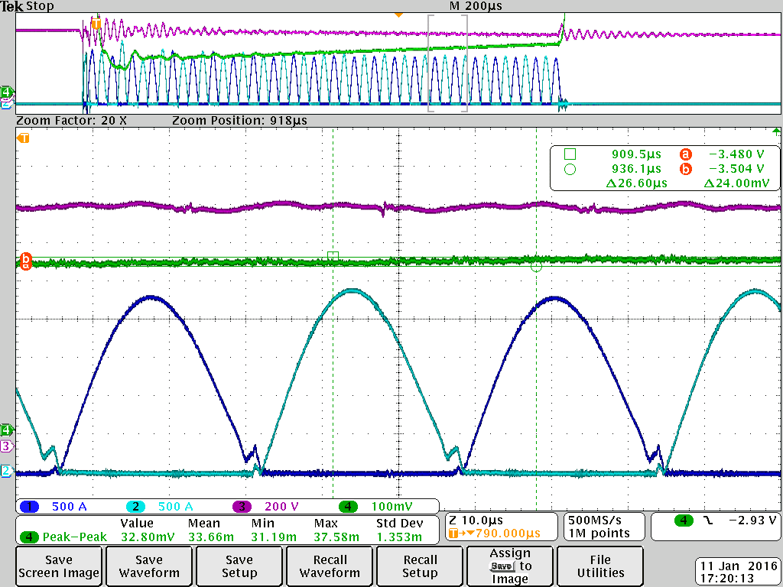
The laminated bus promises lower ripple and reduced MTTR for switch plates
Inductance of header cables, creating a substantial ripple on the switch plate DC bus. The ringing appears at the output and requires additional filtering.
Excessive DC ripple adds additional voltage stress to the IGBTs
Laminated bus reduces inductance and permits removal of most bypass capacitors
0.7% ripple demonstrated (on alternate topology) vs. several percent with current cable system

Slide 16
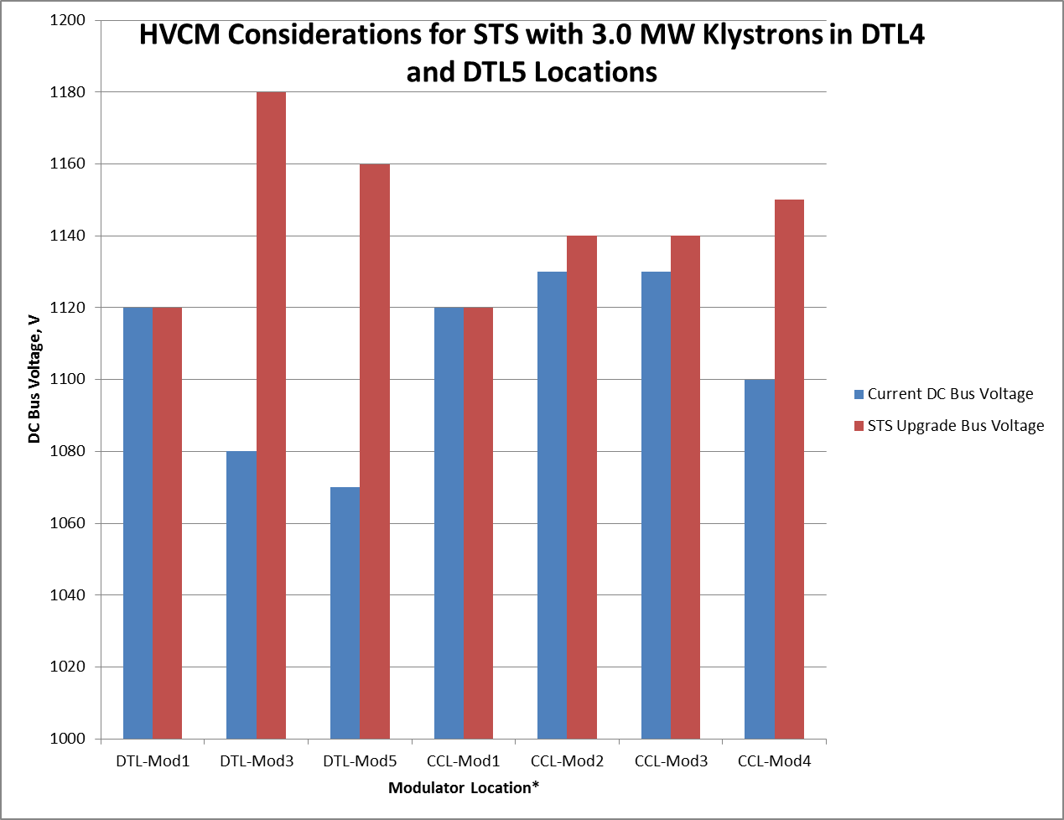
The PPU Project requires some development but should achieve comparable reliability
Modify boost transformers in warm linac to achieve required higher output voltages, esp. for 3.0 MW klystrons
Existing medium/high beta cavity klystron:modulator ratio of 10:1 forces higher DC bus voltage for additional power
Reduction to a 9:1 klystron:modulator ratio for first 18 new cavities (2 HVCMs), 10:1 ratio for the last 10 new cavities at reduced power levels
3 additional modulators required for PPU upgrade
HVCM Considerations for PPU with 3.0 MW Klystrons in DTL4
and DTL5 Locations

Slide 17
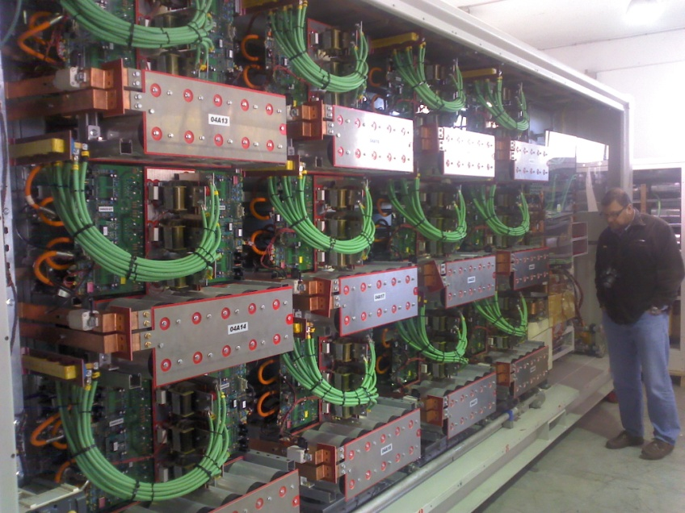
The JEMA modulator tested and awaiting controls upgrades to perform 30-day continuous test
Operated at peak available output power (90 kV, 38 A, 340 kW peak) at extended pulse width (3.5 ms) to achieve ~750 kW average power operation
Upgrading controls to accommodate CO2 discharge, smoke detectors and other equipment-protection systems for unattended 24/7 30-day test
Future applications under negotiation with ESS-Bilbao
Can power up to 12 700 kW CPI klystrons (STS power levels)

Slide 18
Summary
HVCM availability improved substantially and meets facility availability requirements
Synergistic solutions in development or installed to address remaining problems with HVCM to further improve reliability, increase available power and flatten pulse
Shift focus to concentrate on ripple to improve RF regulation error
Capacitor problems continue but multiple options being evaluated
Implementation of proposed alternate topology allows for future expansion & major subsystem redundancy
The SNS modulator team and the demonstrated HVCM high availability makes this topology attractive to KAERI and the proposed MaRIE upgrade
Other modulators (JEMA) being evaluated internally for future applications.
20KHz @ Start of Pulse & 21.2KHz @ End

