Slide 1
Achievements in In-Situ Plasma Processing of High-beta Cavities
SNS AAC
February 16-18, 2016
Marc Doleans
SCL systems group

Slide 2
In-situ plasma processing to increase linac energy
Higher linac energy provides more margin for reliable operation at 1.4 MW
Most cavities at SNS are limited by field emission (FE) leading to thermal instability in end-groups
  Average accelerating gradients are 12 and 13 MV/m for the two cavity geometries
Developed in-situ plasma processing to reduce FE and increase accelerating gradients
In-situ plasma processing

Slide 3
First plasma processing of a cryomodule in the SNS linac tunnel is a success !
Plasma processed cryomodule slot 19 (CM00023)
Average accelerating gradient
  11.2 MV/m before plasma processing
  14.2 MV/m after plasma processing
Beam energy increase from plasma processing of slot 19
  ~11 MeV
Operating gradients increased !
+2.3 MV/m
+5.5 MV/m
+3.7 MV/m
+0.3 MV/m

Slide 4
Since last review
Plasma processed and tested one more cavity in HTA (HB52)
Plasma processed offline cryomodule in RFTF test cave (CM00012)
Plasma processed cryomodule in-situ in the linac tunnel (CM00023)

Slide 5
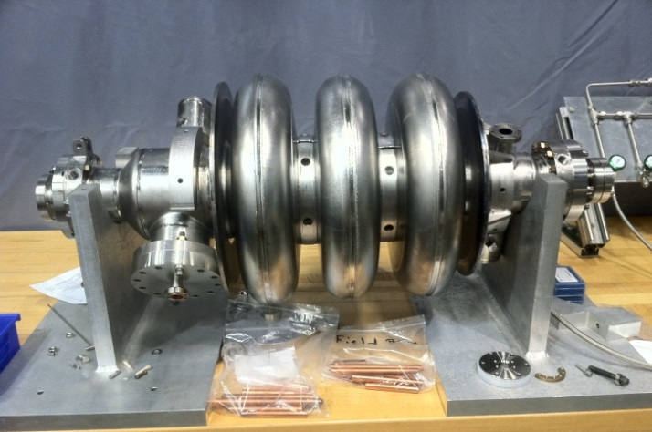
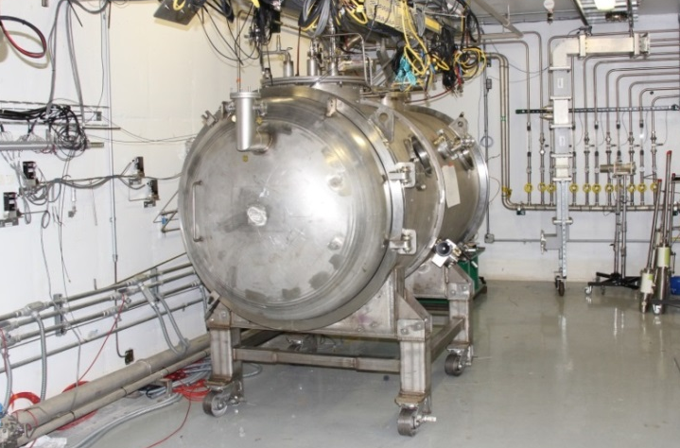
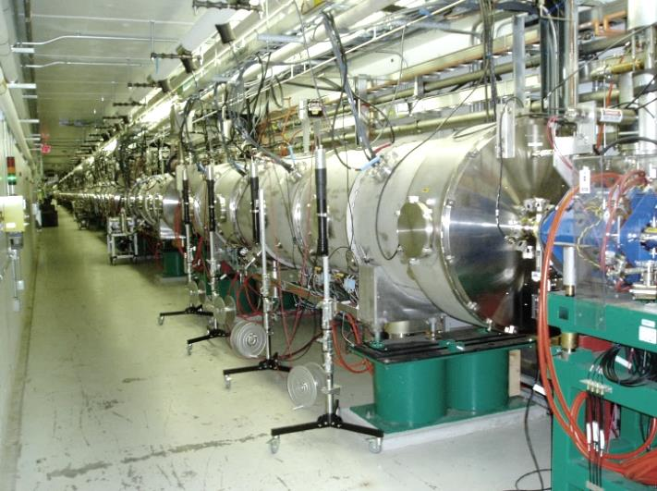
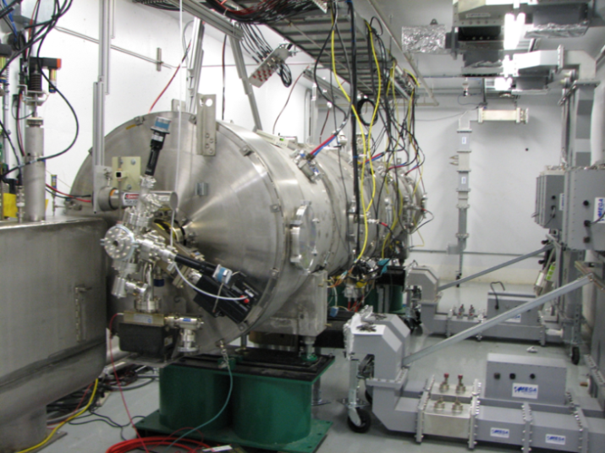
Deployment in linac tunnel started!
HB52
1st phase
2nd phase
R&D with Nb samples and offline cavities
Processing of 6-cell cavity in HTA*
CM00023
CM00012
On-going
FY16
FY17
4th phase
3rd phase
In-situ processing in linac tunnel
Processing of cryomodule in test cave
*HTA: Horizontal Test Apparatus

Slide 6
PLASMA PROCESSING
2nd cavity in HTA (HB52)

Slide 7
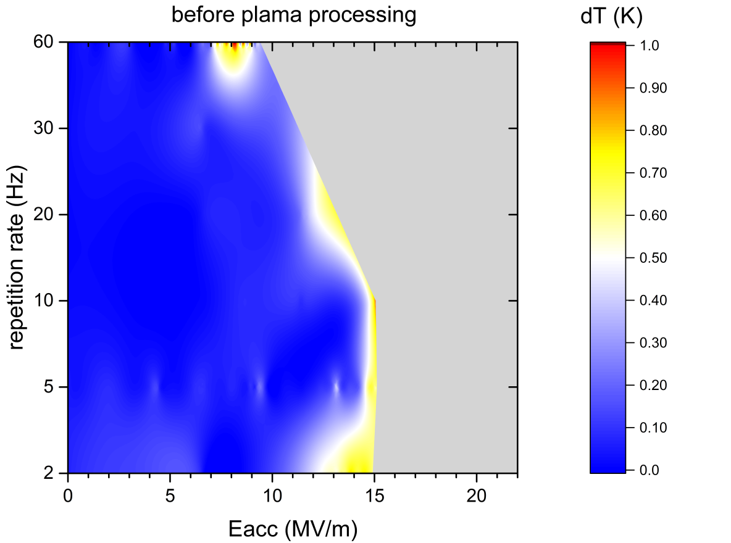
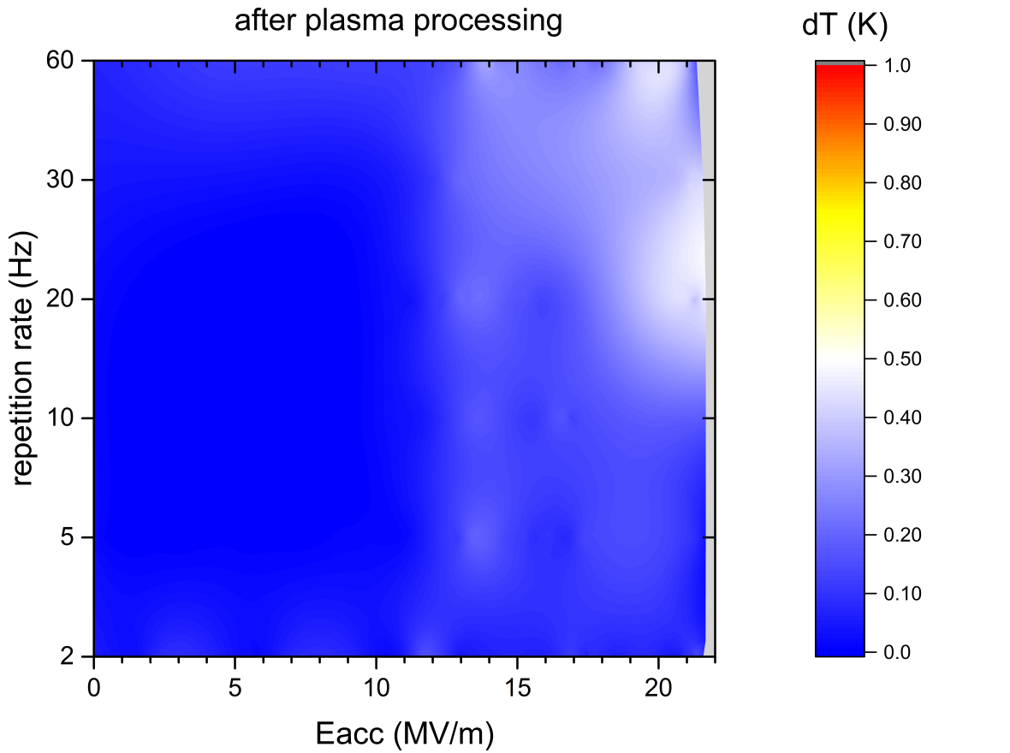
Plasma processing reduces Field emission and Secondary Emission Yield
SNS HB cavities show multipacting activity between 9 and 14 MV/m
  Normally reduces after RF conditioning and cavity performance then limited by FE
  Some cavities have severe multipacting which limits their performance
Cavity HB52 performance initially limited by multipacting
  Severity of end-group heating significantly reduced after plasma processing
Temp. increase of end-groups cooling circuit

Slide 8
PLASMA PROCESSING
OFFLINE CRYOMODULE (CM00012)

Slide 9
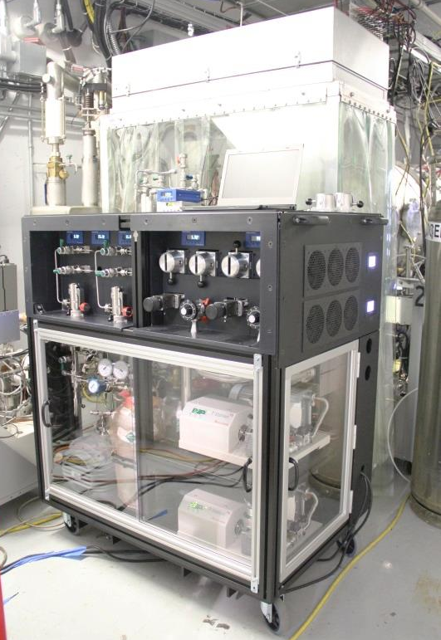
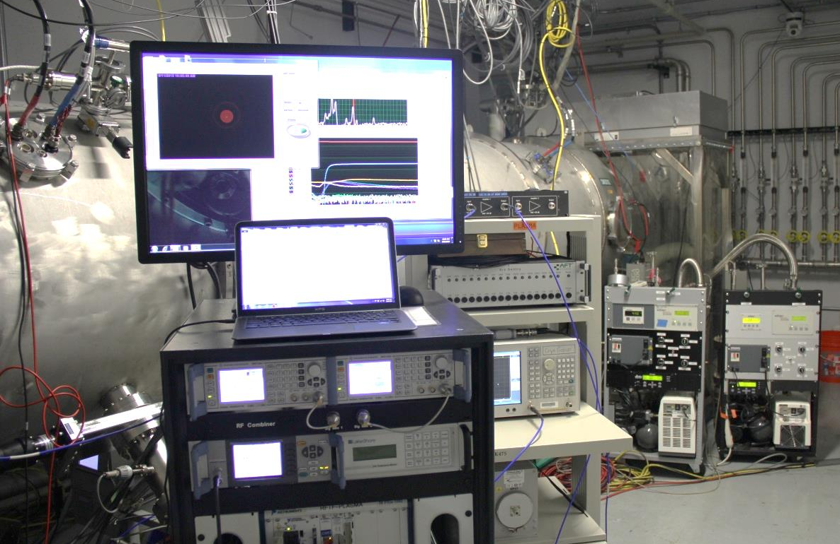
1st Plasma processing of a cryomodule
Offline cryomodule in RFTF test Cave (CM00012)
Plasma processing hardware for cryomodule
  Plasma process gas cart (new)
  Plasma RF cart
Plasma processing recipe successful for 4 cavities of HB cryomodule
New plasma processing cart for cryomodules
1st plasma in a cryomodule !

Slide 10
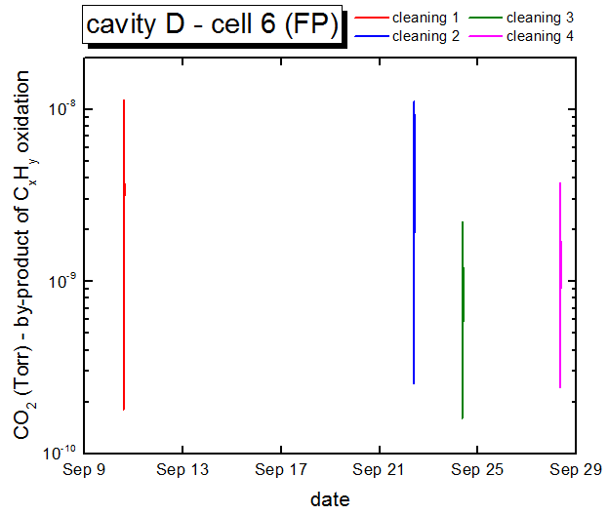
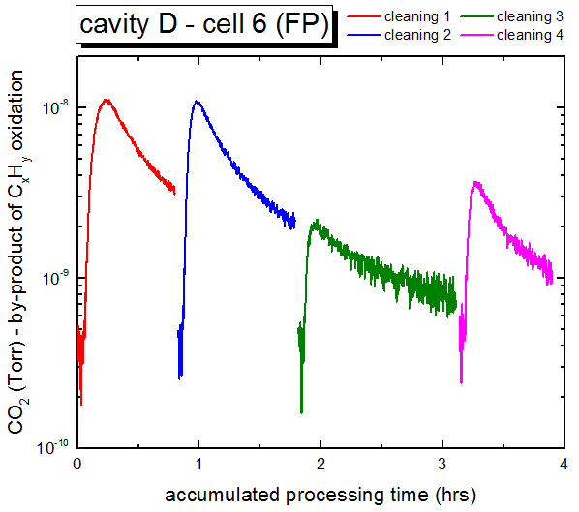
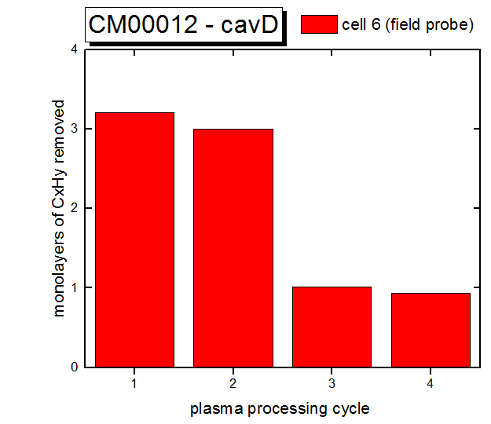
Hydrocarbons in CM00012 cryomodule
Estimated amount of hydrocarbons removed
  Done by Integration of RGA signal from oxidation by-products such as CO₂
  Few monolayers equivalent
Multiple cleaning cycles done over 2-3 weeks
  Used lessons learned from plasma processing of cavities in HTA
    Possible resurgence of hydrocarbons at top surface after cleaning over time
    Best cleaning obtained using multiple cycles

Slide 11
Plasma processing of CM00012 cryomodule
Removal of hydrocarbons from all 4 cavities (A, B, C, D)
  Systematic estimation of removed amount
Several monolayers equivalent removed from each cavity
  ~2/3 of cells cleaned adequately
  ~1/3 cells could benefit from additional plasma cleaning

Slide 12
Total hydrocarbon removed from CM00012
End cells of cavities are found to be most contaminated
Worse cells are at extremities of cryomodule
Beneficial to spend more time plasma processing cells with largest contamination
  Lesson learned applied during cleaning of CM00023 in tunnel

Slide 13
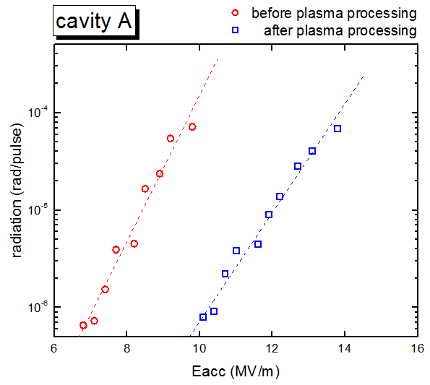
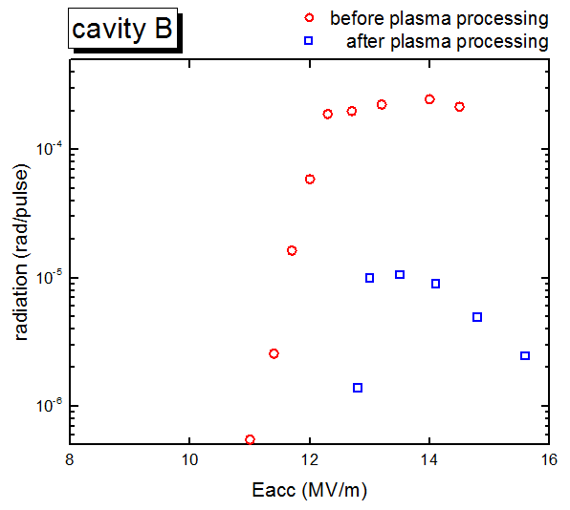
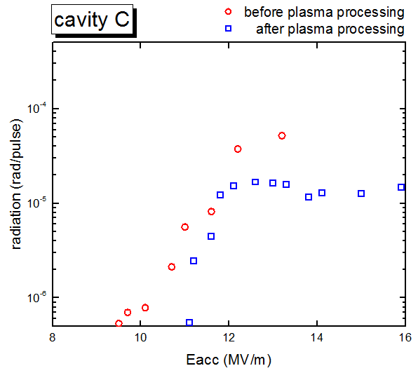
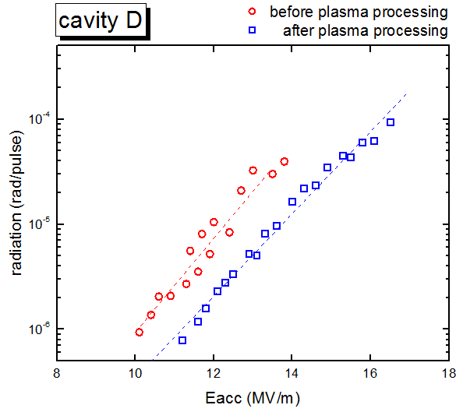
Radiation level reduced after plasma processing
Cav A and D radiation dominated by field emission
Cav B and C radiation dominated by multipacting
Plasma processing reduced radiation level at given gradient in all cavities

Slide 14
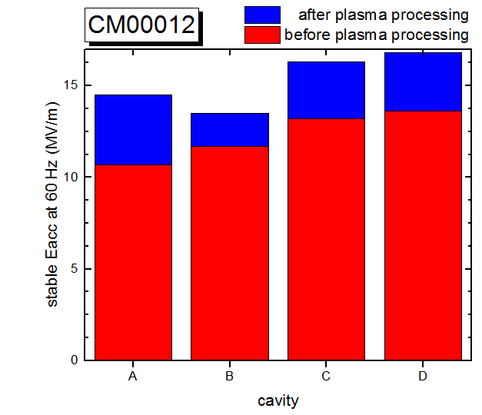
Performance of CM00012 cryomodule improved after plasma processing
Stable accelerating gradient at 60 Hz improved for all 4 cavities
Gradients improved by ~25%
  Avg. gradient 12.3 MV/m before plasma processing
  Avg. gradient 15.3 MV/m after plasma processing
  Cavity A improved by 35%
  Cavity B improved by 15%
    Initially limited by combination of multipacting and hot spot in end group
    Plasma processing reduced severity of multipacting which helped improving performance
      Reached >18 MV/m at low rep. rate with low radiation signal
    Hotspot limits performance at 60 Hz
Ready to deploy plasma processing in linac tunnel

Slide 15
PLASMA PROCESSING
CRYOMODULE SLOT 19 (CM00023)

Slide 16



Vacuum connections for plasma processing
Warm up three cryomodules
  Slot 18, 19 and 20
Beamline turbo carts (turbo) on each cryomodule and warm sections
Plasma gas manifold cart to inject gas cavity D side
  Connections at cryomodules using standard cleanroom and 3nm pore size particulate filter
  Non-flammable gas cylinders and 16psig relief valve (< cryomodule relief pressure)
Pumping /monitoring of process gases
  Pirani gauges at connections inlet and outlet of cryomodule and RGA analysis
Beam direction
Slot 20
WS 19
Slot 19
WS 18
Slot 18
WS 17
SGV
20501
SGV
20001
SGV
19501
SGV
19001
SGV
18501
SGV
18001
SGV
17501
A
B
C
D
E
BL: Beamline turbo cart
CCG: Cold Cathode Gauge
IP: Ion Pump
PLS: Plasma gas manifold cart
RGA: Turbo cart with RGA
SGV: Sector Gate Valve
A, B, C, D & E: Angle valves
BL
A₁
BL
B₁
BL
C₁
PLS
C₂
RGA
D₂
BL
D₁
BL
E₁

Slide 17
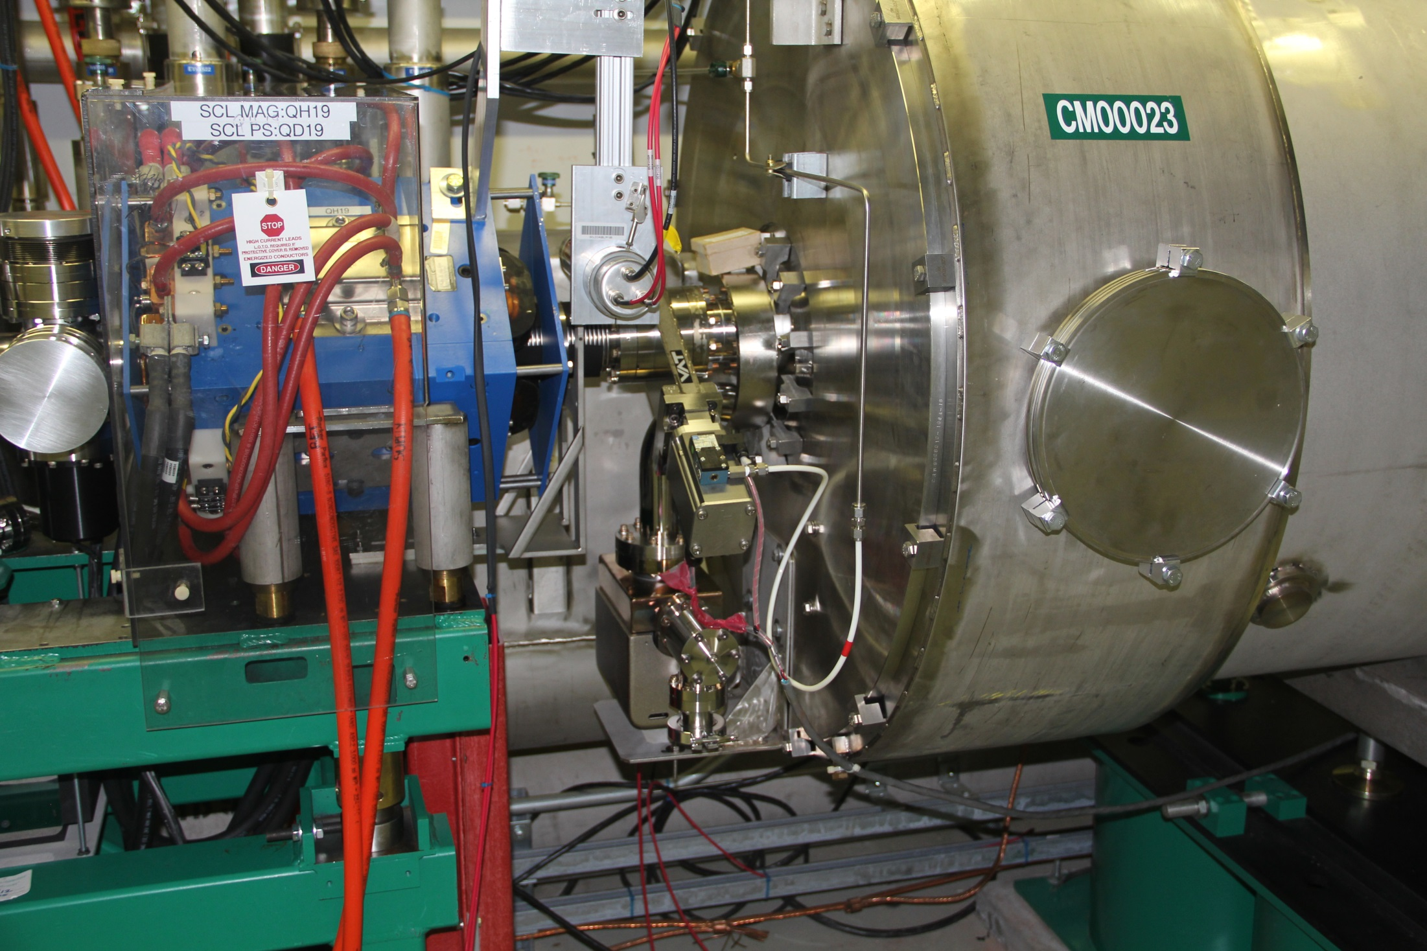
Pumping port on CM
with angle valve
C
WS 19
CM slot 19
(serial number CM00023)
Downstream

Slide 18
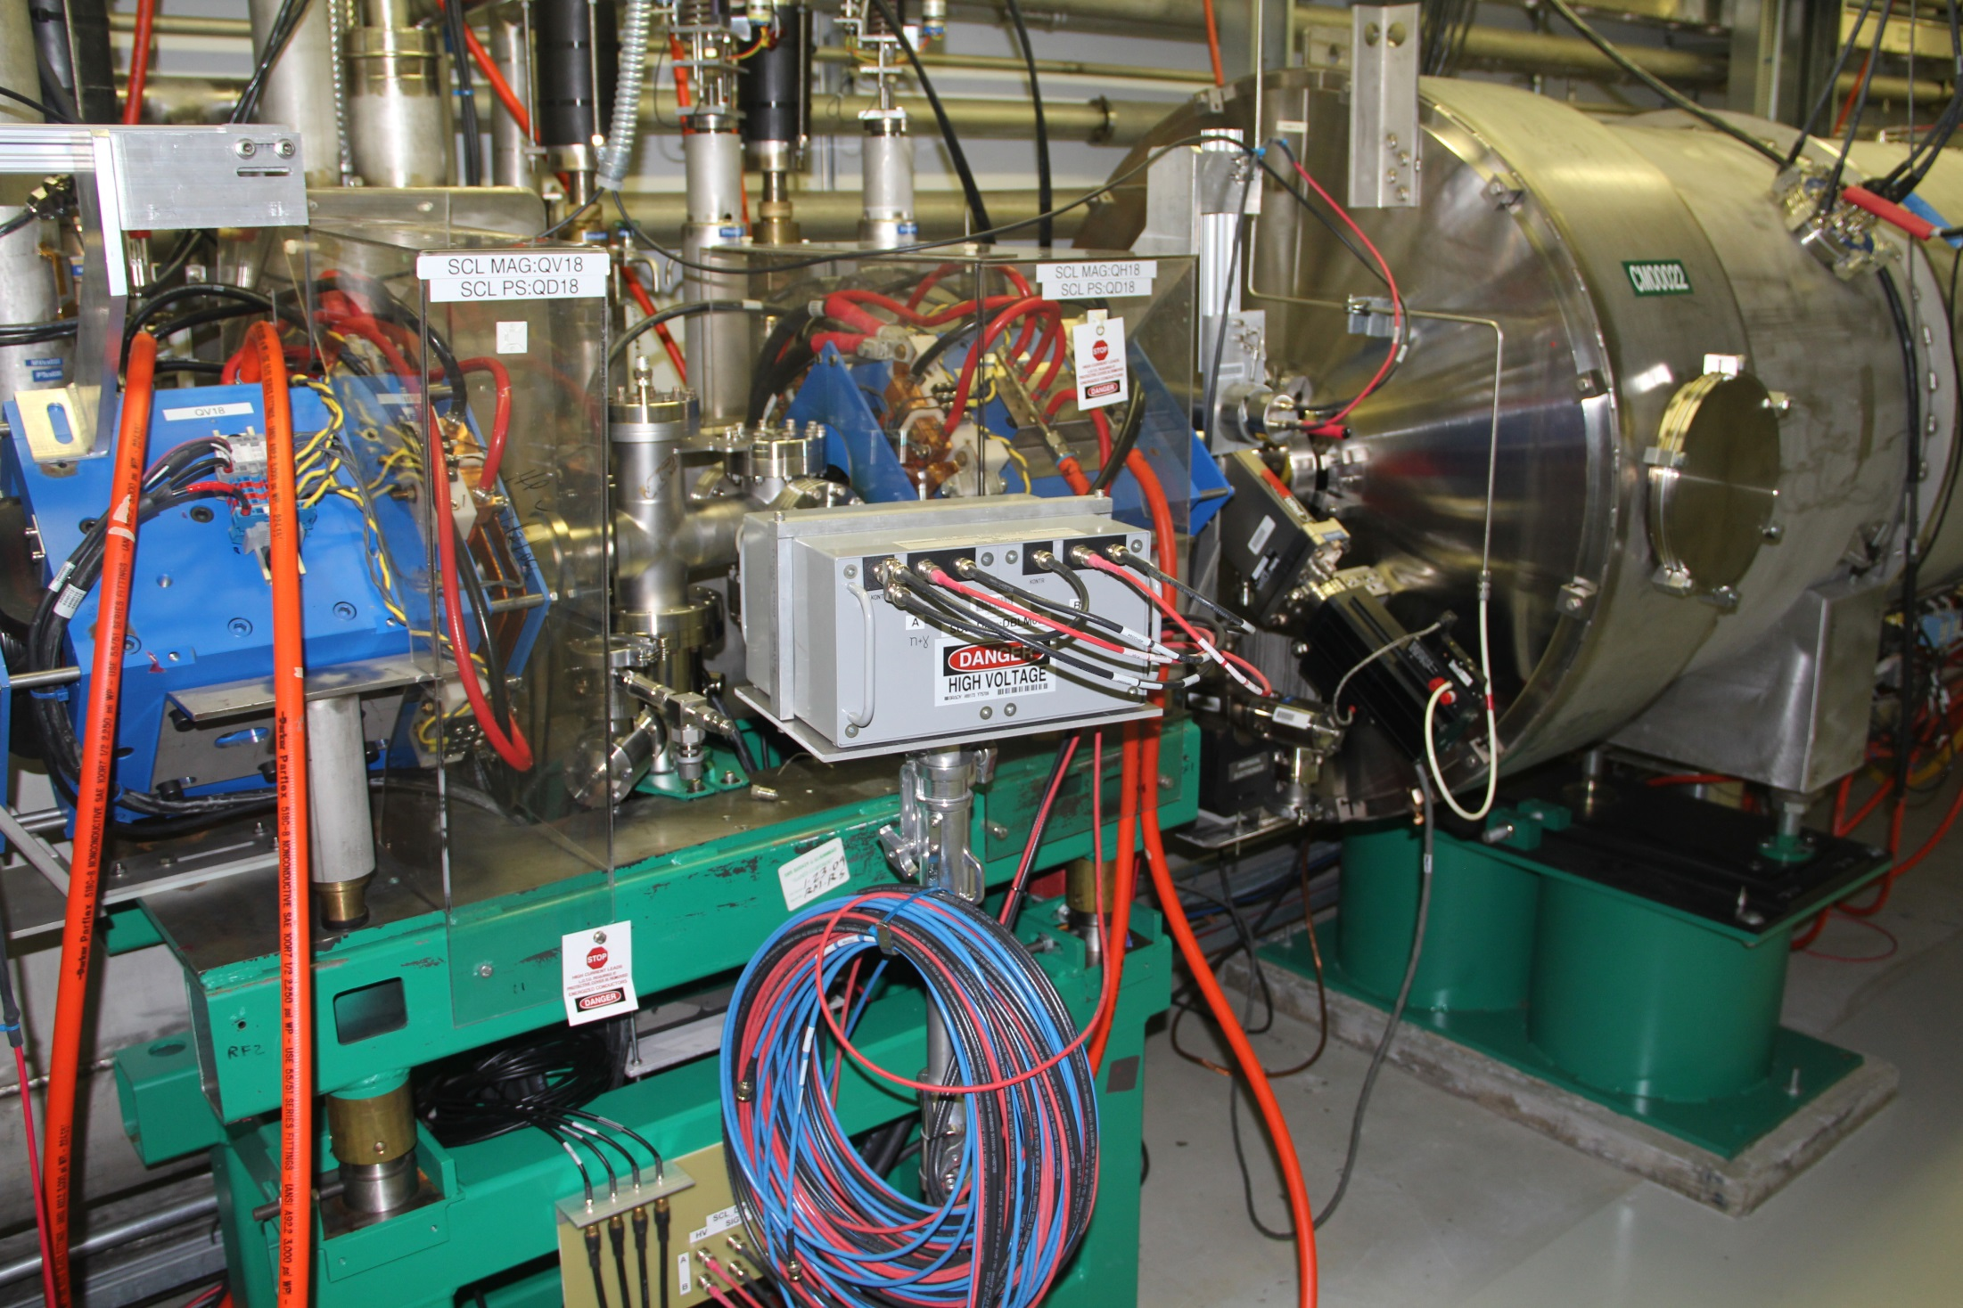
Pumping port on WS
with angle valve
D
WS 18
CM slot 18
Downstream

Slide 19
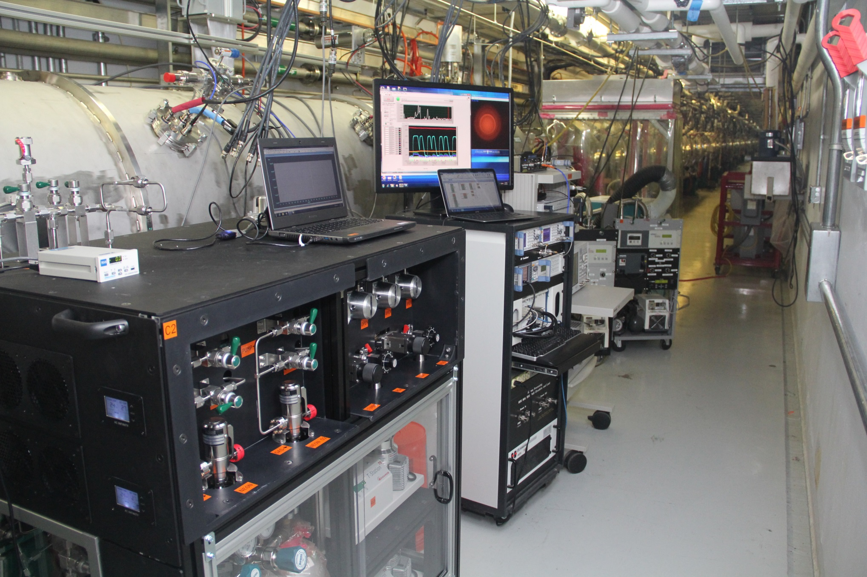
Plasma processing hardware adjacent to CM slot 19
Applied ALARA: Radiation survey indicated best location for minimum radiation exposure during work (<1 mrem/hr)

Slide 20

Vacuum configuration during plasma processing
Sections seeing process gas during processing: CM slot 19 and WS 18
  Ion pumps and CCGs off
Adjacent sections not seeing process gas
  3 gate valves closed on each side to protect nearest cold cryomodules (slots 17 & 21)
    Local mode only to avoid any accidental opening
  IP on and extra pumping using beamline turbo carts (WS19 and CM slots 18 and 20)
Closed - Local mode
Opened - Local mode
Closed - Local mode
Slot 20
WS 19
Slot 19
WS 18
Slot 18
WS 17
10⁻⁶ Torr
10⁻⁸ Torr
10⁻¹ Torr
SGV
19001
10⁻¹ Torr
10⁻⁶ Torr
10⁻⁸ Torr
IP_{on}
warm
IP_{on}
IP_{off}
warm
IP_{off}
IP_{on}
warm
IP_{on}
A
B
C
D
E
BL: Beamline turbo cart
CCG: Cold Cathode Gauge
IP: Ion Pump
PLS: Plasma gas manifold cart
RGA: Turbo cart with RGA
SGV: Sector Gate Valve
A, B, C, D & E: Angle valves
BL
A₁
BL
B₁
BL
C₁
PLS
C₂
RGA
D₂
BL
D₁
BL
E₁

Slide 21
RF configuration during plasma processing
top view
gas
flow
D
C
B
A
FP
FPC
All cavities disconnected from High power RF system
High power top-hats on each cavity
  Air side of coupler assemblies stay on at all time
Cavities processed sequentially and iteratively
  Following gas flow from cavity D to A
Cavity being plasma processed
  FPC and field probe connected to RF cart
  Camera monitors any discharge in FPC
Plasma
RF
Cart

Slide 22
Radiation monitors for evaluating performance before/after plasma processing
“DBLM21”
“Dev03”
PMT3
PMT2
side view
“DBLM24”
“DBLM18”
PMT4
PMT1
D
C
B
A
Radiation waveforms during cavity operation at cold
  Helpful for rf conditioning
  Relevant diagnostic to quantify and understand cavity performance
PMTs have better sensitivity for detection of X-rays from cavity operation
  4 PMTs temporarily installed in the tunnel at slot 19
  Used to evaluate radiation level for each cavity before and after plasma processing

Slide 23
Plasma processing of CM00023 cryomodule
Removal of hydrocarbons from all 4 cavities (A, B, C, D)
  Blind tunning, RF probe signal useful to confirm location of plasma
Several monolayers equivalent removed from each cavity
  Contamination pattern similar to offline cryomodule
  Used lesson learned and plasma processed cavity extremities more

Slide 24
First in-situ plasma cleaning of hydrocarbons in linac tunnel achieved!
Similar contamination pattern as offline cryomodule
Multiple RF carts would allow to plasma process cavities simultaneously
  Reduce amount of time needed for plasma processing
    Further improve on ALARA (less time in the tunnel)
    Facilitate coordination with other work in tunnel during maintenance period

Slide 25
Radiation level reduced after plasma processing
Plasma processing reduced radiation level at given gradient in all cavities
Cavities more stable even at higher radiation level after plasma processing

Slide 26
Performance of CM00023 cryomodule improved after plasma processing
Stable accelerating gradient at 60 Hz improved for all 4 cavities
Gradients improved by ~25%
  Avg. gradient 11.2 MV/m before plasma processing
  Avg. gradient 14.2 MV/m after plasma processing
  Cavity B improved by 60%
  Cavity D barely improved
    Strong emitter affects all cavities
    Ion pump burst at restart
      Affected cavity D?
      Dedicated study with offline cavity will be conducted

Slide 27
CONCLUSION
Plasma processing effort is going very well
Plasma processing of offline cryomodule was a success
  Total accelerating gradient increased by ~12 MV/m
  Not yet re-installed in linac tunnel
First plasma processing of a cryomodule in SNS tunnel is a success!
  Total accelerating gradient increased by ~12 MV/m
  Corresponding beam energy increase ~11 MeV
Main deployment of plasma processing in SNS linac tunnel for high-beta cryomodules foreseen for FY16 and FY17
Plasma processing of medium-beta cryomodules is anticipated during Proton Power Upgrade
  Efficient use of existing RF power in SC linac

Slide 28
Multipacting and FE radiation
Radiation monitors useful diagnostics to assess cavity performance
  Waveform during RF pulse informs about type of electron activity
  Integrated value per pulse simple value of merit for electron activity
  Radiation associated to multipacting tend to saturate after multipacting band is passed
  Radiation associated to FE follow the electric field waveform and keep increasing

