Slide 1
Advances in Accumulator Ring Beam Damping
N.J. Evans

Slide 2
Overview
Motivation
Damper System Status and Overview
Damping Results and Recent Advancements
Summary

Slide 3
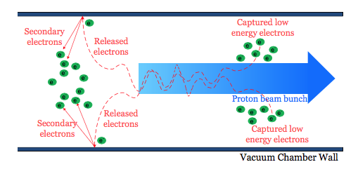
Motivation
E-p instability – interaction of beam with a cloud of electrons in the beam pipe generated by low levels of beam loss, amplified by secondary electron generation
Image credit: Zaipeng Xie

Slide 4
Motivation – E-P Manifestation
Spectrogram of Difference Signal
Broadband (80-120MHz) betatron oscillation:
1000
Turn
300
10.0μC
Extraction
1000
Turn
300
5.0μC
1000
Turn
Rise time ~10’s of turns
2.5μC
300
40
Freq[MHz]
40
200
Freq[MHz]
200
2008 Study by Cousineau et. al.

Slide 5
Motivation – E-P During Operation
E-p produces <1mm oscillation near the end of accumulation – No detectable losses associated with e-p – but:
  Onset will be fast – rise times typically 10s of turns
  Complicated dependence on many parameters – bunch shape, current, momentum spread, etc.
  Could be a problem as we move to 2.8 MW
Mitigation measures include: Beam pipe coating, up to 15 kV 2nd harmonic RF, large apertures (low losses), and active feedback

Slide 6
Making the Damper System Work
By Dec 2014 | Hardware in place, tested, sporadic damping
Jan-Feb 2015 | Hardware Knowledge Transfer*
Mar-Jun 2015 | BTF Studies w/ damper hardware
Jul-Aug 2015 | Software & Operation Knowledge Transfer**
Aug-Sep 2015 | Consistent, Reliable Damping Achieved, Conducted Damper Performance Experiments
Oct 2015 - Present | Data Analysis, Write-up, Documentation, etc.
*Special thanks to *Jeff Bryan, *Craig Deibele, **Zaipeng Xie, ** Eric Breeding

Slide 7
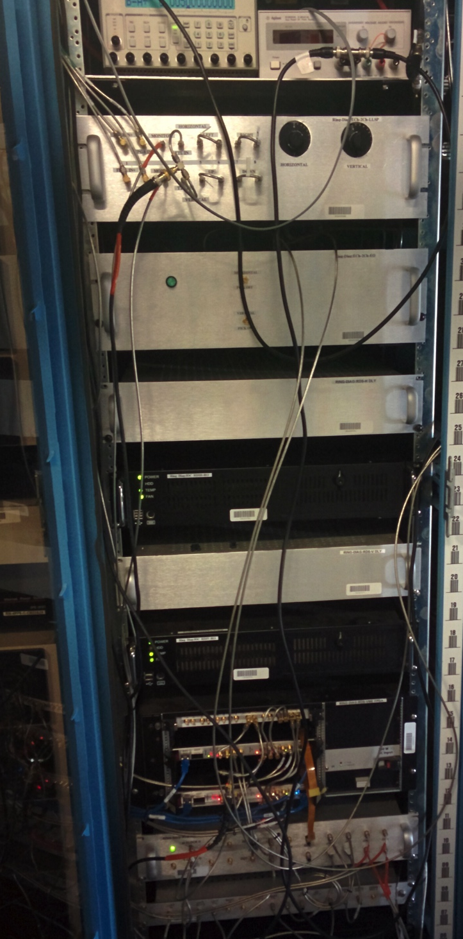
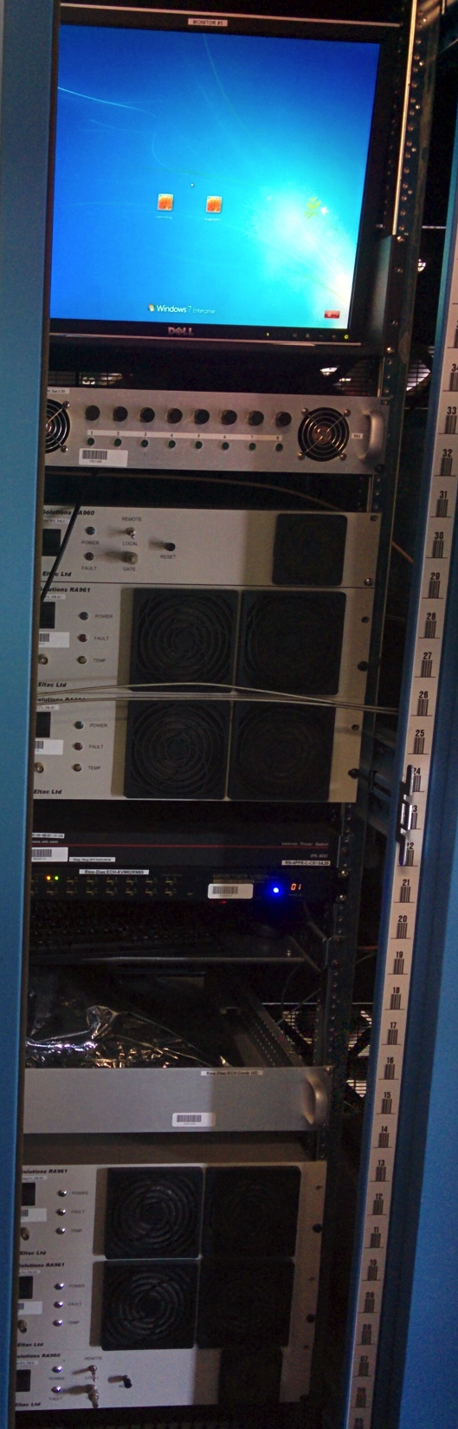
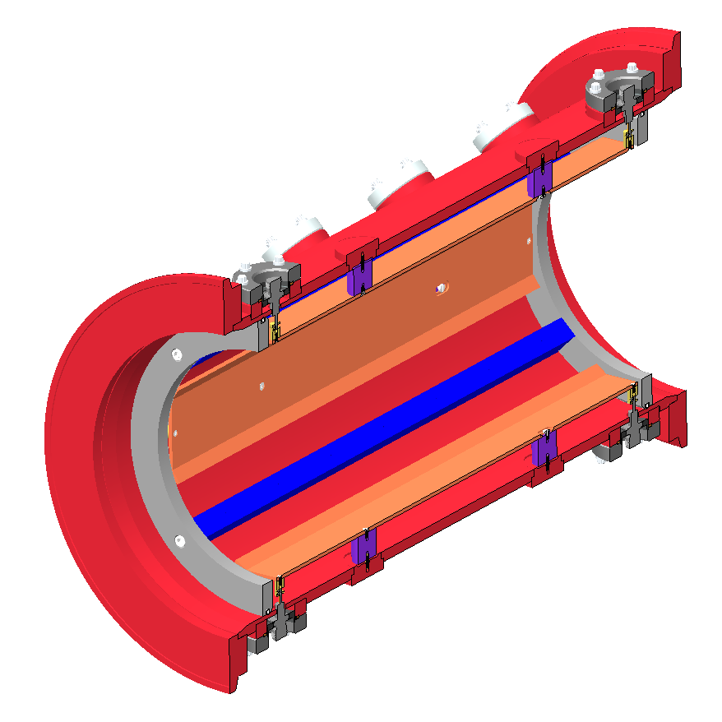
Damper System Overview
User
Interface
LLRF
Analog
Delay
Stripline
Pickup
FPGAs
Stripline
Kicker
Power
Amps
Switch
RF Ref
Sampling Clock

Slide 8
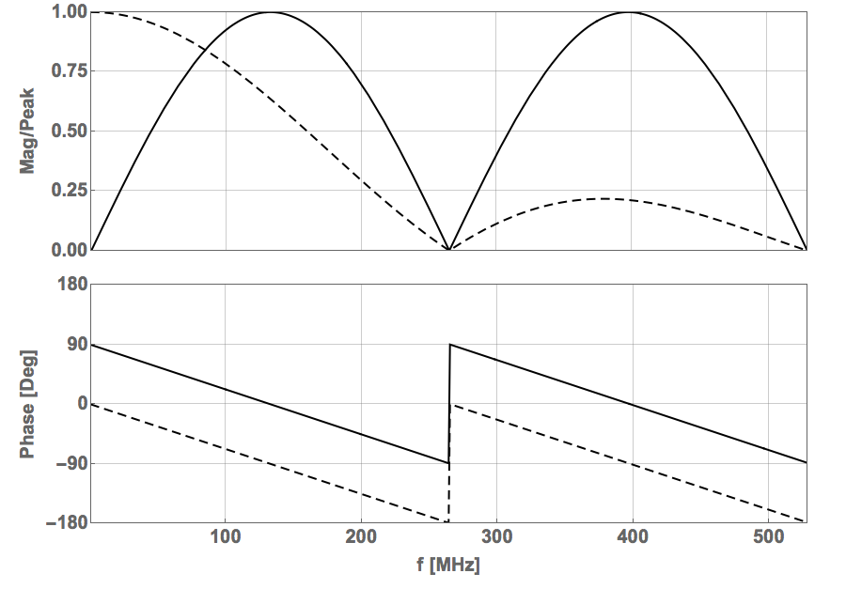
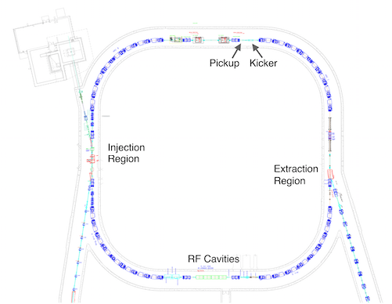
Damper System Overview
Pickup
Kicker
Pickup and kicker are identical 0.49m striplines
e-p
beam

Slide 9
Damper System DSP
1 QuiXilica Triton-V5 Board/plane
  10-bit ADC (up to 2GHz)
  3 Xilinx Virtex-5 FPGAs per board:
    Delay
    Comb Filters
    FIR EQ
    Digital Gain
  12-bit DAC

Slide 10
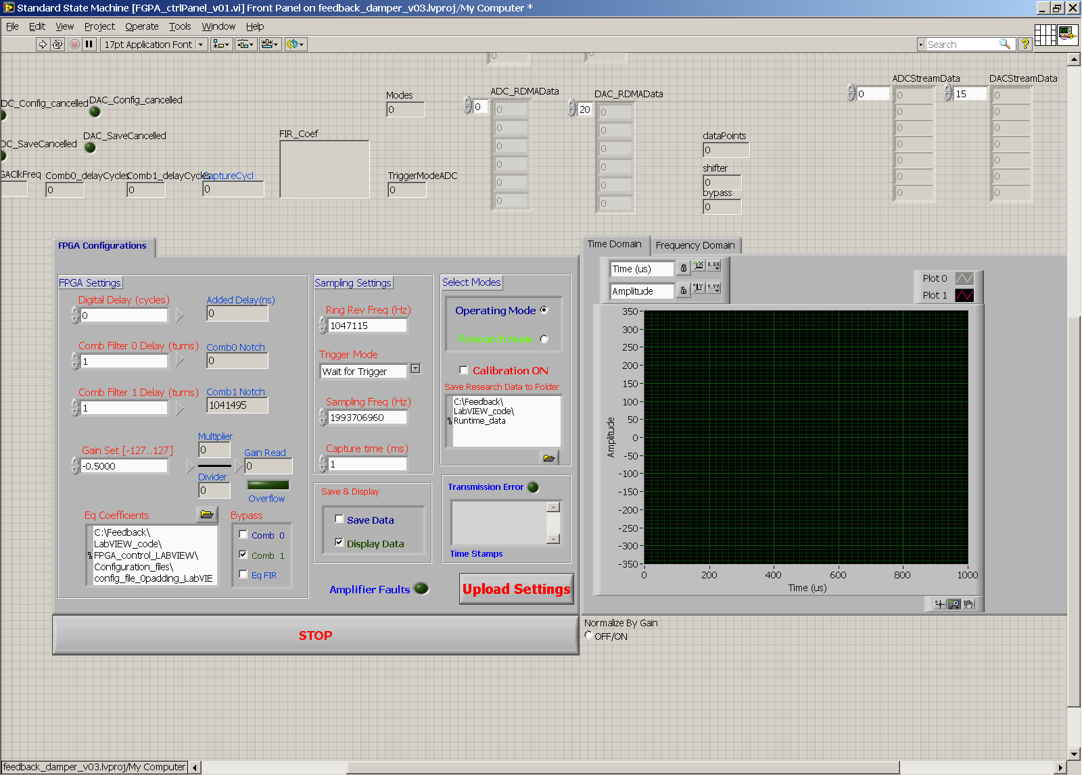
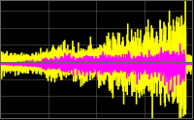
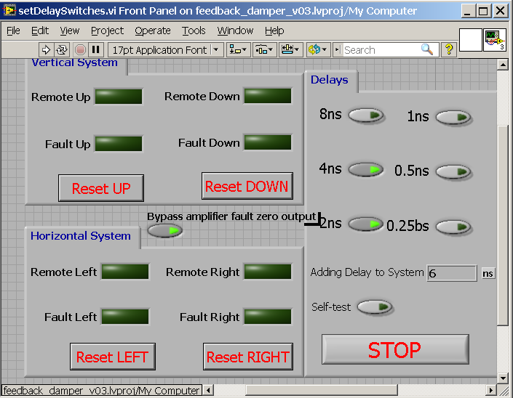
Damper System Interface
Damper Interface
Analog Delay Interface
Works well but not user friendly

Slide 11
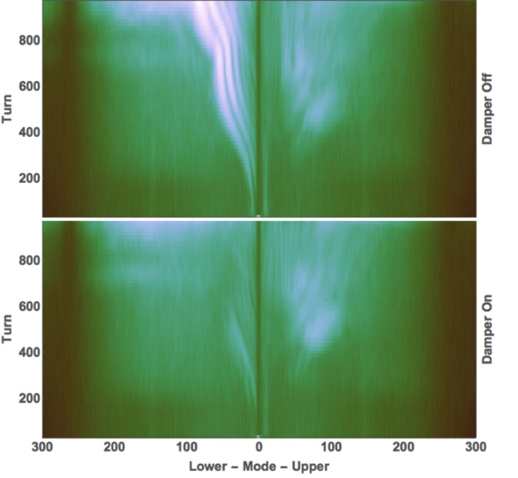
Damper System In Action
Horizontal Plane
Broadband signature of e-p signature on spectrogram fall 2015
Damper effectively suppresses e-p
*Note that upper and lower
sidebands have been separated

Slide 12
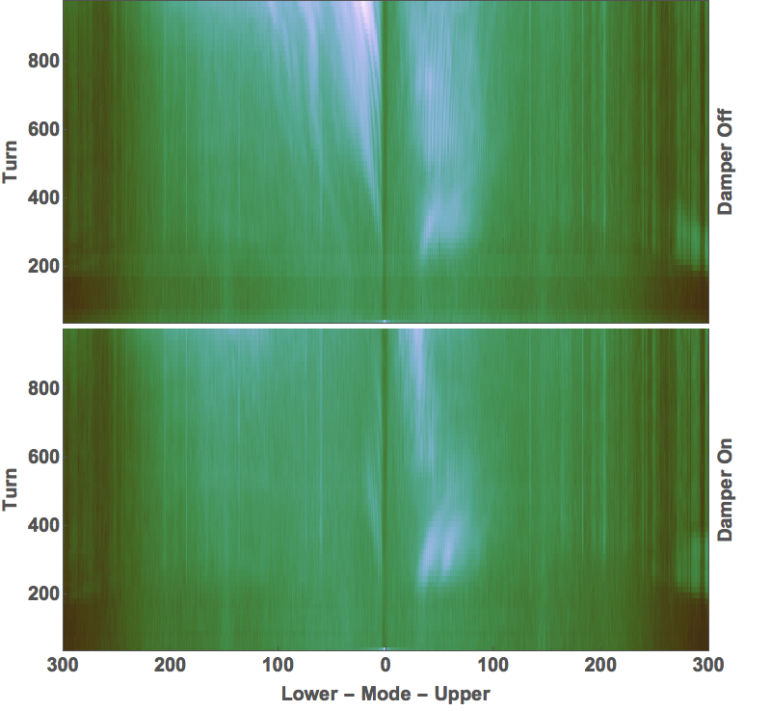
Damper System In Action
Vertical Plane
Total oscillation amplitude is only about 0.5mm at the moment
Vertical oscillation not as pronounced

Slide 13
Damper System – Delay
Multi-turn delay is a big hit to performance
Minimum delay > 2 turns
≥2146 ns
955 ns

Slide 14
Damper System – Delay
Damping is most effective when we kick at odd integers of π/2 phase shift
Minimum delay (red) >2 turns
Optimal delay is longer
X’
X

Slide 15
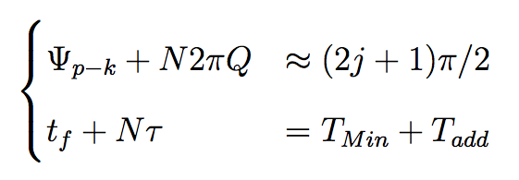
Damper System – Delay
Delay must satisfy:
Total Phase Advance
Total Delay
First choose N to satisfy the phase advance
Then adjust T_{add}

Slide 16
Damper System – Delay
Delay must satisfy:
Total Phase Advance
Total Delay
Actual delays are:
  Hor = 6 turns
  Ver = 4 turns

Slide 17
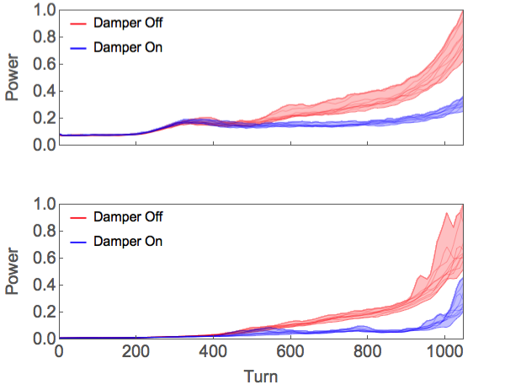
Damper System Performance
Power in the 10-300 MHz band of difference signal
Once timing is set, gain is tuned to minimize total oscillation
Note the small rise near the end of the cycle
Horizontal
Vertical

Slide 18
Damper System – Delay
Delay must satisfy:
Total Phase Advance
Total Delay
If N gets too big trying to meet these conditions, why not change Q?

Slide 19
Delay Reduction Study
Change delay required to damp by changing tune
Find optimal gain for short delay
Changing back to long delay, optimal short delay setting is too large

Slide 20
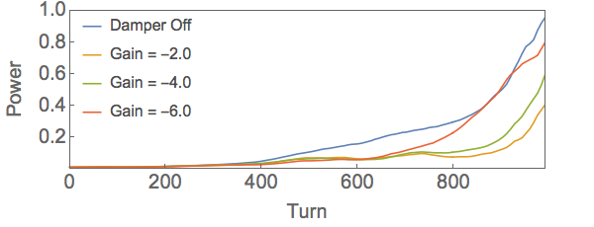
Gain Limitation
As we increase gain eventually beam is driven
Max gain changes throughout the cycle

Slide 21
Gain Limitation
Momentum spread, beam current increase (dipole = y×I, effective gain increase) through cycle
Both could be responsible for some growth

Slide 22
Gain Limitation
Currently gain setting at any time is limited by the trying to minimize oscillation throughout cycle

Slide 23
Gain Scheduling
Gain should be a function of time
We tested this with a two stage gain schedule

Slide 24
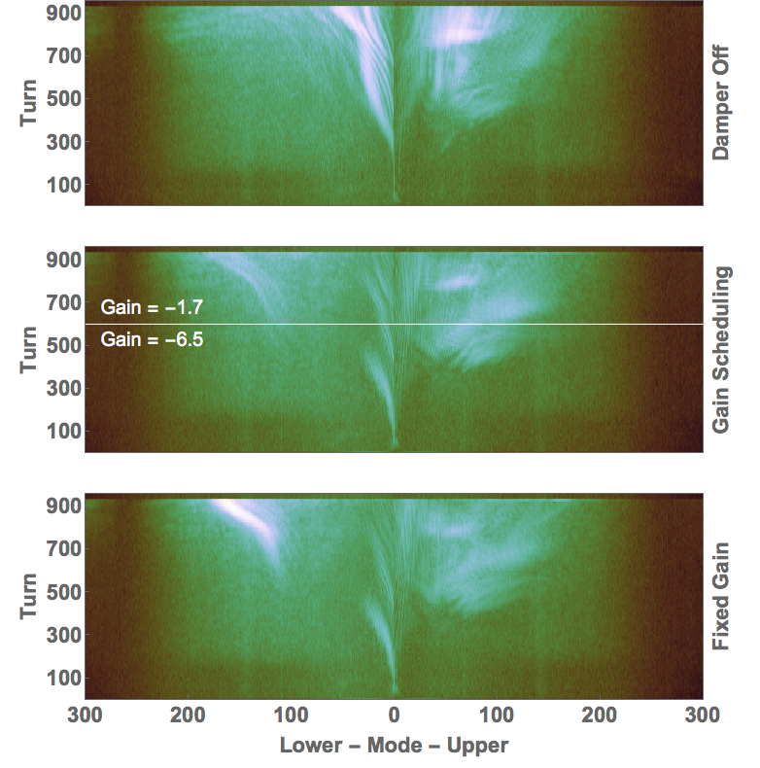
Gain Scheduling
With our large gain, growth occurs in higher modes, and late in the cycle
Gain schedule does help damp e-p and reduce growth late in cycle

Slide 25
Summary
Damper works.
If losses due to e-p are detected damper will provide headroom
We have a lot of power, but we could use it more effectively
We have two specific tasks to improve damper:
  Implement gain scheduling
  Explore delay reduction through tune choice

Slide 26
Summary
Understand physics behind e-p onset better to identify better working point in a complicated parameter space – delay, tune, momentum spread, gain, bunch shape, etc. – to minimize loss
  Beam based experiments
  Understand BTF measurements – simulation underway
Understand limitations of a multi-turn system
  Analytic work and simulation
The software, and documentation need to be polished

Slide 27
Thanks
I want to thank the AP and BI teams for support throughout the last year
I especially want to thank Jeff Bryan, Craig Deibele, and Zaipeng Xie for all their help (and patience) getting the damper up and running

Slide 28
Additional Slides

Slide 29
Damping Rates
We can drive beam, and then damp – timing is good
Difference signal during drive-damp test
Sign of the gain is flipped at turn ~550

Slide 30
Damping Rates
Horizontal Plane, N=6
gain too large for optimal damping
Exponential fit to dipole signal gives growth/damp times

Slide 31
Damper System Overview
Digital Signal Processing:
1 Quixilica Board/plane
10-bit ADC (2GS/sec)
2 Xilinx FPGAs per board:
Coarse Delay
Comb Filters
FIR EQ
Digital Gain
12-bit DAC
LLRF
Analog
Delay
FPGAs
Switch

Slide 32
Damper System – Delay Breakdown
Source | Delay[ns]
Cable ~170m | 560.1
Comb Filters | 955.0 (1 turn)
LLRF thru Amps | 631.1
Total Minimum Delay | 2146.2
>2146 ns
955 ns

Slide 33
Damper System – Delay Breakdown
Delay Control | Total Delay[ns] | Precision[ns]
Analog Delay | 15.75 | 0.25
Digital Delay | 1600 | ~8.0
≥2189 ns
955 ns

Slide 34
Damper System Overview
Damper system:
Pickup, Signal Processing, Kicker

