Slide 1
SCL Systems Status, SRF Activities, and PPU Strategy
Matt Howell,
Sang-ho Kim
February 17, 2016

Slide 2
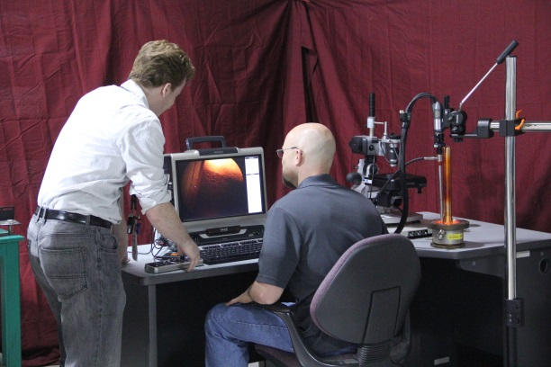
Outline
SCL Systems overview
Response to previous recommendations
SCL performance
CHL performance
SRF Activities
PPU Strategy
Summary

Slide 3
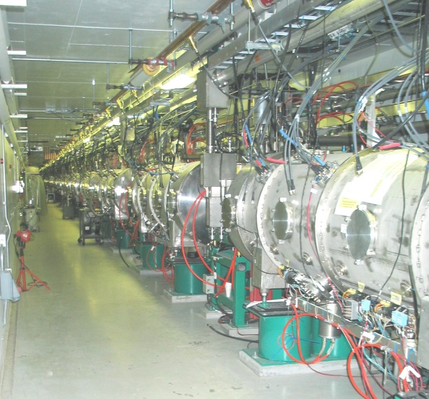
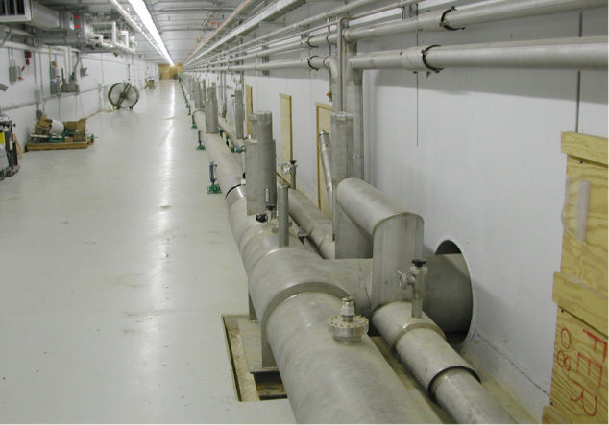
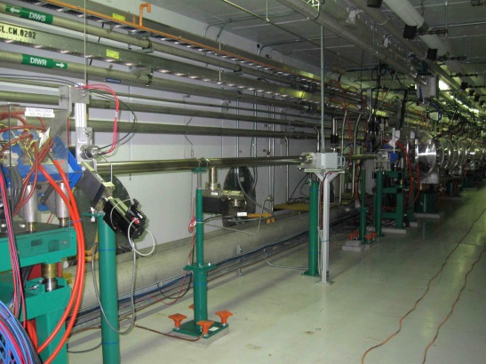
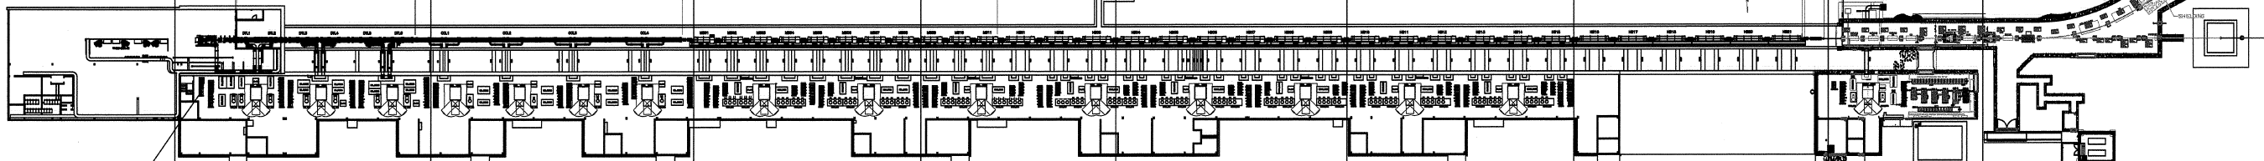
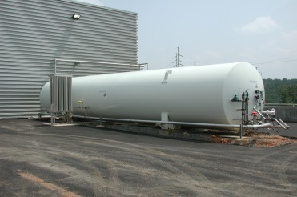
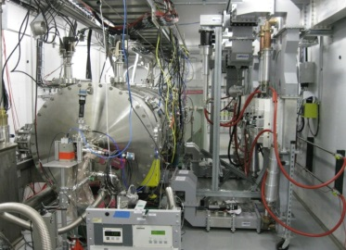
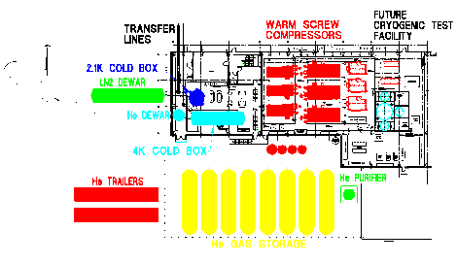
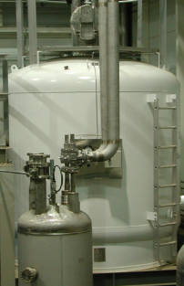
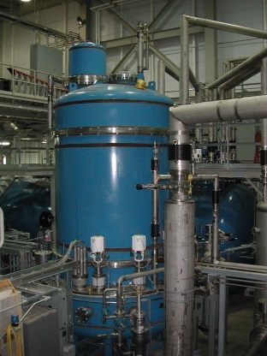
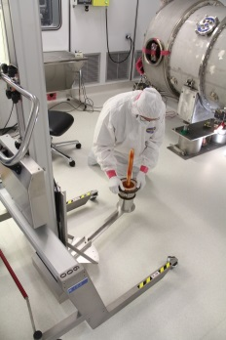
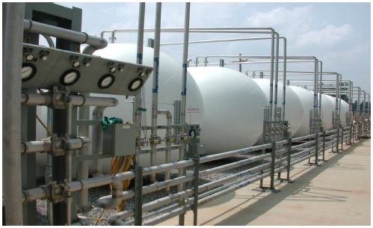
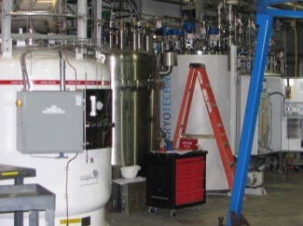
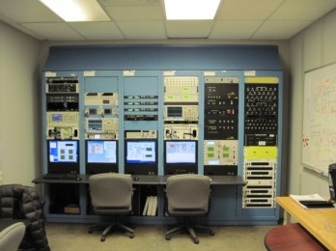
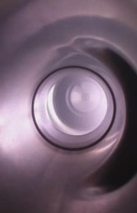
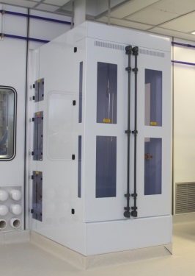
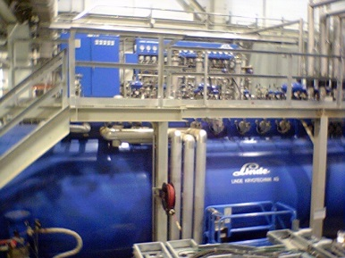
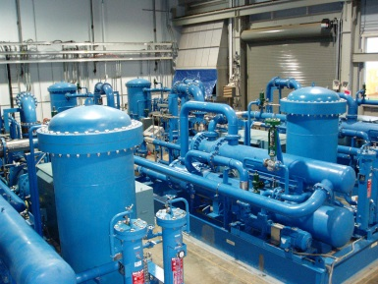
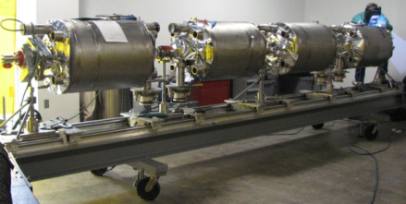
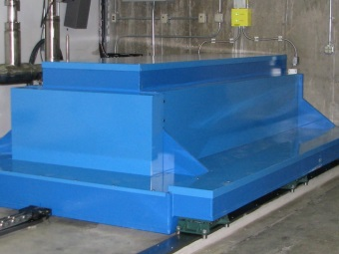
SNS SCL Systems
Empty slots
for upgrade
Transfer lines in the tunnel (during installation)
SCL section in the tunnel
LN2
Test cave
LHe dewar
R&D
CM
rework
2 K Cold Box
GHe storage
Control room
CTF
CTF
CM development
HPR
VTA
4 K Cold Box
Warm Compressor

Slide 4
Response to recommendations from the last AAC
Proceed with plans for on-site electro-polishing. The committee agrees with the plan to develop a small-scale facility as a first step. The committee supports the goal of exploring alternative methods with reduced safety hazards.
  Pending funding.
The committee accepts plans for spare medium-beta cryomodule. However, we encourage the inclusion of the procurement of the spare into the project prioritization process
  Pending funding. One medium beta cavity fabrication is in progress.
Proceed with plans for plasma processing.
  Plasma gas cart, RF/diagnostics cart and the procedure for in-situ processing in the tunnel are developed.
  The first in-situ plasma processing in the tunnel is completed.
  Plan for the next downs is under development

Slide 5
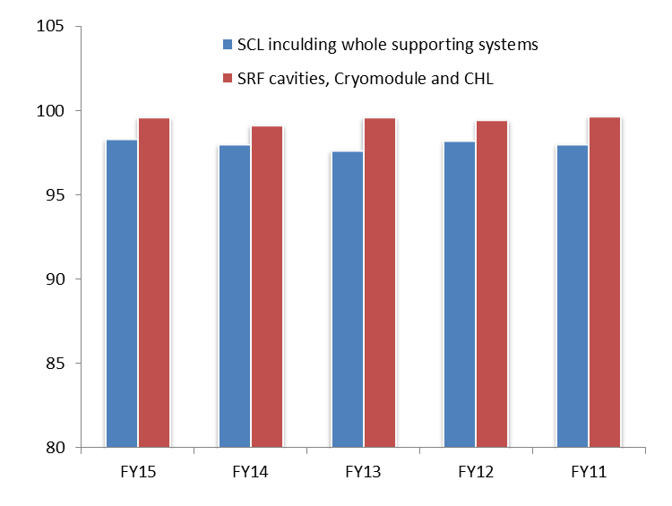
SCL system is performing reliably for neutron production
Availability for neutron production (%)
Availability last 5 years:
  Whole SCL including RF, HVCM, Control, Vacuum, etc.: 98 %
  SRF cavities, cryomodules, and CHL: 99.5 % (average trip or downtime: <1 trip/day or <5 min./day)
Operational flexibility using energy reserve
  Every run a few to several cavities show problems sustaining the nominal accelerating gradients (typically ends up hot spot in the end group)
  lowered Eacc (typically lowered by 1 MV/m or less) or turn-off to avoid further degradation and to minimize downtime
  Early diagnostics and prompt involvement from system experts are the key to minimize additional degradation

Slide 6
Cavities showing performance degradation in FY15 and FY16-1
5a: turned off
  Errant beam in 2009
  Water condensation at air side of the coupler in 2009
  Higher FPC window temperature since 2010
  Frequent arcing started in Aug 2015: since then turn off
1a: lowered gradient by 2 MV/m in September 2015
  Presumably related with ion source condition
Several medium beta cryomodules, CM18 and 19a : lowered gradient slightly
  Presumably related with errant beam at warm linac RF truncation
  Frequency of errant beam event & MPS delay are much reduced but higher beam current increases impact
Other potential issues: ion pump burst and gate valve

Slide 7
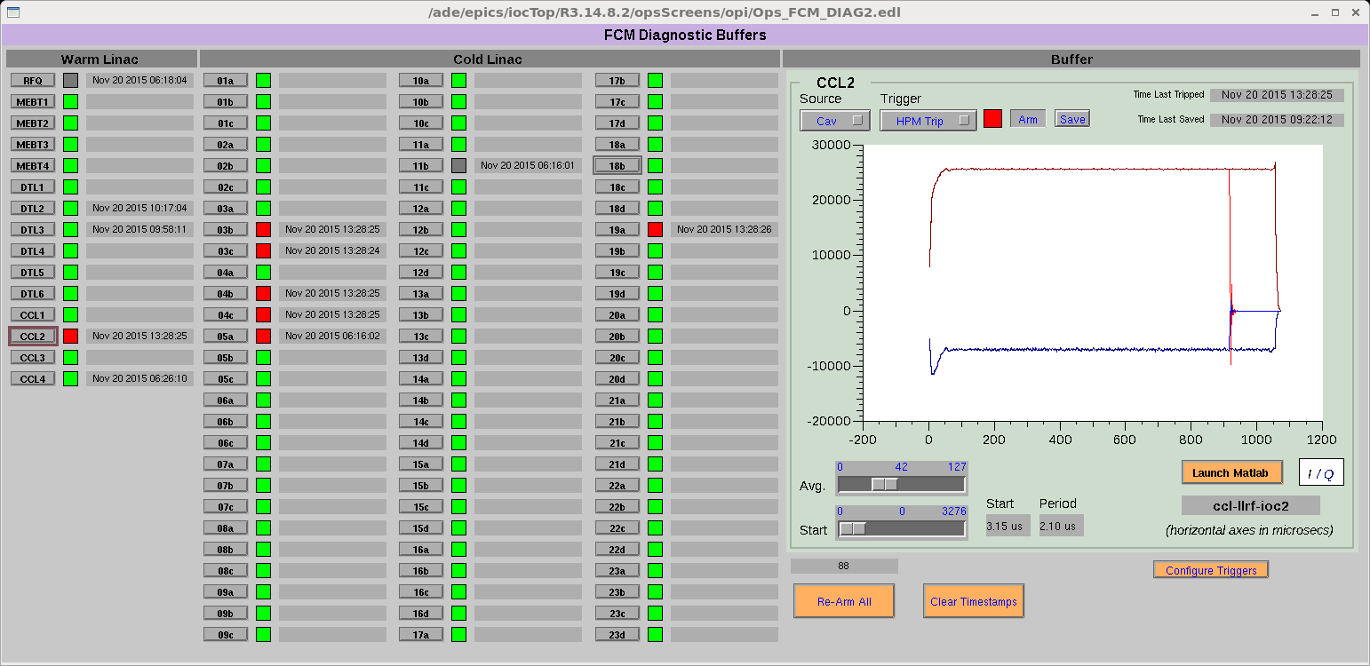
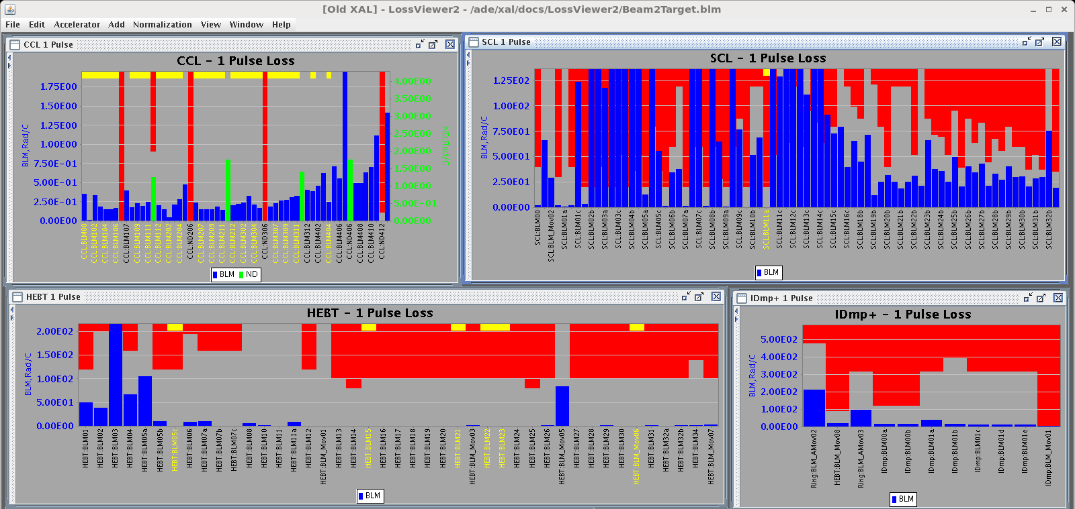
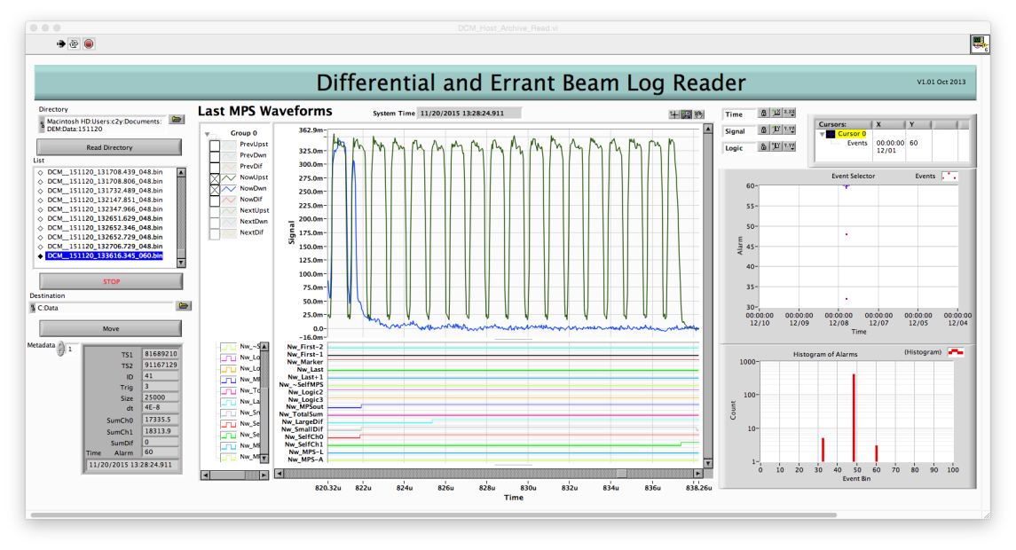
Example of errant beam
CCL2 RF truncation → several SRF cavities tripped
Beam loss monitor during this event
DBCM log: 16 us beam lost in SCL

Slide 8
Performance recovery and improvement
Recovery of cavity performance to previously attained operating gradients
  RF conditioning starting from low repetition rate
    Several cavities recovered in February 2016 including 1a
  Thermal cycling
    CM18 and 20d recovered during last maintenance down
    So far, thermal cycling is successful except two cavities
    More cryomodules are waiting for thermal cycling
  Rework of cryomodules
    CM5 and CM11 repair is required: need medium beta spare
Improvement to new higher operating gradients (In-situ plasma processing)
  First deployment on CM19 in January with good results
  Plan for the next deployment is under development
Date | Output Energy | Energy Reserve
Aug. 2015 | 940 MeV | 10 MeV
Dec. 2015 | 940 MeV | 2 MeV
Feb. 2016 | 957 MeV | 10 MeV

Slide 9
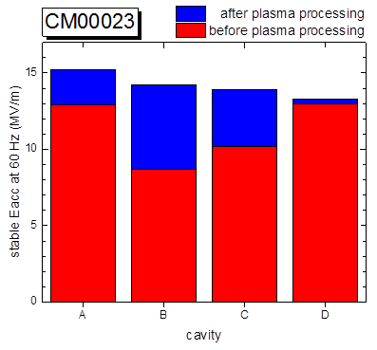
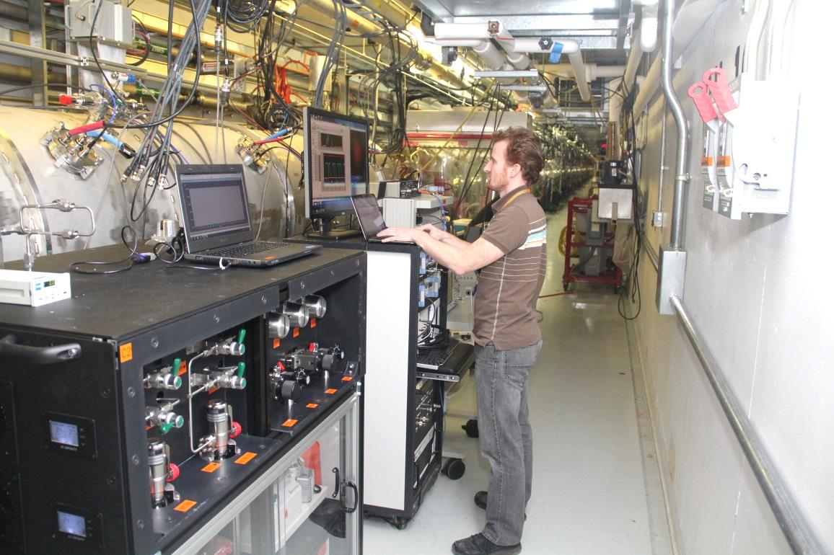
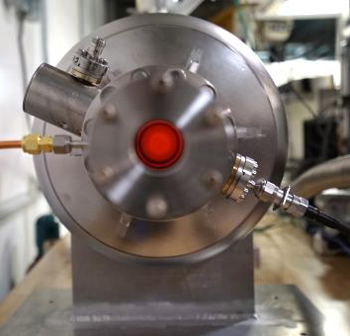
In-situ plasma processing to increase accelerating gradients in SC linac
New processing technique developed at ORNL/SNS
Proof of principle achieved for offline cryomodule
Plasma processing of 1st cryomodule in linac tunnel completed during FY16 winter shutdown
Performance improvement for the four cavities in cryomodule after in-situ plasma processing.
First in-situ plasma processing of a cryomodule in the SNS linac tunnel.

Slide 10
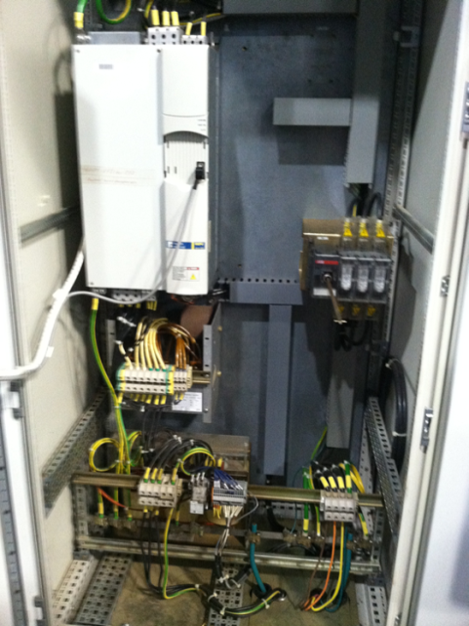
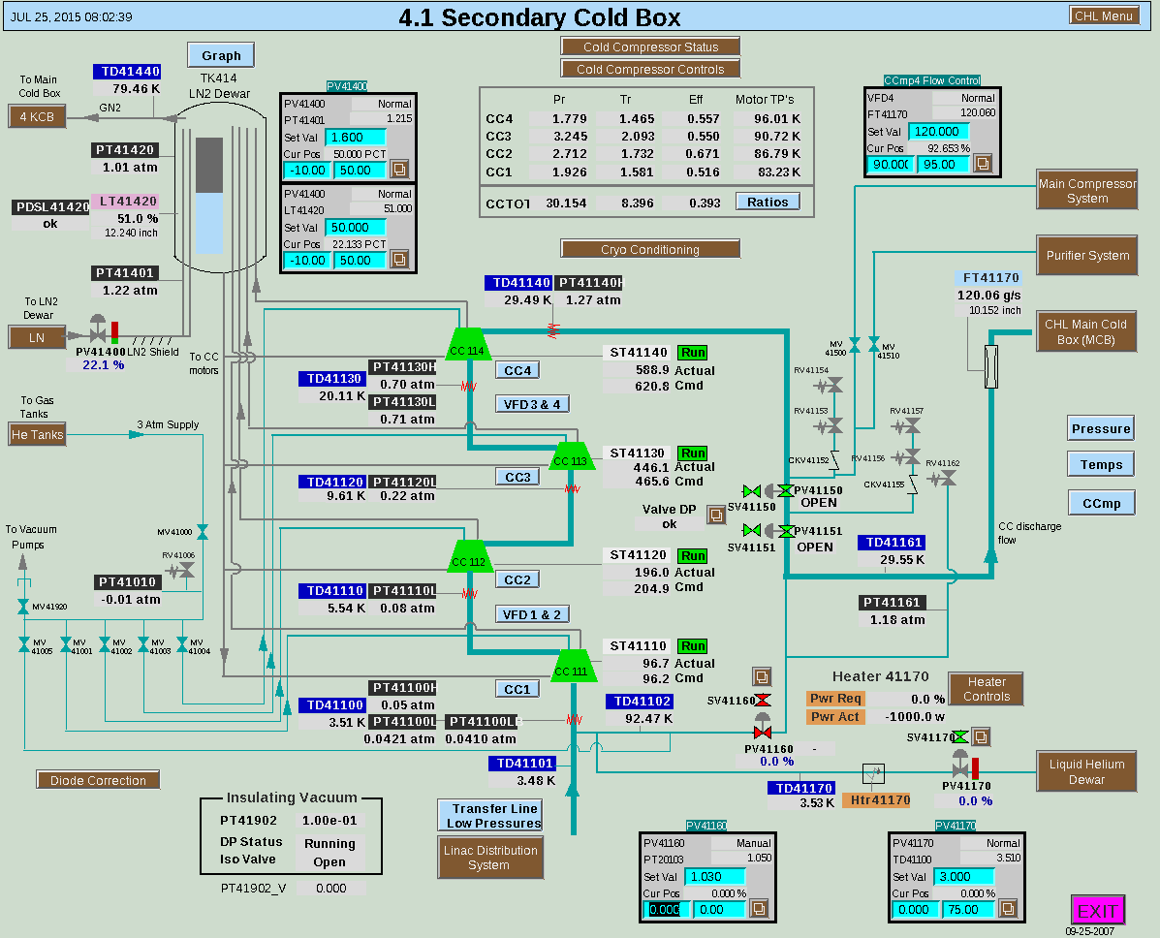
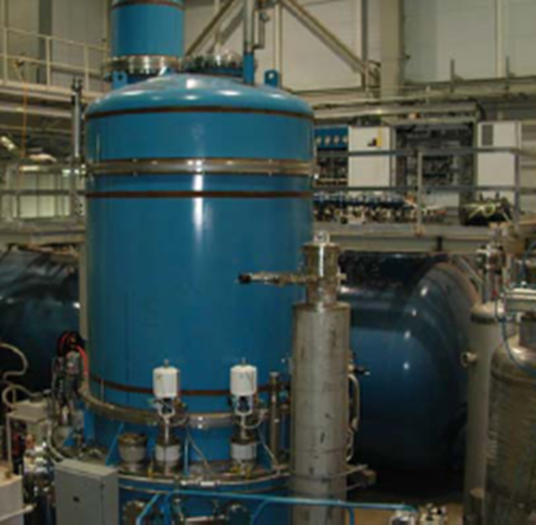
Central Helium Liquefier (CHL) System
Reliable operation
  Typically one 2K cold box trip per year or less
  CHL control room: 1 shift/day to cover CHL operation and to conduct daily maintenance
2K pump down development
  Upgraded controls to adjust gear ratios based on command
  Upgraded control signal circuit to VFDs
  Much improved since replacement of sinus filter on VFD 3

Slide 11
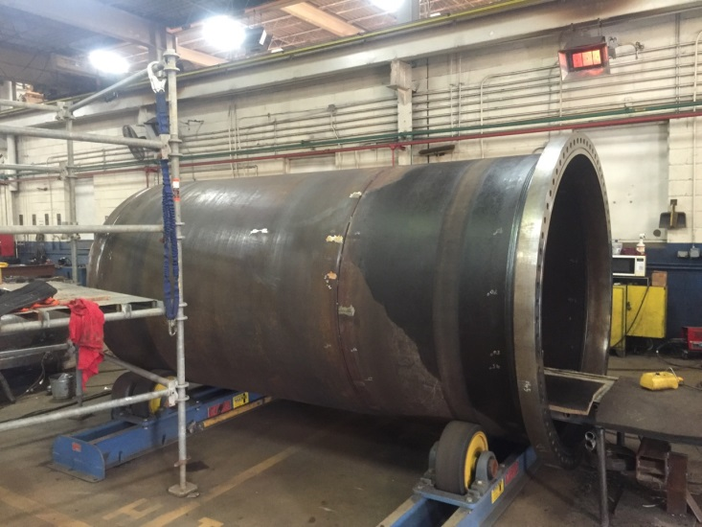
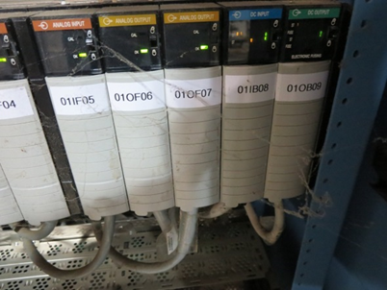
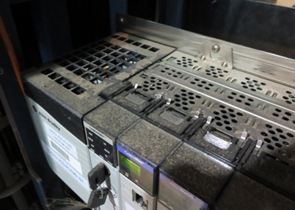
CHL System Upgrades
CHL control system upgrade completed
  Completed during a ~4 hour shut down of CHL
  All IOCs and most PLCs on ATS power
  Controls for warm compressors and RS compressors decoupled
  Warm compressor PLC replaced (10 years of operation in “dirty environment”)
  Successful recovery
Spare carbon bed project
  Projected lifetime of carbon bed is ~12 years
  Spare carbon bed and after filter are being fabricated and due for delivery in 2Q 2016

Slide 12
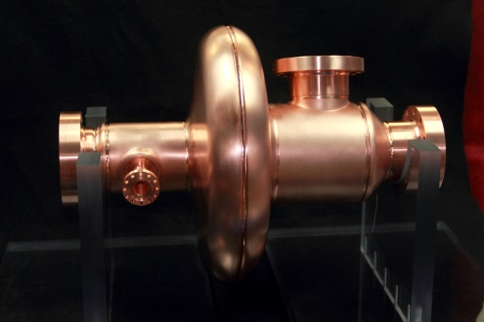
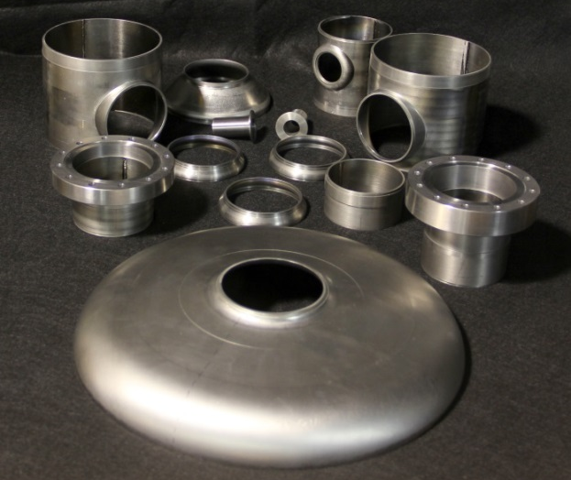
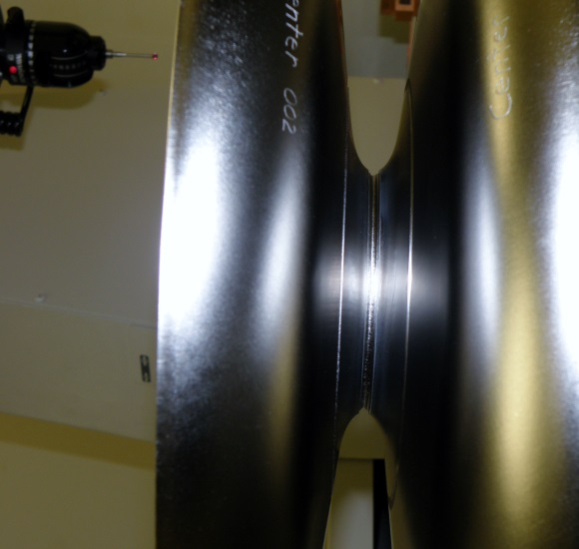
Cavity Fabrication
Copper single cell cavity completed
  Developed deep drawing and machining methodology
  Established contract with partner institute for e-beam welding
Six cell medium beta Nb cavity to be fabricated in 2016
  Many parts have been pressed and machined
  Contract established with domestic industry vendor
    Small parts chemistry
    Electron beam welding
    Tooling development
  The first center cell dumbbell has been welded
  Making use of existing press tooling from SNS production
    Developing methodology for frequency adjustment of dumbbells and cavity tuning
  Supports preparation for medium beta spare cryomodule and future upgrades

Slide 13
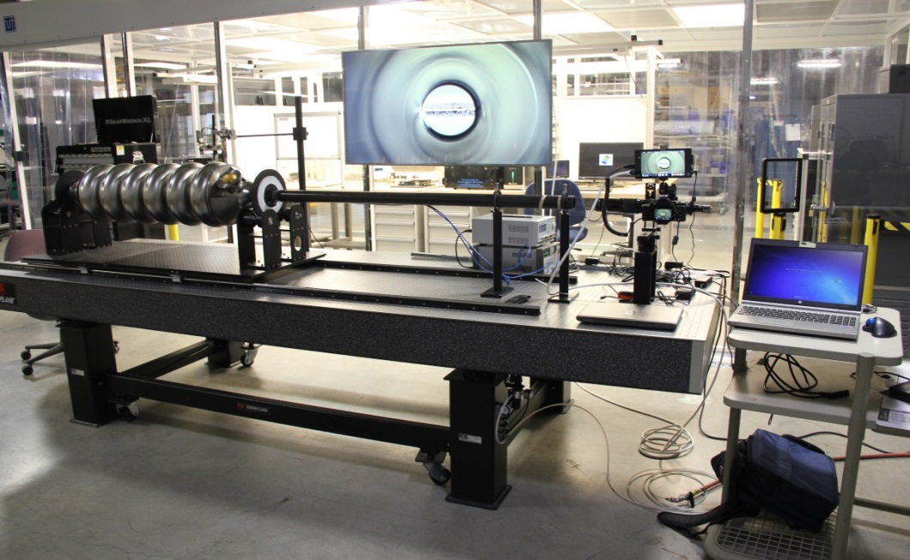
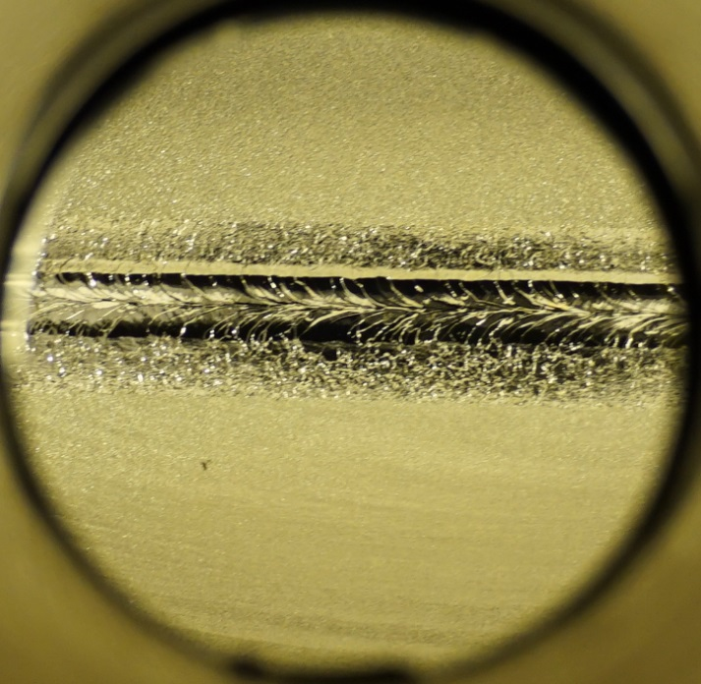
Cavity Inspection Station
Optical table with active vibration damping
Flexible cavity support system (single cell or multi-cell, He vessel...)
  Ultra high definition imaging system
    HD available at 30 fps
    Ability to use multiple cameras
Image of cavity weld
  A defect can be seen below the weld
System is being integrated with cavity fabrication effort as a diagnostic tool to validate production methods

Slide 14
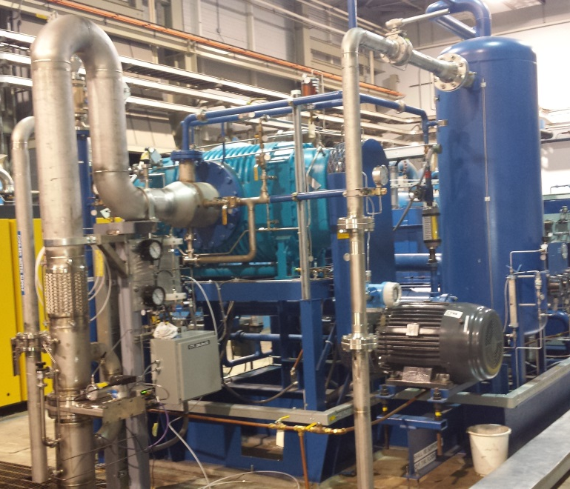
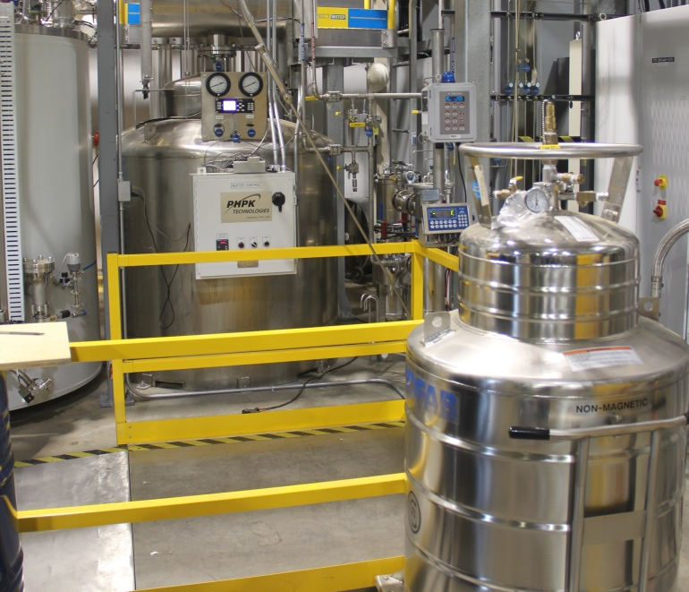
Cryogenic Test Facility (CTF)
Operations & Plans
Stand alone cryogenic system servicing SRF facilities
  Test Cave (cryomodules, HTA, etc.)
  VTA
Operational Achievements:
  Successful SRF testing at 2 K in November of HB cavity in VTA with Kinney Pump
  Controls and alarm system development completed which allows for unattended CTF cold box operation
  Fill Station successfully filled two 250L dewars for sample environment in November to mitigate vendor delivery shortage
    System commissioned in late 2014
  Supported cryogenic testing of ITER Cryo Viscous Compressor (CVC)

Slide 15
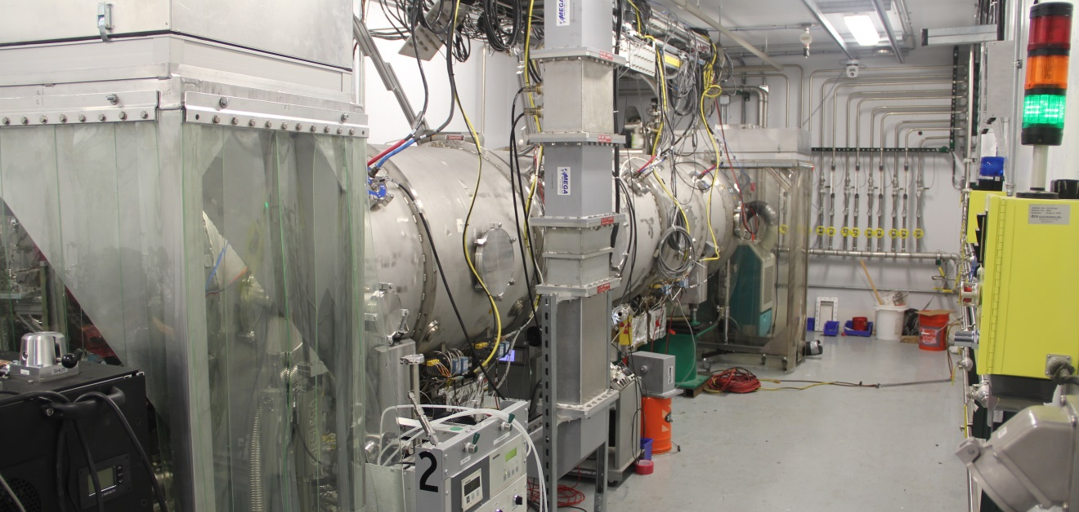
Cryogenic Test Facility (CTF)
Operations & Plans
Future Development:
  Procedural development ongoing to improve system integration and reliability
  Cryomodule 2 K testing with CTF in RFTF Test Cave

Slide 16
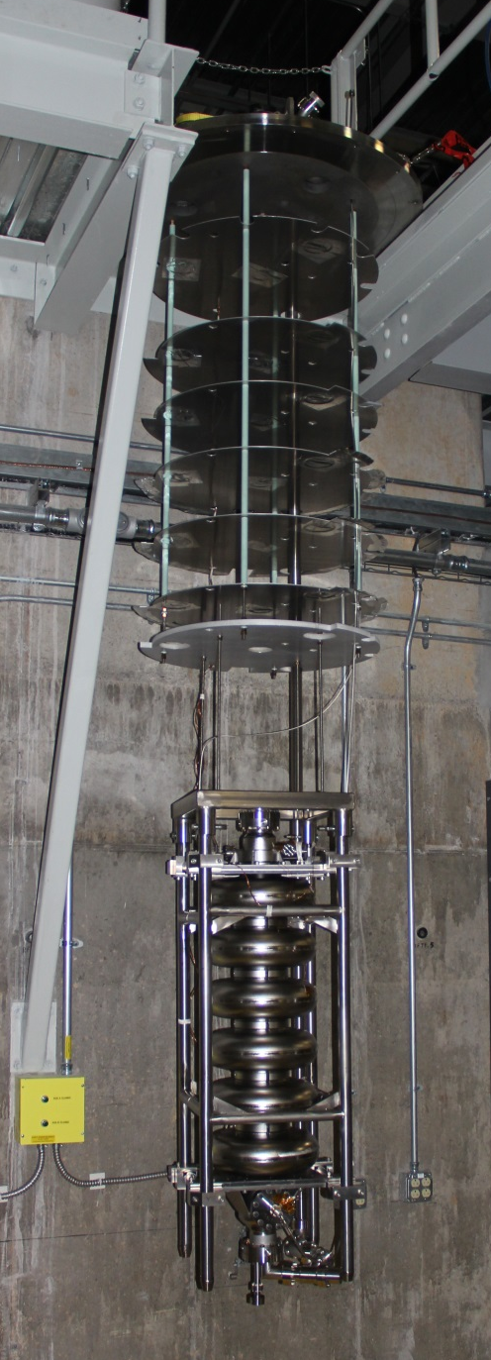
Vertical Test Facility
Vertical Test Stand
Vertical Test Facility Commissioning
  Software and hardware is being vetted with 4 and 2K testing of HB cavities
    Analysis of RF losses of system and subcomponents ongoing
    Measurement examples: reflected power standing waves, Dewar cable losses and system repeatability
    Variable coupler developed and testing underway
    Magnetic field instrumentation installed for cold measurements
Cavity Qualification Tests are Underway
  Qualification of spare HB cavities modified for PPU started
    HB62 assembled and ready for vertical test

Slide 17
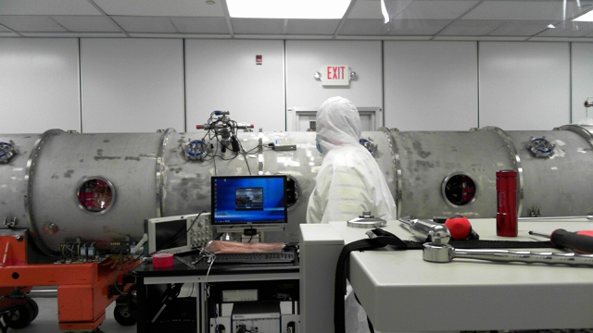
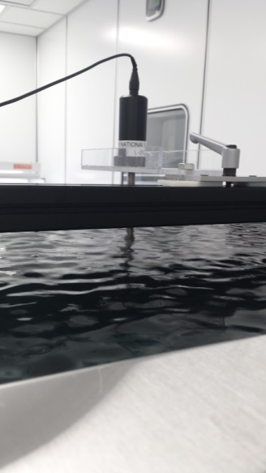
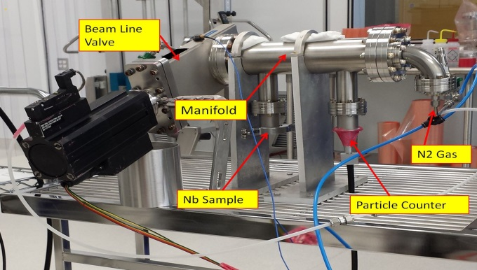
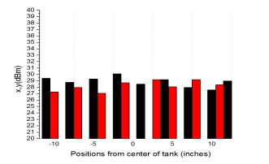
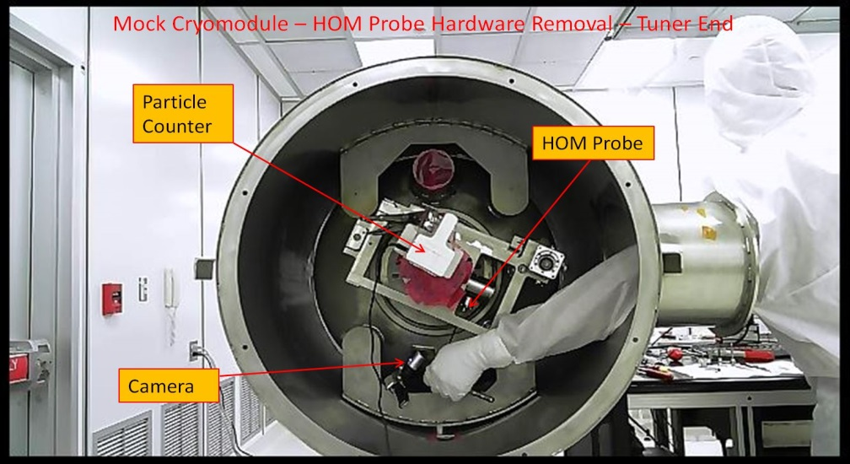
SRF Cleanroom Activities
Beamline Valve Testing
CM12 Repairs in Cleanroom
Quality Assurance Team Activities
  Focus on development of repeatable repair procedures and capturing of critical data
  Reducing particulate contamination during repairs and R&D activities
Mock cryomodule was developed and utilized to develop repair procedures which were successfully applied to CM12
  (5) Beamline components were removed
Ultrasonic Tank
Evaluation
Beam Line Valve testing
Mock CM Procedure Development

Slide 18
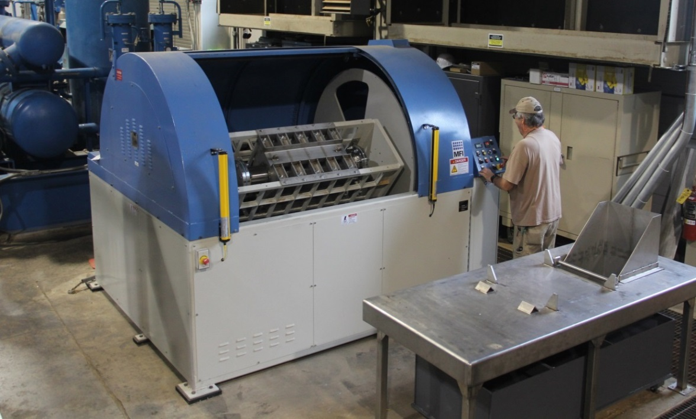
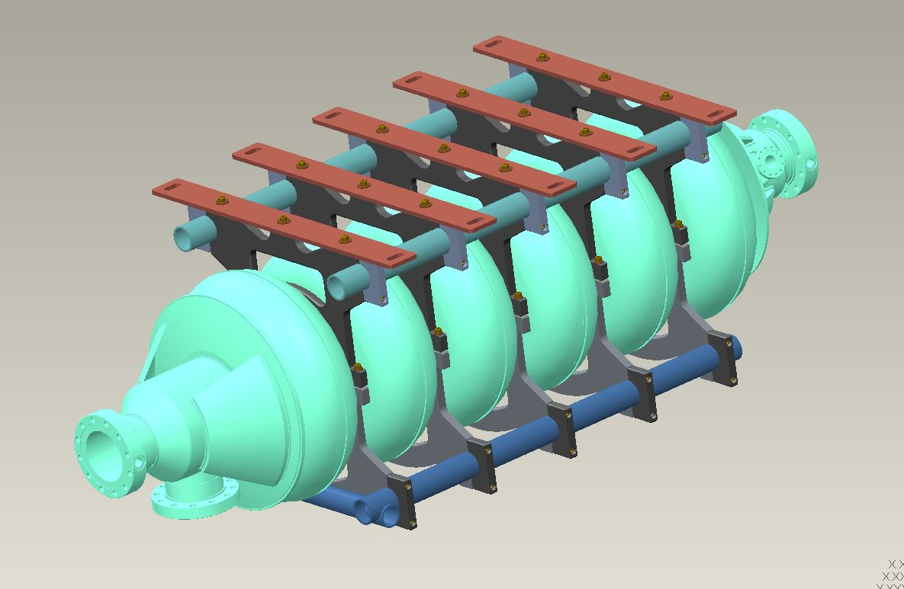
Centrifugal Barrel Polishing
Targeting selected cavities with suspected material defects on the inner surface
  CBP machine has been installed and commissioned
  Identified HB 74 as a possible candidate
Tooling for process development is complete
  Process parameter development ongoing
HB cavity fixture is in fabrication

Slide 19
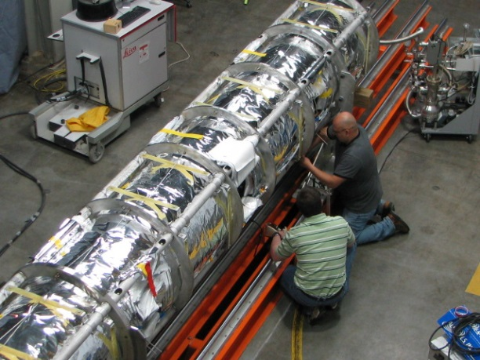


PPU/STS Strategy
Fabricate seven new high beta cryomodules in-house and install to increase beam energy to 1.3 GeV
  A design gradient of 16 MV/m is specified
  Improvements will be incorporated in the cavity design to enhance performance
  Nine empty slots available
Utilize experience from High Beta Spare Cryomodule
  Maintain certain design interface points for ease of integration of new cryomodules into the existing tunnel
  Meet the pressure requirements set forth in 10 CFR 851

Slide 20
Developments impacting PPU/STS
Increase cavity performance for PPU/STS
  HOM Coupler removed from design
    Originally installed to insure against the unknown
      Not needed at SNS
    Presents difficult geometry to process
    Has been problematic at SNS
  High RRR end group material
    Heating of the end group driven by electron activity is a major limiting factor of cavity performance
    Thermal conductivity increased over previous reactor grade material
  Higher power coupler installed
    Supports higher beam current
    Transmits less heat to the end group (more thermally stable)
  Plasma processing studies for medium beta cavities are beginning
  Cavity fabrication efforts are under way to create a relationship with an industry partner

Slide 21
  Executing PPU/STS
Expand in-house capabilities for “production” style work
  Develop “Production” style tooling
  Resource availability for project work while supporting operations and maintenance
Develop strategy for key facilities currently not installed at SNS
  Chemistry system
  Vacuum baking system

Slide 22
Summary
The SCL and CHL are operating reliably
SRF activities and facility developments are ongoing in support of maintenance, improvements, and future upgrades
A baseline PPU/STS strategy has been established
Items that require setting of priorities and associated funding:
  Medium beta spare cryomodule
  Chemistry system
  Vacuum baking system

Slide 23

Current status of SCL cavity operating gradients
Accelerating Gradient (MV/m)
Cavity number

