Slide 1
Operations Report for FY15 and FY16-Q1
Glen D. Johns
Accelerator Operations Manager
Accelerator Advisory Committee
February 16-18, 2016

Slide 2
Outline
Beam Power
FY15/16 Run Schedules
Review of SNS Commitments
Performance
Downtime Overview
Summary

Slide 3
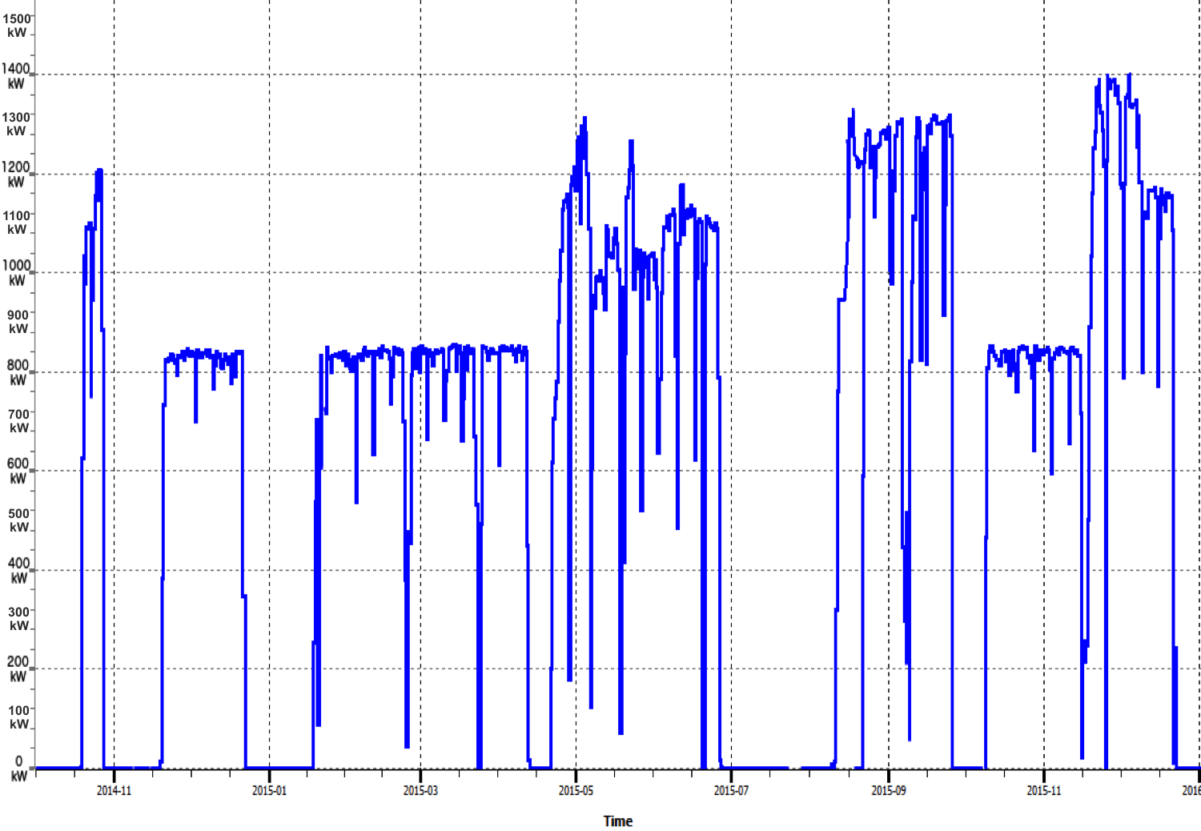
Beam power on target (60 sec average)
1337.8 kW peak
(1.10 MW for ~53 days)
1356.7 kW peak
(1.30 MW for ~32 days)
1416.9 kW peak
(1.27 MW for ~28 days)
1249.4 kW peak
(1.14 MW for ~6 days)
April outage
MEBT BS failure
Target failure
Target failure
Winter outage
Summer outage

Slide 4
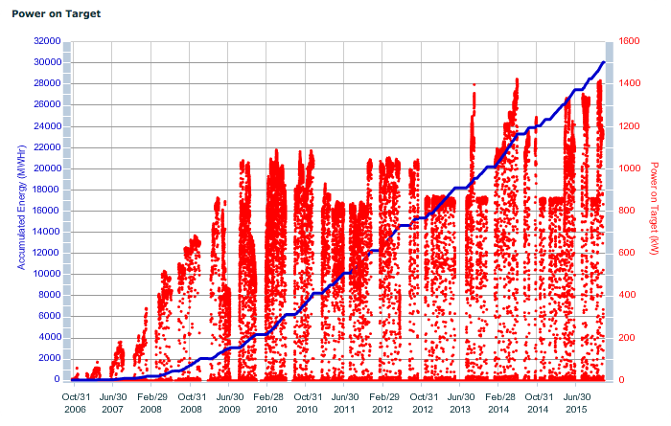
Energy and power on target from October 2006
39 GW-hrs is the IRP limit
Delivered over 30 GW-hrs
FY13 – 3848 MW-hrs
FY14 – 4798 MW-hrs
FY15 – 4612 MW-hrs
FY16 – 1567 MW-hrs

Slide 5
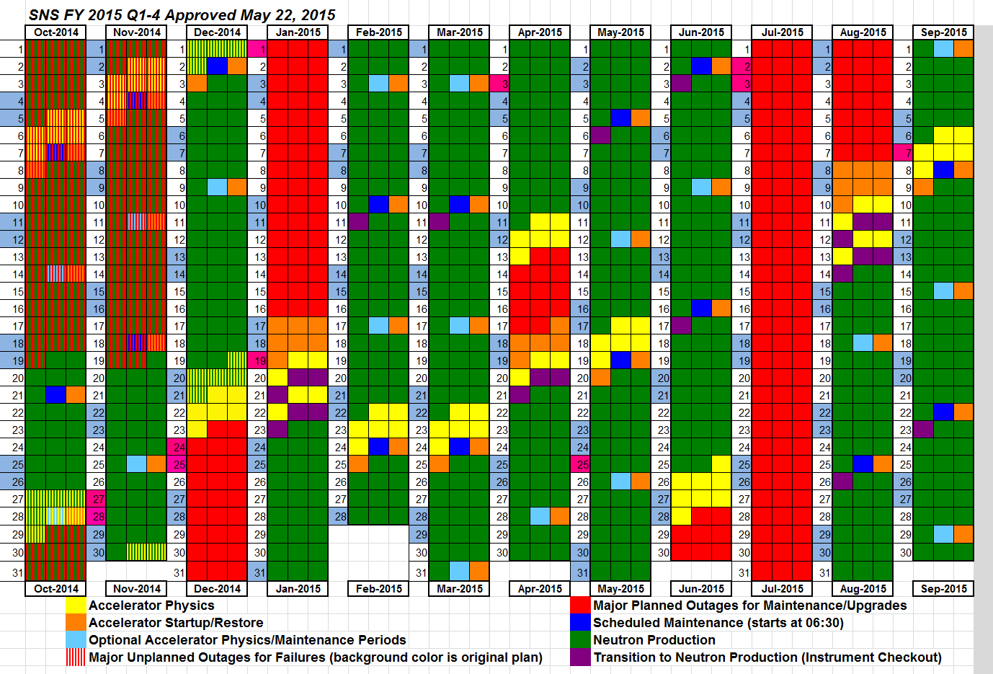
Schedules are built to meet DOE commitments: 90% availability against schedule and ~4500 hours delivered to users

Slide 6
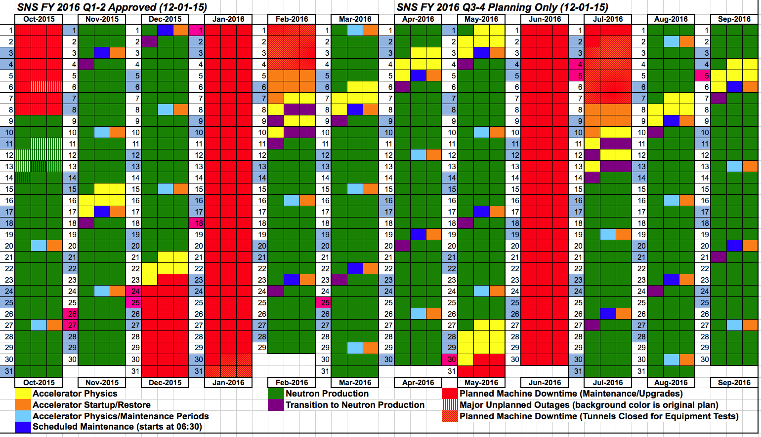
FY16 schedule adjusted for unplanned target failure at start of FY
Commitment of 4230 hours of NP

Slide 7
SNS Commitments We remain committed to delivering 4500 hours of NP
Year | Neutron Production Availability |  | Integrated Beam Power (MW-hrs)
 | Commitment | Actual | Commitment | Actual
FY2007 | 68.0% | 65.7% | 117 | 159
FY2008 | 74.0% | 72.0% | 877 | 945
FY2009 | 80.0% | 80.7% | 2031 | 2166
FY2010 | 85.0% | 85.6% | 3253 | 3455
FY2011 | 88.0% | 92.0% | NA | 4132
FY2012 | 90.0% | 90.0% | NA | 4368
FY2013 | 90.0% | 72.4% | NA | 3848
FY2014 | 90.0% | 83.7% | NA | 4798
FY2015 | 90.0% | 74.6% | NA | 4612
FY2016 (Q1) | 90.0% | 84.5% | NA | 1567
Year | Neutron Production Hours Delivered |  | Total Operating Hours Delivered
 | Commitment | Actual | Commitment | Actual
FY2007 | 1500 | 2078 | 3500 | 3779
FY2008 | 2700 | 2807 | 4000 | 4032
FY2009 | 3500 | 3553 | 4500 | 4916
FY2010 | 3900 | 4250 | 4800 | 5310
FY2011 | 4300 | 5002 | 5000 | 5941
FY2012 | 4500 | 4725 | 5000 | 5746
FY2013 | 4000 | 4202 | 5000 | 5120
FY2014 | 4230 | 4424 | 5000 | 5294
FY2015 | 4230 | 4441 | 5000 | 5278
FY2016 (Q1) | 4230 | 1495 | 5000 | 1651

Slide 8
Excellent after initial difficulties (91% between outages)
DTL5 cavity/window arcs
MEBT chopper & 2 target failures
Lightning strike – Cryo, CMS, RF
Target failure
FDR 2074 switchgear failure

Slide 9
Continued excellent performance in FY16 (84.5%)
Target failure
After target failure
10 out of 11 weeks > 90%
6 out of 11 weeks > 95%

Slide 10
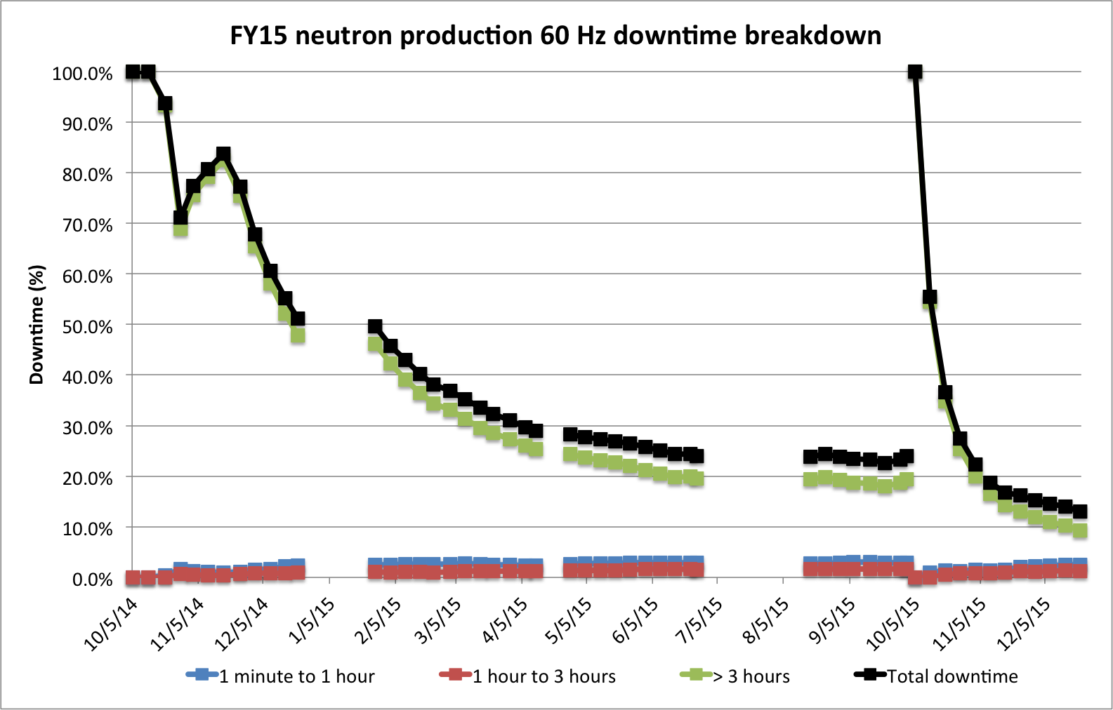
Long duration events dominate our overall downtime numbers
FY15
Run 1
FY15
Run 2
MAINTENANCE
FY15
Run 3
MAINTENANCE
FY15
Run 4
MAINTENANCE
UNSCHEDULED TARGET CHANGE
FY16
Run 1
UNSCHEDULED TARGET CHANGE, MEBT WATER LEAK
UNSCHEDULED TARGET CHANGE

Slide 11
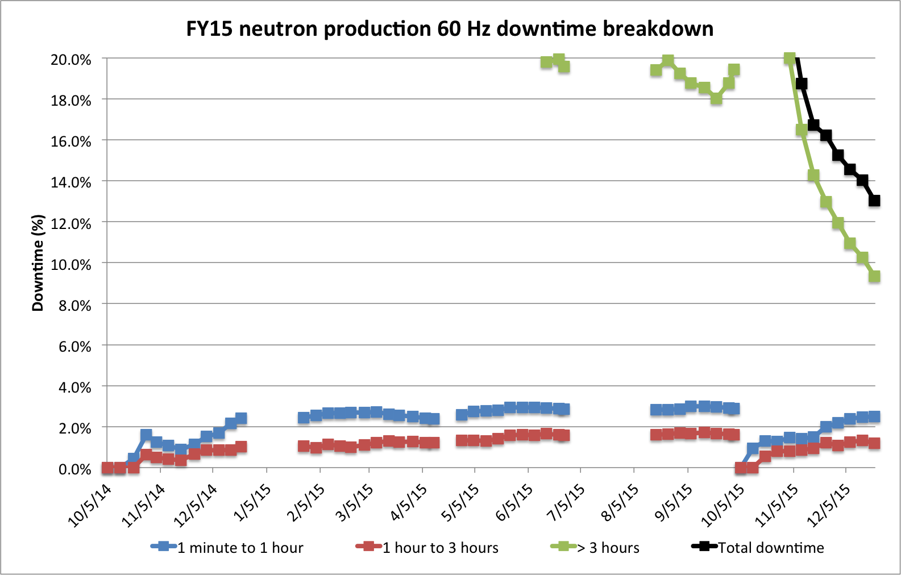
Less than 3 hours trips consistently account for ~4-5% of downtime
FY15
Run 1
FY15
Run 2
MAINTENANCE
FY15
Run 3
MAINTENANCE
FY15
Run 4
MAINTENANCE
UNSCHEDULED TARGET CHANGE
FY16
Run 1
UNSCHEDULED TARGET CHANGE, MEBT WATER LEAK
UNSCHEDULED TARGET CHANGE

Slide 12
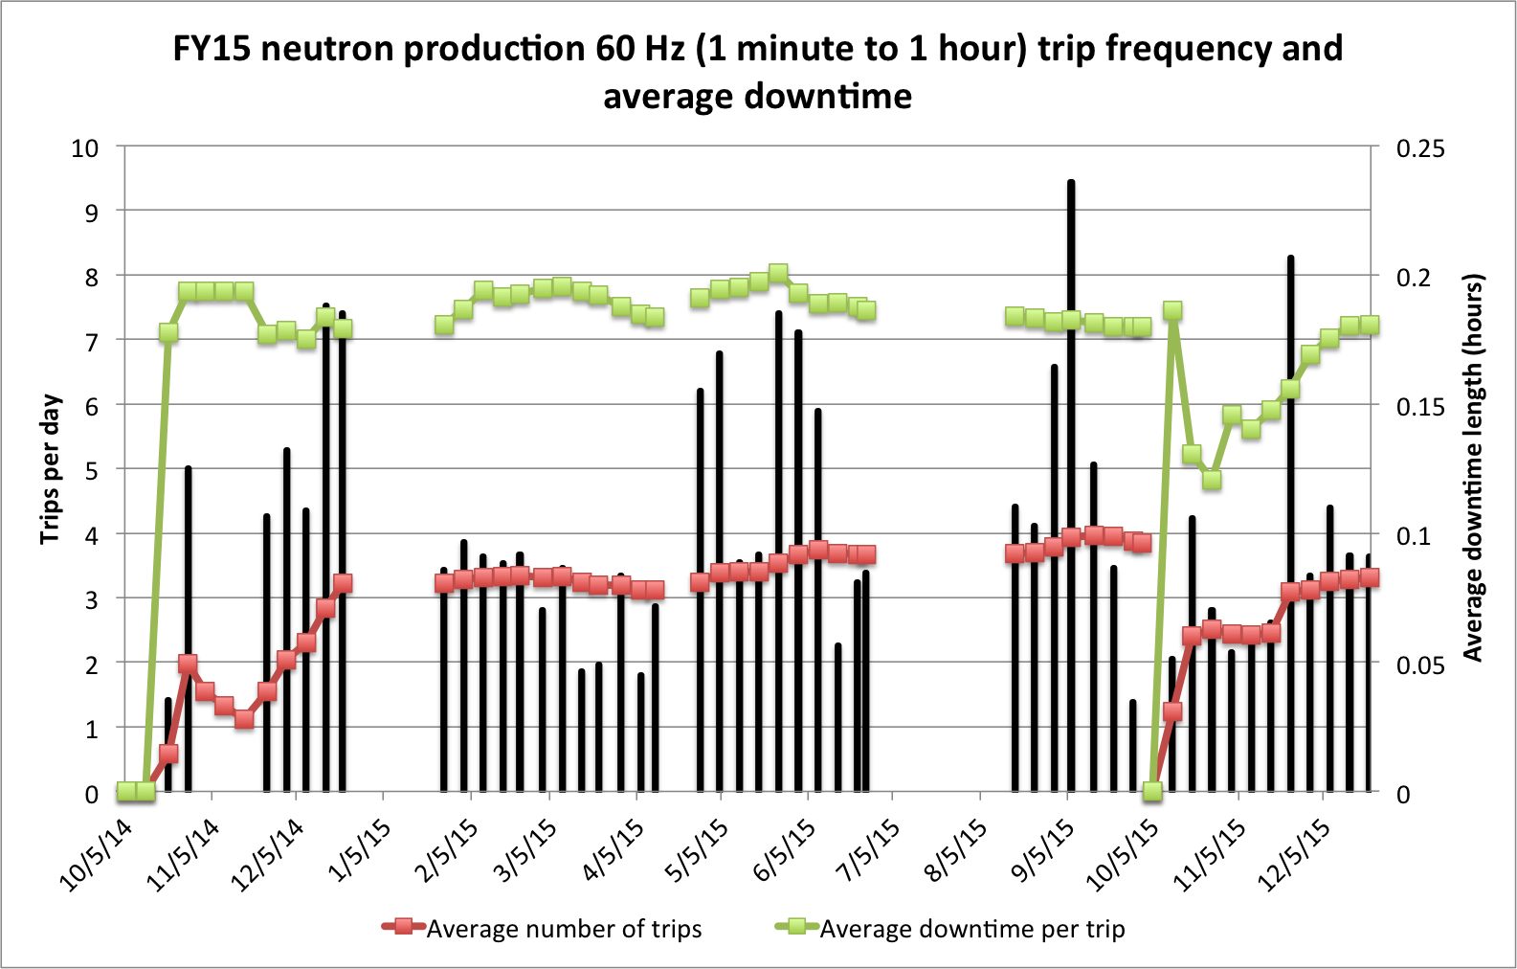
Continue to use frequency plots to evaluate performance Just over 3 trips/day for FY16 Q1
FY15
Run 1
MAINTENANCE
FY15
Run 2
MAINTENANCE
FY15
Run 3
MAINTENANCE
FY15
Run 4
UNSCHEDULED TARGET CHANGE
FY16
Run 1
UNSCHEDULED TARGET CHANGE, MEBT WATER LEAK
UNSCHEDULED TARGET CHANGE

Slide 13
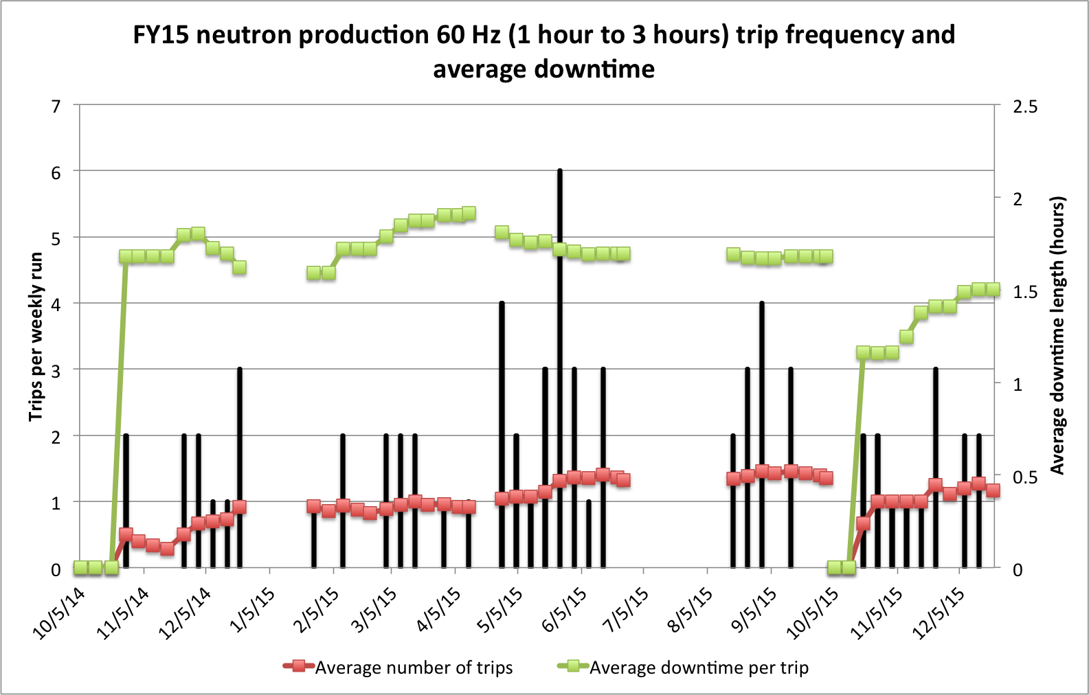
Medium duration events are fairly constant
FY15
Run 1
MAINTENANCE
FY15
Run 2
MAINTENANCE
FY15
Run 3
MAINTENANCE
FY15
Run 4
UNSCHEDULED TARGET CHANGE
FY16
Run 1
UNSCHEDULED TARGET CHANGE, MEBT WATER LEAK
UNSCHEDULED TARGET CHANGE

Slide 14
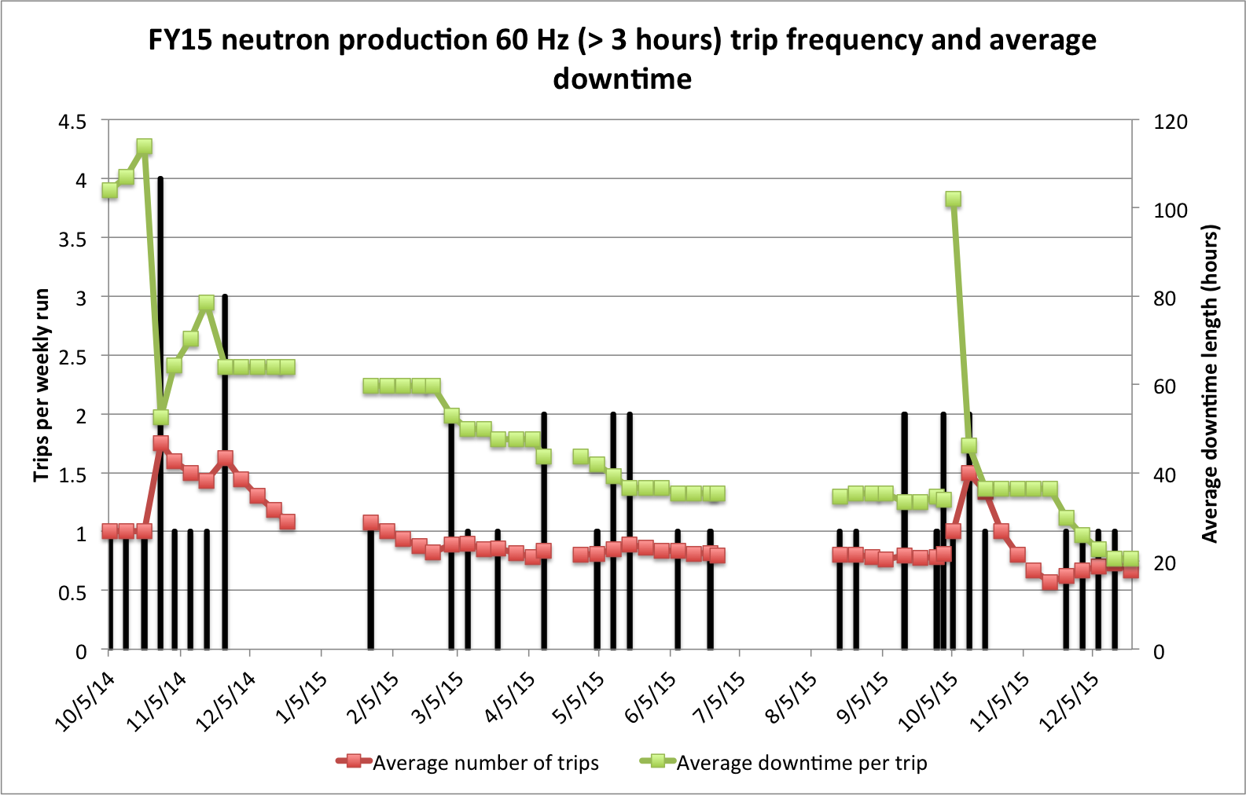
Strive for no more than 1 long duration trip every 2 weeks
FY15
Run 1
MAINTENANCE
FY15
Run 2
MAINTENANCE
FY15
Run 3
MAINTENANCE
FY15
Run 4
UNSCHEDULED TARGET CHANGE
FY16
Run 1
UNSCHEDULED TARGET CHANGE, MEBT WATER LEAK
UNSCHEDULED TARGET CHANGE

Slide 15
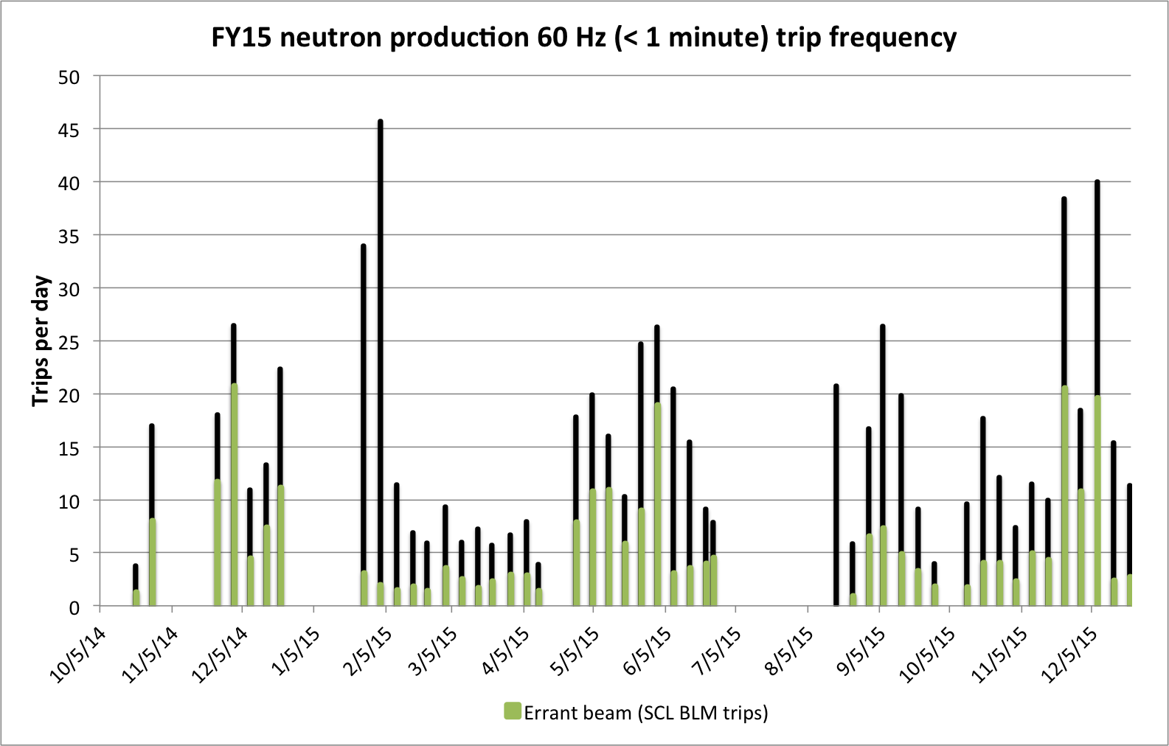
Continue to monitor errant beam trips Individual equipment issues significantly affect the trip rate
FY15
Run 1
MAINTENANCE
FY15
Run 2
MAINTENANCE
FY15
Run 3
MAINTENANCE
FY15
Run 4
UNSCHEDULED TARGET CHANGE
FY16
Run 1
UNSCHEDULED TARGET CHANGE, MEBT WATER LEAK
UNSCHEDULED TARGET CHANGE
Ion source edump insulator arcing
Ion source 65 kV arcing
Damaged DTL5 ceramic RF window

Slide 16
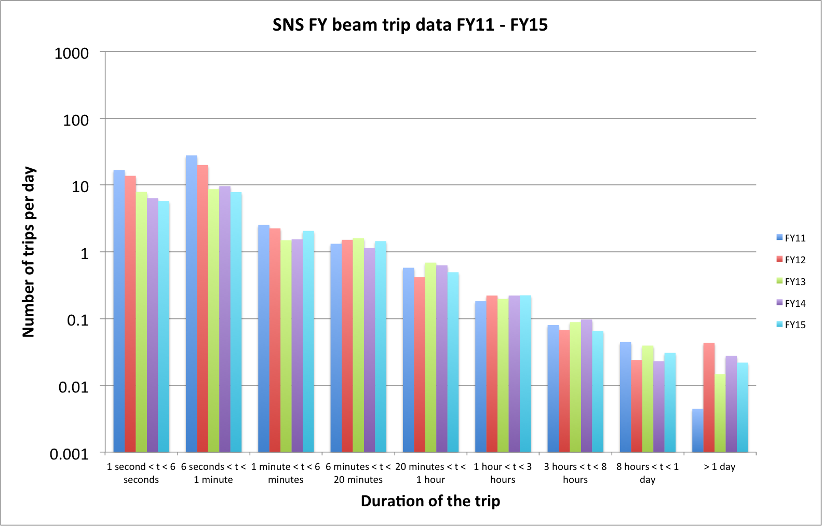
Good progress on reducing the number of short duration trips
Errant beam, magnet ps
SCL cavity trips
Warm linac cavity trips
Requires tech expert or repair (call-in)

Slide 17
Target/MEBT cooling failures account for 65% of downtime
System | FY15 | FY16-1 | Total
Target | 625.9 | 185.1 | 811.0
Beam Inst. | 419.1 | 0.2 | 419.3
RF | 152.7 | 29.1 | 181.8
E-other (TVA, etc.) | 111.6 | 0.0 | 111.6
E-HVCM | 70.5 | 19.8 | 90.3
E-MagPS | 49.9 | 11.5 | 61.4
Ion Source | 38.4 | 11.9 | 50.3
Vacuum | 39.5 | 0.2 | 39.7
CM/SRF | 23.1 | 5.9 | 29.0
Cooling | 26.9 | 1.5 | 28.4
Controls | 21.8 | 5.3 | 27.1
Ops | 20.2 | 0.9 | 21.1
Prot. Sys. | 3.1 | 8.6 | 11.7
E-Choppers | 6.4 | 0.5 | 6.9
Mech. Sys. | 3.4 | 1.2 | 4.6
Cryo | 1.7 | 0.0 | 1.7
Physics | 0.3 | 0.9 | 1.2
Misc. | 0.4 | 0.0 | 0.4
Totals | 1614.9 | 282.6 | 1897.5

Slide 18
Summary
Sustained operations above 1.2 MW with another sustained 1.4 MW run
Excellent availability excluding target failures
Long downtime events continue to have an impact on scheduling, performance, and beam power levels
We continue to measure our performance and make system improvements as you will hear over the next 2 days

