Slide 1
Progress to
1.4 MW Reliable Operations
AAC, February 16-18, 2016
by Mike Plum
Ring Area Manager &
Accelerator Physics Team Leader

Slide 2
Outline
Beam power history, limitations
RFQ transmission update
Smart chopping update
Ring injection at high beam power
Activation levels, path to further improvements
Maximum beam energy for today’s accelerator

Slide 3
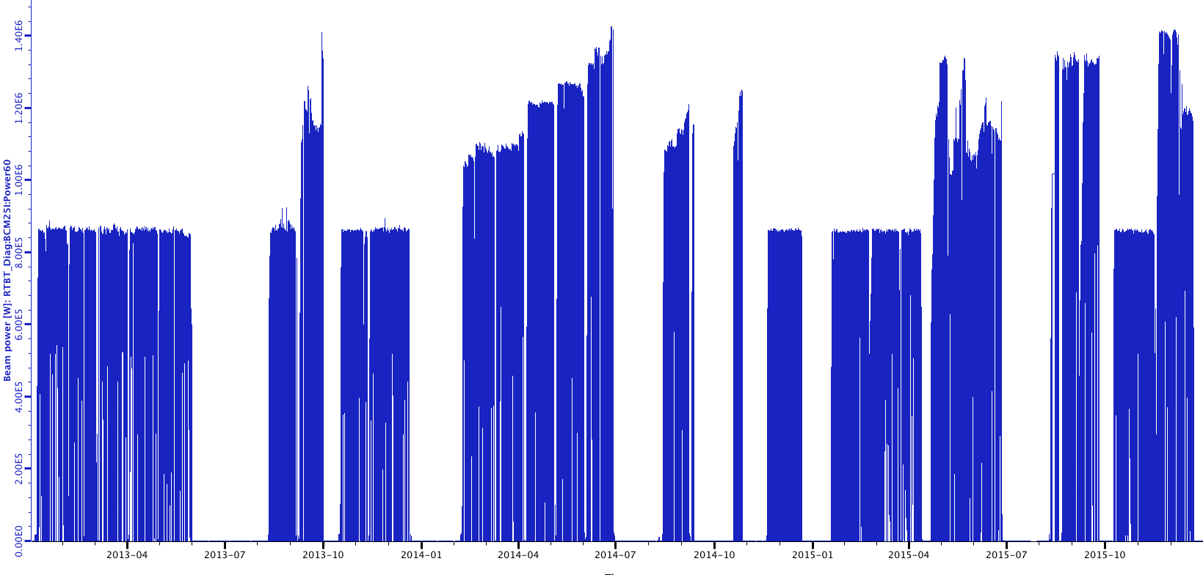
Recent beam power history
Ion source Edump
Damaged RFQ RF couplers
Planned power ramp up
Damaged RFQ RF couplers
Damaged DTL5 ceramic RF window
OE limit restriction
1.4 MW
1.2 MW
1.4 MW 1st time
1.0 MW
0.85 MW*
Beam power on target
MEBT water leak
Target replacement
Target replacement
Target replacement
Target replacement
Target replacement
*0.85 MW is target conservation
Jan. 1, 2013 to Dec. 31, 2015
Notes:
Fall 2013 the RFQ couplers were damaged after a long period of abuse (vacuum event during a power outage, high hydrogen flow). They showed multipacting signatures and high temperature.
Spring 2014 had good RFQ couplers and ion source performance which allowed power increase to 1.4 MW.
July 2014 there were two vacuum events that released water vapor into the RFQ. RFQ couplers showed multipacting signatures and heating after those events. Increased heat load required reducing the field to allow for stable RFQ operation.
Fall 2014 there were two target failures and the MEBT water leak.
April 2015 DTL5 window failed during RF conditioning, and the replacement window had a leak that prohibited running above 1.3 MW.
Fall 2015 the OE limit restricted running below 1.4 MW. There were ion source edump issues with voltage decay and bad insulators before the target failure in September 2015. The ion source edump insulator issues continued throughout the fall. The voltage decay issue was resolved by increasing the cesium collar temperature before the target failure in September 2015. The ion source edump issues also degraded the RFQ performance by increasing beam loss and using up cooling capacity for the RFQ.

Slide 4
Beam power limitations
65 keV
Peak current limitation:
RFQ has poor beam transmission
60 – 75%
Energy limitation:
SCL cavity gradients limit max beam energy to ~957 MeV
Chopper improvement:
Rise/fall time improvements, longer minipulse length, smart chopping help overcome power limitations
Plan to install new RFQ Jan. 2017
Plasma processing will increase SCL cavity gradients (M. Doleans talk)
Peak current and beam energy limitations are offset by the chopper improvements, but we need more margin

Slide 5
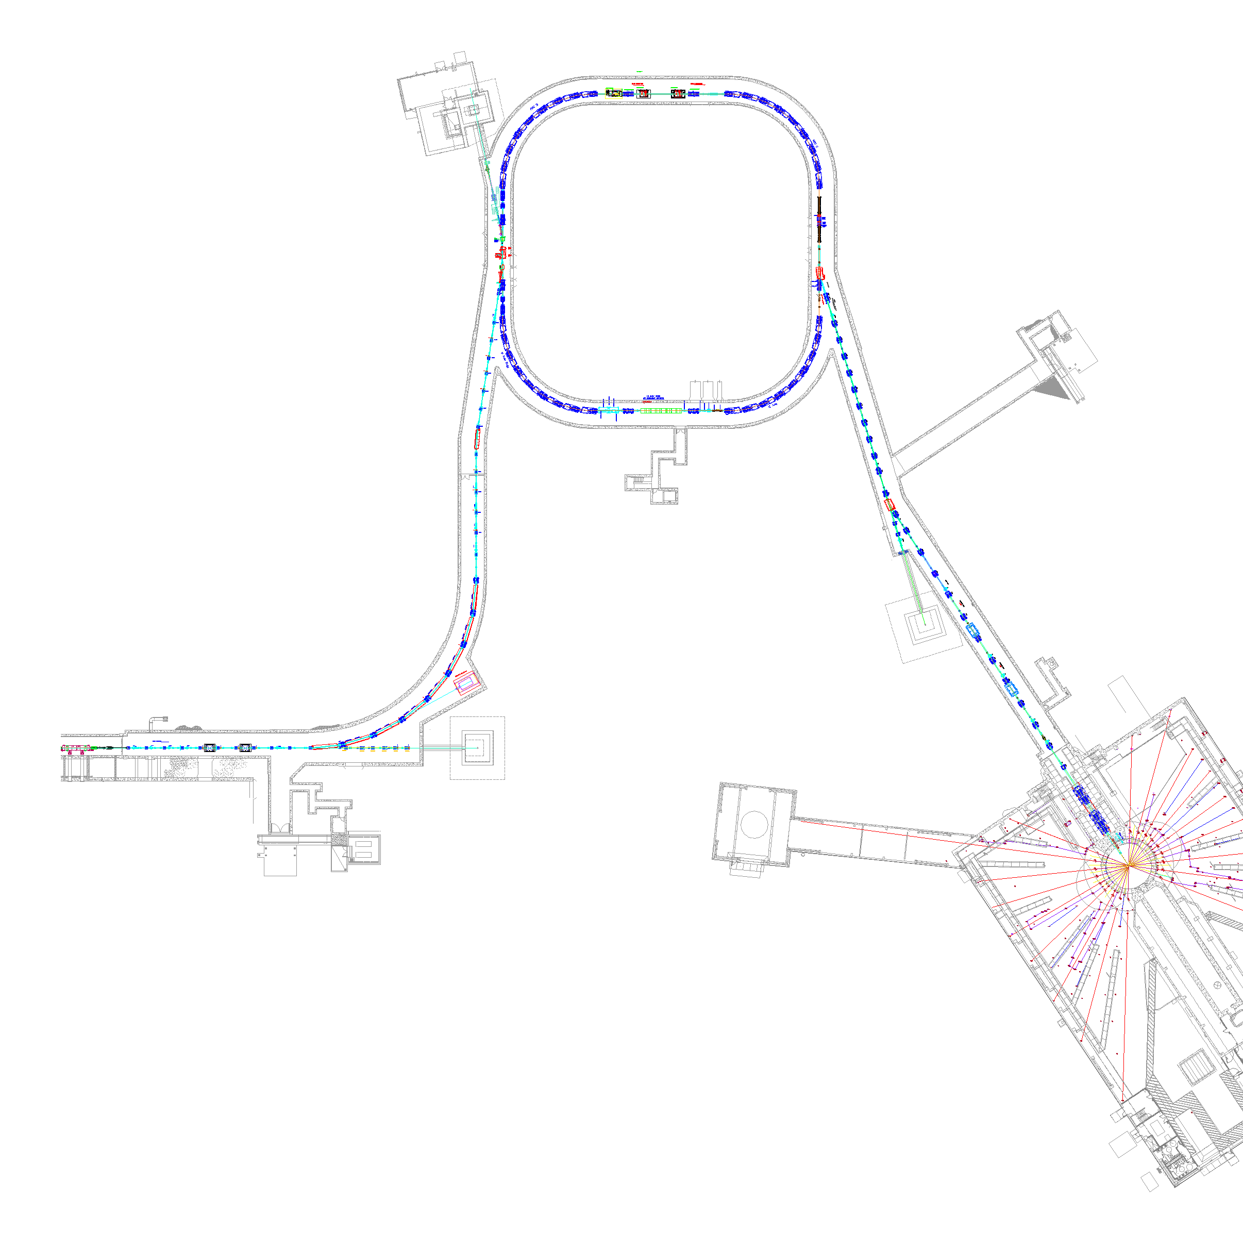
Beam availability limitations
Downtimes by system
System | Subsystem | CY14 [hours] | CY15 [hours]
RF | High power | 132 | 145
Electrical | HVCM | 77 | 74
Electrical | Power supplies | 34 | 43
Electrical | AC distribution | 10 | 76
Ion source | RF | 24 | 15
Accumulator Ring
Collimators
Extraction
Injection
RF
RTBT
HEBT
Front-End
LINAC
Overall availability is good
Biggest sources of availability limitation are linac high power
RF and the associated High Voltage Converter Modulators
No correlation with high beam power

Slide 6
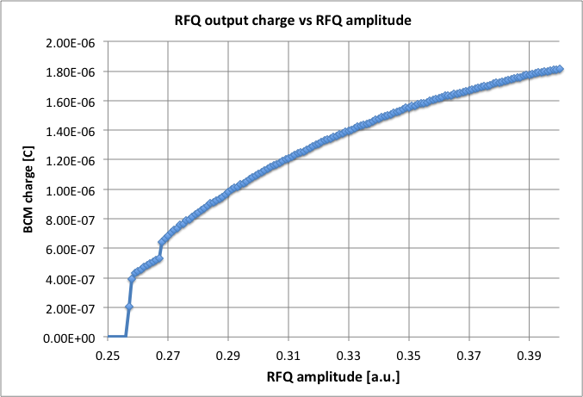
RFQ transmission vs. RFQ field
Due to thermal
(resonance) instability
we cannot operate the
RFQ at the design field
Measured transmission
is 12 – 30% less than
design
This is the primary
limitation in 1.4 MW
margin
Absolute RF field
measurements are difficult, and
there is uncertainty in the actual fields
We know they are low, but how low?
Potential current increase
Typical operating point today
Courtesy A. Shishlo
Oct. 27, 2015

Slide 7
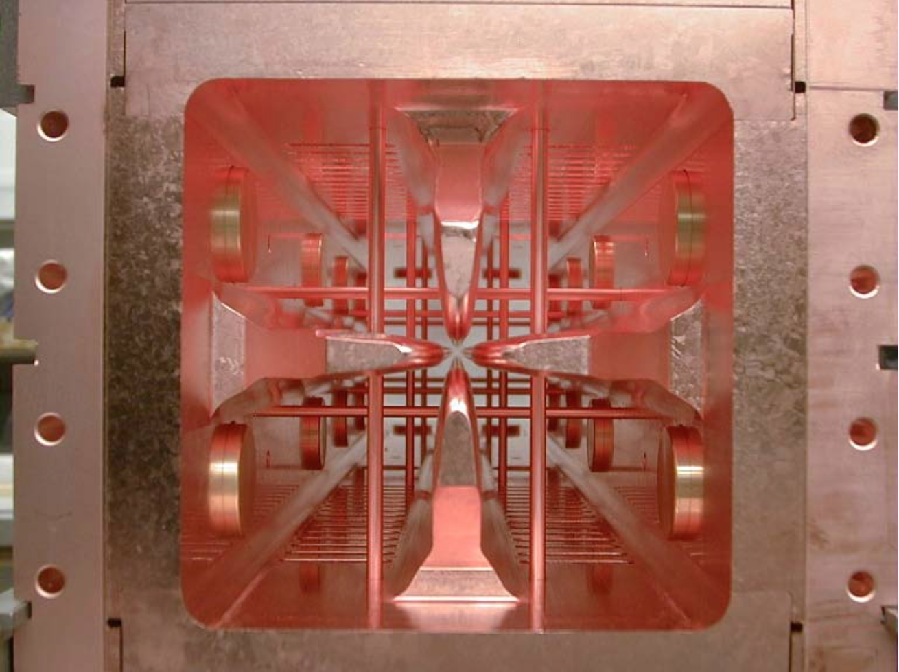
RFQ absolute field measurement
(S. Aleksandrov)
Measure x-ray spectrum emanating from center of RFQ
Gives absolute measurement of maximum voltage between vane tips, and thus absolute measurement of RFQ field amplitude
0.5%
98%
Counts/s
Maximum Energy
1.5%
Energy, keV
Courtesy S. Zhukov, Y. Kang

Slide 8
RFQ inter-vane voltage (field) vs. setpoint
Absolute field measurements suggest the voltage is low by about 15%
Design voltage = 83 kV
Today’s operating voltage
During the next few months these measurements will be improved by calibrating the x-ray detector and by determining the optimum detector position
Preliminary data!
Energy, keV
Setpoint
Courtesy S. Zhukov, Y. Kang

Slide 9
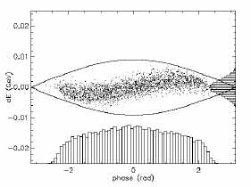
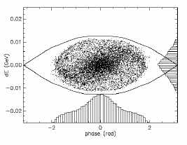
Smart chopping
1 turn
Ramp-down
Flat-top
New features
Relatively large un-chopped flattop most of injection
Ramp-up
Store
Longitudinal “tricks” to recover big gap at extraction time
10% increase in “average un-chopped” fraction may be possible

Slide 10
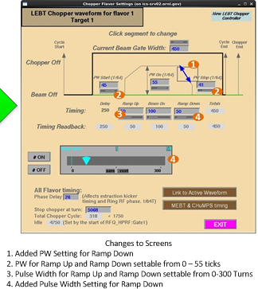
Smart chopping
Status:
  Installed summer 2015
  Basic testing fall 2015
  Now needs careful study (planned for this run cycle)

Slide 11
Path to high power, high availability operations
Replace RFQ
  Plan to install Jan. 2017
Increase SCL cavity gradients See talk by Marc Doleans
  Started Jan. 2016
Smart chopping
  Started Fall 2015
AIP program to address reliability issues See talk by George Dodson
  In progress

Slide 12
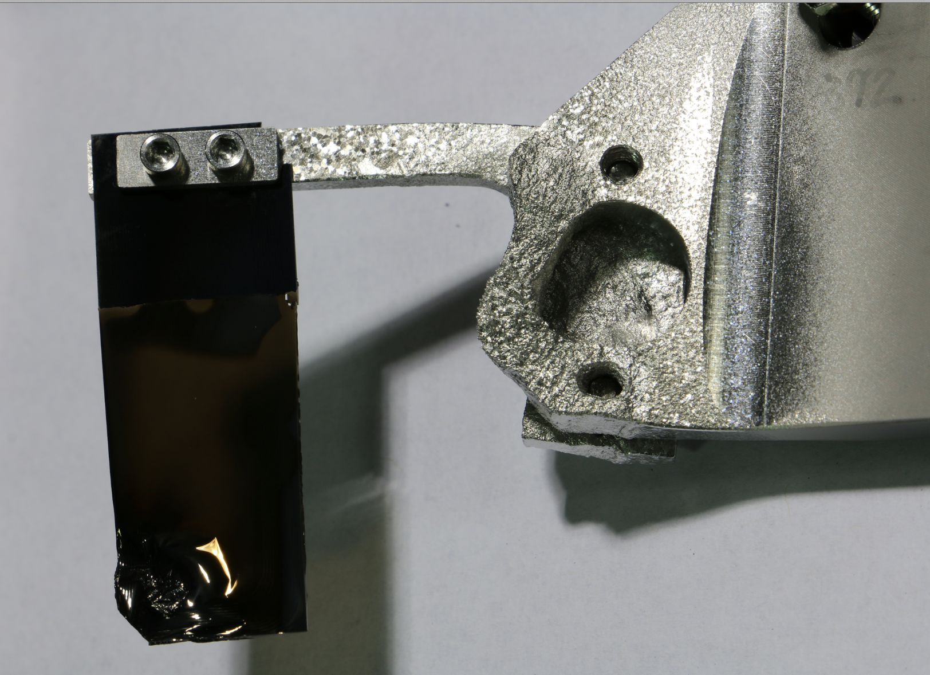
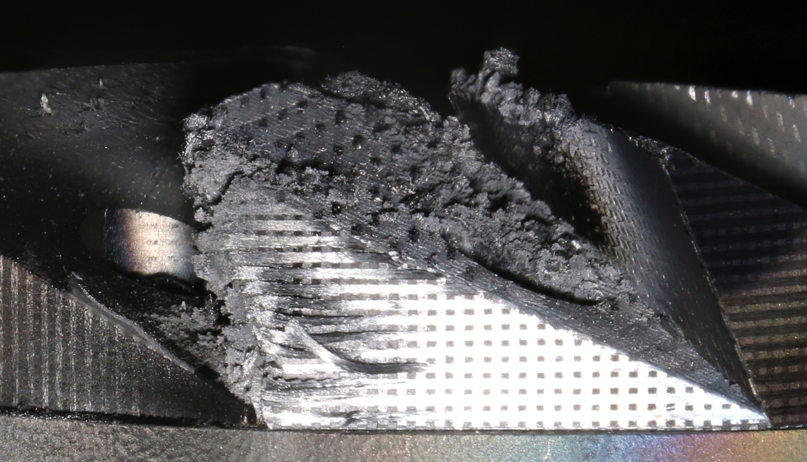
SNS injection at high beam power
Stripper foil mount and bracket damage
Electron collector damage

Slide 13
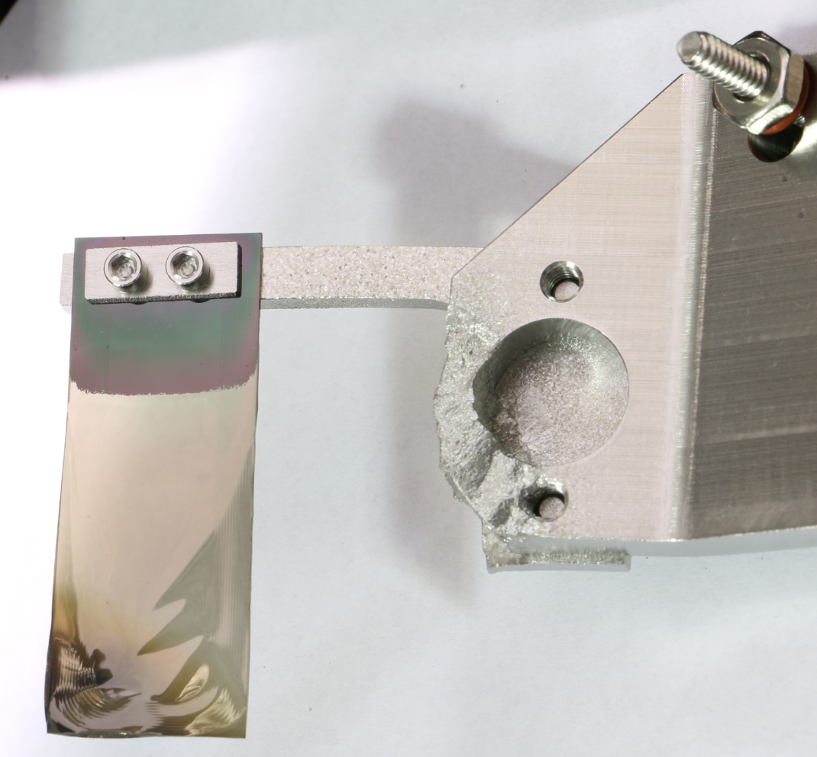
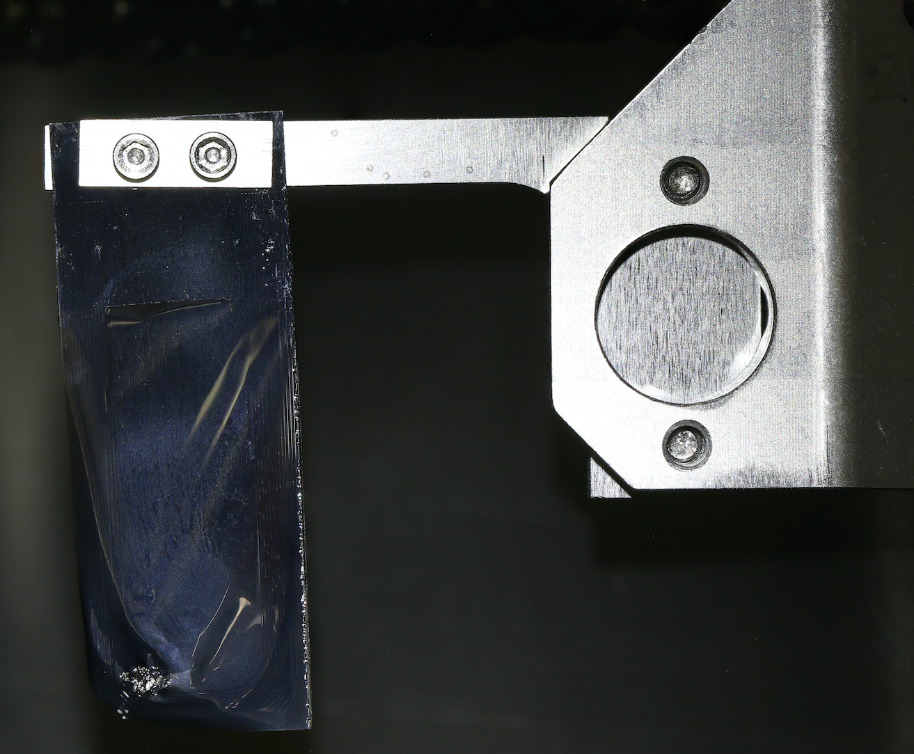
Ti vs TZM bracket comparison
Photos by C. Luck
#BW-18,
~24 days at ~1.2 MW
#1872,
3 months at 1.1 to 1.4 MW.
#2199, TZM bracket,
~16 days at 1.4 MW
New TZM bracket tested Nov. – Dec. 2015
  Almost zero damage at full 1.4 MW beam power
Advantages: high sublimation temperature, low sputtering yield, high sputtering threshold
Disadvantages: Heavy, long-lived radio-activation
Will test three more TZM brackets during Feb – May 2016 run
All brackets and mounts are Ti except this one

Slide 14
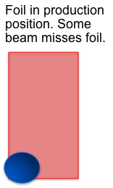
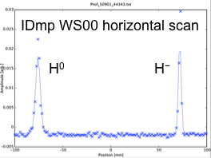
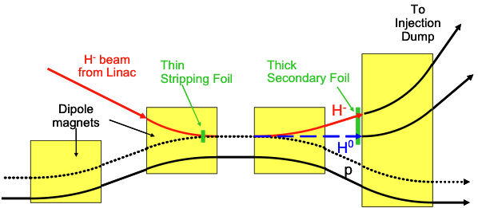
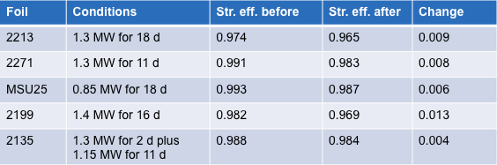
Stripper foil sublimation
If our stripper foils are getting hot enough to sublimate we need to know that now
In 2015 we developed a new method to measure and monitor stripping efficiency
Results to date: maximum observed efficiency drop is 1.3% but errors are large and thinning could easily be due to effects other than sublimation

Slide 15
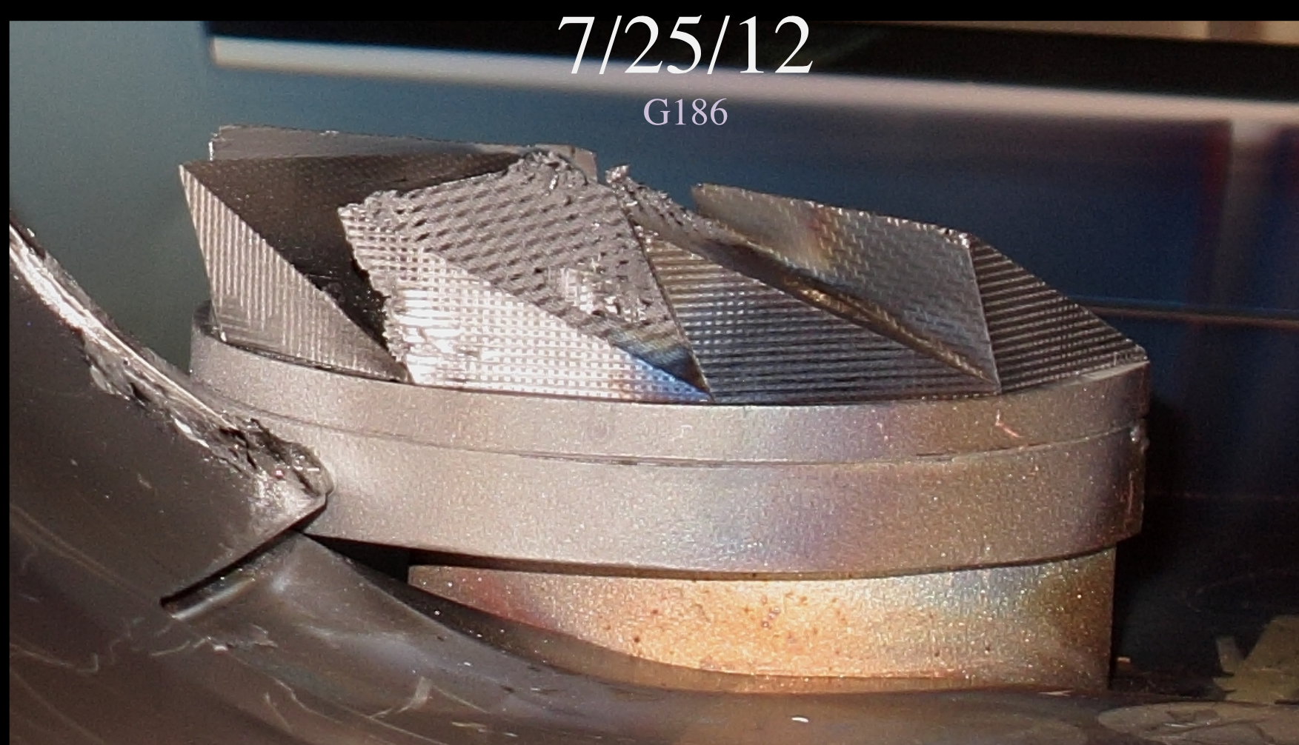
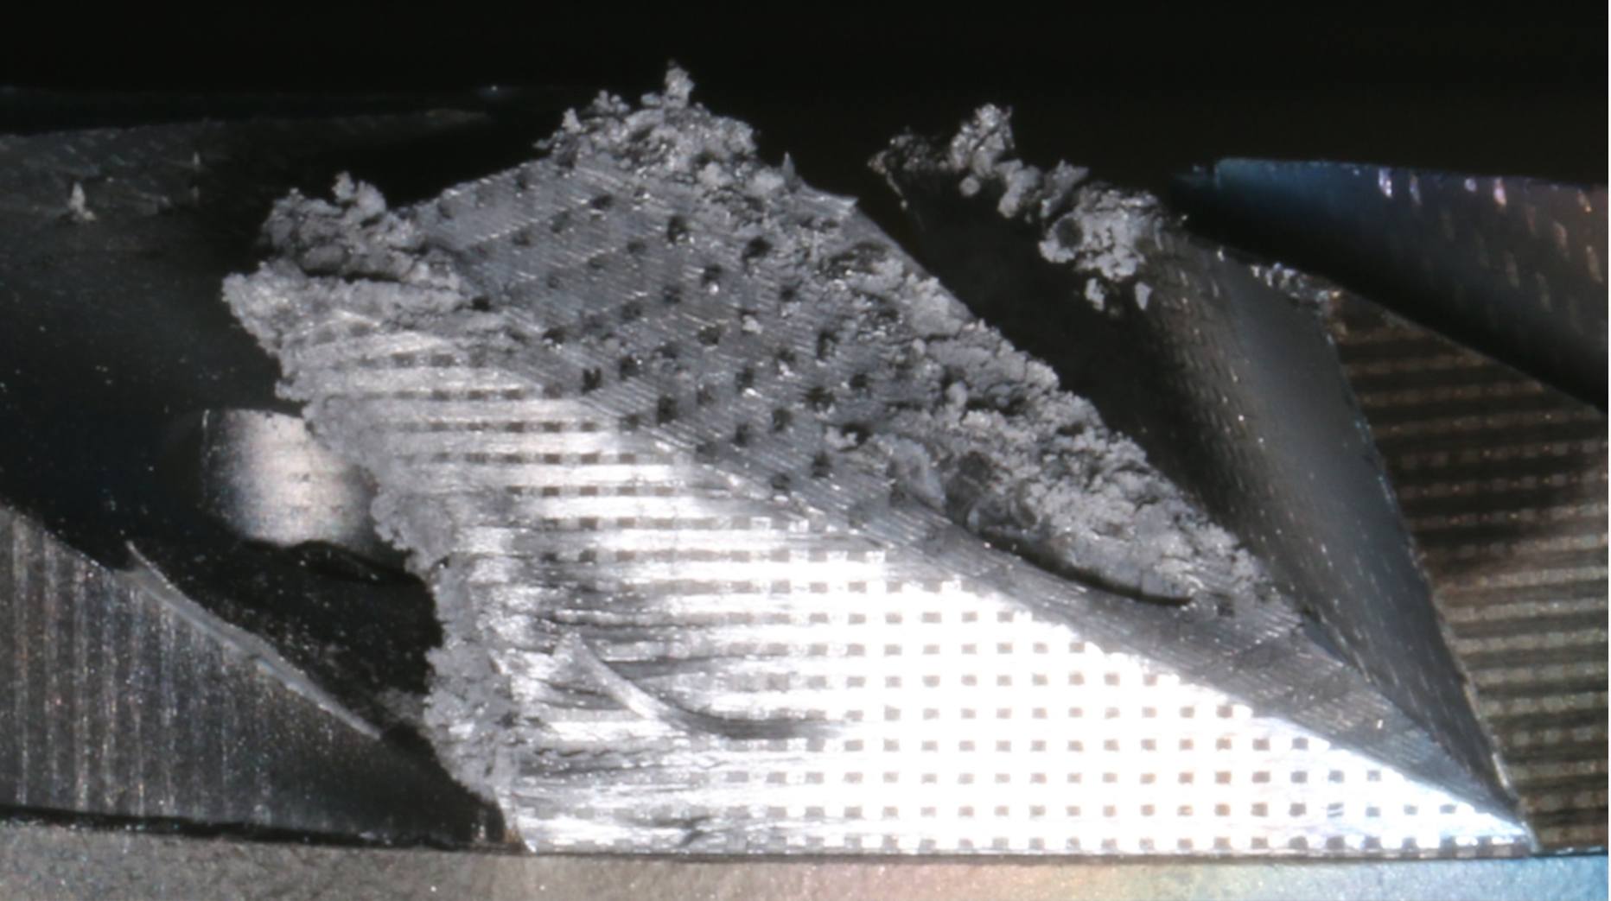
Electron collector erosion
Electron collector is becoming eroded away due to impact of convoy electrons
Design on a new collector should start soon
We are considering different shapes and ability to adjust stripper foil position w.r.t. collector position
Committee advice on the urgency of this issue would be appreciated!
1/15/16
Photos by C. Luck

Slide 16
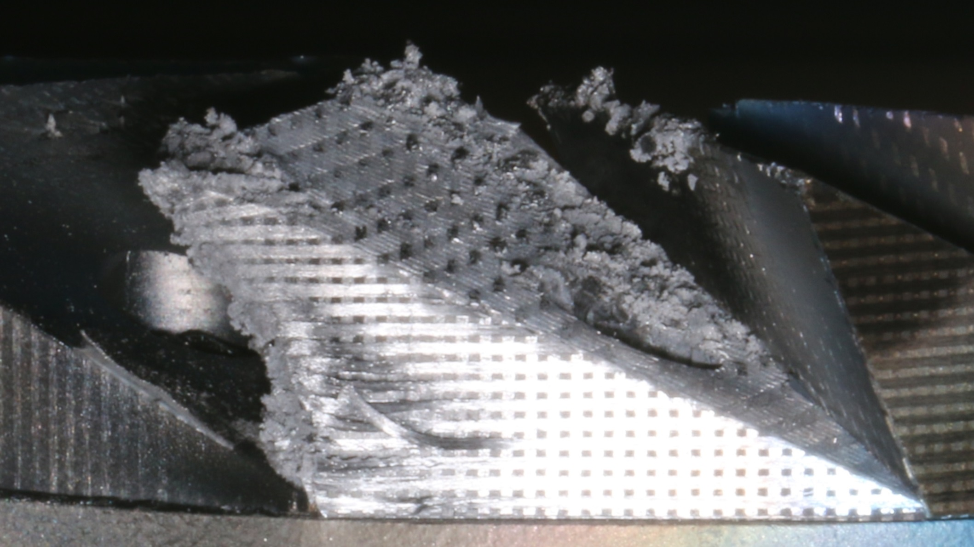
7/28/15
1188

Slide 17
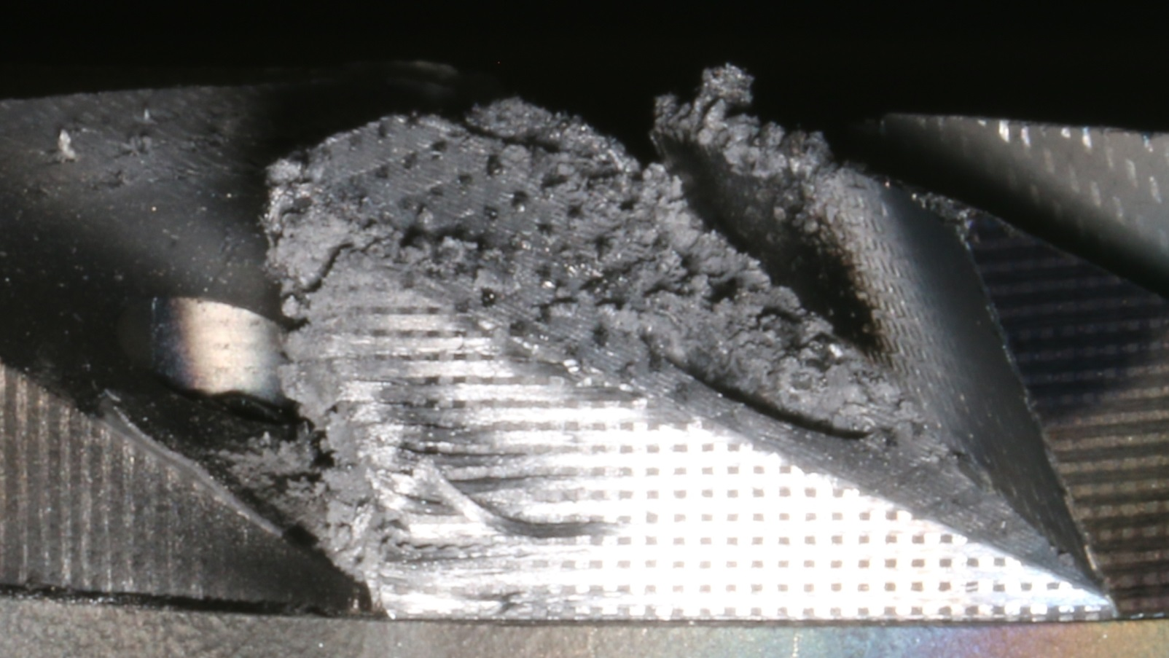
1/15/16
3086

Slide 18
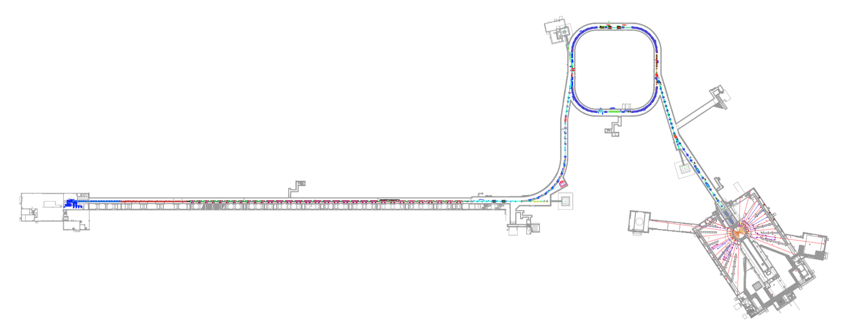
Activation levels
1.3 MW until 3 to 5 hours before survey
Sept. 22, 2015
All numbers are mrem/h at 30 cm
100 mrem/h = 1 mSv/h
90
coll. straight
1000
inj kicker
80
Extr Sptm
1000
strip foil
50*
DH13
90
DH25
DTL
2 – 30
CCL
8 – 60
SCL mb
5 – 40
SCL hb
5 – 45
Ring
5 – 40
150*
QH26
5 – 35
HEBT
<5**
RTBT
5 – 25*
70
Slot 32
90
LEDP
50
After SCL-1
* 3 days after 1.3 MW
** No survey near this time,
indicated does rates are typical
Except for a few hot spots, the dose rates are relatively low

Slide 19
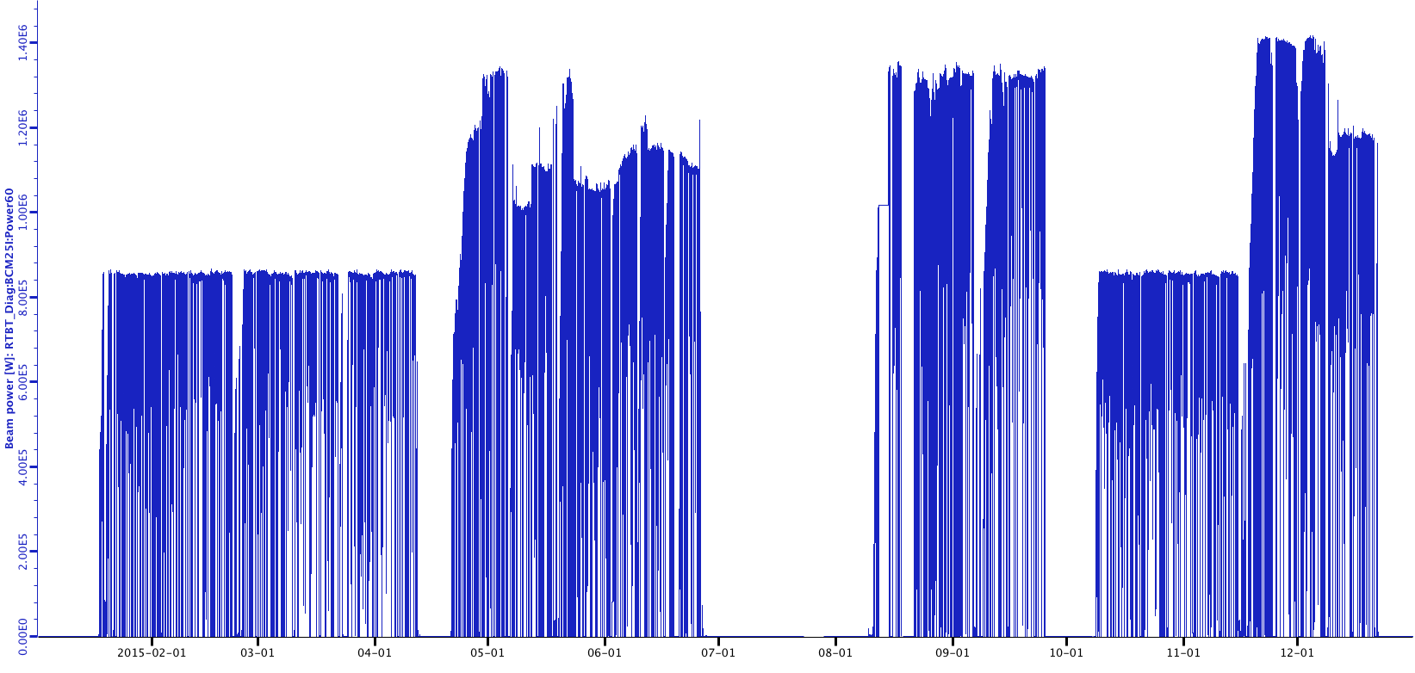
Recent beam power history for 2015
Activation measurements
1.4 MW
1.2 MW
1.0 MW
Beam power on target
Planned outage
Planned outage
Target replacement
Jan. 1, 2015 to Dec. 31, 2015

Slide 20
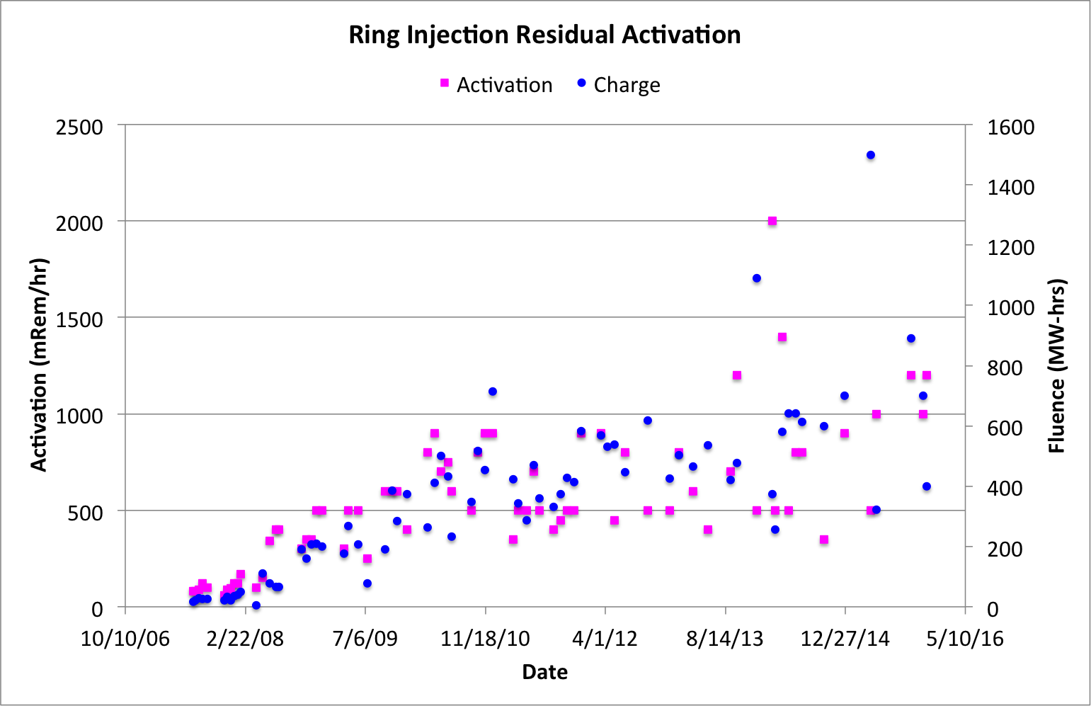
Path to lower activation levels
Beam loss reduction to date has been almost entirely empirical
  Beam loss per Coulomb of beam charge has been steady for years (i.e. beam loss is linear with beam power)
  Possible that we are in a local minimum
  rms Twiss parameters are highly mismatched throughout linac and HEBT
  Possible that the BLMs
  are minimized, but the
  beam loss is not
Ideal route to minimum
loss is accurate simulation
code that will tell us how
to set all parameters
required
Plot courtesy of C. Peters

Slide 21
Path to lower activation levels (cont.)
Simulation determines parameters for minimum beam loss
Need accurate input distribution for simulation codes
Need good linac simulation code
Need accurate SNS linac lattice
6D phase space measurement on Integrated Test Stand
Add linac simulation capability to PyORBIT
Benchmark simulations with measurements
Beam-based measurement of lattice parameters
* S. Cousineau talk
* A. Shishlo talk
* A. Shishlo talk

Slide 22
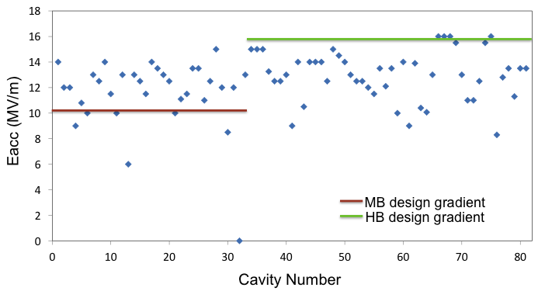
Beam energy limit
Maximum beam energy today is limited to
~957 MeV by SCL cavity gradients
If the gradient limitation is removed (e.g. by plasma processing and cavity repairs) the new linac beam energy limit would be from SCL klystron power
PPU project will install
new cavities before
ring injection area is
upgraded
What is the maximum
energy?
SCL gradients March 2015

Slide 23
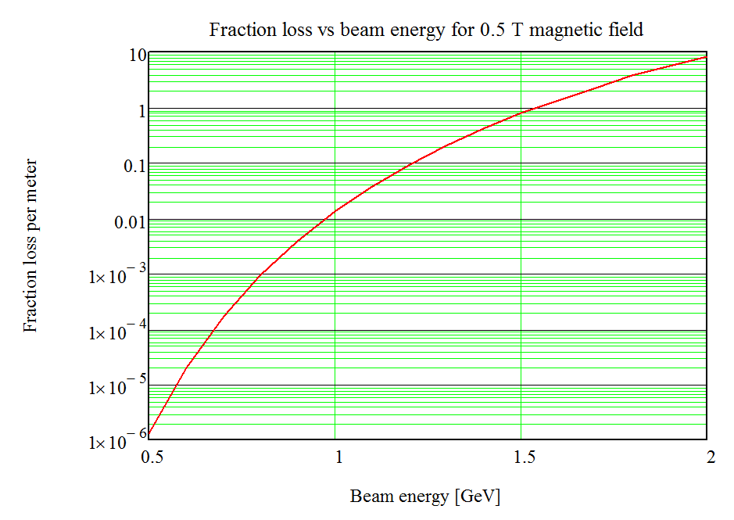
Magnetic field stripping limits ring injection energy
Lorentz-transformed magnetic field looks like electric field in rest frame of beam particles E_{ion} [V/m] = βγcB_{lab} [T]
Loosely-bound electrons on H⁻ particles can be stripped off
Fractional loss per meter:
Frac. loss (10⁻⁶ to 10¹)
A1 = 2.47E-6 V sec/m
A2 = 4.49E9 V/m
B(s) = magnetic field
β, γ, c = relativistic factors
0.5 T case
(A. Jason et al., PAC 1981, p. 2704)
Beam energy (0.5 to 2 GeV)
Double jeopardy for ring injection
Both beam energy and required B field are higher

Slide 24
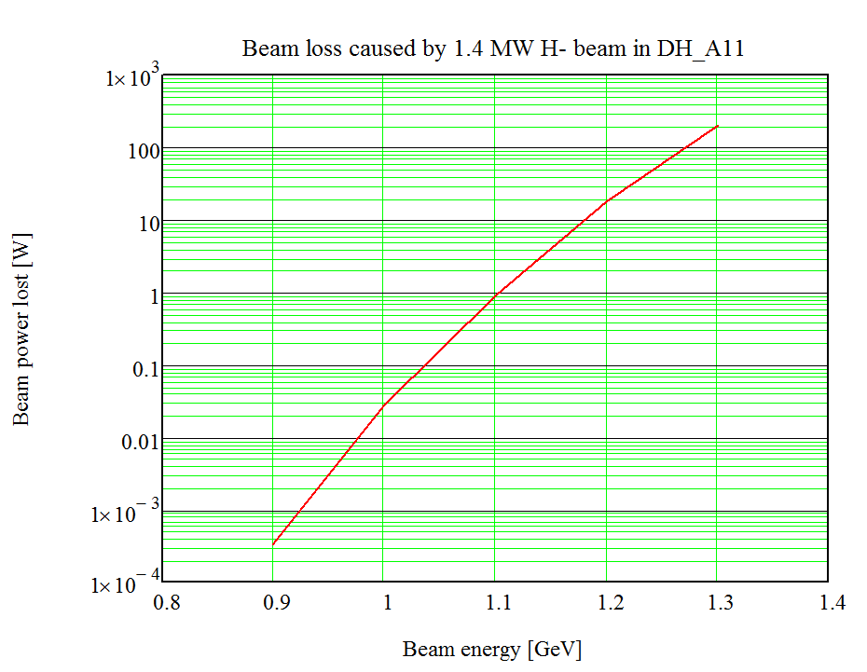
Beam energy limit due to ring chicane
Assume limit on additional beam loss is 1 W (i.e. adds ~1 mSv/h (100 mrem/h))
to dose rate in injection section. Also assume 1.4 MW beam power.
Beam energy must be less than 1.1 GeV to limit additional beam loss to 1 W
(Magnet power supply is only at ~75% for 1.1 GeV)
Beam power lost [W]
Beam energy (0.8 to 1.4 GeV)

Slide 25
Summary
Accelerator today can usually reach 1.4 MW, but need more margin for routine high power delivery
  RFQ replacement, plasma processing
Convoy electron damage to stripper foil brackets at high beam power is mitigated by new bracket material (TZM)
Convoy electron collector damage rate is increasing due to high beam power. Need to redesign & replace.
We have an active program to further improve beam losses and better understand beam dynamics
Maximum practical beam energy is ~1.1 GeV, limited by magnetic stripping at ring injection

Slide 26
Thank you for your attention!

Slide 27
Back up slides

Slide 28
SNS Linac Structure
65 keV
Length: 330 m (Superconducting part 230 m)
Production parameters:
Peak current: 38 mA
Repetition rate: 60 Hz
Macro-pulse length: 1 ms
Final Energy: 940 MeV (1000 MeV design)
Average power: 1.4 MW

Slide 29
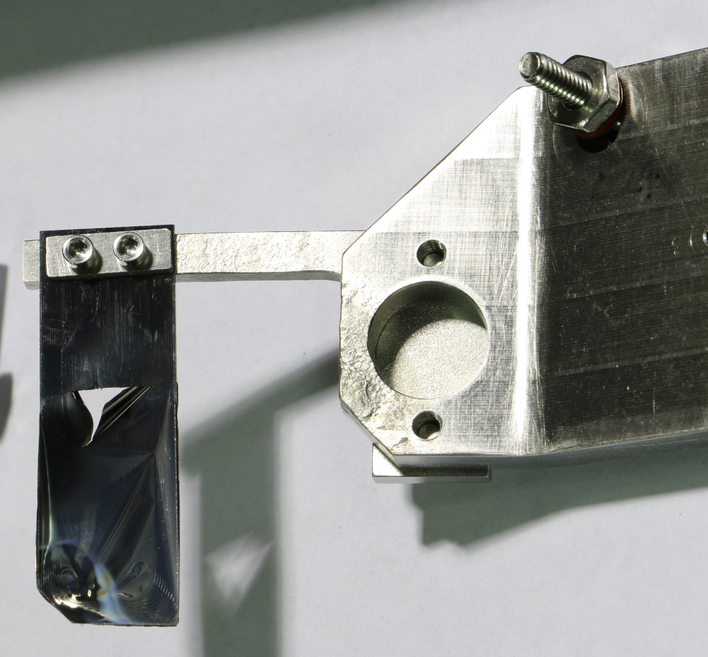
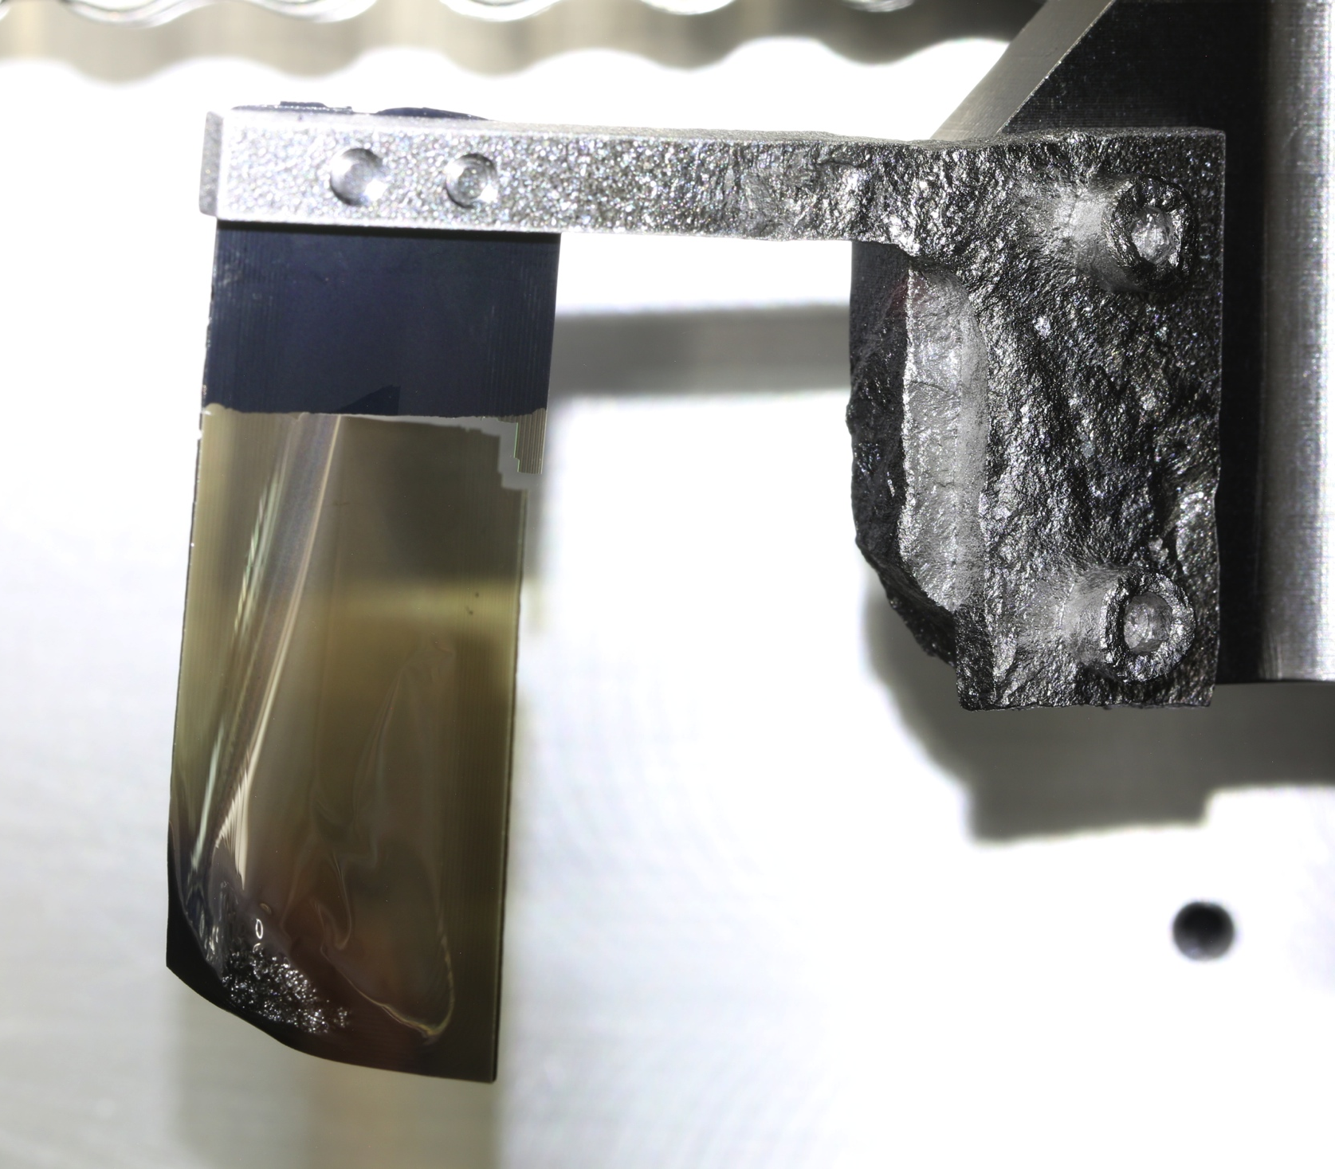
Ti vs TZM bracket comparison
#2024, pos’n 9, used for 4 days, beam high on foil due to positioning error. ~2 days at ~1.3 MW.
BW-18, pos’n 4. ~24 days at ~1.2 MW
#1872, pos’n 7, up to 1.4 MW. 3 months at 1.1 to 1.4 MW.
All brackets and mounts are Ti except this one
Photos by C. Luck
#1937 pos’n #11, Foil in 5.1 mm dnstr position. ~7 days at 1.20 – 1.33 MW, ~13 days at 1.0 to 1.2 MW.
TZM bracket, ~16 days at 1.4 MW, Nov. 15 – Dec. 9, 2016

Slide 30
SNS injection schematic
Multi-Turn Charge-Exchange Injection to accumulate high intensity
Stripping foil removes 2 electrons, injected protons merged with previously accumulated beam.
The Secondary foil strips residual H⁻ and H⁰ which survive the first foil.

Slide 31
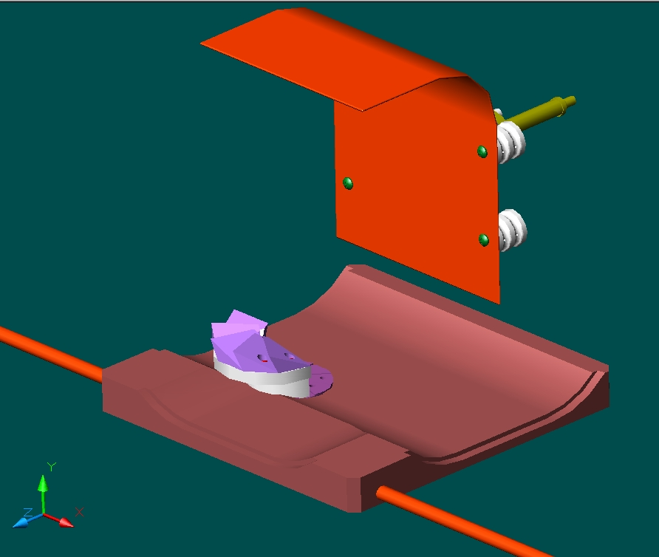
Electron Catcher Design
Field tilt directs electrons downward
Nominally, electrons should impact underside of electron catcher wedges
1 GeV H⁻ convoy electrons
545 keV energy
~ 2 kW
Gyroradius: 12 mm,
Period: 0.29 ns,
Pitch: ~16 – 23 mm
Electron Catcher
Efficient electron catching: catcher and foil need to be properly aligned

Slide 32
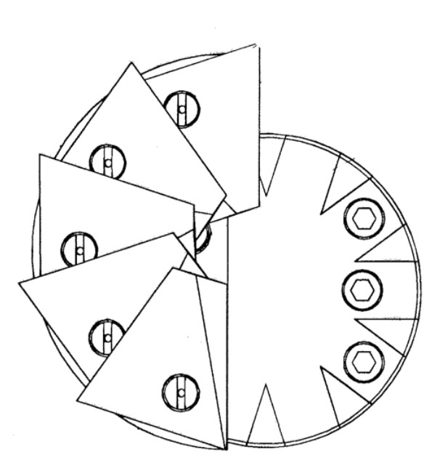
Electron catcher is not at the proper location w.r.t. the foil
Initial installation was misaligned. Foil moved three times to address injection loss and bracket damage issues.
The catcher is not and has never been positioned within design tolerance.
Design at catcher
4
14
 | As built error [mm] | Tolerance [mm]**
Horizontal | 8 | A few
Vertical | 3 | ±6.5
Longitudinal | 6.4 | 6.5
As-built,
at catcher

Slide 33
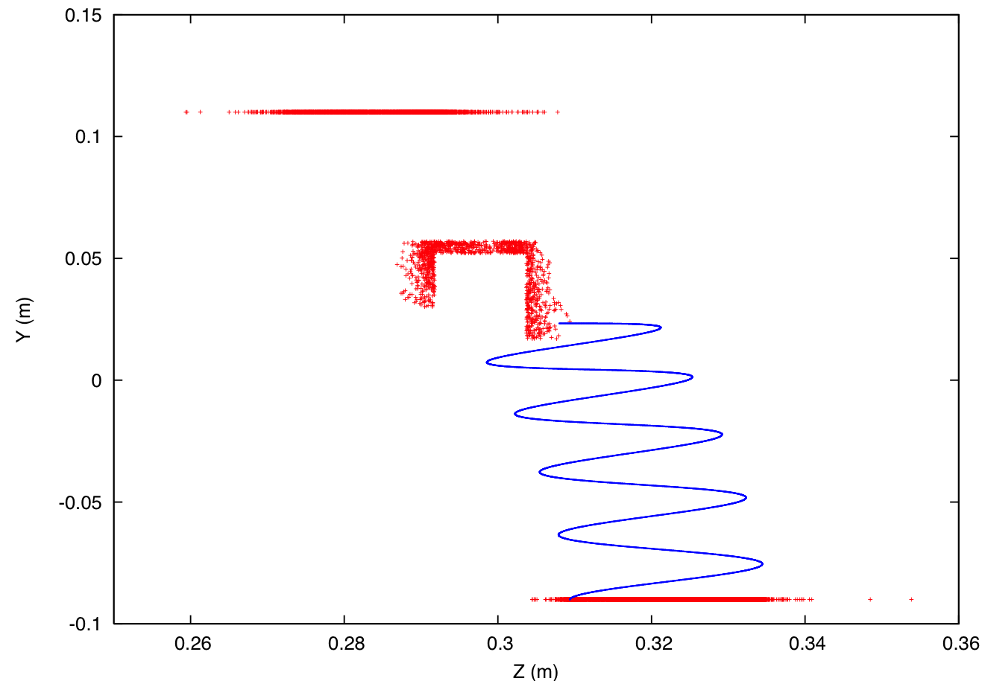
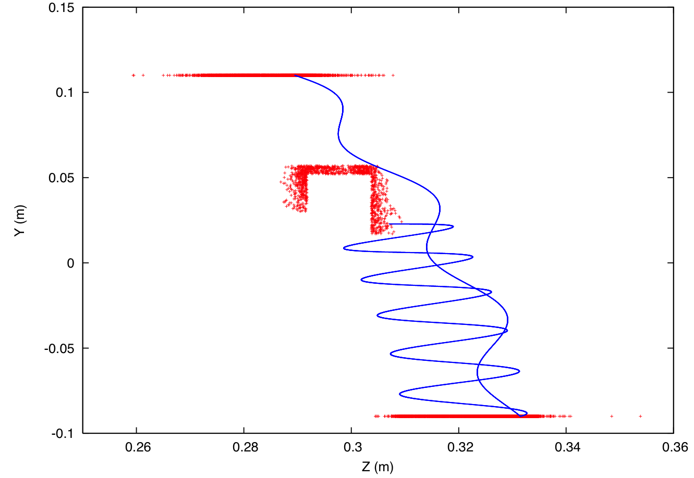

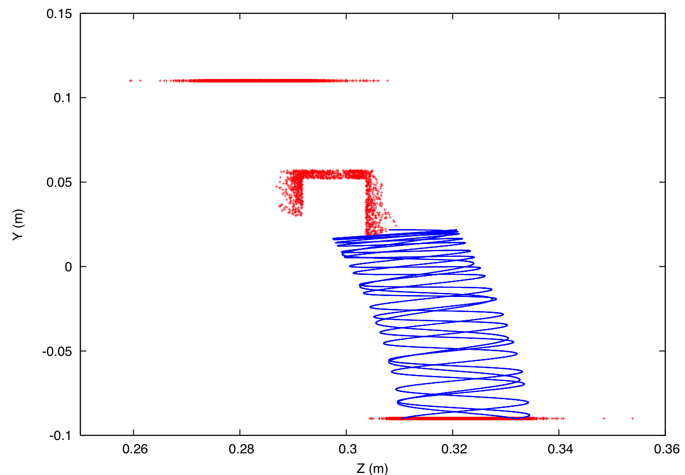
Example Convoy Electron Simulated Trajectories
Reflected electron hits vacuum vessel top
bracket arm
bracket
leg
foil
Electron caught at catcher !
Reflected electron hits bracket arm
Reflected electron hits foil again

Slide 34
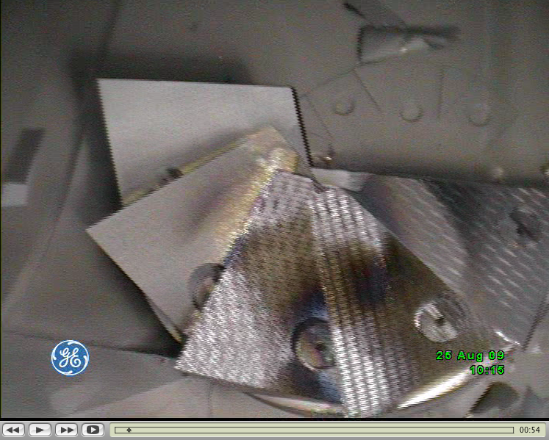
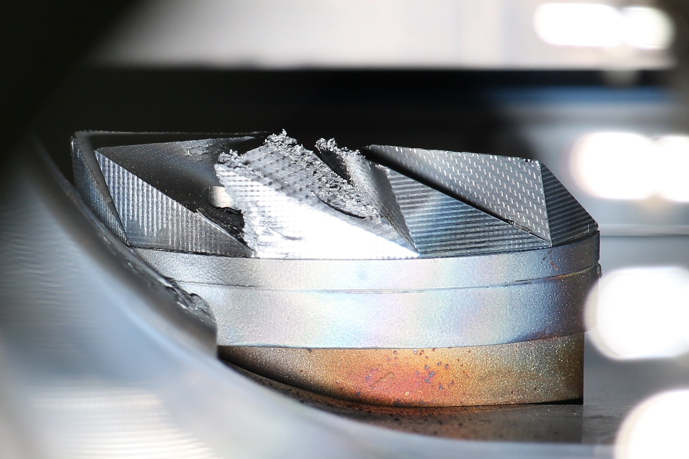
Electron catcher: Electrons striking top?
1
Photo by C. Luck
2
3
5
3
4
August 2009
Carbon-carbon wedges coated by
aluminum from foil brackets, then sputtered / evaporated off by convoy electrons. Electrons appear to be striking tops of wedges #3 and #4.
July 2014
Damage to top of wedge #3 shows circular electron trajectory. Electrons also appear to be striking underside of wedge #3 (as they should), and top edge of wedge #4.

